Slide 1
Analysis of the Third Harmonic of a Vacuum Response in a Subcritical Laser Field
Dmitriev Vadim, Smolyansky Stanislav, Tseryupa Vladislav
Saratov State University, Institute of Physics

Slide 2
Problem Statement
electron-positron plasma (EPP) generated from vacuum
conduction and polarization plasma currents
quasiclassical EPP radiation
the role of the third harmonic
one-photon EPP pair photoproduction/annihilation and emission/absorption processes
analysis of the annihilation channel
complex investigation of the radiation process

Slide 3
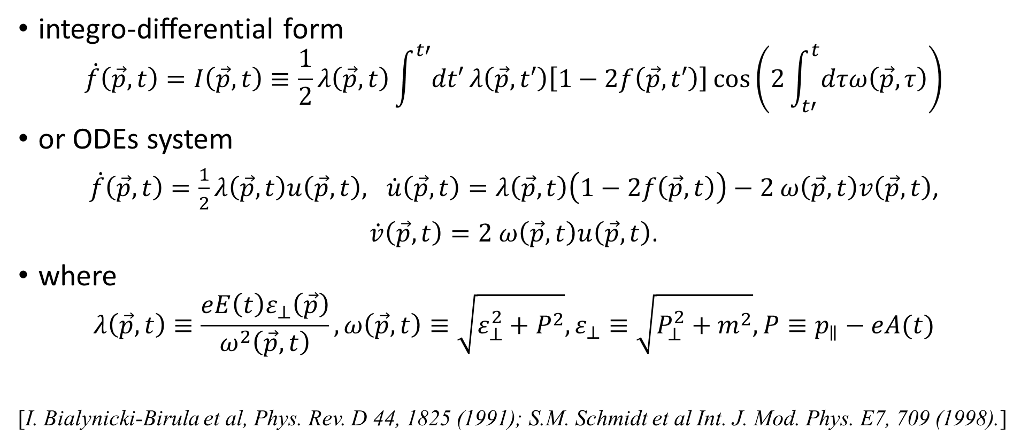
Kinetic Equations
integro-diﬀerential form
$$\dot{f}\left(\vec{p},t\right)=I\left(\vec{p},t\right)≡\frac{1}{2}λ\left(\vec{p},t\right)\int^{t′}{dt′}λ\left(\vec{p},t′\right)\left[1−2f\left(\vec{p},t′\right)\right]\cos\left(2\int_{t′}^{t}{dτω\left(\vec{p},τ\right)}\right)$$
or ODEs system
$\dot{f}\left(\vec{p},t\right)=\frac{1}{2}λ\left(\vec{p},t\right)u\left(\vec{p},t\right), \dot{u}\left(\vec{p},t\right)=λ\left(\vec{p},t\right)\left(1−2f\left(\vec{p},t\right)\right)−2$ $ω\left(\vec{p},t\right)v\left(\vec{p},t\right)$,
$\dot{v}\left(\vec{p},t\right)=2$ $ω\left(\vec{p},t\right)u\left(\vec{p},t\right)$.
where
$$λ\left(\vec{p},t\right)≡\frac{eE\left(t\right)ε_{⊥}\left(\vec{p}\right)}{ω^{2}\left(\vec{p},t\right)}, ω\left(\vec{p},t\right)≡\sqrt{ε_{⊥}^{2}+P^{2}},ε_{⊥}≡\sqrt{P_{⊥}^{2}+m^{2}}, P≡p_{∥}−eA(t)$$
[I. Bialynicki-Birula et al, Phys. Rev. D 44, 1825 (1991); S.M. Schmidt et al Int. J. Mod. Phys. E7, 709 (1998).]

Slide 4
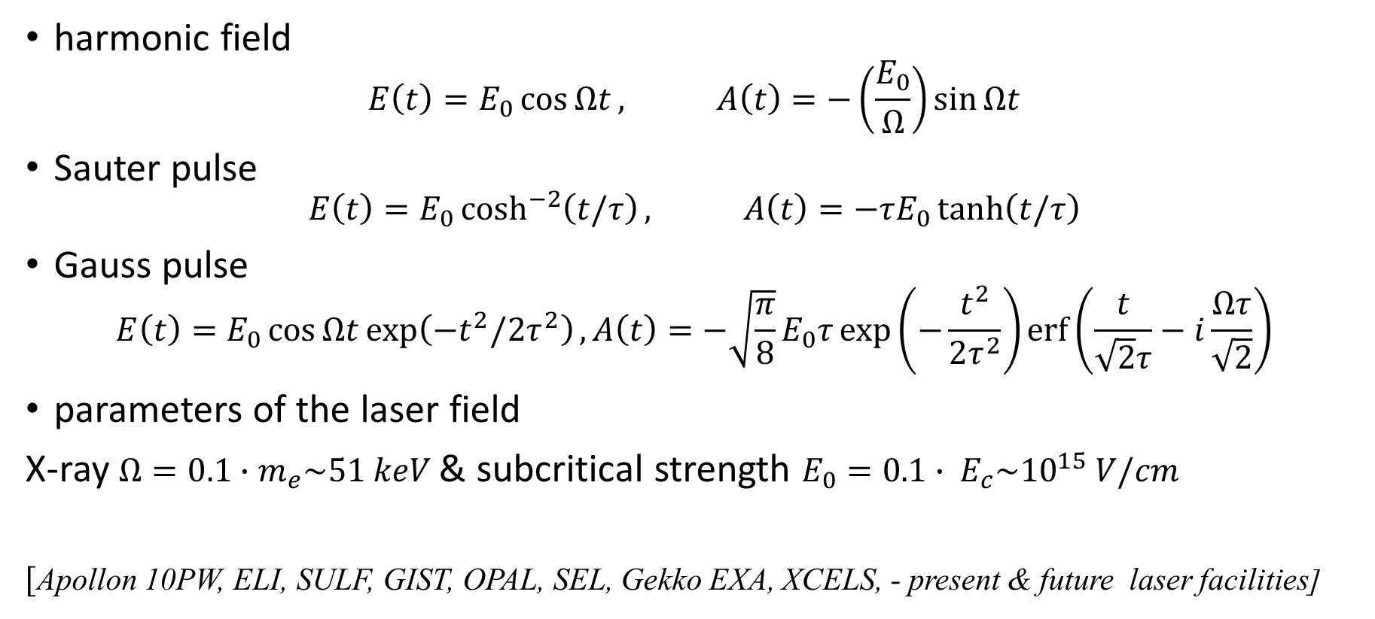
External Fields
harmonic field
$$E\left(t\right)=E_{0}\cos{Ωt}, A\left(t\right)=−\left(\frac{E_{0}}{Ω}\right)\sin{Ωt}$$
Sauter pulse
$$E\left(t\right)=E_{0}\cosh^{−2}\left(t/τ\right), A\left(t\right)=−τE_{0}\tanh\left(t/τ\right)$$
Gauss pulse
$$E\left(t\right)=E_{0}\cos{Ωt}\exp\left(−t^{2}/2τ^{2}\right), A\left(t\right)=−\sqrt{\frac{π}{8}}E_{0}τ\exp\left(−\frac{t^{2}}{2τ^{2}}\right)\operatorname{erf}\left(\frac{t}{\sqrt{2}τ}−i\frac{Ωτ}{\sqrt{2}}\right)$$
parameters of the laser field
X-ray $Ω=0.1∙m_{e}\sim 51 keV$& subcritical strength $E_{0}=0.1∙ E_{c}\sim {10}^{15} V/cm$
[Apollon 10PW, ELI, SULF, GIST, OPAL, SEL, Gekko EXA, XCELS, - present & future laser facilities]

Slide 5
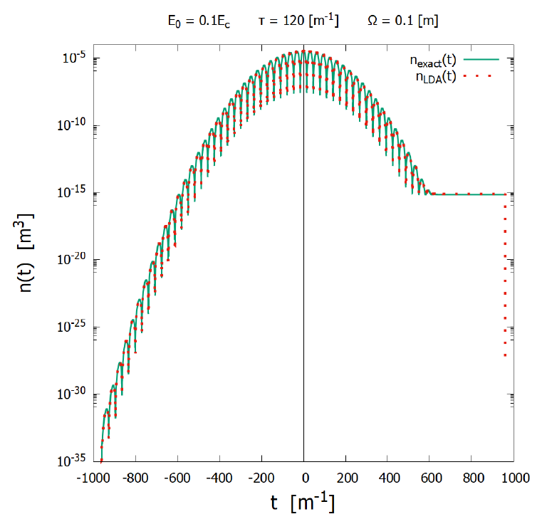
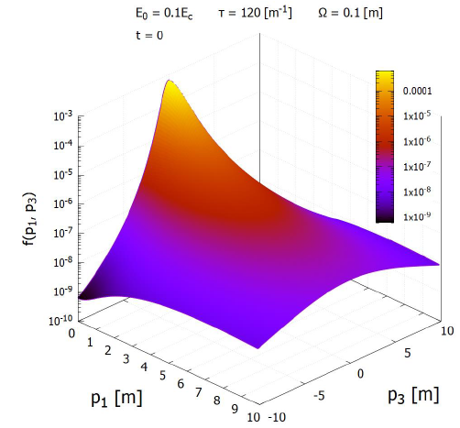
Distribution Functions
$$n\left(t\right)=2\int{\left[dp\right]f(\vec{p},t)}$$
density number

Slide 6
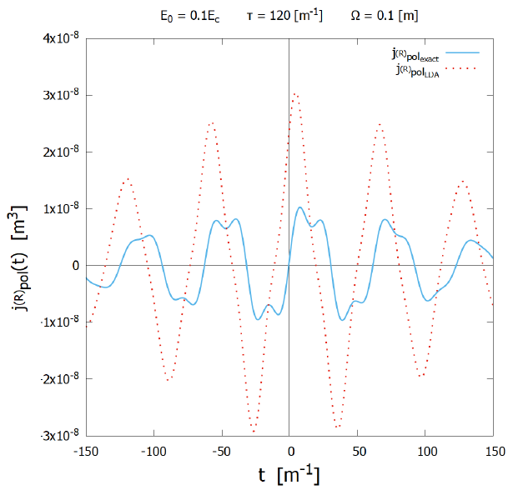
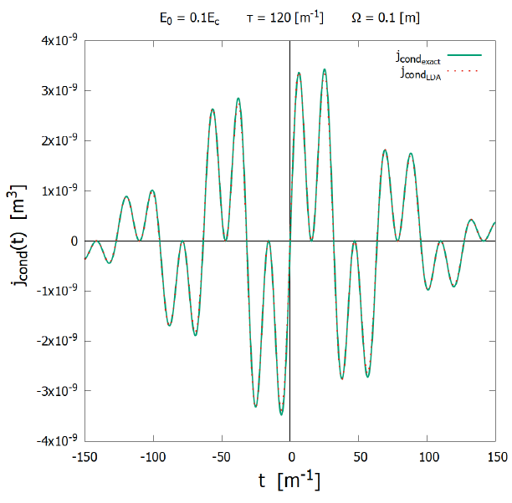
EPP Plasma Currents
[S. A. Smolyansky, A. D. Panferov, S. O. Pirogov, and A. M. Fedotov, arXiv:1901.02305.]
conduction
current
$$j^{cond}(t) =2e\int{\left[dp\right]\frac{Pf(\vec{p},t)}{ω(\vec{p},t)}}$$
vacuum polarization
current
$$j^{pol}\left(t\right)=−e\int{\left[dp\right]\frac{ε_{⊥}u(\vec{p},t)}{ω(\vec{p},t)}}$$

Slide 7
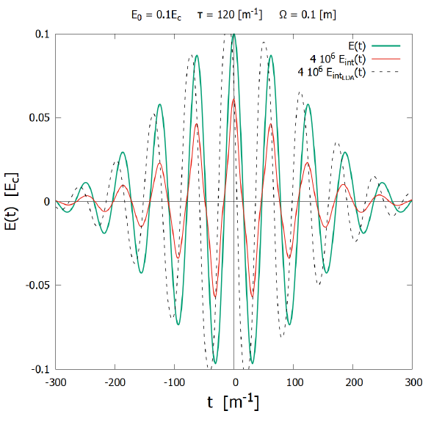
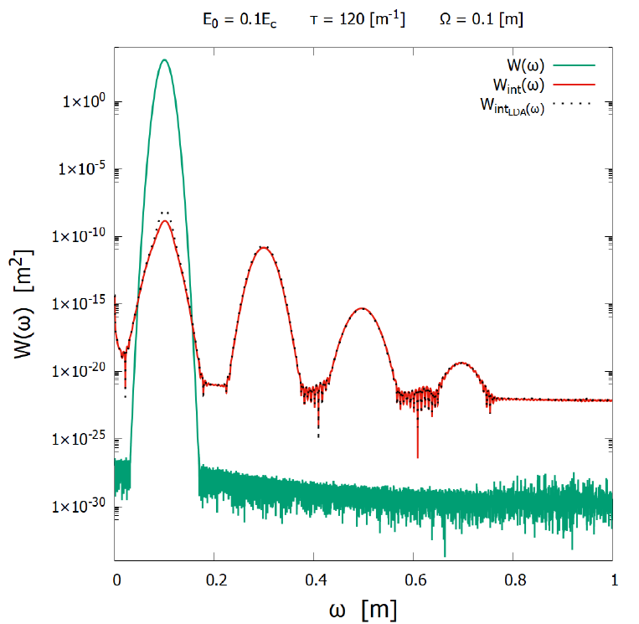
Analysis of the 3d harmonic
[I. A. Aleksandrov, A. D. Panferov, and S. A. Smolyansky, Phys. Rev. A 103, 053107 (2021).]
Maxwell equations
energy density
spectrum
$${\dot{E}}_{int}\left(t\right)=−j^{cond}\left(t\right)−j^{pol}\left(t\right)$$
$$w\left(ω\right)=\frac{1}{8π}{\left|E_{int}\left(ω\right)\right|}^{2}$$

Slide 8
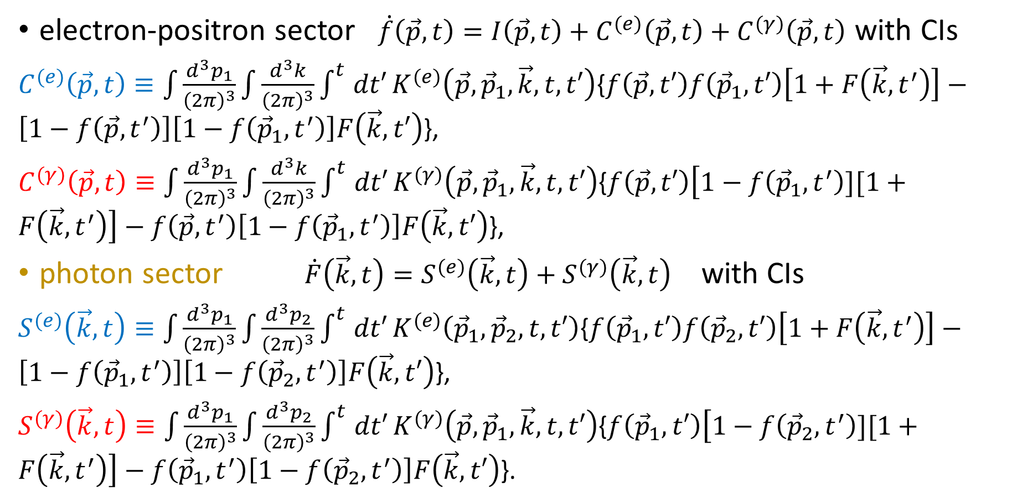
BBGKY chains
[D.B. Blaschke, V.V. Dmitriev, G. Roepke, and
S.A. Smolyansky, Phys. Rev. D 84, 085028 (2011).]
electron-positron sector $\dot{f}\left(\vec{p},t\right)=I\left(\vec{p},t\right)+C^{(e)}\left(\vec{p},t\right)+C^{(γ)}\left(\vec{p},t\right)$ with CIs
$C^{(e)}\left(\vec{p},t\right)≡\int{\frac{d^{3}p_{1}}{{\left(2π\right)}^{3}}}\int{\frac{d^{3}k}{{\left(2π\right)}^{3}}}\int^{t}{dt′}K^{(e)}\left(\vec{p},{\vec{p}}_{1},\vec{k},t,t′\right)${$f\left(\vec{p},t′\right)f\left({\vec{p}}_{1},t′\right)\left[1+F\left(\vec{k},t^{′}\right)\right]−\left[1−f\left(\vec{p},t^{′}\right)\right]\left[1−f\left({\vec{p}}_{1},t^{′}\right)\right]F\left(\vec{k},t′\right)$},
$C^{(γ)}\left(\vec{p},t\right)≡\int{\frac{d^{3}p_{1}}{{\left(2π\right)}^{3}}}\int{\frac{d^{3}k}{{\left(2π\right)}^{3}}}\int^{t}{dt′}K^{(γ)}\left(\vec{p},{\vec{p}}_{1},\vec{k},t,t′\right)${$f\left(\vec{p},t′\right)\left[1−f\left({\vec{p}}_{1},t^{′}\right)][1+F\left(\vec{k},t^{′}\right)\right]−f\left(\vec{p},t^{′}\right)\left[1−f\left({\vec{p}}_{1},t^{′}\right)\right]F\left(\vec{k},t′\right)$},
photon sector $\dot{F}\left(\vec{k},t\right)=S^{(e)}\left(\vec{k},t\right)+S^{(γ)}\left(\vec{k},t\right)$ with CIs
$S^{(e)}\left(\vec{k},t\right)≡\int{\frac{d^{3}p_{1}}{{\left(2π\right)}^{3}}}\int{\frac{d^{3}p_{2}}{{\left(2π\right)}^{3}}}\int^{t}{dt′}K^{(e)}\left({\vec{p}}_{1},{\vec{p}}_{2},t,t′\right)${$f\left({\vec{p}}_{1},t′\right)f\left({\vec{p}}_{2},t′\right)\left[1+F\left(\vec{k},t^{′}\right)\right]−\left[1−f\left({\vec{p}}_{1},t^{′}\right)\right]\left[1−f\left({\vec{p}}_{2},t^{′}\right)\right]F\left(\vec{k},t′\right)$},
$S^{(γ)}\left(\vec{k},t\right)≡\int{\frac{d^{3}p_{1}}{{\left(2π\right)}^{3}}}\int{\frac{d^{3}p_{2}}{{\left(2π\right)}^{3}}}\int^{t}{dt′}K^{(γ)}\left(\vec{p},{\vec{p}}_{1},\vec{k},t,t′\right)${$f\left({\vec{p}}_{1},t′\right)\left[1−f\left({\vec{p}}_{2},t^{′}\right)][1+F\left(\vec{k},t^{′}\right)\right]−f\left({\vec{p}}_{1},t^{′}\right)\left[1−f\left({\vec{p}}_{2},t^{′}\right)\right]F\left(\vec{k},t′\right)$}.
photoproduction/annihilation
emission/absorption
annihilation channel
emission channel

Slide 9
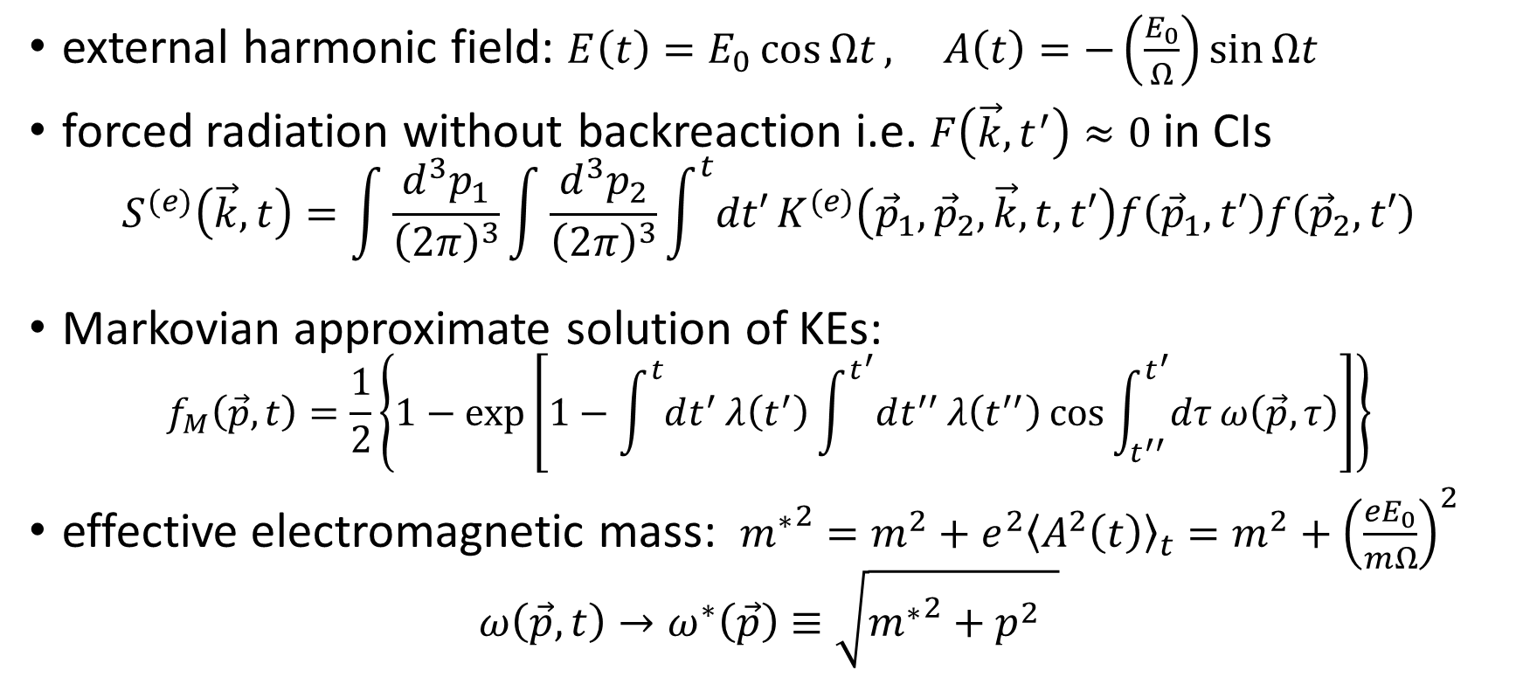
Analysis of the CIs
[A.M. Fedotov, E.G. Gelfer, K.Y. Korolev, and S.A. Smolyansky, Phys. Rev. D. 83(2), 025011 (2011).]
external harmonic field: $E\left(t\right)=E_{0}\cos{Ωt}, A\left(t\right)=−\left(\frac{E_{0}}{Ω}\right)\sin{Ωt}$
forced radiation without backreaction i.e. $F\left(\vec{k},t^{′}\right)≈0$ in CIs
$$S^{(e)}\left(\vec{k},t\right)=\int{\frac{d^{3}p_{1}}{{\left(2π\right)}^{3}}}\int{\frac{d^{3}p_{2}}{{\left(2π\right)}^{3}}}\int^{t}{dt′}K^{(e)}\left({\vec{p}}_{1},{\vec{p}}_{2},\vec{k},t,t′\right)f\left({\vec{p}}_{1},t′\right)f\left({\vec{p}}_{2},t′\right)$$
Markovian approximate solution of KEs:
$$f_{M}\left(\vec{p},t\right)=\frac{1}{2}\left\{1−\exp\left[1−\int^{t}{dt^{′}}λ\left(t^{′}\right)\int^{t^{′}}{dt^{′′}}λ\left(t^{′′}\right)\cos{\int_{t^{′′}}^{t^{′}}{dτ}ω\left(\vec{p},τ\right)}\right]\right\}$$
effective electromagnetic mass: ${m^{∗}}^{2}=m^{2}+e^{2}{\left\langle A^{2}\left(t\right)\right\rangle }_{t}=m^{2}+{\left(\frac{eE_{0}}{mΩ}\right)}^{2}$
$$ω\left(\vec{p},t\right)→ω^{∗}\left(\vec{p}\right)≡\sqrt{{m^{∗}}^{2}+p^{2} }$$

Slide 10
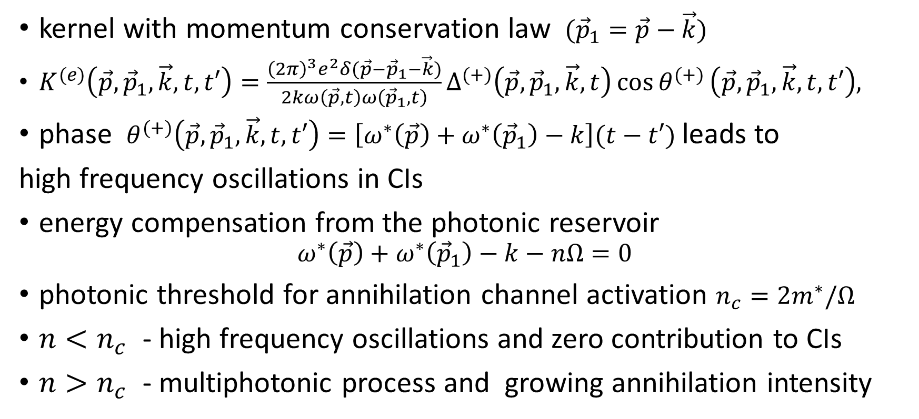
Kernel of Collision Integrals
kernel with momentum conservation law $({\vec{p}}_{1}=\vec{p}−\vec{k})$
$K^{(e)}\left(\vec{p},{\vec{p}}_{1},\vec{k},t,t′\right)=\frac{{\left(2π\right)}^{3}e^{2}δ(\vec{p}−{\vec{p}}_{1}−\vec{k})}{2kω\left(\vec{p},t\right)ω\left({\vec{p}}_{1},t\right)}Δ^{(+)}\left(\vec{p},{\vec{p}}_{1},\vec{k},t\right)\cos{θ^{(+)}}\left(\vec{p},{\vec{p}}_{1},\vec{k},t,t′\right),$
phase $θ^{(+)}\left(\vec{p},{\vec{p}}_{1},\vec{k},t,t′\right)=\left[ω^{∗}\left(\vec{p}\right)+ω^{∗}\left({\vec{p}}_{1}\right)−k\right](t−t′)$ leads to
high frequency oscillations in CIs
energy compensation from the photonic reservoir
$$ω^{∗}\left(\vec{p}\right)+ω^{∗}\left({\vec{p}}_{1}\right)−k−nΩ=0$$
photonic threshold for annihilation channel activation $n_{c}=2m^{∗}/Ω$
${n<n}_{c}$ - high frequency oscillations and zero contribution to CIs
${n>n}_{c}$ - multiphotonic process and growing annihilation intensity

Slide 11
Energy Conservation Law
$S^{(e)}\left(\vec{k},t\right)=\frac{1}{4k}\int{\frac{{d^{3}pd}^{3}p_{1}}{{\left(2π\right)}^{6}}}\int^{t}{dt′}Π\left(\vec{p},{\vec{p}}_{1},\vec{k}\right)\sum_{n>n_{c}}{\left[e^{−A\left(\vec{p} \right)}I_{n}\left(−B\left(\vec{p} \right)\right)+e^{−A\left({\vec{p}}_{1} \right)}I_{n}\left(−B\left({\vec{p}}_{1}\right)\right)\right]}$x
x $\frac{\sin\left[\left(ω^{∗}\left(\vec{p}\right)+ω^{∗}\left({\vec{p}}_{1}\right)−k−nΩ\right)t′\right]}{ω^{∗}\left(\vec{p}\right)+ω^{∗}\left({\vec{p}}_{1}\right)−k−nΩ}$, where $Π\left(\vec{p},{\vec{p}}_{1},\vec{k}\right)$ is a polynomial,
$I_{n}$ - modified Bessel function,
$A\left(\vec{p} \right)=λ_{0}^{2}\frac{4{ω^{∗}}^{2}+Ω^{2}}{{\left(4{ω^{∗}}^{2}−Ω^{2}\right)}^{2}},B\left(\vec{p} \right)=\frac{λ_{0}^{2}}{4{ω^{∗}}^{2}−Ω^{2}}$,
intensity of radiation $I\left(\vec{k}\right)=\lim_{t→∞}{\frac{dF\left(\vec{k},t\right)}{dt}}=S^{(e)}\left(\vec{k}\right)$
limit $t→∞$ leads to Delta function (energy conservation law) with roots
$p_{n}^{(i)}=\frac{k}{2}\cos{α}\left[1−\frac{k^{2}}{{\left(k+nΩ\right)}^{2}}\right]\frac{1}{1−\frac{k^{2}\cos^{2}{α}}{{\left(k+nΩ\right)}^{2}}}±\sqrt{D}$, where
$D=k^{2}\cos^{2}{α}\left[1−\frac{{m^{∗}}^{2}}{{\left(k+nΩ\right)}^{2}}\right]$+ ${\left(nΩ\right)}^{2}{\left[1−\frac{nΩ}{{2\left(k+nΩ\right)}^{}}\right]}^{2}−{m^{∗}}^{2}≥0$
$$\vec{k}$$
$$α$$
$$\vec{p}$$

Slide 12
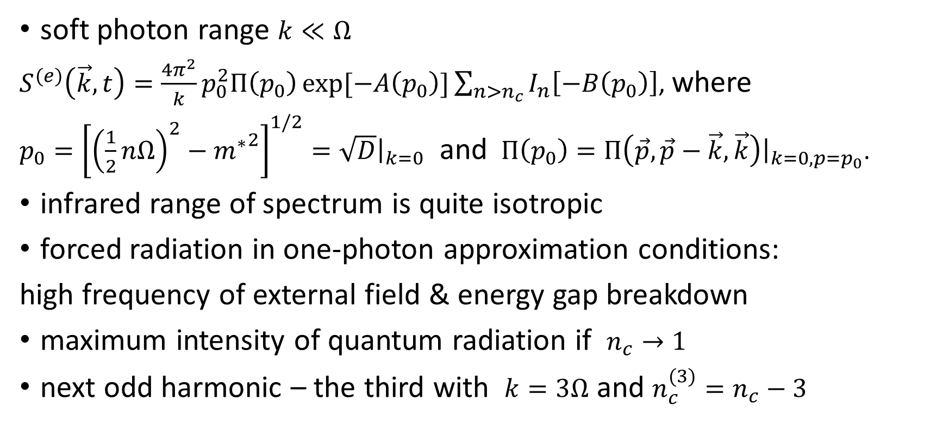
Quantum radiation
[A. Otto and B. Kaempfer Phys. Rev. D 95, ( 2017);
S.P. Gavrilov, D.M. Gitman, V.V. Dmitriev, A.D. Panferov, S.A. Smolyansky, Universe, 6(11), 205, (2020).]
soft photon range $k≪Ω$
$S^{(e)}\left(\vec{k},t\right)=\frac{4π^{2}}{k}p_{0}^{2}Π\left(p_{0}\right)\exp{[−A\left(p_{0}\right)]}\sum_{n>n_{c}}{I_{n}\left[−B\left(p_{0}\right)\right]}$, where
$p_{0}={\left[{\left(\frac{1}{2}nΩ\right)}^{2}−{m^{∗}}^{2}\right]}^{1/2}=\sqrt{D}{\left.​\right|}_{k=0}$ and $Π\left(p_{0}\right)=Π\left(\vec{p},\vec{p}−\vec{k},\vec{k}\right){\left.​\right|}_{k=0, p=p_{0}}$.
infrared range of spectrum is quite isotropic
forced radiation in one-photon approximation conditions:
high frequency of external field & energy gap breakdown
maximum intensity of quantum radiation if $n_{c}→1$
next odd harmonic – the third with $k=3Ω$ and $n_{c}^{(3)}=n_{c}−3$

Slide 13
Thank you for your attention

