Slide 1
Nonperturbative corrections and checking of the hypothesis of vacuum dominance
M. Kozhevnikova in collaboration with: O. V.Teryaev, A. G. Oganesian, O.P. Solovtsova
Joint Institute for Nuclear Research
ICPPA 2022, Moscow, November 2022

Slide 2
Plan of the presentation
Introduction: existing studies of non-perturbative corrections and hypothesis of vacuum dominance
Theoretical framework: R-ratio, Adler function, Borel transform and processing of the experimental data
Exploring of the condensates in OPE: $C_{2}$, $C_{4}$, $C_{6}$. Checking of the possibility of other intermediate states, contributing to four-quark condensate. How other nonperturbative corrections ($C_{2}$ and $C_{4}$ or gluon condensate) change when the additional contribution of intermediate states is taken into account?
Summary

Slide 3
Introduction
Studies of quark and gluon condensates in the framework of operator product expansion (OPE) were initiated by M.A. Shifman, A.I. Vainstein and V.I. Zakharov and reflected in the seminal review (Nucl. Phys. B 147 (1979), 385-447). Nonperturbative effects are related to non-vanishing vacuum average values for the local $O_{n}$ operators in OPE. Also these topics are discussed in work of B.L.Ioffe and A.V.Smilga (Nucl. Phys. B 216 (1983), 373-407).
Our previous works (EPJ Web Conf. 138 (2017), 02006; EPJ Web Conf. 204 (2019), 02005; Nonlin. Phenom. Complex Syst. 22 (2019) no.2, 151-163) were mostly devoted to the operator $C_{2}$ (short string), while the quark condensate or $C_{6}$ was taken as a constant value. As a result, it is shown that $C_{2}$ values. are strongly (anti)correlated with $C_{4}$ and compared with zero.
How this picture changes when the quark condensate is not fixed? In this work, we estimate the range in which the value of $C_{6}$ can vary, comparing${ C}_{4}$ to the available estimates (SVZ, Geshkenbein, Ioffe).
As a reference point we use the vacuum dominance approach, when $C_{6}$ is related to the square of the quark condensate estimated of using the Gell-Mann-Oakes-Renner (GMOR) formula (Phys. Rev. 175 (1968), 2195-2199) for the two lightest flavors:
where $m_{π}$ is pion mass and $f_{π}$ is the decay constant. We use the data from FLAG Review 2021, estimate quark condensate $\left\langle 0\left|\overline{q}q\right|0\right\rangle \text{≈}{−\left(0.290±1.1 MeV\right)}^{3}$ and calculate the coefficient $C_{6}$(through 4-quark operator) which we fix:
$C_{6}=− \frac{448π^{3}}{27}α_{s}{\left\langle 0\left|\overline{q}q\right|0\right\rangle }^{2} \text{≈}−0.104±0.002{ GeV}^{6}$ at 2 GeV
The purpose of the work is to check how vacuum dominance works: the possibility of other intermediate states, contributing to four-quark condensate. How other nonperturbative corrections ($C_{2}$ and $C_{4}$ or gluon condensate) change?

Slide 4
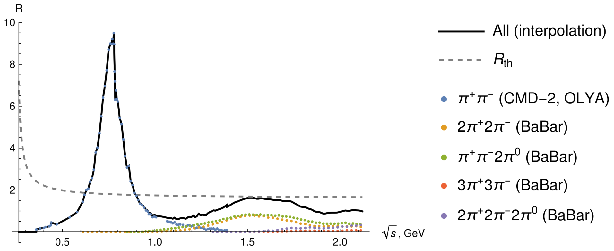
Theoretical framework: R-ratio
$R$-ratio by definition: $R\left(s\right)=\frac{σ_{e^{+}e^{−}→ hadrons} }{σ_{e^{+}e^{−}→μ^{+}μ^{−}}}$
Total ratio is $R(s)=\sum_{k}{R_{k}(s)}$, where $k$ is the channel number.
experimental data on $e^{+}e^{−}$-annihilation into even number of pions: CMD-2, OLYA and BaBar.
Fig. 1. The experimental data for different channels, the total $R$-ratio as sum of all interpolated data and theoretical prediction. The decline of the total $R$-ratio at values $\sqrt{s}≥1.5$GeV is explained by the fact that there are no data on $e^{+}e^{−}$-annihilation into 8 pions and more.

Slide 5
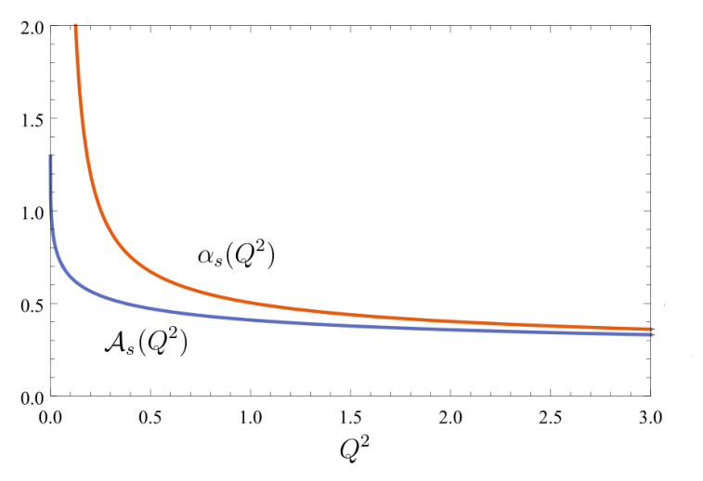
Theoretical framework: Adler function
Adler function can be constructed by two ways, by dispersional approach:
where
and $s_{0}$ is continuum threshold.
And by OPE in PT and APT (D. V. Shirkov, I. L. Solovtsov, Phys. Rev. Lett. 79,
1209 (1997); K. A. Milton andI. L. Solovtsov, Phys. Rev. D 55, 5295 (1997)):
$PT⇒ α_{s}\left(Q^{2}\right)=\frac{4π}{b_{0}}\left[\frac{1}{ln⁡(Q^{2}/Λ^{2})}\right]$, $APT⇒$
where
is the first coefficient of the β-function expansion and Λ is the QCD scale parameter, which we choose as 0.25 GeV.
Defining we get $D_{PT\left(APT\right)+OPE}=\frac{3}{2}\left[1+\frac{α_{s}^{PT\left(APT\right)}(Q^{2})}{π}+\frac{C_{2}}{Q^{2}}+\frac{C_{4}}{Q^{4}}+\frac{C_{6}}{Q^{6}}\right]$
$$D_{PT\left(APT\right)+OPE}=N_{c}\sum_{q}{e_{q}^{2}}\left[1+\frac{α_{s}^{PT\left(APT\right)}(Q^{2})}{π}+\sum_{n≥1}{Γ(n)\frac{c_{2n}}{Q^{2n}}}\right],$$

Slide 6
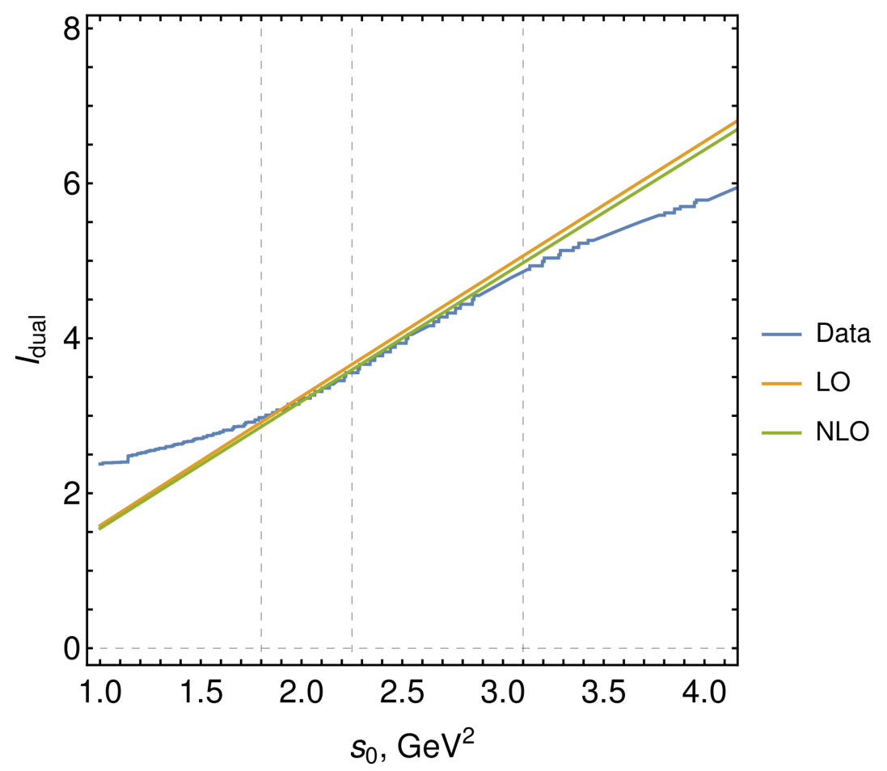
Theoretical framework
The continuum threshold $s_{0}$, we fixed from the local quark-hadron duality. The corresponding duality relation reads
Using the experimental data and the perturbative ansatz in the leading order (LO) and in the next to leading order (NLO), we find that the best value is $s_{0}≃{1.51}^{2}{GeV}^{2}$: we show integrals as functions of the upper limit of the integration in Fig. 2.
Fig.2. The integral $I_{dual}$ versus the upper integration limit, $s_{0}$ . The integral for the experimental data corresponds to the blue line (Data). The theoretical curves are the orange (LO) and green (NLO) lines.

Slide 7
Theoretical framework: Borel transform
In order to smooth the function and reduce errors we apply the Borel transform.
The Borel transform of the function f by definition is:
The Borel transformed forms in PT and APT of the D-function are
The Borel transform of the running coupling give the following results:
Equating the two forms of the Adler function, we get the sum rule: $Φ_{exp}\left(M^{2}\right)=Φ_{PT\left(APT\right)+OPE}(M^{2})$.
Using the method of Monte-Carlo generating of events and simulating measurements with their statistic and systematic errors, we extract coefficients $C_{2}$, $C_{4}$ and $C_{6}.$In this work usually - by fixing one of them and calculating others. We control the errors of the experimental data more precisely.

Slide 8
Exploring of the condensates I
Let us start the analysis from the consideration of quark condensate in vacuum dominance approach defined by GMOR formula and data from FLAG Review 2021 with $\left\langle 0\left|\overline{q}q\right|0\right\rangle \text{≈}{−\left(0.290±1.1 MeV\right)}^{3}$, corresponding to $C_{6}=− \frac{448π^{3}}{27}α_{s}{\left\langle 0\left|\overline{q}q\right|0\right\rangle }^{2} \text{≈}−0.104±0.002{ GeV}^{6}$ at 2 GeV.
The value of M = 2 GeV is outside the selected region on Borel mass, ${\text{[0.75;3]} GeV}^{2}$, however, the $C_{6}∼α_{s}{\left\langle 0\left|\overline{q}q\right|0\right\rangle }^{2}$ is the renorm-invariant value with good precision, therefore, we can use it at values in the selected region.
When the found $C_{6}\text{≈}−0.104{ GeV}^{6}$ is fixed, the corresponding regions of $C_{2}$ and gluon condensate at 1σ, 2σ and 3σ are calculated and shown on Fig. 3, first panel.
We explore the deviations from vacuum dominance approach by taking into account of the intermediate states different from the vacuum one. This effect is parameterized by multiplication factors for value of $C_{6}$ .

Slide 9
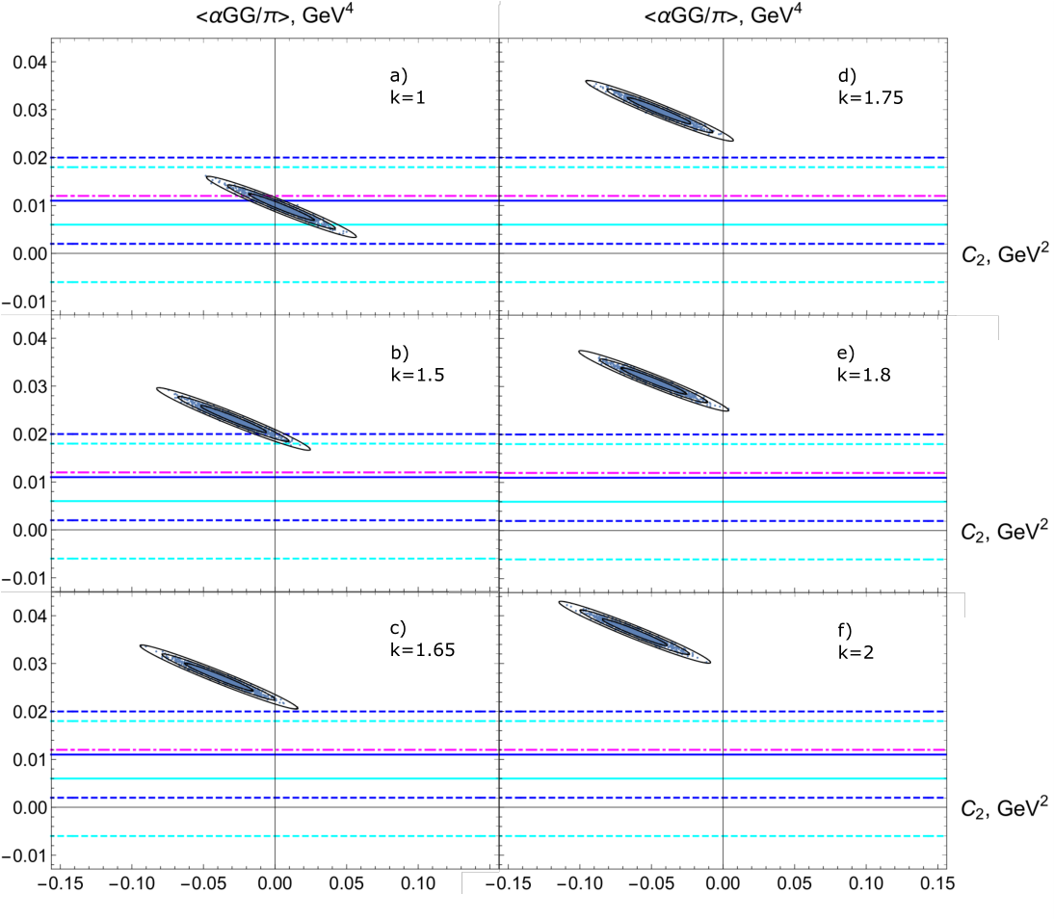
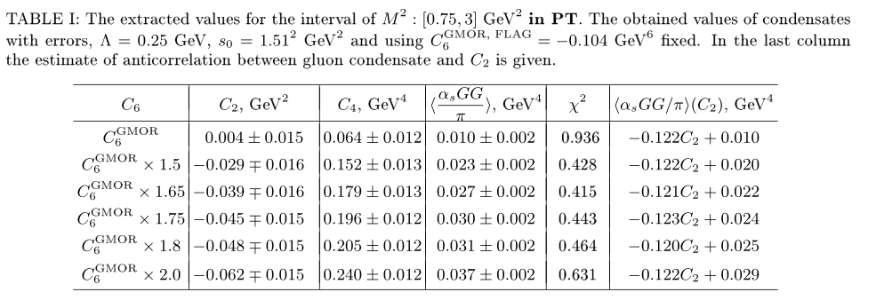
Exploring: fixing of C6 at different values
FIG. 3. Allowed regions of $C_{2}$ and gluon condensate with various multiplication factors for quark condensate (or $C_{6}$ ) within 1, 2 and 3 standard deviations. The values for gluon condensate from the literature together with corresponding limits are also shown.

Slide 10
Exploring of the condensates II
Let us now find the allowed domains for $C_{2}$ and $C_{6}$ calculated at various fixed values of the gluon condensate, see Fig. 4, ranging from the value $\left\langle 0\left|\frac{α_{s}}{π}GG\right|0\right\rangle$= 0.006 ${ GeV}^{4}$ (Ioffe, Zyabluk) to $\left\langle 0\left|\frac{α_{s}}{π}GG\right|0\right\rangle$= 0.012 ${ GeV}^{4}$ (SVZ). We also show the available estimates of the quark condensate converted to $C_{6}$ (green lines) for comparison — our estimate using the GMOR formula, the value given in review SVZ and the value of Geshkenbein, Ioffe, Zyablyuk.
It can be seen that $C_{2}$ is compatible to zero within one standard deviation whereas our calculation of the value of $C_{6}$ gives a reasonable value using the GMOR formula. Furthermore, it is possible to increase $C_{6}$ by 20%, especially in the case of $\left\langle 0\left|\frac{α_{s}}{π}GG\right|0\right\rangle$= 0.012 ${ GeV}^{4}$ (SVZ). As soon as the gluon condensate increases to large values, $C_{2}$ becomes essentially negative.

Slide 11
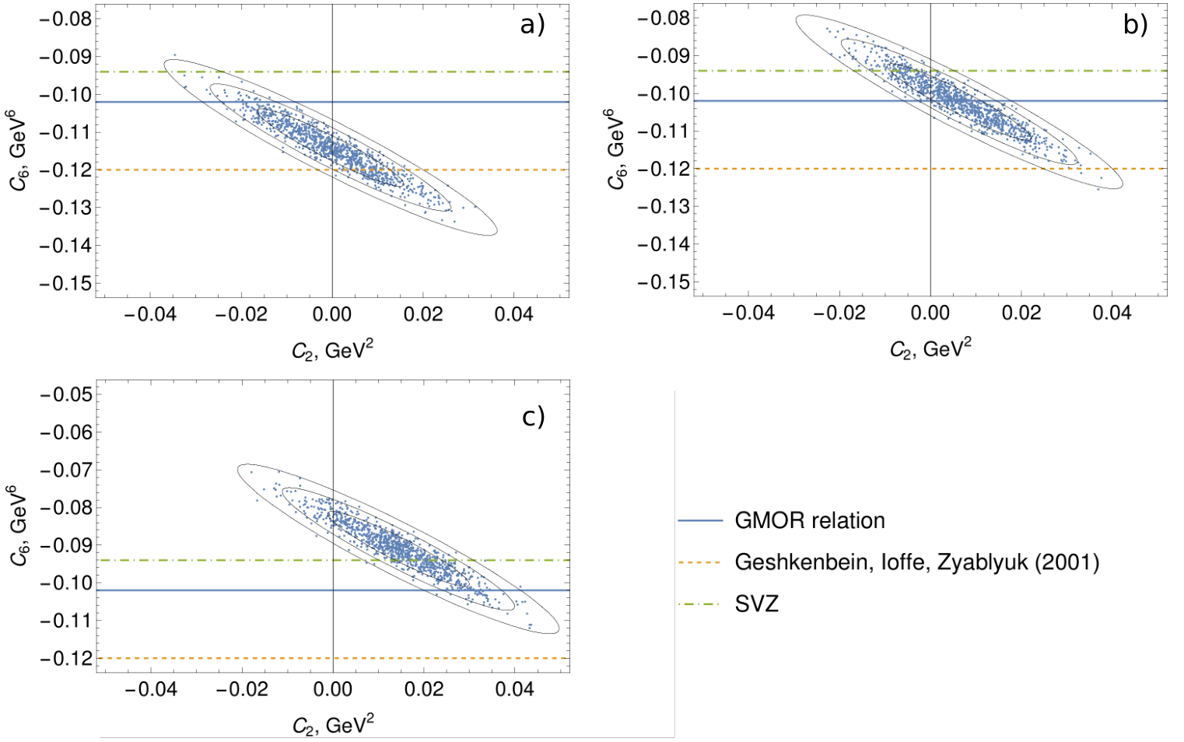
Exploring: fixing of C4 at different values
FIG. 4. The regions of existence of condensates $C_{2}$ and $C_{6}$ for different fixed $C_{4}$ - from SVZ values to Ioffe-Zyabluk. The known values of quark condensate recalculated into $C_{6}$ are shown.

Slide 12
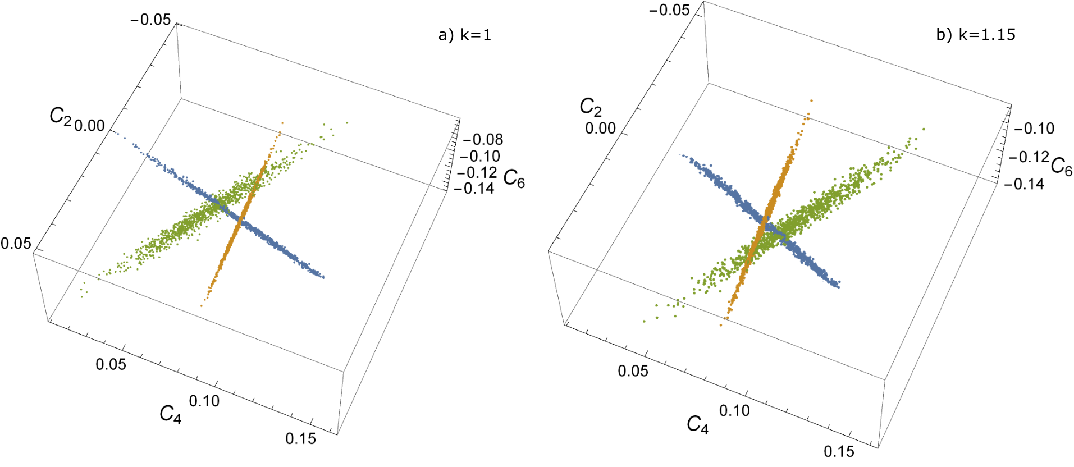
Exploring of the condensates III
FIG. 5. The allowed regions for condensates $C_{2}−C_{4}$, $C_{2}−C_{6}$ and $C_{4}−C_{6}$ for fixed values $C_{6}$ , $C_{4}$ and $C_{2}$ respectively. On the left panel we take the value 1.15 × $C_{6}$ - all three regions intersect at one point. Hypothesis of vacuum dominance performed with an accuracy of 15% (comparing SVZ).

Slide 13
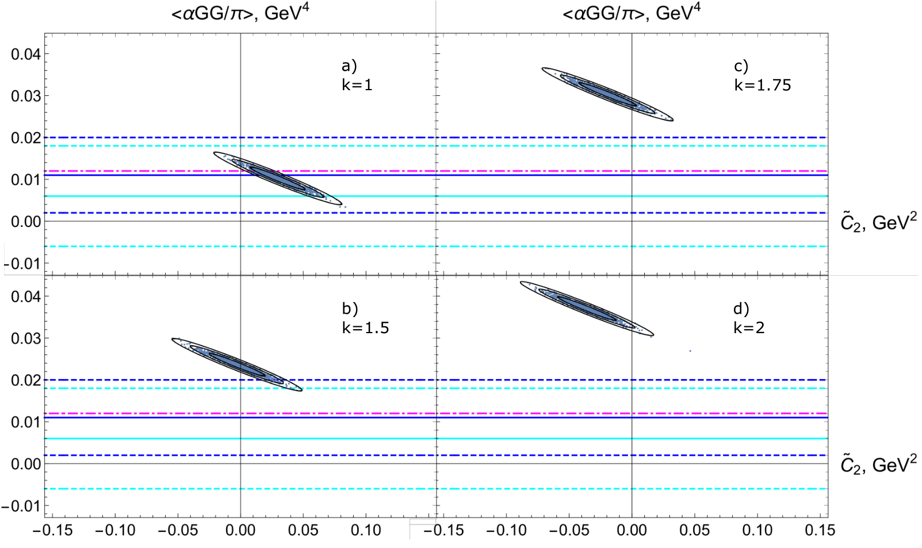
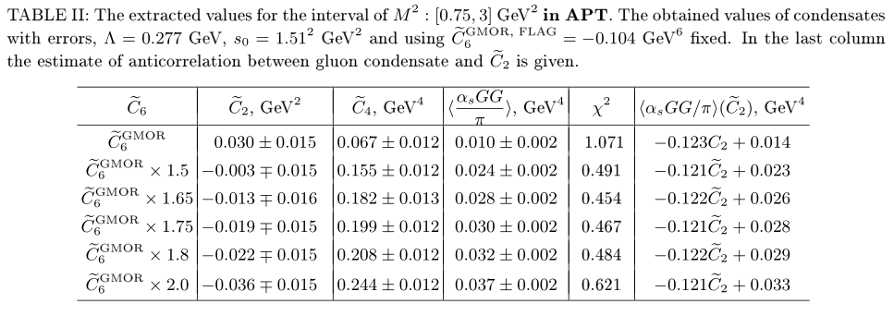
Exploring: fixing of C6 at different values in APT
FIG. 3. Allowed regions of $C_{2}$ and gluon condensate in APT with various multiplication factors for quark condensate (or $C_{6}$ ) within 1, 2 and 3 standard deviations. The values for gluon condensate from the literature together with corresponding limits are also shown.
In APT the effect of non-vacuum intermediate states seems to be about 50%.

Slide 14
Summary
We have presented the checking of hypothesis of vacuum dominance based on processing of the data of $e^{+}e^{−}$-annihilation into pions.
The method: construction of the Adler function for the modern data on $e^{+}e^{−}$-annihilation into hadrons (an even number of pions), the Borel transform, sum rule construction, extraction the nonperturbative corrections in OPE, is developed. The Monte-Carlo simulating of events with taking into account errors of the data gives good accuracy. The interval on Borel mass is selected in analysis, not one point - that gives stability of the result.
The found anticorrelation between OPE corrections remains strong.
We explored the possible deviation from vacuum dominance and its interplay with short strings contribution. We checked that it is possible to increase the coefficient $C_{6}$ in OPE, and hence the 4-quark condensate, but no more than 20%, and it is better by 15% - that may be due to the correction to vacuum dominance of intermediate states. In this case the value of $C_{2}$ is compatible with zero, and $C_{4}$ is within reasonable values.
In APT this effect is about 50% - much more larger than in PT.

Slide 15
Thank you for your attention!

