Slide 1


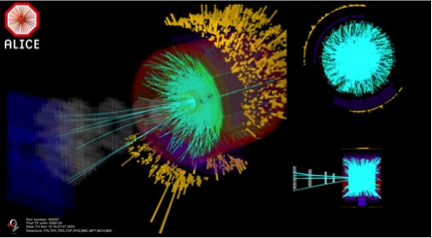


From Strangeness to Charm and Beauty with Inner Tracking System of ALICE at LHC
© ALICE Collaboration, 18 Nov. 2022,
the first Pb-Pb collisions at √s_{NN}=5.36 TeV
G. Feofilov¹ (for ALICE Collaboration)
¹St. Petersburg State University, St. Petersburg, RF
ICPPA-2022, Moscow , Russia, (2022-07-11 - 2022-07-16 ) https://indico.particle.mephi.ru/event/275/overview
Session: Facilities and Advanced Detector Technologies, 2 Dec 2022, 18:00

Slide 2


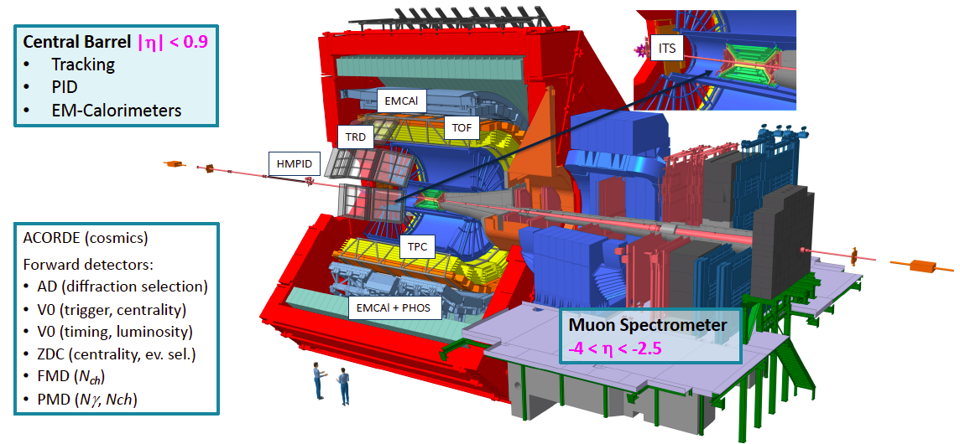
ALICE in Run 1 and Run 2
Central Barrel |η|<0.9
Tracking, vertexing
PID
EM-Calorimeters
ALICE is optimized for Heavy-Ion Physics - excellent tracking of low momenta particles
Efficient registration of the hadrons, electrons, muons, and photons
produced in pp, p-Pb and Pb-Pb collisions at the LHC.

Slide 3
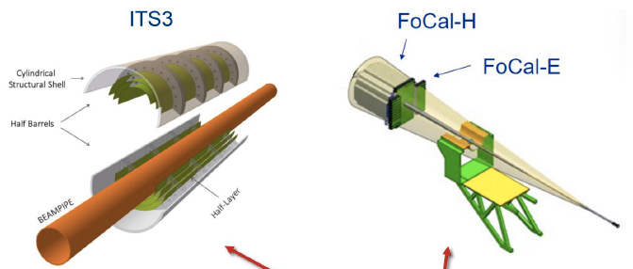
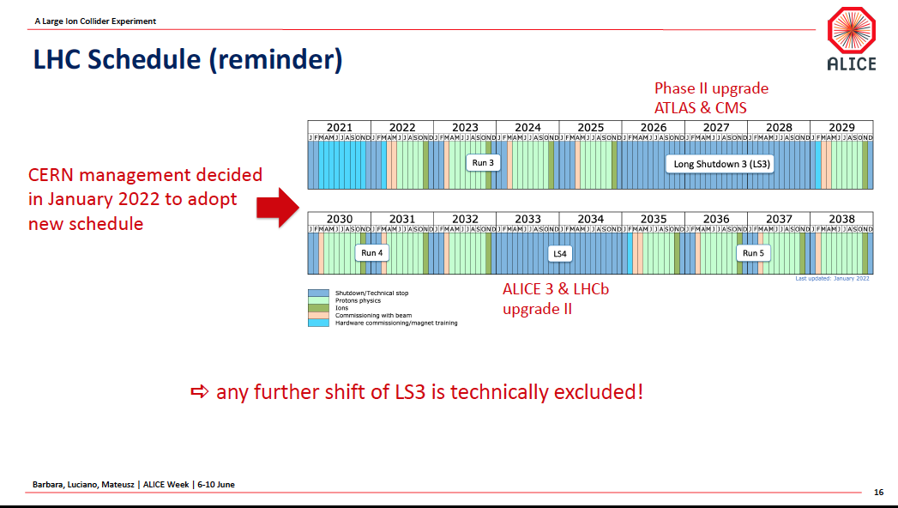
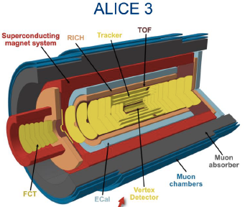
ALICE @LHC Schedule
ALICE LS2 Upgrade
finished
ALICE LS3 Upgrade
5 July Start of Run 3 - first pp collisions at 13.6 TeV
18 November 2022
The first Pb-Pb collisions at √s_{NN}=5.36 TeV !

Slide 4

Charm and beauty in pp, p-Pb and Pb-Pb collisions
Time
Why open heavy flavour
is interesting?
Production is relevant to early collision stages
Theoretical calculation of production in perturbative QCD
Transport of c-quark and b- quarks through the medium: collisions and radiative e-losses ?
Hadronisation mechanism?
π, K, p, Λ,Ξ,Ω,…d,He3,He4…
D
B
C-quark
B-quark
z
Colliding
nuclei
Precision studies during the LHC Runs 3 and 4 are planned with 10 times increased statistics
Notes:
fast equilibration, within roughly 10^{–24} s,
The resulting deconfined and thermalised medium expands and cools over the next few 10^{–24} s, before the quarks and gluons recombine to form a hadron gas.
Heavy quarks are mainly produced in hard-scattering processes and hence in shorter timescales compared to the QGP.
Charm azimuthal correlations (DD azimuthal correlations)
Heavy flavour transport
Interactions with the plasma generate azimuthal anisotropy v2:

Slide 5
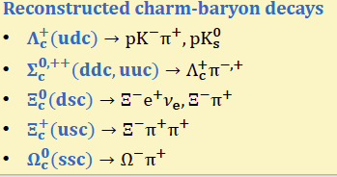
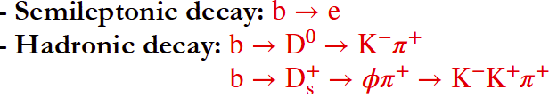
Charm and beauty in pp, p-Pb and Pb-Pb collisions
Time
Charm measurements in ALICE:
π, K, p, Λ,Ξ,Ω,…d,He3,He4…
D⁰ ⟶K⁻⁻π⁺
D⁺⟶K⁻⁻π⁺ π⁺
D_{s}⁺⟶ ϕ π⁺ ⟶ K ⁺ K⁻⁻π⁺
D*⁺ ⟶D⁰π⁺ ⟶K⁻⁻π⁺ π⁺
Λ_{c}⁺⟶ K_{s}⁰ p ⟶ π⁺ π – p
c ⟶ μ± 𝑋 (with muon spectrometer)
D
B
C-quark
B-quark
z
Beauty measurements in ALICE:
Colliding
nuclei
See also JHEP 05 (2021) 220
Notes:
fast equilibration, within roughly 10^{–24} s,
The resulting deconfined and thermalised medium expands and cools over the next few 10^{–24} s, before the quarks and gluons recombine to form a hadron gas.
Heavy quarks are mainly produced in hard-scattering processes and hence in shorter timescales compared to the QGP.
Charm azimuthal correlations (DD azimuthal correlations)
Heavy flavour transport
Interactions with the plasma generate azimuthal anisotropy v2:

Slide 6
Challenges for open charm measurements
Challenge-1: Short life-time for charm
hadrons (< τ >=410.1± 1.5)x10⁻¹⁵ s[1] )
Small mean decay length !
cτ ~100μm (!)
Reconstruction: from hadronic decay channels
.
Vito Manzari,
LXV Conf.Nucl.Phys.,
29.06-03.07.2015, SPb
Λ_{c} | Λ_{c}⟶pKπ | ~ 60μm | 6.35%
[1]PDG, PL B667, 1 (2008)

Slide 7
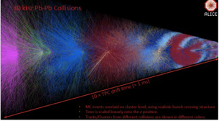
Challenges for open charm measurements
Challenge-2: high efficiency is needed for rare-probe registration
Coverage in transverse momentum has to be as complete as possible, in particular down to very low momenta.
Challenge-2: Fast detectors and continuous readout^{[1]} are needed to ensure statistics:
from 1 kHz → 50 kHz in Pb-Pb,
[1] David Rohr et al., arXiv:1811.11481

Slide 8

Requirements to meet new physics:
Improve impact parameter resolution factor of ~3 in r-φ (z) at 500 MeV/c)
First layer closer to interaction point: r0 = 39 mm → 22 mm
Smaller beam pipe radius: 29 mm → 18.2 mm
Smaller pixel size: 50μm x 425μm → 30μm x 30μm
Improve tracking efficiency and p_{T} resolution at low p_{T:} Increase the number of layers 6 →7
Easier maintenance – all services only from on one side!
Fast readout : 1 kHz → 50 -100kHz in Pb-Pb, 200-400 kHz in pp
Low-material budget (< 0.35% X₀ for the inner layers)
ITS2 : New, high-resolution, low-material budget, Inner Tracker System based on CMOS sensors is needed!
CDR: Endorsed by LHCC in Sept. 2012
ITS Upgrade TDR:
in March 2014

Slide 9
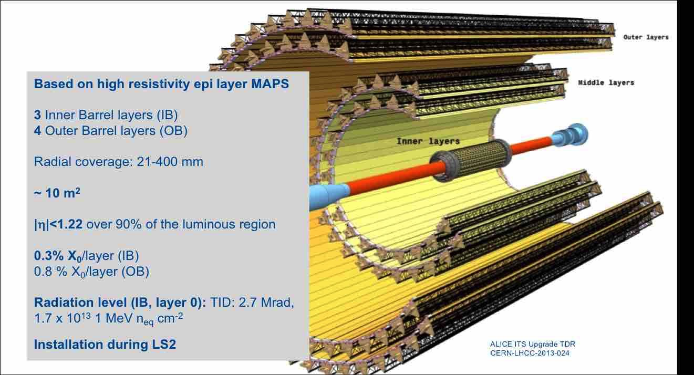
ITS2 concept
.

Slide 10
]
CMOS Pixel Sensor ^{[1]}
TowerJazz 0.18 μm CMOS Imaging Process
Pixel size ~ 30μm x 30μm
High-resistivity (> 1 kΩ cm) p-type
epitaxial layer (25 μm) on p-type substrate
Small n-well diode (2 μm diameter),
=> low capacitance
Reverse bias voltage to substrate
(contact from the top) can be used
to increase depletion zone around NWELL collection diode
Deep p-well shields n-well L of PMOS
Transistors
Very low power dissipation
(<300 nW/pixel)
Schematic of MAPS pixel [1]
[1] J. Phys. G: Nucl. Part. Phys. 41 (2014) 087002

Slide 11
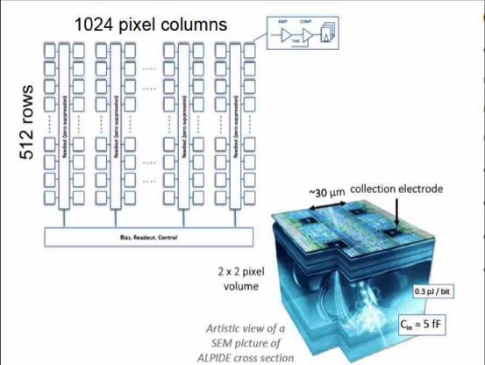
ALPIDE chip
Each pixel:
Amplification (always active)
Discrimination
Multiple hit buffer
Data compression
Common biasing settings
Only digital outputs
Triggering:
Continuous
or triggered mode

Slide 12
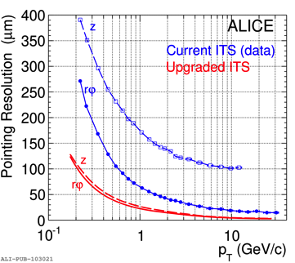
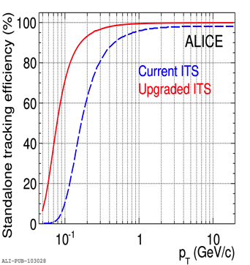
  Identification of secondary vertices
CERN-PH-EP-2012-XXX March 6, 2012
Schematic view of the D0 decay
in the D0 → K−π+ channel.
Impact parameter ~100 μm
Impact parameter resolutions
for ITS1 and ITS2
Stand-alone tracking efficiency

Slide 13
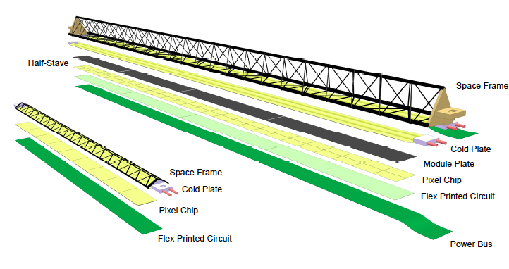
ALICE technology for ITS2
Inner and 0uter Barrel staves
-

Slide 14
ALICE technology for ITS2
Inner and 0uter Barrel staves
-
Record level of radiation transparency

Slide 15
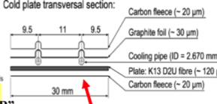
ALICE technology for ITS2
Inner and 0uter Barrel staves
-
Material budget
Outer layer
Inner layer
Record level of radiation transparency:
Inner layers of 30 cm length: X/X₀~ 0.36%
Outer layers 1500 cm length: X/X₀~1.1%
Cold plate design (details)_

Slide 16
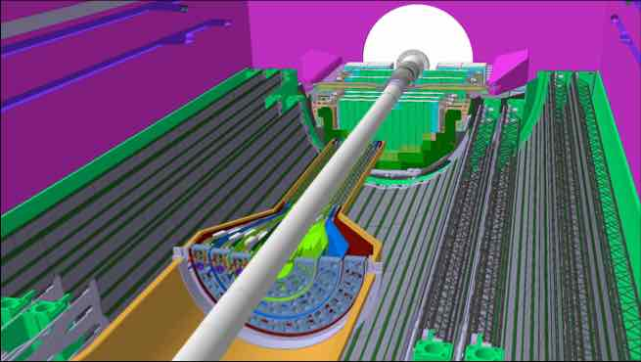
  Comparison with
  ATLAS and CMS upgrade
0,36%
20
ALICE Inner Barrel
ALICE ITS2 general design
CERN-LHCC-2012-013 (LHCC-P-005)

Slide 17
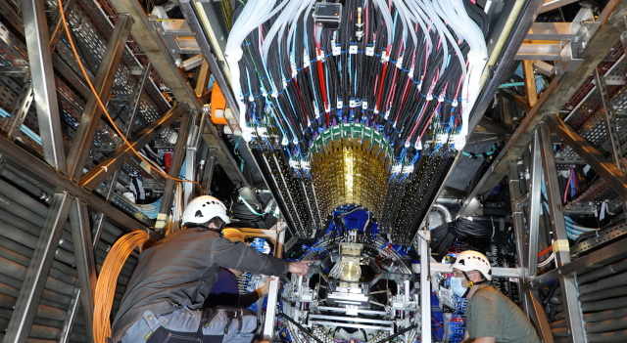
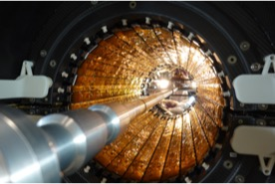
ALICE upgrade: Inner Tracking System
(ITS2) for RUN 3
Spring 2021:
ITS 2 in the process of installation
ALICE, the new Inner Tracking System
Installation of the Outer Barrel of the new ITS. (Image: CERN)
The new ITS is the largest pixel detector ever built in CMOS Monolithic Active Pixel Sensor (MAPS) technology: 12,5 Gpixel camera of ~10 m² of active silicon area.
High tracking precision and vertex resolution in rφ (~20μm),
Fast readout 100 kHz for Pb-Pb collisions) at 400 kHz for p-p at the LHC
Closer to the IP: first layer at ≈22 mm
Smaller pixels: 30 x 30 μm²
The lowest material budget of the Inner Barrel: X/X₀ ~0.36%
Notes:
ALICE records first lead-ion collisions today: PbPb collisions at the LHC at record energy: 5.36 TeV centre-of-mass energy per nucleon pair!! ALICE has recorded the first Pb-ion collisions since the major LS2 upgrade!! Lots of excitement today at the ALICE Run Control Centre!!
Congratulations to the Run coordination and whole operation team at P2.

Slide 18

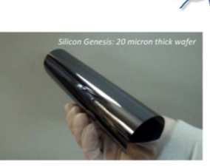
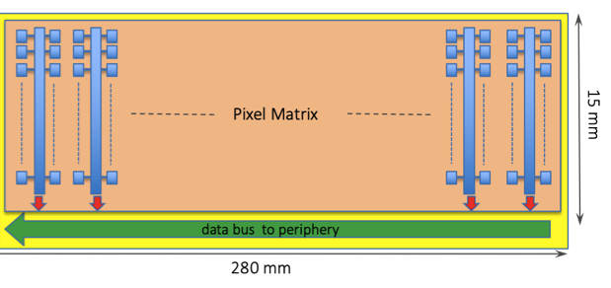
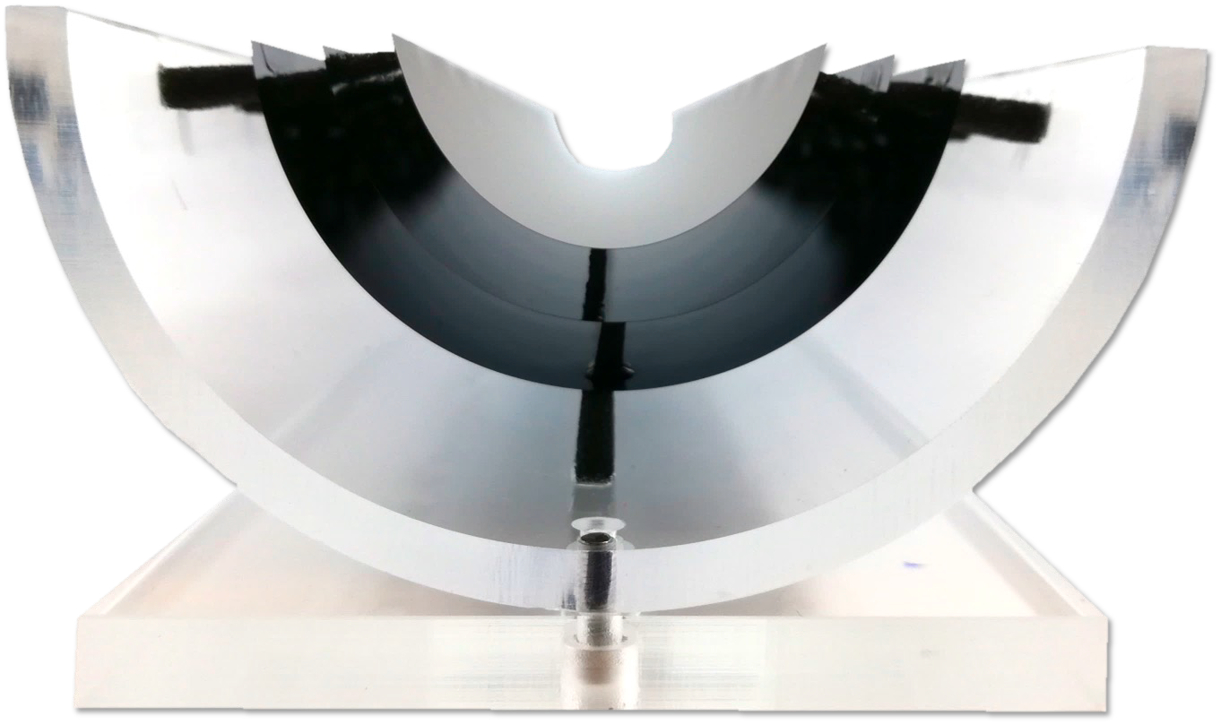
Under study: new technologies of stitched sensors for ITS3^{[1]}
Ultra-thin 20 μm wafers
Diagram of sensor 15x280 mm² stitched in one direction (dimensions are not to scale).
Technology of stitching
Thinning sensors to 20 μm – allows bending to cylindrical shape
MAPS sensors could be curved to radius 10-20 mm
Power ~20 mW/cm² – it is possible to use gas-flow cooling
Eliminate electrical substrate
Record level of ~ 0.05% X/X₀ per layer (!!!)
3 layers of bent sensors:
~6x less material budget
[1] ALICE-PUBLIC-2018-013

Slide 19
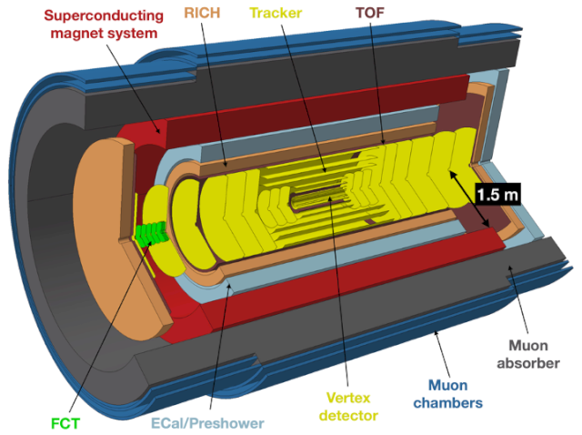
ALICE 3 in Run 5 expected > 2031–?
ALICE 3 -- a completely new experiment, fast with precise tracking and timing.
A large-acceptance, ultra-low material budget, all-pixel silicon tracking system
Future HI programme
at the LHC:
Low-mass dileptons and soft hadrons (<50 MeV)
Evolution of QGP and chiral symmetry restoration
Exotic (multi-)heavy-flavoured hadrons, hadronisation mechanisms
Hadron correlations and interaction potentials
searches beyond-the-Standard-Model
Letter of Intent for ALICE 3 was reviewed
by the LHCC in March 2022
Notes:
While the heavy-ion physics programme in Runs 3 and 4 will provide deep insights into the rich field of QCD phenomenology, open questions will remain that can only be addressed with further advancements in detector performance and with the significant increase in heavy-ion luminosity anticipated in Run 5 (expected in 2035–2038). This extension of the LHC heavy-ion programme through the 2030s has been supported by the 2020 update of the European strategy for particle physics,
Such studies are currently far beyond experimental reach. A comprehensive programme of
measurements in the multi-charm sector requires a new detector, featuring unprecedented point-
ing resolution, ultra-low material thickness, high-rate capabilities, large rapidity coverage, high
mass resolution and particle identification over a large pT interval and the full rapidity range
of the apparatus. Moreover, it also requires a special layout close to the interaction region,
with the tracking layers spaced very closely, in order to enable a novel experimental technique
(“strangeness tracking”), that relies on measuring the trajectories of hyperons before their decay.
The large pseudorapidity coverage of ALICE 3, about four times larger than that of the cur-
rent ALICE experiment, will also allow for rapidity-dependent measurements of multi-charm
production to explore the dependence of the production yields on the charm density. Stud-
ies of the expected performance of ALICE 3 for multi-charm baryons are presented in Sec-
tion 3.3.1.2.
TOF ~ 25ps

Slide 20
Summary
The impressive amount of progress in the last decade
for the ITS2 development and successful start in Run 3:
2012–2014: the ITS2 R&D
2014–2016: evaluation of technologies & prototypes, selection of technologies, engineering, design, TDR, final design are done
2017–2020: production, tests, assembly and commissioning
2021 – cosmic ray tests
2021: pilot Beam test at 900 GeV
2022, the 5th of July: start of Run 3 – the first pp collisions at 13.6 TeV
2022, the 18th of November: the first Pb-Pb collisions at √s_{NN}=5.36 TeV
New physics opportunities in study of strong interaction are opening!

Slide 21
.
Thank you for your attention!

