Slide 1
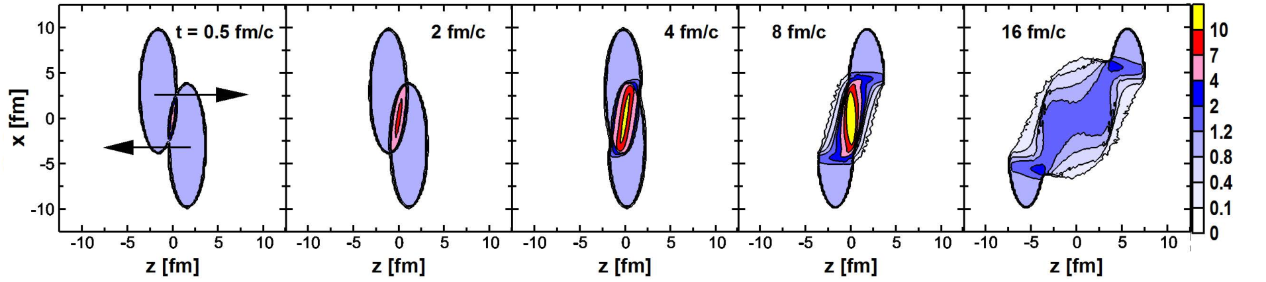
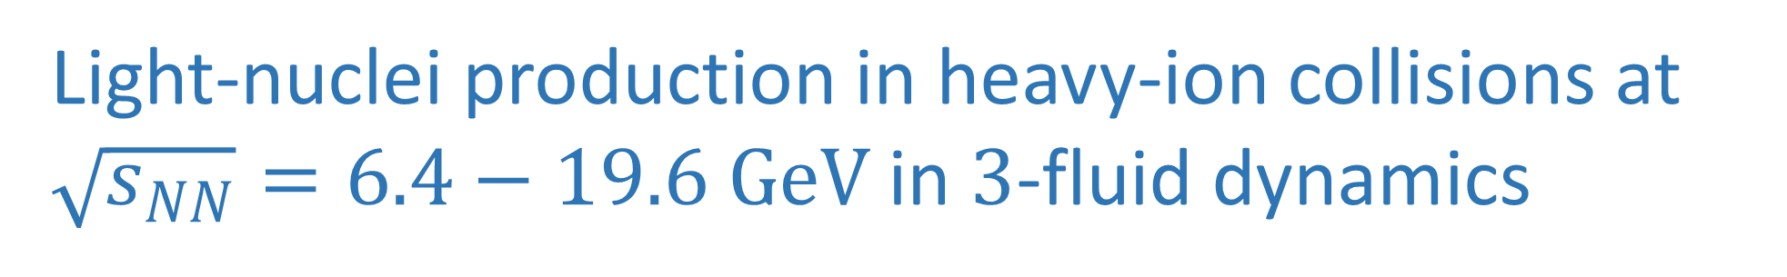
Light-nuclei production in heavy-ion collisions at $\sqrt{s_{NN}}=6.4−19.6 GeV$ in $3$-fluid dynamics
Marina Kozhevnikova (JINR)
In collaboration with Yu. B. Ivanov
ICPPA 2022, Moscow, 2 December 2022

Slide 2
Introduction
Light-nuclei production is related to search for critical point in QCD phase diagram.
There are various 3D dynamical models with coalescence mechanism of the light-nuclei production.
Microscopic approaches – PHQMD and SMASH
The thermodynamical approach: no additional parameters needed for light-nuclei production.
THESEUS generator is based on the thermodynamical approach.
Main areas of research: study the light-nuclei production at collision energies of the BES-RHIC, SPS, NICA and FAIR.

Slide 3
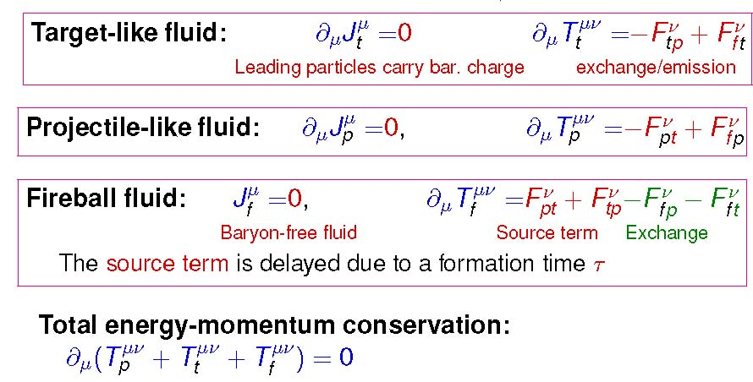
3FD model
The output = Lagrangian test particles (i.e. fluid droplets) for each fluid α(= p, t or f).
Fluid droplets = elements of freeze-out surface in hydrodynamic models.
Observables = numerically integrating hadron distribution functions over the set of droplets.
Physical Input:
Equation of State
Friction
Freeze-out energy density ε_{frz} = 0.4 GeV/fm³
EoS:
hadronic EoS (no phase transition)
hadronic+QGP EoS with 1st-order PT
hadronic+QGP EoS with crossover
3FD: Yu.B. Ivanov, V.N. Russkikh, V.D. Toneev,
PHYSICAL REVIEW C 73, 044904 (2006)
EoS: A. Khvorostukhin, V.V. Skokov, V.D. Toneev, K. Redlich, EPJ C48, 531 (2006)
3

Slide 4
THESEUS event generator
In 2016 the THESEUS event generator was introduced.
(3FD+Particlization+UrQMD): P. Batyuk et al., PHYSICAL REVIEW C 94, 044917 (2016)
THESEUS = 3FD + Monte Carlo hadron sampling + rescatterings/decays via UrQMD
There were no light nuclei included.
THESEUS presents the 3FD output in terms of a set of observed particles.
Since the time THESEUS was first presented, certain updates have been made, further referred to as THESEUS-v2.
THESEUS-v2: M. Kozhevnikova, Yu. Ivanov, Yu. Karpenko, D. Blaschke, O. Rogachevsky, PRC 103 (2021) 4, 044905

Slide 5
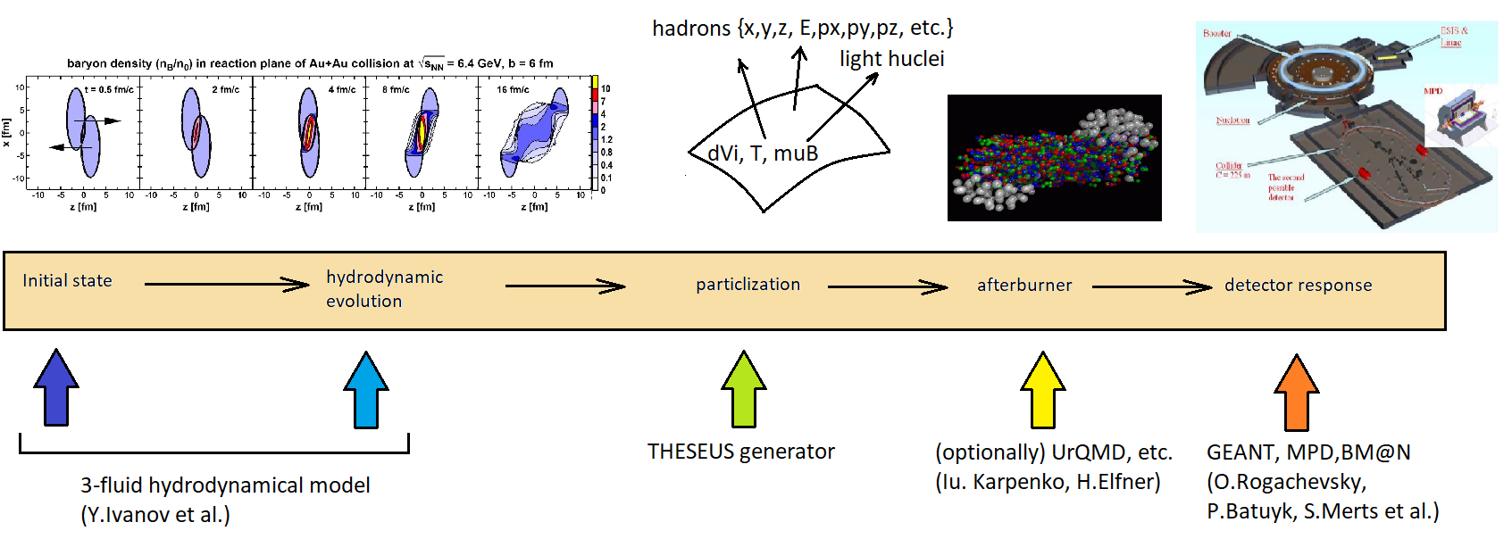
Hydrodynamic modelling of nuclear collisions for NICA / FAIR

Slide 6
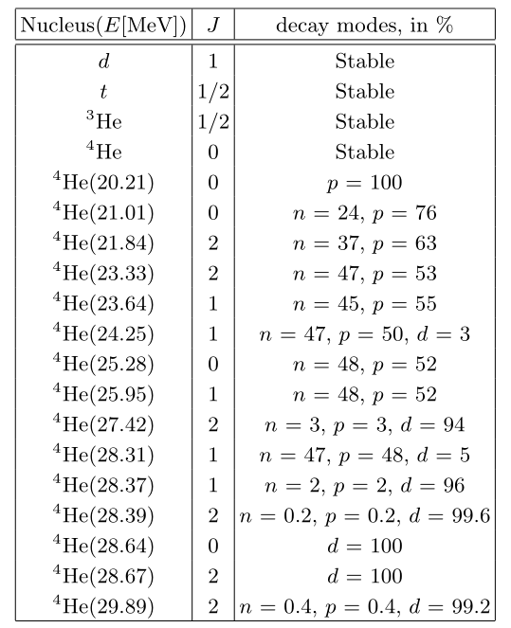
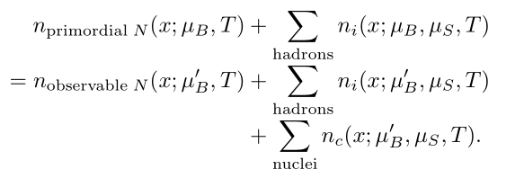
THESEUS-v2: updates
No clusters in 3FD originally.
To include light nuclei in thermodynamics, baryon chemical potential should be recalculated.
Recalculation of baryon chemical potential taking into account light nuclei production, proceeding from the local baryon number conservation:
The list of light-nuclei species is shown in Table.
Table: Stable light nuclei and low-lying resonances of the ⁴He system (from BNL properties of nuclides).

Slide 7
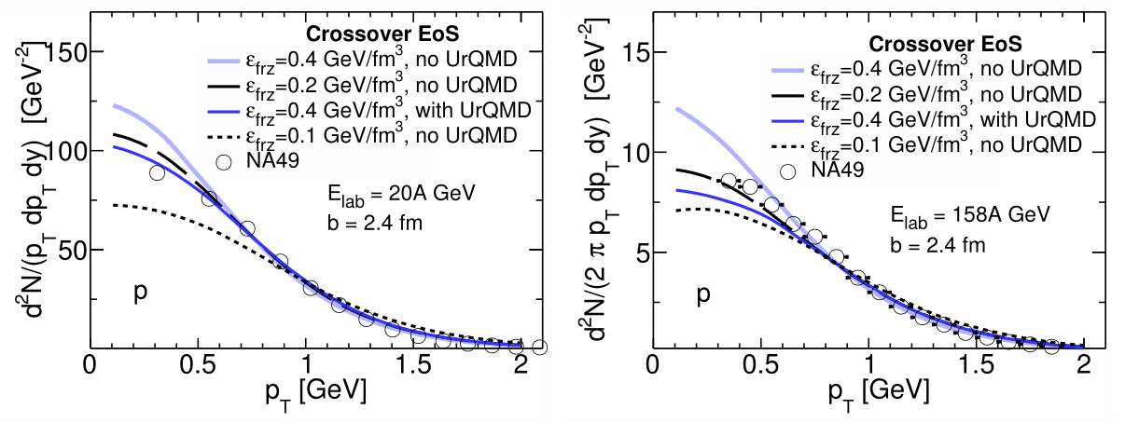
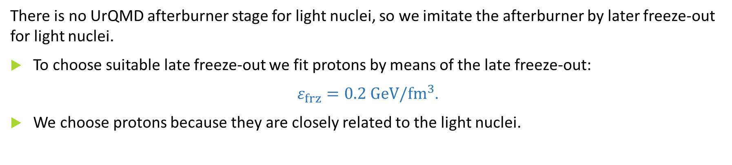
THESEUS-v2: afterburner for light nuclei
There is no UrQMD afterburner stage for light nuclei, so we imitate the afterburner by later freeze-out for light nuclei.
To choose suitable late freeze-out we fit protons by means of the late freeze-out:
$ε_{frz}=0.2 GeV/{fm}^{3}$.
We choose protons because they are closely related to the light nuclei.
Fig.: Transverse-momentum spectra of protons in central Au+Au collisions.

Slide 8
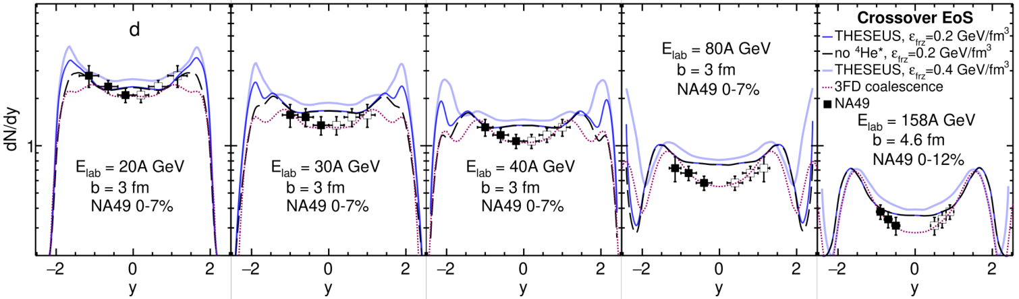
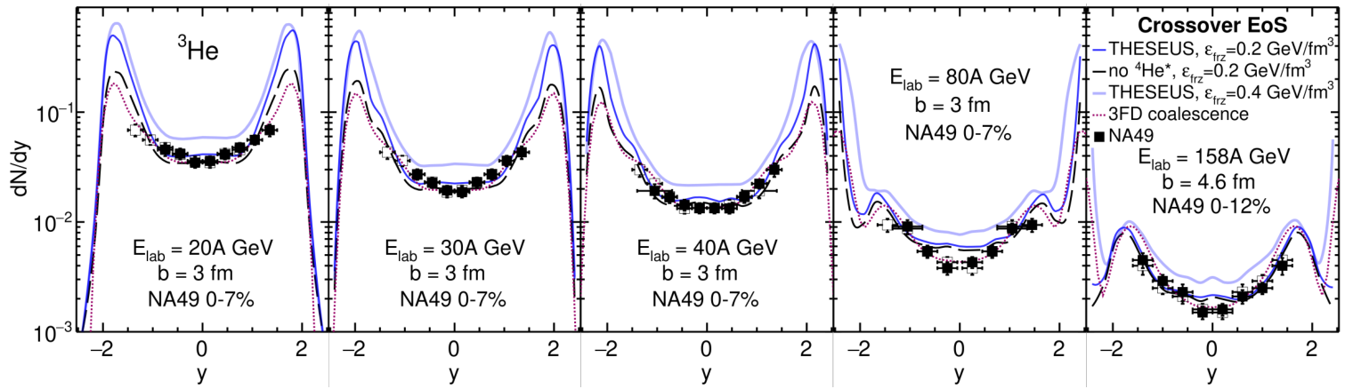
THESEUS-v2: rapidity distributions, $ε_{frz}=0.2 GeV/{fm}^{3}$.
Resonances of ⁴He are unimportant in midrapidity at the considered collision energies.
Puzzle: reproduction of the ³He data is better than that of deuterons, in spite of that ³He heavier.

Slide 9
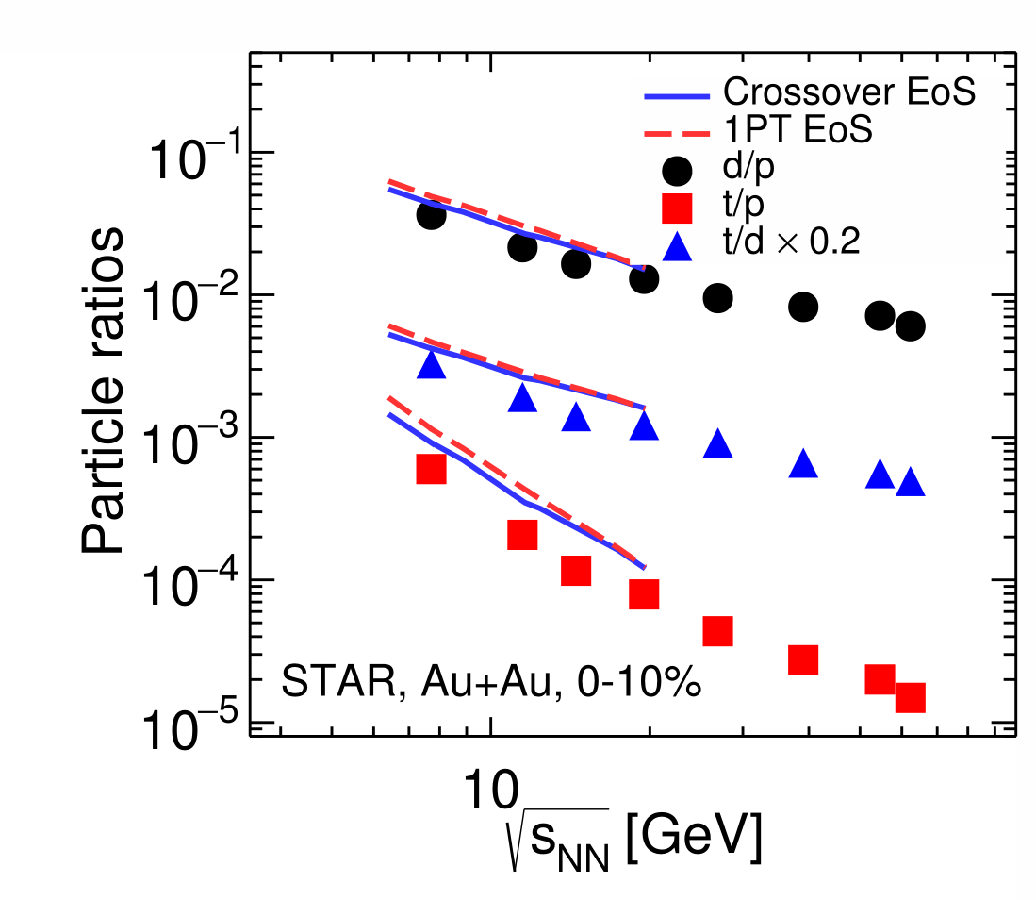
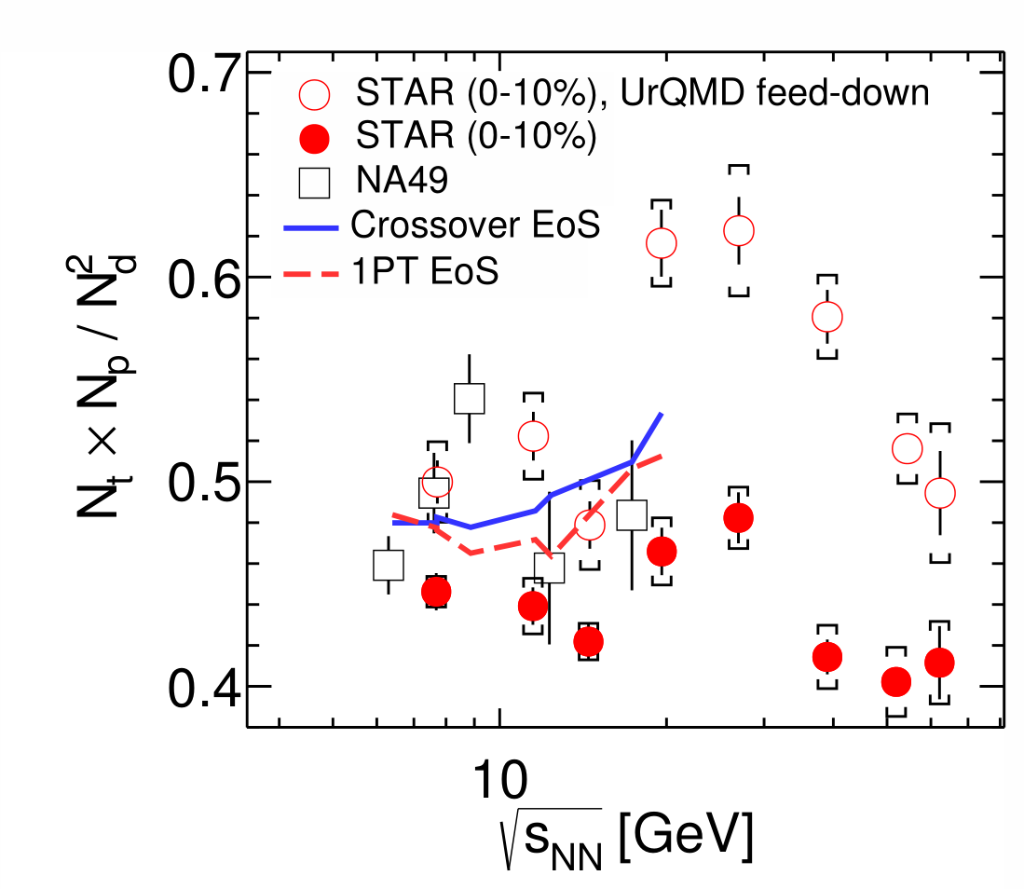
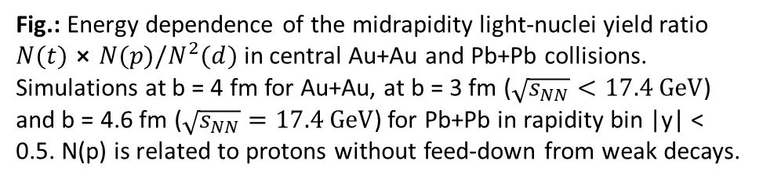
Particle ratios
Fig.: Energy dependence of d/p, t/p, and t/d midrapidity ratios for central (0-10%) Au+Au collisions. Simulations were performed at b = 4 fm for Au+Au and at b = 3 fm for Pb+Pb in rapidity bin |y| < 0.5.
Fig.: Energy dependence of the midrapidity light-nuclei yield ratio ${N(t)⨯N(p)/N}^{2}(d)$ in central Au+Au and Pb+Pb collisions. Simulations at b = 4 fm for Au+Au, at b = 3 fm ($\sqrt{s_{NN}}<17.4 GeV$) and b = 4.6 fm ($\sqrt{s_{NN}}=17.4 GeV$) for Pb+Pb in rapidity bin |y| < 0.5. N(p) is related to protons without feed-down from weak decays.
Observed growth near 20 GeV resembles the result of feed-down from weak decays into proton yield.

Slide 10
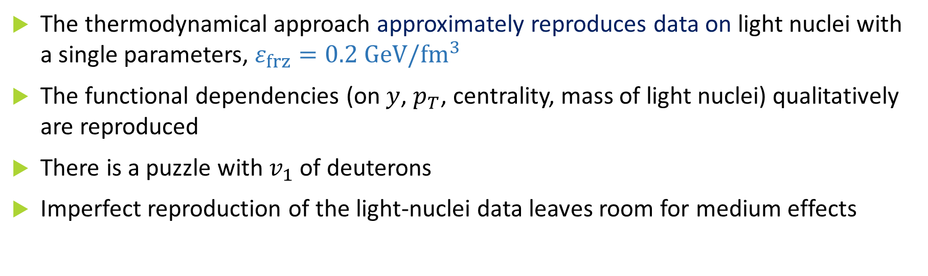
Summary
The thermodynamical approach approximately reproduces data on light nuclei with a single parameters, $ε_{frz}=0.2 GeV/{fm}^{3}$
The functional dependencies (on $y$, $p_{T}$, centrality, mass of light nuclei) qualitatively are reproduced
There is a puzzle with $v_{1}$ of deuterons
Imperfect reproduction of the light-nuclei data leaves room for medium effects

Slide 11
Acknowledgments
We are grateful to David Blaschke for convincing us to apply the thermodynamic approach to modeling the light-nuclei production in heavy-ion collisions.
We are especially grateful to Iu. Karpenko, without his help expertise this work would hardly have been possible.

Slide 12
Thank you
for your attention!

Slide 13
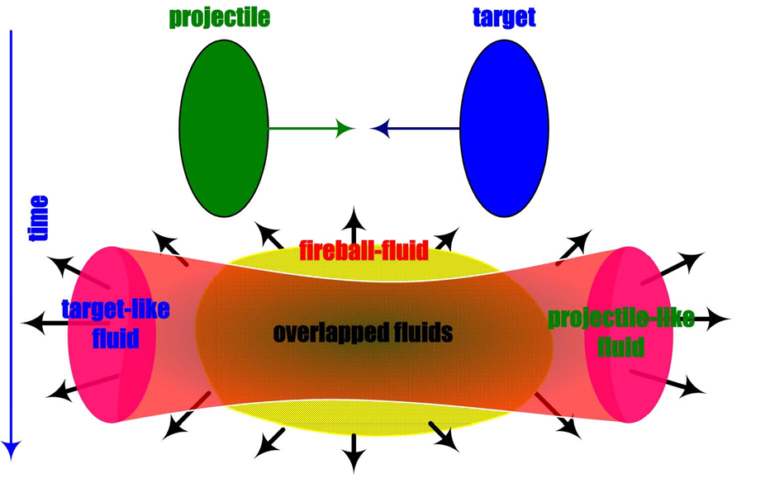
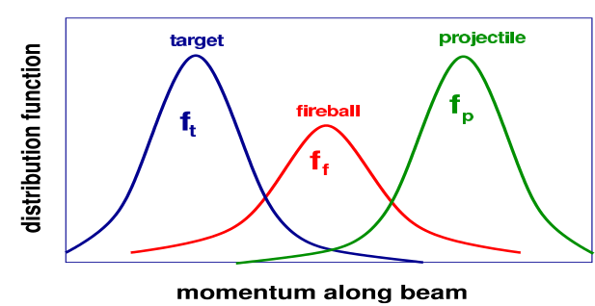
Three-fluid dynamics (3FD) model
The 3FD approximation simulate the early, nonequilibrium stage of the strongly-interacting matter:
baryon-rich fluids: nucleons of the projectile (p) and the target (t) nuclei;
fireball (f) fluid: newly produced particles which dominantly populate the midrapidity region.

Slide 14
THESEUS-v2: $m_{T}$-spectra of protons.
$m_{T}$-spectra of protons: thermodynamics works good with soft particles and with hard particles not perfect.

Slide 15
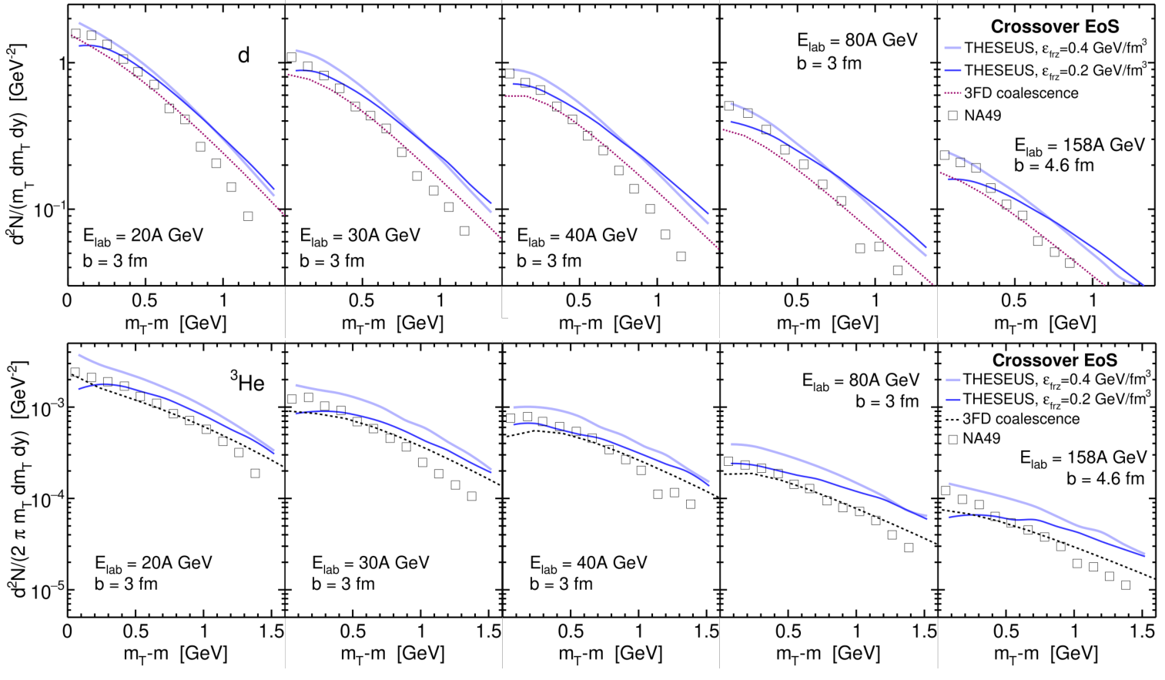
$m_{T}$-spectra: deuterons and Helium 3
Small disagreement with proton $m_{T}$ data transforms into a large disagreement with data on light nuclei.

Slide 16

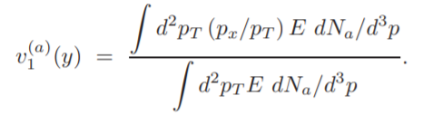

Directed flow $v_{1}(y)$
The single particle distribution function:
The first coefficient of Fourier expansion, i.e. directed flow:
, where φ – azimuthal angle.
In THESEUS: $v_{1}\left(y\right)$ is calculated in terms of sums over hadrons rather than integrals over momenta.

Slide 17
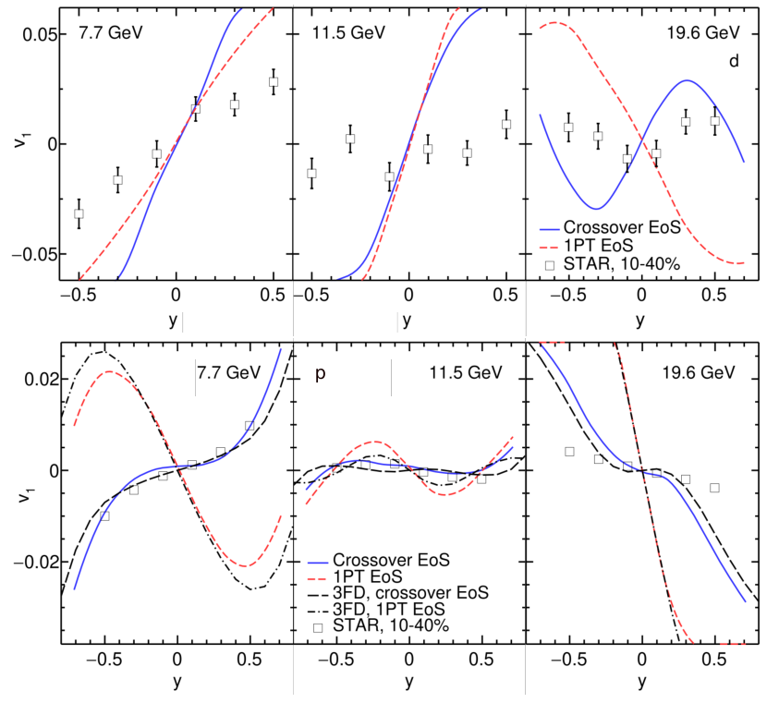
Directed flow $v_{1}(y)$: protons and deuterons
Fig.: Directed flow of deuterons (upper raw of panels) and protons (lower raw of panels) as function of rapidity in semicentral (b = 6 fm) Au+Au collisions.

Slide 18
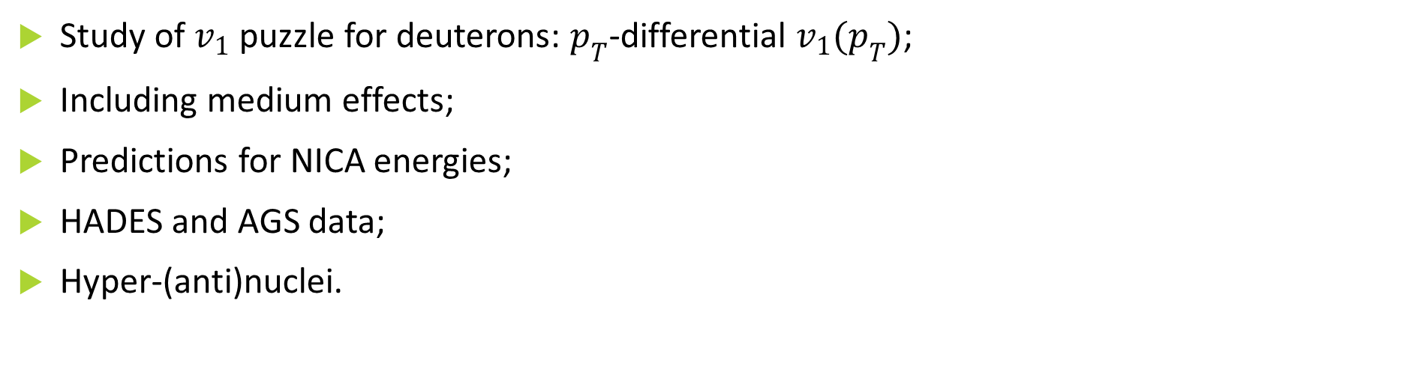
Nearest plans
Study of $v_{1}$ puzzle for deuterons: $p_{T}$-differential ${v_{1}(p}_{T})$;
Including medium effects;
Predictions for NICA energies;
HADES and AGS data;
Hyper-(anti)nuclei.

