Slide 1
Neutron Stars Structure in
the Era of Multi-Messenger Astronomy
Farrukh J. Fattoyev
Manhattan College, Riverdale
ICPPA - 2020
The 5th International Conference on Particle Physics and Astrophysics
National Research Nuclear University (MEPhi)
October 5-9, 2020, Moscow, Russian Federation (online)

Slide 2
Outline
Introduction
Nuclear Physics Input on the Structure of Neutron Stars
Connecting nuclei to neutron stars
The role of the nuclear equation of state and the neutron star structure
Nuclear constraints on the equation of state
Astrophysical Constraints of the Structure of Neutron Stars
Astrophysical measurements of the neutron star structure
Tidal polarizability and gravitational waves
1. Tidal polarizability and the stiffness of the EOS
2. Tidal polarizability and constraints on the NS radii
GW190814 and the role of the high-density EOS
Concluding Remarks

Slide 3
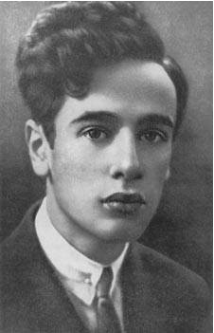
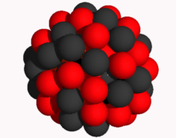
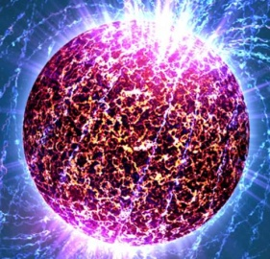
Neutron Star as a Giant (Neutron-Rich) Nucleus:
Similarities and Differences
Nucleus of an atom
A ≃ 10²
ρ_{ave} ≃ 0.7 ρ₀
R ≃ 10⁻¹⁴ m
Supported by surface tension
Neutron Star
A ≃ 10⁵⁹
ρ_{ave} ≃ 2.0 ρ₀
R ≃ 10⁴ m
Supported by gravity
Feb, 1931 – Zurich
“the density of matter becomes so great that atomic nuclei come in close contact,
forming one gigantic nucleus.”
They are both governed by the same Physics:
The Physics of the Strong Interaction

Slide 4
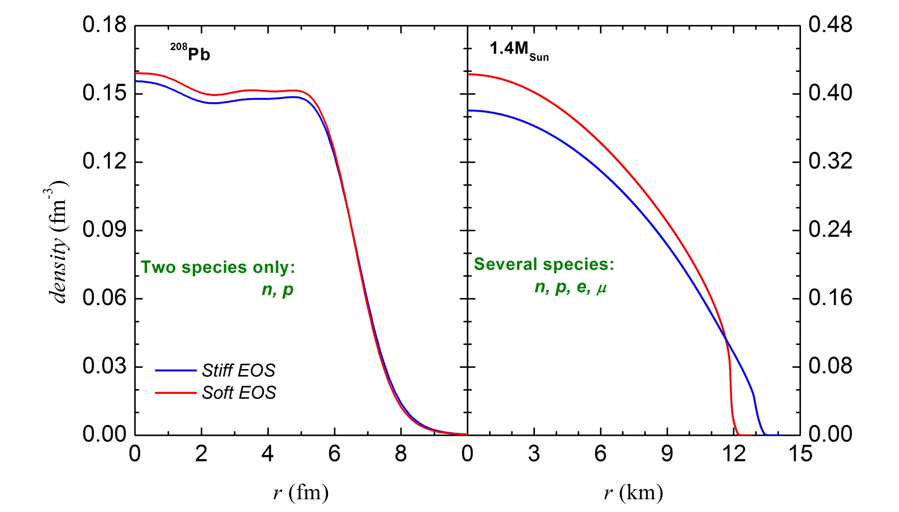
Neutron Star as a Giant Nucleus:
The Role of the Equation of State
Nucleus of an atom
Relativistic nuclear structure (Dirac) equation
Neutron Star
General Relativistic stellar structure (TOV) equation

Slide 5
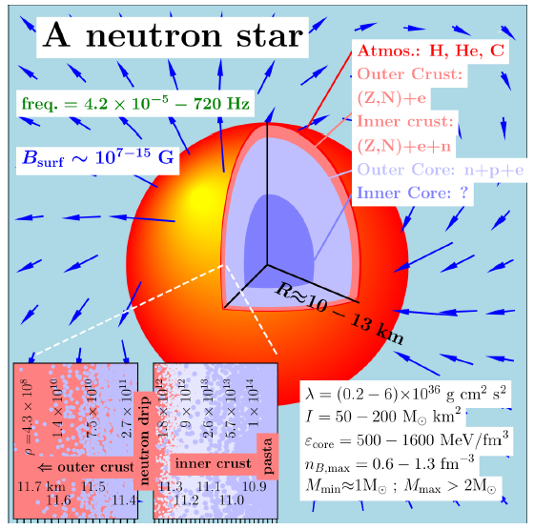
The Structure of Neutron Stars
Taken from S. Gandolfi et al., J. Phys. G 46 (2019) 103001

Slide 6
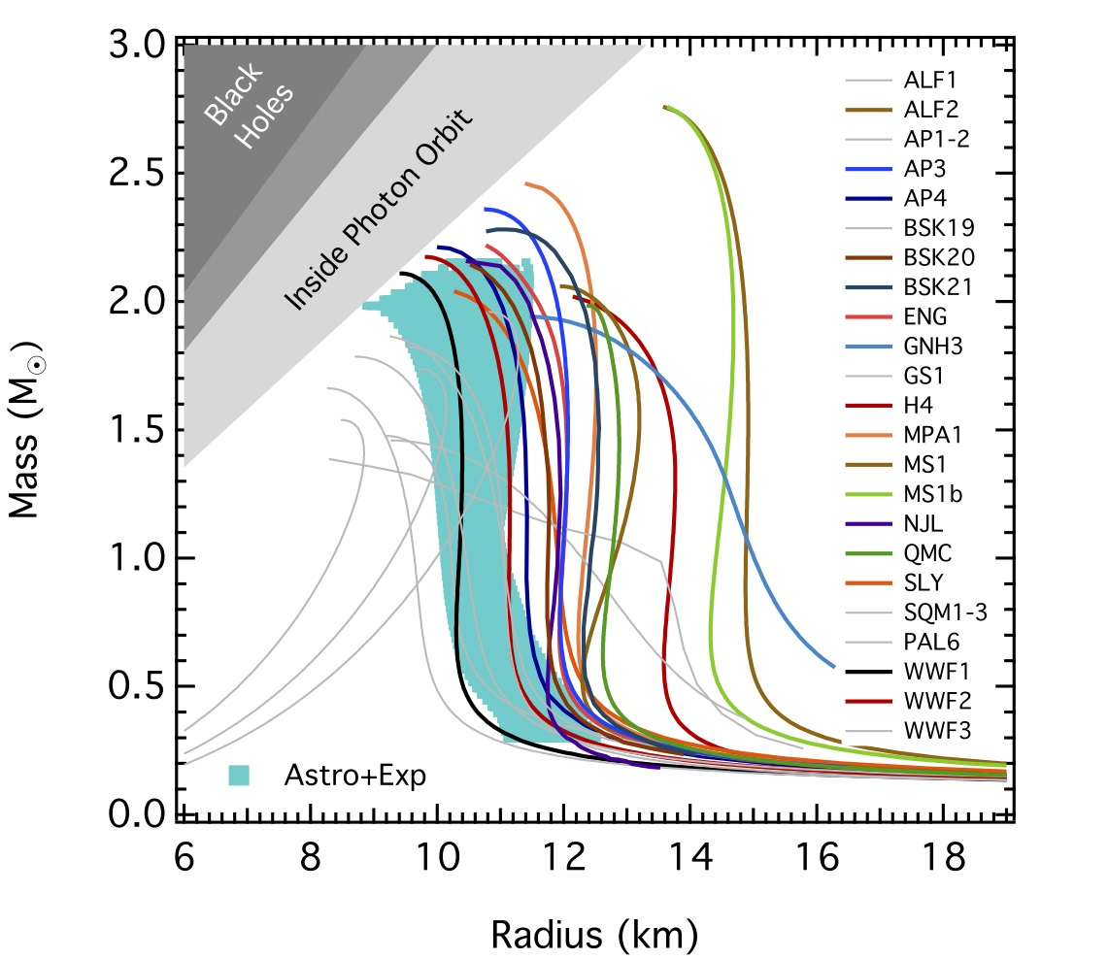
Mass-vs-Radius Relations
F. Ozel, http://xtreme.as.arizona.edu/NeutronStars/index.php/neutron-star-radii/
Hydrostatic Structure: the only input required is the equation of state (EOS):
P = P(ρ)
High-density EOS
is not constrained.
In particular,
the isovector sector of the nuclear interaction
is not constrained.
?

Slide 7
Nuclear Physics Input

Slide 8
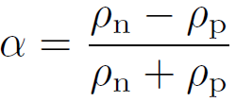
Nuclear Equation of State
Many nuclear models exist that are based on relativistic or non-relativistic interactions that use realistic or phenomenological potentials.
isospin asymmetry
For a neutron-rich matter it is useful to expand:

Slide 9
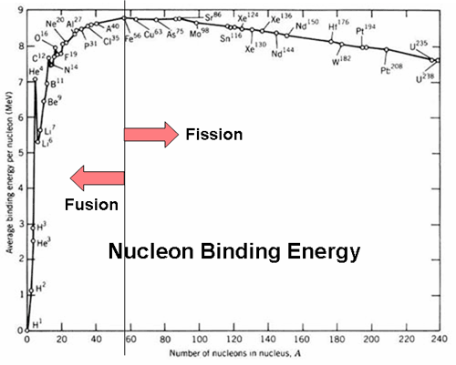
Constraining Nuclear EOS: Symmetric Nuclear Matter
Nuclear masses constrain binding energy at saturation at about less than 5% level;
Giant Monopole Resonances constrain the value of the nuclear incompressibility at about less than 10% level – Youngblood et al., PRL 82, 691 (1999); Garg, NuSym13, (2013)
High density component of the EOS is constrained by the experimental – Danielewicz et al. Science 298, 1592 (2002), and observational data – Antoniadis, et al., Science 340, 1233232 (2013).

Slide 10
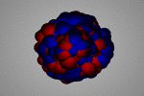
Constraining Nuclear EOS: Symmetric Nuclear Matter
Nuclear masses constrain binding energy at saturation at about less than 5% level;
Giant Monopole Resonances constrain the value of the nuclear incompressibility at about less than 10% level – Youngblood et al., PRL 82, 691 (1999); Garg, NuSym13, (2013)
High density component of the EOS is constrained by the experimental – Danielewicz et al. Science 298, 1592 (2002), and observational data – Antoniadis, et al., Science 340, 1233232 (2013).

Slide 11
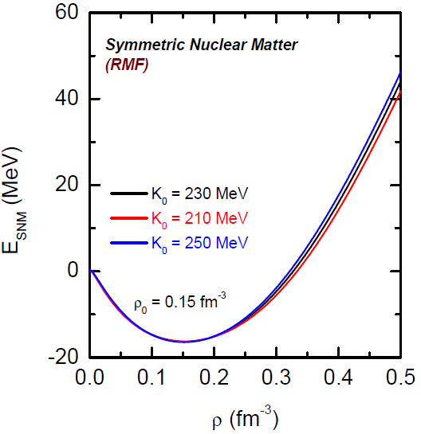
Constraining Nuclear EOS: Symmetric Nuclear Matter
Nuclear masses constrain binding energy at saturation at about less than 5% level;
Giant Monopole Resonances constrain the value of the nuclear incompressibility at about less than 10% level – Youngblood et al., PRL 82, 691 (1999); Garg, NuSym13, (2013)
High density component of the EOS is constrained by the experimental – Danielewicz et al. Science 298, 1592 (2002), and observational data – Antoniadis, et al., Science 340, 1233232 (2013).

Slide 12
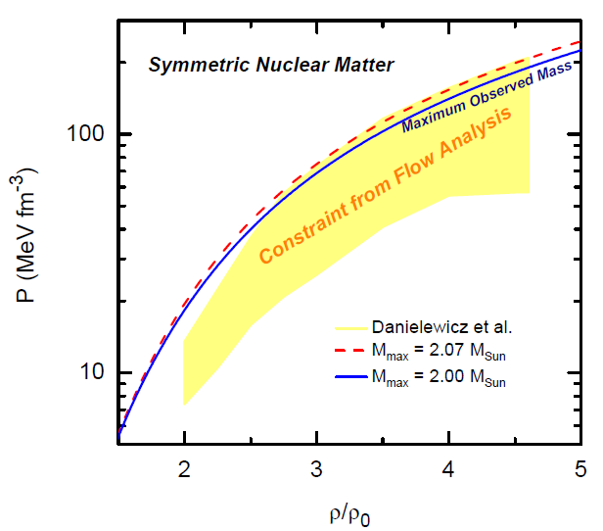
Constraining Nuclear EOS: Symmetric Nuclear Matter
Nuclear masses constrain binding energy at saturation at about less than 5% level;
Giant Monopole Resonances constrain the value of the nuclear incompressibility at about less than 10% level – Youngblood et al., PRL 82, 691 (1999); Garg, NuSym13, (2013)
High density component of the EOS is constrained by the experimental – Danielewicz et al. Science 298, 1592 (2002), and observational data – Antoniadis, et al., Science 340, 1233232 (2013).
Recent observations by
H. T. Cromartie et al., Nat. Astron. 4, 72 (2019).

Slide 13
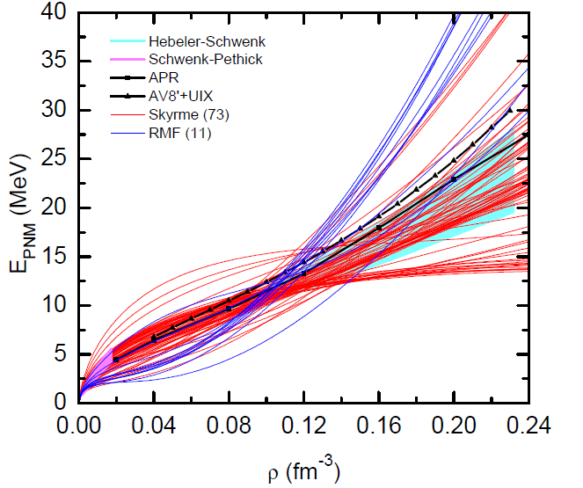
Equation of State of Pure Neutron Matter
?
?
Recent theoretical progresses on chiral EFT and AFDMC (QMC) calculations puts some constraints on the EOS of PNM below saturation.

Slide 14
Astrophysics Input

Slide 15
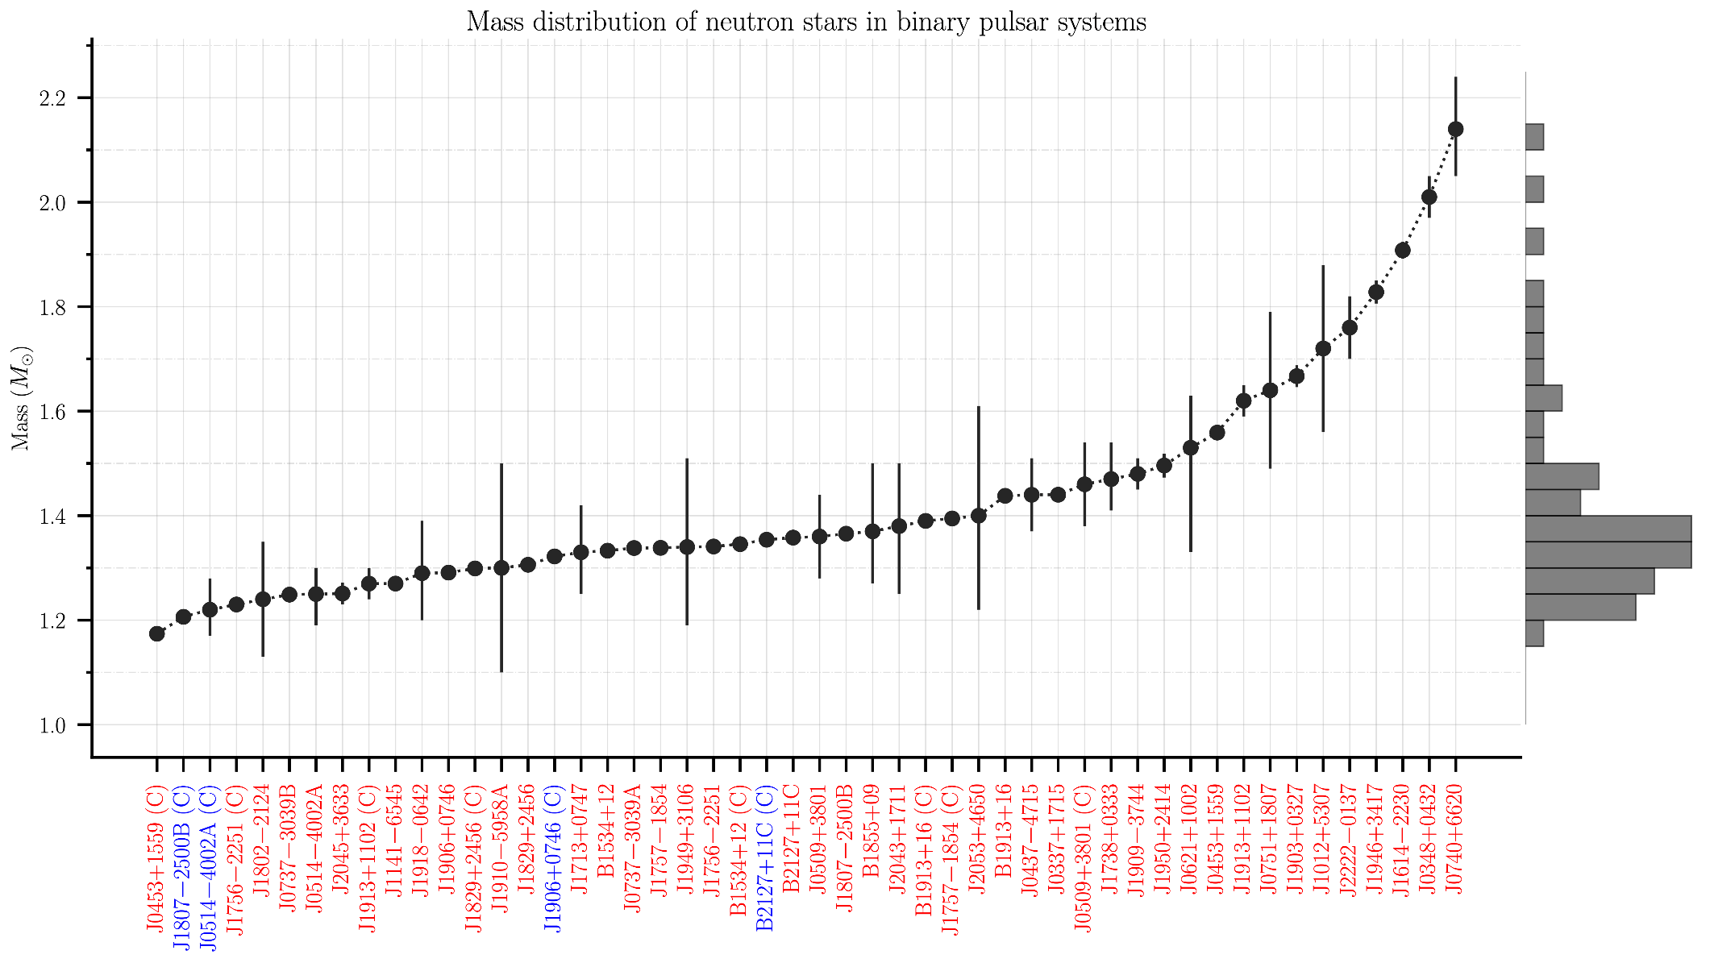
Mass measurements
Pulsar timing, optical spectroscopy, rates of advance of periastron, Shapiro delay, Einstein delay, orbital decay
The maximum mass of a neutron star is sensitive to the EOS at the core
https://www3.mpifr-bonn.mpg.de/staff/pfreire/NS_masses.html

Slide 16
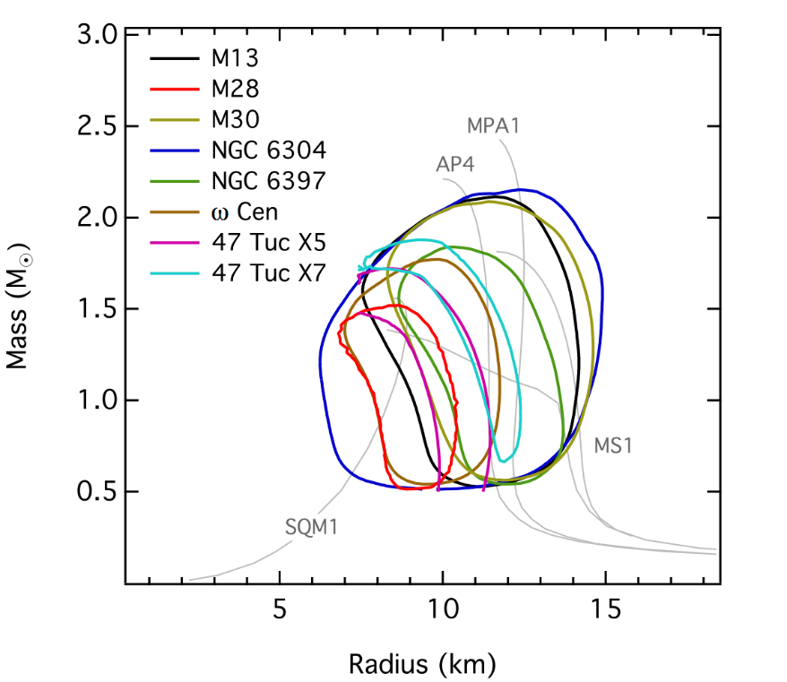
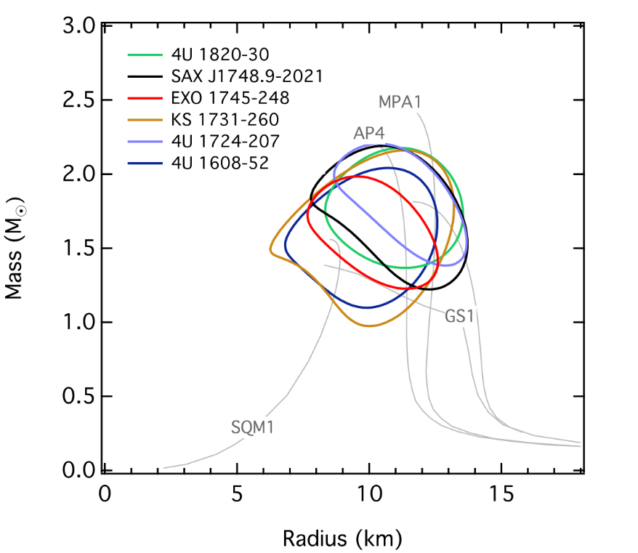
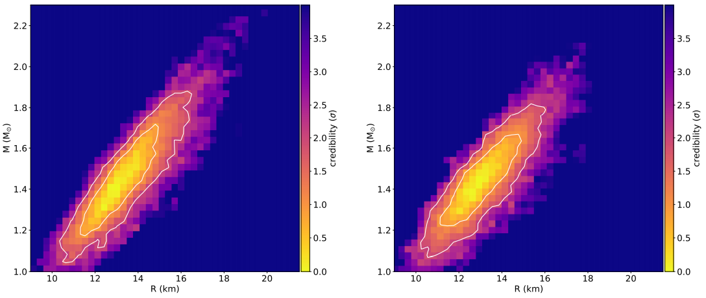
Mass-vs-Radius Measurements
X-ray observations, thermal emission
F. Ozel,
http://xtreme.as.arizona.edu/NeutronStars/
NS Radii are strongly sensitive to neutron-rich matter EOS.
NICER,
Miller et al., ApJL 2019, 887, L24

Slide 17
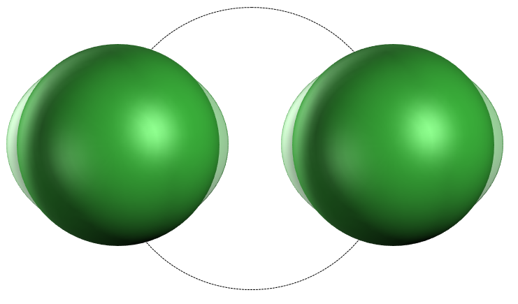
Tidal Polarizability and Gravitational Waves
On August 17 2017, 12:41:04.43 UTC two neutron stars got merged.
This was the 9th GW detection (the 6th announced at the time) by LIGO/Virgo Collaboration.
This single event generated most of post-iron elements
Including 10 Earth mass of Gold!
Abbott et al. PRL 119, 161101 (2017)
external
gravitational
field
quadrupole
deformation
tidal Love number
tidal polarizability
Quadrupole deformation scales
as the 5th power of the Radius.
Flanagan and Hinderer, Phys. Rev. D77, 021502 (2008)
Fattoyev, Carvajal, Newton, Li, Phys. Rev. C 87, 015806 (2013)
Steiner, Gandolfi, Fattoyev, Newton, Phys. Rev. C 91, 015804 (2015)
Fattoyev, Piekarewicz, Horowitz, Phys. Rev. Lett., 172702 (2018)

Slide 18
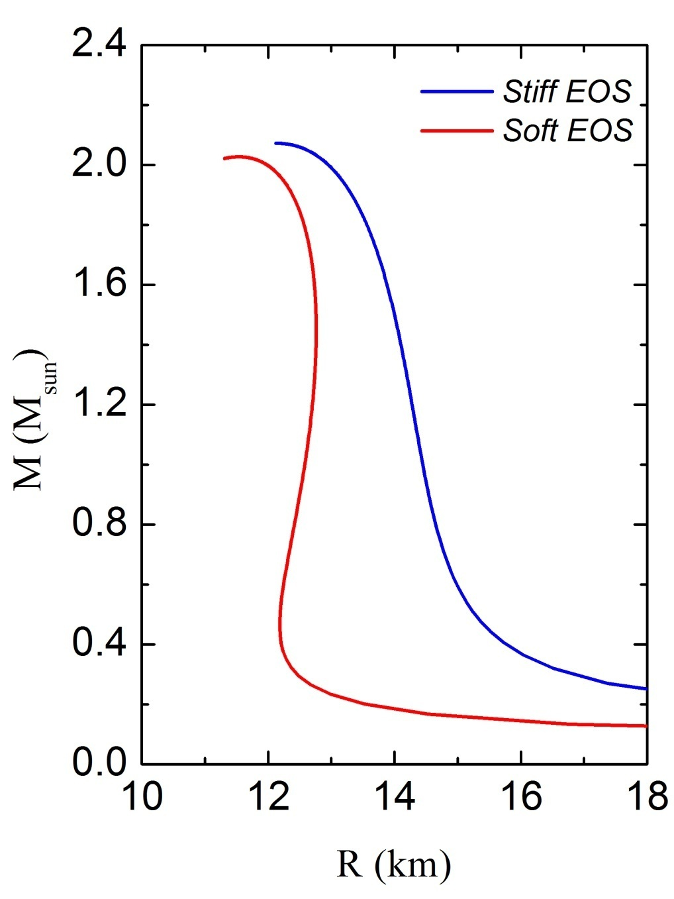
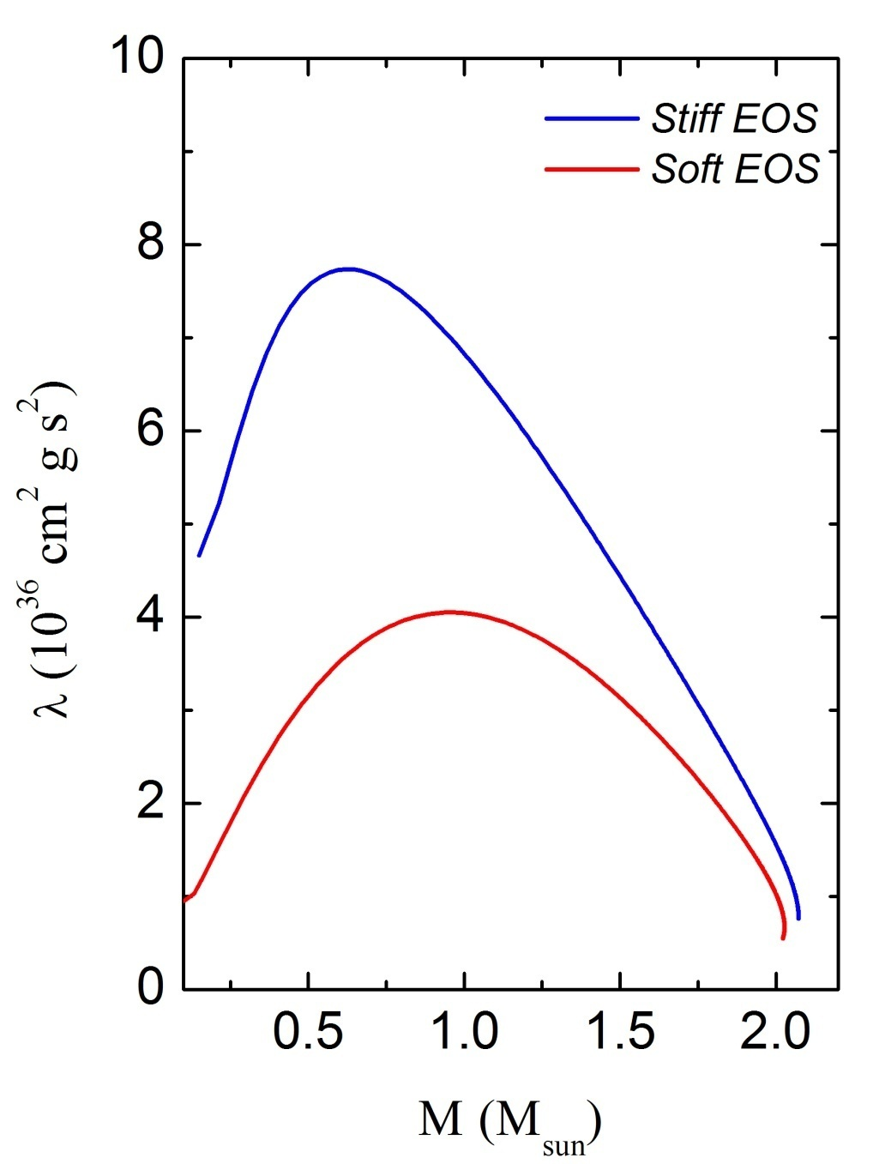
Example: A Stiff and a Soft Equation of State

Slide 19
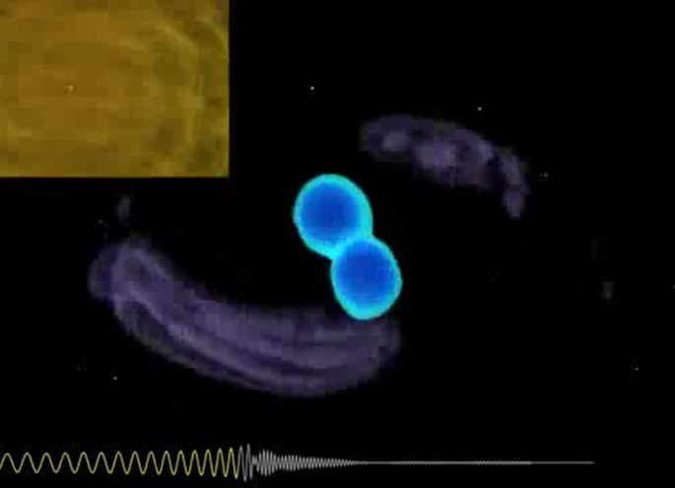
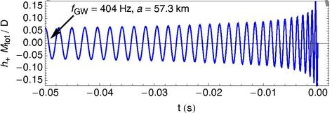
Tidal Polarizability and Gravitaional Waves
The induced quadrupole deformation advances the orbit and changes the
rotational phase.
BH-BH merger:
1
2
Image Credit: Jocelyn Read

Slide 20
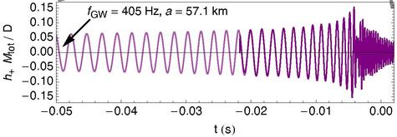
Tidal Polarizability and Gravitaional Waves
The induced quadrupole deformation advances the orbit and changes the
rotational phase.
NS-NS merger:
1
2
Image Credit: Jocelyn Read

Slide 21
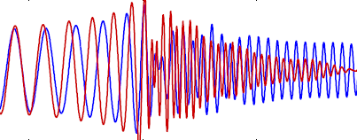
Tidal Polarizability, EOS, and Gravitaional Waves
Fluffy stars collide earlier and merge at a lower frequency.
Compact stars continue to orbit and merge at a higher frequency.
The waveform is complicated and requires numerical relativistic simulations.
1
2
Credit: Takami et al. (2014)
APR4 (compact) and GNH3 (fluffy)
-6.5 ms 0 ms 6.5 ms

Slide 22
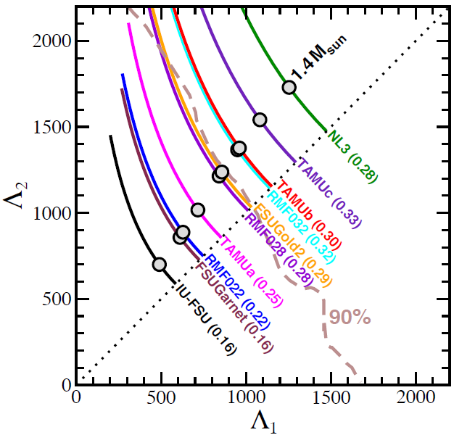
EOS and Tidal Polarizability
We used ten distinct RMF models (these EOSs are naturally causal):
Fattoyev, Piekarewicz, Horowitz, Phys. Rev. Lett. 120, 172702 (2018)
NL3, IU-FSU, TAMUC-FSU, FSUGold2, FSUGarnet, RMF022, RMF028, RMF032
The SNM EOS at high-densities
becomes important.
Models with stiff SNM EOS,
such as NL3 (with M = 2.77 M_{sun}),
may be ruled out.
e. g. see:
Margalit & Metzger, Astrophys. J. Lett. 850, L19 (2017)
Rezzolla, Most, Weih, Astrophys. J. Lett. 852, L25 (2018)

Slide 23
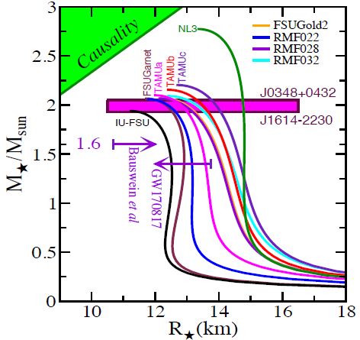
EOS and Tidal Polarizability
We used ten distinct RMF models (these EOSs are naturally causal):
Fattoyev, Piekarewicz, Horowitz, Phys. Rev. Lett. 120, 172702 (2018)
NL3, IU-FSU, TAMUC-FSU, FSUGold2, FSUGarnet, RMF022, RMF028, RMF032
The SNM EOS at high-densities
becomes important.
Models with stiff SNM EOS,
such as NL3 (with M = 2.77 M_{sun}),
may be ruled out.
e. g. see:
Margalit & Metzger, Astrophys. J. Lett. 850, L19 (2017)
Rezzolla, Most, Weih, Astrophys. J. Lett. 852, L25 (2018)

Slide 24
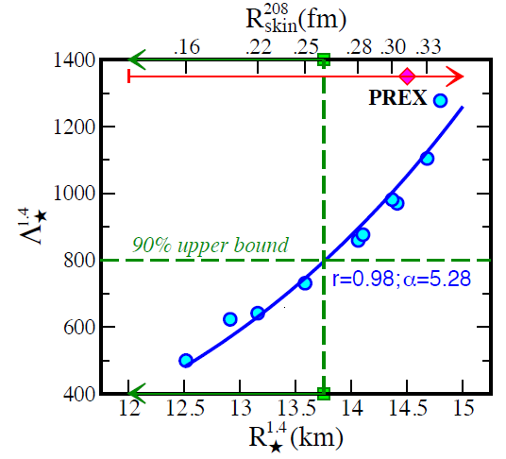
Neutron Star Radius Constraints
Also, see:
E. Annala et al., Phys. Rev. Lett.
120, 172703 (2018)
I. Tews et al., Eur. Phys. J. A 55, 97 (2019)

Slide 25
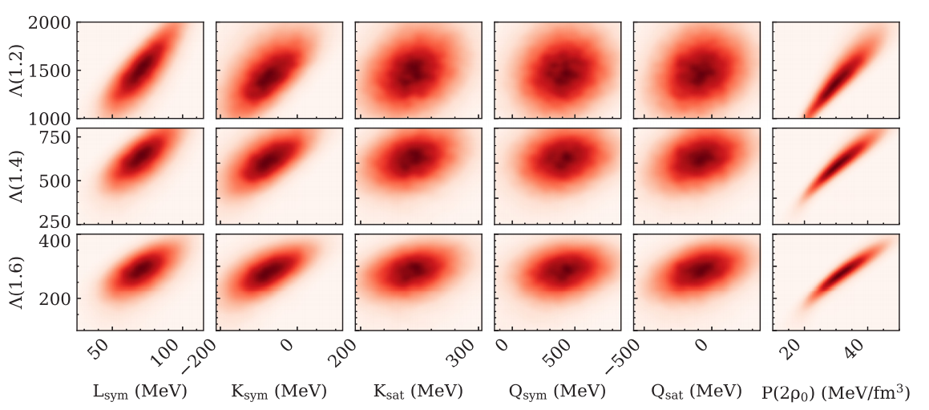
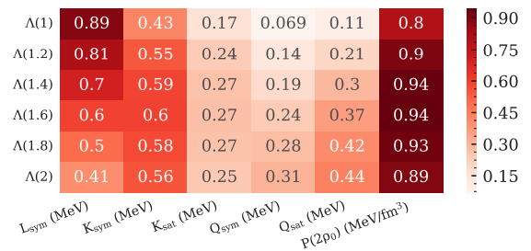
Detailed Bayesian Analysis of GW170817 data
C. Y. Tsang et al, Physical Review C, arXiv: 2009.05239 (accepted)
Low-mass neutron star tidal polarizability
is strongly correlated with the slope of the symmetry energy.
The knowledge of pressure at twice saturation density is very important.

Slide 26
GW190814 and the “Big Apple”
R. Abbott et al, Astrophys.J.Lett. 896, 3, L44 (2020) & F. J. Fattoyev et al, PRL, arXiv: 2007.03799 (submitted)
"We don't know if this object is the heaviest known neutron star, or the lightest known black hole…
– Vicky Kalogera, Northwestern University
Already cited by 142 and counting…
Analyses so far, suggest it could be a rapidly rotating neutron star, a black hole, a quark star…

Slide 27
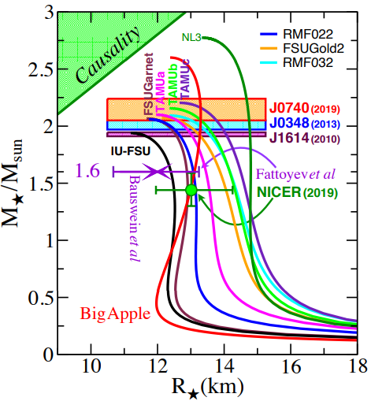
GW190814 and the “Big Apple”
Agrees with the nuclear structure experimental data
F. J. Fattoyev et al, arXiv: 2007.0379 (2020)
H. S. Das et al, arXiv: 2009.10690 (2020)
Agrees with astrophysical observations
F. J. Fattoyev et al, arXiv: 2007.0379 (2020)
Calculated tidal polarizability of
Λ_{1.4} = 717.3
is in agreement with the original analysis (Λ_{1.4} < 800), but overestimates the later analysis (70 < Λ_{1.4} < 580) of GW170817.
Also in agreement with GW190814 analysis under NSBH scenario:
R. Abbott et al, Astrophys.J.Lett. 896, 3, L44 (2020)

Slide 28
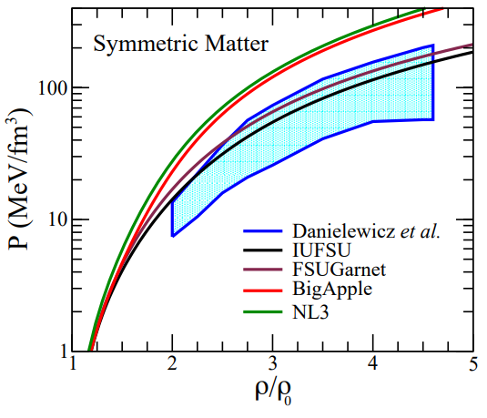
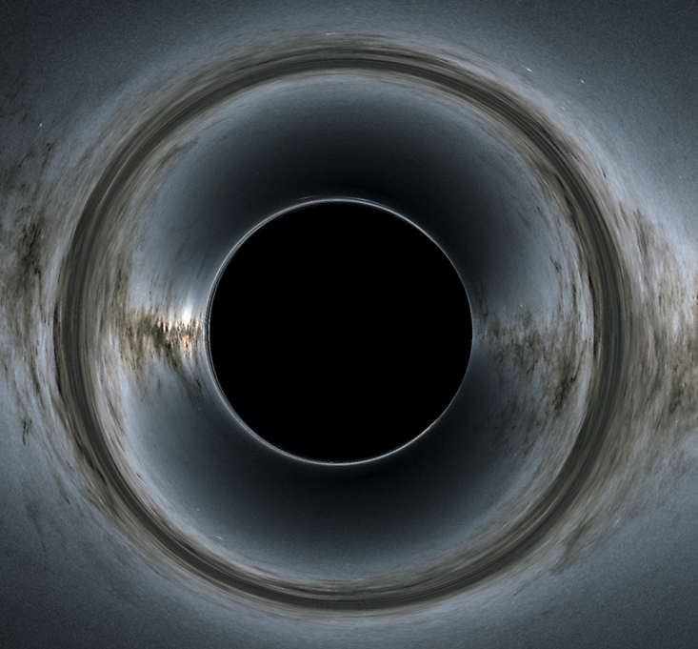
GW190814 and the “Big Apple”
A stiff EOS, in principle, can be obtained by stiffening the nuclear symmetry energy.
(also see Lim et al., arXiv:2007.06526 (2020))
Or this companion is just a black hole.
Disagrees with constraints obtained by the heavy-ion collision experiment.
P. Danielewicz, et al, Science 298, 1592 (2002), F. J. Fattoyev et al, arXiv:2007.0379 (2020)

Slide 29
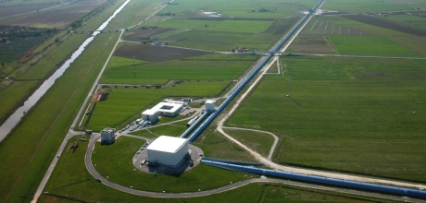
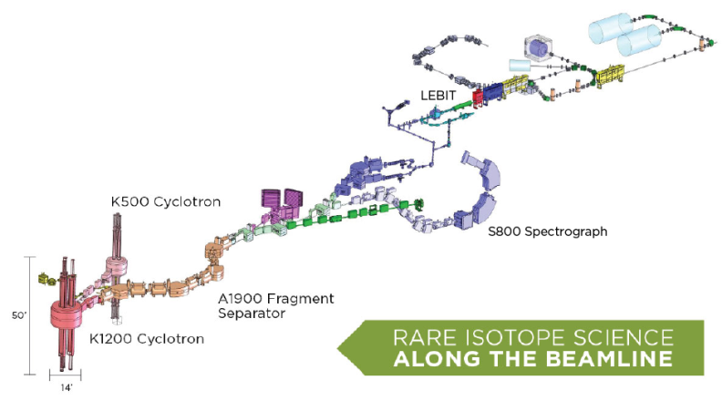
Concluding Remarks
Historical first detection of GW from BNS merger GW170817 has already
improved the EOS of dense matter.
Nuclear structure experiments will continue to provide information on
the EOS at and below nuclear saturation that are important for NS structure.
Current and future Heavy-Ion-Collision experiments will constrain the EOS
at supra-saturation density – relevant to the core of neutron stars.
Current and future GW observations from BNS mergers and NS radii
observations (e. g. NICER) shall provide tighter constraints on dense matter EOS.
More exciting opportunities are ahead!

Slide 30
Acknowledgement
My Collaborators:
J. Piekarewicz, W.-C. Chen (FSU)
B.-A. Li, W. G. Newton (Texas A&M U-Commerce)
J. Carvajal (FIU)
C. J. Horowitz, B. Reed, A. Deibel (IU)
A.W. Steiner (UTK/ORNL)
C. Y. Tsang, M. B. Tsang, P. Danielewicz, W. G. Lynch, E. F. Brown, B. Schuetrumpf (NSCL/MSU)
S. Gandolfi, I. Sagert (Los Alamos)
A. Cumming (McGill U.)
S. Reddy (UW)
D. Page (UNAM)
J. Xu (SINAP)
X.-H. Li (U. South China)
C. Xu (Nanjing U)
L.-W. Chen (Shanghai Jiao Tong U.)
W.-Z. Jiang (Southeast U.)
X.-T. He (Nanjing U. Aeronautics and Astronautics)
B.-J. Cai (Shanghai U.)
Thank You!

Slide 31
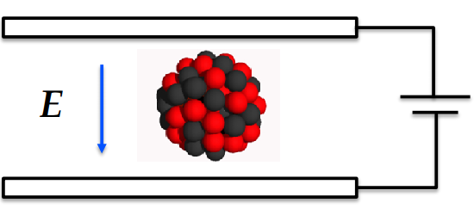
Scaling Analogy: Tidal Polarizability and its Scaling with Radii
Consider the electric dipole polarizability.
This scales as:
Since energy denominator scales: 1/r.
A. Tamii et al.
Phys. Rev. Lett. 107, 062502 (2011)
The gravitational dipole moment however vanishes (momentum conservation).
Thus it becomes important to define the mass quadrupole polarizability.
which scales as:
Abbott et al.
Phys. Rev. Lett. 119, 161101 (2017)
This contributes to the gravitational wave emission!

