Slide 1
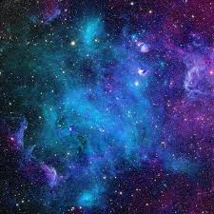
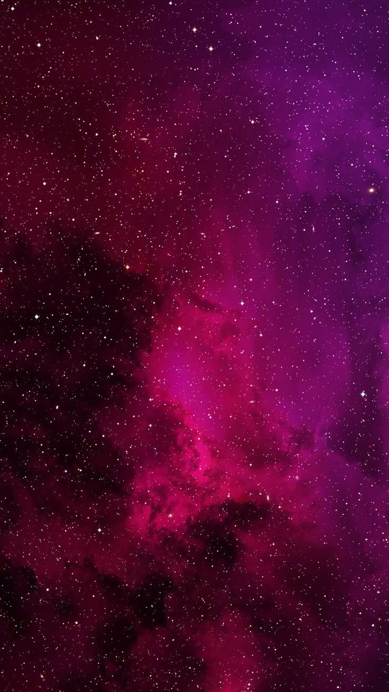
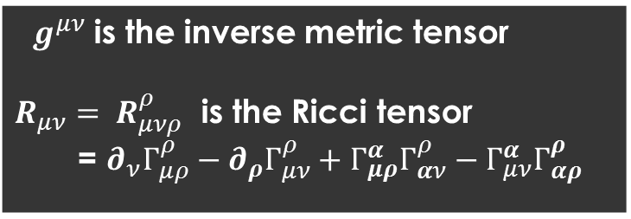
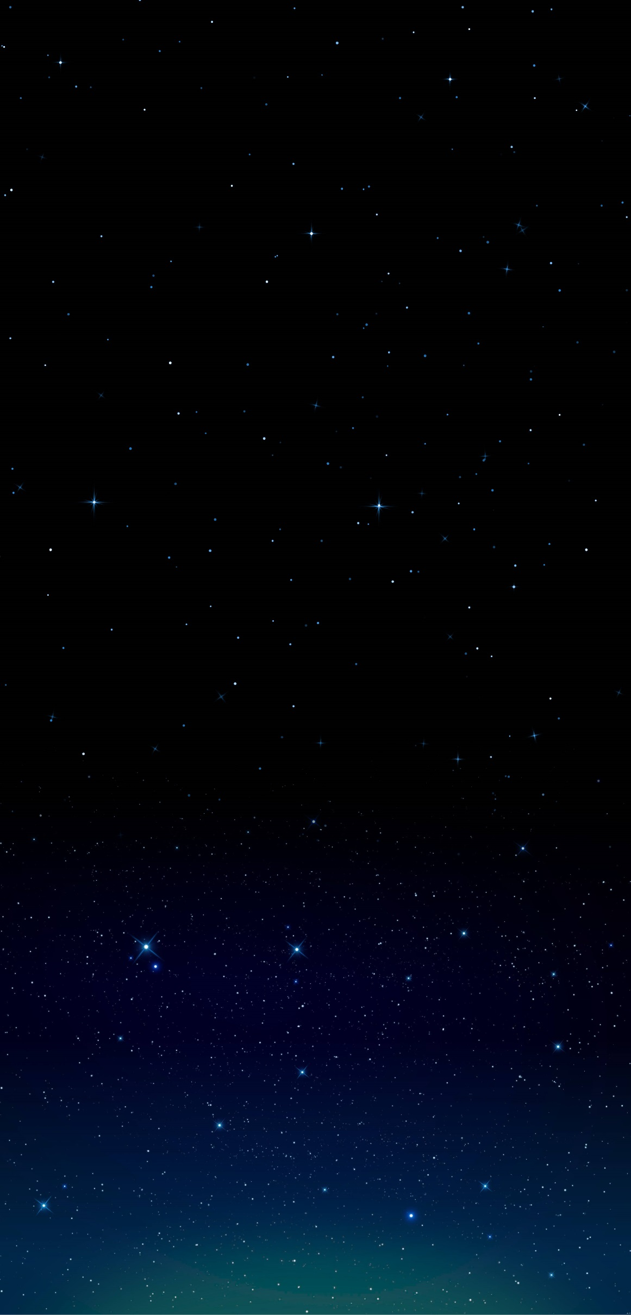
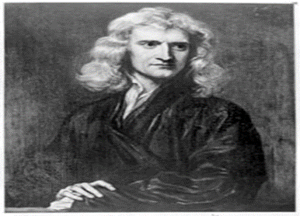
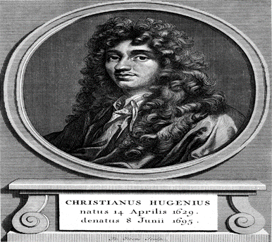
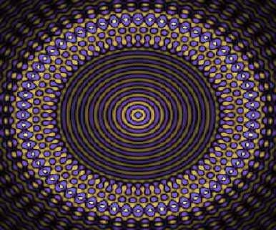
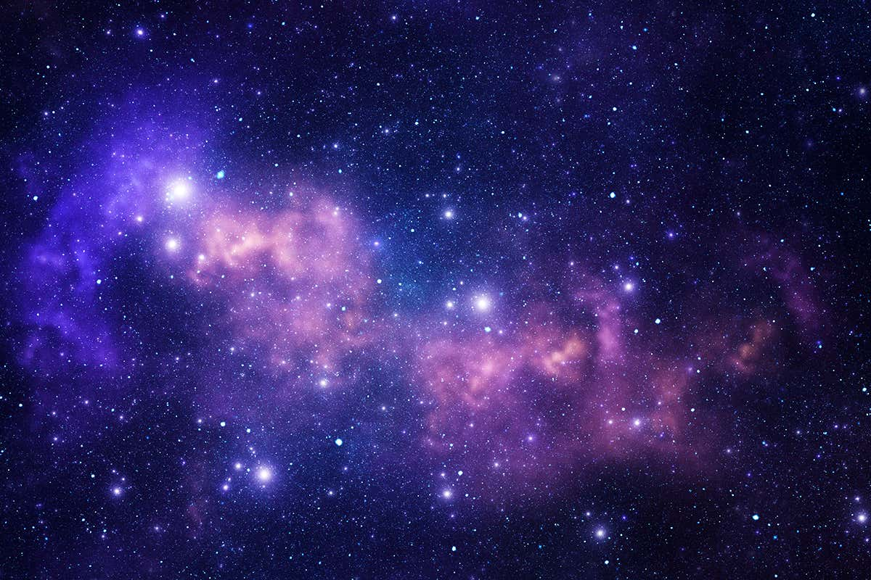
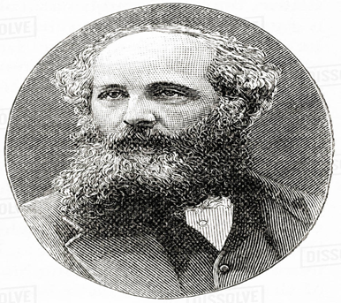
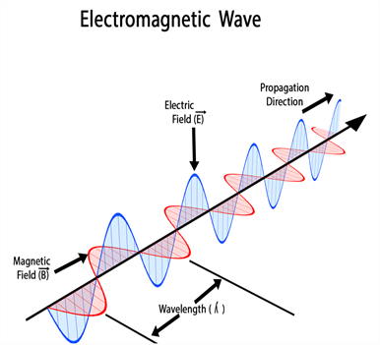
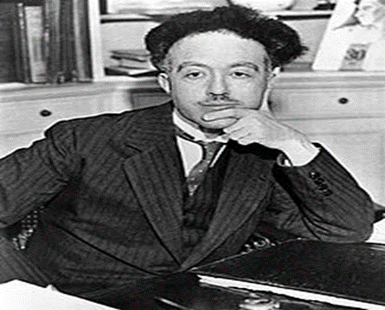
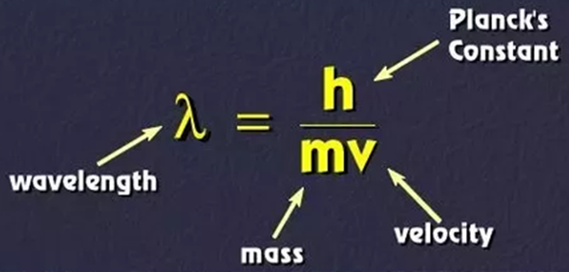
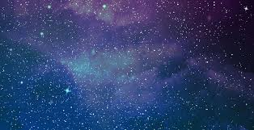
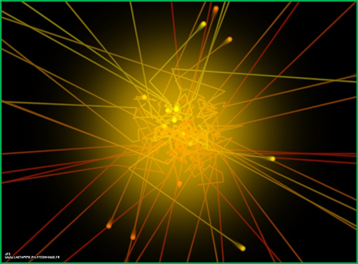
5th International Conference on Particle Physics and Astrophysics.
ICPPA-2020, Russia,
5-9 October 2020 Online,
Rest mass and energy of photon in the form of complex number.
Mr. Mahendra Goray
mgoray92.res@pondiuni.edu.in
Department of Physics, Pondicherry University, INDIA
Abstract
Methods
The behavior of a photon is strange. It possesses both wave nature and particle nature. Some experiments show both behaviors of photons can coexist simultaneously, while some other experiment state that both properties do not coexist simultaneously. According to electromagnetic theory, the rest mass of photon in free space is zero and also photon has non zero rest mass, as well as wavelength-dependent. The very recent experiment revealed its non-zero value is 10^ (-51) g. Even experimental results concluded within matter (dispersive) shows its imaginary rest mass. We have no exact answer as to why photon incarnates itself with versatile mass. Here we try to theoretically investigate about the rest mass of a photon when it touches the surface of matter, it makes illusion and mathematically the rest mass is a complex number that mass dubbed illusive mass. Rest mass of the photon depends upon scalar curvature of the surface of matter and wavelength of the photon. Photon itself reveals illusion posing with mass because of its dual nature. Corresponding energy of the photon, which imply the unknown form of the energy of the Universe i.e. one of the forms of Dark Energy.
Velocity greater than $c$ :
$c_{w}>c$,
$c_{w}$ is the phase velocity of photon
Einstein’s mass and energy equations :
$$m=\frac{m_{0}}{\sqrt{1−\frac{v^{2}}{c^{2}}}}$$
$$E=mc^{2}$$
3-D Scalar curvature:
$$I^{n}=g^{μν}R_{μν}$$
1. Rest mass of the photon :
$m=m(λ)\sqrt{1−\frac{v_{ph}^{2}}{c^{2}}}$+i$m^{′}$($λ_{p}$)$I^{n}\sqrt{E_{i}^{2}−1}$
$$m_{x}$$
$$m_{y}$$
$m=m_{x}$+i$m_{y}$
$$E_{i}=\frac{c_{w}}{c}$$
Introduction
Results
N Nature of Light
2. Energy of the photon :
$E=m(λ)c^{2}$+i $m^{′}$($λ_{p}$)$c_{y}^{2}I^{n}\sqrt{E_{i}^{2}−1}$
1. Corpuscular Theory
$$E_{x}$$
$$E_{y}$$
$$E=E_{y}+i{ E}_{y}$$
$$c_{y}^{2}=c^{2}+\frac{c_{p}^{2}}{2}$$
2. Wave Theory
Conclusions
$$⨂$$
Mathematically rest mass and energy of photons is complex number when comes in contact with the surface of matter.
3. Electromagnetic Theory
Mass and energy of photon depends upon scalar curvature of the surface of matter and wavelength of the photon.
Photon itself reveals illusion posing with mass and hides its energy on the surface of matter because of wave-particle duality.
De Broglie Hypothesis
References
Acknowledgements
Goray, Mahendra, and Ramesh Naidu Annavarapu. "Rest mass of photon on the surface of matter." Results in Physics 16 (2020): 102866.
DOI:10.1016/j.rinp.2019.102866
Thanks to supervisor Dr. A.R. Naidu for encouragement and support for research work. Also want to acknowledge CSIR-UGC for providing scholarship.
Mass posing as light
1. Real Rest Mass
de Broglie assumed : 10^(−50) 𝑔 recent experimental value: 10^(−54) 𝑔
2. Zero Rest Mass
3. Imaginary Rest Mass

