Slide 1
Planacon XP85002/FIT-Q MCP-PMTs for the ALICE FIT detector
Yury Melikyan, on behalf of the ALICE collaboration
Institute for Nuclear Research of the Russian academy of science, Moscow
October 5-9, 2020
The 5th International conference on particle physics and astrophysics, NRNU MEPhI

Slide 2
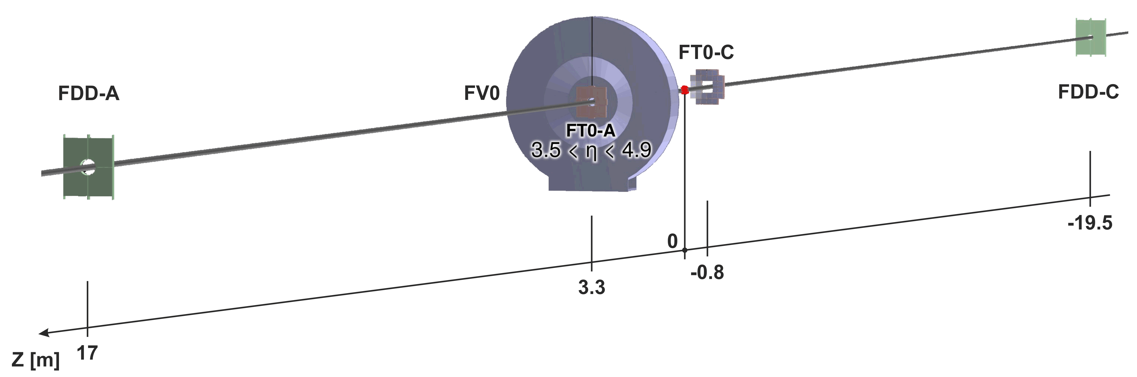
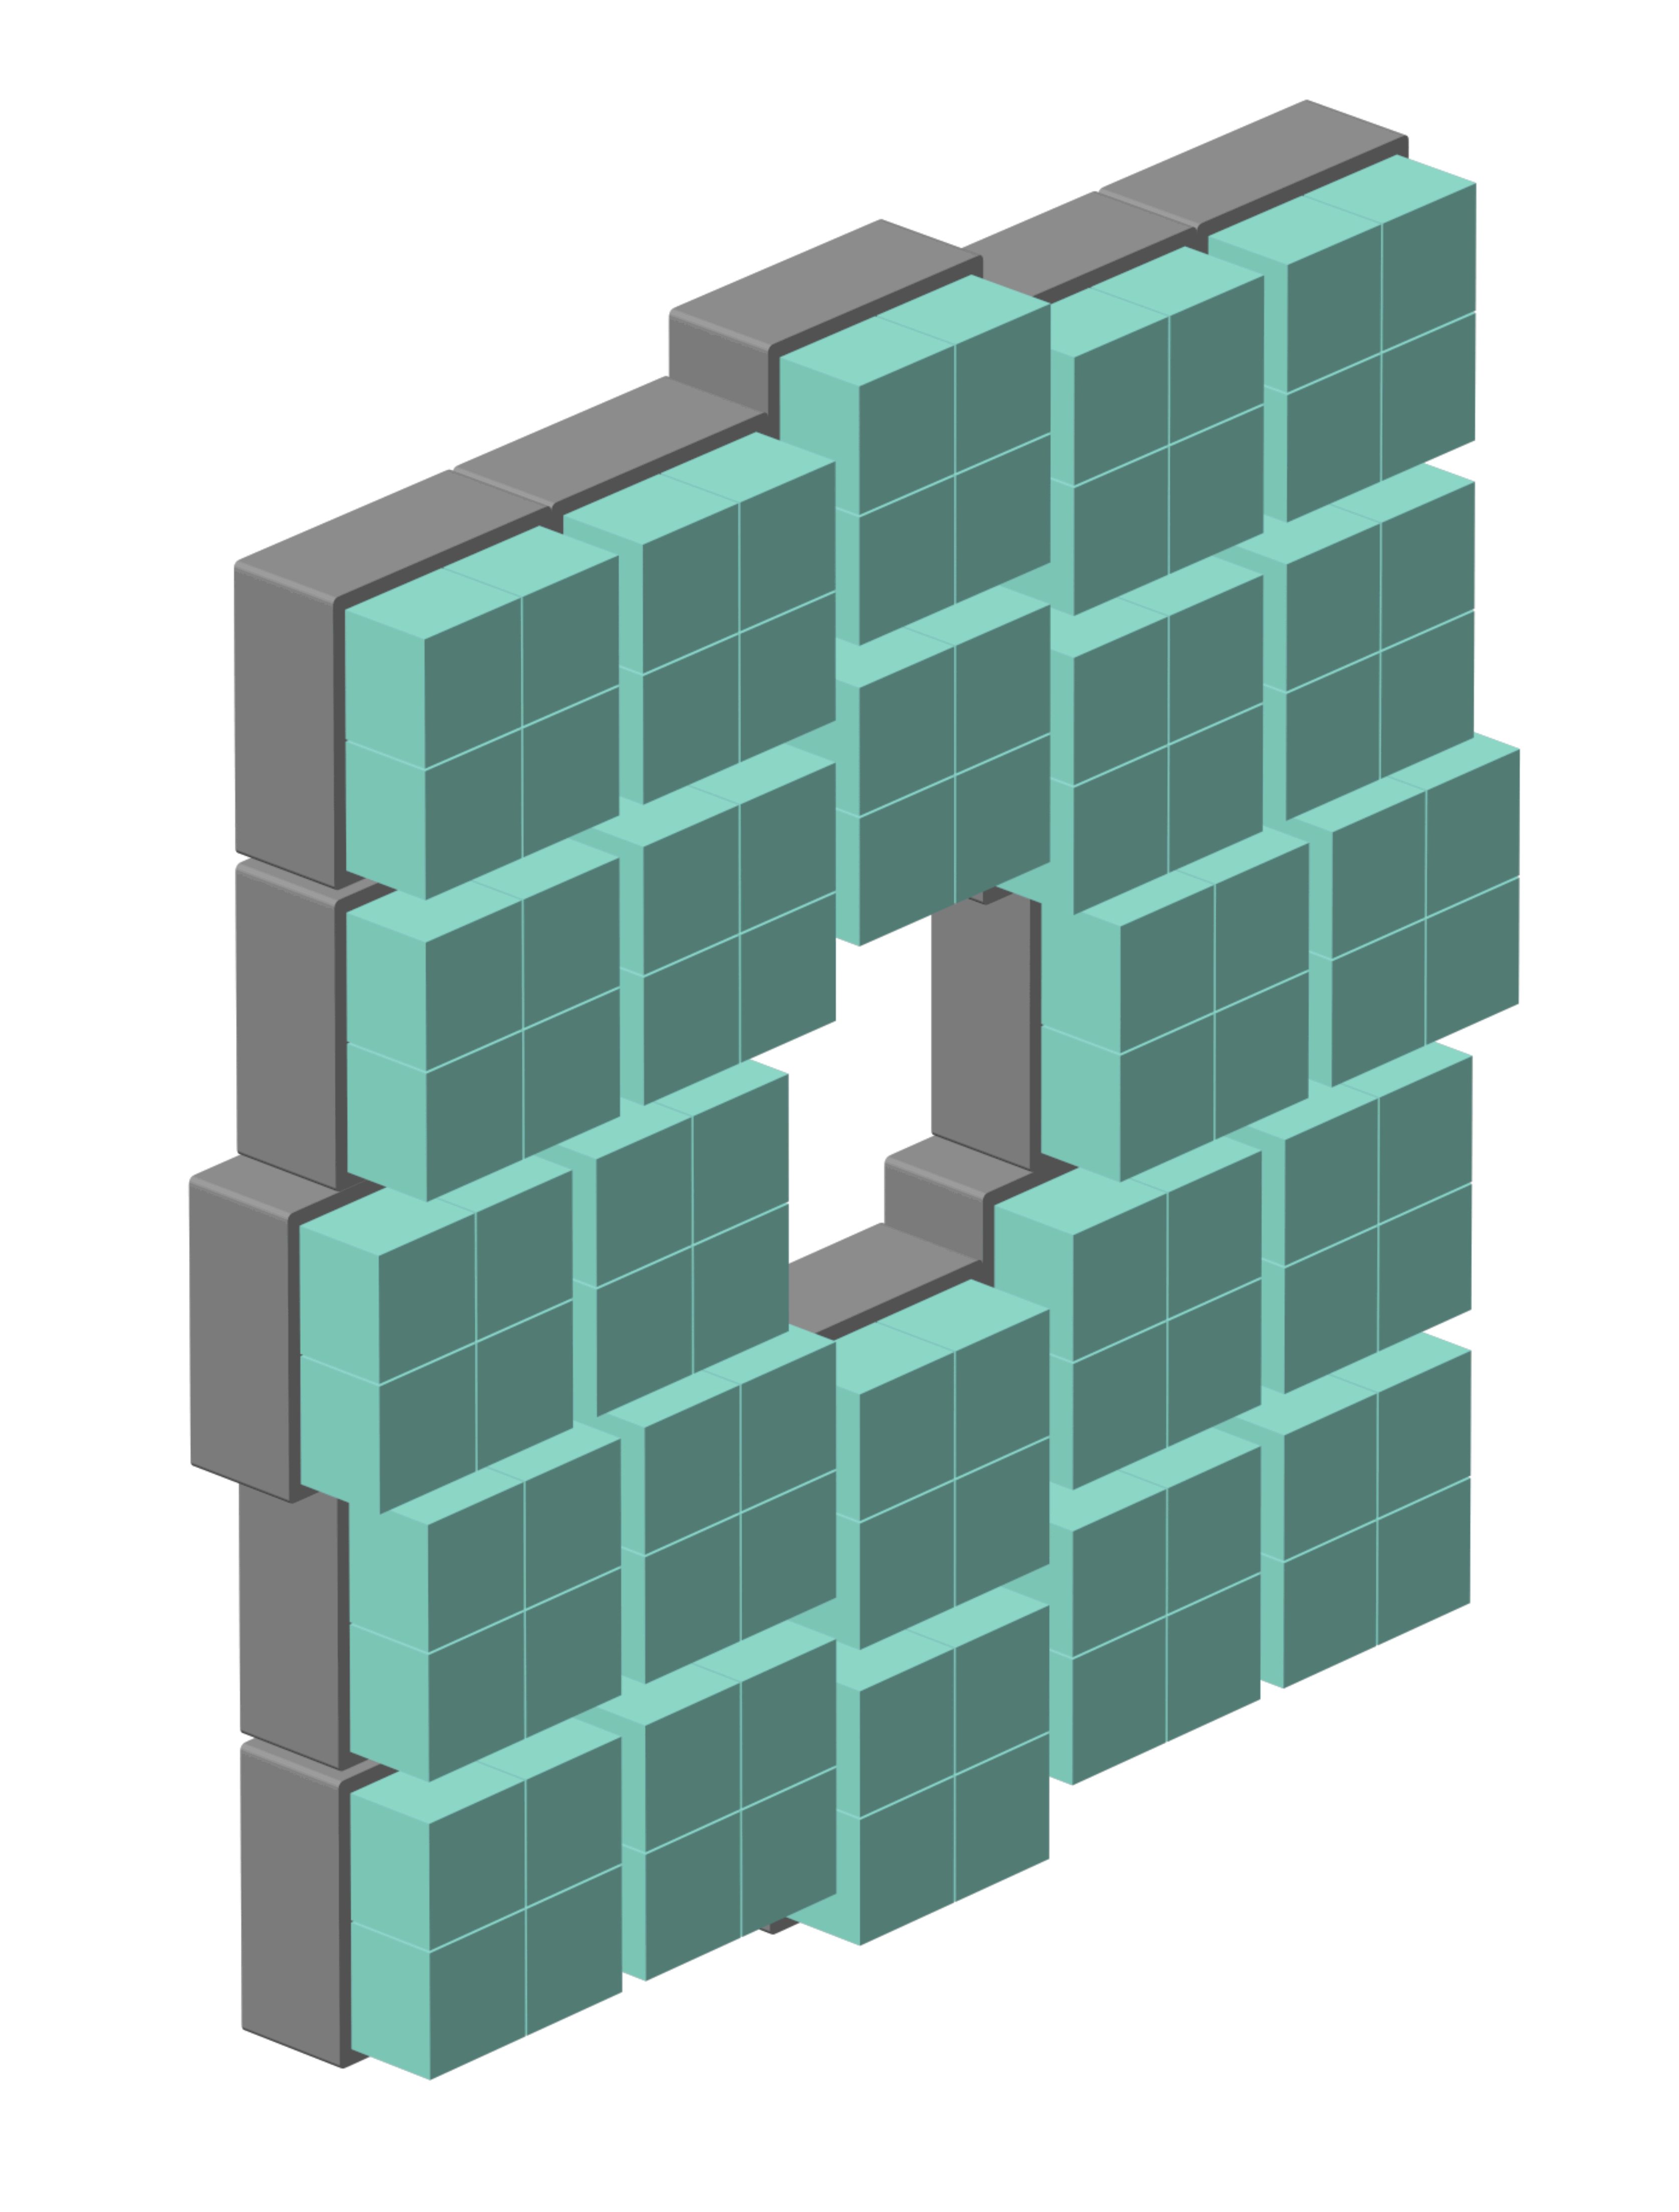
The Fast Interaction Trigger (FIT) of ALICE
A set of scintillation (FV0, FDD) and Cherenkov (FT0) detectors:
Main trigger detector and luminometer;
Collision time detector for TOF PID;
Multiplicity detector, etc.
Further details presented by A. Mayevskaya in the previous talk*.
(IP)
FT0 consists of 52 Cherenkov modules composed in two arrays on both sides of the IP (A- and C-side);
Each Cherenkov module uses a 2 cm-thick quartz radiator and a microchannel plate-based PMT (MCP-PMT);
Strict limit on the detector thickness (92 mm) and radiation tolerance (~10¹³ n_{eq}/cm²) in 0.5 T B-field – use of no other fast PMT type feasible;
*https://indico.particle.mephi.ru/event/35/contributions/2304/
October 5-9, 2020
The 5th International conference on particle physics and astrophysics, NRNU MEPhI
2

Slide 3
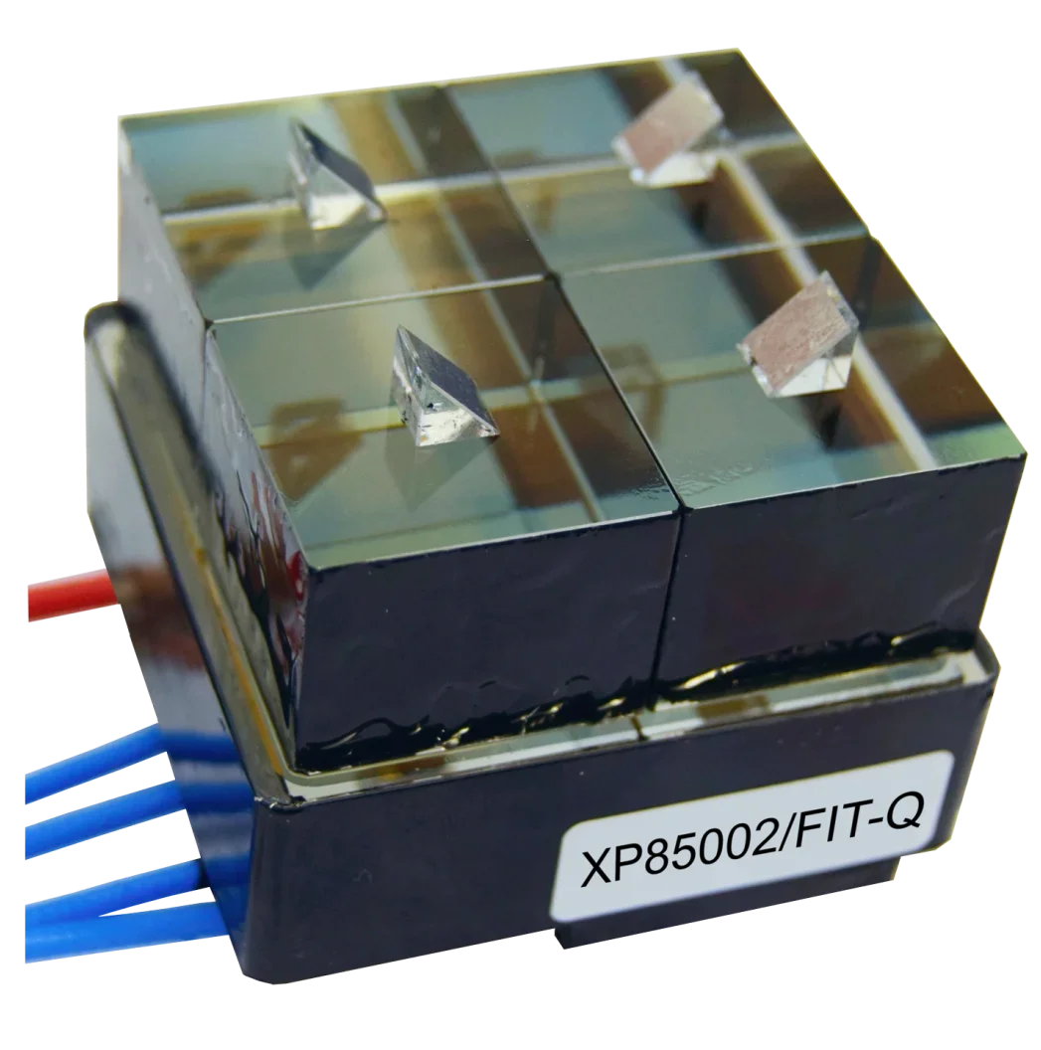
MCP-PMTs for FT0 Cherenkov modules
Due to the optimal price and sizing, multi-anode Planacon MCP-PMTs produced by Photonis are the photosensors of choice for FT0.
For the best timing and efficiency, each PMT is segmented by four readout channels – 208 channels in total.
Backplane wiring of the off-the-shelf Planacons is not optimized for the precise timing measurements (cross-talk problems*).
To solve this problem, our group has modified the PMT backplane circuitry*. FT0 will use this customized XP85002/FIT-Q version.
*https://doi.org/10.1016/j.nima.2018.12.004
October 5-9, 2020
The 5th International conference on particle physics and astrophysics, NRNU MEPhI
3

Slide 4
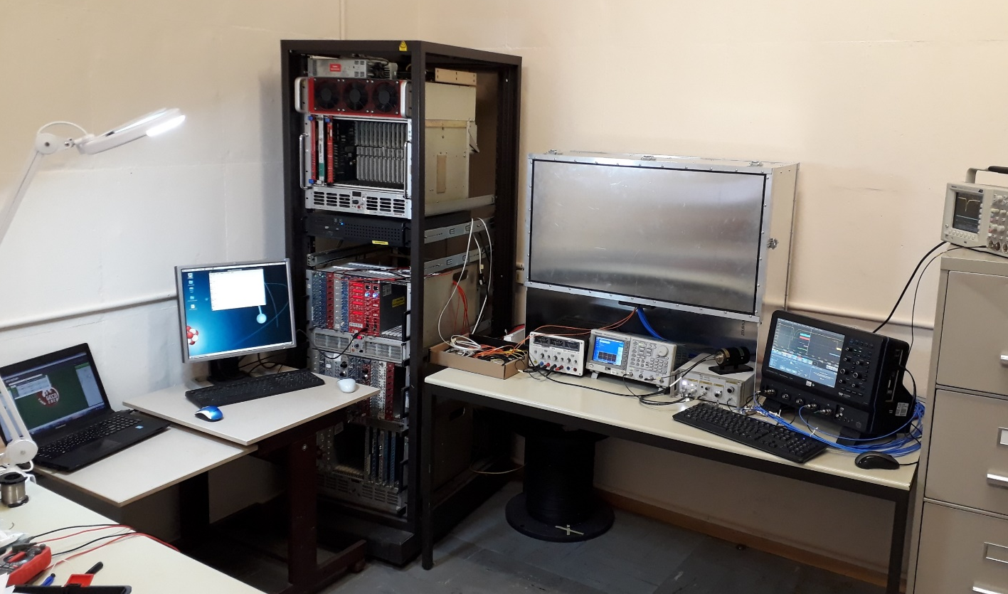
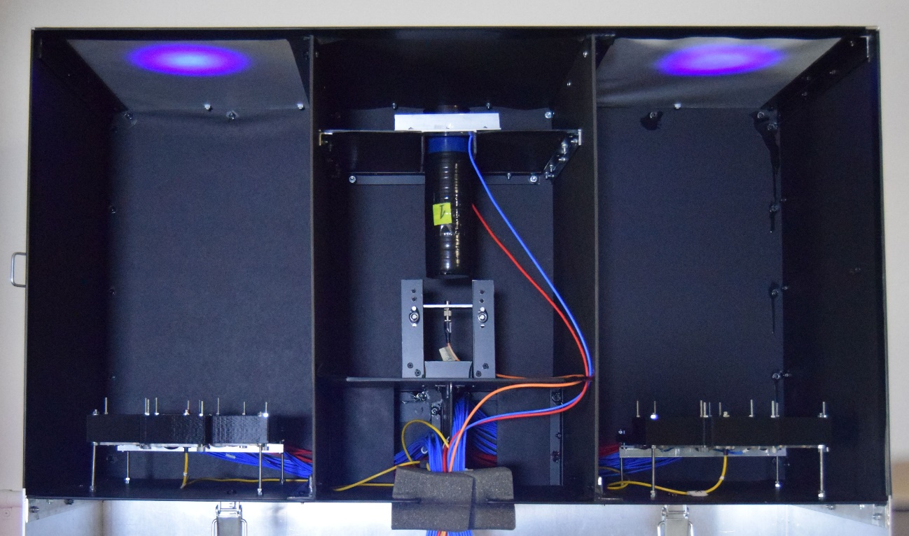
The test bench
66 Planacons for FIT were delivered to CERN in 2018-2019 (the whole production took ~1 year);
Each device was characterized in the dedicated test bench at CERN.
Interior of the light-tight box
October 5-9, 2020
The 5th International conference on particle physics and astrophysics, NRNU MEPhI
4

Slide 5
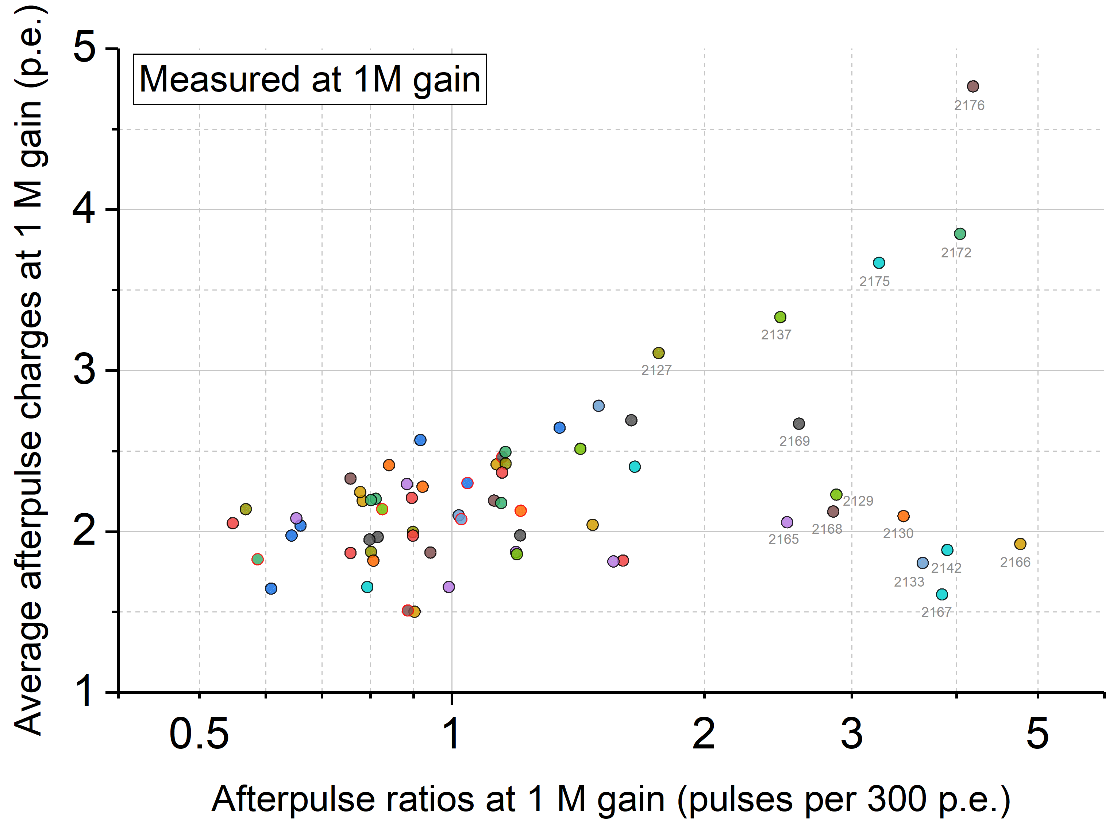
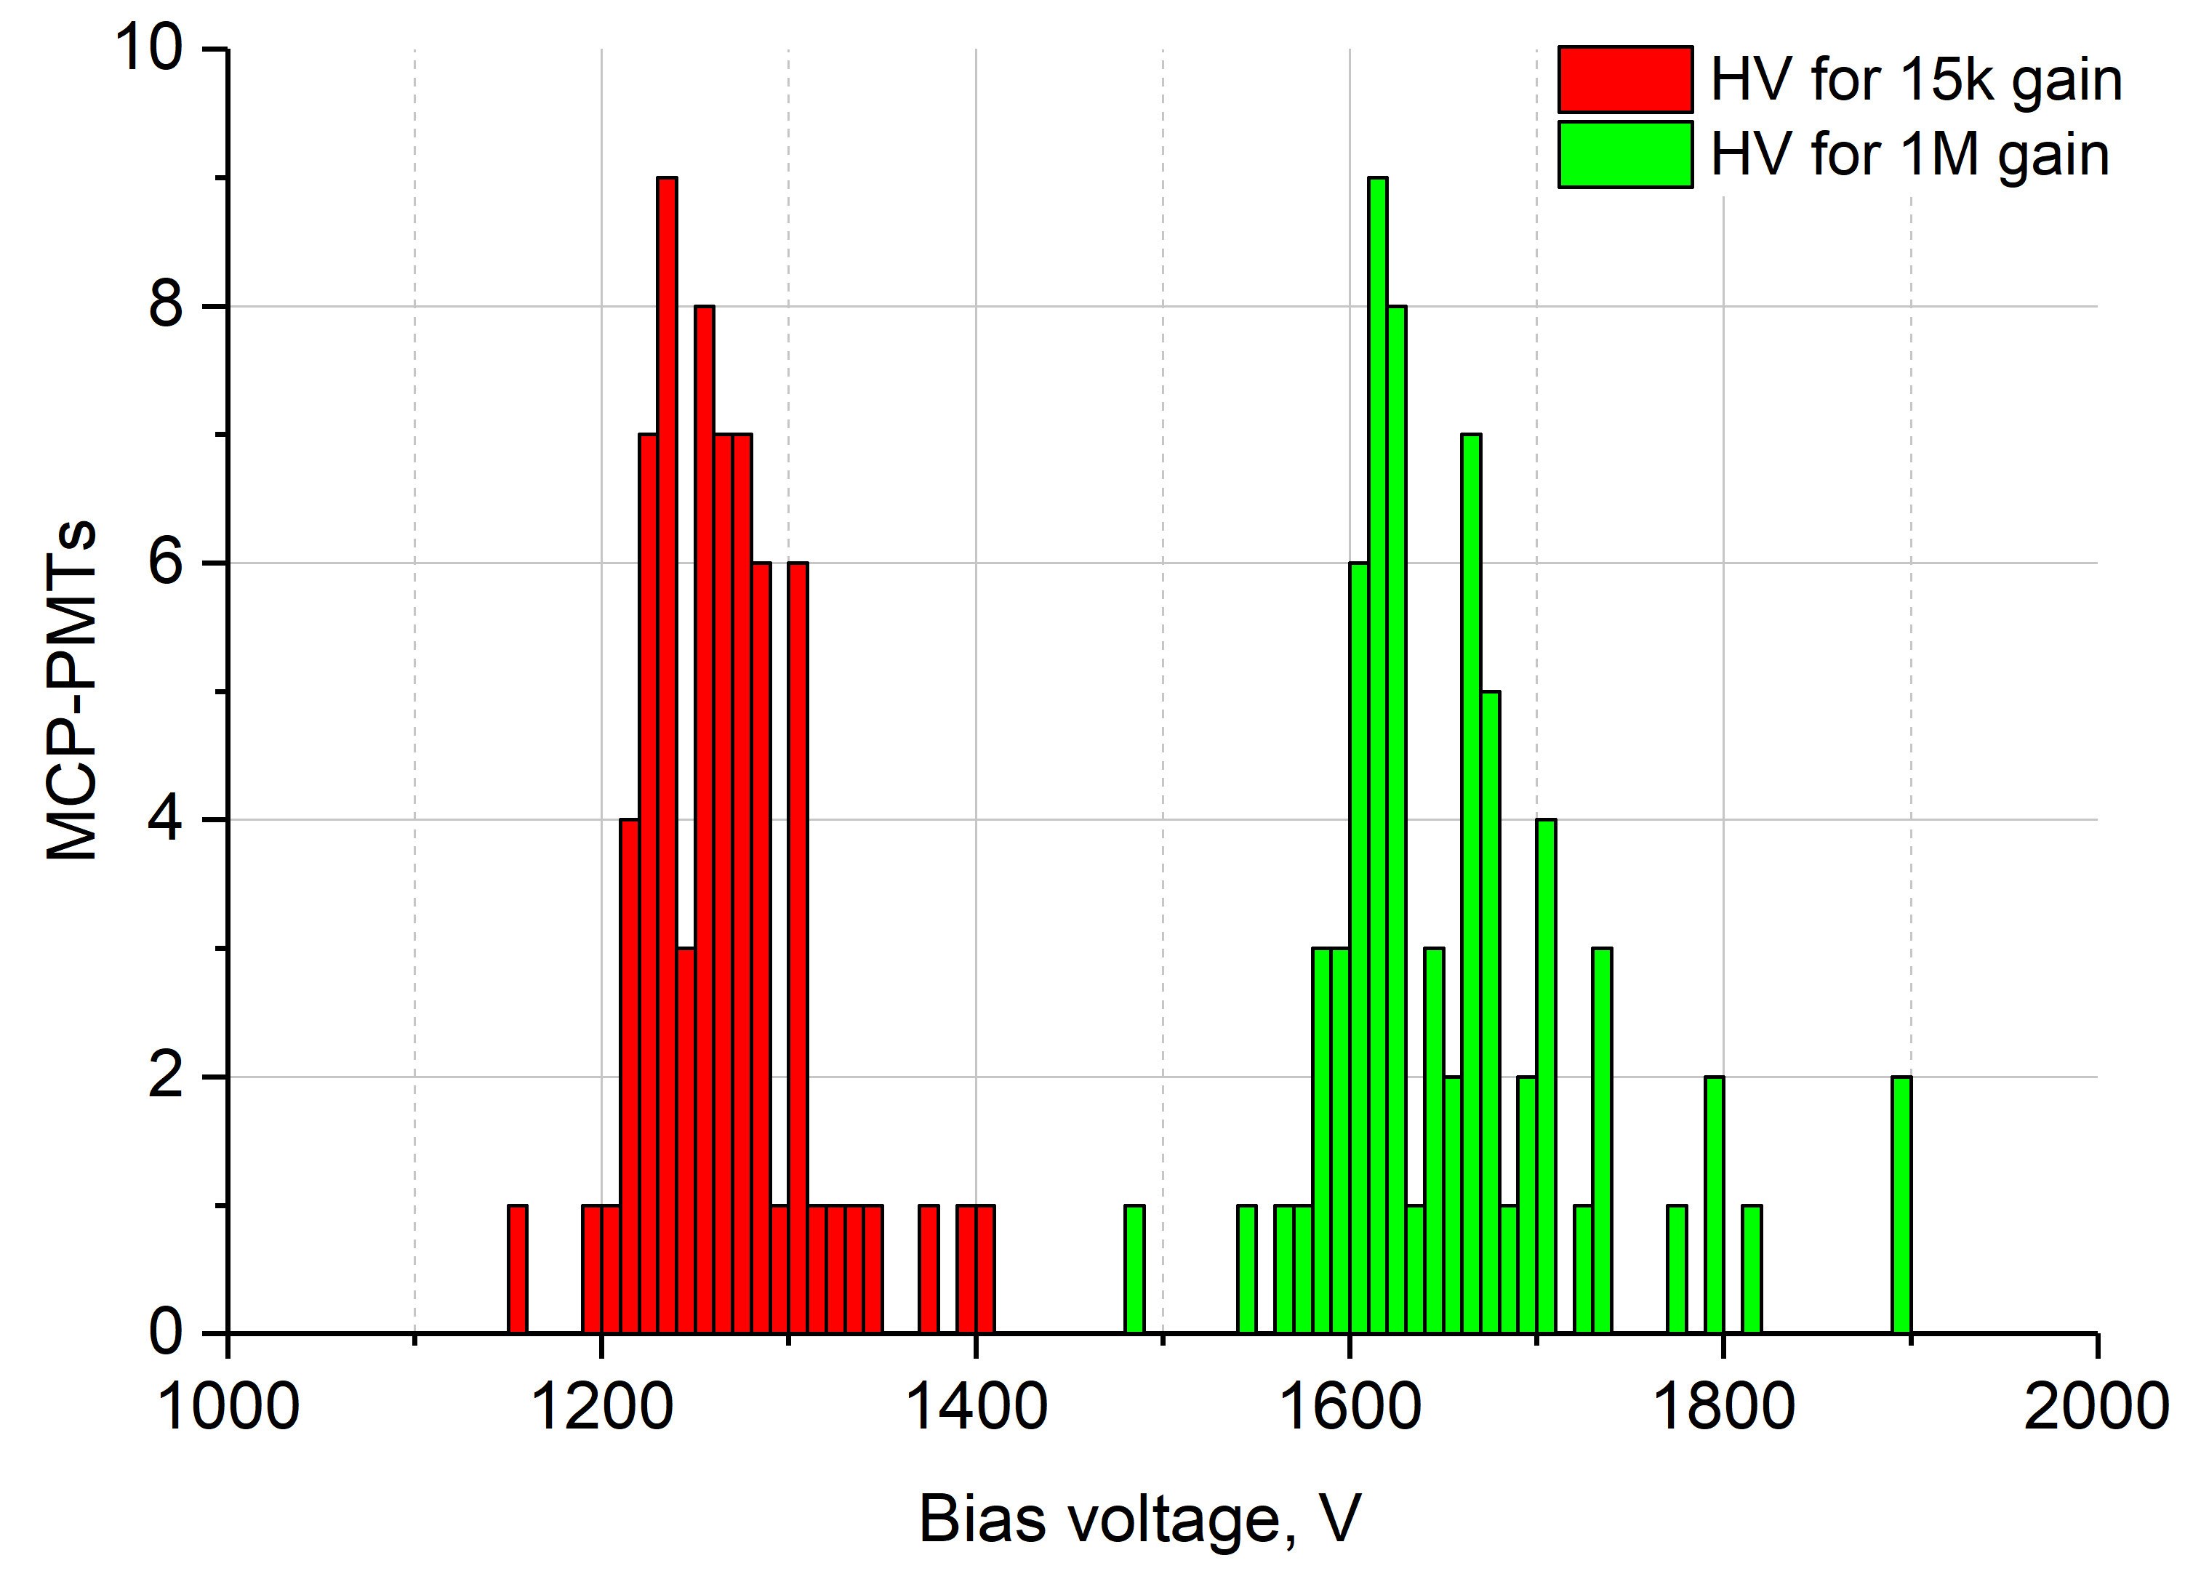
Basic characteristics
Atypically low bias voltage for a given gain:
1630 ± 45 V for 10⁶ electron gain;
1260 ± 35 V for 1.5*10⁴ electron gain (default for FIT);
Other MCP-PMTs require a bias voltage higher by 40…100% *;
Low bias voltage is profitable for the afterpulsing and HV stability;
~0.2…2 % of detected photons are followed by an afterpulse with an average amplitude of ~2 p.e at 1 M gain.
* https://doi.org/10.1016/j.nima.2020.164591
October 5-9, 2020
The 5th International conference on particle physics and astrophysics, NRNU MEPhI
5

Slide 6
Load capacity
ALICE operation in a high-rate (50 kHz) Pb-Pb mode is very demanding on the FT0 PMTs’ load capacity. Average anode current (AAC) ≳7 µA is expected for the inner MCP-PMTs, while standard Planacons are limited by 3 µA.
Load capacity is limited by the MCP strip current. Because of this, lower-resistance MCPs produce better linearity. On the other hand, too low resistance may lead to the device overheating.
12 MΩ ≤ R ≤ 22 MΩ microchannel plates were requested for FIT PMTs. Standard Planacons are equipped with 35…70 MΩ plates; AAC saturation curves were measured for each Planacon.
October 5-9, 2020
The 5th International conference on particle physics and astrophysics, NRNU MEPhI
6

Slide 7
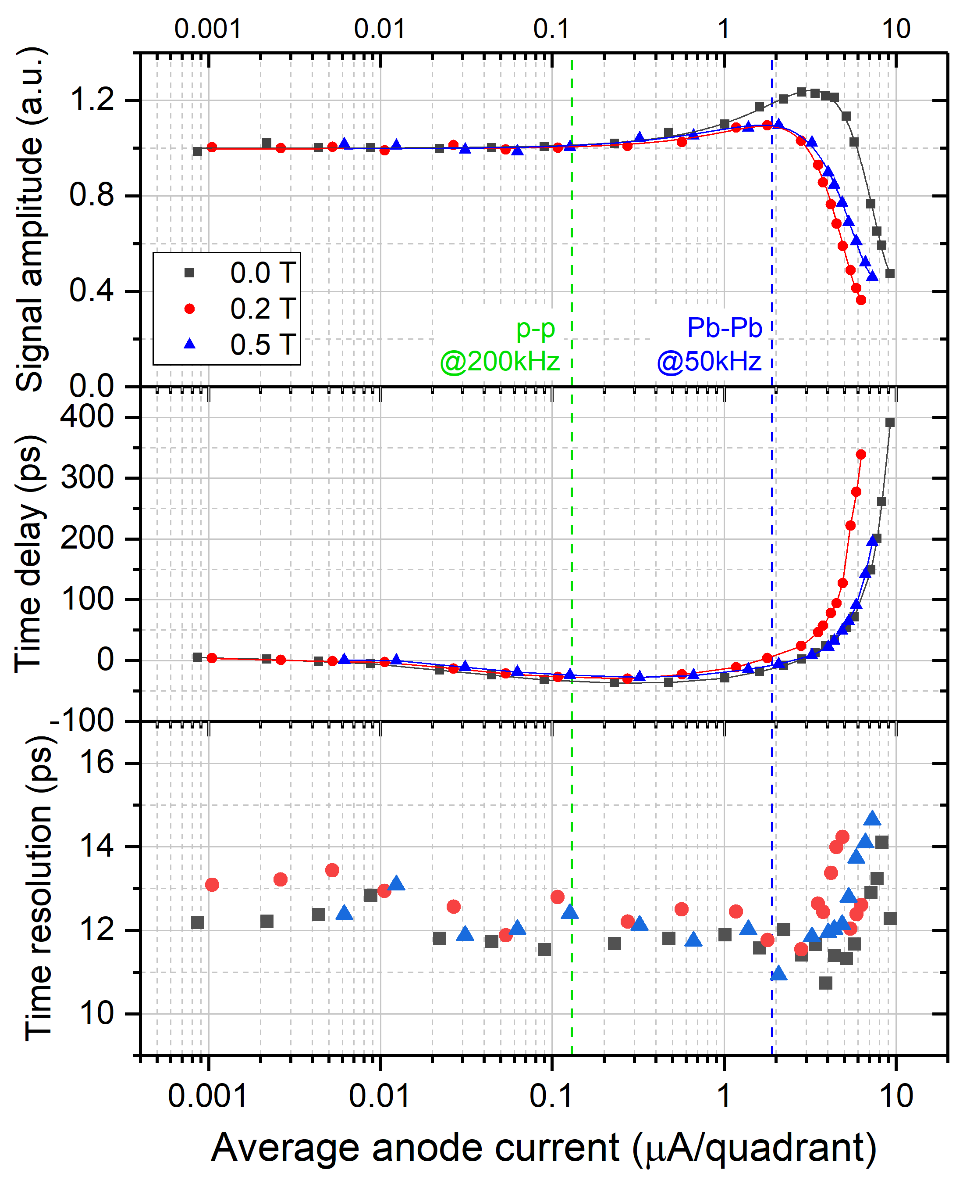
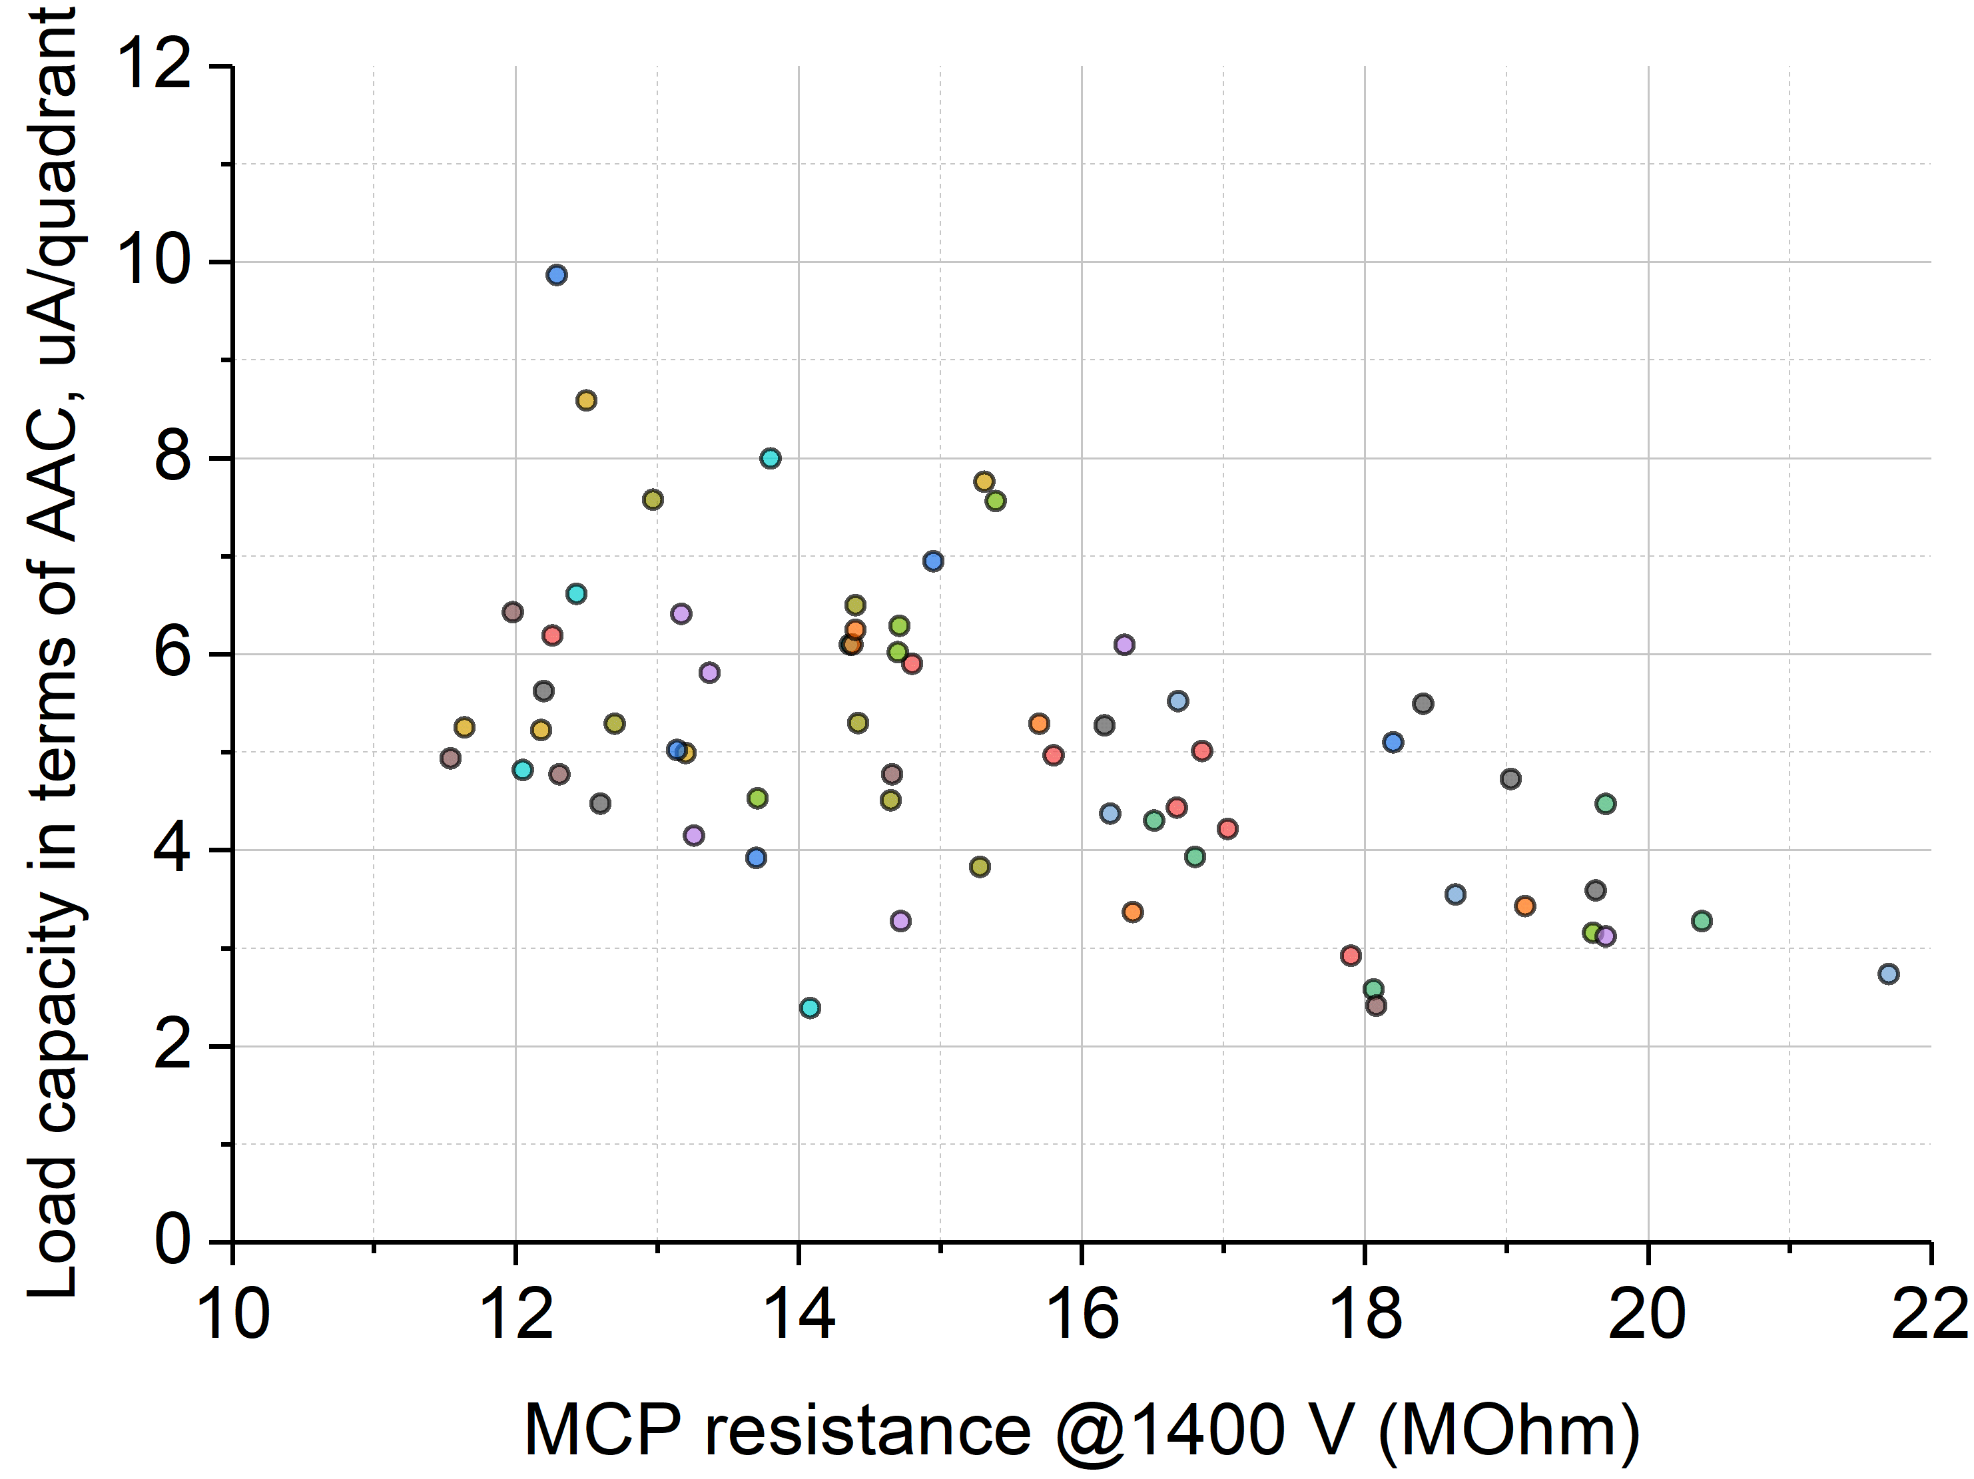
Load capacity
Linearity of the Planacons for FIT is broken at 2…10 µA/quadrant (8…40 µA/device);
This limit is further decreased by 15…50% in a strong magnetic field of B=0.5 T.
October 5-9, 2020
The 5th International conference on particle physics and astrophysics, NRNU MEPhI
7

Slide 8
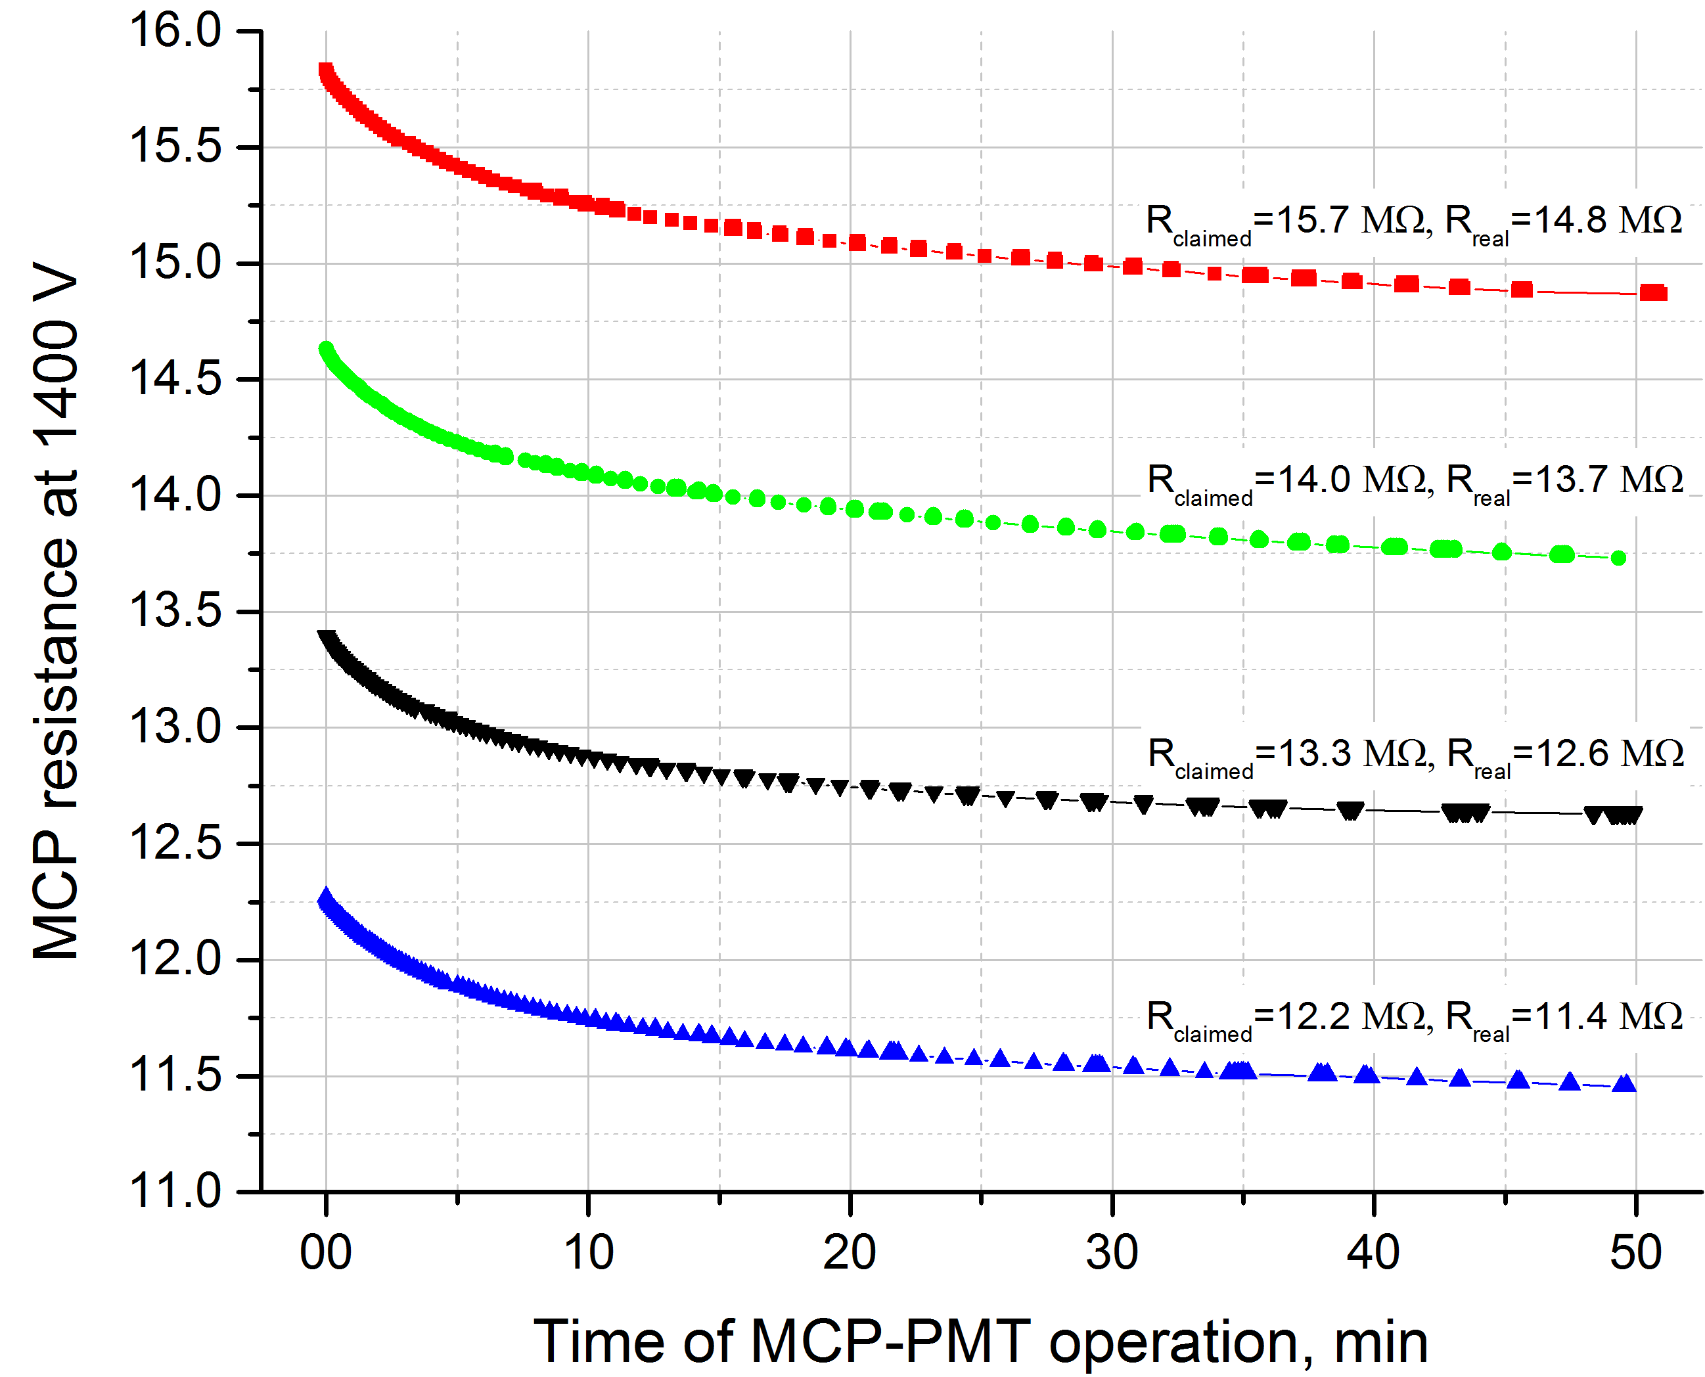
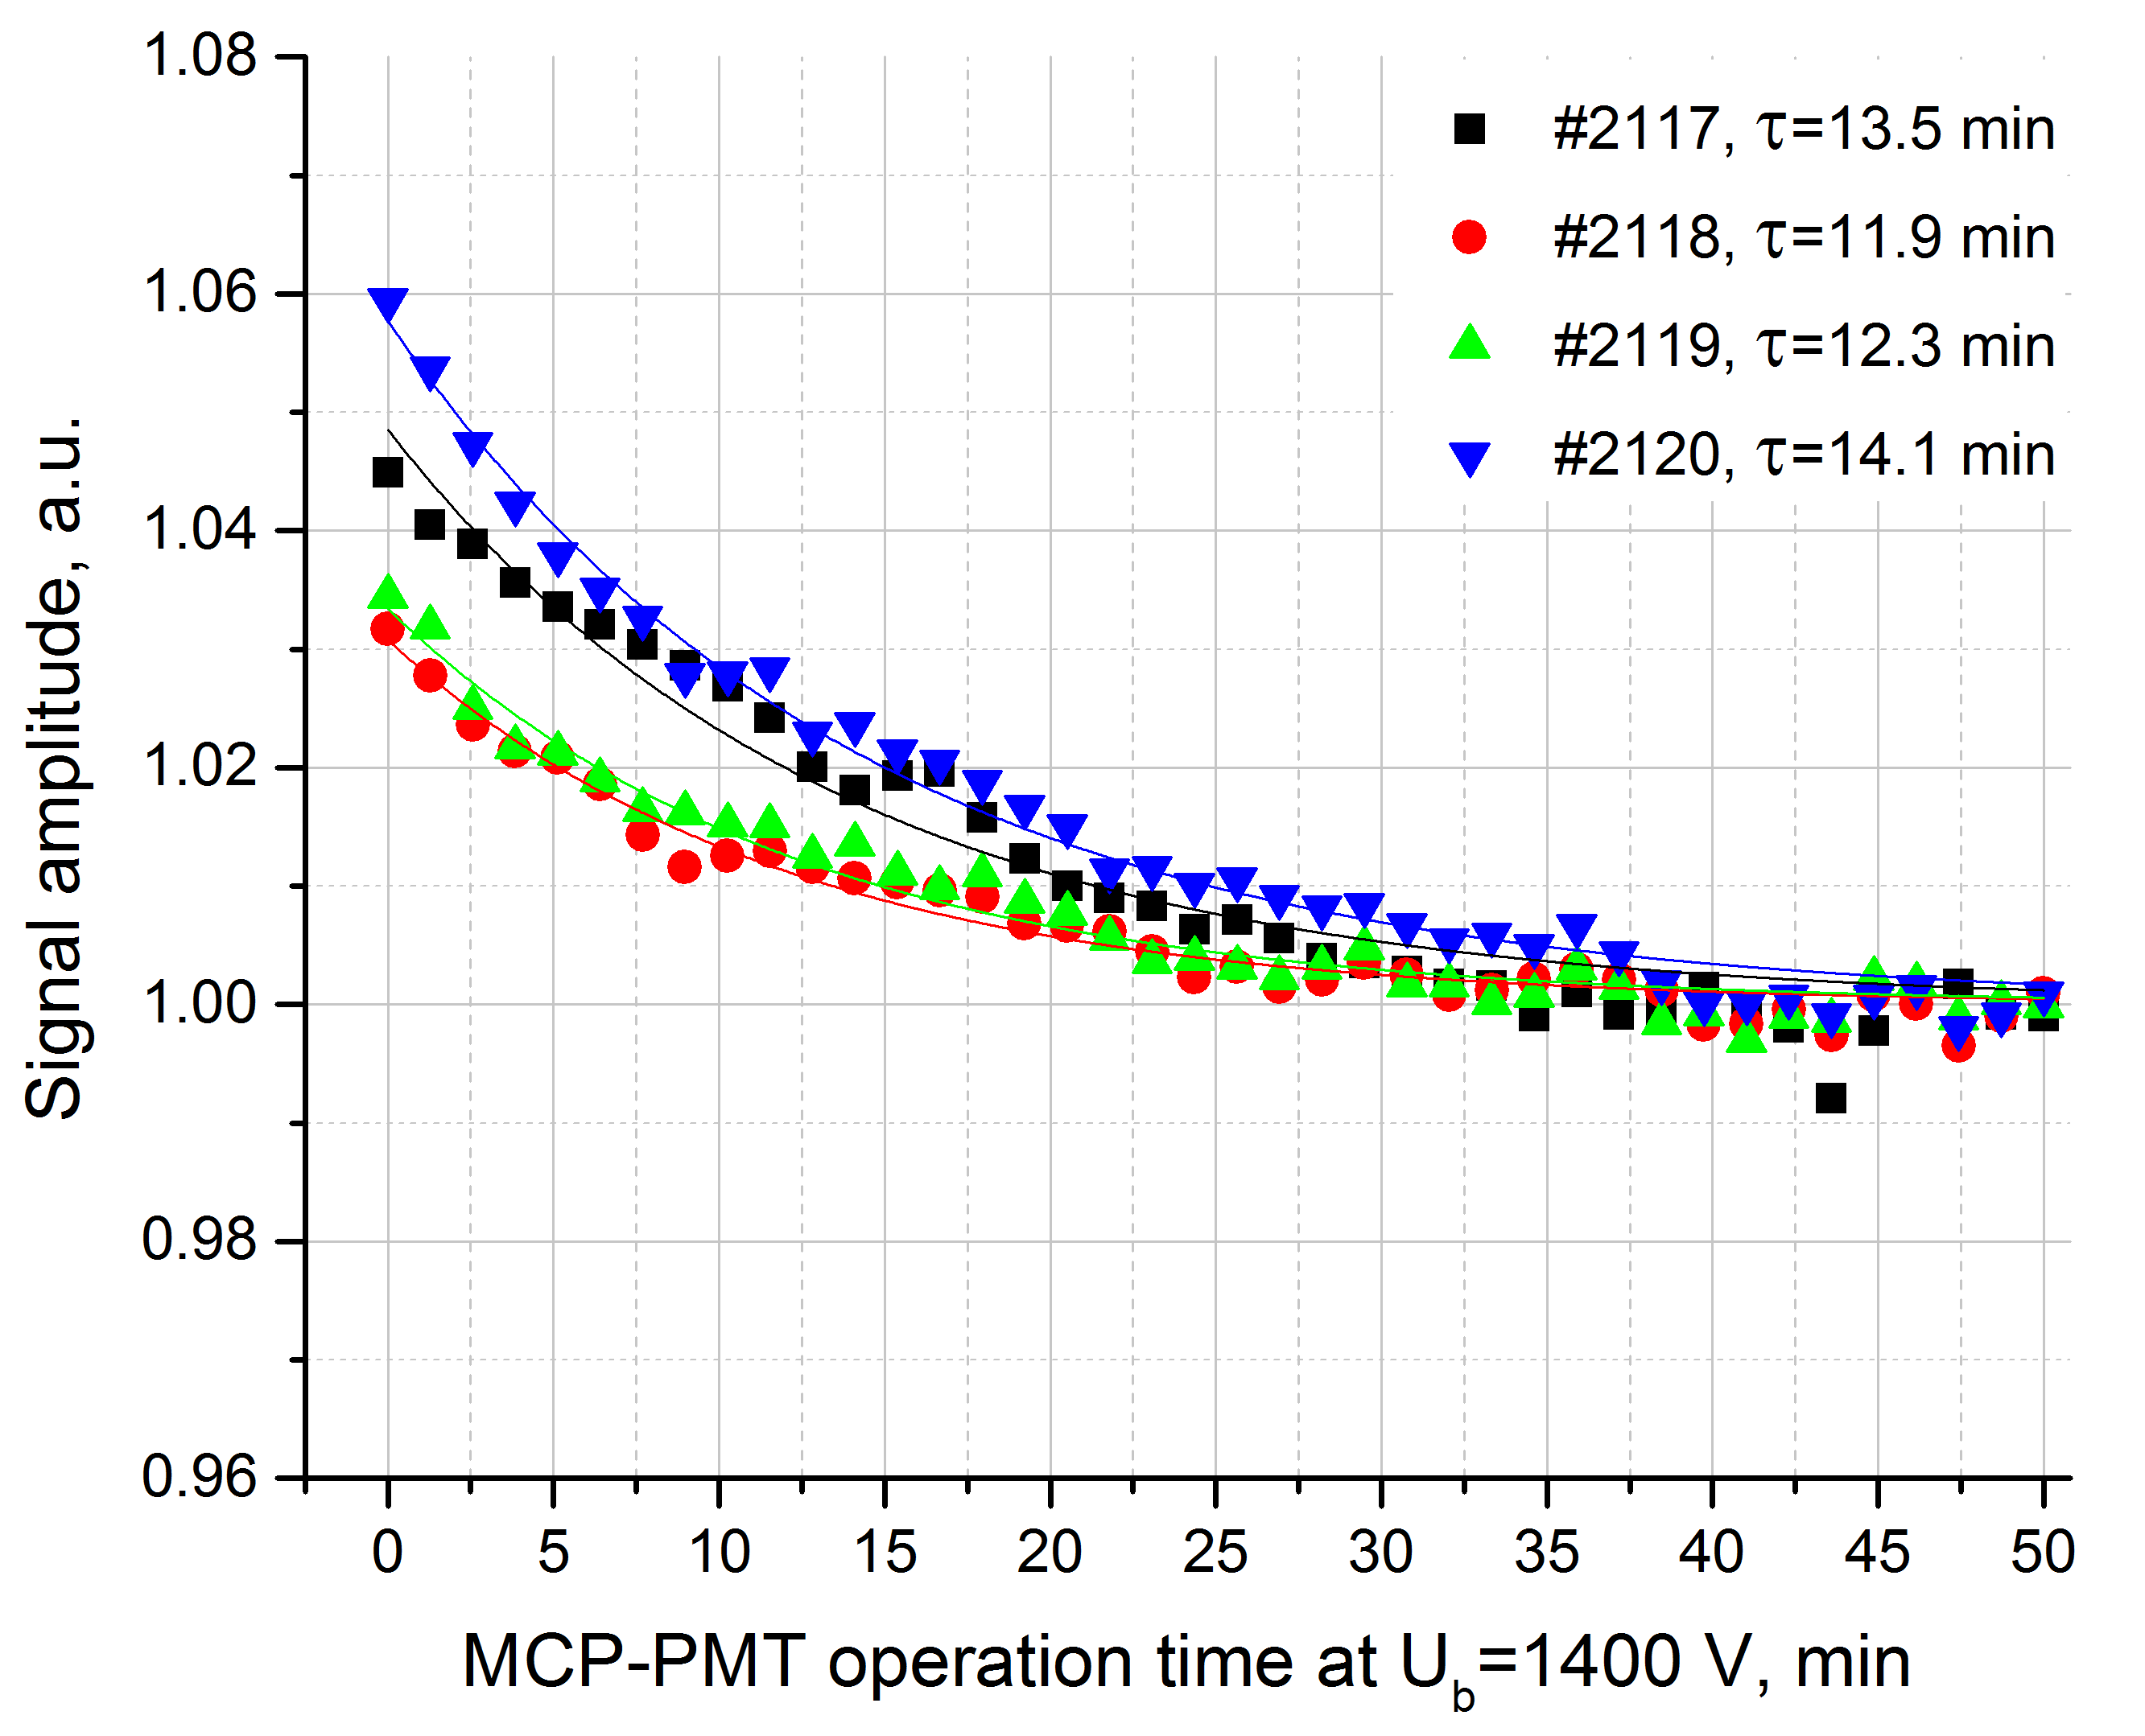
Warm-up effects
The reduced MCP resistance leads to detectable warm-up effects:
Decrease in the MCP conductive layer resistance → decrease in voltage across the MCP → decrease in the MCP-PMT gain.
Although, the gain variation is limited to few % only, it lasts <30 min after the ramp-up.
October 5-9, 2020
The 5th International conference on particle physics and astrophysics, NRNU MEPhI
8

Slide 9
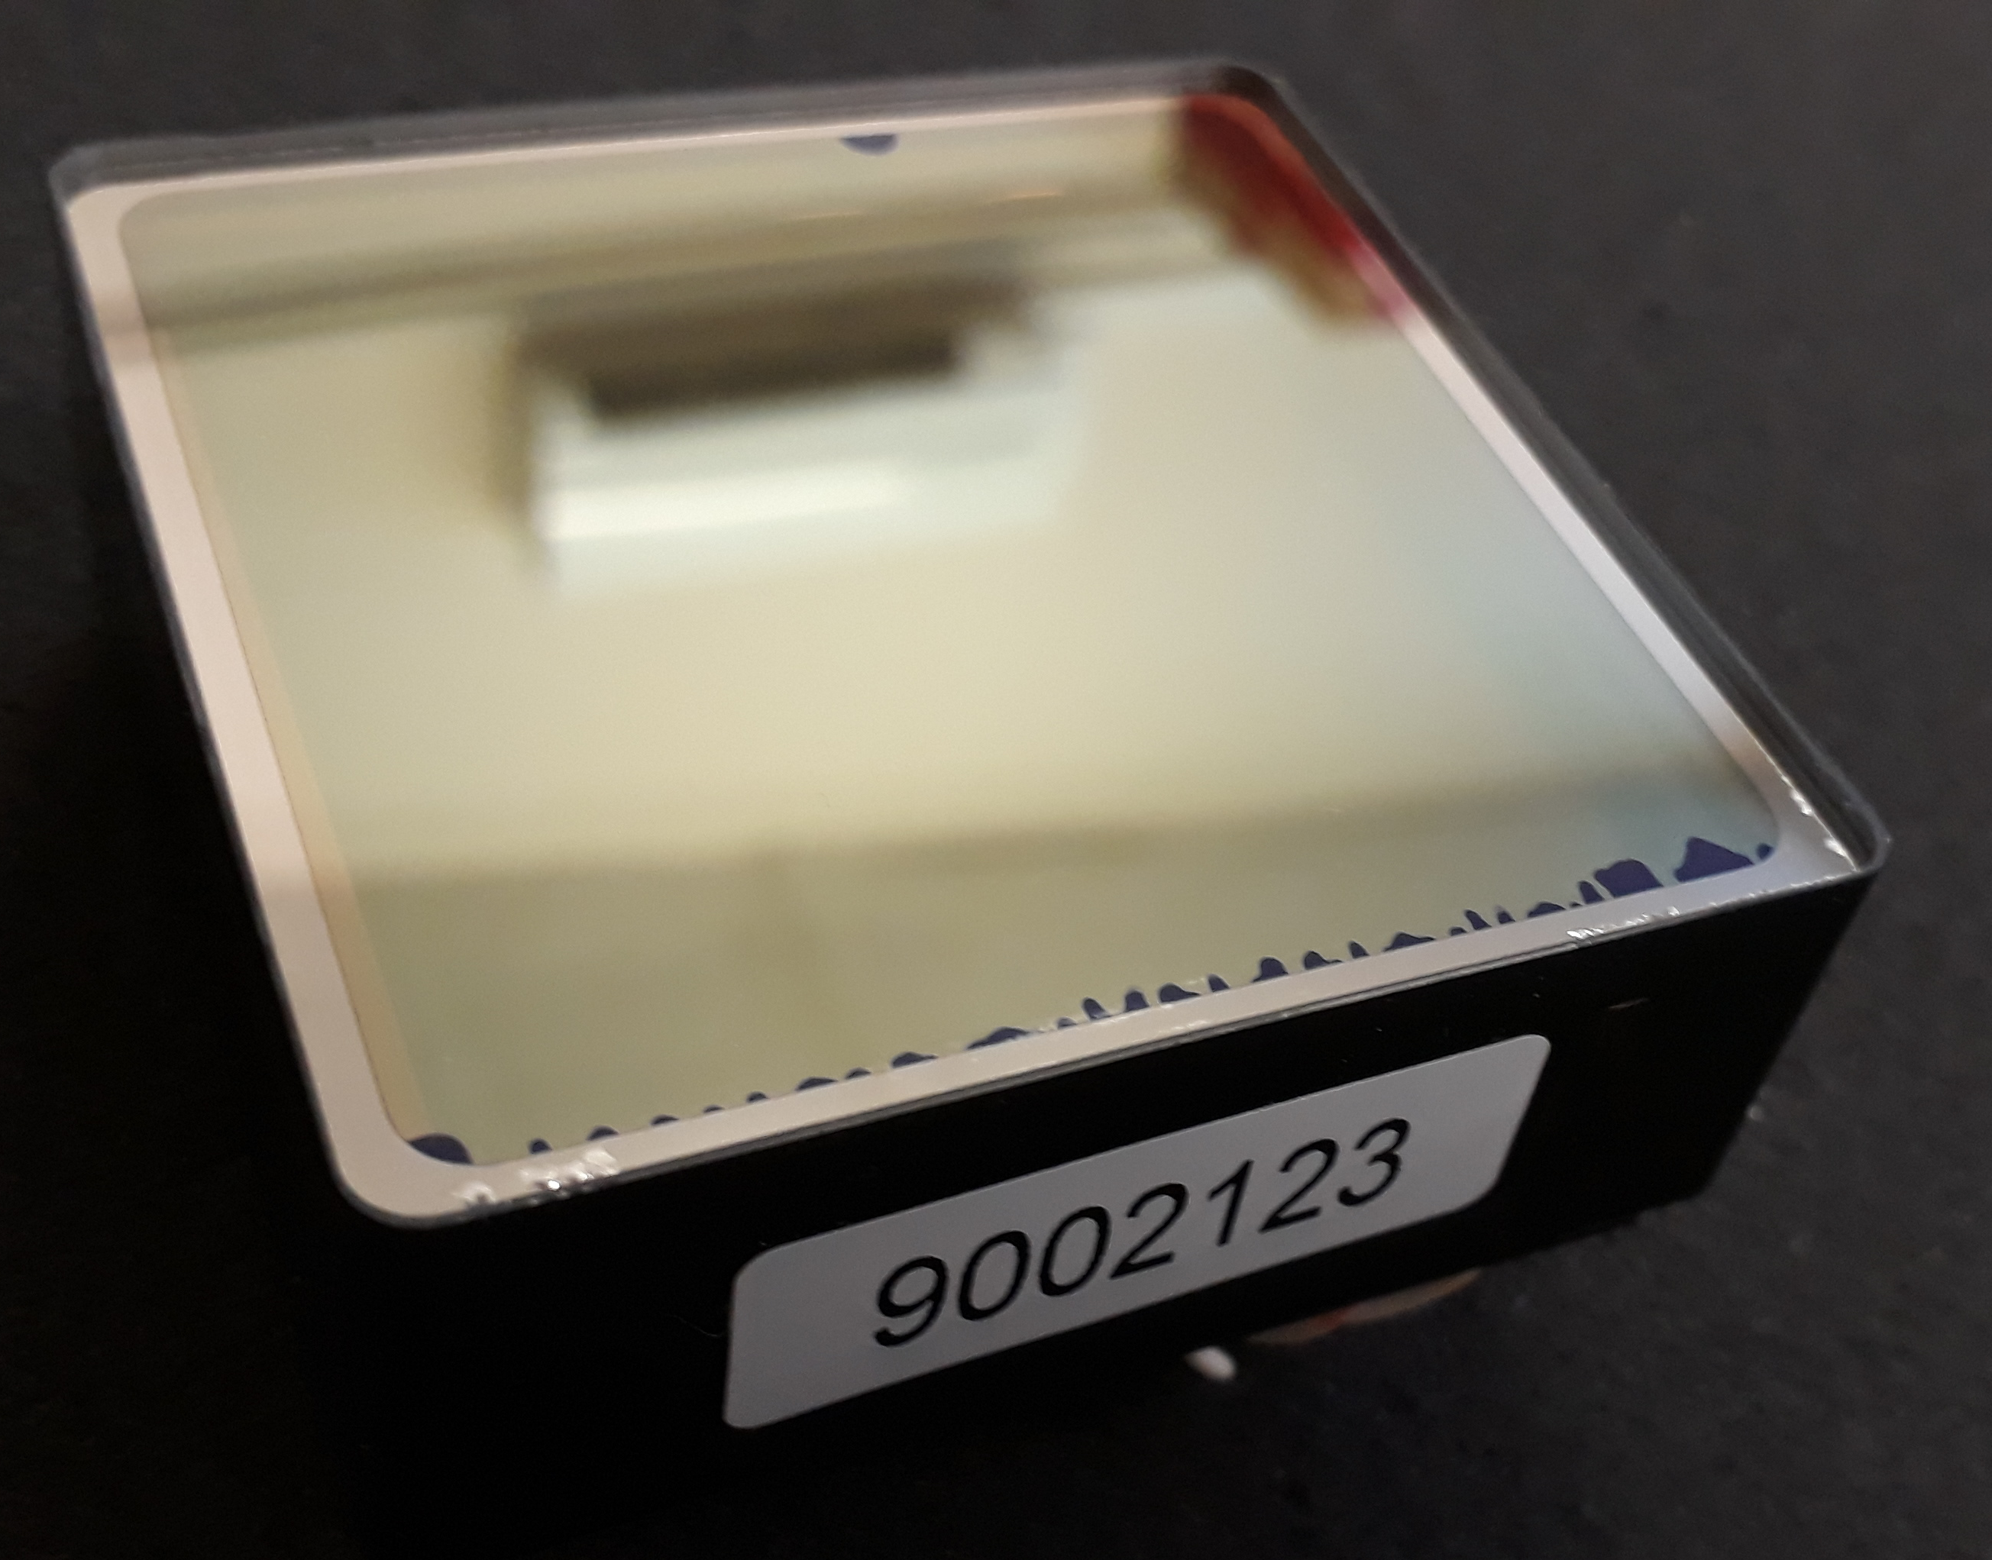
Issues discovered
Visible problems with the entrance window:
Photocathode edge damaged by indium sealing in a dozen of PMTs – appeared to be a cosmetic flaw only;
Damaged quartz window – replaced by Photonis;
Damaged sealing area.
October 5-9, 2020
The 5th International conference on particle physics and astrophysics, NRNU MEPhI
9

Slide 10
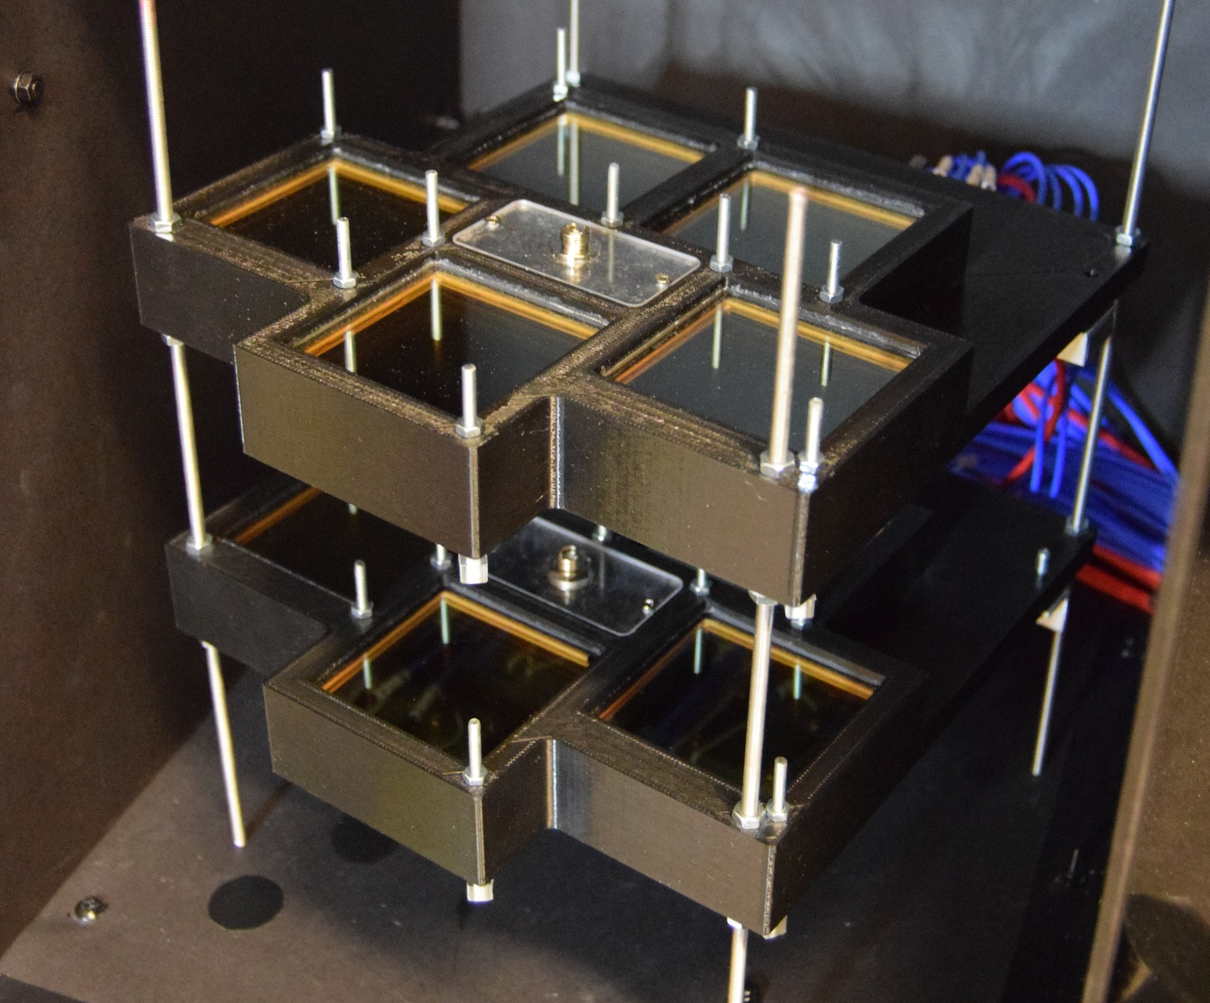
Issues discovered
Visible problems with the entrance window:
Photocathode edge damaged by indium sealing in a dozen of PMTs – appeared to be a cosmetic flaw only;
Damaged quartz window – replaced by Photonis;
Damaged sealing area.
Critical (~50%) non-uniformity of the quantum efficiency across the photocathode in two devices, including the one with damaged sealing area - both replaced by Photonis;
Expected
level
October 5-9, 2020
The 5th International conference on particle physics and astrophysics, NRNU MEPhI
10

Slide 11
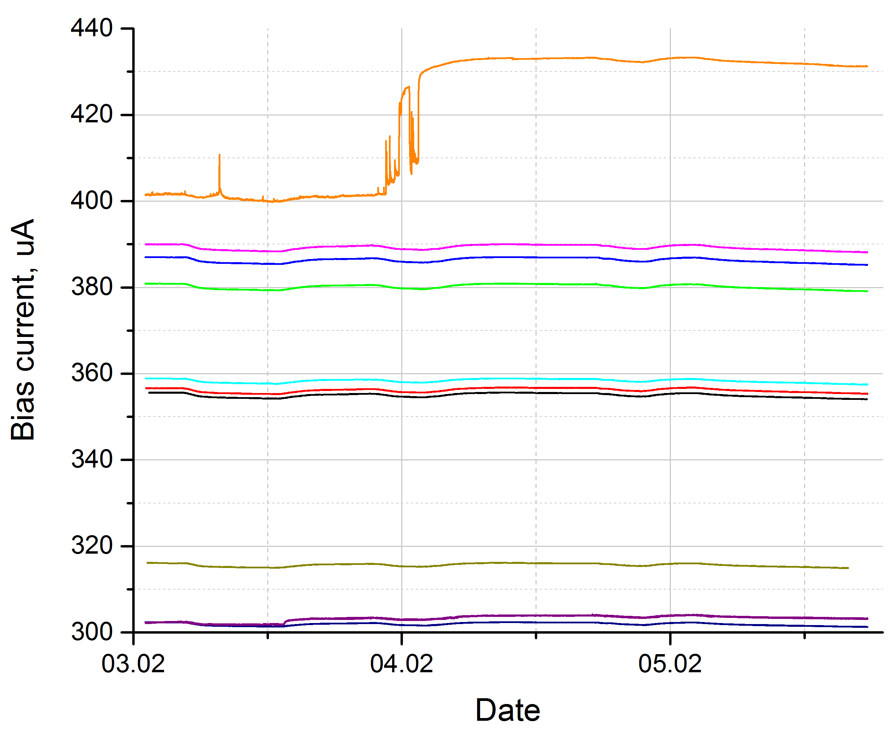
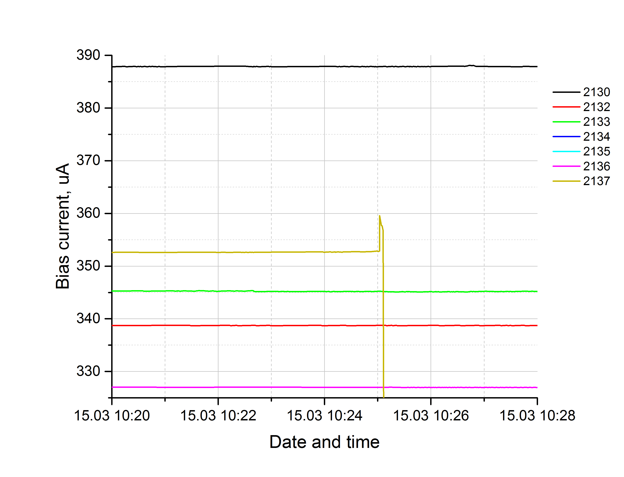
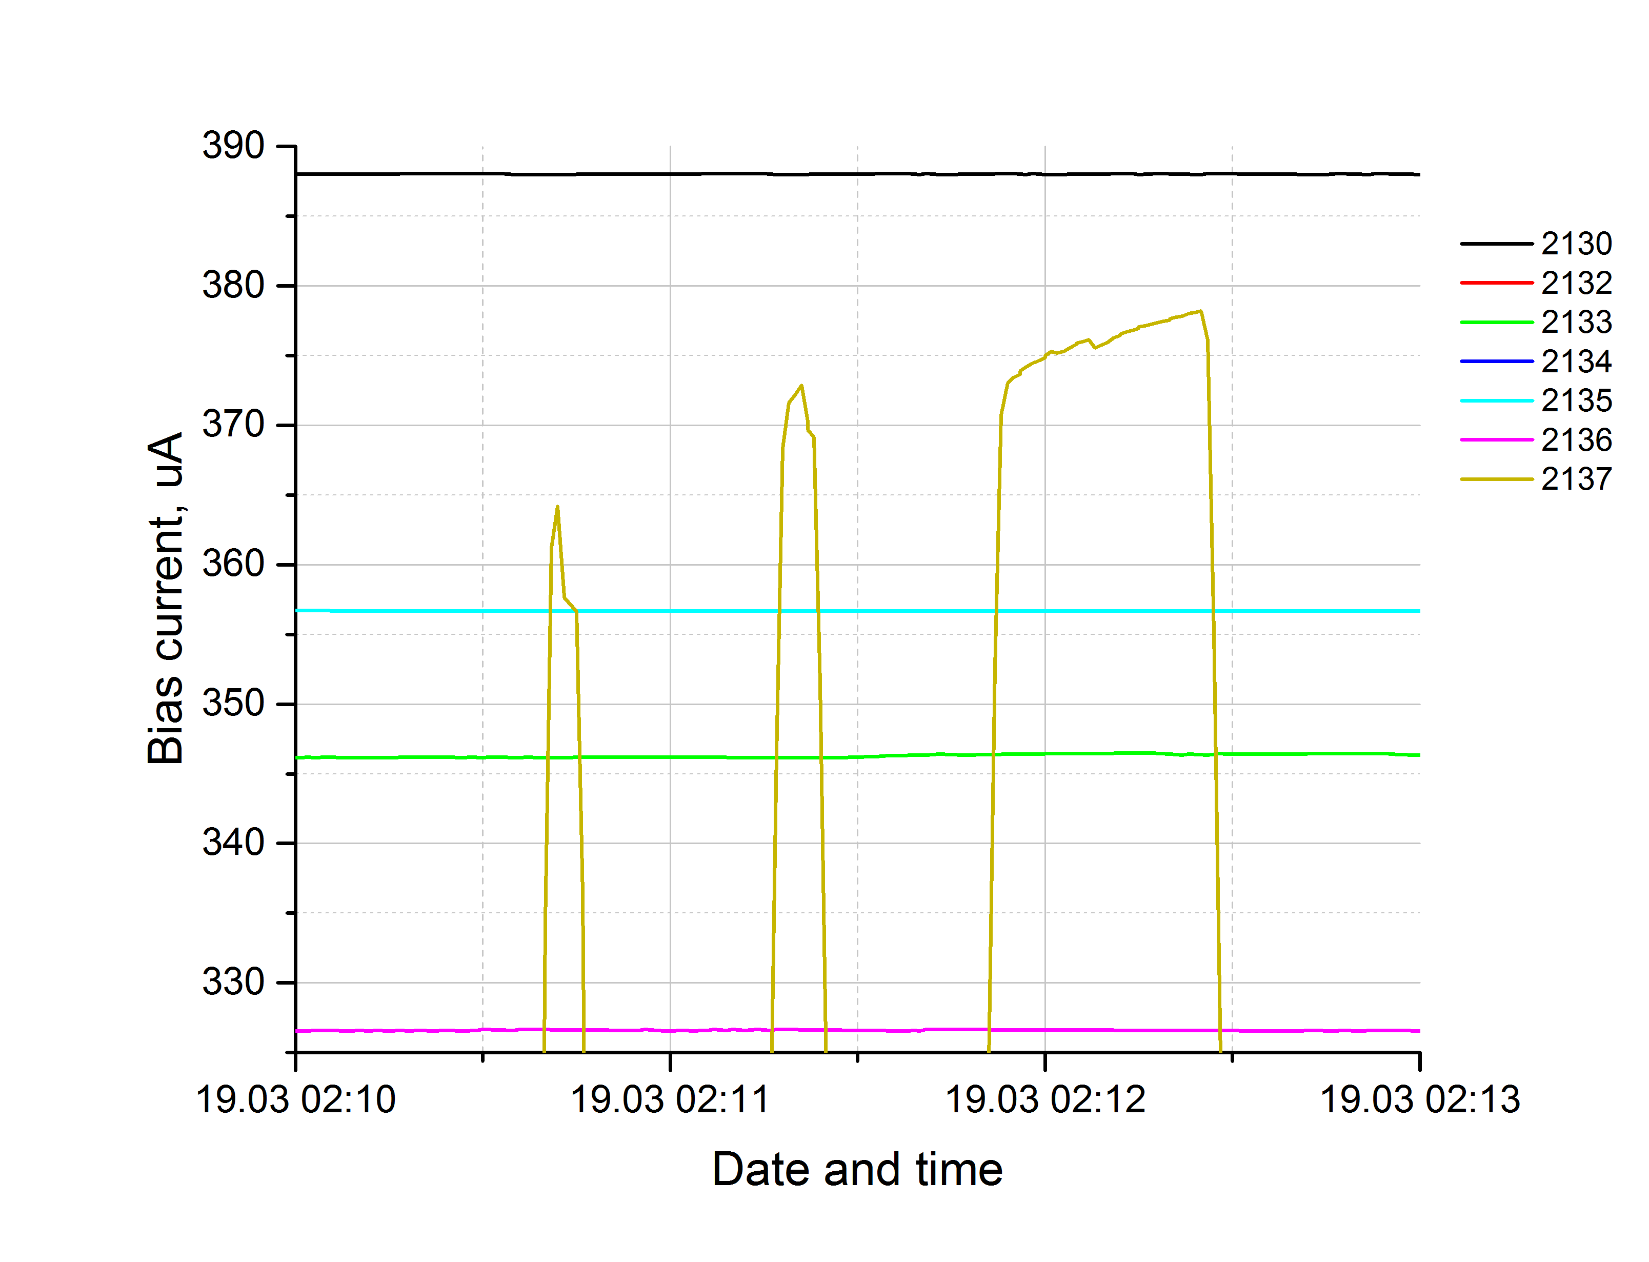
Issues discovered
10 out of 66 devices suffered from a sudden MCP breakdown during the long-term testing at an increased gain (10⁶).
This problem is caused by the residual air trapped in the micropores along the MCP edge covered by the support structure.
Though inoperable after the breakdown, these PMTs were recovered at the factory.
October 5-9, 2020
The 5th International conference on particle physics and astrophysics, NRNU MEPhI
11

Slide 12
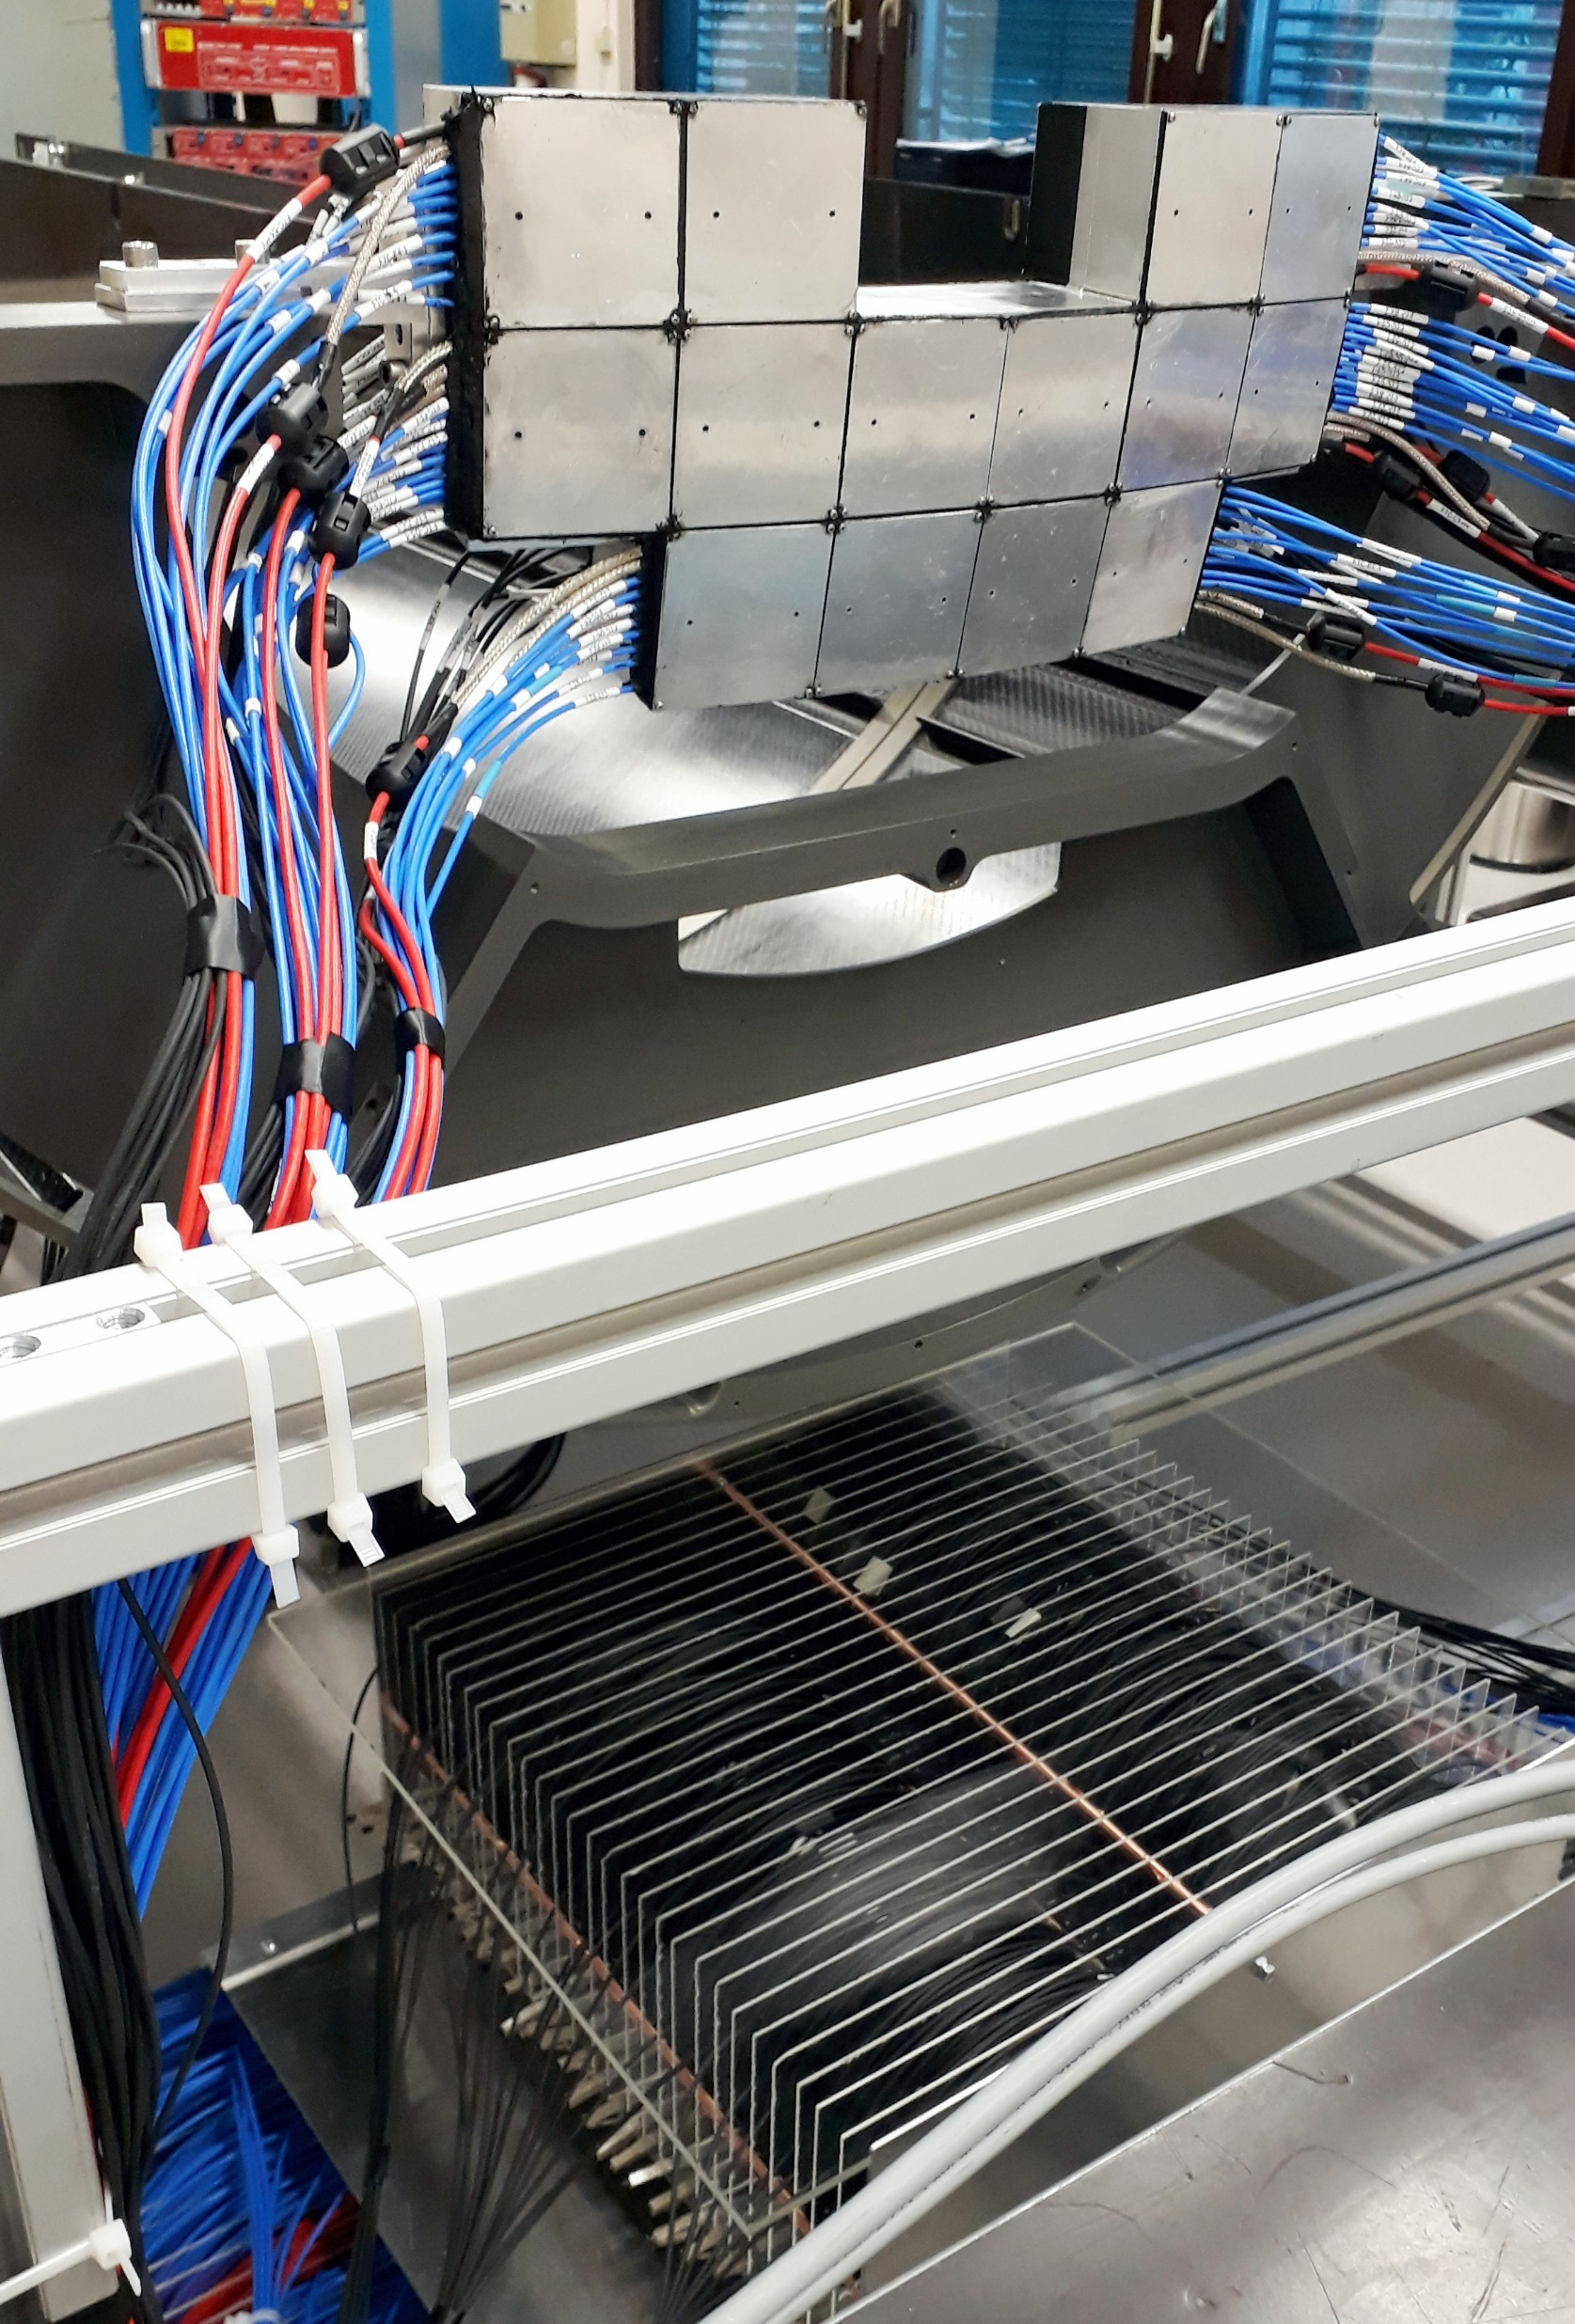
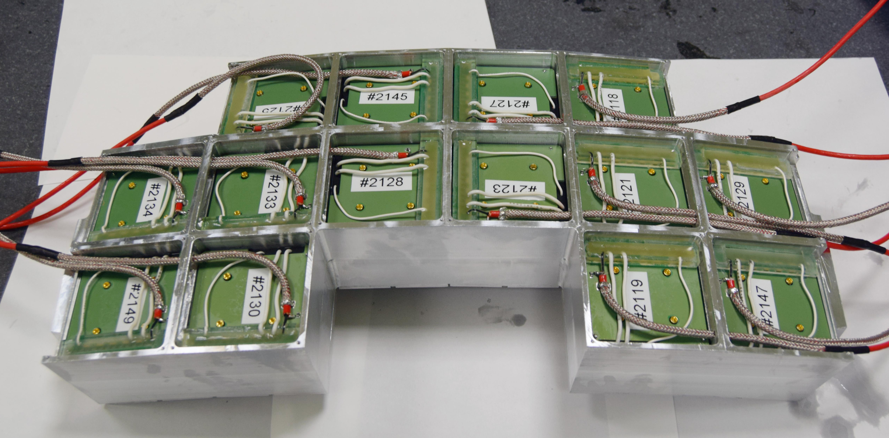
FT0 assembly status
Acceptance of the MCP-PMTs was completed by the end of 2019;
One FT0 array is fully assembled, tested and integrated into other subsystems of the upgraded ALICE detector;
Assembly of the other array is delayed due to the pandemic travel restrictions, though all components are fully ready;
According to the current plan, installation of both arrays in ALICE should be completed by July 2021.
October 5-9, 2020
The 5th International conference on particle physics and astrophysics, NRNU MEPhI
12

Slide 13
Summary
66 customized Planacons are characterized for the use in ALICE FIT in a dedicated set-up;
Excellent performance of the accepted devices made it possible to satisfy the critical requirements of the Cherenkov subsystem of ALICE FIT;
A set of important Planacon advantages, as well as some systematic drawbacks, avoidable in case of a thorough PMT selection, are identified:
Customizable PMT backplane;
Very low bias voltage for a given gain;
Limited warm-up effects;
Extended load capacity;
Low afterpulsing;
Critical Q.E. non-uniformity in 2 out of 66 devices;
Possible MCP breakdowns at an increased HV (repairable);
(Limited) sensitivity to 0.5 T B-field.
October 5-9, 2020
The 5th International conference on particle physics and astrophysics, NRNU MEPhI
13

Slide 14
Thank you for your attention!
October 5-9, 2020
The 5th International conference on particle physics and astrophysics, NRNU MEPhI
14

Slide 15
Back-up slides
15

Slide 16
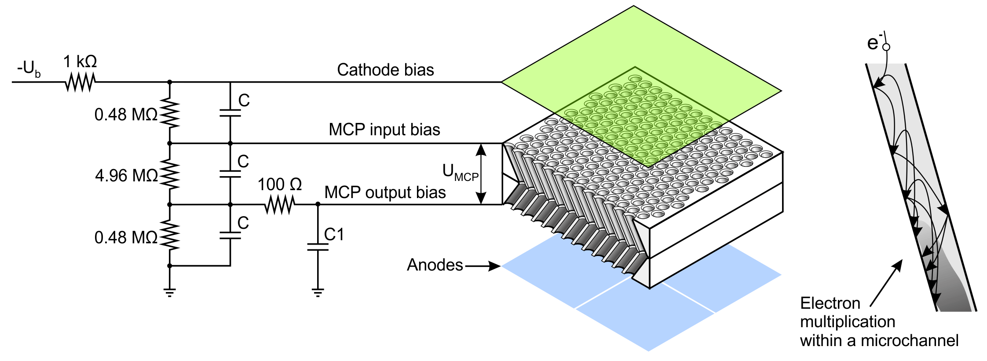
16

Slide 17
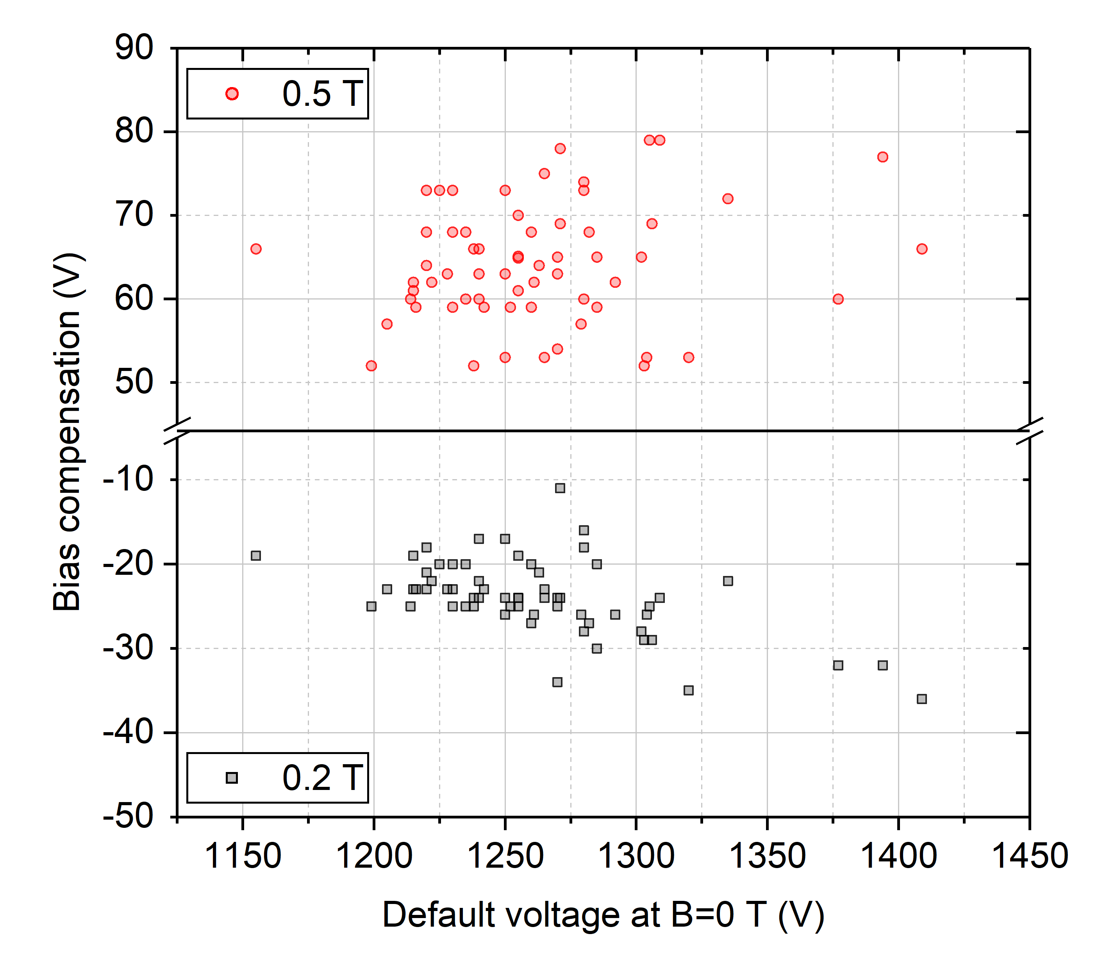
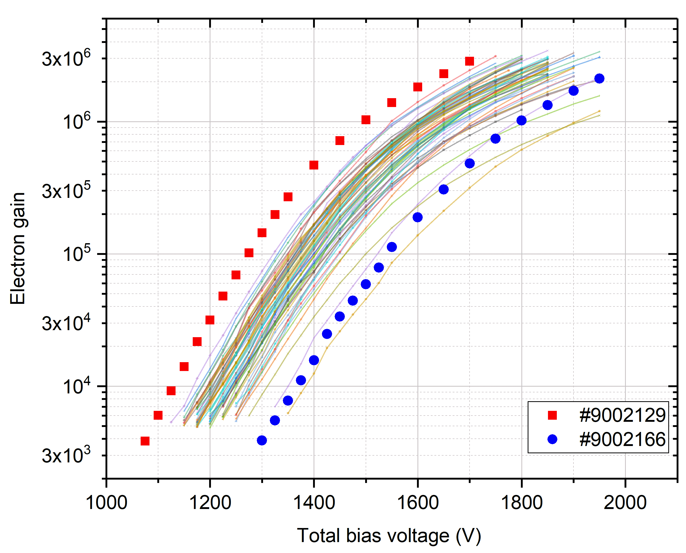
17

