Slide 1

First results and future prospects from PHELEX
Institute for Nuclear Research of RAS, Moscow
A.V.Kopylov, I.V.Orekhov, V.V.Petukhov
ICPPA 2020, Moscow

Slide 2
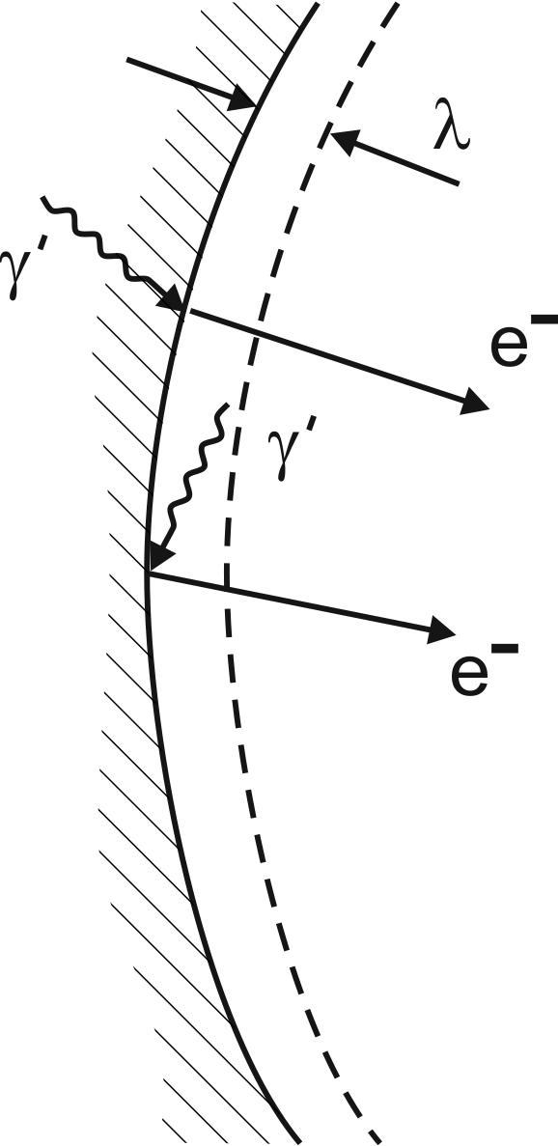

PHELEX – PHoton-ELectron EXperiment
Multicathode counter technique as an extension of a method of dish-antenna
θ – angle between a field of a hidden photon and the surface
χ- dimensionless parameter quantifying a kinetic mixing
(D.Horns, J.Jackel, A.Lindner, A.Lobanov, J.Redondo, A.Ringwald , “Searching for wispy cold dark matter with a dish antenna” Journal of Cosmology and Astroparticle Physics, vol.4. article 16, 2013)
In our case:
sensitivity
ICPPA 2020, Moscow

Slide 3
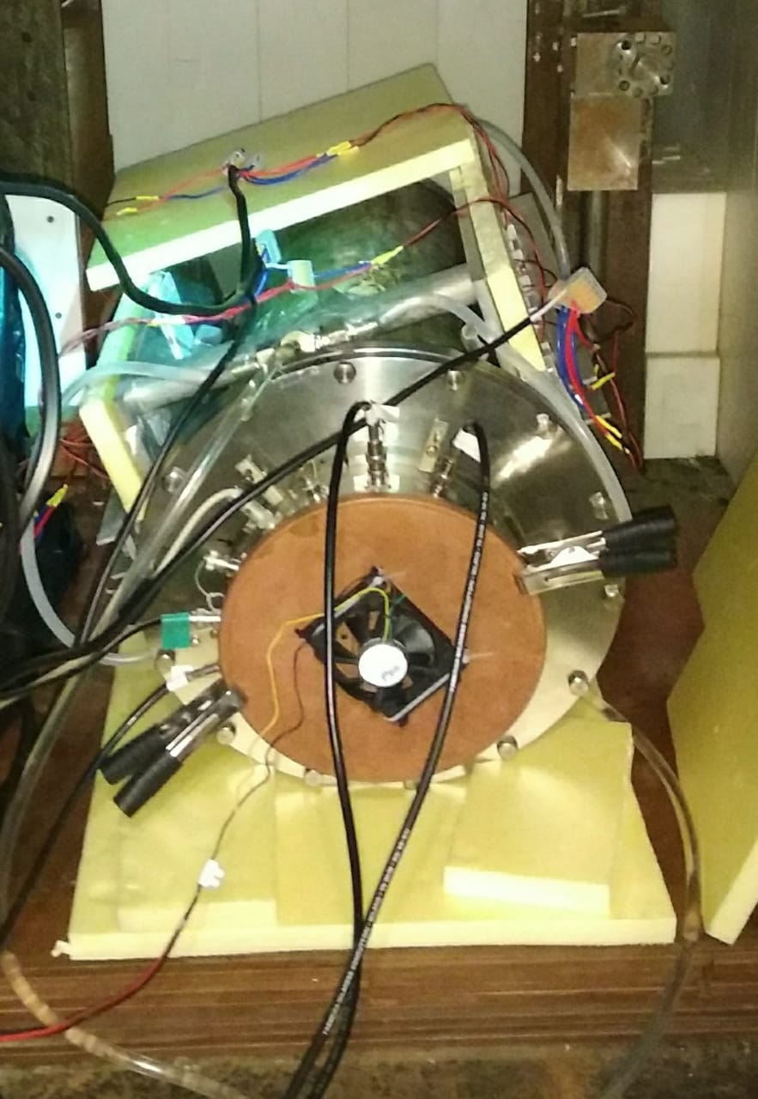
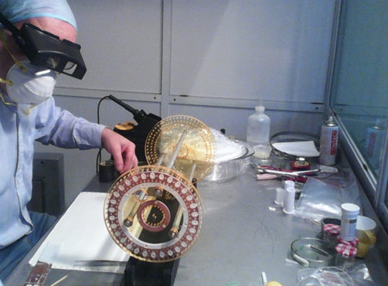
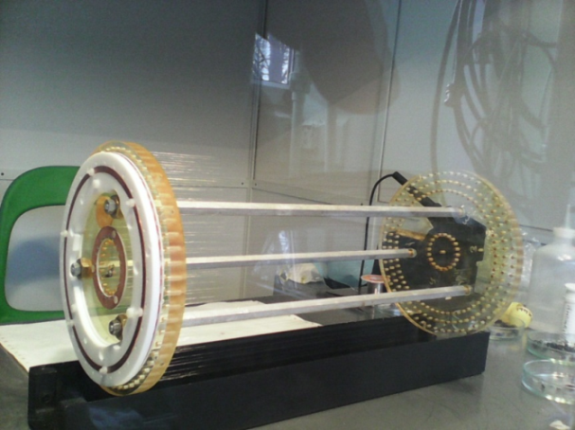
Multicathode counter
ICPPA 2020, Moscow

Slide 4
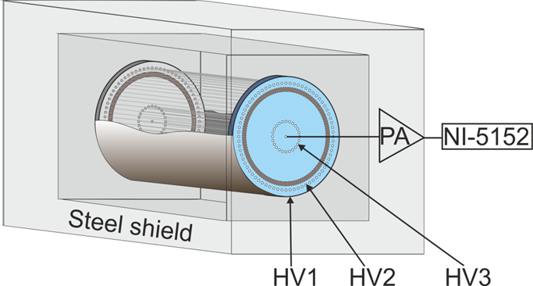
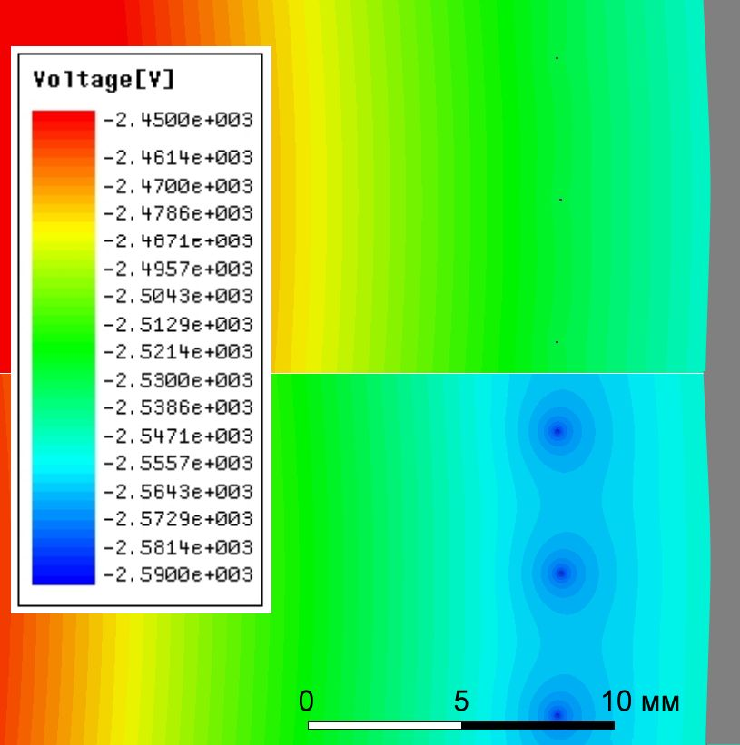
Multicathode counter technique
Retarding potential of the second cathode in configuration 2
Potential applied to
second cathode allows
electrons emitted from outer
cathode to freely drift
to central counter
Conf 1
A retarding potential
at the second cathode
prevents the drifting
electrons reaching the
central counter
Conf 2
The schematic of the counter
Configurations 1/2
The pulse shapes were digitized in interval ± 50 mV with a frequency 10 MHz and a sampling step of 400 μV
ICPPA 2020, Moscow

Slide 5
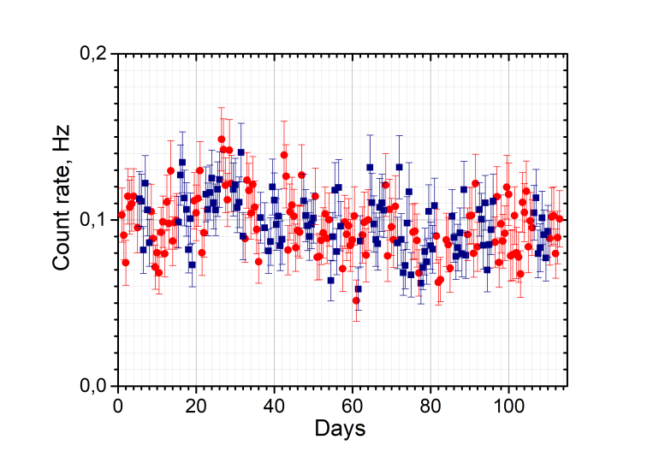
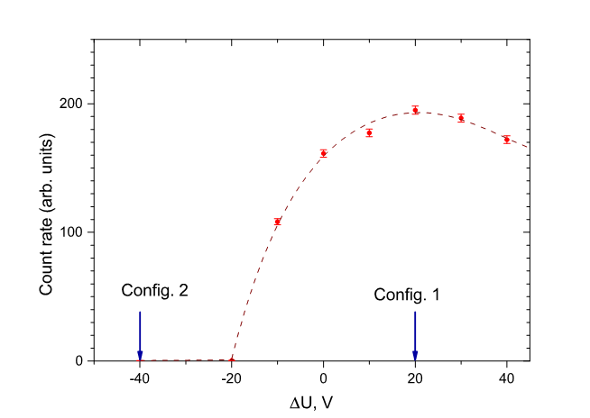
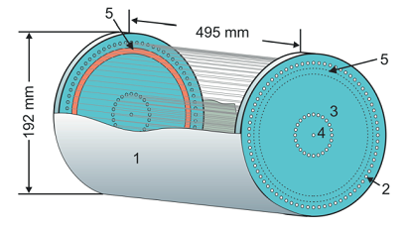
Principle of a multicathode counter:
The effect = R1 – R2
HV2
HV1
R1 – red, R2 - blue
ΔU = HV2 – HV1
From calibration by UV lamp
ICPPA 2020, Moscow

Slide 6
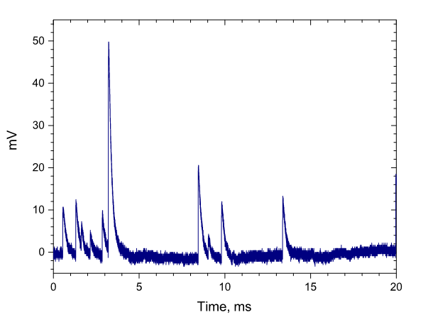
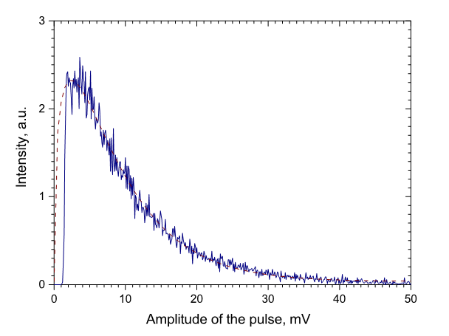

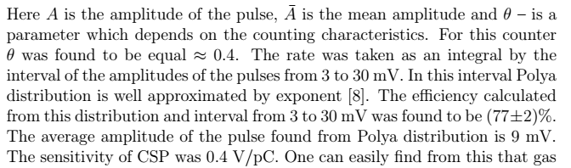
Multicathode counter technique
ICPPA 2020, Moscow

Slide 7
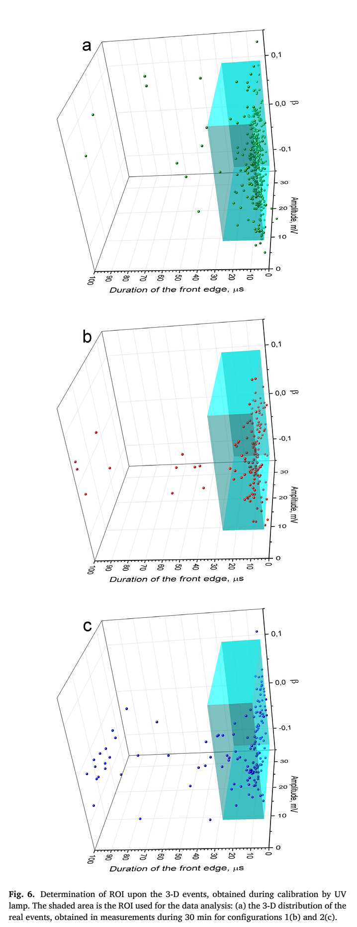
Data treatment off-line
Calibration
Selection by amplitude,
Duration of leading edge
Zero line within a certain limits
The time intervals beyond these limits are discarded with a proper account of live-time
Config. 1
Config. 2
ICPPA 2020, Moscow

Slide 8
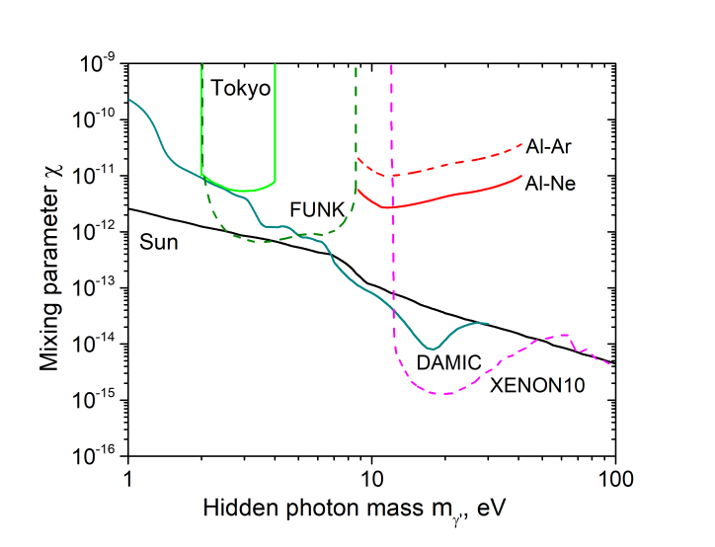
The results of measurements with Ar +CH₄(10%) and Ne + CH₄(10%) gas mixtures
The target – free electrons of a degenerate electron gas of a metal
HV2
HV1
R1 – red, R2 - blue
ΔU = HV2 – HV1
Target – valence electrons
ICPPA 2020, Moscow

Slide 9
Directionality of the counting
θ – angle between a field of a hidden photon and the surface
χ- dimensionless parameter quantifying a kinetic mixing
Field along the axes of the counter
(D.Horns, J.Jackel, A.Lindner, A.Lobanov, J.Redondo, A.Ringwald , “Searching for wispy cold dark matter with a dish antenna” Journal of Cosmology and Astroparticle Physics, vol.4. article 16, 2013)
Field normal to the axes of the counter
By rotation of the counter – variation of the count rate
If the surface is mirror-like!
The counter with a matt surface –
for the control measurements
ICPPA 2020, Moscow

Slide 10
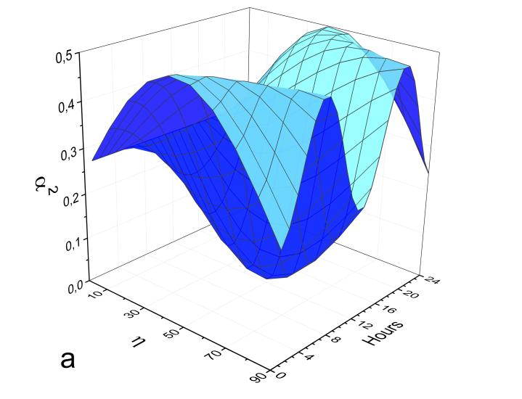
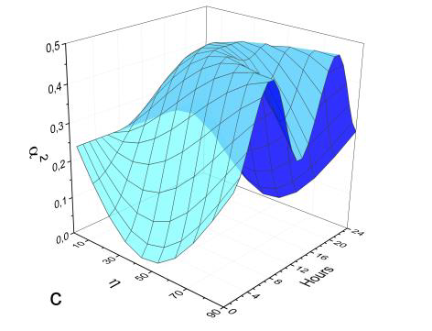
Diurnal variations, Baksan, Russia 43ºN
<α²> averaged for 1 hour
vertical
along the meridian
along the parallel
η – angle between vector of the field and celestial north
Time zero has been chosen when the vector of the field was in the plane of the corresponding meridian
ICPPA 2020, Moscow

Slide 11
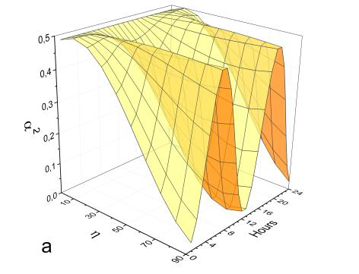
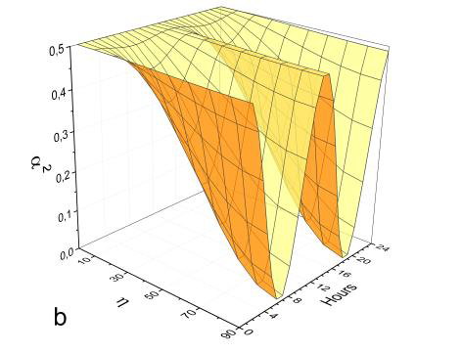
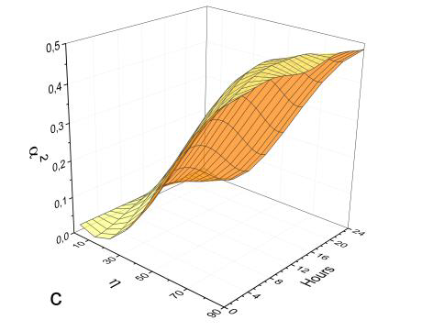
Diurnal variations, INO, India 10ºN
vertical
along the parallel
along the meridian
η – angle between vector of the field and celestial north
ICPPA 2020, Moscow

Slide 12
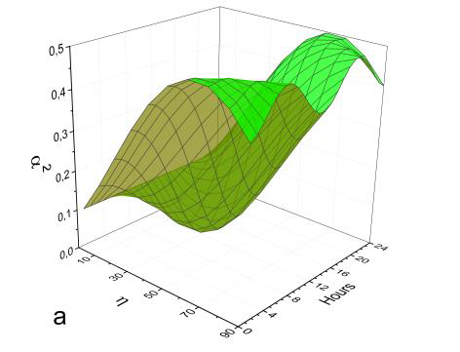
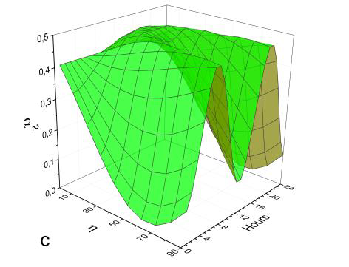
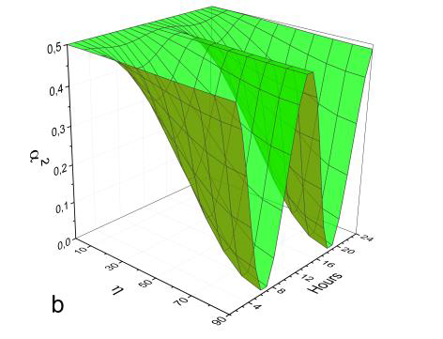
Diurnal variations, Pyhäsalmi, Finland 64ºN
vertical
along the parallel
along the meridian
η – angle between vector of the field and celestial north
ICPPA 2020, Moscow

Slide 13
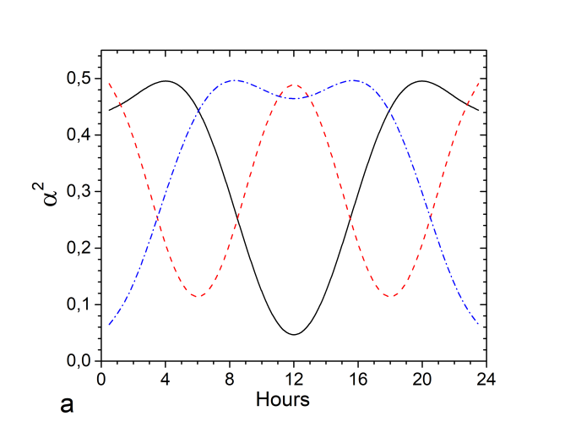
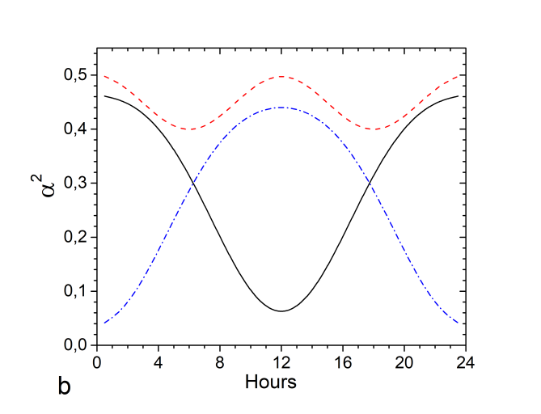
Diurnal variations for different directions of the field at BNO, Russia 43ºN
The averaged (for 1 hour) value α2 = <cos2θ> for BNO, Russia as a function of time for three
orientations of the counter: solid line – the vertical one, dashed line – along the parallel, dot-dashed line along the meridian. Left picture: for η = 63º, angle: Galactic North- Celestial North right picture: for η = 27º, minimal angle Celestial North – Galactic Equator
ICPPA 2020, Moscow

Slide 14
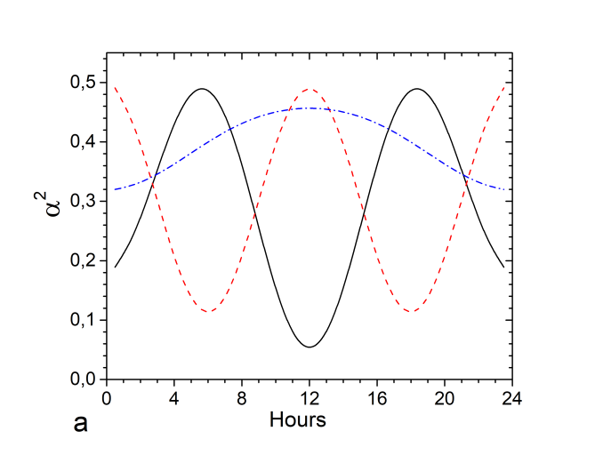
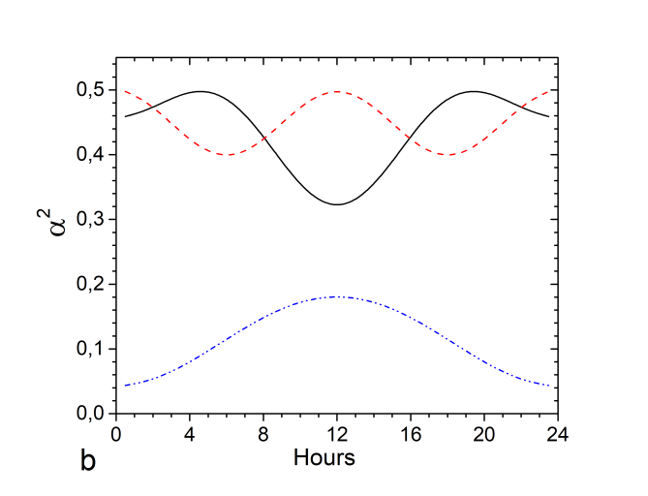
Diurnal variations for different directions of the field at INO, India 10ºN
The averaged (for 1 hour) value α2 = <cos2θ> for INO, India as a function of time for three
orientations of the counter: solid line – the vertical one, dashed line – along the parallel, dot-dashed line along the meridian. Left picture: for η = 63º , angle: Galactic North- Celestial North
right picture: for η = 27º, minimal angle Celestial North – Galactic Equator
ICPPA 2020, Moscow

Slide 15
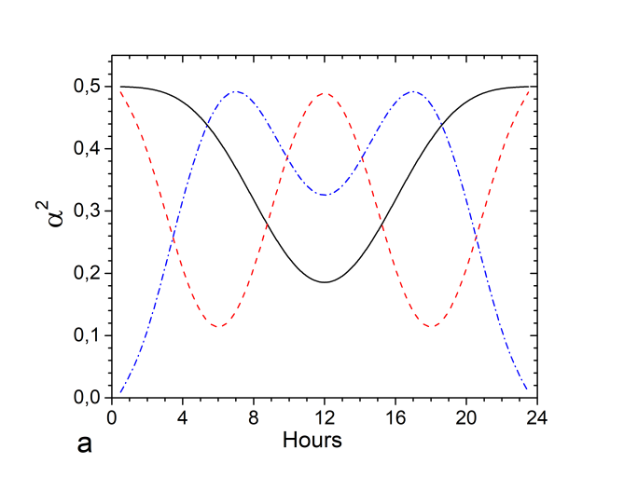
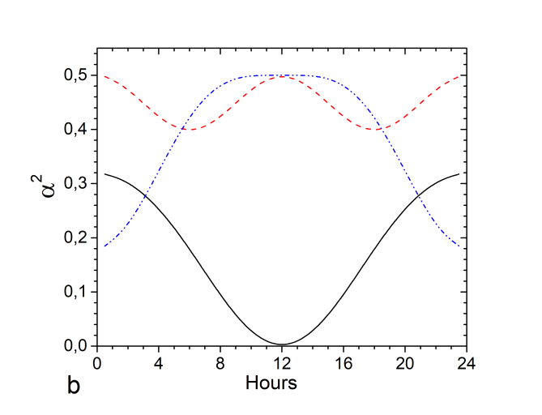
Diurnal variations for different directions of the field at Pyhäsalmi, Finland 64ºN
Dashed line – the same for each latitude → useful for control measurements
The averaged (for 1 hour) value α2 = <cos2θ> for Pyhäsalmi, Finland as a function of time for three orientations of the counter: solid line – the vertical one, dashed line – along the parallel, dot-dashed line along the meridian. Left picture: for η = 63º, right picture: for η = 27º.
ICPPA 2020, Moscow

Slide 16

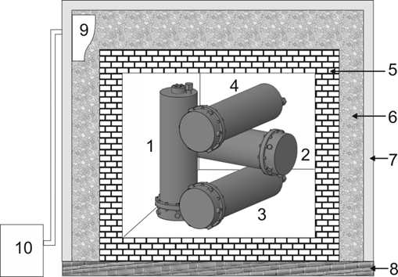
Installation with 4 multicathode counters
One can see substantial difference of the diurnal run for three detectors at each latitude that will enable for sufficiently large samples to determine the absolute phase of the diurnal run and thus to find the absolute direction of the vector of the field.
1,2,3,4 - counters
5 – lead bricks
6 – thermal insulation
7 – metallic housing
8 – impregnated wood
9 - ventilator
10 – refrigeration unit
ICPPA 2020, Moscow

Slide 17
To summarize:
The method is working
First results are encouraging
Future prospects are well outlined
The possibility to observe diurnal variations promises a discovery.
The work can be conducted by independent groups in different mines
at different geographical latitudes
ICPPA 2020, Moscow

Slide 18
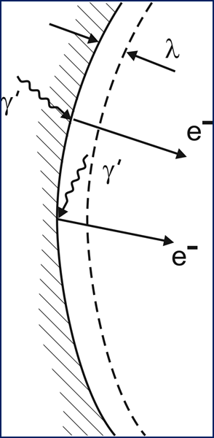
References:
A. K., I. Orekhov, V. Petukhov, A multi-cathode counter in a single-electron counting mode NIM A 910, 164 (2018)
A. K., I. Orekhov, V. Petukhov Results from a hidden photon dark matter search using a multi-cathode counter // JCAP. 2019. V.07. P.008
A. V. K., I. V. Orekhov, V. V. Petukhov, About the possibility to observe diurnal variations of the count rate from dark photons by the multi-cathode counters. // arXiv:2006.05452 [hep-ex]
ICPPA 2020, Moscow

Slide 19
Thank you for watching
ICPPA 2020, Moscow

