Slide 1
EVALUATION OF THE ANTIPROTON PRODUCTION FROM CR INTERACTIONS
FROM NEW MCMC ANALISES OF THE CR PROPAGATION
Pedro de la Torre Luque, INFN Bari
pedro.delatorreluque@ba.infn.it
06/10/2020

Slide 2
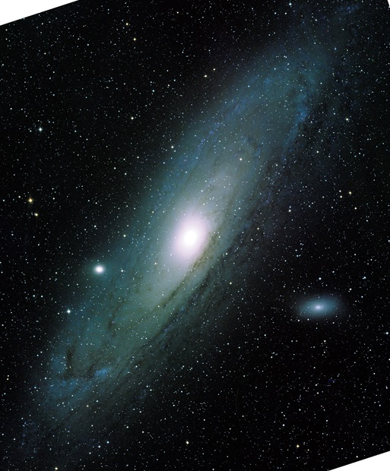
Outline
Propagation and generation of secondary cosmic rays:
Spallation cross-sections problem
Antiproton production
Background of cosmic p
Primary production hints?
Uncertainties evaluation
Is there any hint of exotic sources of antiproton production?
-
CR + ISM → B, Li, Be, p

Slide 3
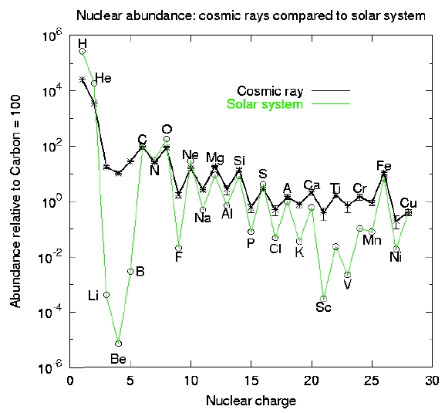
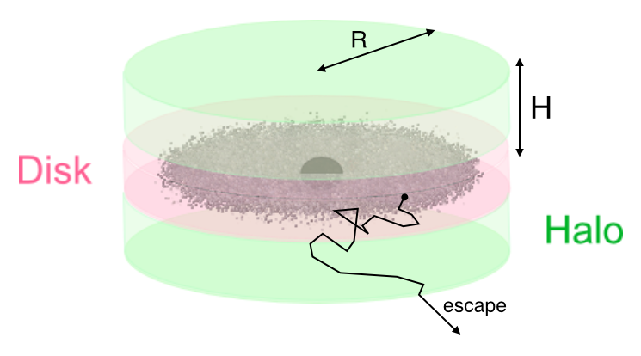
Diffusive transport of Galactic cosmic rays
The basic idea is that primary particles are accelerated in astrophysical sources (namely SNRs) and propagate throughout the Galaxy, occasionally interacting with gas, mainly in the disc of the Galaxy, and there they produce secondary nuclei through spallation.
Diffusion coefficient (D ∝ 1/ τ^{diff})
J_{pr} ∝ Q_{pr}(E) τ(E)
J_{sec} ∝ Q_{sec}(E) τ(E)
Q_{sec} ∝ $\text{J}\text{pr}$(E) σ(E)
$\frac{\text{J}\text{sec}}{\text{J}\text{pr}}= \frac{\text{Q}\text{sec}}{\text{Q}\text{pr}} \sim$σ(E)/$D\left(E\right)$

Slide 4
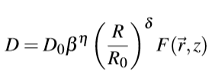
Diffusive transport of Galactic cosmic rays
The basic idea is that primary particles are accelerated in astrophysical sources (namely SNRs) and propagate throughout the Galaxy, occasionally interacting with gas, mainly in the disc of the Galaxy, and there they produce secondary nuclei through spallation.
Using the GALPROP XSecs
$$\frac{\text{J}\text{sec}}{\text{J}\text{pr}} \sim \text{σ}\text{(}\text{E}\text{)}/D\left(E\right)$$
https://dmaurin.gitlab.io/USINE/input_xs_data.html#nuclei-xs-nuclei
Solved with the DRAGON code https://github.com/cosmicrays/DRAGON2-Beta_version
Notes:
The diffusion coefficient is tuned to reproduce the prim/sec spectrum since the XSecs are constraint by experimental measurements and the shape is supposed to be well constraint up to a normalization factor

Slide 5
CURRENT SITUATION
Wonderful and precise (~2-3%) data of CR fluxes from AMS-02 has made Be and Li data as precise as B
Nevertheless…
High uncertainties in the production cross sections
Very few data in most of the channels and significant uncertainties (~ 10-50 %)
: e.g. ¹⁶O + gas → ¹¹B + X
Uncertainties in Xsec parametrizations dominated by their normalization
Necessity of new and more precise analyses able to combine different species and overcome the cross sections problem
Notes:
Important scarcity of data, and hardly reaching 10 GeV

Slide 6
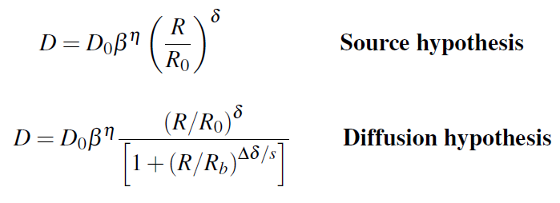
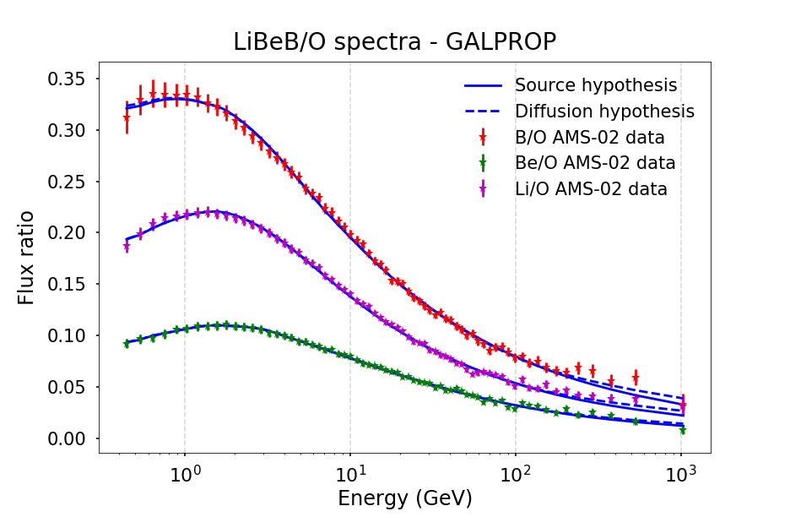
Independent Markov-Chain Monte Carlo analysis
Bayesian inference with a modified version of the Metropolis-Hastings algorithm
Two different diffusion coefficients tested:
Inference of the propagation parameters from the sec/prim ratios, simulated with the DRAGON code and GALPROP Xsecs
Diffusion hypothesis preferred by AMS-02 data

Slide 7
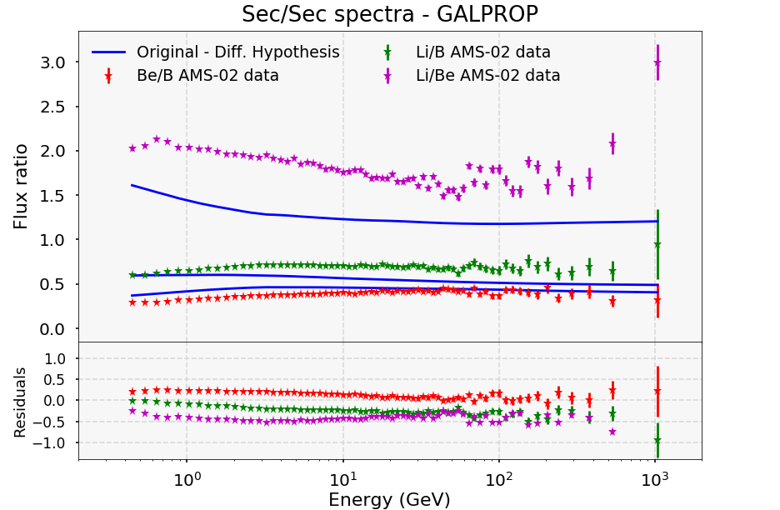
Independent Markov-Chain Monte Carlo analysis
Bayesian inference with a modified version of the Metropolis-Hastings algorithm

Slide 8
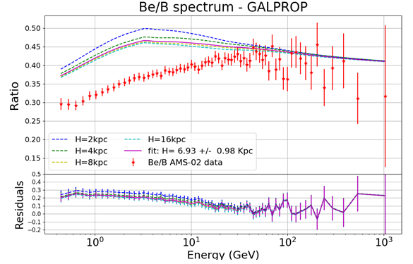
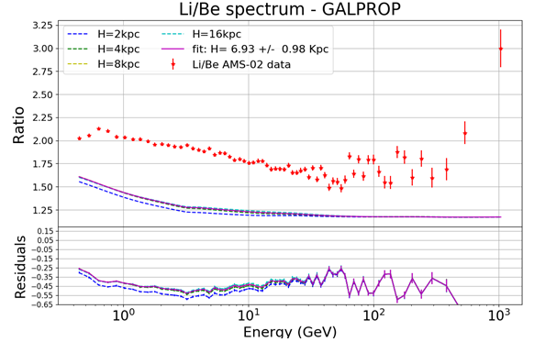
Secondary-over-secondary ratios
Insensitive to the diffusion coefficient parametrization
Roughly independent of the values of the diffusion parameters at E > 10 GeV
Halo size effect not relevant at E>30 GeV
Different XSecs do not show meaningful differences in the shape of the ratios at high E, just in their normalization
Notes:
20% change in D0 turns out to be around 22% change in the fluxes of Li, B, Be

Slide 9
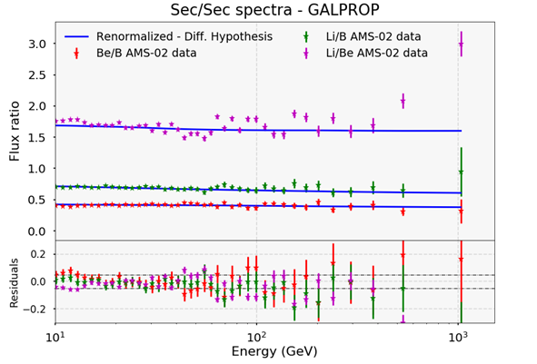
Basic idea
All possible renormalizations that fit the Sec/Sec AMS-02 data and lay inside the bands of XSec uncertainties are allowed candidates
Fit of the ratios (E > 15 GeV) + penalty factor
Following the reasoning of the extrapolation algorithms this renormalization is applied evenly to all channels
The preferred candidate is that which involves the minimum change from the original parametrization
BEST CANDIDATE
ΔB → - 6 %
ΔBe → - 12 %
ΔLi → + 18 %
Notes:
So let’s correct our cross sections like this to obtain a better estimate on the diffusion coefficient

Slide 10
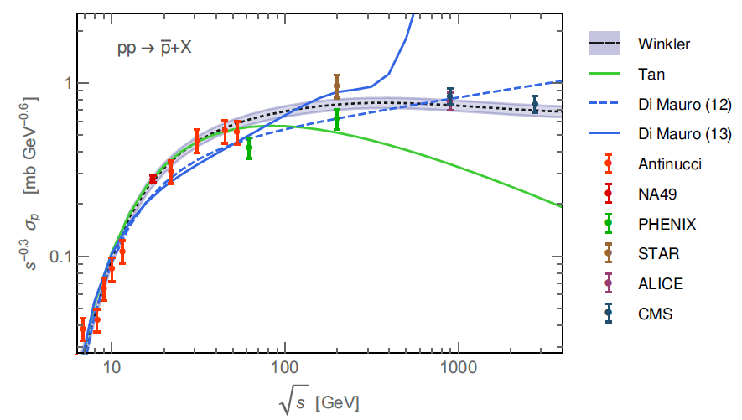
ANTIPROTON PREDICTIONS
Secondary production from CR interactions
Primary production from Dark matter?
Antiprotons cross sections
$·(2+ ΔIS+2$ $Δ$_{Λ})
Kappl & Winkler, 2019 ; arXiv:1408.0299

Slide 11
PROPAGATING ANTIPROTONS
DIFFUSION NOT CORRECTED
Diff. params which fit B/O
Tan & NG Xsecs of p production
-
https://journals.aps.org/prd/abstract/10.1103/PhysRevD.26.1179
Remember: this is not a fit of the antiproton spectrum, but the predictions from the propagation models adjusted to the sec/prim ratios!
Discrepancy found to be as significant as 3.9σ favouring DM origin (Cuoco et al, 2019)
arXiv:1903.01472
Notes:
This signal is compatible with the galactic centre excess in gamma rays

Slide 12
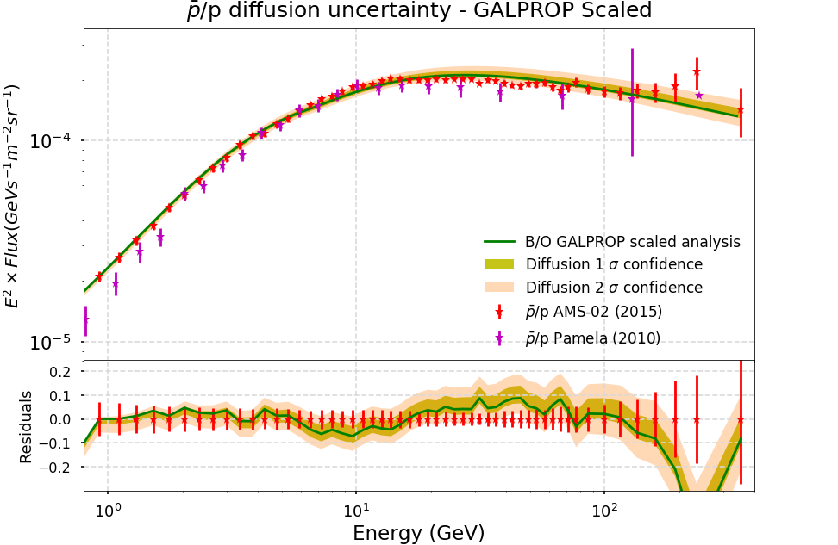
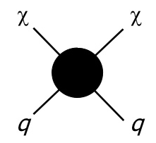
PROPAGATING ANTIPROTONS
CORRECTED DIFFUSION
Discrepancy has disappeared
They seem to be inside 1σ uncertainties in the determination of the diffusion coefficient
Notes:
This signal is compatible with the galactic centre excess in gamma rays

Slide 13
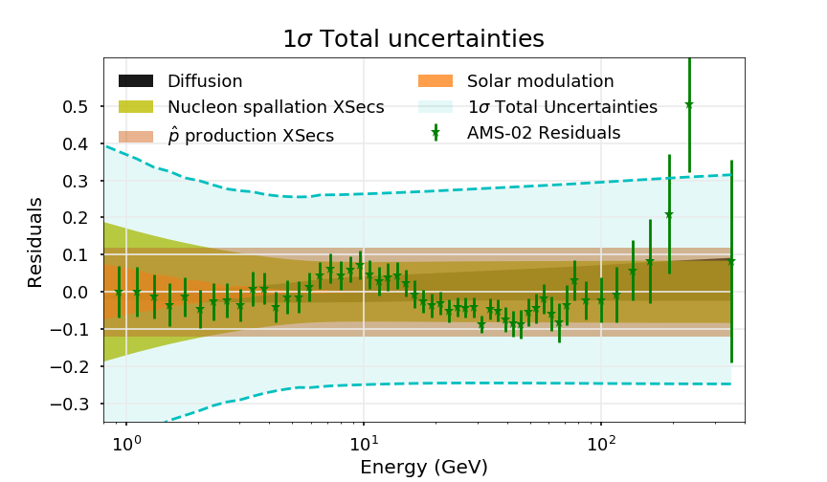
TOTAL UNCERTAINTIES
Crucial to include all these uncertainties in order to put correct constraints on the antiproton production from possible dark matter or primordial black holes
DM → Interaction rate and WIMP mass
PBH → Fraction of mass density and BH mass

Slide 14
In conclusion…
A simultaneous renormalization on the spallation XSecs makes possible to fit the flux ratios among secondary CRs → More robust determination of D(E).
The procedure significantly improves the antiproton flux predicted w.r.t. AMS-02 data even when not using it to evaluate the diffusion parameters
At minimum, it is demonstrated that the excess of data around 10-11 GeV is dependent on the spallation cross sections used to predict the diffusion coefficient
The current uncertainties make such precision tests to infer signals of primary production difficult, just constraints on WIMPs and PBHs properties

Slide 15
BACK UP

Slide 16
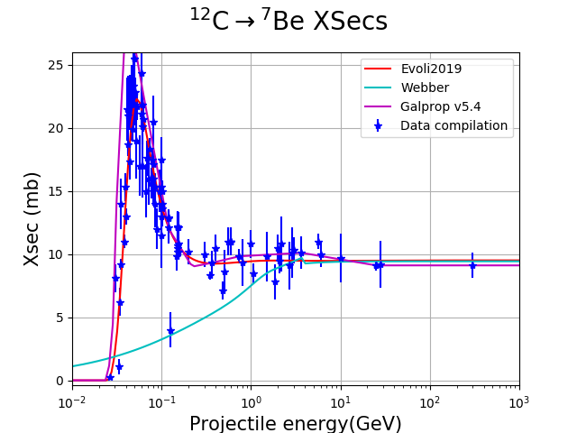
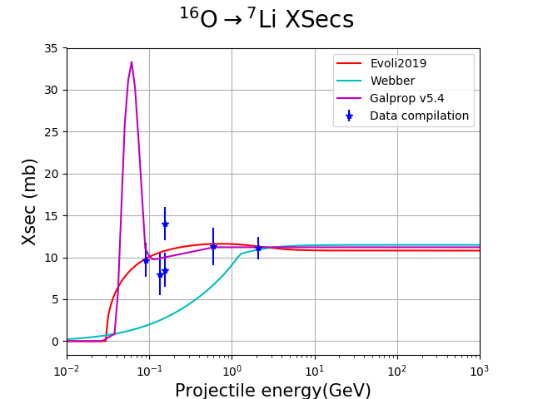
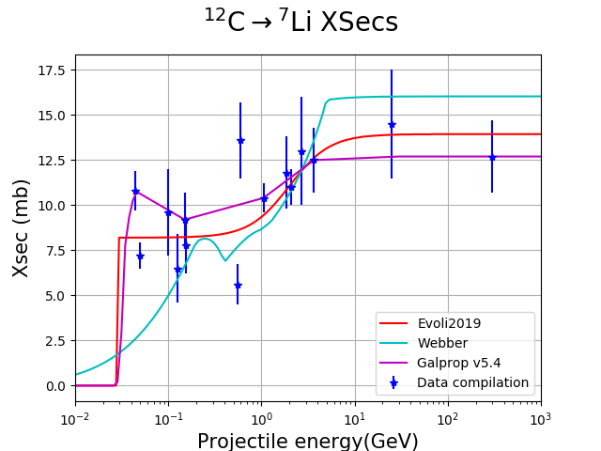
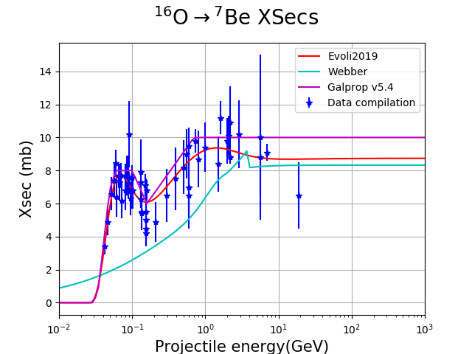
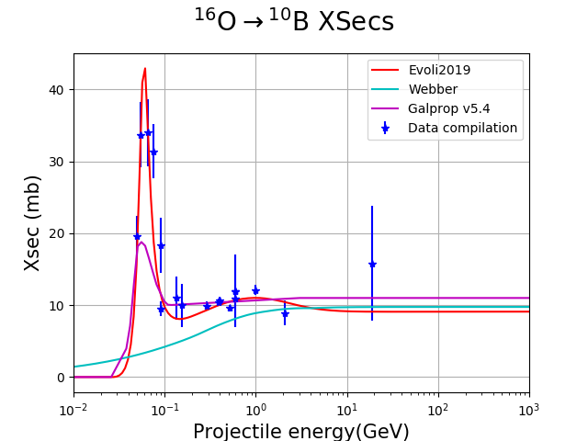
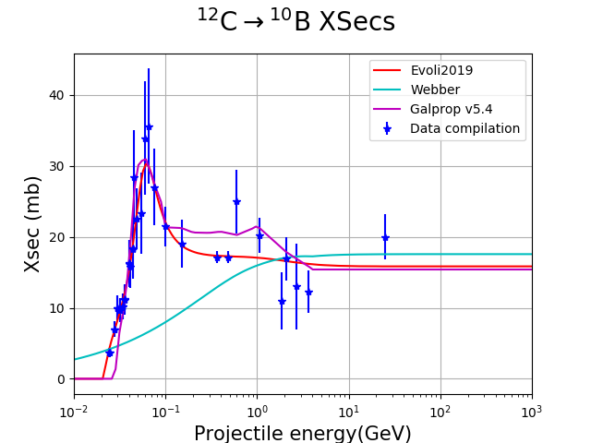
PARAMETRIZATIONS
Evoli et al., 2019 (arXiv:1904.10220)

Slide 17
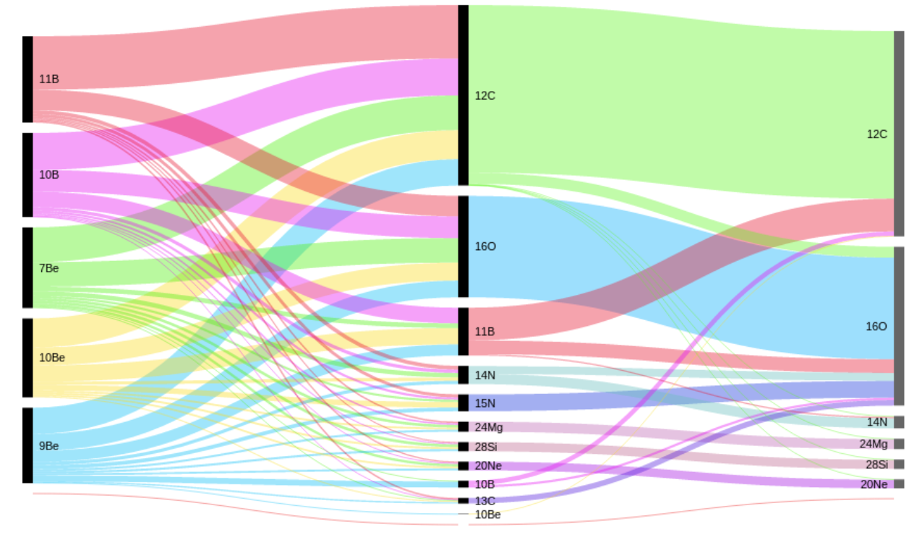
High uncertainties in XSecs → High uncertainties in the secondary CRs
Q_{sec}$(E)$∝ $\sum^{pr}{\text{J}\text{pr}\text{(}\text{E}\text{) }\text{σ}\text{pr}\text{→ }\text{sec}}(E)$
Complexity of the XS network
Assessment of XSec errors in sec. CRs
· Main spallation channels: O and C
· Secondary channels (N, Ne, Mg, Si & Fe) . are very important for Li and Be (< 50%)
· Tertiary channels also matter:
e.g. ¹¹B + gas → ¹⁰B + X
Genolini et al. 2019 ; arXiv:1803.04686
Tomassetti, 2018 ; arXiv:1707.06917
Tomassetti, 2018
Notes:
O and C: They are the most abundant heavy ions

Slide 18
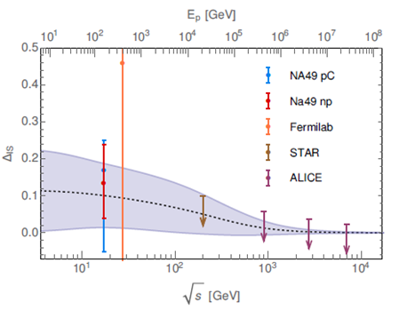
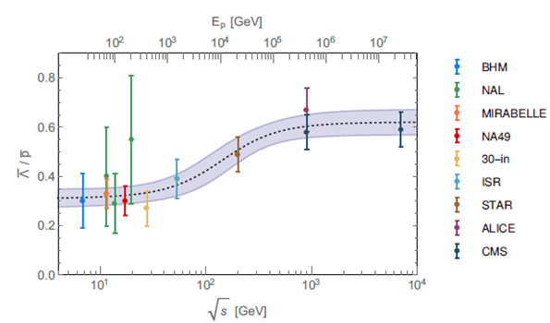
ANTIPROTON XSECS
$·(2+ ΔIS+2$ $Δ$_{Λ})
Kappl & Winkler, 2019 ; arXiv:1408.0299
A. Reinert, M. W. Winkler, 2017 ; arXiv:1712.00002
Notes:
new precision data from the NA49 experiment atCERN

Slide 19
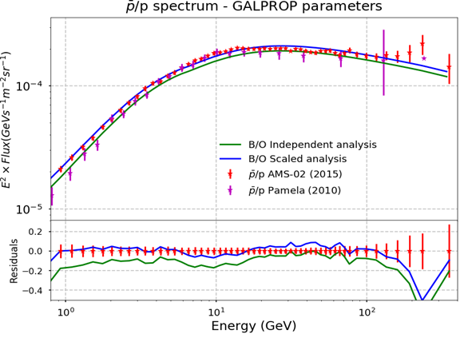
p/p spectrum gets rid of uncertainties related to the fit of primary CRs spectra and mitigate solar modulation uncertainties
-
-
A combined analysis of B/prim and p/p for different cross sections parametrization of antiproton production is the next step

Slide 20
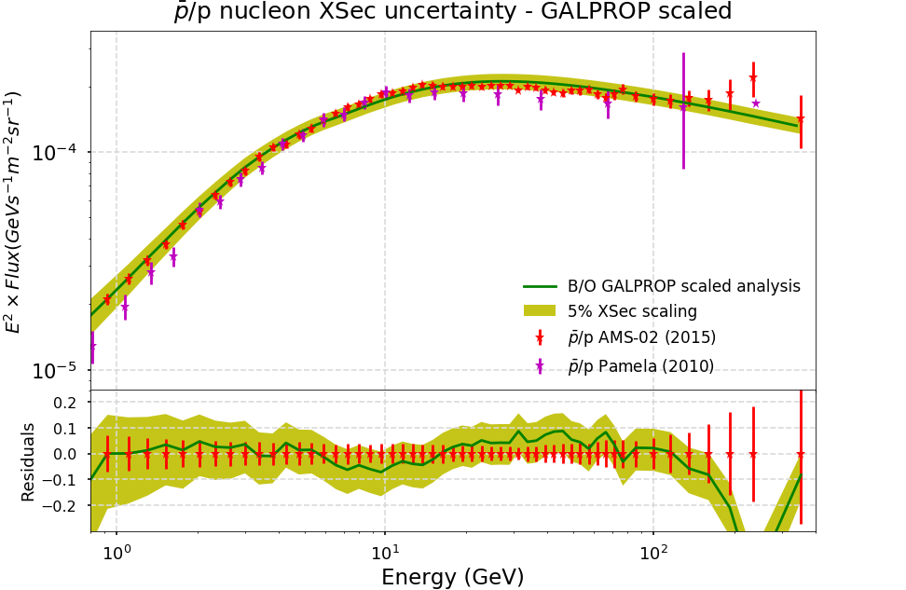
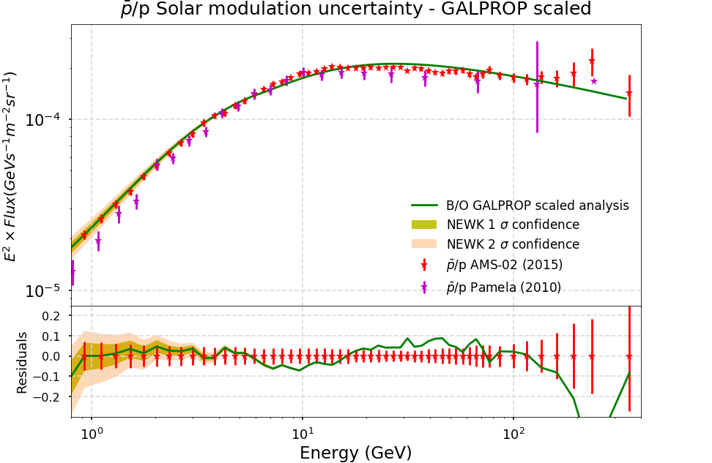
Charge-sign modulation assumed in an extension of the Force-Field approximation. Fisk potential chosen in agreement to the neutron monitor detector NEWK and Voyager data.
Assuming a ±5% uncertainty in the determination of the scaling factors derived from secondary-over-secondary ratios. It results in about a 9% change in the antiproton production.

