Slide 1
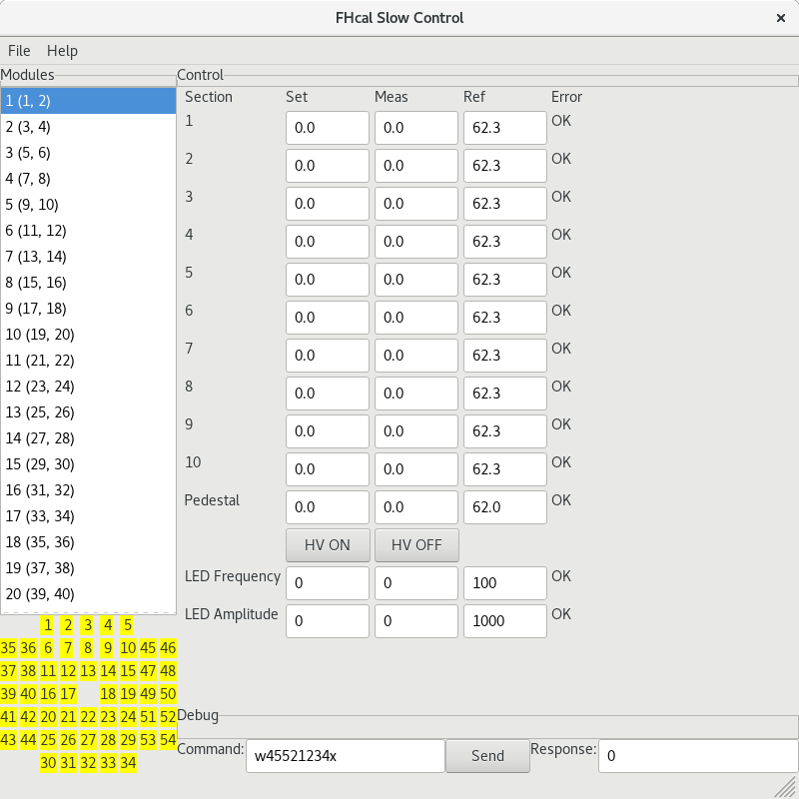
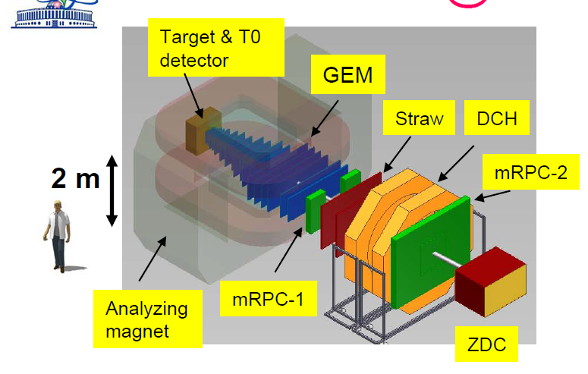
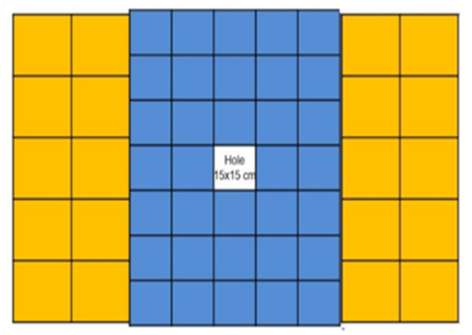
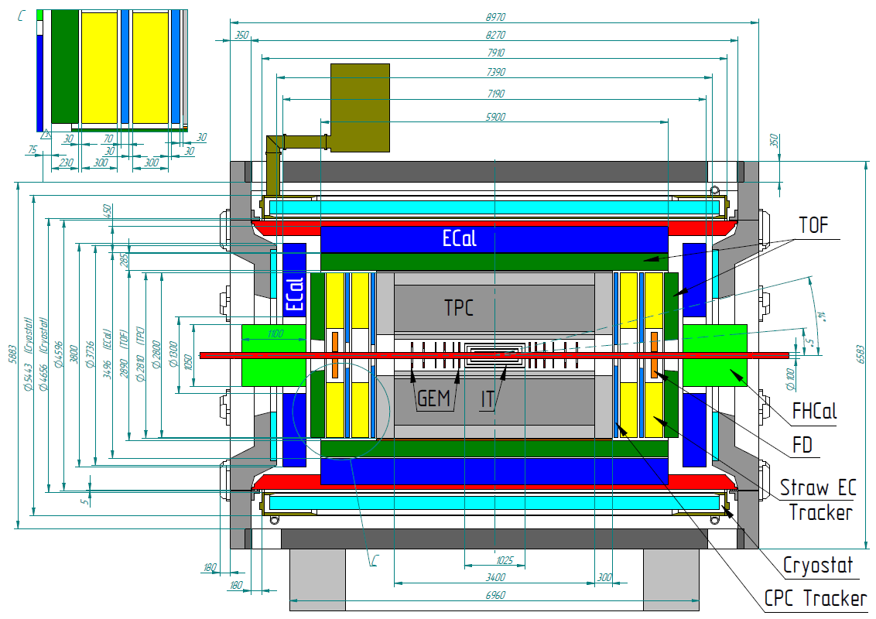
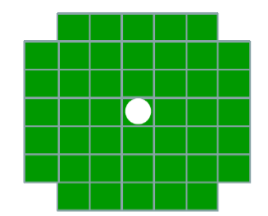
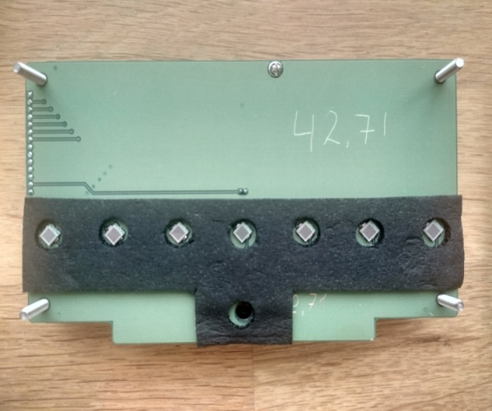
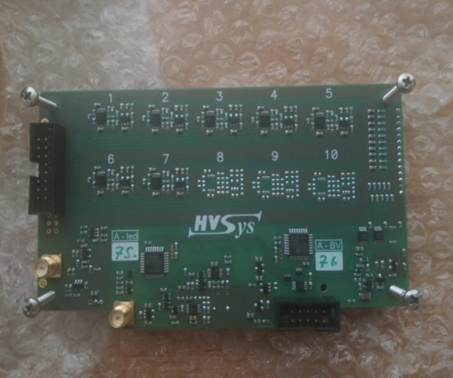
Development of FHCal DCS for the BM@N and MPD
S. Morozov^{1,2} and O. Petukhov¹
¹Institute for Nuclear Research, Moscow, Russia; pr. 60-letiya Oktyabrya 7a, Moscow, Russia
²Moscow Engineering Physics Institute , Moscow, Russia; Kashirskoe highway 31, Moscow, Russia
The BM@N and MPD experiments at NICA facility (Dubna, Russia) will use the forward hadron calorimeters (FHCal) for centrality and reaction plane determination in the heavy ion collisions. FHCal’s are assembled of modules with lead/scintillator sampling structure and longitudinal readout segmentation. The light from each section in module is detected by separate silicon photomultiplier (MMPC) with sensitive area of 3x3mm². In total, FHCal at BM@N has 438 readout channels, while two MPD calorimeters have 616 readout channels. The algorithms and development of software for the Detector Control Systems (DCS) of these calorimeters to control the bias MPPCs voltages and the temperature of MPPCs and its integration into the main DCS of both experiments will be reported.
Forward Hadron Calorimeters
DCS Development Goals
FHCal is a compensating lead-scintillator calorimeter designed to measure the energy distribution of the projectile nuclei fragments (spectators) and forward going particles produced close to the beam rapidity. The proposed modular design of the FHCal covers large transverse area around the beam spot position such that most of the projectile spectator fragments deposit their energy in the FHCal.
DCS should provide fast and stable access to all parameters of the FHCal electronics, have extensible architecture for possible hardware upgrades. DCS functions also include online temperature correction, logging parameters to database, and non-blocking interaction with multiple devices (we need 2 for MPD)
BM@N FHCal consists of 34 central part modules with 15x15 cm² transverse sizes (longitudinal segmentation of 7 sections) and 20 outer part modules with 20x20 cm² transverse sizes (longitudinal segmentation of 10 sections ). The structure of the BM@N FHCal calorimeter and its position in setup are shown in Fig.1.
Fig. 5. Screenshot of the main DCS window
FHCal
Software Architecture
Modular structure: all detector parts have capabilities (= controller registers available to R/W on bus) described in respective configuration files. Adding new module type means creating new configuration file.
Detector parts can be grouped into modules for DCS display. Any module will display controls for all its parts (e.g. HV controller, LED controller).
MPD FHCal consists of two identical left/right arms placed at the distance of about 3.2 meters from the beam collision point. The schematic design of the FHCAL module, the structure of the FHCAL calorimeter and its position in MPD setup are shown in Fig.2.
Physical device | Comment | Software class | Functions
Entire FHCal | Has one or more system modules Has one or more bus devices | Detector | Dispatch commands to system modules
System module |  | HVsysSystemModule | Manage command queue
Any HVsys bus device (FEE, power switch, ...) | Has one or more parts with RS485 bus address | HVsysModule | Logical display unit
FEE, including: HV controller LED controller Power switch | Controls HV with temperature correction for gain stabilization LED calibration Provides remote ADC board restart | HVsysSupply HVsysLED HVsysSwitch | Control, periodical temperature correction Control + LED calibration Control
FHCal
Front-end Electronics (FEE)
Front-end electronics was produced by HVsys Co. (Dubna) and includes MPPCs for light readout with precise power supplies, amplifiers and LED pulser, managed by two microcontrollers with common serial RS-485 bus.
HV controller provides the following parameters: status, set / measured voltage (7-10 channels), set / measured pedestal voltage, ramp time, ramp status, Voltage calibration min / max, temperature.
LED controller provides status, LED pulse frequency, amplitude and auto regulation parameters.
Performance Measurements
With a few hundreds of readout channels, the required time to control a single channel or FEE board become crucial. The performance bottleneck is relatively slow common serial bus. Software should fully utilize the bus, and be capable of parallel interaction on two buses (by using 2 system modules) in case of two-calorimeter MPD setup. The following table shows performance measurements for different connection modes for legacy DCS system and the new DCS. “Time” is given for single request-response in ms (the less the better), and “Poll sequence per second” is for reading the complete status of a 10-section module (the more the better).
Fig. 3. Front and back views of the FEE board for 7-section FHCal module with 7 MPPC readout channels, HV and LED controllers.
Mode | Time, ms | FHCal module poll sequence per second
“Legacy”, LAN | 150 | 0,33
“Legacy”, Moxa Real COM mode | 50 | 1,00
Socket (LAN), single command | 23 | 2,17
Socket (LAN), double command | 18 | 2,78
Moxa Real COM mode | 25 | 2,00
Moxa Real COM mode, double command | 20 | 2,50
FTDI serial over USB | 15 (avg) | 3,33
Connection Diagram
Connection Diagram
RS485
Module 1 (FEE)
Module 2 (FEE)
Module N (FEE)
DCS Integration
System module 1
HV controller
Status
HV channels
Temp. correction
HV controller
Status
HV channels
Temp. correction
HV controller
Status
HV channels
Temp. correction
Current architecture: FHCal DCS controls detector parameters, experiment-wide tango-based DCS system records historical database in parallel.
Integration plans: include pytango module into FHCal DCS to import data to the experiment-wide system.
LAN
...
System module 2
LED controller
Status
LED calibration
LED controller
Status
LED calibration
LED controller
Status
LED calibration
NICA Slow Control
DCS
System Module
FEE
FEE
System Module
FEE
...
Power Supply
Database
FEE
FEE
DCS PC
FEE
Fig. 4 The connection diagram of the DCS.
Acknowledgements
This work was supported by the Russian Foundation of Basic Research (RFBR) Grants No. 18-02-40065 and No. 18-02-40081

