Slide 1
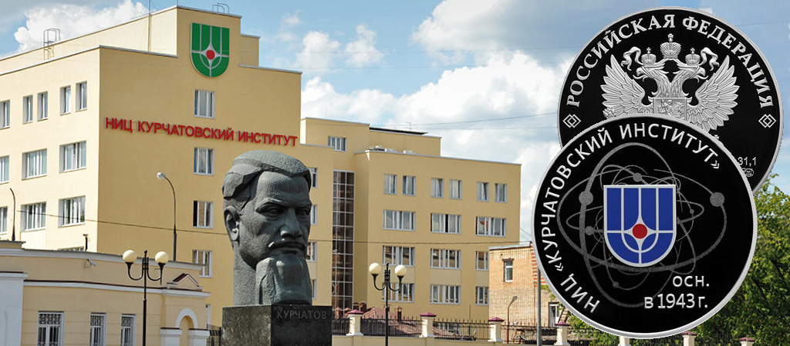
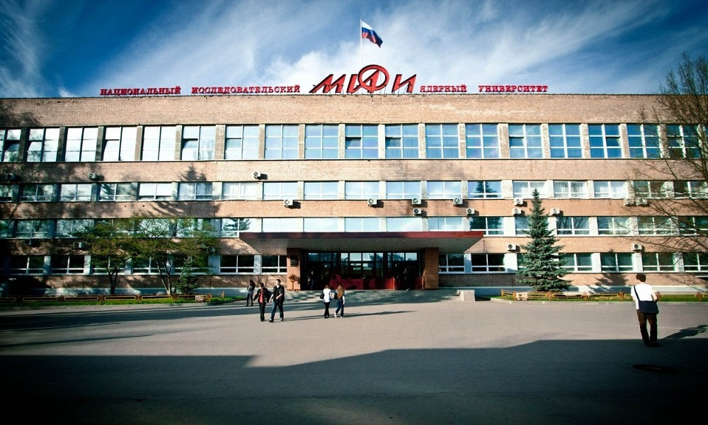

Status
of the iDream project
ICPPA 2020
October 4-11
Russia Moscow
Andrey
Konstantinov
NRC Kurchatov institute

Slide 2


iDream team
Currently there is a collaboration of NRC Kurchatov Institute and Skobeltsyn Institute for Nuclear Physics (Lomonosov Moscow State University):
  NRC Kurchatov Institute: A. Abramov, A. Chernov, A. Etenko, A. Konstantinov, D. Kuznetsov, E. Litvinovich, G. Lukyanchenko, A. Murchenko, A. Nemeryuk, R. Nugmanov, B. Obinyakov, A. Oralbaev, A. Rastimeshin, M. Skorokhvatov, S. Sukhotin.
  SINP MSU: A. Chepurnov, M. Gromov, K. Zamogilny.

Slide 3
Prospects for the development
of neutrino monitoring
- Determination of the operational condition reactor (on or off) can be detected within 5 hours of shutdown or start-up with 99% confidence
- Determination of the current / daily reactor thermal power
- Determination of fission fractions of U and Pu isotopes in the reactor core
- Remote confirmation of the technogenic nature of a nuclear explosion
- Technically our detector has the ability to transmit registration data remotely, so in the future we can detect any reactor shutdowns and exclude nuclear proliferation of materials remotely

Slide 4
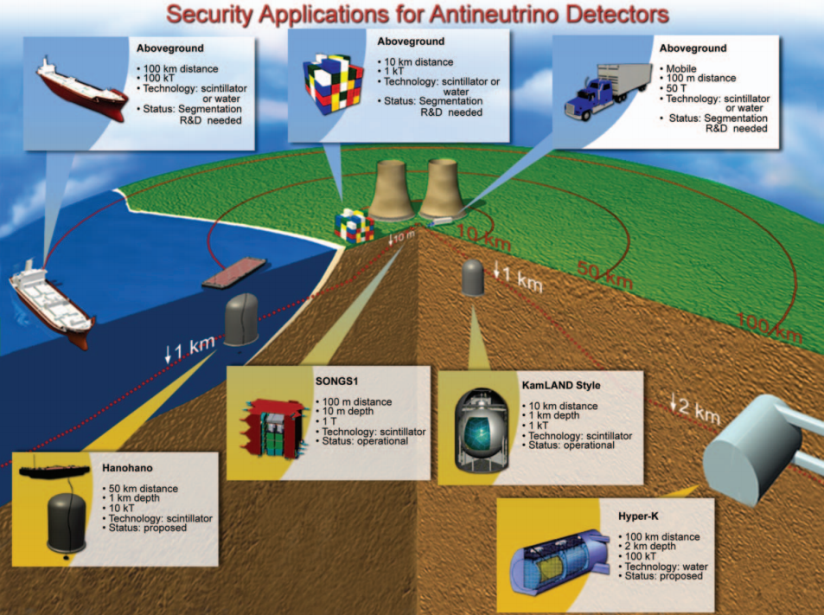
Different approaches of Reactor Safeguards
A. Bernstein et al., Nuclear Security Applications of Antineutrino Detectors: Current Capabilities and Future Prospects, Science & Global Security, 18:127–192, 2010.

Slide 5
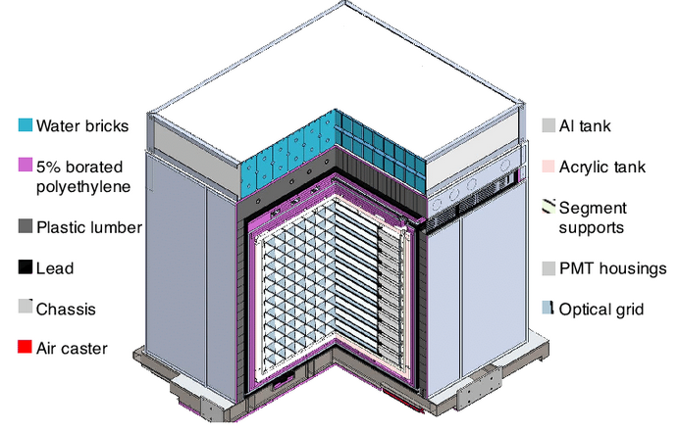
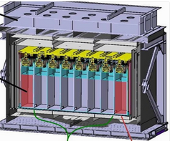
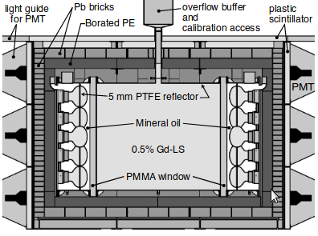
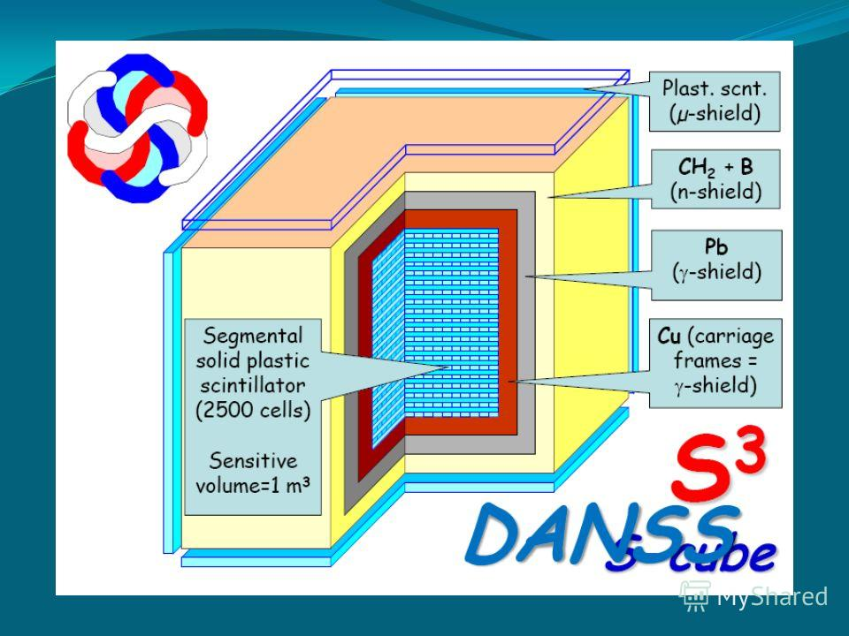
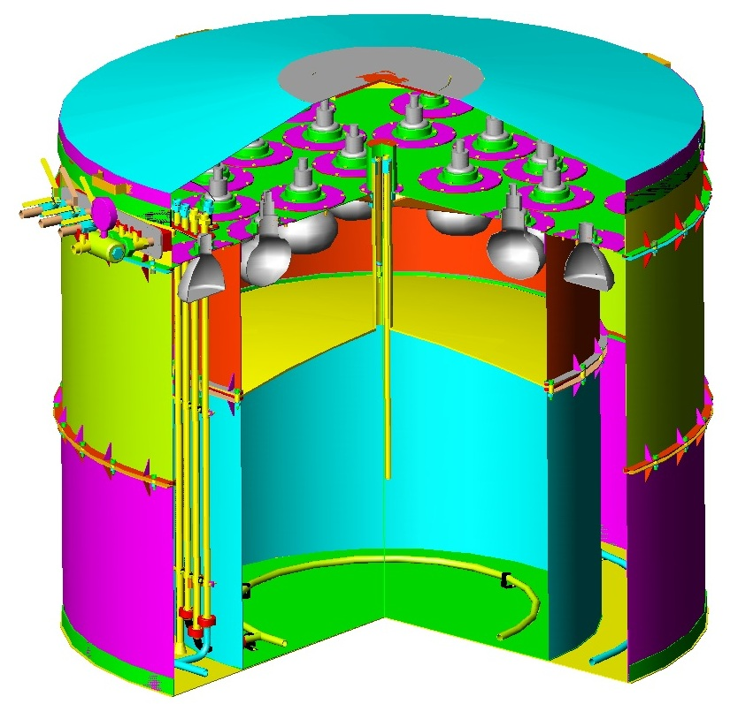
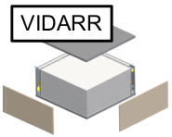
Applications of Antineutrino Detectors for Security
STEREO
NEOS
PROSPECT
DANSS
iDream
and other projects

Slide 6
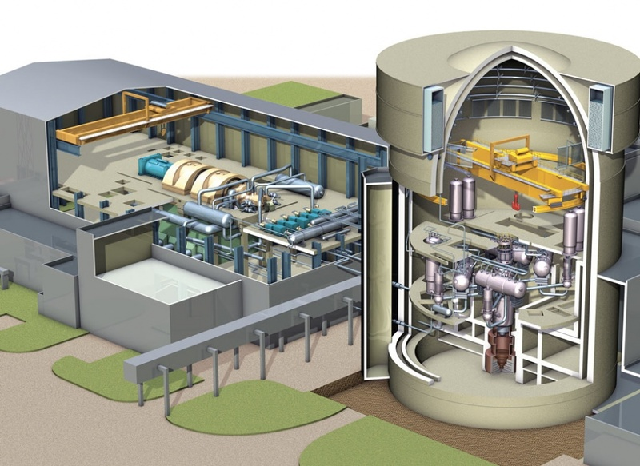
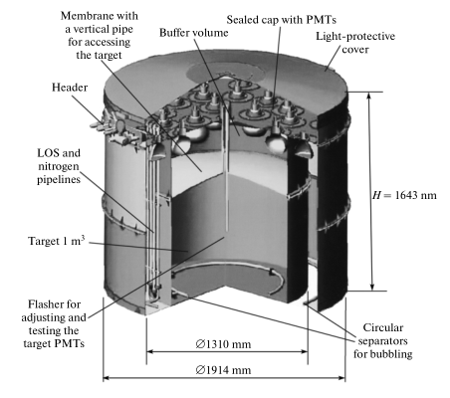
iDream – industrial Detector of Reactor Antineutrinos for Monitoring
Our detector is:
- Structurally simple
- High-maintainability
- Easily-dismountable
and easy-to-assemble.
iDream is expected to be easily mounted at the plant
Top only location of the PMTs guarantees quick access for their removal/repair, if needed
Reference: https://vashurok.ru/articles/2019-10-24-pochemu-aes-samye-ekol

Slide 7
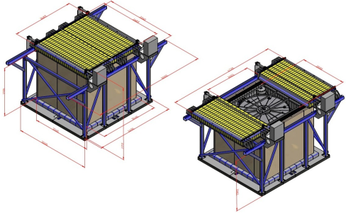
The detector design has radiation protection
working condition
for setting up the detector

Slide 8
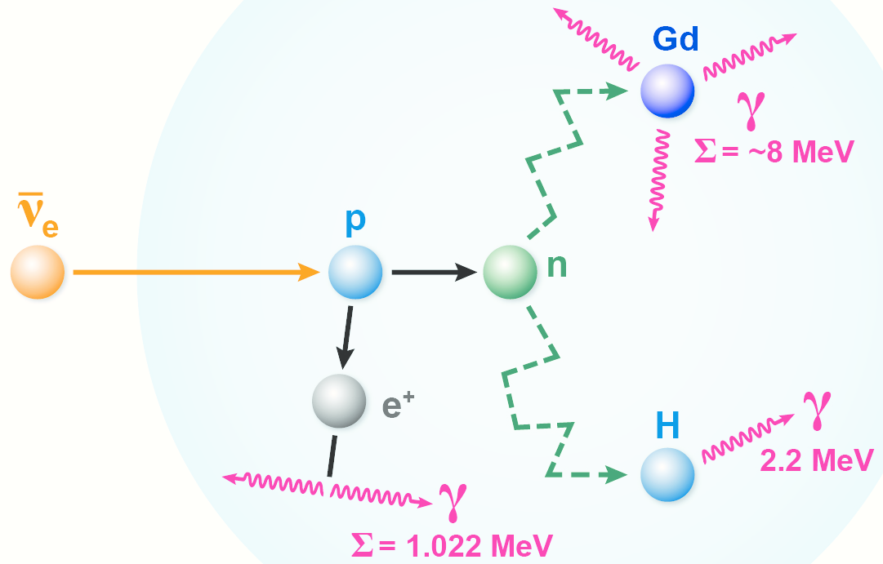
Using Gd-loaded LAB-based liquid scintillator
Inverse beta-decay reaction:
Gd improves the efficiency of
neutron detection.

Slide 9
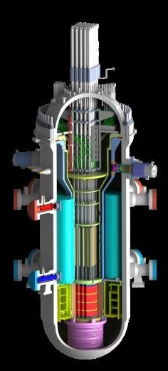


Exclusion of data falsification
Registration of detector data should prevent falsification of physical data by external influences on the detector.
iDream
No falsification!

Slide 10
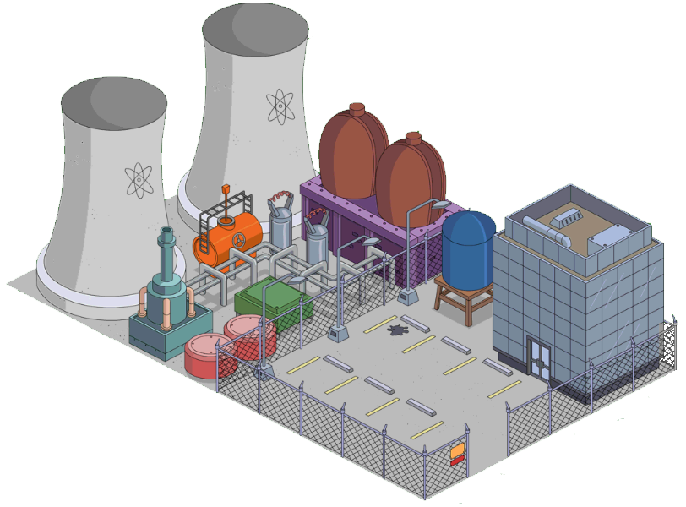

Remote detector control
iDream has the ability remotely to transmit registration data via communication channels to the remote control center.

Slide 11



The detector must work independently 24/7/365
No iDream service
Only autonomy

Slide 12
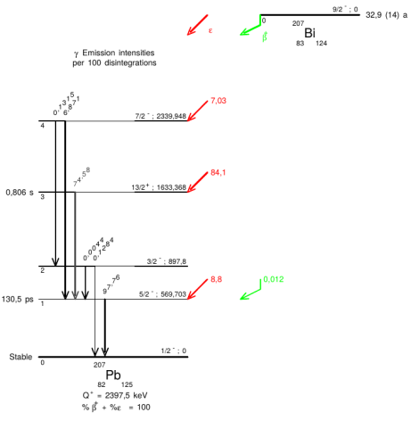
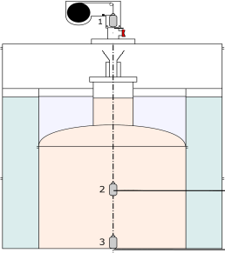
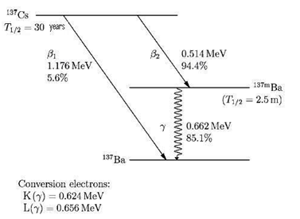
Built-in calibration tools
of iDREAM detector
²⁰⁷Bi decay
The calibrations were performed along
z-axis (in the range -400 / +400 mm).
iDREAM detector
calibration scheme:
1 - engine source
2,3 - calibration
source position
¹³⁷Cs decay

Slide 13
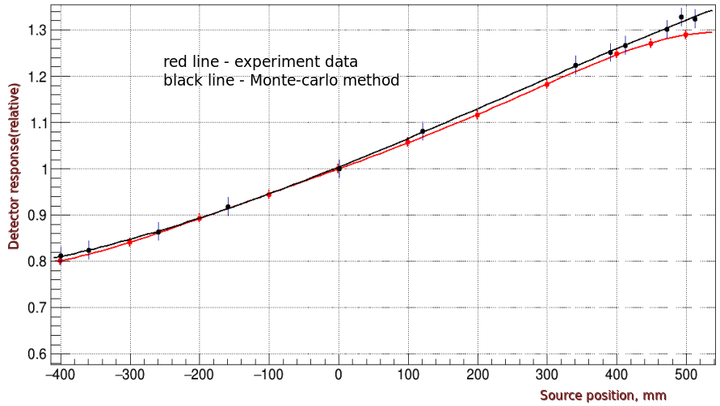
The latest results of calibrations
The mathematical model (Geant4 based Monte Carlo method) showed good agreement with the calibration data at about 1%.
Detector was filled scintillator with LAB+PPO+bis-MSB

Slide 14
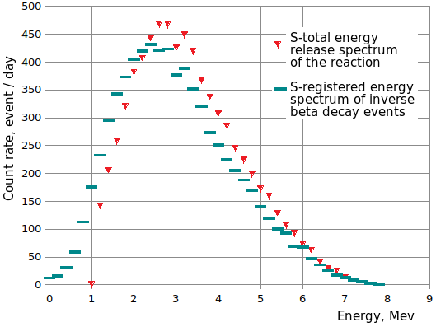
Positron spectrum
Detector response has been simulated in the antineutrino flux (Huber-Mueller model), 19m from the VVER-1000 reactor core.

Slide 15
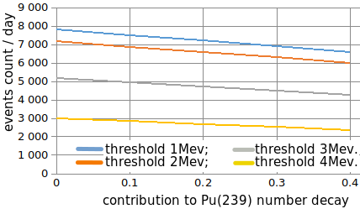
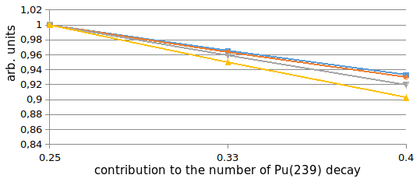
Comparative change of the antineutrino
count of accumulated 239Pu
Expected change in the rate of the antineutrino interaction in the target as a result of Pu-239 accumulation.
Comparative change of the antineutrino count rate:
the beginning (239Pu=0.25), middle (239Pu=0.33), and end of the campaign (239Pu=0.40).

Slide 16
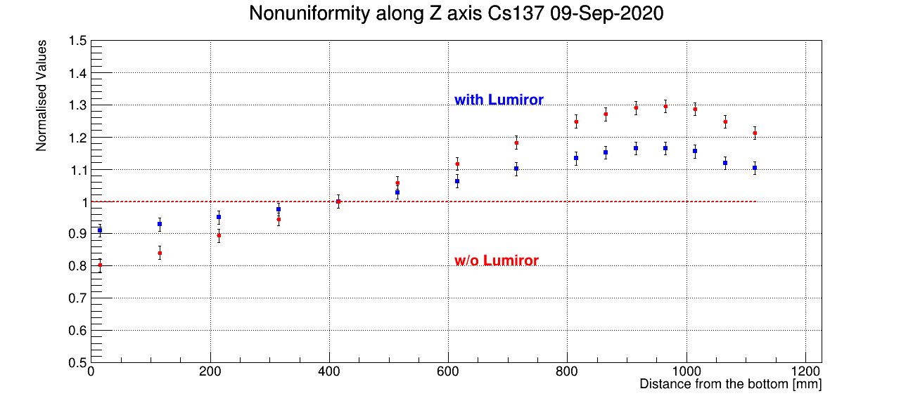
Last calibration data with/without lumir
For the detector with target fully coated by the Lumirror, we achieved the light collection inhomogeneity (-9%; +12%) - for (-400; +400) mm part of the target along z-axis.

Slide 17


Prospects for the development of neutrino monitoring for IAEA
- The industrial detector iDream must be an IAEA tool for non-proliferation safeguards
- The ability to constantly monitor the use of fissile materials in real time
- The ability of a State to control its nuclear materials independently on international operating companies
- As a result: improving the operational safety of nuclear power plants
iDream is on the
international arena

Slide 18
Summary
- The detector is being prepared for commissioning at Kalinin nuclear power plant, start of data taking planned for 2021
- Detector calibrations with gamma-sources have been performed
- The Monte-Carlo model of the detector showed good agreement with the calibration data - about 1%
- The light collection inhomogeneity was studied with the calibration data: for cylindrical part of the detector’s target (-400; +400) mm along z-axis we achieved (-9%; +12%) inhomogeneity
- Positron response of the detector in the antineutrino flux, 19m from the reactor core, was simulated; estimation of the expected change in the rate of the antineutrino interactions during the reactor campaign was obtained

Slide 19




The end

