Slide 1
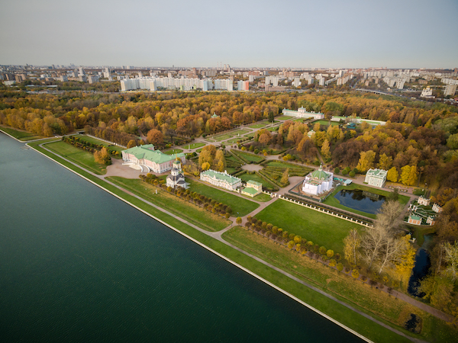
The 5rd International Conference on Particle Physics and Astrophysics
Search for ¹⁰He in the stopped pion absorption ¹⁴С(π⁻, p³He)X
B.A. Chernyshev
National Research Nuclear University “MEPhI”
Moscow, 2020
Notes:
Б.А.Чернышев

Slide 2
Superheavy Helium Isotope ¹⁰He
The ground state of ¹⁰He is a resonance system comprising
the ground state of ⁸He_{g.s.} and two neutrons.
For Z ≥ 2 the ¹⁰He has largest ratio N/Z of any nucleus (nucleon stable or nonstable). Therefore, the study of a level structure of ¹⁰He is of increased interest.
This isotope is difficult to study as there are very few ways to produce the nucleus with such an enormous neutron excess.

Slide 3
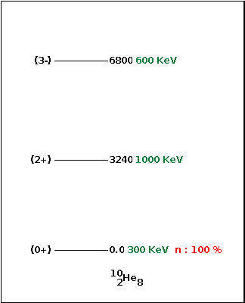
Level structure of ¹⁰He
E_{r}, MeV | Г, MeV | J^{P} | Reaction | Work
1.2(3) | ≤1.2 |  | CD₂(¹¹Li,nn⁸He)X | [1, 2]
1.07(7) | 0.3(2) | (0⁺) | ¹⁰Be(¹⁴C, ¹⁴O)¹⁰He | [3]
4.31(20) | 1.0(3) | (2⁺)
7.87(6) | 0.6(3) | (3⁻)
1.7(3)(3) |  |  | p(¹¹Li,2p)¹⁰He | [4]
1.54(11) | 1.91(41) | 0⁺ | ¹H(¹¹Li,nn⁸He)X | [5, 6]
3.99(26) | 1.64(89) | 2⁺
~3 |  |  | ³H(⁸He, p)¹⁰He | [7]
2.1(2) | 2 | 0⁺ | ³H(⁸He, p)¹⁰He | [8]
>4.5 |  | 2⁺
>6 |  | 1⁻
1.4(3) | 1.8(2) | 0⁺ | ¹H(¹⁴Be,nn⁸He)X | [9, 10]
4.7(8) | 1.64 | 2⁺
1.4(3) | 1.4 |  | d(¹¹Li, ³He) ¹⁰He | [11]
6.3(7) | 3.2
Excited levels
https://www.nndc.bnl.gov/nudat2
[1] A.A.Korsheninnikov et al., Phys. Lett. B326, 31 (1994).
[2]A.A.Korsheninnikov et al., Nucl. Phys. A588, 23c (1995).
[3] H.G.Bohlen et al., Nucl. Phys. A583, 775 (1995).
[4]T.H.Kobayashi et al., Nucl. Phys. A616, 223c (1997).
[5]H.T.Johansson et al., Nucl. Phys. A842, 15 (2010).
[6]H.T.Johansson et al., Nucl. Phys. A847, 66 (2010).
[7] M.S.Golovkov et al., Phys. Lett. B672, 22 (2009).
[8] S.I.Sidorchuk et al., Phys. Rev. Lett. 108, 202502 (2012).
[9] Z.Kohley et al., Phys. Rev. Lett. 109, 232501 (2012).
[10] Z.Kohley et al., Phys. Rev. C91, 044212 (2015). [11] A.Matta et al., Phys. Rev. C92, 041302R (2015)
S_{2n}( ¹⁰He_{g.s}) = 1.07 МэВ ???

Slide 4
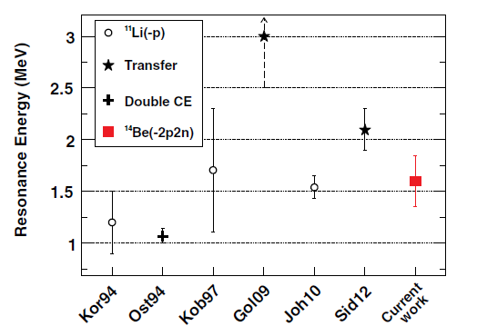
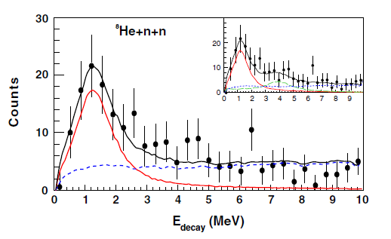
[10] Z.Kohley et al., Phys. Rev. Lett. 109, 232501 (2012).
Grigorenko and Zhukov [ Phys. Rev. C 77, 034611, (2008)] showed that the observed peak in the three-body spectrum of the GSI invariant mass measurement could result from the halo nature of the 11Li projectile, which may explain the discrepancy between the GSI and Dubna (8He projectile) results.
⁸He
Dubna
GSI
However, the results of [10] cast doubt on this hypothesis.
[10] Z.Kohley et al., Phys. Rev. C91, 044212 (2015).

Slide 5
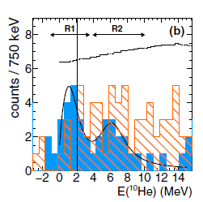
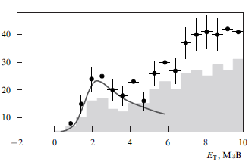
[3] H.G.Bohlen et al., Nucl. Phys. A583, 775 (1995).
[11] A.Matta et al., Phys. Rev. C92, 041302R (2015).
[8] S.I.Sidorchuk et al., Phys. Rev. Lett. 108, 202502 (2012).

Slide 6
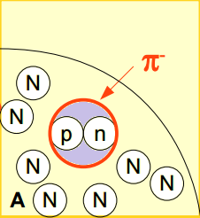
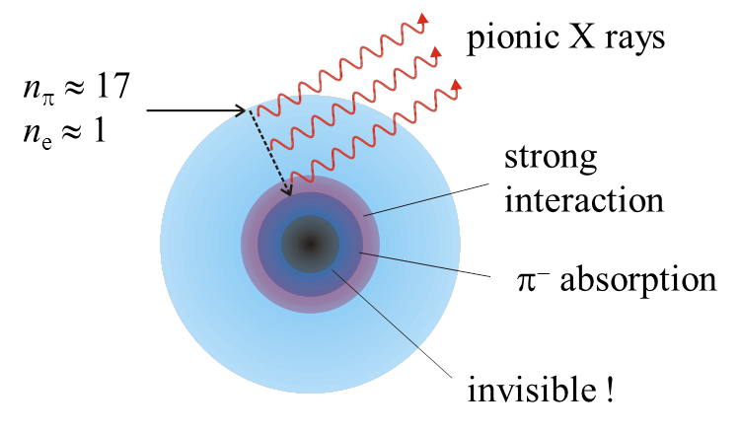
Stopped pion absorption by nuclei −
Tool for production of neutron-rich states
π⁻ + ⁹Be, ^{10,11}B, ¹²C → exotic nuclei + X
π⁻ + pn (T=0, S=1, l_{pn}=0) → nn
π⁻ + pp → pn

Slide 7
¹⁰He production in the stopped pion absorption by ¹⁴C

Slide 8
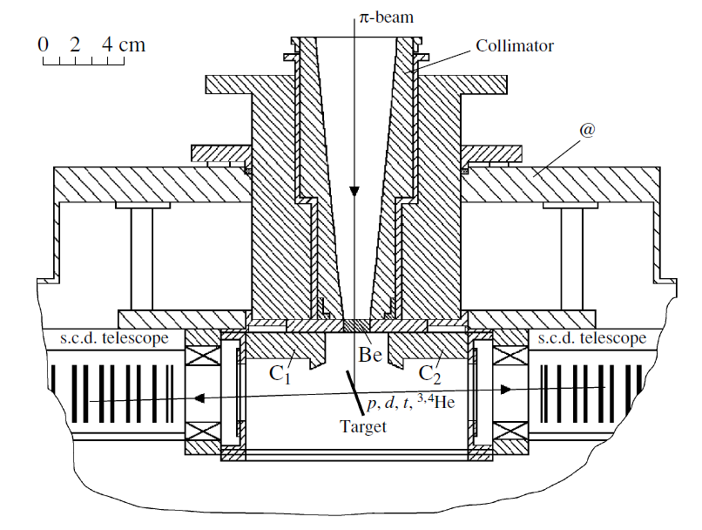
Layout of spectrometer (LAMPF)
Beam | Target | Sizes and Impurities | Stop rate, 1/s | SCD- telescopes | Threshold(MeV)
Еπ= 30 MeV (Δp/p=±1%) | ⁹Be ^{10,11}B ^{12,14}C | Thickness – 25 mg/sm², (135µm), diameter – 26 mm, | ∼ 6⋅10⁴ | 2 Si(Au) -Т=100, 450µm 14 Si(Li) -Т=3 mm, Wd≈0.1mm S=8 mm² Ω=55÷15 mster | Е_{p} ≈ 3.5, Е_{d} ≈ 4, Е_{t} ≈ 4.5, E_{He} ≈ 15.
¹⁴C “radioactive” target
76% ¹⁴C, 23% ¹²C
FWHM
ΔЕ < 0.5 MeV (Z=1)
ΔЕ < 2.0 MeV (Z=2)
ΔMM < 3 MeV (Z₁=1, Z₂=2)
Gornov M. G. et al. // Nucl. Inst. and Meth. in Phys. Res. A 2000. V. 446. P. 461.

Slide 9
⁸He production in the ¹²C(π⁻, p³He)X reaction

Slide 10
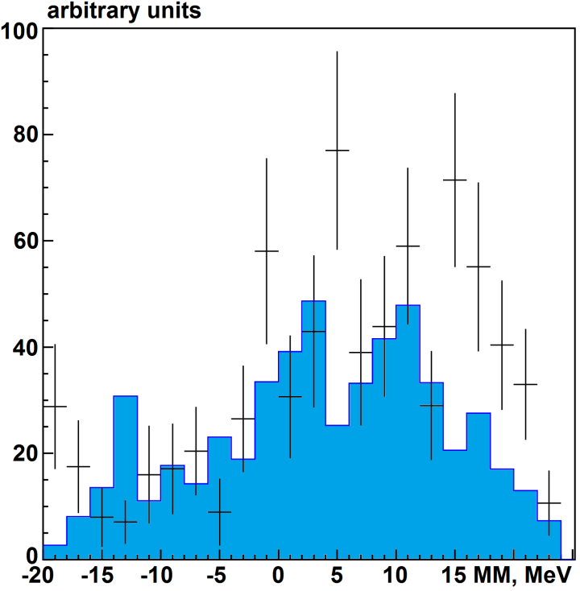
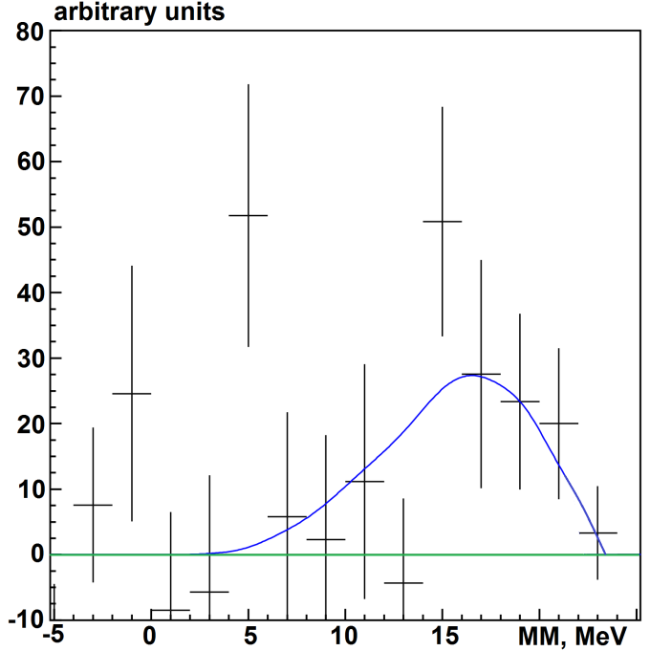
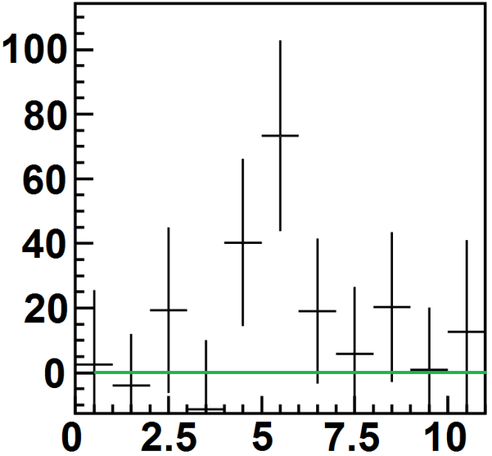
¹⁰He production in the ¹⁴C(π⁻, p³He)X reaction
77% −¹⁴С 23% −¹²С
1-Phase volume π⁻ ¹⁴С → p³He⁷He3n
¹⁰He* → ⁶He +4n or ⁷He +3n

Slide 11
Conclusion
• ¹⁴C(π⁻, p³He)X reaction indicated the existence of an excited level with E_{x}.~ 6 MeV (E_{r} ~ 7 MeV).
Analysis of the spectrum showed that the observed state appears to be decaying into ⁶He +4n or ⁷He +3n.
• The absence of indications for states with lower resonance energies may be due to insufficient statistics of the data and structure of the absorbing nucleus ¹⁴C.

Slide 12
Thank you
for your attention!

