Slide 1
Application of machine learning methods for simulation and analysis of the properties of linear structures in the mass distribution of nuclear reaction products
The 5th International Conference on Particle Physics and Astrophysics Online 5–9 October 2020
Mikhail Rudenko
Dubna State University
G.A. Ososkov*, Yu.V. Pyatkov**, ***
*Laboratory of Information Technologies, JINR
**National Nuclear Research University MEPhI
(Moscow Engineering Physics Institute), Moscow, Russia
**Flerov Laboratory of Nuclear Reactions, JINR

Slide 2
Research project on clustering in heavy nuclei
+
The Main goal of the project:
search and analysis of clusterization manifestations in rare multibody decays of heavy nuclei by the example of the study of spontaneous fission of Californium ²⁵²Cf

Slide 3
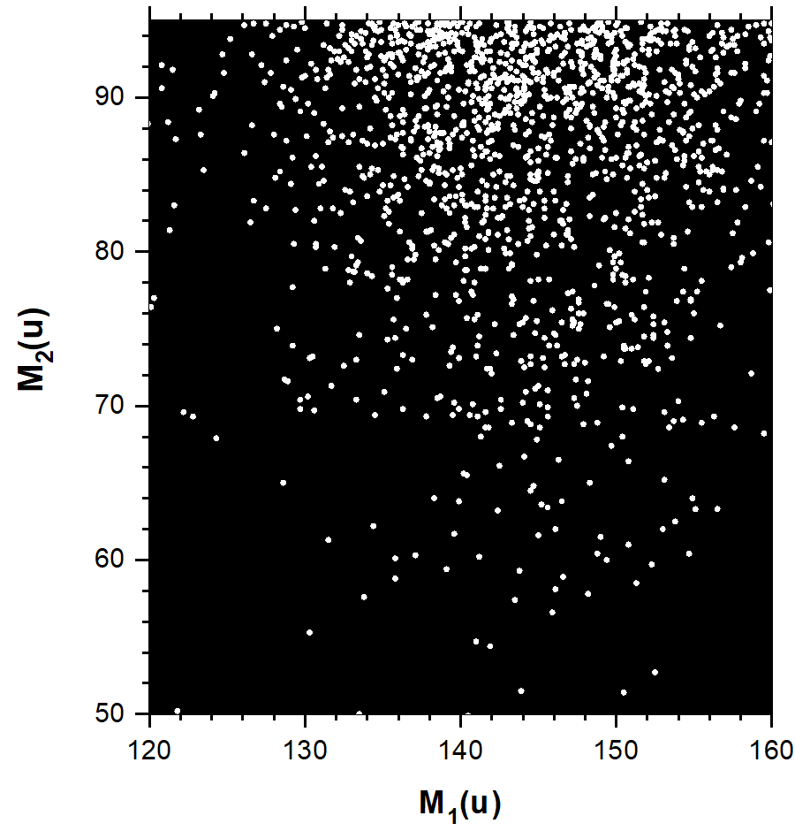
Californium fission analysis
Fission fragments mass
correlation distribution from ²⁵²Cf(sf) measured
by the FOBOS group in FLNR

Slide 4
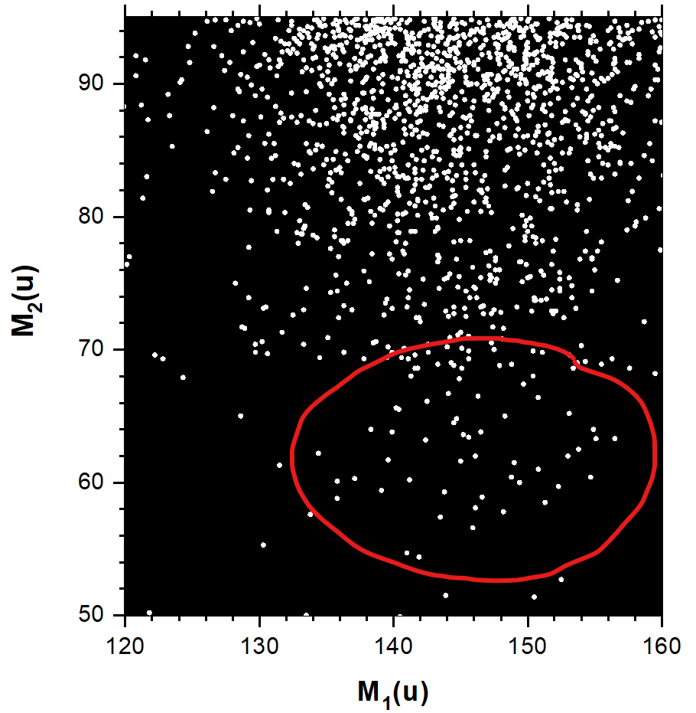
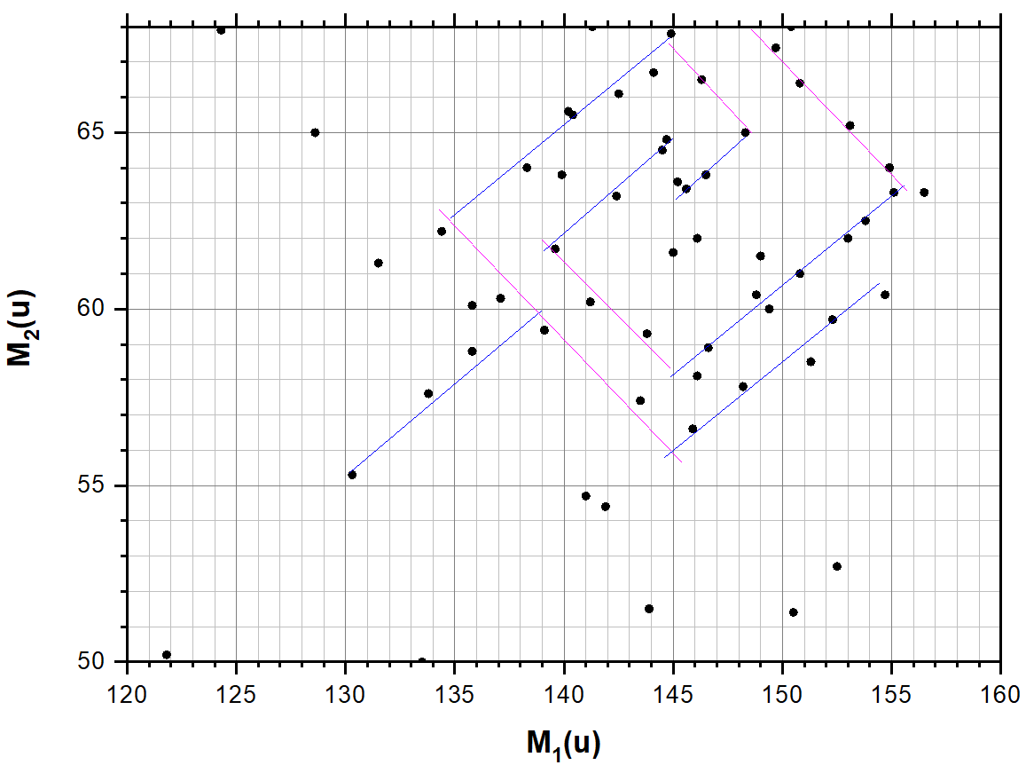
«Nuclear rose»
The rhombo-spiral structure consists of lines M1 + M2 = const and lines almost perpendicular to them

Slide 5
«Nuclear rose»
Task:
prove that the "rose" is not a random set of points

Slide 6
Task
It is necessary to create a flexible tool that can recognize not only the structure similar to the nuclear rose in the original and noisy image, but also similar ones. With this tool, prove that a rose is not a simple set of points
Solution
develop a numerical model of "rose"
create a dataset for training ANN used as a neural-classifier
train a convolutional ANN-classifier to distinguish noise from the "rose" and to make sure that the probability of the wrong prediction of the “rose” among a set of noise points is negligible

Slide 7
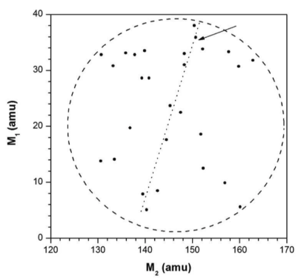
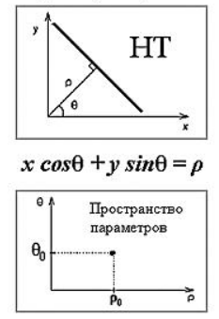
Hough transform for recognizing straight lines
The Hough transform consists of a transition from the measurement space to the parameter space
We did not apply the original Hough parameterization, because it wasn’t supposed to search for vertical lines and due to complexity of the original Hough algorithm

Slide 8
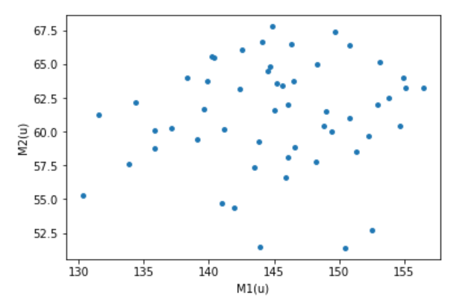
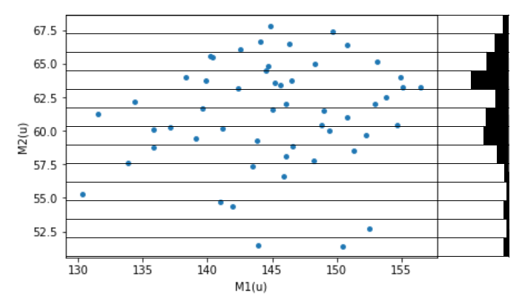
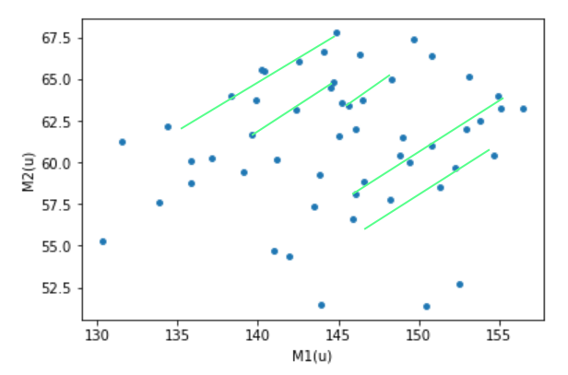
Method of inclined histograms for constructing the «rose» model

Slide 9
Method of inclined histograms for constructing the «rose» model

Slide 10
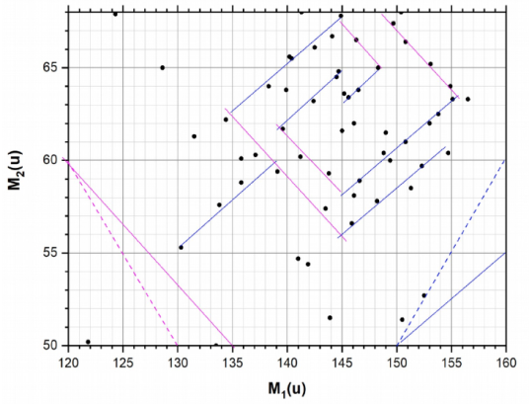
Development of the «rose» model
1. Statistical processing
Using inclined histograms to find 10 straight lines
Apply least square method to determine the parameters of the lines and the mean scatter of points around them
Find the coordinates of 10 line intersection points to determine the lengths of 10 segments forming the «rose» and its «stem»
Count the number of points n_{i} around each of these segments and determine their average number λ and rms σ
Using the Kolmogorov’s Criterion, verify the hypothesis of the Poisson distribution law of numbers n_{i}
2. Creating a numeric model
For every of the given segments i, forming the «rose» and its «stem», generate m_{i} points belonging to this segment according to Poisson's law with the parameter λ
Generate m_{i} points uniformly distributed inside the i-th segment
Scatter those points around the i-th segment according to the normal law with parameters (0, σ)
Notes:
Ordinary Least Squares (OLS)

Slide 11
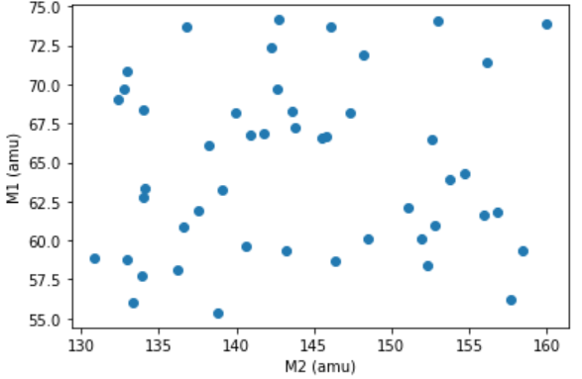
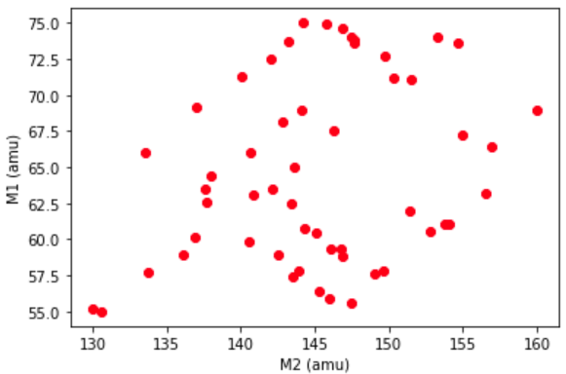
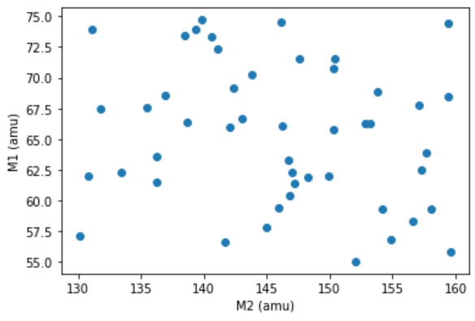
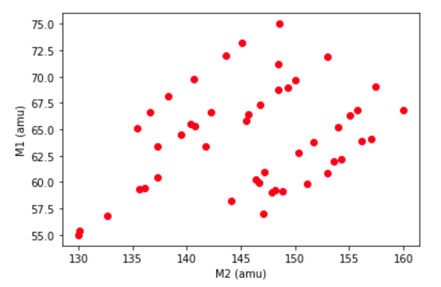
Training sample
Image of points uniformly distributed inside the meander field
Generated implementation of a rhombic meander
The sample of 3*10⁴ such simulated images was simulated for training and validating the neuro-classifier (70% for training and 30% for validating)

Slide 12
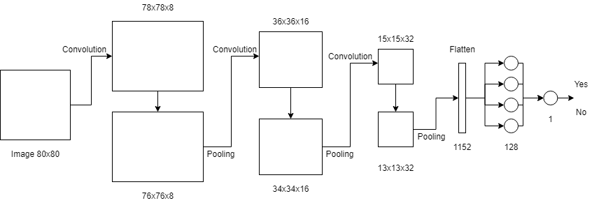
Neuroclassficator
Optimizer – ADAM
Batch size – 256 images
Number of epochs – 25
Accuracy on training and validating datasets – 99%

Slide 13
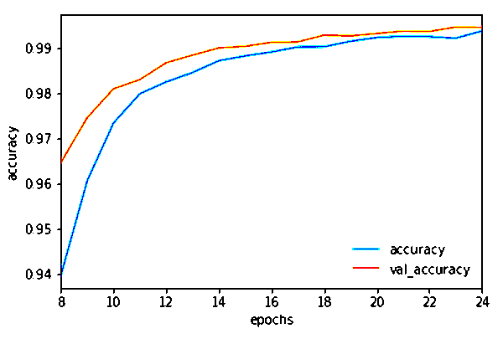
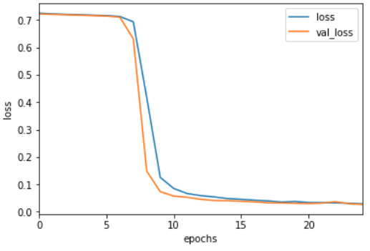
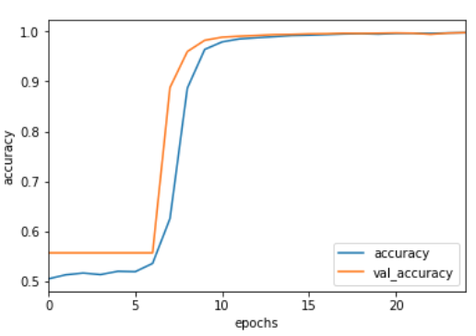
The results of training and validating the neuroclassifier
Enlarged fragment of the figure below
loss function behavior on the training and validation datasets
Increase of
the recognition accuracy on the training and validation datasets
To prevent ANN overfitting the training was stopped on the 25th epoch. As it is seen from the fragment above, the trained ANN retains the ability to generalize, since the orange line (the validation accuracy) is always higher than the blue line (the recognition accuracy of the training sample images)

Slide 14
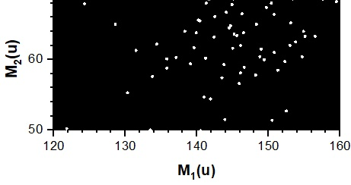
«Nuclear rose» ???
Is a «nuclear rose» present in the original image?
The result of neuroclassification:
Probability = 99.913955%

Slide 15
When a random combination of points is a rhombic meander?
Numerical Monte Carlo experiment with n = 100 000 trials
T = 80%
m = Pmax > T = 17
T – threshold
Pmax – probability of the presence of a «rose» in the image
n – number of images
m – number of threshold exceeded
It is the famous Bernoulli scheme
probability P = m/n = 0.00017,
its rms
$$σ_{T}=\frac{1}{n}\sqrt{\frac{\left.m(n−m\right)}{n}}$$

Slide 16
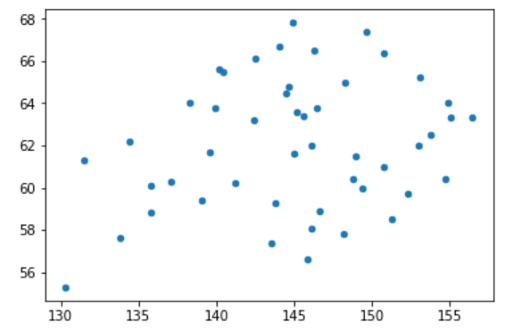
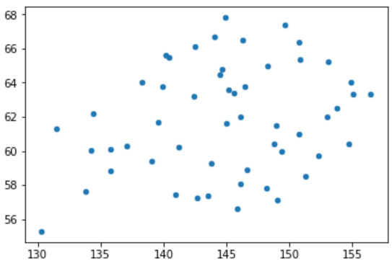
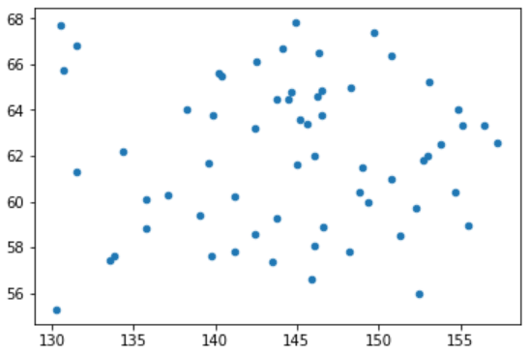
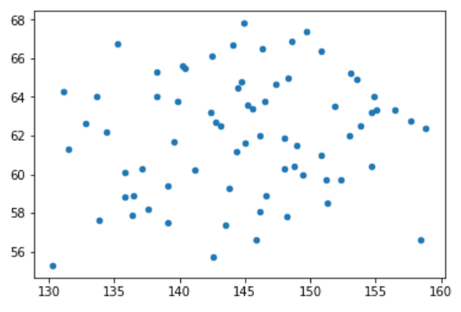
Study of the uniform noise effect on the correct recognition probability
noise 0%
noise 10%
noise 30%
noise 50%

Slide 17
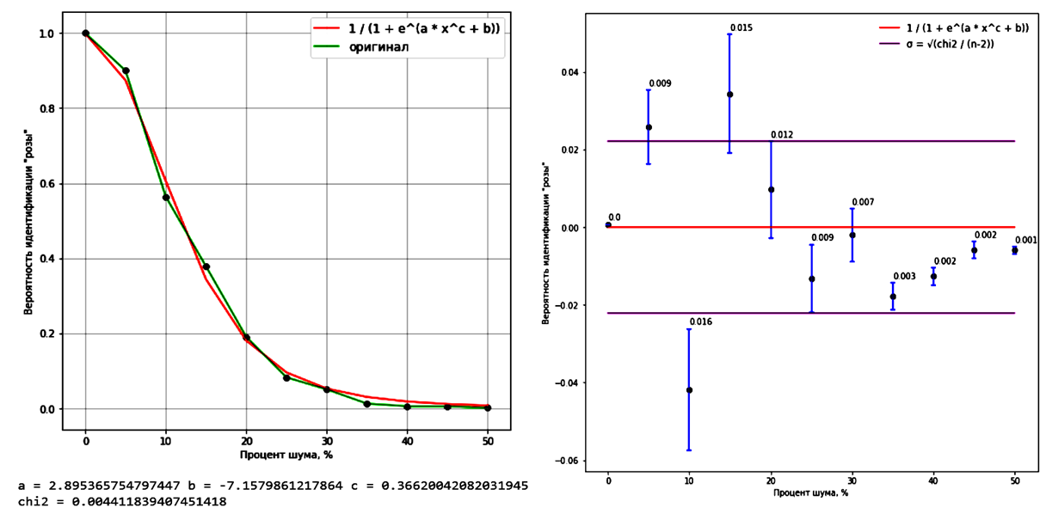
Uniform noise effect. The original «rose»
1000 Monte Carlo experiments noise from 0% to 50% in increments of 5%
Approximation function
$$σ_{T}=\frac{1}{n}\sqrt{\frac{\left.m(n−m\right)}{n}}$$
Probability of identifying a "rose"
Probability of identifying a "rose"
Noise, %
Noise, %
Fit residuals plot with the corridor of errors

Slide 18
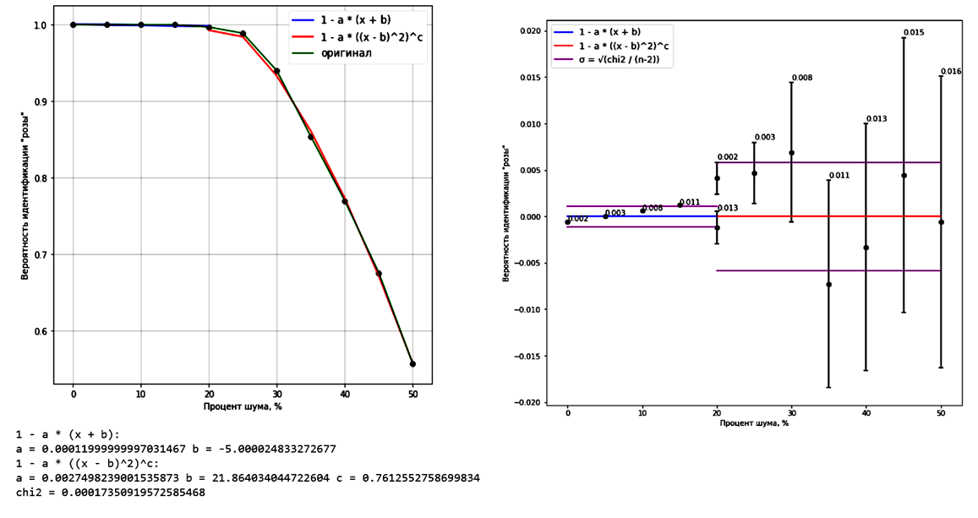
Uniform noise effect «Rose» generated by the model
1000 Monte Carlo experiments noise from 0% to 50% in increments of 5%
Approximation functions
Probability of identifying a "rose"
Probability of identifying a "rose"
Noise, %
Noise, %
Fit residuals plot with the corridor of errors

Slide 19
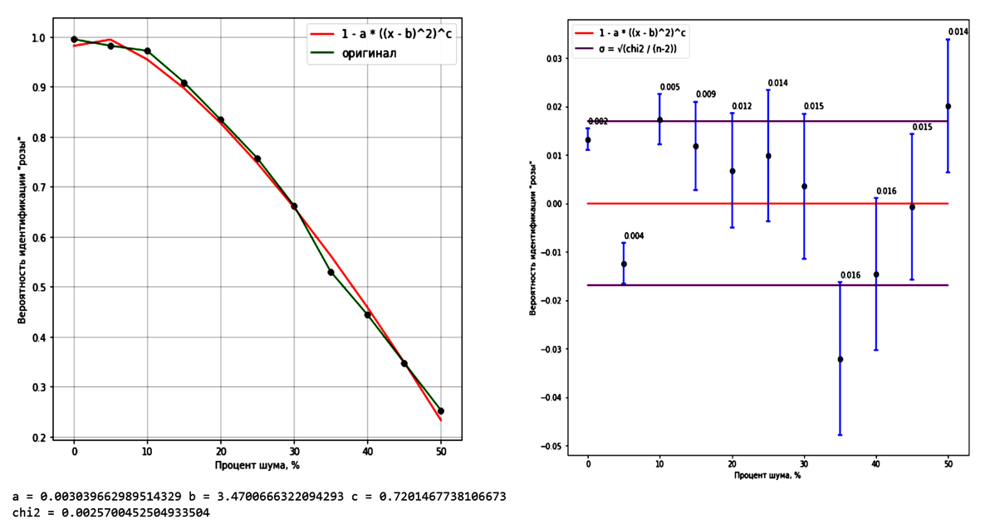
Uniform noise effect «Rose» generated for each of n experiments
1000 Monte Carlo experiments noise from 0% to 50% in increments of 5%
Approximation function
Probability of identifying a "rose"
Probability of identifying a "rose"
Noise, %
Noise, %
Fit residuals plot with the corridor of errors

Slide 20
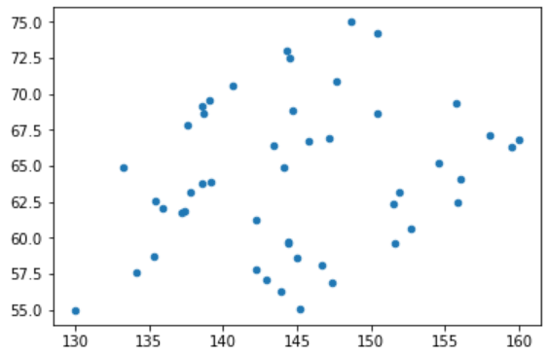
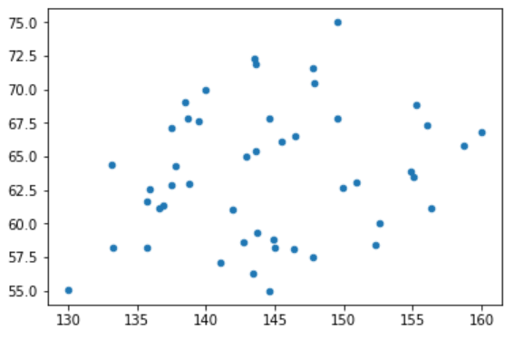
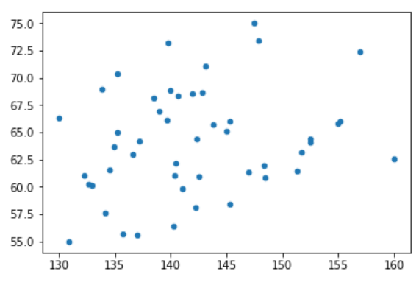
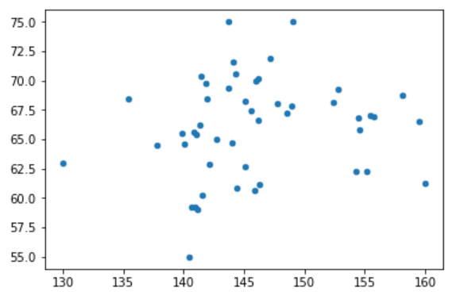
Study the influence of point scattered around the lines forming the meander on the probability of correct recognition
Original σ = 0.2
4 times increase of σ
10 times increase of σ
20 times increase of σ

Slide 21
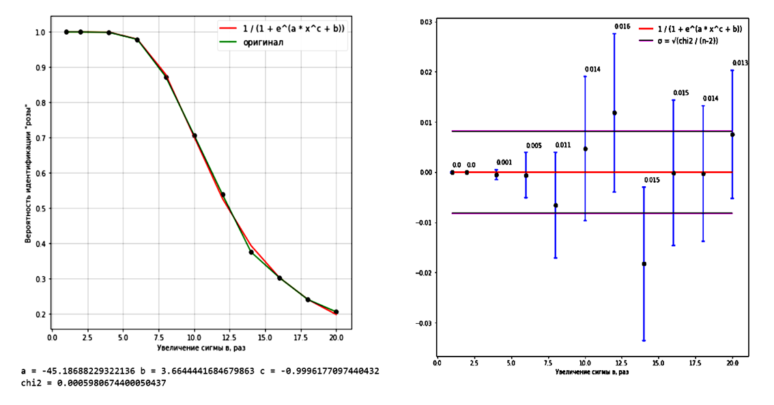
Study of point scattering «Rose» generated by the model
1000 Monte Carlo experiments σ increase from 1 to 20 In increments of 2
Approximation function
Probability of identifying a "rose"
Probability of identifying a "rose"
Increase sigma, times
Increase sigma, times
Fit residuals plot with the corridor of errors

Slide 22
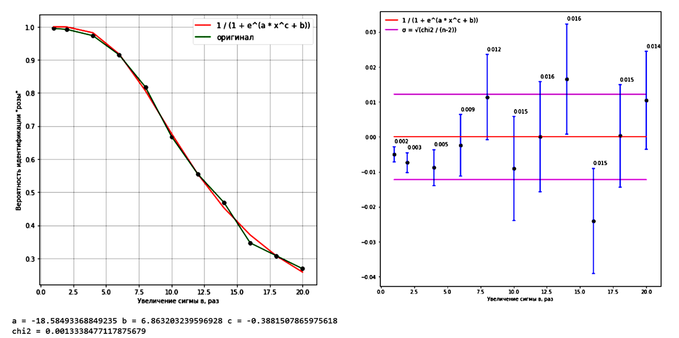
Study of point scattering «Rose» generating for each of n experiments
1000 Monte Carlo experiments σ increase from 1 to 20 In increments of 2
Approximation function
Probability of identifying a "rose"
Probability of identifying a "rose"
Increase sigma, times
Increase sigma, times
Fit residuals plot with the corridor of errors

Slide 23
Conclusion
A number of quantitative estimates have been obtained that indicate the non-random origin of the structure in the form of a rhombic meander and the procedure stability to such parameters as data noise and mass resolution of the spectrometer
Probability of detecting the line structure using a pre-trained neural network on an array of its statistically independent generations is p=99.913955%
The probability of taking a random set of points for a line structure is negligible (0.00017)
The developed neuro-classifier can handle meander identification up to 25% of noise in data
Degradation of mass resolution up to 5 times does not have a strong effect on the probability of structure identification

Slide 24
Thanks for your attention!

