Slide 1



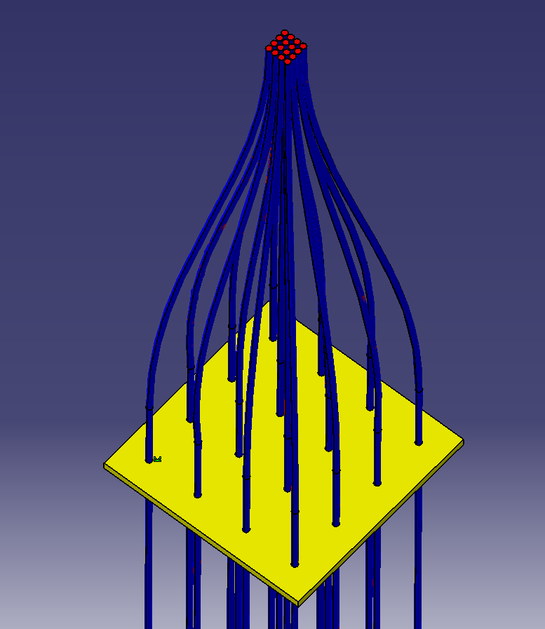
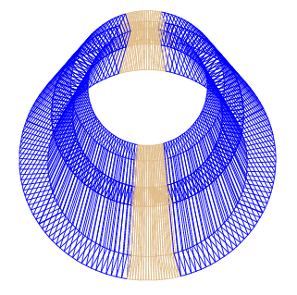
ITEP
Time response simulation of a “shashlyk”-type calorimeter as applied to ECAL MPD / NICA.
A.V.Skobliakov, V.V. Kulikov, S.A. Bulychjov, A.V,Kantsyrev M. A. Martemianov, M.A.Matsyuk, I.A. Tyapkin
07.10.2020

Slide 2
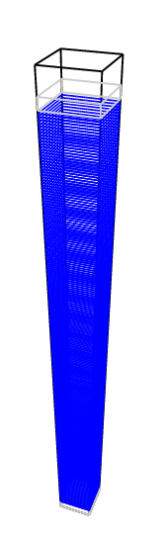
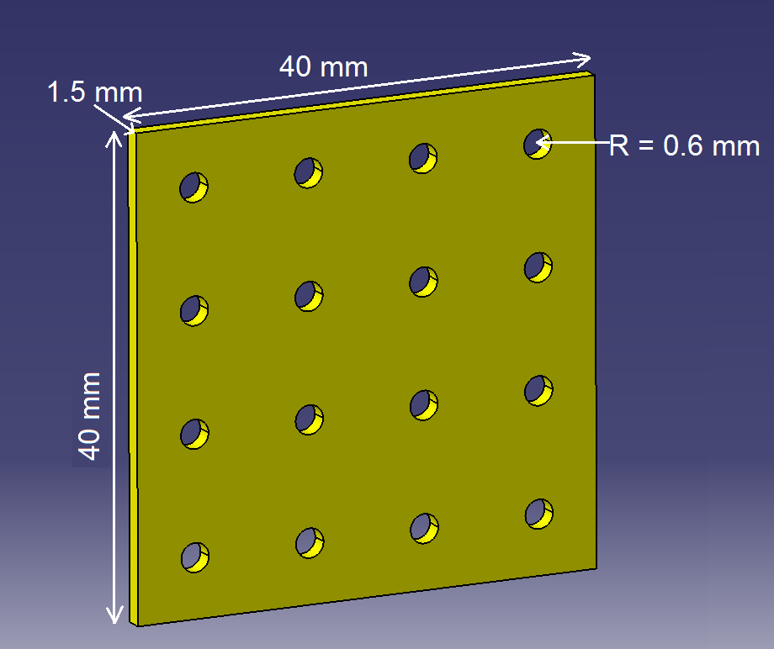
Geometry of electromagnetic calorimeter (ECAL)
One tower
Z_{local} – axis
FscScint - C₉H₁₀
41.5 cm
Total number of towers: 38400
Each tower has 210 Pb (h = 0.3 мм) plates and
211 (FscScint - C₉H₁₀ , h = 1.5 мм)
Weight: 60 t
R_{in} = 1.72 m, R_{out} = 2.21 m, L = 6 m

Slide 3

Simulation model
WLS Fiber Kuraray Y-11(200)
Model (“shashlyk” type)
Photodetector
place*
0.599 mm
0.575 mm
n = 1.59
Fibers
n = 1.42
25 cm
C₉H_{10,} density = 1.03 g/cm³
Ref. coeff. = 1.58
Absorption length = 210 cm
*6x6 mm² MPPC Hamamatsu S13360-6025PE (57600 cells)

Slide 4
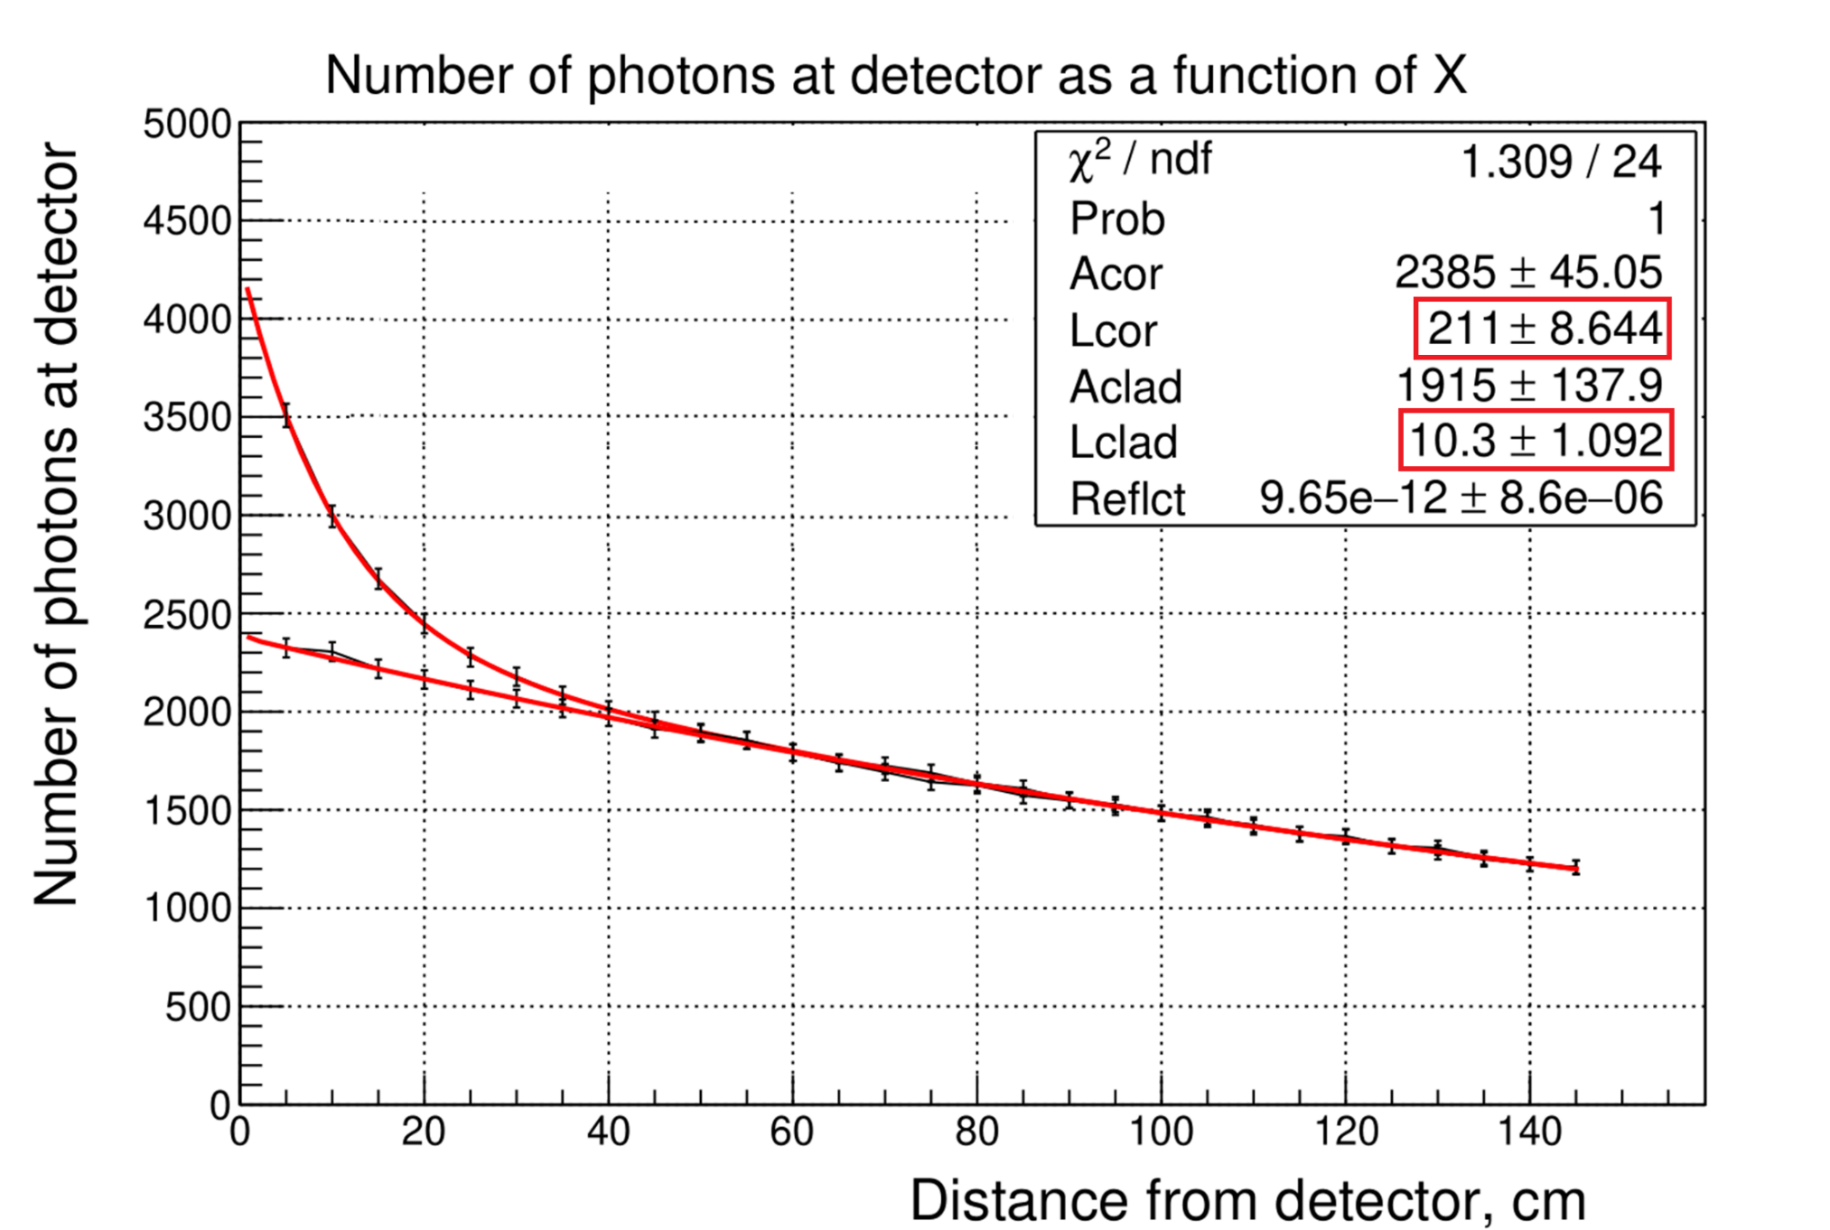
Setting of fibers absorption lengths
The accounting of absorption of photons in cladding
*M.David et al. Nucl.Phys.B Proc.Suppl. 61 (1998) 106-111

Slide 5
Determination of TiO₂ paint reflection coefficient
flash of photons was distributed uniformly inside the scintillator
only the sides of plate were painted
Initial intensity – 10⁷ photons
Event is recorded when photon reached any fiber
IHEP group made panted/no painted tests with TiO₂ paint and found a 1.6-fold increase in light yield

Slide 6
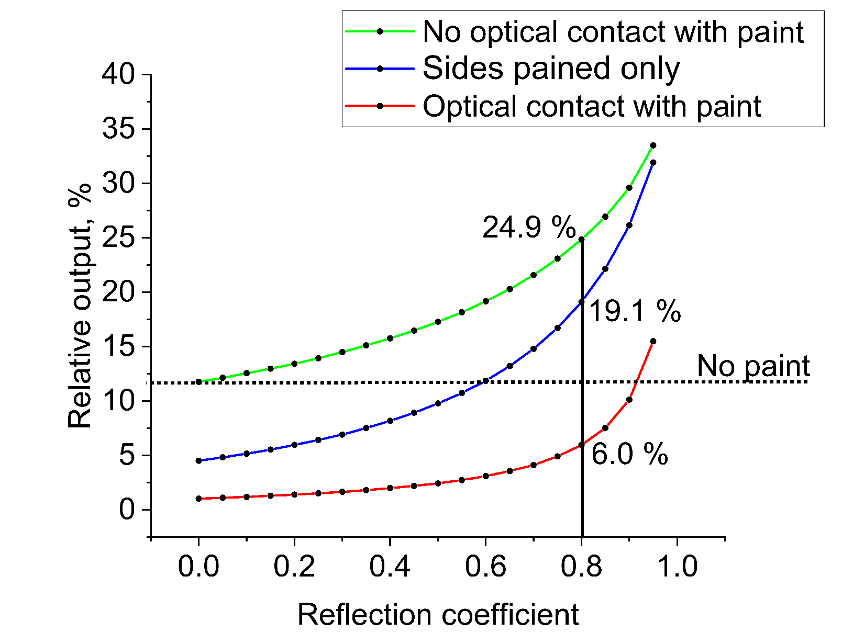
Signal relative output on fibers as function of reflection coefficient of paint

Slide 7
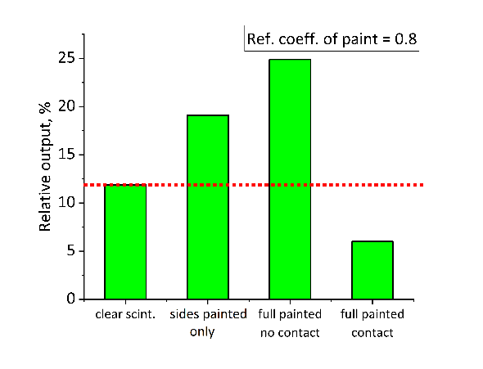
Signal relative output on fibers at different method of painting

Slide 8

Relative output as function of reflection coefficient of paint and time collection on fibers
Event is recorded when photon reach any fiber
Initial intensity – 10⁷ photons
$$fit:y=y0+{A∗e}^{−\frac{t0}{t}}$$
Optical contact
No optical contact

Slide 9
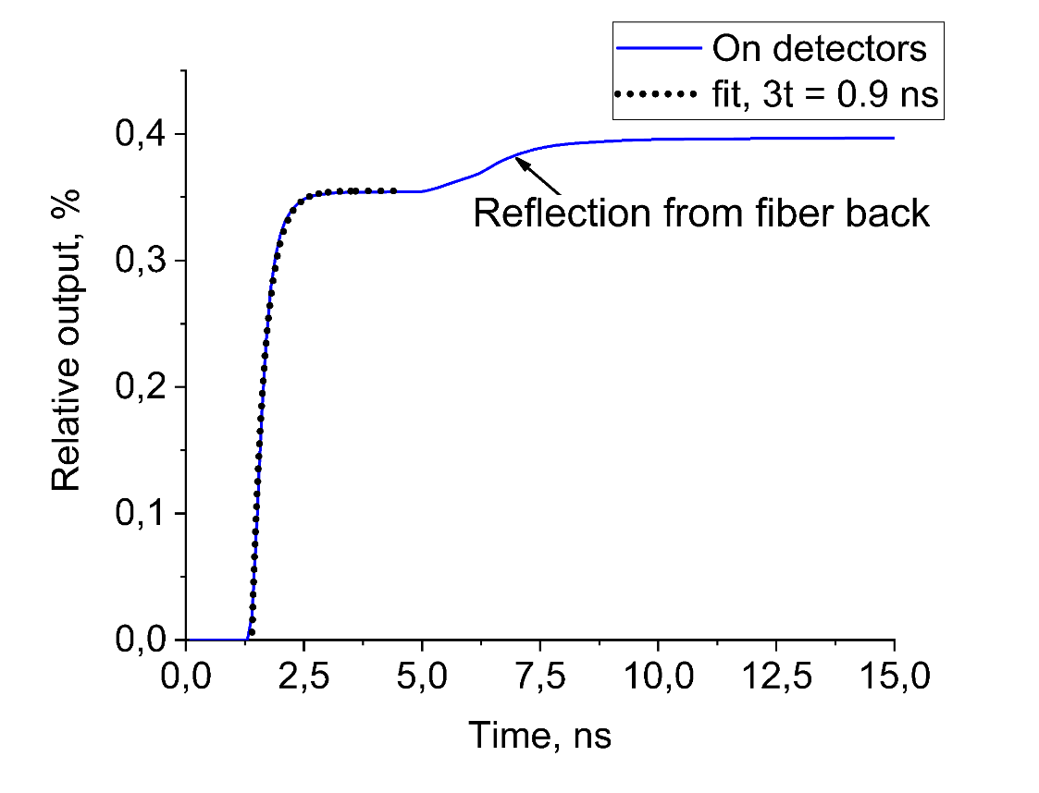
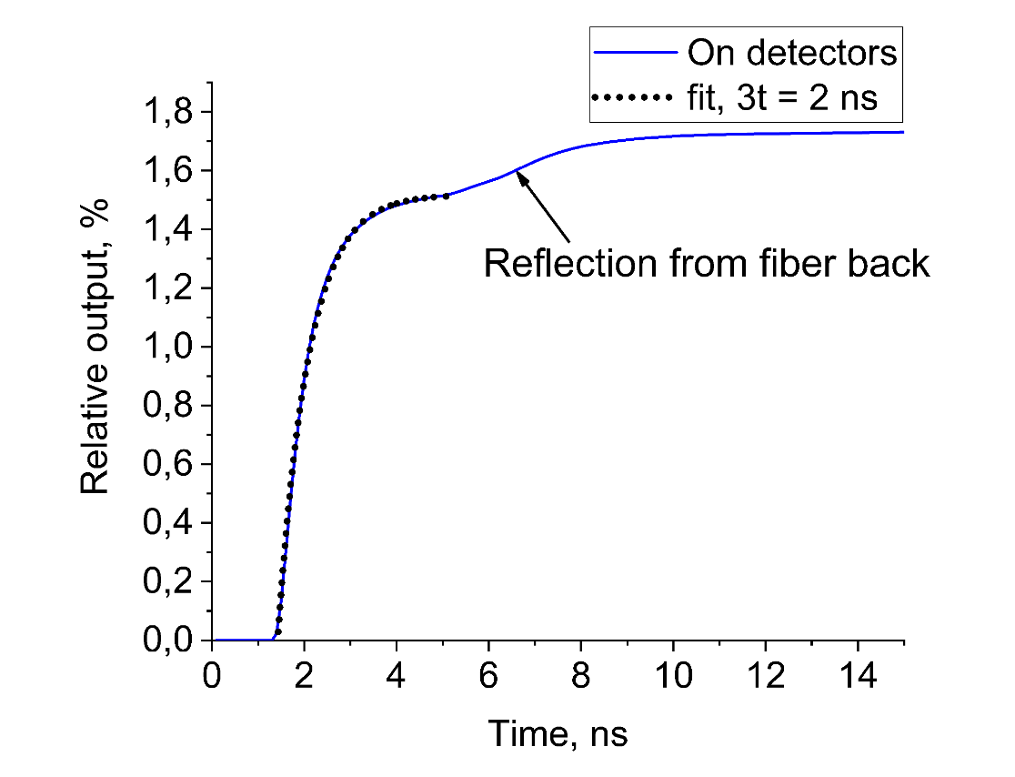
Relative output as function of reflection coefficient of paint and time collection on detector
Event was recorded when photon reached detector
Initial intensity – 10⁷ photons
distance between scintillator and detector – 25 cm
Ref. coeff. of paint = 0.8
Optical contact
No optical contact

Slide 10
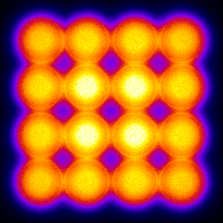
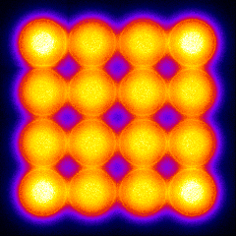
Signal at detector
6x6 mm² (57600 cells)
distance between end of fibers and detector 0.3 mm
number of initial photons 2×10⁹
Flash in the center of the scintillator
Volume flash
~1500 ph. per cell
In realistic case 3 GeV electron can produce 10^7 photons in scintilator of tower and 7.5 photons on MPPC cell. They can produce in average 1 photoelectron ( quantum efficiency = 0.25 and formfactor = 0.5). This means that the probability of missing photons is high, which will lead to nonlinearity of the energy response of the calorimeter.

Slide 11
Summary
Reflection coefficient of paint = 0.8
Optical contact is ON
On fibers |  | On detector
Rel. output (ref. = 0.8) | Collection time | Rel. output (ref. = 0.8) | Collection time
6 % | 0.5 ns | 0.4 % | 0.9 ns
Optical contact is OFF
On fibers |  | On detector
Rel. output (ref. = 0.8) | Collection time | Rel. output (ref. = 0.8) | Collection time
24.9 % | 1.65 ns | 1.78 % | 2 ns
The relative light output is 4 times higher, but light collection time is 2 times longer

Slide 12
Results
The detailed simulation of light collection was performed for «shashlyk» type calorimeter, which was created in frame of MPD/NICA project.
It was shown that the quality and reflection coefficient of light from the surface of scintillator plates contribute the high uncertainty to the total light output.
In optimal case the collection of light at detector is about 2 %, which lead to the high probability of two photon hitting into the one cell of the photodetector and to non-linearity of energy response of calorimeter with GeV photon energy. However more real estimation of non-linearity can be obtained only taking into account simulation of producing of electromagnetic shower and its distribution between towers.
The estimation of time resolution will be done in future work.
Supported by RFBR grant # 18-02-40054

