Slide 1
Feasibility studies for the measurement of single-spin asymmetry in inclusive K⁰_{s} production at
π⁻ beam at U-70.
N.K. Kalugin^{1,*}, V.V. Mochalov^{1,2}, V.V. Moiseev¹, D.A Morozov¹, M.B. Nurusheva²,V.L. Rykov², P.A. Semenov^{1,2}, A.N. Vasiliev^{1,2}
¹NRC «Kurchatov Institute» - IHEP, Protvino, Russia
²National Research Nuclear University MEPhI (Moscow Engineering Physics Institute), Moscow, Russia

Slide 2
Backup slides
The single-spin asymmetry A_{N} is defined as a dependence of particle production cross-section on the direction perpendicular to the plane defined by the vectors of initial proton momentum and spin.
2
N. Kalugin, 5th International Conference on Particle Physics and Astrophysics

Slide 3
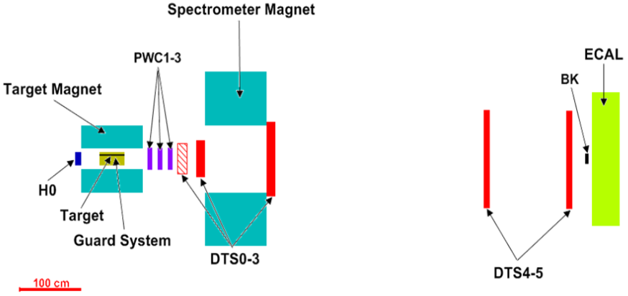
SPASCHARM experimental set-up
The fixed target SPASCHARM experiment (SPin Asymmetry CHARMonia) is aimed at studying of polarization phenomena in hadronic reactions at U-70
The SPASCHARM setup has the full 2π coverage in azimuth, this is an important advantage for minimizing the systematic errors in the measurement of spin observables.
The setup contain a polarized frozen proton Target with an average polarization of 65%.
The tracking system includes 3 proportional chamber stations (PC1-3) and 5 drift tube stations (DTS0-5). The field integral of Spectrometer Magnet is about 0.6 T•m, the field is directed upward.
3
N. Kalugin, 5th International Conference on Particle Physics and Astrophysics

Slide 4
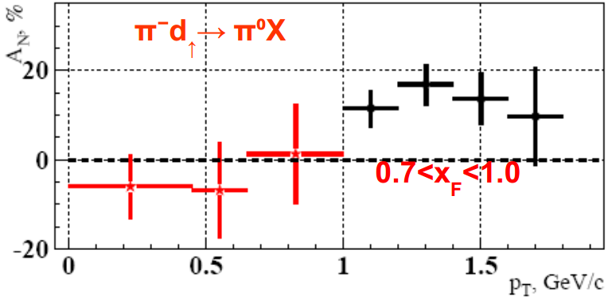
Single-spin asymmetry measurements at SPASCHARM (Motivations)
One of the most important and interesting result of single-spin asymmetry measurement was obtained in the late 1980s by PROZA collaboration (U-70, Protvino) : the value of asymmetry in reaction π⁻ + d↑ → π⁰ + X in the unpolarized beam fragmentation region was significant.
Fig.2 Measured asymmetry versus π⁰ transverse momentum (p_{T}) in π⁻ + d↑ → π⁰ + X reaction [*].
*V.D.Apokin et al., Sov.J.Nucl.Phys. 49 (1989) 103, Yad.Fiz. 49 (1989) 165-168Mochalov, V.V., Belikov, N.I., Borisov, N.S. et al. Phys. Atom. Nuclei (2010) 73: 2017. doi:10.1134/S1063778810120069
The question arises: is it valid for other inclusive reactions and what is theoretical explanation of this effect?
4
N. Kalugin, 5th International Conference on Particle Physics and Astrophysics

Slide 5
Single-spin asymmetry measurements at SPASCHARM (Motivations)
Asymmetry mainly does not depend on energy (see Fig.3, data from ANL, E704, BNL and RHIC experiments). So, we can conclude, energy makes no different in polarization experiments, but it is important to collect and analyze a big data of various reactions. Most theoretical models predict decreasing of asymmetry with increase of energy and p_{T}.
Fig.3 Measured asymmetry versus π± Feynman x (x_{F}) for various e.c.m [*].
C. A. Aidala, et al., Rev. Mod. Phys. 85 (2013) 655
There is good possibility to measure asymmetry in different channels and kinematic ranges at intermediate energies with good accuracy at the SPASCHARM experiment
5
N. Kalugin, 5th International Conference on Particle Physics and Astrophysics

Slide 6
Single-spin asymmetry measurements at SPASCHARM (Motivations)
Why we should study single-spin asymmetry in inclusive K⁰_{s} production?
Single spin asymmetry measurements of inclusive π⁰ have been already done (see PROZA results)
Tracking system of SPASCHARM is more important detector and gives us new possibilities to detect charged particles. Single spin asymmetry of inclusive π± production is being studied (see V.Moiseev report).
K⁰_{s} meson contains s-quark. There is a great interest for studying single-spin asymmetry in reactions with s-quark production.
Inclusive K⁰_{s} production cross-section is significant (for U-70 accelerator energies). Expected statistics for data analysis is reasonable. K0s mass peak is narrow and it seems to be easily observed.
6

Slide 7
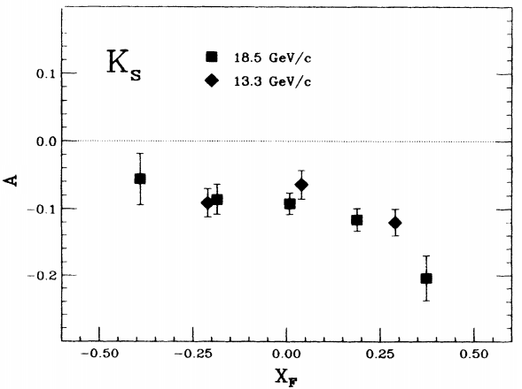
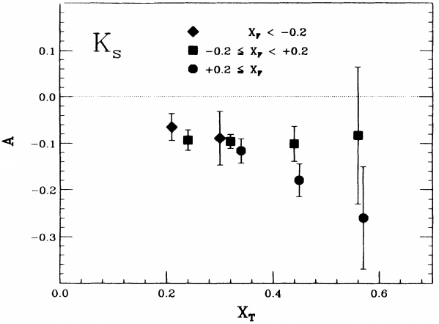
Previous results of single-spin asymmetry of inclusive K⁰_{s} production.
First and single result of single-spin asymmetry measurement for K0s was obtained in 1990 . (See Fig. 4 and Fig. 5)
B.E Bonner, et. al., Phys. Rev. D., v. 41 (1990) 13
Fig.4 Measured asymmetry versus K0s Feynman x (x_{F}) in p↑+Be →K⁰_{s}+X reaction.
Fig.5 Measured asymmetry versus K0s x_{T} in p↑+Be →K0s+X reaction.
It is interesting to check that result in other experiments (like SPASCHARM) and study the asymmetry in extended kinematic ranges (for x_{F} and p_{T})
7
N. Kalugin, 5th International Conference on Particle Physics and Astrophysics

Slide 8
Simulation of K⁰_{s} registration at SPASCHARM experiment
The program Pythia 8.212 (as a part of SpascharmRoot software) for simulation of particle collisions has been used for π⁻p-interactions at √s = 7.311GeV.
Simulation options:
Beam particle momentum: p(π) = 28 GeV/c. Fixed target experiment
Soft QCD processes were turned on, hard QCD processes were turned off
Two modes: minibias (without filtration) and inclusive K⁰_{s} production
Tracking detectors (drift chambers and proportional chambers) efficiency: 95%
8
N. Kalugin, 5th International Conference on Particle Physics and Astrophysics

Slide 9
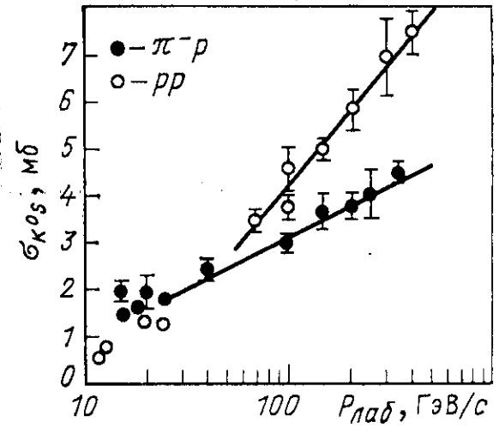
Simulation of K⁰_{s} registration at SPASCHARM experiment
Inclusive K0s production cross section (from Pythia): 2.207mb
Inclusive K0s production cross section (experimental data): (1.89±0.72)mb
Fig.6 Inclusive K0s production cross-section (mb) versus π⁻(p) laboratory momentum(Gev/C)
9
N. Kalugin, 5th International Conference on Particle Physics and Astrophysics

Slide 10
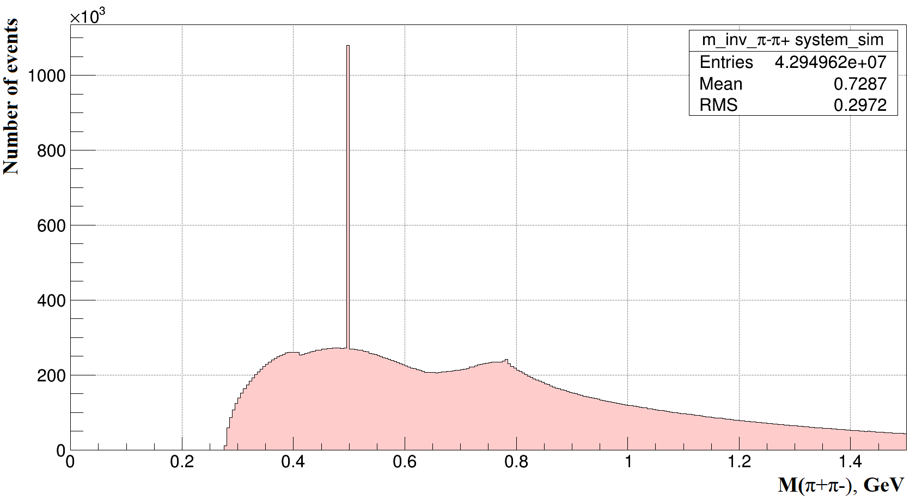
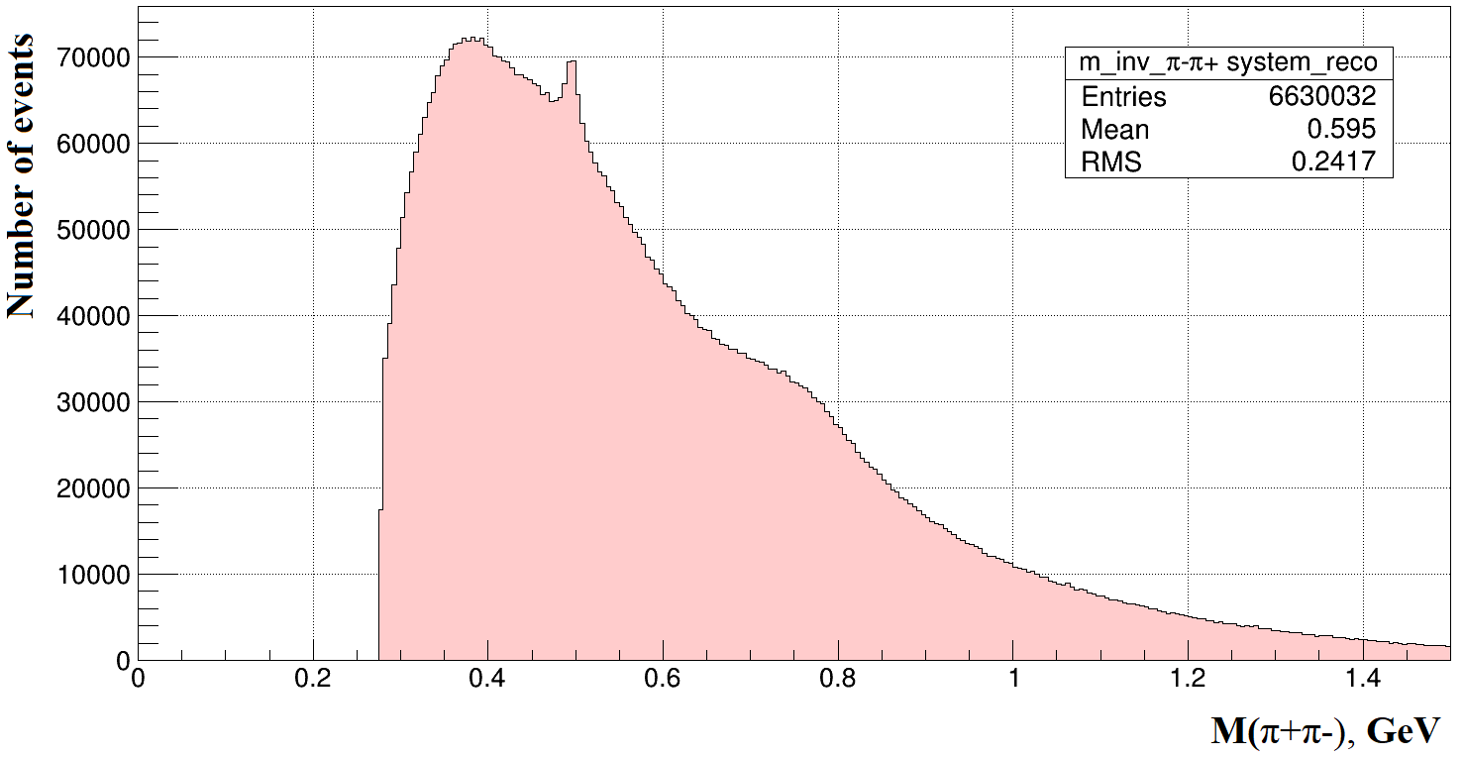
Simulation of K⁰_{s} registration at SPASCHARM experiment
10⁷ minibias events were generated for analysis
Fig.6 Invariant mass of π⁻π⁺ system for minibias events without any selection criteria (MC truth data). Just to verify simulation software.
Fig.7 Invariant mass of π⁻π⁺ system for minibias events without any selection criteria (reconstructed data)
10
N. Kalugin, 5th International Conference on Particle Physics and Astrophysics

Slide 11
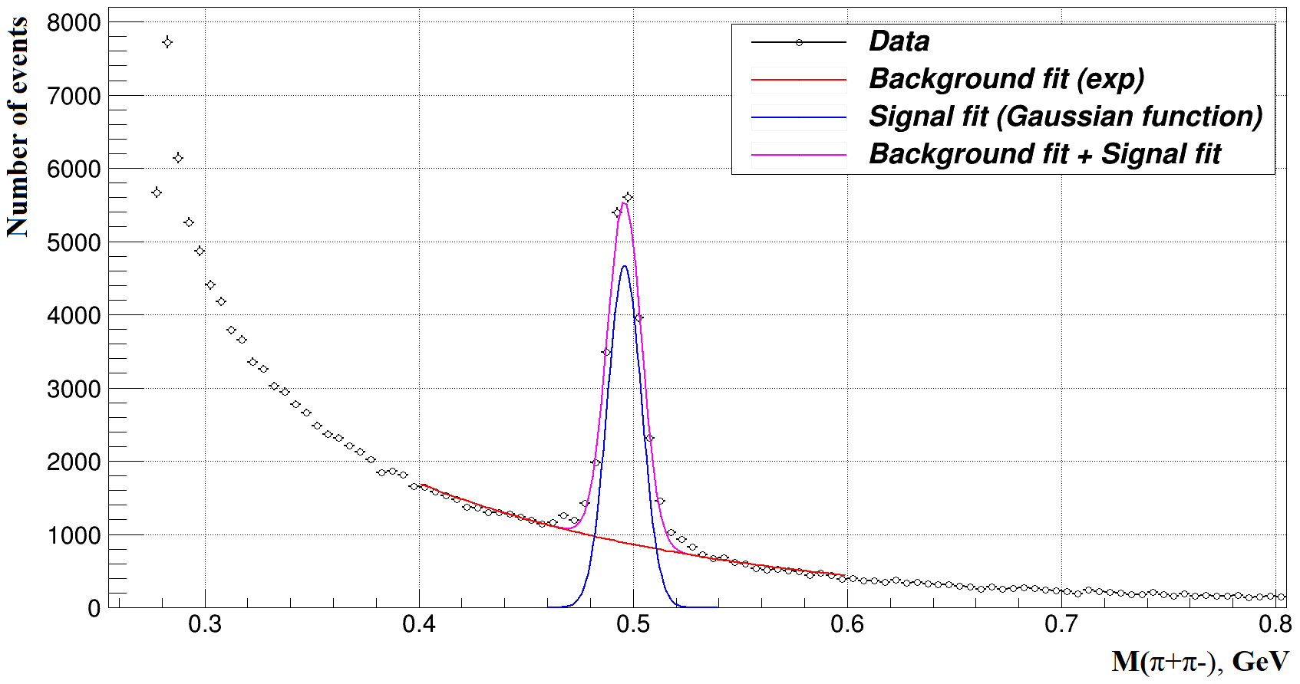
Simulation of K⁰_{s} registration at SPASCHARM experiment
K⁰_{s} was analyzed with V0 events (K⁰_{s} → π⁻ + π⁺).
The criteria of V0 events selection are following (this criteria based on K⁰_{s} inclusive MC data):
σ(K⁰_{s}) = 0.008GeV
At least one π⁺ and one π⁻
Minimal distance between π⁺ and π⁻
tracks is less than 0.6 cm
Z-coordinate of K0s decay (secondary vertex) more than 8 cm from primary interaction point
Fig.8 Invariant mass of π⁻π⁺ system for minibias events after application of all selection criteria (reconstructed data). S/N = 2.35
11
N. Kalugin, 5th International Conference on Particle Physics and Astrophysics

Slide 12
Backup slides
GeV/с | 0 < p_{Z} ≤ 4.0 | 4.0 < p_{Z} ≤ 8.0 | 8.0 < p_{Z} ≤ 12.0 | 12.0 < p_{Z} ≤ 16.0 | p_{Z} > 16.0
0 < p_{T} ≤ 0.25 | 0.013 | 0.091 | 0.093 | 0.042 | 0.02
0.25 < p_{T} ≤ 0.5 | 0.004 | 0.077 | 0.096 | 0.069 | 0.041
0.5 < p_{T} ≤ 1.0 | - | 0.03 | 0.093 | 0.084 | 0.065
p_{T} > 1.0 | - | - | 0.031 | 0.071 | 0.081
Fig.9 Geometry efficiency of K0s events in various kinematical bins
12
N. Kalugin, 5th International Conference on Particle Physics and Astrophysics

Slide 13
Simulation of K⁰_{s} registration at SPASCHARM experiment
Total expected number of inclusive K0s events per 20 days data taking run at SPASCHARM: ~10⁷
GeV/с | 0 < p_{Z} ≤ 4.0 | 4.0 < p_{Z} ≤ 8.0 | 8.0 < p_{Z} ≤ 12.0 | 12.0 < p_{Z} ≤ 16.0 | p_{Z} > 16.0
0 < p_{T} ≤ 0.25 | 0.016 | 0.01 | 0,018 | 0.043 | 0.073
0.25 < p_{T} ≤ 0.5 | 0.024 | 0.008 | 0.012 | 0.024 | 0.039
0.5 < p_{T} ≤ 1.0 | 0.237 | 0.013 | 0.011 | 0.019 | 0.033
p_{T} > 1.0 | - | 0.186 | 0.039 | 0.039 | 0.058
Fig.10 Expected accuracy of inclusive K0s production asymmetry measurement in various kinematical bins per 20 days data taking run at SPASCHARM
13
N. Kalugin, 5th International Conference on Particle Physics and Astrophysics

Slide 14
CONCLUSION
Simulation of K⁰_{s} in SPASCHARM with real detector description software(reconstruction tools) is performed
Single-spin asymmetry in inclusive K⁰_{s} production could be measured at SPASCHARM experiment with accuracy about 2% in various kinematic ranges (x_{F} and p_{T}).
The reported study was funded by RFBR, project numbers 19-32-90068, 18-02-00006 and Ministry of Science and Higher Education of the Russian Federation, Project "Fundamental properties of elementary particles and cosmology" No 0723-2020-0041.
14
N. Kalugin, 5th International Conference on Particle Physics and Astrophysics

Slide 15
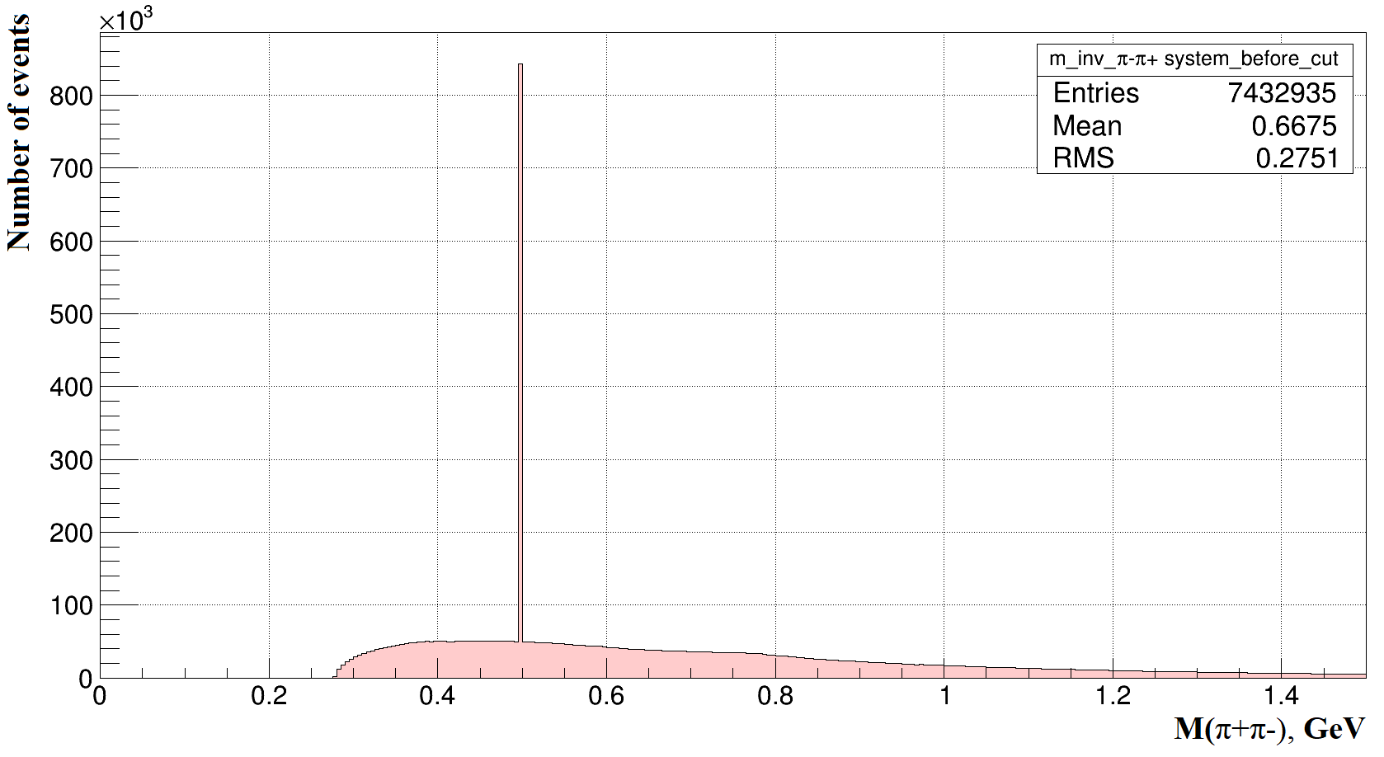
Backup slides
10⁶ inclusive events were generated for analysis
Fig.11 Invariant mass of π⁻π⁺ system for inclusive events without any selection criteria (MC truth data)
15
N. Kalugin, 5th International Conference on Particle Physics and Astrophysics

Slide 16
Backup slides
$$N_{i}=\frac{N_{{ev}/{cyc}}·N_{{cyc}/{hour}}·N_{{hour}/{day}}·N_{{day}/{run}}·K_{\left.K_{S}^{0}(minbias\right)}·N_{i}^{hist}}{N_{tot_ev}}$$
GeV/с | 0 < p_{Z} ≤ 4.0 | 4.0 < p_{Z} ≤ 8.0 | 8.0 < p_{Z} ≤ 12.0 | 12.0 < p_{Z} ≤ 16.0 | p_{Z} > 16.0
0 < p_{T} ≤ 0.25 | 6.6∙10⁵ | 1.6∙10⁶ | 5.0∙10⁵ | 9.3∙10⁴ | 3.2∙10⁴
0.25 < p_{T} ≤ 0.5 | 3.0∙10⁵ | 2.4∙10⁶ | 1.1∙10⁶ | 3.0∙10⁵ | 1.1∙10⁵
0.5 < p_{T} ≤ 1.0 | 3.0∙10³ | 1.0∙10⁶ | 1.3∙10⁶ | 4.6∙10⁵ | 1.6∙10⁵
p_{T} > 1.0 | - | 4.9∙10³ | 1.1∙10⁵ | 1.1∙10⁵ | 5.0∙10⁴
Fig.12 Expected number of inclusive K0s events in various kinematical bins per 20 days beam run at SPASCHARM
16
N. Kalugin, 5th International Conference on Particle Physics and Astrophysics

Slide 17
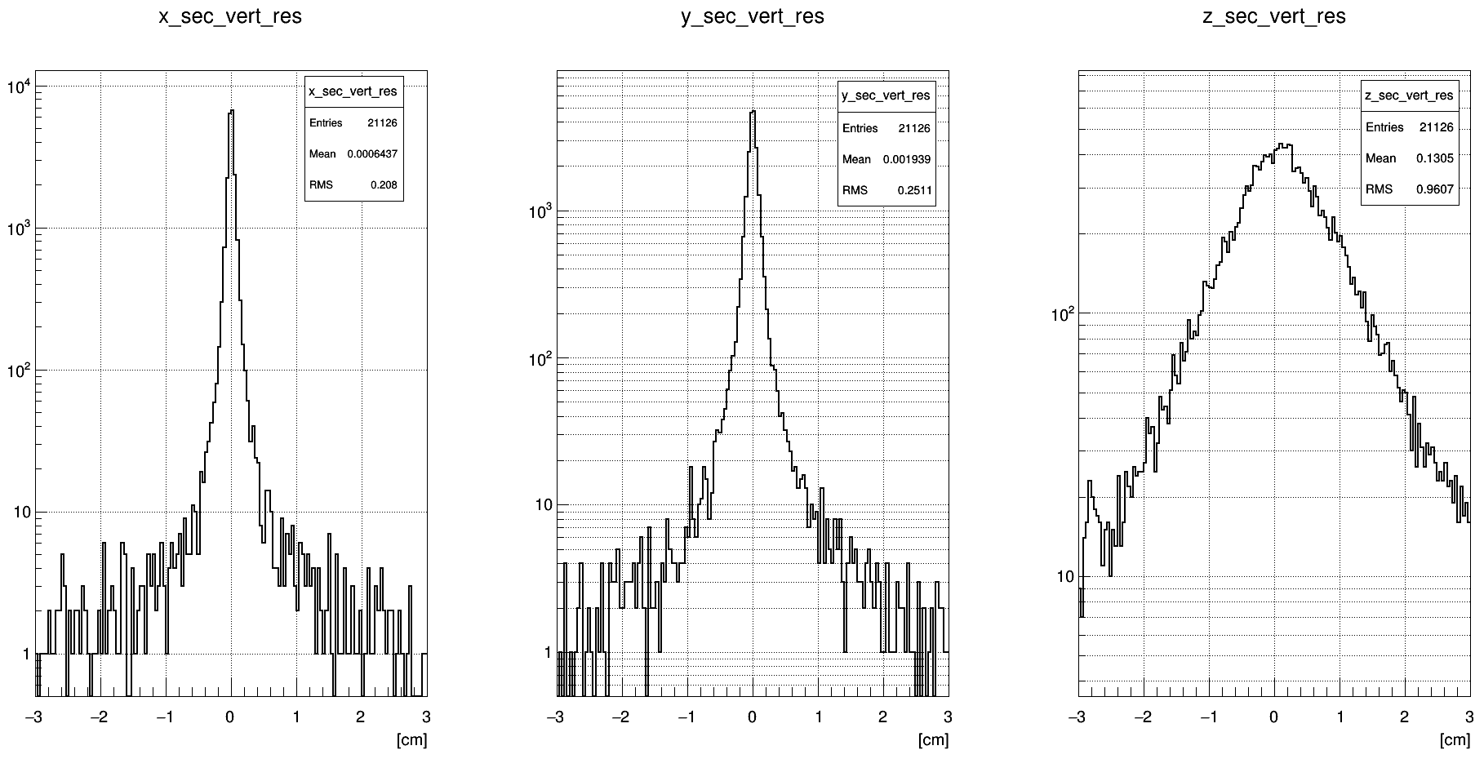
Backup slides
Fig.13 Resolution of secondary vertex
17
N. Kalugin, 5th International Conference on Particle Physics and Astrophysics

