Slide 1

Investigation of variations in the intensity of the muon flux in the time series of matrix data of the URAGAN hodoscope
V.E. Chinkin¹, V.G. Getmanov ¹, V.V. Shutenko ², I.I Yashin ^{1 ,2}, A.G Gvishiani ², A.A Kovylyaeva^{1,2}
¹ Geophysical Center RAS, Russia
² National Research Nuclear University MEPhI,Russia
³Schmidt Institute of Physics of the Earth RAS,Russia
e-mail: v.chinkin@gcras.ru
Notes:
Dear parti’cipants of the online conference, we present to your attention a report from the Geophysical Center of the Russian Academy of Sciences, speaker Chinkin. Our work (Investigation of variations in the intensity of the muon flux in the time series of matrix data of the URAGAN hodoscope[ˈhädəˌskōp]) is focused on the development of methods for digital processing of observations of this hodoscope in order to extract information from them.

Slide 2

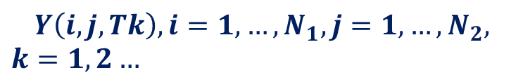

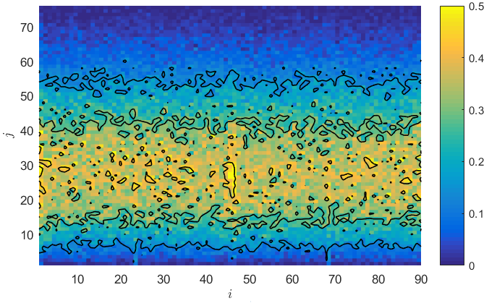


Statement of the Problem
Experimental data - output matrices of observations of the URAGAN hodoscope
Output muon flux intensity distribution function MFIDF
$$Y\left(i,j, Tk\right)=A(i,j, Tk)Y_{0}\left(i,j,Tk,μ\right)$$
$$Y\left(i,j,Tk\right), i=1,…,N_{1}, j=1,…, N_{2},$$
$$k=1,2…$$
Hardware functions (HF)
$A(i,j,Tk)$-?
Input (MFIDF)
$Y_{0}\left(i,j,kT,μ\right)=Y_{0}\left(i,j,Tk\right)μ\left(i,j,Tk\right)$-?
Local anisotropy
$μ\left(i,j,Tk\right)$-?
Aim
$Y\left(i,j,Tk\right), k=1,2…⇒μ\left(i,j,Tk\right)$
Notes:
Let's move to the content of the report. The experimental data are rectangular matrix for different time intervals T. We assume a linear relationship between the input and output matrix of the muon flux distribution functions, the output matrix is unknown to us. The link is set using a hardware function, which is also unknown to us. The input matrix contains anisotropy [ˌanaɪsə(ʊ)ˈtrɒpɪ]. Thus, our aim is to investigate the intensity functions of muon fluxes to estimate anisotropy.

Slide 3

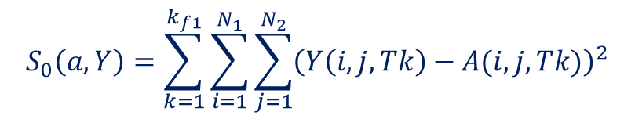

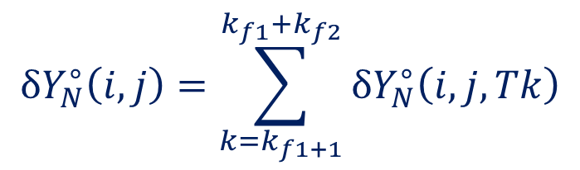
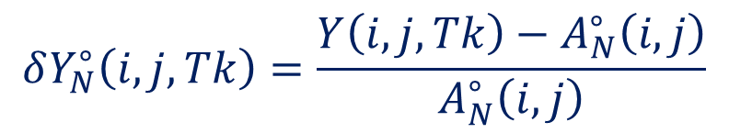
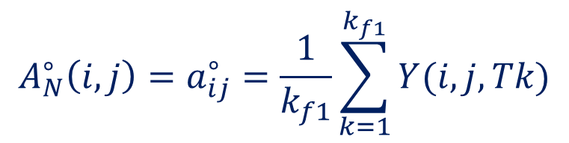

Estimates of normalized HF and output variations of MFIDF
Normalized HF
Estimation of the output normalized variations of MFIDF
$A_{0}(i,j,Tk)=A(i,j,Tk) c_{0}$ normalized HF
$$c_{0}=const−MF intensity$$
$$δY_{N}^{∘}\left(i,j,Tk\right)=\frac{Y\left(i,j,Tk\right)−A_{N}^{∘}\left(i,j\right)}{A_{N}^{∘}\left(i,j\right)}$$
Functional for determining the normalized AF
$$S_{0}\left(a,Y\right)=\sum_{k=1}^{k_{f1}}{\sum_{i=1}^{N_{1}}{\sum_{j=1}^{N_{2}}{{\left(Y\left(i,j,Tk\right)−A(i,j,Tk)\right)}^{2}}}}$$
Averaged estimates of output normalized variations of MFIDF
$$δY_{N}^{∘}\left(i,j\right)=\sum_{k=k_{f1+1}}^{k_{f1}+k_{f2}}{δY_{N}^{∘}\left(i,j,Tk\right)}$$
Estimation of normalized HF
$$A_{N}^{∘}\left(i,j\right)=a_{ij}^{∘}=\frac{1}{k_{f1}}\sum_{k=1}^{k_{f1}}{Y(i,j,Tk)}$$
Spatially Filtered Estimates of the Output Normalized Variations of the MFIDF
$$δY_{N,Φ}^{∘}\left(i,j,Tk\right)$$
Notes:
To do this, we solve the problem of estimating the normalized variations of the distribution and estimating the normalized hardware functions. To do this, we determine the functional S. Using the necessary conditions for an extremum, we obtain the equation for estimating the normalized hardware functions. The estimate of the normalized variations of the matrix is written as the normalized difference. Also, to reduce noise components, we use averaging[|ˈævrɪdʒɪŋ] over time and the filter over space.

Slide 4


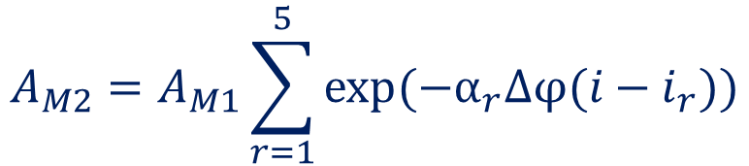
Model HF
HF Model
$$A_{M}=A_{M1}+A_{M2}$$
Atmospheric and structural part
$$A_{M1}=A_{0}⁡\cos^{α}\left(Δθj\right)sin⁡(Δθj)$$
Additional rib components
$$A_{M2}=A_{M1}\sum_{r=1}^{5}{exp⁡(−α_{r}Δφ(i−i_{r}))}$$
Image of Model HF
Notes:
The model hardware function of the URAGAN hodoscope[ˈhädəˌskōp] is determined in this work by two terms. The first term si’mulates the main component, including the atmospheric and structural parts. The second term simulates the action of additional components. The figure shows an example.

Slide 5
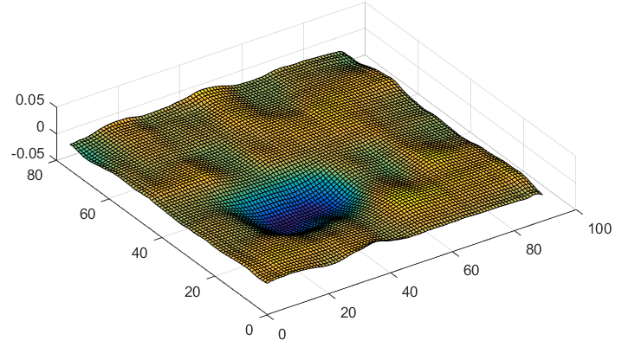
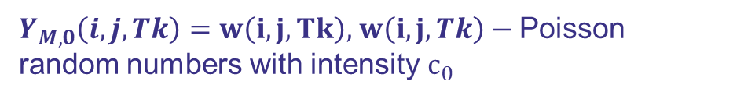


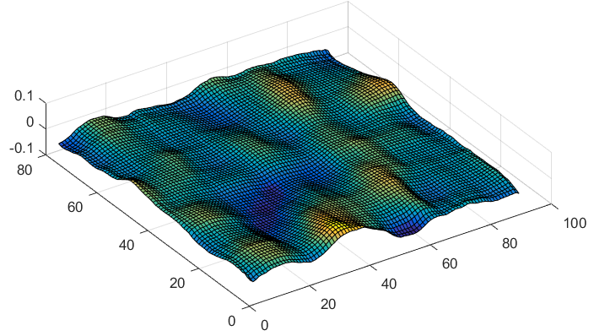

Testing. Model data
Model intensity reductions
Model input normalized MFIDF
$$μ\left(i,j,Tk\right)=1−δμ, i_{1}<i<i_{2},j_{1}<j<j_{2}$$
$$Y_{M,0}\left(i,j,Tk,μ\right)=A_{M}\left(i,j\right)Y_{M,0}(i,j,Tk)μ(i,j,Tk)$$
$Y_{M,0}\left(i,j,Tk\right)=w\left(i,j,Tk\right),$ $w\left(i,j,Tk\right)−$ Poisson random numbers with intensity$с_{0}$
$$μ(i,j,Tk)=1, otherwise$$
Estimates of the model input filtered normalized MFIDF
Averaged estimates of the input filtered normalized MFIDF
$$δY_{MN,Φ}^{∘}\left(i,j,Tk\right)$$
$$δ\overline{Y_{MN,Φ}^{∘}}\left(i,j,Tk\right)$$
Notes:
The method was tested on Model data. For this, were formed model output matrix and model hardware function. The figure shows the result of the work. From the results, we was concluded to possible recognize three percent local decreases

Slide 6
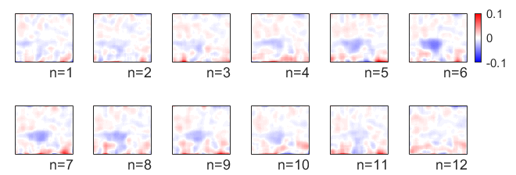
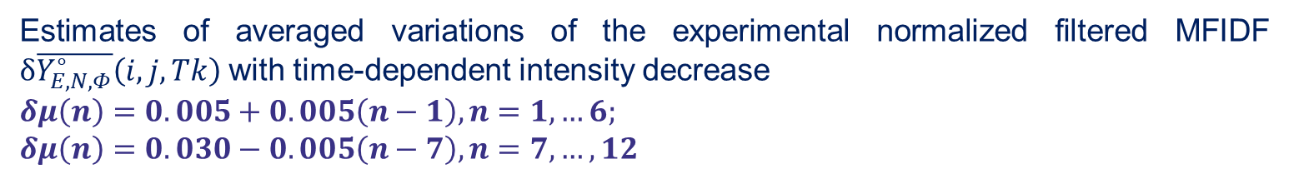
Testing. Experimental data
Estimates of averaged variations of the experimental normalized filtered MFIDF $δ\overline{Y_{E,N,Φ}^{∘}}\left(i,j,Tk\right)$ with time-dependent intensity decrease
$$δμ\left(n\right)=0.005+0.005\left(n−1\right),n=1,…6;$$
$$δμ\left(n\right)=0.030−0.005\left(n−7\right), n=7,…,12$$
Notes:
The method was tested on experimental observations with a model local decrease. The figure shows the evolution of the normalized matrix. An analysis of this result allows us to conclude that 2-3% decreases can be recognized on experimental data.

Slide 7
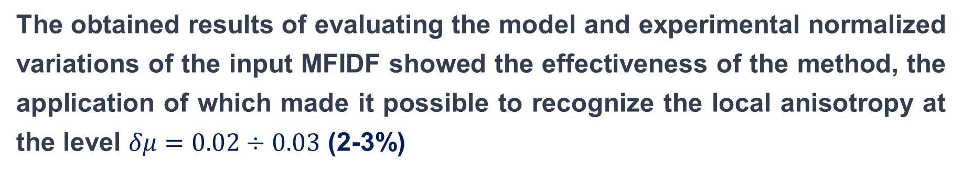
Conclusion
The obtained results of evaluating the model and experimental normalized variations of the input MFIDF showed the effectiveness of the method, the application of which made it possible to recognize the local anisotropy at the level $δμ=0.02÷0.03$ (2-3%)
Notes:
The obtained results of evaluating[ɪˈvæljʊeɪtɪŋ] the model and experimental normalized variations of the input matrix showed that the method is effective, its application will can made to possible to recognize the local anisotropy at the level . of two to three percent

