Slide 1
Measurements with scintillator tiles
F. Dubinin, P. Teterin

Slide 2
What can be measured?
Cosmic rays
Calibration of energy scale
Integral efficiency w.r.t. each other or with other trigger
Low rate
Electrons
Hight rate
Efficiency at the point
Calibration of energy scale - ??? (depends on energy)
X-ray (collimated)
Map of response

Slide 3
Set-up
2 tiles one on top of the other
Diffusive cover used on the tiles
Top tile coupled directly to PMT ФЭУ-85 and to SiPM via shifter
Bottom tile couple to SiPM via shifter
Trigger - coincidence between SiPM and PMT
Source – cosmic rays with energy deposit ~ 1MeV

Slide 4
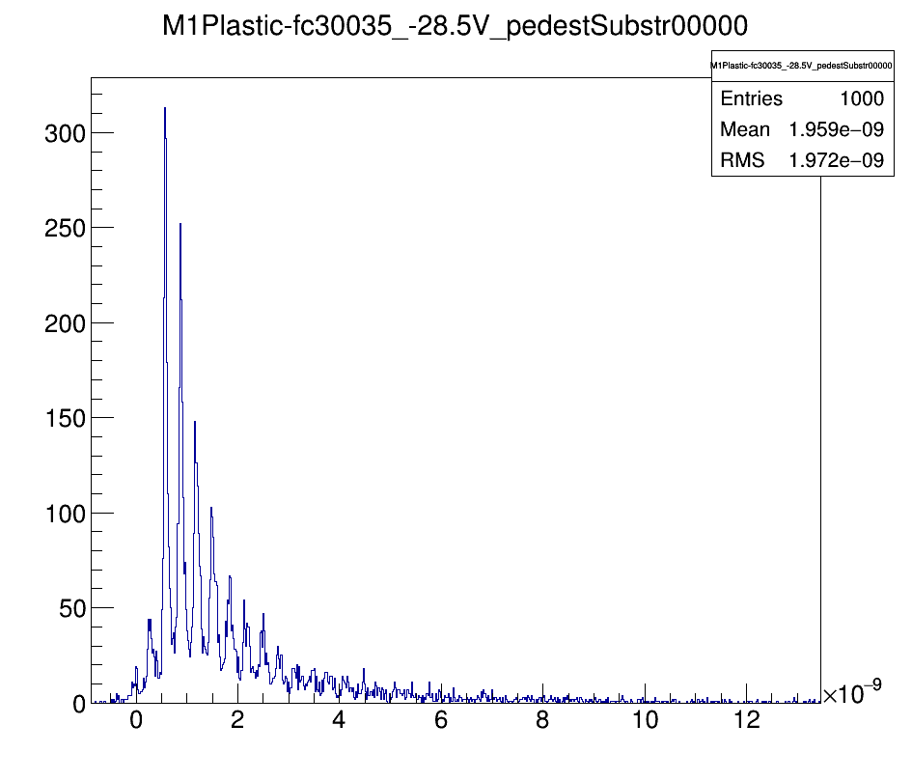
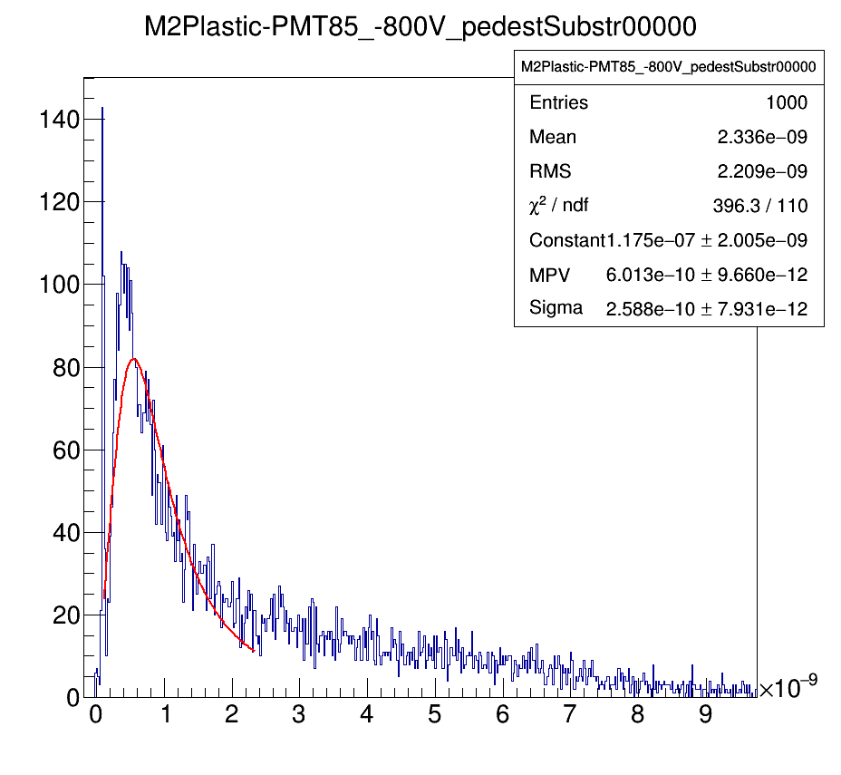
Preliminary results with cosmic rays

Slide 5
Conclusion
Single-electron spectrum observed with the SiPMs at energy deposit 1MeV - ??
Efficiency – to be understood

Slide 6
Results with gammas

