Slide 1
Materials selection of the SPD Beam-Beam Counter scintillation detector prototype
М22-115
Zakharov A.M.
Preliminary Report
SPD MEPhI Group

Slide 2
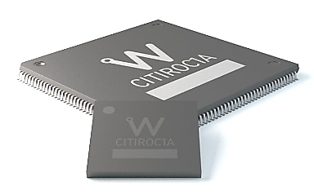
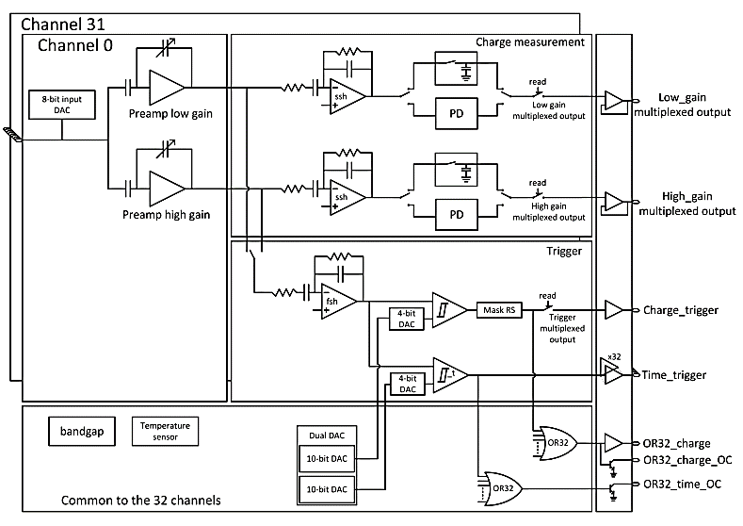
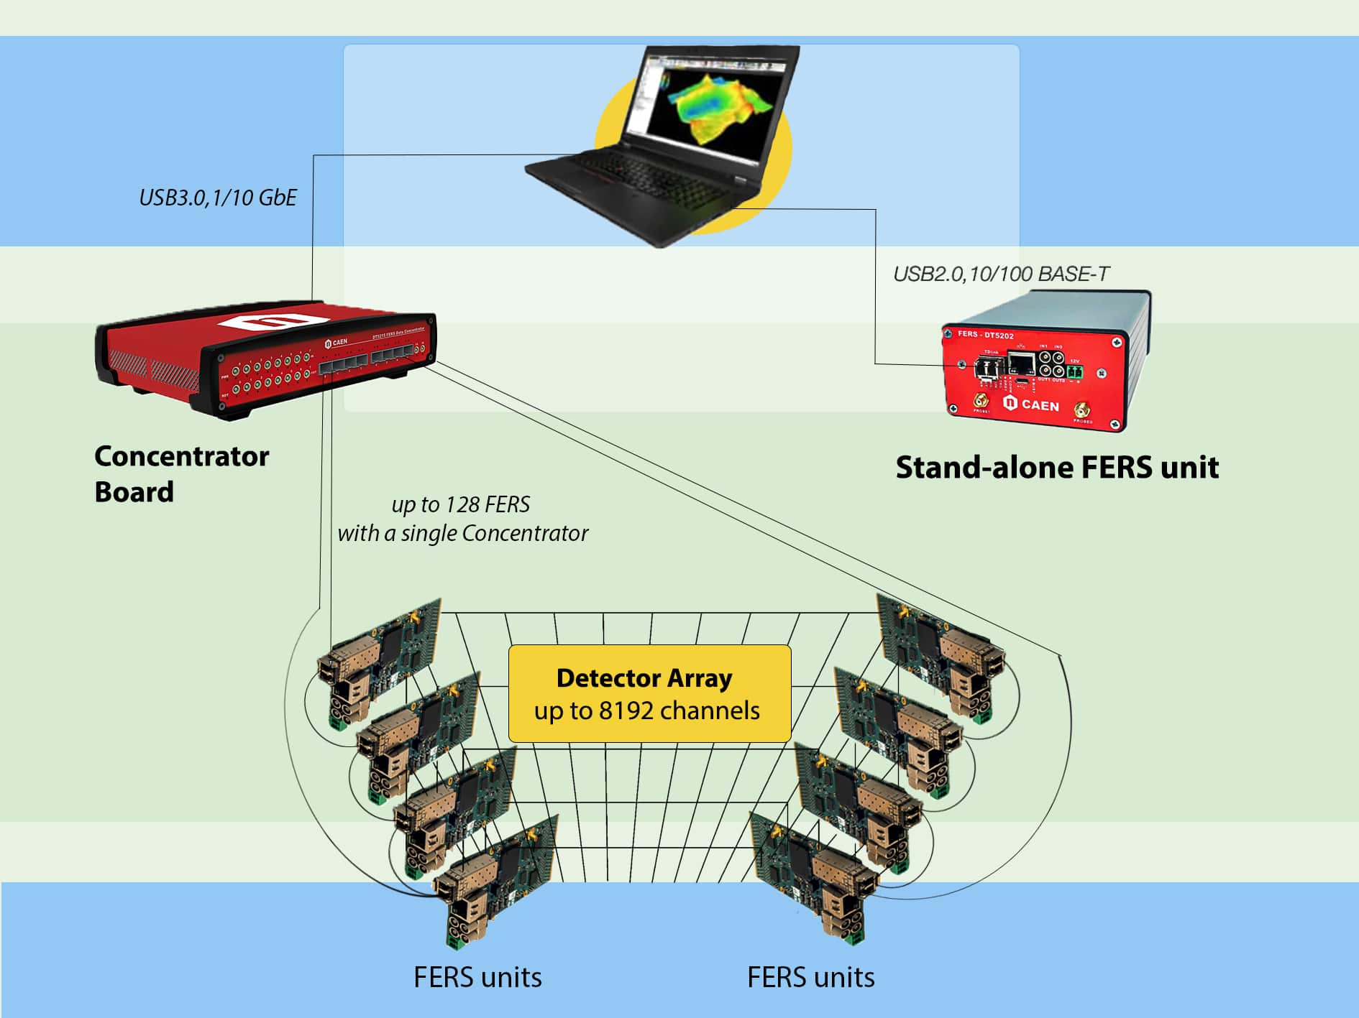
FEE studies results
CAEN FERS-5200 readout system
FERS-5200 is an extendable high speed front‐end readout system based on the DT5202 64-channel module for SiPM.
Concentrator DT5215 for the possibility of expanding the number of channels to 8192.
Citiroc 1A allows triggering down to 1/3 p.e. and provides the charge measurement with a good noise rejection. Moreover, Citiroc 1A outputs the 32-channel triggers with a high resolution timing (better than 100 ps).
Fine for testbeam and Phase0 experiments.
Main Acquisition Modes:
• SPECTROSCOPY.
• TIMING.
SPECT_TIMING. The Spectroscopy + Timing
1

Slide 3
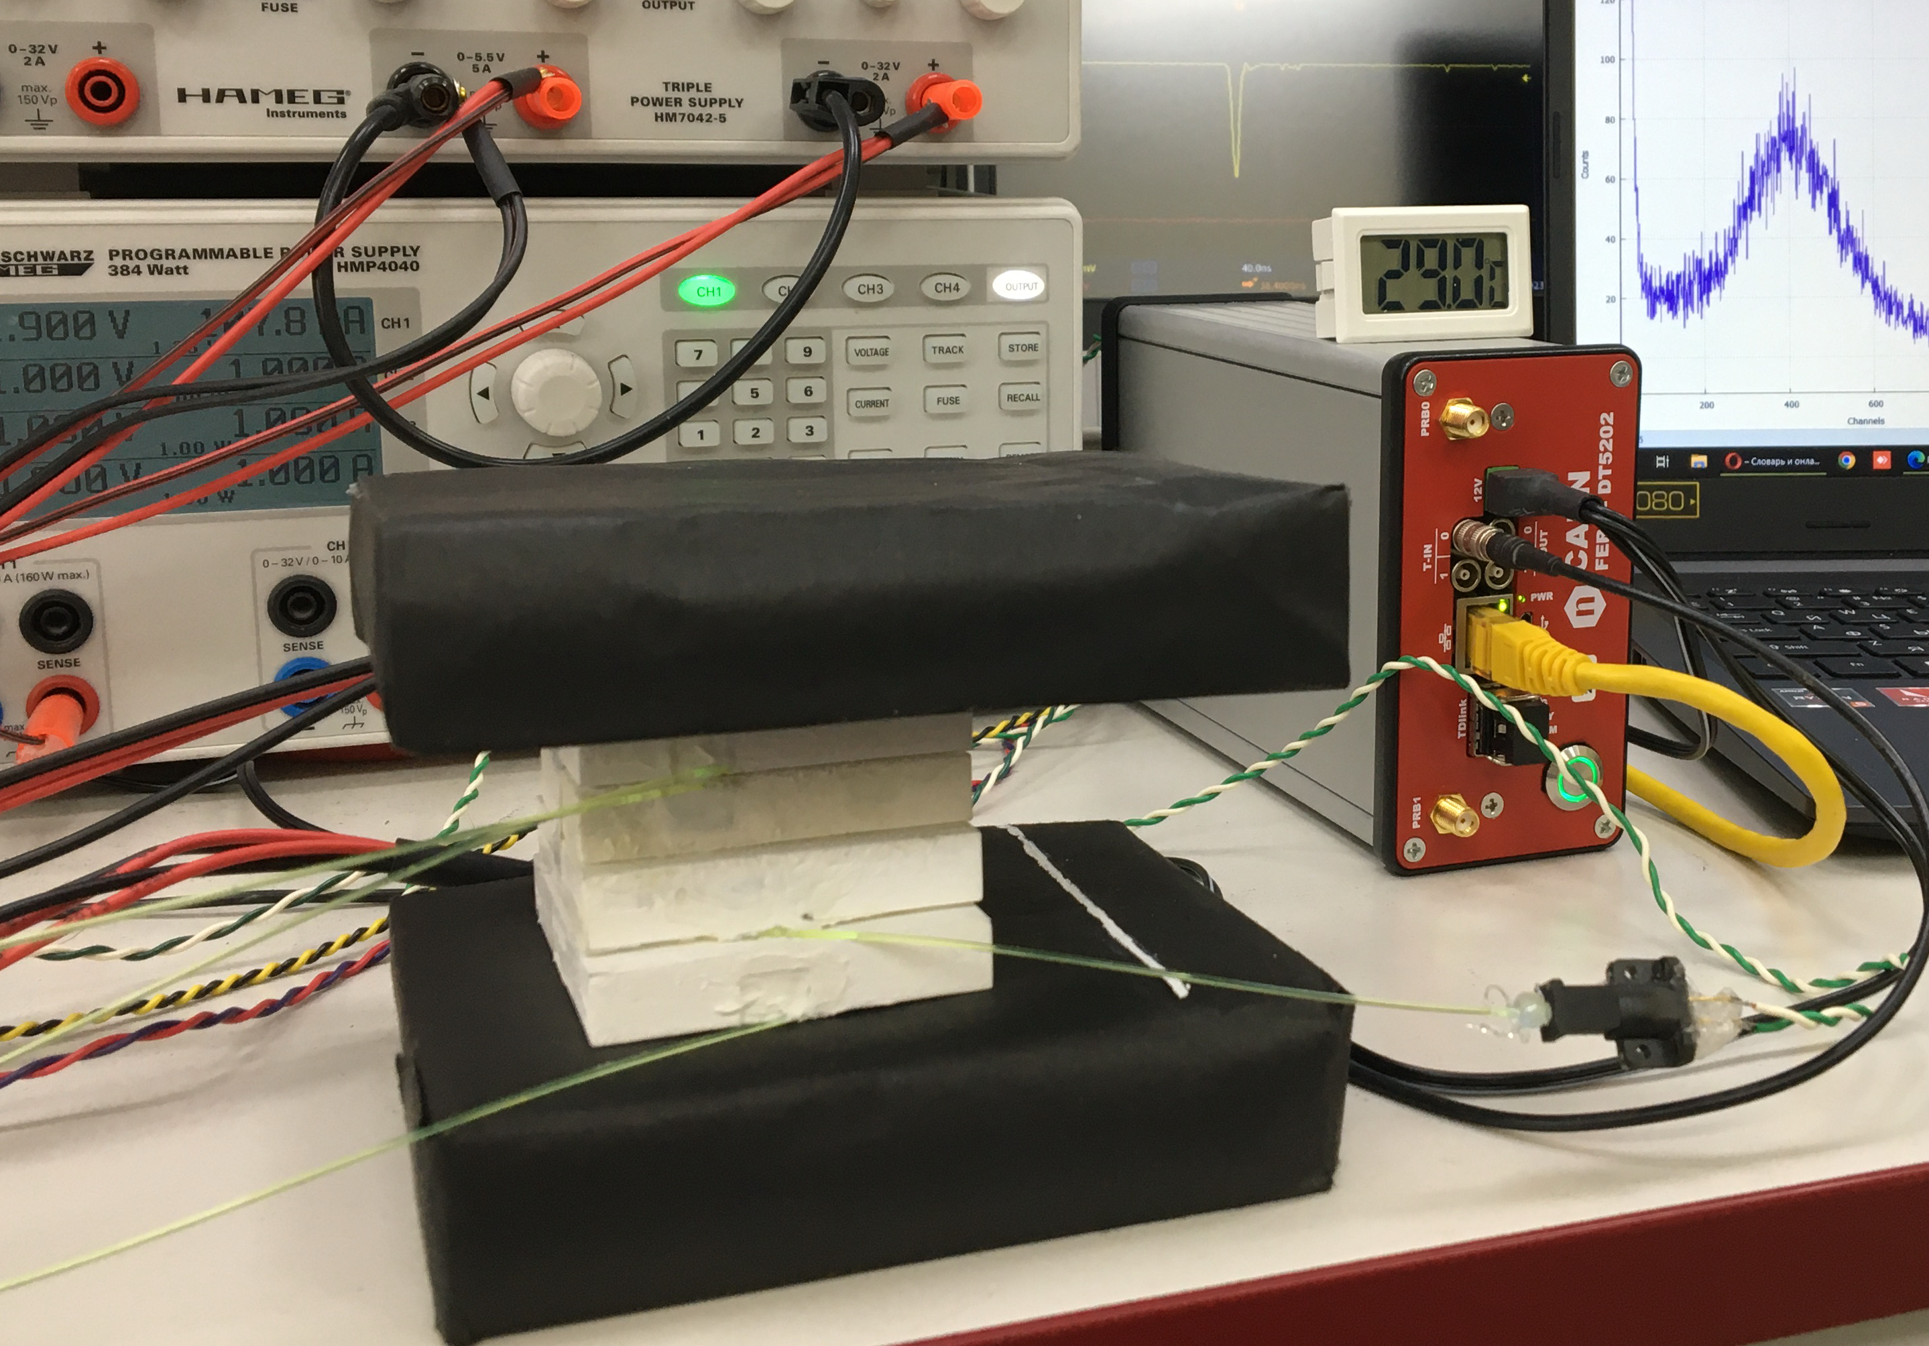
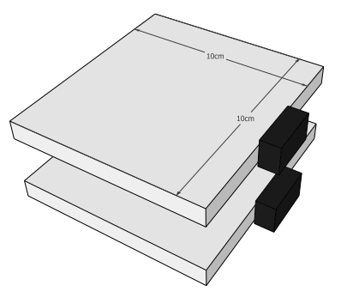
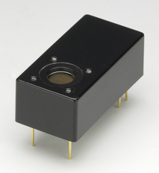
FEE studies results
The stand for BBC tile tests
BC-404
PMT Hamamatsu H10720-110
Trigger time resolution ~650 ps
2

Slide 4
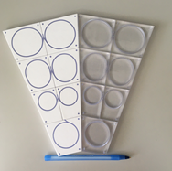
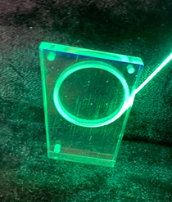
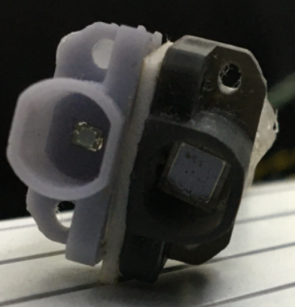
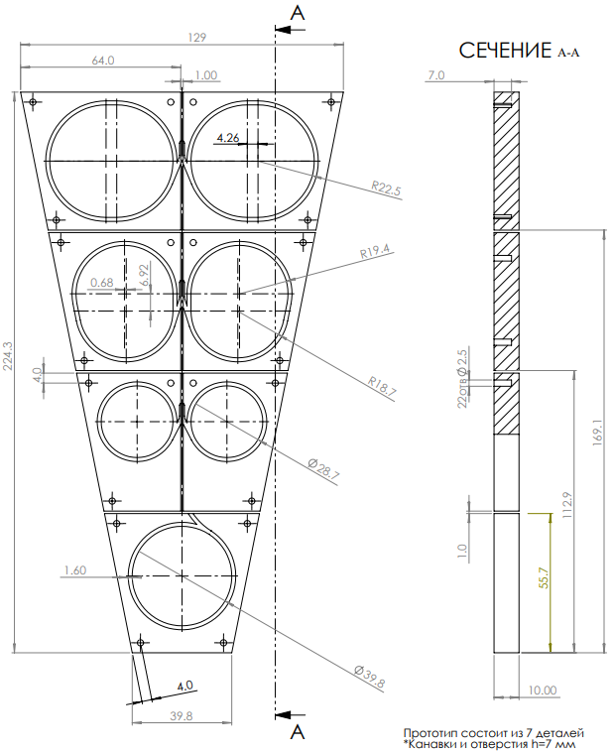
JINR and MEPhI Tests
Scintillation detector prototype materials
Line
3 (L;R)
2 (L;R)
1 (L;R)
central
Materials selection (scintillator, optical cement, fibers, etc) and prototype tiles testing with material combinations.
Scintillator: Matte vs Tyvek covered
Optical cement: CKTN Med vs OK-72
Fibers: Saint-Gobain Crystals vs KURARAY
SiPMs: 3x3 mm² ; 1x1 mm²
3

Slide 5
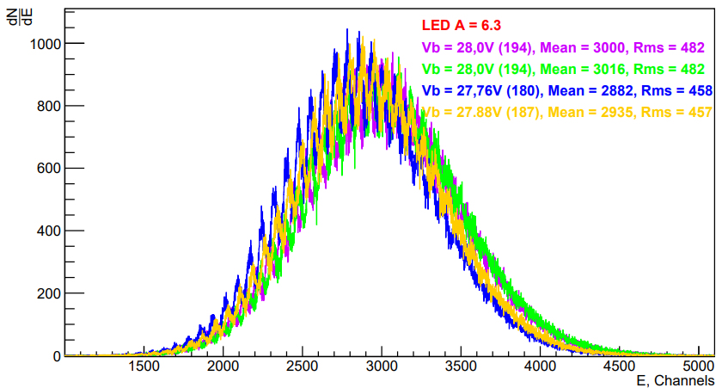
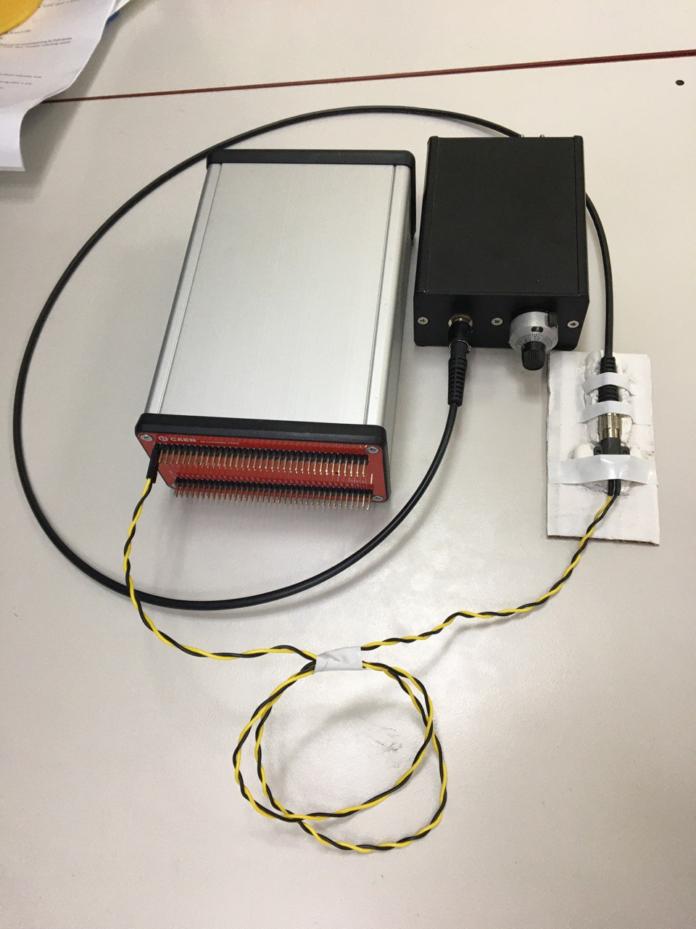
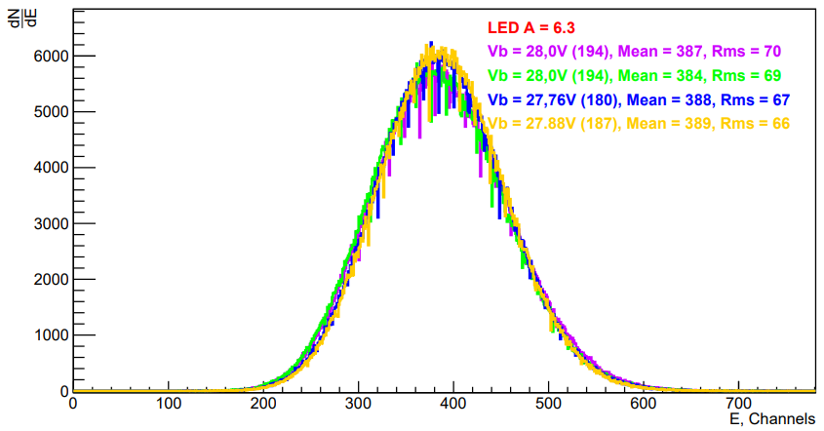
FEE studies results
Calibration method (Led source)
DT5202 with CAEN
LED Driver (SP5601)
4

Slide 6
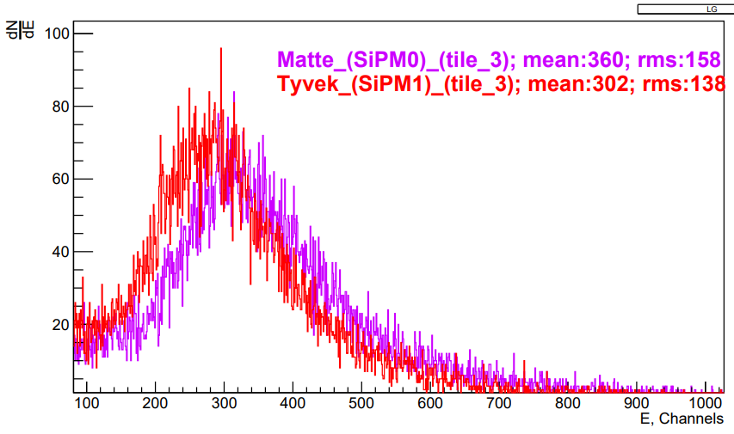
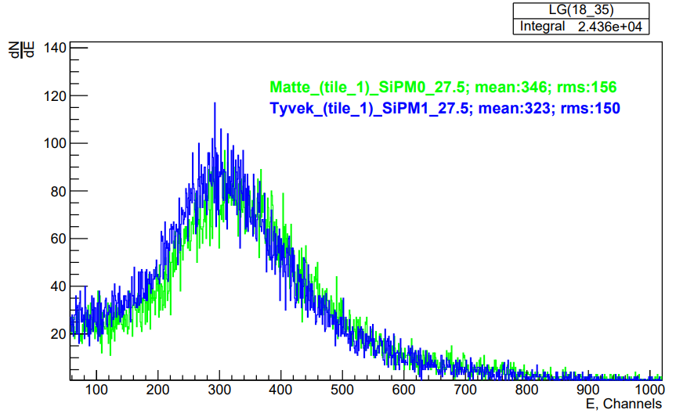
FEE studies results
Matte and Tyvek comparison
3 line tiles
1 line tiles
Line
3 (L;R)
The result is similar, and due to the fact that the option with Tyvek carries the technological complexity of mass production, the option with matted one is more acceptable.
2 (L;R)
1 (L;R)
central
5

Slide 7
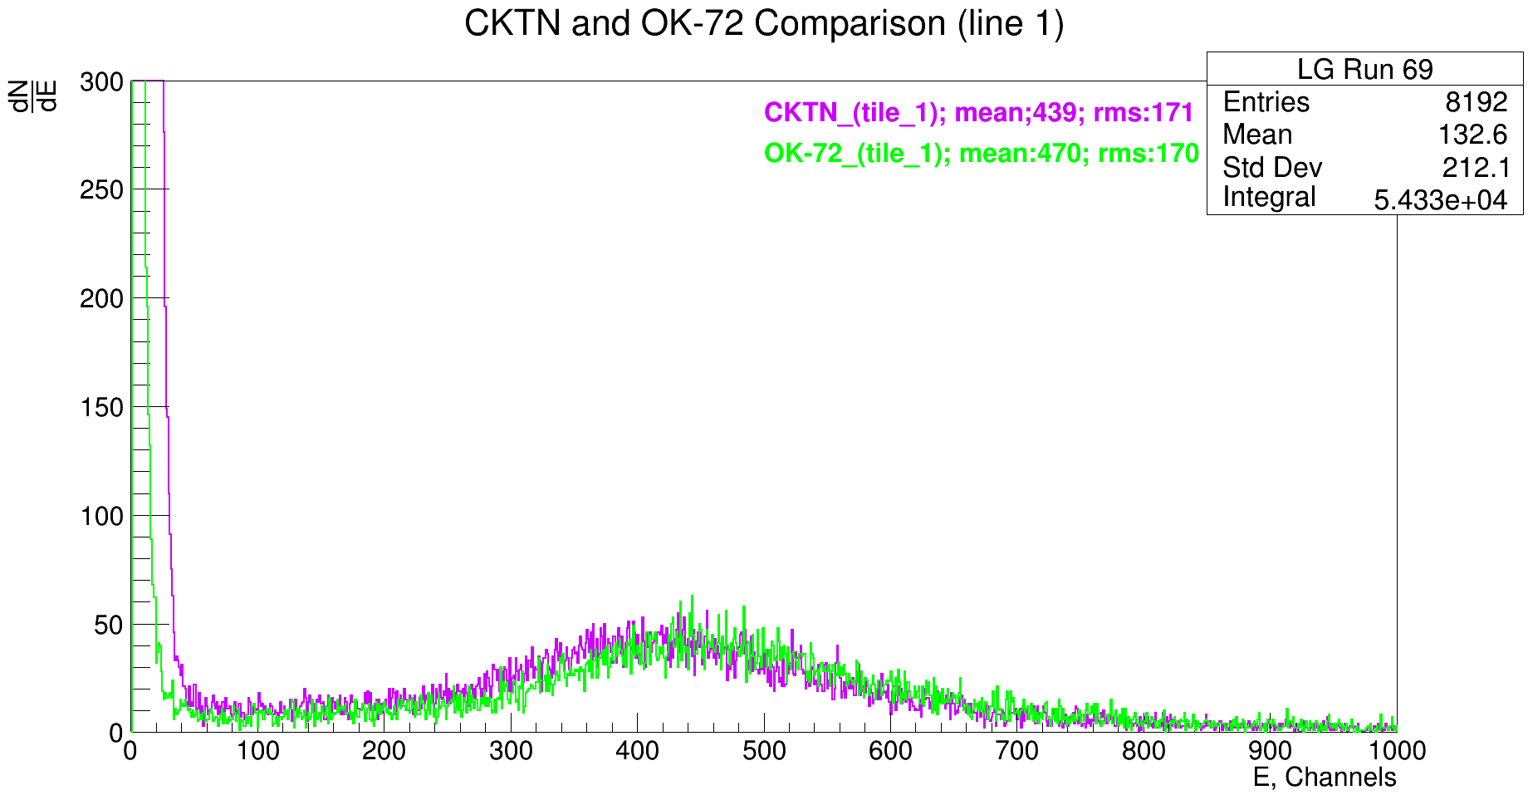
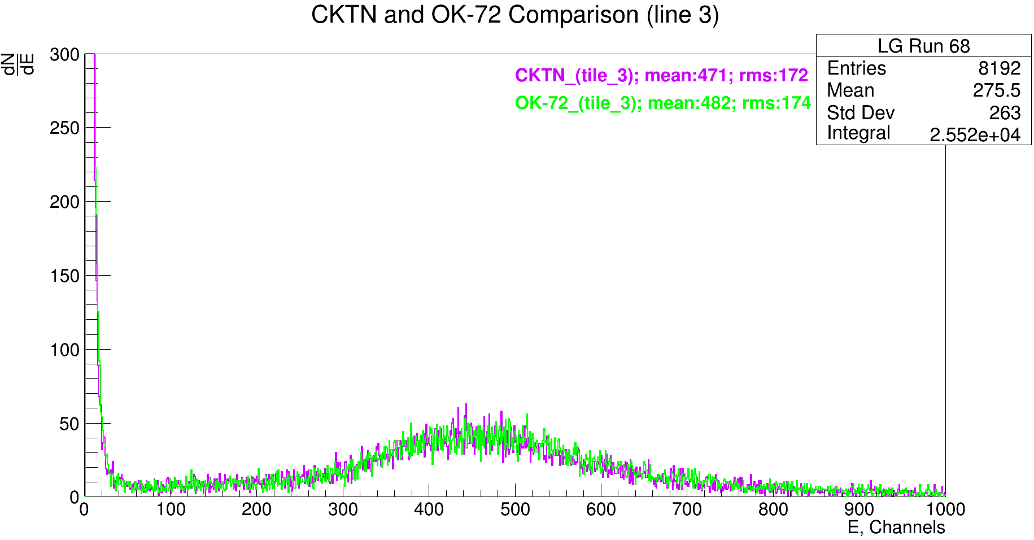
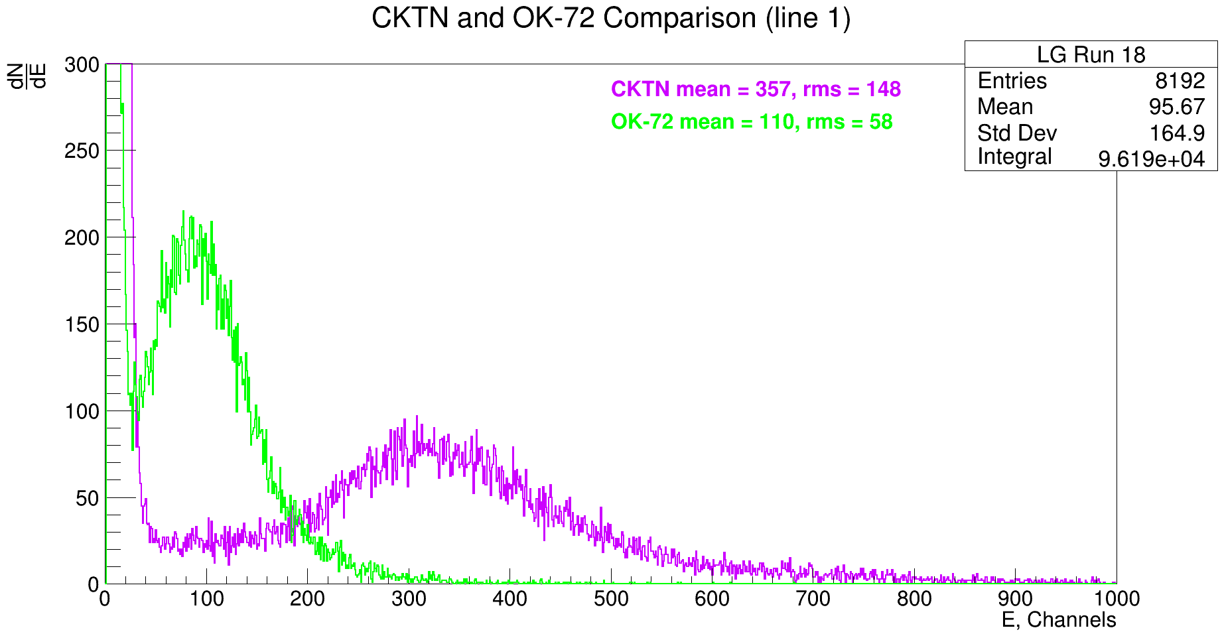
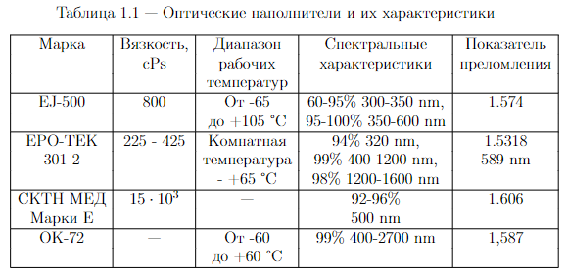
FEE studies results
CKTN and OK-72 comparison
CKTN and OK-72 Comparison Line 1
CKTN and OK-72 Comparison Line 3
Line
3 (L;R)
2 (L;R)
1 (L;R)
central
CKTN and OK-72 Comparison Line 3 (old sample)
6

Slide 8
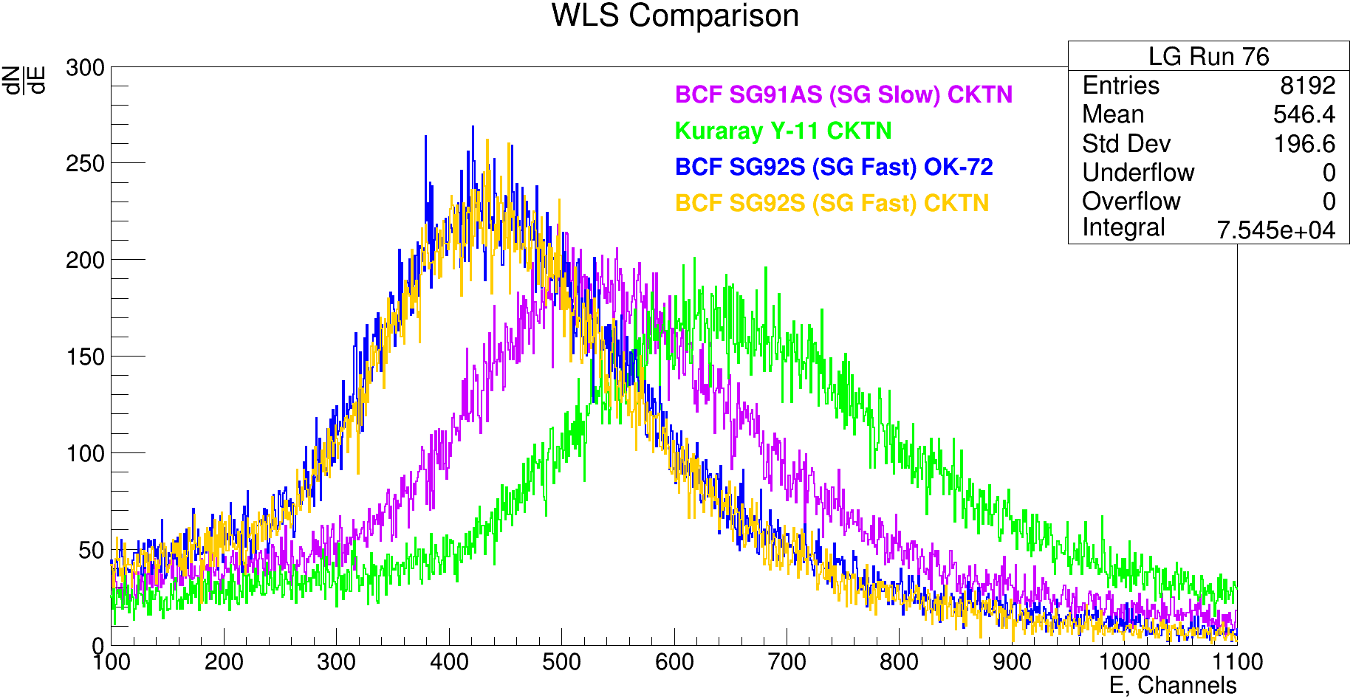
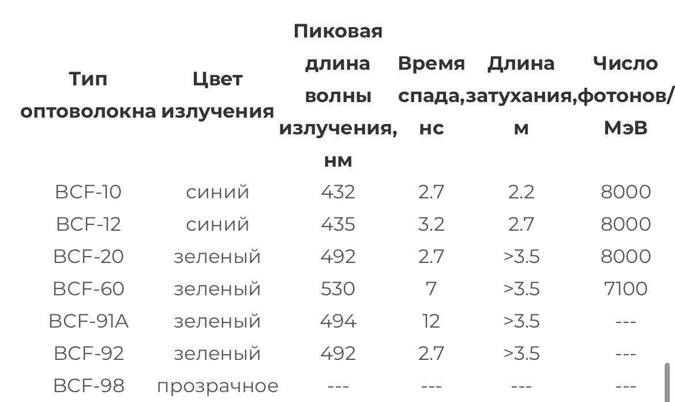
FEE studies results
SG91AS, SG92S and Y-11 comparison
WLS Comparison Line 3
Line
3 (L;R)
2 (L;R)
1 (L;R)
7
central

Slide 9
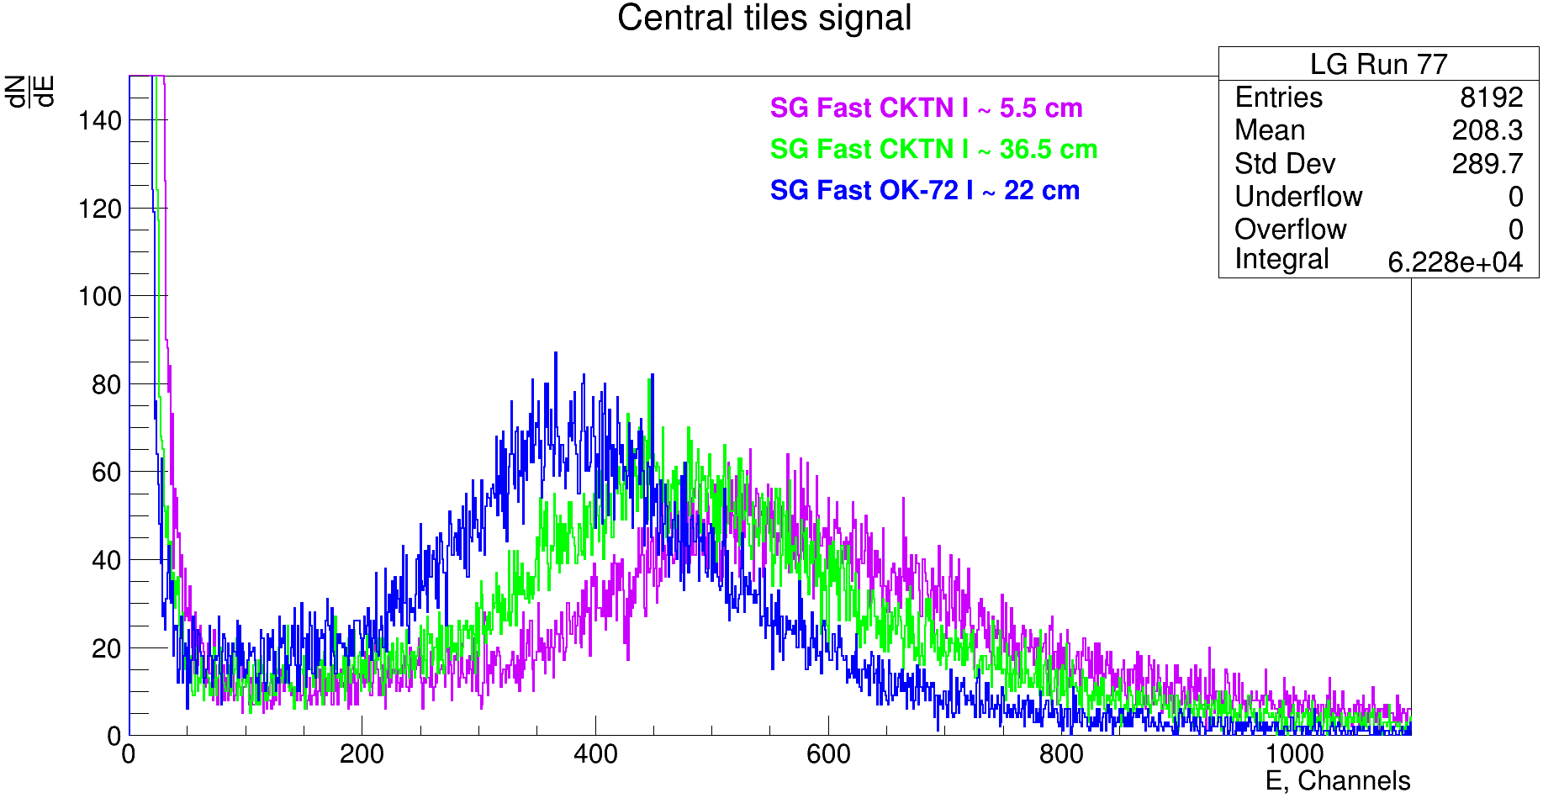
FEE studies results
Signal from central tiles
Line
3 (L;R)
2 (L;R)
1 (L;R)
central
Signal from central tiles, using different optical cements and WLS length
8

Slide 10
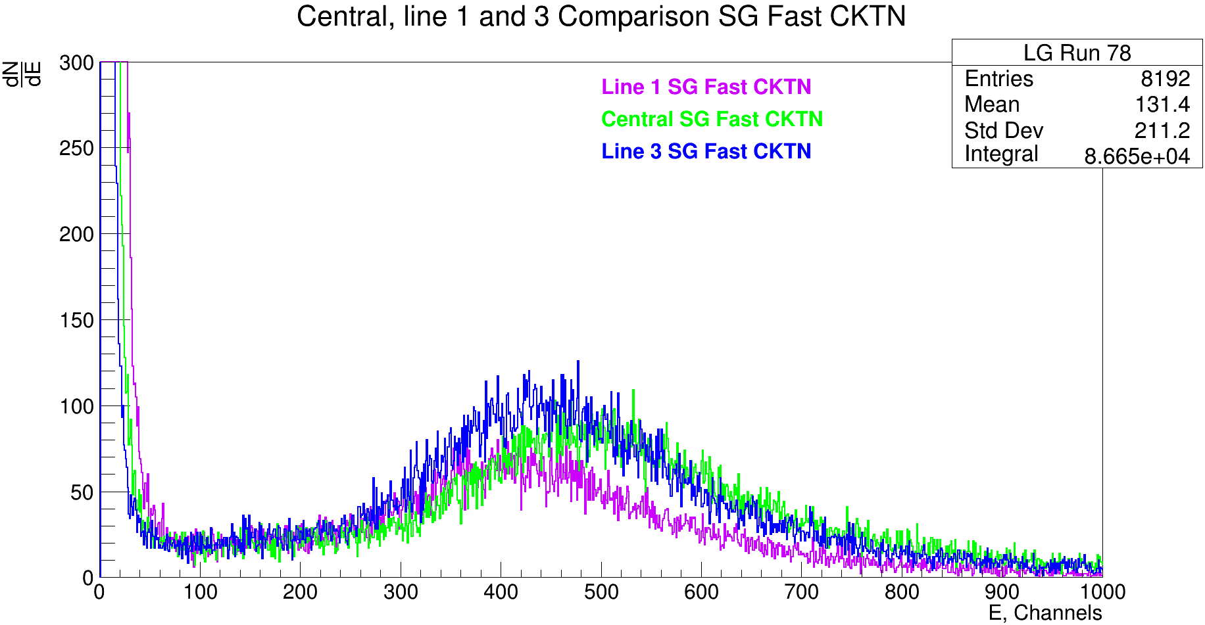
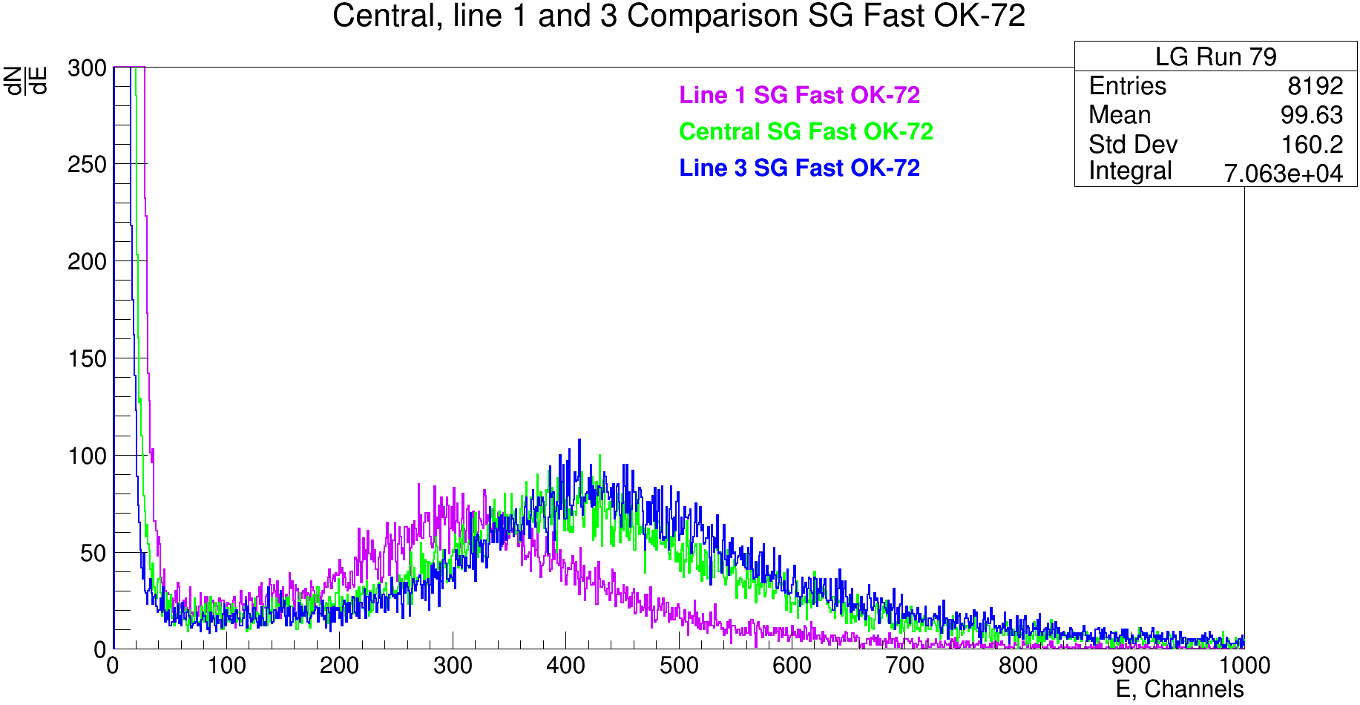
FEE studies results
Central, line 1 and line 3 comparison
Signals from central, line 1 and line 3 tiles seems to be different because of different fiber curvature (see tile system scheme)
9

Slide 11
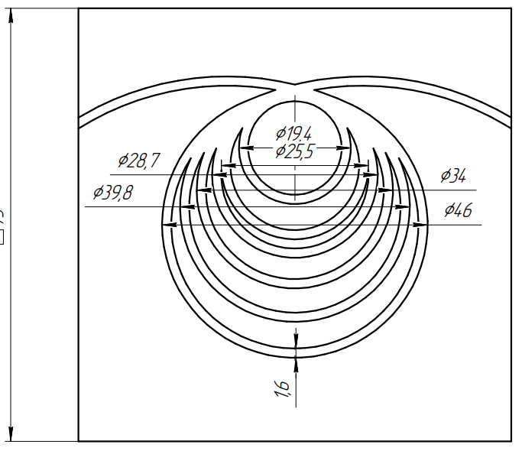
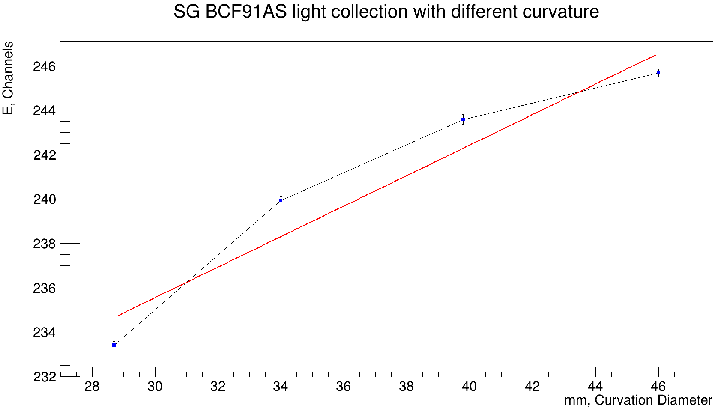
FEE studies results
SG BCF92AS light collection
d4
d3
d2
d1
Fit using pol1 function parameters
Difference between d1 and d4 for SG BCF91AS ≈ 5% of light collection
10

Slide 12
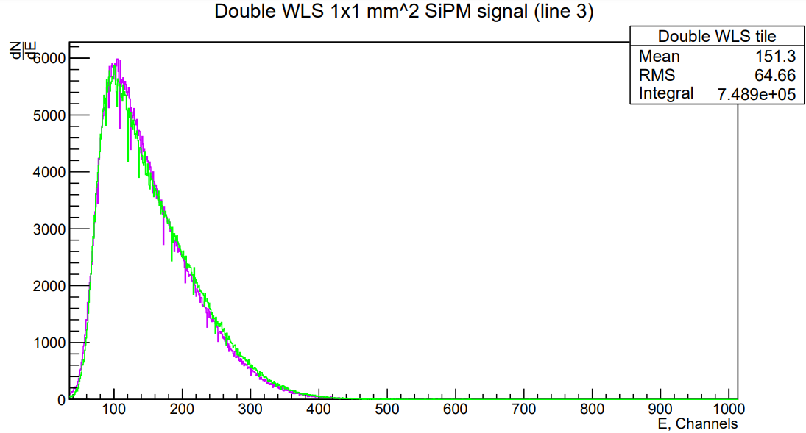
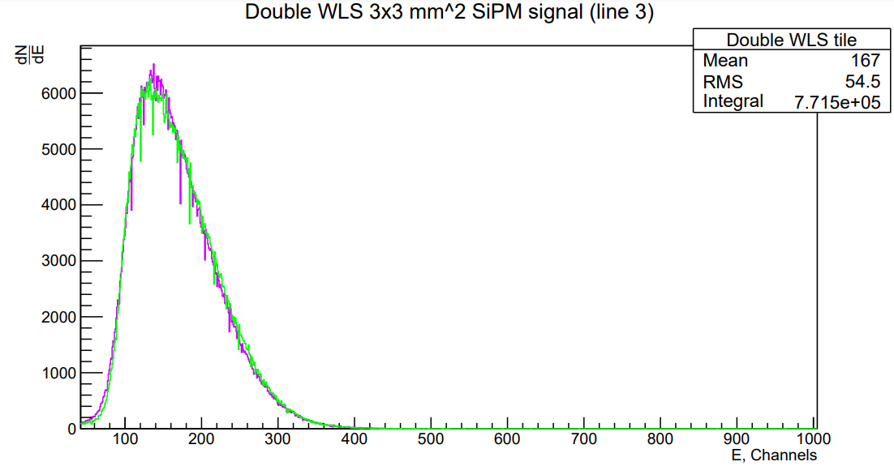
FEE studies results
3x3 and 1x1 calibration using 2 WLS tile
Double WLS tile, used for calibration
11

Slide 13
Thanks for attention!

