Slide 1
Universal Main Magnetic Focus Ion Source: A New Tool for Laboratory Astrophysics and Tokamak Microplasma Research
Vladimir P. Ovsyannikov,ª Andrei V. Nefiodov,^{b} Aleksandr A. Levinª
ª MaMFIS group, Hochchulstr. 13, D-01069 Dresden, Germany
^{b} Petersburg Nuclear Physics Institute, 188300 Gatchina, Russia

Slide 2
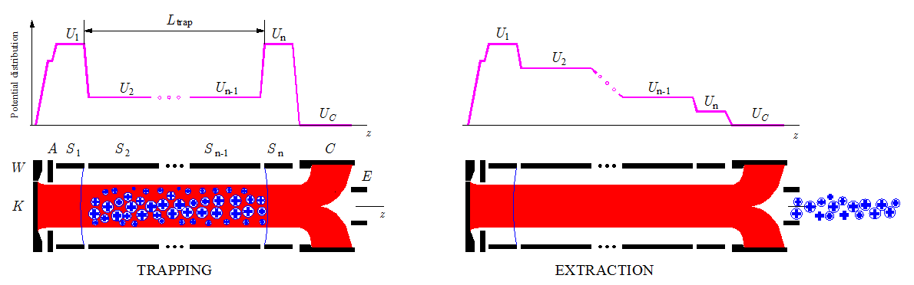
History
Production of highly charged ions
Electron Beam Ion Source (EBIS), E.D. Donets, Dubna, 1967
K, cathode
W, focusing (Wehnelt) electrode
A, anode
S₁, S₂,…, S_{n}, sections of drift tube
C, collector
E, extractor
z, axis of electron beam
j_{e} , effective electron current density
L_{trap} , trap length
L_{trap}= 0.7 – 1.5 m
j_{e} ~ 500 A/cm²

Slide 3
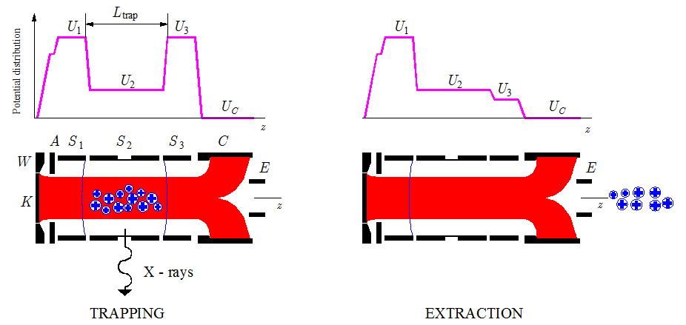
History
Production of highly charged ions
Electron Beam Ion Trap (EBIT), M. Levine, R. Marrs, LLNL, 1986
K, cathode
W, focusing (Wehnelt) electrode
A, anode
S₁, S₂, S₃, sections of drift tube
C, collector
E, extractor
z, axis of electron beam
j_{e} , effective electron current density
L_{trap} , trap length
L_{trap}= 2 cm
j_{e} ~ 2 kA/cm²
EBIT + EXTRACTION = EBIS

Slide 4
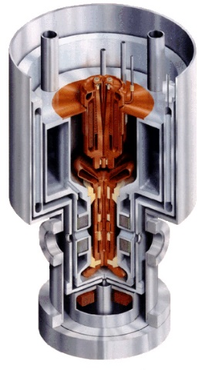
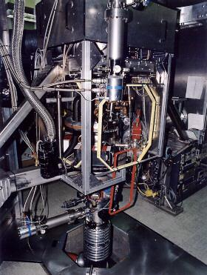
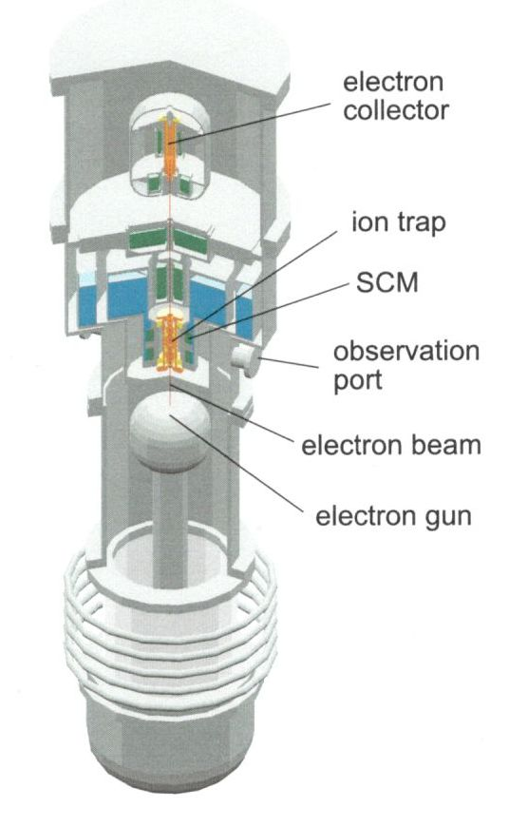
History
Superconducting EBITs: design
Lawrence Livermore National Laboratory
The LLNL EBIT (1986)
The LLNL Super-EBIT (1992)

Slide 5
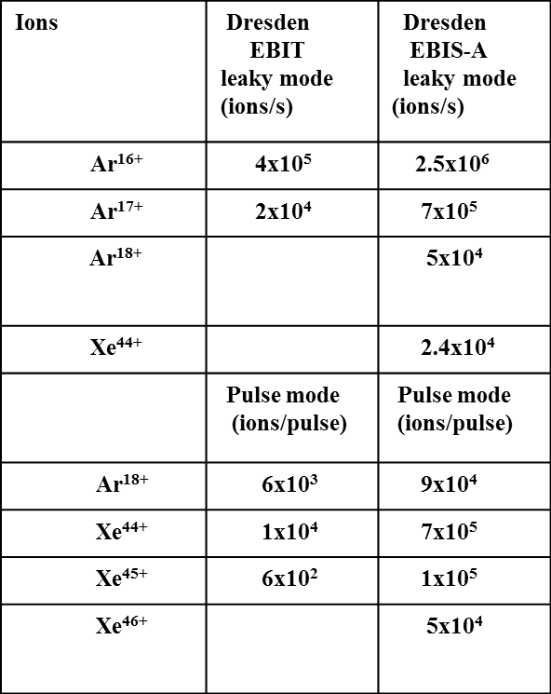
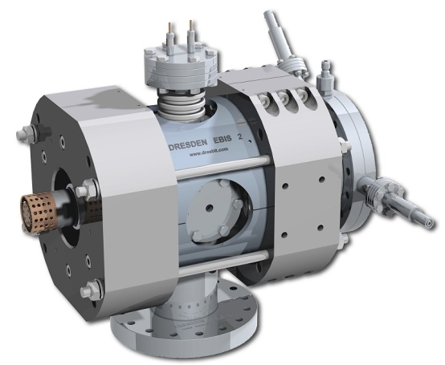
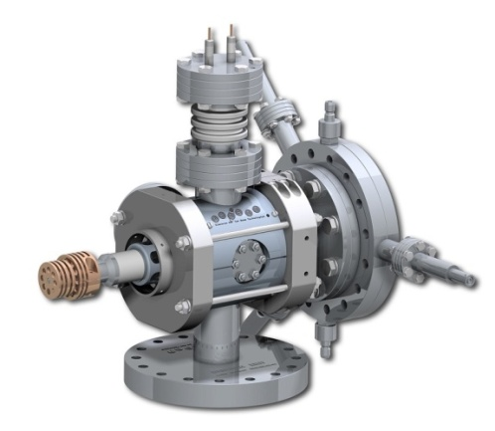
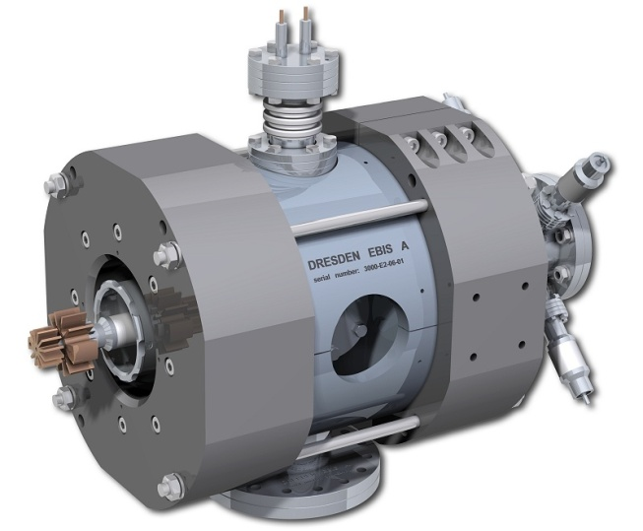
Family of room-temperature
Dresden Electron Beam Ion Sources
Dresden EBIS
Dresden EBIT
Dresden EBIS-A
DREEBIT GmbH

Slide 6
Dresden EBIS/Ts with permanent magnet focusing system
Germany Poland Swiss China
TU Dresden Jan Kochanowski University, Kielce PSI, Villigen NAOC, Beijing
FZ Dresden-Rossendorf Jagiellonian University, Krakow
Friedrich Schiller University, Jena
University of Duisburg-Essen
GSI, Darmstadt
MPI for Nuclear Physics, Heidelberg
Siemens AG Erlangen
Other permanent magnet EBITs around the Globe
USA Germany China
NIST, Gaithersburg MPI for Nuclear Physics, Heidelberg Fudan University, Shanghai

Slide 7
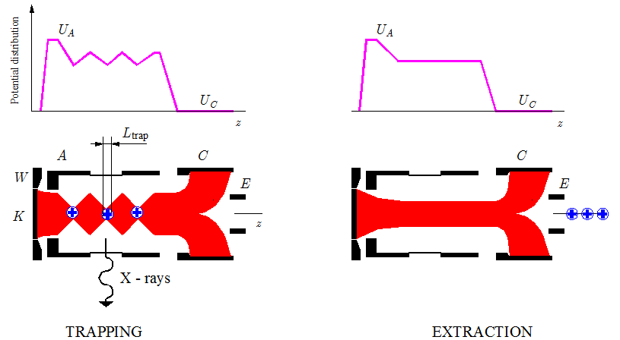
Production of highly charged ions
Main Magnetic Focus Ion Source (MaMFIS)
K, cathode
W, focusing (Wehnelt) electrode
A, anode
C, collector
E, extractor
z, axis of electron beam
j_{e} , effective electron current density
L_{trap} , trap length
L_{trap}= 1 mm
j_{e} > 10 kA/cm²

Slide 8
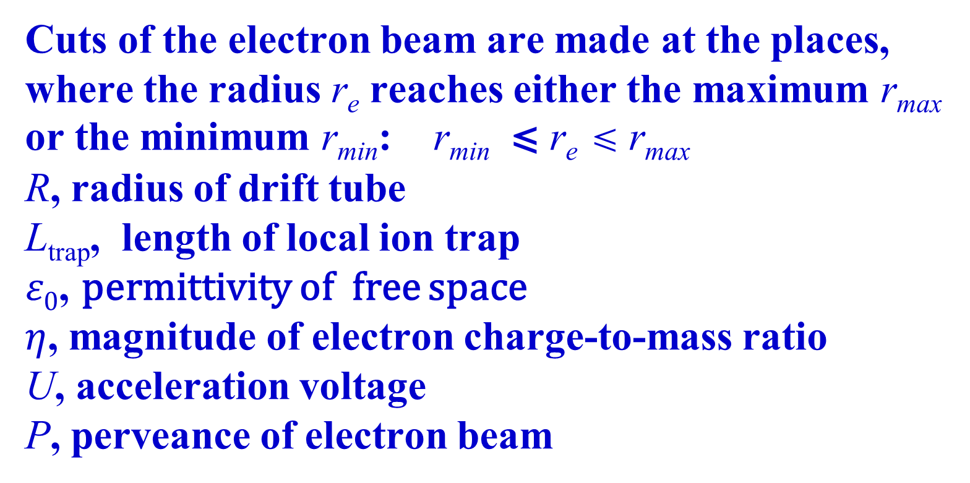
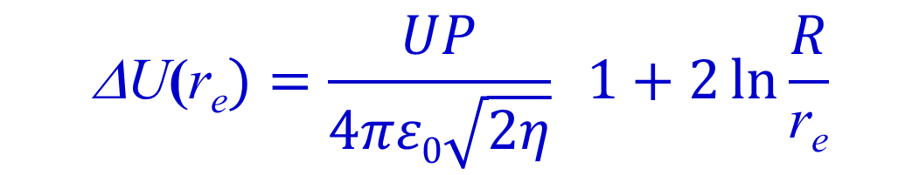
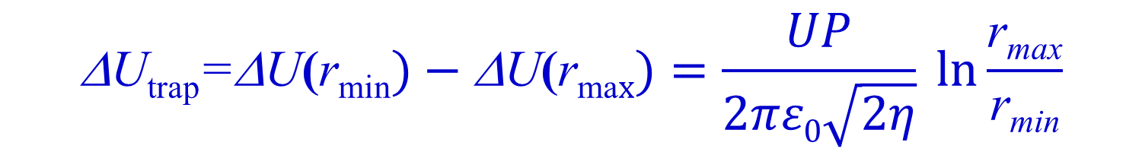

Formation of local ion traps by rippled electron beam
Sag of radial potential
Depth of axial potential well (local ion trap)

Slide 9
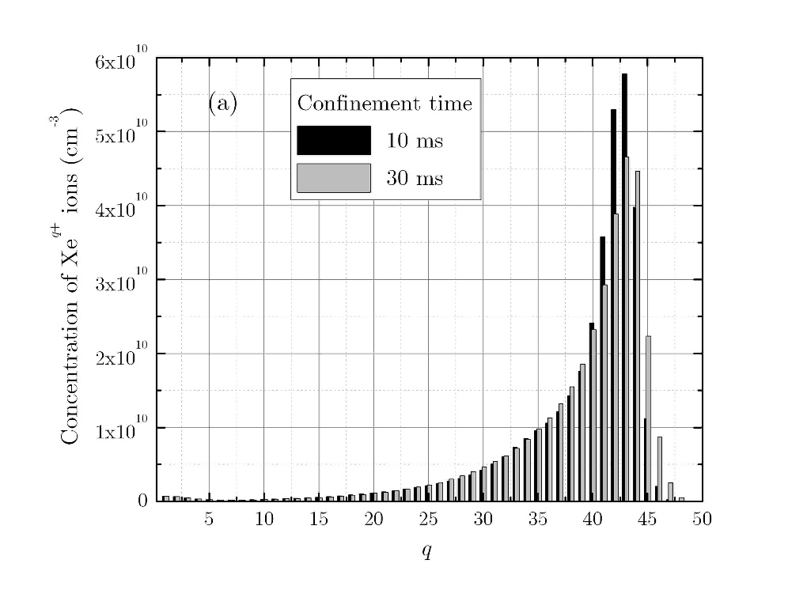
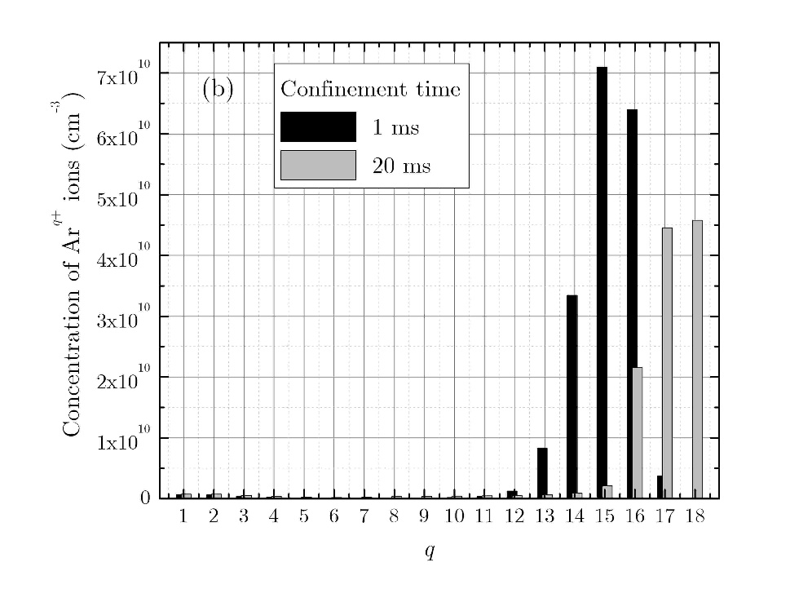
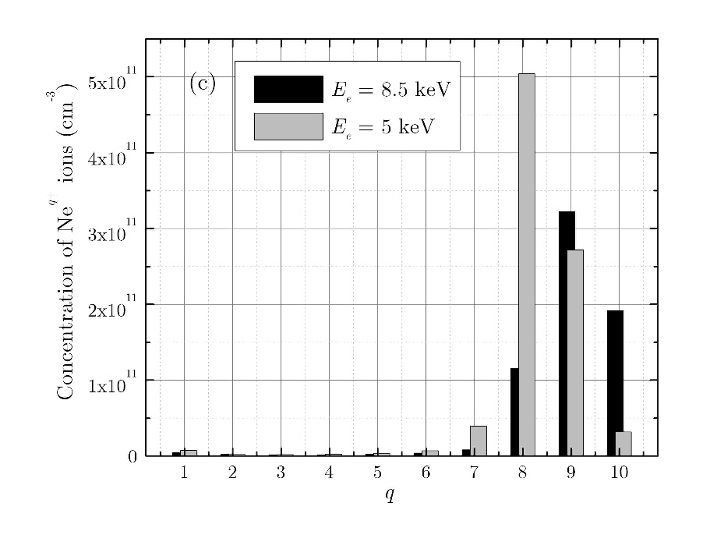
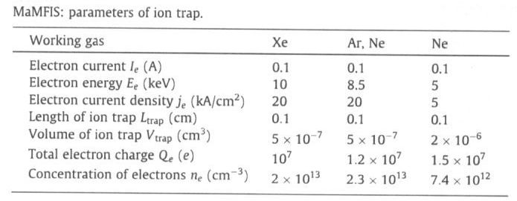
Theoretical prediction of ion yields
Xe
Ar
Ne
Ion yield
Xe⁴⁴⁺ : 2x10⁶ ions/s (f = 100 Hz)
Ar¹⁶⁺ : 3x10⁷ ions/s (f = 100 Hz)
Ar¹⁸⁺ : 10⁶ ions/s (f = 50 Hz)
Ne¹⁰⁺ : 10⁸ ions/s (f = 0.5 kHz)
Ne⁸⁺ : 10⁹ ions/s (f = 1 kHz)

Slide 10
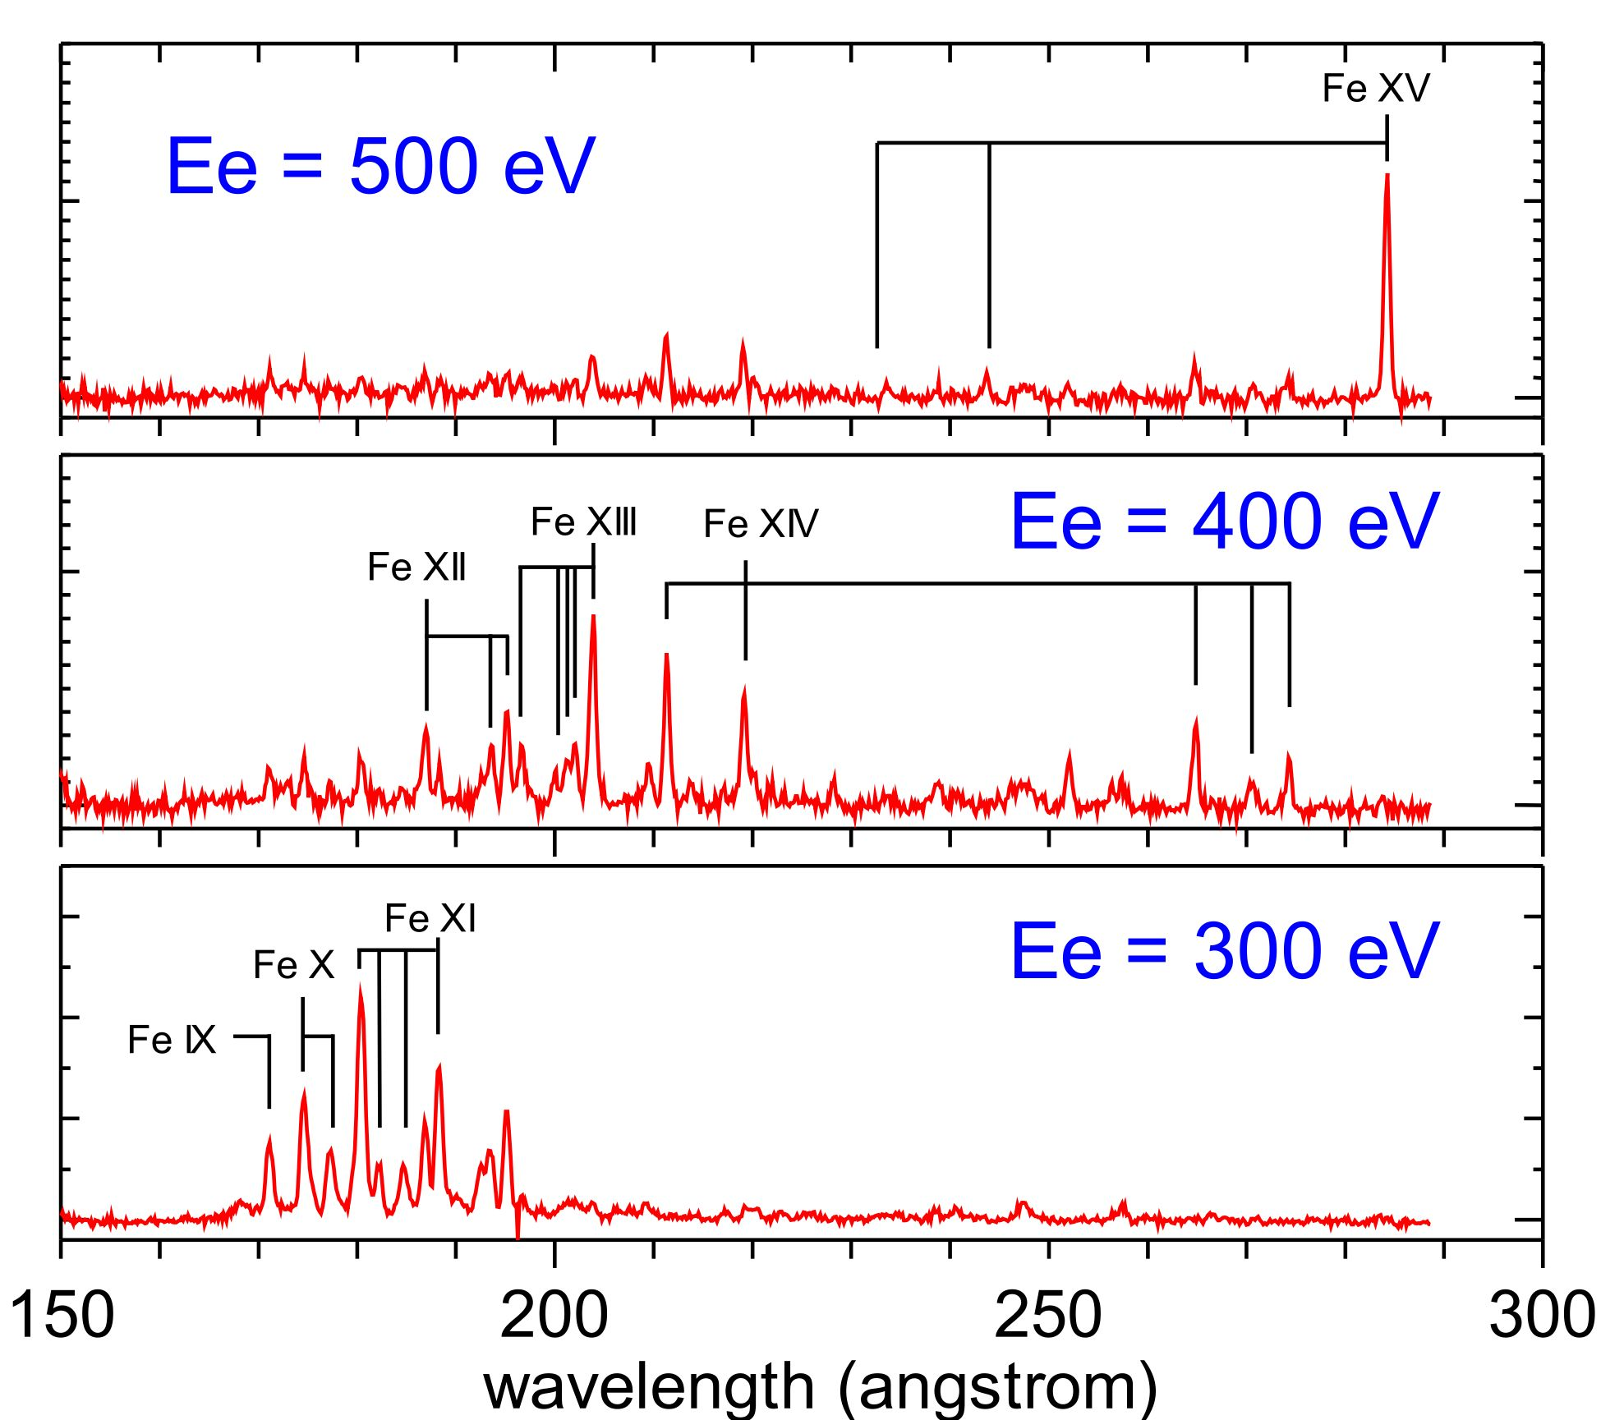
CoBIT (N.Nakamura et al., RSI 79 (2008) 063104)
Solar satellite
HINODE with
spectrometer EIS
Fe¹³⁺spectrum
by
HINODE
I_{e} = 20 mA,
U b 0.1 - 2.5 kV,
T = 77 K
EUV spectra of Fe ions obtained with CoBIT
T. Watanabe et al. Ap. J. (2009)

Slide 11
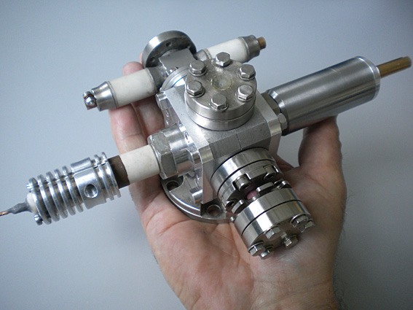
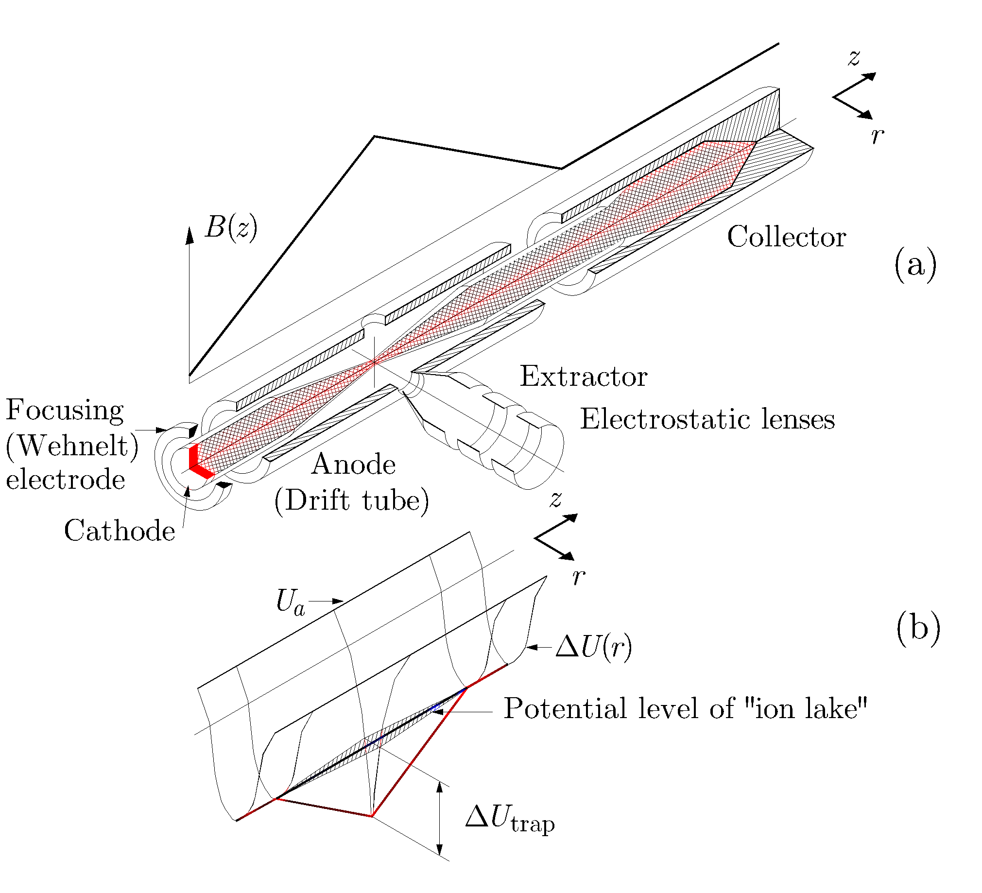
CoBIT (N.Nakamura et al., RSI 79 (2008) 063104)
MaMFIS-4 with radial extraction of ions
I_{e} = 50 mA, U b 0.1 - 4 kV,
j_{e} ~ 10 kA/cm²
T = 300 K
I_{e} = 20 mA, U b 0.1 - 2.5 kV,
T = 77 K
Principal scheme of ion source

Slide 12
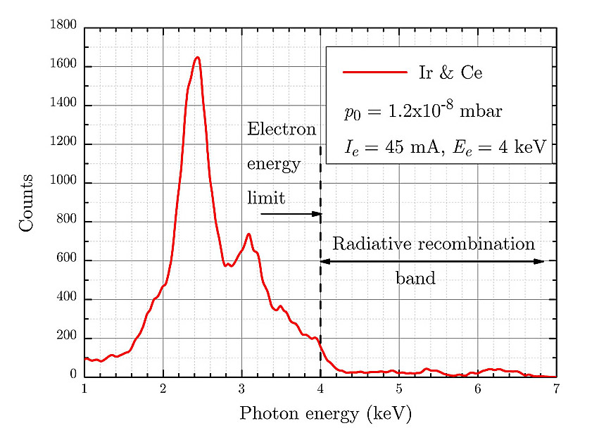
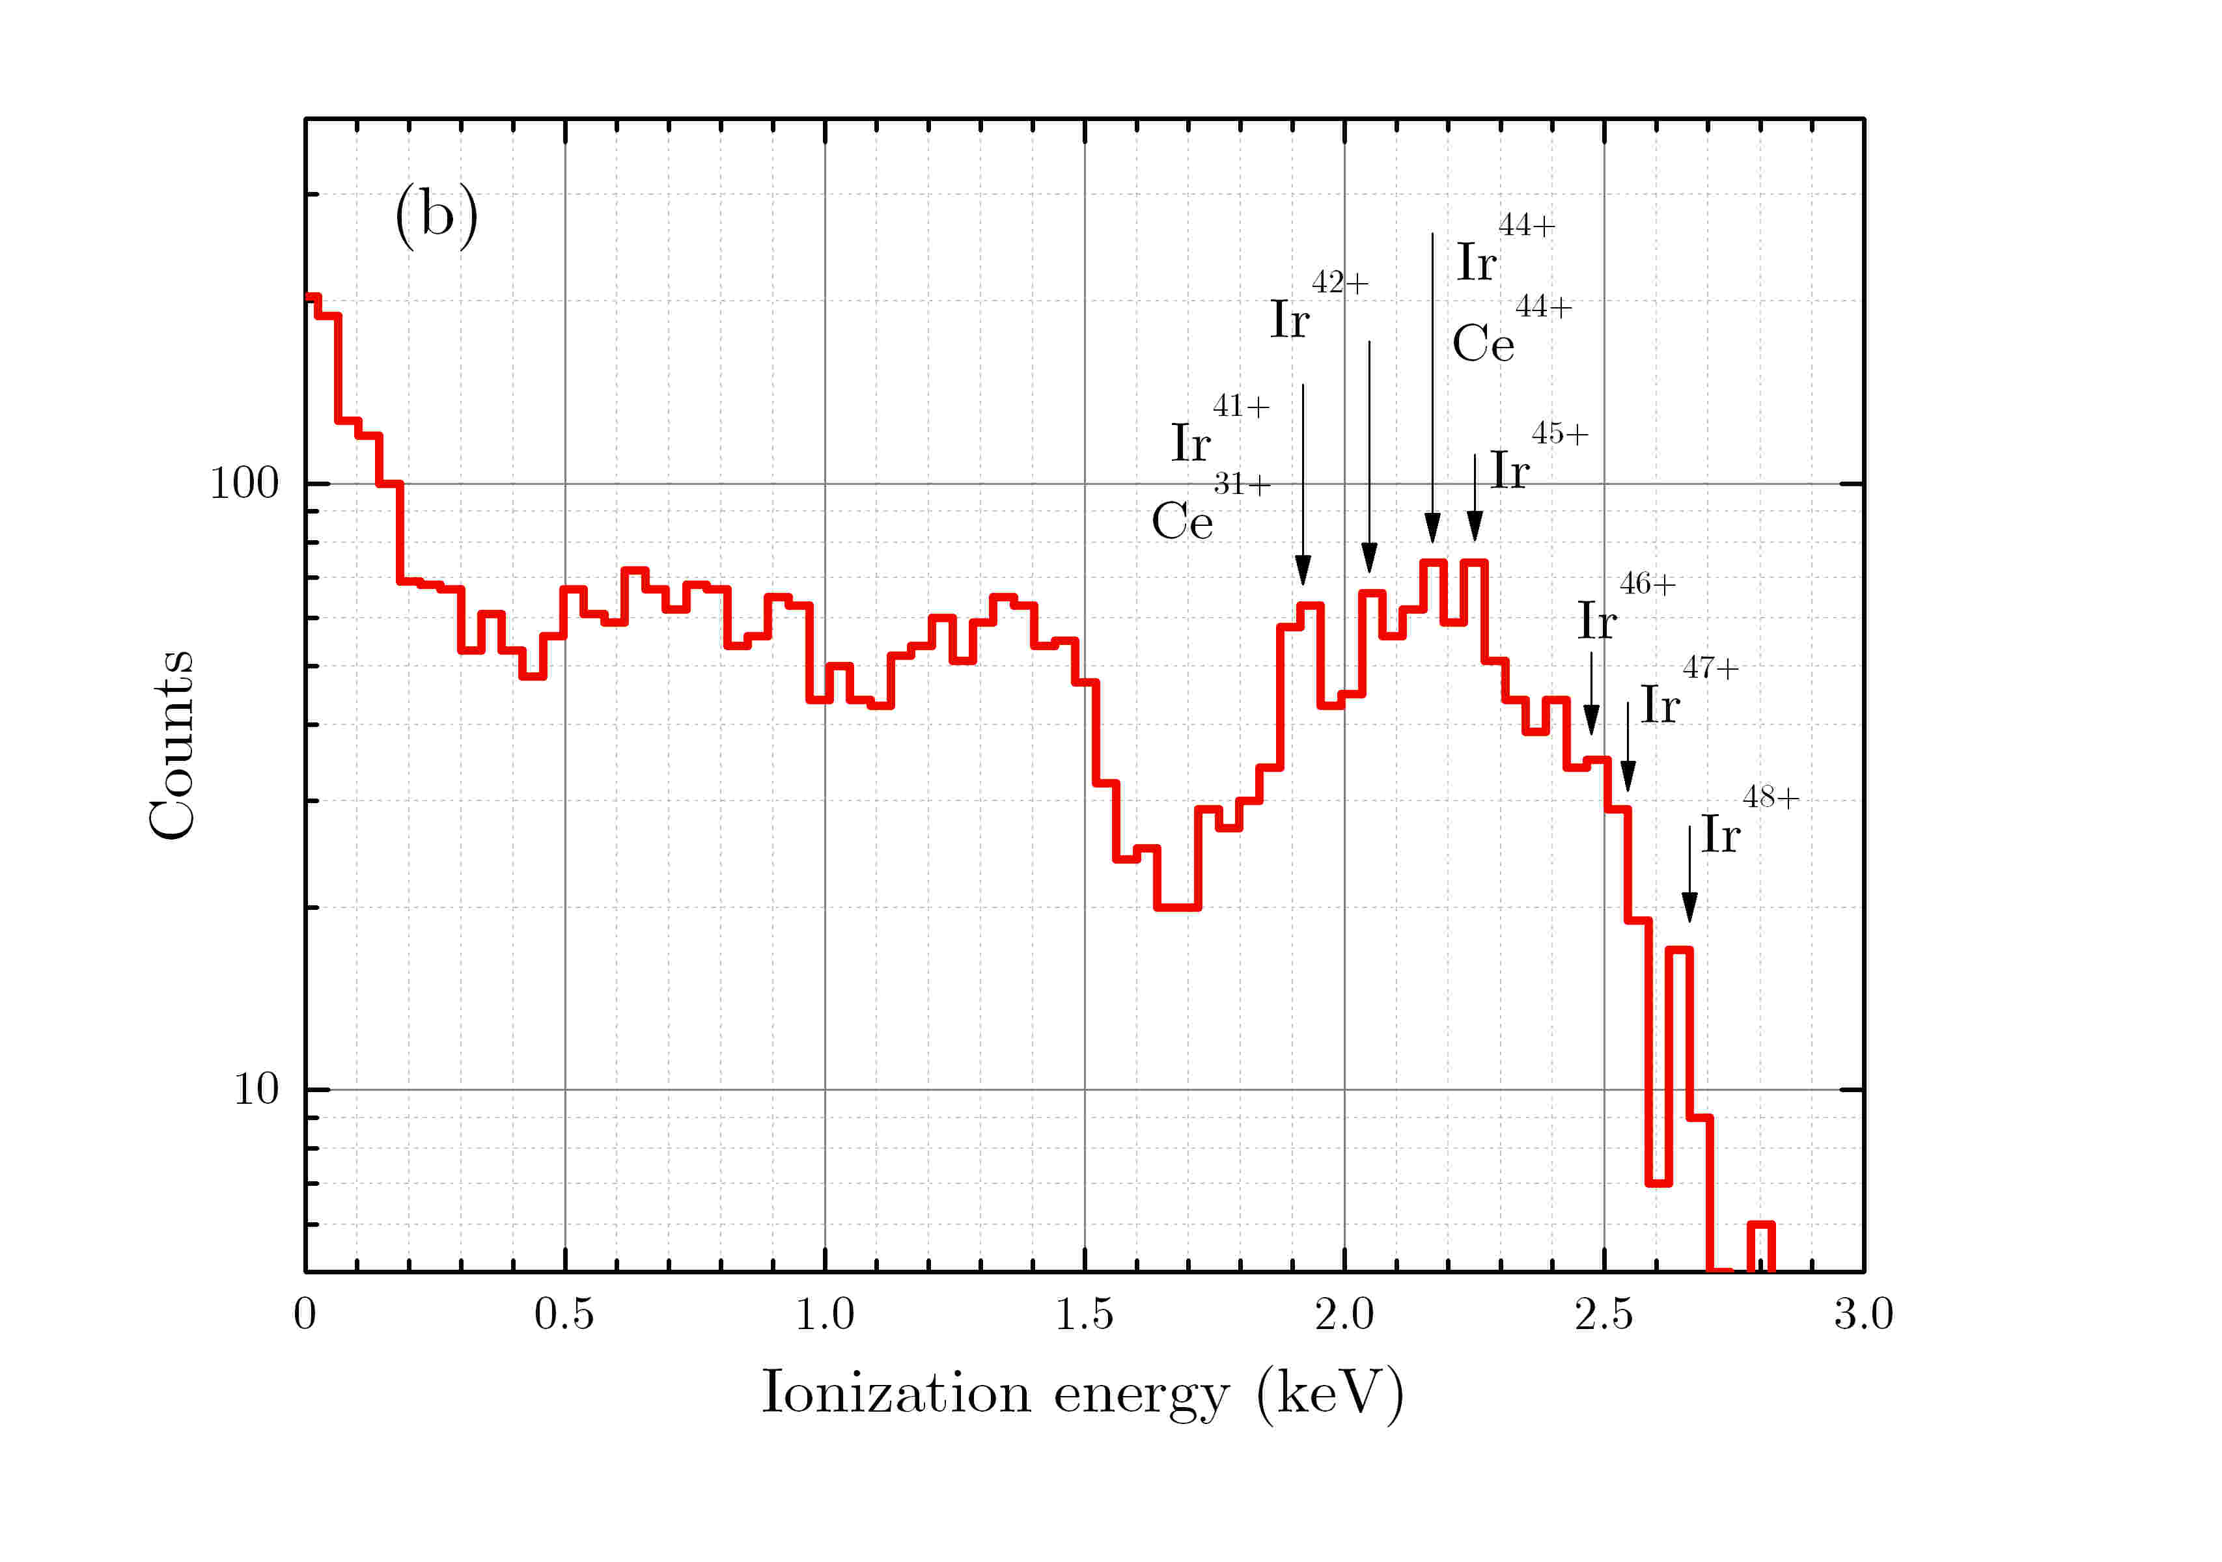
MaMFIS-4: x-ray emission measurements
Basic x-ray spectrum of Ir and Ce ions
Emission due to radiative recombintion

Slide 13
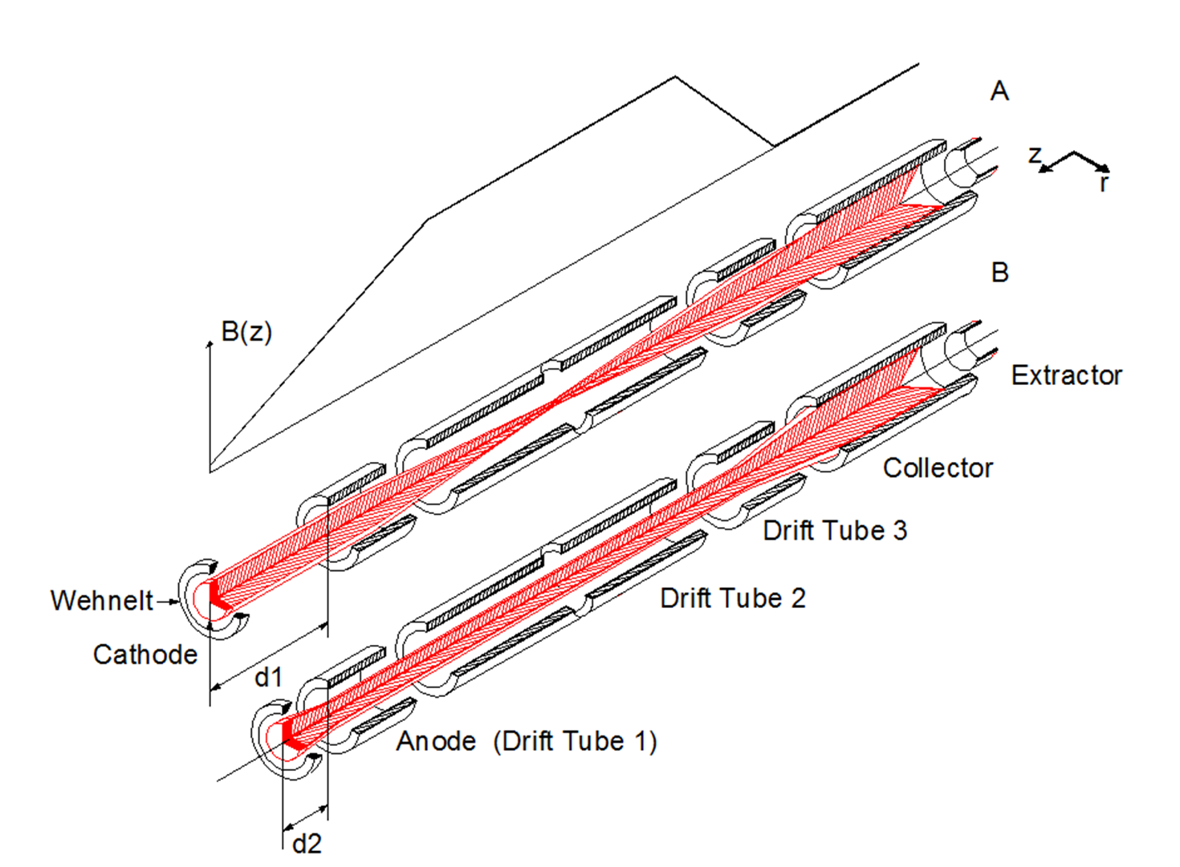
UniMaMFIS
A. MaMFIS running mode
Magnetic field at the cathode B_{c} is zero.
The cathode-anode distance is equal to d₁ for high-voltage ionization in a local ion trap with extremely high electron current density (j_{e} >= 10 kA/cm²).
B. EBIT running mode
Magnetic field at the cathode Bc is of a significant value.
The cathode-anode distance is equal to d2 for low-voltage ionization in the potential ion trap with relatively low current density (10 A/cm² <= j_{e} <= 100 A/cm²

Slide 14
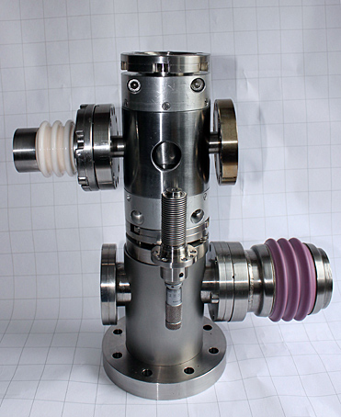
Universal MaMFIS
Project parameters:
Operational regime | EBIS | MaMFIS
E_{e} (eV) | 200 – 12 000 | Up to 60 000
I_{e} (mA) | 10 – 200 | 200
j_{e} (A/cm²) | 20 – 500 | 20 000
L_{trap} (cm) | 2 | 0.1
Expected yield of Xe⁵²⁺ ~ 300 ions per second

Slide 15
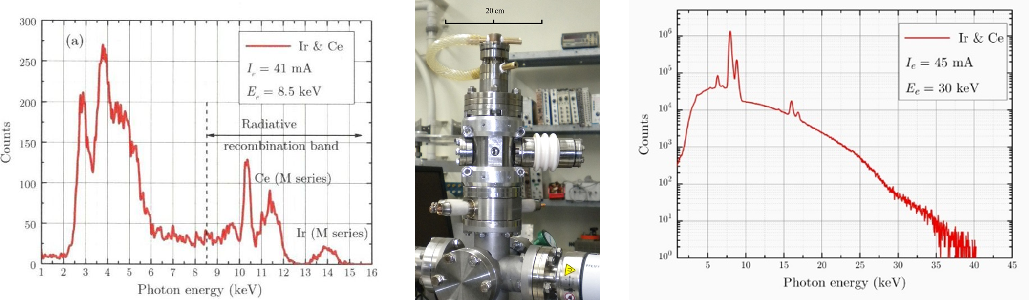
Pilot exemplar of UniMaMFIS
Pilot example of the device has been designed for two positions of cathode at 8.5 kV and 30 kV voltages of electron gun. The first measurements of X-ray emission spectra from cathode material were performed at the Institute for Atomic and Molecular Physics of the Justus-Liebig-University Giessen in Germany.

Slide 16

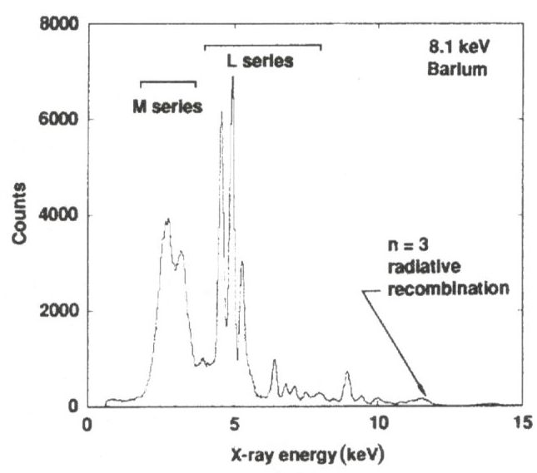
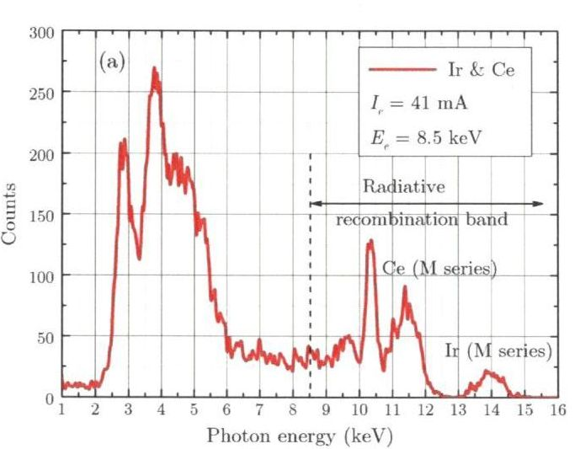
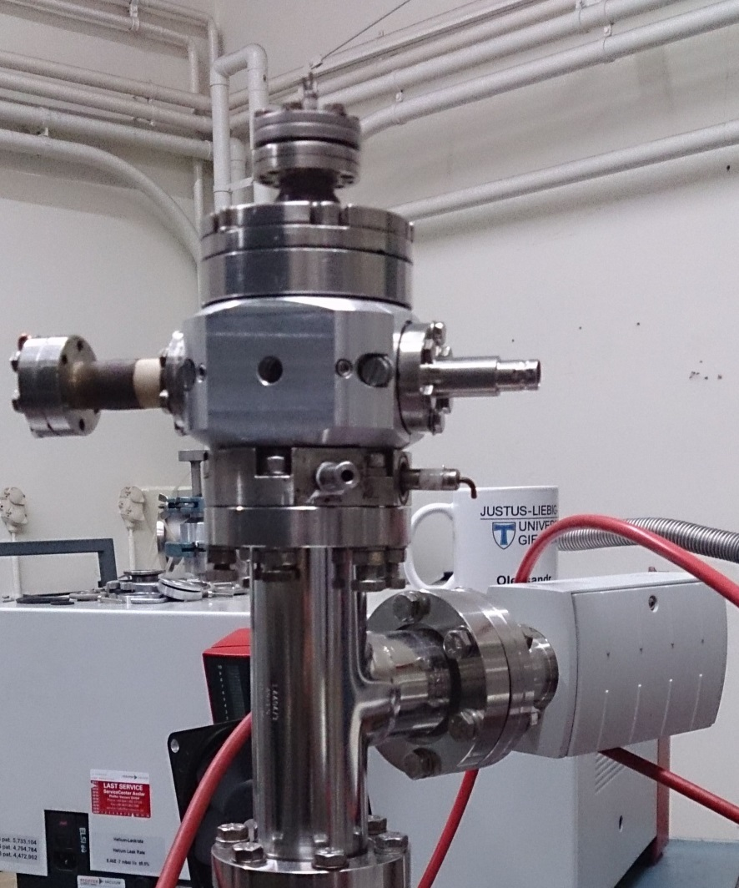
UniMaMFIS in mode of MaMFIS-10 versus LLNL superconducting EBIT
M.A. Levine, R.E. Marrs,
J.R. Henderson, D.A. Knapp,
M.B. Schneider,
Phys. Scripta T22, 157 (1988)
V.P. Ovsyannikov, A.V. Nefiodov,
NIMB 370, 32 (2016)
MaMFIS-10
First run: Giessen, March 2013
LLNL EBIT

Slide 17
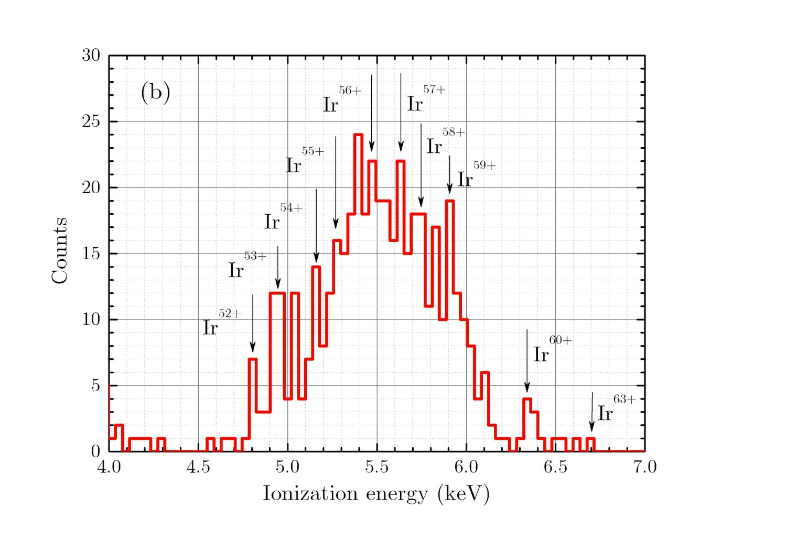
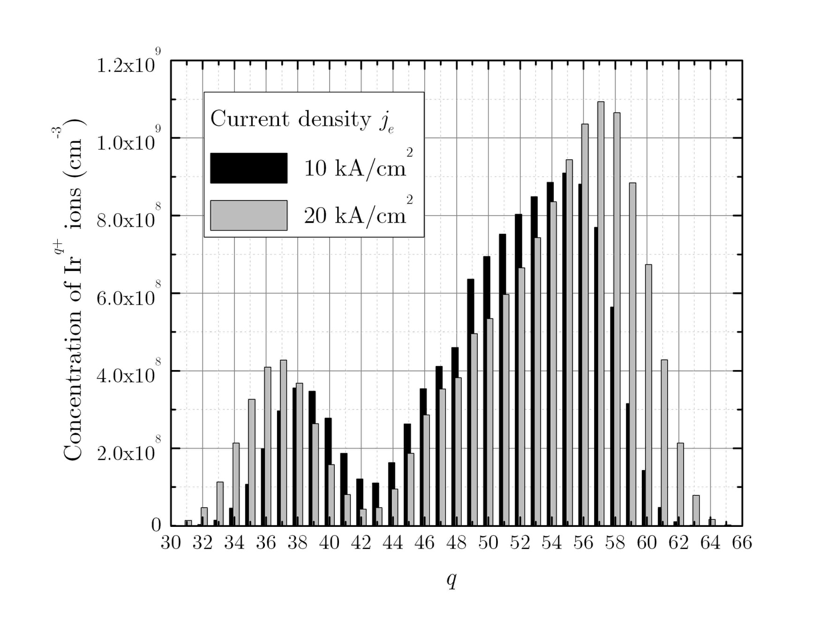
UniMaMFIS running as MaMFIS-10: determination of electron beam current density
X-ray emission due to radiative recombination into M-shell of Ir ions
Electron current density j_{e} ~ 20 kA/cm²

Slide 18
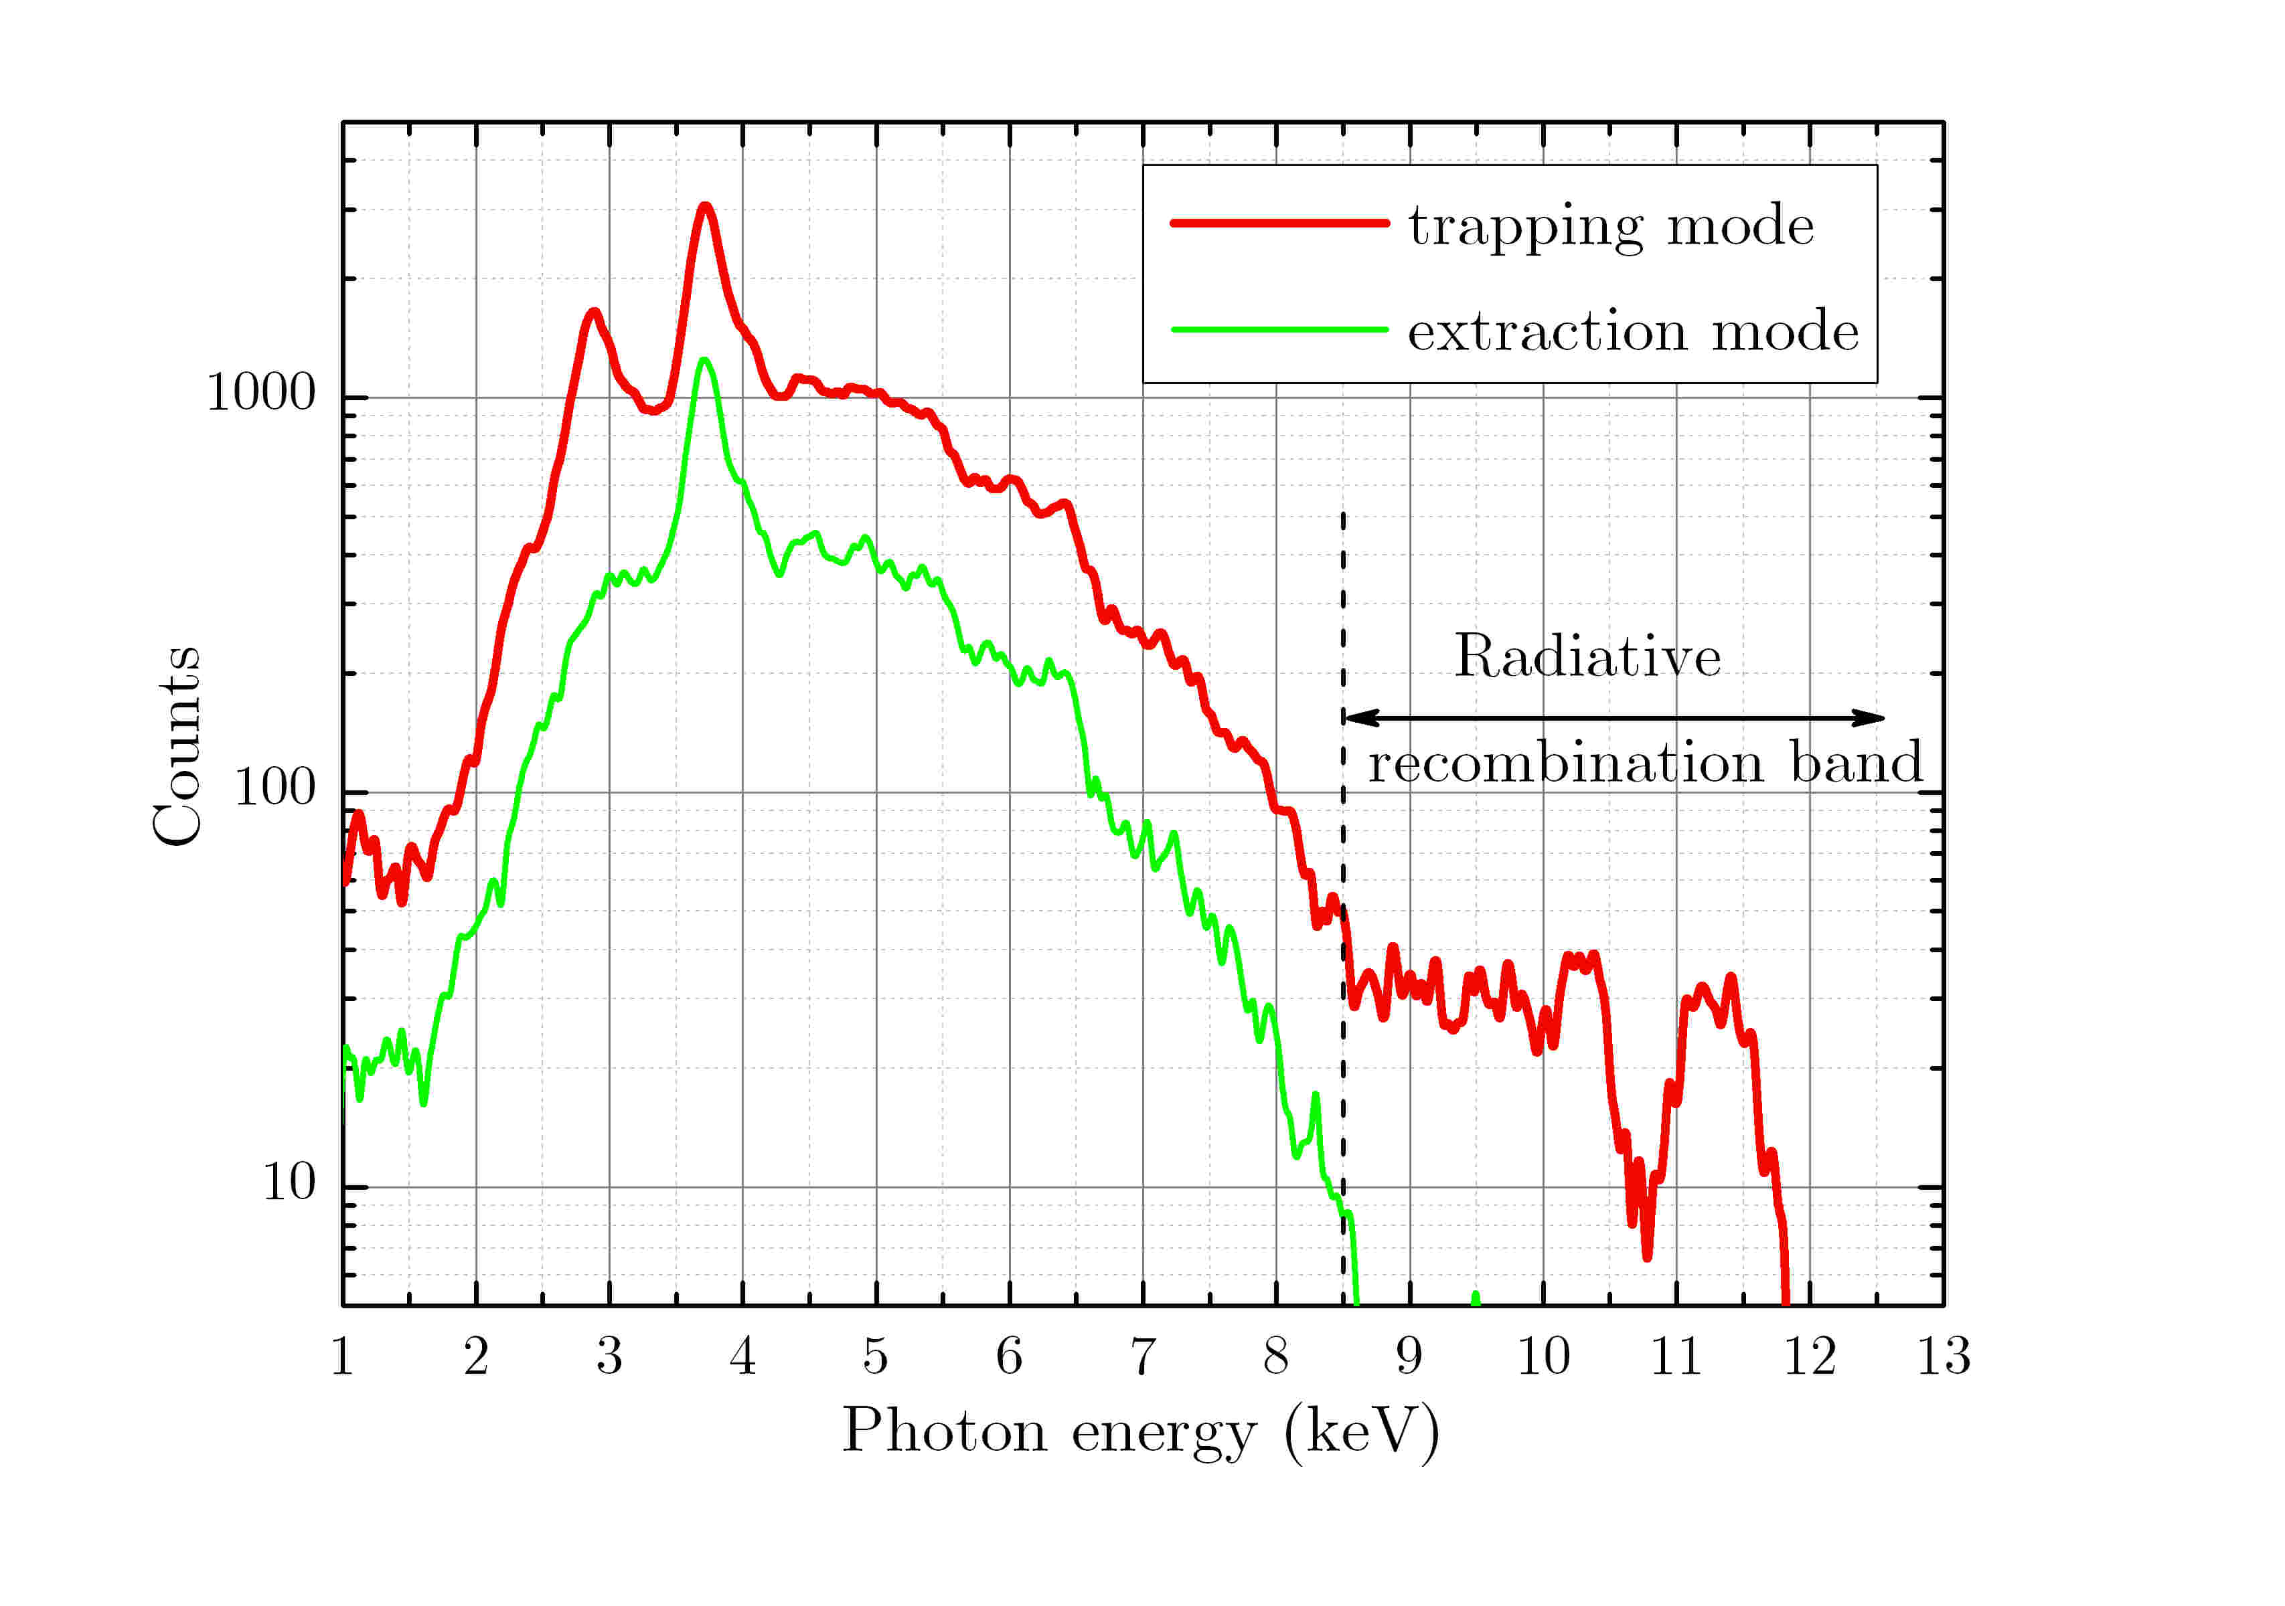
UniMaMFIS running as MaMFIS-10: control of local ion trap
Axial extraction of highly charged ions
from local ion trap is feasible
X-ray spectra measured in trapping and extraction modes

Slide 19
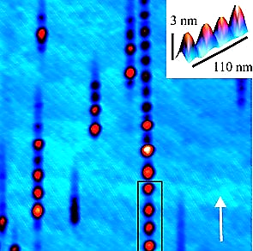
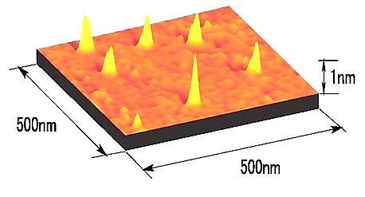
Applications of highly charged ions
Accelerators (charge breeding, nuclear physics, cancer therapy)
Atomic physics (ion-atom collisions and x-ray spectroscopy)
X-ray astrophysics and solar physics
Extreme ultraviolet lithography
Plasma physics (magnetic fusion diagnostics)
Interaction of ions with surface (secondary electron and ion emission)
Secondary ion mass spectrometry
Nanostructuring
http://yebisu.ils.uec.ac.jp/surface.html
E. Akcoeltekin et al.,
Nature Nanotechnology 2, 290 (2007)

Slide 20
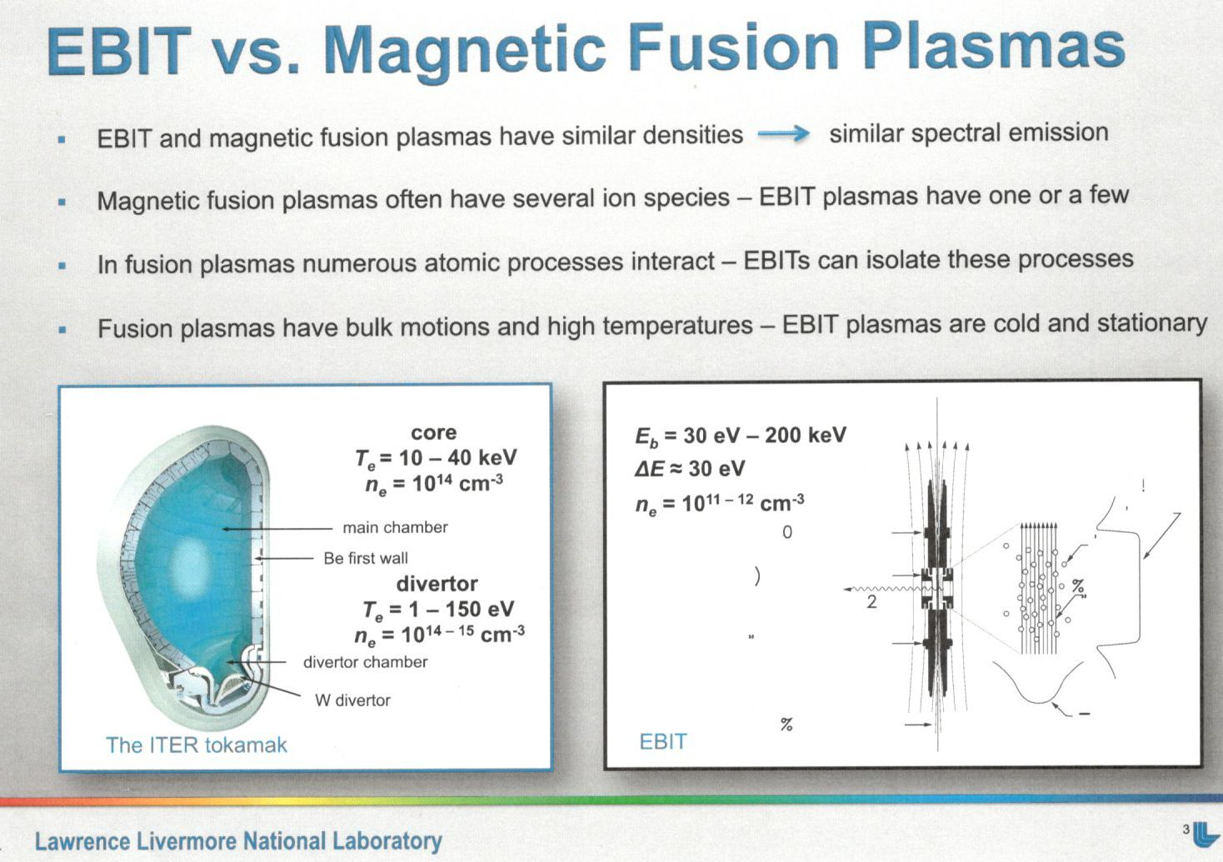
High density microplasma research
MaMFIS:
E_{e} ~ 10 keV
j_{e} ~ 20 kA/cm²
n_{e} ~ 2x10¹³ cm⁻³
E_{e} ~ 40 keV
j_{e} ~ 200 kA/cm²
n_{e} ~ 10¹⁴ cm⁻³

Slide 21
Summary
Novel method for the production of highly charged ions in rippled electron beam is developed and confirmed experimentally
Electron beam current density of about 20 kA/cm² is achieved, what allows to model experimentally the microplasma characterized by high density close to that in tokamak
Method allows to produce any ions of arbitrary elements of the periodic table up to U⁹²⁺ ions in simple compact devices
X-ray spectroscopy of all elements of the periodic table is feasible
Novel devices for nanostructering and surface analysis can be developed

Slide 22
Acknowledgements
The authors express deep gratitude
to A. Mueller for giving opportunity to test MaMFIS in the laboratory of IAMP (Justus Liebig University Giessen),
to O. K. Kultashev for his contribution to creation of electron optics,
to I. V. Kalagin for his contribution for development of computer codes and
to A. V. Nukin for production of some details of MaMFIS.
THANK YOU FOR YOUR ATTENTION !

