Slide 1
Response function simulation of the
anti-coincidence detector based on NaI crystal with a complex shape in registration systems for experiments SAGE and BEST
Vladimir Kazalov
Baksan Neutrino Observatory
INR RAS
The 2nd International Conference on Particle Physics and Astrophysics, 10 - 14 October 2016, MEPhI, Moscow

Slide 2
V.N. Gavrin, V.V. Gorbachev, Yu.M. Gavriljuk, T.V. Ibragimova, A.V. Kalikhov,
V.V. Kazalov, A.A. Shikhin
Institute for Nuclear Research of the Russian Academy of Sciences, Moscow, Russia
We would like to thank Dr. V. Kuzminov and Dr. A. Gangapshev for useful discussions.

Slide 3
Main objects of the job
Build the model of real detector using Geant 4 simulation software and determine the influence of its different components to the response function.
Find the model response on gamma-sources (Co-60, Cs-137, Na-22) in calibration position and associate them with real calibration spectra.
Find the model response on gamma-sources (K-40, Tl-208, Bi-214) uniformly distributed in the detector volume and associate them with real background spectra.
Find the model response on gamma-sources (K-40, Ga-68, Ge-69, Xe-127) in the position of proportional counter inside the detector well.
Calculate the efficiencies of full and partial absorptions for energies of all these sources in the detector.
Determine the possible sources of increased background of the detector.
Explain some peculiarities of the spectra.

Slide 4
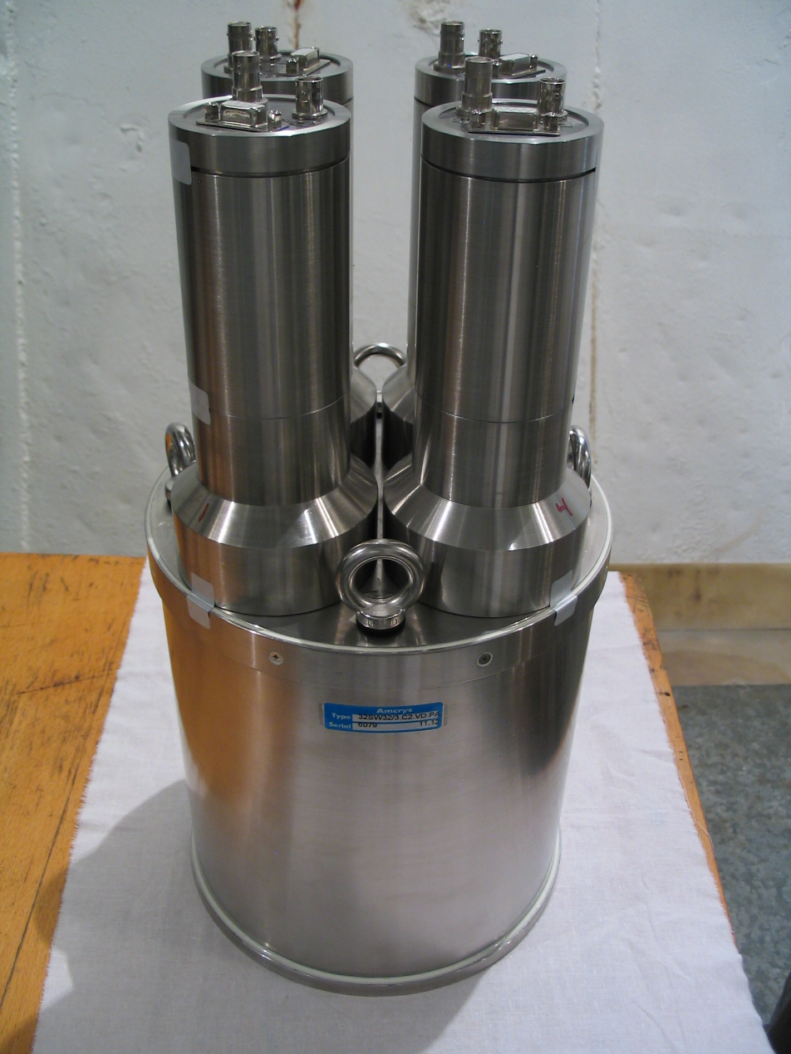
NaI (Tl) Scintillation assembly
Made: “Amkris”, Kharkov, Ukraine
Size: ∅200×200~mm
Well: ∅ 100×150~mm
PMTs~model: 3" ET9757QL (4 pieces.)
Body: Stainless steel
Reflector: Teflon
Windows: Quartz
Volume: 5105.1 cm³
Mass: 18.74 kg
Resolution: R≈7.6% (Eγ=1460 keV)
Bkg: v_{bg}=3.24±0.03 s⁻¹ (Eγ=40–3500 keV)

Slide 5
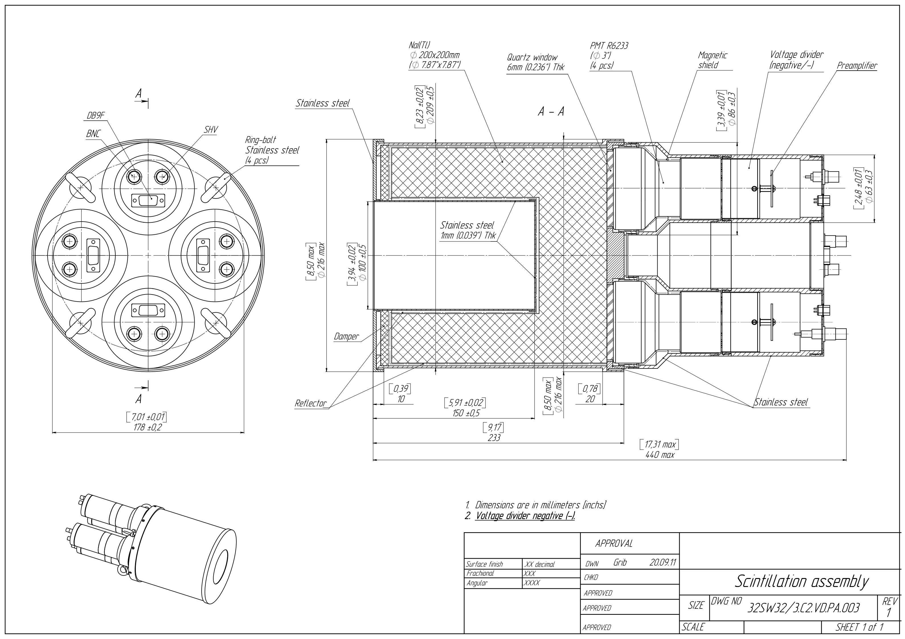
The detector project

Slide 6
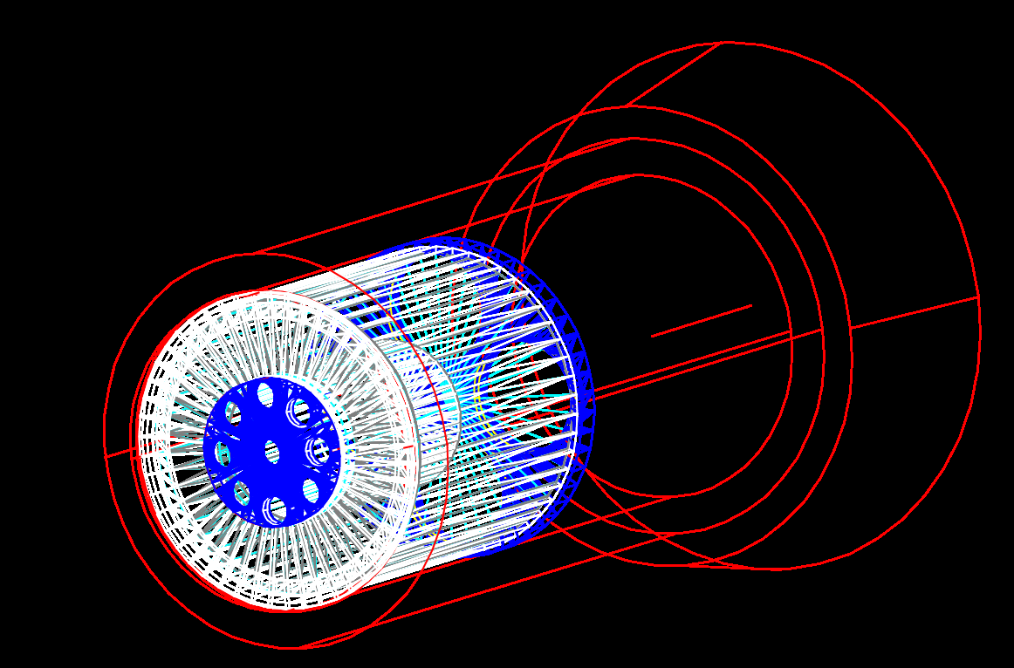
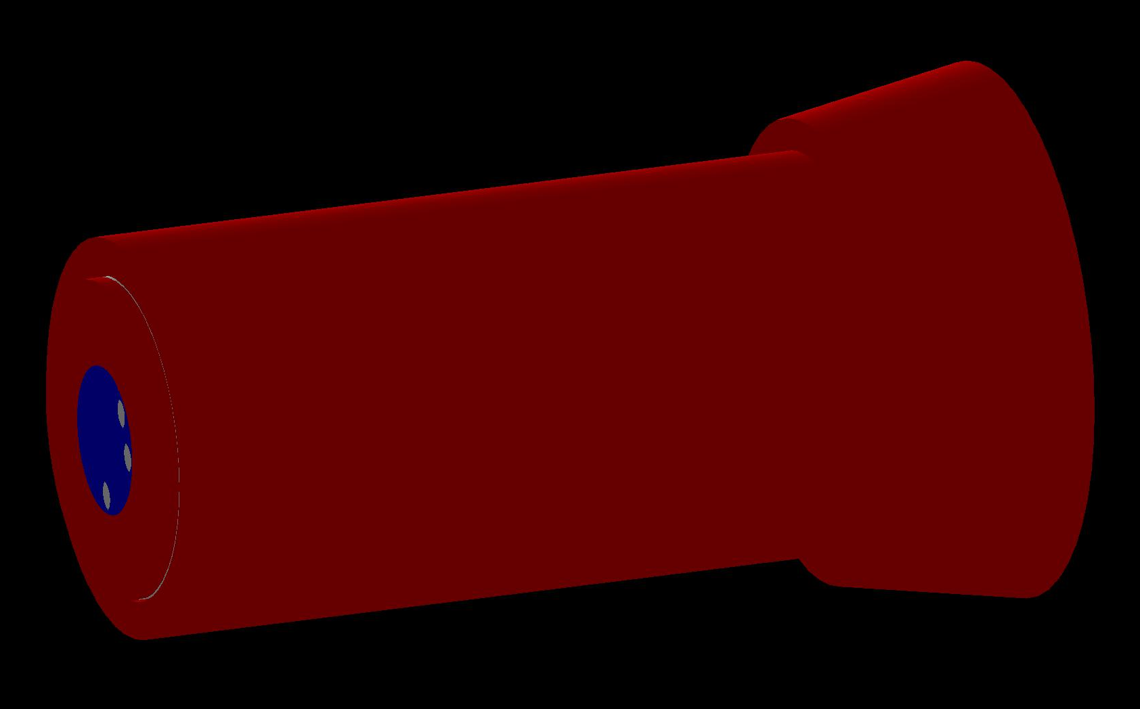
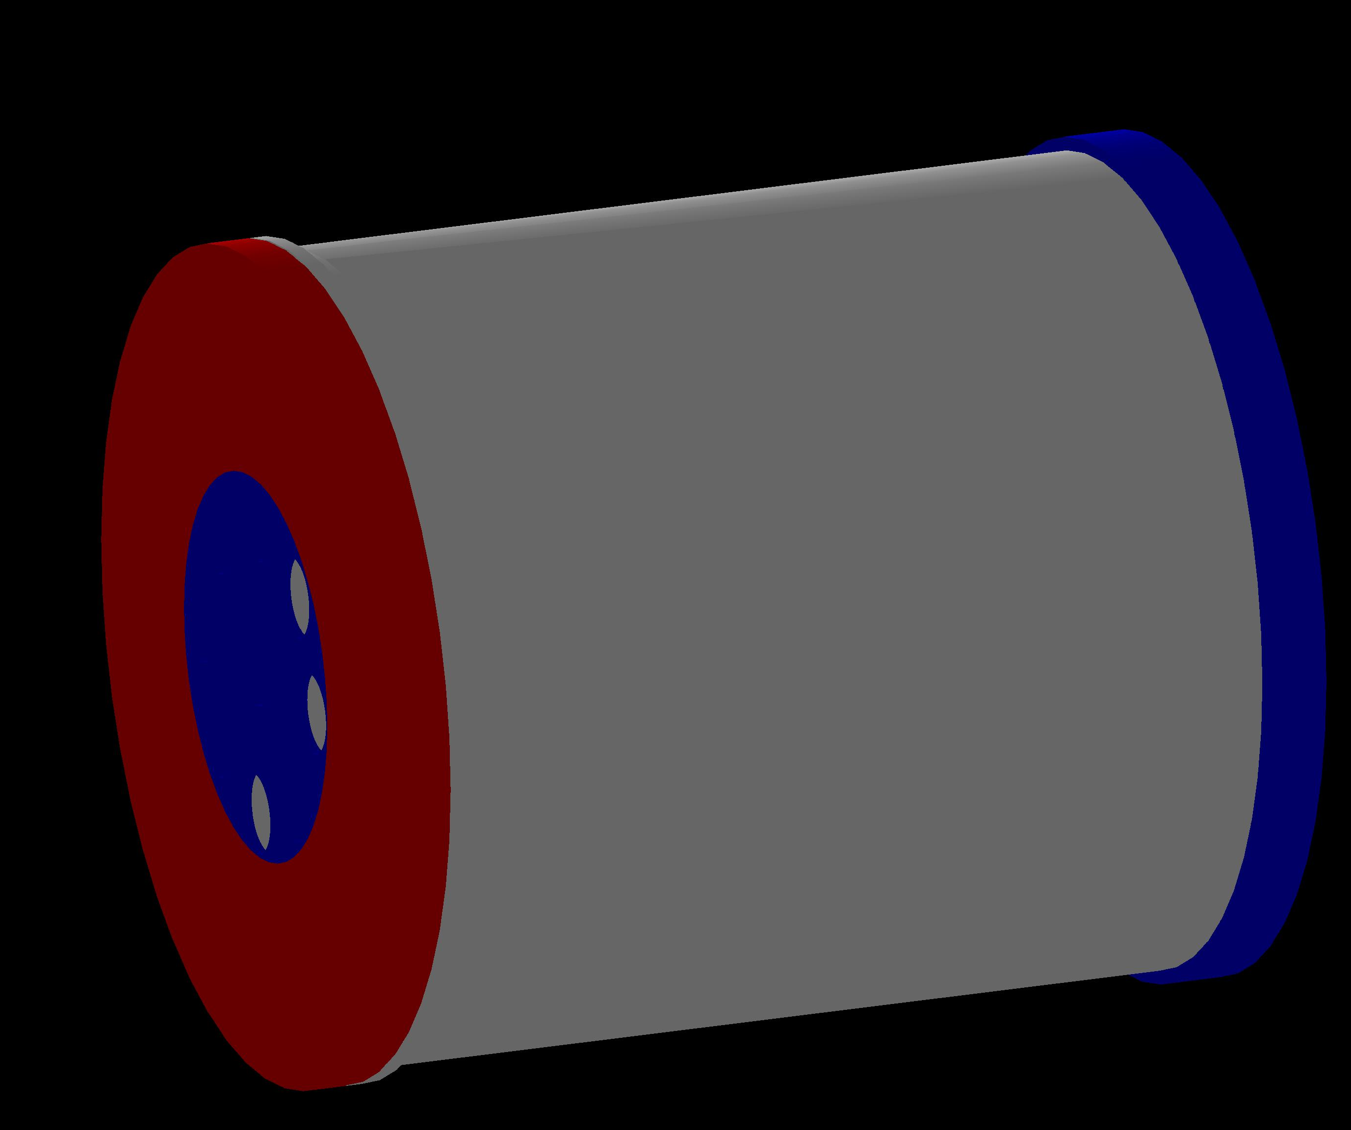
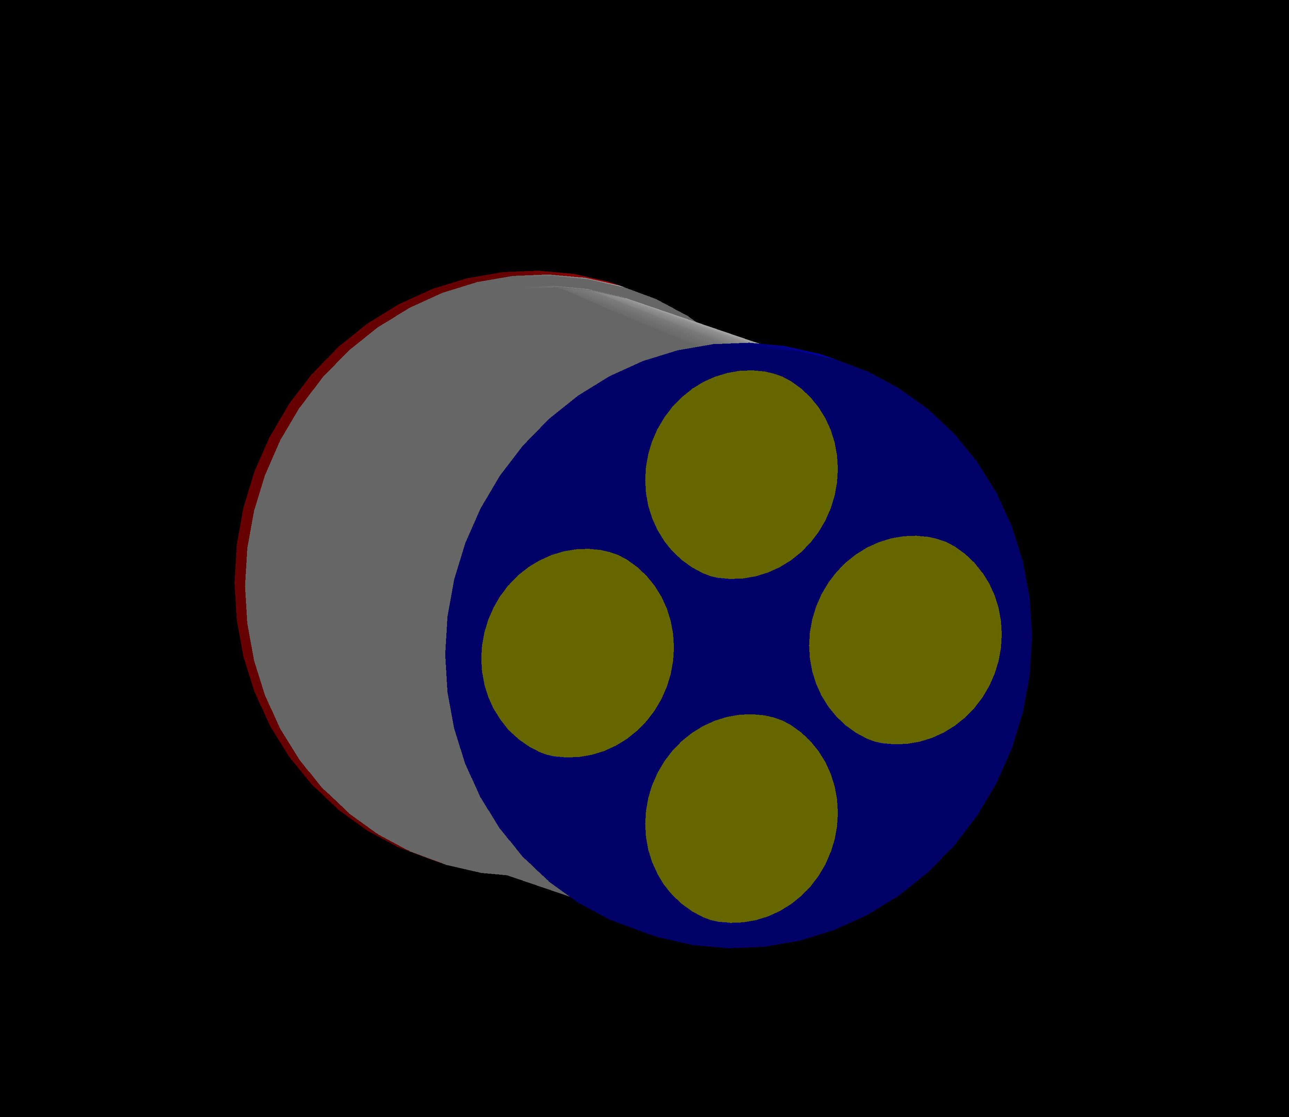
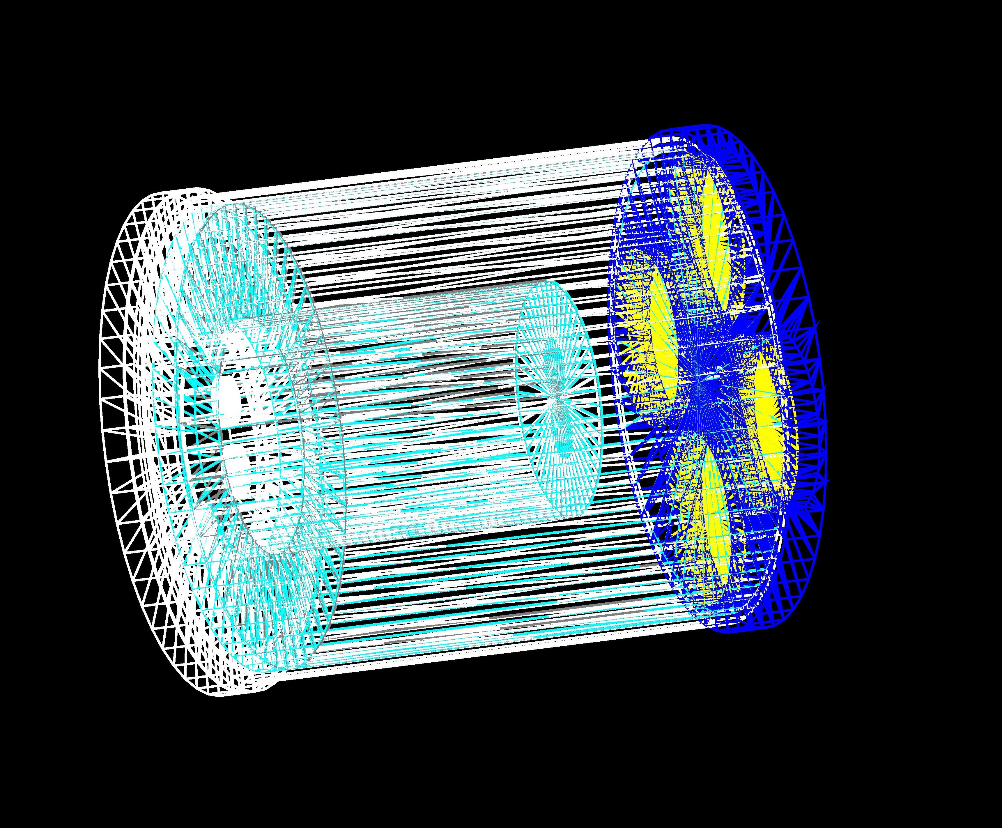
Geant4 model of scintillation assembly

Slide 7
Geant4 model of scintillation assembly
Geant4-10.2.0
G4Data:
G4ABLA3.0
G4EMLOW6.48
G4ENSDFSTATE1.2
G4NDL4.5
G4NEUTRONXS1.4
G4PII1.3
G4SAIDDATA1.1
PhotonEvaporation3.2
RadioactiveDecay4.3
RealSurface1.0

Slide 8
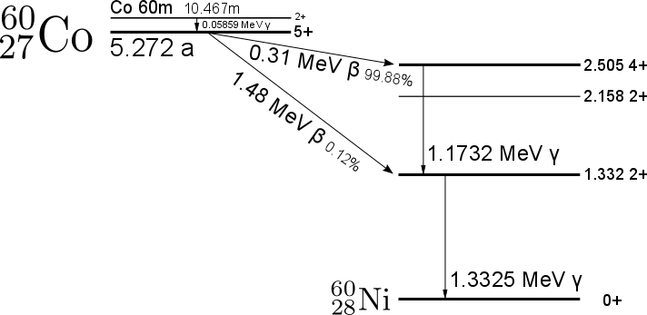
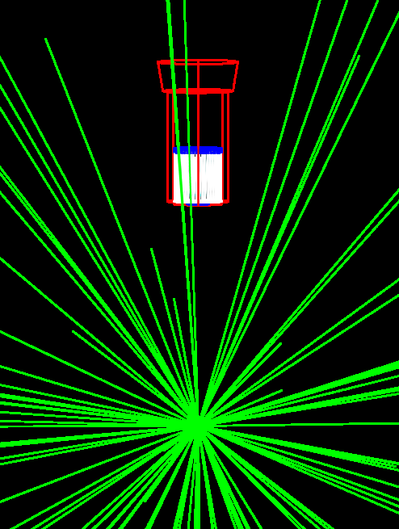
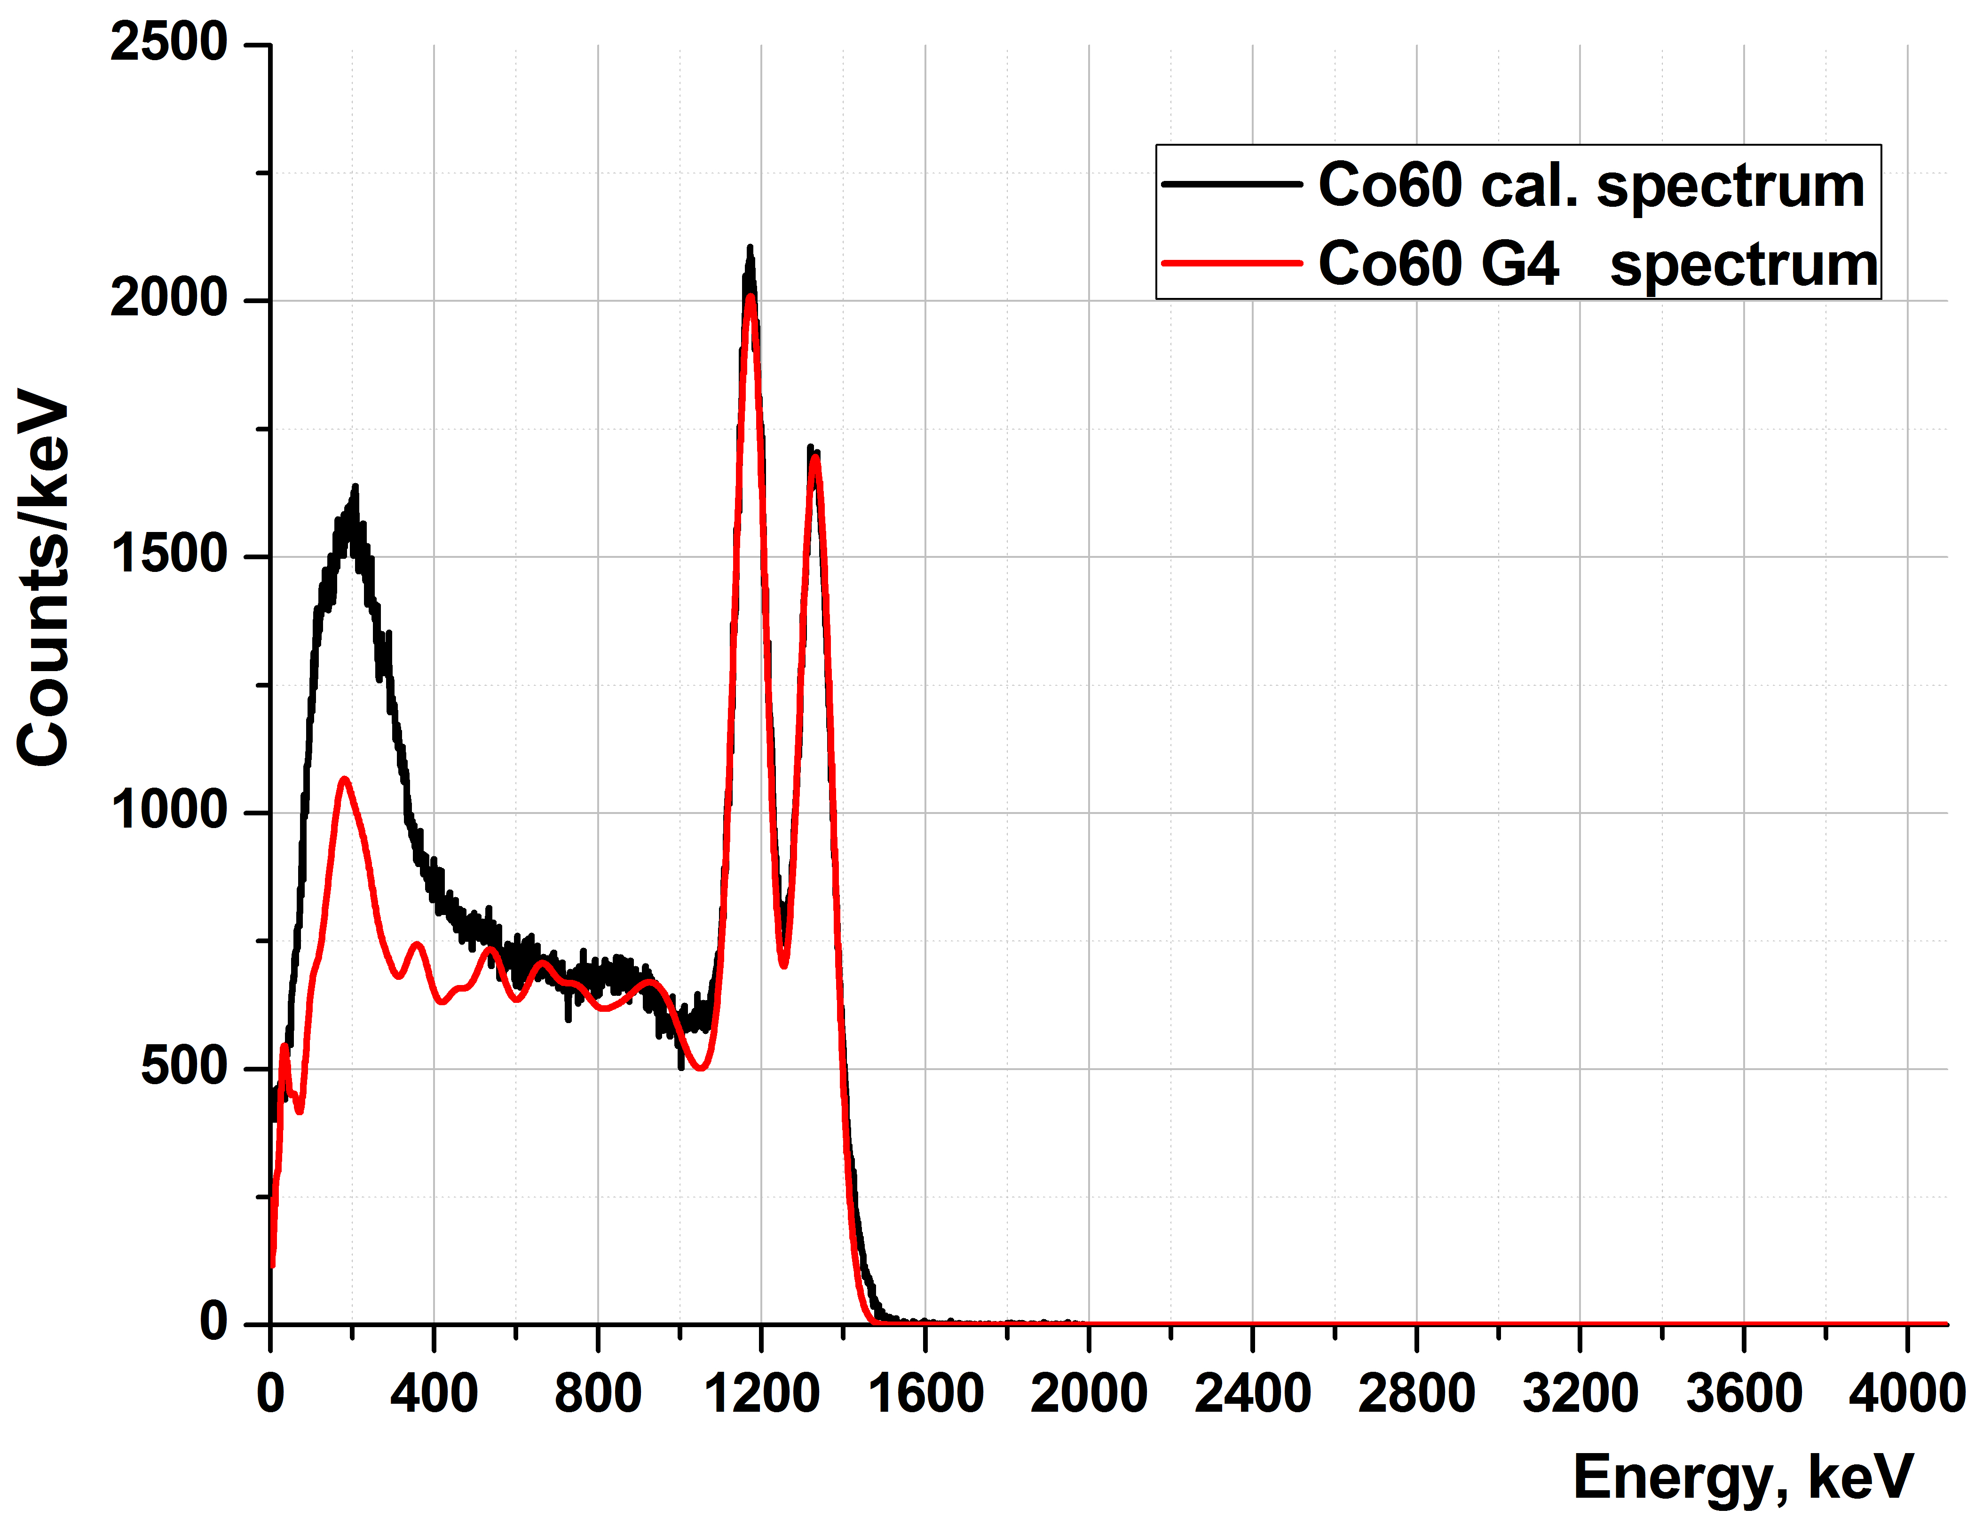
Calibration source Co-60
##Co-60
/gps/pos/centre 0 0 1126. mm /gps/energy 0 keV
/gps/particle ion
/gps/ion 27 60 0 0

Slide 9
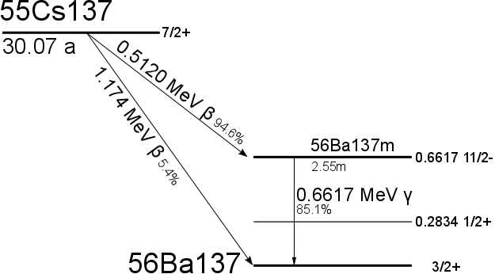
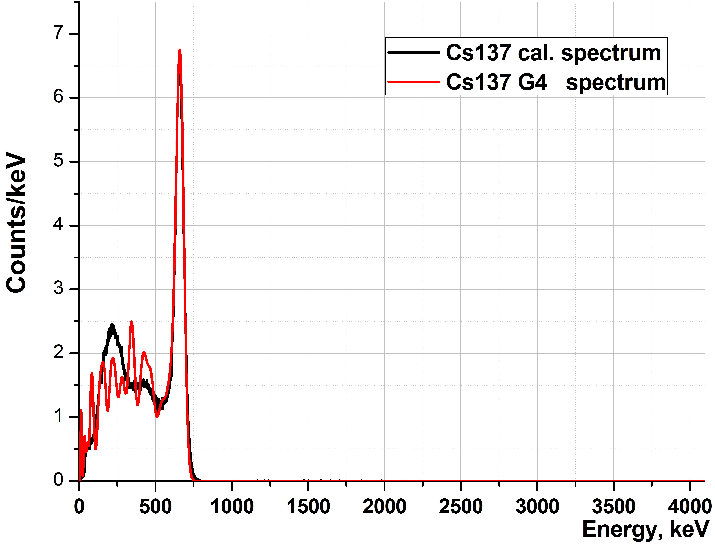
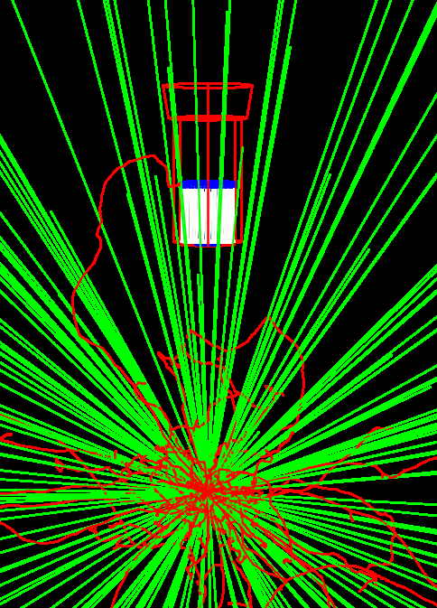
Calibration source Cs-137
##Cs-137
/gps/pos/centre 0 0 1126. mm /gps/energy 0 keV
/gps/particle ion
/gps/ion 55 137 0 0

Slide 10
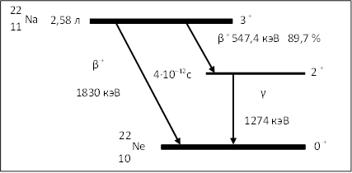
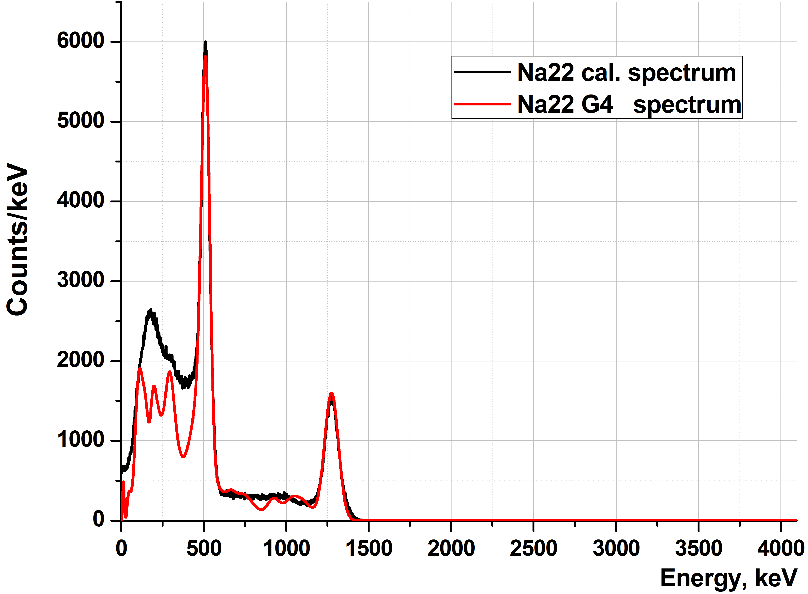
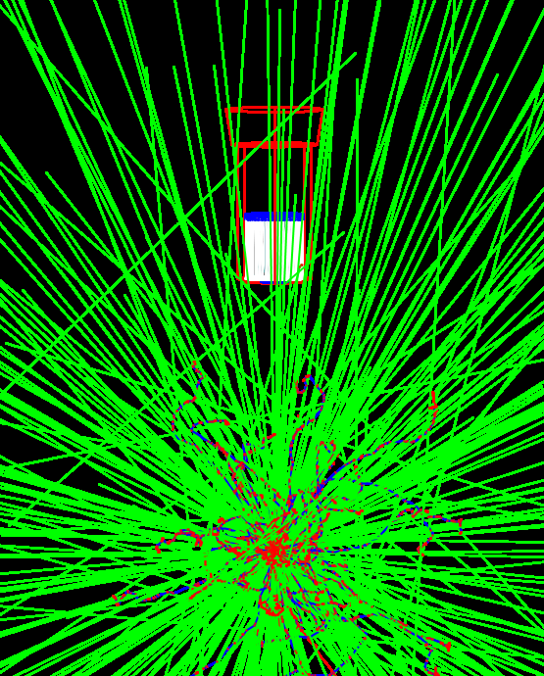
Calibration source Na-22
#Na-22
/gps/pos/centre 0 0 1126. mm /gps/energy 0 keV
/gps/particle ion
/gps/ion 11 22 0 0

Slide 11
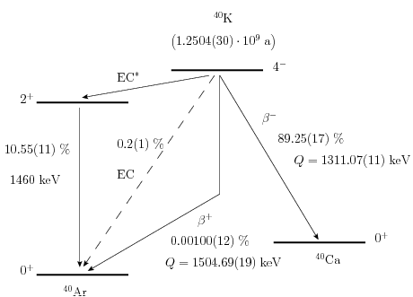
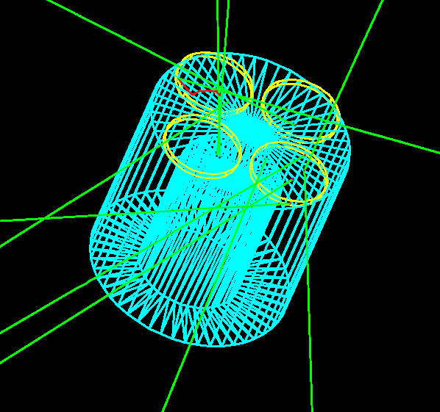
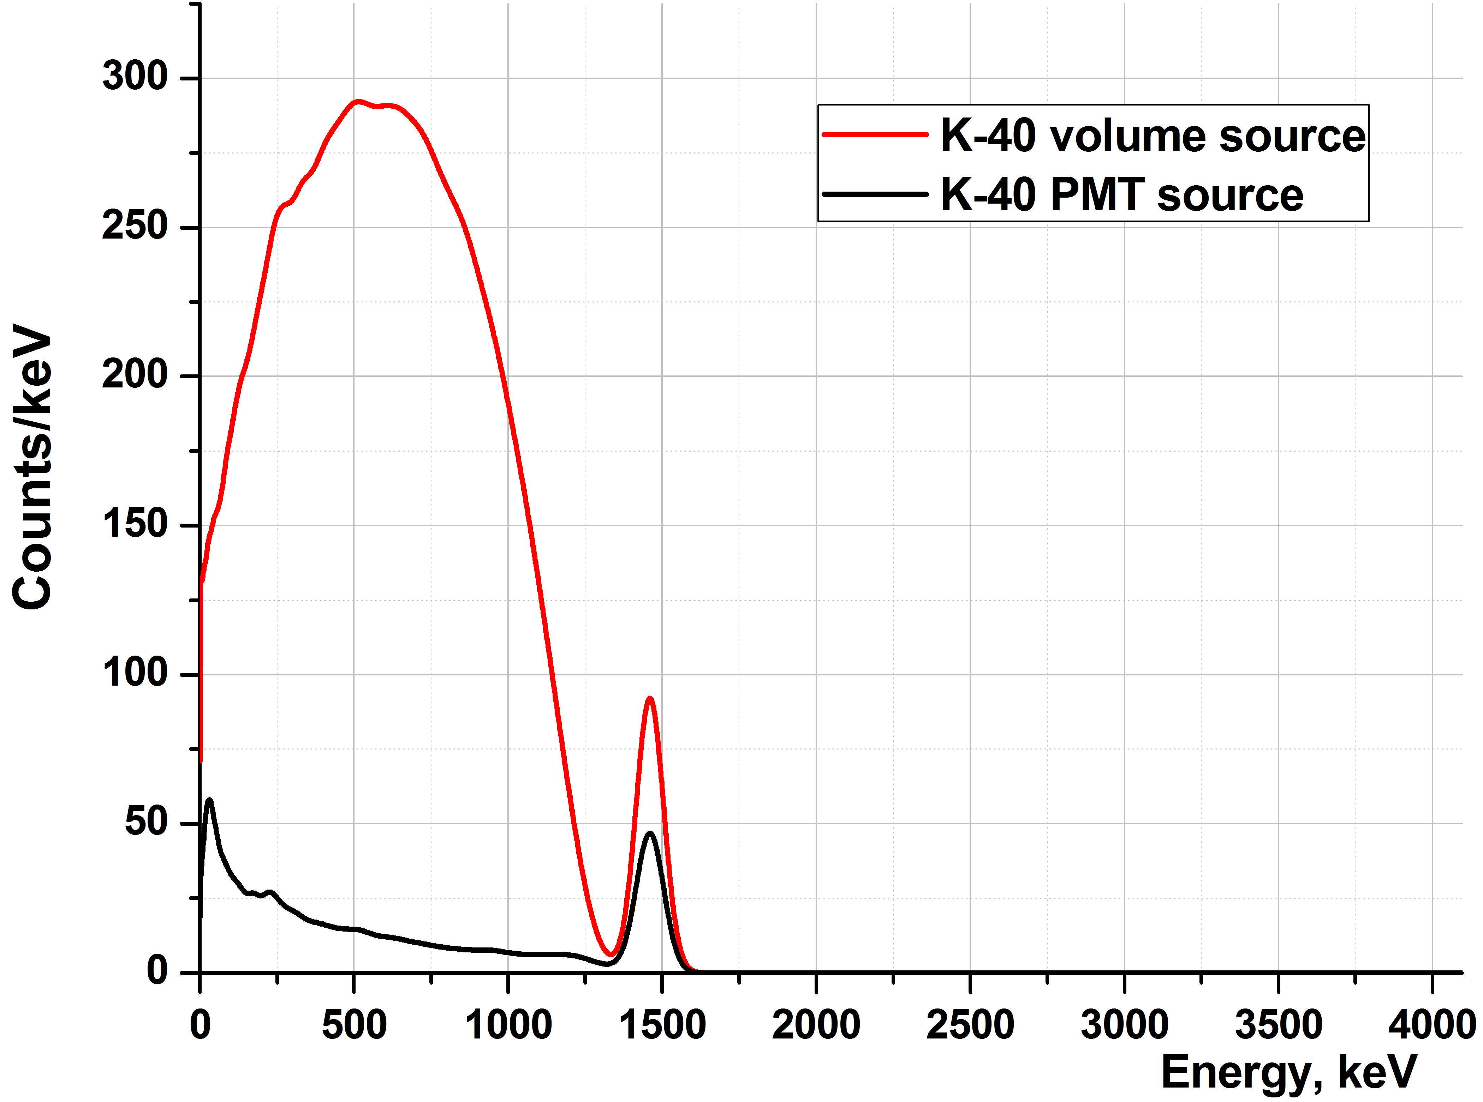
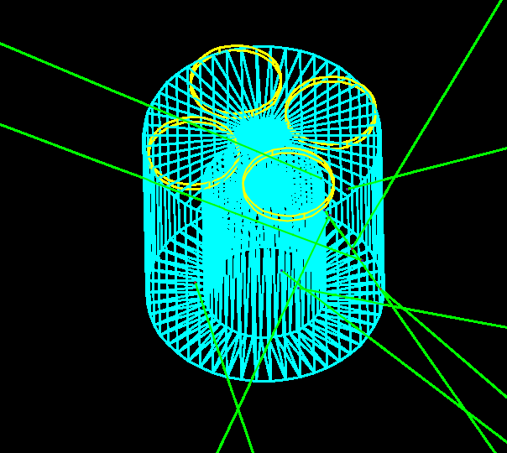
Compare the volume and PMT K-40 source, G4 model

Slide 12
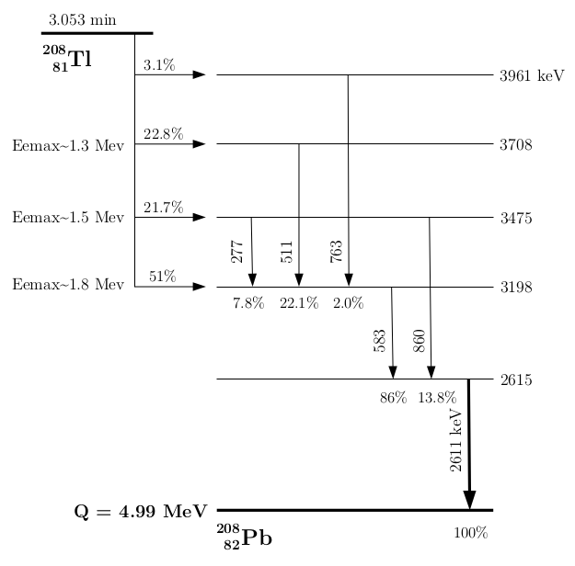
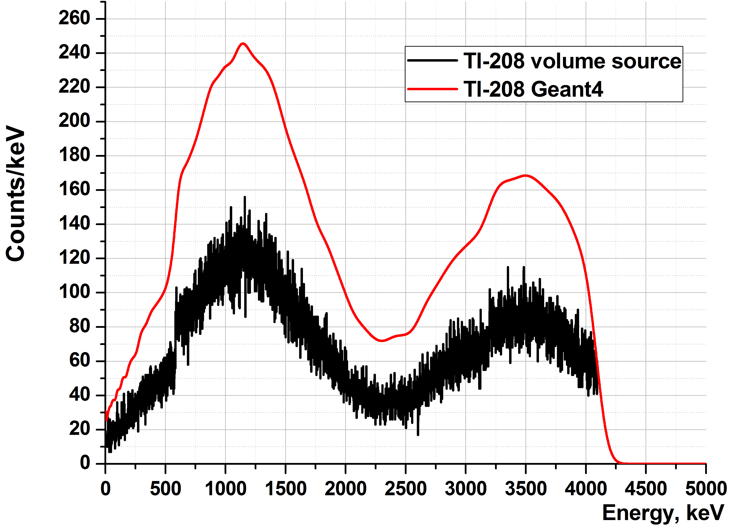
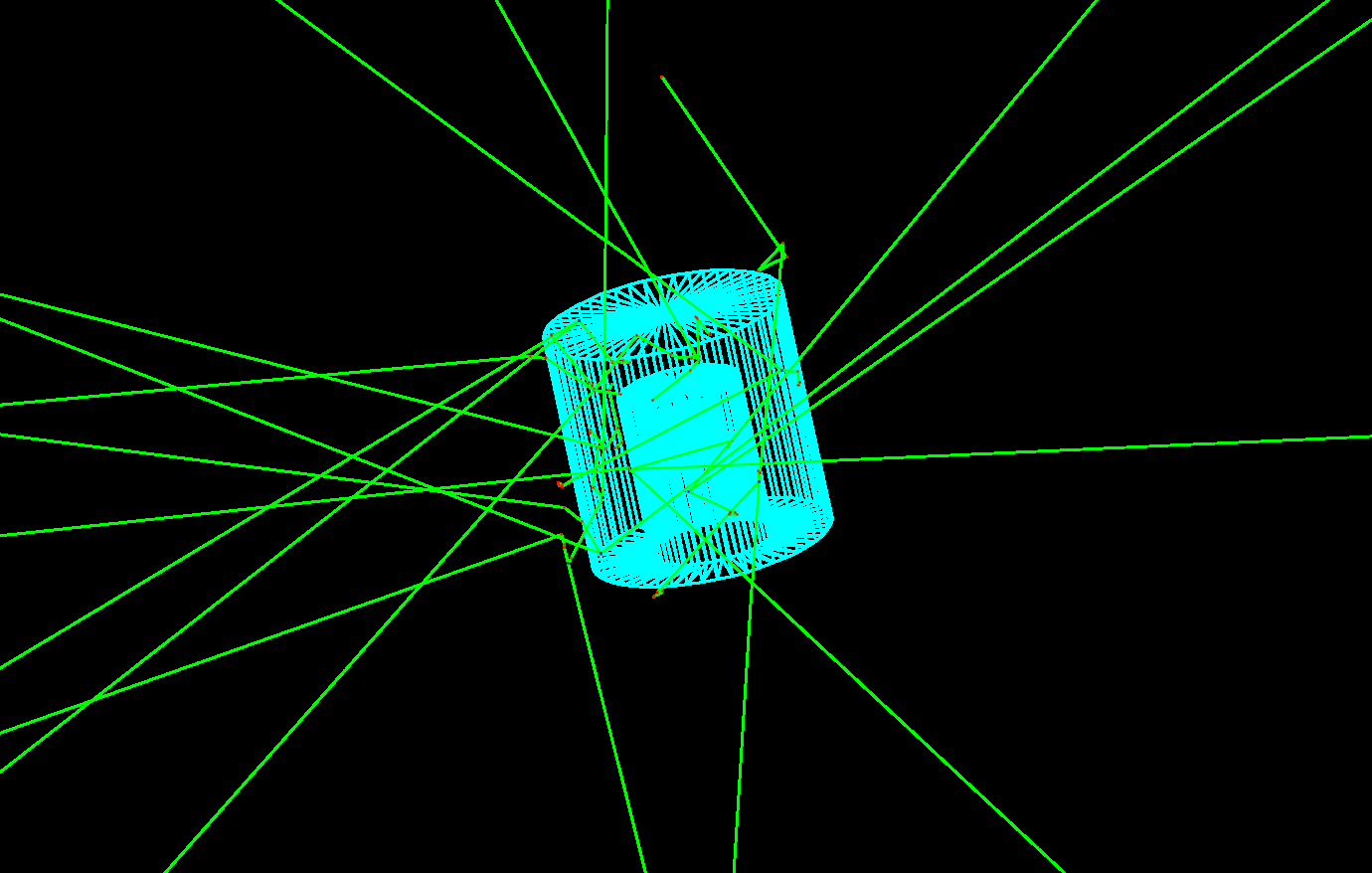
Volume source Tl-208, G4 model

Slide 13
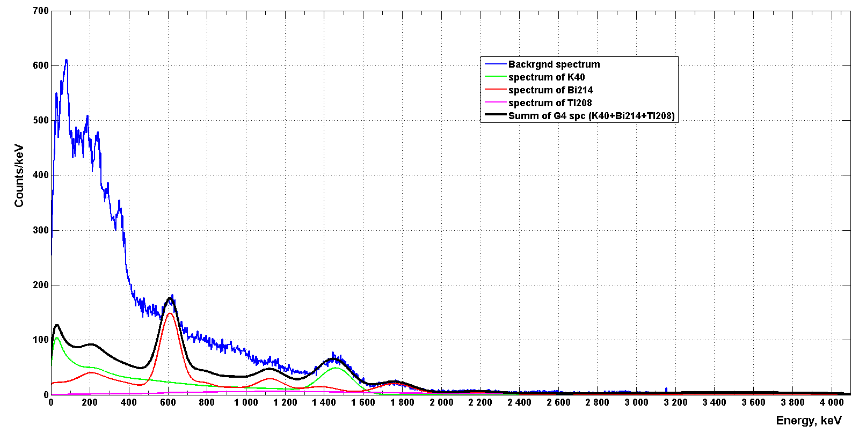
Background spectrum + sum of G4 spectrum (K-40+Bi-214+Tl-208)

Slide 14
Efficiency of registrations for calibration sources: Co-60, Cs-137,Na-22
Energy Source | 1173 keV | 1332 keV | 662 keV | 511 keV |  | 1274 keV | Absolute Efficiency
 | Efficiency, %
Co-60 | 0.0285 | 0.028 | -- | -- | -- |  | 0.1831
Cs-137 | -- | -- | 0.043 | -- | -- |  | 0.15
Na-22 | -- | -- | -- | 0.115 | 0.054 |  | 0.44
1 m under scintillation assembly, on the detector axis

Slide 15
Efficiency of registrations of gamma-lines for sources in the place of proportional counter
Energy Source | 511 keV | 1460 keV | Absolute Efficiency
 | Efficiency, %
K-40 | -- | 28 | 77
Ga-68 | 10.5 | -- | 87.5
Energy Source | 511 keV | 574 keV | 872 keV | 1107 keV | 1336 keV | Absolute Efficiency
 | Efficiency, %
Ge-69 | 10.5 | 35 | 34.5 | 31 | 27 | 69.5

Slide 16
Efficiency of registrations of gamma-lines for sources in the place of proportional counter
Energy Source | 145 keV | 172 keV | 203 keV | 375 keV | Absolute Efficiency
 | Efficiency, %
Xe-127 | 43 | 17.2 | 46.2 | 99.5 | 78.66

Slide 17
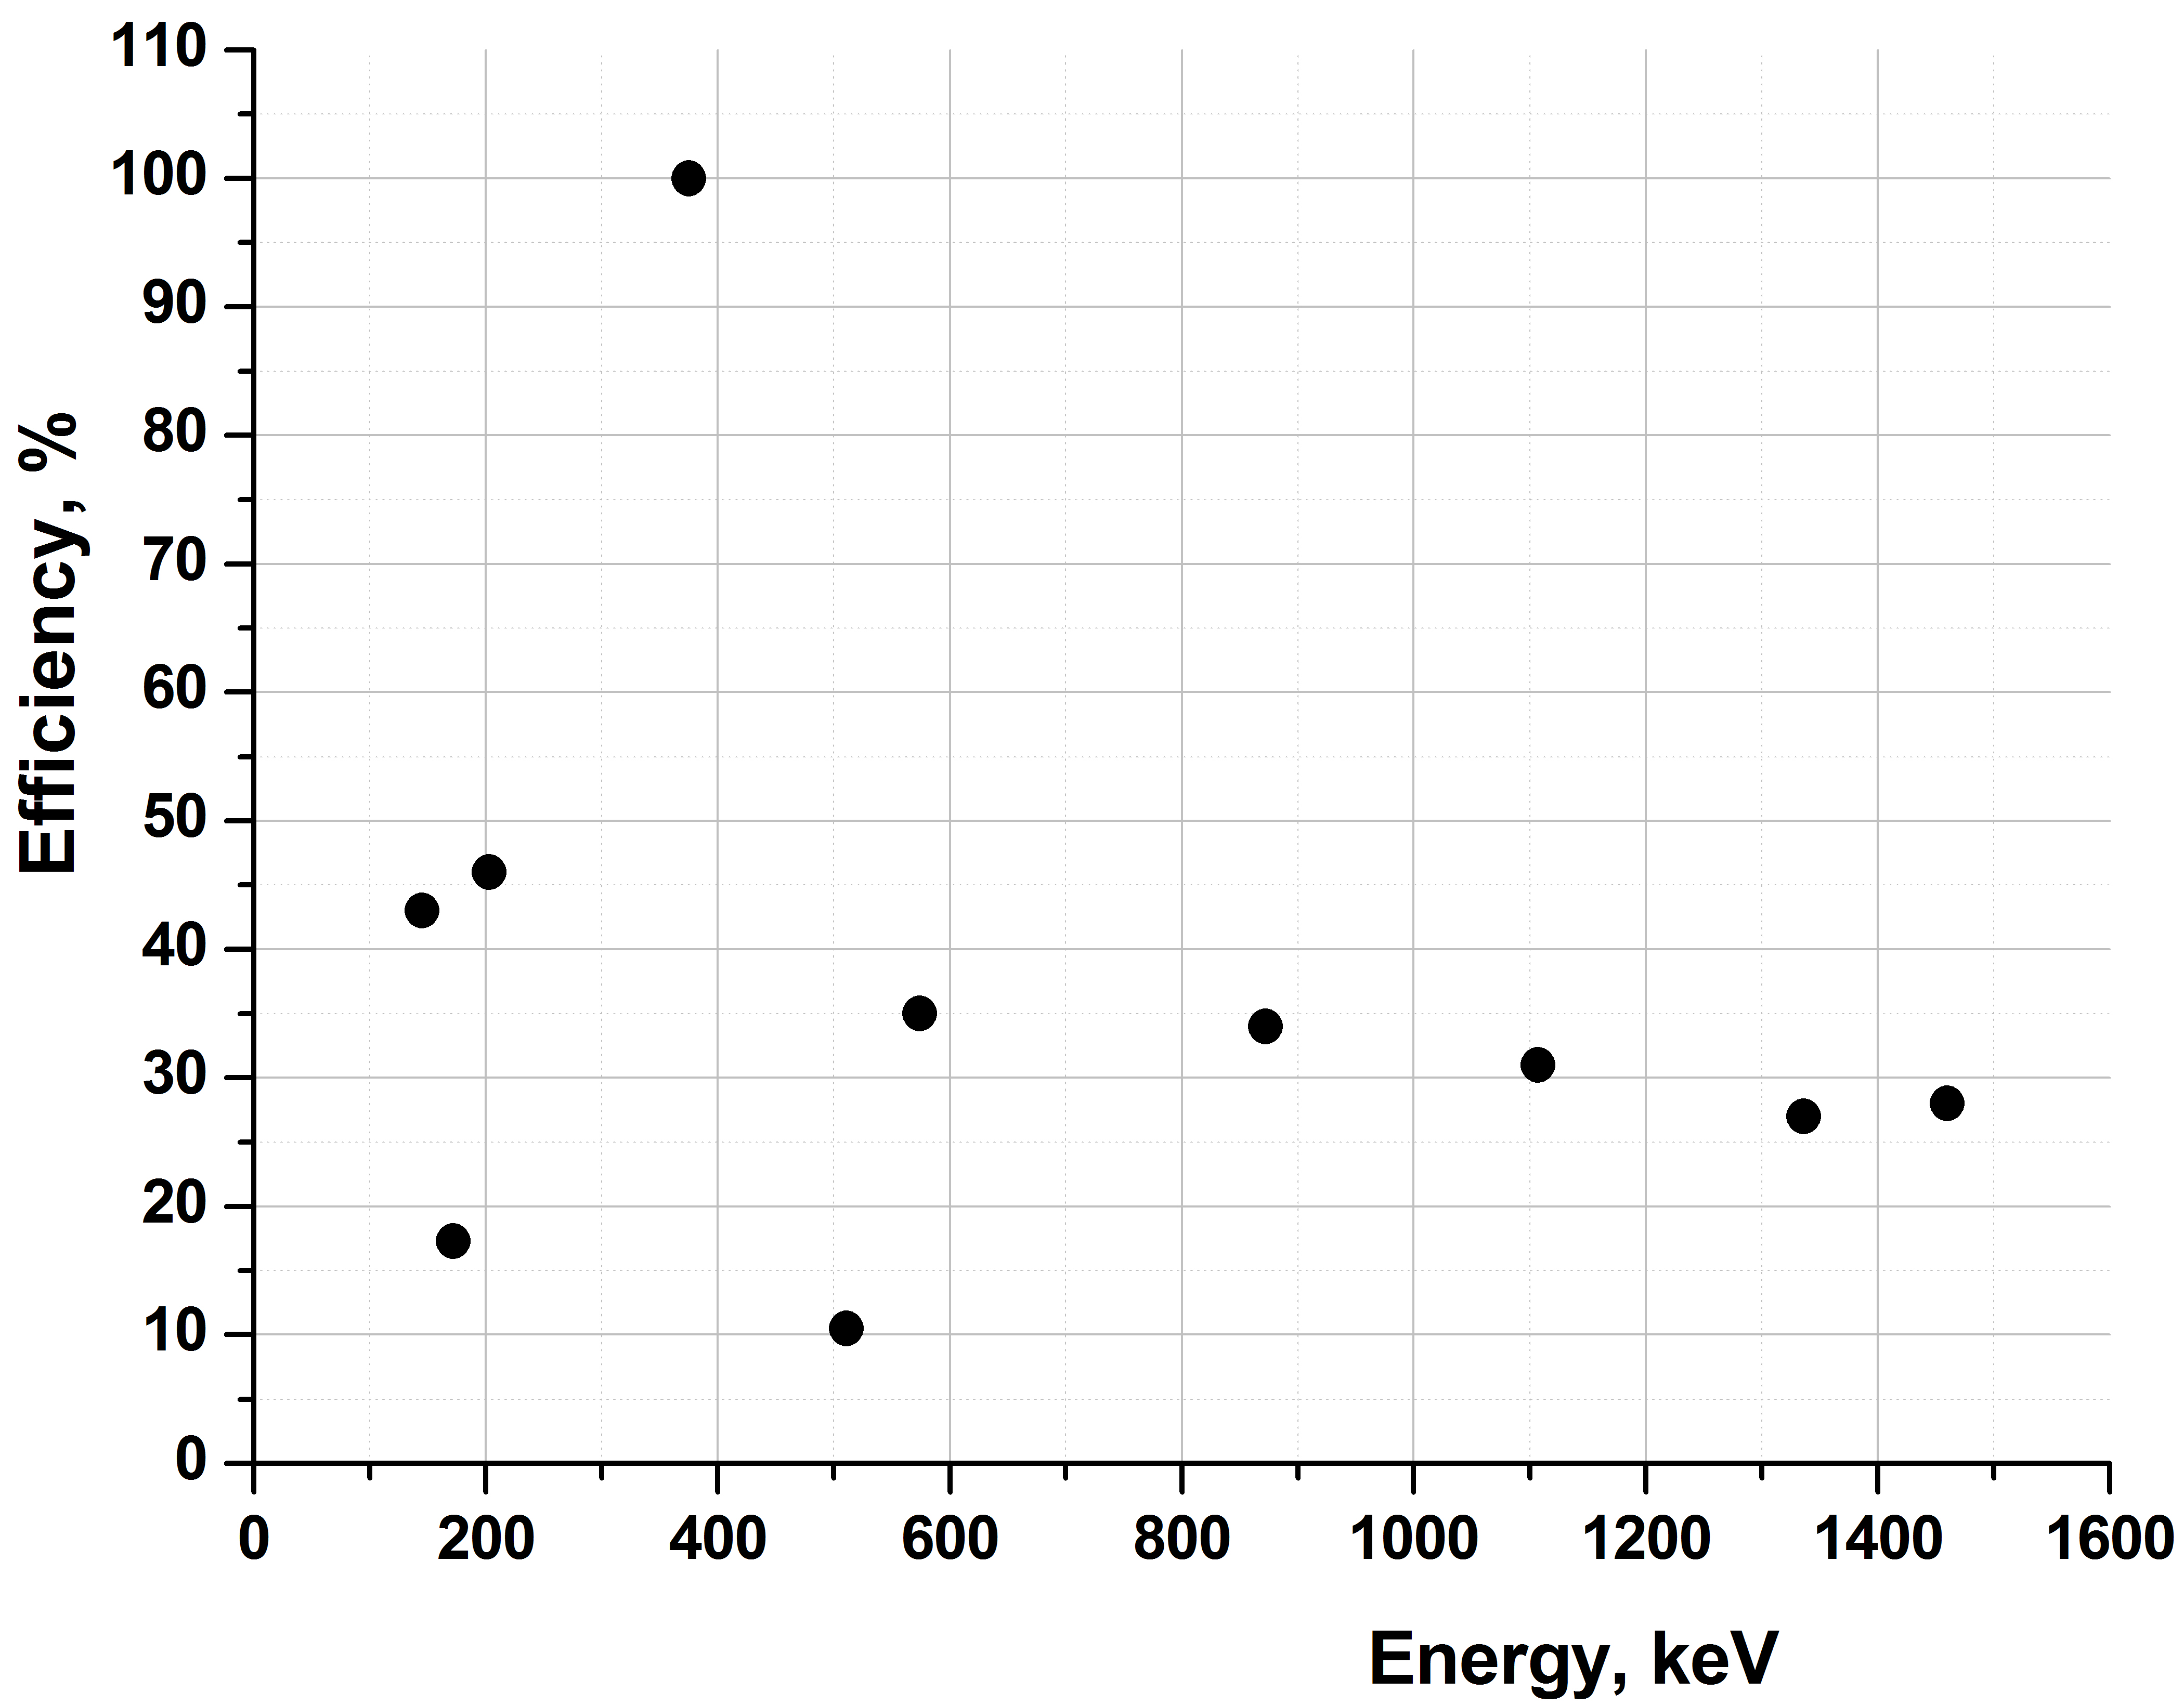
Efficiency of registrations of gamma-lines for sources in the place of proportional counter

Slide 18
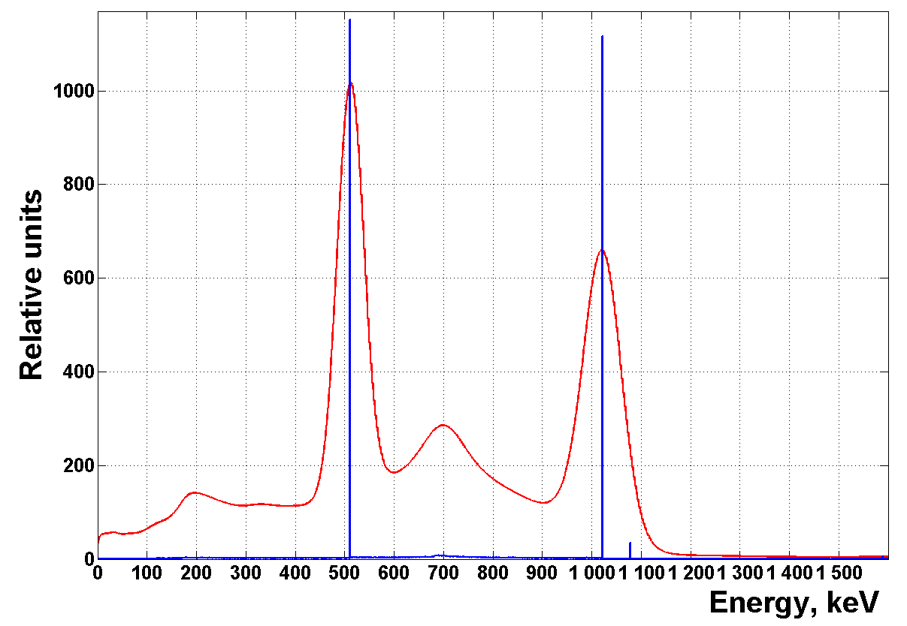
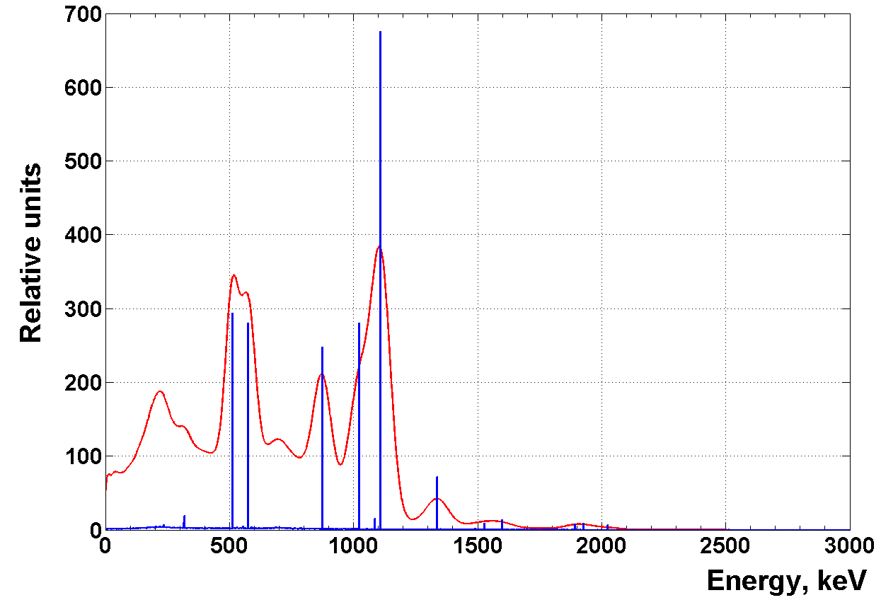
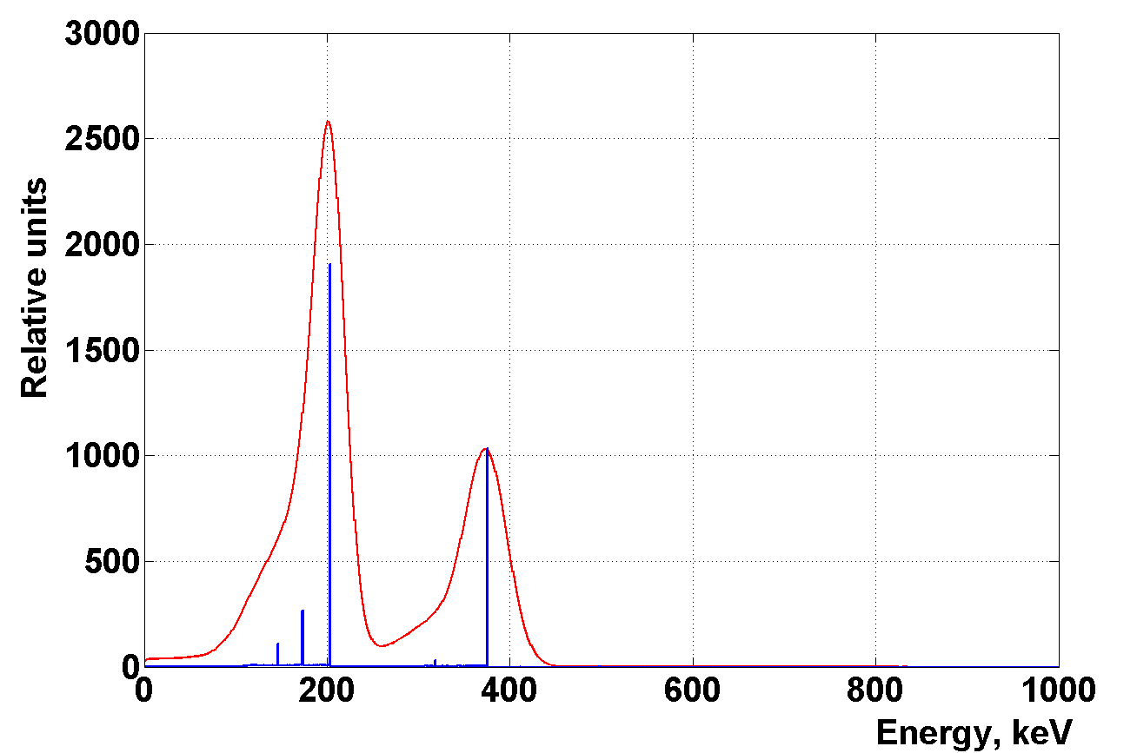
Sources Ga-68, Ge-69, Xe-127 simulated in volume of proportional counter
Ga-68
Ge-69
Xe-127

Slide 19
Results and future plans
The job is mainly done with the detector of the registration system for BEST.
The origin of K-40 background of the detector is disposed mainly in the PMT’s, not in the volume of the detector itself. It is one of the reasons to replace the PMT’s.
The Tl-208 background gamma-source (Th-232 origin) have not peak of full absorption it the detector of such geometry.
Given result should be compared with real data from the counter filled with Ge-69 and (or) Xe-127 contamination.
The is start of large job only. It will be continue for the detector of the SAGE registration system which has another geometry and environment. These results are important for further combine using of both systems in BEST.

Slide 20
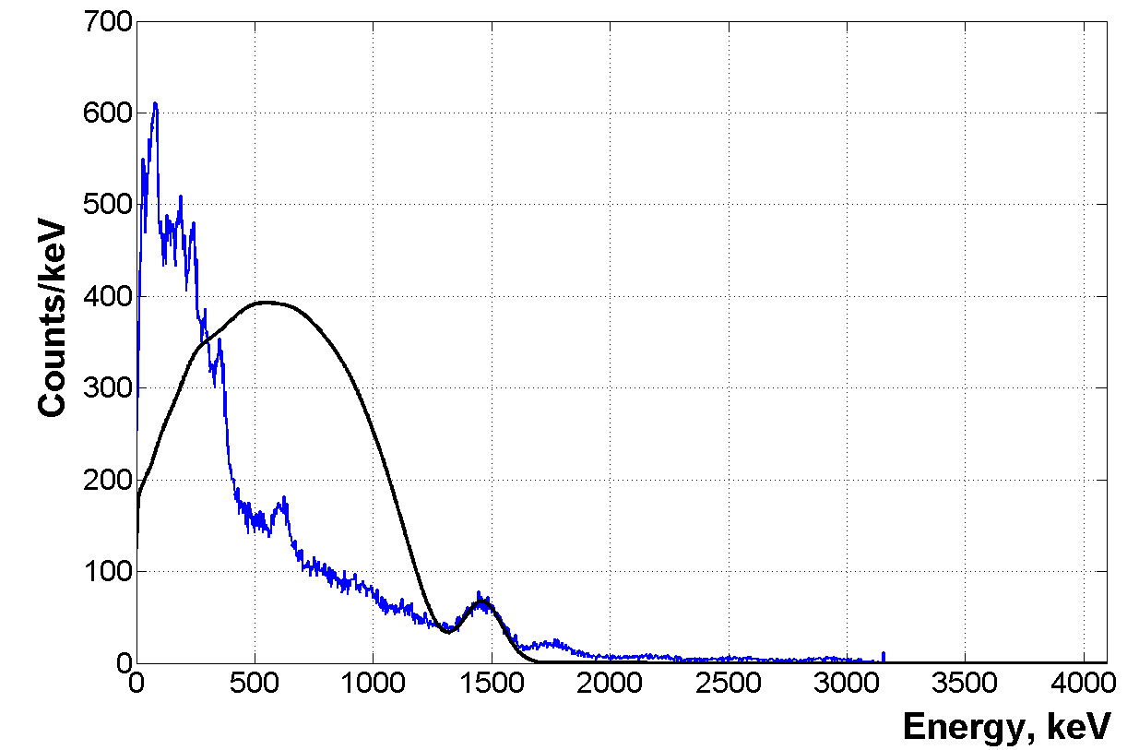
Background spectrum + G4 spectrum of K-40 volume source

Slide 21
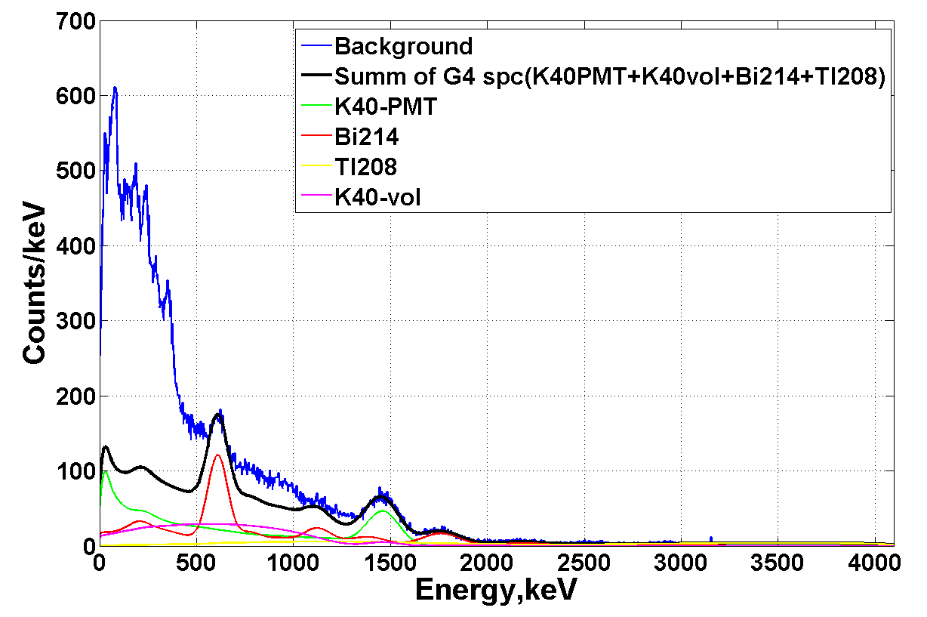

Slide 22
Probability of registration for gamma-lines for sources in the place of proportional counter
Energy, keV | 145 | 172 | 203 | 375 | 511 | 574 | 872 | 1107 | 1336 | 1460
Probability of registration,%
 | 43 | 17.3 | 46 | 100 | 10.5 | 35 | 34 | 31 | 27 | 28

