Slide 1


ICPPA 2016
Oct 10-14 ,2016
The Fast Interaction Trigger detector for the ALICE Upgrade
T. Karavicheva
for the ALICE Collaboration
Institute for Nuclear Research of the Russian Academy of Sciences

Slide 2
Outline
LHC injectors upgrade during LS2 (2019 – 2020)
– Impact on ALICE detectors
Concept and functionality of FIT
Performance of the prototypes
– Cherenkov radiator + MCP-PMT
FIT trigger & readout concepts

Slide 3

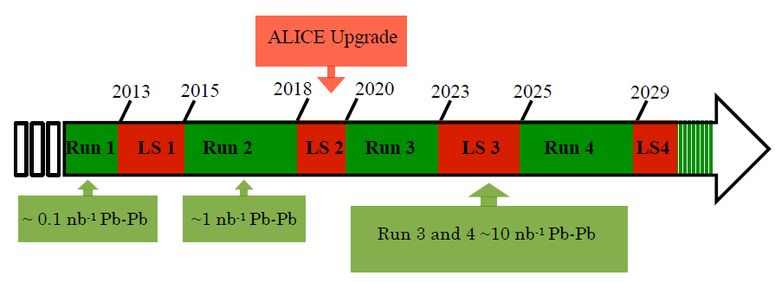
LHC injectors upgrade
(After the Long Shutdown 2019-2020)
• Increase in luminosity
LHC target luminosity Pb-Pb L = 6 ×10²⁷cm⁻²s⁻¹
corresponding to collision rates of 50 kHz
and >200 kHz for pp and p-Pb
• 25 ns bunch spacing option for RUN3 and RUN4

Slide 4
Upgrade Strategy for ALICE at High Rate
Physics plans focused on rare processes where ALICE is unique
- Low-pT heavy-flavour mesons and baryons
- Low-pT charmonia (J/ψ and ψ (2S))
- Low-mass dileptons
Rate limits of current setup (500 Hz of Pb-Pb events)
Detector upgrades
New readout and trigger system

Slide 5
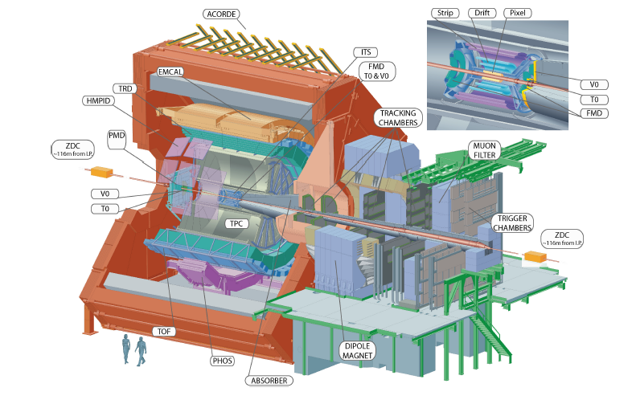
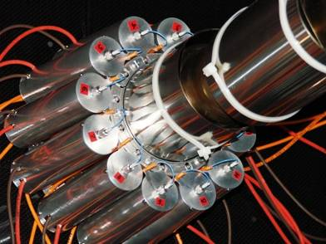
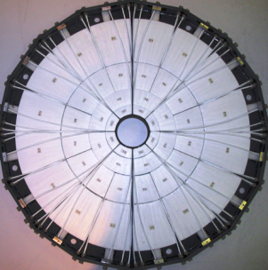
The present ALICE detector
Current T0
• T0 consists of two arrays, placed
on the opposite sides of the IP
• Cherenkov radiators, each
coupled to PMTs (12 per module)
• -5 < η < -4.5, 2.9 < η < 3.3
Time resolution of ~ 40ps for protons and ~25ps for PbPb collisions
Current V0
V0 consists of two arrays of 32
scintillating counters
Installed on opposite sides of IP
Scintillators coupled to PMTs by fibers
−3.7< η < −1.7 , 2.8< η < 5.1
Time resolutions of about 450 ps and 350 ps are achieved for V0-A and V0-C
V0 & T0 Provide triggers, luminosity monitoring, background reduction, collision time (for PID), centrality,
and event plane determinations

Slide 6
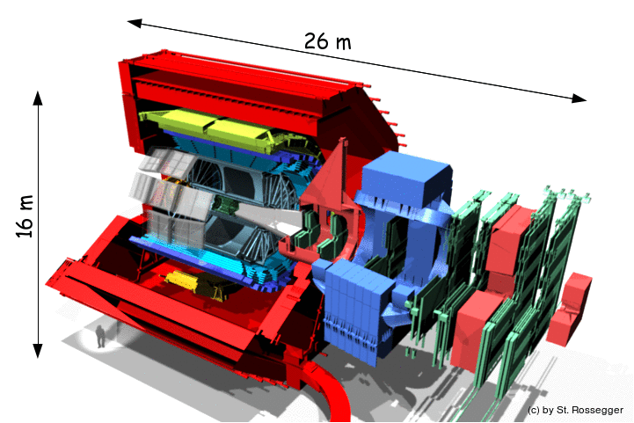
The Future : ALICE upgrade Program
New Inner Tracking System (ITS)
improved pointing precision
less material -> thinnest tracker at the LHC
Muon Forward Tracker (MFT)
new Si tracker
Improved MUON pointing precision
MUON ARM
continuous readout electronics
Time Projection Chamber (TPC)
new GEM technology for readout chambers
continuous readout
faster readout electronics
New Central Trigger Processor
Data Acquisition (DAQ)/
High Level Trigger (HLT)
new architecture
on line tracking & data compression
50kHz Pb-Pb event rate
TOF, TRD
Faster readout
New Trigger
Detectors (FIT)

Slide 7
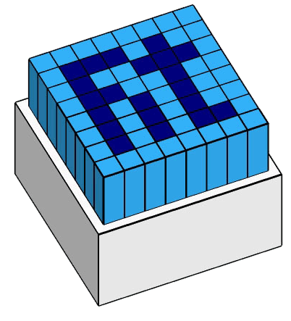


Fast Interaction Trigger
replaces 3 detectors in ALICE:
T0, V0, and FMD
https://cds.cern.ch/record/781854/files/lhcc-2004-025.pdf
https://cds.cern.ch/record/1603472/files/ALICE-TDR-015.pdf
FIT will consist of two arrays of Cherenkov radiators with MCP-PMT sensors (T0+) and of a single, large-size scintillator ring (V0+)
(FIT = T0+ and V0+ for ALICE after LS2)

Slide 8
Why ALICE needs FIT:
Luminosity monitoring & feedback to LHC
  Essential for the operation of ALICE
Fast Interaction Trigger
  Online Vertex determination
  Minimum Bias and centrality selection
  Rejection of beam/gas events
  Veto for Ultra Peripheral Collisions
Collision time for Time-Of-Flight particle ID
Multiplicity → Centrality and Event Plane

Slide 9
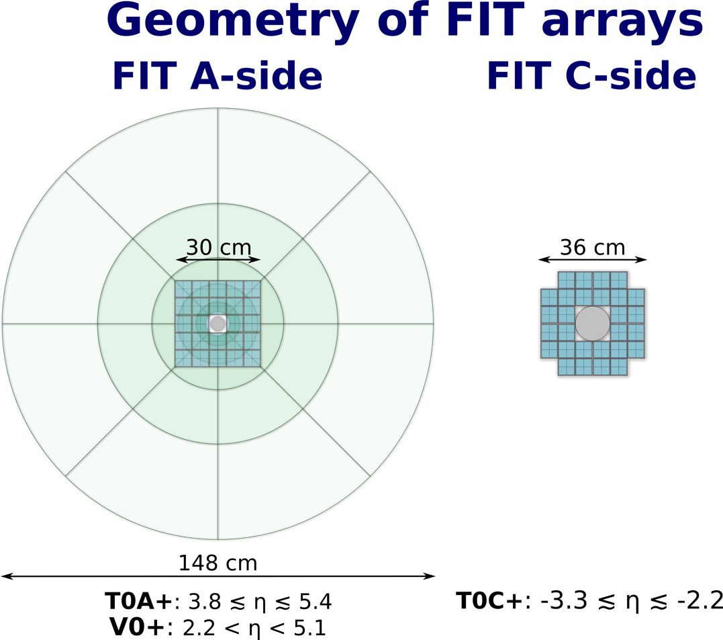
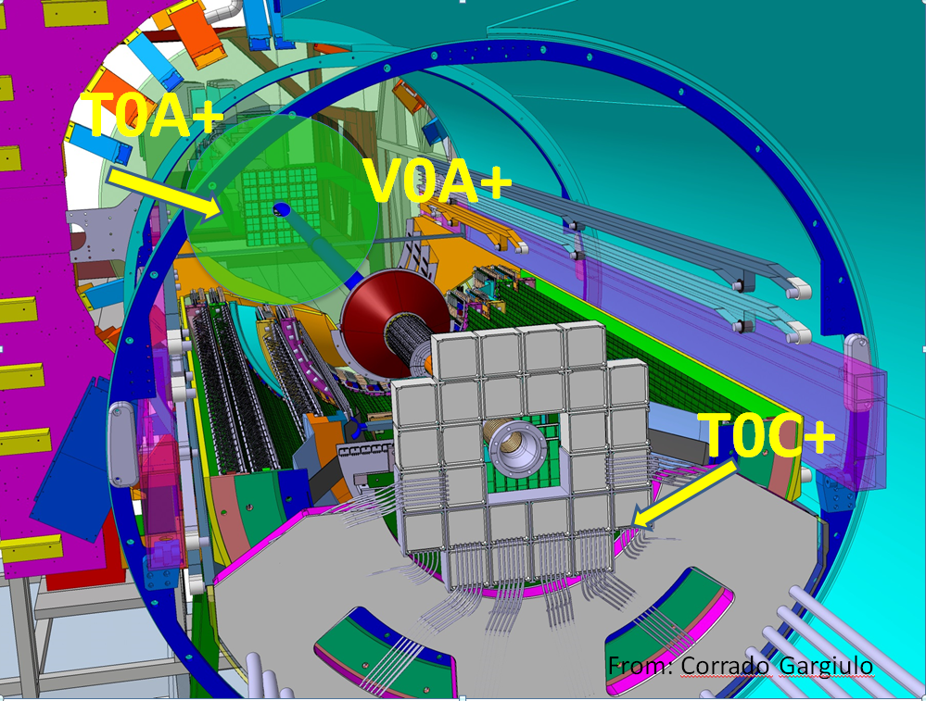
FIT = T0+ and V0+

Slide 10
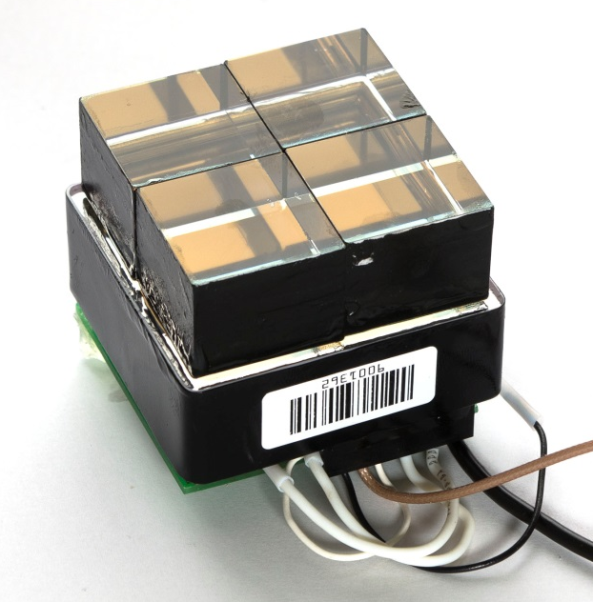
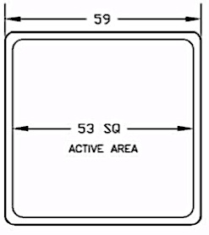
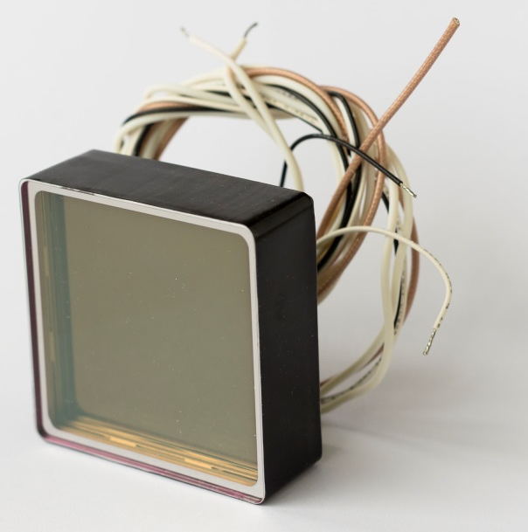
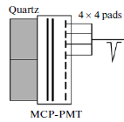
Prototype of T0+ module
PLANACON® XP85012 + quartz radiators
Time resolution < 20 ps
MCP-PMT : The MCP-PMT XP85012 with 64 anode pads is
transformed into the 4channel photo detector
by merging 16 pads (4 × 4) of each cell into a single channel
XP85012

Slide 11
Our solution to Modify PLANACON® XP85012
New PCB for XP85012 was designed and manufactured at Institute of Nuclear Research and assembled to a new PLANACON by Photonis
The modified PLANACON
  Eliminated the “positive crosstalk”.
  Increased signal amplitude for a given MCP gain*
  Eliminated additional PCB
  Reduced the size of the unit
  Improved time resolution and signal shape stability
  *now the anode capacitance is 30 pF/quadrant, 2 pF between quadrants

Slide 12
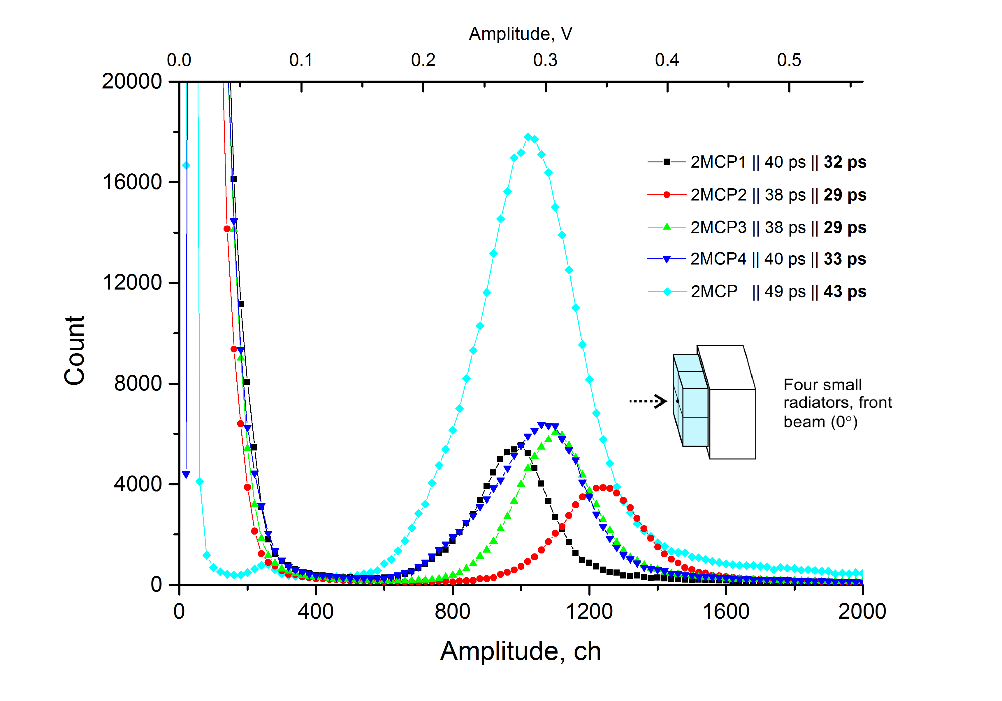
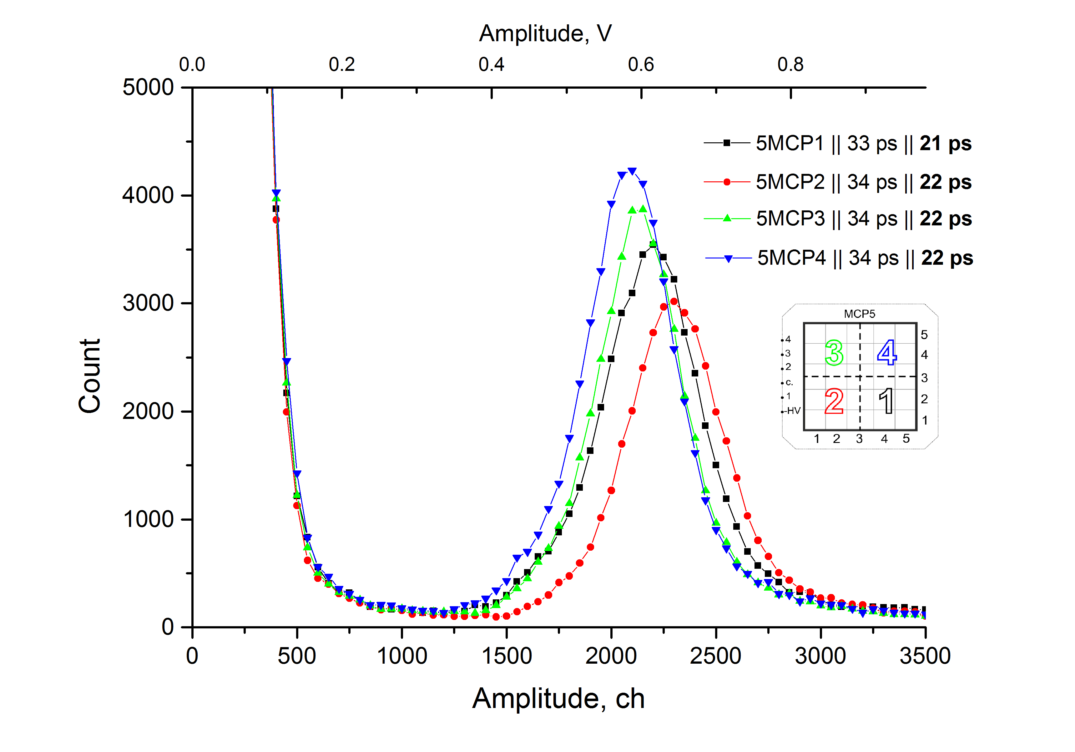
Beam tests of the modified PLANACON
Standard XP85012 Modified
As measured in June 2015
Standard XP85012
MCP amplification 10⁶
Amplitude ~1100 channels
Time resolution ~30 ps
As measured in October 2015
Modified XP85012
MCP amplification 10⁶
Amplitude ~2100 channels
Time resolution ~22 ps

Slide 13
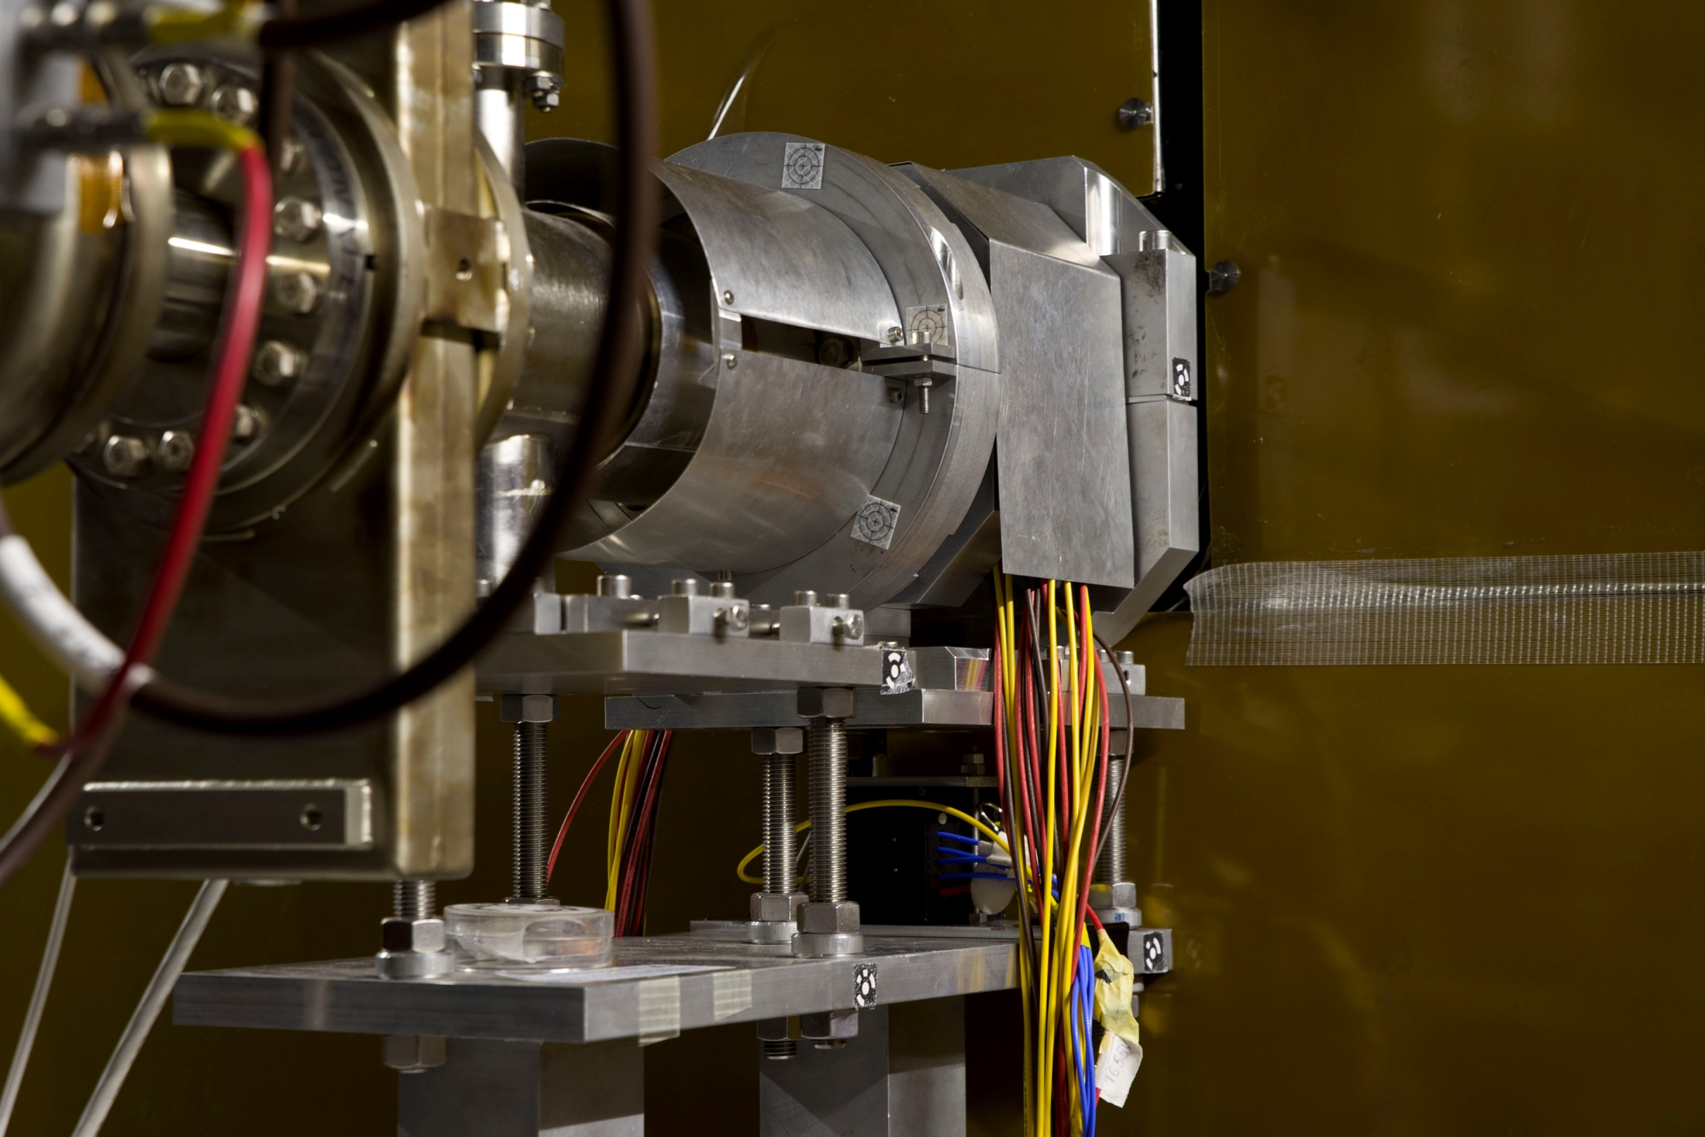

FIT module installed in ALICE
PMD
T0
FIT

Slide 14
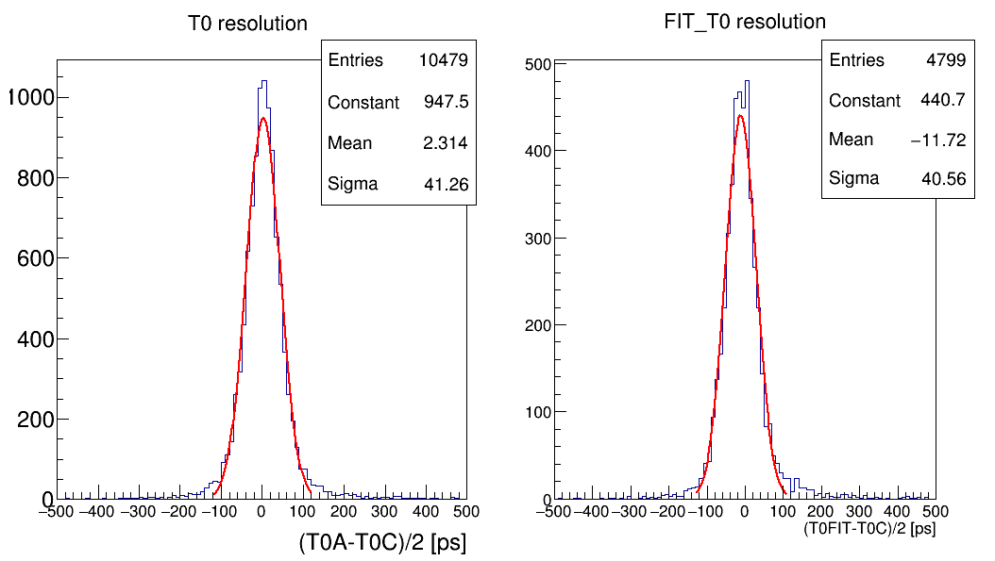
Detector resolution run 255181 local reconstruction
T0FIT → FIT CFD1 (aligned to 0) and corrected with SPD vertex

Slide 15
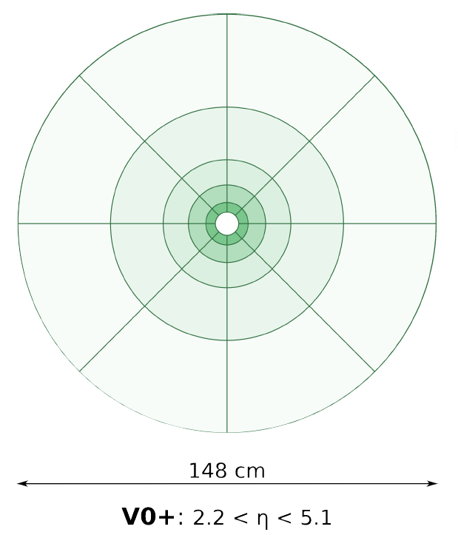
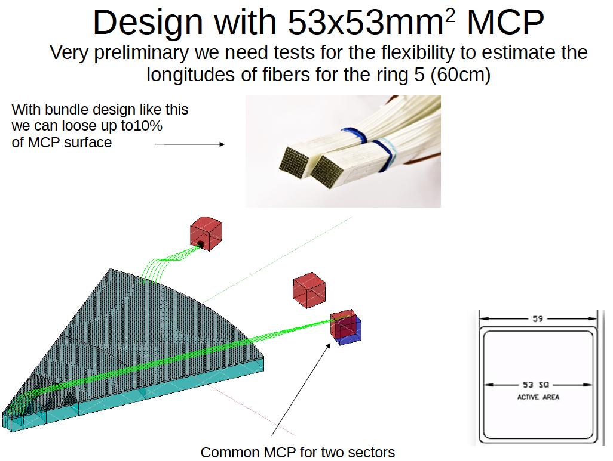
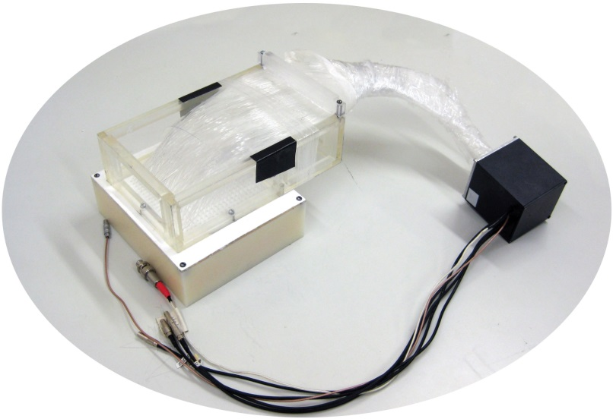
V0+ detector
V0+ design
still evolving

Slide 16
ALICE Readout System Diagram for LHC RUN3

Slide 17
FIT system block diagrams
CTP
LTU
CRU
O2 &DCS
LM trigger inputs
O²
FIT Electronics
GBT links
Clock (?) &
Trigger/Busy/Data
&configuration
Slow control link (IPBus)
The CRU shell accept the BUSY signal from the FIT electronics and propagate it to the CTP/LTU
The FIT requires the LHC clock and then trigger information from the CRU (or HQClock)
The FIT will also use its own slow control link (Luminosity monitoring :
Feedback to the LHC & Feed back to ALICE )

Slide 18
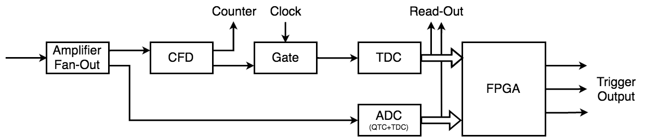
Trigger decision concept
LM trigger Latency 170-190 ns
FIT -> trigger decision based on digitized data (after TDCs & ADCs)

Slide 19
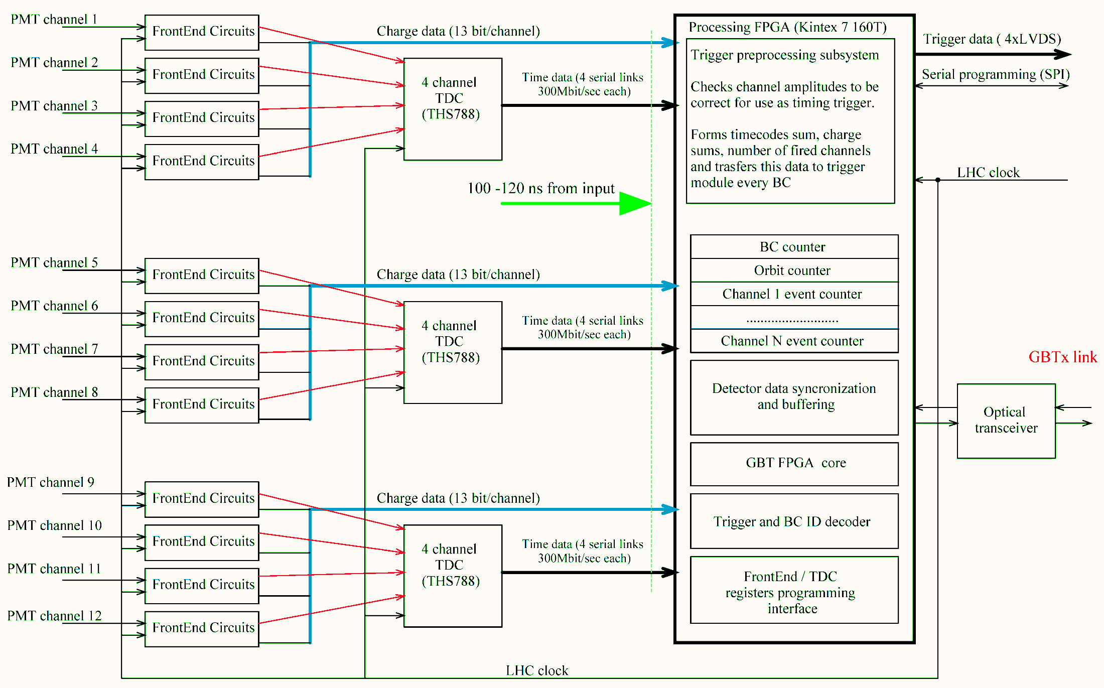
Processing module structure Option A
FE mezzanine
board
*TDC THS788 also performs on-the-fly delay compensation

Slide 20
FIT Collaboration
(~50 people, 14 institutes, 6 countries)
Country | City | Institute
Austria | Vienna | Stefan Meyer Institute
Denmark | Copenhagen | Niels Bohr Institute, University of Copenhagen
Finland | Jyväskylä | Helsinki Institute of Physics (HIP) and Univ. of Jyväskylä
Finland | Helsinki | Helsinki Institute of Physics (HIP) and Univ. of Helsinki
Mexico | Mexico City | Instituto de Física, UNAM
Mexico | Mexico City and Merida | CINVESTAV
Mexico | Mexico City | Instituto de Ciencias Nucleares, UNAM
Mexico | Puebla | Benemérita Universidad Autónoma de Puebla
Mexico | Culiacan, Sinaloa | Universidad Autónoma de Sinaloa
Russia | Moscow | Institute for Nuclear Research, RAS
Russia | Moscow | Moscow Engineering Physics Institute
Russia | Moscow | Russian Research Centre Kurchatov Institute
USA | Chicago | Chicago State University
USA | San Luis Obispo | California Polytechnic State University

Slide 21
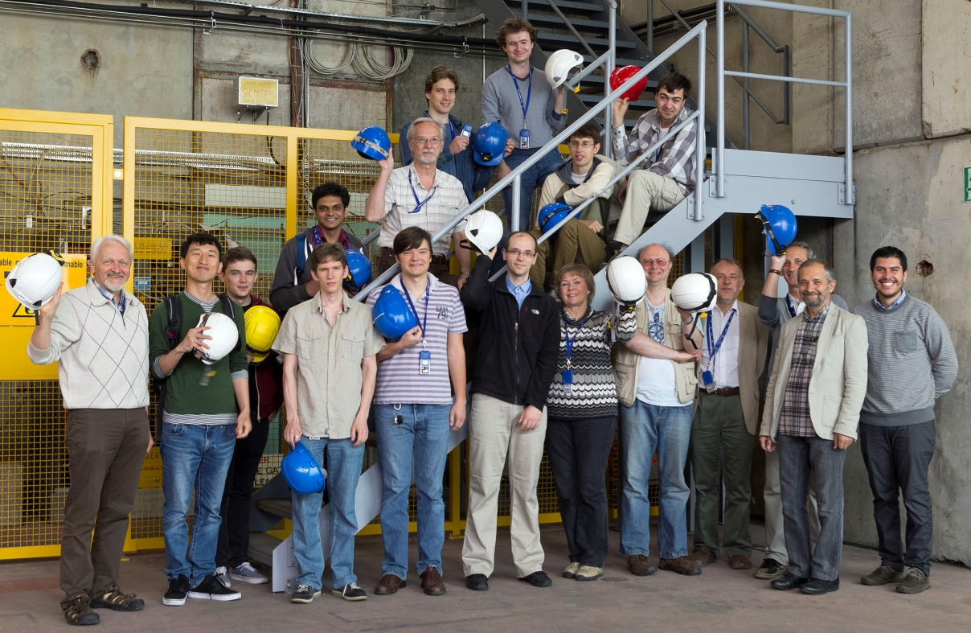
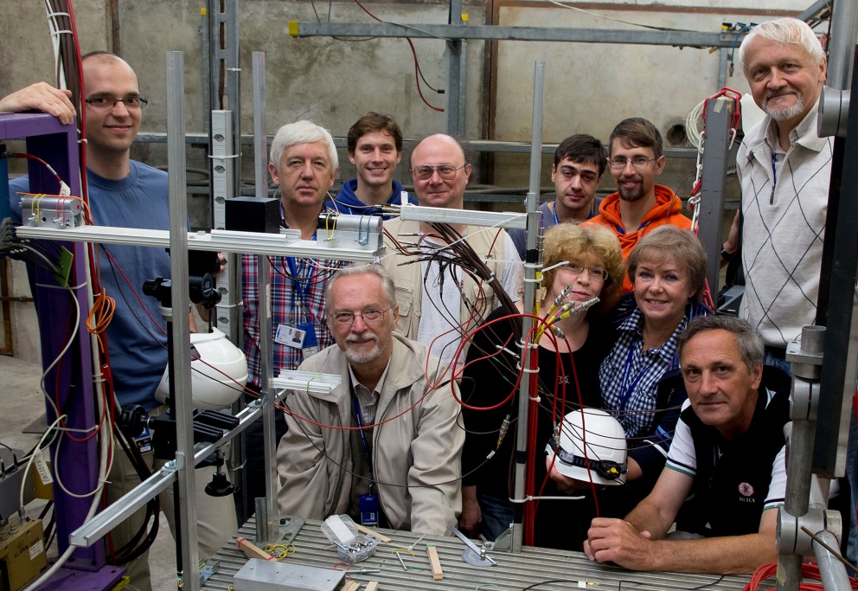
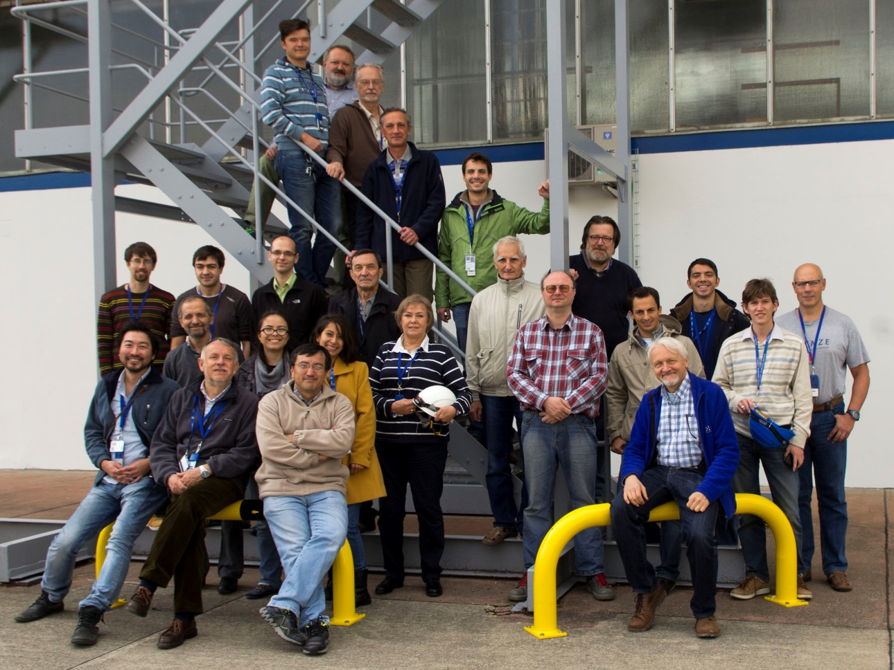
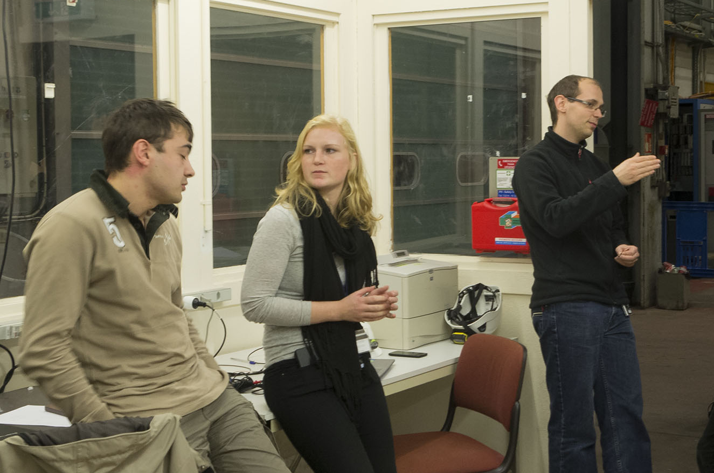
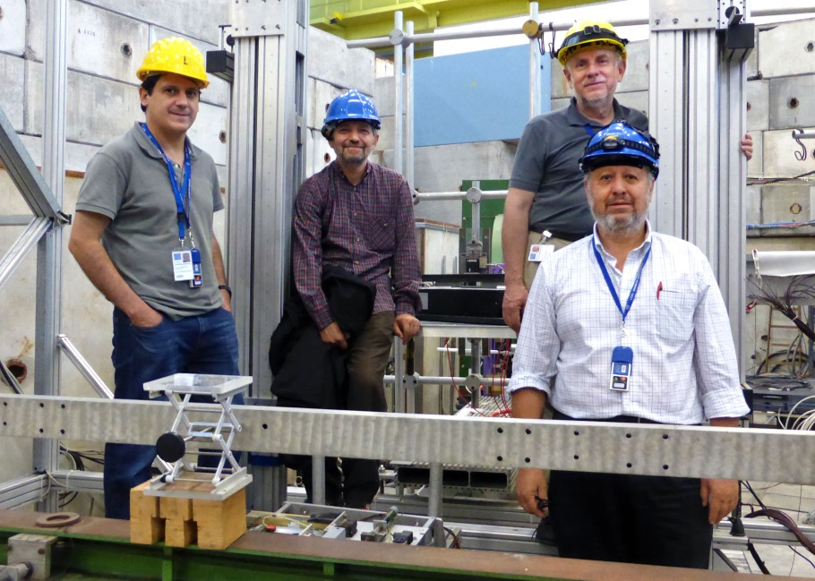
FIT collaboration
during PS beam tests
~50 people, 14 institutes, 6 counties

Slide 22
Summary
During the upcoming LS2 ALICE is going to upgrade several of the key detectors including the Fast Interaction Trigger (FIT).
FIT will consist of two arrays of T0+ modules (Cherenkov radiators coupled to MCP-PMTs) and one V0+ (segmented scintillator ring).
T0+ prototype achieved ΔT ~22 ps during the tests at PS
The FIT upgrade is on track.

Slide 23
Acknowledgements. This work was supported for the INR RAS and MEPhI participants within the Program of Russian groups activities in the ALICE upgrade by the Ministry of Education and Science of Russian Federation, contract No14.610.21.0003

Slide 24

Thank you for your attention!

Slide 25
BACKUP SLIDES

Slide 26
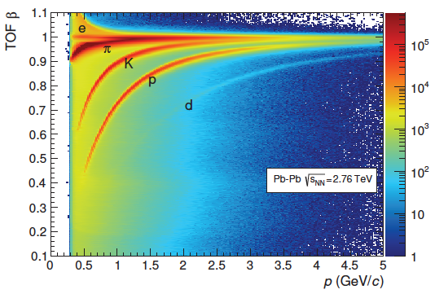
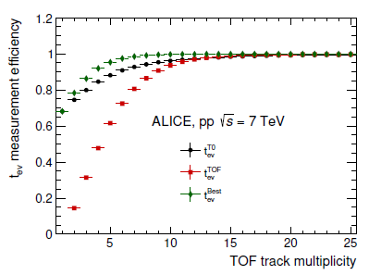
Why ALICE needs timing from FIT:
Measurement of the event collision time for particle identification via the time-of- flight technique
In pp collisions, for very low multiplicity events, the curent T0 detector can provide a t_{ev} measurement with an efficiency of the order of 70% that increases with the track multiplicity. At the same time, for all events having high multiplicity, the t^{TOF} _{ev} method is able to provide a t_{ev} measurement.
FIT should be as fast as possible!

Slide 27
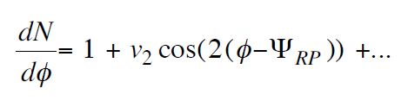
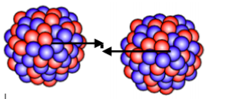
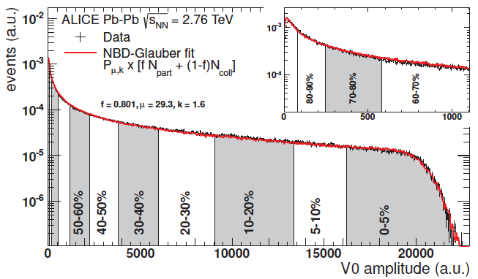
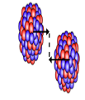
Why FIT should maximize acceptance:
Reaction plain
FIT should be as large as possible within the available space inside ALICE!

Slide 28
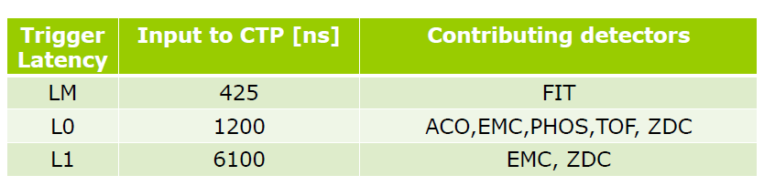
FIT: trigger and readout requirements
Fast Interaction Trigger (FIT)
Minimum bias (MB) used by most of detector
TRD wake-up
FIT Trigger Input latency
425 ns from interaction to signal at detector CTP input
Continuous readout (rare processes do not exhibit signatures that can be selected by hardware triggers, they can only be collected by a zero bias triggers)

Slide 29
The main problems with a Standard PLANACON® XP85012
64 individual anodes (sectors) are electrically connected to the common output. The anode – MCP capacitance creates inversed (positive) crosstalk which distorts time measurements when more than one quadrant is hit.
To collect signals from each quadrant we need to attach an additional PCB. This increases inductance and capacitance of the traces and distorts the shape of the signal. It also makes signal shape dependent on the coordinates.
The total capacitance of the anode system for one quadrant is about 80 pF.
Different trace lengths for individual anodes decrease the MCP time resolution.

Slide 30
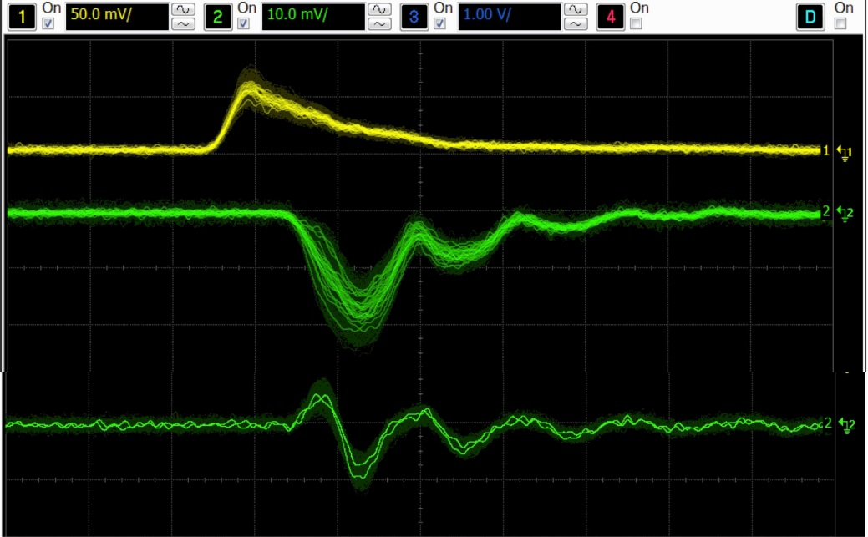
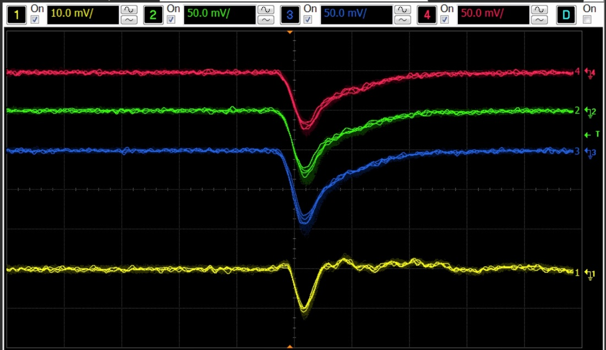
Laser tests of the modified PLANACON
Three quadrants are open to laser pulses. One quadrant is covered.
Standard XP85012 Modified
CROSSTALK
SIGNAL X 1
CROSSTALK
SIGNAL X 5
The leading edge is unstable, depends on charge distribution between individual anodes of the three illuminated quadrants. Oscillation on the trailing edge can be seen. The crosstalk signal is large.
Signals from the 3 illuminated quadrants are stable and without oscillations. The crosstalk signal (on the darkened quadrant) is now ~5x smaller and has only a negative component. There is no time shift. The trailing edge is 1.5x shorter.

Slide 31
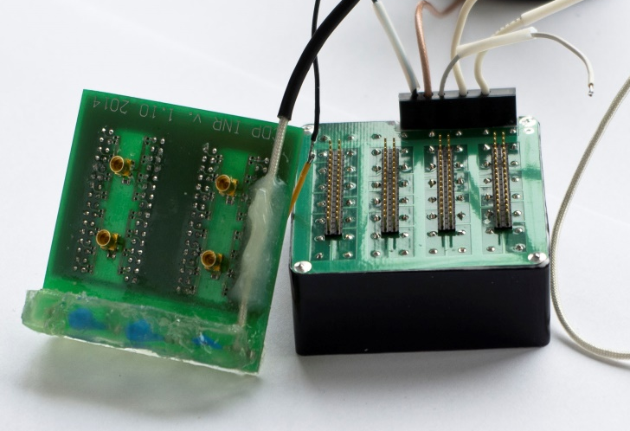
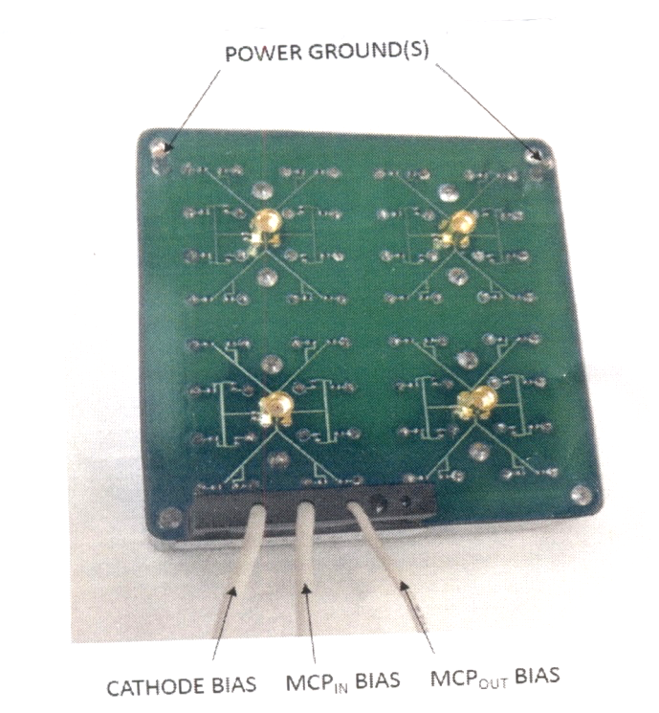
Standard XP85012 Modified
Modified variant has RF grounded MCP out electrode, reduced anode-ground capacitance, and equalized propagation time from individual anodes to the output connectors.
Standard off-the-shelf PLANACON®
has a common output and uses non-RF connectors for anode outputs

Slide 32
Modified PLANACON® XP85012 version 2
Changes from Version 1 :
Reduced size of the HV port, optimized HV divider placement
Result: Assembled detector module length
decreases ~10 mm to 67 mm
MCP plates resistance decreased ~3 times to 16 -17 Mohms
Result:
- Dynamic range increases at least
2 times, now covers FIT requirements.
- All MCP internal time constants are reduced
in 3 times.
- 40 MHz burst repetition rate test passed.
- Average 1 MHz interaction rate test to be
finished, preliminary – passed.
Minor changes of the PCB
Result:
- Electrical crosstalk between quadrants now
is less than optical one.
32

Slide 33
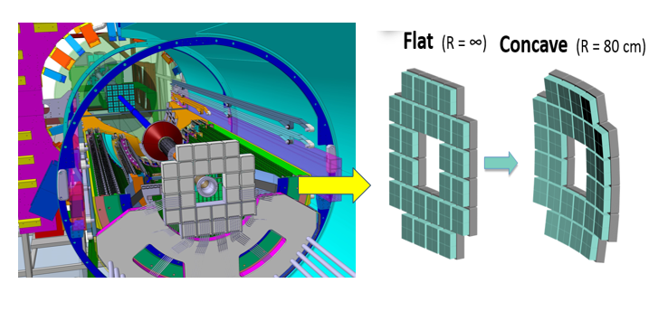
FIT configuration T0C+
The distance between IP
and T0C+ is only 80 cm
Performance of the T0+
module depends on the
impact angle of MIPs
Concave geometry is now possible due to the thinning of the MCP-PMT sensor

Slide 34

Importance of V0+

Slide 35
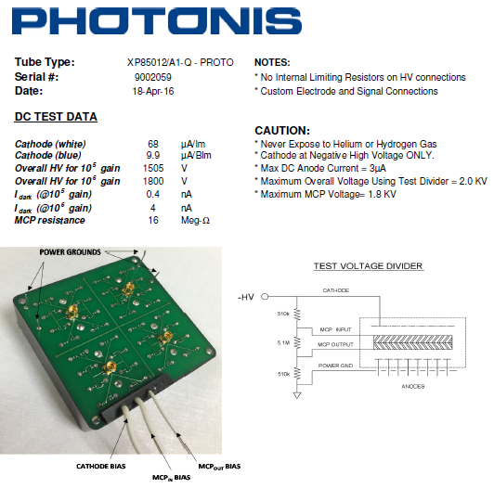
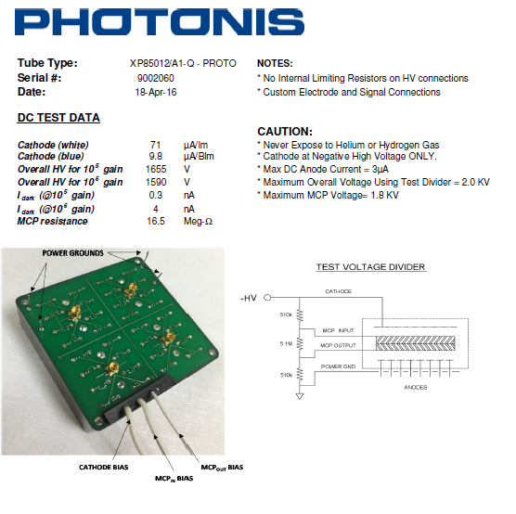
New Modified XP85012-V2

Slide 36
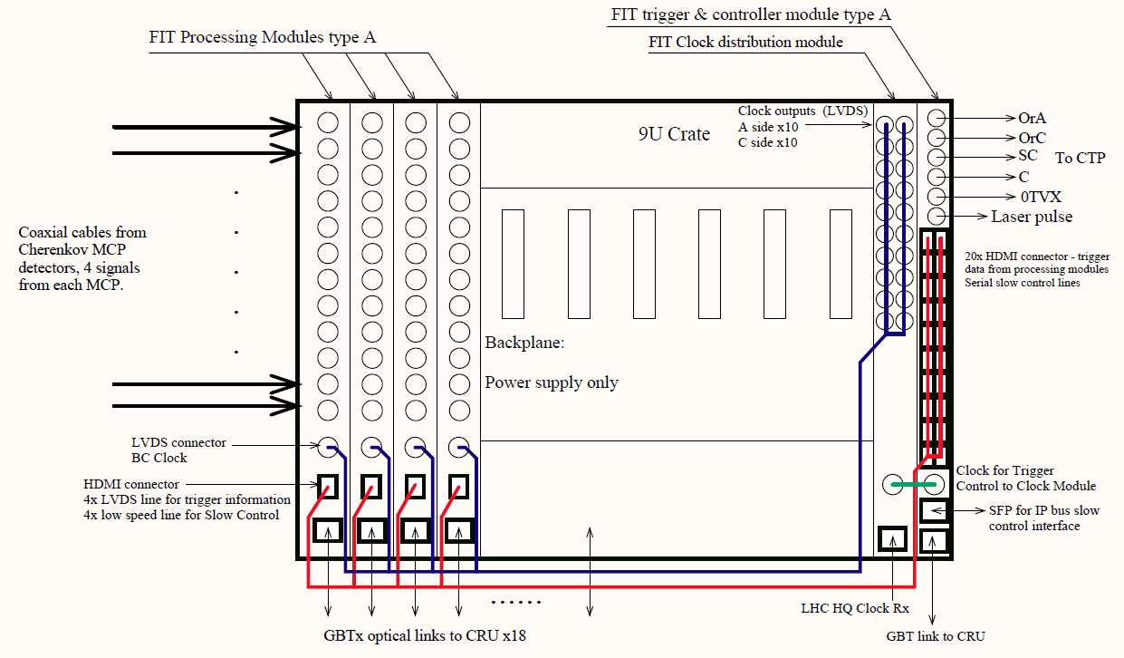
Fit electronics and custom readout

Slide 37
FIT LM trigger Latency
FIT Time-of-Fligth -12ns
(corresponds to ~4 m between IP and FIT-A)
MCP-PMT delay ~5ns
Cabling from detector to electronics-167 ns
4m (thin cable -4,8ns/m) +34 m (thick cable-
4,1 ns/m) + 1,5 m( thin cable -4,8ns/m)
Cabling to CTP –43 ns
43 ns (8,5 m)
Total ~ 227ns
Max .Trigger processing time = 425 -227=198 ns!
(T0 has trigger processing time ~175-190 ns)

Slide 38
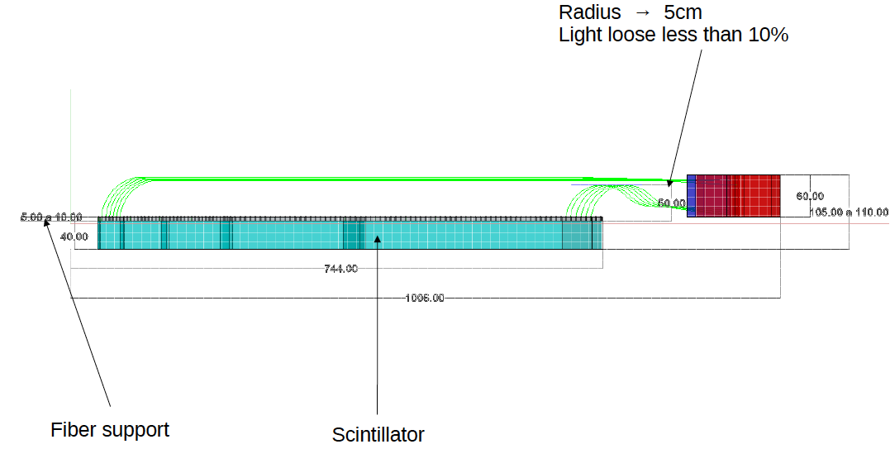
V0+ design

Slide 39
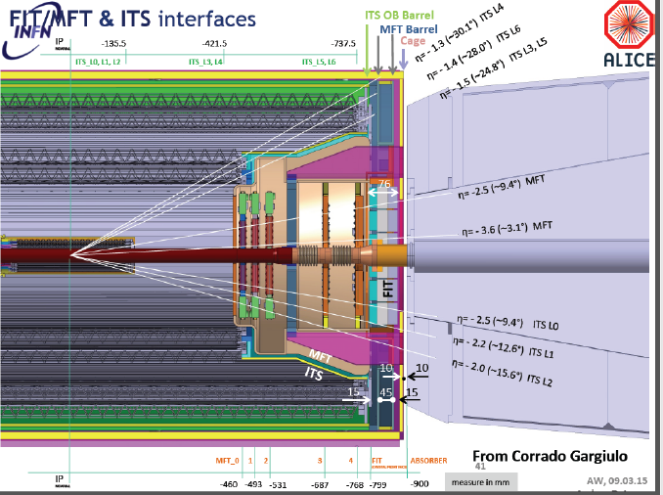

Slide 40
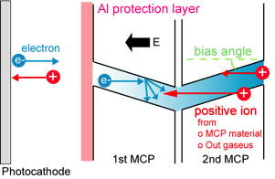
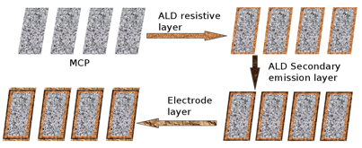
Big progress in MCP technology
(since the initial R&D for ALICE)
Appearance of commercially available MCP-PMTs (Hamamatsu, Photonis USA, BINP)
Significant and ongoing improvement in lifetime:
  Atomic Layer Deposition technology [NIM A639 (2011) 148]
  Modified photocathodes [JINST 6 C12026 (2011)]
  Reduced outgassing (borosilicate glass)
For more information: Albert Lehmann, 12th Pisa Meeting on Advanced Detectors, May 2012

Slide 41
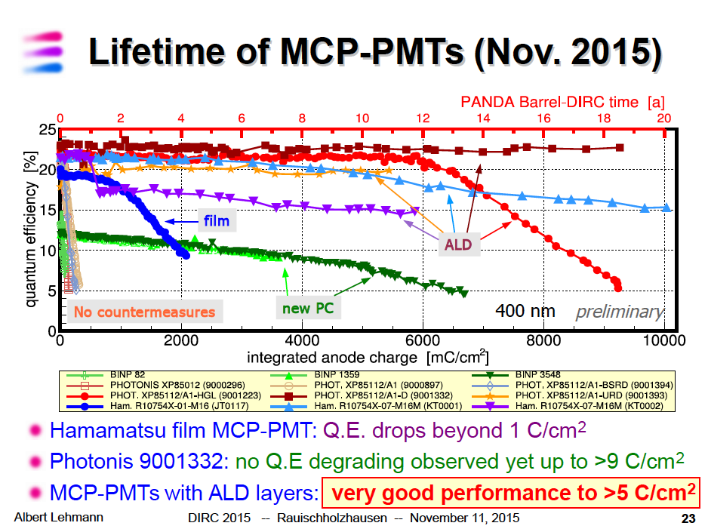

Slide 42
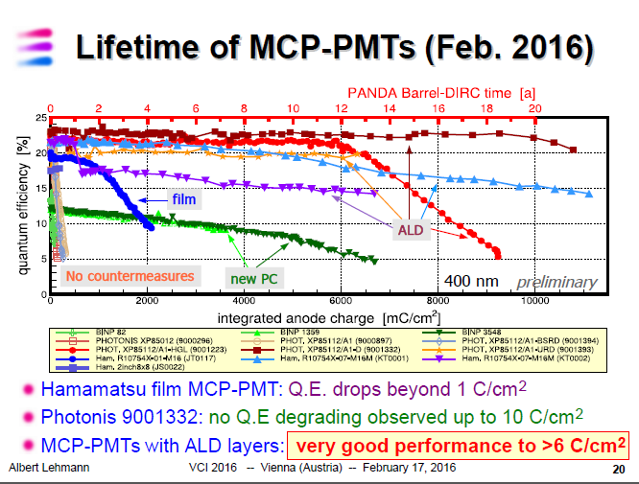

Slide 43
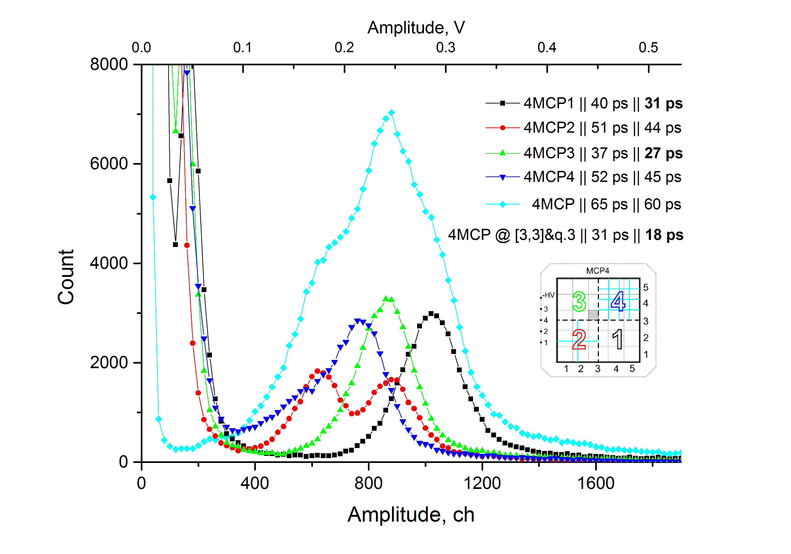
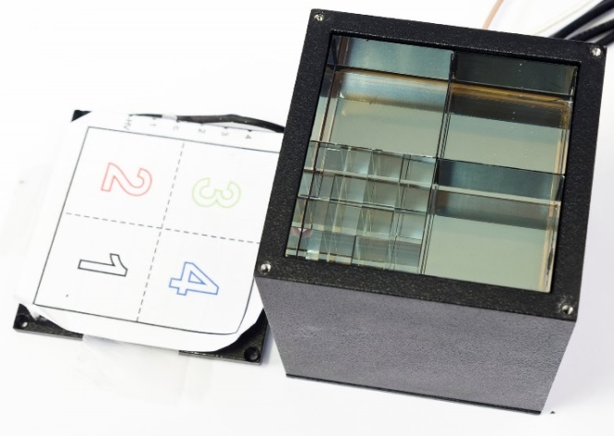
Radiator granularity results (October 2015 data)
Results for the repaired NBI MCP with different combinations of fragmented radiators.
4MCP1-radiator- 1/4
4MCP2-radiators 4/16 new
4MCP4-radiators 16/64
4MCP3-radiator 1/4
Conclusion - Reproducible results for quadrants with default
radiators (#1, #3) comparing to June 2015 data.
- No benefit in further segmentation of radiators;
  - Best timing for 4 default radiators;
  -Perfect pulse shape and largest amplitude for 4 default radiators;

Slide 44
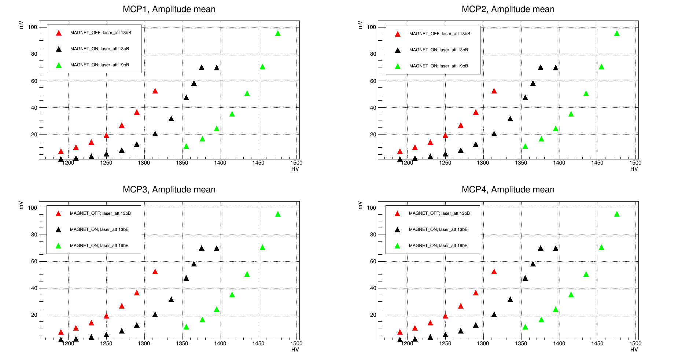
Study of the characteristics of MCP-PMT in a magnetic field
Magnet on=0.5T
Measurements of MCP gain as dependent on magnetic field strength were carried out for FIT samples. In connection with the necessity to choose the PMT operational voltages so, as to make possible the work in a wide dynamic range of MCP signal amplitudes, namely 1:350

