Slide 1
How to make nonlinear gravity with scalar field
R. Budaev, S. Rubin

Slide 2
Addition of scalar field to multidimensional nonlinear action of gravity strongly facilitate research and at the same time reduce the beauty of pure gravitational approach.
$$f(R_{do})$$
Let we have F(R) gravity with an extra space of D dimensions. The aim is to obtain f(R) gravity
with d₀-dim extra space (d₀<D) + a scalar field Lagrangian.
$$d_{0}<D$$
For further investigations d₀ – dim space has to contain a compact subspace

Slide 3
Metric of an extra space is invariant at coordinate transformations of
The Ricci scalar for chosen metric
Let us start with the action
Assume that the action has extremum at
function varies around the minimum
β

Slide 4
Taylor series around the potential minimum
Taylor set of the action
Expansion on :

Slide 6
$$V_{0}$$
Last remark
$$M_{4}×W_{0}{×V}_{1}$$
$$m\left(R_{0}+R_{1}\right)‼$$
For a following research we need to vary and m independently
$${R_{0}≪R_{1}? R}_{0}=\frac{d_{0}}{d_{1}}R_{1}$$
If then mass of the scalar field does not depend on a metric of
$$d_{0}≪d_{1}$$
$$V_{0}$$

Slide 7
CONCLUSION
Multidimensional gravity with higher derivatives and scalar fields
is (almost) equivalent to
pure multidimensional gravity of larger dimensionality.
Thank you

Slide 8
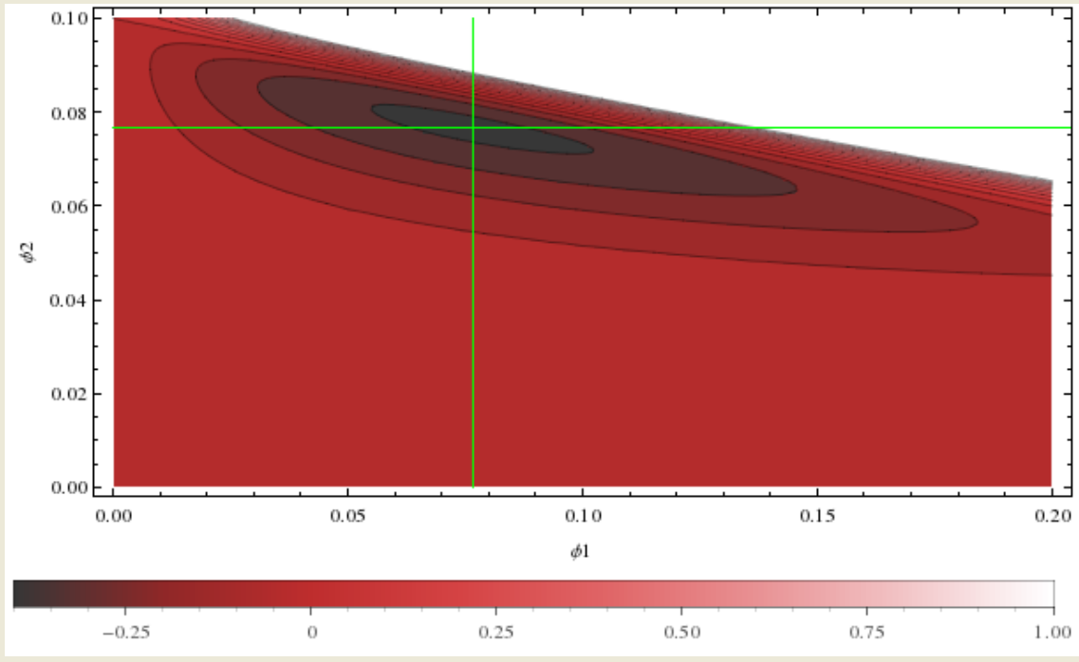
F(R)=
Parameters:

