Slide 1
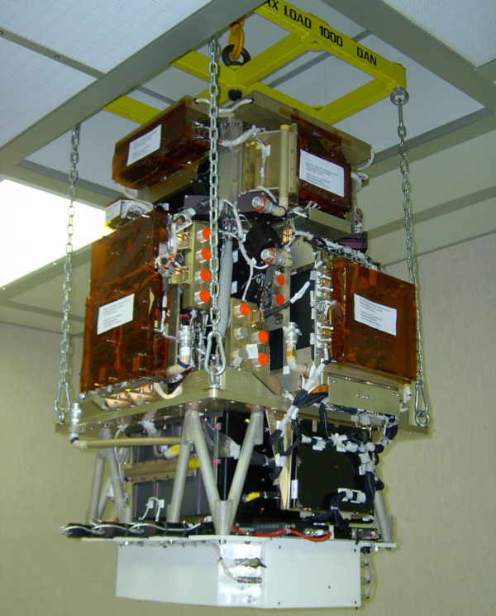
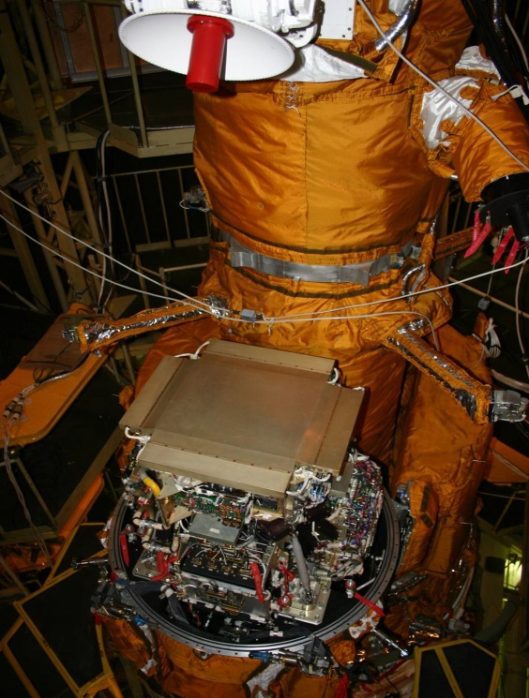
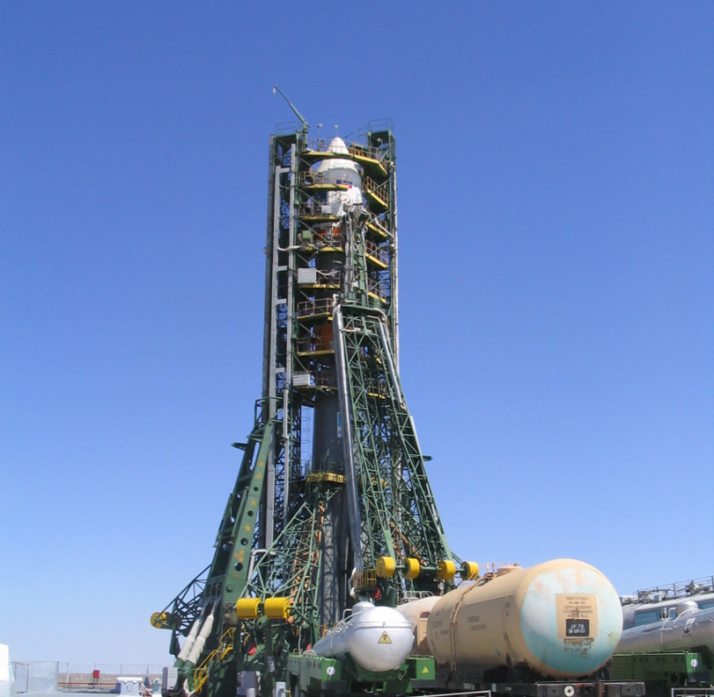
The PAMELA experiment: a decade of Cosmic Rays Physics in space
Roberta sparvoli & the pamela collaboration
UniversiTy of rome tor vergata and infn

Slide 2

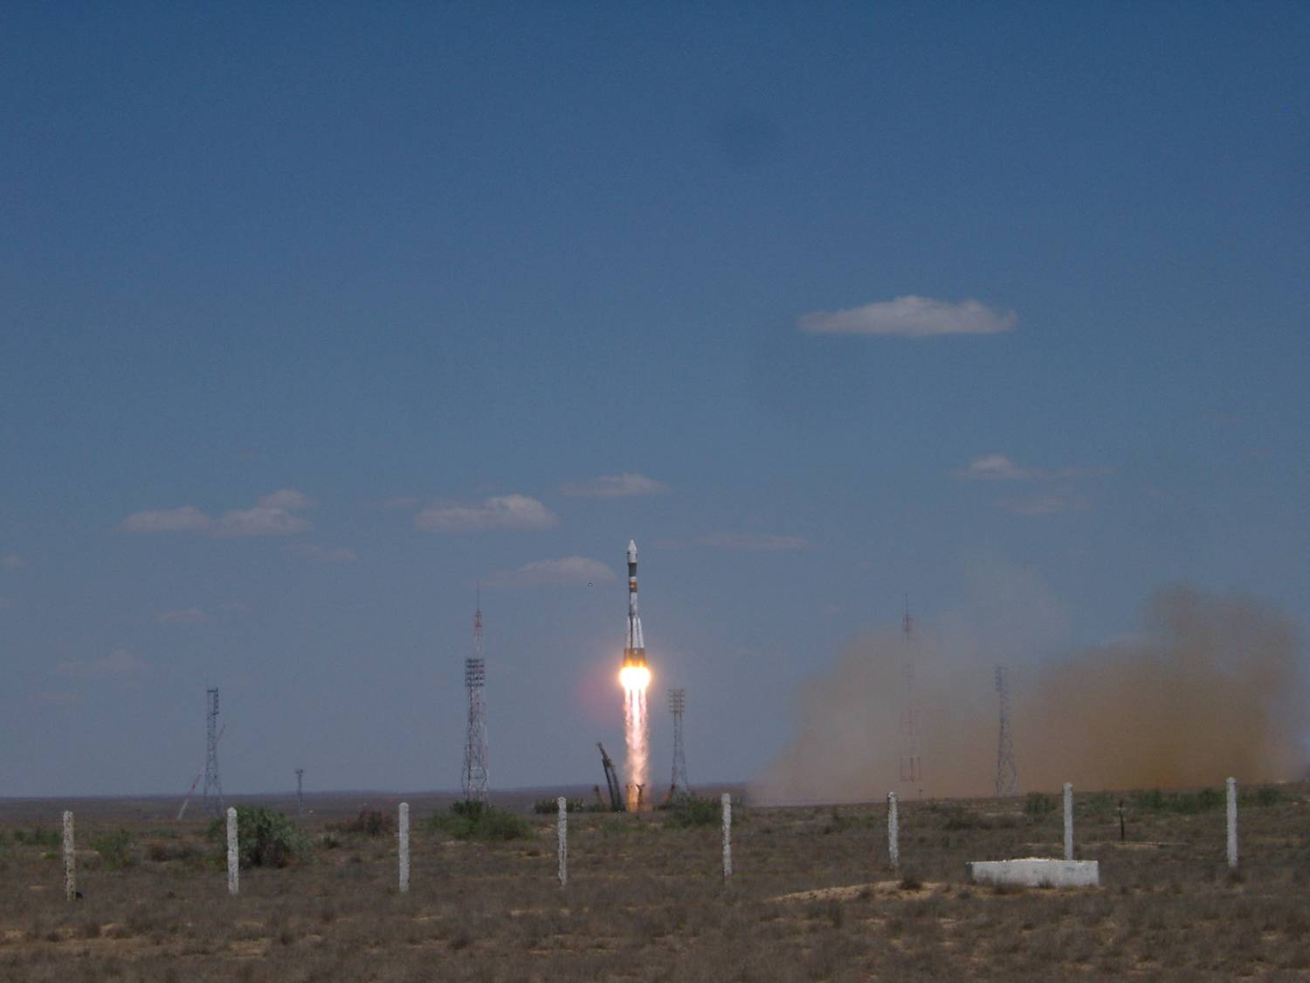
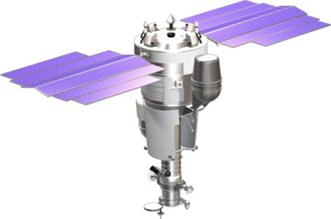
PAMELA
Payload for Matter/antimatter Exploration and Light-nuclei Astrophysics
Direct detection of CRs in space
Main focus on antiparticles (antiprotons and positrons)
PAMELA on board of Russian satellite Resurs DK1
Orbital parameters:
  inclination ~70º (low energy)
  altitude ~ 360-600 km (elliptical) – now 500 km (circular)
Launch from Baykonur
→ Launched on 15th June 2006
Just celebrated 10 years!

Slide 3
The PAMELA collaboration

Slide 4
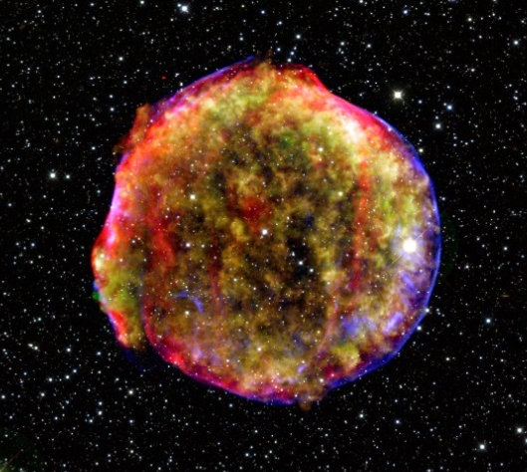
Absolute fluxes of
(primary and secondary) GCRs
Protons & Helium nuclei, Electrons
Light secondary nuclei from CR interactions with ISM

Slide 5
Published results on GCRs
Antimatter
  p-bar fraction PRL 102 (2009)
  e+ fraction Nature 458 (2009)
  e+ fraction ApJ 34 (2010)
  p-bar PRL 105 (2010)
  e+ PRL 111 (2013)
  e+ anisotropies ApJ 811 (2015)
Electrons
  e- PRL 106 (2011)
  e- variation jul-2006/dec-2009 ApJ 810 (2015)
Nuclear component
  H&He Science 332 (2011)
  H variation jul-2006/dec-2009 ApJ 765 (2013)
  B&C ApJ 791 (2014)
  H&He isotopes ApJ 818 (2016)

Slide 6
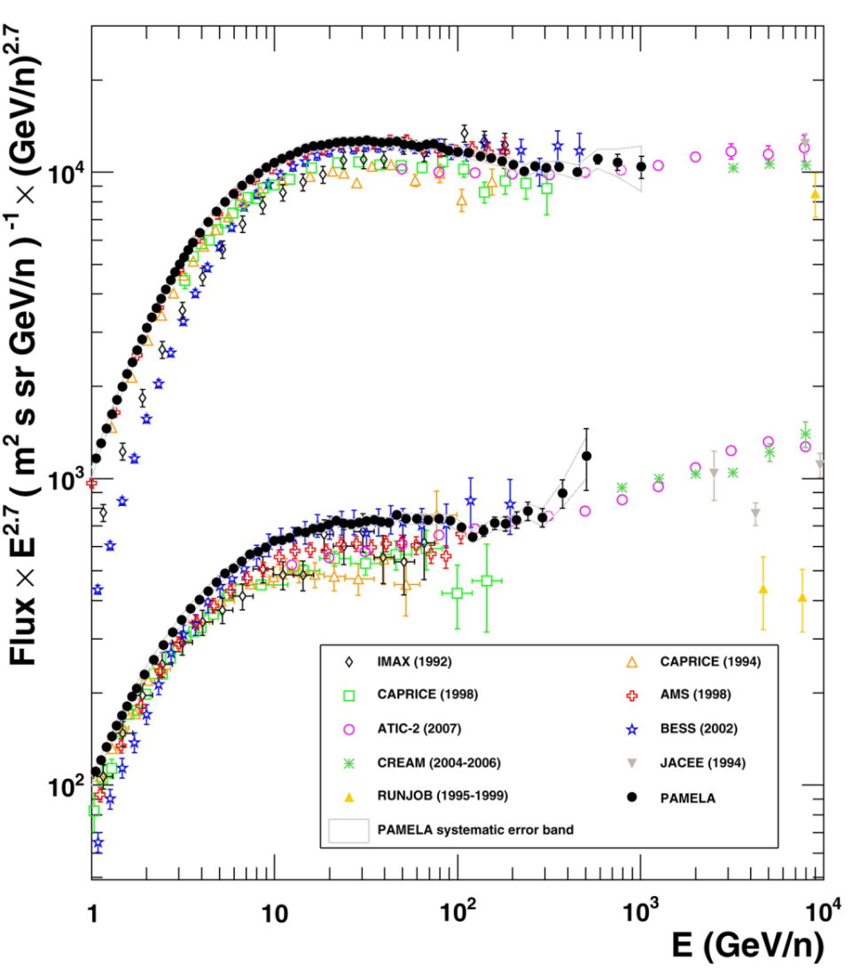
H & He absolute fluxes
Adriani et al. - Science - 332 (2011) 6025
First high-statistics and high-precision measurement over three decades in energy
Deviation from single power law @98% CL
Spectral hardening Δγ~0.2÷0.3 @R~235GV
PAMELA data→ Jul 2006 ÷ Mar 2008

Slide 7
H & He absolute fluxes
Adriani et al. - Science - 332 (2011) 6025
First high-statistics and high-precision measurement over three decades in energy
Deviation from single power law @98% CL
Spectral hardening Δγ~0.2÷0.3 @R~235GV
  Spectral features @injection?
  Different astrophysical objects?
  Propagation feature not constrained by S/N ratio data?
PAMELA data→ Jul 2006 ÷ Mar 2008

Slide 8
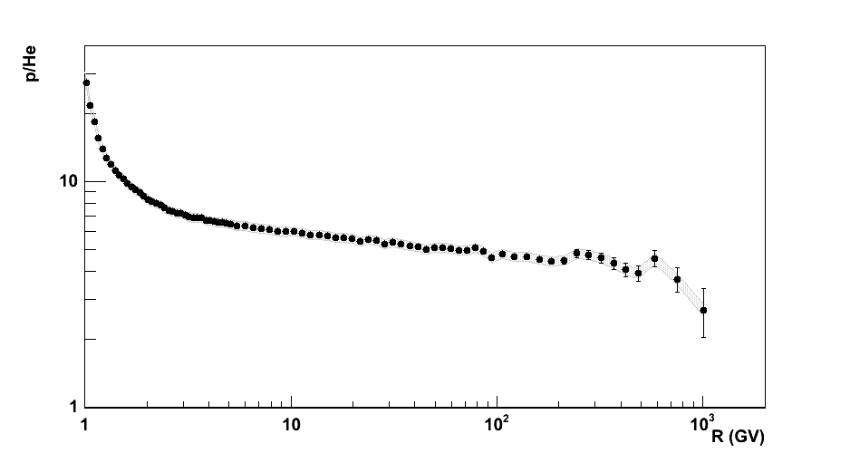
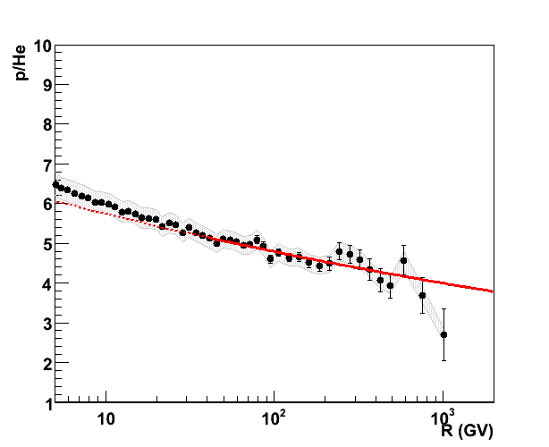
H & He absolute fluxes
Adriani et al. - Science - 332 (2011) 6025
First evidence of different H and He slopes above ∼ 10 GV
α_{He}-α_{p} = 0.078 ±0.008
  Spectral features @injection?
  Different astrophysical objects?
  Propagation feature not constrained by S/N ratio data?

Slide 9
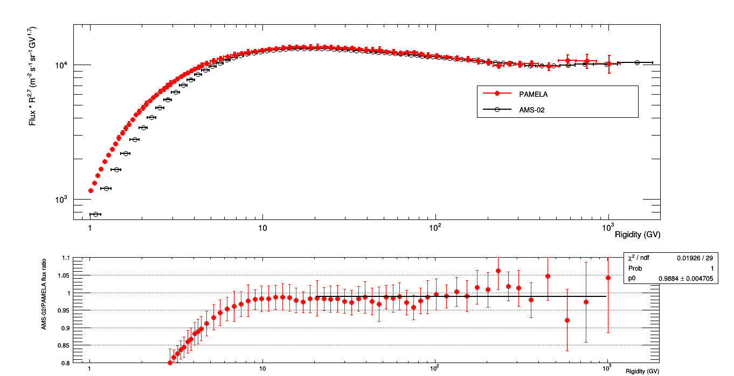
PAMELA vs AMS02: protons
PAMELA data → Jul 2006 ÷ Mar 2008
AMS02 data → May 2011 ÷ Nov 2013
 solar modulation
Adriani et al. - Phys.Rep. – 544 (2014) 323-370
(“Science” flux rescaled, according to solar-modulation analysis)
M. Aguilar et al., PRL 114 (2015) 171103
0.988

Slide 10
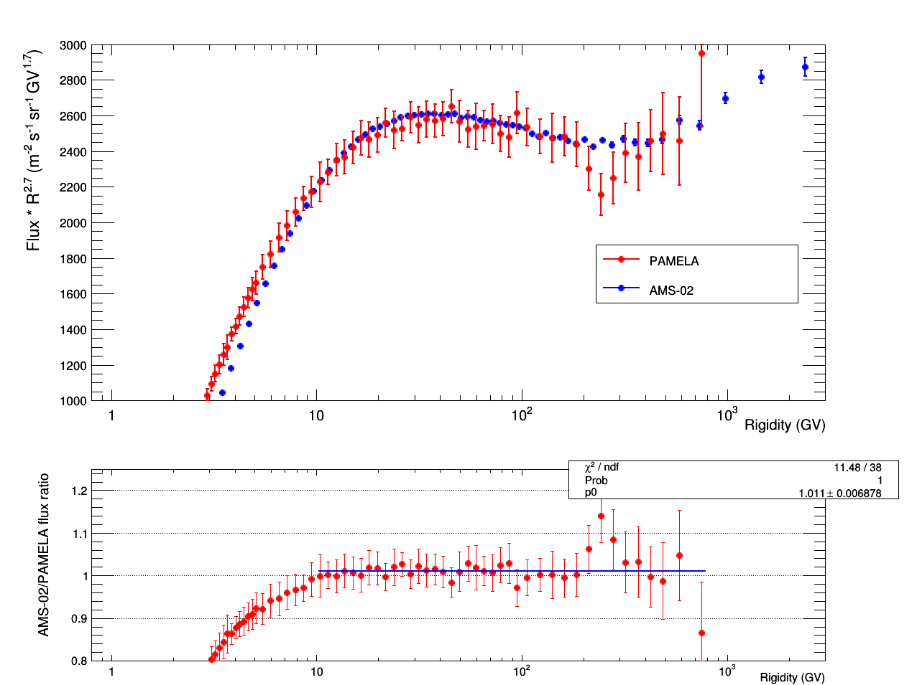
PAMELA vs AMS02: heliums
 solar modulation
Adriani et al. - Science - 332 (2011) 6025
Aguilar et al – PRL - 115 (2015) 211101
1.011

Slide 11
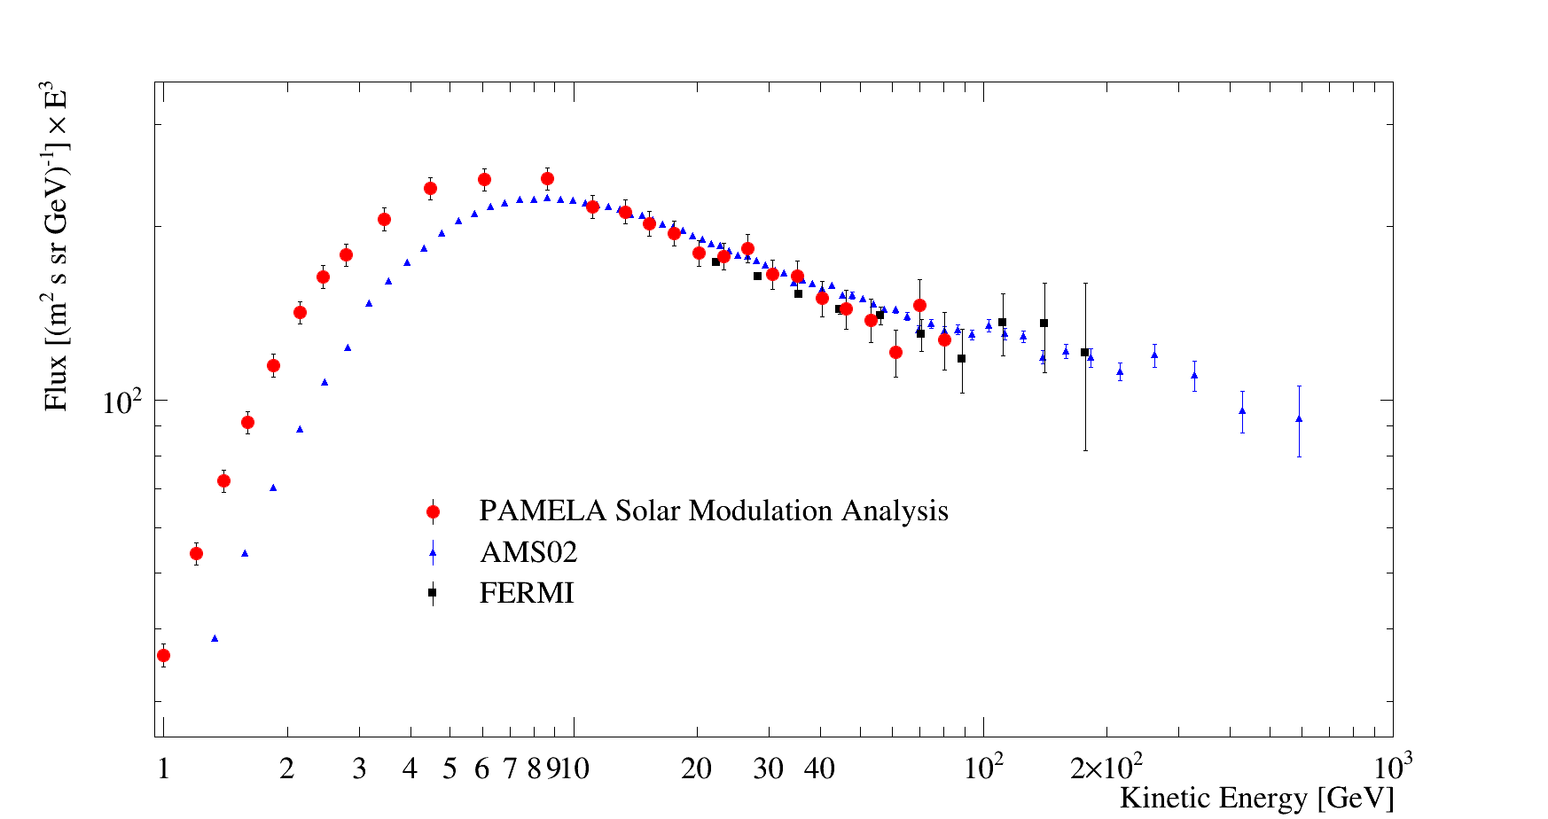
Electron spectrum
PAMELA data → Jul 2006 ÷ Dec 2009
AMS02 data → May 2011 ÷ Nov 2013
 solar modulation
Adriani et al. - ApJ- 810 (2015) 142

Slide 12
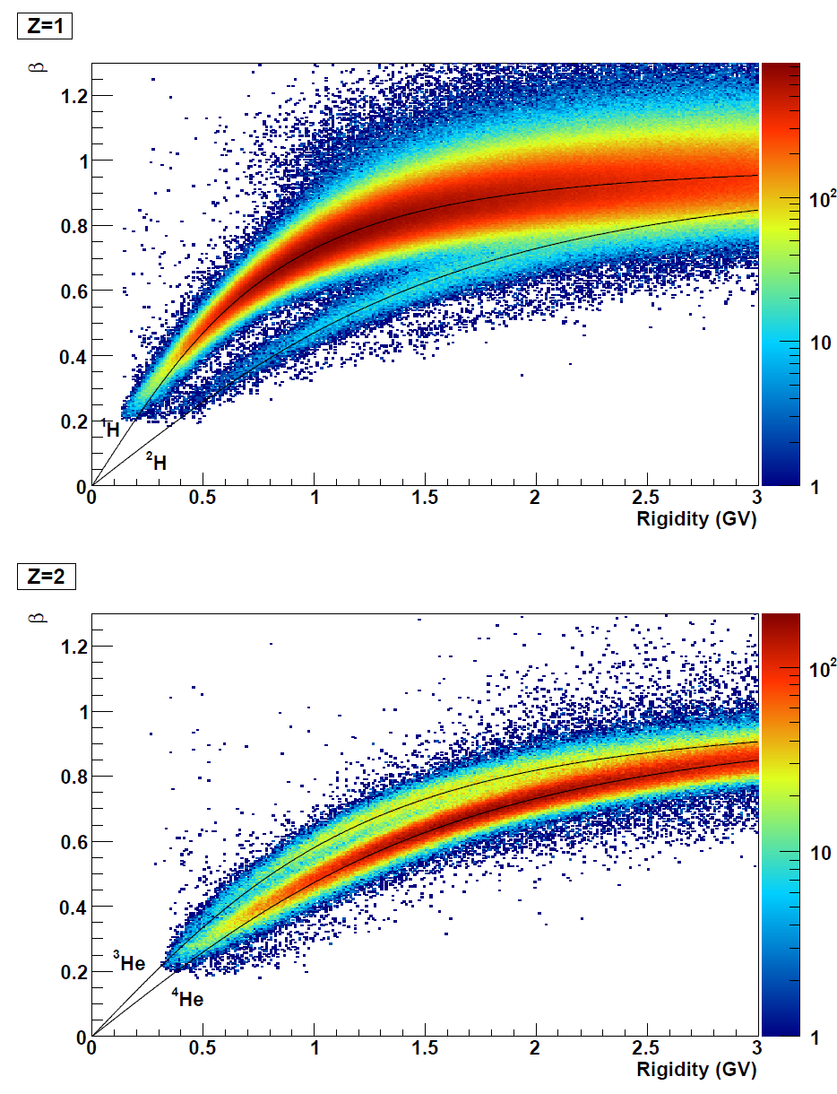
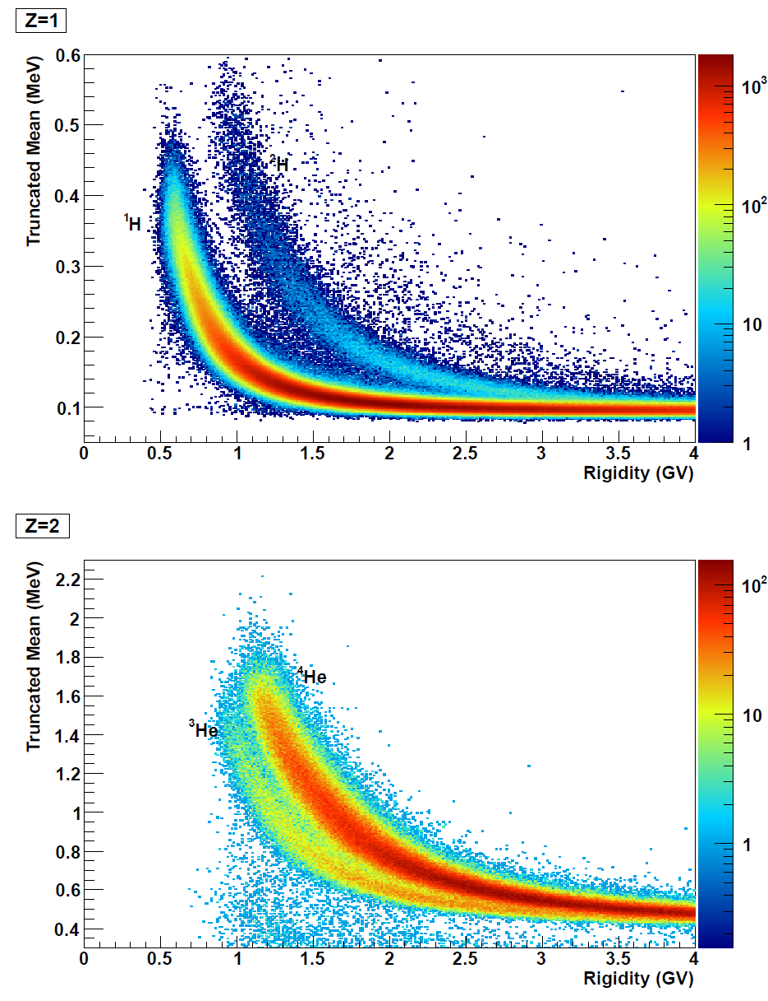
H and He isotopes
Multiple energy deposits from calorimeter
β from ToF
Reduntant identification cababilities

Slide 13
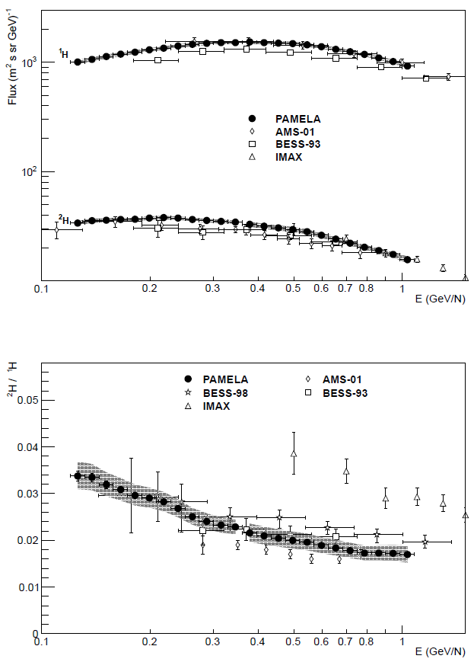
H isotopes
Adriani et al – ApJ 218 (2016)
¹H → primary
²H → secondary
90% from 4He+1H (40%@1 GeV/n)
Parameter constraint competitve/complementary to B/C measurement with current instrument precision
Probe different Z/A regime
Test «universality» of propagation
(Coste et al. 2012)

Slide 14
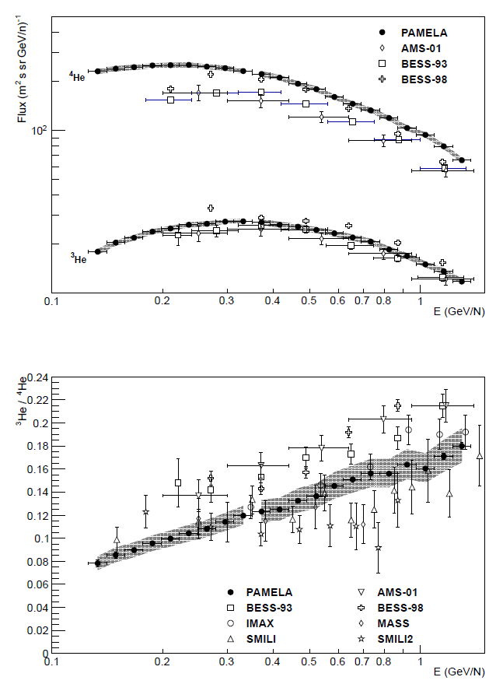
He isotopes
Adriani et al – ApJ 218 (2016)
⁴He → primary + secondary
∼10% @2 GeV/n from CNO
³He → secondary
95% from 4He
Parameter constraint competitve/complementary to B/C measurement with current instrument precision
Probe different Z/A regime
Test «universality» of propagation
(Coste et al. 2012)

Slide 15
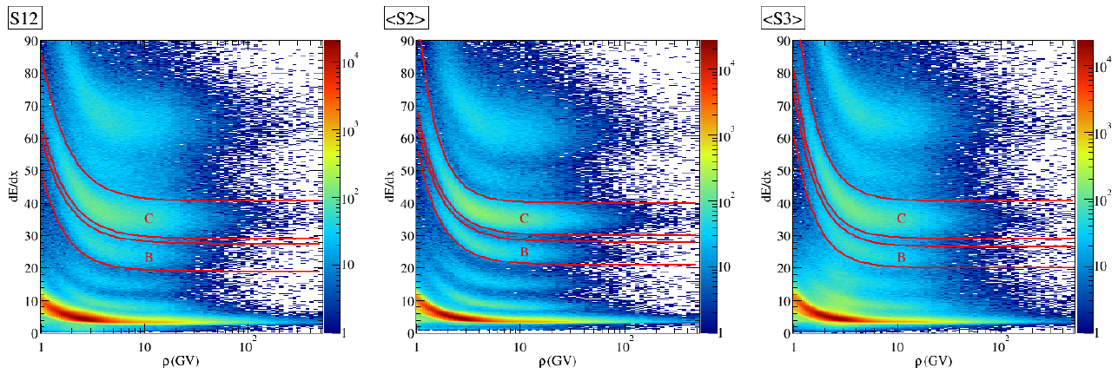
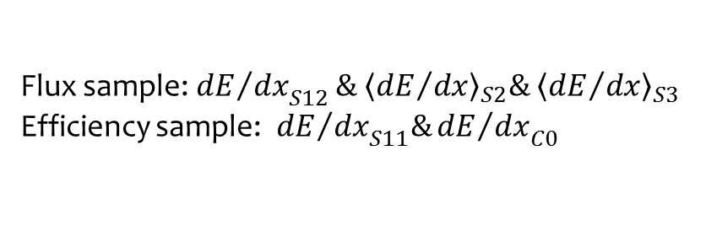
B&C → Z-selection
Flux sample:${{dE}/{dx}}_{S12}\& {\left\langle {dE}/{dx}\right\rangle }_{S2}\& {\left\langle {dE}/{dx}\right\rangle }_{S3}$
Efficiency sample:${ {dE}/{dx}}_{S11}\&{{dE}/{dx}}_{C0}$
The analysis can be extended to Oxygen
(some saturation issues to be addressed)
Adriani et al. ApJ 791 (2014)

Slide 16
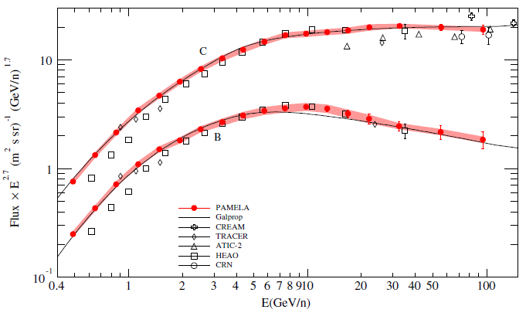
B and C absolute fluxes
Adriani et al. - ApJ- 791 (2014) 93
Reduced tracking performance, due to detector saturation:
σ_{x} = 14 μm, σ_{y} = 19 μm
MDR = 250 GV
GALPROP code tuned to PAMELA B&C data
Plain diffusion model (Vladimirov et al. 2012)
Solar modulation: spherical model ( φ=400MV )

Slide 17
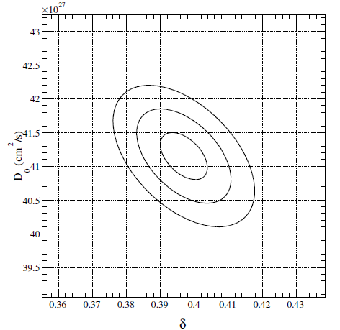
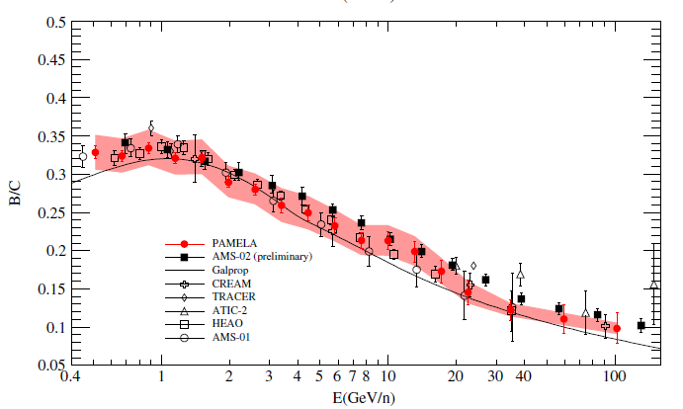
B/C ratio
B nuclei are of ∼pure secondary origin
C,N,O + ISM → B + …
→ B/C provides the strongest constraint to propagation parameters so far
PAMELA data consistent with previous measurements and with a standard scenario
Adriani et al. - ApJ- 791 (2014) 93
GALPROP code tuned to PAMELA B&C data
Plain diffusion model (Vladimirov et al. 2012)
Solar modulation: spherical model ( φ=400MV )

Slide 18
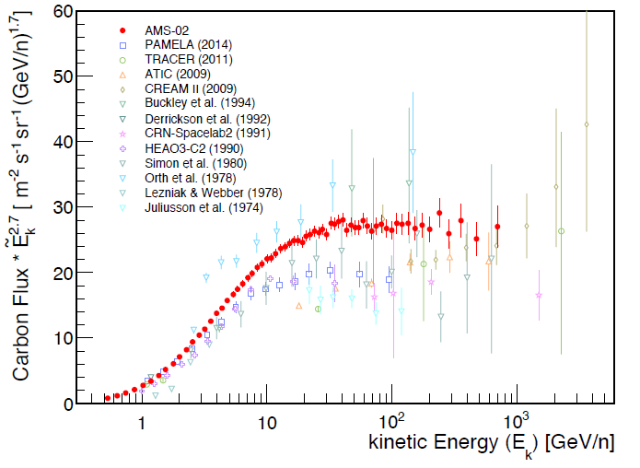
PAMELA vs AMS-02: Carbon flux
Heil @ AMS days (2015)
Notes:
Controllare talk AMS !!

Slide 19
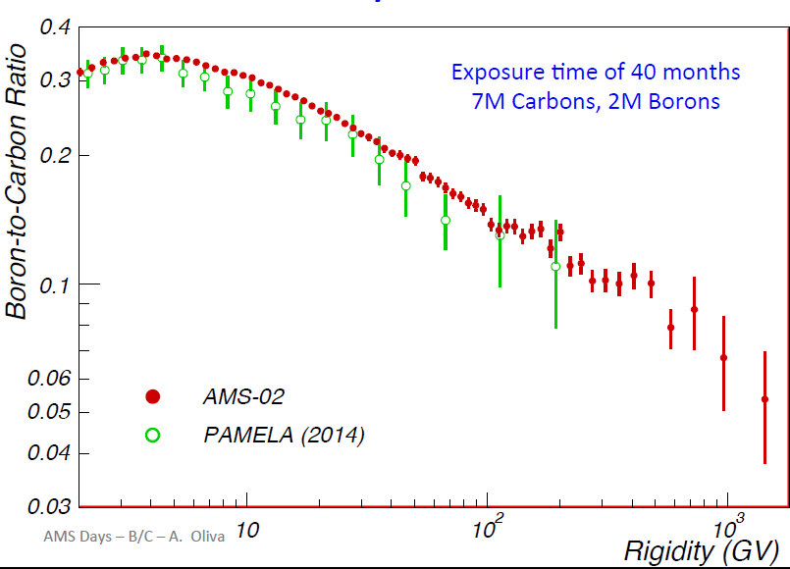
PAMELA vs AMS-02
Oliva @ AMS days (2015)

Slide 20
Work in progress : TO DO LIST !
H&He
  measure fluxes over the BESS-Polar and AMS-02 periods
Electrons
  extend new analysis at high energy
Primary nuclei
  extend C analysis to O
Secondary nuclei
  Finalize Li, Be flux analysis
  Finalize Li, Be isotope analysis (possibly resolving ¹⁰Be)

Slide 21
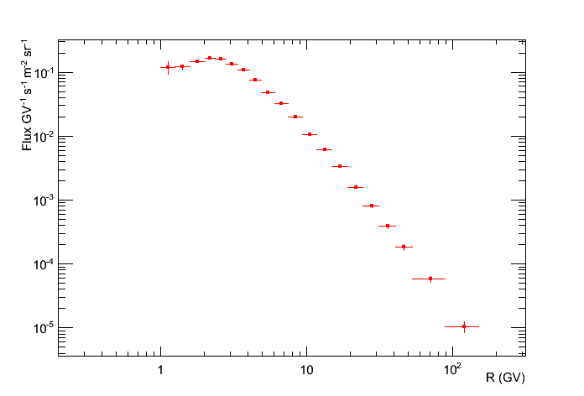
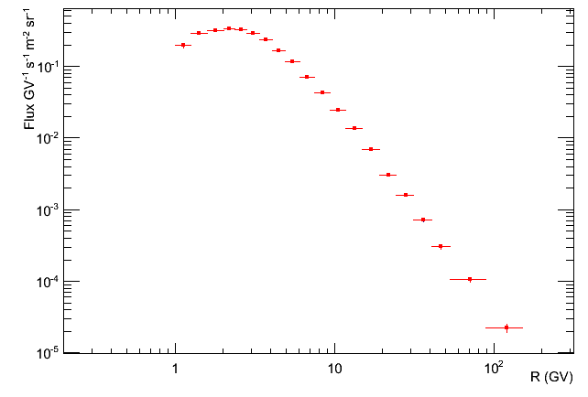
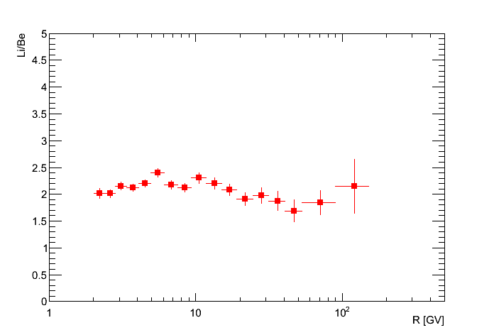
Li&Be
Beryllium
Preliminary
Lithium
A not-negligible fraction of Li and Be is of tertiary origin
Complementary constraint to propagation parameters
Full tracking performance for Li (no saturation at high-energy):
MDR up to 1.2TV
relevant MDR effects for Be, due to saturated clusters

Slide 22
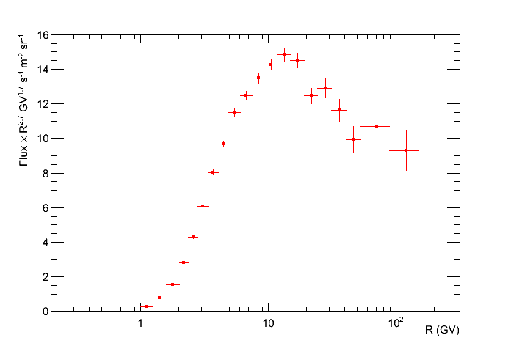
PAMELA Li flux
2006÷2009 data
No unfolding
No interaction corrections
Statistical error only
Preliminary

Slide 23
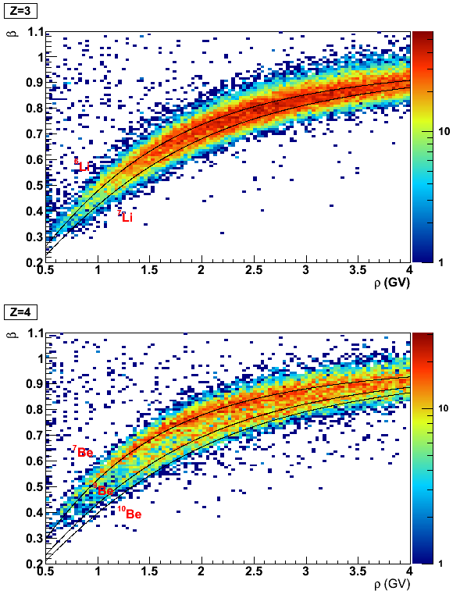
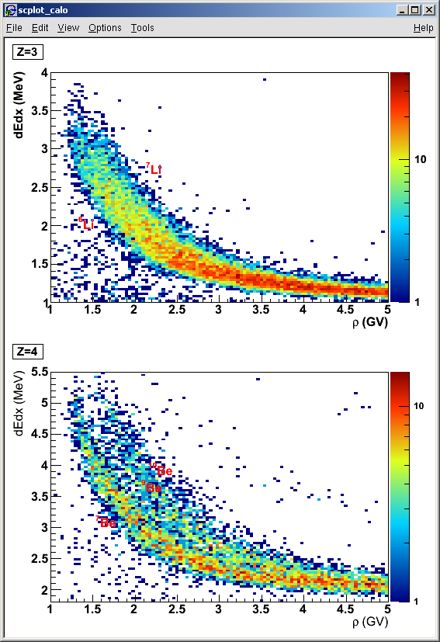
Li&Be isotopes
Multiple energy deposits from calorimeter
β from ToF
Menn et al. @ICRC2015
Preliminary
Reduntant identification cababilities

Slide 24
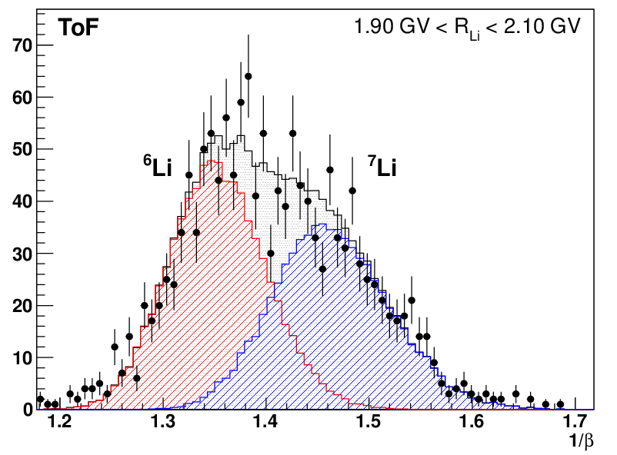
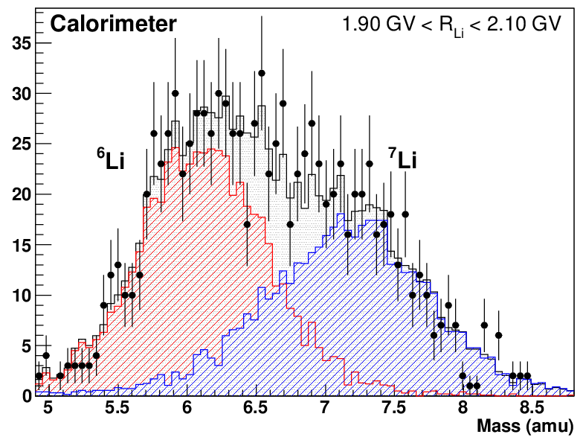
Li isotopes
Menn et al. @ICRC2015
Preliminary

Slide 25
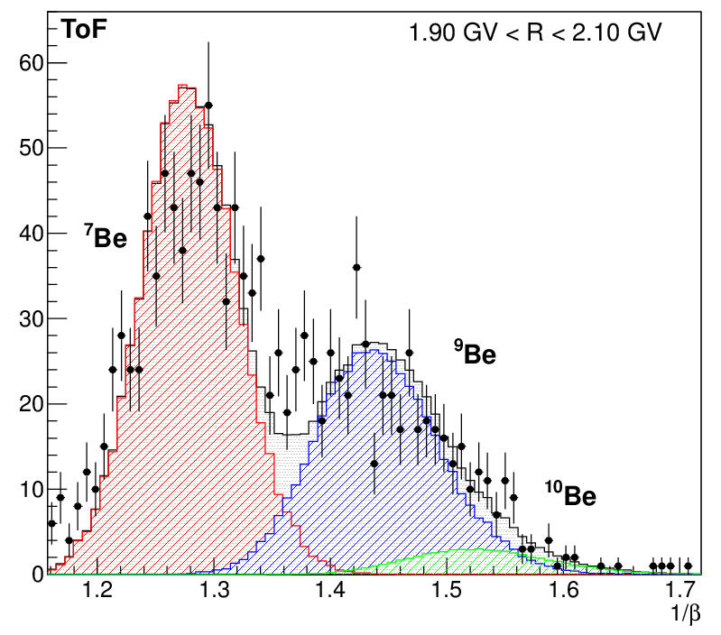
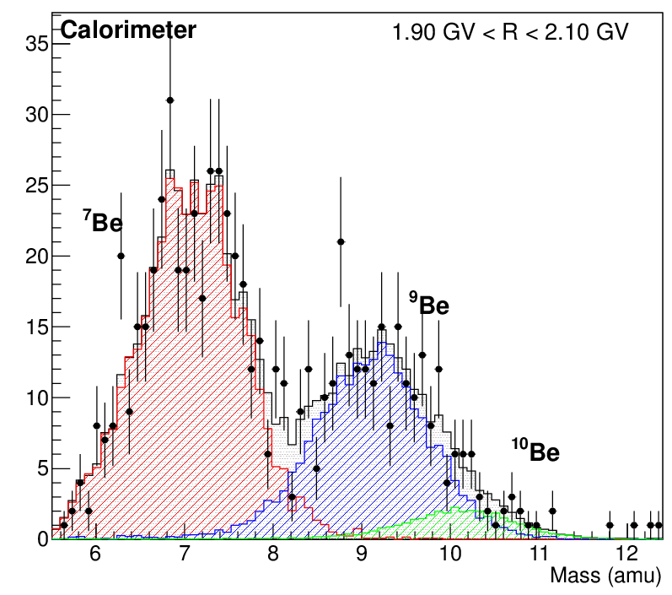
Be isotopes
Menn et al. @ICRC2015
Preliminary

Slide 26
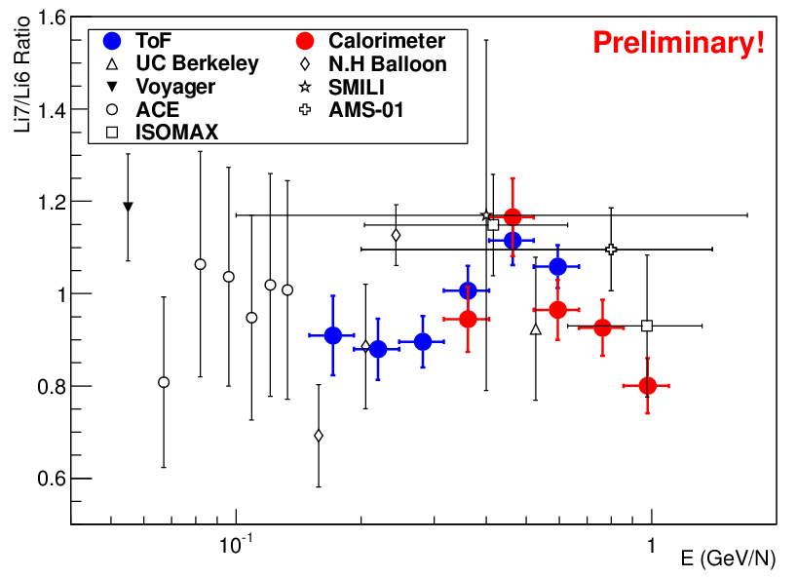
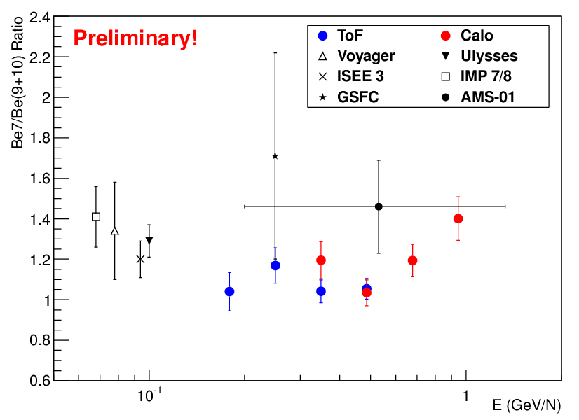
Li & Be isotopes
W. Menn et al. ICRC2015 CR08
Possibility to improve mass separation (and maybe to resolve Be10) with a different analysis technique in the calorimeter (fit of the slow-down curve instead of truncated mean of the deposits)

Slide 27

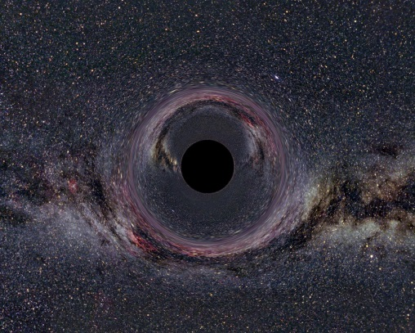
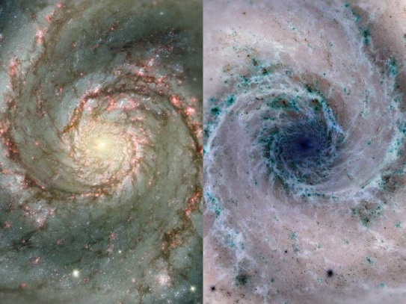

Antiparticles &co.
Positrons
Antiprotons
$\overline{He}$ & SQM
?
?
?

Slide 28
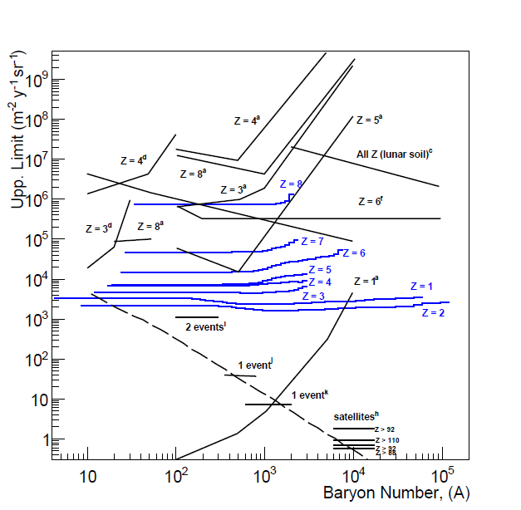
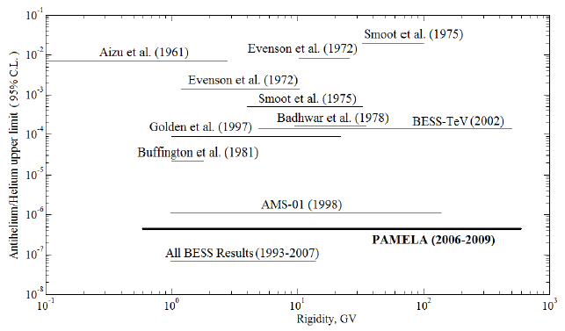


Search for $\overline{He}$ and SQM
O. Adriani et al., PRL 115 (2015) 111101
∼no astrophysical background
No $\overline{He}$ nuclei detected
No anomalous A/Z particle has been found (for Z <8 ) in the rigidity range 1-10³ GV

Slide 29
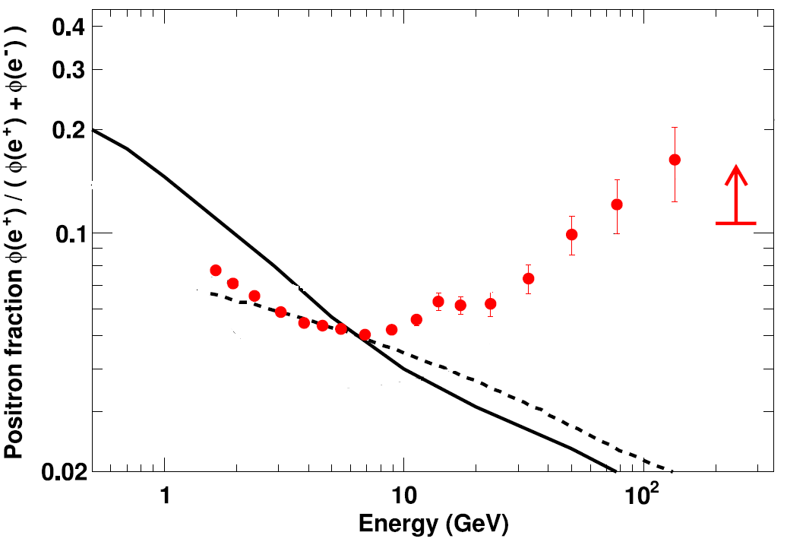
Positrons
Adriani et al.
-- Nature 458 (2009) 607;
-- Astropart. Phys. 34 (2010) 1
– PRL – 111 (2013) 081102
– PR 544 (2014) 323
First measurement extending up to 200 GV
Clear evidence for a deviation from pure secondary production
------ Moskalenko & Strong 1998 (GALPROP code)
- - - - Delahaye et al. 2010
Plain diffusion model
Solar modulation: spherical model ( φ=600MV )

Slide 30
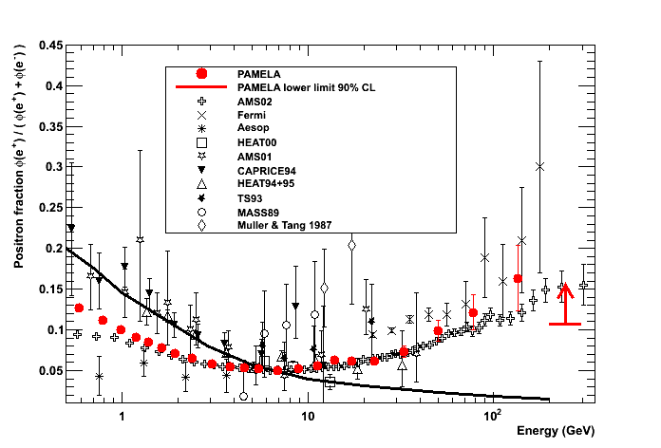
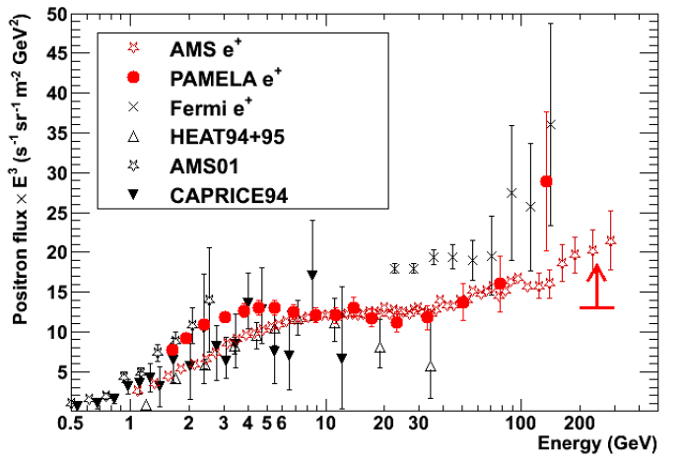
Positrons
Adriani et al.
-- Nature 458 (2009) 607;
-- Astropart. Phys. 34 (2010) 1
– PRL – 111 (2013) 081102
– PR 544 (2014) 323
First measurement extending up to 200 GV
Clear evidence for an hardening of positron spectra

positron excess

solar modulation
(charge-dependent)

Slide 31
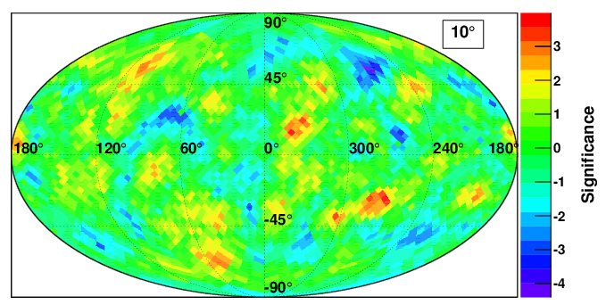
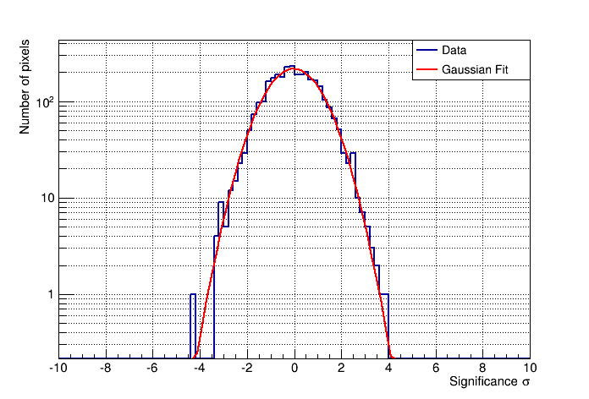
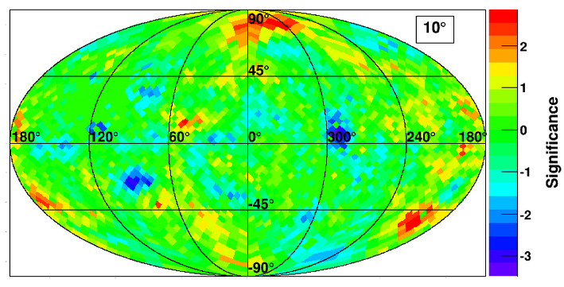
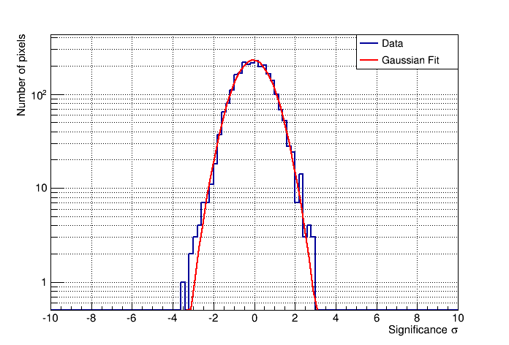
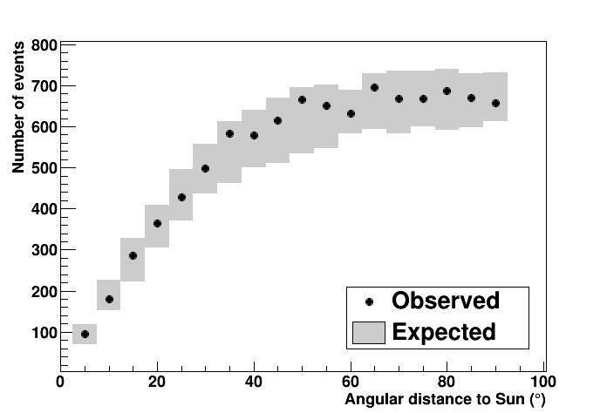
Anisotropy in e+/e- arrival directions
Positrons (bk: protons)
No evidence for e+/e- anisotropies
Electrons (bk: MC)
O. Adriani et al., ApJ 811 (2015) 21
Significance galactic maps for back-traced positrons and electrons > 10 GeV (angular scale 10°)
Distribution of angular-distance from the Sun

Slide 32
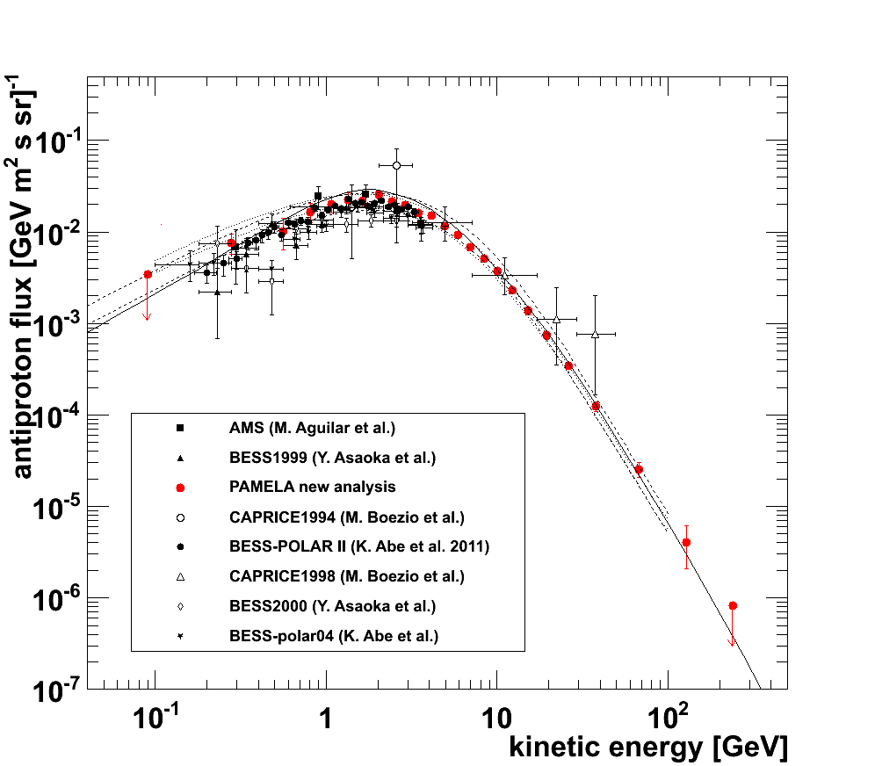
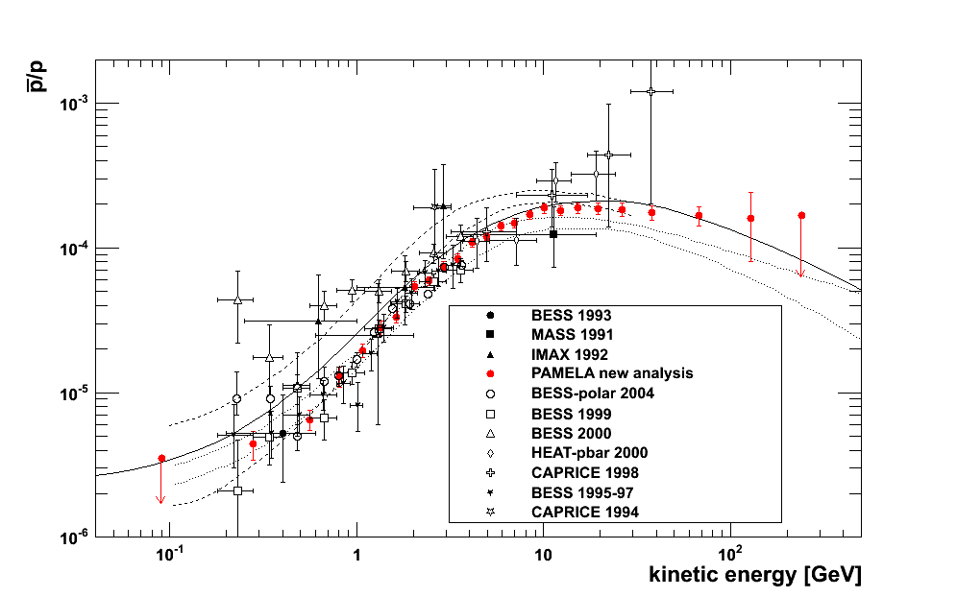
Antiprotons
Secondary-production calculations
CR(p) + ISM → p-bar + …
First measurement extending up to 200 GV
Overall agreement with pure secondary calculation
 solar modulation
(charge-dependent)
Adriani et al.
-- PRL 102 (2009) 051101
-- PRL 105 (2010) 121101
-- PR 544 (2014) 323

Slide 33
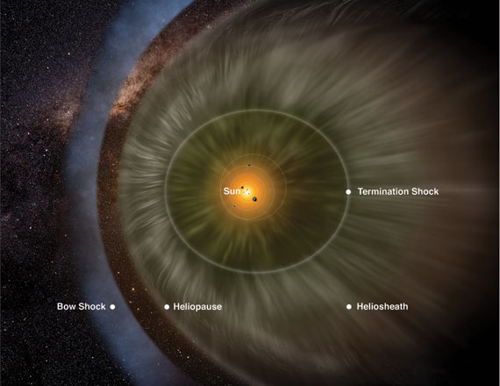
CRs in the heliosphere
Long-term CR-flux variation
Solar-particle events (SEPs)

Slide 34
Published results on Solar Physics
  Solar modulation
    Latitudinal and radial gradients (PAMELA and Ulysses) ASSTRA (2011)
    H variation jul-2006/dec-2009 ApJ 765 (2013)
    e- variation jul-2006/dec-2009 ApJ 810 (2015)
    Positron/electron charge ratio 2006/2015 PRL 116 (2016)
  SEP events
    SEP event 13 December 2006 ApJ 742 (2011)
    SEP event 17 May 2012 ApJL 801 (2015)

Slide 38

Solar cycles & CR modulation
∼ 22-year cycle
∼ 11-year cycle
Cycle 20
Cycle 21
Cycle 22
Cycle 23

Slide 39


The solar wind
Convection with solar-wind velocity V
Adiabatic energy changes ($∝∇∙V$ )

Slide 40



Heliospheric magnetic field (HMF)
A>0 magnetic-field reversal A<0
∼22-year cycle to return to the same polarity

Slide 41


Drift & diffusion
A>0
A<0
A<0
HP
HP
HP
Strauss et al. (2012)
HCS
HCS
HCS
Diffusion, driven by small-scale HMF irregularities
Drift caused by gradients and curvature in the global HMF
Strauss et al. (2012)

Slide 42

Drift path
GCR
↓
qA > 0
qA < 0
← GCR
Drift path changes at each field reversal → ∼22-year cycle
Asimmetry between particle of opposite charge →charge dependent solar modulation

Slide 43


PAMELA observations during 23° solar cycle
expected
recovery
A<0
PAMELA
Cycle 23
Neutron Monitor counts
Data from http://cosmicrays.oulu.fi/
Maximum inclination of HCS (N-S mean)
Computed HCS tilt angle
Data from http://wso.stanford.edu/

Slide 44


Long-term variation of GCR protons during 23° solar minimum
(Potgieter et al. 2014)
3D model
Parker eq: convection, drift, diffusion & adiabatic en.changes
Evolution of the proton energy spectra
from July 2006 to December 2009
→ Minimum solar activity
Adriani et al.
-- ApJ - 765 (2013) 91
Potgieter et al.
– Solar Phys. – 289 (2014) 391

Slide 45


Long-term variation of GCR electrons during 23° solar minimum
Potgieter et al. – ApJ – 810 (2015) 141
Adriani et al. -- ApJ -- 810(2015) 142
Evolution of the electron energy spectra
from July 2006 to December 2009
→ Minimum solar activity
Measured down to 80 MeV
3D model
Parker eq: convection, drift, diffusion & adiabatic en.changes

Slide 46

Particle-dependent solar modulation
Preliminary
Larger modulation effect for protons than electrons
Proton modulation consistent with that of positrons (preliminary)

Slide 47
PAMELA observations during 24° solar cycle
A<0
A>0
PAMELA
Cycle 23
Cycle 24
Neutron Monitor counts
Data from http://cosmicrays.oulu.fi/
Maximum inclination of HCS (N-S mean)
Computed HCS tilt angle
Data from http://wso.stanford.edu/

Slide 48


Long-term variation of GCR protons towards 24° solar maximum
Preliminary
Evolution of the proton energy spectra from 2006 to present
Modeling during solar maximum activity (not-stationary condition)

Slide 49

Evolution of the electron charge ratio: sign-dependent solar modulation
O. Adriani et al., PRL, 2016 Highlighted !!
-> Analysis from July 2006 to December 2015, covering the period from the minimum of solar cycle 23 (2006-2009) till the middle of the maximum of solar cycle 24.
→ polarity reversal of the heliospheric magnetic field took place between 2013 and 2014.
Results provide the first clear and continuous observation of how drift effects on solar modulation have unfolded with time from solar minimum to solar maximum and their dependence on the particle rigidity and the cyclic polarity of the solar magnetic field.

Slide 50



Solar energetic particles (SEPs)
Sun can accelerate particles up to relativistic energies
Magnetic reconnections
CME-driven shock
SEPs can be observed in the interplanetary space
Often associated to other solar phenomena, eg:
X and gamma-ray flares
Coronal-mass ejections (CMEs)
...
Magnetic field lines
SEP observation on Earth:
Propagation of SEPs along IMF lines
⇒ Earth must be magnetically connected
Anisotropic emission
⇒ flux observed on Earth depends on geomagnetic location

Slide 51
The acceleration of solar particles
The site/mechanisms of acceleration could be studied by analyzing the differential spectra of protons → fit with specific functions that describe different mechanisms
Try to disentangle from transport mechanisms
Events «well connected» (in which the Parker spiral connects directly the Sun with the Earth) are perfect because the transport effects are less important

Slide 52
The event of June 7 2011
Preliminary

Slide 53


Multi-particle measurements
Helium and protons flux evolution vs. time and helium enhancement studies are possible for events that present traces of He

Slide 54


SEPs observed by PAMELA
Preliminary
SEP-analysis issues:
Source identification & classification
    Association to flares, CMEs…
GLEs
  different class of events?
Spectra evolution
    Intensity, time profile , spectral signatures…
Composition
  p/He, ³He content…
Magnetospheric effects

Slide 55
Work in progress : TO DO LIST !
Solar modulation
  Time dependence of He, C, positrons over solar minimum 2006-2009
  All particle time evolutions during solar maximum 2010-2015
  Effects on fluxes on the inversion of Sun polarity (2013-2014)
Solar particle events SEP
  Fluxes and time profiles for all PAMELA detected SEPS
  Detailed analysis of the Forbush decrease
  Analysis of SEP events seen by other detectors (AMS?) and Neutron Monitors on Ground.

Slide 56

CRs in the magnetosphere
Trapped and re-entrand albedo particles

Slide 57
Published results on CRs in the magnetosphere
Quasi-trapped electrons and positrons JGR(2009)
Trapped antiproton fluxes ApJL (2011)
Trapped proton fluxes ApJ (2015)
Reentrant albedo proton fluxes JGR(2015)
Geomagnetic cutoff variations accepted by Space Weather

Slide 58





The PAMELA orbital environment
Particle count rate (S11*S12)
PAMELA provides unique capability to investigate particle populations in the Magnetosphere, enhancing the description of trapped, re-entrant albedo particles in different regions, including the penumbral ones.
Comparison with radiation models, like AP9/AE9 and SPENVIS is foreseen to benchmark these models at higher energies.
Fundamental for instrumentation in space and safety of astronauts
Latitude
Altitude
Altitude
SAA
(South-Atlantic Anomaly)
Longitude

Slide 59
PAMELA trajectory reconstruction
PAMELA data:
spacecraft position & orientation
particle rigidity and direction
(provided by the tracking system)
IMF, SW and geomagnetic parameters:
high-resolution (5-min) OMNIWeb data
NASA/Goddard Space Flight Center
NB: the magnetospheric configuration is updated event by event, intepolating involved parameters
TRAJECTORY TRACING CODE
Runge-Kutta integration
of motion equations
Based on Smart & Shea (2000, 2005)
Realistic description of
the geomagnetic field:
  internal sources: IGRF11
  external sources: TS05/TS07D
Trajectories propagated back and forth from the measurement location with no limit on tracing time/path
Interplanetary (SCR+GCR)
(back-traced) trajectories escape
the model magnetosphere
Albedo
(back-traced) trajectories intersect
the atmosphere (40km)
Geomagnetically trapped
trajectories perform more than ∼10⁶/R² steps
for both propagation directions (≥4 drift cycles)
NB: step-length ∼1% of particle gyro-distance in the magnetic field

Slide 60


Positrons & electrons
stably-trapped
stably-trapped
albedo
albedo
galactic
galactic

Slide 61


Trapped antiprotons
First observation of geomagnetically trapped p-bar
Produced by CR interaction with atmosfere and trapped by the magnetosphere
Most abundant p-bar source near the Earth!
Adriani et al. - ApJ Lett. - 737 (2011) L29

Slide 62


Trapped protons
Observation of trapped radiation performed down to L_{shell}∼1.1R_{E} and up to 4 GeV
Comparison with empirical model
Improvement in low-altitude radiation-environment description
Adriani et al. - Apj Lett. – 799,(2015) L4

Slide 63


Re-entrant albedo protons
Caracterization of high-energy albedo population
Adriani et al. - JgR (2015)
SAA region
(SAA excluded)
quasi-trapped
precipitating
pseudo-trapped
galactic

Slide 64


Geomagnetic cutoff variations during SEPs
Geomagnetic cutoff latitude measured during Dec 13°-14° 2006 SEP event
Measurement of cutoff latitude during SEPs (def: 50% of polar flux)
Cross-check with back-tracing techniques
Large SEPs (CMEs) can induce geomagnetic storms that can increase potential radiation exposure
Adriani et al. - Space Weather
AACGM → Altitude Adjusted Corrected Geomagnetic
Notes:
for each rigidity bin, a mean flux was obtained by averaging fluxes
above 65 degrees latitude,
and the cutoff latitude was evaluated as the latitude where the flux intensity
is equal to the half of the average value.

Slide 65
Work in progress : TO DO LIST !
Particles in the magnetosphere
  Trapped and albedo protons over solar maximum
  Trapped and albedo positrons and electrons
Variation of the geomagnetic field
  Measure the variations during PAMELA SEPs
Collaboration with new NASA AP-9
  Confrontation between PAMELA data and NASA radiation models.

Slide 66
Conclusions
The PAMELA data have marked a breakthrough in the cosmic ray physics. With PAMELA, a new era of precision study of cosmic rays in space has started.
Indeed, before PAMELA:
Standard paradigm
  GCRs originates from uniformly distributed SNRs via shock-driven 2°-order Fermi acceleration (single power-law spectra)
  Antiparticles are produced by nuclear interactions with uniformly distributed matter within the Galaxy
  Absolute fluxes of GCRs altered while penetrating the heliosphere, modulation described by spherical potential.

Slide 67
Conclusions
After PAMELA
Measurement of GCR particles and antiparticles over a wide energy range:
  Spectral hardening of H and He at about 200GV and different slope for H and He indicate a more complex scenario of nuclear GCR origin and/or propagation
  Evidence of a positron excess above 10 GeV indicates new phenomena (dark matter? astrophysical e+- sources?)
  p-bar consistent with secondary production hypothesis up to 200 GeV puts further constraints to possible sources
  Precise measurements of light particle spectra provides improvement to propagation models
Measurement of long- and short- time variation of low-energy particles:
  Evidence of charge-dependent solar modulation
  Study of solar phenomena, bridging the information provided by low-energy in-situ observations and high-energy surface observations
Measurement of trapped and quasi-trapped particles:
  Significant improvements in magnetosphere modeling (radiation-environment)
Mode data still to be analyzed !
Years of physics ahead, in energy windows not reachable by
current experiments

Slide 68

10 years of PAMELA!
15 June 2016 - Villa Mondragone

