Slide 1
Beam polarimetry at the SPASCHARM experiment at IHEP U-70 accelerator.
A.A. Bogdanov ^{1 †}, M.A. Chetvertkov ², V.A. Chetvertkova ², B.I.Garkusha³, A.P. Meshchanin³ ,
V.V. Mochalov ³, M.B. Nurusheva ¹²³, S.B. Nurushev ¹³, A.V. Ridiger ²,V.L.Rykov¹ ,
P.A. Semenov ³ ,M.N. Strikhanov¹, A.N. Vasiliev ³, V.N. Zapolsky³
(1) National Research Nuclear University MEPhI, Moscow, Russia
(2) Federal state budget organization State center Interphysica, Ministry of education and science, Moscow, Russia
(3) State Research Center of Russian Federation -Institute for High Energy Physics, Protvino, Russia
† E-mail: bogdanov411@mail.ru

Slide 2
Contents
1. Task
2. Polarimeters for measuring proton polarization.
  2.1Diffraction polarimeter.
  2.2Interfirience polarimeter.
  2.3Combined polarimeter.
3. Polarimeters for measuring antiproton polarization.
  3.1 Elastic ppbar scattering
  3.2 Inclusive π⁰, π±
4. Conclusion

Slide 3
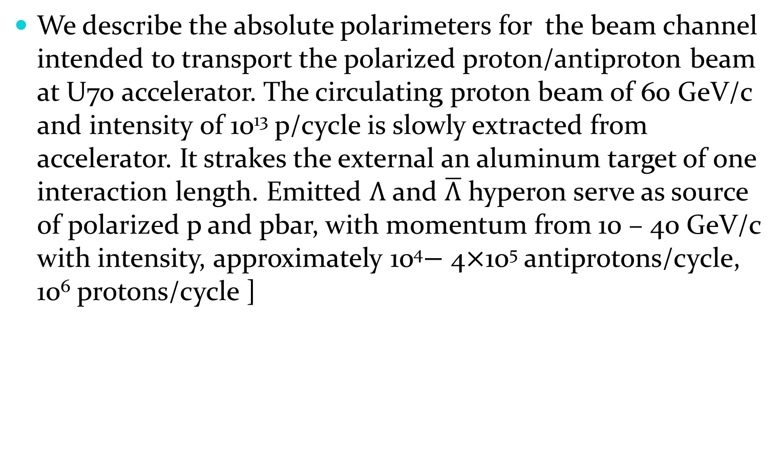
1. TASK
We describe the absolute polarimeters for the beam channel intended to transport the polarized proton/antiproton beam at U70 accelerator. The circulating proton beam of 60 GeV/c and intensity of 10¹³ p/cycle is slowly extracted from accelerator. It strakes the external an aluminum target of one interaction length. Emitted $Λ$ and $\overline{Λ}$ hyperon serve as source of polarized p and pbar, with momentum from 10 – 40 GeV/c with intensity, approximately 10⁴$−$ 4$×$10⁵ antiprotons/cycle, 10⁶ protons/cycle ]

Slide 4
2. Polarimeters for measuring proton polarization.
1. Polarimeter based on pp elastic scattering
0.04 ≤ |t| ≤0,5 (GeV/с)². Diffraction cone.
2. Polarimeter based on pp elastic scattering in CNI region.
0.002 ≤ |t| ≤0,05 (GeV/с)².
3. Combined polarimeter.
0.002 ≤ |t| ≤0,5 (GeV/с)².

Slide 5
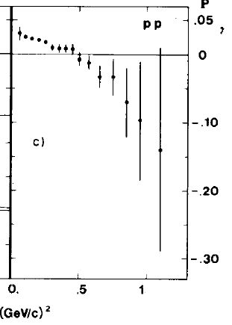
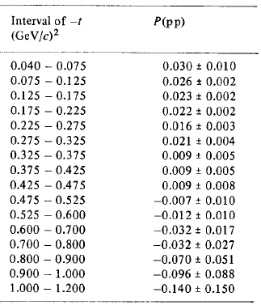
Diffraction polarimeter
Polarization has been measured at U70 for pp elastic scattering at 45 GeV/c. A. Gaido et al., Phys. Lett. 61B (1976)104
J.C. Raquel te al., Nucl. Instr. And Methods 125 (1975) 585
Fig. 2. Experimental data at 45 GeV/c.
Table 2. Experimental data at 45 GeV/c

Slide 6
Table 3. Kinematics parameters of diffraction polarimeter
t (Gev/c)2 | η=signal/(signal+background) | γ=signal/signal_{max} | M=P²*(dσ/dt),µb/(GeV/c)² | Θ scattering, grad | Θ recoil , grad | T, МэВ
(0.04 – 0.075) | 0,993802 | 1 | 38,7 | 0.285-0.395 | 81.5-84 | (21-40)
(0.075 – 0.125) | 0,984301 | 0,912958 | 18,9 | 0.39-0.51 | 79.07-81.5 | (40 – 67)
(0.125 – 0.175) | 0,977868 | 0,535022 | 7,7604 | 0.51-0.60 | 77.13-79.08 | (67-93)
(0.175 – 0.225) | 0,967702 | 0,31275 | 5,2887 | 0.60-0.69 | 75.47-77.13 | (93-120)
(0.225 – 0.275) | 0,959285 | 0,184704 | 1,5654 | 0.69-0.76 | 74.01-75.47 | (120-147)
(0.275 – 0.325) | 0,944408 | 0,107838 | 1,7861 | 0.76-0.82 | 72.69-74.01 | (120-173)
(0.325 – 0.375) | 0,923676 | 0,063056 | 0,2088 | 0.82-0.88 | 71.49-72.69 | (173-199)
(0.375 – 0.425) | 0,883977 | 0,0355 | 0,1071 | 0.88-0.94 | 70.38-71.49 | (199-226)
(0.425 – 0.475) | 0,861419 | 0,022025 | 0,0738 | 0.94-0.99 | 69.33-70.37 | (226-253)
(0.475 – 0.525) | 0,813561 | 0,012648 | 0,0303 | 0.99-1.05 | 68.37-69.33 | (253-280)

Slide 7

Rate and time for 10% accuracy
L=νI N_{a}ρx= 0,7•10²⁹ сm⁻²s⁻¹
ν =0,07- number of cycles per second.
I=10⁶p/cycle - beam intensity in cycle,
ρ=0,07 g/сm³ – target density,
x=20 cm – target length.
p/hour
t₀= 0,22 (GeV/с)²
dσ/dt(t₀ 0,22) = (8,326±0,073) mb/(GeV/c)²
Δt=0,03(GeV/с)², Δϕ/ϕ=0,17

Slide 8

Rate and time for 14% accuracy
P_{B} = ε/ A_{N}.
[σ( P_{B})/ P_{B}]² = [σ(ε)/ε]² + [σ(A_{N})/A_{N}]²
σ(ε)/ε =σ(A_{N})/A_{N}
A_{N}=(2,2±0,2)%.
Δε=0,1•ε=0,1P_{B} A_{N}
P_{B} =0,4, A_{N} = 0,022
Δε=0,88•10⁻³
N=1/(Δε)² = 1.29•10⁶
events
Accuracy in beam polarization 14%

Slide 9
Interference polarimeter
Polarization at 45 GeV/c (√s=9.3 GeV) was not measured in CNI region. We use data from STAR experiment at RHIC BNL at √s=6,8, 7,7, 13,7, 21,7 GeV.
Fig. 6. Experimental data of analyzing power in CNI region measured at RHIC.

Slide 10




Analyzing power can be expressed in following way
To calculate analyzing power at sqrt(s)=9.3 GeV we have to calculate Rer5 and Imr5. We use power law to fit data of STAR experiment.
p₀, p₁ - fit parameters, s₀=1 GeV²

Slide 11
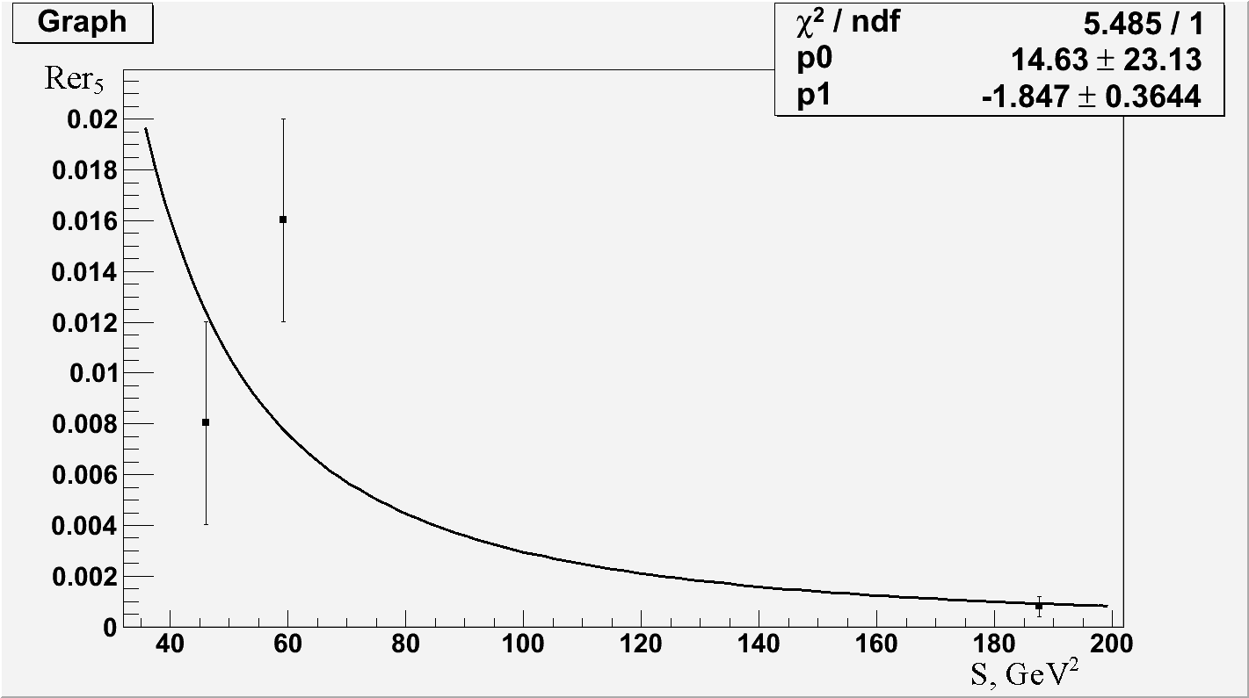
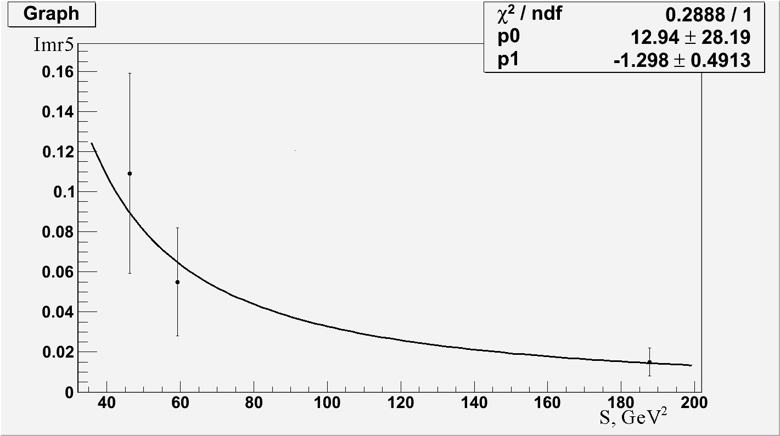
Fit results
Fig. 7a.
Fig. 7b.
Fig. 7 Fit of Rer5 (Fig. 7a) and Imr5(Fig. 7b)
 | 6.8 | 7.7 | 13.7 | 21.7 | 9.3 (6.8,7.7, 13.7)
Rer5 | -0.008 | -0.055 | -0.0008 | -0.002 | 0.004±0.006
Imr5 | -0.109 | -0.016 | -0.015 | -0.005 | 0.04±0.09

Slide 12
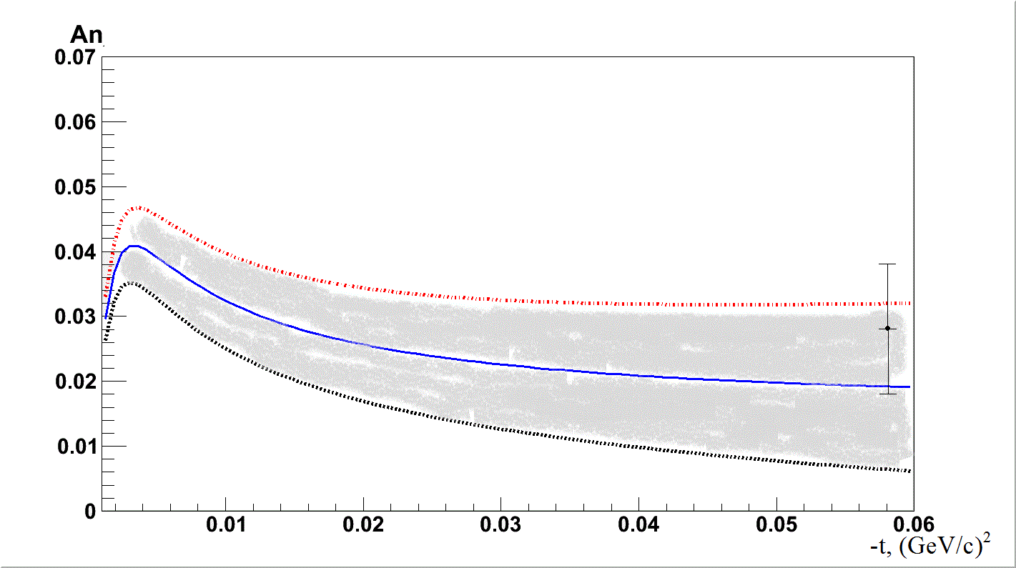
Analyzing power in CNI region at √s=9.3 GeV
Fig. 8. Analyzing power in CNI region at √s=9.3 GeV

Slide 13

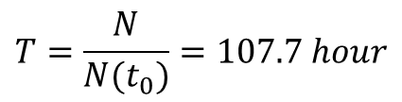
Rate and time for 10% accuracy
Can be calculated in same way as for diffraction polarimeter
0.65 10^4 p/hour
L=νI N_{a}ρx= 0,7•10²⁹ сm⁻²s⁻¹
t₀= 0,0134 (GeV/с)²
dσ/dt(t₀ 0,0134) = (67,4±0,073) mb/(GeV/c)²
Δt=0,0023(GeV/с)², Δϕ/ϕ=0,17
A_{N}=(0,03±0,01)%.
Δε=0,1•ε=0,1P_{B} A_{N}
P_{B} =0,4, A_{N} = 0,03
Δε=1,2•10⁻³
N=1/(Δε)² = 0.7•10⁶
$$T=\frac{N}{N(t_{0})}=107.7 hour$$

Slide 14
Combined polarimeter
Fig. 9. Combined polarimeter on channel 24A. Diffraction part.

Slide 15
Combined polarimeter interference part
Fig. 10. Combined polarimeter on channel 24A. Interference part.

Slide 16
3. Polarimeters for measuring antiproton polarization.
1. Since there are no experimental data on the analyzing power in the process of elastic p pbar scattering in the region of interest (10 – 20 GeV/c), we have to measure this directly using a polarized proton target [ PM-"PROSE"]. However, we need to have a reference point in the area of t, were we expect a non-zero value of the analyzing power.
2. We are known for two works, in which analyzing power has been measured in elastic ppbar scattering:
1 F. Bradomante, LEAR , which contains measurements in the field of small initial momentum of 0.1 – 2 GeV/C;
2 A.Gaidot et.al., Phys. Lett., 57B, p. 389, 1975. These data were obtained at 40-GeV/C. Similar measurements of the analyzing power were carried out for elastic pp scattering at 45 GeV/C. Fig.1 and Table 1.

Slide 17
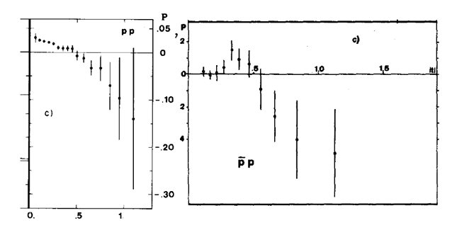
Fig. 1
Polarization as a function of t for a) elastic proton proton scattering at 45 GeV/c and b) elastic antiproton proton scattering at 40 GeV/c
A comparison between these two results show that both the analyzing power have the same sign and approximately equal in magnitude (within measurement errors).

Slide 18
3. Since we are interested in the area of momentum 10 – 20 GeV/C , we use data on А_{N} elastic pp scattering in the following work M. Corcoran et al., Phys. Rev. D 22,2624 (1980), at momentum р = 20∓6 ГэВ/с, -t = 0,3 (ГэВ/с)² , А_{N} =( 5,8∓1,5) % , for elastic pp scattering. We expect the same in magnitude of А_{N} , as for elastic ppbar scattering at momentum 16 GeV/C .
4. At the same time there is the region of t , where we can expect a non-zero analyzing power. We construct our polarimeter to scan this area with the required accuracy of А_{N.} This area was defined as 0.1 – 0.5 5 (GeV/с)².

Slide 19
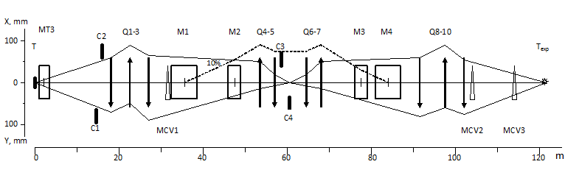
Polarized beam of anti-protons, obtained from anti-lambda consist from three parts: unpolarized Central part (|P_B |<0.3) and polarized peripheral parts of different sign (|P_B |>0,3).
A special system of three steering magnets MCV1 - MCV3 allows to select any of these parts of the beam and directed it at the target of polarimeter or the experimental setup
Fig. 2 Optical scheme of channel 24 A.

Slide 20
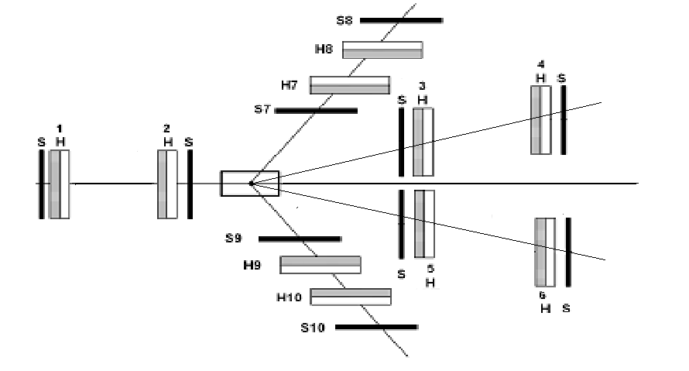
For registration scattered anti protons and recoiled protons scintillation hodoscopes are used .
Fig .3. Schema of the absolute polarimeter for polarized antiproton beam with momentum p = 16 GeV/c. S1-S10 – scintillation counters for flux measurement, H1,H2 – beam hodoscopes for measurement of the polarized antiproton beam parameters, H3-H6 – for measurement the forward scattered antiprotons, H7-H10 - hodoscopes for measurement the recoil protons.

Slide 21
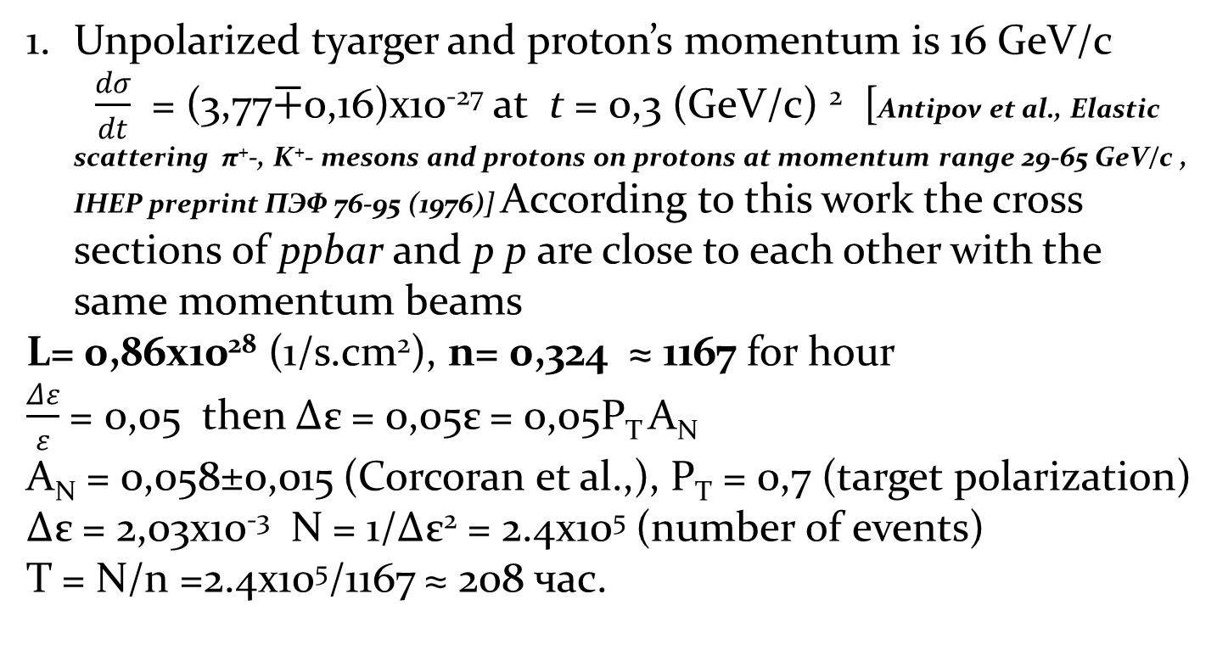

To determine the necessary data taking time we need define error of the raw asymmetry. Consider separately three cases :
ikk

Slide 22
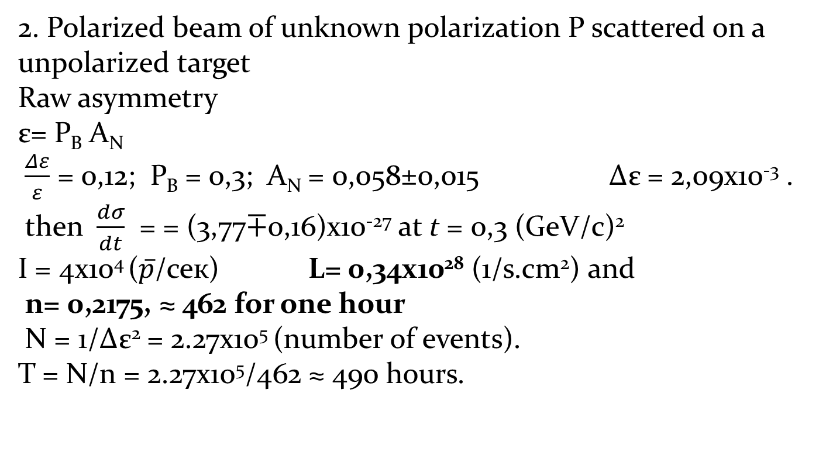
2. Polarized beam of unknown polarization P scattered on a unpolarized target
Raw asymmetry
ε= P_{B} A_{N}
$\frac{Δε}{ε}$ = 0,12; P_{B} = 0,3; A_{N} = 0,058±0,015 Δε = 2,09х10⁻³ .
then $\frac{dσ}{dt}$ = = (3,77∓0,16)х10⁻²⁷ at t = 0,3 (GeV/c)²
I = 4х10⁴ ($\overline{p}$/сек) L= 0,34х10²⁸ (1/s.сm²) and
n= 0,2175, ≈ 462 for one hour
N = 1/Δε² = 2.27х10⁵ (number of events).
Т = N/n = 2.27х10⁵/462 ≈ 490 hours.

Slide 23
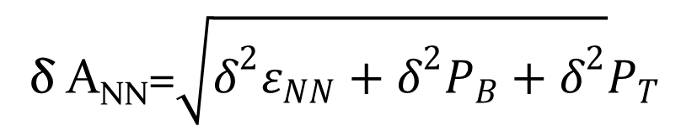
3. We work with polarized beam and polarized target. If we assume that the polarization of the target and beam is known, we can measure spin correlation coefficient A_{NN}. Number of scattered on polarized target particles in the reaction of the elastic ppbar scattering is defined as follows:
N^{bt}(θ) = N⁰⁰(θ)[1+($\vec{P_{b}}$+$\vec{P_{t}}$) $·\vec{n}$ A_{N} +$(\vec{P_{b}}·\vec{n}) (\vec{P_{t}}·\vec{n})$ A_{NN}]
Raw asymmetry can be determined in following way
ε_{NN} = (N⁺⁺+N⁻⁻) - (N⁺⁻+N⁻⁺)/ (N⁺⁺+N⁻⁻) + (N⁺⁻+N⁻⁺)
the result is
ε_{NN} = P_{B} P_{T} A_{NN}
δ A_{NN}=$\sqrt{δ^{2}ε_{NN}+δ^{2}P_{B}+δ^{2}}P_{T}$
Statistical error
At δε_{NN} = δ P_{B}=10%, δP_{T} = 5% , expected precision A_{NN} is δ A_{NN}=15%.
P_{B} = 0,3, P_{T}= 0,7, A_{NN}=0,06, measured in elastic pp scattering at
t=0.27 (GeV/c)² and momentum 6 GeV/c.
(I.P.Auer, et. All, Rhys. Pev/ D, vol. 32 №7, (1985),1611)
We assume that spin correlation coefficient is the same
as in pp elastic scattering.

Slide 24
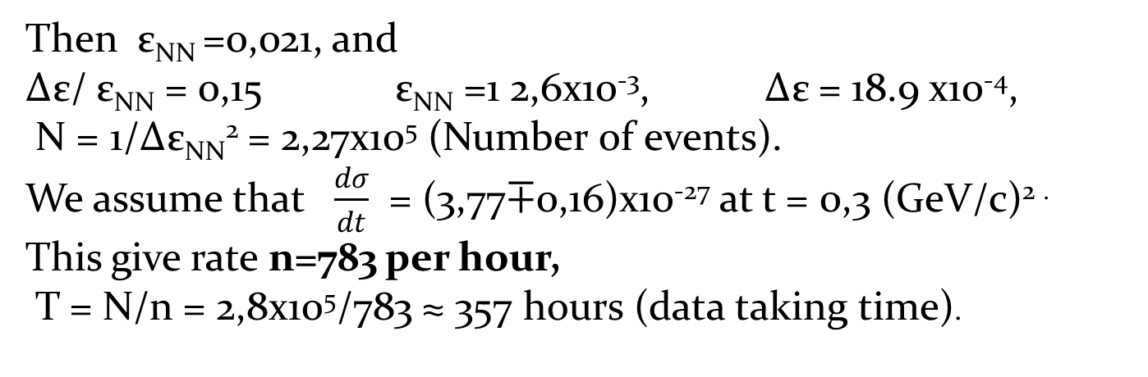
Then ε_{NN} =0,021, and
Δε/ ε_{NN} = 0,15 ε_{NN} =1 2,6х10⁻³, Δε = 18.9 х10⁻⁴,
N = 1/Δε_{NN}² = 2,27х10⁵ (Number of events).
We assume that $\frac{dσ}{dt}$ = (3,77∓0,16)х10⁻²⁷ at t = 0,3 (GeV/c)^{2 .}
This give rate n=783 per hour,
Т = N/n = 2,8х10⁵/783 ≈ 357 hours (data taking time).
For all three situation data taking time can be reduced, if we consider the statistics over all interval t, assuming that the analyzing power is constant in this region.

Slide 25
It is extremely important to conduct similar measurements on a polarized proton beam with the same momentum. Since the intensity of a polarized proton beam is expected to 10 times higher than polarized anti-proton beam, such measurements can be made in 3 times faster.
Comparison of these results is very important for the following reasons: 1) because of the similarity parameters of polarized p and pbar beams can conduct a quick pre-adjusting of the channel settings, experimental apparatus and the calibration of the tagging system of the beam on a polarized proton beam; 2) for the first time we will be able to compare the analyzing power and spin correlations in elastic scattering pp and ppbar.

Slide 26
Survey of reaction for measuring antiproton polarization.

Slide 27
Interference polarimeter
Polarization at 45 GeV/c (√s=9.3 GeV) was not measured in CNI region. We use data from STAR experiment at RHIC BNL at √s=6,8, 7,7, 13,7, 21,7 GeV.
Fig. 6. Experimental data of analyzing power in CNI region measured at RHIC.

Slide 28
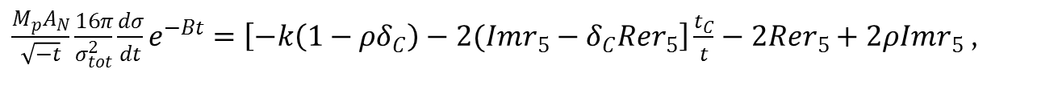
Analyzing power can be expressed in following way
$\frac{M_{p}A_{N}}{\sqrt{−t}}\frac{16π}{σ_{tot}^{2}}\frac{dσ}{dt}e^{−Bt}=\left[−k\left(1−ρδ_{C}\right)−2(Imr_{5}−δ_{C}Rer_{5}\right]\frac{t_{C}}{t}−2Rer_{5}+2ρImr_{5}$,
To calculate analyzing power at sqrt(s)=5.642 GeV we have to calculate Rer5 and Imr5. We use power law to fit data of STAR experiment.
p₀, p₁ - fit parameters, s₀=1 GeV²

Slide 29
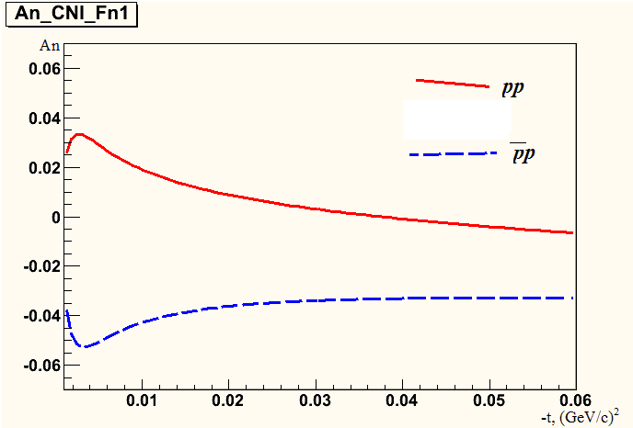
Table 4. Fit results
√s, ГэВ | 5.642
Rer5 | 0.024±0.004
Imr5 | 0.144±0.027
Fig. 7. Analyzing power in CNI region at √s=5.642 GeV

Slide 30
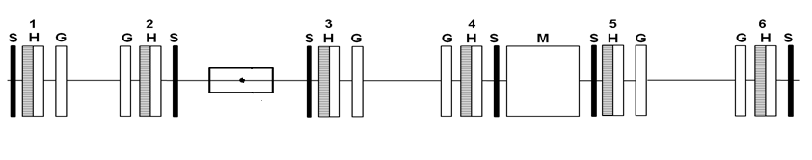
Interference polarimeter
Fig. 8. Antiproton interfernterference polarimeter.
Interference polarimeter is expected to create on the basis of GEM detectors. GEM provides a number of advantages: a small amount of the substance in the path of the beam, a low sensitivity to the magnetic field (Fig. 8), the high spatial resolution of 70 µ.
Interference polarimeter consists of a liquid hydrogen target, six of GEM detectors G1-G6, six horoscopes H1-H6 and magnetic spectrometer SP12.

Slide 31

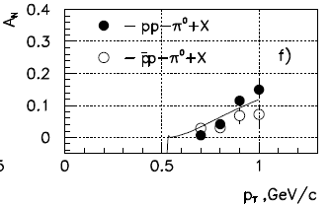
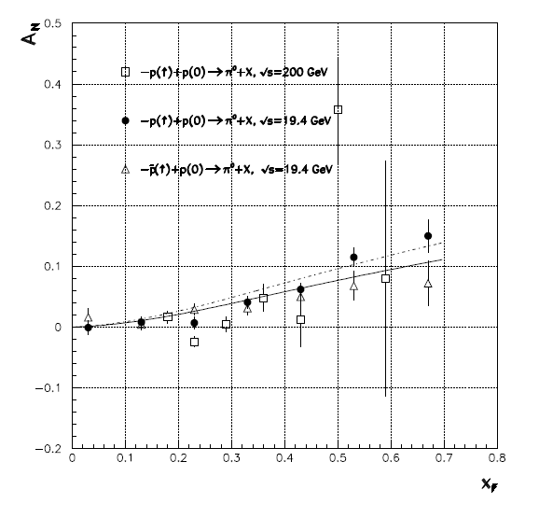
Inclusive π⁰, π± polarimeter
Analyzing power of inclusive π⁰ production at reactions
was measured at √s=200 GeV (E704D.L. Adams et al., Phys. Rev. D53, 4747 (1996))
and at √s=19.4 GeV (A.N. Vasiliev et al., IHEP Preprint 2003-22. Protvino, 2003.)
has significant value at pt=1 GeV/c and it is slightly depends from energy.
S.B. Nurushev, M.G. Ryskin, IHEP Preprint 2004-16. Protvino, 2004

Slide 32


Rate and time for 10% accuracy
SPASCHARM experimental apparatus and target can be used for polarimeter. To determine the necessary data taking time we need define error of the raw asymmetry.
Δε=0,1•ε=0,1P_{B} A_{N}
P_{B} =0,4, A_{N} = 0,15
Δε=18.0•10⁻⁴
N=1/(Δε)² = 30•10⁴
Then data taking time can be calculating in such way
Where n is the rate
L=5.0*10²⁸ (1/s/sm²) for protons and L=1.68*10²⁷ (1/s/sm²) for antiprotons
at p_{T}=1 GeV/c, Δp_{T}=0.1, Δσ=0.08 mb for protons, , Δσ=0.098 mb for antiprotons
n=4.00 s⁻¹ for protons and n=0.16 s⁻¹ for antiprotons. This rate give following times for data taking 21 hours for protons and 520 hours for antiprotons in case π⁰ inclusive polarimeter.

Slide 33


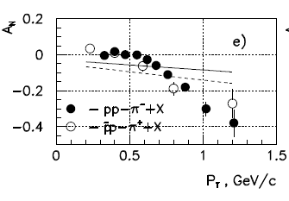
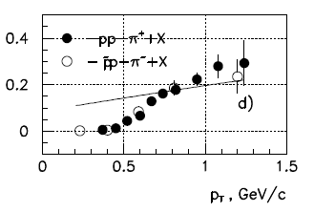
Analyzing power of inclusive π± production at reactions
and
was measured at √s=200 GeV (E704D.L. Adams et al., Phys. Rev. D53, 4747 (1996))
S.B. Nurushev, M.G. Ryskin, IHEP Preprint 2004-16. Protvino, 2004
Cross section and analyzig power of this reaction close one to other and this give time for 10% accuracy in measuring of beam polarization
T ≈ 22 hours for protons
T ≈ 520 hours for antiprotons

Slide 34
Conclusions
We propose combined absolute polarimeter for measuring proton beam polarization at momentum of 45 GeV/c.
We propose to create absolute polarimeter for polarized anti-proton beam on the basis of the process of elastic ppbar scattering . Specific estimates of the sizes of the detectors and analyzing power were carried out for momentum 16 GeV/C , since at this value of the momentum is expected maximum yield of anti protons.
Polarized anti-proton beam can be used to study asymmetries in inclusive pions production, polarization in elastic ppbar scattering , also, spin-dependent total cross section ∆ϭ_{T} .
The advantage of elastic polarimeter is that: a) at any energy we can measure the unknown polarization of the beam, b) we can achieve the required accuracy in measurement of the polarization of the beam, d) simple adjust for different energy.

Slide 35
Hodoscopes are located: in front of the target at distance of -2,20 m and after the target at a distance of +60cm. Since there is no analyzing power measurements at energies of interest to us, we intend to experimentally measure this using a non-polarized anti-proton beam and polarized target.
Target dimensions | d =19.6 mm, l=200mm, V=60 sm³
Material of target | C₃H₈O₂ propanediol 44g
Concentration Cr² | 1.5*10²⁰ sm⁻³
Maximal polarization | 95%
Magnetic field | 2.1 T
Polarization building time | 60 min (P± = 80%)
Dynamic polarization regime | T=0.3 K, SHF power=100 mVt, f=56 GH, n_{s}= 3*10⁻² mole/s
Polarization disintegration during 24 h, T=0.02 K at field 0,45 T | P₊=1% P₋=2%
Consumption of liquid helium | 2 l/h at dynamic polarization 0.5 l/h in “frozenind ” mode
Table 3. Main parameters of the polarized target (PT).

Slide 36
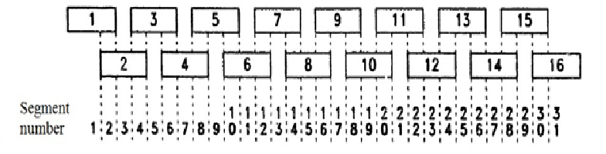
First level triggers are "good hit" and "momentum" from the tagging detectors polarization and momentum (see figure 4.) The final signal for reading information from the hodoscopes is a coincidence of signals from the front hodoscopes and recoil hodoscopes
The beam hodoscopes H1, H2 each consists of two planes X and Y. Each plane consist of two sub planes. The principal design of sub plane is shown on fig 4. The Y-plane of hodoscopes contain 31 scintillators while the X-plane contain 17 scintillators. The structure of others hodoscope is presented in table 4.
THE DESIGN AND PERFORMANCE OF FNAL HIGH-ENERGY POLARIZED-BEAM FACILITY The FNAL-E581/704 Collaboration Nuclear Instruments and Methods in Physics Research A290 (1990) 269-292
Fig 4. The overlapping scintillator design of the beam hodoscopes. The hodoscope is shown divided into 31 segments. Only the central 27 segments are usually used in the electronics.

Slide 37
Horoscope | Distance from PT (m) | Total dimensions (mm) | Dimension of scintillator width×thickness×length (mm) |  | Number of PM
 | Z | X × Y | X | Y | X | Y |  | ∑
Beam Hodoscope
H1 | -6.20 | 72 × 128 | 6 × 3 × 72 | 6 × 3 × 128 | 17 | 31 |  | 48
H2 | -2.20 | 72 × 128 | 6 × 3 × 72 | 6 × 3 × 128 | 17 | 31 |  | 48
Forward Hodoscope
H3-H5 | 0.6 | 48 × 40 | 6 × 3 × 48 | 6 × 3 × 40 | 11 | 9 |  | 20
H4-H6 | 4.6 | 144 × 168 | 6 × 3 × 144 | 6 × 3 × 168 | 35 | 41 |  | 76
Recoil Hodoscope
 | X | Z × Y | Z | Y | Z | Y |  | ∑
H7- H9 | 0.3 | 317 × 193 | 6 × 3 × 317 | 6 × 3 × 193 | 79 |  | 49 | 128
H8- H10 | 0.6 | 320 × 365 | 6 × 3 × 320 | 6 × 3 × 365 | 79 | 91 |  | 160
Table 4 The structure of polarimeter based on the elastic antiproton proton scattering
A fast pre-trigger signal, known as GOOD HIT, is calculated as quickly as possible from the momentum and polarization information and sent to the experimental hall. GOOD HIT requires exactly one hit in each of the six active hodoscopes, which means that the beam-tagging logic has sufficient data to calculate both a momentum and a polarization value.

