Slide 1




Detection of extensive air showers with the NEVOD-EAS array cluster
The 2nd International Conference on Particle Physics and Astrophysics
(ICPPA-2016)
I.A. Shulzhenko¹, M.B. Amelchakov¹, A.G. Bogdanov¹, A. Chiavassa^{2,3},
D.M. Gromushkin¹, N.N. Kamlev¹, S.S. Khokhlov¹, R.P. Kokoulin¹, O.I. Likiy¹,
A.A. Petrukhin¹, O. Saavedra², I.I. Yashin¹
¹ National Research Nuclear University MEPhI, Scientific and Educational Center NEVOD, Moscow, Russia
² Dipartimento di Fisica dell’ Università degli Studi di Torino, Turin, Italy
³ Sezione di Torino dell’ Istituto Nazionale di Fisica Nucleare - INFN, Turin, Italy
Moscow, Russia, October 10 - 14, 2016

Slide 2
NEVOD-EAS array

Slide 3
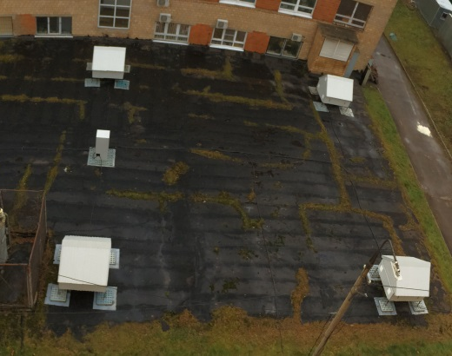
Central part of the NEVOD-EAS array
Clusters No. 1 & 2
13.3×12.4 m²
Cluster No. 4
15.0×15.0 m²
Cluster No. 3
25.1×18.9 m²

Slide 4
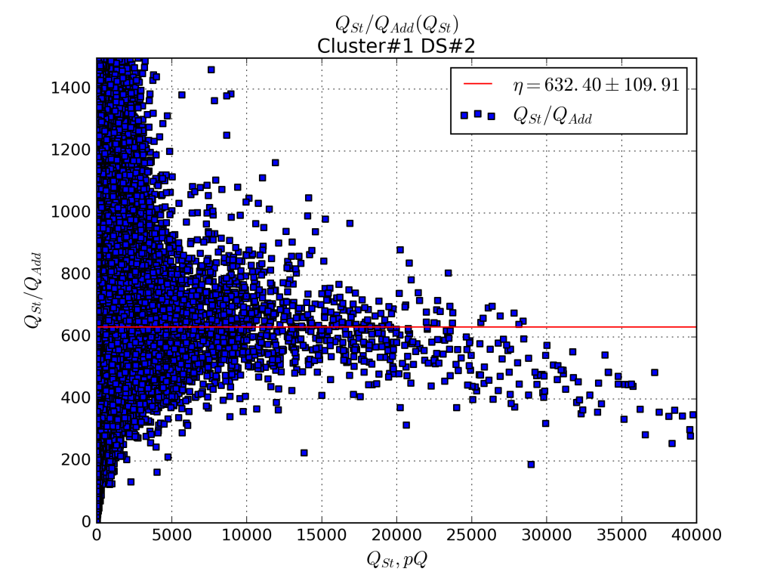
Response of the NEVOD EAS DS and counters
Cluster #1 DS#2
Ratio between response charges of
DS and additional PMT
Cluster 2 DS 2
Response charge, pC
Charge of DS response, pC
Distribution of DS on position of “muon” peaks
Distribution of additional PMTs on charge of response to 1 particle (VEM)
<Q_{add1µ}> = 0.14 pC
σ_{Qadd1µ} = 0.03 pC
Position of the DS “muon” peak, pC
Charge of the additional PMT response
To 1 particle (VEM), pC

Slide 5
Response of the NEVOD EAS DS and counters

Slide 6
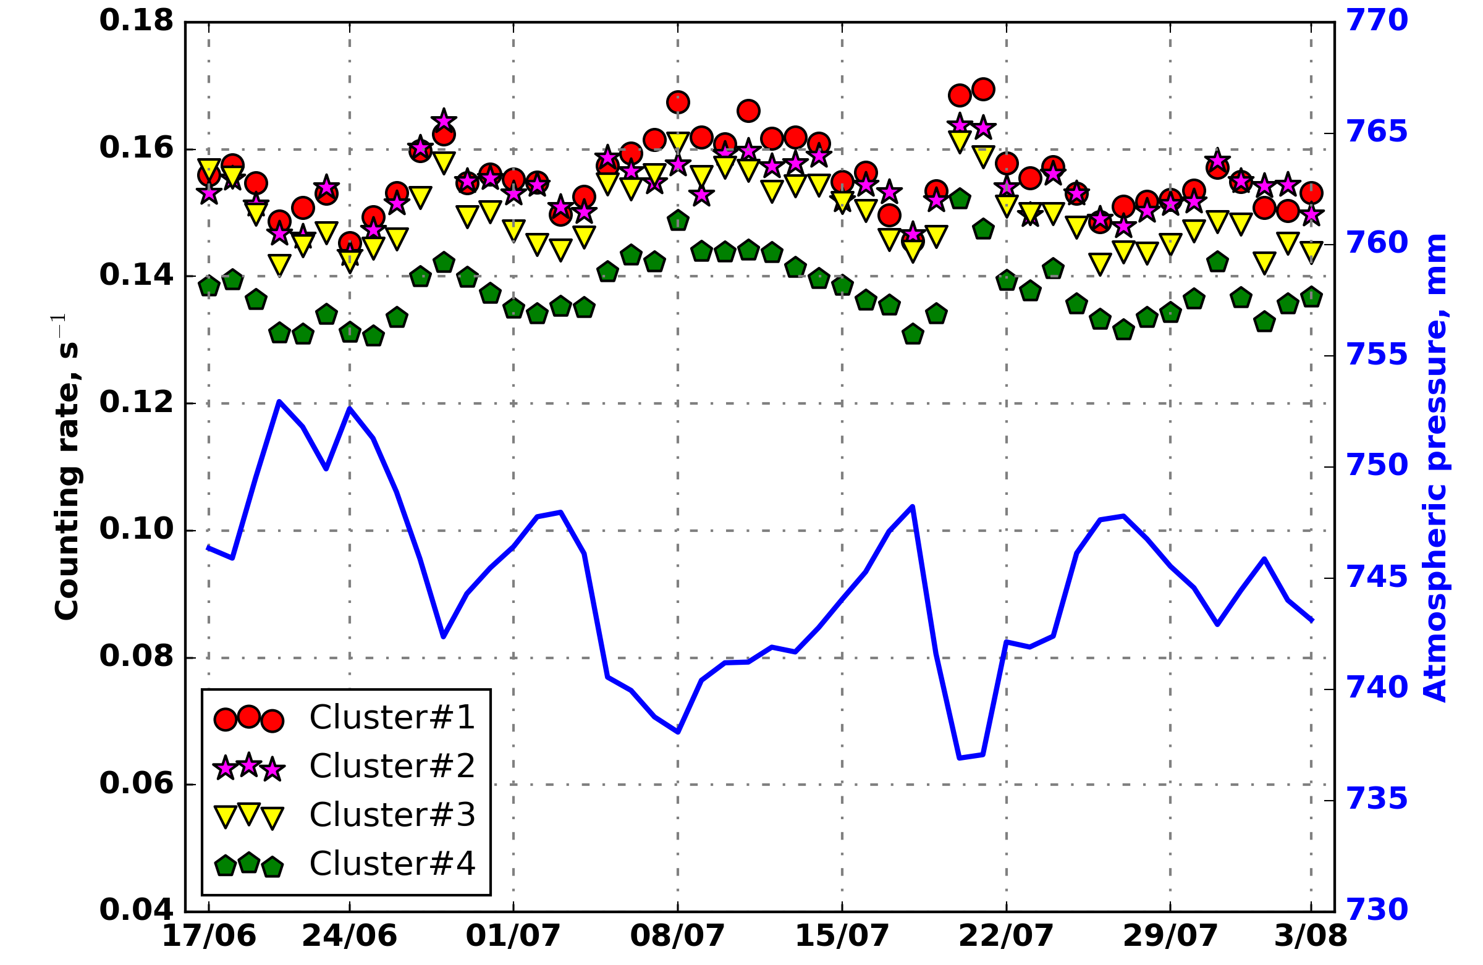
Counting rate of the NEVOD-EAS clusters
Barometric coefficient ~ -0.71 ÷ -0.81 %/mmHg

Slide 7
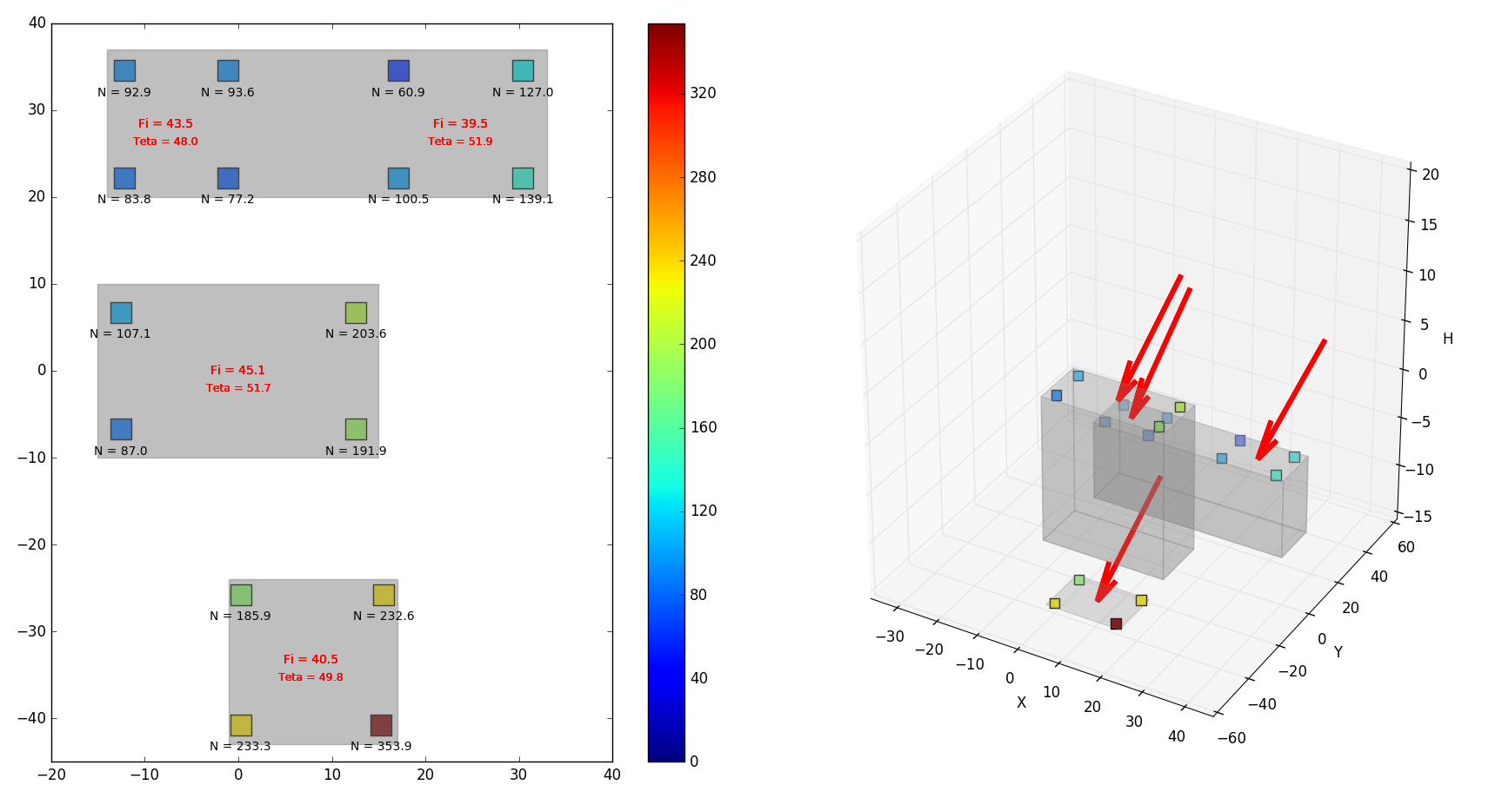
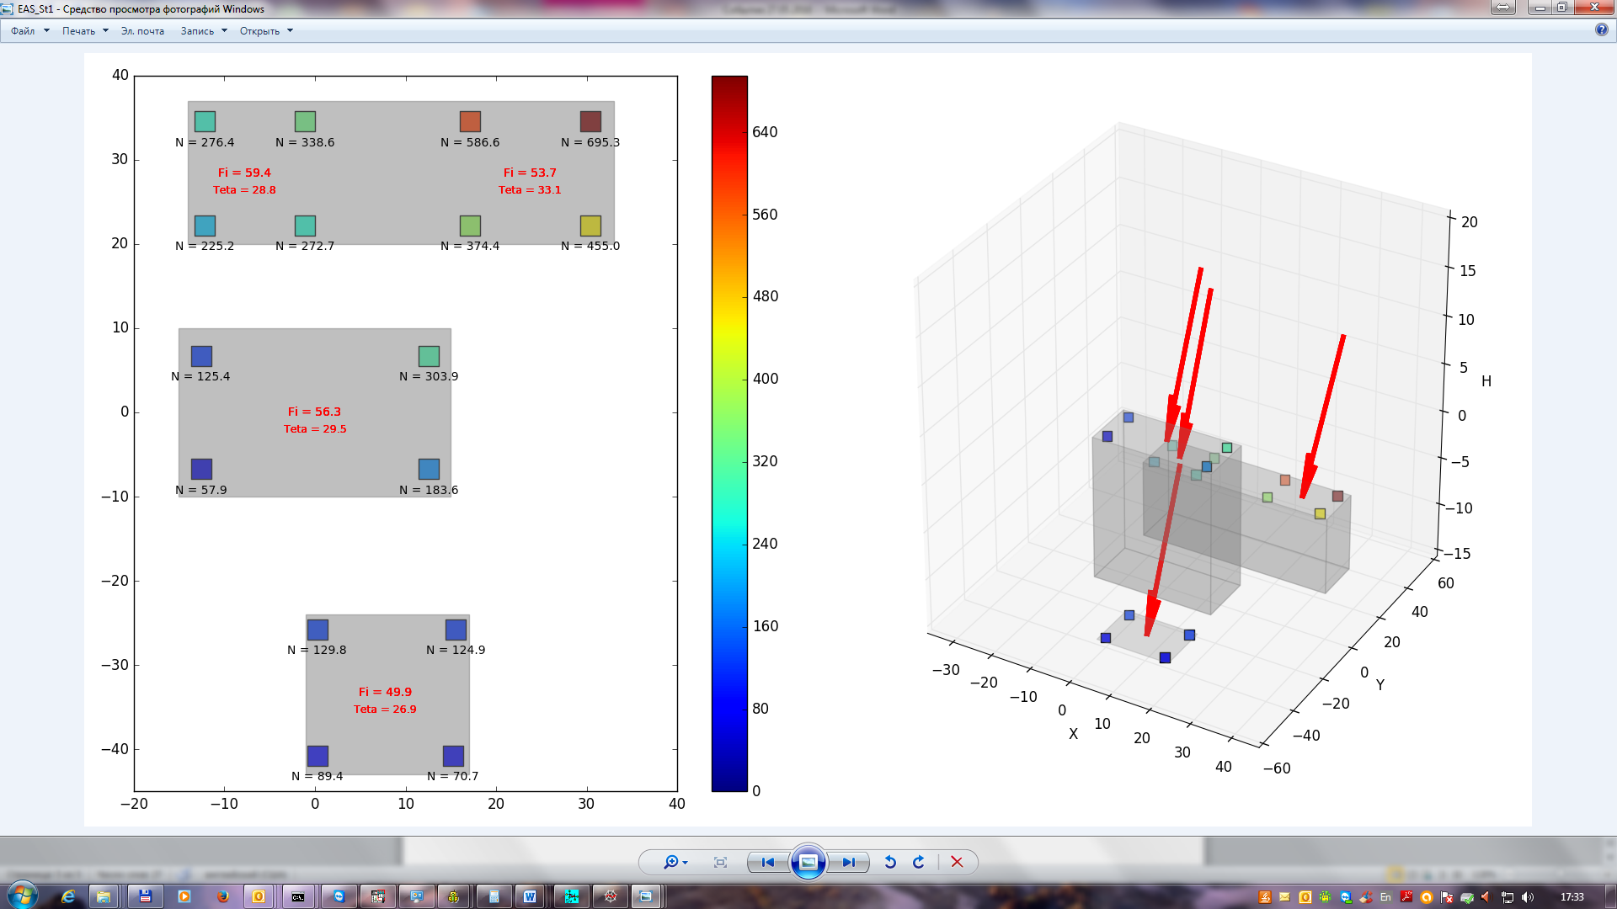
Registration of showers with the NEVOD-EAS array
θ = 48.0°
φ = 133.5°
θ = 51.9°
φ = 129.5°
Число ШАЛ: 712
θ = 51.7°
φ = 135.1°
Number of EAS: 712
<ψ> = 3.8°
σ_{ψ} = 2.6°
Number of registered EAS
θ = 49.8°
φ = 130.5°
Mean angular deviation of directions reconstituted by individual clusters from the average direction in the event, °

Slide 8
Reconstruction of EAS arrival direction

Slide 9
Reconstruction of EAS arrival direction

Slide 10
Example of joint event:
NEVOD-EAS (27.05.2016 3:09:26)
Cluster No.3 on the roof of the NEVOD-DECOR building
θ = 28.8°
φ = 149.4°
θ = 33.1°
φ = 143.7°
θ = 29.5°
φ = 146.5°
θ = 26.9°
φ = 139.9°

Slide 11
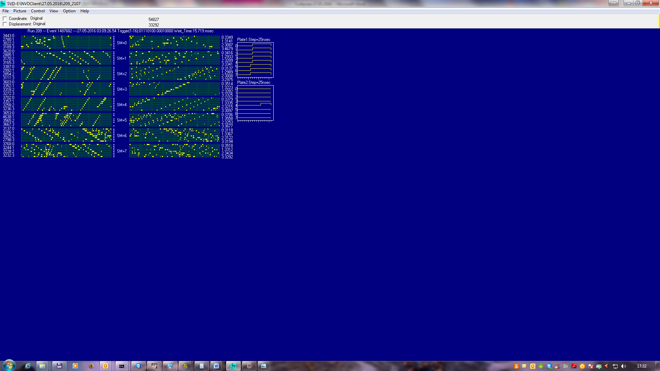
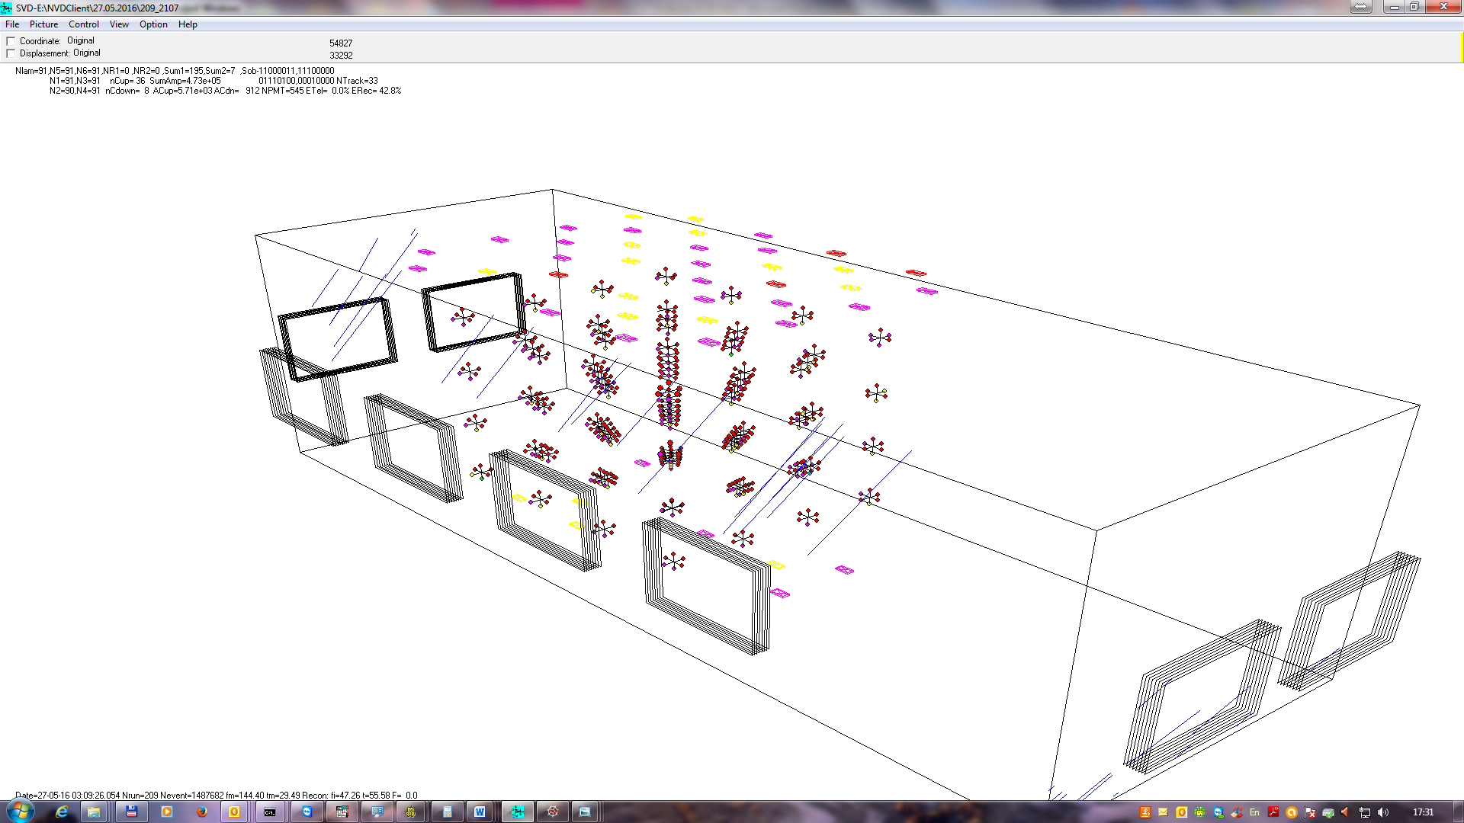
Example of joint event:
NEVOD-DECOR-CTS (27.05.2016 3:09:26)
NEVOD-DECOR-CTS
θ = 29.49°
φ = 144.40°
NEVOD-EAS
θ = 29.5°
φ = 146.5°

Slide 12
Conclusion
The 1st experimental series with a duration of 49 days (17/06/2016 – 03/08/2016)
has shown:
the amplitude and temporal characteristics of response of 4 clusters of the NEVOD-EAS central part are quite similar;
the detector station time resolution is about 3.7 ns;
the accuracy of EAS arrival direction reconstruction is, at this stage, about 4° and will be improved with an increase of number of clusters;
the possibility of using of cluster approach to the reconstruction of EAS parameters has been proved.

Slide 13
Thank you for attention!

