Slide 1




Data acquisition system of the
NEVOD-EAS array
The 2nd International Conference on Particle Physics and Astrophysics
(ICPPA-2016)
O.I. Likiy¹, M.B. Amelchakov¹, N.V. Ampilogov¹, I.I. Astapov¹, D.S. Brovtsev¹,
A. Chiavassa^{2,3}, D.M. Gromushkin¹, N.N. Kamlev¹, S.S. Khokhlov¹, K.G. Kompaniets¹, A.S. Mazhuto¹, V.V. Ovchinnikov¹, O. Saavedra², P.V. Semov¹,
I.A. Shulzhenko¹, I.I. Yashin¹
¹ National Research Nuclear University MEPhI, Scientific and Educational Center NEVOD, Moscow, Russia
² Dipartimento di Fisica dell’ Università degli Studi di Torino, Turin, Italy
³ Sezione di Torino dell’ Istituto Nazionale di Fisica Nucleare - INFN, Turin, Italy
Moscow, Russia, October 10 - 14, 2016

Slide 2
NEVOD-EAS array

Slide 3
Cluster of the NEVOD-EAS array

Slide 4
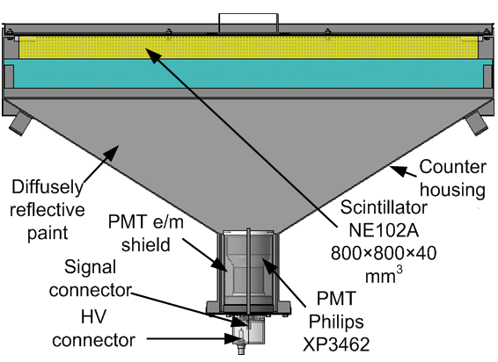
Scintillation counter of the NEVOD-EAS array
Scintillator:
NE102A 80 × 80 × 4 cm³
Photomultiplier:
Philips XP3462
Most probable response to 1 particle (VEM): ~ 13 pC
Upper limit of dynamic range (with standard PMT): 100 particles VEM
Upper limit of dynamic range (with additional PMT): 10⁴ particles/m²

Slide 5
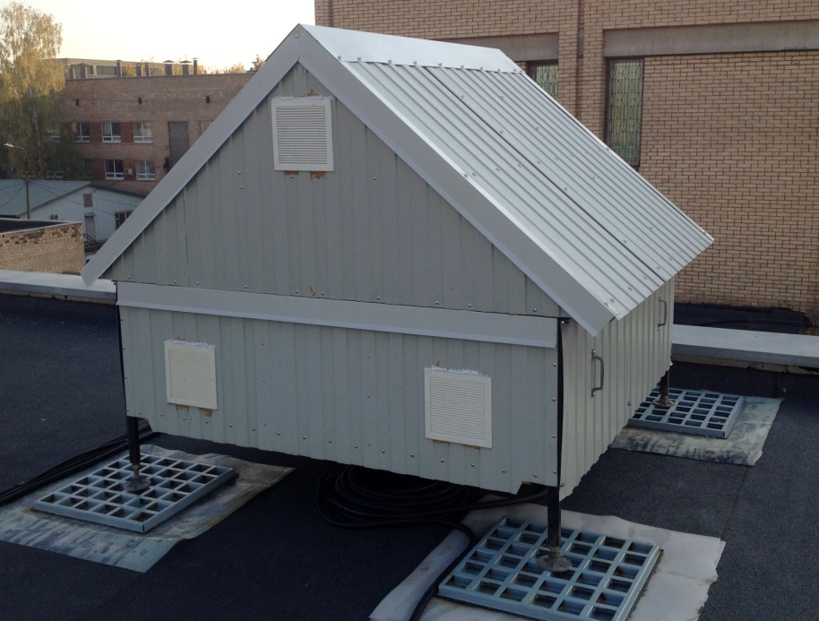
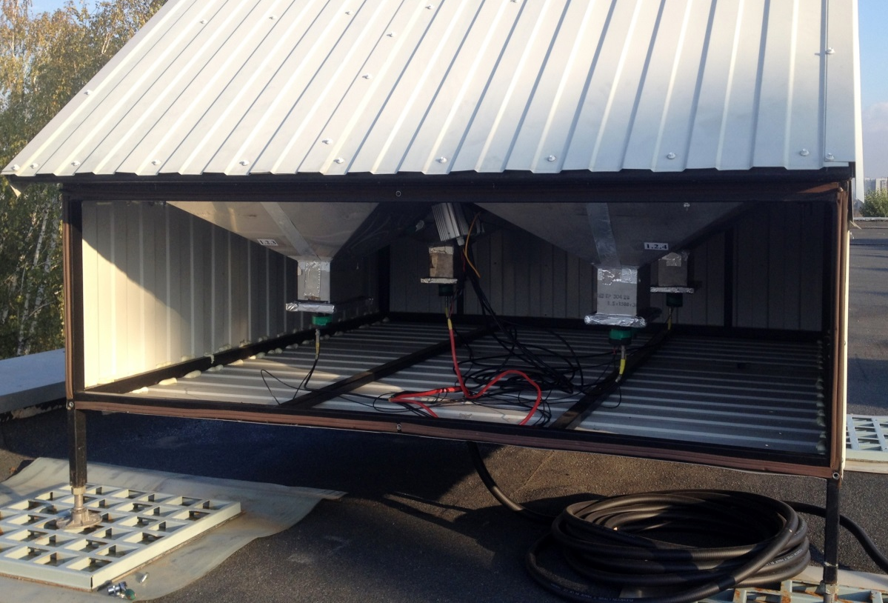
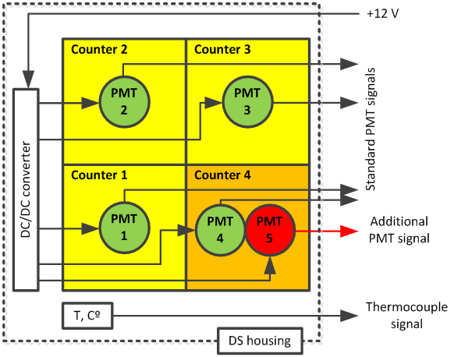
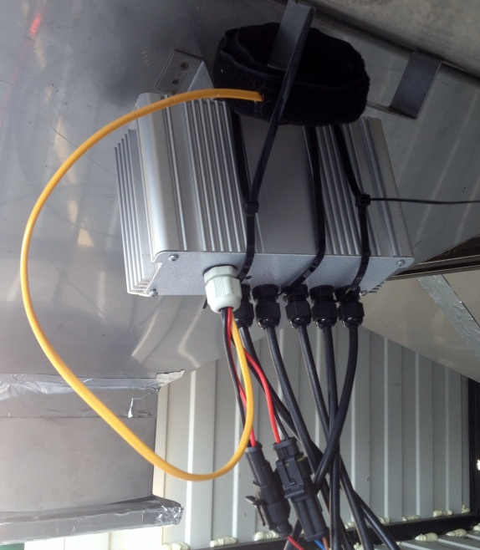
Detector Station (DS) of the NEVOD-EAS array
4 PMTs (standard): measuring EAS particle densities and time measurements.
5th PMT (additional): a gain of ≈ 90 times less than for the standard PMT; ensures wide linearity range of measured signals at high particle densities.

Slide 6
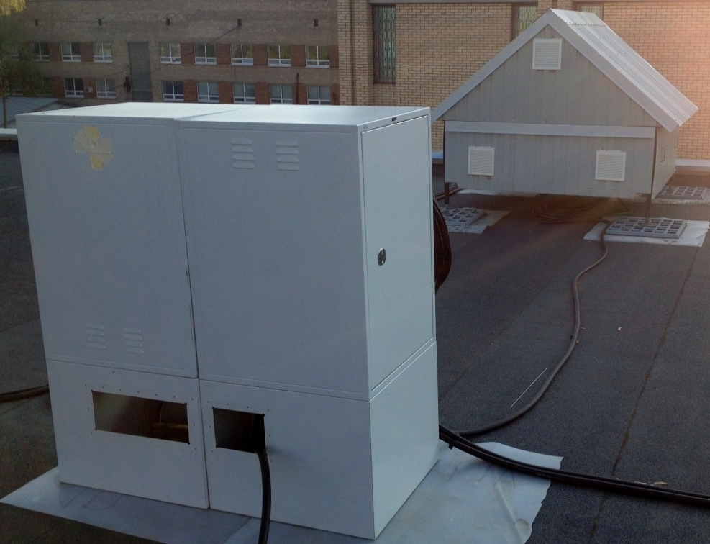
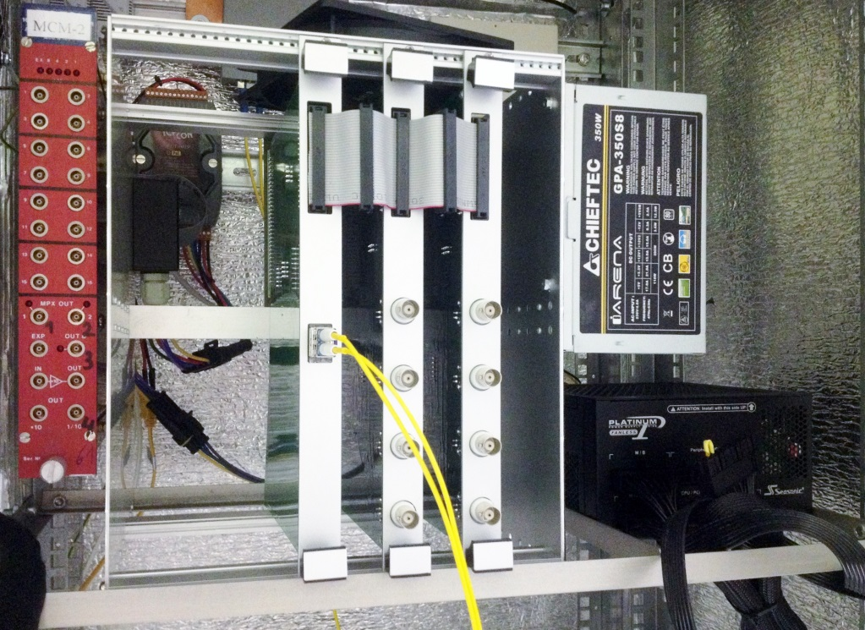
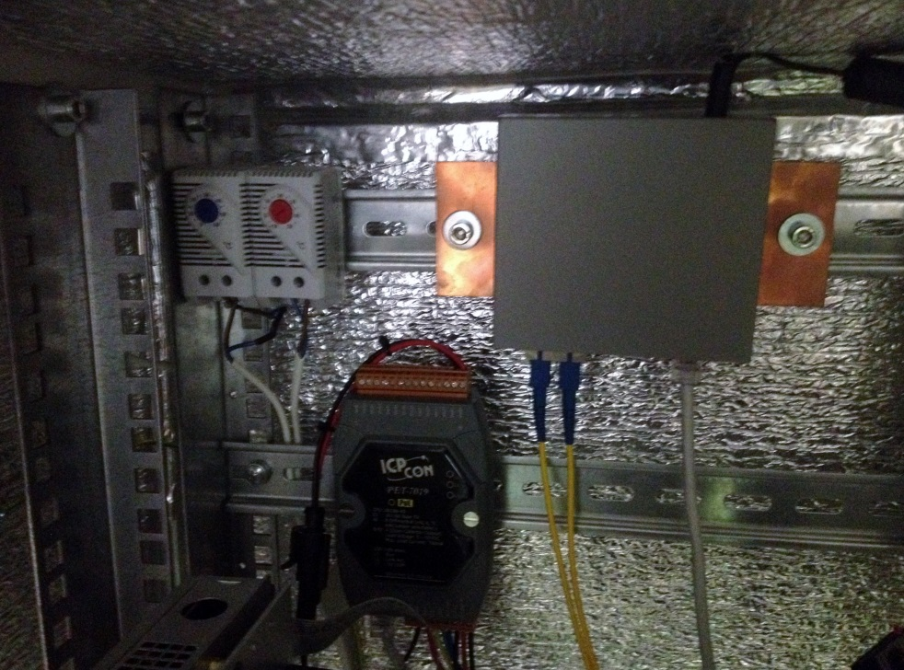
Local Post (LP) of the NEVOD-EAS cluster
Local Post tasks:
- summation of standard PMTs signals;
- digitizing of PMTs signals;
- event selection according to triggering conditions;
- operation in exposition and monitoring modes;
- DS power supply;
- control of temperature inside DS and LP.
DS
Local Post
Controller
BAA
Thermal Relay
Media converter
Summator - Multiplexer
DS Power Supply
PET-7019

Slide 7
Central DAQ Post
Central DAQ Post tasks: - cluster synchronization;
- cluster control;
- reception and storage of experimental
and monitoring data.

Slide 8
Central DAQ Post

Slide 9
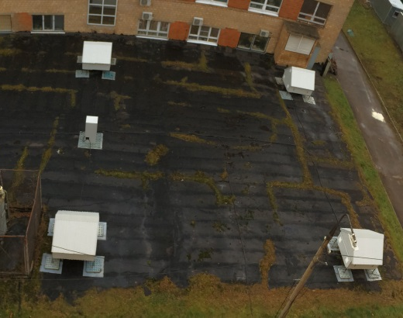
Central part of the NEVOD-EAS array
Clusters No. 1 & 2
13.3×12.4 m²
Cluster No. 4
15.0×15.0 m²
Cluster No. 3
25.1×18.9 m²

Slide 10
Conclusion
In 2015–2016 the central part of the NEVOD-EAS cluster type shower array which includes 4 independent clusters (totally, 64 scintillation counters) located around the Experimental Complex of the CWD NEVOD and coordinate detector DECOR at the area of about 10⁴ m² has been created and started.
The distributed structure of the NEVOD-EAS array DAQ system allows to deploy registering elements of the setup even at different altitudes and provides implementation of a newly developed cluster approach to the reconstruction of EAS parameters.
Our plans:
2016–2017
2018–2020
- start of operation of the 1st stage of the NEVOD-EAS peripheral part (+ 6 clusters, total area ~ 2×10⁴ m²)
- start of operation of the 2nd stage of the NEVOD-EAS peripheral part (total area ~ 0.2 × 10⁶ m²)

Slide 11
Thank you for attention!

