Slide 1
Polarized proton and antiproton beams for the SPASCHARM experiment at U-70 accelerator
V. V. Abramov¹, I. I. Azhgirey¹, V. I. Garkusha¹, V. V. Mochalov^{1, 2}, S. B. Nurushev^{1, 2},
M. B. Nurusheva², V. L. Rykov², P. A. Semenov^{1, 2}, M. N. Strikhanov², A. N. Vasiliev^{1,2},
A. E. Yakutin¹, V. N. Zapolsky¹, V. G. Zarucheisky¹
¹ Institute for High Energy Physics National Research Centre Kurchatov Institute
² National Research Nuclear University (Moscow Engineering Physics Institute)
ICPPA-2016, Moscow
October 13, 2016

Slide 2
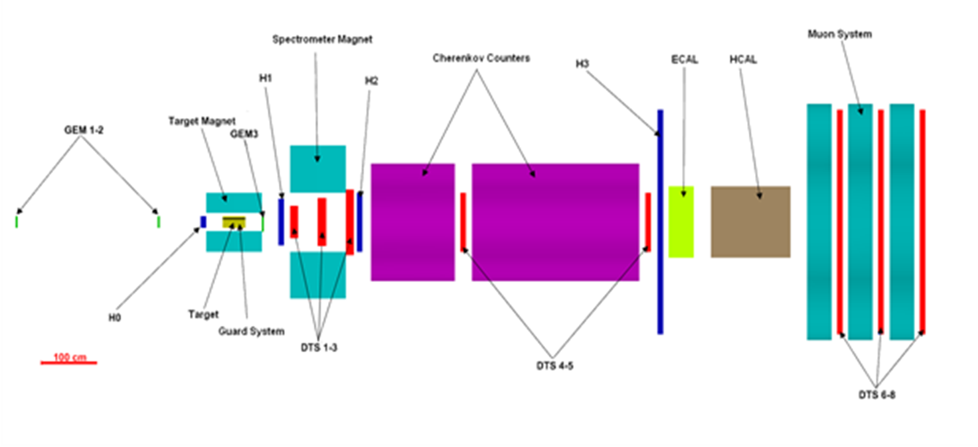
Brief overview of the SPASCHARM program
The main goals: Systematic study of spin phenomena for a wide range of inclusive and exclusive reactions in collisions of high-energy polarized hadrons in the QCD non-perturbative region.
The detector: Large acceptance forward spectrometer for charged and neutral particles with good identification, covering 2π in azimuth and 0 < x_{F} < 1 and p_{T} up to 2.5 GeV/c for the beams in the momentum range of ~10-45 GeV/c.
Stage 1: Study of single–spin asymmetries at the existing beam line #14, using unpolarized meson and proton beams, interacting with transversely polarized protons or deuterons of the “frozen” target.
Stage 2 (Beginning in 2020): Polarized proton and antiproton beams will be available at the new 24A beam line.
More on the SPASCHARM physics program and detector capabilities in the talk by V. V. Mochalov on 10.10.2016

Slide 3
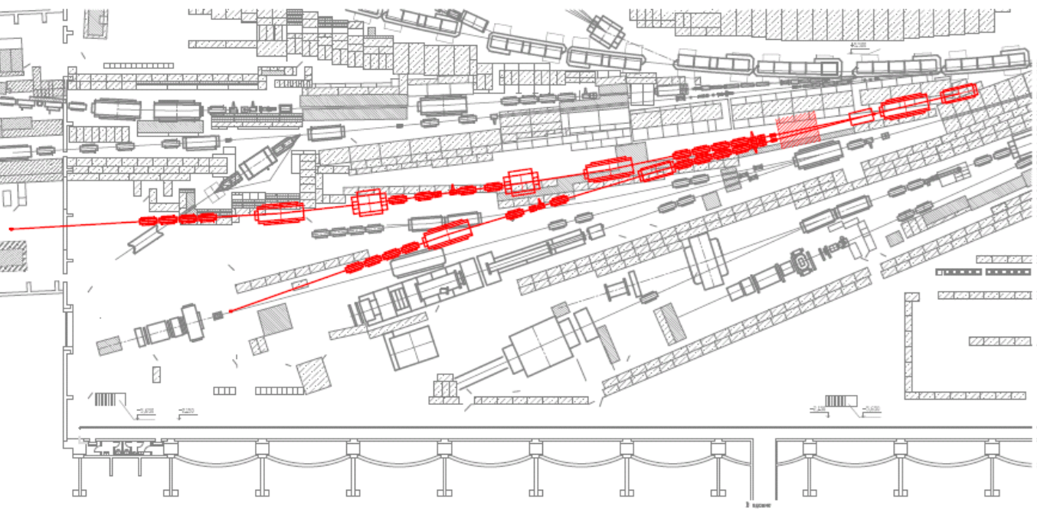
24A/24B Facility Layout and Primary Target Station
Two beam lines 24A and 24B operate from a single external primary target hit by protons from U-70
Primary target
24A
24B
Primary target T: Aluminum, 40 cm length
MT1 & MT2: Standard dipoles SP-129 & SP-7
Dump: 5 m of steel
φ_{max} = 27 mrad
Secondary beams of opposite charge from 16 to 28 GeV/c
q₁p₁(φ_{max} + φ ) + q₂p₂(φ_{max} - φ ) = 0
Neutral secondary beam toward either 24A or 24B line
MC: Magnets-Correctors for a better acceptance tunning
Primary proton beam energy:
up to 60 GeV/c
Primary proton beam intensity:
up to 2∙10¹³ protons per 9 second cycle
Slowly extracted:
up to ~2 second spill
Special MT3 magnet (dimensions in cm):
L = 2.6 m, H×V = 24 (14 useful)×5 cm², B_{max} = 1.9 T
Coil is behind the steel pole and concrete shield
Coil life-time to 10 MGy dose: 2600 days (<I>=10¹³ ppp)

Slide 4
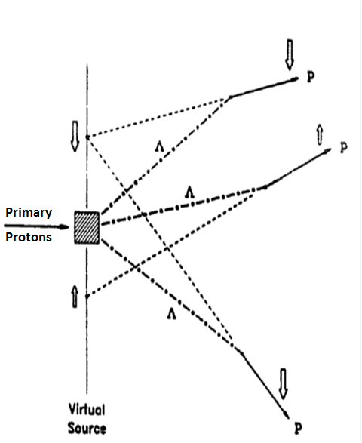
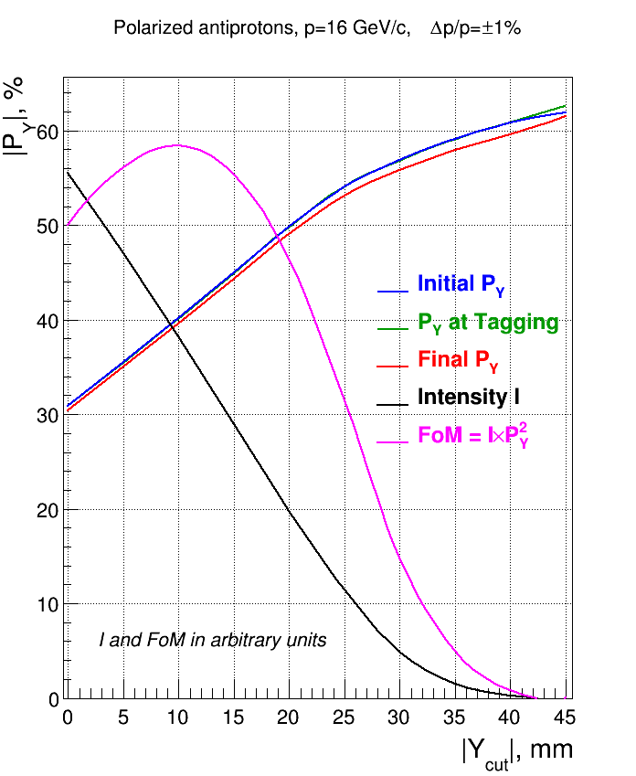
Polarized protons from Λ-hyperon decays
The method for generating polarized (anti)proton beams, using parity-violating (anti-)Λ-decays, had been suggested by O. T. Overseth and J. Sandweiss in 1969. Since then, it successfully has been used in E581/E704 (FNAL) and FODS (IHEP, Protvino) experiments.
In the rest frames of decayed Λ-hyperons, protons are produces longitudinally polarized with helicity equal to decay parameter α=0.642.
After the Lorentz boost into the laboratory frame, (anti)protons obtain a transverse polarization component which rises up as the decay angle increases.
The latter is equivalent to the transverse polarization dependence on the transverse position of the decay (anti)proton’s Virtual Source (VS) in the primary target plane .
The best FoM: |y| > 10 mm, |P_{Y}| ~40%
Simplified beam optics for polarized (anti)proton sample selection
Intermediate focus
Protons 40 GeV/c

Slide 5
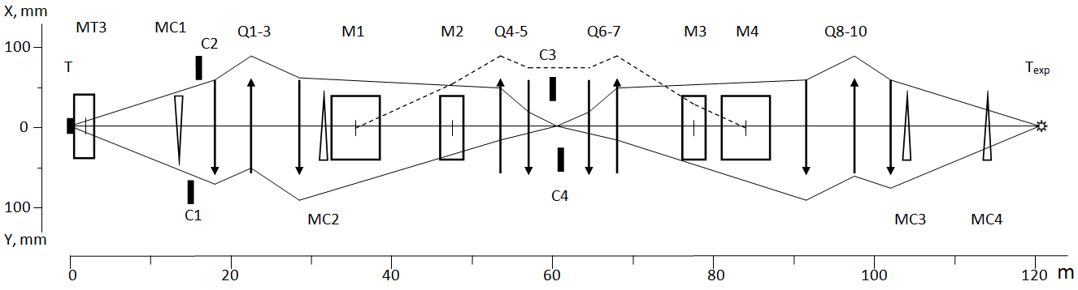
Optical scheme of beam line 24A
Intermediate focus
Q – quads; М – dipoles; MC – correctors; К – collimators; Т & Тexp – primary and experiment targets
Horizontal plane: Momentum analysis. Beam momentum range: 10 < p < 45 GeV/c.
Total beam rotation angle in horizontal plane = 147 mrad
Vertical plane: Analysis and sorting on the vertical component of transverse polarization P_{Y}
Identity Transfer Matrix from primary to experiment target => No depolarization in the first order
Two sections with “mirror” optics, separated by the Intermediate Focus in the both planes
Intermediate Focus: Inversed and magnified image of the Virtual Source at Primary Target
Total beam line length: 121.4 m
Not shown:
Cherenkov beam counters: To separate (anti)protons from other particles in the beam.
Spin-rotator (“Siberian Snake”): To rotate the direction of (anti)proton polarization at the experiment target.

Slide 6
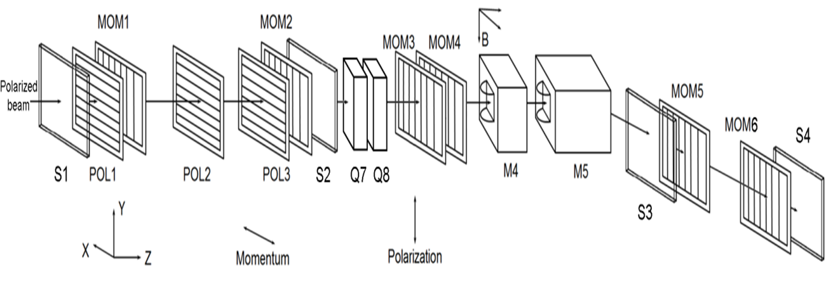
Selection of polarized beam-samples: Beam Polarization Tagging
Intermediate focus
Q – quads; М – dipoles; MC – correctors; К – collimators; Т & Тexp – primary and experiment targets
Reconstruction of the trajectory and momentum for each beam particle with the fast scintillator hodoscopes.
On-line assignment of P_{Y} value to each trajectory from simulated (anti)proton propagation through the beam optics.
At the data analysis stage, using the P_{Y} tags for sorting out events over beam-particle polarization.
Advantages:
Full beam intensity is used.
No polarization smearing over the beam momentum spread.
Flexibility for selecting appropriate polarized beam samples at the analysis stage.
Disadvantages:
Spatial and angular distributions at the experiment differ for opposite polarization signs => Potential source for additional systematic errors in spin-asymmetries.
Large beam size at the experiment target, particularly at low momenta => Hard to utilize full beam intensity, for example, with polarized target of only 2 cm in diameter.
More details on beam tagging system in the talk by P. Semenov at this section

Slide 7
Selection of polarized beam-samples: Collimation or Blinking Polarization
Intermediate focus
Q – quads; М – dipoles; MC – correctors; К – collimators; Т & Тexp – primary and experiment targets
Set the desired opening of collimator C4 centered at the axis of full beam.
Move beam up or down by corrector MC2.
Steer the selected beam sample onto the experiment target, using correctors MC3 & MC4.
Flip the beam sample’s mean P_{Y} from cycle to cycle by the current reversal in MC2—MC4 correctors.
Advantages:
Simple and robust experimental setup.
Beam position at experiment target independent of the sign of polarization P_{Y}.
Smaller beam size at experiment target compared to tagging.
Disadvantages:
The effective beam intensity is reduced by a factor of 2 or more.
Sample mean polarization is smeared over the beam momentum spread.
Polarized beam samples cannot be changed in the data analysis.
The latter two deficiencies could be partially or fully eliminated if polarization tagging is used along with collimation.
Protons p=40 GeV/c
Δp/p = 1.2% (RMS)
P_{Y}

Slide 8
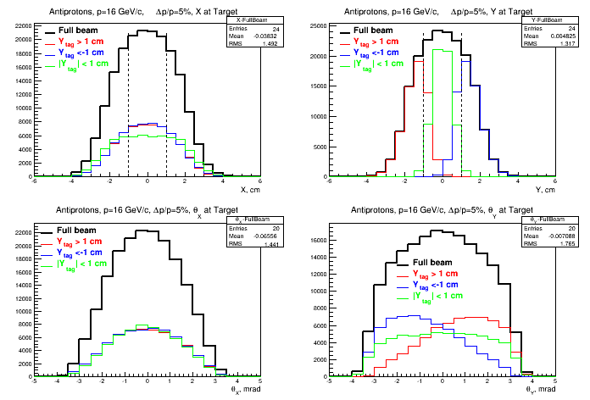
Beam profiles at the experiment target
Protons p=40 GeV/c, Δp/p = 1.2%
Beam size at the experiment target grows as the beam momentum decreases and the momentum spread increases

Slide 9
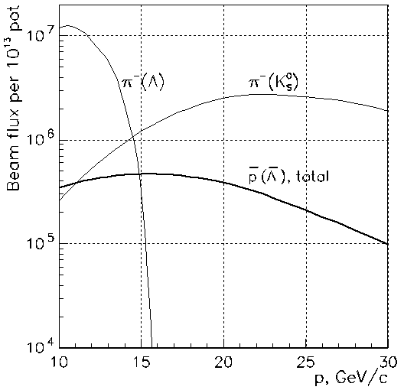
Beam characteristics at the experiment target
Beam intensities and background per 10¹³ of primary protons
At 15-16 GeV/c, the intensity of antiproton beam is by a factor of 20-30 as low as of the proton beam.
The high pion background from Λ→pπ⁻ decays might make it not feasible to operate antiproton beam at momenta below 16 GeV/c.
The background from K⁰_{S}→π⁺π⁻ decays is expected to be suppressed by the beam Cherenkov counters.
p(Λ), P_{Y} > 0.35
antiprotons
protons
Beam characteristics at the experiment target
p, GeV/c | 15 |  | 30 |  | 45
Δp/p (RMS), % | 2.0 | 4.5 | 1.4 | 4.4 | 1.2 | 4.1
σ_{x}×σ_{y}, mm | 17 × 14 | 19 × 16 | 14 × 10 | 17 × 11 | 11 × 8.7 | 16 × 9
σ _{x’}×σ_{y’}, mrad | 1.4×1.5 | 1.3×1.5 | 1.5×1.8 | 1.3×2.3 | 1.4×1.7 | 1.4×1.7
I_{beam} per 10¹³ ppp | 3.5×10⁶ | 9.2×10⁶ | 2.1×10⁷ | 7.8×10⁷ | 1.5×10⁷ | 6.8×10⁷
Total intensity of 16 GeV/c antiproton beam at Δp/p=4.5% is ~4∙10⁵ per 10¹³ of primary protons

Slide 10
Concluding remarks
The design and optimization of parameters of the 24A/24B beam facility for U-70 accelerator of IHEP, Protvino, is currently at its final stage.
The construction is expected to begin in the year 2019.
The commissioning and the first technical run is anticipated in the year 2020.
The new polarized proton and antiproton beam line 24A will provide an opportunity for unique systematic studies of spin phenomena for a wide range of inclusive and exclusive reactions in collisions of high-energy polarized hadrons in the QCD non-perturbative region with the multipurpose large acceptance SPASCHARM spectrometer.

Slide 11
Backup slides

Slide 12
Beam-line equipment
SP-129 dipole: L=4 m, H×V= 33×10 cm², B_{max}=1.8 T
SP-7 dipole: L=6 m, H×V= 50×20 cm², B_{max}=1.8 T
Quadrupoles 20K200: L=2 m, d=20 cm, G_{max}=13 T/m
Collimators: Maximum slit opening = ±75 mm, L=75 cm

