Slide 1
Neutrino-4 experiment on search for sterile neutrino
with multi-section model of detector
А. Serebrov
Collaboration Neutrino-4:
NRC “KI” Petersburg Nuclear Physics Institute, Gatchinа, NRC “Kurchatov institute”, Moscow,
JSC “SSC RIAR”, Dimitrovgrad, Russia
DETI MEPhI, Dimitrovgrad, 433511 Russia
The 2nd international conference on particle physics and astrophysics Moscow, Russia,
10-14 of October 2016

Slide 2
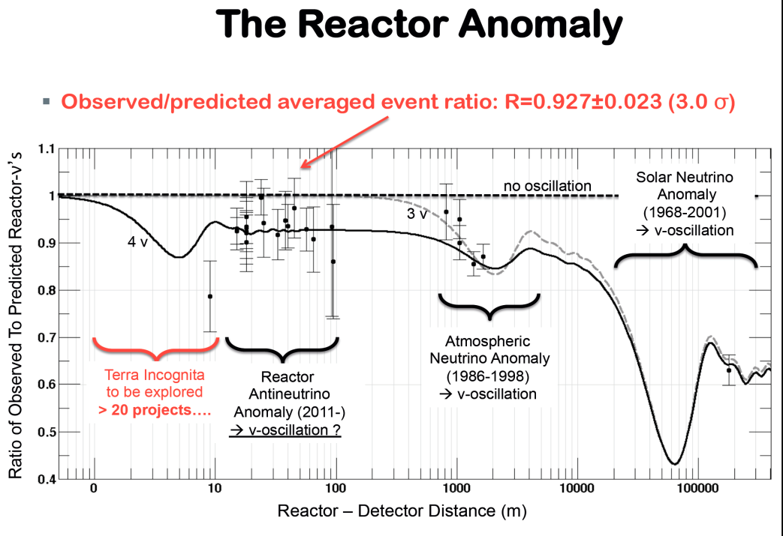

G. Mention et al., Phys. Rev. D83, 073006, 2011
The reactor antineutrino anomaly and sterile neutrino

Slide 3

New Short Baseline Reactor Experiments
US Short Baseline Interest Group
Neutrino4 @ SM-3 Dimitrovgrad
SOLID @ BR2, Belgium
CARR site Beijing
Stereo @ ILL Grenoble
DANSS @ KNPP
Udolmya
Hanaro, Corea

Slide 4
Biological reactor shielding

Slide 5
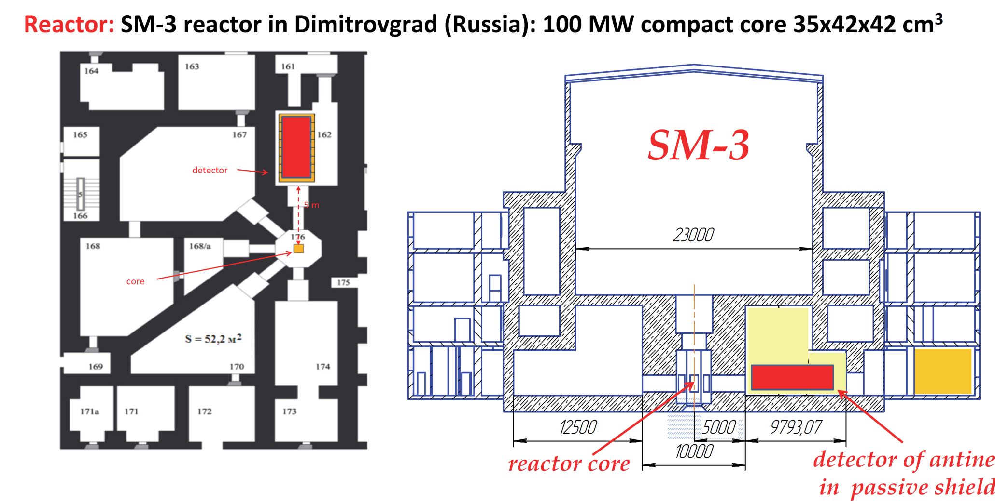
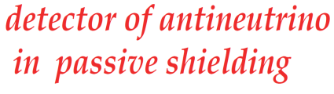

Slide 6

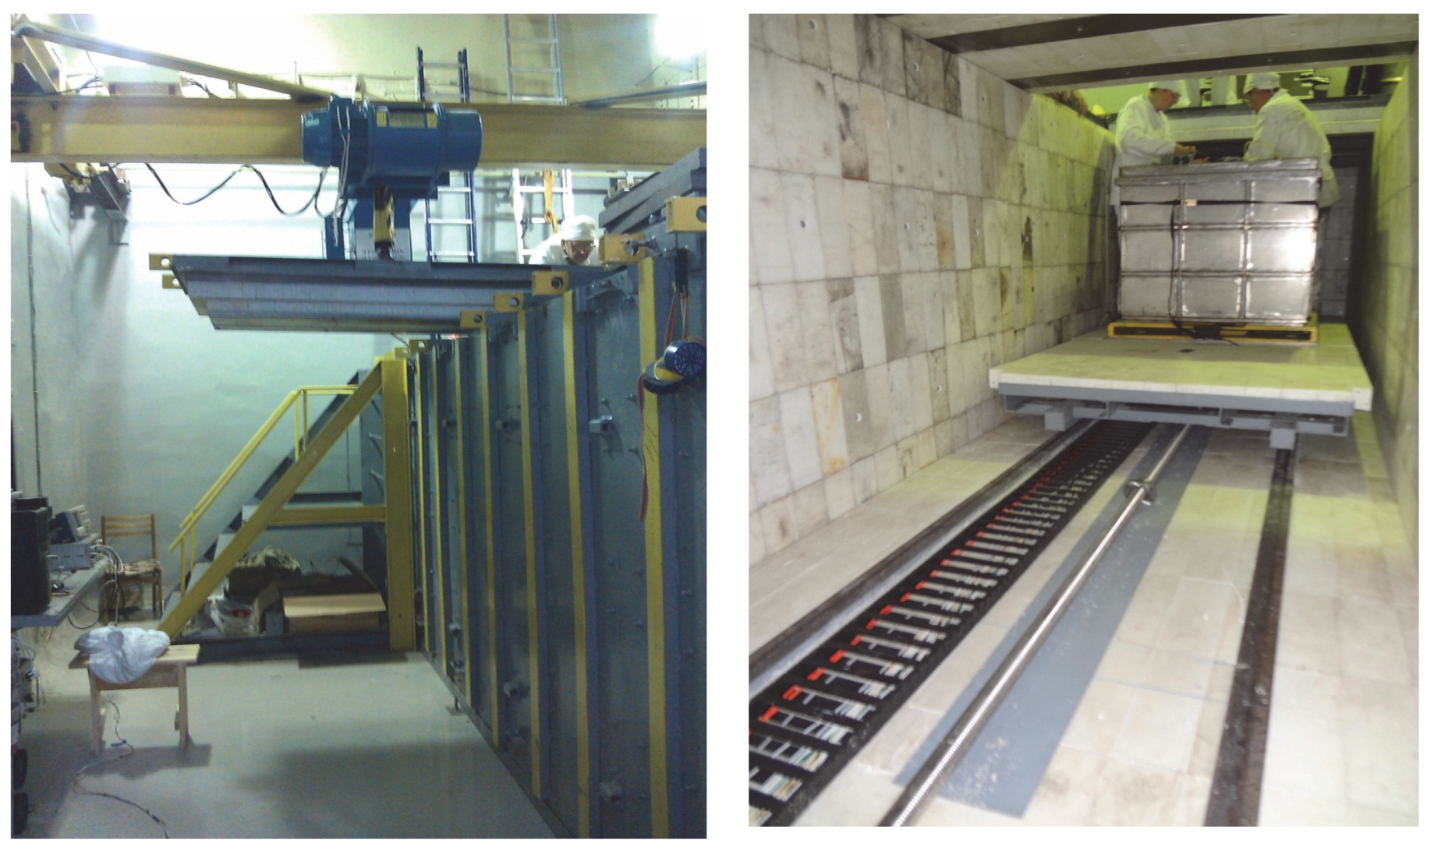
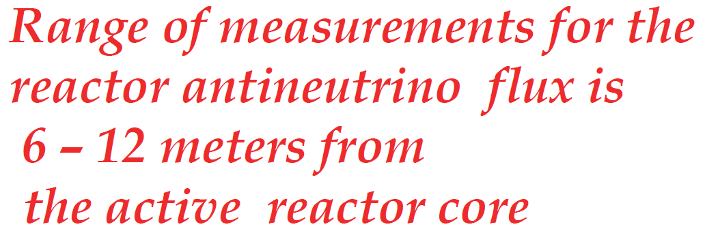


Slide 7
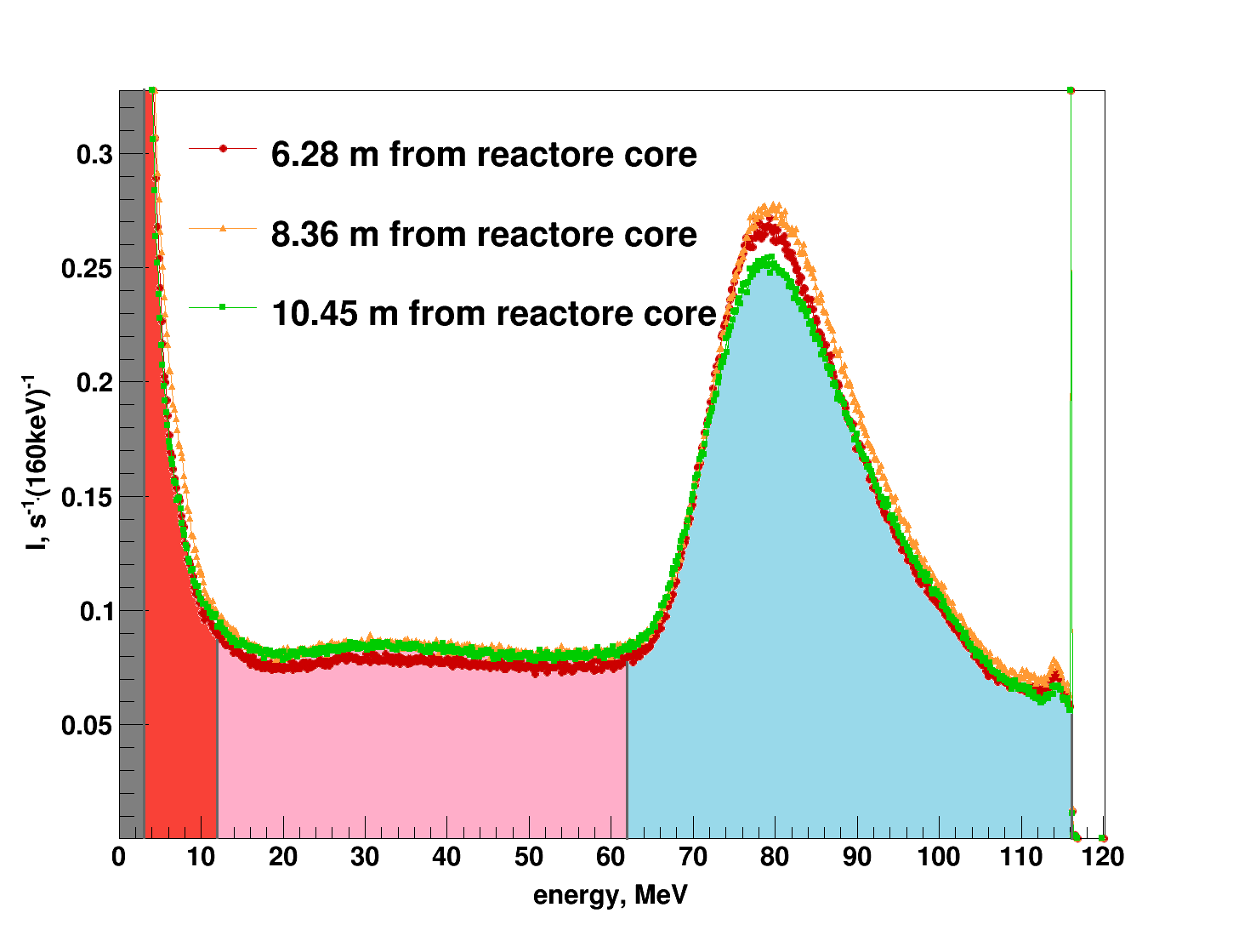
Different part of spectrum
at the different distance
R/A background
Neutrons
Muons
Soft component of cosmic rays

Slide 8
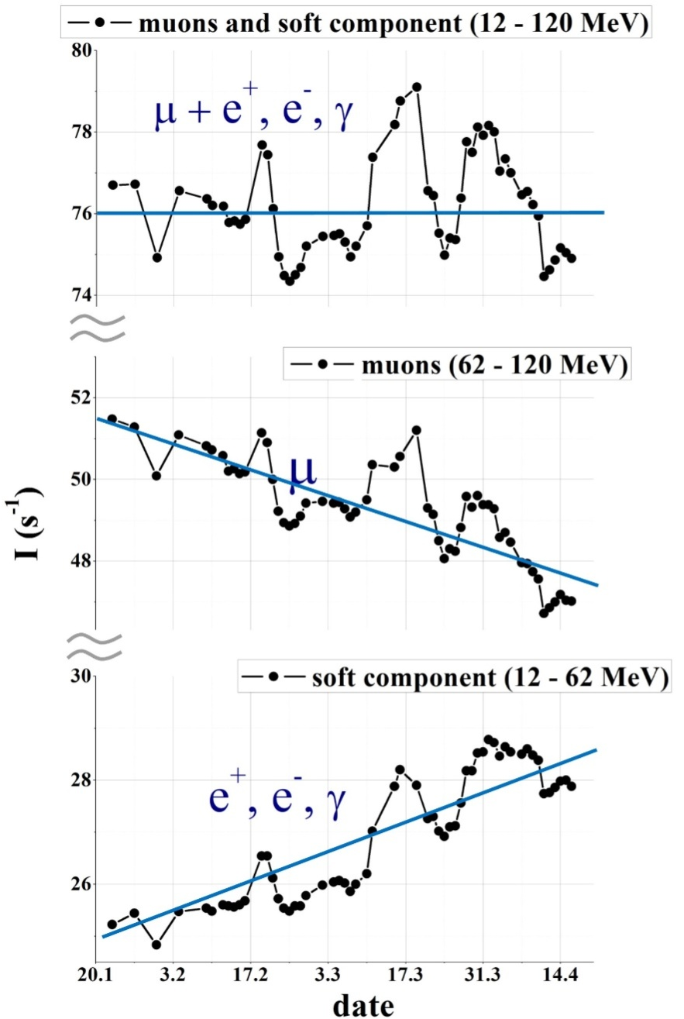
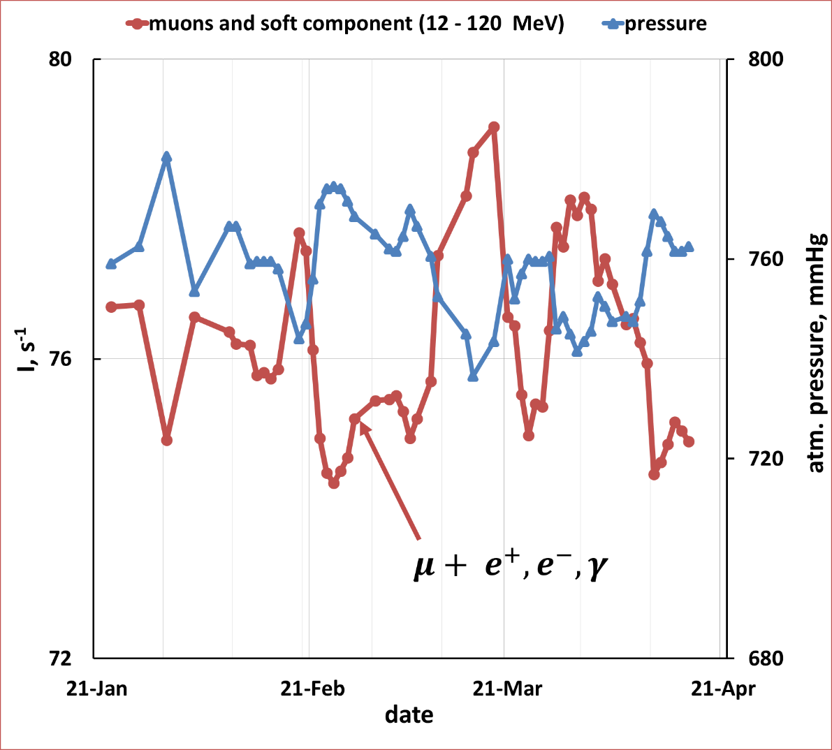
The effects of atmospheric temperature and pressure on cosmic rays
5%
8%
14%

Slide 9
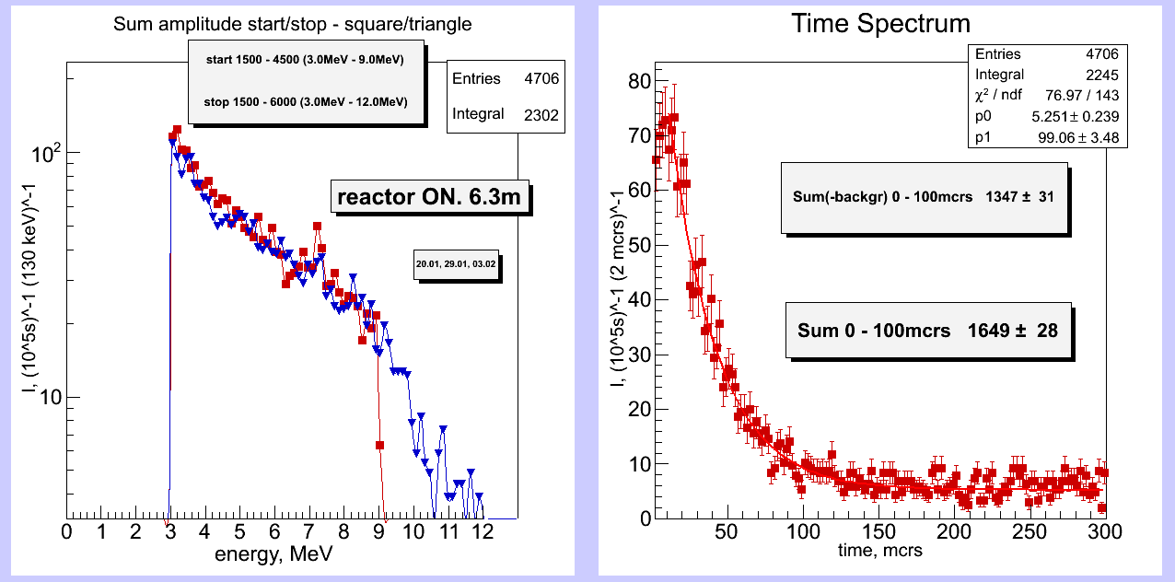
Signal of correlated events
time of arrival of the second
impulse
prompt signal
delayed signal
time window
10 μs
100 μs

Slide 10
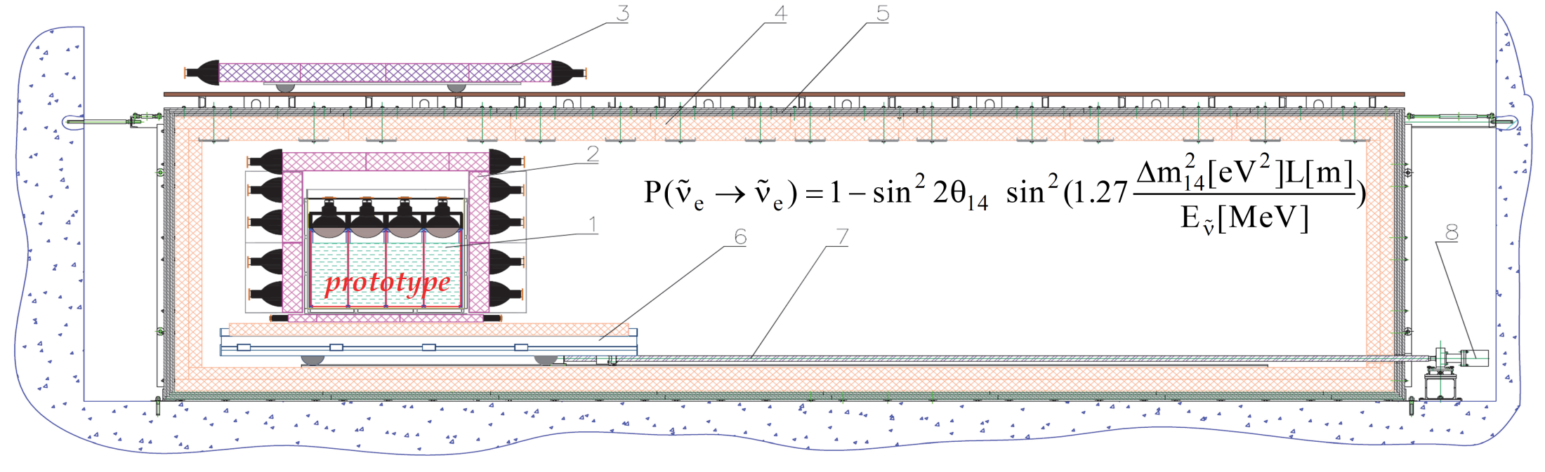
General scheme of experimental setup

Slide 11
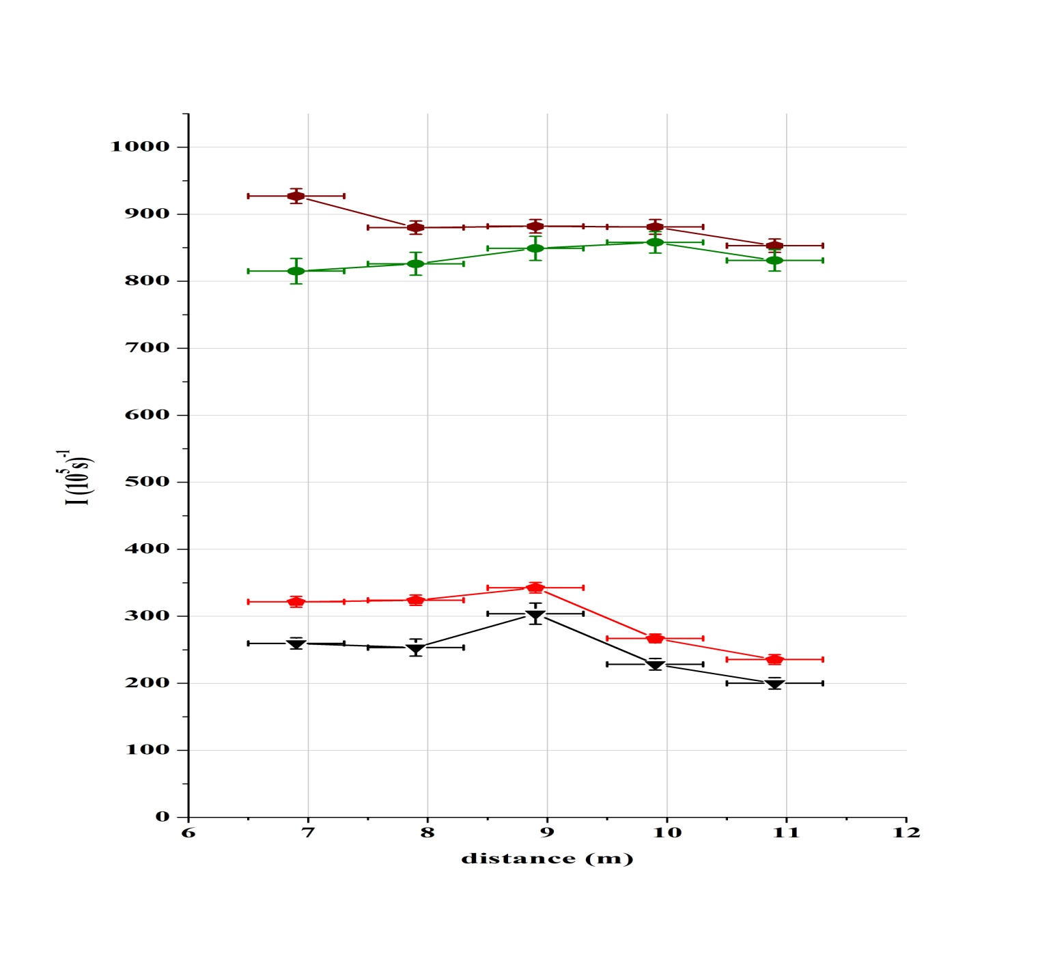
Two level of active shielding
Reactor on
(active shielding - off)
Reactor off
(active shielding - off)
The total suppression provided by two level active shielding is by factor about 4 times.
Reactor on
(active shielding - on)
Reactor off
(active shielding - on)

Slide 12
The problem of fast neutrons
Neutron scattering imitate neutrino reaction

Slide 13
Multi-section model of detector
liquid scintillator
PTM
Table 1. The probability of double-start events registration in various sections.
central section | side section | corner section | average
0.42 | 0.29 | 0.19 | 0.30
Monte-Carlo calculations

Slide 14
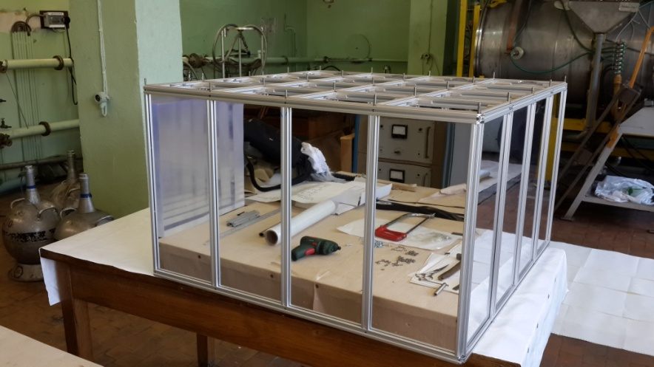
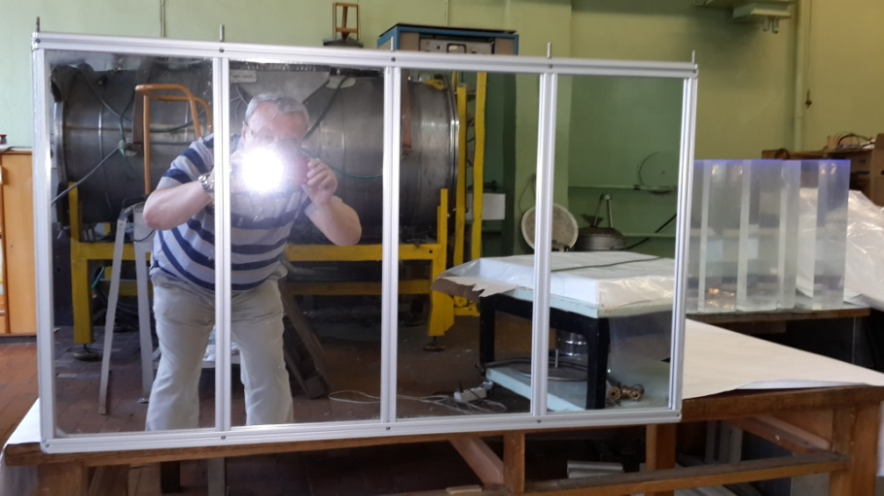
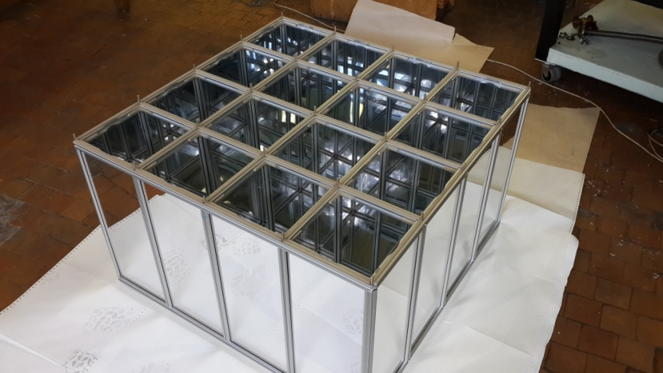
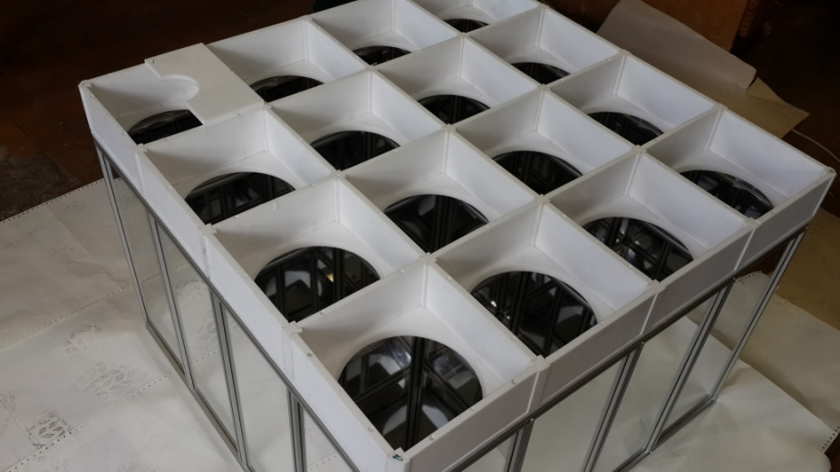
Multi-section antineutrino detector model
The detector consists of 16 sections 22.5 x 22.5 x 50 cm³ with fixed baffles. The baffles are made of acrylic plastic and have specular surface serve to prevent light from leaving the section. Scintillator material is mineral oil (CH₂) with addition of Gadolinium 1g per litter.

Slide 15
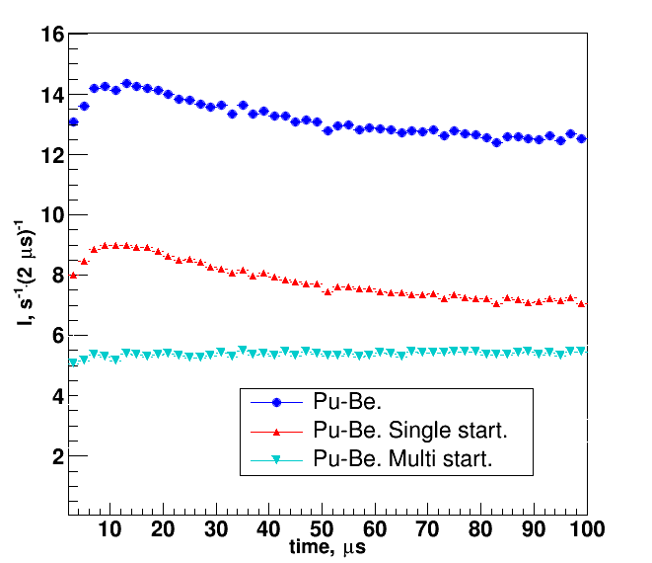
Test measurements with neutron Pu-Be source
all events
Before getting down to the main measurements with a new detector model, measurements with neutron Pu-Be source were made.
This experiment proved that rapid neutrons provide single section starts.
single section starts
multi-section starts

Slide 16
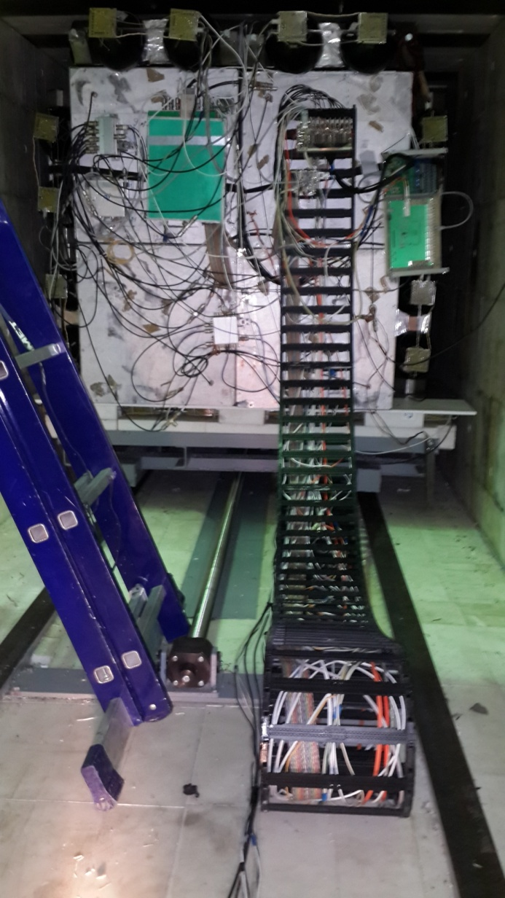
Energy calibration
Fig. 5. Results of energy calibration.

Slide 17
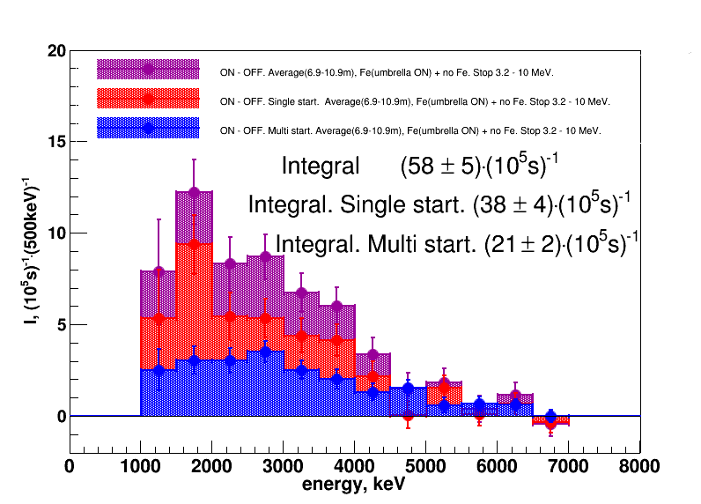
The difference spectra (ON-OFF) of prompt signals
Differences in count rates in reactor on and off regimes for double and single starts integrated over all distances are (35±7)% and (65±11)%.

Slide 18
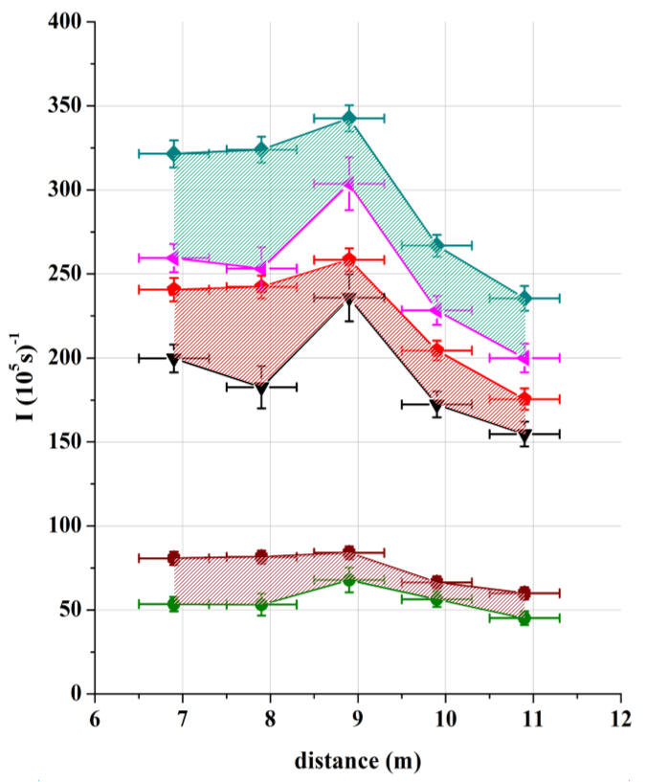
a - all events
Reactor on
Reactor off
Reactor on
Reactor off
b - single section prompt signal events
Reactor on
c - multi-section prompt signal events
Reactor off

Slide 19
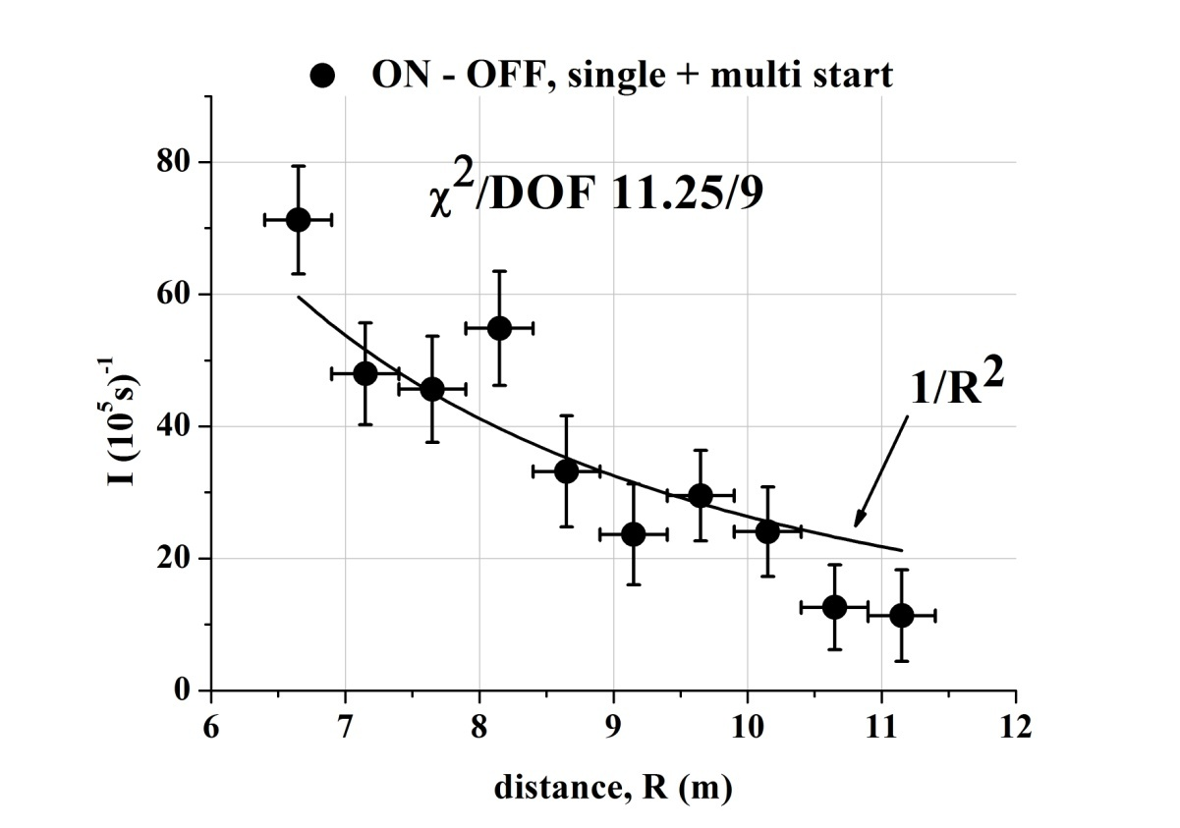
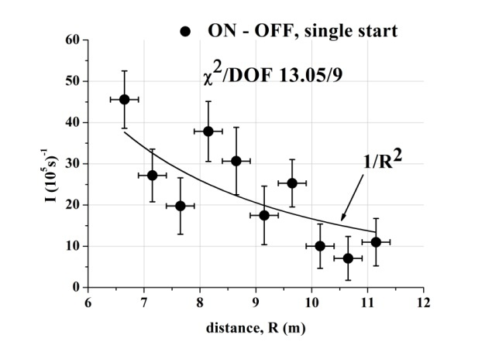
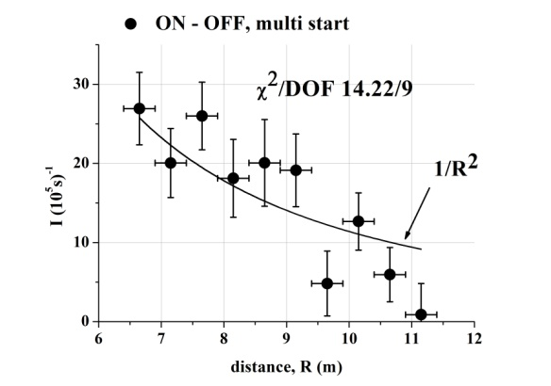
Neutrino flux dependence on the distance from the reactor core
Fig. 2. Neutrino flux dependence on the distance from the reactor core (6-11 meters). Measurements performed with sectioned neutrino detector prototype. Difference in count rates, in reactor on and off regimes, for delayed coincidence in time window 100 µs with cut off random coincidence: a - all events, b - single section prompt signal events, c - multi-section prompt signal events.

Slide 20
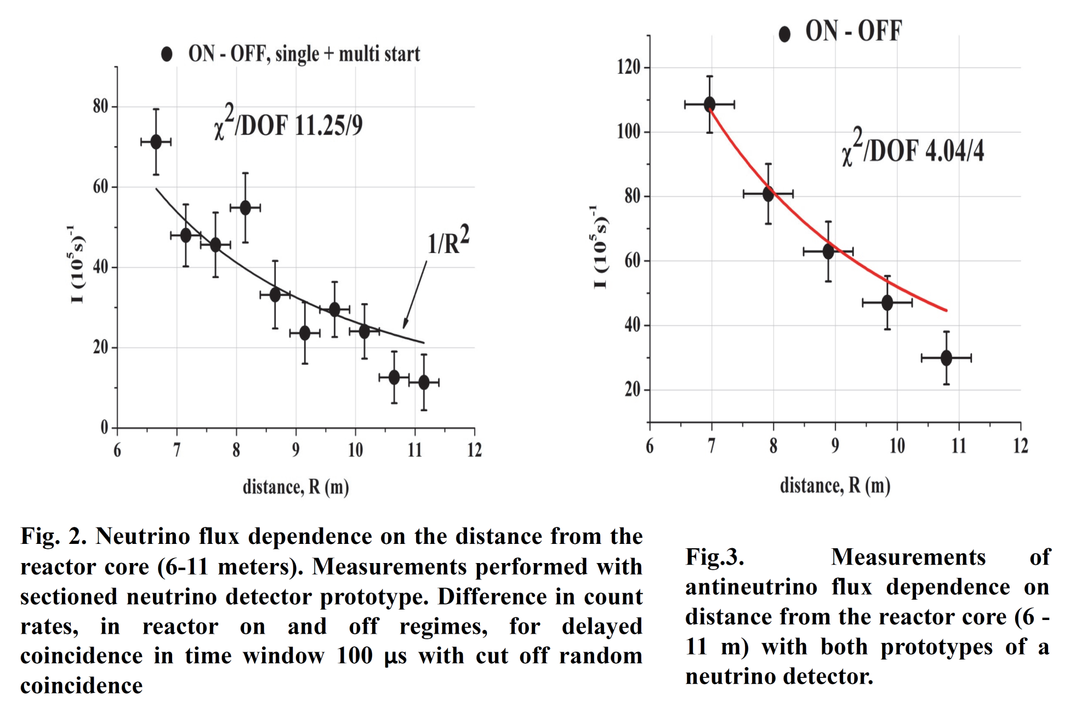
Neutrino flux dependence on the distance from the reactor core

Slide 21
Results of positron (promt) spectrum measuring at various distances and comparison with MC calculations of zero oscillation scenario: a – 6.9 m, b – 7.9 m, c – 8.9 m, d – 9.9 m, e – 10.9 m, f –averaged spectrum.
6.9 m
7.9 m
8.9 m
9.9 m
10.9 m
averaged spectrum

Slide 22
G. Mention et al., Phys. Rev. D83, 073006, 2011
The reactor antineutrino anomaly and sterile neutrino

Slide 23
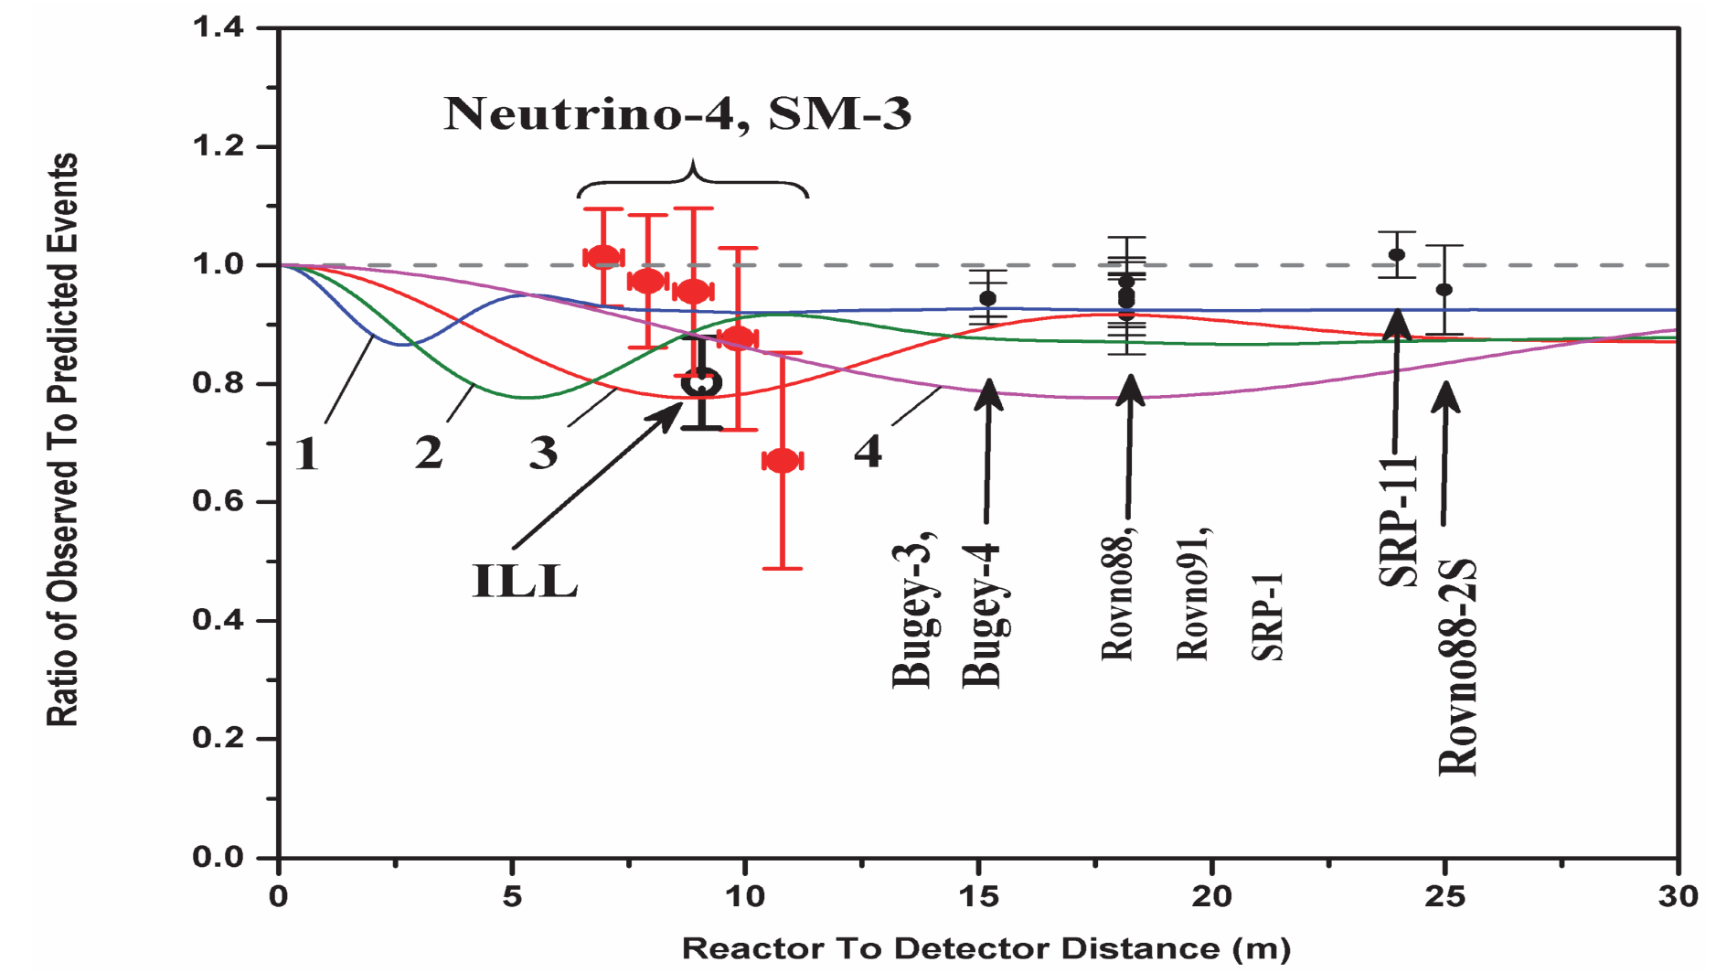
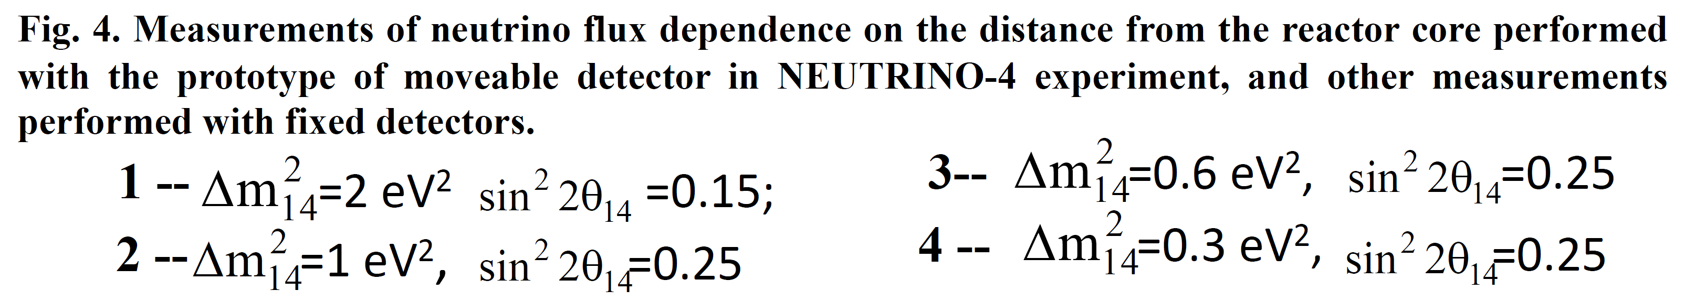
The first measurement of antineutrino flux at the short distance from reactor core

Slide 24
FUTURE PROSPECTS
The full-scale detector with liquid scintillator volume of
3 m³ (5x10 sections) is installed already

Slide 25
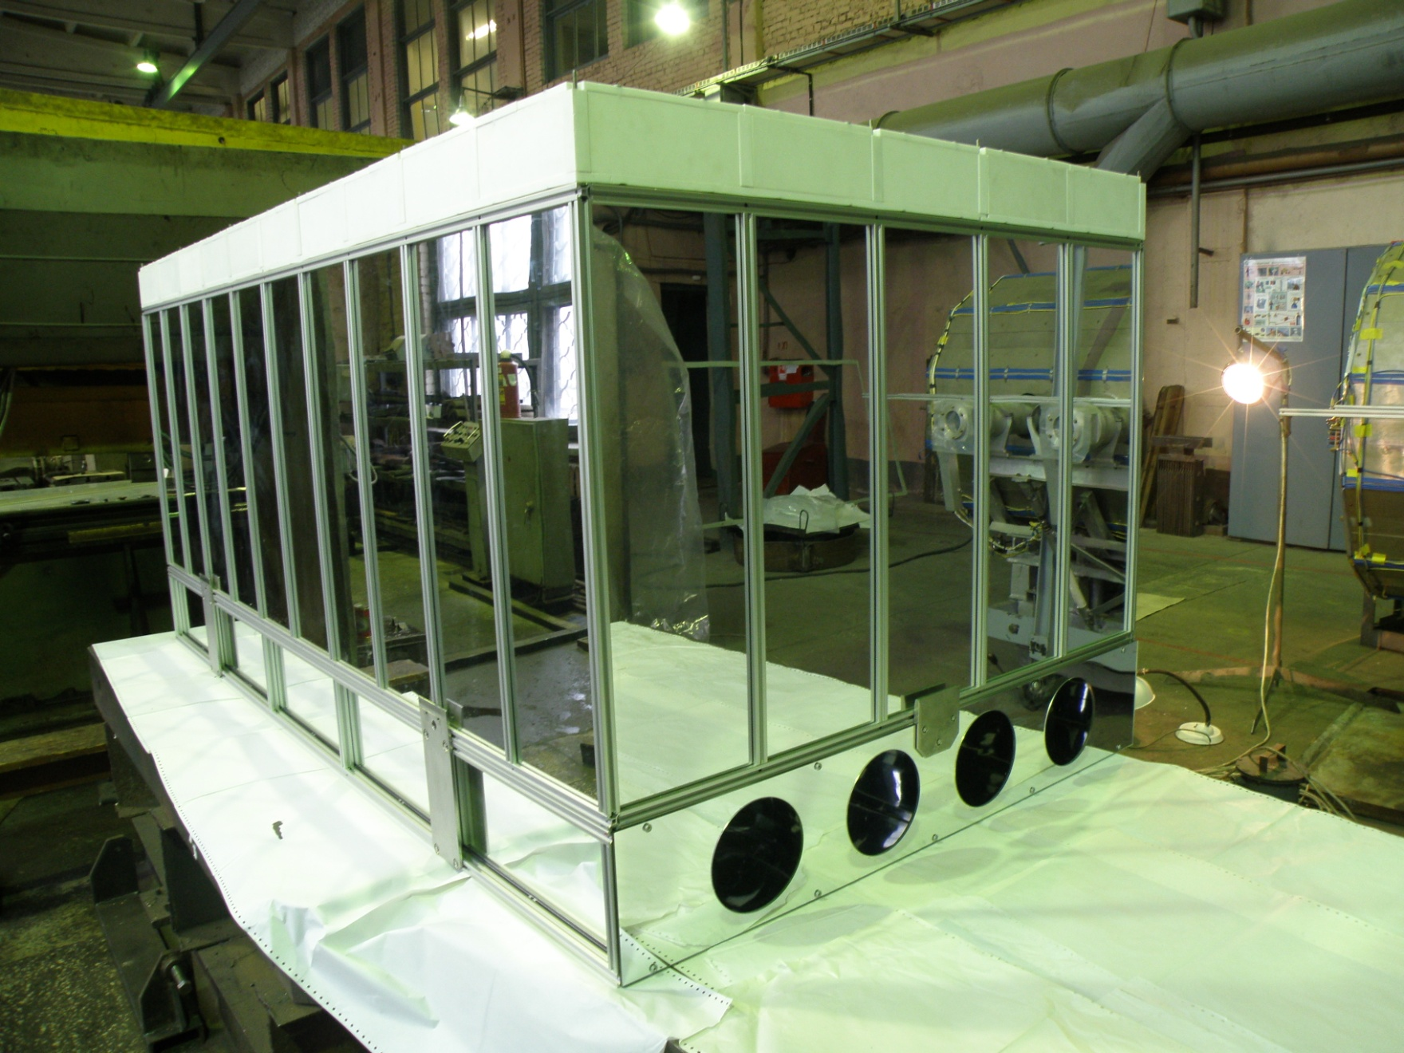
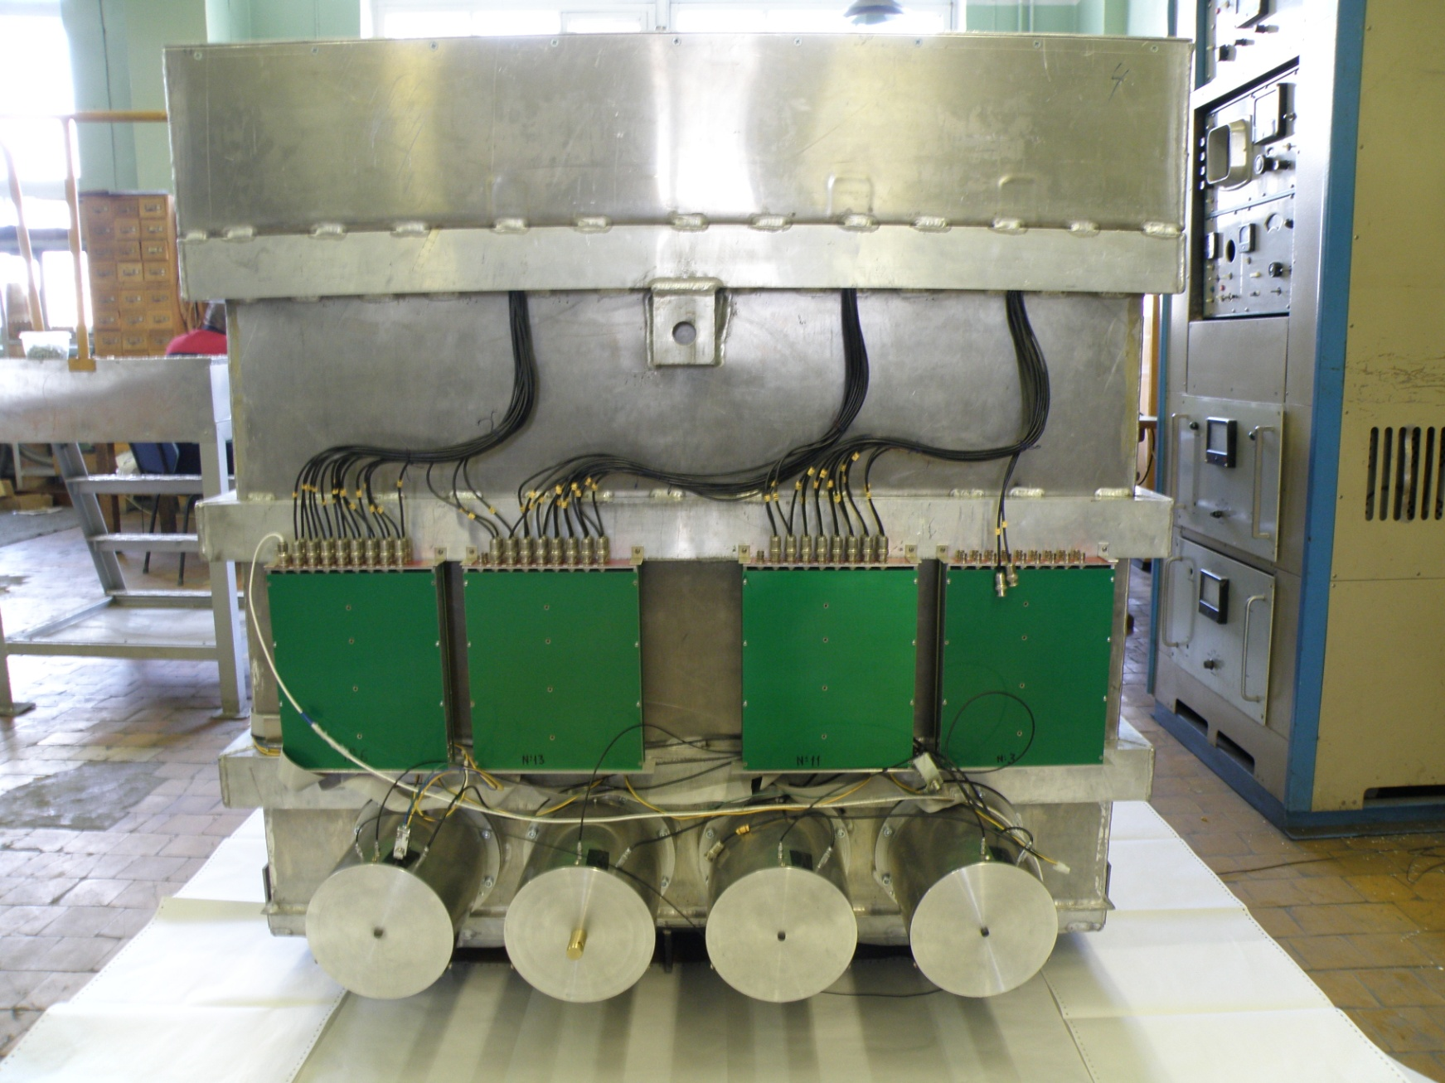
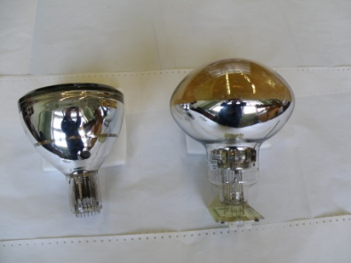
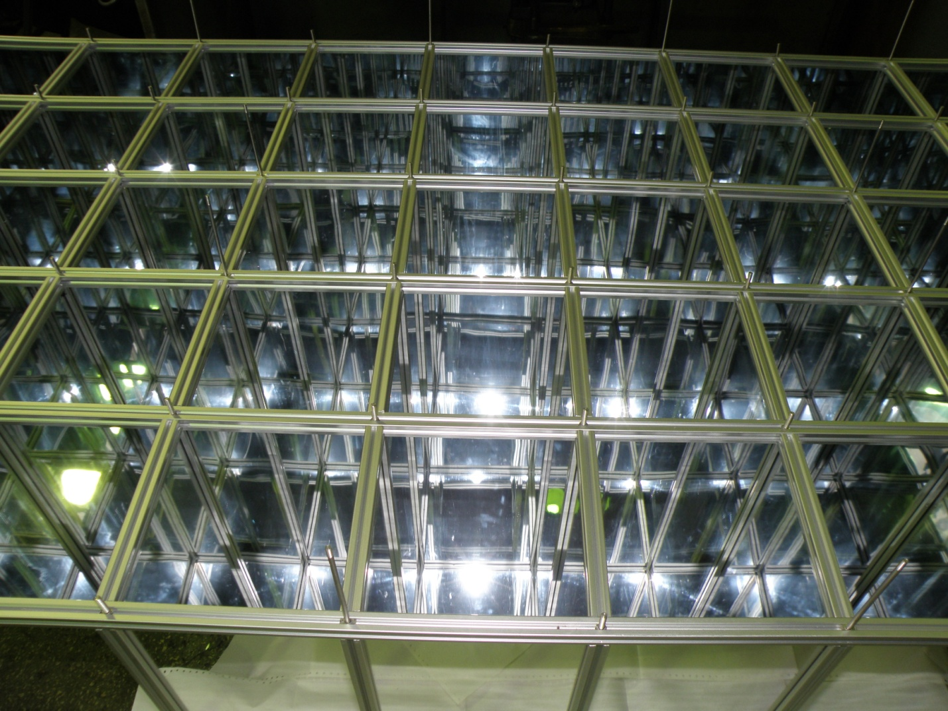
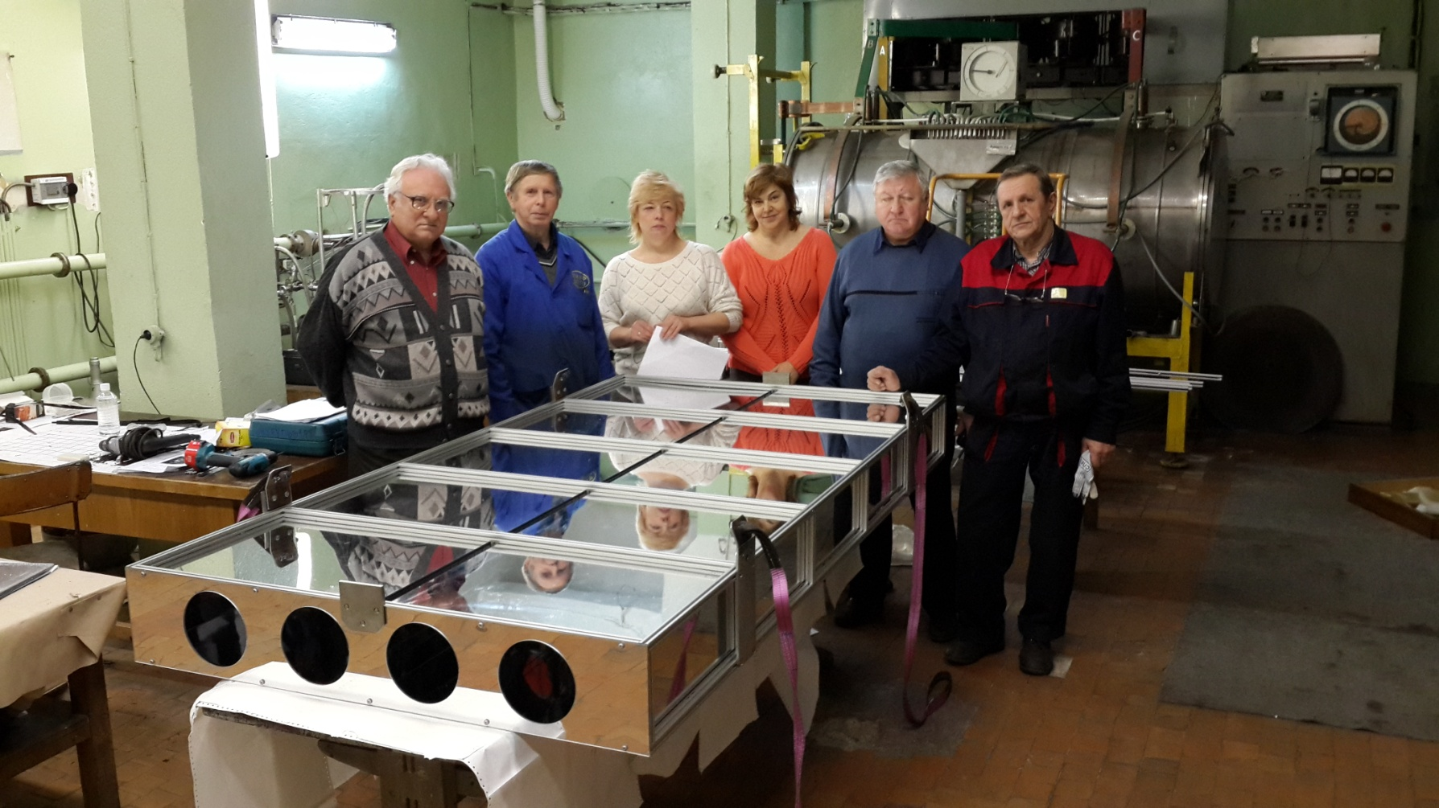
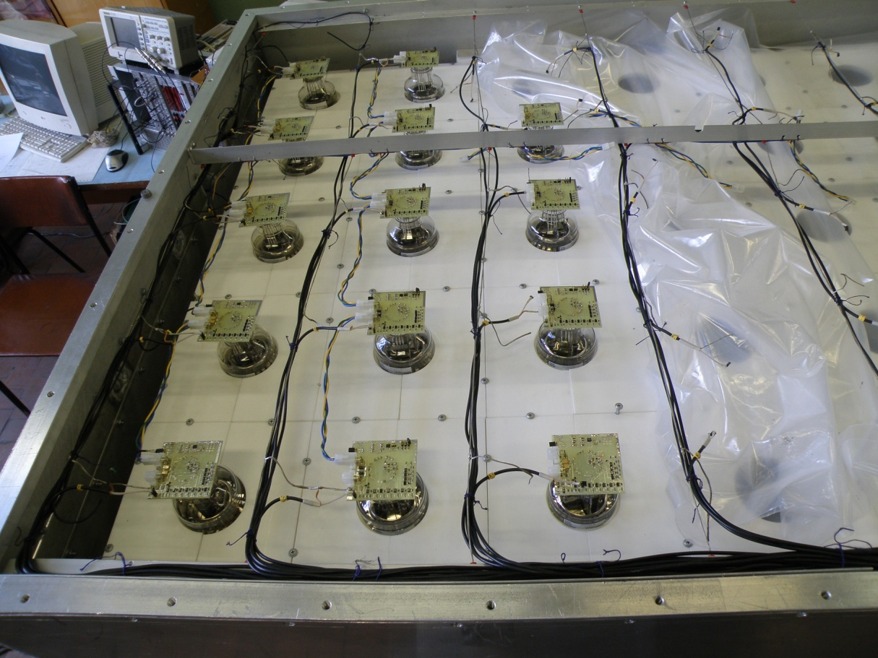
The full-scale detector with liquid scintillator volume of
3 m³ (5x10 sections) is installed already

Slide 26
CONCLUSION
Measurements of antineutrino flux at small reactor distances with moveable detector carried out for the first time.
New detector will allow us to obtain up to 1.5-3.0% statistic accuracy of measurements at the distances from 6 to 12 meters after 2 years of measurements.
We hope that would bring light to the problem of neutrino oscillation in the sterile state.
Thank you for attention

Slide 27
А Serebrov¹, V Ivochkin¹, R Samoilov¹, А Fomin¹, A Polyushkin¹,
V Zinoviev¹, P Neustroev¹, V Golovtsov¹, А Chernyj¹, О Zherebtsov¹,
V Martemyanov², V Tarasenkov², V Aleshin², А Petelin³, А Izhutov³,
А Тuzov³, S Sazontov³, D Ryazanov⁴, М Gromov³, V Afanasiev³,
М Zaytsev^{1, 4}, М Chaikovskii¹
¹ NRC “KI” Petersburg Nuclear Physics Institute, Gatchinа, 188300 Russia
² NRC “Kurchatov institute”, Moscow, 123182 Russia
³ JSC “SSC RIAR”, Dimitrovgrad, 433510 Russia
⁴ DETI MEPhI, Dimitrovgrad, 433511 Russia
E-mail: serebrov@pnpi.spb.ru

