Slide 1
High energy positron detection via synchrotron radiation in magentosphere “SONYA” project
А.М. Гальпер¹, О.Ф. Прилуцкий², С.В. Колдашов¹, В.В. Михайлов¹
¹ Национальный исследовательский ядерный университет МИФИ
² Институт космических исследований РАН
A.M. Galper. O.F. Priluchkii, S.V. Koladashov, V.V. Mikhailov
Presented by Vladimir Mikhailov

Slide 2
Positron fraction e⁺/(e⁺+e⁻) in Galactic Cosmic Ray
Nature, 2009

Slide 3
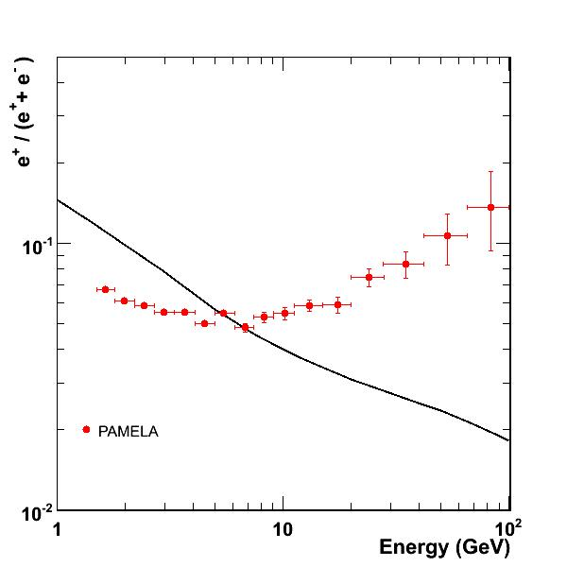
Positron fraction Secondary Production Models
Dark matter? Pulsars? SNR?
There is a source of primary positrons in CR
(Moskalenko & Strong 1998)
GALPROP code
Plain diffusion model
Interstellar spectra
CR + ISM → π± + … → μ± + … → e± + …
CR + ISM → π⁰ + … → γγ → e±

Slide 4
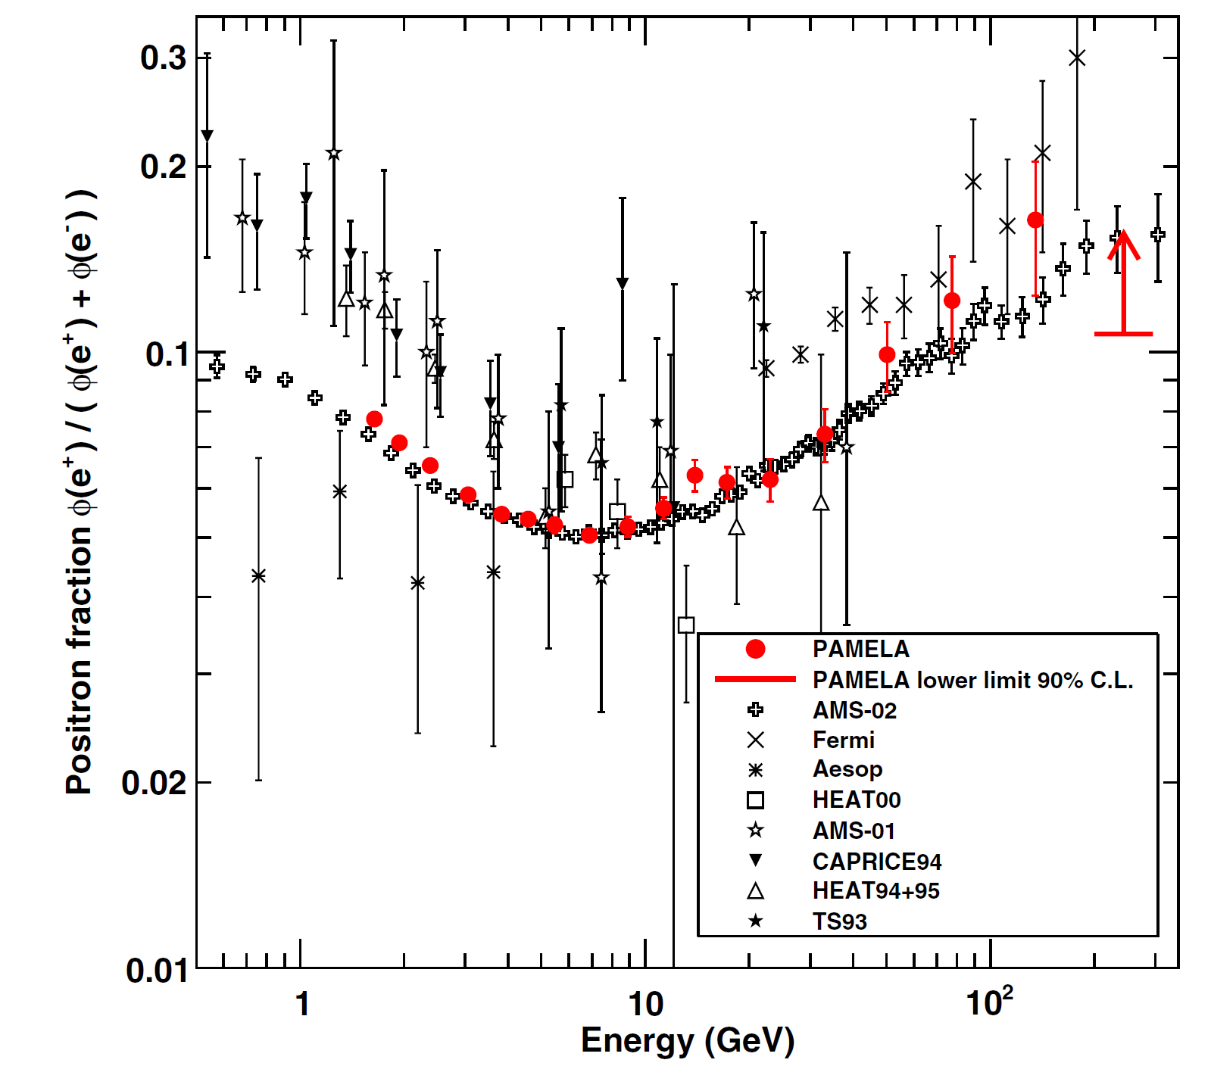
Measurements with AMS02 magnetic spectrometer
Figure from
O. Adriani, et al. Physics Reports, 2014,
http://dx.doi.org/10.1016/j.physrep.2014.06.003
At present AMS-02 extended measurements till ~500 GeV.
AMS-02 M. Aguilar, et al., Phys. Rev. Lett. 110 (2013) 141102

Slide 5
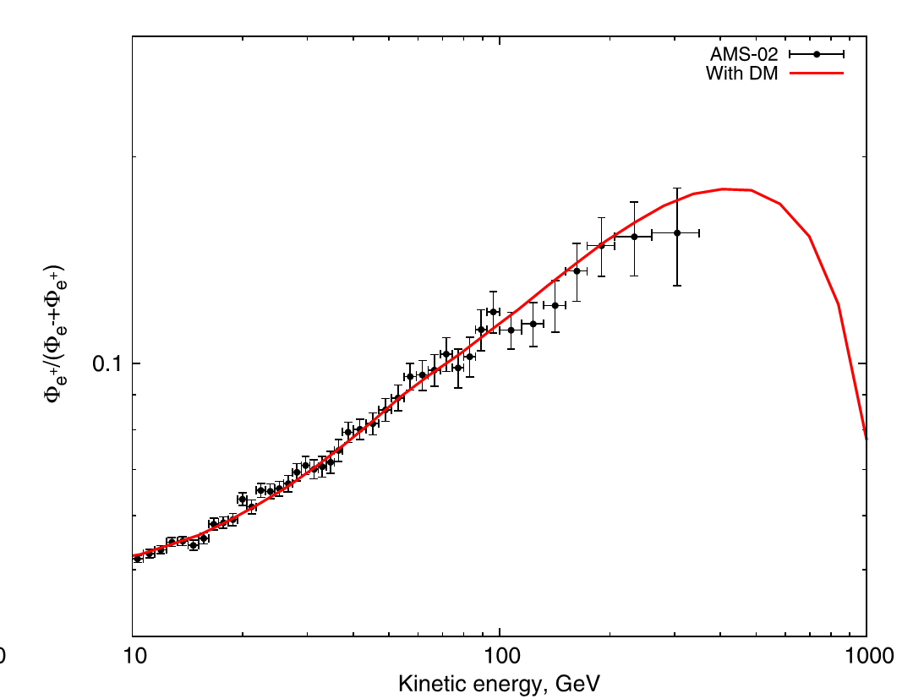
Positron fraction with DM source: an example
Physics Letters B 728 (2014) 250–255

Slide 6
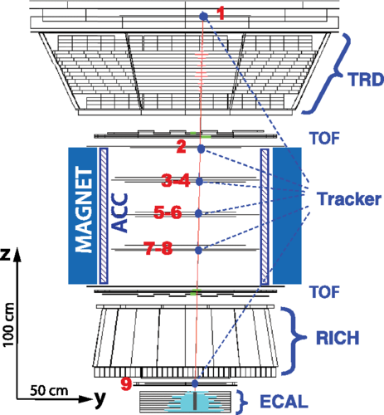
Magnetic spectrometer technique
At high energy dominant background is due to spillover events
Finite deflection resolution of tracker ⇒ wrong assignment of charge-sign & high energy
The AMS-02 MDR is about 2 TV, a very high value with respect to similar experiments.
Problems with MDR increasing
AMS-02 magnetic spectrometer

Slide 7
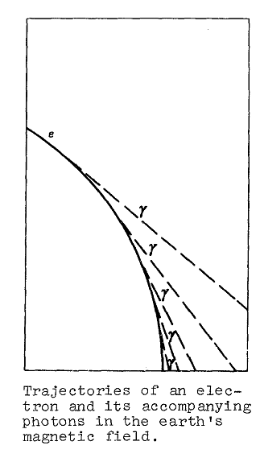
Prilutshkii idea (1972)
Detection of co-linear simultaneous X-ray photons in the detector
Advantages:
increase of the effective area of the instrument
proton background rejection factor ~10⁶
possibility to reduce spillover till ~hundreds TV
Challenges:
background from CR

Slide 8
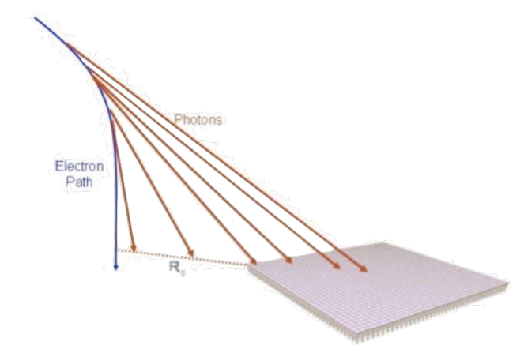
CREST EXPERIMENT 2011-2012
10 days balloon flight in Antarctica
Nahee Park , ICRC 2013

Slide 9
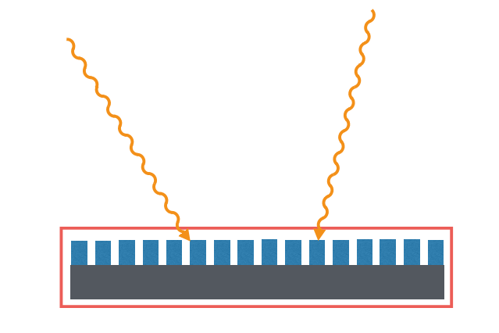
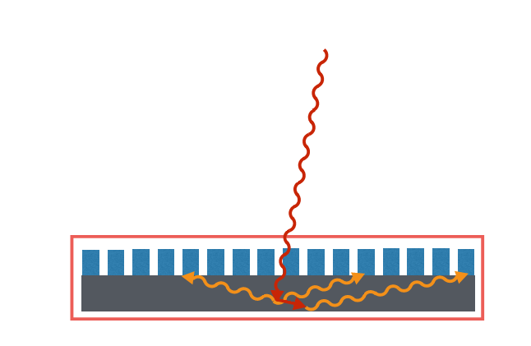
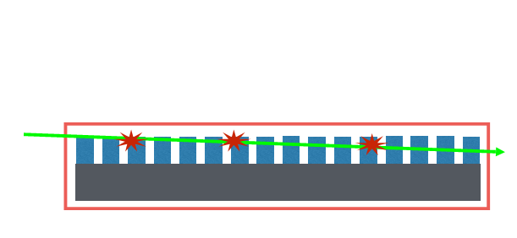
Good event
Coincidence events
Horizontal passing of charge particles
Interaction inside detector
Atmospheric background events were too large
Nahee Park , ICRC 2013

Slide 10
Prototype SRD test flight on board STS-108
Small prototype of SRD with
YAP (Ce) scitillator crystals 18x18X1 mm
12 days flight in 2001.
Yttrium Aluminum Perovskite activated by Ce3+
SRD principle works in blue region
H. Anderhub+, Nucl Phys 2002, 113,166
B. Zimmerman, 2003, ETZH

Slide 11
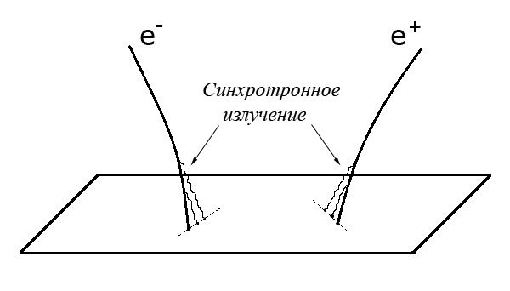
Positron detection
X-ray photons
Relative position of synchrotron photons and primary particle is signature for e+ and e-

Slide 12
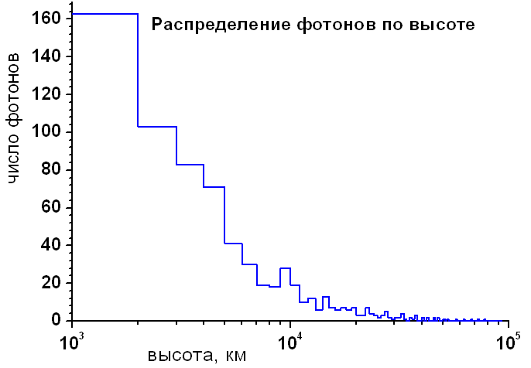
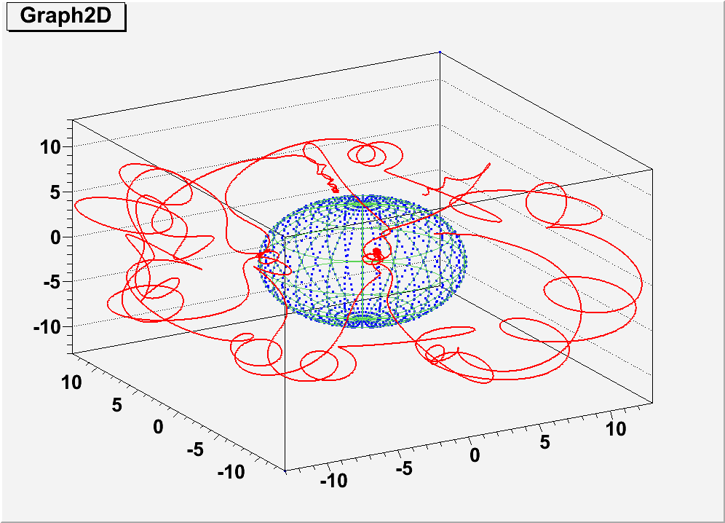
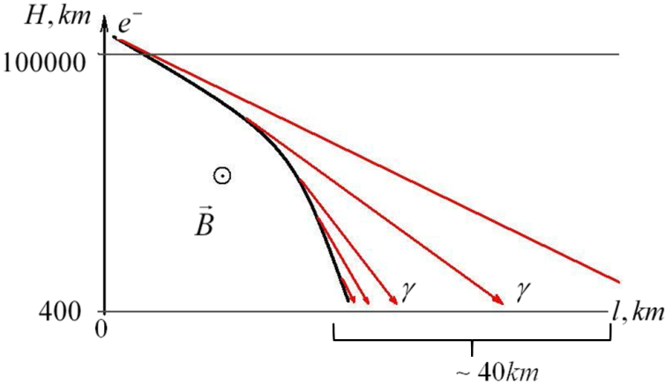
Simulation of particles trajectories in magnetosphere
Trajectories of positrons and electrons were reconstructed in the Earth's magnetic field.
IGRF field model was used
Number of photons
Altitude distribution of emitted photons for 1 TeV electrons
Altitude, km
Examples of trajectory calculations into geomagnetic field near cut-off rigidity.

Slide 13
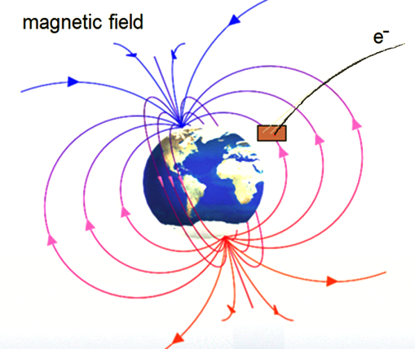
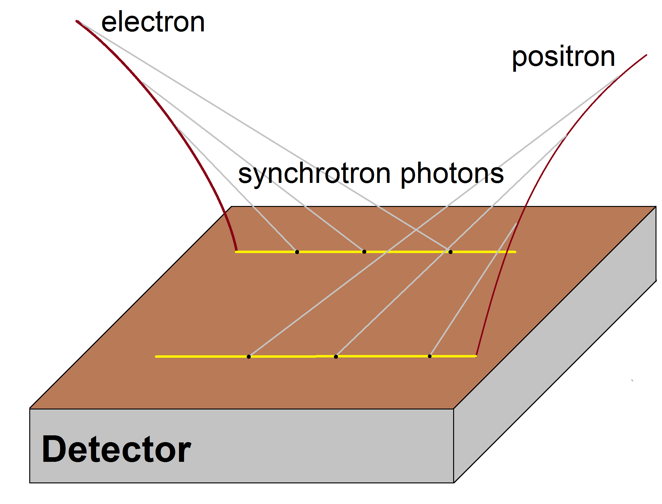
Project SONYA
Task: Measurements energy spectra of cosmic ray electrons and positrons of very high energy form handreds GeV till 10-20 TeV using SR method
Object : to study origin of high energy positron excess and
DM properties
CdZnTe Х-ray pixel detector
С1
Trigger with scintillator detectors
С1 &&C2.
C1~ 1mip, C2>10 mip
Place : LEO satellite or ISS
Size : > 1м²
Duration : ~ 3 years
Expected number of events : ~ 300 positrons ~ 3000 electrons above 1 TeV
С2
С1
Tungsten W ~3X₀
Scheme of the instrument
W-converter reduce proton background and help to identify positrons
ToF reduce background from albedo particles.
Cadmium zinc telluride CdZnTe X-ray detectors are widely used . It allows to reach energy resolution ~better 10 % at about ~10 KeV

Slide 14
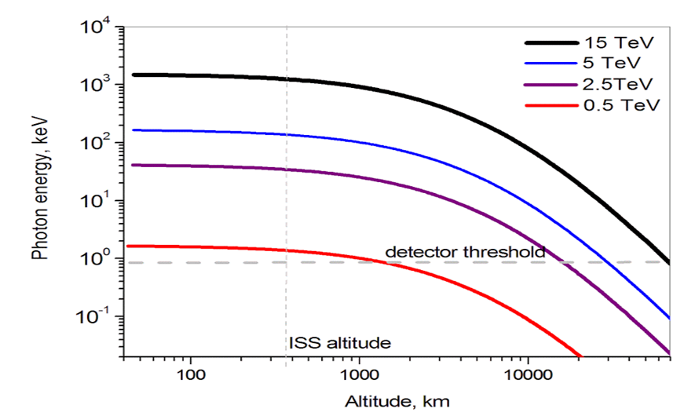
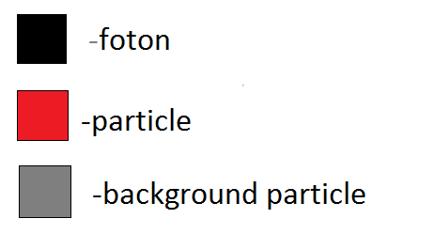
Simulation and conclusion
Average energy of photons as function of altitude of emission for differenc electron energies. If detector is placed on ISS the detector threshold ~2 KeV provide measurements of positrons with energy from ~0.5 TeV
Conclusion:
Experiments CREST и PSRD and our simulations shows principal possibility to create Synchrotron Radiation Detector to study electron and positron energy spectra above 0.5 TeV.
Detector have to include at least low threshold X-ray detector about 1m², thin electromagnetic calorimeter/converter and ToF systems.
The instrument have to be placed on LEO orbit with relatively small inclination
Topology of «good» event.
Good coordinate resolution ( better 1 cm) allows to reject background
references 1.J. Musser, C. Bower, S. Coutu et al. Proc. 34th ICRC, PoS, Hague, 2015
2.H. Anderhuba, et al, Nuclear Physics B , 113 (2002) 166

Slide 15
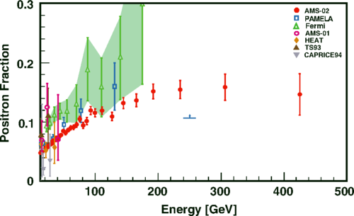
Phys. Rev. Lett. 113, 121101 – Published 18 September 2014

