Slide 1
ICPPA-2016
Novelties in Elementary Particle
Gaseous Detectors
Technology
Fulvio Tessarotto
INFN - Trieste
Moscow, 12/10/2016, 2nd International Conference on Particle Physics and Astrophysics ICPPA-2016 - Fulvio Tessarotto

Slide 2
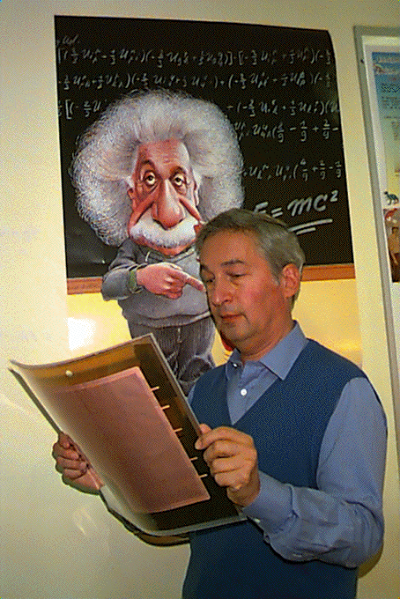
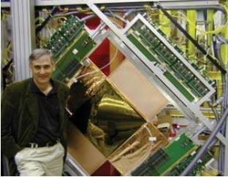
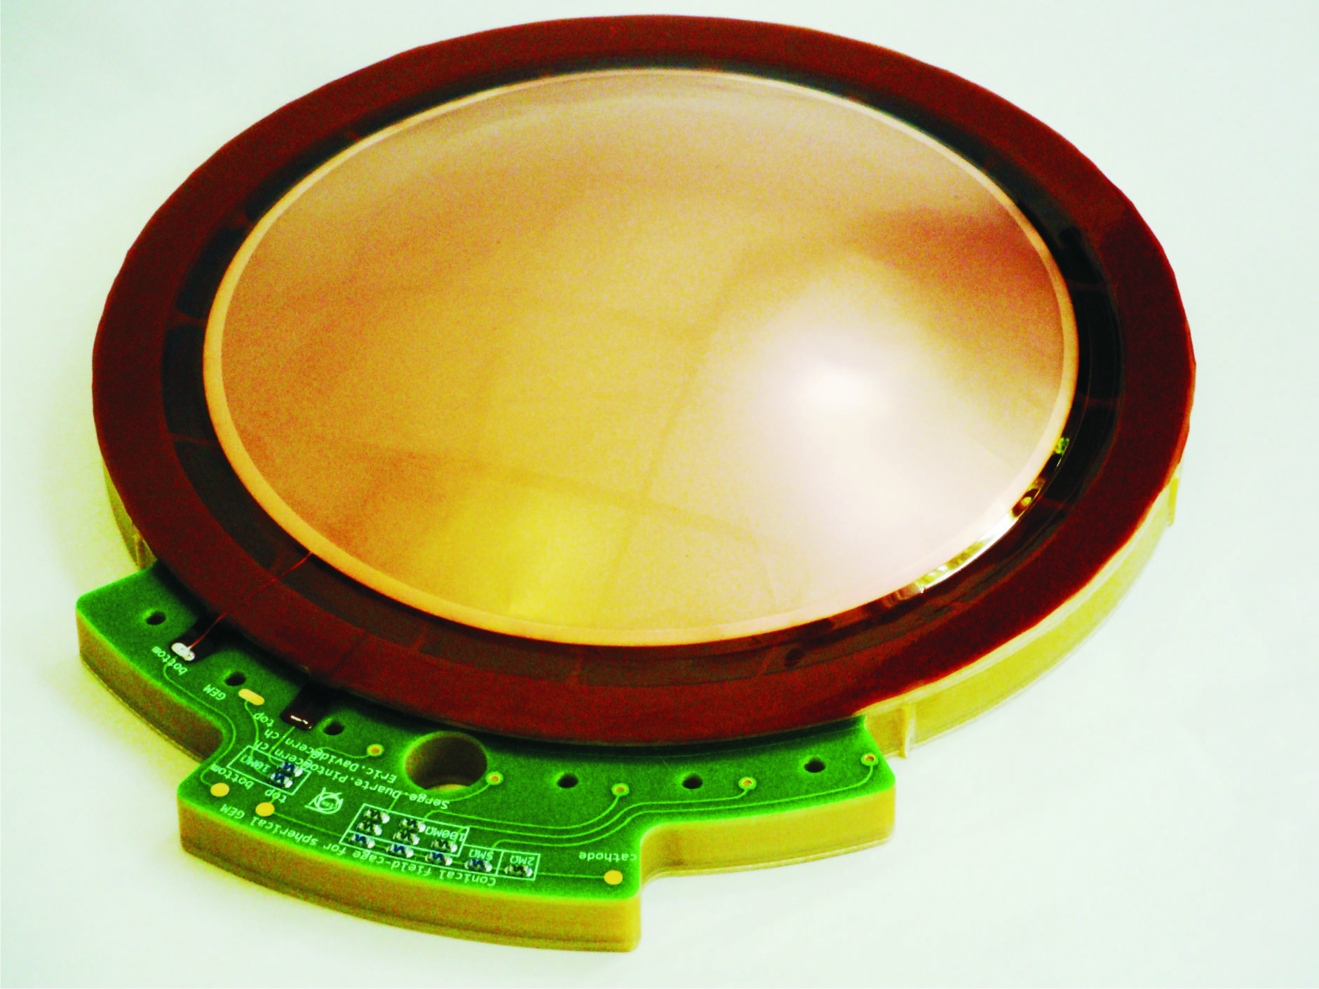
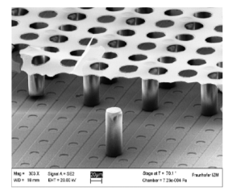
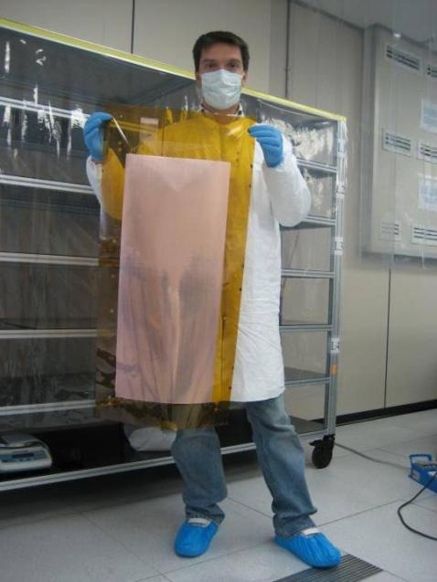
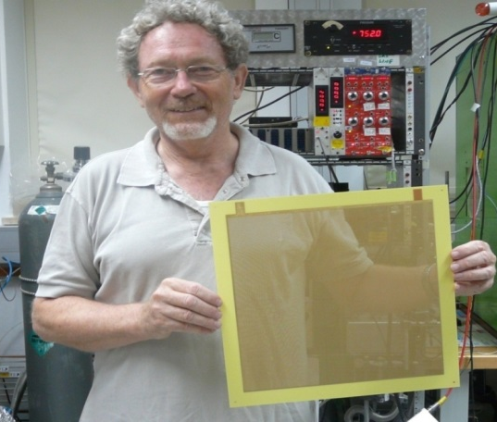
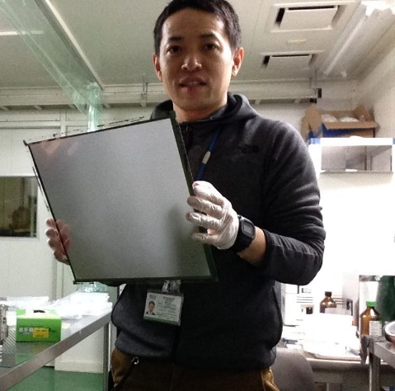
outline
Historical introduction
Micromegas
GEMs
Novel detectors
Gaseous photon detectors
Conclusions
Moscow, 12/10/2016, 2nd International Conference on Particle Physics and Astrophysics ICPPA-2016 - Fulvio Tessarotto

Slide 3
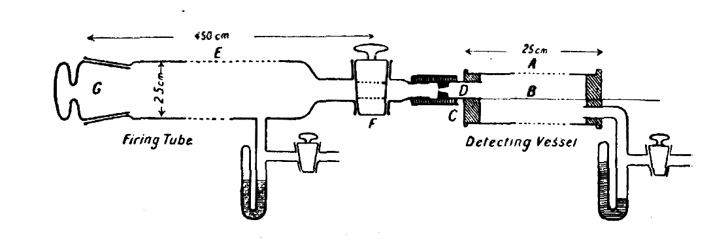
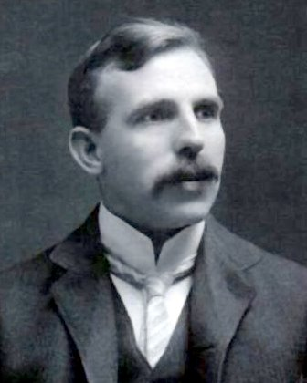
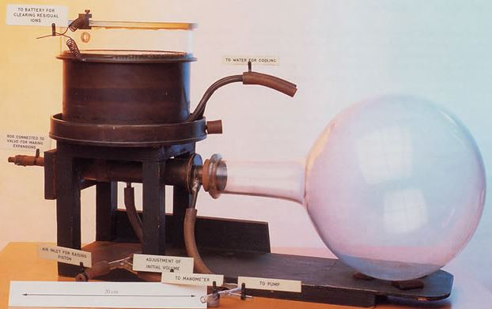
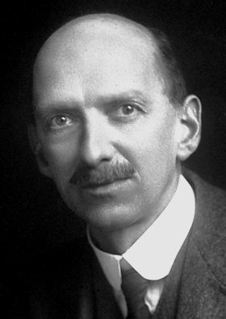
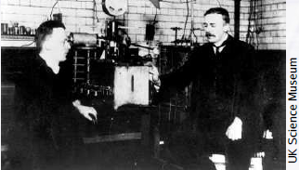
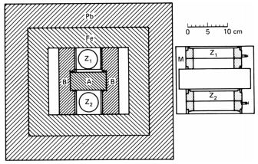
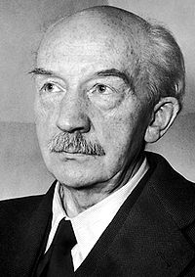
Glorious tradition: 100 years of gaseous detector developments
1908: FIRST WIRE COUNTER
USED BY RUTHERFORD IN THE STUDY OF NATURAL RADIOACTIVITY
1911: CLOUD CHAMBER
E. Rutherford and H. Geiger , Proc. Royal Soc. A81 (1908) 141
Nobel Prize in Chemistry in 1908
1928: GEIGER COUNTER
SINGLE ELECTRON SENSITIVITY
Charles T.R. Wilson
Nobel Prize in 1927
COINCIDENCE METHOD
Ernst Rutherford
Hans Geiger
H. Geiger and W. Müller, Phys. Zeits. 29 (1928) 839
Walther Bothe
Nobel Prize in 1954
Moscow, 12/10/2016, 2nd International Conference on Particle Physics and Astrophysics ICPPA-2016 - Fulvio Tessarotto

Slide 4
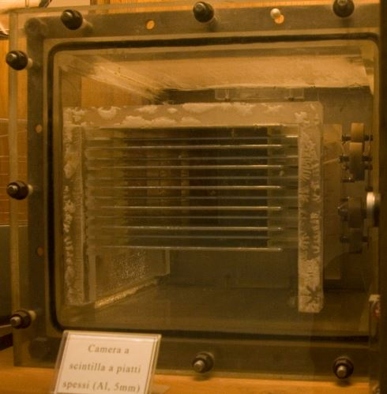
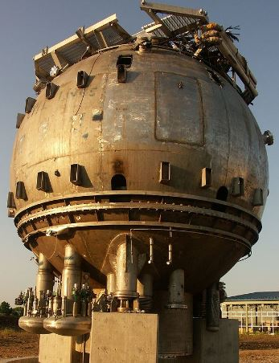
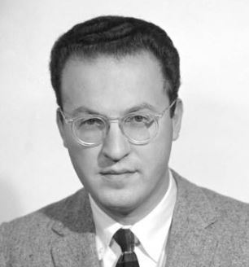
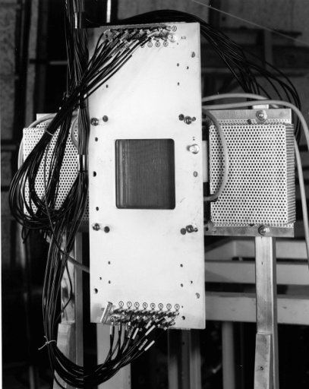
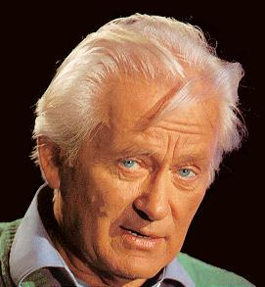
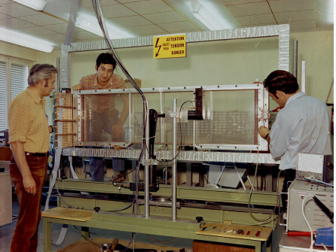
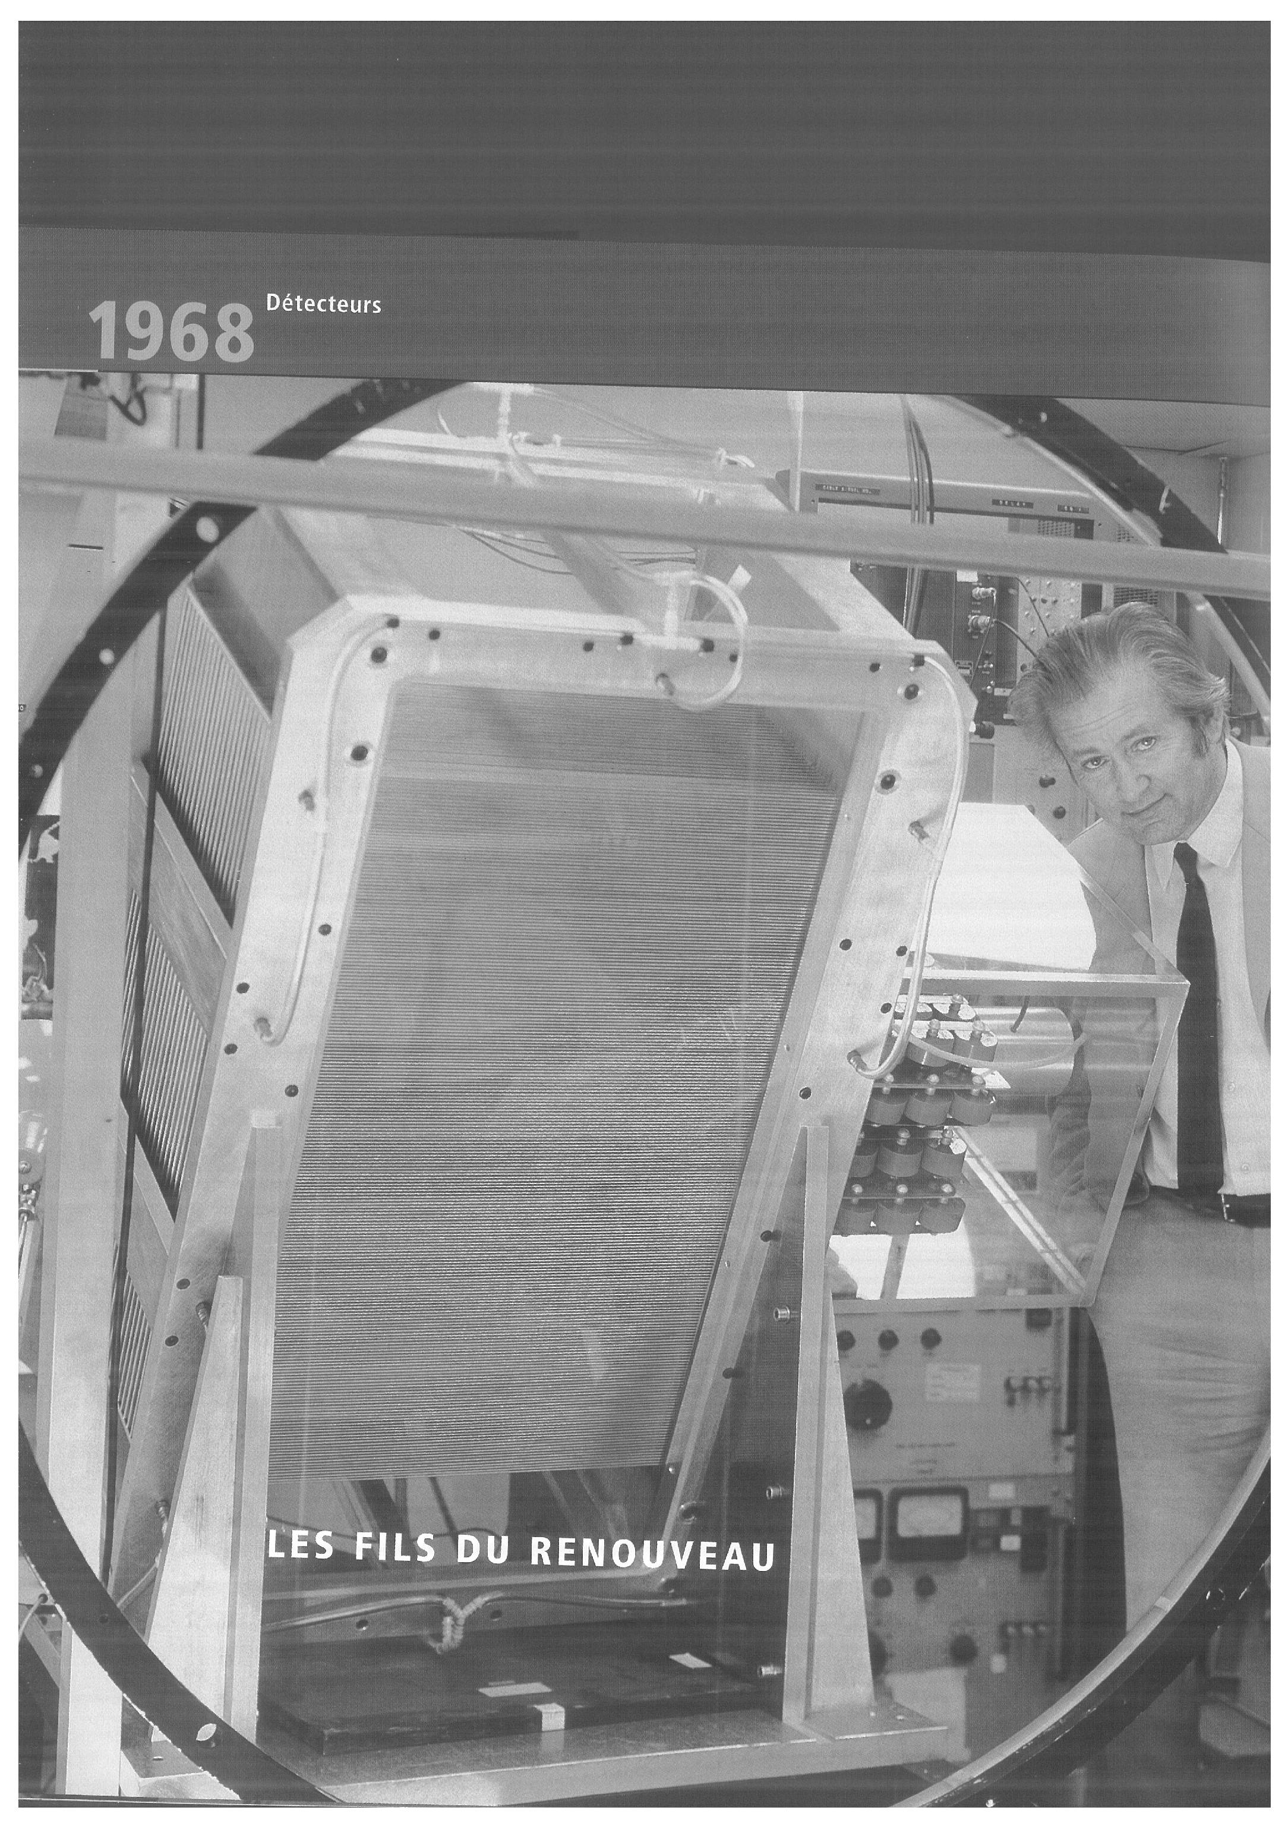
Glorious tradition: 100 years of gaseous detector developments
SPARK CHAMBER
1952: BUBBLE CHAMBER
1968: MULTIWIRE PROPORTIONAL CHAMBER
Donald A. Glaser
Nobel Prize in 1992
F. Sauli
G. C. Santiard
G. Charpak
George Charpak
Nobel Prize in 1992
Moscow, 12/10/2016, 2nd International Conference on Particle Physics and Astrophysics ICPPA-2016 - Fulvio Tessarotto

Slide 5
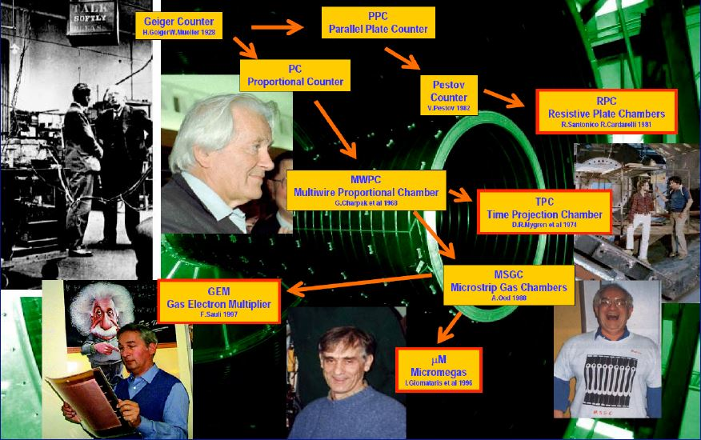
Glorious tradition: 100 years of gaseous detector developments
Moscow, 12/10/2016, 2nd International Conference on Particle Physics and Astrophysics ICPPA-2016 - Fulvio Tessarotto

Slide 6
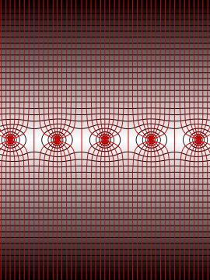
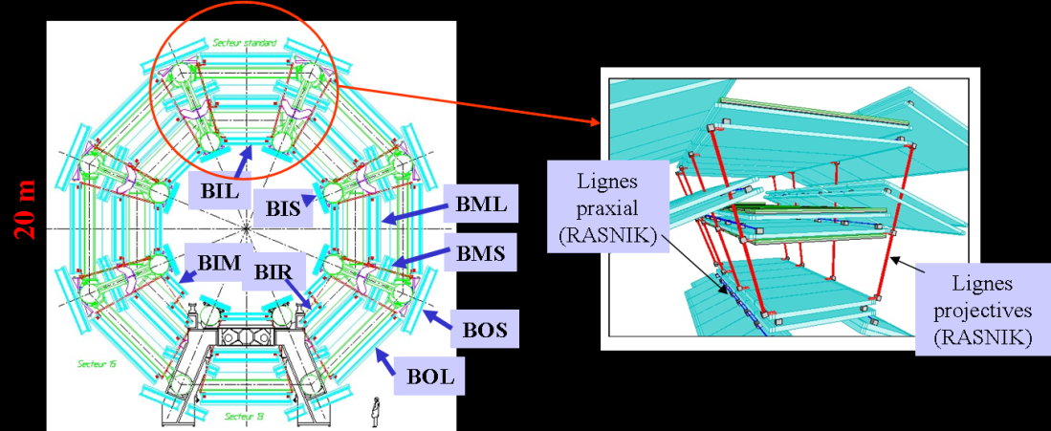
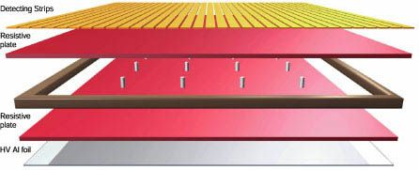
GASEOUS DETECTORS
was the only approach to achieve good space resolution before introducing the Si trackers
Still today the only way to equip large volumes at a
reasonable cost, with good space resolution and
limited material budget
ATLAS, μ spectrometer
Time resolution record in
extended counters
RPC: σ_{t} ≤1 ns
trigger in ALICE, ATLAS, CMS
Moscow, 12/10/2016, 2nd International Conference on Particle Physics and Astrophysics ICPPA-2016 - Fulvio Tessarotto

Slide 7
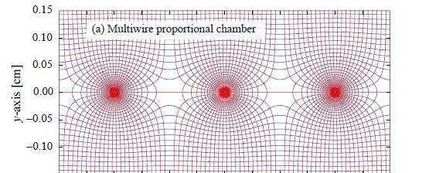
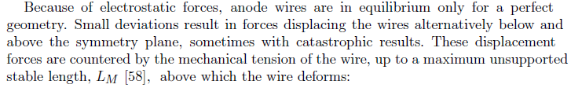

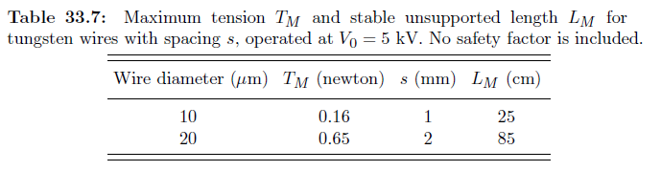
MWPCs
Extraordinary success and ubiquitous use of MWPCs:
in many discoveries they played an essential role
To increase the rate capability: reduce the cell size
Even the best wires (Au coated, Rhenium/Tungsten) with a diameter of 5 µm cannot hold the tension needed to operate a 10 cm long MWPC.
Moscow, 12/10/2016, 2nd International Conference on Particle Physics and Astrophysics ICPPA-2016 - Fulvio Tessarotto

Slide 8
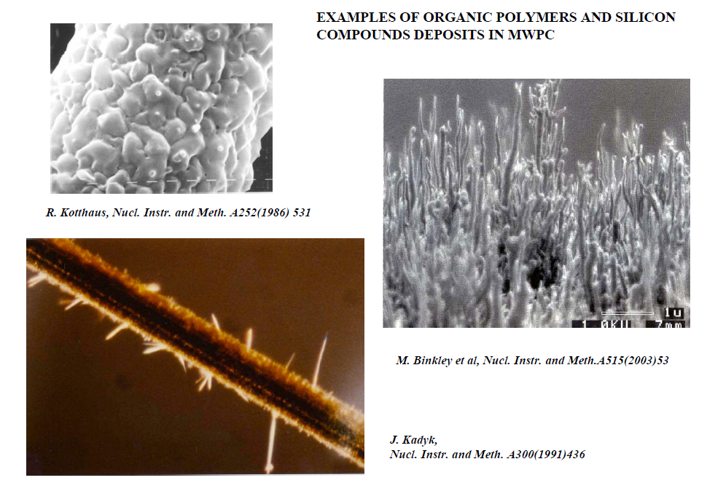
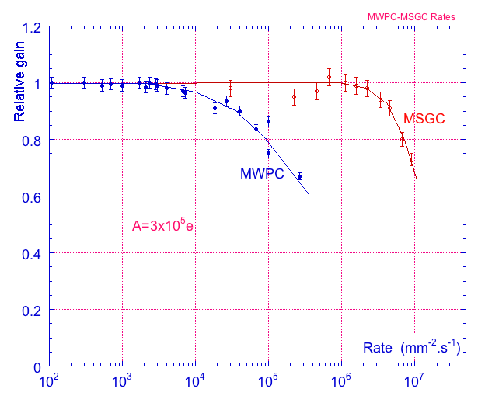
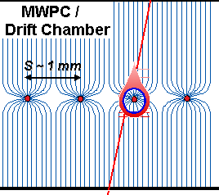
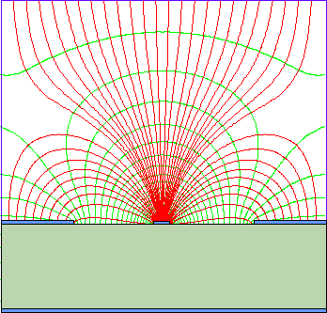
After MWPCs
Advantages of gas detectors:
low radiation length
large areas at low price
flexible geometry
space and energy resolution
The MWPC limits in:
- rate capability (space charge ➔ E distortion)
- space resolution (cell size limitation)
- time resolution (signal from ion drift)
- aging
have been overcome by a change in technology since the anode is no more self supporting: strip on insulating substrate, …
Amplifying cell
size reduction by
factor of 10

Slide 9
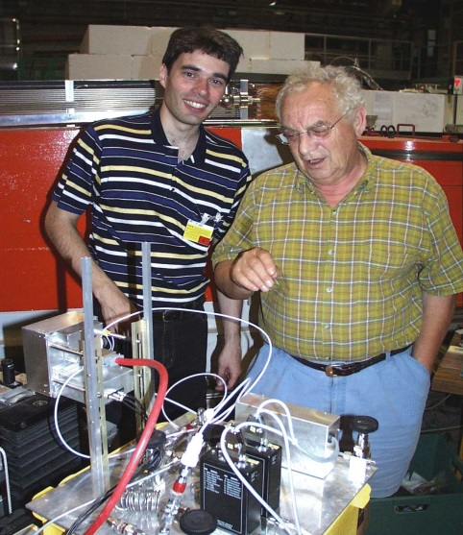
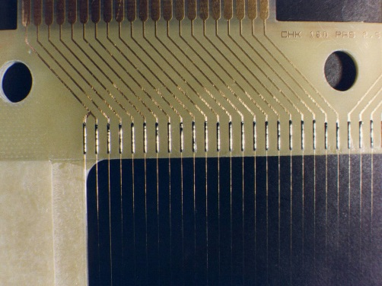
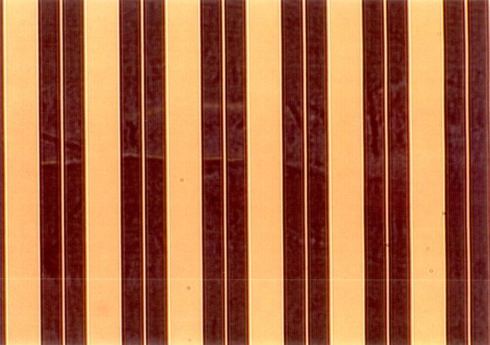
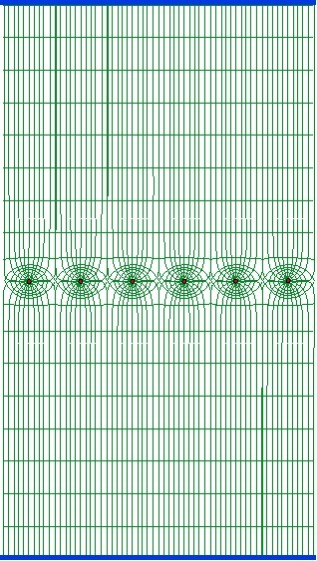
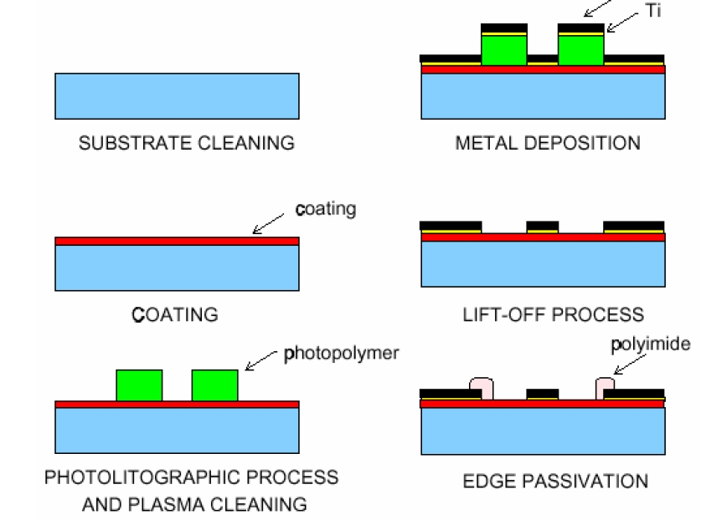
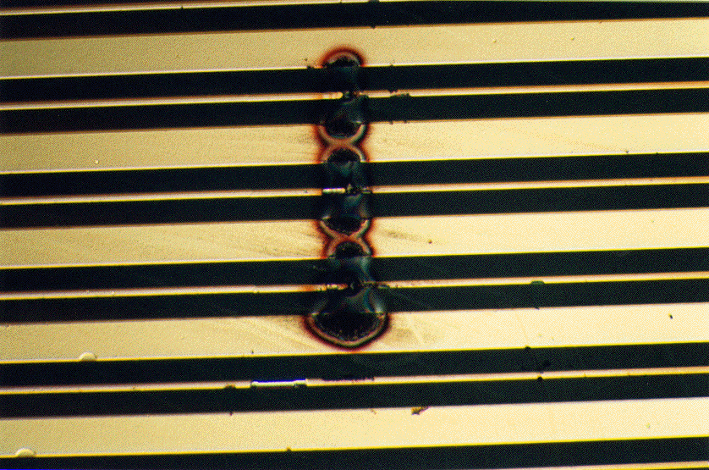
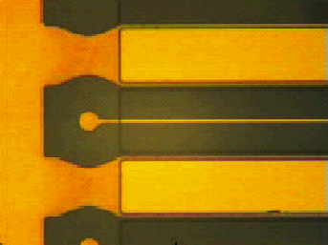
MicroStrip Gas Chamber
MWPC
MSGC
Semiconductor industry technology:
Photolithography
Etching
Coating
Doping
Typical distance between
wires limited to 1 mm
Typical distance
between anodes 200 μm
thanks to semiconductor
etching technology
A. Oed, Nucl. Instr. and Meth. A263 (1988) 351.
In the early days:
high E-values at the edge between insulator and strips → damages
Charge accumulation at the insulator → gain evolution vs time
Later (~ 1999-2000):
Passivation of the cathode edges
→ MSGC operational
Moscow, 12/10/2016, 2nd International Conference on Particle Physics and Astrophysics ICPPA-2016 - Fulvio Tessarotto

Slide 10
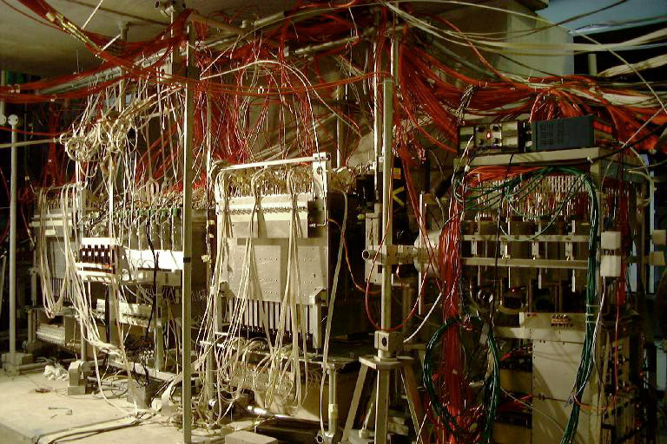
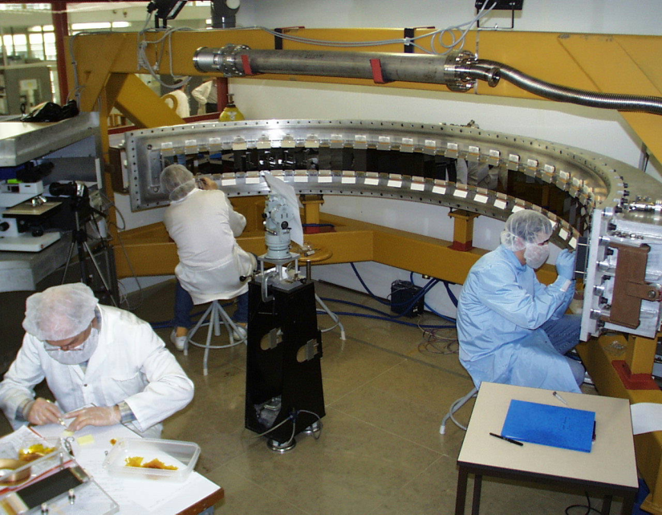
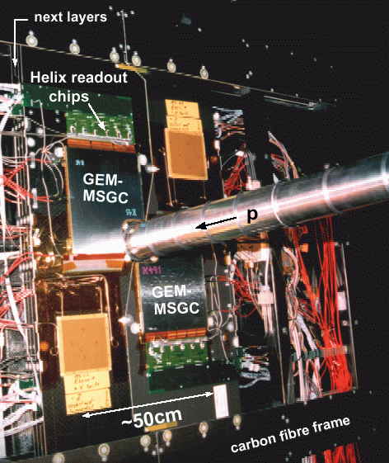
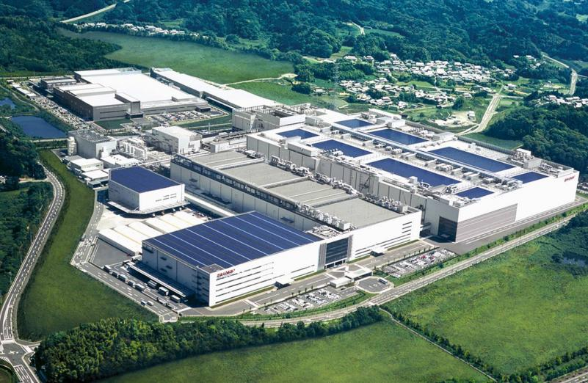

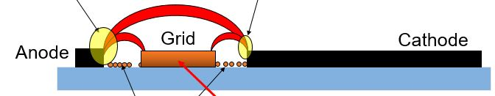
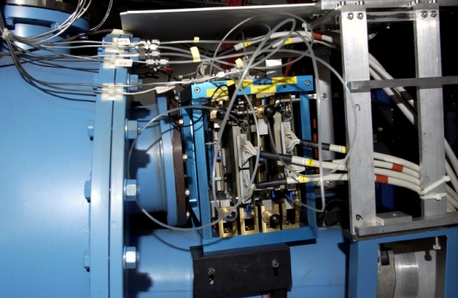
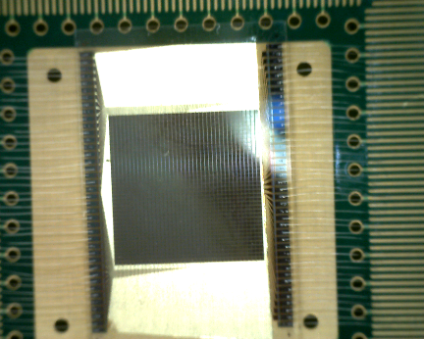
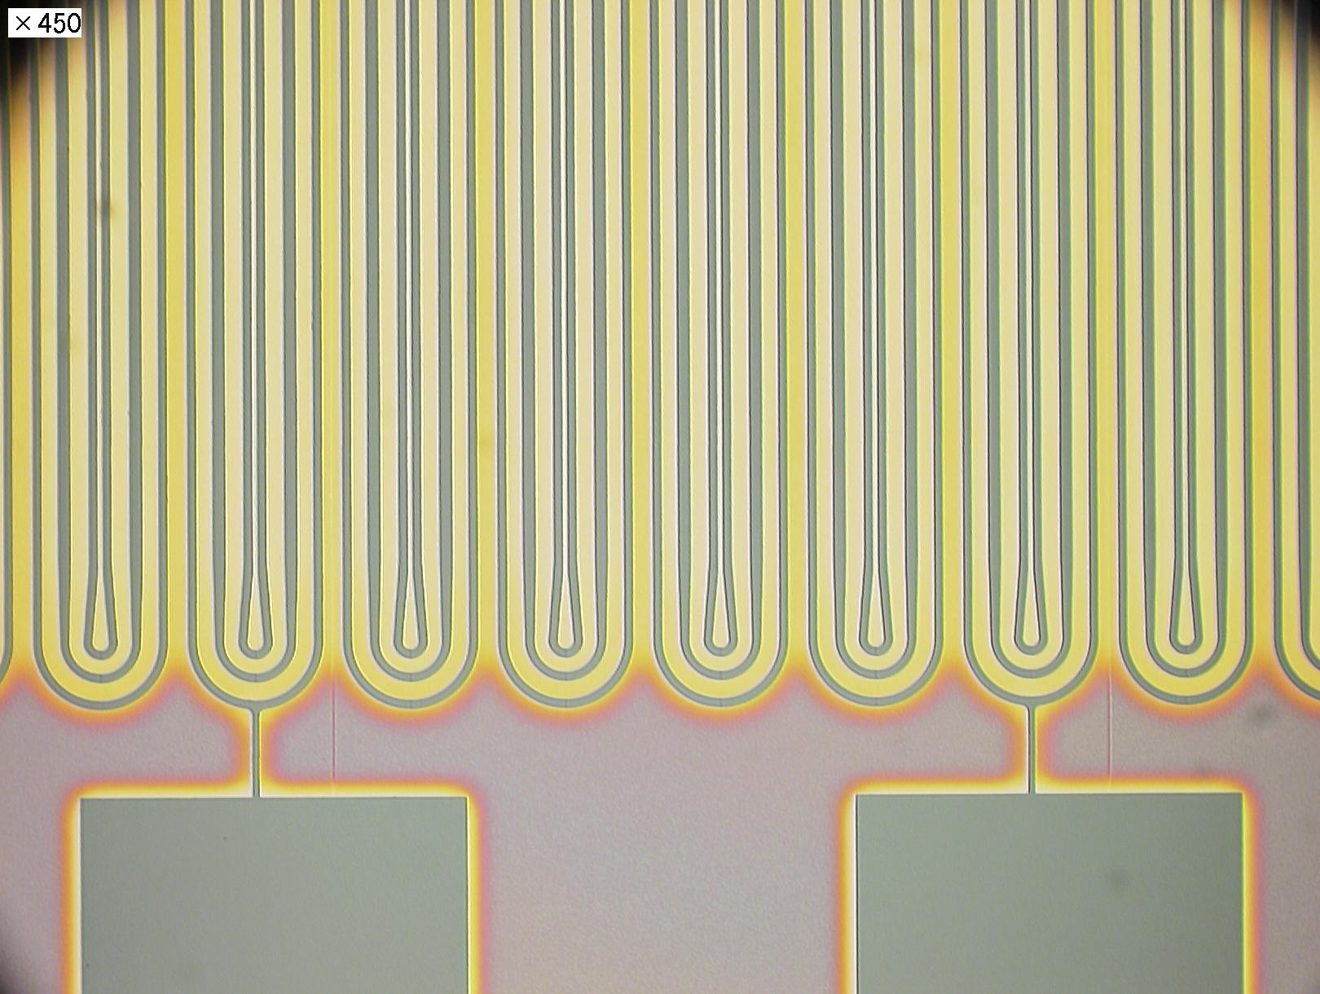
MSGC – MicroStrip Gas Chamber
The D20 diffractometer MSGC
is working since Sept 2000
1D localisation
48 MSGC plates (8 cm x 15 cm)
Substrate: Schott S8900
Angular coverage : 160° x 5,8°
Position resolution : 2.57 mm ( 0,1°)
5 cm gap; 1.2 bar CF4 + 2.8 bars 3He
Efficiency 60% @ 0.8 Å
ILL Grenoble
Telescope of 32 MSGCs tested at PSI in Nov99 (CMS Milestone)
SHARP
HIROYUKI TAKAHASHI - Tokyo University
Collaboration with SHARP
transparent Single-grid-type MSGC based on LCD technology
HERA-B Inner Tracker
MSGC-GEM detectors
R_{min} ~ 6 cm
⇒ 10⁶ particles/cm²•sec
300 μm pitch
184 chambers: max 25x25 cm²
~ 10 m²; 140.000 channels
8 um wide Anode
20um wide Grid
62 um Cathode
150 um pitch
2,000 billion € / year
DIRAC
4 planes MSGC-GEM
Planes 10x10 cm²
Moscow, 12/10/2016, 2nd International Conference on Particle Physics and Astrophysics ICPPA-2016 - Fulvio Tessarotto

Slide 11
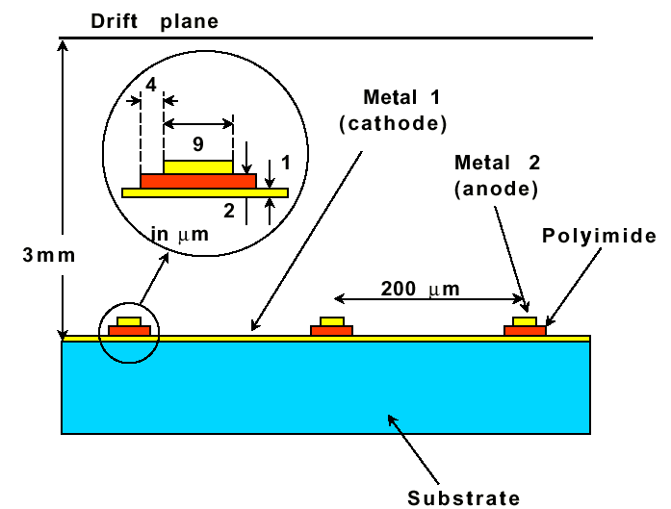
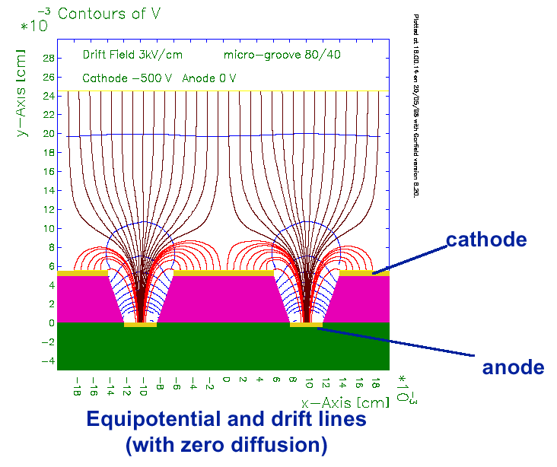
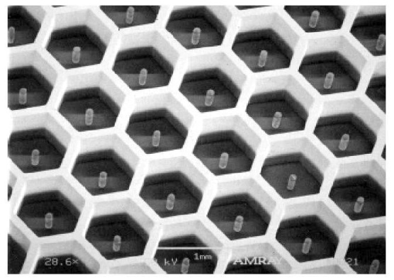



Several different MPGDs have been developed
MICRO-GAP CHAMBER
MICRO-GROOVE CHAMBER
MICRO-PIN ARRAY
MICRO-WIRE CHAMBER
COMPTEUR A TROUS
MICRO-PIXEL CHAMBER

Slide 12


MPGD
2 very solid, fully established technologies:
MICRO MEsh GAseous Structure (MICROMEGAS)
Thin gap Parallel Plate Chamber: micromesh stretched over readout electrode.
Y. Giomataris et al., Nucl. Instr. and Meth. A376(1996)29
GAS ELECTRON MULTIPLIER (GEM)
Thin, metal-coated polymer foil with high density of holes, each hole acting as an individual proportional counter.
F. Sauli, Nucl. Instrum. Methods A386(1997)531
HIGHER LUMINOSITIES, HIGHER PRECISION EXPERIMENTS
MPGDs allow for
  High rates (granularity & occupancy, signal formation time)
  Fine space resolution
Technological maturity and accurate engineering FUNDAMENTAL for successful MPGDs
Moscow, 12/10/2016, 2nd International Conference on Particle Physics and Astrophysics ICPPA-2016 - Fulvio Tessarotto

Slide 13
operational in COMPASS since 2002
Moscow, 12/10/2016, 2nd International Conference on Particle Physics and Astrophysics ICPPA-2016 - Fulvio Tessarotto

Slide 14




Micromegas
Micromesh mounted above readout
structure (typically strips).
E field similar to parallel plate detector.
E_{a}/E_{i} ~ 50 to secure electron transparency
and positive ion
backflow supression.
efficiency & discharge probability
10⁻⁴
1
gain
energy res. ~ 10%
10⁻⁵
gain
0.9
discharge probability
efficiency
10⁵
10⁻⁶
10⁵
0.8
10⁴
⁵⁵ Fe
Ar + 10% C₄H₁₀
0.7
10⁻⁷
10³
0.6
10⁻⁸
10²
350
400
450
500
550
600
650
High voltage [V]
High Voltage [V]
Moscow, 12/10/2016, 2nd International Conference on Particle Physics and Astrophysics ICPPA-2016 - Fulvio Tessarotto

Slide 15



Standard Micromegas
σ =70 µm
σ = 9 ns
Moscow, 12/10/2016, 2nd International Conference on Particle Physics and Astrophysics ICPPA-2016 - Fulvio Tessarotto

Slide 16




Bulk Micromegas technology
woven mesh
Moscow, 12/10/2016, 2nd International Conference on Particle Physics and Astrophysics ICPPA-2016 - Fulvio Tessarotto

Slide 17




Resistive Micromegas
ATLAS – MM
New Small Wheel,
1200 m²
tracking & trigger
Assembly … as important as the micro structure .. If you want to preserve the properties at large scales
Screen Printed Resistive Layer for ATLAS
Moscow, 12/10/2016, 2nd International Conference on Particle Physics and Astrophysics ICPPA-2016 - Fulvio Tessarotto

Slide 18





Micromegas with resistive strips
in Japan a different production
method:
Resistive pads:
Moscow, 12/10/2016, 2nd International Conference on Particle Physics and Astrophysics ICPPA-2016 - Fulvio Tessarotto

Slide 19



Microbulk technology
Kapton micro-bulk
Copper Etching
Kapton Etching
Moscow, 12/10/2016, 2nd International Conference on Particle Physics and Astrophysics ICPPA-2016 - Fulvio Tessarotto

Slide 20


INGRID
Moscow, 12/10/2016, 2nd International Conference on Particle Physics and Astrophysics ICPPA-2016 - Fulvio Tessarotto

Slide 21
Timing with MPGD
Using Cherenkov photons
Efficiency is very high
Time resolution much lower than 100 ps
hope to achieve 30 ps or better.
Moscow, 12/10/2016, 2nd International Conference on Particle Physics and Astrophysics ICPPA-2016 - Fulvio Tessarotto

Slide 22


GEM
Thin metal-coated polymer foil pierced by a high density of holes (50-100/mm²)
Typical geometry: 5 μm Cu on 50 μm Kapton, 70 μm holes at 140 μm pitch
70 µm
I⁺
e⁻
140 µm
Ions
Induction gap
e⁻
5 µm
40 %
50 µm
60 %
55 µm
Electrons
Moscow, 12/10/2016, 2nd International Conference on Particle Physics and Astrophysics ICPPA-2016 - Fulvio Tessarotto
70 µm

Slide 23

GEM Manufacturing
GEM foils are produced at
CERN using proprietary process.
50 μm Kapton
5 μm Cu both sides
Rui De Oliveira
CERN-EST-DEM
Photoresist coating, masking and exposure
to UV light
Metal etching
Kapton etching
Second masking
Metal etching
and cleaning
Moscow, 12/10/2016, 2nd International Conference on Particle Physics and Astrophysics ICPPA-2016 - Fulvio Tessarotto

Slide 24








GEM – Gas Electron Multiplier
Full decoupling of the charge amplification
structure from the charge collection and
readout structure.
Both structures can be optimized
independently !
Cartesian
Compass, LHCb
A. Bressan et al, Nucl. Instr. and Meth. A425(1999)254
Small angle
Hexaboard, pads
MICE
Different flat shapes
cylindrical
spherical
Most of the detectors use three GEM foils in cascade for amplification
to reduce discharge probability by reducing field strength.
Mixed
Totem

Slide 25




Multi-GEM Detectors are operated in discharge free mode
Discharge Probability on Exposure to 5 MeV Alphas
Multiple structures provide equal gain at lower voltage.
S. Bachmann et al Nucl. Instr. and Meth. A479(2002)294

Slide 26






GEMs, spacers & stretching
GEM detectors w/ spacers
Emphasis on GEM foils stretching
COMPASS
no spacers
KLOE2: Triple cylindrical GEM
assembly completed 14/3/2013
no spacers
B. Ketzeret al, NIMA A535 (2004) 314
LHCb
60 cm
CMS upgrade:
mechanical
stretching
for mass
production
TOTEM
Moscow, 12/10/2016, 2nd International Conference on Particle Physics and Astrophysics ICPPA-2016 - Fulvio Tessarotto

Slide 27



HIGH RATE applications
Pixelised GEMs (COMPASS)
Hybrid GEM + Micromegas
GEM pre-amplification:
control the discharge
rate in tracking
stable operation in particle flux up to 1.2·10⁵/s/mm²
extremely thin: 0.2% X₀
spatial resolution: 90 μm
MM w GEM pre-amplification
Austregesilo et al.,
NP B PS 197 (2009) 113
Moscow, 12/10/2016, 2nd International Conference on Particle Physics and Astrophysics ICPPA-2016 - Fulvio Tessarotto

Slide 28



Large area single Mask GEM
Moscow, 12/10/2016, 2nd International Conference on Particle Physics and Astrophysics ICPPA-2016 - Fulvio Tessarotto

Slide 29

Large GEMs at LHC
Moscow, 12/10/2016, 2nd International Conference on Particle Physics and Astrophysics ICPPA-2016 - Fulvio Tessarotto

Slide 30



WELL and μ-RWELL
Drift/cathode PCB
Motivation: higher stability under intense irradiation and simplified construction
Copper top layer (5µm)
Well pitch: 140 µm
Well diameter: 70-50 µm
Kapton thickness: 50 µm
Principle of operation:
DLC layer (0.1-0.2 µm)
R ̴50 -100 MΩ/□
top copper layer
1
kapton
HV
2
3
ρ
Rigid PCB readout electrode
kapton
ε_{r}
t
µ-RWELL PCB
G. Bencivenni et al., 2015_JINST_10_P02008
Moscow, 12/10/2016, 2nd International Conference on Particle Physics and Astrophysics ICPPA-2016 - Fulvio Tessarotto

Slide 31
NOVEL ARCHITECTURE
General purpose tracking: fundamental research & applications
Motivation:
use PCB technology for mass production,
no floating structure
Spark-tolerant structure
E-field will be dropped by spark current.
25μm
25μm
Cathode
Resistive
film
μPIC
Anode
A.Ochi and T.Tanimori,
NIMA 471 (2001) 264
Resistive μPIC

Slide 32







New gaseous neutron detectors
B(Gd)-GEM & uTPC concept
NMX Spectrometer @ ESS
GEM
GEM
GEM
Triple GEM + 3D borated cathode
Thermal neutrons
LOKI-SANS Instrument @ ESS
BANDGEM Modules
As rear detector panels
Moscow, 12/10/2016, 2nd International Conference on Particle Physics and Astrophysics ICPPA-2016 - Fulvio Tessarotto

Slide 33
Gaseous Photon Detectors
need for π-K identification from HEP Experiments
- Large momentum acceptance → Cherenkov angle measurement technique
Large angular acceptance → large area of efficient single photon detection
1970s: large area position sensitive gaseous detectors available
Suitable photo-ionizing agent:
benzene: Seguinot-Ypsilantis NIM 142 (1977) 377,
TEA (7.6 eV) NIM 173 (1980) 283,
TMAE (5.3 eV) NIM 178 (1980) 125.
a gas gain high enough to detect single photoelectrons
conflicting requirements because of the copious UV emission by the multiplication avalanche.
solution: multistep avalanche chamber
(Charpak-Sauli Phys. Lett. B 142 (1977) 377) or TPC
Particle Identification Techniques:
^{TR+dE/dx}
^{Cherenkov}
^{dE/dx}
^{TOF}
^{150 ps}
^{FWHM}
electron identification
^{π-K identification range}
^{p (GeV/c)}
Gaseous detectors: 1) cheap, 2) magnetic insensitive, 3) low material budget
Moscow, 12/10/2016, 2nd International Conference on Particle Physics and Astrophysics ICPPA-2016 - Fulvio Tessarotto

Slide 34





RICH with large area gaseous PD’s
1st generation: photoconverting vapours
E605
SLD - CRID
Cherenkov photon
Townsend
avalanche
photoelectron
E
CLEO III
anode wires cathode pads
TEA (Tri-Ethyl-Amine)
NIMA 554 (2005) 147
OMEGA
DELPHI
TMAE(Tetrakis-Dimethylamine-Ethylene)
Moscow, 12/10/2016, 2nd International Conference on Particle Physics and Astrophysics ICPPA-2016 - Fulvio Tessarotto

Slide 35



Thin CsI film
1956:
CsI layer has large QE for photons with hν > 6 eV
(Philipp and Taft)
CsI is highly reactive with water: it took many years to develop appropriate substrate preparation, deposition method, handling technology for high QE gaseous PDs
Semitransparent photocathode:
thin metallic film and precise thickness.
Reflective photocathode:
no metallic film and non critical thickness
(important for large area)
Townsend
avalanche
Cherenkov
photon
thin layer (300 - 500 nm) of
CsI on a cathode pad plane
Moscow, 12/10/2016, 2nd International Conference on Particle Physics and Astrophysics ICPPA-2016 - Fulvio Tessarotto

Slide 36




RD26: the technology of MWPCs + CsI
1992, F. Piuz et al. Development of large area advanced fast-RICH detector for particle identification at LHC operated with heavy ions
François Piuz
  TO ACHIEVE HIGH CsI QE:
  Substrate preparation:
  Cu clad PCB coated by Ni (7 µm) and Au(0.5 µm), surface cleaning in ultrasonic bath, outgassing at 60 ºC for 1 day
  Slow deposition of 300 nm CsI film:
  1 nm/s (by thermal evaporation or e⁻-gun) at a vacuum
  of ~ 10⁻⁷ mbar, monitoring of residual gas composition
  Thermal treatment:
  after deposition at 60 ºC for 8 h
  Careful Handling:
  measurement of PC response, encapsulation under dry Ar, mounting by glove-box.
The best fused silica cuts here
Schematic structure of the COMPASS Photon Detector:
A. Di Mauro, NIM A 525 (2004) 173.
Moscow, 12/10/2016, 2nd International Conference on Particle Physics and Astrophysics ICPPA-2016 - Fulvio Tessarotto

Slide 37






RICH with large area gaseous PD’s
2 nd generation: MWPC’s + CsI
MWPCs with solid state photocathode (the RD26 effort)
ALICE-HMPID
2009
CsI > 10 m²
TIC, NA44
JLAB-HALL A
HADES 1999
CsI > 1 m²
COMPASS RICH-1 2002 CsI > 5 m²
STAR
Moscow, 12/10/2016, 2nd International Conference on Particle Physics and Astrophysics ICPPA-2016 - Fulvio Tessarotto

Slide 38




MWPC’s with
Moscow, 12/10/2016, 2nd International Conference on Particle Physics and Astrophysics ICPPA-2016 - Fulvio Tessarotto

Slide 39






CsI coated photocathodes
Moscow, 12/10/2016, 2nd International Conference on Particle Physics and Astrophysics ICPPA-2016 - Fulvio Tessarotto

Slide 40

MWPCs with CsI: the limits
Severe recovery time (~ 1 d) after detector trips
  Ion accumulation at the photocathode moderate gain:<10⁵
Feedback pulses (effective gain: <1/2)
  Ion and photons feedback from the multiplication process not fast
Aging after integrating a few mC / cm²
  Ion bombardment of the photocathode
0.2 mC/cm²
MWPCs → slow signal formation
  + low gain → “slow” electronics (signal
  integration, low noise level)
  Gassiplex FE : integration time ~ 0.5 μs, time res> 1 μs
  APV (COMPASS RICH-1 upgrade) : resolution ~ 400 ns
  → Detector memory, i.e. not adequate for high rates
1 mC/cm²
H. Hoedlmoser et al., NIM A 574 (2007) 28.
Moscow, 12/10/2016, 2nd International Conference on Particle Physics and Astrophysics ICPPA-2016 - Fulvio Tessarotto

Slide 41
MPGD-BASED PDs
Reduced photon feed-back and Ion BackFlow (IBF)
  Reduced ageing
  High gain → high photoelectron detection efficiency
Intrinsically fast gaseous detectors
Short integration time
  High rate environments
MICROPATTERN GASEOUS DETECTORS
Moscow, 12/10/2016, 2nd International Conference on Particle Physics and Astrophysics ICPPA-2016 - Fulvio Tessarotto

Slide 42




ION & PHOTON BLOCKING GEOMETRIES
GEM-based PDs
Semi-transparent PC
Reflective PC
NO photon feedback
Reduced ion feedback
e⁻ avalanche
An “old” idea
ion avalanche
R. Chechik et al., NIM A 419 (1998) 423
A. Breskin and R. Chechik, NIM A 595 (2008) 116
Moscow, 12/10/2016, 2nd International Conference on Particle Physics and Astrophysics ICPPA-2016 - Fulvio Tessarotto

Slide 43


HBD – the basic concept
HBD- Cherenkov detector with GEMs +CsI
Proximity focus configuration, no window,
no mirror
CF₄ radiator and active gas. L_{rad}=50 cm
Very large bandwidth
108 – 200 nm
(6.2 - 11.5 eV)
triple GEMs for
signal
multiplication
CsI photocathode
0.65 m
θ_{pair}
opening angle
Cherenkov
blobs
e⁻
e⁺
1.21 m
B≈0
W. Anderson et al.,
NIM A 646 (2011) 35
Moscow, 12/10/2016, 2nd International Conference on Particle Physics and Astrophysics ICPPA-2016 - Fulvio Tessarotto
Notes:
The HBD is a windowless Cherenkov detector
CF₄ radiator gas and active gas. L_{rad}=50 cm. Cherenkov threshold for pions 4 GeV/c
triple GEMs for signal multiplication
CsI photocathode evaporated on top of the triple GEM stack
proximity focused configuration – no mirrors, the Cherenkov light forms a circular blob image
hexagonal pad readout, with pad side = 1.55 cm
total weight per arm < 10 kg
total radiation length: 4.4%
0.9% (vessel) + 0.5% (CF₄) + 3% (backplane)
Materials used:

Slide 44

HBD – hadron blindness
Electron signals are relatively rare (compared to hadrons)
mesh
El. Field
primary ionization from dE/dx
photo
electron
CsI (350 nm)
GEMs
pads
Detector operated in reverse bias mode to repel the ionization charge from dE/dx
Cherenkov light is formed only by e⁺ or e⁻
Successfull operation at PHENIX since seversl years
It is not a detector of single photons
Moscow, 12/10/2016, 2nd International Conference on Particle Physics and Astrophysics ICPPA-2016 - Fulvio Tessarotto
Notes:
In order to enable measurement of relatively weak and rare electron signals in the overwhelming hadron environment, the following concept of hadron blindness has been developed:
Cherenkov light is formed only by e⁺ or e⁻, threshold for πι⁰ is 4 GeV/c
the detector is operated in reverse bias mode in which a reverse voltage is applied between the first GEM and a mesh to repulse the ionization charge coming from dE/dx
any remaining signals from hadron dE/dx will form a single pad blob in HBD, while single electrons will form a blob with an average of 3 pads
Reflective photocathode scheme:
photoelectrons are pulled into the holes by strong electric field
the photocathode is screened from avalanche photons

Slide 45








OVERCOMING IBF
More complex geometries needed with extra electrodes to trap the ions:
Micro-Hole & Strip Plate (MHSP), COBRA
MHSP
J.F.C.A. Veloso et al.,
Rev.Sc. Instr. 71 (2000) 2371
A.V. Lyashenko et al.,
JINST 2 (2007) P08004
COBRA
A.V. Lyashenko et al.,
NIMA 598 (2009) 116
A.V. Lyashenko et al.,
NIMA 598 (2009) 116
Moscow, 12/10/2016, 2nd International Conference on Particle Physics and Astrophysics ICPPA-2016 - Fulvio Tessarotto

Slide 46

THGEM-based PDs
PCB technology, thus:
robust
mechanically self supporting
industrial production of large size
boards
large gains have been immediately
reported (rim !)
Comparing to GEMs
Geometrical dimensions X ~10
  But e⁻ motion/multiplic. properties do not!
  Larger holes:
    dipole fields and external fields
    are strongly coupled
    e⁻ dispersion plays a minor role
About PCB geometrical dimensions:
Hole diameter : 0.2 – 1 mm
Pitch : 0.5 – 5 mm
Thickness : 0.2 – 3 mm
RIM
introduced in // by different groups:
L. Periale et al., NIM A478 (2002) 377.
P. Jeanneret, PhD thesis, Neuchatel U., 2001.
P.S. Barbeau et al, IEEE NS50 (2003) 1285
R. Chechik et al, .NIMA 535 (2004) 303
Moscow, 12/10/2016, 2nd International Conference on Particle Physics and Astrophysics ICPPA-2016 - Fulvio Tessarotto

Slide 47



THGEM rate capability and IBF
High rate device
IBF control
IBFR (%)
A
Irradiation:
8.9 KeV X-ray
Triple THGEM:
Ion Back Flow
reduction by
staggering plates
E_{TR2} (kV/cm)
I (pA)
0 1000 2000
E_{TR2} (kV/cm)
M
0 20 40 60 80 100 120
Rate (kHz / mm²)
IBFR < 5% !
single THGEM, no RIM
E_{TR1} (kV/cm)
M. Alexeev et al. JINST 10 (2015 ) P03026
The gain in Thick GEM multipliers and its time-evolution
M. Alexeev et al., JINST 7 (2012) C002014
Moscow, 12/10/2016, 2nd International Conference on Particle Physics and Astrophysics ICPPA-2016 - Fulvio Tessarotto

Slide 48








THGEM R&D for RICHes
ALICE VHMPID
THGEM & HYBRID
V.Peskov et al., NIMA 695 (2012) 154
COMPASS, RICH-1 upgrade by Triple THGEM detectors
beam
Č photon
Moscow, 12/10/2016, 2nd International Conference on Particle Physics and Astrophysics ICPPA-2016 - Fulvio Tessarotto

Slide 49




HYBRID MPGD PDs (THGEM + MM)
The 1st THGEM forms the PC
The 2nd THGEM (staggered) forces the electron diffusion
The MM provides large gain, made larger by the diffusing the impinging electron cloud
THGEM
staggered !
beam
Gain ~ 130K
Single Photon spectrum in BEAM !!!
Č photon
The same architecture independently studied in parallel as GPM for DM searches (see later)
Moscow, 12/10/2016, 2nd International Conference on Particle Physics and Astrophysics ICPPA-2016 - Fulvio Tessarotto

Slide 50











THGEM production @ ELTOS and the surface treatment in Trieste
A post production specific surface treating and cleaning procedure developed in Trieste is applied:
Surface Polishing.
High pressure water cleaning.
Ultrasonic Bath with Sonica PCB solution (PH11), distilled water rinsing and oven @ 160 ºC
  image transfer
  development
  etching
  stripping dry-film
  mounting
  multi-spindle drilling
  drilling
Moscow, 12/10/2016, 2nd International Conference on Particle Physics and Astrophysics ICPPA-2016 - Fulvio Tessarotto

Slide 51








Mounting the detectors on the COMPASS RICH-1
Moscow, 12/10/2016, 2nd International Conference on Particle Physics and Astrophysics ICPPA-2016 - Fulvio Tessarotto

Slide 52



First large area THGEM-based PDs
COMPASS RICH UPGRADE
TAKING DATA DURING 2016 RUN
Moscow, 12/10/2016, 2nd International Conference on Particle Physics and Astrophysics ICPPA-2016 - Fulvio Tessarotto

Slide 53
Different photocathodes and their thresholds
ε_{Q} = Q.E. = N_{e} / N_{γ}
external photoeffect
ε_{Q} < 50%
internal or external photoeffect
ε_{Q} > 50%
Multialkali
NaKCsSb
Si
TMAE,CsI
GaAs
gas
vacuum
TEA
bialkali K₂CsSb
solid state
12.3 4.9 3.1 2.24 1.76 1.12 1.03
E (eV)
100 250 400 550 700 1100 1200
λ (nm)
ultraviolet
visible infrared
Photon detection involves often materials like K, Na, Rb, Cs (alkali metals). They have the smallest electronegativity → highest tendency to release electrons.
Most photocathodes are VERY reactive; Exceptions: Si and CsI.
Bled, 10/6/2015, 9th International Workshop on Ring Imaging Cherenkov Detectors RICH2016 - Fulvio Tessarotto

Slide 54


PHOTOCATHODES FOR VISIBLE LIGHT
  Chemical reactivity (gas purity better than ppm level needed →
  UHV materials and sealed detectors)
  PC stability under ion bombardment - work function lower than CsI one
  AGEING CsI: -16% QE at 25μC/mm²
  Bilkaly: -20% QE at 0.4μC/mm²
F.Tokanai et al., NIMA 628 (2011) 190
T.Moriya et al., NIMA 732 (2013) 263
K-Cs-Sb vs CsI
F-R-MHSP,
IBF: 3 x 10 ⁻⁴
Bialkali,
Gas P 675 torr
Doulble GEM,
IBF: ~ 10 ⁻²
A.V.Lyashenko et al., 2009 JINST 4 P07005
F. Tokanai et al., NIMA 610 (2009) 164
Moscow, 12/10/2016, 2nd International Conference on Particle Physics and Astrophysics ICPPA-2016 - Fulvio Tessarotto

Slide 55



GASEOUS DETECTORS FOR VISIBLE LIGHT
the GEM approach
Multiple GEM
sealed
Pulsed ion gating
K-Cs-Sb - Continuous
mode, not a sealed PD
R.Chechik
et al., NIMA
502 (2003) 195
Breskin et al.,
NIMA 553 (2005) 46
A.V.Lyashenko et al.,
2009 JINST 4 P07005
Poor compatibility of bialkali and GEM material ?
Extremely poor QE of the bialkali PC:
the material of the GEM chemically reacts with the bialkali metals
F. Tokanai et al., NIMA 610 (2009) 164
Moscow, 12/10/2016, 2nd International Conference on Particle Physics and Astrophysics ICPPA-2016 - Fulvio Tessarotto

Slide 56




GASEOUS DETECTORS FOR VISIBLE LIGHT
the Micromegas approach
2 staggered MM layers to enhance ion trapping
K-Cs-Sb
Double MM, Ni mesh
In collaboration with HAMAMATSU
IBF : <2.5×10⁻³
Gain < 10⁴
Vacuum, 20%
IBF : 6 ×10⁻⁴
Gain : 10⁴
Ar (90%)+CH₄ (10%)
12% (stable) after 1.5 y
F. Tokanai et al., NIMA 766 (2014) 176
F. Tokanai et al., NIMA 610 (2009) 164
Moscow, 12/10/2016, 2nd International Conference on Particle Physics and Astrophysics ICPPA-2016 - Fulvio Tessarotto

Slide 57



GASEOUS DETECTORS FOR
VISIBLE LIGHT
H. Sugiyama et al., NIMA (2016) in press
Moscow, 12/10/2016, 2nd International Conference on Particle Physics and Astrophysics ICPPA-2016 - Fulvio Tessarotto

Slide 58






Scintillating Glass-GEM imager
T. Fujiwara, et al., JINST 8 C12020, 2013
Moscow, 12/10/2016, 2nd International Conference on Particle Physics and Astrophysics ICPPA-2016 - Fulvio Tessarotto

Slide 59



CRYOGENIC MPGD-PDs
Read-out elements of cryogenic noble liquid detectors
  Rear event detectors (ν, DM)
  Detecting the scintillation light produced in the noble liquids
  Options of scintillator light and ionization charge detection by a same detector !
with WINDOW WINDOWLESS OPERATED IN THE
(2-PHASES) CRYOGENIC LIQUID
S.Duval et al., JINST 6 (2011) P04007
Bondar et al.,NIMA 556 (2006) 273
L.Arazi et al., JINST 8 (2013) C12004
Moscow, 12/10/2016, 2nd International Conference on Particle Physics and Astrophysics ICPPA-2016 - Fulvio Tessarotto

Slide 60

Bubble-assisted electroluminescence in LXe
Moscow, 12/10/2016, 2nd International Conference on Particle Physics and Astrophysics ICPPA-2016 - Fulvio Tessarotto

Slide 61

Dual-phase LAr LEM TPC
C.Cantini et al.,
JINST 10 P03017
(2015)
Moscow, 12/10/2016, 2nd International Conference on Particle Physics and Astrophysics ICPPA-2016 - Fulvio Tessarotto

Slide 62





LARGE SIZE PROJECTS
(bulkMM)
(THGEM)
LBNO – GLACIER (THGEM)
Panda-X, THGEM +
MM (dark matter)
DUNE (40-kt LAr)
DARWIN
Moscow, 12/10/2016, 2nd International Conference on Particle Physics and Astrophysics ICPPA-2016 - Fulvio Tessarotto

Slide 63
CONCLUSIONS
THE DEVELOPMENT OF MPGDS IS SUCCESSFUL AND EXPANDING
  Consolidated technologies are spreading over small and large projects
  Advanced R&D is making continuous progress on new solutions
NEW GENERATION OF GASEOUS PHOTON DETECTORS
  Large size MPGD-based PDs operating in Experiment
  Progress toward gaseous visible light PD
BRIGHT FUTURE FOR:
  Inventions: new ideas, new techniques
  Technology consolidation, new applications
  Large scale projects
Moscow, 12/10/2016, 2nd International Conference on Particle Physics and Astrophysics ICPPA-2016 - Fulvio Tessarotto

