Slide 1
The investigation of timing large area scintillation detectors with SiPM light sensors properties.
Dr. Mikhail Runtso, Mr. Pavel Naumov,
Dr. Peter Naumov, Mr. Evgeny MAKLYAEV
Dr. Vladimir KAPLIN, Mr. Vladislav FOMIN,
Mr. Igor RAZZHIVIN, Mr. Yury Melikyan
National Research Nuclear University MEPhI (Moscow Engineering Physics Institute) (NRNU MEPhI)

Slide 2
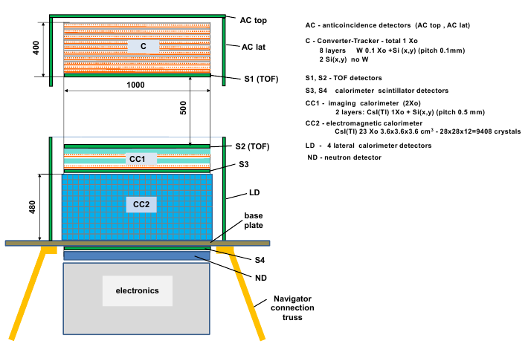
The layout of the GAMMA-400 gamma-ray telescope

Slide 3
Fast timing scintillator detectors
AC – anticoincidence detector
S1-S2 – time-of-flight (TOF) system
S3 – calorimeter scintillation detector shows the events with high probability of back-splash particles generation
S4 – leakage detector.
Scintillator – BICRON BC-408 (Polyvinyltoluene),
Modules 1000x100x10 mm³
Light Output - 64% Anthracene,
Rise time – 0,9 ns,
Decay time – 2,1 ns,
Wavelength of max. emission – 425 nm,
Light “e” times attenuation length – 210 cm,
May be used in vacuum.

Slide 4
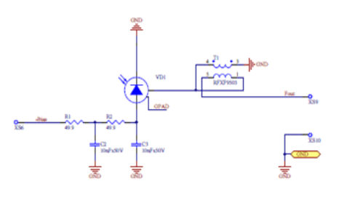
SiPM light sensors
MicroFB 60000 Series SMT Package
Fast output with SMT Transformer RFXF9503

Slide 5
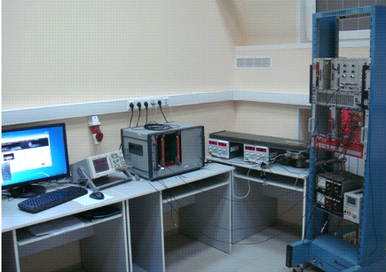
The setup for the plastic scintillator with SiPM as photosensors characteristics measurement

Slide 6
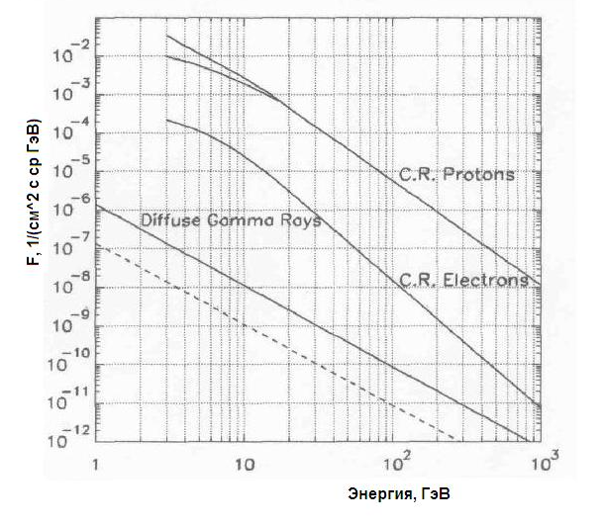
AC detector
The flux of cosmic radiation charged particles in space is five orders higher than the flux of high energy gamma-quanta, so gamma-telescopes have anticoincidence (AC) detector to register charged particles with high efficiency (> 99.999 %) to exclude these events.
F, 1/(cm² s sr GeV)
Energy, GeV

Slide 7
Efficiency measurement
Usually the measurement of detector response for the relativistic charged particles in laboratory conditions is carrying out by detection of cosmic radiation charged particles (mainly secondary muons). Particularly detection efficiency is determining from the ratio of the number of triple coincidences of two additional detectors arranged above and below the detector under investigation and this detector itself to the number of double coincidences of additional detectors.

Slide 8
False triggering
This method when using cosmic radiation with the counting rate of some Hz shows low efficiency because of detecting in additional detectors double Compton effects from gamma quanta or radioactive decay of nuclei in surrounding materials with double particles or gamma-quanta.
Double Compton scattering in additionjal detectors
Radioactive decay with double particles or gamma-quanta
γ
γ
*
γ

Slide 9
AC detector can’t have the high efficiency for every particle energy, so we must have the amplitude registration threshold to remove very low amplitudes and fotosensor’s noise. The efficiency must be > 99,999 % only for the relativistic particles with the minimal energy 6 MeV, necessary to pass throw AC detector and two TOF detectors all having the 1 g/cm² thickness and 2 MeV energy deposit in each detector. The softer charged particles will not trigger TOF system. But we must be sure that our threshold will not remove relativistic charged particles. Final value of detector efficiency will be obtained during the accelerator calibration when the particle intensity is so high that mentioned false trigger will give the neglecting part of events but we must have the threshold adjusting method for cosmic radiation in laboratory conditions.

Slide 10
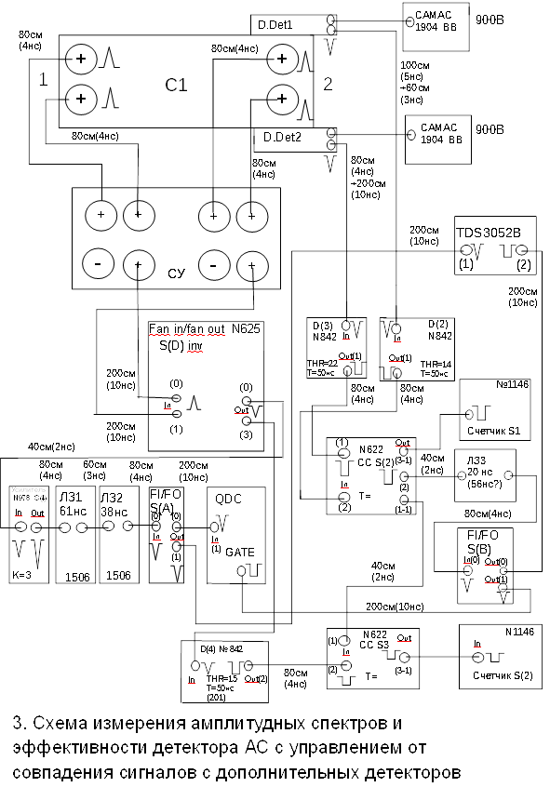
The layout of the amplitude spectra and efficiency of AC detector measurements triggered by the coincidence of additional detectors signals.

Slide 11
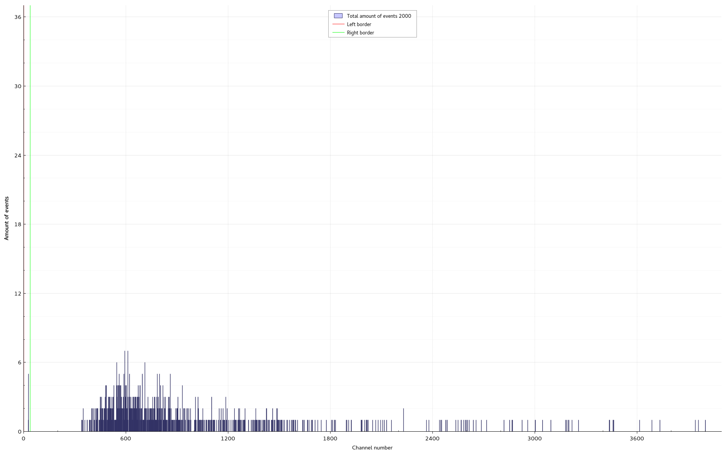
The cosmic ray see-level muons amplitude spectrum of AC detector sum signal from the opposite ends triggered by the coincidence of additional detectors signals (efficiency 99.5 %)

Slide 12
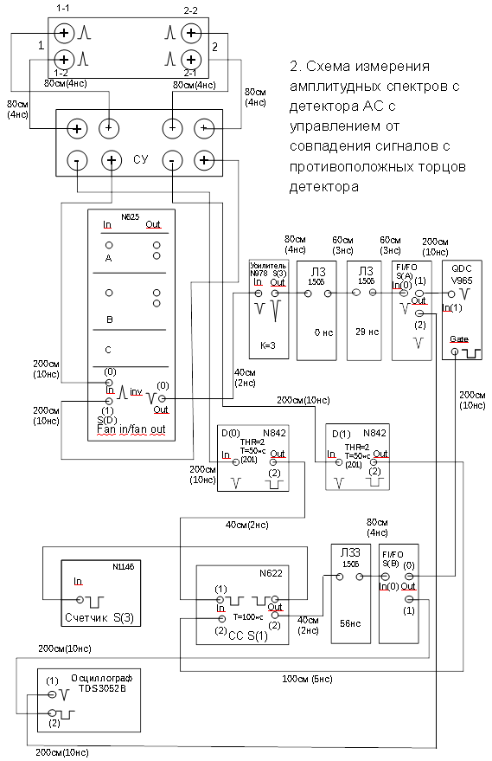
The layout of the amplitude spectra of AC detector measurements triggered by the coincidence of the signals from the detector opposite ends.

Slide 13
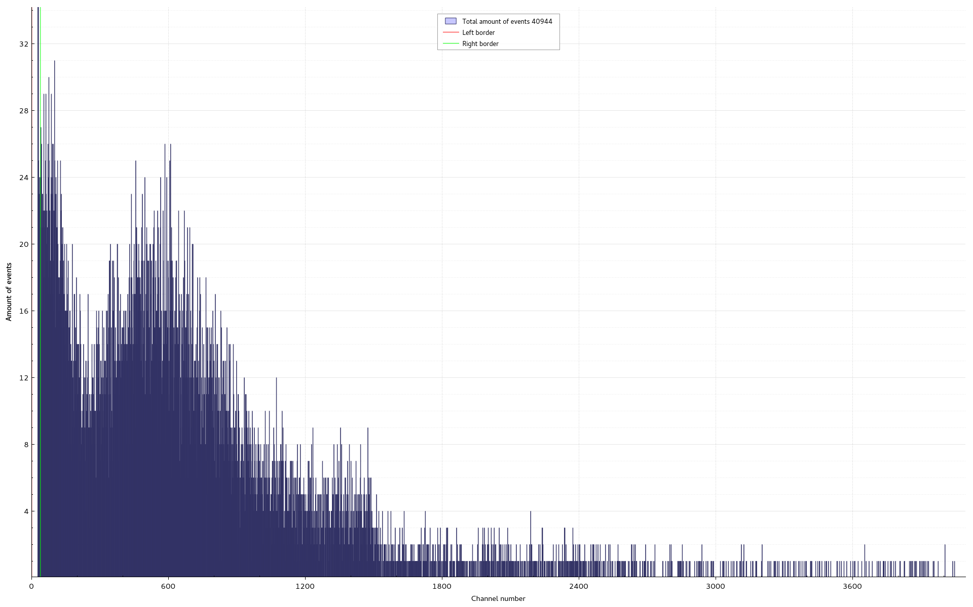
The amplitude spectrum from AC detector for cosmic rays muons detection with triggering by the coincidence of the discriminated signals from the opposite ends of detector stripe. The discrimination threshold equals 20 mV. Very much of pedestal events.

Slide 14
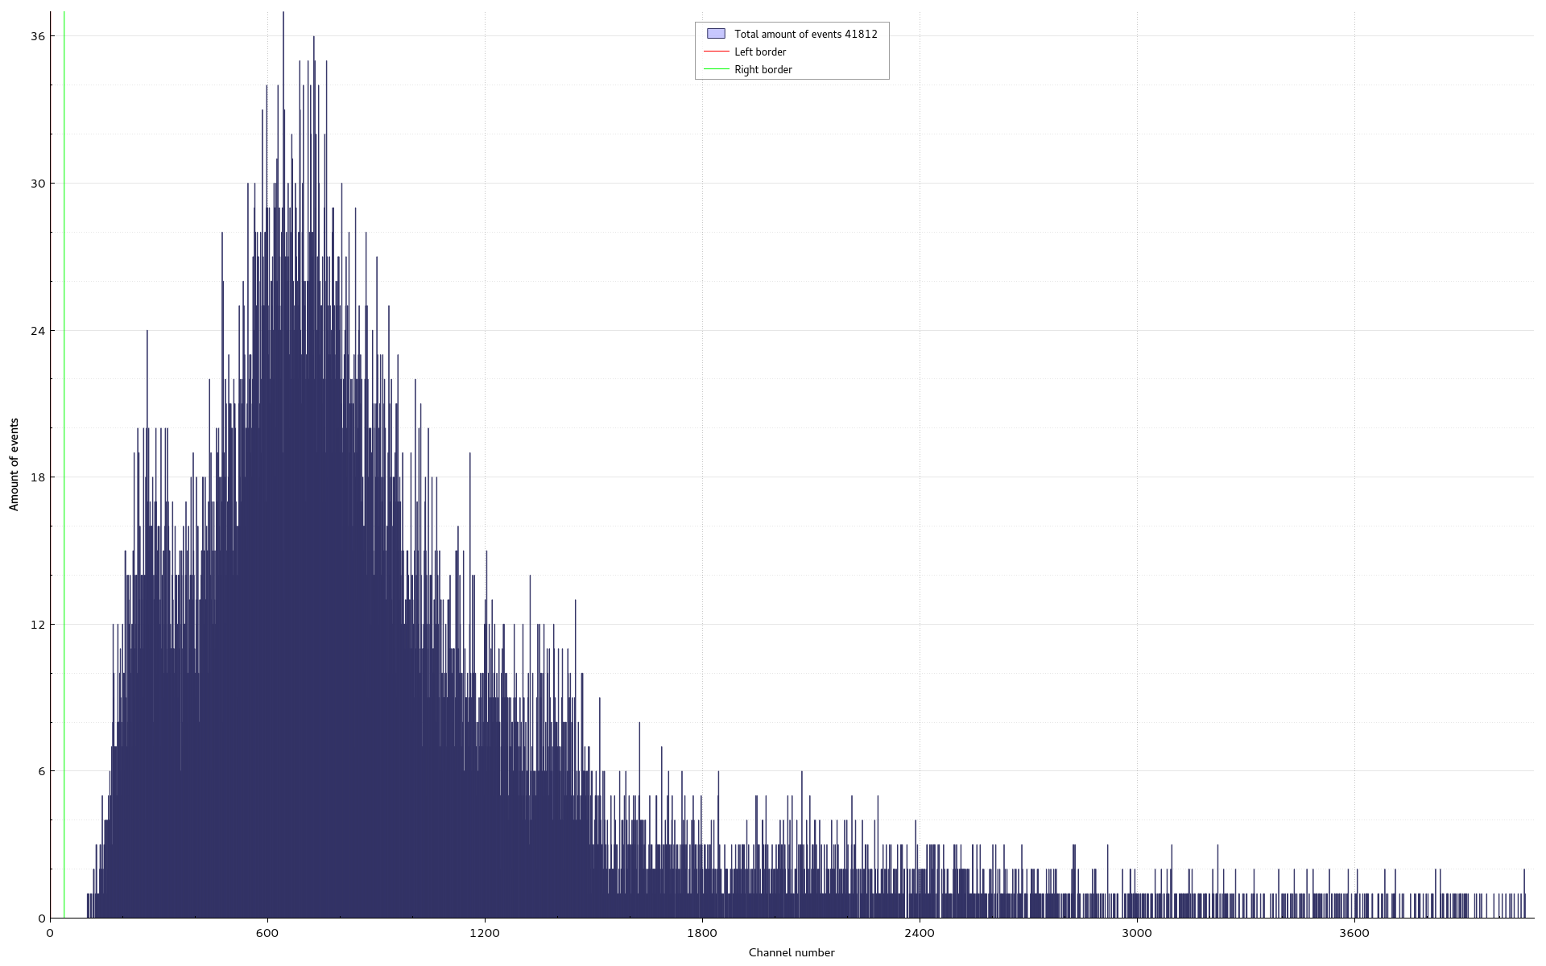
The amplitude spectrum from AC detector for cosmic rays muons detection with triggering by the coincidence of the discriminated signals from additional detectors. The discrimination threshold equals 50 mV. No pedestal events. Red points – rescaling of additional detector triggered spectrum

Slide 15
Conclusion
We suggest and experimentally demonstrate the method of fast scintillation detector threshold determination allowing to get high efficiency detecting secondary cosmic ray charged particles.

Slide 16
Thank You for your attention

