Slide 1
Gamma-quanta and charged particles recognition by the counting and triggers signals formation system of GAMMA-400 space gamma-telescope
I.V. Arkhangelskaja¹,
A.I. Arkhangelskiy¹, E.N. Chasovikov¹, M.D. Kheymits¹,
Y.T. Yurkin¹, A.M. Galper^{1,2}, S.I. Suchkov²,
N.P. Topchiev², A.E. Murchenko¹
¹National Research Nuclear University MEPhI
(Moscow Engineering Physics Institute)
² Lebedev Physical Institute, Russian Academy of Sciences

Slide 2
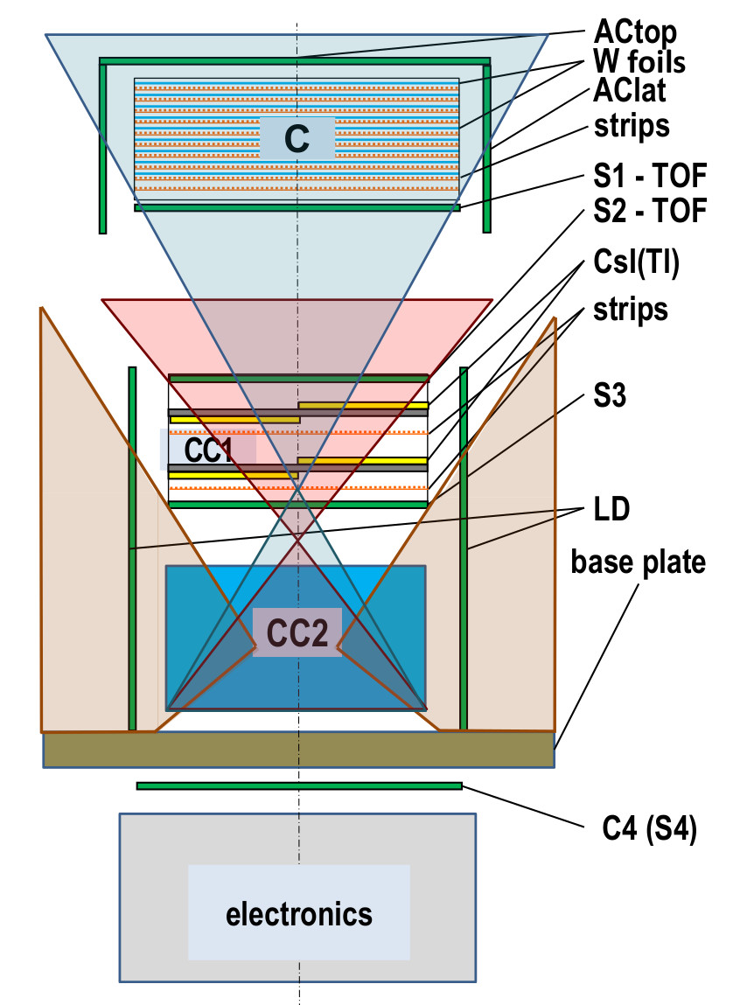
Main
Additional
lateral

Slide 3
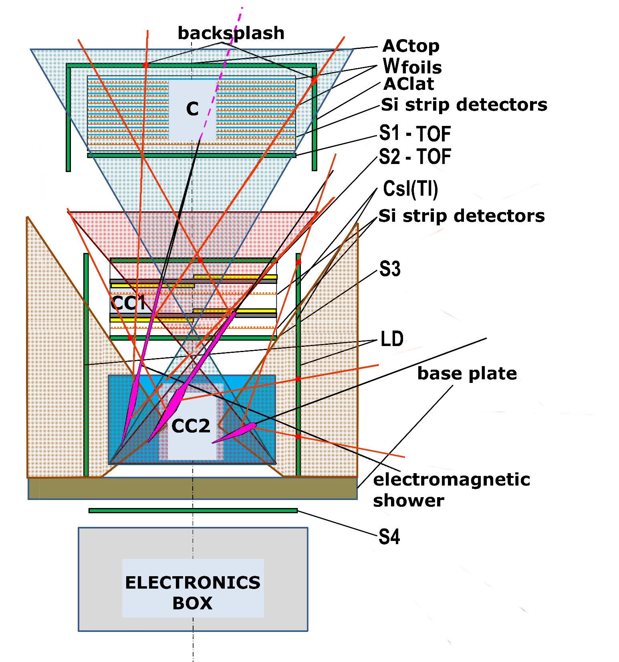

Slide 4
The main aperture |  |  |  |  |  |  |  |  | The additional aperture |  |  |  |  |  |  | The lateral aperture
 | γ |  |  |  | е+/е_ |  | nuclei |  | γ |  |  | е+/е_ |  | nuclei |  | γ |  | е+/е_ |  | nuclei
 | Еlow1 | Еlow2 | Еm | Еh | Еm | Еh | Еm | Еh | Еlow | Еm | Еh | Еm | Еh | Еm | Еh | Еlow | Еh | Еm | Еh | Еm | Еh
АСtop (upper and lower layers individual detectors) energy deposition
AClat (outer and inner layers individual detectors) energy deposition
LD system (outer and inner layers individual detectors) energy deposition
TOFsystem (signal TOF): the combination of S1 and S2 sections upper and lower layers individual detectors energy deposition with time-coordinate compensation
Signals BS1_ACtop (amplitude backsplash analysis): the combination of both layers individual detectors energy deposition of TOF S1 section and anticoincidence system АСtop one
Signal BS1_AClat (amplitude backsplash analysis): the combination of both layers individual detectors energy deposition of TOF S1 section and anticoincidence system AClat one
Signal BS1t (time analysis backsplash): the time delay between combination of both layers individual detectors of TOF S1 section and АСtop one
Signal BS2 (amplitude backsplash): the combination of both layers individual detectors of TOF S2 section and LD one energy deposition
Signal BS3 (amplitude backsplash): the combination of both layers individual detectors of calorimeter scintillation detectors sections S3, S4 and anticoincidence detectors LD
Time of light system detector S1 energy deposition
Time of light system detector S2 energy deposition
Individual scintillation detectors of CC1 amplitude discriminators
Individual scintillation detectors of CC1
Strip detectors CC1
S3 (upper and lower layers individual detectors) energy deposition
S4 (upper and lower layers individual detectors) energy deposition
Individual scintillation detectors of СС2 amplitude discriminators
Individual scintillation detectors of СС2
Strip detectors of converter C
Neutron detector
coincidence
energy deposition
energy deposition
anti-
coincidence
energy deposition
energy deposition
energy deposition
energy deposition

Slide 5
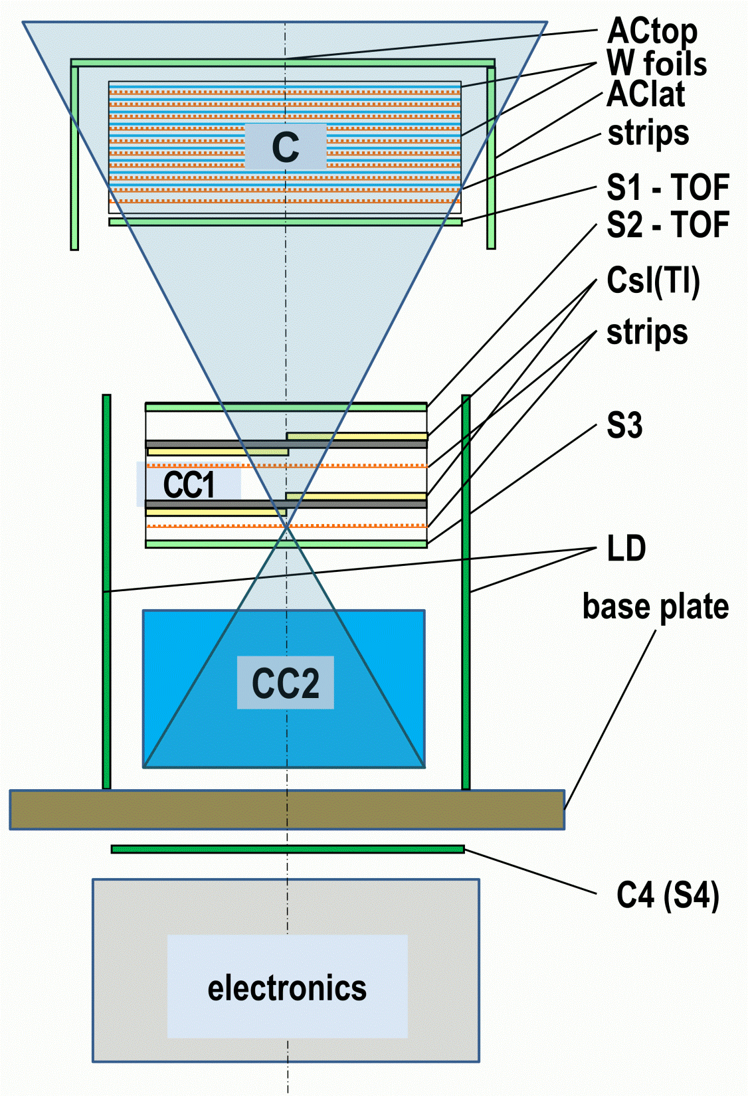

Slide 6
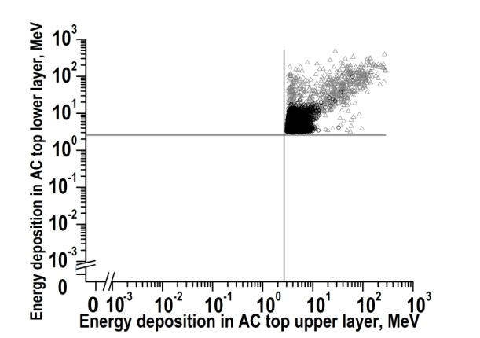
Direct energy deposition in double layers ACtop for relativistic protons (grey) and electrons (black) used for thresholds definition.

Slide 7
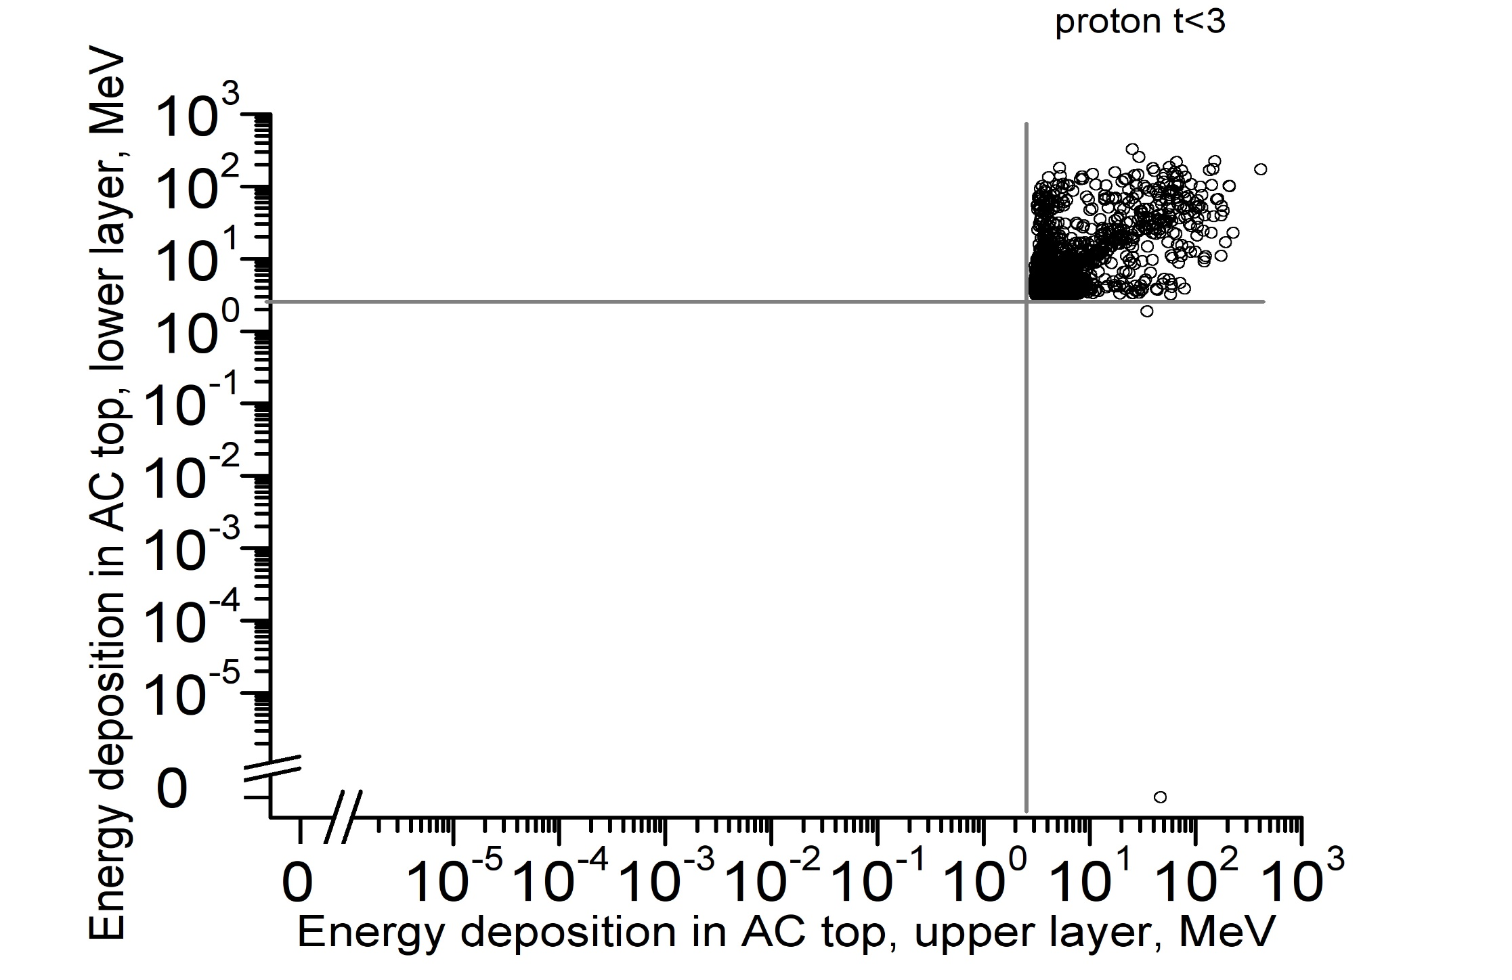
Direct energy deposition in double layers ACtop for 3 GeV protons used for thresholds definition.

Slide 8
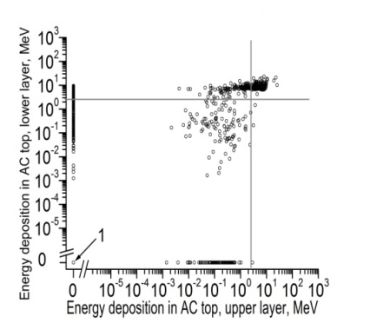
Direct energy deposition in double layers ACtop for 100 GeV γ-quanta with backsplash subtraction using temporal analysis (area marked (1) contains ~60% of events with energy deposition less than 1 keV in both ACtop layers)

Slide 9
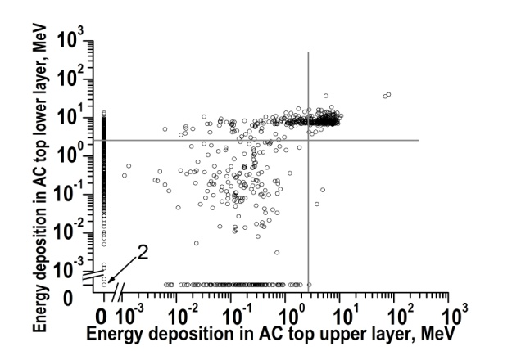
Direct energy deposition in double layers ACtop for 3 GeV γ-quanta with backsplash subtraction using temporal analysis (area marked (2) contains ~70% of events with energy deposition less than 1 keV in both ACtop layers)

Slide 10
Triggers in the main aperture will be formed using information about particle direction provided by time of flight system and presence of charged particles or backsplash signal formed according to analysis of energy deposition in combination of both layers anticoincidence systems АСtop and AClat individual detectors.
For double-layer ACtop less than 3% photons will be wrongly recognized as electrons or protons for ~3-100 GeV particles. The part of charged particles mistakenly identified as gammas will be ~10⁻⁵ using described algorithms.

Slide 11
Low energy charged particles
Amount of particles with non-zero energy deposition in plastic detectors.
Detector layer | e- 1MeV | e- 3MeV | e- 10MeV | р 30 MeV | р 100 MeV
AC top upper level | 161 | 9834 | 9992 | 9936 | 9996
AC top lower layer | 75 | 401 | 9640 | 38 | 9936
S1 upper layer | 0 | 17 | 122 | 2 | 256
S1 lower layer | 1 | 16 | 123 | 0 | 225
S2 upper layer | 0 | 4 | 77 | 5 | 100
S2 lower layer | 0 | 11 | 75 | 3 | 85
S3 upper layer | 0 | 4 | 16 | 0 | 7
S3 lower layer | 0 | 1 | 12 | 0 | 3
Maximal energy deposition in plastic detectors, MeV.
Detector layer | e- 1MeV | e- 3MeV | e- 10MeV | р 30 MeV | р 100 MeV
AC top upper level | 0.199 | 2.668 | 9.343 | 20.983 | 96.570
AC top lower layer | 0.261 | 1.659 | 6.069 | 5.823 | 79.943
S1 upper layer | 0 | 0.766 | 3.371 | 1.364 | 17.906
S1 lower layer | 0.450 | 0.875 | 3.948 | 0 | 21.944
S2 upper layer | 0 | 0.322 | 2.831 | 0.467 | 13.779
S2 lower layer | 0 | 0.320 | 1.926 | 0.975 | 2.468
S3 upper layer | 0 | 0.255 | 0.904 | 0 | 1.225
S3 lower layer | 0 | 0.041 | 0.705 | 0 | 0.021

Slide 12
Fragment of sample 3 MeV electron full tracking
Detector layer | Particle type | Par-ticle ID | Parent ID | Process | ΔE, MeV | Etotal, MeV | X, mm | Y, mm | Z, mm
T.i. upper foil T.i. polyamide | e- | 1 | - | bremsstrahlung bremsstrahlung | 0.654 0.314 | 2.346 2.032 | 376.33 376.32 | 200.17 200.16 | -1309.92 -1309.47
T.i. lower foil | e- | 1 | - | Transportation | 0.050 | 1.981 | 376.31 | 200.17 | -1309.30
AC top upper | e- | 1 | - | Multiple scattering | 0.144 | 1.402 | 379.14 | 197.72 | -1253.09
AC top upper | e- | 1 | - | Multiple scattering | 0.202 | 1.200 | 379.24 | 196.91 | -1252.94
AC top upper | e- | 1 | - | Multiple scattering | 0.213 | 0.987 | 379.46 | 196.104 | -1252.98
AC top upper | e- | 1 | - | Multiple scattering | 0.188 | 0.780 | 380.06 | 195.64 | -1252.92
AC top upper | e- | 1 | - | Ionisation | 0.289 | 0.511 | 380.32 | 195.44 | -1252.62
T.i. lower foil layer | γ | 2 | 1 | Transportation | 0 | 1.165 | 376.37 | 200.15 | -1309.30
AC top upper | γ | 2 | 1 | Transportation | 0 | 1.165 | 400.73 | 197.09 | -1233.80
AC top lower | γ | 2 | 1 | Transportation | 0 | 1.165 | 407.18 | 196.28 | -1213.80
Converter | γ | 2 | 1 | Transportation | 0 | 1.165 | 444.60 | 191.56 | -1097.80
S1 upper | γ | 2 | 1 | Transportation | 0 | 1.165 | 449.78 | 190.92 | -1081.80
S1 lower layer | γ | 2 | 1 | Transportation | 0 | 1.165 | 452.99 | 190.51 | -1071.80
S2 upper | γ | 2 | 1 | Transportation | 0 | 1.165 | 629.26 | 168.32 | -525.40
S2 lower | γ | 2 | 1 | Compton | 0.266 | 0.899 | 631.56 | 168.03 | -518.27
S2 lower layer | γ | 2 | 1 | Transportation | 0 | 0.899 | 632.72 | 166.14 | -515.40
CC1 upper l | γ | 2 | 1 | Transportation | 0 | 0.899 | 679.19 | 90.11 | -400.00
CC1 lower | γ | 2 | 1 | Transportation | 0 | 0.899 | 724.00 | 16.82 | -288.75
CC1 lower | γ | 2 | 1 | Compton | 0.204 | 0.695 | 726.57 | 12.61 | -282.36
CC1 lower | γ | 2 | 1 | Transportation | 0 | 0.695 | 726.37 | 12.24 | -280.00

Slide 13
The additional aperture
 | γ |  |  | е+/е_ |  | nuclei
 | Еlow | Еm | Еh | Еm | Еh | Еm | Еh
АСtop (upper and lower layers individual detectors) energy deposition
AClat (outer and inner layers individual detectors) energy deposition
LD system (outer and inner layers individual detectors) energy deposition
TOFsystem (signal TOF): the combination of S1 and S2 sections upper and lower layers individual detectors energy deposition with time-coordinate compensation
Signals BS1_ACtop (amplitude backsplash analysis): the combination of both layers individual detectors energy deposition of TOF S1 section and anticoincidence system АСtop one
Signal BS1_AClat (amplitude backsplash analysis): the combination of both layers individual detectors energy deposition of TOF S1 section and anticoincidence system AClat one
Signal BS1t (time analysis backsplash): the time delay between combination of both layers individual detectors of TOF S1 section and АСtop one
Signal BS2 (amplitude backsplash): the combination of both layers individual detectors of TOF S2 section and LD one energy deposition
Signal BS3 (amplitude backsplash): the combination of both layers individual detectors of calorimeter scintillation detectors sections S3, S4 and anticoincidence detectors LD
Time of light system detector S1 energy deposition
Time of light system detector S2 energy deposition
Individual scintillation detectors of CC1 amplitude discriminators
Individual scintillation detectors of CC1
Strip detectors CC1
S3 (upper and lower layers individual detectors) energy deposition
S4 (upper and lower layers individual detectors) energy deposition
Individual scintillation detectors of СС2 amplitude discriminators
Individual scintillation detectors of СС2
Strip detectors of converter C
Neutron detector
energy deposition
energy deposition
energy deposition

Slide 14
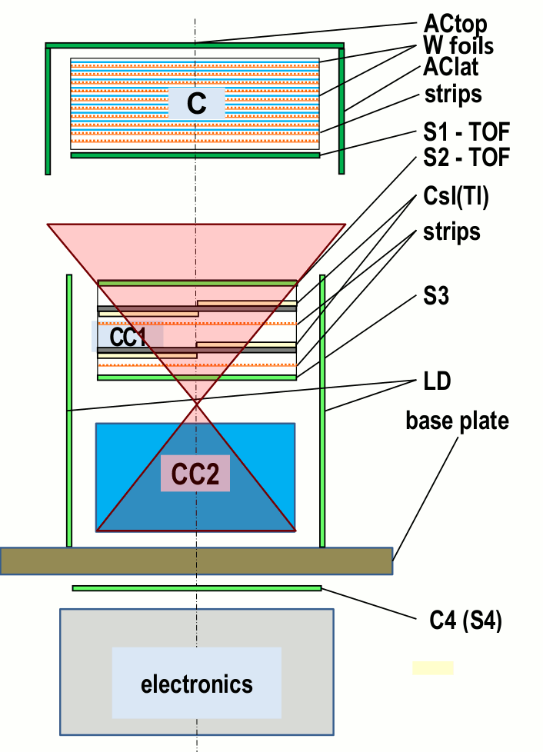

Slide 15
The lateral aperture | The lateral aperture
 | γ |  | е+/е_ |  | nuclei
 | Еlow | Еh | Еm | Еh | Еm | Еh
АСtop (upper and lower layers individual detectors) energy deposition
AClat (outer and inner layers individual detectors) energy deposition
LD system (outer and inner layers individual detectors) energy deposition
TOFsystem (signal TOF): the combination of S1 and S2 sections upper and lower layers individual detectors energy deposition with time-coordinate compensation
Signals BS1_ACtop (amplitude backsplash analysis): the combination of both layers individual detectors energy deposition of TOF S1 section and anticoincidence system АСtop one
Signal BS1_AClat (amplitude backsplash analysis): the combination of both layers individual detectors energy deposition of TOF S1 section and anticoincidence system AClat one
Signal BS1t (time analysis backsplash): the time delay between combination of both layers individual detectors of TOF S1 section and АСtop one
Signal BS2 (amplitude backsplash): the combination of both layers individual detectors of TOF S2 section and LD one energy deposition
Signal BS3 (amplitude backsplash): the combination of both layers individual detectors of calorimeter scintillation detectors sections S3, S4 and anticoincidence detectors LD
Time of light system detector S1 energy deposition
Time of light system detector S2 energy deposition
Individual scintillation detectors of CC1 amplitude discriminators
Individual scintillation detectors of CC1
Strip detectors CC1
S3 (upper and lower layers individual detectors) energy deposition
S4 (upper and lower layers individual detectors) energy deposition
Individual scintillation detectors of СС2 amplitude discriminators
Individual scintillation detectors of СС2
Strip detectors of converter C
Neutron detector
energy deposition

Slide 16
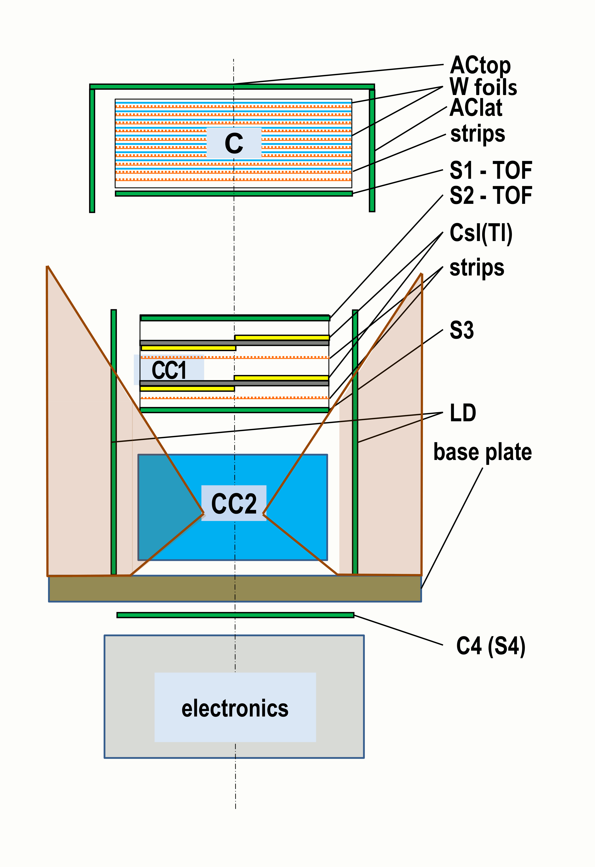

Slide 17
Conclusions:
to provide particles registration and recognition in the main aperture :
At least 2 layers of plastics in AC (both top and lateral)
At least 20% energy deposition in plastics
At least 2 layers of scintillators in CC1
S3 between CC1 and CC2
Several discriminators in plastics and CC1 to provide different thresholds of energy deposition fast analysis
+ For additional aperture:
1) At least 2 layers of plastics in LD
2) At least 2 layers of plastics in S4 and several
discriminators in S4
+ for lateral aperture: several discriminators in CC2

Slide 18
the main aperture
Energy band | Energy resolution
0.1-0.25 GeV | from ~30% up to ~15%
0.25 – 1 GeV | from ~15% up to ~9%
1 – 10 GeV | from ~9% up to ~2.7%
10-10² GeV | from ~2.7% up to 2%
> 10² GeV | 2%
Aperture type | Energy band | Energy resolution
Additional | 1-10 MeV | from 3% up to 2%
 | 10-10² MeV | 2%
 | 0.1-1 GeV | 2%
 | > 1 GeV | 2%
Lateral | 0.2-1 MeV | from ~9% up to ~3%
 | 1-5 MeV | ~3%
 | > 10 MeV | ~2%

Slide 19
Thank you for attention!!!!!

