Slide 1
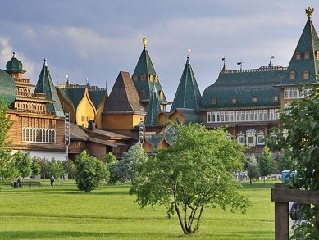
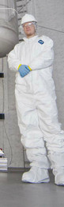



Searching for Dark Matter with LUX and LZ
v1.0
Presenting combined results from 427 LUX livedays
Matthew Szydagis
for the LUX and LZ collaborations
2nd Int’l. Conf. on Particle Physics and Astrophysics
Milan Hotel, Moscow, Russia, October 13, 2016

Slide 2
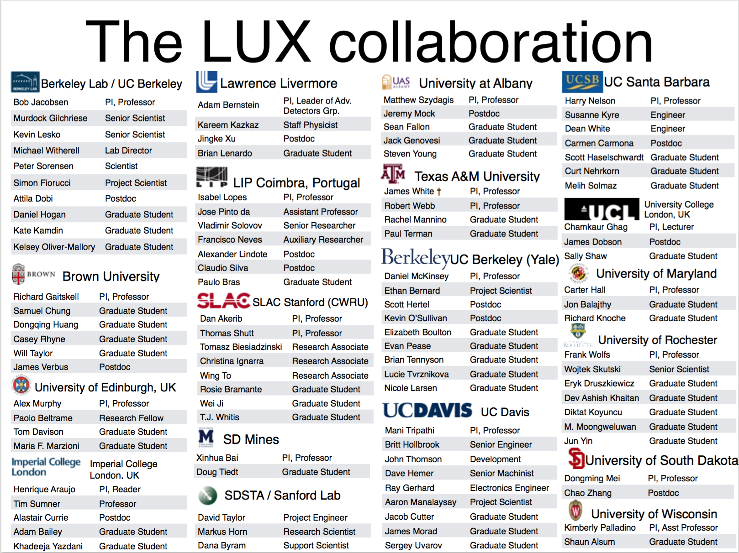


Slide 3
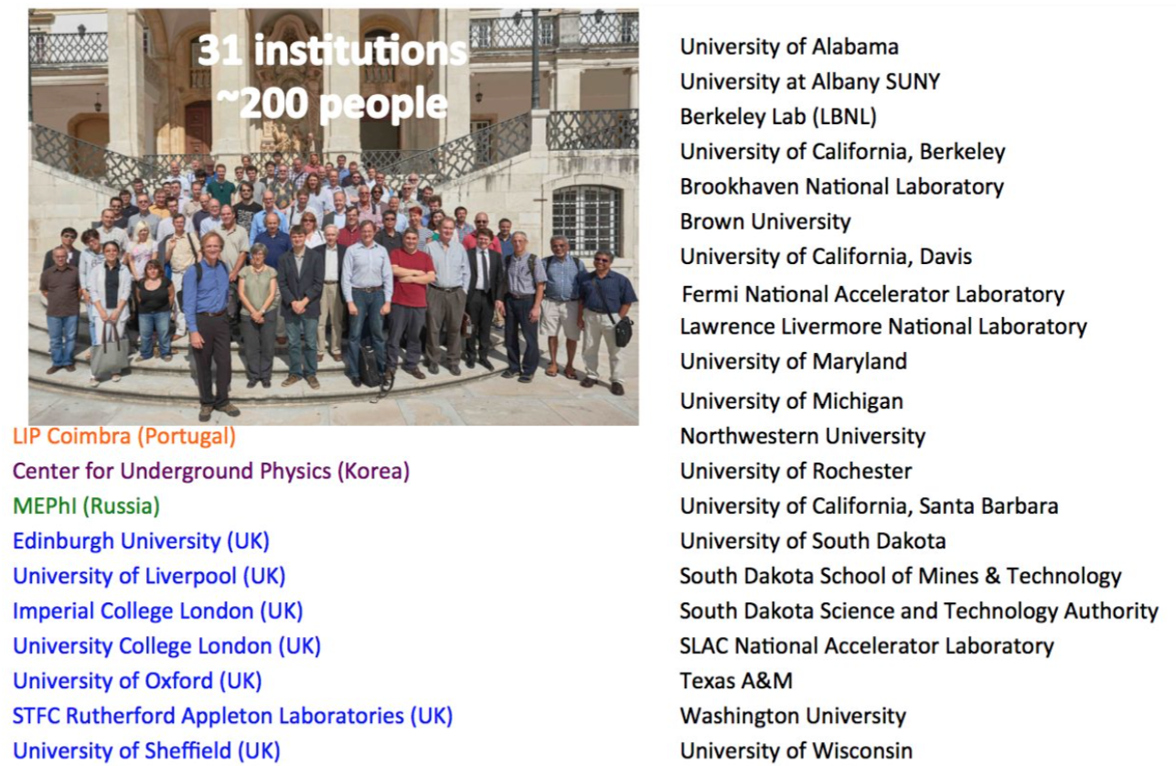

3

Slide 4
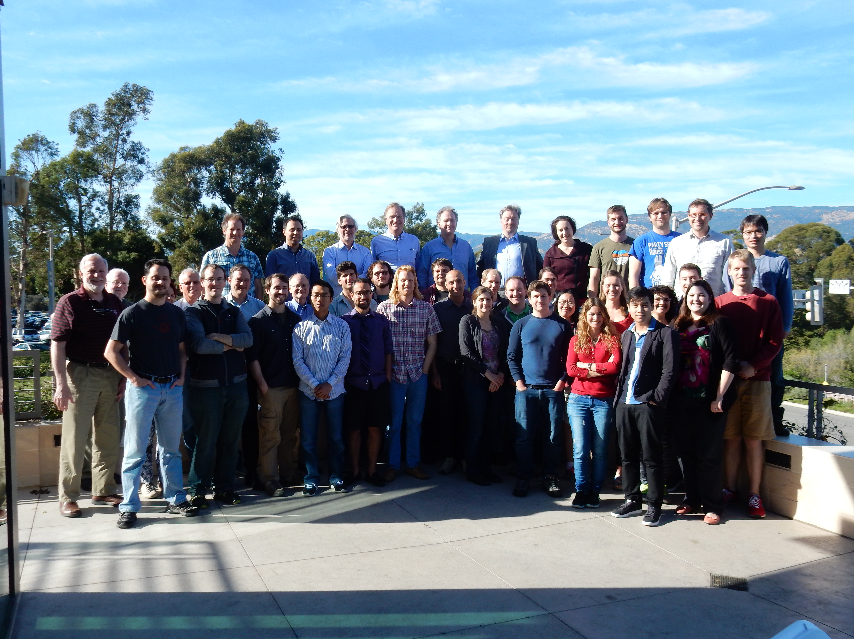
LUX

Slide 5
A Brief Outline
A review of the LUX experiment, a two-phase Xe TPC
The first LUX result (2013-4) and its re-analysis (2014-5)
Details of internal electric field post grid conditioning
332 live-day WIMP search run (300 live-days salted)
Salting of data with NR events as a form of blinding
Latest LUX sensitivity to WIMP-nucleon SI cross-section
First-run SD sensitivity, and preliminary axion/ALP limits
A bright future: more LUX, plus ton-scale LZ detector

Slide 6
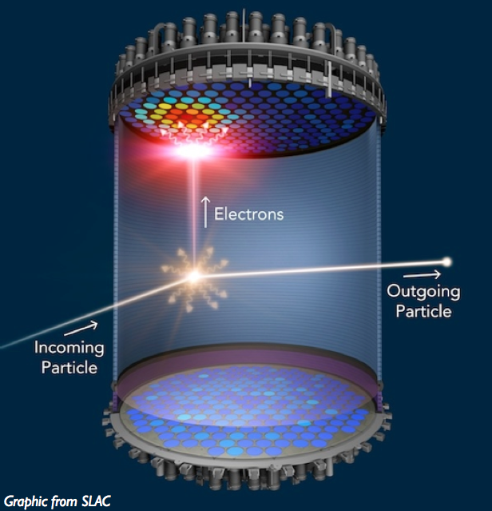
The Detection Method
Xe-based TPCs have been leading pack for 10 years
  XENON10, ZEPLIN-II/III, XENON100, now LUX/LZ
PMTs convert single photons into single photo-electrons (phe)
  phd = photons detected, term coined by LUX (better-resolution counting method)
Time between S1 and S2 gives you depth (Z), and S2 top hit pattern is radial position (X and Y)
LUX is @Sanford Lab, Lead

Slide 7
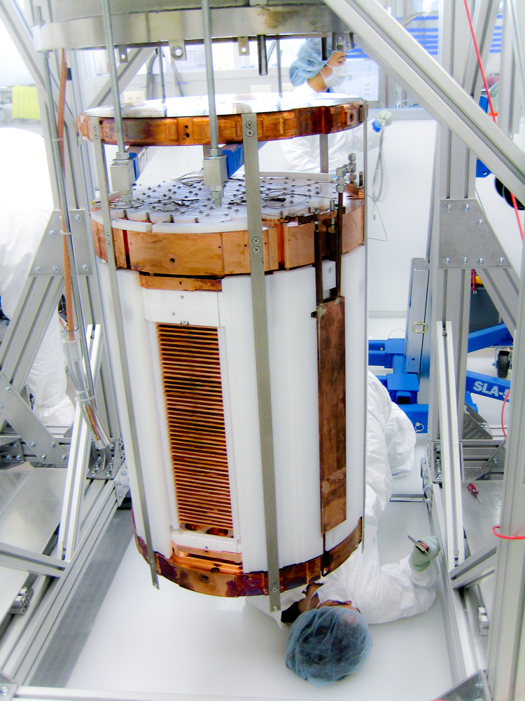
Large Underground Xenon
~1:1 ratio: 50 x 50 cm dodecagonal cylinder of highly reflective PTFE
370 kg LXe in total (within all crevices)
  250 kg in active region (with field)
  118, 145, 100 kg fiducial across different analyses (depends on BG)
122 phototubes (2 x 61, top and bot)
  Low BG, sensitive to 175 nm VUV
Xe pre-purified of Kr-85, plus re-circulated during run for impurities
Ultra-low BG Ti cryostat, big thermos!
~3-4 keV NR threshold (point of 50% efficiency pre-discrimination of ER)
0.2% ER leak for ~50% NR accepted
(approximate, as PLR used)

Slide 8
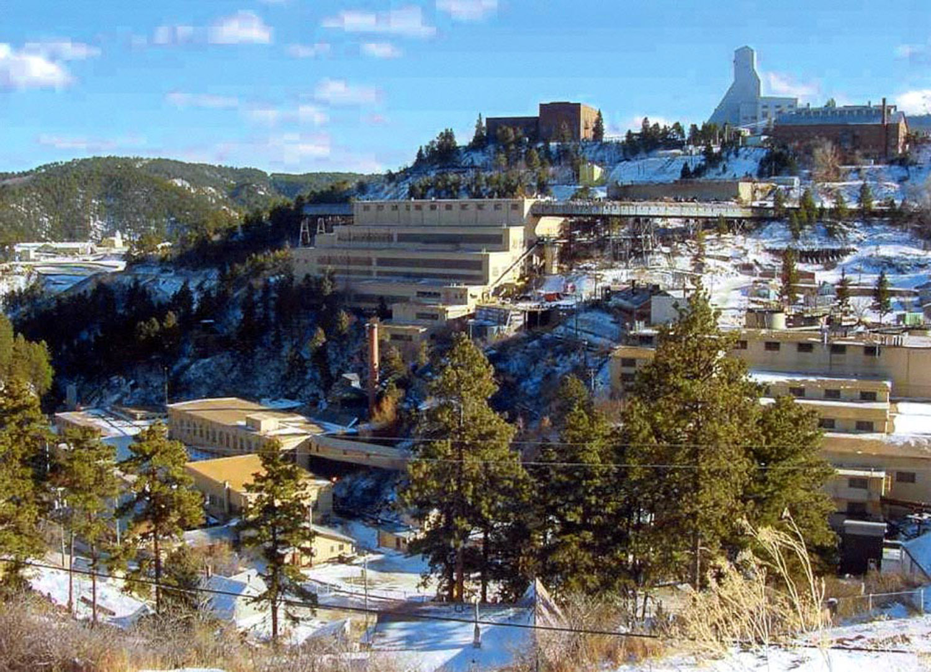
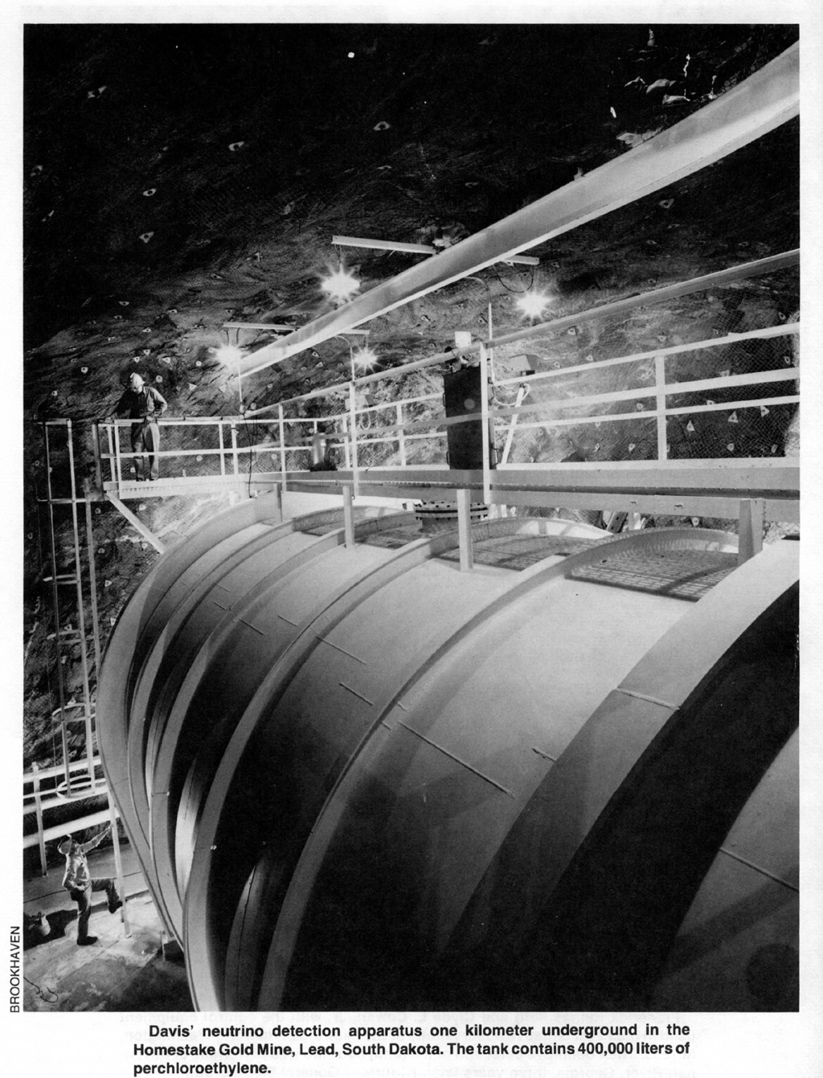
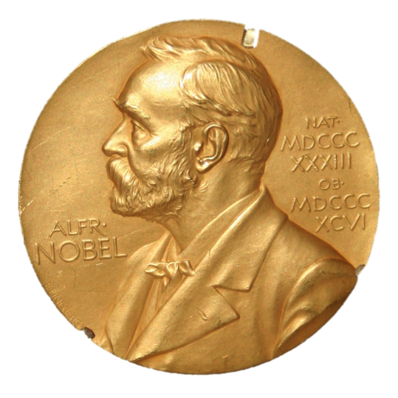

SURF (Sanford Underground Research Facility)
4850 ft. below Lead, SD. The former site of the Homestake gold mine
8
LUX is installed in the Davis cavern, once home to the Nobel prize-winning Ray Davis neutrino experiment

Slide 9
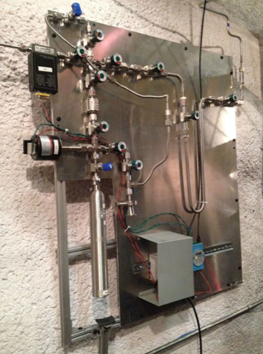
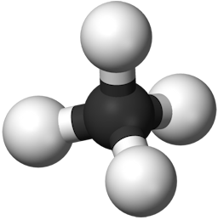
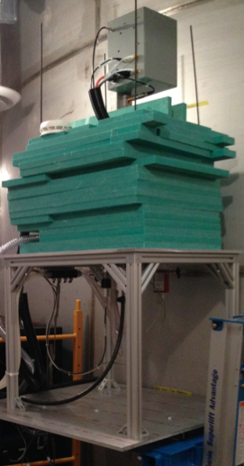
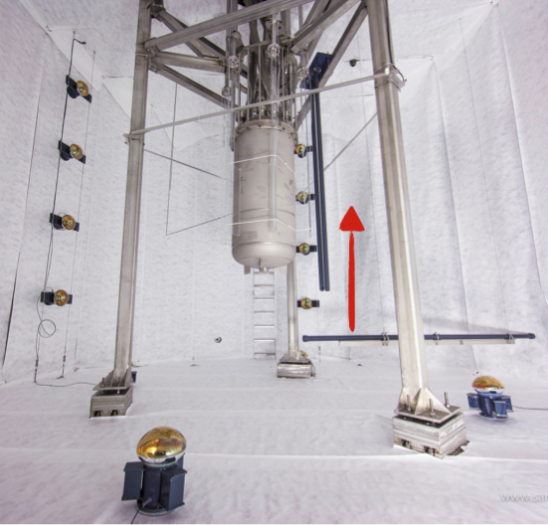
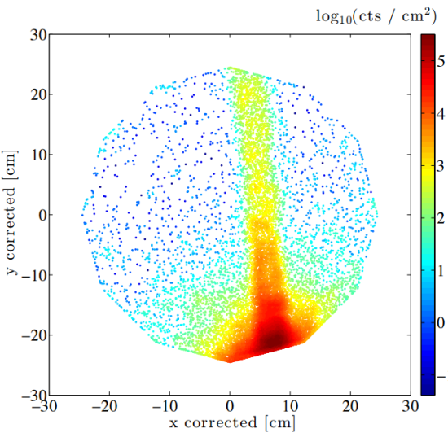
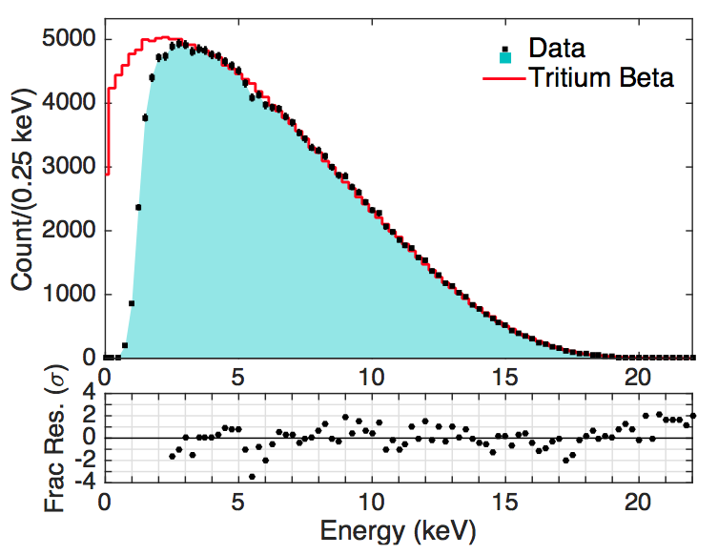
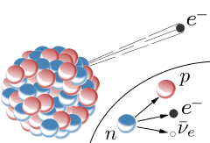
NR / ER Calibrations

Slide 10
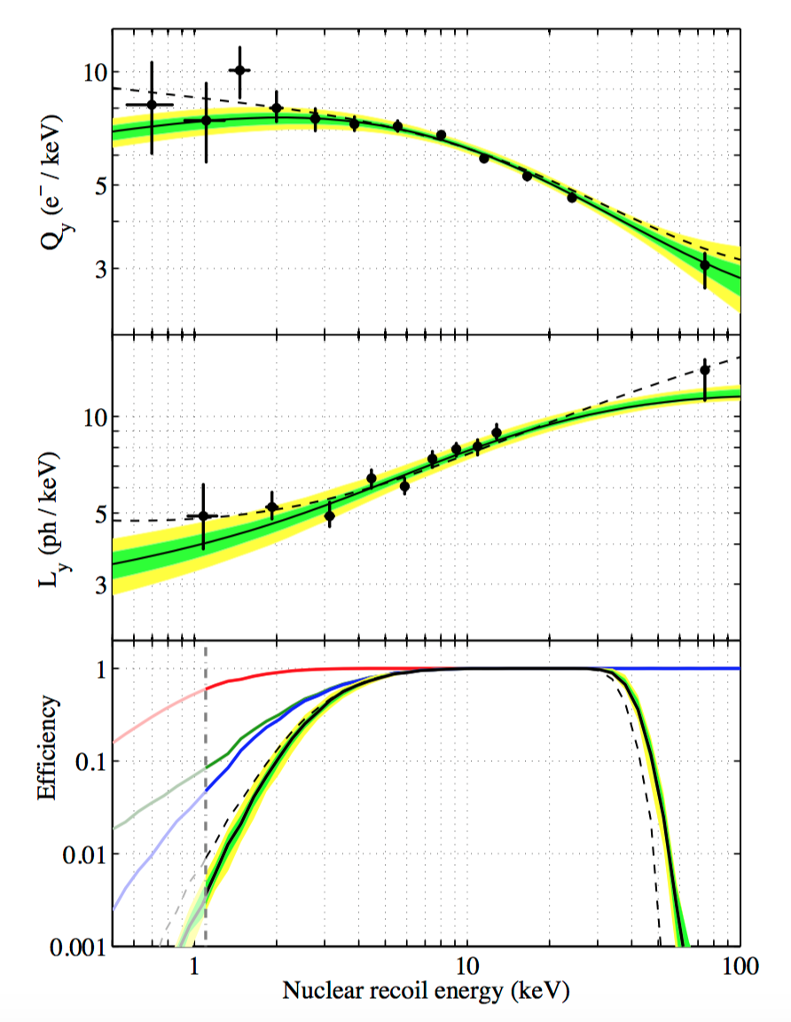
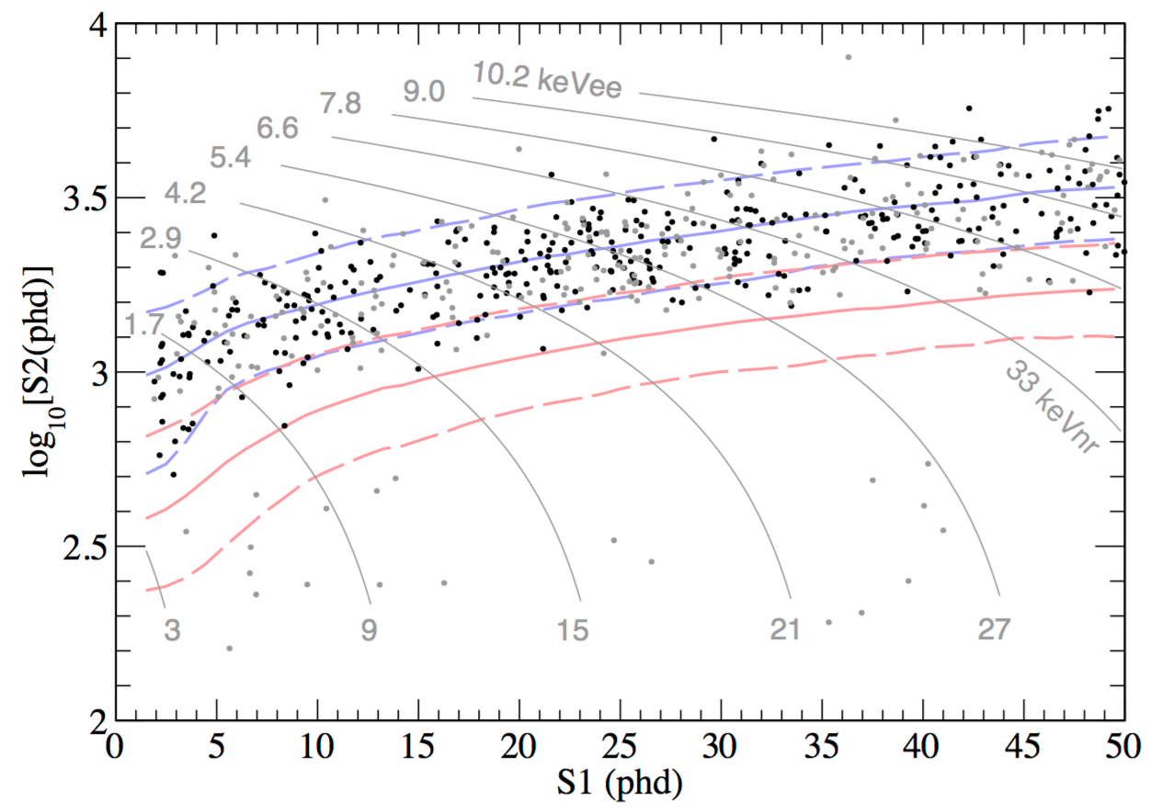
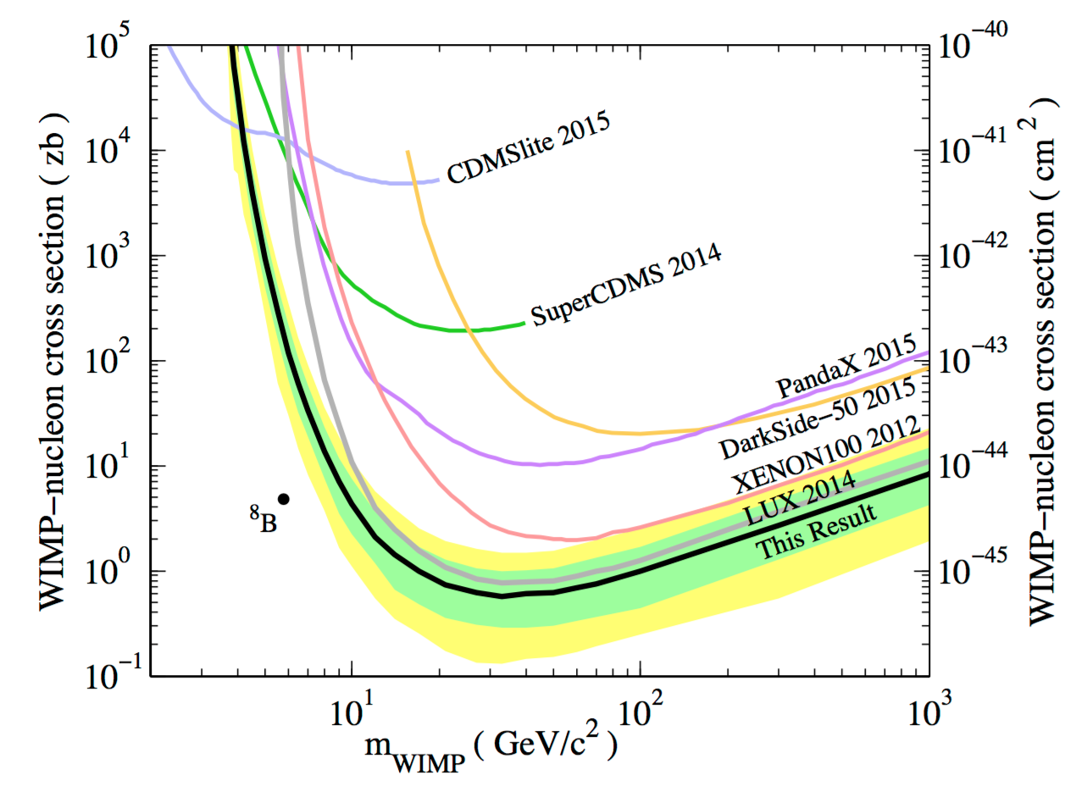
LUX 2013, ’14 works: 95 days
Notes:
Sum of light and charge close match to Lindhard model now: see upcoming DD paper(s)

Slide 11
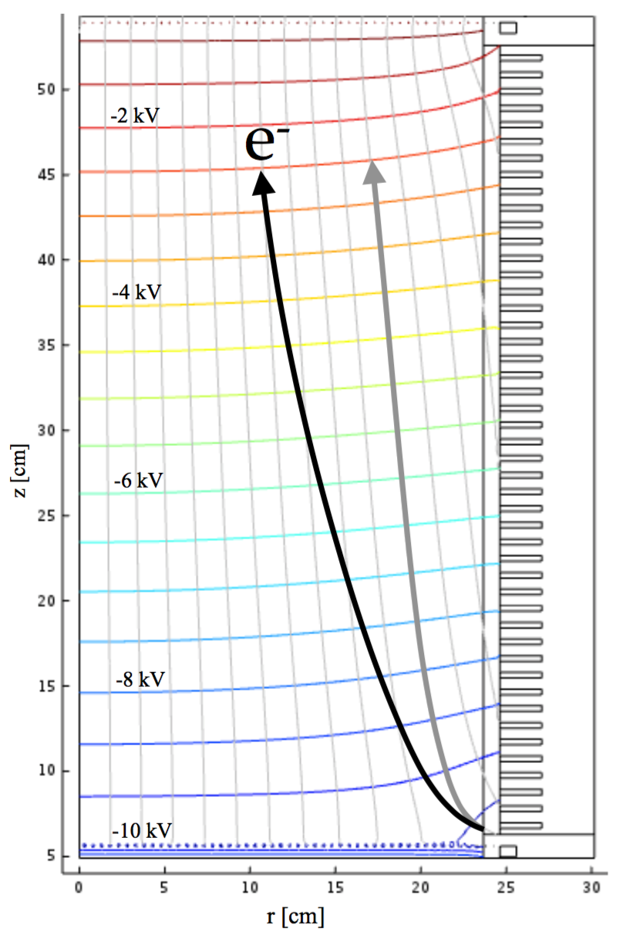
Effects of Grid “Conditioning”
~LHC baguette??
Attempted to raise 180 V/cm drift and 6 kV/cm extraction after science run; succeeded
  Motivated by alleged higher discrimination (turned out light collection more important)
  Also to seek lower S2 threshold
Successful on both counts
  Electron extraction efficiency raised from 48.9% to >70%
However, drift electric field became distorted, both in magnitude and in direction

Slide 12
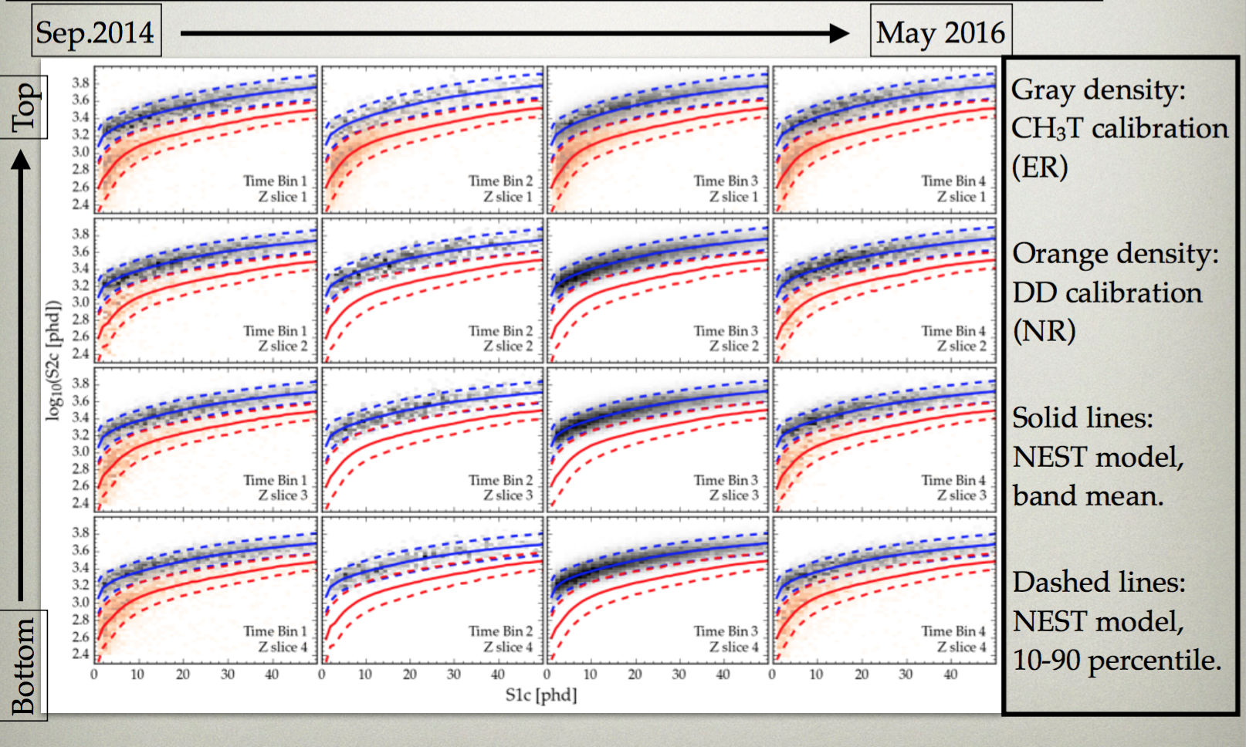
Solution: Time / Space Bins
4 event date bins X 4 z-slices = 16 ‘segments’

Slide 13

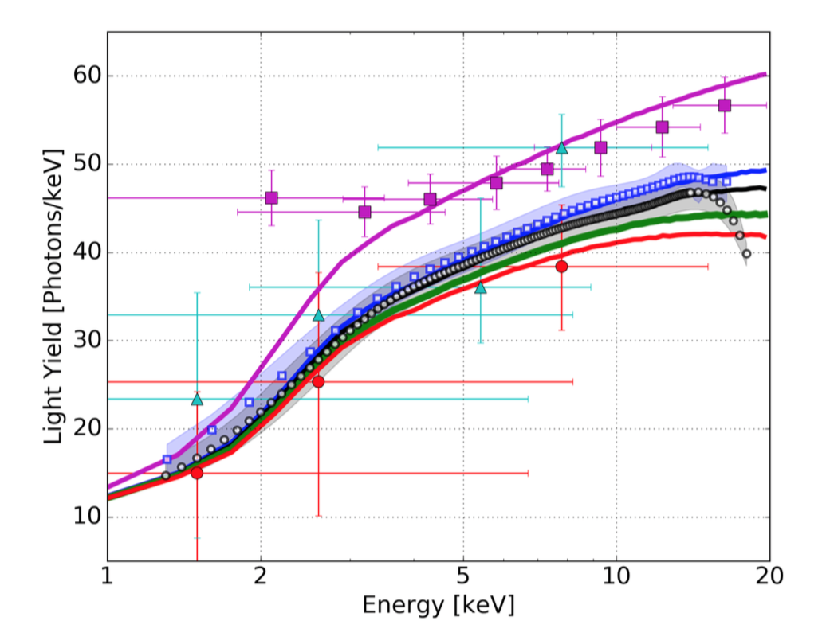
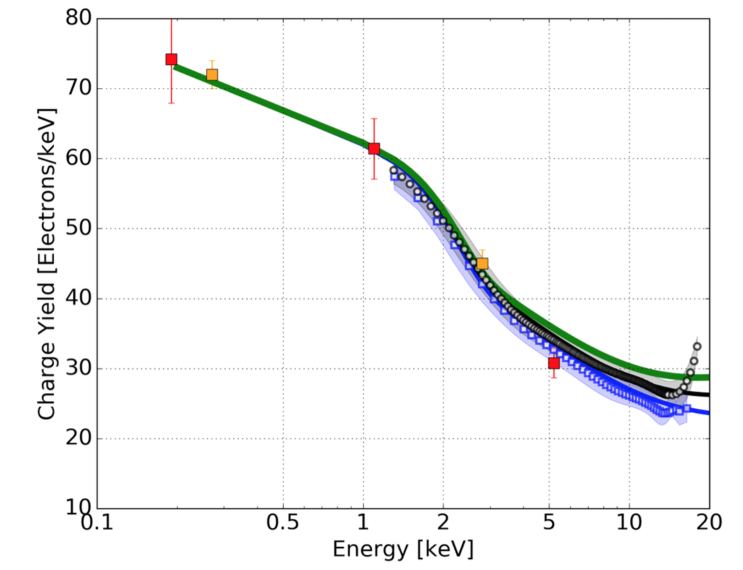
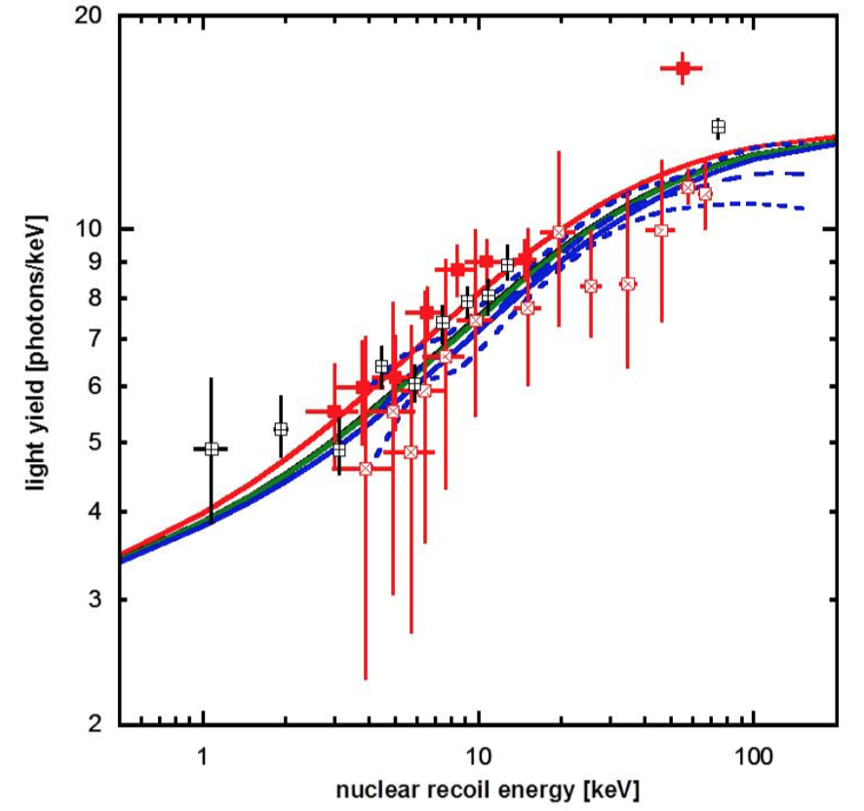
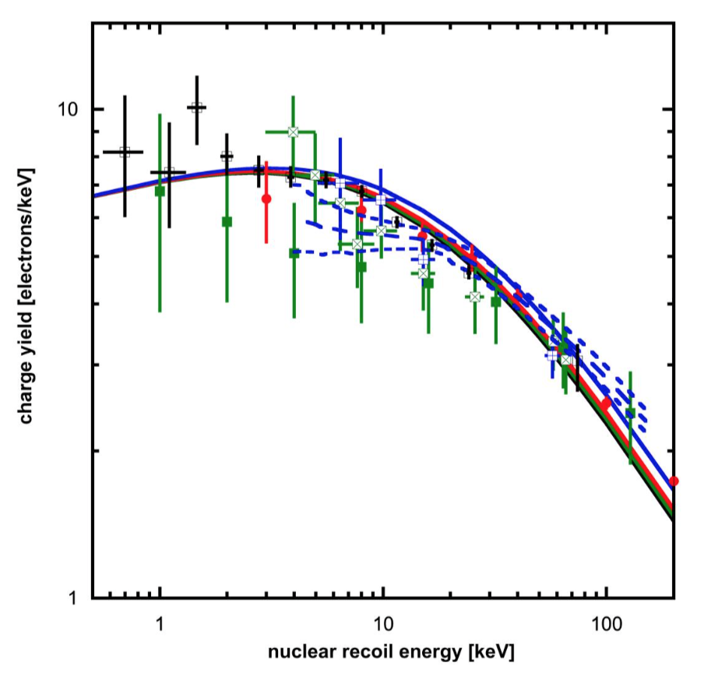
What is ?
See my parallel session talk on NEST from Monday
The Noble Element Simulation Technique
MC model/ framework
ER Ly
ER Qy
NR Ly
Best-fit electric fields agreed within uncertainty with COMSOL out of the box
Semi-empirical, absorbing existing data
NR Qy
(plots for LZ planning)

Slide 14
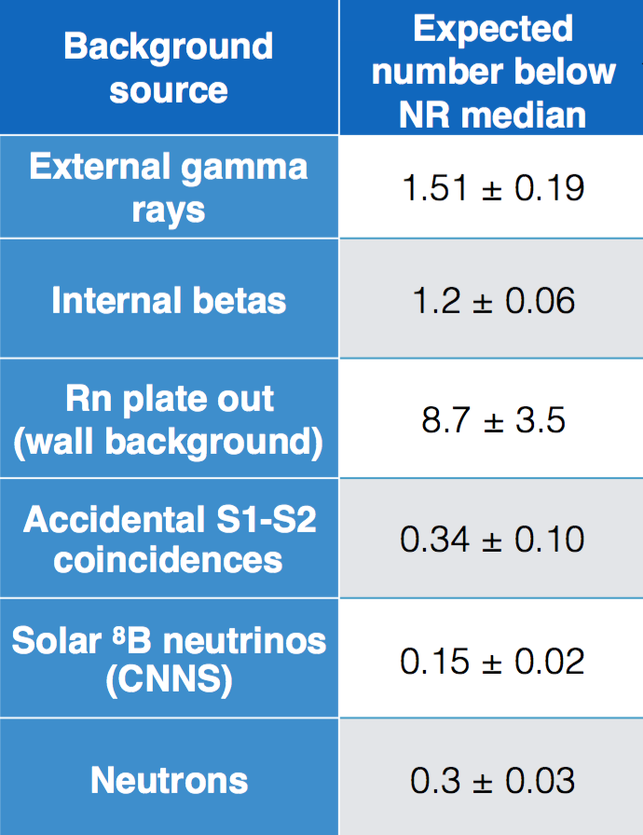
Estimation of Backgrounds
Figure of merit only (we do a likelihood analysis)
Bulk volume, but leakage at all energies
Low-energy, but confined to the edge of our fiducial volume
  Our likelihood analysis includes position information, so these events have low 𝓛(signal) likelihood
In the bulk volume, low- energy, in the NR band

Slide 15
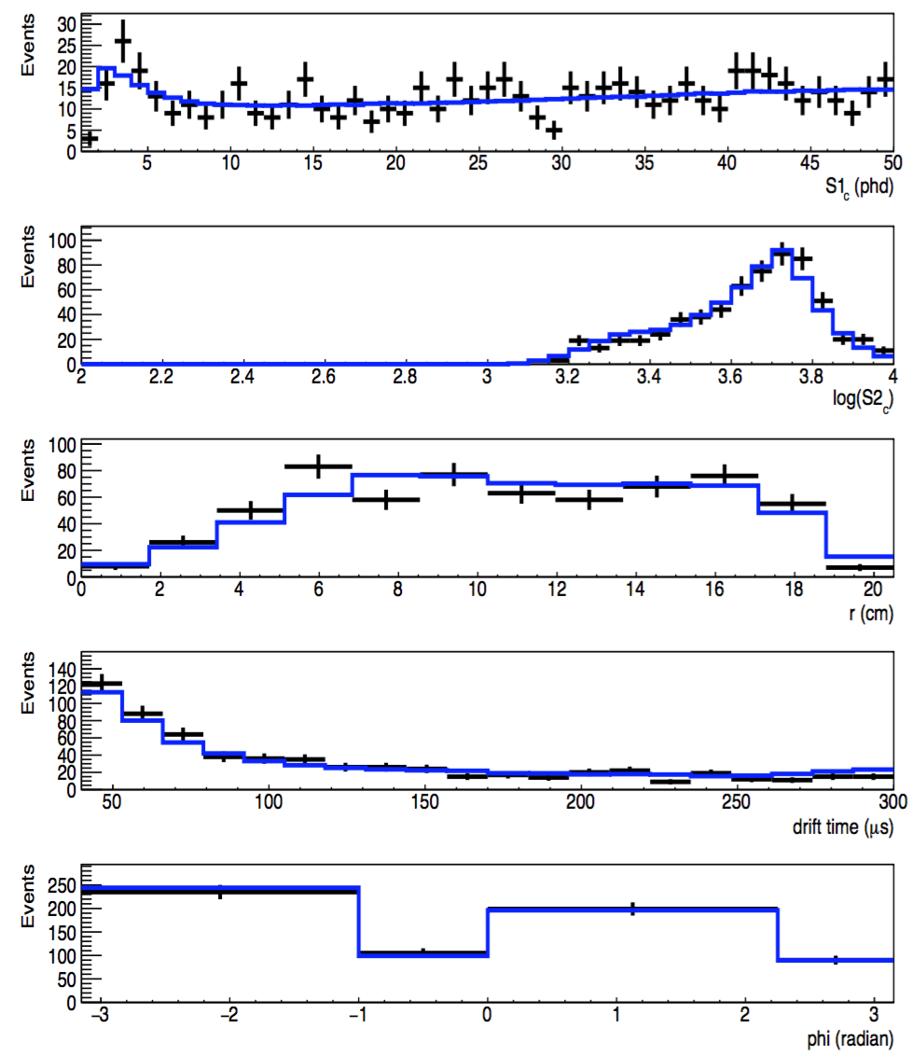
Pre-Unsalting Verification
Data are compared with models in an un-binned, 2-sided Profile Likelihood Ratio (PLR)
Six dimensions
  Spatial (raw): radius, polar angle, drift time
  Energy: S1 and S2
  Temporal (date bins)
Side-band: upper ER
Outstanding p-values >>10%, outstripping last run’s great BG model
Sim Data

Slide 16
Taking a Look at the Dark Matter Search Data
16

Slide 17
Traditional blinding masks this (red) signal region completely, plus more (ER band lower half)
Challenge seen very often in the direct detection community is side effect of blindness to rare backgrounds and pathologies as well
One may not need to go to such great lengths to mitigate the potential for bias
17

Slide 18
Energy contours added as guides
Salt is included within next slide!
18

Slide 19
Instead of traditional blinding, we employ a technique where fake signal events (“salt”) are injected into data stream. NOT SIM!!
Mitigate bias while allowing for scrutiny of individual events
Used already to great effect in neutrino experiments and searches for fractional charge
Plot shows data from our “16 detectors” stacked on top of each other
19

Slide 20
Grey within 1cm of our fiducial volume boundary
Black: bulk events
Red and blue curves are the ER and NR bands respectively
Salt identified as blue dots now
20

Slide 21
With salt removed. A success (!)
21

Slide 22
After desalinization but prior to limit calculation, events outside of the ER band re-scrutinized
2 populations of rare pathological events were identified contributing 3 sub-NR-band events
Loose cuts with flat, high (NR) signal acceptance, defined only on calibration
(quite rich!)
Post-unblinding cuts were created, targeting gas S1 events and Cerenkov-like events (light mostly in 1 PMT). S1 quality cuts had been lacking, since focus was on S2 quality cuts
22

Slide 23
p-value = 40% (BG only)
With the red events from the previous slide included amongst those removed using post-unblinding cuts
23

Slide 24
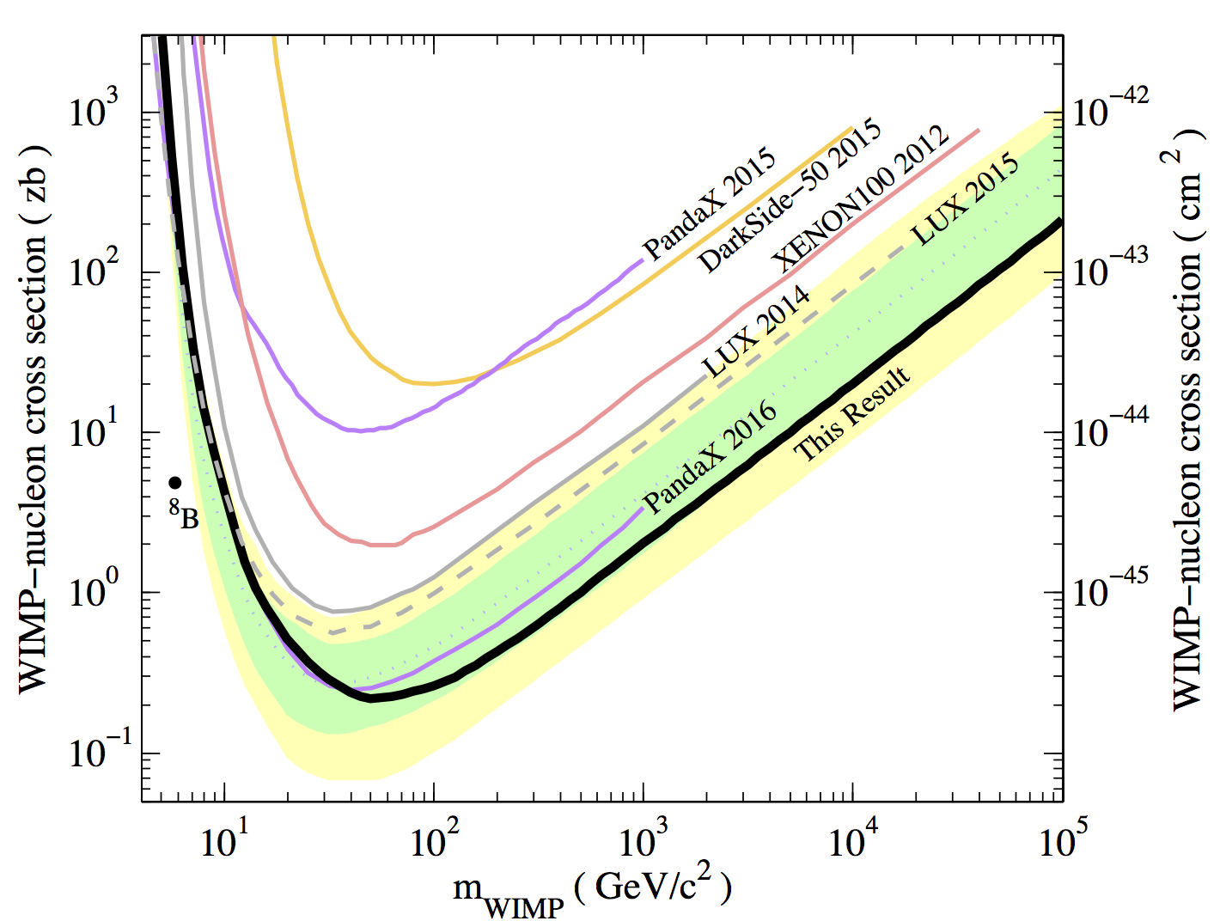
WIMP-nucleon SI Exclusion
Our best, lowest exclusion is at 50 GeV: 2.2 x10⁻⁴⁶ cm² (That’s 0.22 zeptobarns in σ!)
  1 order of magnitude off XENON1T
  Within < 2 orders of LZ projection
Comparable to LUX 2015 re-analysis of 3 months’ worth of data at low mass but FOUR TIMES better at high mass. (Final G1?)
(NOT preliminary. Analysis / limit is final. Paper is being submitted to PRL.)
Within (log) spitting distance of coherent neutrino
scattering
~2x below
PandaX curve
arXiv:1608.07648
24

Slide 25
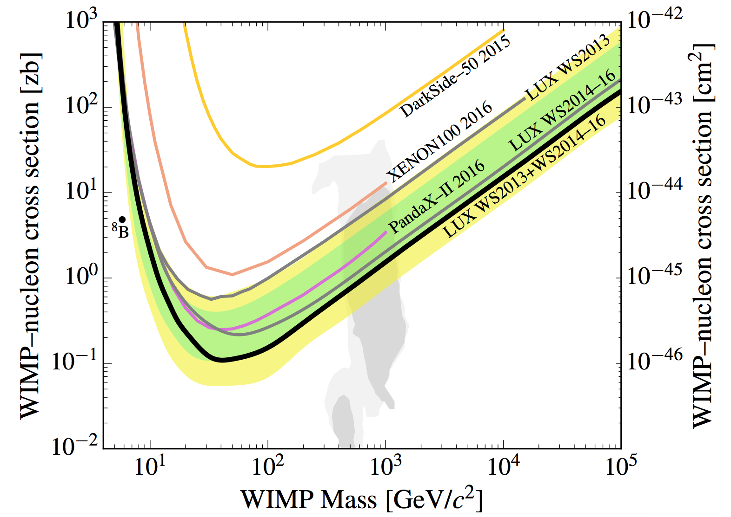
Both LUX Runs Combined
(the 1 TeV Higgsino is partially ruled out)
arXiv:1508.01173
arXiv:1603.06519

Slide 26
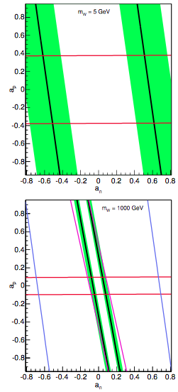
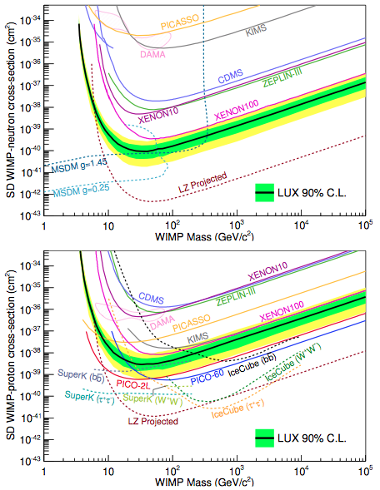
SD Exclusion
NOTE: This is still the old run. Still needs to be updated with the 1 year’s worth of new data
Xenon is the *best* element for neutron coupling (while fluorine is best for protons)

Slide 27
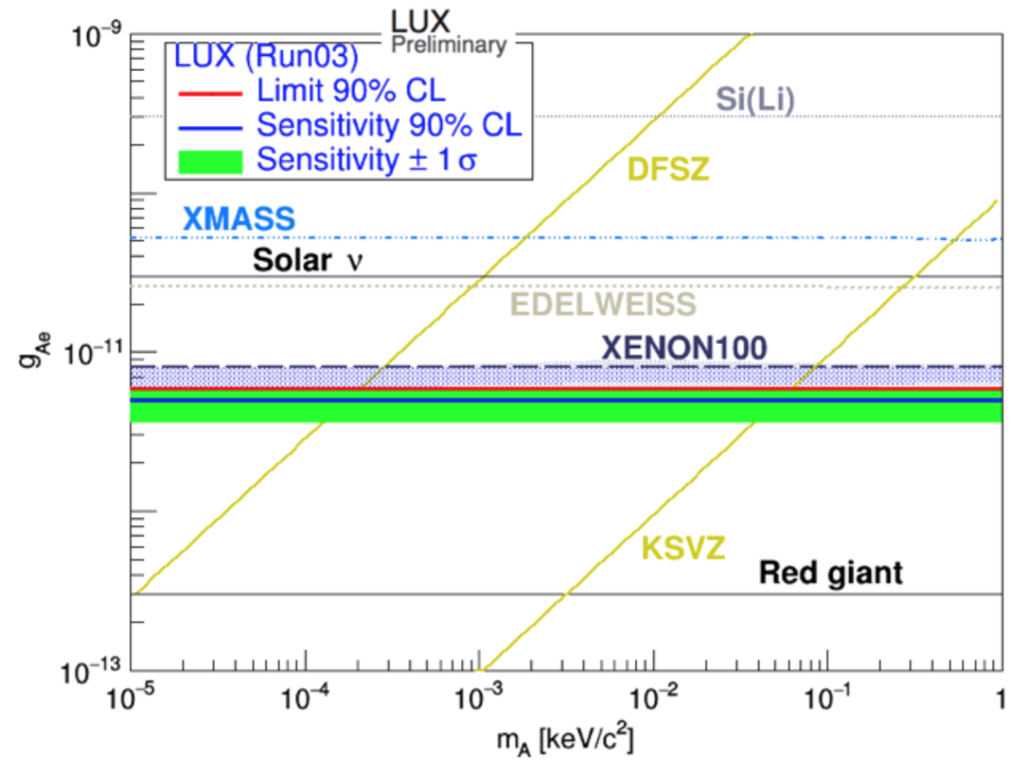
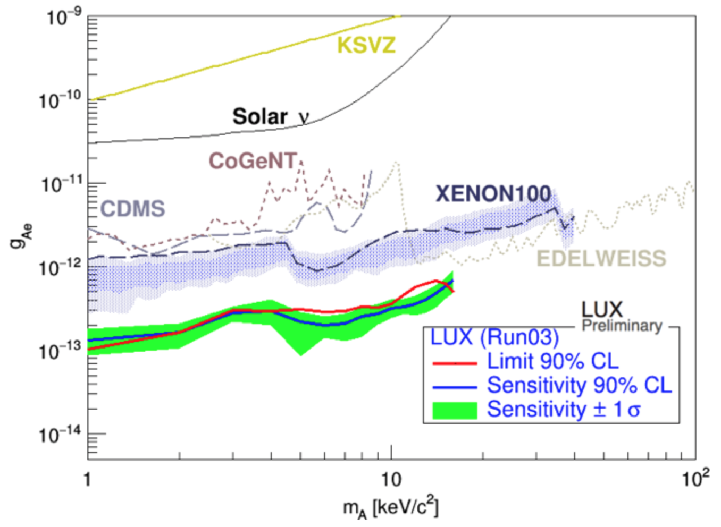
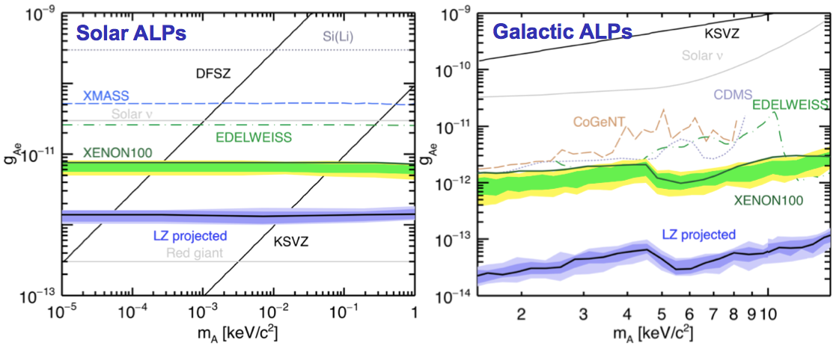
Axions (LUX 95 days, and LZ)
PRELIMINARY
(projection for 3 years)

Slide 28
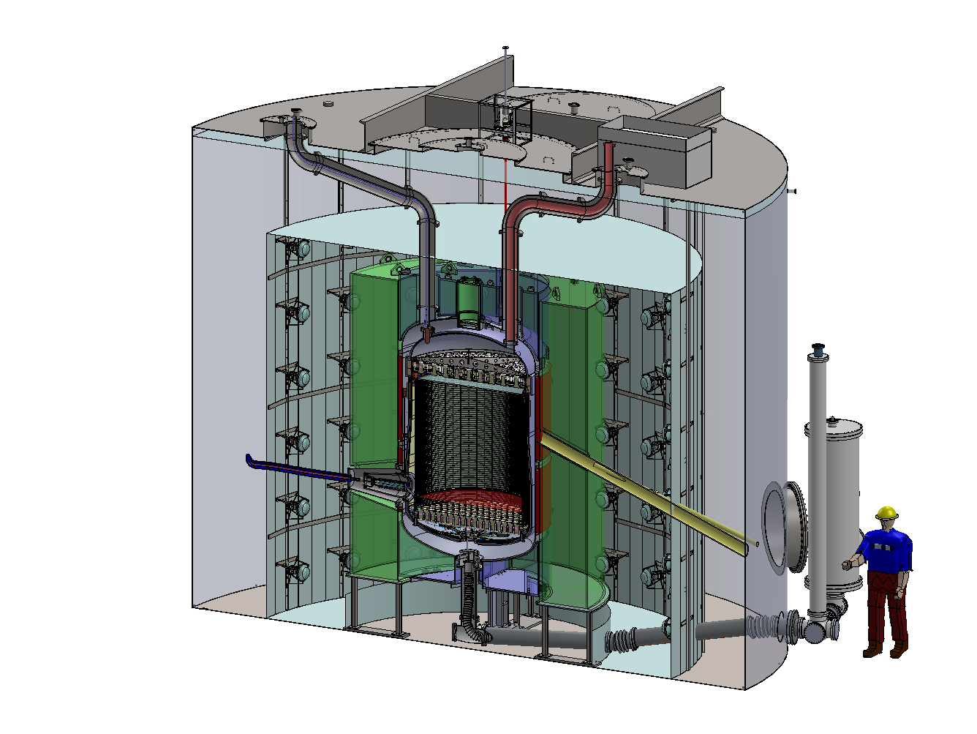

LUX-ZEPLIN Collaboration
Instrumentation enters through conduits here
Separate project from LUX
A bigger and better version of LUX. Funded!
(A merger of 2 collaborations)
Existing water tank
LZ has just passed its DOE CD- 2/3b review. (Was already past CD-1/3a last year.)
Gd-loaded liquid scintillator
LXe heat exchanger
Cathode high voltage feedthrough
120 outer detector PMTs
2-phase XeTPC
494 (131) TPC (Xe skin) PMTs
28
n tubes

Slide 29
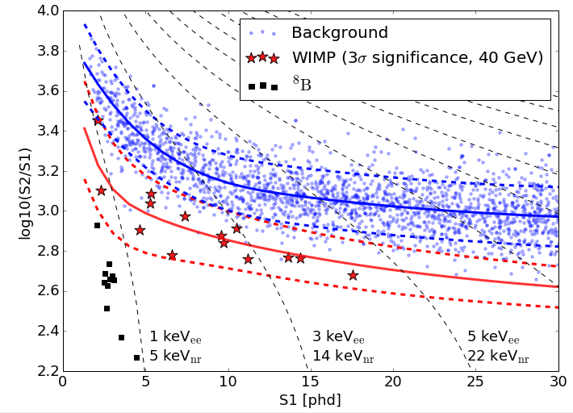
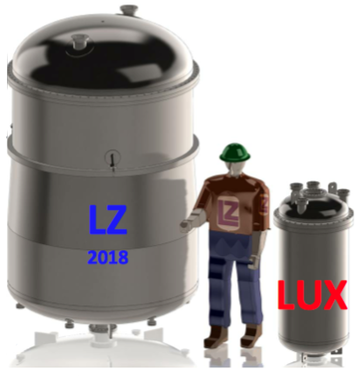
LZ’s Reach
29
Turning on by 2020 with 1,000 initial live-days plan
10 tons total, 7 tons active, ~5.6 ton fiducial mass
  Due to unique triple veto
GOALS: < 3 x 10⁻⁴⁸ cm², at 40 GeV. Clip ν shoulder
6 keVnr threshold with at least 99.5% discrimination
(latest)
Many Higgs-mediated models probed
*plot and models from LZ’s Conceptual Design Report, arXiv:1509.02910
Notes:
1)`Sprinkles' on the LZ plot are 15-parameter SUSY models, and Atlas did way better with a 19-parameter and deeper inclusion of *all* LHC Run-1 results
2)`islands' on the LZ plot are 5-paramter CMSSM, and that too has been updated (3) LHC Run 2 will change everything, be on the lookout at ICHEP for that!

Slide 30
Summary and Outlook
New world-leading result, from LUX’s 332 live-day search, cutting into unprobed parameter space
  33,500 kg-days exposure, most of any LXeTPC ever
More publications forthcoming: SD, axions, inelastic DM, more detailed longer paper on the nitty-gritty, new calibrations that will be useful for future experiments like LZ, S1 pulse-shape discrimination, EFT operator limits...
  Now: “Signal yields, energy resolution, and recombination fluctuations” -arXiv:1610.02076
LUX-ZEPLIN (LZ) will come within ~one order of magnitude of the neutrino floor at high mass with multi-ton-scale detector and SURF infrastructure
  One of only 3 down-selected DOE Gen-2 projects

Slide 31
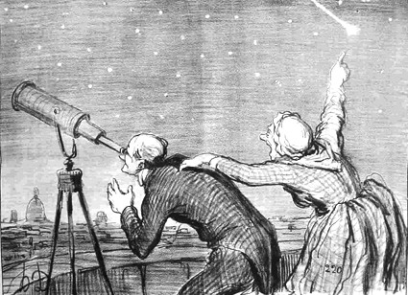
Honoré Daumier, “Mr. Babinet, warned by his concierge of the arrival of the comet”, illustration for Le Charivari, 22 September 1858.
Hopefully, we are looking in the correct places for the dark matter!
THANK YOU!

Slide 32
Additional Slides
for backup
See also especially: https://idm2016.shef.ac.uk/indico/event/0/contribution/50/material/slides/0.pdf (the first announcement talk, by Dr. Aaron Manalaysay, this past July at the IDM conference in the UK)
Selected Publications:
Phys. Rev. Lett. 112, 091303 (2014)
Phys. Rev. Lett. 116, 161301 (2016)
Phys. Rev. Lett. 116, 161302 (2016)
Phys. Rev. D 93, 072009 (2016)
Notes:
Publications: first, re-anal, SD, tritium. No Run04, PRD, axions yet.

Slide 33
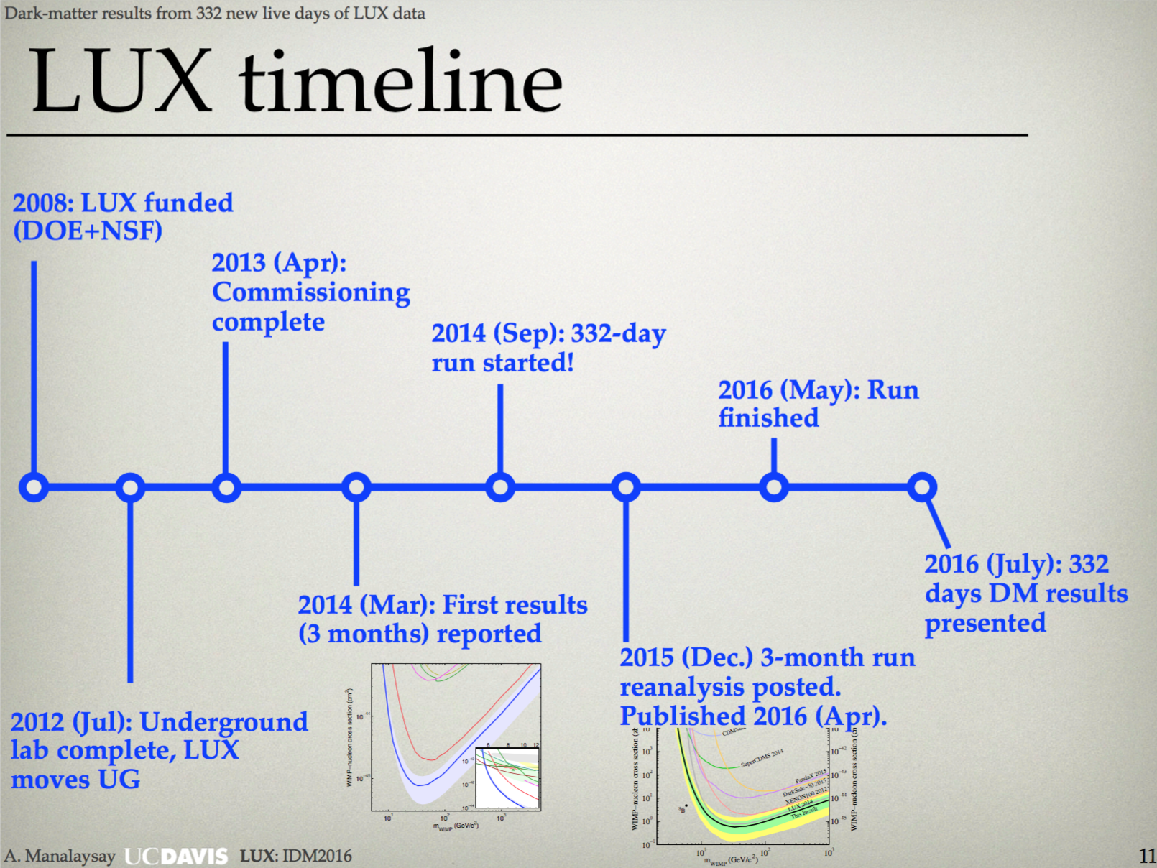
Translation of confusing run names
Run01: systems test with GAr
Run02: technical surface run (Xe)
Run03: Three months / 95 days live underground
Run04: A 1-year /332 live-day run
Astoparticle Phys., Vol. 45, May 2013, pp. 34–43
Not over: analyses!
original sensitivity goals were exceeded

Slide 34
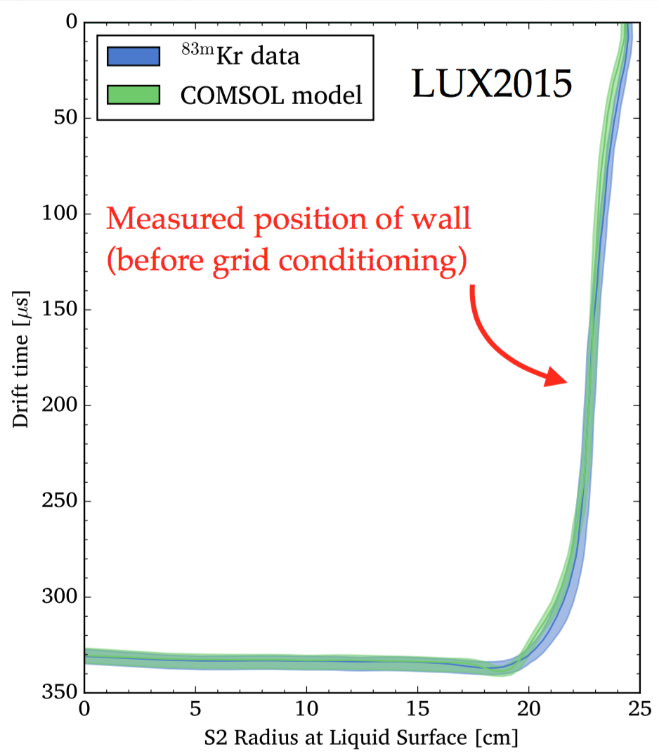
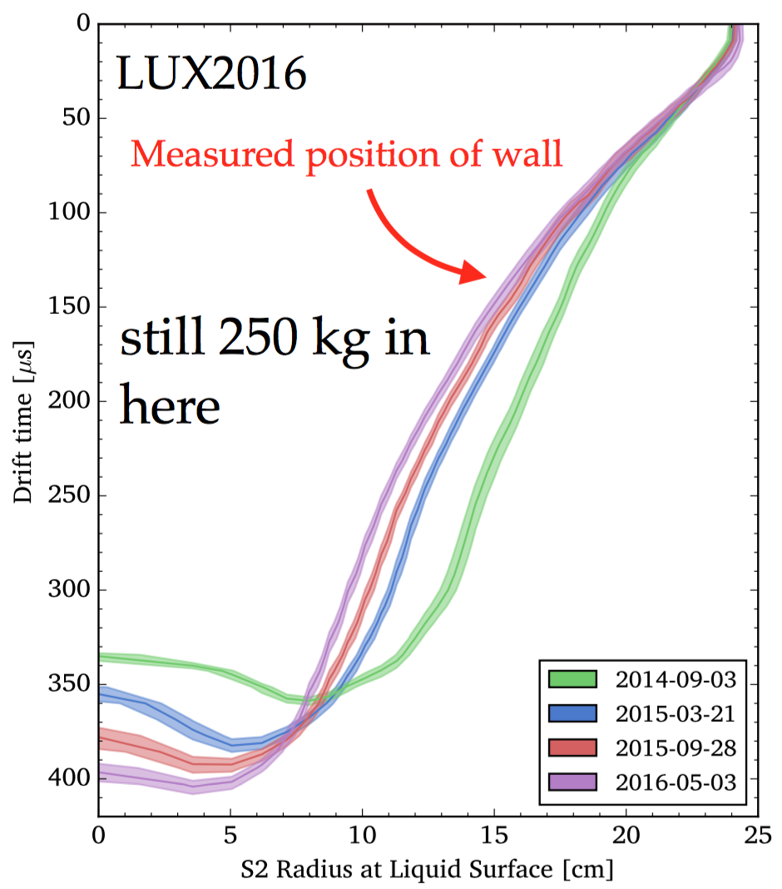
Electric Field Uniformity

Slide 35
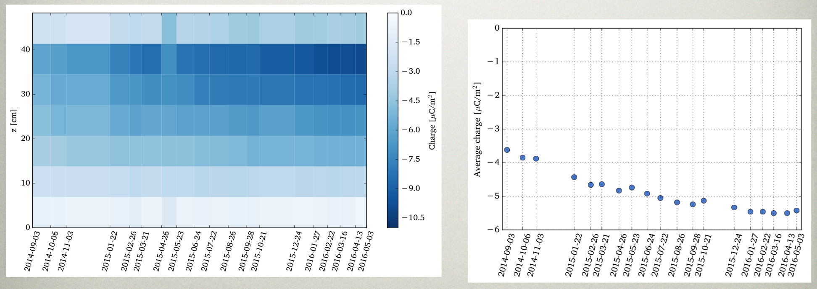
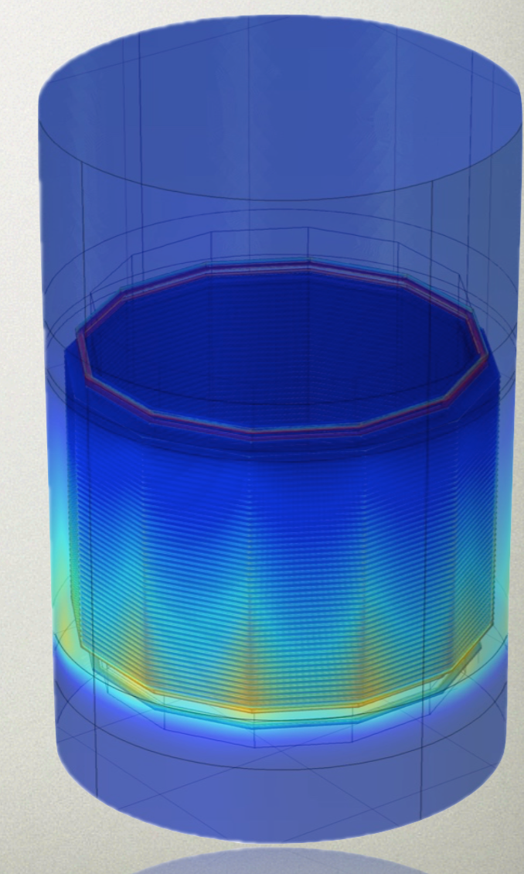
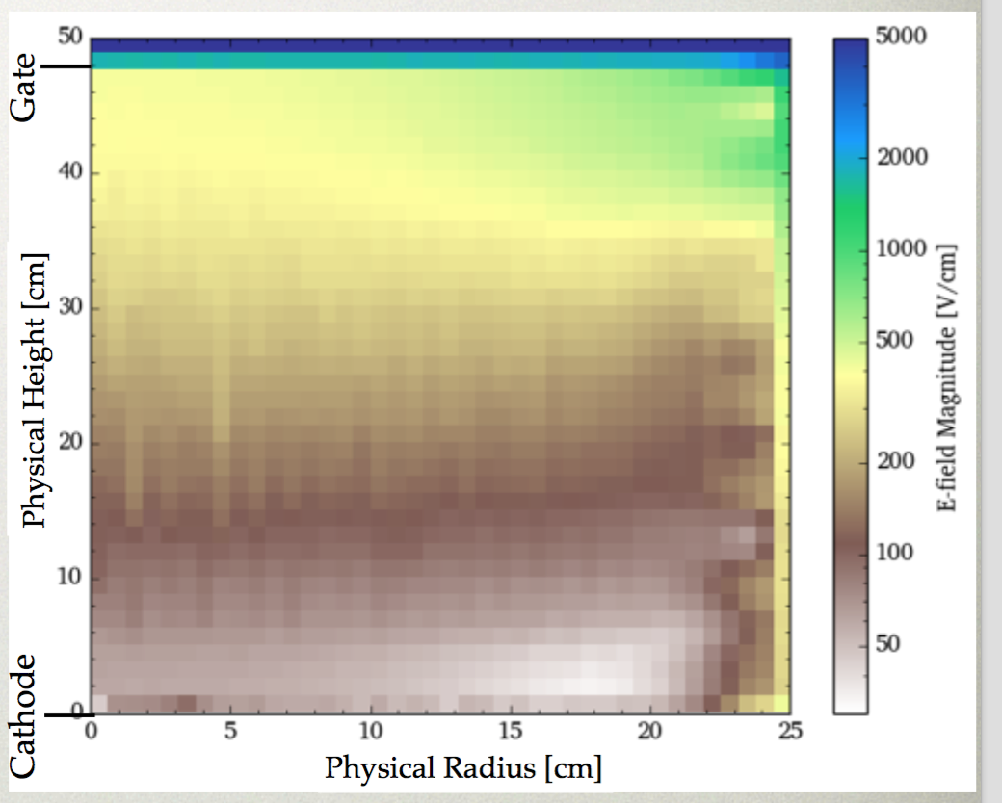
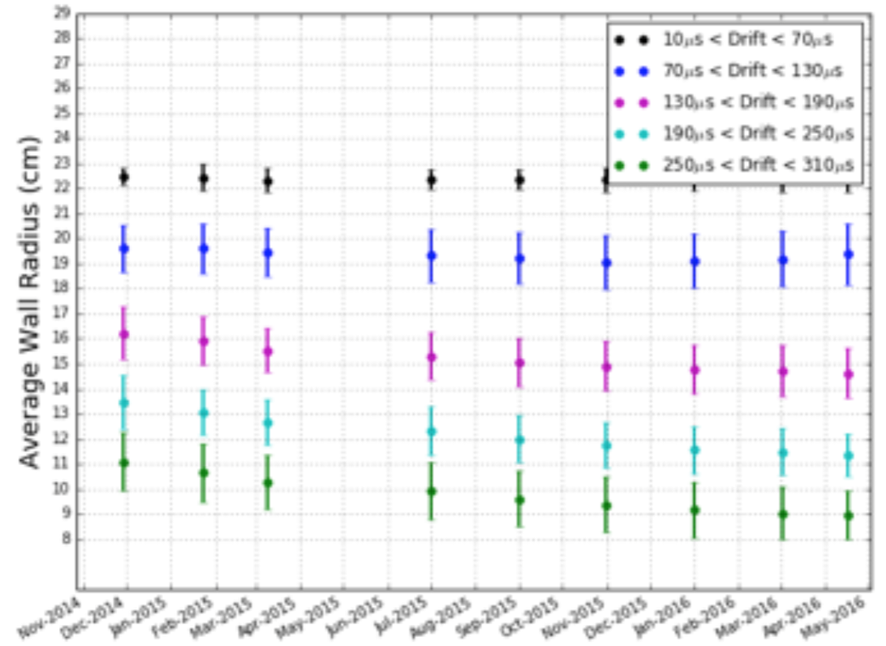
E-field modeling

Slide 36
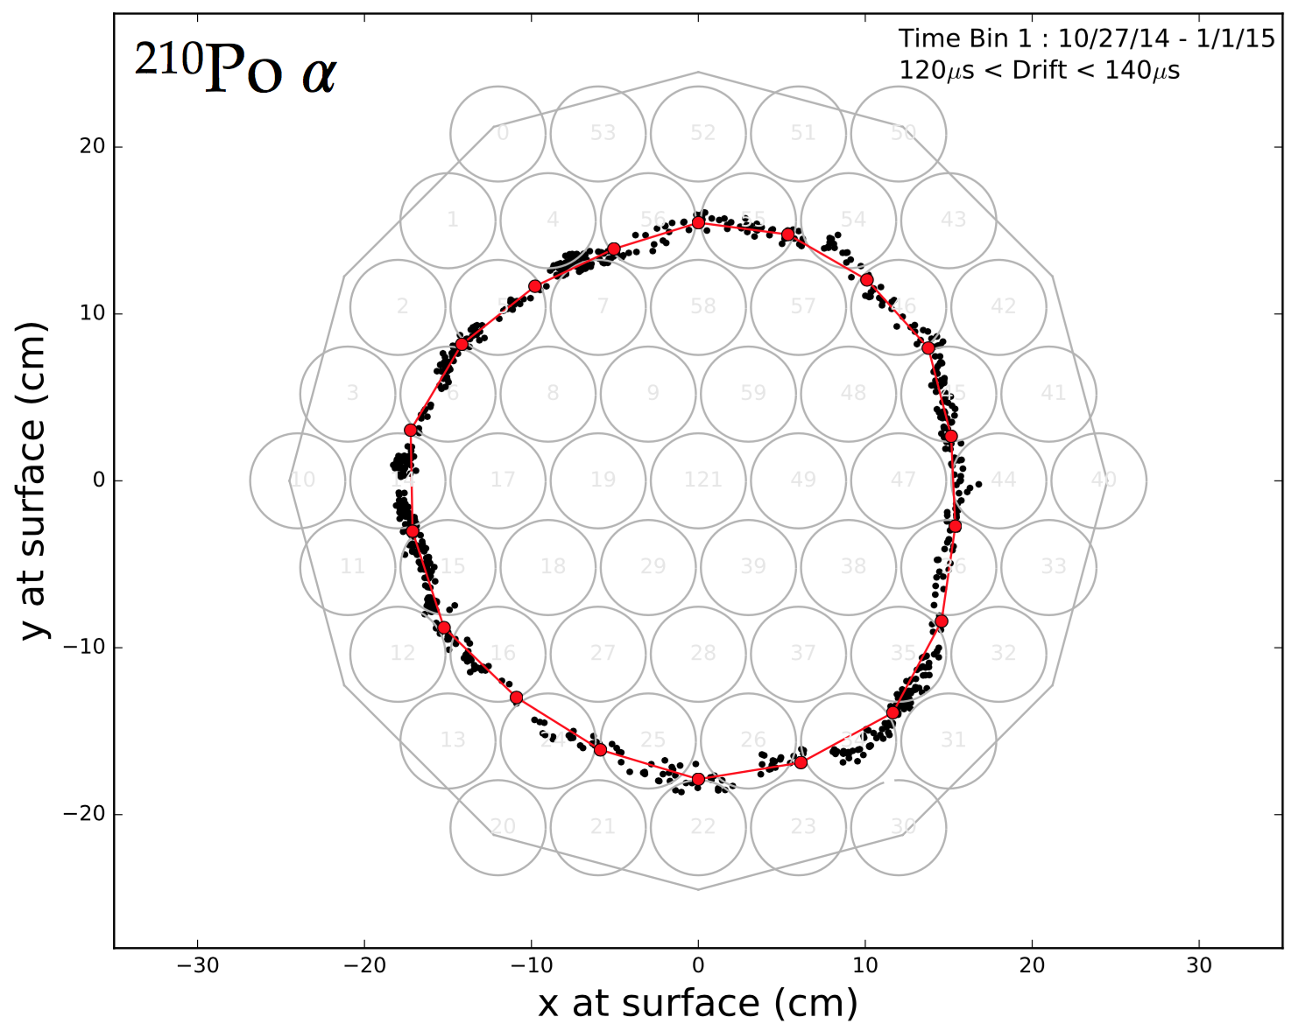
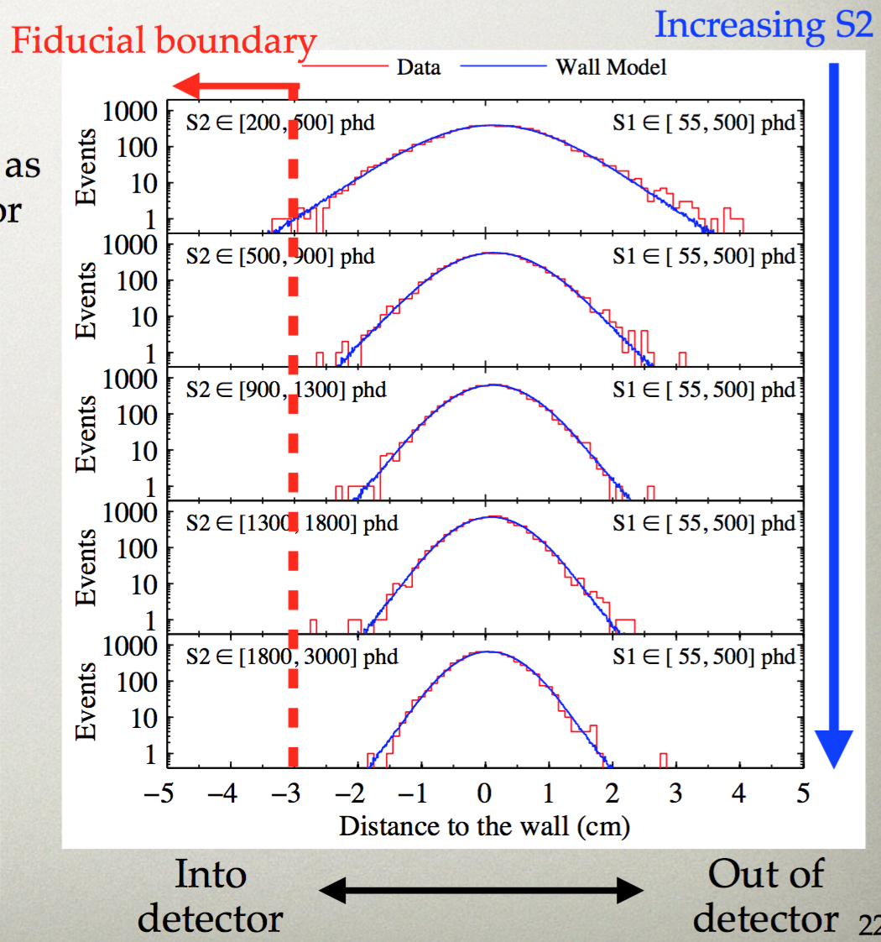
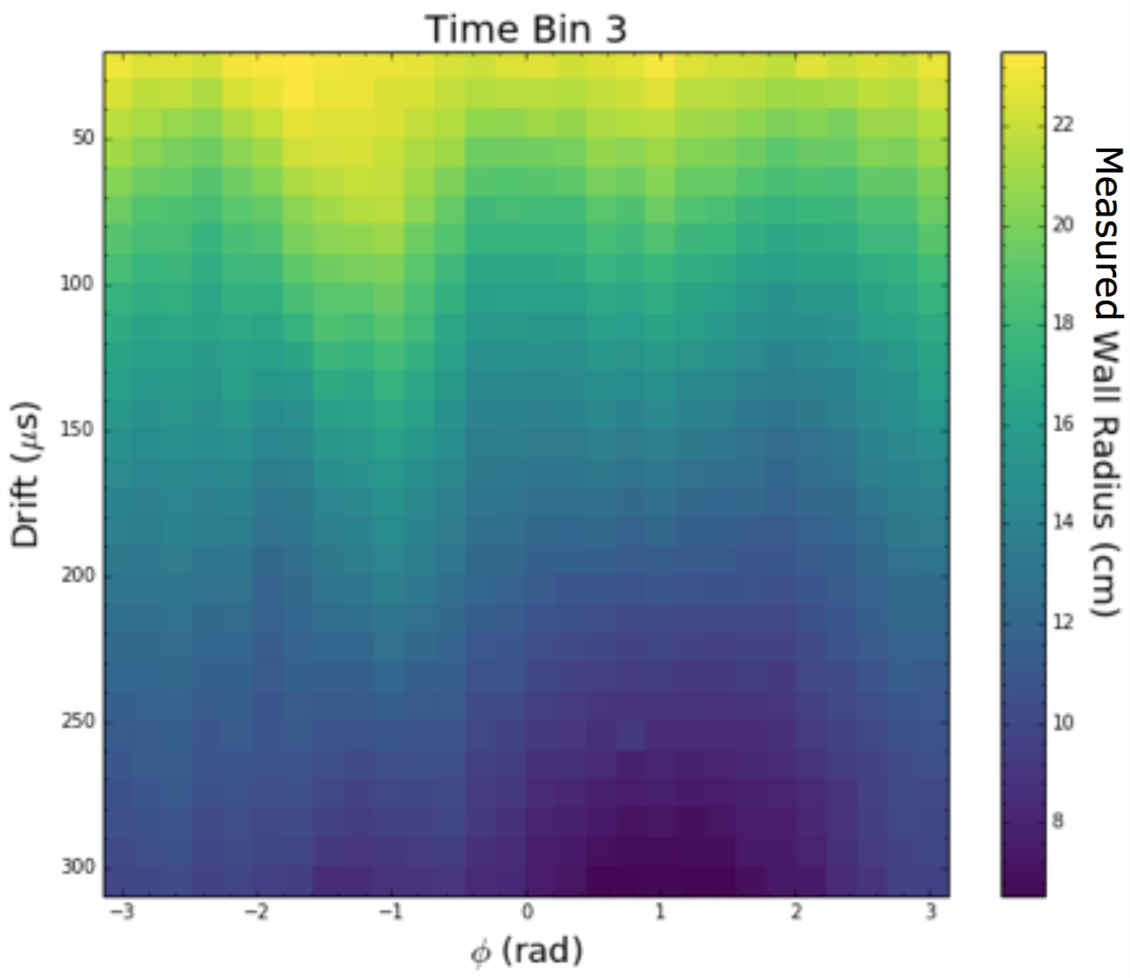
Wall Surface Background
²⁰⁶Pb

Slide 37
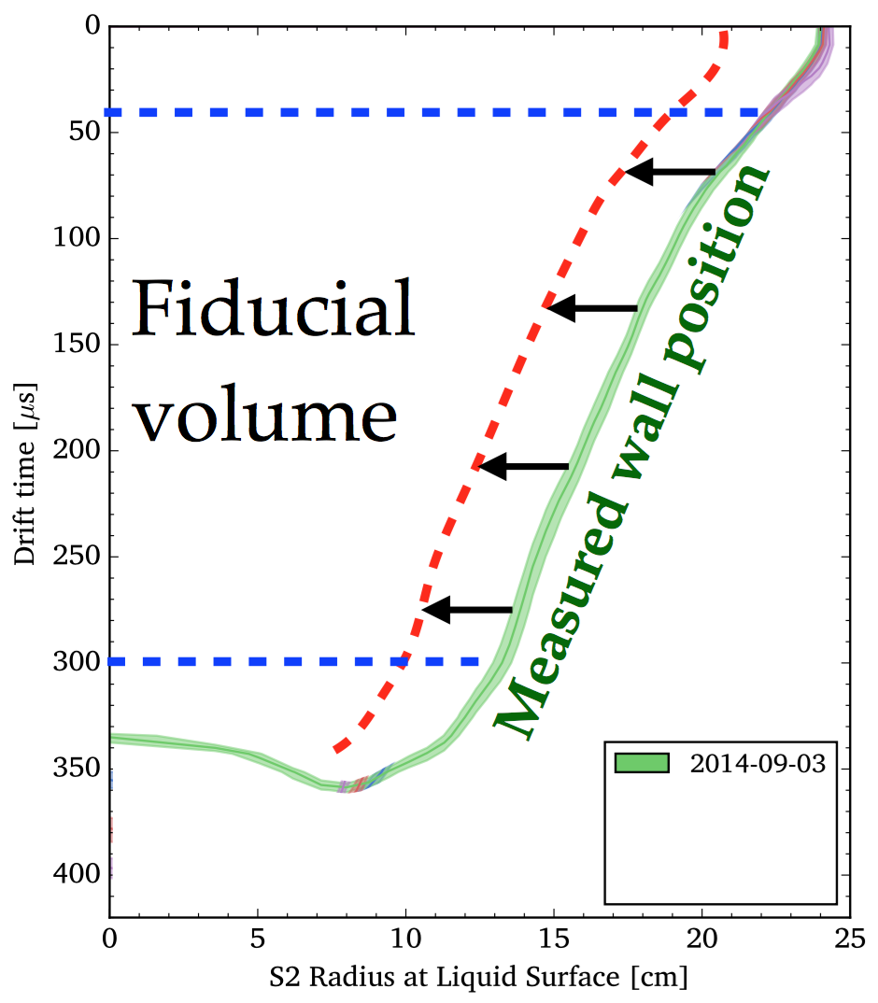

Fiducial Calculation
^{83m}Kr

Slide 38

the key dates
Original proposal objectives met; how often does that happen?!
Initial goal (2008): 300 live-days
Lots of tritium and DD calibrations in there as well
Initial goal (2008): 100 kg
Initial goal (2008): 30,000 kg-days

Slide 39



Efficiencies
NR
S1
Caption:
S2
Lots of things push and pull to make Run04 efficiency very comparable to 03

Slide 40



Pathologies

Slide 41


Slide 42


Slide 43




