Slide 1
Once again about origin of the solar energetic particles (solar cosmic rays) in the “gradual” events
The Second International Conference on Particle Physics and Astrophysics (ICPPA 2016),
Moscow, 10 - 14 October 2016
G.F. Bazilevskaya
Lebedev Physical Institute
of Russian Academy of Sciences

Slide 2
Overview
Observational features of the Solar Energetic Particles
Separation of the SEP events into “impulsive” – flare origin and “gradual” – coronal mass ejection (CME) origin
Main characteristics of the “flare” or “shock” origin of the SEPs
Possible ways to discern the sources:
  Backward time history for the first arriving SEPs
  Correlation between the SEPs, flares and CMEs
  Heliolongitude distribution of the parent flares
  Energy spectrum, elemental and isotope features of the SEPs
  Concomitant phenomena on the Sun: Gamma ray emission, solar neutrons, radio-emission – recent discoveries in these fields
Conclusion: It is not reasonable to divide the SEP events into “the flare origin” and “the shock origin”, i.e. into “the impulsive” and “the gradual”. New paradigm should be developed.
Notes:
The problem is complicated by the fact that some accelerated particles could not escape from the Sun and remain trapped by the solar magnetic field.

Slide 3
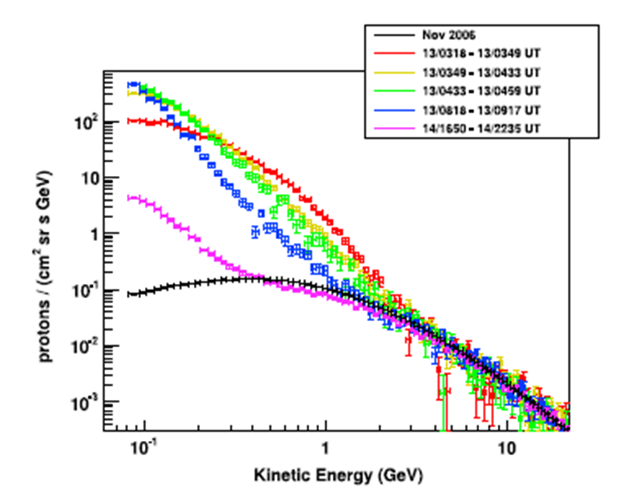
Energy spectrum of the Solar Energetic Particles
Combined energy spectrum for the first 3 hours of the GLE 70
PAMELA data, 20061213, GLE 70
Adapted from Adriani et al., 2014
No normalization
>11 decades in J, >5 decades in E
Notes:
d:\PAM_SOLAR\GLE70\Combined spectrum\combined PAM spec.xlsx list1

Slide 4
Main recently used instruments for the energetic charged particle observations
Spacecraft Ground-based
GOES | Since 1974 | 6.6 Re | H, He, el 1-n100 MeV
МЕТЕОР | Since ~1975 | ~900 km | Р 5-100, 600 MeV
ACE | Since 1997- -next ~10 y | L1 | H, el 0.05-1n,He,C,O,Fe ~0.05-100n MeV/n
WIND | Since 1994- next ~50 y | L1 | El,,p, He Fe, z=1-26
SOHO | Since 1995 | L1 | El, p,He and angular resolution
STEREO A,B | Since 2006. STB not operative since 2014. | Round the Sun, 1 a.e. | El,p,He H-Ni, He3 and with 30≤Z≤83 isotopes
AMS | 2011 | МКС, R=330-450 km, ϕ=52° | >1 GeV
PAMELA | 2006-2016 | R= 300-600 km, ϕ=70° | P, He >80 MeV/n up to ~several GeV/n
SAMPEX | 1992-2012 | R= 520-670 km, ϕ=82° | El,p, He-Fe
Neutron monitor world-wide network, Е>1 GeV
Muon and EAS installations
Balloon observations
E~100-500 MeV
Notes:
L is the point at which one of the bodies is at rest in relation to the two others, 0.01 а.е. ~3.5 раз дальше Луны
Эксперимент Гагарина на МКС

Slide 5
Intensity-time profile of the Solar Energetic Particle (SEP) events
2012.01.23 M8.7, N28, W21
2012.01.27 X1.7,N27,W71
Bazilevskaya et al., ICRC2013

Slide 6
Time history of SEP event observations
J>10 MeV data: 1955-1969 (Švestka and Simon, eds., 1975), 1970-2006 (Logachev Y.I., ed. and author, 1983,1986,1990, 1990а,1998, 2016) : from 1955 to 2006 - 476 events http://www.wdcb.ru/stp/data/SPE/katalog_SPS_23_cikla_SA.pdf
Notes:
d:\27_day\SPE\PLT.XLS, обратить внимание на изменение характера цикла 24!

Slide 7

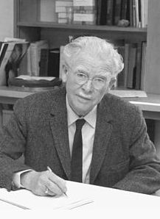
History of the SEP sources definition
John T. Gosling
“..a different paradigm of cause and effect in solar-terrestrial physics that removes solar flares from their central position as the 'cause' of major disturbances in the near-Earth space environment. Instead, this central role of 'cause' is played by events now known as coronal mass ejections, or CMEs”.
The Solar Flare Myth, JGR, 1993, 18937-18949
Scott Forbush (1904-1984)
Observed SEPs on 28 Feb.1942, 7 March 1942 and 25 Jul 1946. Recognized Solar origin. Three Unusual Cosmic-Ray Increases Possibly Due to Charged Particles from the Sun. Phys. Rev. 70, 771-772. The American Physical Society. (11/1946)
Bazilevskaya GA. ICPPA 2016, Moscow, 10 - 14 October 2016

Slide 8
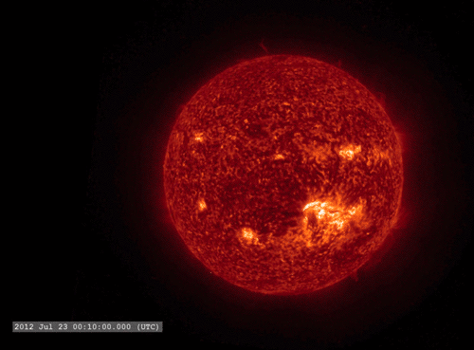
23 Jul 2012
Flares are sudden releases of energy, leading to increased emission in most wavelength ranges lasting for minutes to hours. A typical solar flare emits about 10³² ergs in total.
http://giphy.com/gifs/sun-star-astronomy-OHhC5T8YWnHH2
Bazilevskaya GA. ICPPA 2016, Moscow, 10 - 14 October 2016

Slide 9
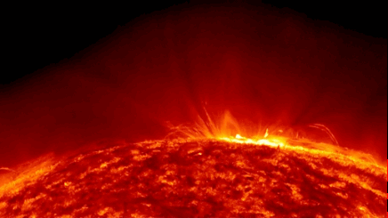
http://giphy.com/gifs/sun-star-astronomy-OHhC5T8YWnHH2

Slide 10
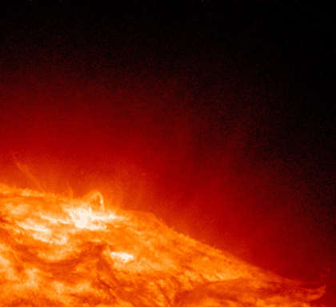
http://giphy.com/gifs/sun-star-astronomy-OHhC5T8YWnHH2

Slide 11
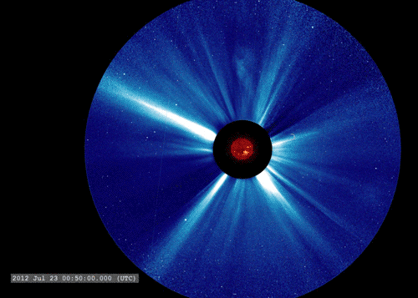
23 Jul. 2012
Coronal mass ejections (CMEs) are huge ejections of mass ejected from the Sun threaded with magnetic field lines. They can involve 10¹⁶ g of gas that is suddenly ejected at speeds up to 2000 km/s with a kinetic energy of >10³² ergs.
http://giphy.com/gifs/sun-star-astronomy-OHhC5T8YWnHH2
Notes:
SEP event far side

Slide 12
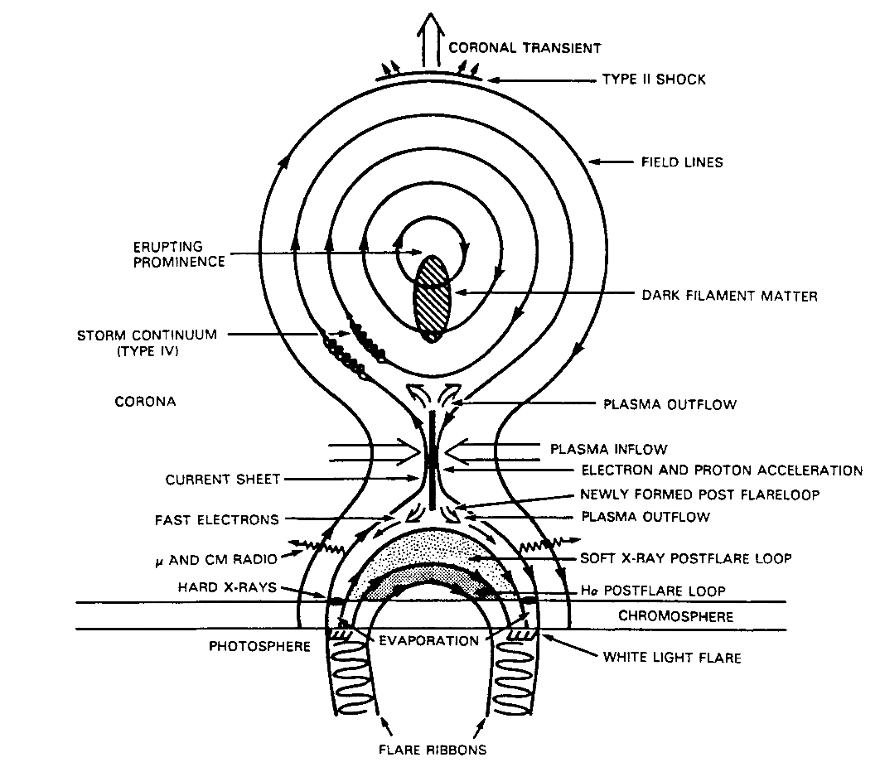
Solar flare model
Solar corona T ~ 10⁶K
Flaring region T ~ 4x10⁷ Flare volume 10²⁷ cm³
Plasma density 10¹⁰ cm⁻³
Gyrosynchrotron radio emission
Soft X-ray emission
Gamma
Brehmsstrahlung hard X-ray
& optical emission
Neutrons
Places of particle acceleration
Adapted from Martins & Kuin, 1990

Slide 13
Fig. 2. from Lee, 2005—”Schematic snapshot of an evolving coronal interplanetary shock driven by a CME. Accelerated ions are denoted by dots. Magnetic field lines are shown, with wiggles denoting magnetic fluctuations. The spatial domain accessible to the ions is divided into solar wind (1), a proton-excited turbulent
sheath upstream of the shock (2), and the turbulent shock-heated solar wind
downstream of the shock (3)”.
M. Lee, COUPLED HYDROMAGNETIC WAVE EXCITATION AND ION ACCELERATION AT AN EVOLVING CORONAL/INTERPLANETARY SHOCK
The Astrophysical Journal Supplement Series, 158:38–67, 2005 May

Slide 14
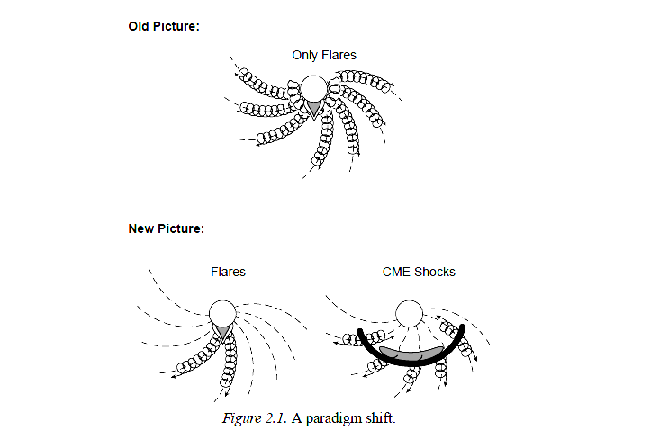
A paradigm shift
Impulsive event
Gradual event
Particles propagate along the IMF lines
Reames, 1999, SSR

Slide 15
Some features of the impulsive and gradual solar energetic particle events
Parameter | Impulsive events | Gradual events
Rate per year in the SA maximum period | ~1000 | ~10
Heliolongitude distribution of sources | <60° | ~180°
Heavy element enrichment: Fe/O | ~1 | ~0.1
Fe <Q> | ~20 | ~14
³Не/⁴He | ~10 | ~5·10⁻³
Temperature, K | ~10⁷ | ~(1.5-2)10⁶
Density, cm⁻³ | 10¹¹-10¹² | 10⁹-10¹¹
Height, km | <10⁴ | 10⁵
Acceleration site | Flare | Shock

Slide 16
Correlations – not conclusive!
Big Flare Syndrome is “a general correspondence between the energy release in an eruptive flare and its various manifestations” (Kahler, 1982). Therefore interpretation of correlations is complicated.
For instance, all GLEs are connected with powerful flares >M5 and SMEs with speed of >1500 km/s and (often) angular width of the halo type.
Typical conclusions of “the correlation works”
The correlation of the particle peak intensity (electrons with n10-n100 keV, protons with n10 MeV) with the peak intensity of the X-ray burst or with the CME speed does not significantly differ and correlation coefficient is around 0.4-0.6 (Miteva et al., 2013).
However, correlation between the SEPs (protons of 5-200 MeV) and flares increases with energy of the SPEs, and correlation of the SEPs with the CME speed, on the contrary) decreases with the E growing (Dierckxsens, 2015).

Slide 17
Backward time history for the first arriving SEPs – not conclusive!
First particle arriving
SRT- solar release time
Particle intensity vs. time
Reames, 2009, 2015

Slide 18
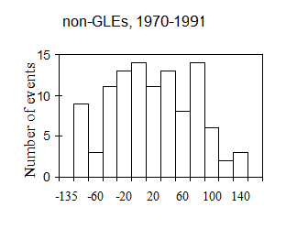
Longitudinal source distribution of impulsive
and gradual SEP events – not conclusive!
Reames, 1999, SSR
Bazilevskaya & Sladkova, 1997
Heliolongitude
Notes:
Bazilevskaya G.A., Sladkova A.I. Two groups of large solar proton events. Proc. 25th ICRC, Durban, South Africa, 1997. Potchefstroom: Westprint, 1997, v. 7, 333-336, d:\Flare\GLE.XLS, d:\Doc\Conferences\Rcrc\34RCRC\К докладу на ВККП_2016\longdis.png

Slide 19
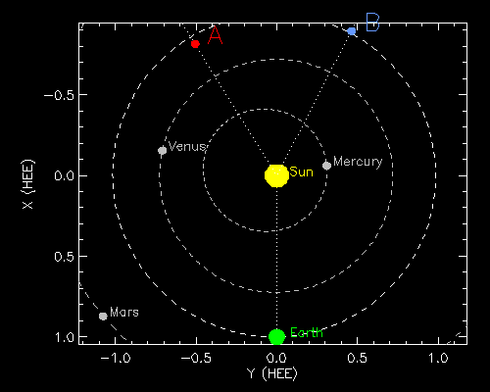
Positions of STEREO A and B for 4-Oct-2016 08:00 UT
STEREO Ahead and Behind were launched in 2006, were placed on the 1 a.e.
round the Sun orbit in 2007. In October 2014 STEREO B was lost, but
now it is in process of recovery.

Slide 20
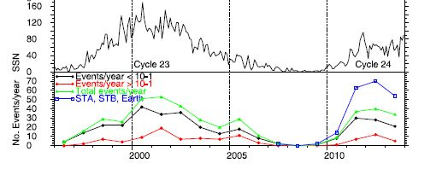
STEREO results
Upper panel – sunspot number. Lower panel – number of the SEP events with ~25 MeV protons, J>∼2×10⁻⁴ (MeV s cm² sr)⁻¹. Green line is observations near the Earth, blue curve is observations at the Earth, or STEREO A, or STEREO B.
After Richardson et al., 2014
Notes:
Exciting!

Slide 21
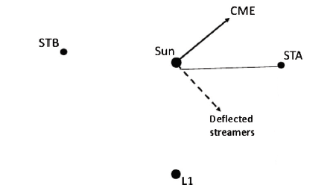
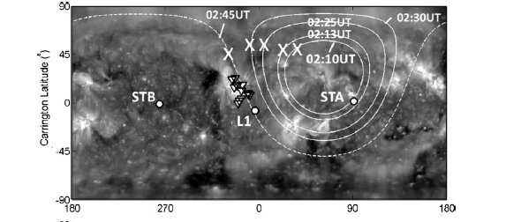
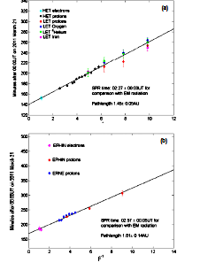
21.03.2011
Rouillard et al. , 2012
Carrington Longitude
Front speed in the lower corona is 450 km/s (EUV 190 nm)
STEREO A SPR time 02:27
SOHO
SPR time 02:57
SEPs do not generally populate a given field line until the shock reaches that field line.
1/β
Notes:
newly accelerated particles do not generally appear on a field line until that field line is connected to the shock. On the other hand, in the 3
November 2011 event it is observed that SEPs can very quickly (within ~30-45 minutes) make their way all around the Sun (Mewaldt, rev. 2013). SEPs do not generally populate a given field line until the shock reaches that field line.

Slide 22
Relative flare position:
For the Earth E155°
For the STA W103°
For the STB E53°
SEPs were recorded within 35 min.
SEPs can very quickly (within ~30-45 minutes) make their way all around the Sun.~30 min
Velocity of propagation along the Sun surface was
1070 км/s.
A role of a coronal wave – releases and/or accelerates the SEPs?

Slide 23
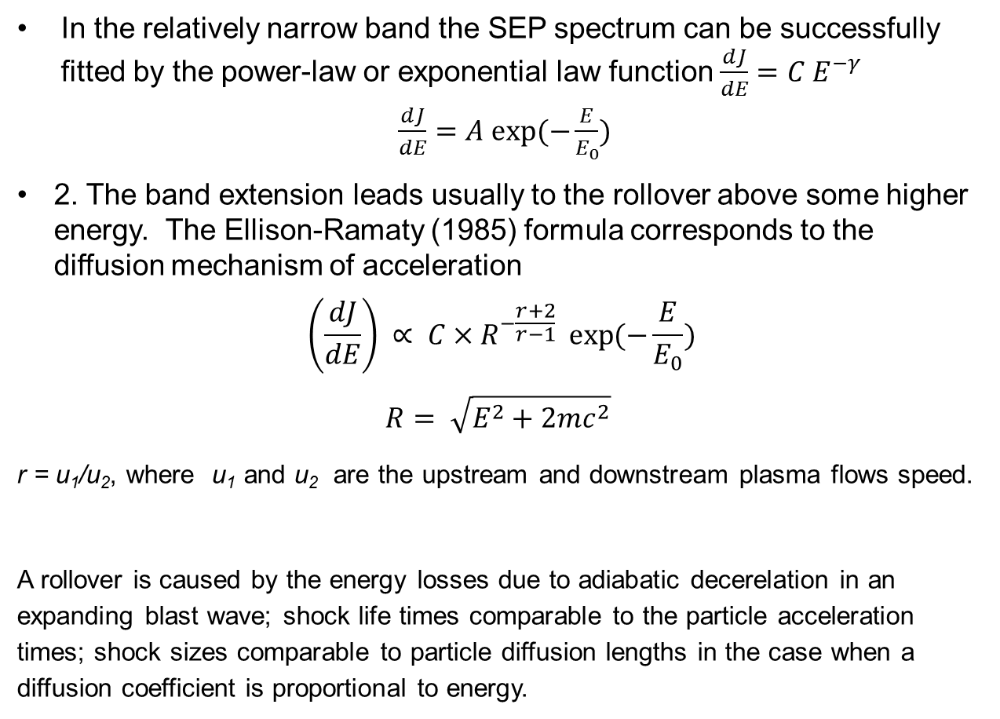
Energy spectrum of the SEPs
Can the shape of the spectrum indicate the source of the particles?
In the relatively narrow band the SEP spectrum can be successfully fitted by the power-law or exponential law function $\frac{dJ}{dE}=C E^{−γ}$
$\frac{dJ}{dE}=A exp⁡(−\frac{E}{E_{0}})$
2. The band extension leads usually to the rollover above some higher energy. The Ellison-Ramaty (1985) formula corresponds to the diffusion mechanism of acceleration
$$\left(\frac{dJ}{dE}\right) ∝ C×R^{−\frac{r+2}{r−1}} \exp{(−\frac{E}{E_{0}}})$$
$$R= \sqrt{E^{2}+2mc^{2}}$$
r = u₁/u₂, where u₁ and u₂ are the upstream and downstream plasma flows speed.
A rollover is caused by the energy losses due to adiabatic decerelation in an expanding blast wave; shock life times comparable to the particle acceleration times; shock sizes comparable to particle diffusion lengths in the case when a diffusion coefficient is proportional to energy.
Notes:
The effects that can truncate the adiabatic deceleration in an expanding blast wave; shock life times comparable to the particle acceleration times; shock sizes comparable to particle diffusion lengths. These effects produce spectra that turn over at high energy when the diffusion coefficient increases with energy. These effects yield spectra that turn over approximately exponentially when a diffusion coefficient is proportional to energy.

Slide 24
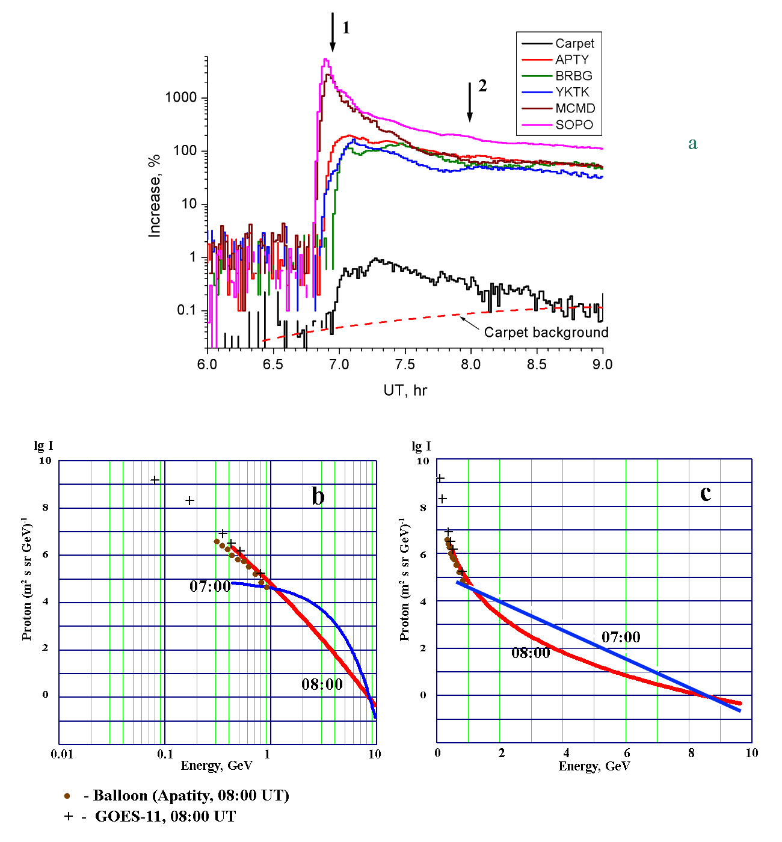
20.01.2005
Vashenyuk et al., 2000, 2003, 2007,2009
2 components:
Prompt component with an exponential spectrum → acceleration in the flare regiojn;
Delayed component with a power-law spctrum → shock acceleration.
Heerikhuisen, Litvinenko,
and Craig, 2002; Hamilton et al., 2003; Wood and Neukirch, 2005; Zharkova and Gordovskyy, 2005, Li&Lin, 2012: power-law spectrum from a reconnection region

Slide 25
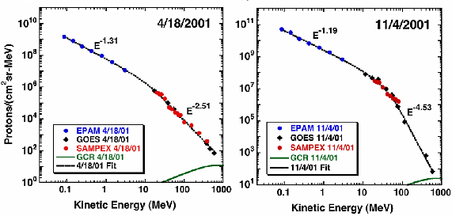
Fitting by the double power-law: Mewaldt, 2006; Mewaldt et al., 2007; Nymmik, 2011 Desai, 2016
Band fitting:
J(E) = C E^{-γ1} exp(-E/E_{b}) for E ≤ (γ2 - γ1)E_{b}
J(E) = C E^{-γ2}[(γ2 - γ1)Eb]^{γ2 - γ1} exp(γ1 - γ2) for E ≥ (γ2 - γ1)E_{b}

Slide 26
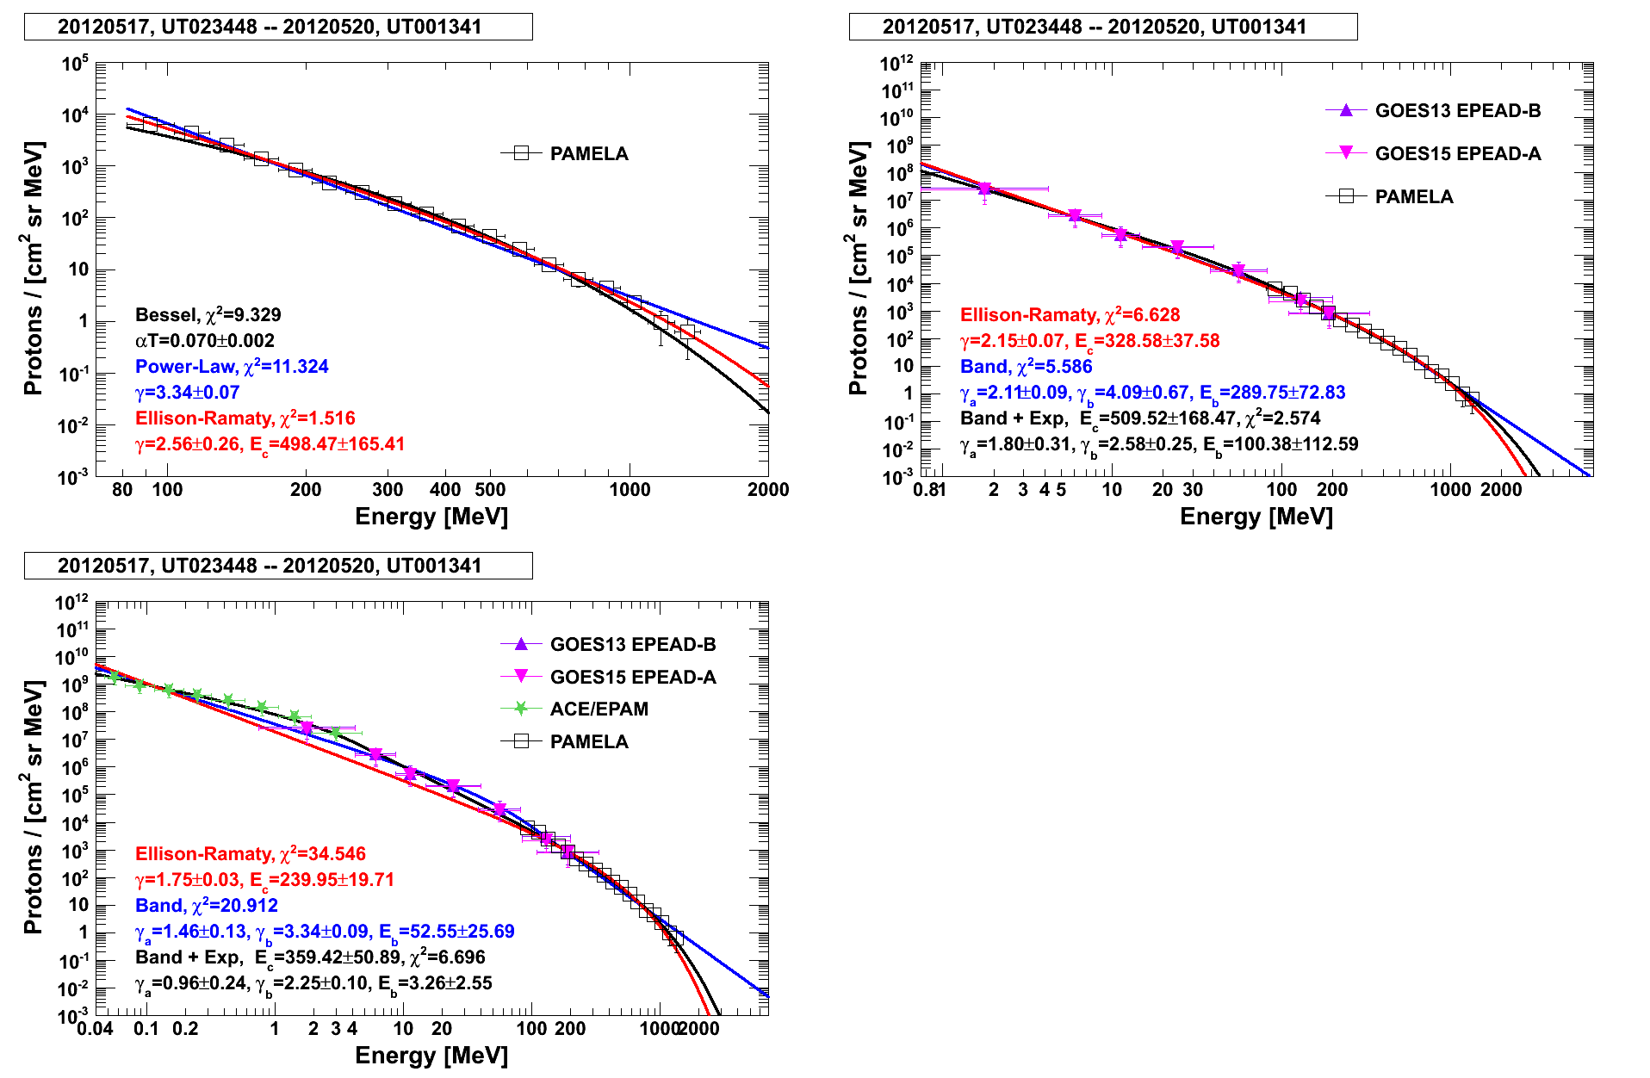
The May 17, 2012 event. A.Bruno, 10th PAMELA collaboration meeting, 2016
While extending the diapason of fitting, one get different parameters of approximation in the Band function. Therefore, these parameters cannot be used for the mechanism of acceleration search. This approach needs precaution in retrieving physical sense from the analysis.
Courtesy of Alessandro Bruno

Slide 27
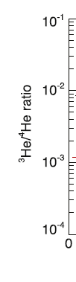

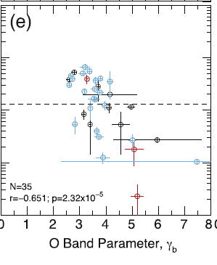
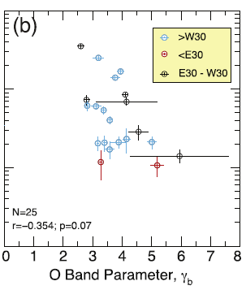
The harder the spectrum is in the high energy band the more the “flare component” enriched by Fe and ³He contributes. (Desai et al., 2016)
Contribution of the flare component to the high energy range is proven

Slide 28
Cane et al., 2006; Cohen et al., 2008:
:
The gradual SEP events connected to the western flares are enriched in Fe, i.e., they bear signature of the flare component. The Fe enrichment is more for the more energetic particles.
Tylka et al., 2013
Contribution of the flare component is proven for the first arriving particles (early phase of the event)

Slide 29
Laurenza et al., 2013
Different energy ranges may be dominated by a particular place of acceleration

Slide 30
What can be drawn from the spectrum analysis
The approximation of the spectrum does not allow to specify the acceleration mechanism of the SEP. Various mechanisms of acceleration – DC, diffusion, stochastic – yield similar spectrum forms but influenced by a model parameters.
The spectrum form may be rather linked to the site of acceleration (the flare area, the corona, the interplanetary space), and different energy ranges may be dominated by a particular place of acceleration.
Joint analysis of the SEP spectra and elemental composition shows:
In the events with harder spectrum in the higher energy band there are energetic particles accelerated in the flare region.
First arriving energetic particles originate from the flare region.

Slide 31
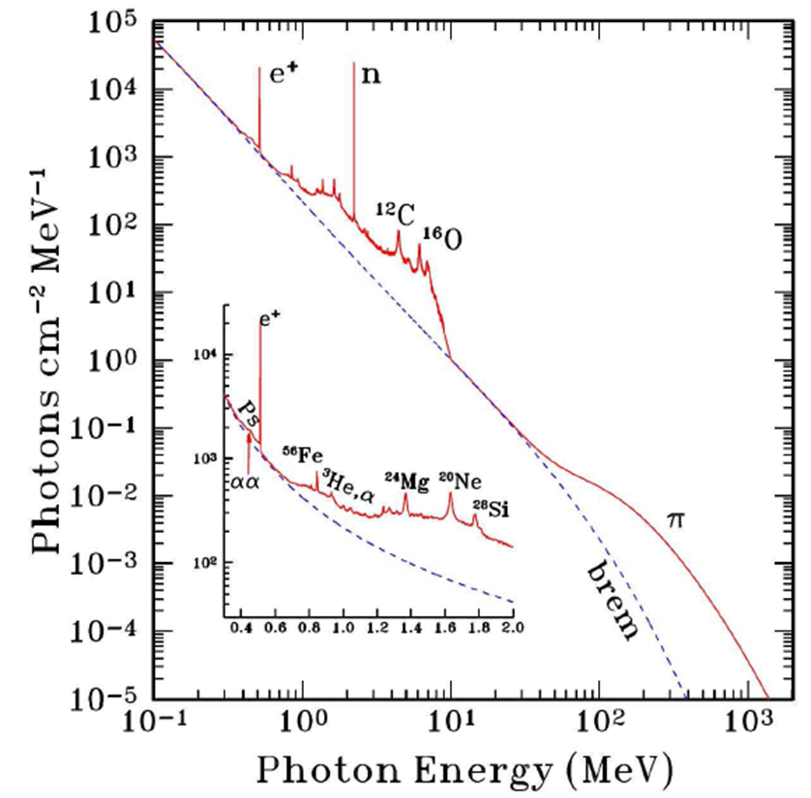
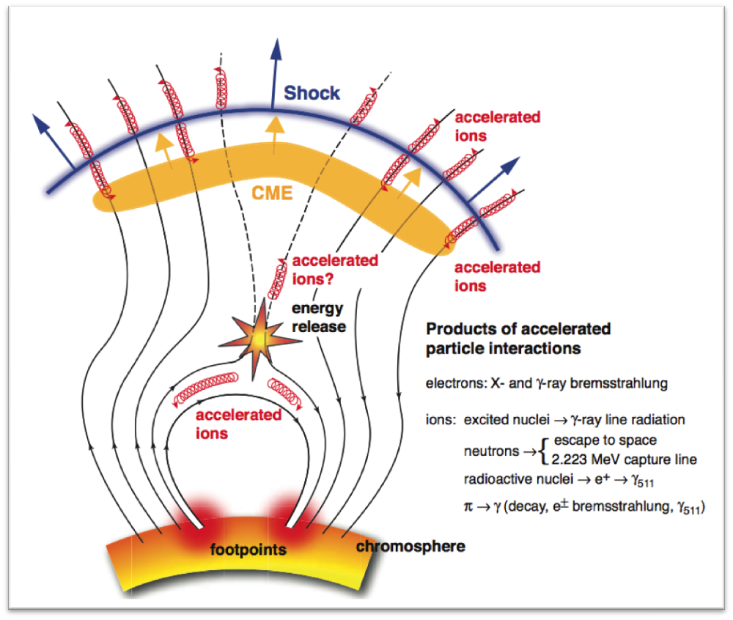
Concomitant phenomena on the Sun: gamma emission, solar neutrons, radio emission.
From Nicola Omodei
Sako, 2007
Notes:
Sako_2007

Slide 32
Main reactions generating the gamma-emission
e⁺ + e⁻ →2γ, Eγ = 0.511 MeV
n + p → d + γ, Eγ = 2.223 MeV
p + ¹²C → p + ¹²C* → p+¹²C + γ, Eγ = 4.43 MeV
p + ¹⁶O → p +¹⁶O* → p + ¹⁶O + γ, Eγ = 6.14 MeV
p + p → p + p + π⁰ → p+ p +2γ Eγ = ~70 MeV` E_{th} = ~300 MeV
Interactions with the neutron yield
p + p → p + n + π⁺ E_{th} = 293.3 MeV
⁴He + p → p+ ³He + n E_{th} = 25.9 MeV/n
⁴He + p → 2p + n + d E_{th} = 32.8 MeV/n
⁴He + p → 3p + 2n E_{th} = 35.6 MeV/n
¹⁶O + p → p + ¹⁵O+n E_{th} = 16.5 MeV/n и т.д.
Notes:
mass of π⁺ = 139.6 MeV, τ = 2.6e-8 s, mass of π⁰ = 135 MeV, τ = 0.9e-17 s

Slide 33
Main instruments for observation of concomitant phenomena
Spacecraft/Instrument | Parameter | Features
GOES | Soft X-rays Hard X-rays | 0.1-0.8 nm 0.05-0.3 nm | Geostationary orbit
SOHO/LASCO | CME | Image
RHESSI | X-rays and gamma 3 keV-17 MeV | Spectroscopy and Image | Since 2002, ~600 km, 38°
Fermi-Lat | Gamma-rays | 20 MeV – 30 GeV | Since 2008, 550 km, 28.5°
STEREO | UV, CME | Image | Period А 346 days, В 388 days
TRACE | UV | Image | 1998-2010, ~530км 98°
SDO | UV, white light | Image | 2010, Geostat. 102°W
WIND | Radio | 20 kHz – 14 MHz | C 1994, L1
Radio-spectrographs/ Radio-heliographs | Radio | n kHz – n GHz (up to 90 GHz) | Ground-based
SST “New” KOSMA | Radio | 212, 405 GHz 30 THz 230, 305 ГГц | Since 1999, El Leoncito, 2550 a.s.l.. São Paulo (30THz) , Gornergrat , 3135 a.s.l.
Notes:
Т.к. диагностика источников производится по различным сопутствующим излучениям, целесообразно

Slide 34
Ackermann et al., 2014
Most significant event: 07.03.2011; M3.7/S22W64
Fermi Gamma-Ray Space
Telescope, with the Fermi-LAT instrument, launched in 2008. Orbit: 550 km, 28.5°, 96 min. Gamma ray energy range
20 МeV - >300 GeV.
Sun is observed during 20-40 min. every 3 hours.
During the first 4 years of mission ~18 events of gamma emission with E >100 MeV.
Confirmation of the GAMMA-1 and CGRO results on events with long-lasting >100 MeV gamma emission in 1991 [Akimov et al., 1991; Kanbach et al, 1993].
Ajello et al., 2014: In the event of 07.03.2011 the gamma-rays were most likely generated by hadrons (rather than leptons) in the process of acceleration (rather than trapping) in the flare region (rather than at the CME shock front). The process was long-lasting acceleration.
Notes:
Максимум гам через 7 час после вспышки М3.7. Длит. 14 час. The highest energy γ -ray recorded from the 2011 March 7
flare has an energy of ∼1 GeV. If this is due to pion decay, it requires protons of energies ∼5 GeV since the mean energy of
γ -rays from π0 decay is typically ∼1/5 of the proton energy (in the relativistic limit) (Gaisser 1991). If the γ -ray emission
is due to electron bremsstrahlung, the electron spectrum must extend beyond 1 GeV, with the exact value depending on the
electron spectral index.
Второе событие 2010 June 12, тоже СКЛ

Slide 35
Pesce-Rollins et al., 2015.
Three solar flares behind the limb according to STEREO B
Gamma
duration
30 min
~20 min
~1 hour
The SEP were recorded near the Earth from the events of 06 Jan (subGLE) and 01 Sept 2014.
Gamma emission originated not from the AR since the optical depths involved
was too large. Although the scenario in which the emission originates from the
Corona is not entirely excluded, the authors suggest that the gamma-ray
emission was caused by protons accelerated at the CME-driven shock.
The particles are accelerated on open field lines and can either precipitate
to the visible disk and produce gamma-ray emission or escape to be
observed as SEPs.

Slide 36
A. Struminsky and W. Gan, 2015:
Analysis by Ackermann et al., 2014 was complemented by the Anti-Coincidence Shield of the Spectrometer aboard INTEGRAL (ACS SPI) и Gamma-Ray burst Monitor (GBM, FermiGRO).
Х ray >100 keV bursts were not found during a long gamma-emission episodes of LAT / FermiGRO
5 episodes of the long lasting gamma emission of LAT / FermiGRO did not match with the SEP events even with account for detected by the STEREOs.

Slide 37
Comparison of the SEP events recorded by the GOES spacecraft and
the long lasting Fermi Lat gamma ray events
2010.08 – 2012.08
 | GOES, Jmax J(>10 MeV) >=1 pfu | Fermi Lat Egam>100 MeV
Total number of events | 36 | 18
The number of matching events | 13** (9 with P>100 МeV) | 16*
The number of not matching events | 23 (8 with Р>100 MeV) | 2
*F20110307 and F20110308 inside of long event of GOES20110307;
F20120307, 0309 и 0310 inside of long event of GOES20120307;
**F 20100612 on GOES < 1pfu, included
Data from Fermi Lat: Ackermann et al., 2014
Data on SCR: Catalog, Logachev et al., 2014
Notes:
F20110307 и F20110308 внутри длительного события GOES20110307
F20120307, 0309 и 0310 внутри длительного события GOES20120307
**F 201006 12 на GOES < 1pfu, включено
*** J(>100 MeV)>~0.1 (редко 0.05) pfu

Slide 38
Conclusion about >100 MeV long lasting gamma ray emission from the solar flares
Particle acceleration up to very high energies in solar flares is more common than previously thought
More than half of events were related to the M class flares, and 1 event even to the C class
Maximum energy required for the gamma generation in the recorded events is for protons ~ 5 GeV, for electrons ~ 1 GeV.
Acceleration can last during several hours and is much longer than the impulsive phase of a flare duration.
There is no match between the high energy gamma and the SEP events. The SEPs with >10 MeV protons occure much more often.
Observations argue that particles can be accelerated protractedly in the active region (7 March 2011 , 7 June 2011), or by the CME driven shock (11 Oct. 2013, 6 Jan. 2014, 1 Sep. 2014).

Slide 39
Solar neutrons (direct observations)
Instruments for the solar neutron detection
Instrument | Е, MeV | Years of observation | Number of events recorded
Neutron monitors | >~100 | Since 1982 | ~10
SNT network, 7 stations | > 30 | Since 1991 | 3
Muon hodoscope TEMP | > 4000 |  | 1*
SMM | >50 | 1980-1989 | 4 (2?)
CGRO | >10 | 1991-2000 | 2
Coronas-F | >20 | 2001-2005 | 3
SEDA /ISS | 40-150 | 2009- | 17**
PAMELA | >100 | 2006-2016 | 21**
*15/04/2001 Borog and Yakovleva, Bull. Russ. Acad. Sci. , 2011
** Preliminary!

Slide 40
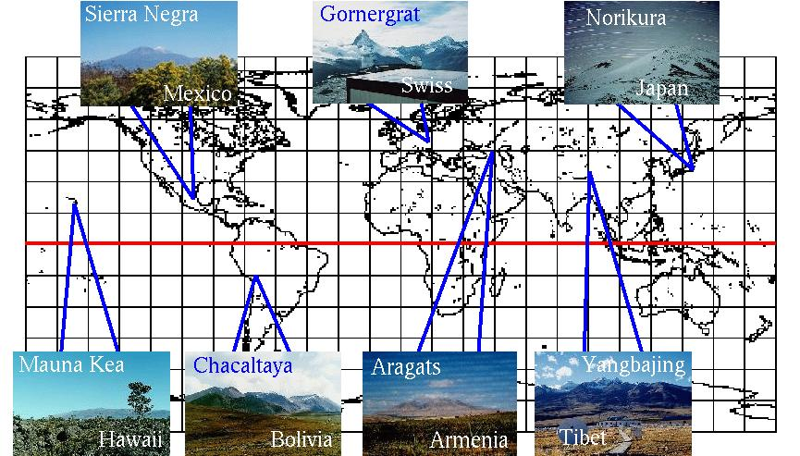
SNT Network, from Sako, 2007

Slide 41
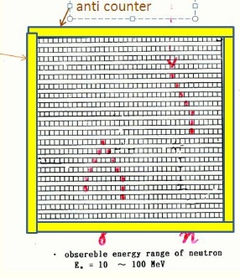
Muraki et al., 2013, 2015
The SEDA instrument onboard ISS since 2009. Еn = 40-150 МeV. SEDA detected ~17(?) events with solar neutrons.
The parent flares are moderate, mostly, of M class.
Solar neutron events correlate with the long lasting episodes of the gamma emission on Fermi Lat
The relation with the SEP events is ambiguous.
Scenario for 08.07.2014: The first peak - 16:05 – reconnnection (SDO), neutrons from the impulsive phase. Hard X-ray emission at the Fermi Lat ended at 16:27, Second enhancement of the neutron flux is at 16:33-17:00. Neutrons were generated as a result of the of bombardment of the solar atmosphere with protons accelerated near the shock and directed toward the Sun.
Event of 8.07.2014 is detected by the SND at the Mt. Chacaltaya, SNT at Mt. Sierra Negra and by the SEDA at the ISS (only since 16:20)
Notes:
Энергия падающего нейтрона определяется по длине трека рассеянного протона. Солнечные нейтроны выделяются из фона по направлению прихода от Солнца.
16 событий – из презентации Мураки 2013 г

Slide 42
Conclusion on the solar neutrons:
A full monitoring began in 2006-2009.
All events with neutrons> 100 MeV, except for the PAMELA ones, coincide with the SEP events (20010825 - weak).
Of the 23 reliably documented events, only two do not coincide with the SEP events, and they are from the eastern flares.
No "big flare syndrome“: majority of the neutron events from the M class flares.
"New source" of solar neutrons - the protons accelerated by the shock wave and the direction to the sun.
Questions: neutron connection with SCR and Fermi-events
Notes:
Высокоэнергичные практически все совпадают с СКЛ (даже 20010825, X5.3/3B S17E34, NM,SONG>20MeV,noSEP, J10< 1МэВ). Из 23 событий, документированных надежно (без презентации Мураки и ПАМЕЛЫ) не совпадают с СКЛ два, но они от восточных вспышек (2011. 9.24, N12E60, 20140708, 6.5 N12E56). Только 3 события от западных вспышек, но все – предварительные.
Высокоэнергичные практически все совпадают с СКЛ (даже 20010825, X5.3/3B S17E34, NM,SONG>20MeV,noSEP, J10< 1МэВ). Из 23 событий, документированных надежно (без презентации Мураки и ПАМЕЛЫ) не совпадает с СКЛ два, но они от восточных вспышек (2011. 9.24, N12E60, 20140708, 6.5 N12E56). Только 3 события от западных вспышек, но все – предварительные.

Slide 43
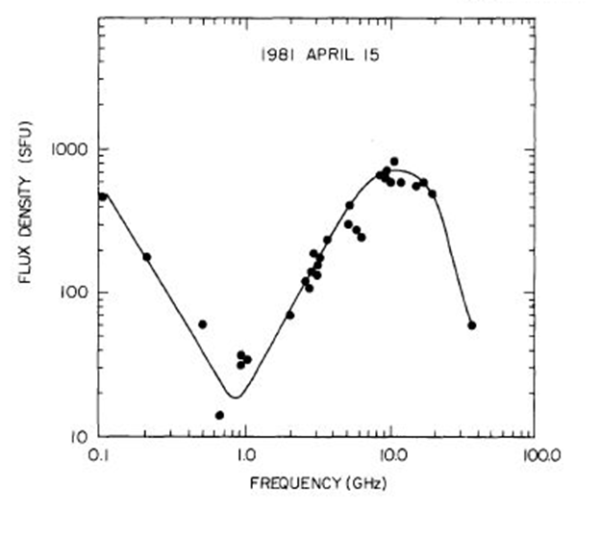
SEPs and radio emission
In general, microwave bursts correlate with the spectral and temporal characteristics of the solar protons (e.g., Akinyan et al.,1980)
The peak flux-density spectrum of a large microwave burst. A mechanism is a gyrosynchrotron radiation from mildly relativistic electrons.
(Fig. from Barron et al., ca. 1982)
V.V. Grechnev, et al.· 2015
Relations Between Microwave Bursts and Near-Earth High-Energy Proton Enhancements and Their Origin.
Correlation between the >100 MeV solar proton fluences (Ф100) and the fluences of the microwave emission at F=35 GHz is higher than correlation between the Ф100 and the CME speed. With the proton energy growth a contribution of shock acceleration decreases and a flare contribution increases. Although the role of the shock acceleration for the lower energy protons may be dominating.
Notes:
The observed frequency spectra of microwave bursts statistically peak near
10 GHz, but the peak frequency increases with increasing peak flux density and can exceed 20 GHz in major
events/. A peak frequency of 10 GHz, together with a typical harmonic number s = 5, implies a typical magnetic field of
700 G in the microwave source.

Slide 44
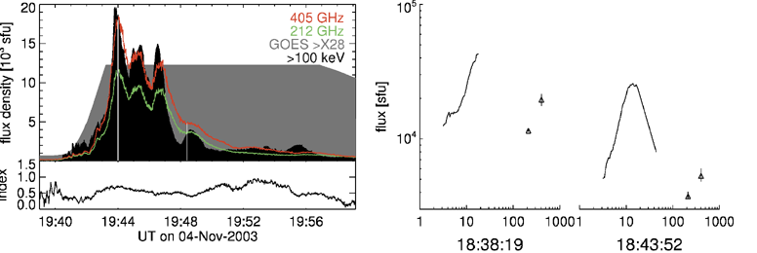
New type of radio emission from the solar flares
SEP avaialble
SST “New” KOSMA | 212, 405 GHz 30 THz 230, 305 GHz | Since 1999, El Leoncito, 2550 м a.s.l. and São Paulo (Since 2012, 30 THz) Since 2000?, Gornergrat, 3135 м a.s.l.
Krucker et al. 2013

Slide 45
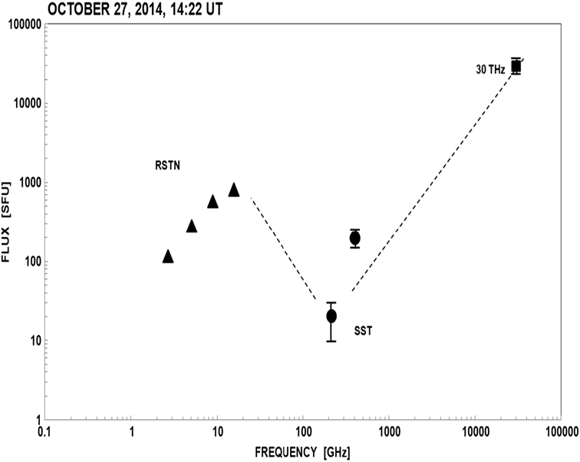
New type of radio emission from the solar flares
(No SEP)
Kaufmann et al., 2015
Similar spectra in events of 13.03.2012 (SEP available), 01.08.2014 (no SEP)
Notes:
События не совпадают с Fermi Lat

Slide 46
The events with radio emission at F > 200 GHz as measured by the SST and KOSMA telescopes (2000-2006) (Krucker et al., 2013) and with F=30 THz (2012-1014) (Kaufmann et al., 2015)
Frequency range | Total number of events | With enhanced emission at F ≥200 ГГц | Match with the SEP events | «Normal» spectrum | Match with the SEP events
200<F<500 GHz (SST+KOSMA) | 14 | 6 | 6 | 7+1? | 0
F =30 THz | 3 | 3 | 1 | - | -
SEP events from Logachev et al., 2014

Slide 47
Conclusion on the radio emission at F > 50 FHz
The radio emission at frequencies F> 50-100 GHz opens a new insight to the problem of particle acceleration in the Sun. For its production electrons with energies above few MeV in the presence of strong magnetic fields are needed.
The review by Krucker et al., 2015, examined 10 mechanisms for generation of the subTHz radiation, which may be fundamental to the physics of energy release and particle acceleration.
A relationship between the SEPs and the flares with the sub-terahertz emission seems to be likely. It is necessary to incorporate the terahertz events to the paradigm of particle acceleration on the Sun.

Slide 48
Conclusion
SEPs are a manifestation of an explosive energy release on the Sun, where particle acceleration, electromagnetic emission from the radio up to gamma, coronal mass ejection occur. Characteristics of these processes appear to be various depending on the local condition on the Sun.
Majority of researchers agree that both flares and CMEs contribute to the SEPs. It seems that acceleration at different sites, i.e. at the flare region, corona or interplanetary shock, dominates in different energy range.
New findings prove that particle acceleration up to high energies occurs more often than it was earlier thought and do not need most powerful flares.
It is necessary to understand:
The partitioning of the ejected particles between flares and CMEs;
How do particles propagate and/or accelerate in the corona along the heliolongitude and heliolatitude;
How can episodes of gamma rays with energies above tens of MeV, solar neutrons, terahertz radiation be integrated in the overall picture of the explosive energy release on the Sun;
How these phenomena are associated with the SEPs

Slide 49
SEPs are important for radiation safety, the formation of space weather and atmospheric processes. This practical interest makes it necessary to continue and improve monitoring of SEPs even against the background of the modern decline in solar activity.
Thank you for your attention!

Slide 50
Причины разнообразия наблюдаемых характеристик СКЛ
1. Состав частиц, инжектируемых в область ускорения: Локальный состав в области вспышки(?).
Для ударной волны или стохастического механизма: надтепловые частицы от предыдущих импульсных вспышек, включая события на обратной стороне Солнца и частицы, ускоренные предыдущим КВМ; смесь частиц СВ и уже ускоренных вблизи ударного фронта, зависимость от конфигурации фронта.
2. Условия в области ускорения: мощность вспышки, мощность геометрия и размер КВМ, наличие предыдущего фронта, когда частицы ускоряются в сжимающейся магнитной ловушки. Доминирование разных механизмов ускорения в разных областях.
3. Зависимость от положения наблюдателя относительно точки магнитного соединения с источником, условия распространения СКЛ в изменчивой межпланетной среде, включая отклонение от Паркеровской спирали; зависимость наблюдаемых свойств от времени.

Slide 51
Высота КВМ в момент формирования фронта 1.38 Rs, в момент выхода частиц 2.32 Rs. Время для ускорения ГэВ-ных частиц – 8 мин. Такое же как в GLEs цикла 23.
Gopalswamy et al., 2013
Notes:
Figure 1. (a) Height–time (h–t), speed, and acceleration plots of the 2012 May 17 CME obtained from STEREO COR1, COR2, EUVI, and LASCO C2, C3 data.
The line through the speed points indicates a slow deceleration. The GOES soft X-ray flux and GLE intensity (5 minute resolution) are in arbitrary units. SPR and
metric type II burst onsets are marked by vertical arrows. GLE data (OULU) are shifted to the right by 3 minutes assuming propagation along a 1.2 AU Parker spiral.

Slide 52
ЗLONGITUDE STRUCTUREависимость от долготы соединения источника и наблюдателя
W53
E45
Intensities increase as observer’s connection point swings eastward toward the nose of the shock…., peak
intensities only occur after the observer passes through the shock, on field lines that connect him to the shock from behind.
The observer was well connected to the nose of the shock early, when the shock was near the Sun,
But..he moves onto flux tubes that connect him to a weaker and
weaker source, as a function of time, and intensities decline.
E01
The centrally located observer …for a CME with wide longitude extent will see the flat time profile that corresponds to nearly constant acceleration.
Reames, 1998

Slide 53
STEREO A and B
STEREO A and B were launched in 2006. Early in 2007 a gravitation после гравитационного маневра около Луны (~450тыс.км) выведены на орбиту Земли - перед ней (А) и за ней (В)
В октябре 2014 г. связь со STEREO B была потеряна. Будут предприняты попытки возобновить его работу.

Slide 54
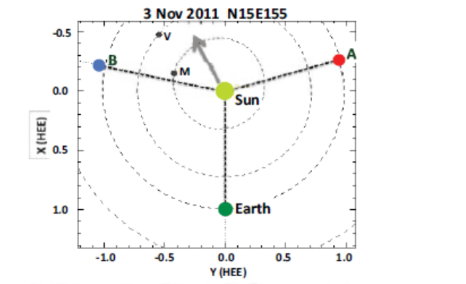
03.11.2011
Положение вспышки:
Для Земли E155°
Для STA W100°
Для STB E53°
Undoubtedly, far-side events have always played a
role in space weather at 1 AU.
Mewaldt et al., 2013 rev.

Slide 55
Измерения на ACE, SOHO, STEREO A, STEREO B.
04.08.2011
Для Земли W38
Для STA E63
Для STB W130
27.01.2012
Положение вспышки:
Для Земли W85
Для STA E23
Для STB W131
Различия в спектре объясняются геометрией ударного фронта, или вкладом вспышки…
Mewaldt et al., 2013, review
Notes:
quasi-perpendicular shocks may produce harder spectra than quasi-parallel
shocks [18,19], longitude-dependent mixes of flare and shock-accelerated particles [20], or differences in
the density and spectra of seed particles encountered by the shock.

Slide 56
34-я Всероссийская конференция по космическим лучам
Дубна, 15-19 августа 2016 г.
Энергетический спектр
Спектр первых приходящих частиц близок к источнику. Трудности в определении времени прихода частиц и исключении фона.
Спектр в максимуме временного профиля (TOM spectrum). Предполагался близким к спектру испускания. Возможно искажение за счет длительной инжекции. Сейчас используется как один из индексов события.
Спектр флюенса события. Минимум неопределенностей при определении, но вклад всех процессов ускорения, распространения, модуляции трудно разделим.
Может ли форма спектра указать источник частиц?

Slide 57
Аппроксимация улучшается, если использовать степенной закон с изломом:
Ныммик Р.А., 2011
(Е≤Ео/w) - γ=γ₁,
(Е≥Ео∙w) - γ=γ₂ ,
где величина w определяет ширину области перегиба. Внутри перегиба – (Ео/w) < E < (Ео∙w) γ изменяется, как

Slide 58
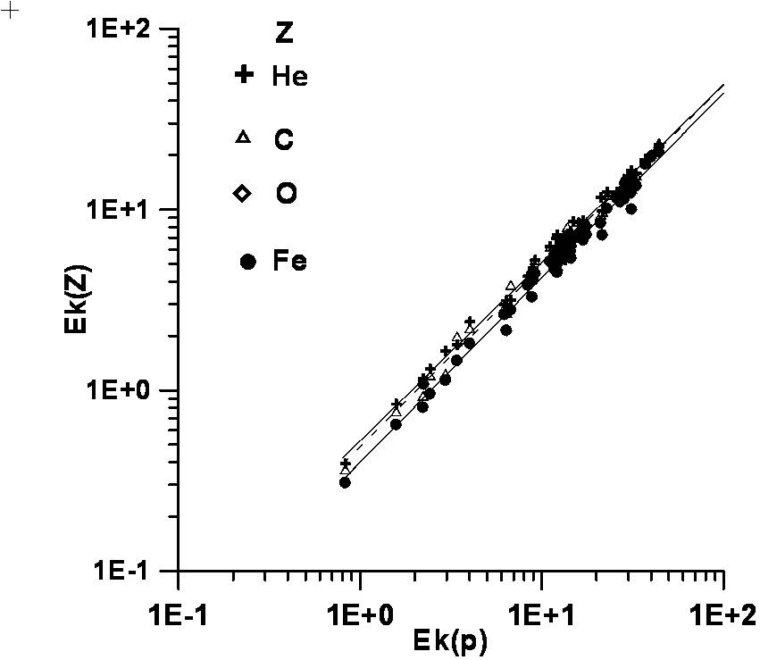
Соотношение энергии излома в спектрах солнечных протонов и ионов
<Q(Fe)> 14.52 ± 0.25
Соответствует ускорению в короне.
Ek(Z)/ Ek(1) ≅ Q(z)/M(z)
Р. А. Ныммик, ИЗВ. РАН. СЕР. ФИЗ., 2013, том 77, № 5, с. 553–556
Моделирование. Вклад В.М. Острякова

Slide 59
An example of finding of physical sense in the Eb parameter
Figure from Mewaldt, 2007
Излом в спектре отдельных элементов в данном событии зависит от отношения Q/M. Mewaldt et al. (2005) предположили, что излом происходит при одинаковой величине коэффициента диффузии, если он зависит от жесткости R ~ M/Q. Тогда Fe, для которого M/Q выше, будет загибаться раньше.
(Desai et al., 2016)
Notes:
a power law in wave number k^{-q}, with α = 2 - q [Droege, 1994]. The values of α derived
here, ranging from 0.5 to 2, correspond to wave spectra
varying from k1.5 to k0, consistent with the range found by
Cohen et al. [2005].

Slide 60
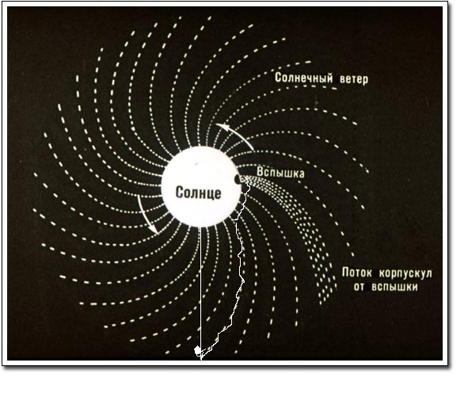
First particles arrive along the IMF field line crossing an observer, even from a source remote from the heliolongitude of observer’s connection with the Sun.

Slide 61
CME and flare statistics
Data | CME number | Flare number | Related events | Reference
1996-2006, ±45°, 10-80 min after a flare | 6733 | 12050 (8411 C+M+X) | 826, i.e. 11% CMEs 7(10)% flares | Aarnio at al, 2011
142 SEP events J10≥1pfu, 1997-2006 | 104 from 112 (there were gaps in observations) | 135 from 142 | 93% CMEs 95% flares | Logachev et al., 2016
CMEs and flares are not obligatory connected: only ~10% of all events coincide with each other within ±45° and
10-80 min. However, virtually all SEP events are accompanied both a flare and a CME.
Notes:
Без различий в степени отождествления.

Slide 62
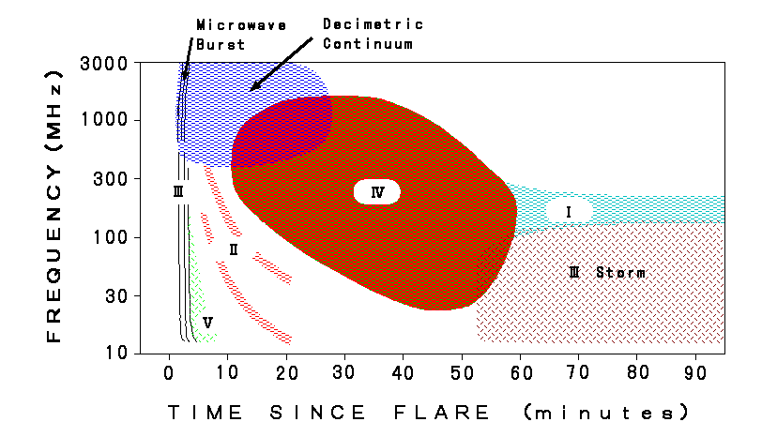
Solar flare radio emission
Type III bursts evidence possibility for particles to be ejected into interplanetary space (plasma waves of 10-100 keV electrons streaming away).
Type II emission is connected with a shock forming in the corona.
Type IV emission is a signature of electron acceleration up to relativistic energies (synchrotron emission of the trapped electrons).
Notes:
Fast-drift type III bursts are produced when
10–100 keV electrons excite the plasma as they stream out from the source near the Sun
and slow-drift type II emission is produced at a shock wave moving outward more slowly
at a speed of the order of 1000 km s−1 Type II radio bursts have been observed from decimetric to kilometric wavelengths. They are believed to originate from the conversion of electrostatic plasma emission produced at a weak fast-mode MHD shock front.
Type II radio bursts have been observed from decimetric to kilometric wavelengths. They are believed to originate from the conversion of electrostatic plasma emission produced at a weak fast-mode MHD shock front.
, IV type is

Slide 63
Attempts to identify the SEP source from the particle solar release time do not lead to an unambiguous conclusive results.
Uncertainties during calculation:
Particle path length in the IP depending on configuration of the IMF lines
CME height fitting
Proximity of times of the X-ray peak and the formation of a shock wave (type II radio emission) does not allow to choose between a flare and a shock sources.

Slide 64
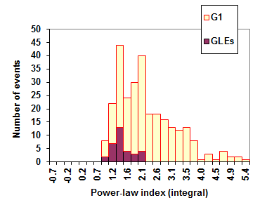
SEP events in 1970-2001, J( Е>10 MeV)>=1 pfu: G1 is a power-law index for E=~10-200 MeV. Contribution from GLE events are painted by purple. [Базилевская и Сладкова, . Изв. РАН, сер. физ., 2003, т. 67(10), 1431-1434, in Russian]

Slide 65
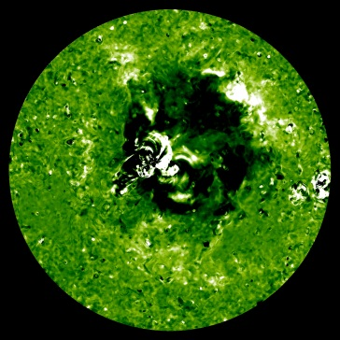
19.5 nm
Coronal waves
(EUV waves, EIT waves)
•A fast front with an increase in the Extreme ultraviolet emission travelling along the solar surface
(The Extreme ultraviolet Imaging Telescope (EIT) on the SOHO spacecraft, ~18-30 nm)
• Velocity is ~ 100-500 km/s
Highly associated with solar eruptive events (SEEs), which includes flares, CMEs (and erupting filaments), and other forms of ejections at smaller spatial scales. However not all flares and CME trigger coronal waves
• Associated with the type II radio emission
A role in the SEP acceleration and/or release not studied enough.

Slide 66
“…Spectral differences may reflect the effects of
variations in shock geometry (quasi-perpendicular shocks may produce harder spectra than quasi-parallel
Shocks, longitude-dependent mixes of flare
and shock-accelerated particles, or differences in
the density and spectra of seed particles encountered
by the shock”.
Mewaldt et al., 2013 rev.
Notes:
longitude-dependent mixes of flare
and shock-accelerated particles [20], or differences in
the density and spectra of seed particles encountered
by the shock.

Slide 67
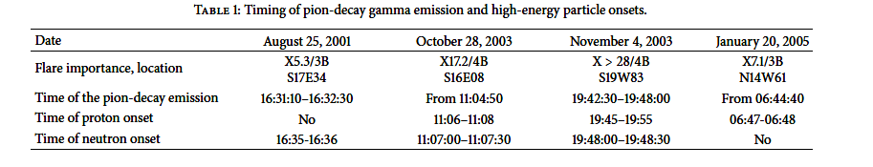
V. Кurt, K. Kudela, B. Yushkov, V. Galkin. 2013 .
An analysis of x-ray and gamma emission, proton and neutron fluxes in 4 SEP events as recorded with the SONG spectrometer onboard the CORONAS-F
Comprehensive analysis of the intensity-time history of the X-ray, gamma and neutron emissions as well as solar protons recorded by the spacecraft.
Conclusion: the protons which produced the pions and neutrons on the Sun, and the protons which were observed in the near-Earth space were accelerated simultaneously during the energy release in the flare region. They both belong to the same population of accelerated particles.
Верх: мягкий рентген (GOES) и гамма (SONG), низ – наложение 5 НМ

Slide 68
SNT observations 20050907, flare X17/3B, S06E89. (Valde´s-Galicia et al., 2009).
The SNT network reliably recorded only 3 events since 1991
Notes:
No SEP

Slide 69
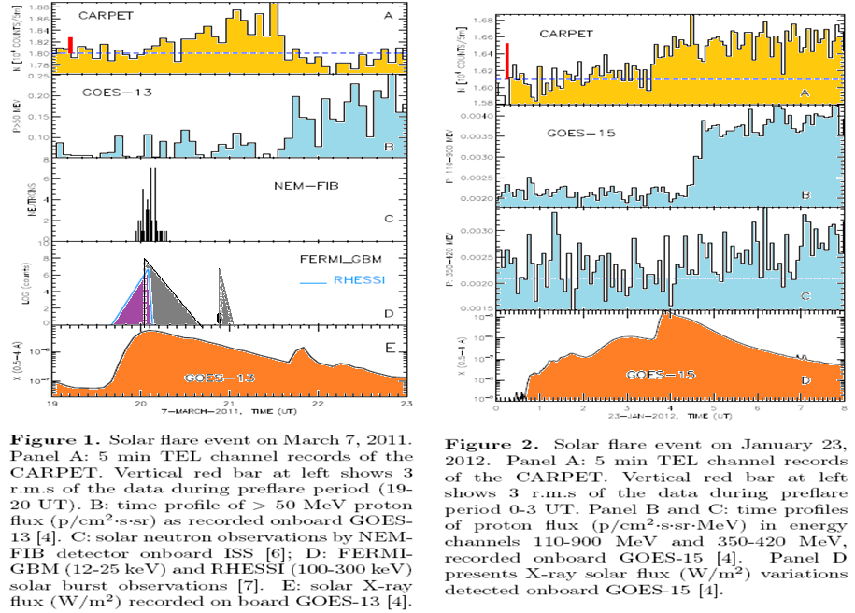
7 МАРТА 2011 23 ЯНВАРЯ 2012

Slide 70
«Unidentified events»
V.S. Makhmutov et al., 2013, 2015
Enhancement of charged particle fluxes at the middle and low latitudes (R > 4.5 GV and R > 4.5 GV) during moderate SEP events without response at the neutron monitors. 7 such events were recorded in 2011-2013.
Observations:
A carpet of the Geiger tubes.
Site: Astronomical Complex , El Leoncito,
2550 м a.s.l., Argentina, S31.8°, W69.3°; R_{c} = 9.65 GV;
CERN, R_{c} = 4.48 GV

Slide 71
  Elemental and isotope features of the SEPs
Reames, 1999 SSR

Slide 72
What can be drawn from the spectrum analysis
The observed spectra depend on the heliolongtude connected with an observer and do not represent the “SEP source spectrum”.
The approximation of the spectrum does not allow to specify the acceleration mechanism of the SEP. The spectrum form may be rather linked to the site of acceleration (the flare area, the corona, the interplanetary space), and different energy ranges may be dominated by a particular place of acceleration. Various mechanisms of acceleration – DC, diffusion, stochastic – yield similar spectrum forms but influenced by a model parameters.
The results of the spectrum fitting depends on the energy coverage. Contribution from different acceleration mechanisms and conditions do not allow to fit the spectrum with a unique function indicative of the acceleration mechanism.
Joint analysis of the SEP spectra and elemental composition shows:
In the events with harder spectrum in the higher energy band there are energetic particles accelerated in the flare region.
First arriving energetic particles originate from the flare region.

