Slide 1


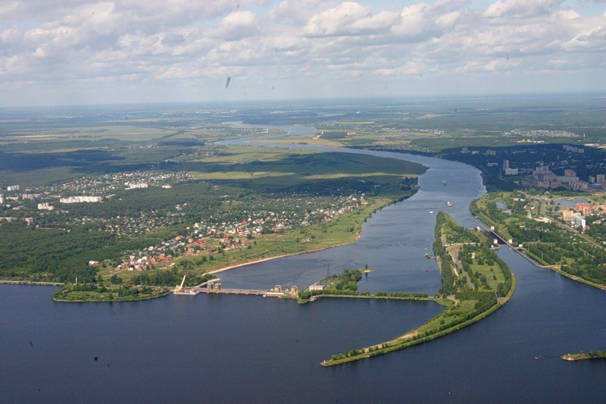
Physics program of the NICA facility at JINR
V. Kekelidze,
JINR, Dubna
NICA
Volga
river
II ICPPA, October 10 - 14, 2016, Moscow
Notes:
Dear members of Scientific Committee let me give a brief presentation on the status of NICA project

Slide 2
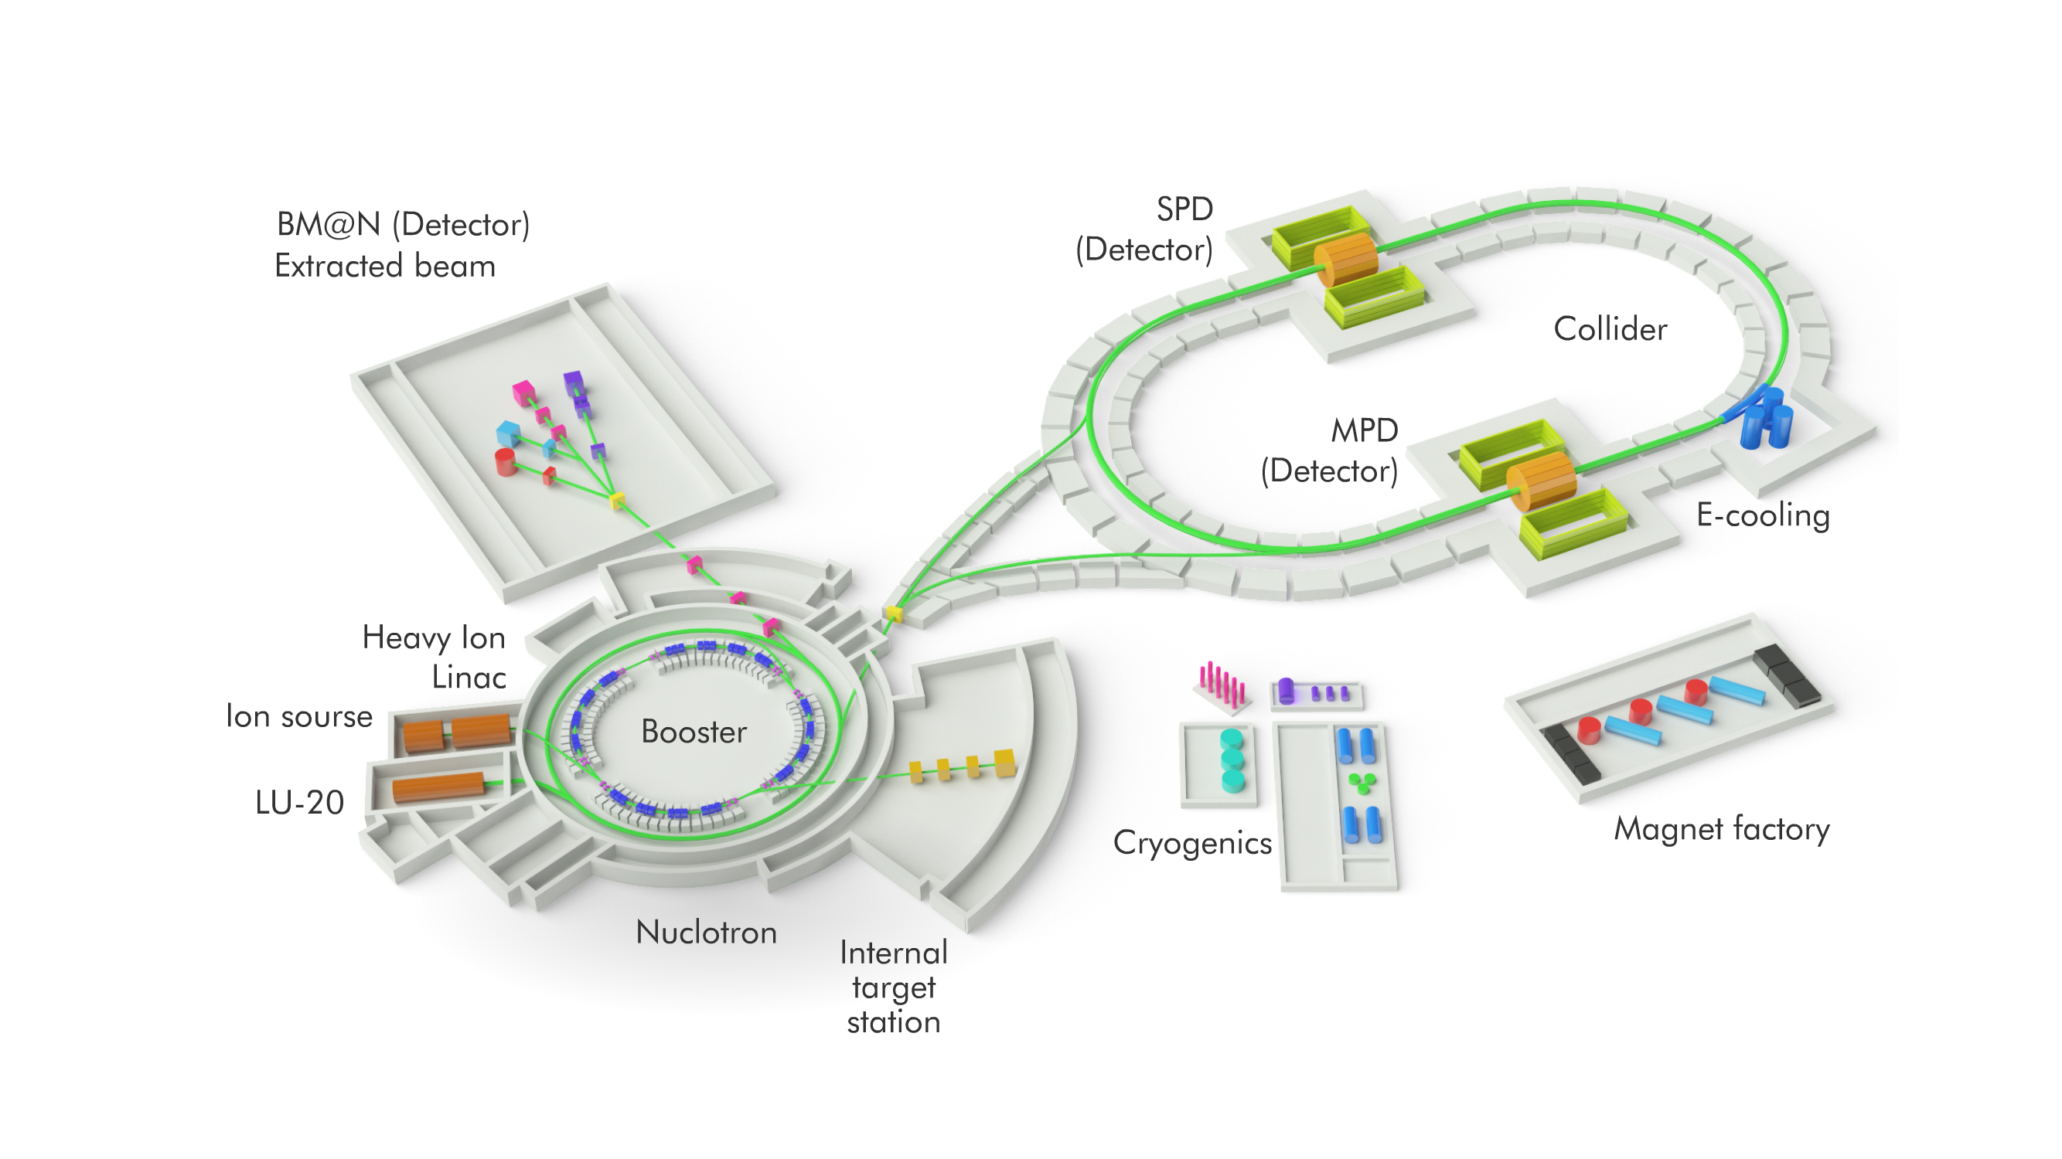
NICA (Nuclotron based Ion Colider fAcility)
Main targets:
- study of hot and dense baryonic matter
at the energy range of max baryonic density
- investigation of nucleon spin structure, polarization phenomena
- development of accelerator facility for HEP @ JINR
construction of Collider of relativistic ions from p to Au,
polarized protons and deuterons
with max energy up to √S_{NN}= 11 GeV (Au⁷⁹⁺) and =27 GeV (p)
Ione source
Notes:
Main targets of the project are: ; that requires a development …

Slide 3
major blocks of the NICA
Injection Complex
Booster
Nuclotron
Collider
Cryogenic Complex
Detector BM@N
MPD
SPD
Magnet production line
Computing
Infrastructure
Notes:
There are 10 major blocks of the NICA project

Slide 4
Accelerator blocks
Leaders:
G. Trubnikov, I. Meshkov, A. Butenko, A. Kovalenko
  Alexander Zlobin, FNAL
  Takeshi Katayama, Tokyo Univ.
  Valeri Lebedev, FNAL
  Rolf Stassen, FZJ
  Yuri Senichev, FZJ
  Evgeny Levichev, BINP
  Victor Yarba, FNAL
  Pavel Zenkevich, ITEP
  Machine Advisory Committee:
  Boris Sharkov, ITEP, chairman
  Pavel Beloshitsky, CERN
  Sergei Ivanov, IHEP
  Thomas Roser, BNL
  Alexei Fedotov , BNL
  Markus Steck, GSI
  Nicholas Walker, Desy
  Sergei Nagaitsev, FNAL
The TDR is approved
Notes:
The accelerator blocks were comprehensively revised by the MAC. The TDR is approved.

Slide 5
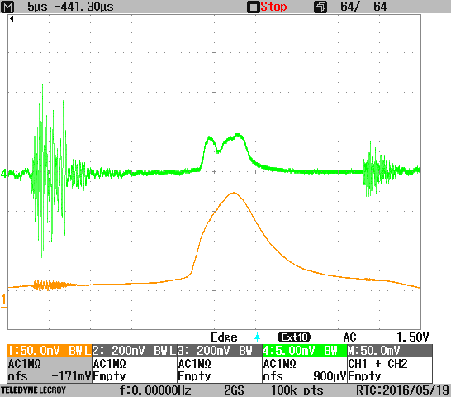
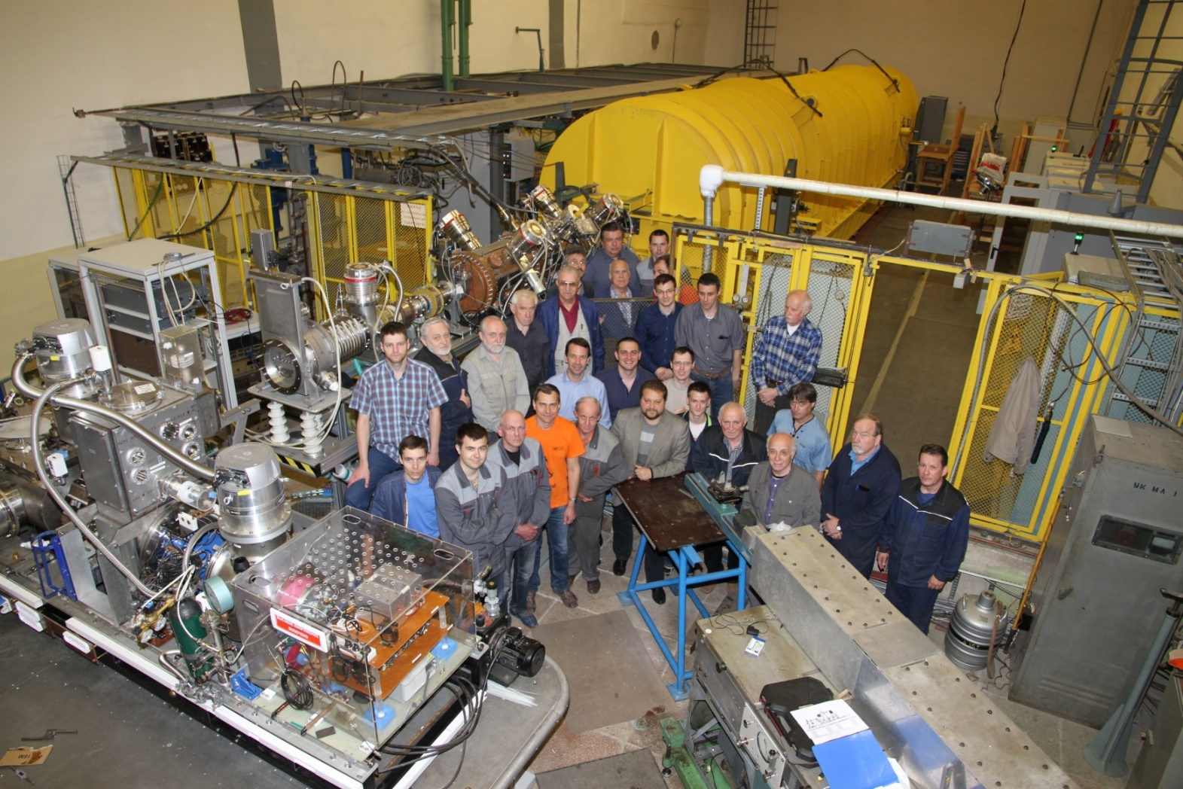
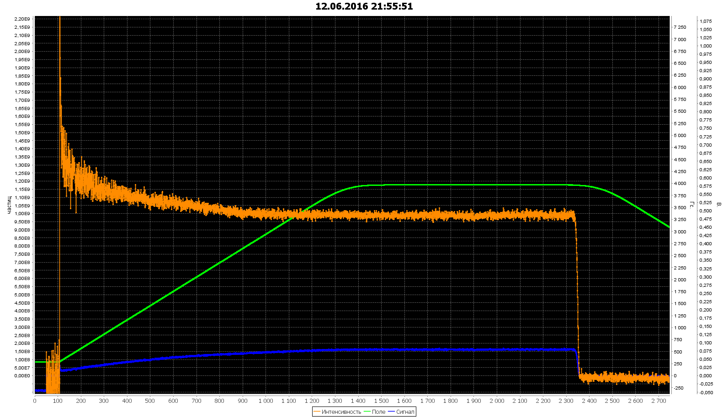
New fore-injector for LU-20 + SPI
A.Butenko,
A.Govorov,
V.Monchinsky,
T.Kulevoy,
S.Polozov
V.V.Fimushkin
A.S.Belov
…
COMMISSIONED
RUN #52, d+
Energy 750 MeV/u, intensity 10⁹
16 of May – beam accelerated in LU-20
12 of June - the deuteron beam from
SPI accelerated in the Nuclotron ring

Slide 6
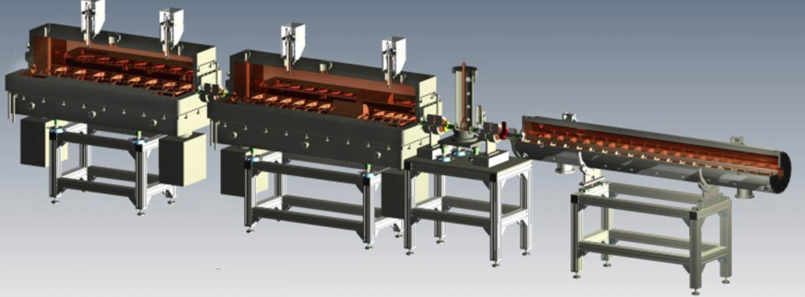
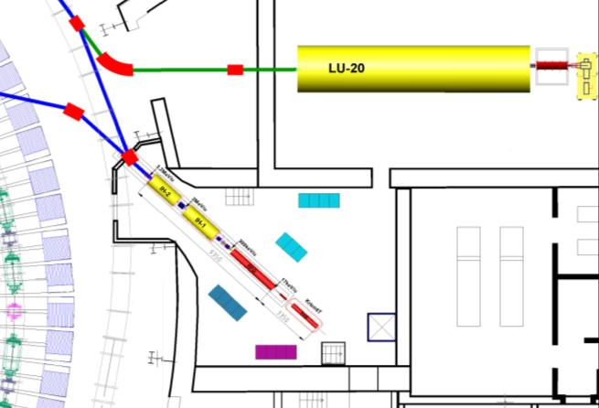
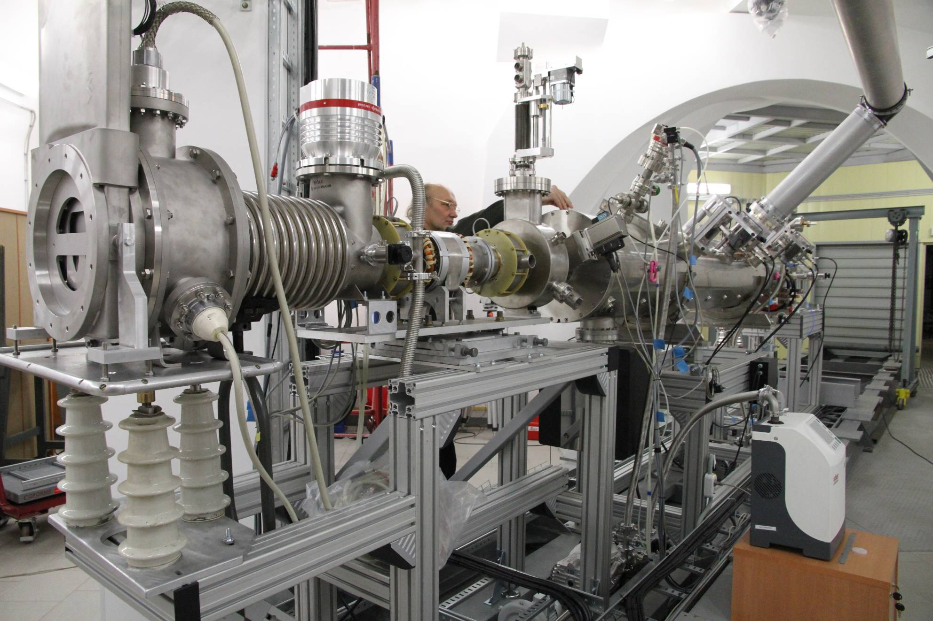
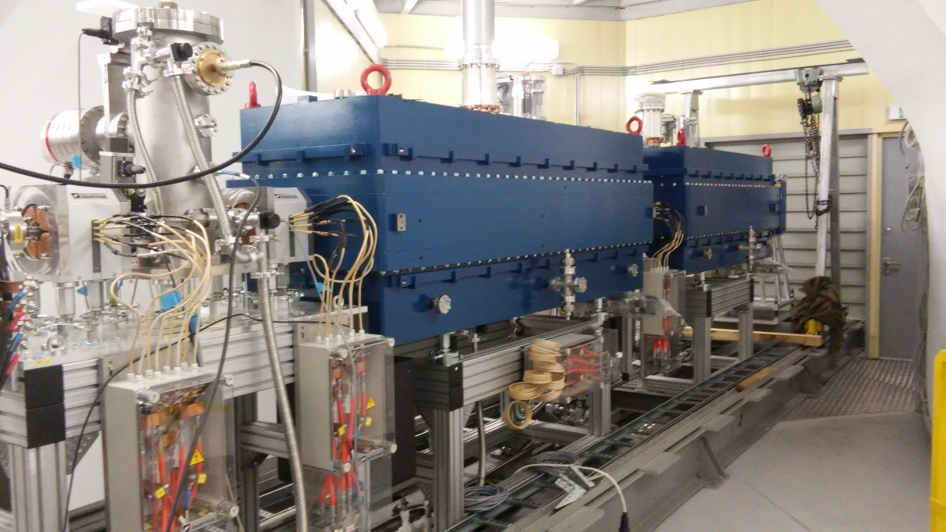
Heavy Ion Linear Accelerator HILAc
MEBT
IH-1
IH-2
RFQ
MOUNTED
COMMISSIONED
MOUNTED
COMMISSIONED
overall commissioning: Oct. 16

Slide 7
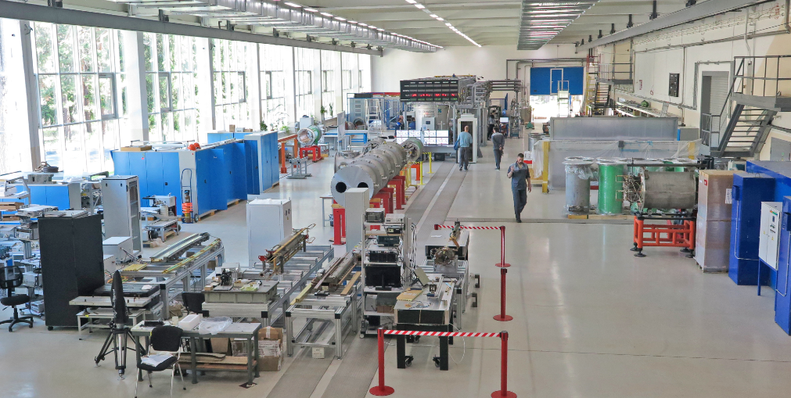
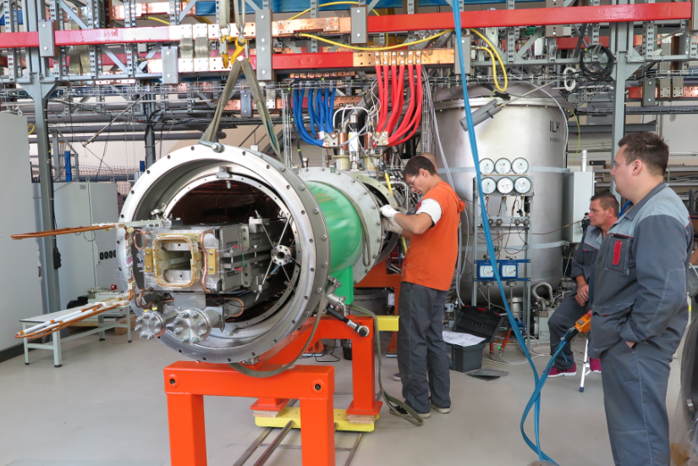
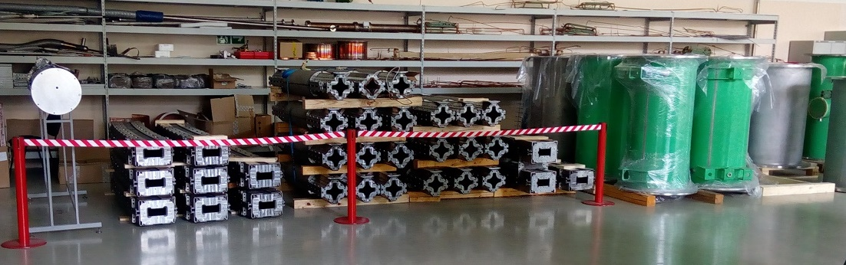
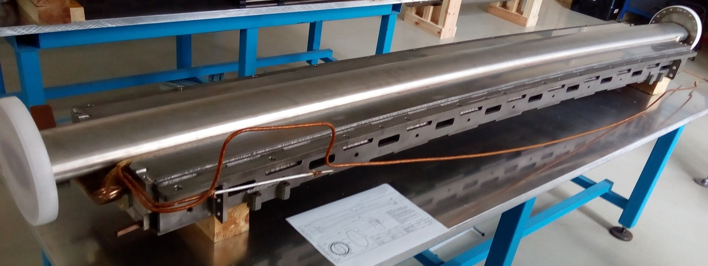
SC Magnets for Booster, Collider & SIS-100/FAIR
workshop at VBLHEP JINR (bld. 217)
Serial tests of Booster magnets has started
procurement of magnet systems is in progress
status of yoke proc. 06.09.2016
 | total | schedule | delivered yokes
dipoles | 40 | 40 | 21
quadrupoles | 48 | 48 | 42

Slide 8
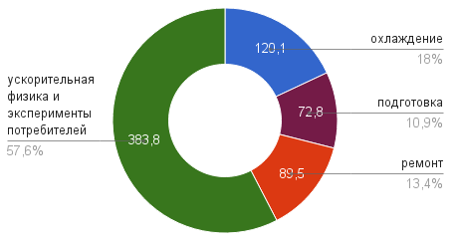
Technical Run 52 of the Nuclotron (d , d)
(02.06 – 08.07.2016)
time distribution
cooling
accelerator physics
and R&D of user
preparation
repairing
5 experiments at extracted beams:
1 experiments with polarized beam (data taking);
4 experiments with unpolarized beams (R&D and calibrations ).
≈ 456 hours scheduled for users.
≈ 120 hourst obtained
SPI (unpolarized mode)→RFQ →LU-20 →Nuclotron OK!
Polarimeters (the Low Energy Polarimeter (after LU-20) and the ITS
polarimeter at the internal beam) were prepared for measurements.
SPI (vector polarized mode) + LEP → OK (16.06.16 - 7.07.16):
vector polarization – as expected ∼ (+/- 0.5)

Slide 9
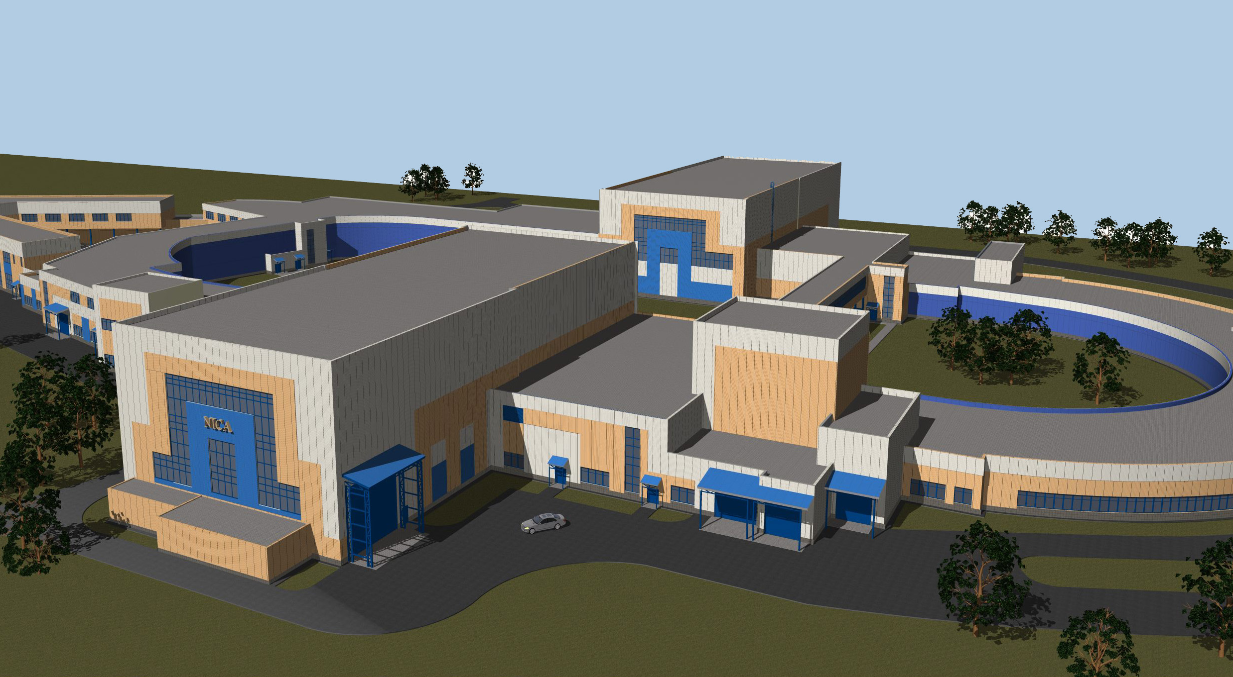
Civil Construction of NICA Complex
STRABAG – General contractor; КометА – designer
The works are in progress: piling, subcontractor for iron/concrete works
The whole Complex comprises several Objects to be commissioned:
Bld.#1reconstruction,
I q., 2019
SPD Hall, II q., 2019
East semi-ring,
IV q., 2018
Beam transport ch.,
I q., 2019
West semi-ring,
III q., 2018
MPD Hall, I q., 2018

Slide 10
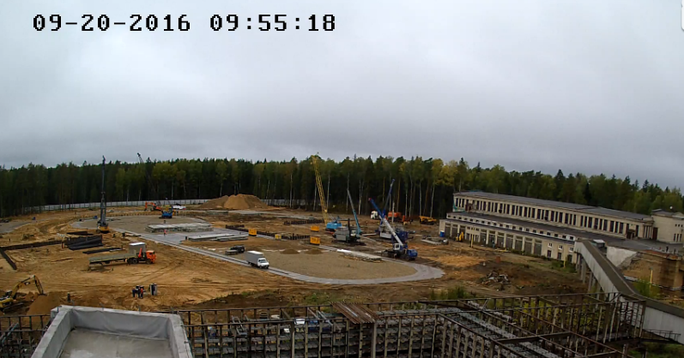
the construction is in progress

Slide 11
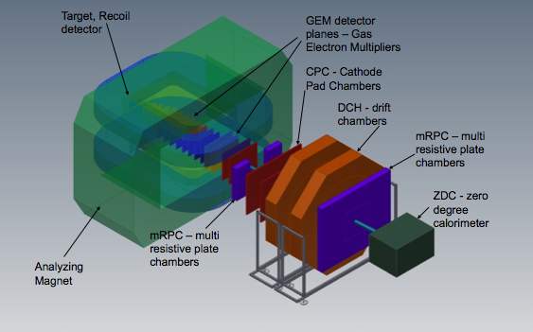
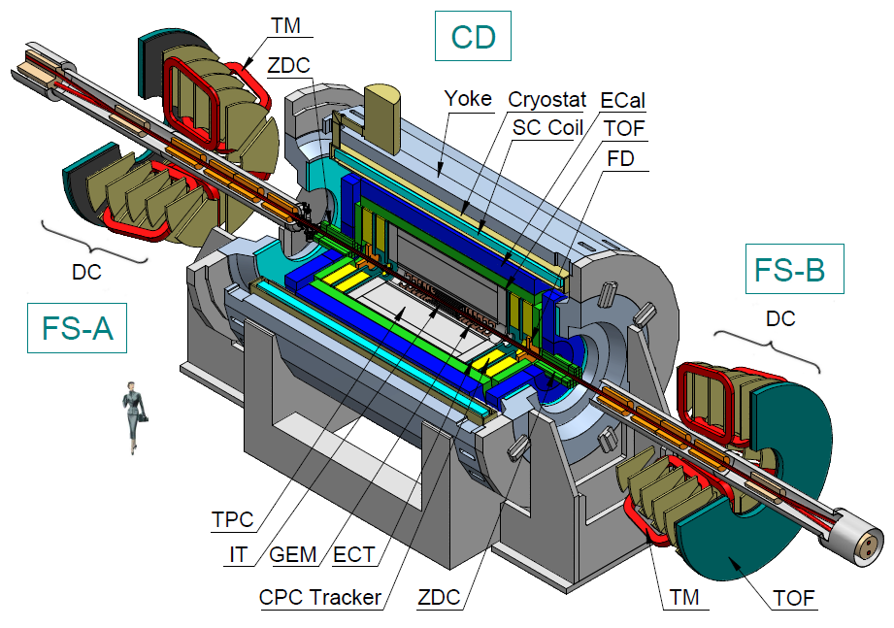
3 detectors
Baryonic Matter at Nuclotron (BM@N)
the fixed target experiment
at the Nuclotron
Stage I 2017
MultiPurpose Detector (MPD)
at the Collider
Stage I 2020
SPD (Spin Physics Detector) at the Collider
the project - in preparation
Notes:
3 detectors will be constructed: one for the fixed target experiment and two at the collider. The project for SPD detector is in preparation.

Slide 12
NICA schedule
 | 2015 |  |  |  | 2016 |  |  |  | 2017 |  |  |  | 2018 |  |  |  | 2019 |  |  |  | 2020 |  |  |  | 2021 |  |  |  | 2022 |  |  |  | 2023
Injection complex
Lu-20 upgrade
HI Source
HI Linac
Nuclotron
general development
extracted channels
Booster
Collider
startup configuration
design configuration
BM@N
I stage
II stage
MPD
solenoid
TPC, TOF, Ecal (barrel)
upgraded end-caps
Civil engineering
MPD Hall
SPD Hall
collider tunnel
HEBT Nuclotron-collider
Cryogenic
for Booster
for Collider
running time

Slide 13
NICA program in heavy ion collisions
and
experimental strategy
for 2020-2023

Slide 14
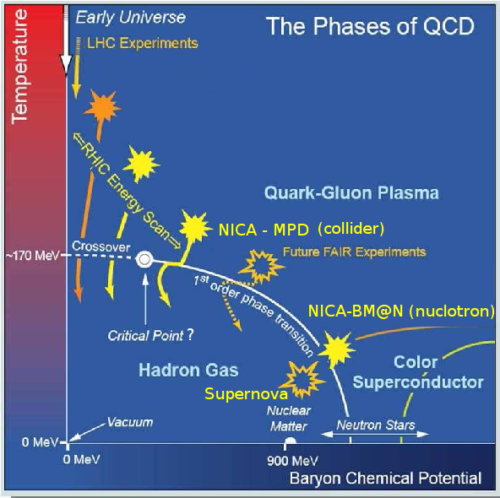
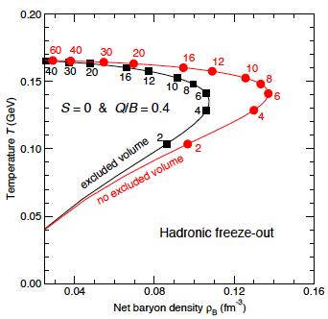
Exploration of the QCD Phase Diagram
Exploring high-density baryonic matter: maximun freeze-out density
Jurgen Randrup, Jean Cleymans
NICA
NICA is well suited for exploring the transition between the hadronic phase and the new plasma phase. This exploration is the top priority of the NICA program

Slide 15
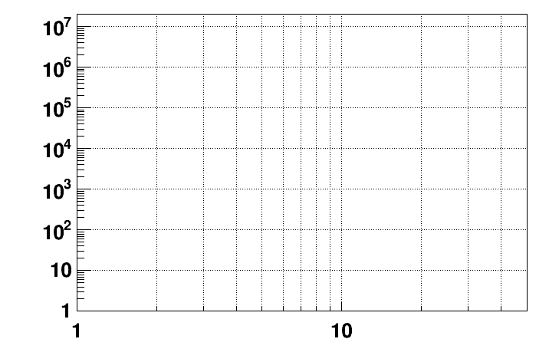
Present and future HI experiments
energy region of max.
baryonic density
CBM
2022 – 2025: SIS-100 FAIR
NICA/BM@N II
HADES
NICA/MPD
Interaction rate [Hz]
STAR F.T.
STAR BES II
NA-61/SHINE
Collision energy √S [GeV]
NN
Notes:
Concerning fixed target experiments –there are several ones including NICA/BMN. CBM/FAIR will provide extremely high interaction rate.

Slide 16
Both, collider and fixed target approaches,
are complementary and necessary
for approval of potential discovery
In this view the NICA and FAIR projects are complementary
and their joined efforts have aimed to
discovering and to studying new forms of baryonic matter

Slide 17
Present and future HI F.T. experiments
energy region of max.
baryonic density
CBM
2022 – 2025: SIS-100 FAIR
NICA/BM@N II
Interaction rate [Hz]
HADES
STAR F.T.
NA-61/SHINE
Collision energy √S [GeV]
NN
Notes:
Concerning fixed target experiments –there are several ones including NICA/BMN. CBM/FAIR will provide extremely high interaction rate.

Slide 18

Baryonic Matter at Nuclotron (BM@N)
Leader: M. Kapishin
Detector Advisory Committee:
Hans Rudolf Schmidt, Tubingen Uni. - chairman
Hans Gutbrod, GSI
Itzhak Tserruya, Weitzmann Istitute
Peter Hristov, CERN
Karlheinz Hiller, DESY
Notes:
This detector will operate at the beam extracted from the Nuclotron.

Slide 19

BM@N: the 1st stage
Participants from:
Russia: INR, MEPhi, SINP, MSU,
IHEP, S-Ptr Radium Inst.
Bulgaria: Plovdiv University;
China: Tsinghua University, Beijin;
Poland: Warsaw Tech.Uni.
Israel: Tel Aviv Uni.
Germany: Frankfurt Uni.
+ expression of interest from CBM
Physics:
strange / multi-strange hyperon and hypernuclei production
at the threshold
hadron femtoscopy
event-by event fluctuations
in-medium modifications of strange & vector mesons
in dense nuclear matter
electromagnetic probes, states decaying into γ, e (with ECAL)
area prepared
for detector installation
Notes:
The participants from several institutions are contributing to the experiment preparation. At the fist stage it will be studied: strange and …..

Slide 20
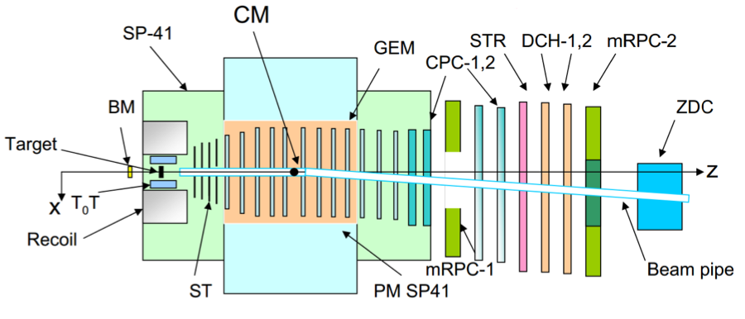
BM@N status and milestones
BM@N schematic view
BM@N configuration
DAQ GEM (CERN) ST TOF Outer tracker
2016, IV: basic 6 half 1 small half DCH
        config. planes plane config.
2017, III: complete 10 h/pl. 2 s/pl. basic DCH
2019, I: -”- 8-10 full pl. 2 s.,2 large pl. complete Straw+DCH
area prepared
for detector installation
Notes:
Several milestones are foreseen to put in operation the fully equipped detector. There major tracker is based on the GEM detectors fabricated with the help of CERN.
Silicon tracer is produced in cooperation with the GSI and other institutions.

Slide 21
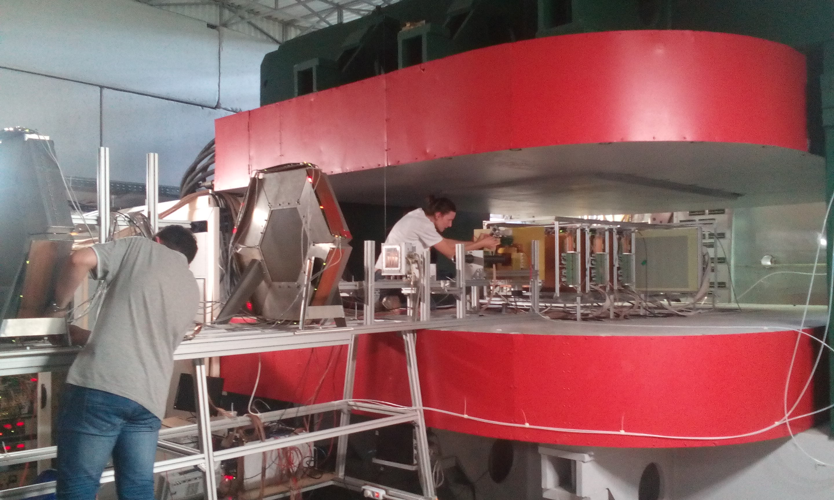
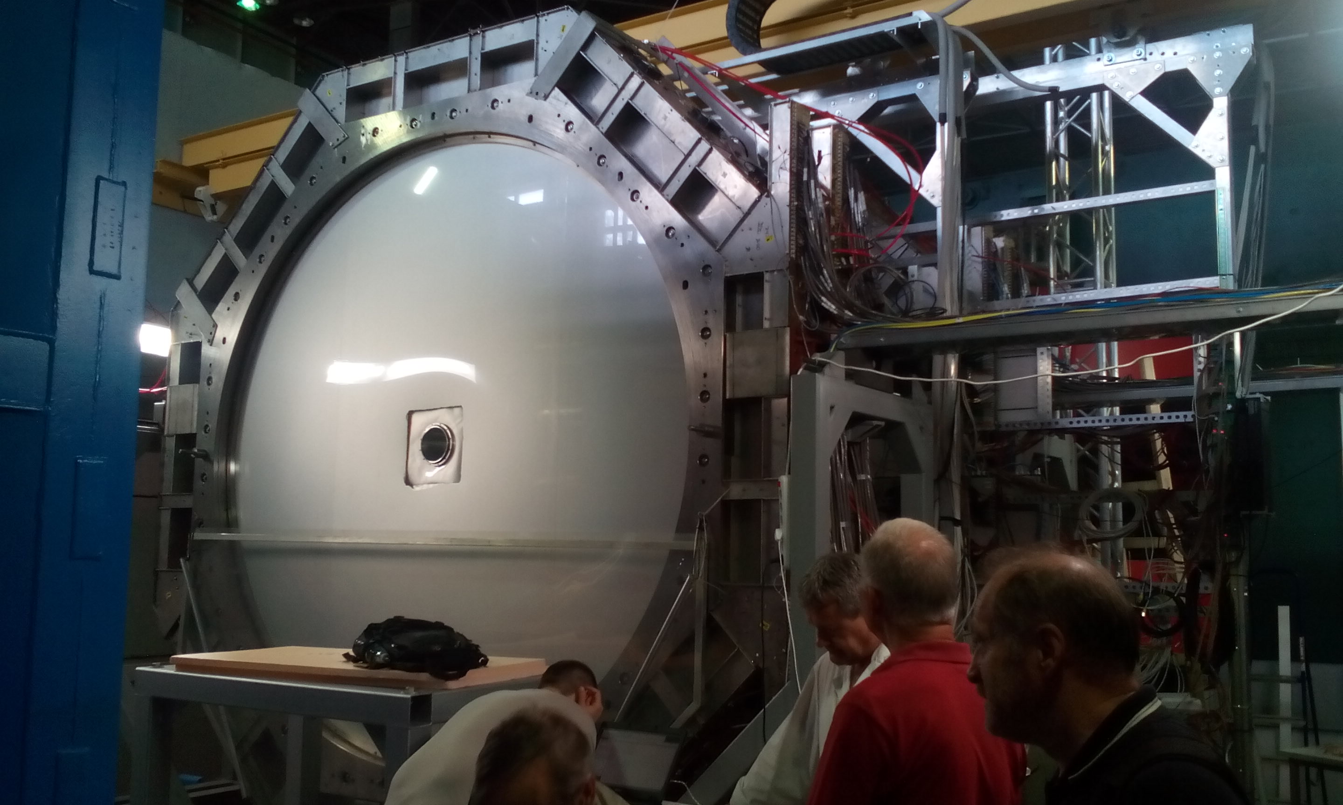
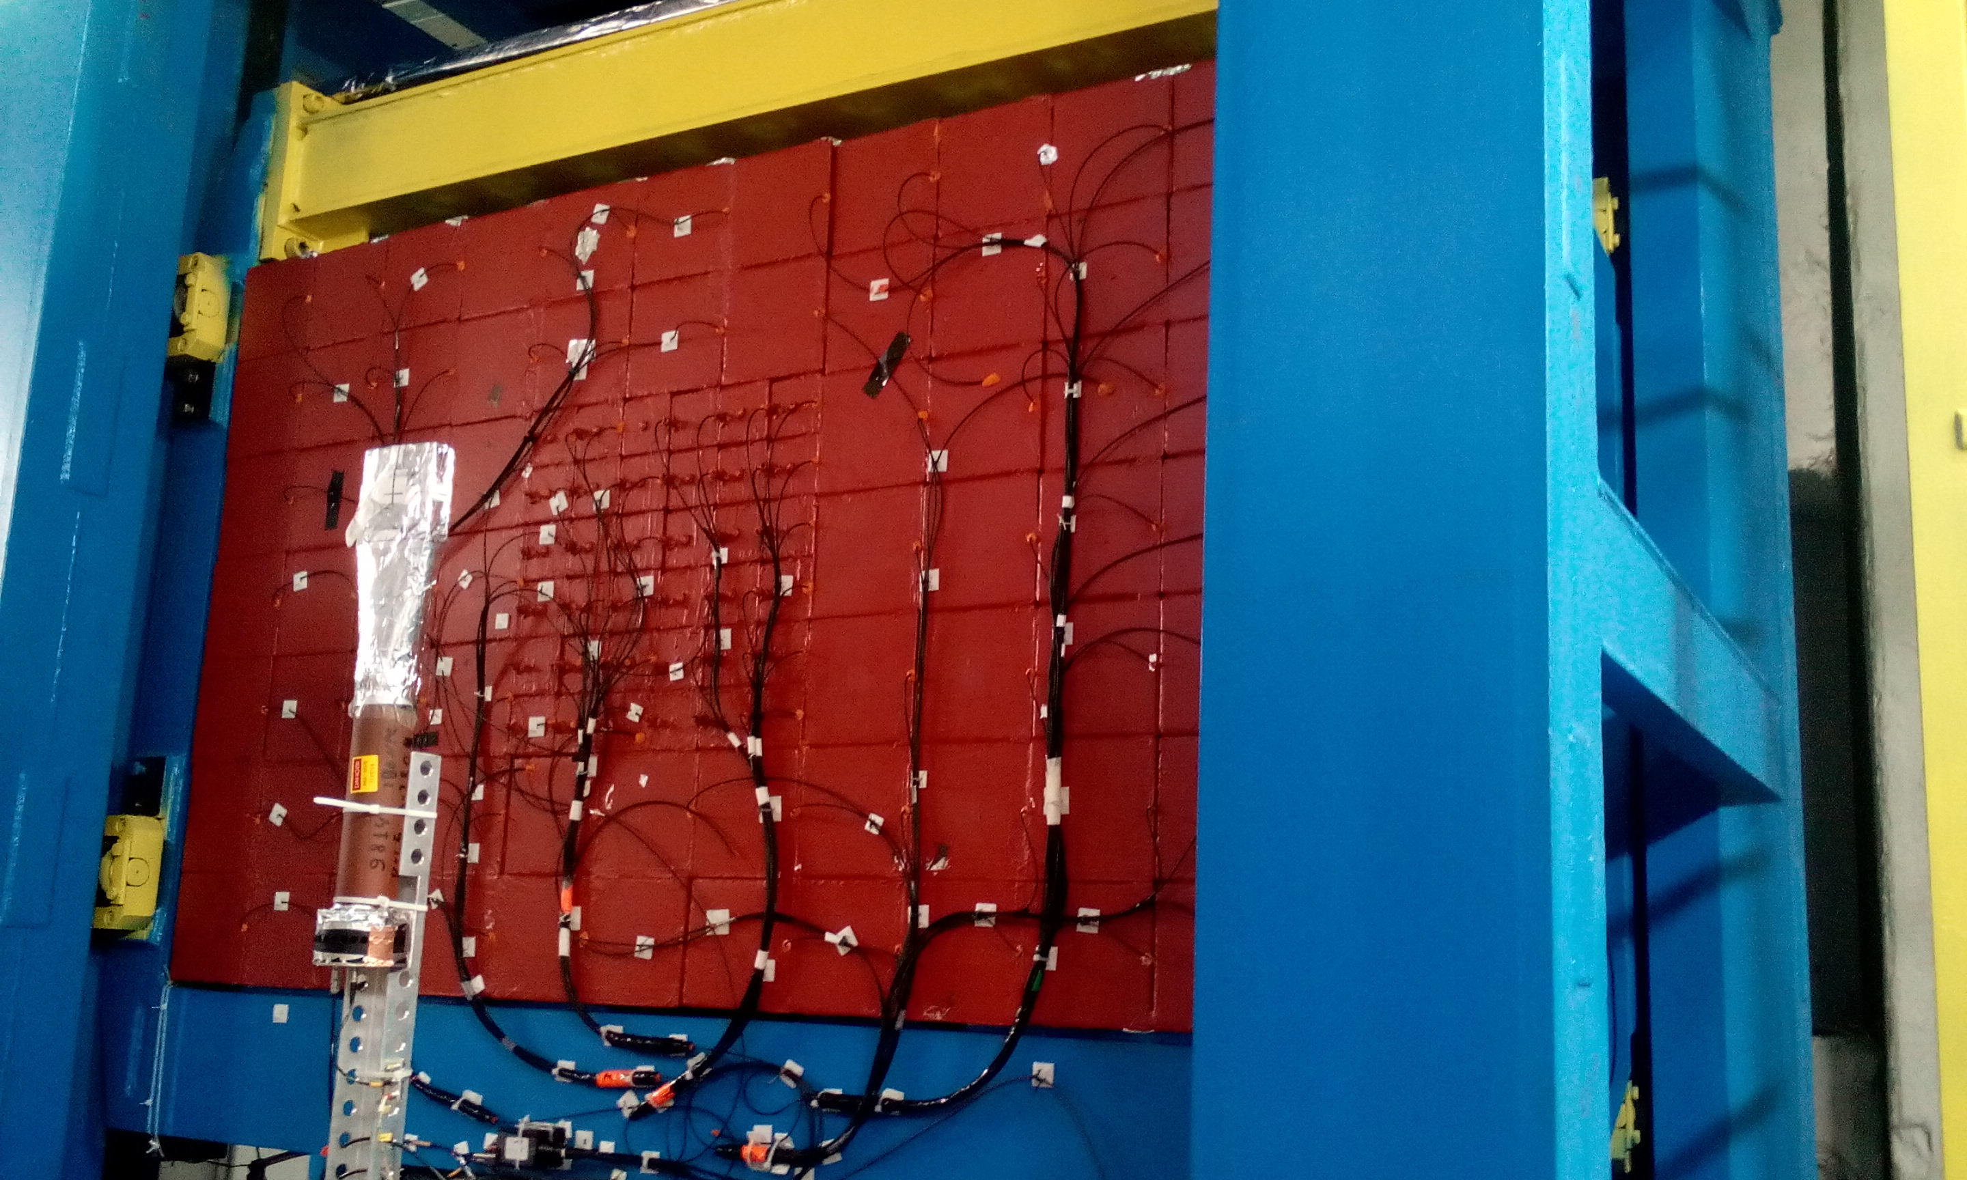
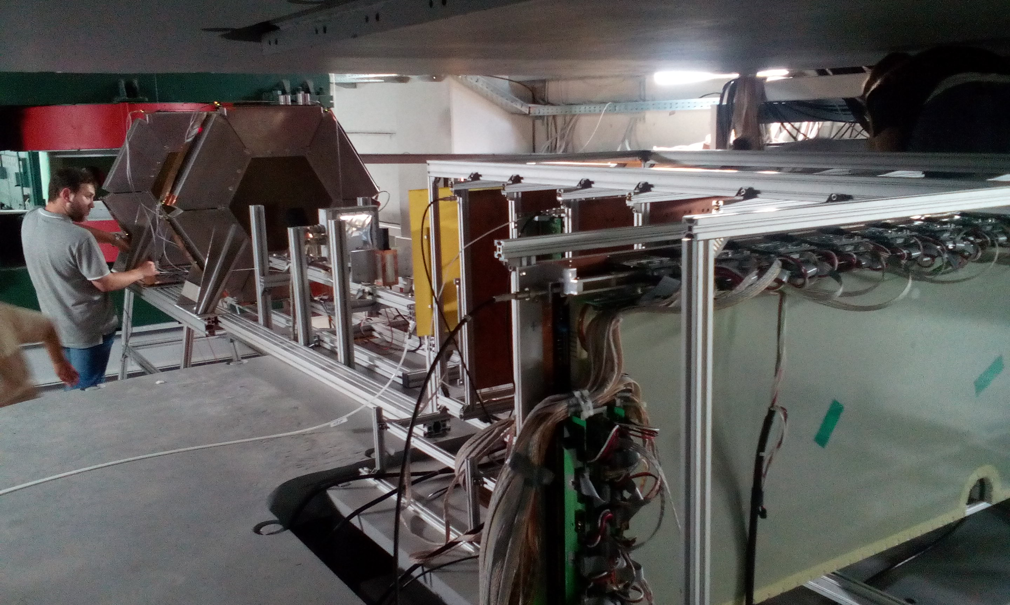
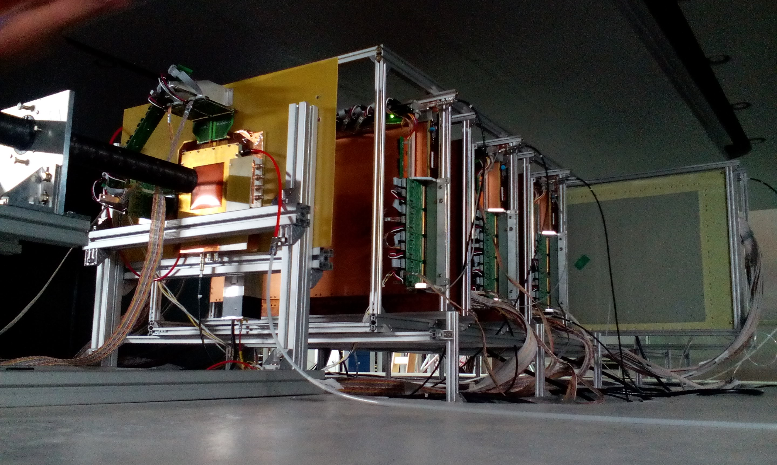
BM@N Run 52 (June 2016): tests & commissioning
of GEM CT located inside analyzing magnet
d beam (~5·10⁵ /cycle) with 2.94 GeV/n
5 GEM detectors 66 x 41cm² + 1 detector 163 x 45 cm²

Slide 22
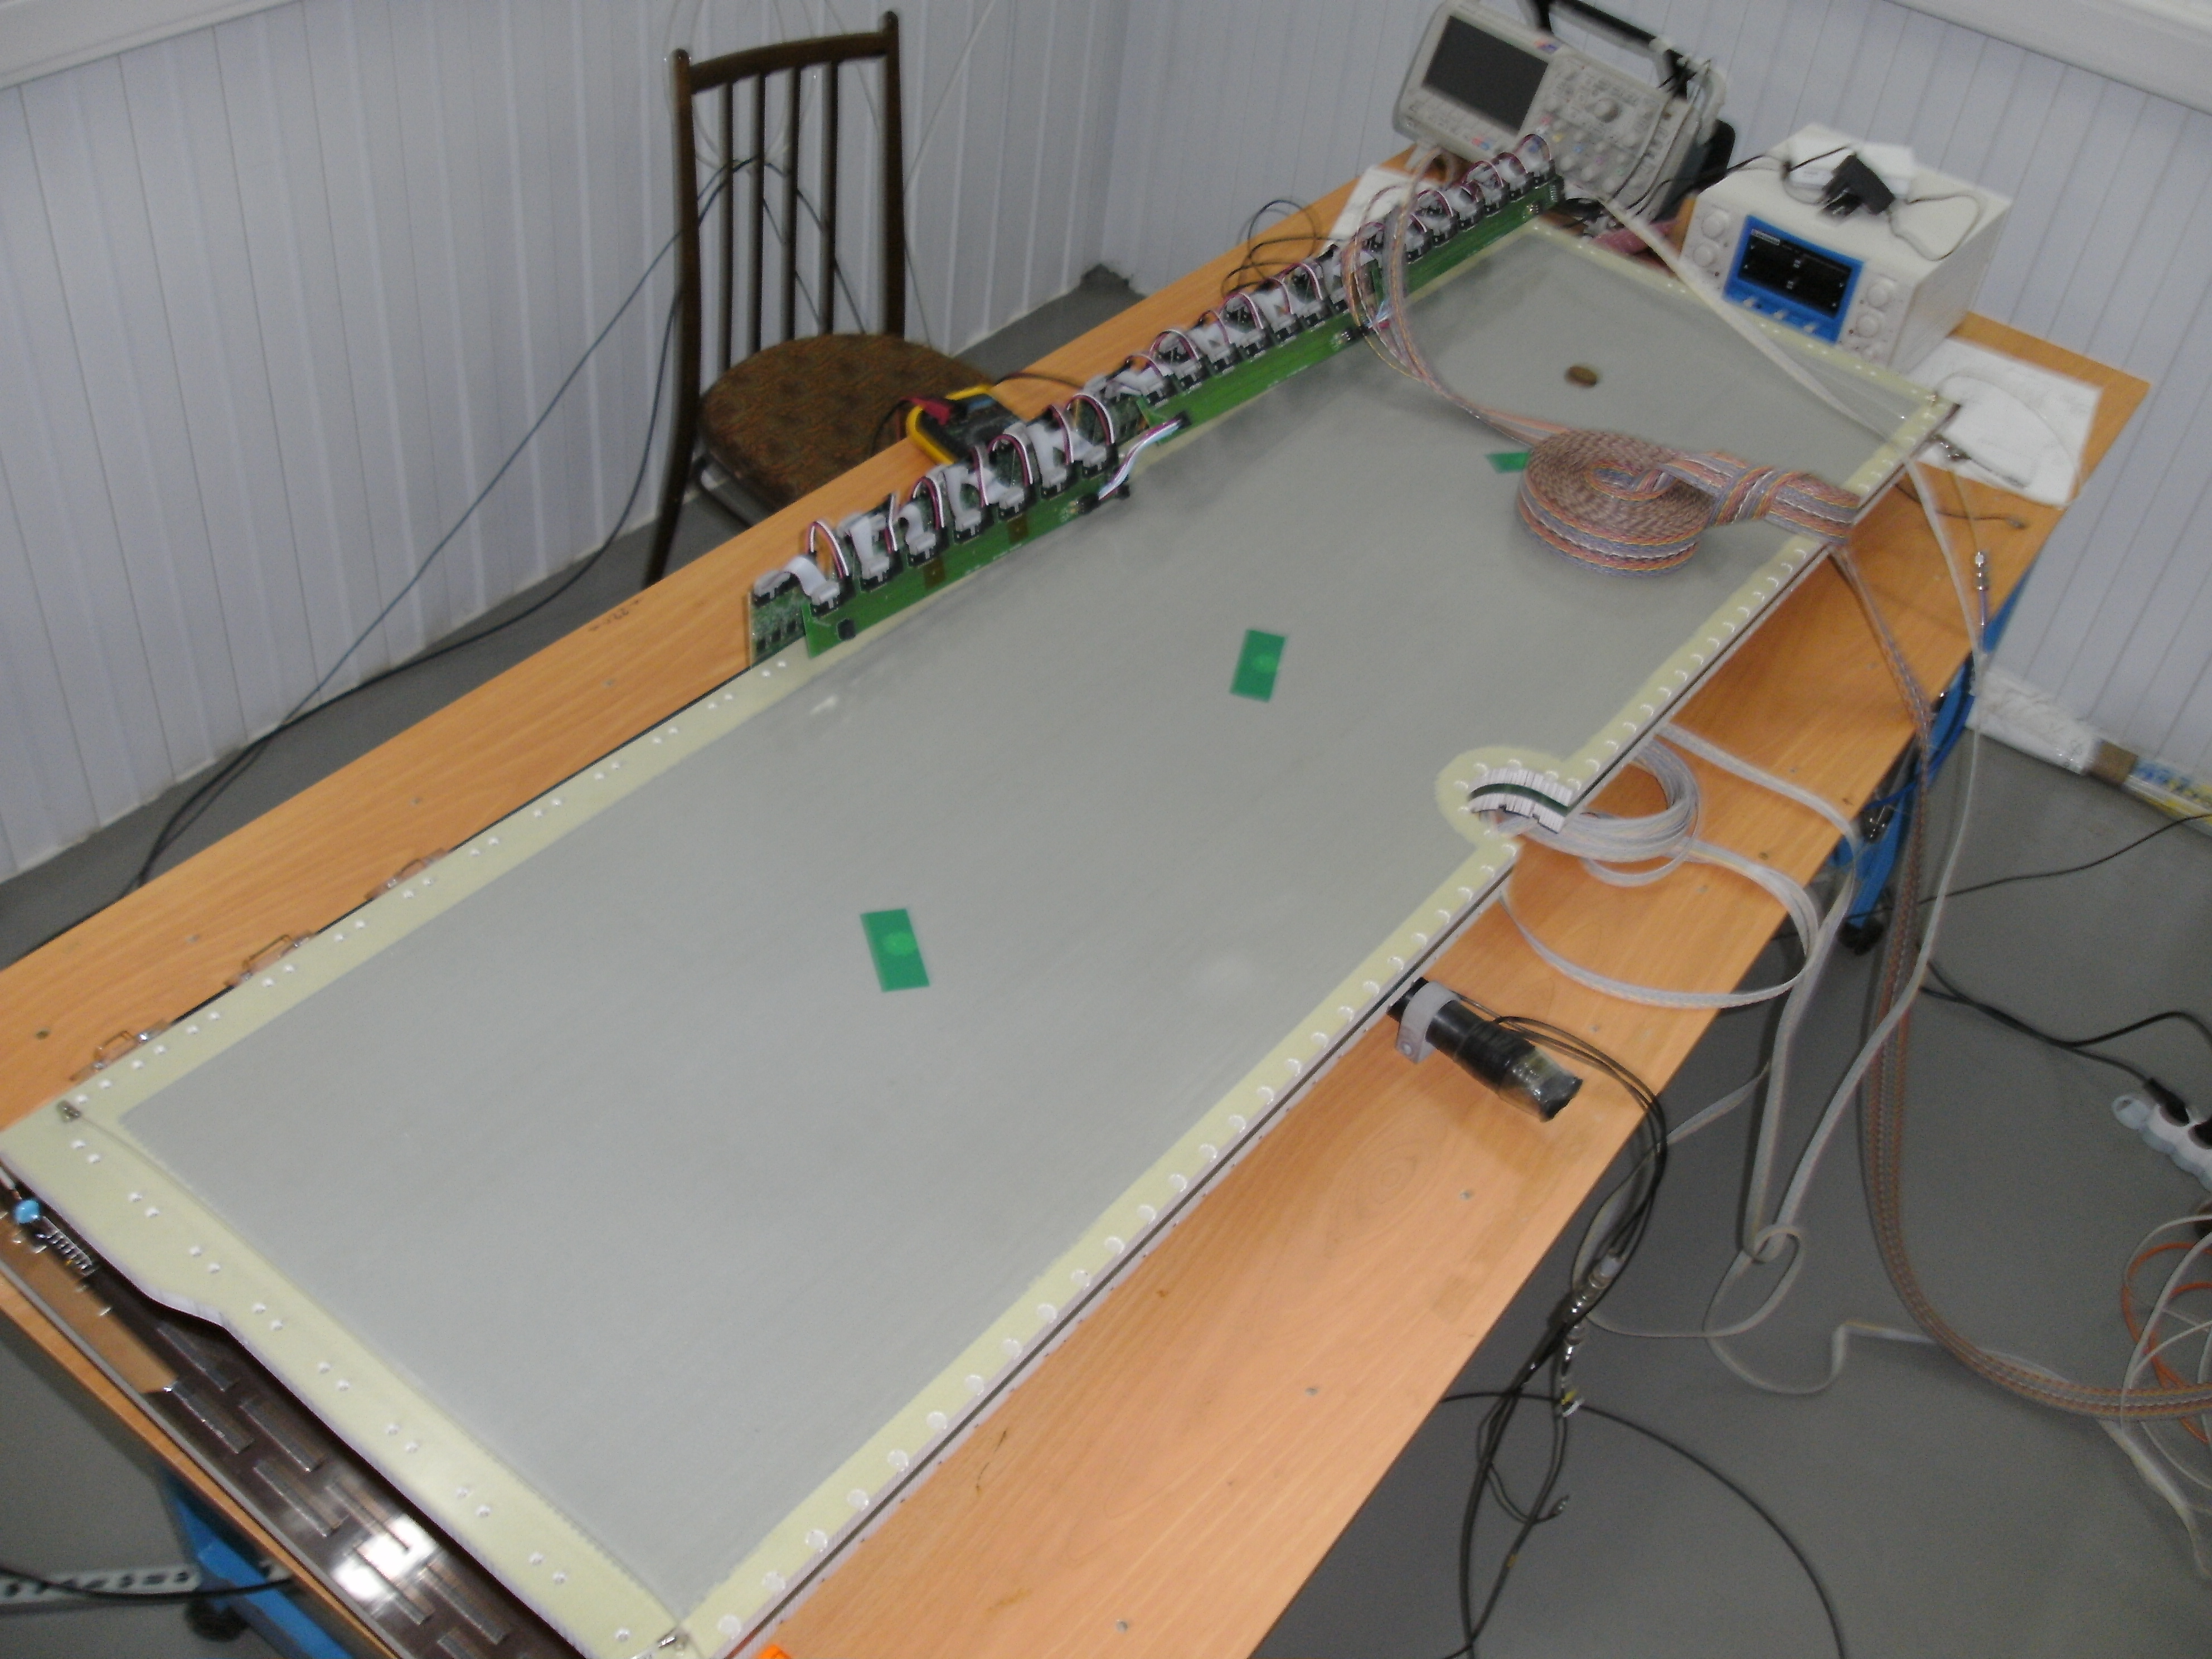
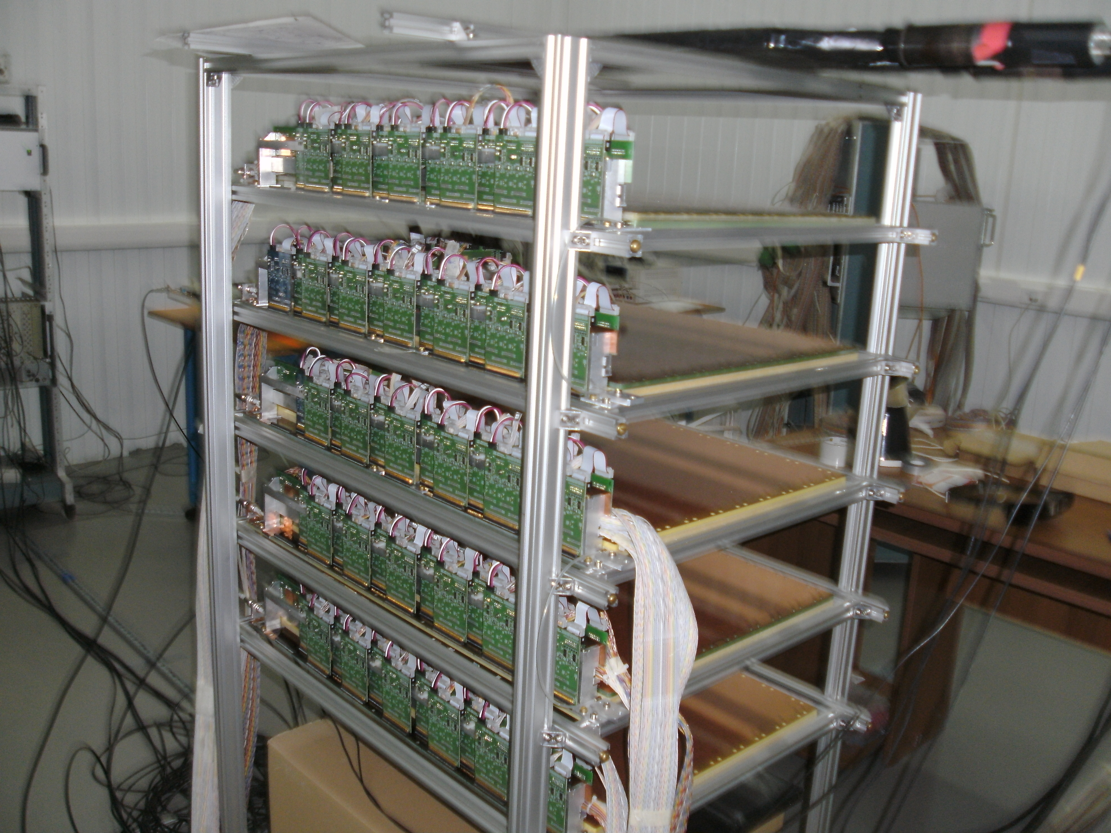
GEM detectors for central tracker
Tests of GEM detector 163 x 45 cm²
Set of 5 GEM detectors 66 x 41 cm² prepared for cosmic tests, June 2016
GEM design and production at CERN workshop is going slower
than expected
5 detectors 66 x 41 cm² and 2 detectors 163 x 45 cm² are foreseen to use
in technical run at the end 2016
6-8 more detectors 163 x 45 cm² should be commissioned in autumn 2017 plan to produce

Slide 23
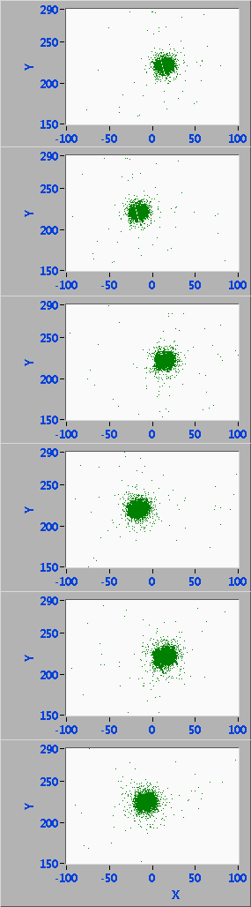
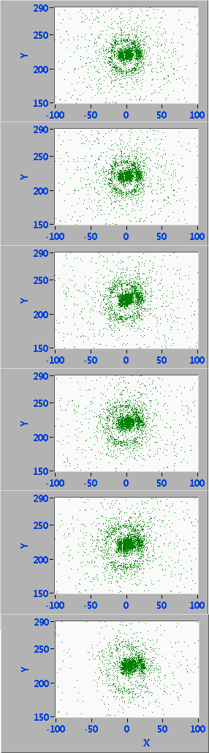
Performance of GEM tracker in séance 52, June 2016
5 middle size + 1 big GEM detectors
Beam spot
(detectors are displaced to ±15 mm)
Products of interaction with target & proton spectators / pile-up events in center
beam profile
in middle GEM detector
beam
beam track residuals in big GEM detector

Slide 24
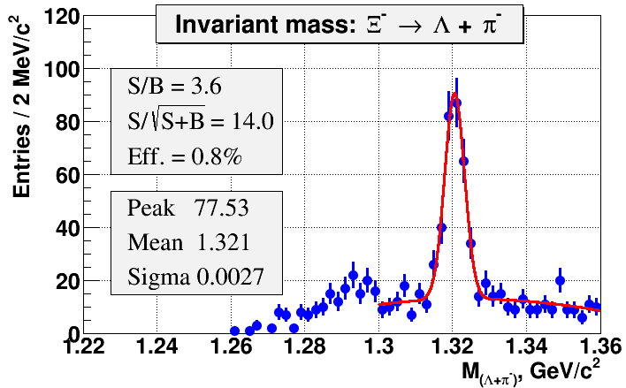
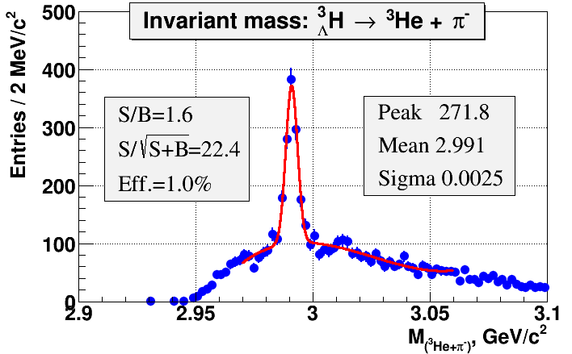
BM@N feasibility study
A.Zinchenko, V.Vasendina
Simulation: UrQMD & DCM-QGSM, Au+Au 4,5 AGeV
900 k central events
7,5M Ξ⁻ in 1 m, 20 kHz trigger
2,6M central events
8,5M ³H_{Λ} in 1 m, 20 kHz trigger
Ξ⁻
³H_{Λ} → ³He π⁻
area prepared
for detector installation
DCH-1,2
ToF-700
Scint-700
ZDC
Notes:
The second technical run is foreseen in May-june. The first physics run is planned at the end of 2017 when the Booster will be put in operation. The run with high intensity gold beam is planned in 2019. The simulation indicates a reliable detection of cascades and hyper-nuclei.

Slide 25
BM@N plans
year | 2016 | 2017 spring | 2017 autumn | 2019 | 2020 + ..
beam | d ( ) | C, Ar | Kr | Au | Au, p
maximum intensity, Hz | 1M | 1M | 1M | 1M | 10M
trig. rate, Hz | 10k | 10k | 20k | 20k | 50k
central tracker | 6 GEM half pl. | 8 GEM half pl. | 10 GEM half pl. | 8 GEM full pl. | 12 GEM or 8+2Si
expiment status | techn. run | techn. run | physics run | physics stage 1 | physics stage 2

Slide 26
MultiPurpose Detector (MPD)
Coordinator: V. Golovatyuk
Detector Advisory Committee:
Hans Gutbrod, GSI - chairman
Itzhak Tserruya, Weizmann Institute
Hans Rudolf Scmidt, Tubingen Uni.
Jean Cleymans, Cape Town Uni.
Nu Xu, BNL
TDRs for most sub-detectors have been prepared
and now are under evaluation by DAC
Notes:
The MPD will be the fist detector operated at the Collider. The TDRs for…

Slide 27
Present and future HI collider experiments
energy region of max.
baryonic density
NICA/MPD
Interaction rate [Hz]
STAR BES II
Collision energy √S [GeV]
NN
Notes:
Only two collider experiments can explore the energy range of maximum baryonic density: Beam energy scan of STAR and NICA/MPD.
However at different interaction rates.

Slide 28
MPD experimental strategy
measure a variety of observables systematically changing
collision conditions: energy, centrality, system size;
reference data (i.e. p+p) will be taken at the same conditions
Observables:
Bulk observables (hadrons): spectra,yields (OD, EOS) from p to Ω
(charm is under evaluation)
Event-by-event fluctuation in hadron productions (CEP)
Femtoscopy: correlations involving π, K, p, Λ … (OD)
Directed & elliptic flows for identified hadron species (EOS,OD)
Multi-strange hyperon production : yields & spectra (OD, EOS)
Electromagnetic probes (CSR, OD) – limited specifications in 2019
Hypernuclei
OD – Onset of Deconfinement CEP – Critical End Point
CSR – Chiral Symmetry Restoration EOS – Equation Of State
Notes:
28

Slide 29

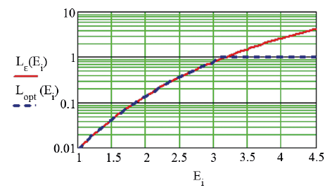
NICA parameters at very beginning (from 2020)
This is the goal for 2023!
Start-up version (2020)
reduced luminosity: 5 .10²⁵ at 11 GeV/A
enlarged beam diamond: s =0.6 m

Slide 30
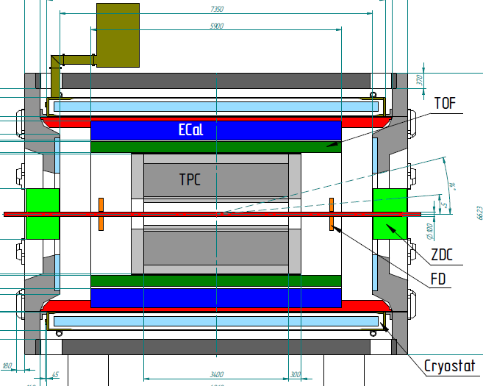


MPD detector for Heavy-Ion Collisions @ NICA
FFD
Tracking: up to |η|<1.8 (TPC)
PID: hadrons, e, γ (TOF, TPC, ECAL)
Event characterization:
centrality & event plane (ZDC)
Stage 1: TPC, TOF, ECAL, ZDC, FD
Stage 2: IT + Endcaps (tracker, TOF, ECAL)
Status: technical design and detector R&D – completed;
Preparation for the mass production
Notes:
The MPD will be put in operation at two stages. At the first one the barrel part will be equipped with major tracking detector TPC, TOF end ECAL. ZDC and FD will be in operation as well.
At the second stage the detector will be supplemented with IT and end cap subdetectors.

Slide 31
strategy in 2020-2023
energy and system size scan from 4 to 11 GeV in steps of 1-2 GeV
limitation by the accelerator:
lower luminosity
extra reduction by 40% because of a larger beam diamond
Detector limitation
TPC tracking: |η|<1.8 (N points>10)
TOF coverage: |η|<1.2
PID: combined |η|<1.2, 0.1<pT<4 GeV/c,
limited in 1.2 < |η|>1.8 (only dE/dx)
ECAL coverage : |η|<2.5
FHCAL coverage: 2.2<|η|<4.8
FD inside the TPC inner pipe

Slide 32
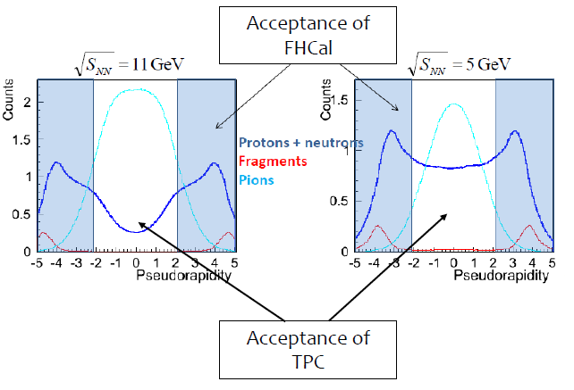
Acceptance on η
MEPhI: P. Parfenov, I. Svintsov, I. Selyuzhenkov, A. Taranenko

Slide 33
data rates
possible scenario:
to take data at 8 energies 4, 5, 6, 7, 8, 9, 10, 11 GeV
for beam/target combinations: Au+Au, Xe+Xe, C+C, p+p
In total: 32 data sets (1 week for each of the top-half energies
and 2 weeks for lower energies).
In 48 weeks (~1,5 year) of data taking the statistics equal to one
at RHIC will be accumulated (duty factor 0.5 is used)
Beam | Luminosity (cm ⁻² c ⁻ ¹) |  | Data sample per 1 week at √s = 4 GeV | Data sample per 1 week at √s = 11 GeV
 | √s=4 GeV | √s=11 GeV
¹⁹⁷Au | 7 .10²⁴ | 5 . 10²⁵ | 9.1 . 10⁶ | 6.3 . 10⁷

Slide 34
Particle yields in Au+Au collisions @ √s_{NN} = 8 GeV
(central collisions)
one week of running at L = 5 10²⁵cm⁻²s⁻¹ (duty factor = 0,5)
Particle | Multiplicity | Decay mode | BR | *Efficiency % | Yield /1 w
π⁺ | 293 | ---- | --- | 61 | 7.7 . 10⁸
K⁺ | 59 | --- | ---- | 50 | 1.5 . 10⁸
p | 140 | --- | ---- | 60 | 4.2 . 10⁸
Λ | ~35 | p+π⁻ | 64% | ~10% | ~1 . 10⁷
Ξ ⁻ | ~2 | Λ+π⁻ | ~100% | 1.6% | 1.0 . 10⁵
ρ | 31 | e+e- | 4.7 . 10⁻⁵ | 35 | 2.5 . 10³
ω | 20 | e+e- | 7.1 . 10⁻⁵ | 35 | 2.5 . 10³
ϕ | 2.6 | e+e- | 3 . 10⁻⁴ | 5 | 2.0 . 10²
Ω | 0.14 | Λ+K | 0.68 | 2 | 9.5 . 10³

Slide 35
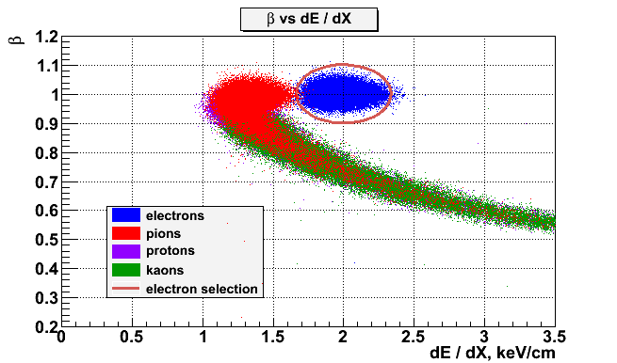
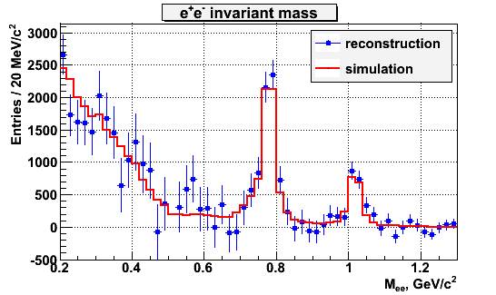
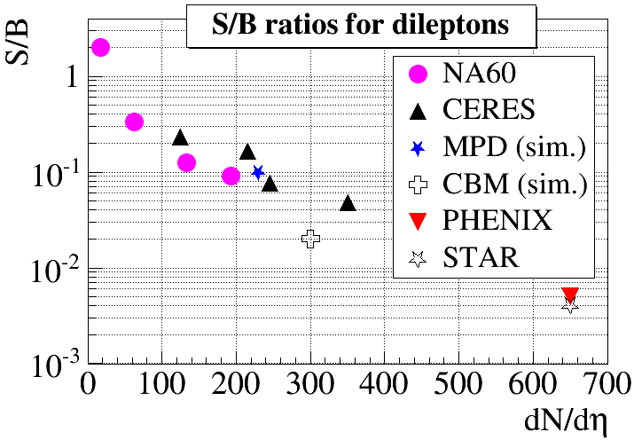
MPD performance for dileptons
Zinchenko, at SQM-2015
Good probes to indicate medium modifications of spectral functions due to chiral symmetry restoration in A+A collisions; effect is proportional to baryon density
PID
σ_{ω}≈14 MeV/c²
Hadron suppression
up to 10⁻⁵
Yields, central Au+Au st √s_{NN} = 8.8 GeV/u
meson | Yields |  | Yield/1 w
 | 4π | y=0
ρ | 31 | 17 | 7 . 10⁴
ω | 20 | 11 | 7 . 10⁴
ϕ | 2.6 | 1.2 | 1.7 . 10⁴

Slide 36
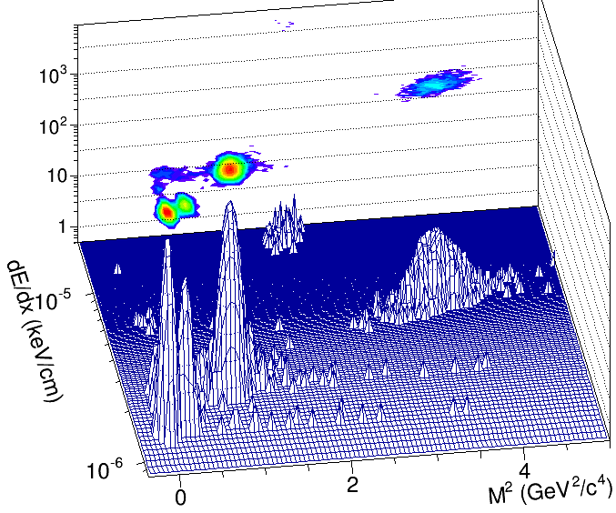
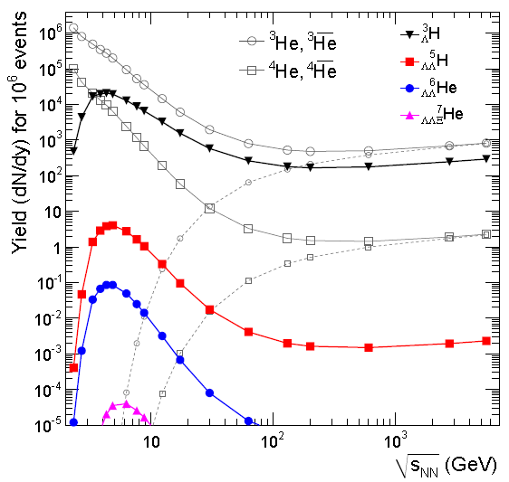

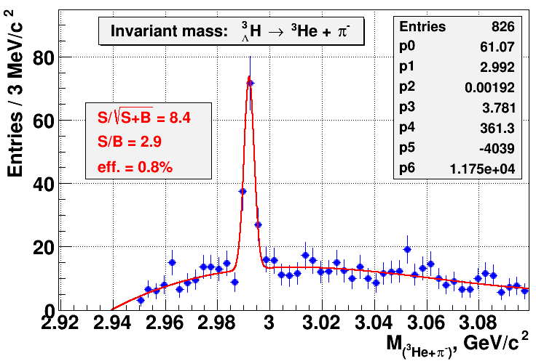
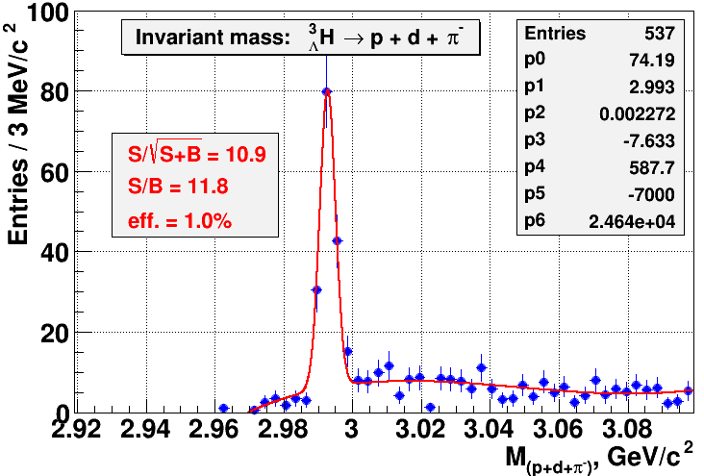
Hypernuclei @ MPD
M. Ilieva, at “SQM-2015”
PID
P = 1 GeV/c
p
³He
d
π⁻
Hypernuclei production
enhanced at high
baryon densities (NICA)
Hypertritons (central Au+Au @ 5A GeV (DCM-QGSM)
³_{Λ}H → ³He + π –
³_{Λ}H → p + d + π ⁻
~ 10⁶ ³_{Λ}H are expected
in 10 weeks

Slide 37
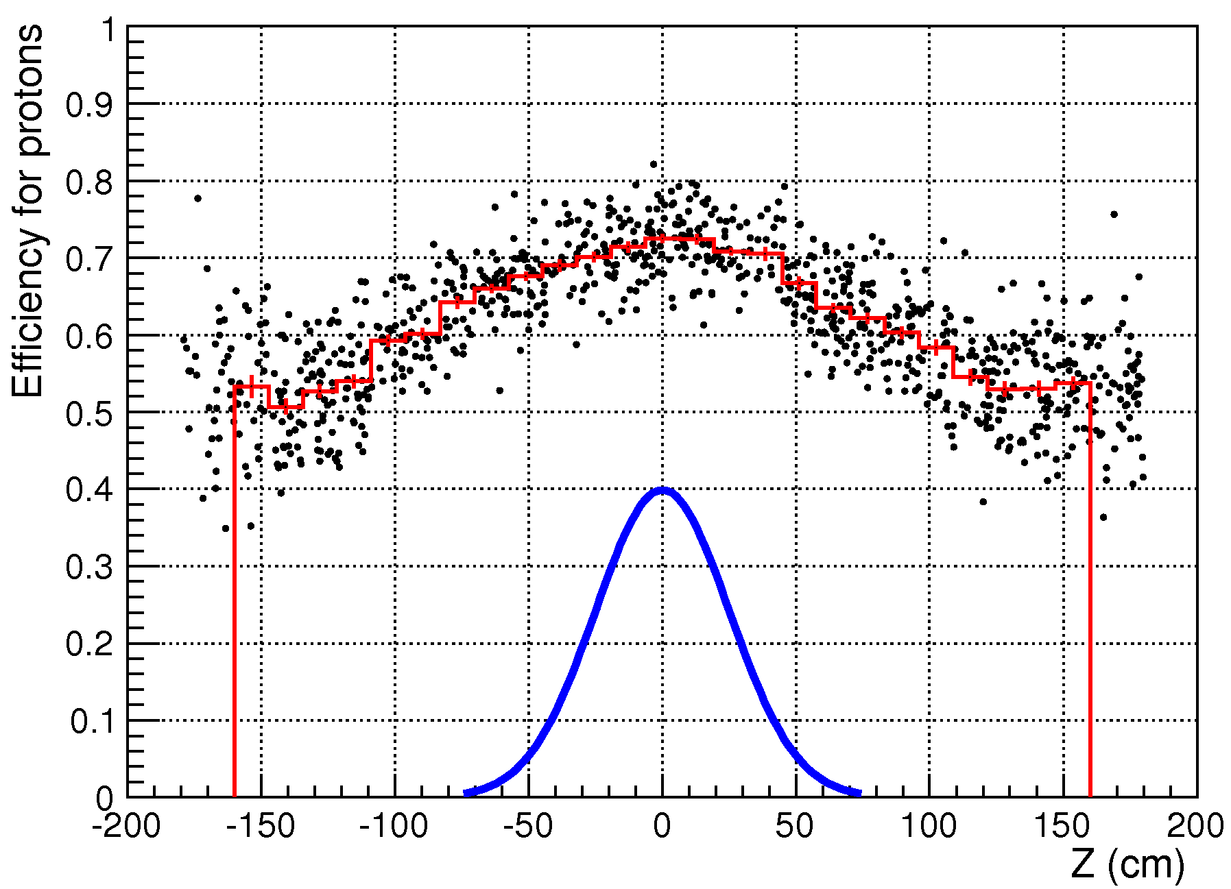
MPD perspectives for ev-by-ev fluctuations at Stage’1
Defined by the phase-space (barrel), PID performance
and (partially) by beam dimensions
Central Au+Au.
Early study from V. Kireev
at √s=4 GeV MPD accumulates ~100 PIDed protons (73%),
efficiency drops to 55% at Z_{Vertex}=120cm
Maximal allowed phase-space
even for a limited set of MPD elements
15

Slide 38
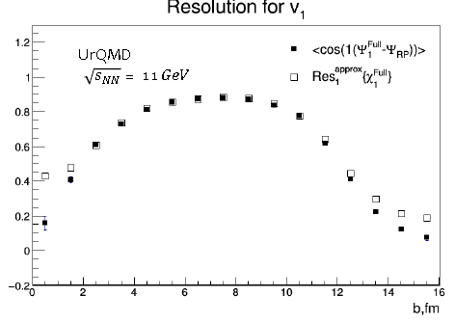
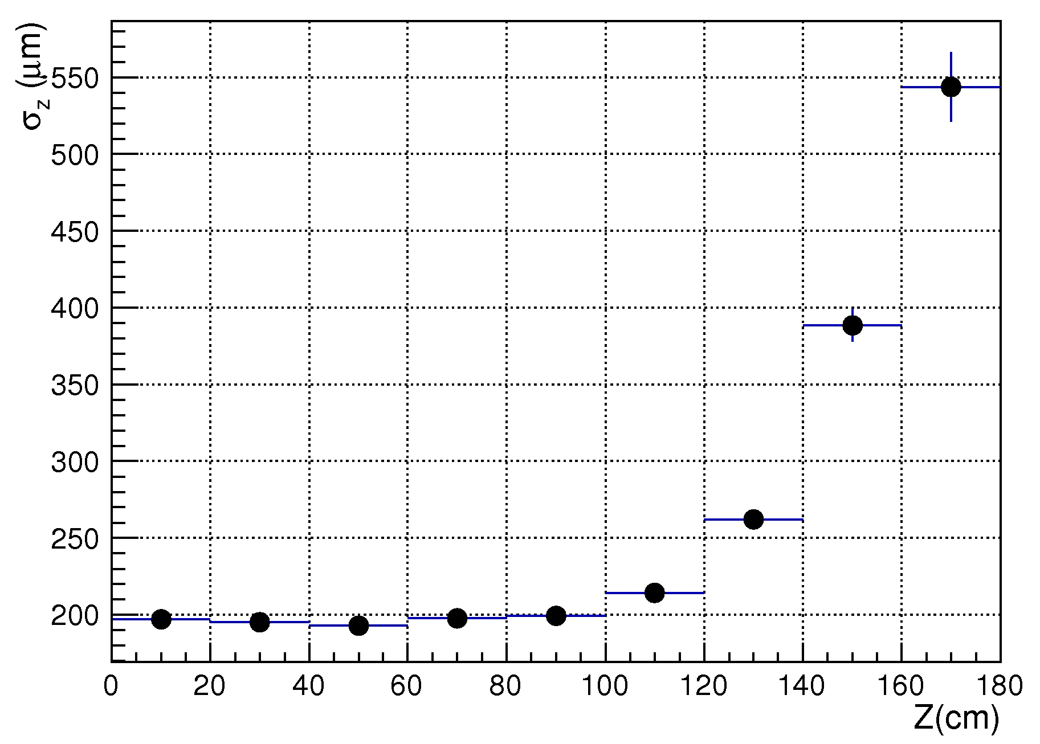
MPD perspectives for event-by-event fluctuations at Stage’1
Is defined by the FHCAL performance, phase-space, tracking and PID performance, and (slightly) by beam dimensions
good v1,2 event plane resolution
using FHCAL
Peripheral Au+Au √s=4 GeV
<N_{tracks}> ~ 50 (b=10 fm)
primary vertex reconstruction with
TPC tracks: σ_{Z} ~ 200 μm is stable
within |Z|<100 cm
15

Slide 39
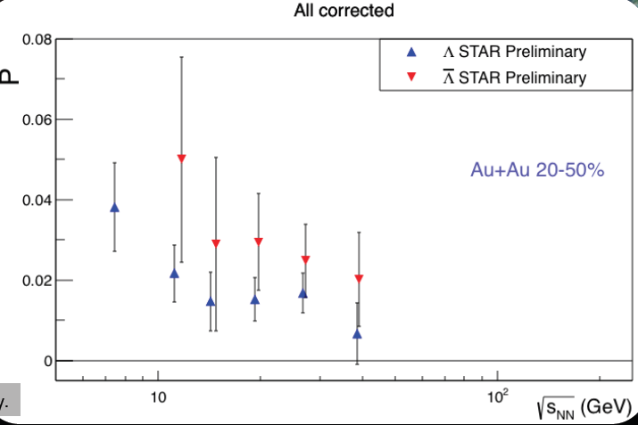
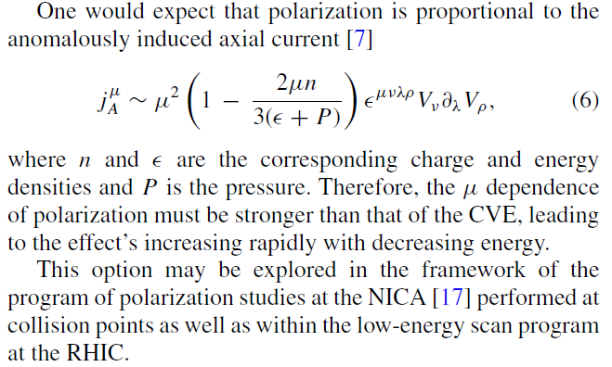
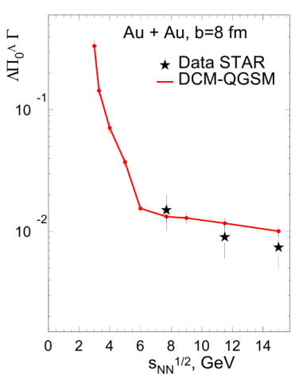
Spin effects in HI collisions
as a complementary probe
M. Lisa, for the STAR collaboration,
SQM2016, Berkeley, June 2016
O. Rogachevsky, A. Sorin, O. Teryaev,
Phys. Rev. C 82, 054910, 2010.
O.Teryaev, M.Baznat, K.Gudima, A.Sorin, XXIII Baldin Seminar,2016
M. Baznat, K. Gudima, A. Sorin, O.Teryaev
Phys. Rev. C (2013); Phys. Rev C (2015);
A. Sorin, O. Teryaev arXiv:1606.08398

Slide 40
MPD physics cases (2020-2023)
Observable | Set-up | Coverage | New insights
Hadron yields & ratios | TPC, TOF, FHCAL,ECAL | |η| < 1.5 pT < 4 GeV/c | Data for 4<√s<7 GeV, critical assessment of y-spectra and K/π-ratio
Hyperons: yields, flow, Polarization | TPC, TOF FHCAL | |η| < 1.5 pT < 4 GeV/c | New data on yields, flow and polarization at √s < 7 GeV.
Dileptons | TPC, TOF ECAL, FHCAL | |η| < 1.2 pT < 3 GeV/c | low statistics data for comparison
Fluctuations & Correlations | TPC, TOF ECAL, FHCAL | |η|< 1.5 | New data on Ev-by-Ev fluct. for √s > 4 GeV
Chiral Magnetic & vortical effects | TPC, TOF FHCAL | |η| < 1.5 pT < 3 GeV/c | Data @ √s < 7GeV (CME) Vortical @ 4 < √s < 11 GeV
(Hyper)Nuclei | TPC, TOF ZDC | |η| < 1.5 pT< 5 GeV/c | low statistics data for comparison
In stage-II one should consider efficient measurements of open-charm hadrons, di-leptons, and direct photons.

Slide 41
MPD status

Slide 42
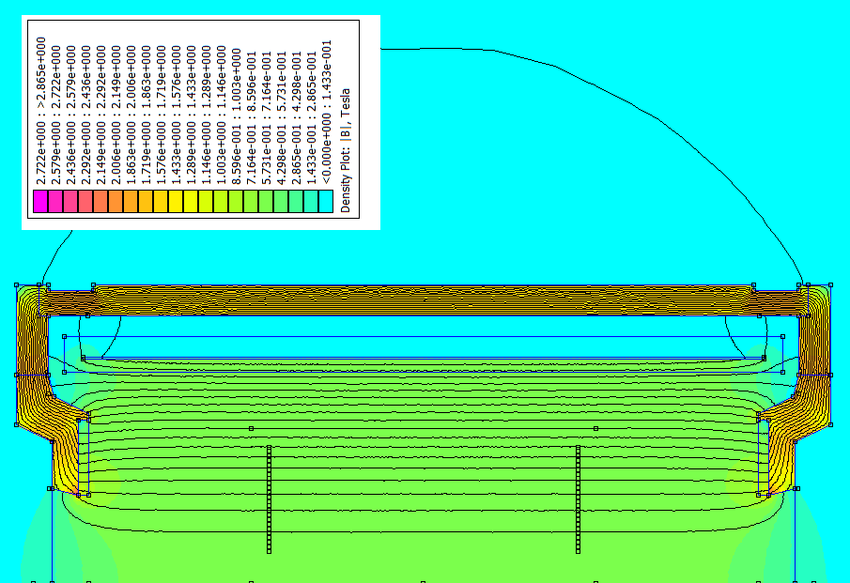

MPD superconducting Solenoid
B₀=0.66 T
weight ~ 900 t
Control Dewar,
pipe lines
SC coil
TPC region
high level (~ 3x10⁻⁴) of magnetic
field homogeneity
Trim Coil
ASG superconducting
(Genova, Italy):
Cold Mass + Cryostat
Vacuum System
Trim Coils
Control System
PS
General responsibility
Cryostat
Contract - signed; works – in progress
Notes:
The major part of MPD is SC solenoiodal magnet. It is a challenging project due to very high requirement for the magnetic field homogeneity – better that a permill.
After long negotiations a contract is signed with the ASG sc company – the one which produced a big solenoid for CMS. The ASG is responsible for production of coils, cryostat control system etc. In addition the company takes responsibility for the overall supervision and final characteristics.

Slide 43




Yoke production: all packages are at Vitkovice HM
VITKOVICE Heavy Machinery, Sept. 5, 2016

Slide 44
Schedule for MPD Magnet fabrication & commissioning
critical !
Of navigation in Volga. And water | 2015 |  |  |  | 2016 |  |  |  | 2017 |  |  |  | 2018 |  |  |  | 2019
 | I | II | III | IV | I | II | III | IV | I | II | III | IV | I | II | III | IV | I | II | III | IV
Contract with ASG
- final design report | -
- trim coils + forgings
- SC cable, cryostat, coils
- FAT
- delivery to Dubna
- tests & overall commissioning |  |  | -
Yoke production
- contract preparation
- production drawings
- production & assembly test
- delivery to Dubna
Preparatory works & cryo (ILK / JINR)
System of movement
- technical design
- production and delivery to Dubna
Assembly and tests (JINR / ASG)
The field measurement (JINR /CERN)
Readiness for MPD integration |  |  |  |  |  |  |  | the MPD Hall is available
34 months
delivery by sea
Notes:
A schedule for magnet fabrication and delivery is critical because of limitation of Volga navigation.

Slide 45




Time Projection Chamber
Leaders: S. Movchan, Yu. Zanevsky
Sketch of TPC
HV-electrode
~ 28 kV
TPC Prototype
3400
Ø2800
12 Readout
chamber
E
E
beam
beam
~ 110 000 readout channels
C3
Project status:
basic R&D finished,
(cont. alternative RO Ch.);
assembly workshop
in preparation
(readiness – IIq., 2016)
C2
Works are going in accordance with the schedule

Slide 46





Time Projection Chamber
Leaders: S. Movchan, Yu. Zanevsky
clean room input gate
climate control
Project status:
basic R&D finished,
(cont. alternative RO Ch.);
assembly workshop
(clean room) close to completion (Sept., 2016)
gas system: delivery to JINR in I 2017
RoC chambers preparation
Works are going in accordance with the schedule

Slide 47






TPC assembly tools, cooling & laser calibration system:
ready for production
outer thermal
screen
TPC deformation:
max = 32 µm
front thermal
screen

Slide 48




TOF Barrel
Leader: V. Golovatyuk
The barrel consist of 12 super-modules (two modules connected together)
active area of TOF barrel ~56 m²
number of channels 13 824
triple-stack MRPC
readout board with strips
Project status:
- 90% readiness for the mass production

Slide 49




beam test results
Efficiency and time resolution of the MRPC versus HV
Time resolution in dependence from the position along strip
Time resolution in dependence of rotation in surface YZ

Slide 50








TOF Barrel: mass production preparation status
ARTMASH (Minsk, Belarus)
module housing was developed in close cooperation with NC PHEP BSU
and “ Artmash” (Minsk, Belarus)
MRPC
Workshop for the TOF mass-production
basic elements - NINO & HPTDC chips have been purchased
sufficient to produce read-out
electronics for the TOF +
reserve (~24000 channels).
Notes:
The TOF module housing was developed in close collaboration with NC PHEP BSU and “Artmash” (Minsk, Belarus). It consists of two volumes: the volume for detectors filled with the gas mixture and the volume for electronics and cables. One prototype of the module housing is available now. Total 28 boxes planned to produce to the end of the year.

Slide 51



Fast Forward Detector (FFD)
Leader: V. Yurevich
JINR + Radium Institute (St.Petersburg).
Provides:
T0 for TOF, beam adjustment & collision L0-trigger
FFD prototype module
Fig. 3
the achieved time resolution fits the requirement
Status:
procurement of necessary elements;
production in accordance with the schedule.

Slide 52



Ecal (shashlyk type):
TDR - in preparation
Leaders: I. Tyapkin, A. Ol‘shevsky
L ~35 cm (~ 14 X₀), Pb+Scint. (4x4 cm²) read-out: WLS fibers + MAPD
integration with the MPD - design is completed
Agreement between JINR and Tsinghua University has been signed on:
- participation in the MPD experiment;
- mass production of Ecal modules in China;
- production first 10 test modules
performance fits the requirements
the time scale without redundancy

Slide 53



FHCAL: for determination of reaction plane and centrality
Institute for Nuclear Research RAS
Leader: A. Ivashkin
In cooperation with MEPhI
2-arm (left/right) calorimeter (at ~3.2 m from the IP)
each arm consists of 45 modules.
E_{out}
E_{in}
Transverse granularity allows to measure:
the reaction plane with the accuracy ~ 20⁰-30⁰
the centrality with accuracy below 10%.
module preproduction:
agreement on production of 9 mod. is signed;
agreement on production of the rest 81 mod.
for the whole FHCal is in preparation;
scintillator tiles are under production at Vladimir plant;
lead absorber & mechanics are ready for assembling;
first 9 FHCAL modules are under construction now.

Slide 54



CBM-MPD consortium for R&D and production of IT modules manifests efficient cooperation since 2008
IT: workshop for microstrip detector assembly & test
CERN & JINR have signed MoU for manufacturing the STS carbon fiber space frames for NICA (BM@N & MPD) and FAIR
the Probe-station automat for DSSD QA
the clean room workshop
has started operation in 2015.
- put in operation
D. Gross in the workshop
the first test stand for the in-beam tests of the assembled boards with silicon sensors
– put in operation

Slide 55









BM@N ST comprises four first stations of CBM STS
ladder
1220 sensors:
module
252 single /
324 daisy-pairs
900 / 220
6.2 × 6.2 cm2
CBM STS: 8 stations
BM@N ST: 4 stations
260 / 216
6.2 × 4.2 cm2
60 / 60
Double-sided-double-metalized sensors from Hamamatsu
and CiS
(pitch 58 um, stereo angle 7,5 degrees)
sensor: 0.3% X₀
6.2 × 2.2 cm2
r/o cables: 2×0.11% X₀
3.2 × 2.2 cm2
+ a number of “half” sensors

Slide 56
NICA program
in spin physics
SPD project preparation stage

Slide 57



Study of nucleon spin structure
must confirm
the sum rule:
NICA collider will provide collisions of protons and deuterons with
all combinations of polarization – transversal and longitudinal
It will allow to measure all 8 intrinsic-transverse-momentum dependent PDFs (at leading twist) in one experiment
Matveev-Muradyan-Tavkhelidze-Drell-Yan mechanism and SIDIS processes – are good tools for these measurements
Direct photons production
(gluon polarization)
Notes:
Study of nucleon spin structure must prove the sum rule and to solve a puzzle of “spin deficit”. NICA collider will provide collisions of protons and deuterons with all combinations of polarization – transversal and longitudinal. It will allow to measure all 8 intrinsic-transverse-momentum PDFs at leading twists in one experiment. MMTDY mechanism and SIDIS processes are good tools for these measurements.

Slide 58
Experiments studying nucleon spin structure
experiment | CERN, COMPASS-II | FAIR, PANDA | FNAL, E-906 | RHIC, STAR | RHIC-PHENIX | NICA, SPD
mode | F.T. | F.T. | F.T. | collider | collider | collider
Beam/target | π- , p | anti-p, p | π- , p | pp | pp | pp, pd,dd
Polarization:b/t | 0; 0.8 | 0; 0 | 0; 0 | 0.5 | 0.5 | 0.7
Luminosity | 2·10³³ | 2·10³² | 3.5·10³⁵ | 5·10³² | 5·10³² | 10³²
√s , GeV | 14 | 6 | 16 | 200, 500 | 200, 500 | 10 - 26
x_{1(beam)} range | 0.1-0.9 | 0.1-0.6 | 0.1-0.5 | 0.03-1.0 | 0.03-1.0 | 0.1-0.8
q_{T}, GeV | 0.5 -4.0 | 0.5 -1.5 | 0.5 -3.0 | 1.0 -10.0 | 1.0 -10.0 | 0.5 -6.0
Lepton pairs, | μ-μ+ | μ-μ+ | μ-μ+ | μ-μ+ | μ-μ+ | μ-μ+, e+e-
Data taking | 2015 | >2025 | 2013 | >2016 | >2016 | >2020
Transversity | NO | NO | NO | YES | YES | YES
Boer-Mulders | YES | YES | YES | YES | YES | YES
Sivers | YES | YES | YES | YES | YES | YES
Pretzelosity | NO | NO | NO | NO | YES | YES
Worm Gear | NO | NO | NO | NO | NO | YES
Direct γ | NO | NO | NO | YES | YES | YES

Slide 59
SPD/NICA will provide unique opportunity
not available at other facilities
to study all of the PDF in one experiment
and obtain the comprehensive information
on the nucleon spin structure
at high statistical level
with min. systematic uncertainties

Slide 60
some events
Ione source

Slide 61

Laboratory hosted
the 15-th international conference SQM in July 2015

Slide 62


New issues: NICA White Paper, SQM proceedings
Physics targets for the exploration of first order phase transitions in the region of the QCD phase diagram accessible to NICA & CBM and possible observable effects of a “mixed phase culminates this year in the release of the “NICA White Paper” as a Topical Issue of the EPJ A (July 2016).
111 contributions,
188 authors
from 24 countries

Slide 63
In the medium-term prospect the NICA complex will be
the only facility in Europe providing unique high intensity ion beams
(from p to Au, p↑ and d↑)
in the energy range from 2 – 27 GeV (c.m.s.),
which could be used for both fundamental and applied researches.
Researches at the NICA complex will contribute to
discovery and study of new forms of nuclear matter;
comprehensive study of nucleon spin structure;
applied researches, like irradiation of biological objects
by heavy ion beams (space mission program) etc.
“It is clear that both FAIR and NICA could have an advantage in developing and extending explicitely their collaboration….”

Slide 64

New issue of the ESFRI Roadmap
Main Research Infrastructure in Particle and Nuclear Physics
NICA – Complementary Project

Slide 65


RF Governmental disposal

Slide 66

Agreement
between
the RF Government
and
the Joint Institute for
Nuclear Research
has been signed

Slide 67
Concluding remarks
The construction of accelerator complex
and both detectors BM@N & MPD
is going close to the schedule
Physics program development is in progress,
it indicates competitiveness with other experiments
RF Governmental disposal is
an important contribution to the NICA project
The cooperation on all NICA parts is growing
New partners are welcome to join NICA

Slide 68

NICA
the cooperation makes us stronger!
FAIR
CERN
Thank you!

