Slide 1
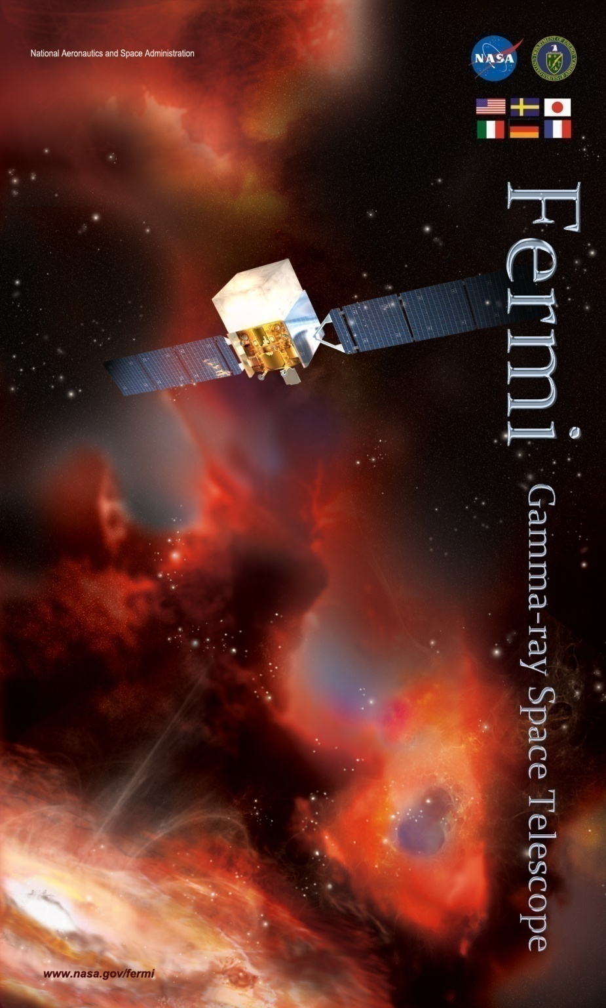
Astrophysics with Fermi-LAT
Fermi is 8!
Some highlights from Fermi Large Area Telescope
Igor V. Moskalenko
Stanford University
For the Fermi LAT Collaboration
2nd Int. Conf. on Particle Physics & Astrophysics
Moscow, October 10-14, 2016

Slide 2
June 11, 2008
12:05 pm (EDT)

Slide 3
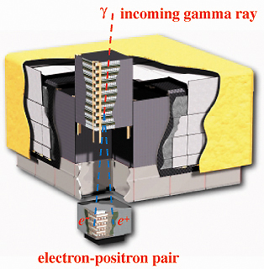
Fermi Gamma-ray Space Telescope
Large Area Telescope
20 MeV − >300 GeV
Gamma-ray Burst Monitor
10 keV – 30 MeV
The LAT is a unique resource providing
Broad energy coverage, overlap with ACTs
Large FoV: all-sky coverage every 3 hours – transients
Observatory is operating smoothly
Instruments and spacecraft operate as designed, no degradation in science performance since launch
Observation Modes
Dec 2013 – Dec 2014 in Galactic Center biased survey mode
Currently in 50° rock sky survey

Slide 4
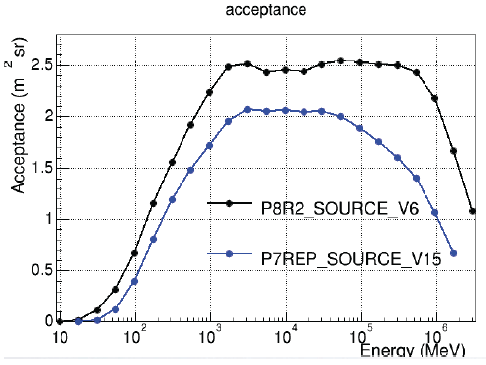
Pass 8 is here!
Provided a substantial improvement in the capabilities of the LAT
40% increase in point-source sensitivity
Up to ×2 gain in acceptance at very low (<100 MeV) and very high (>100 GeV) energies
Updates: data and software releases
In-flight IRFs
Cal-only event class
New Science Tool features

Slide 5
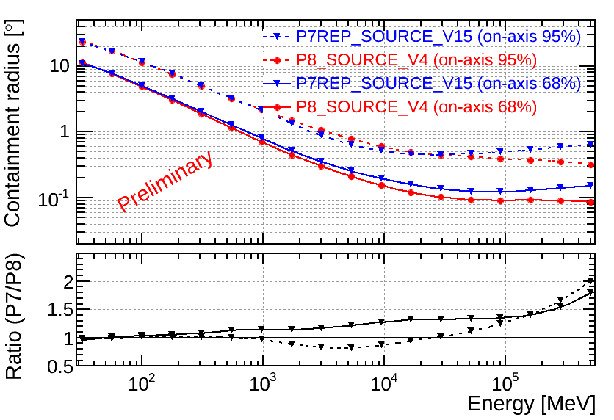
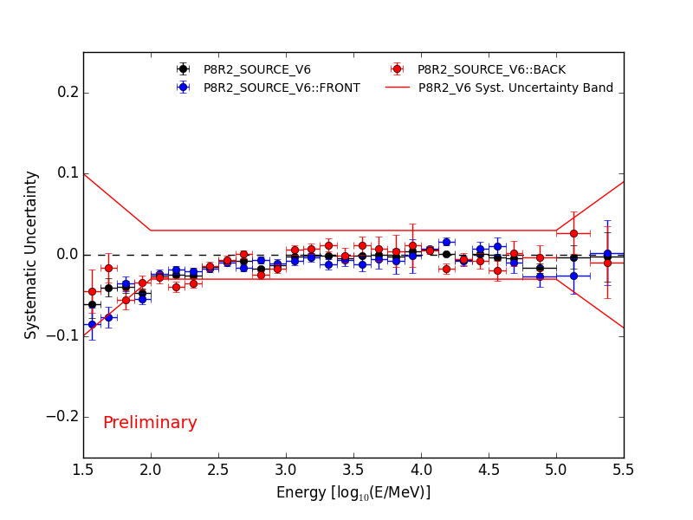
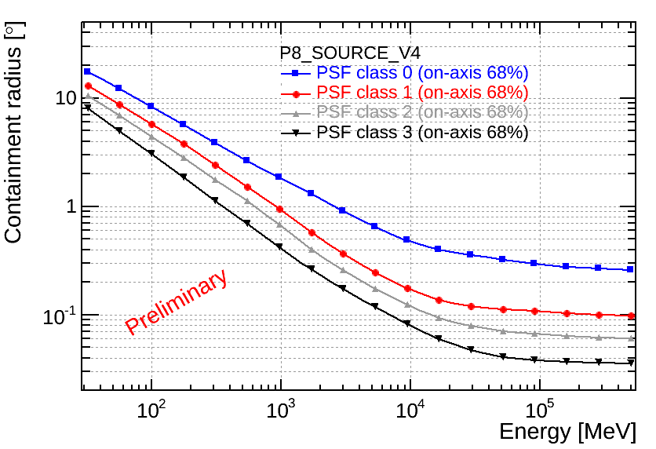
Pass 8 Performance
Significant improvement in the angular resolution
Additional event selection classes
On-axis 68% containment (class 3)
3° at 100 MeV
0.4° at 1 GeV
0.07° (~4.2’) at 10 GeV
0.035° (~2.1’) at >100 GeV
Cf. HESS 2 angular resolution is ~0.05° at best
Significant reduction in the systematic uncertainty of the Effective Area
A_{eff}

Slide 6
High energy gamma-ray emission processes
p
γ
pp −> π⁰(2γ)+X − neutral pion production and decay
Inverse Compton scattering
Bremsstrahlung
Curvature (or synchrotron) radiation
p
p
p
π⁰
γ
γ
π⁰
γ
hν
γ
e
γ
p
e
e
e
B

Slide 7
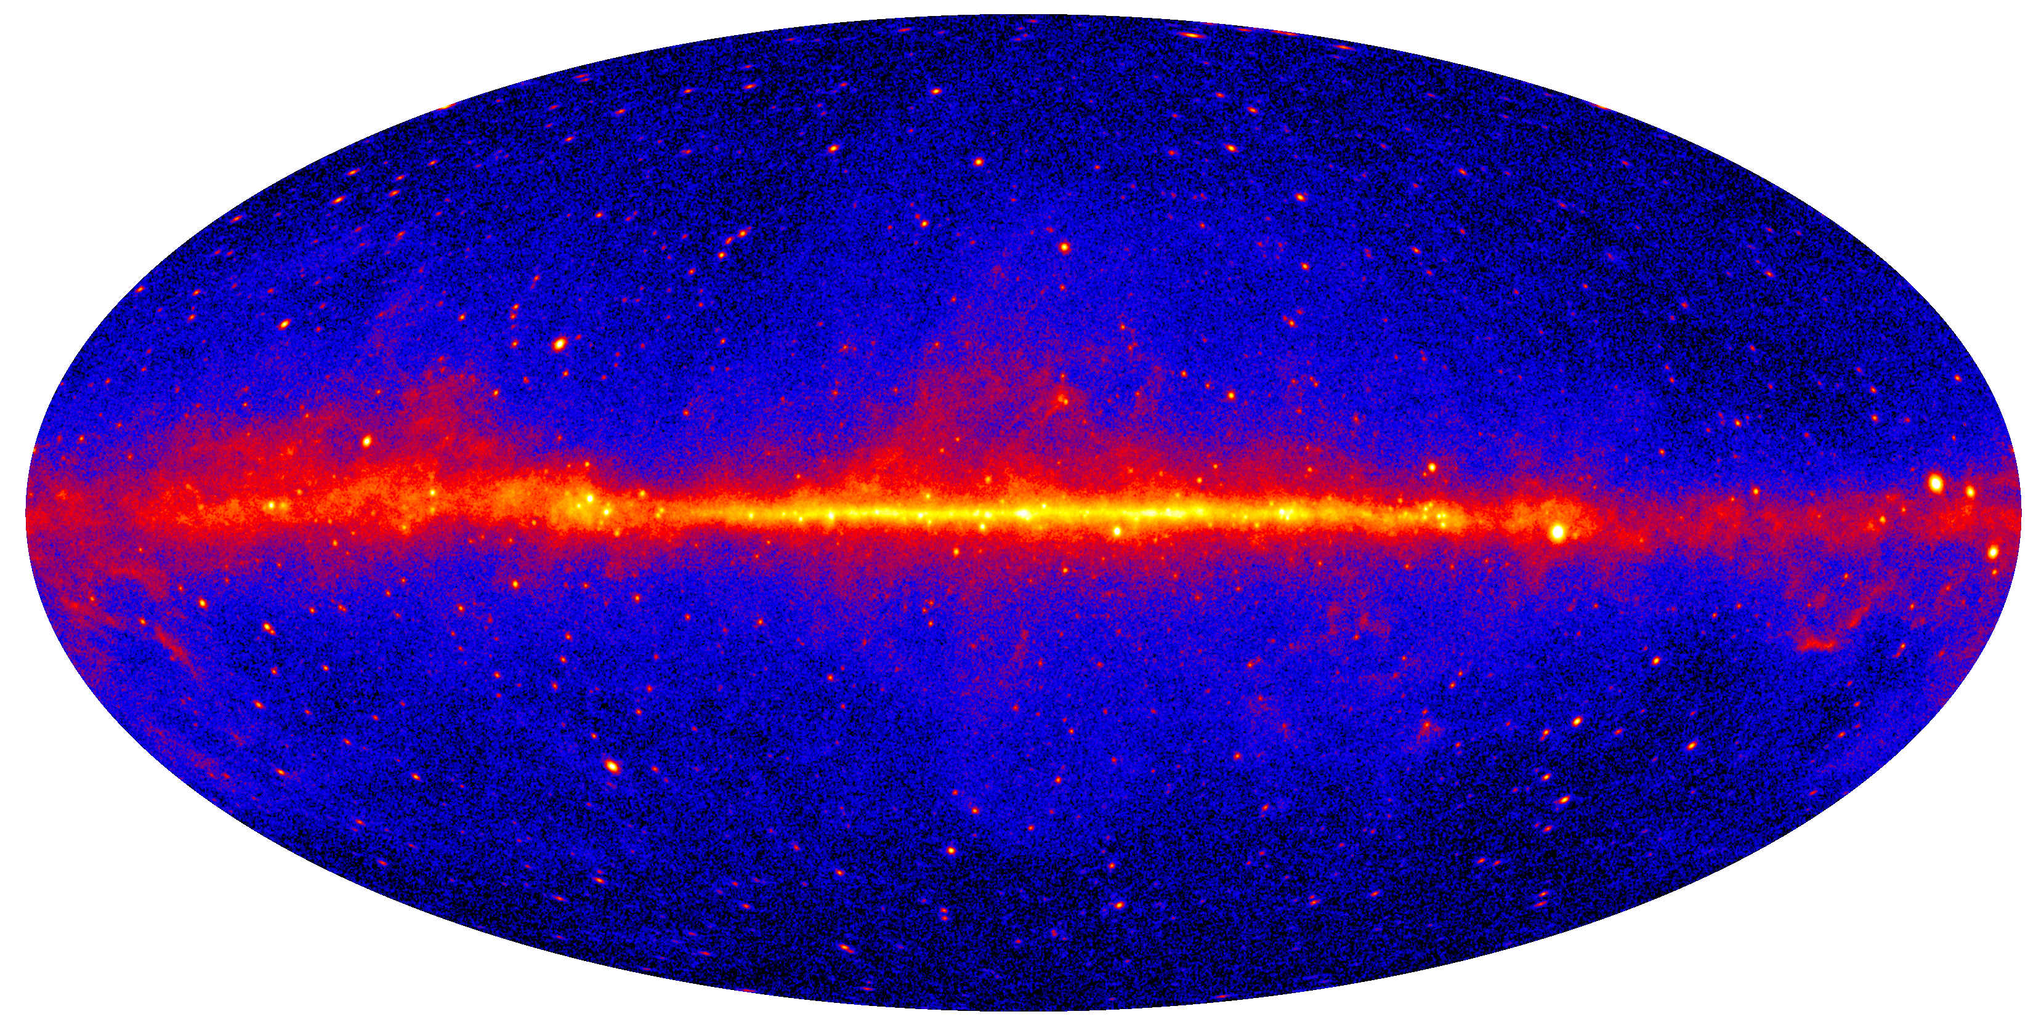
Fermi-LAT skymap >1 GeV, 48 months
Shows where accelerated particles meet targets (gas, photons)
~80% of the emission is diffuse
Our Galaxy provides the best opportunity to study CRs: direct and indirect measurements with excellent resolution
4-year sky map, >1 GeV, front converting (best psf) (4.52M events)
LAT: ~275B triggers, 225M Source class events
GBM: >1000 GRBs •In 8 years LAT collected ~2 PetaBytes of data!
Notes:
Gamma-ray skymap is, in fact, a map of HE interactions, it shows the places where accelerated particles, the beam, meets targets, interstellar gas and soft photons. The diffuse emission is dominating the sky, about 80% of all photons are diffuse.

Slide 8
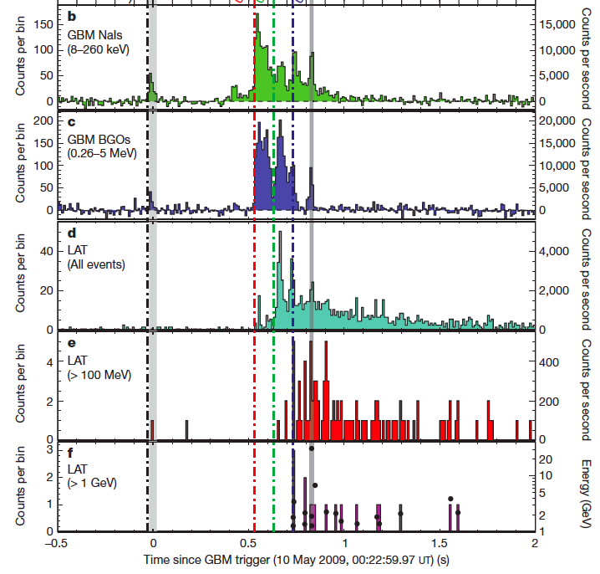
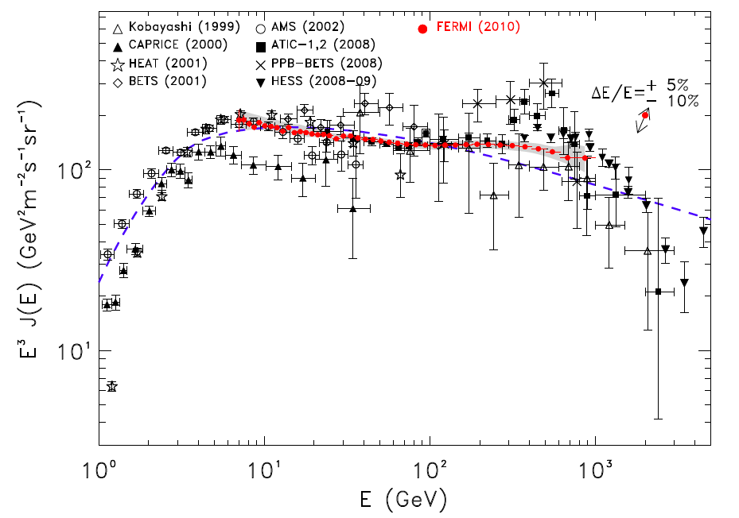
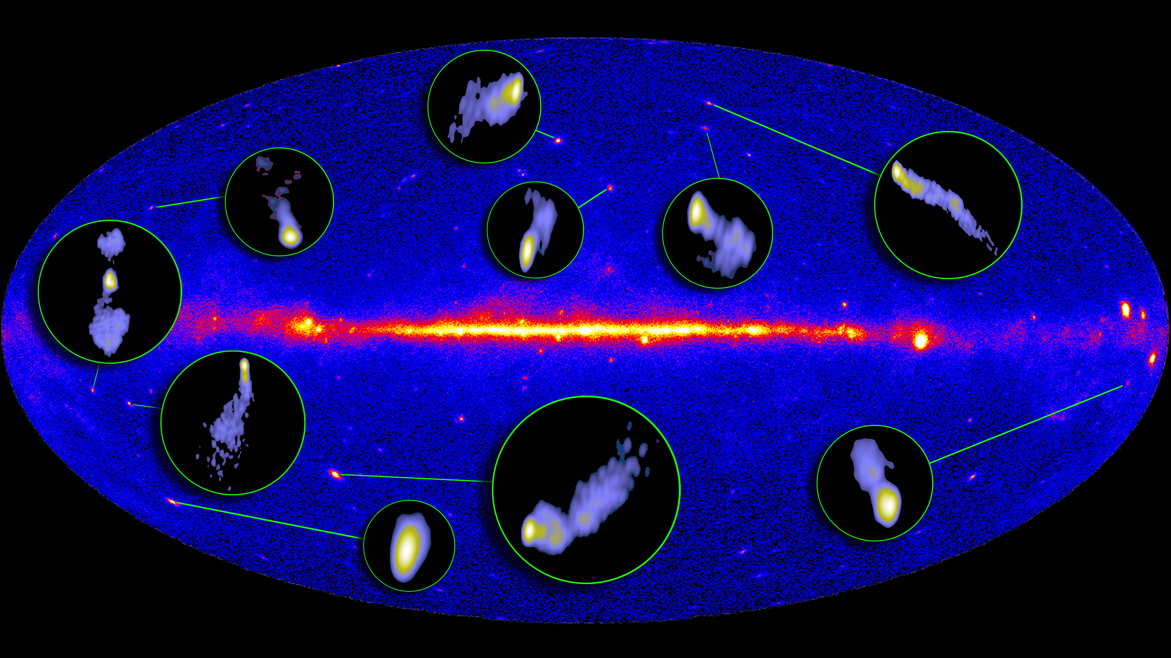
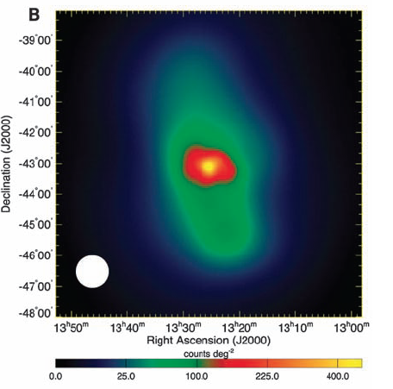
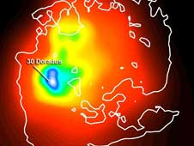
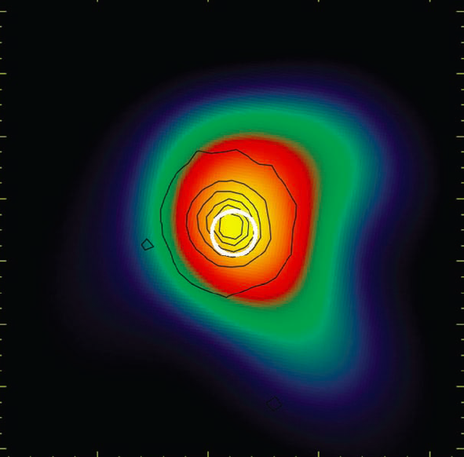
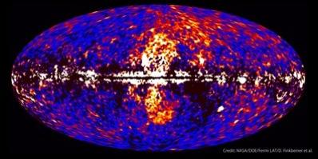
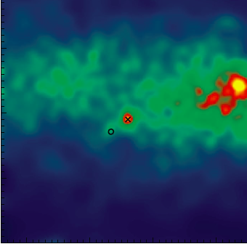
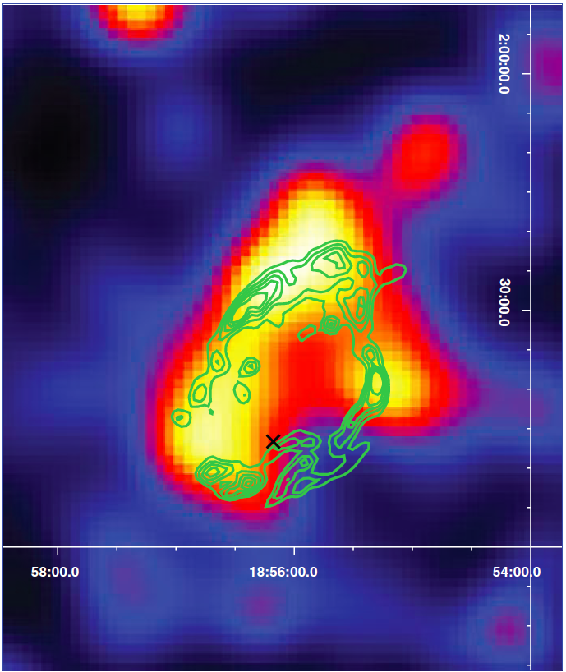
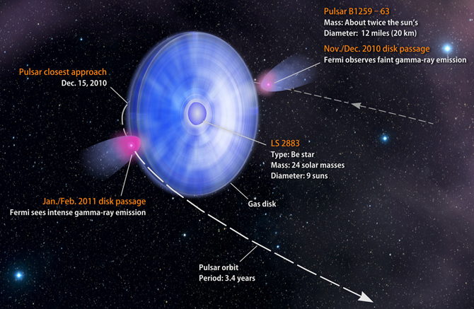
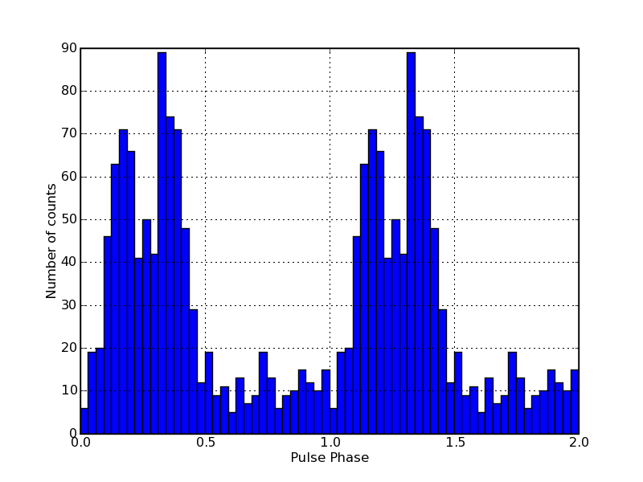
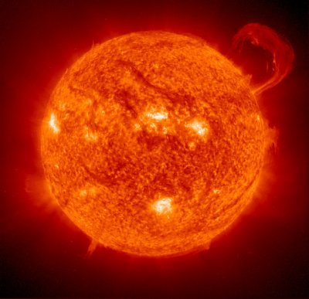
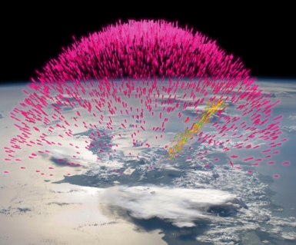
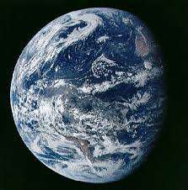
Fermi Highlights and Discoveries (GeV range)
GRBs
e⁺e⁻ spectrum
Blazars
Radio Galaxies
Extragalactic
Starburst Galaxies
LMC & SMC
Globular Clusters
Fermi Bubbles
Novae
SNRs & PWN
Galactic
γ-ray Binaries
Pulsars: isolated, binaries, & MSPs
Sun: flares & CR interactions
Terrestrial γ-ray Flashes
& Earth’s limb
Unidentified Sources (1010/3033) 3FGL
Notes:
Pulsars – more subclasses of a known class

Slide 9
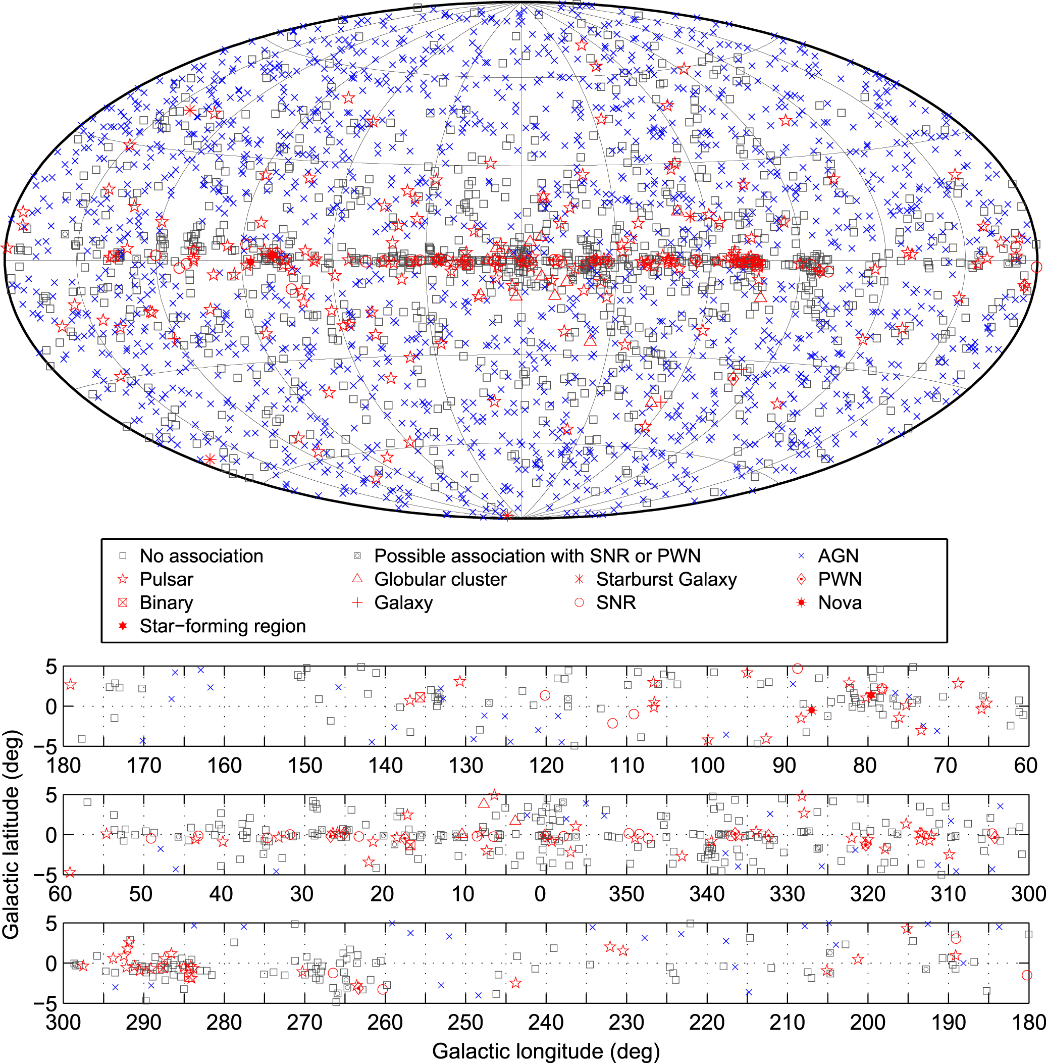
3FGL Catalog: 3033 sources
4 years (P7 reprocessed)
0.1 – 100 (300) GeV
5 (14) energy bins uniformly spaced in log E
20 extended sources
Identified – 238
Associated – 1745
Unidentified ~1/3 of all sources
4FGL Catalog – in progress

Slide 10
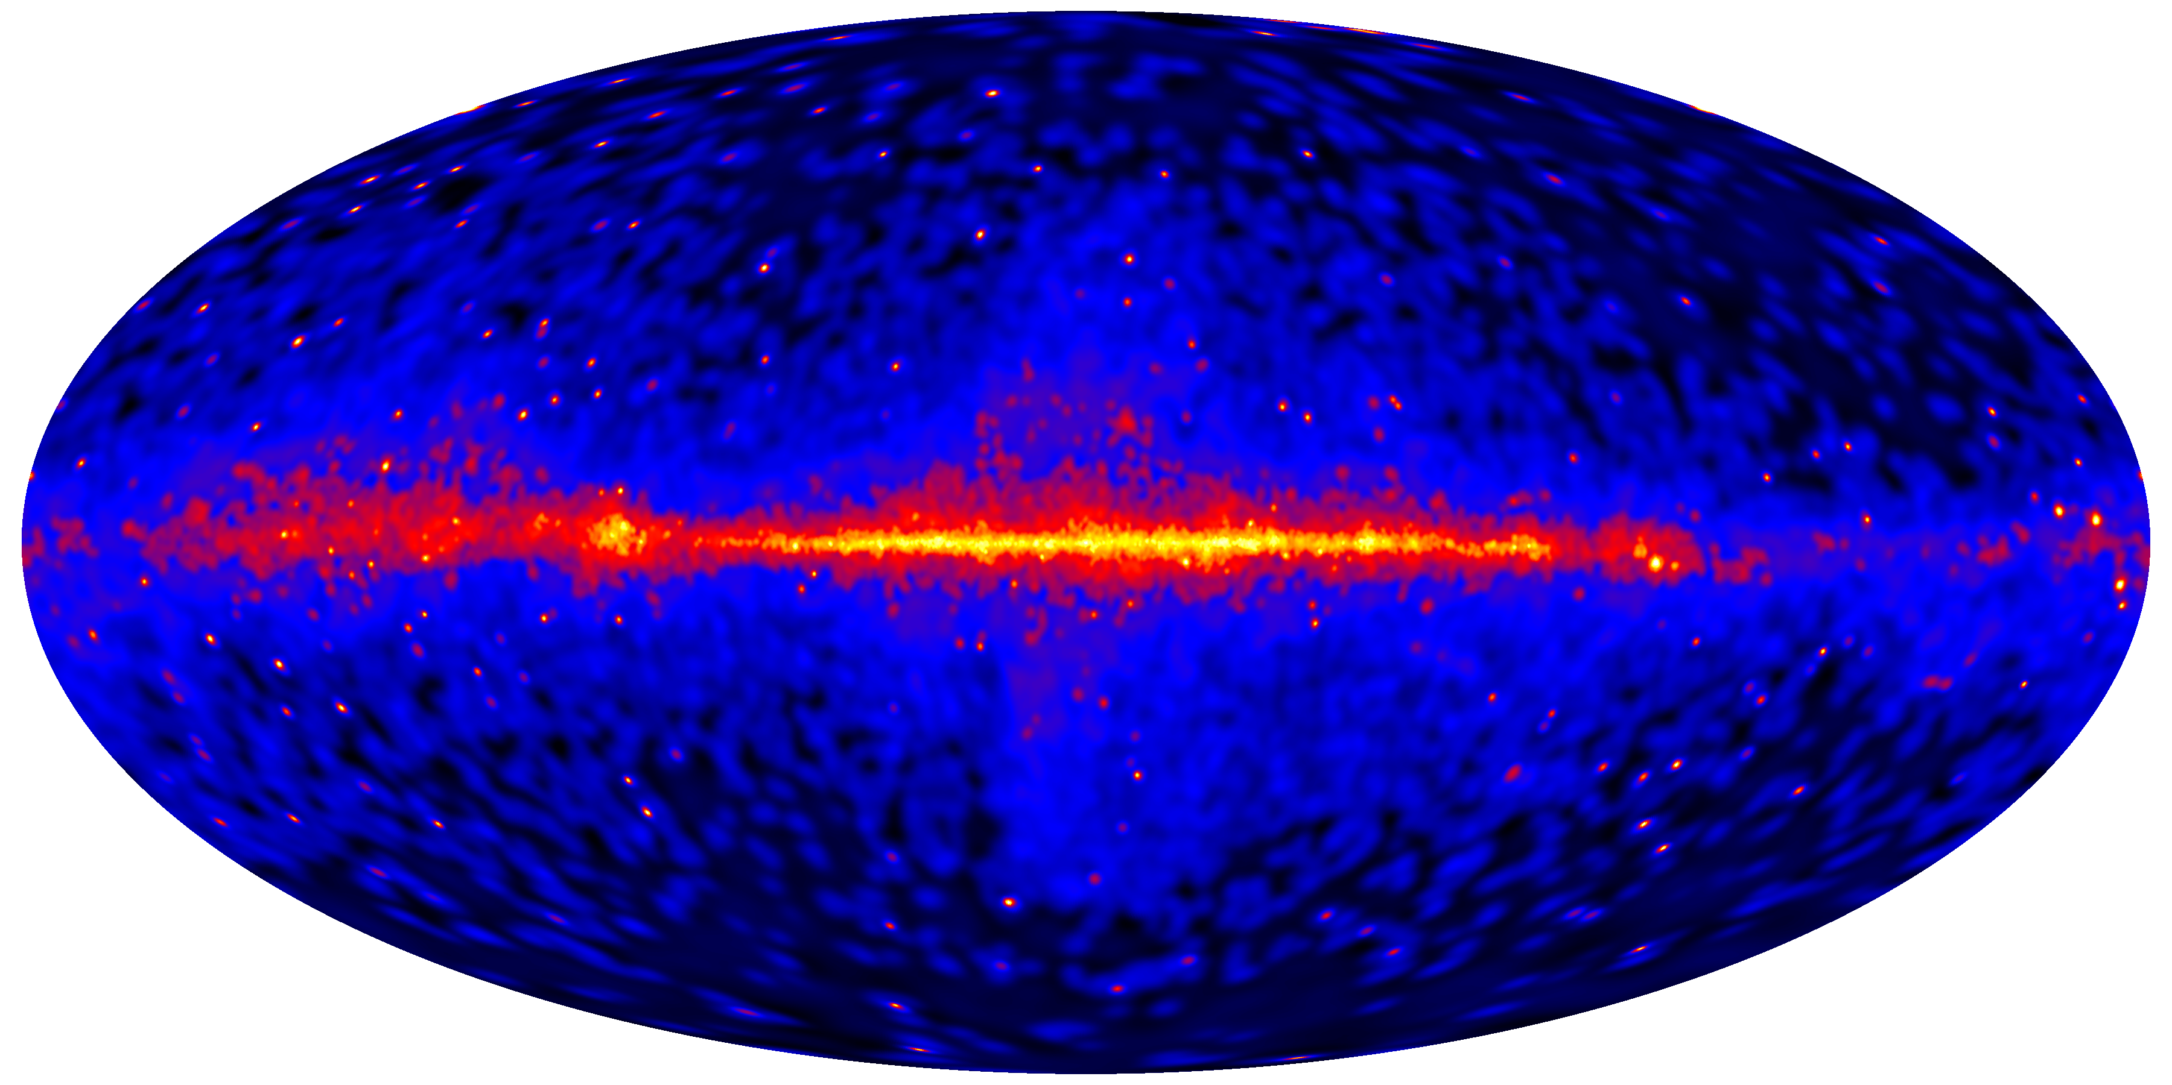
1FHL: Fermi-LAT skymap >10 GeV
36 months
Less diffuse emission
Fewer (514 sources) but more powerful sources at high energies

Slide 11
2FHL:“TeVatron map” – Fermi Sky 50 GeV–2 TeV
61,000 photons E > 50 GeV
22,100 photons E > 100 GeV
2,000 photons E > 500 GeV
360 sources
80 months
~1.5 phot/deg²

Slide 12
Comparison with HESS Galactic Plane survey
Significance Map
Aharonian et al. 2006, Carrigan et al. 2013
H.E.S.S. detects 69 sources reaching a sensitivity of ~2% of the >1 TeV Crab Nebula flux
LAT detects 36 sources (in 2FHL) in the same region reaching an average sensitivity of 3-4% of the Crab Nebula flux
Fermi-LAT >50 GeV Count Map (adaptively smoothed)
Total: 103 sources at |b|<10°
12

Slide 13
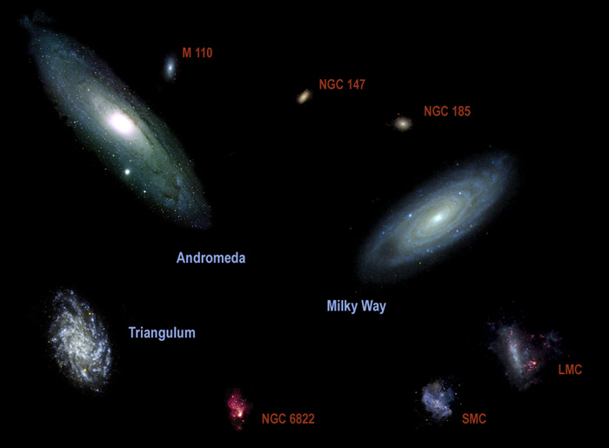
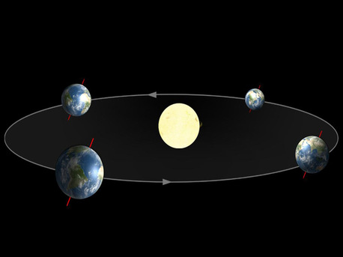
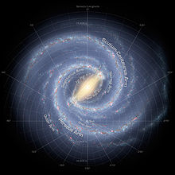
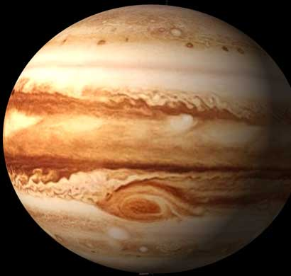
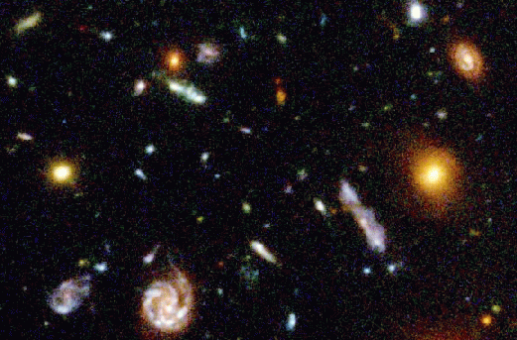
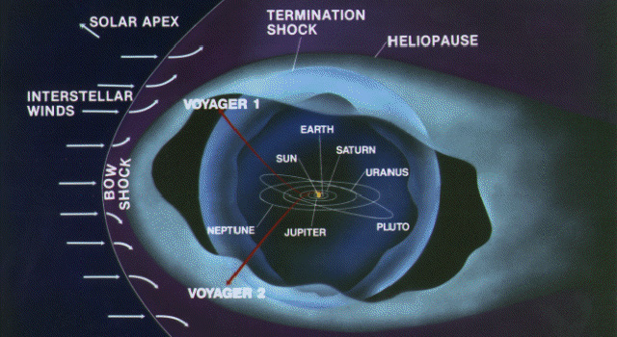
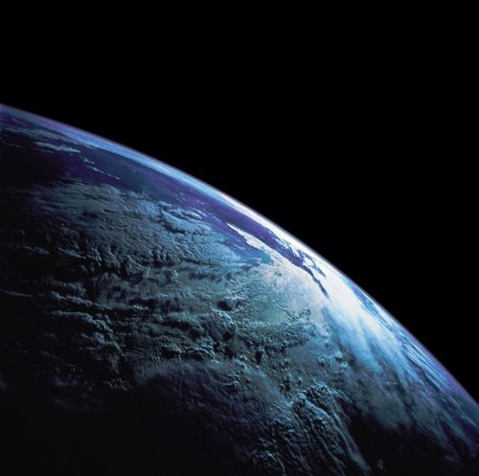
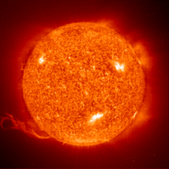
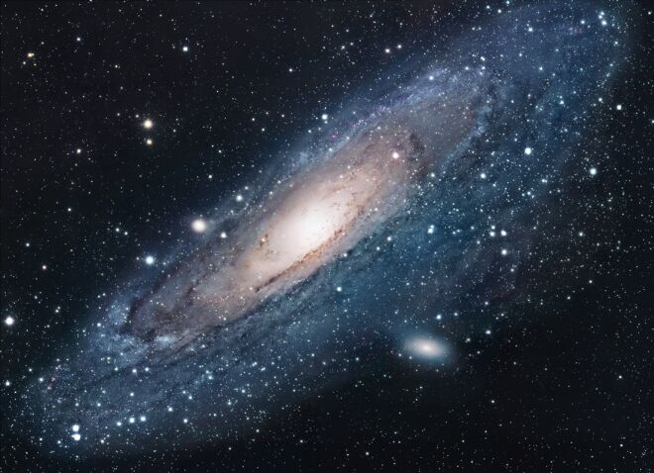
Cosmic Scales
Local Group
Milky Way
Antares
Andromeda
Galaxy (@0.8 Mpc)
Vega
Sirius
Proxima Centauri
parsec | 10⁻¹⁰ | 10⁻⁹ | 10⁻⁸ | 10⁻⁷ | 10⁻⁶ | 10⁻⁵ | 10⁻⁴ | 10⁻³ | 10⁻² | 10⁻¹ | 10⁰ | 10¹ | 10² | 10³ | 10⁴ | 10⁵ | 10⁶ | 10⁷ | 10⁸ | 10⁹ | 10¹⁰
 | 3 000 km | 30 000 km | 300 000 km | 3✕10⁶ km | 3✕10⁷ km | 2 AU | 20 AU | 200 AU | 2 000 AU | 0.1 pc | 1 pc | 10 pc | 100 pc | 1 kpc | 10 kpc | 100 kpc | 1 Mpc | 10 Mpc | 100 Mpc | 1 Gpc | 10 Gpc
Notes:
The sources of HE gamma rays can be also be found in the solar system. Their emission is the result of Galactic CR cascades in their surfaces or inverse Compton scattering of CR electrons off solar photons. In fact, it is a very important point. Simultaneous direct measurements of CR species in the solar system and indirect observations of their intensities through the gamma-ray emission from solar bodies enables us to reconcile the direct and indirect CR measurements and ensure that our interpretation of the emission from distant sources is correct.

Slide 14
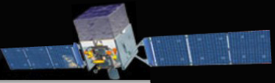
Fermi-LAT observations of the Earth’s limb
p
Atmospheric model
Column density
γ-ray flux
thin target: 68.4°≤θ≤70.0°
2 g cm⁻²
γ-ray flux >3.6 GeV
γ
Emission profile >30 GeV
Diffuse emission dominates
Due to its proximity, the Earth is the brightest γ-ray source on the sky
The emission is produced by the CR cascades in the atmosphere
Most energetic γ-rays are produced by CRs hitting the top of the atmosphere at tangential directions (thin target)
PSF

Slide 16
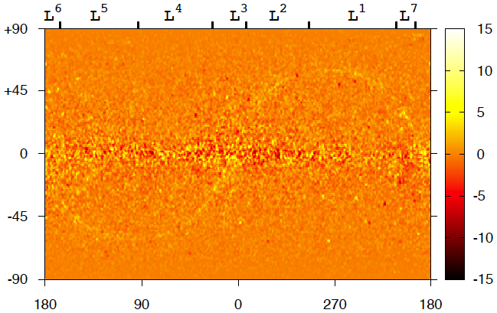
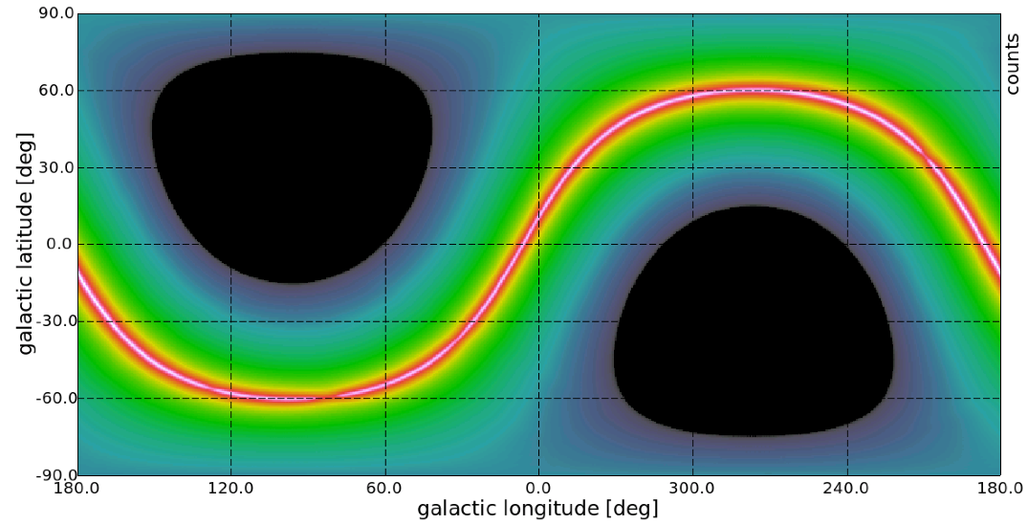
Solar system
Fermi-LAT (Galactic coordinates)
Raw data sliced by 2 months interval, background removed; ➔ the solar track is clearly visible
Solar IC
Tracks of the Sun and Moon
Averaged over one year, the ecliptic is seen as a bright stripe on the sky, but the emission comes from all directions
Model calculations

Slide 17
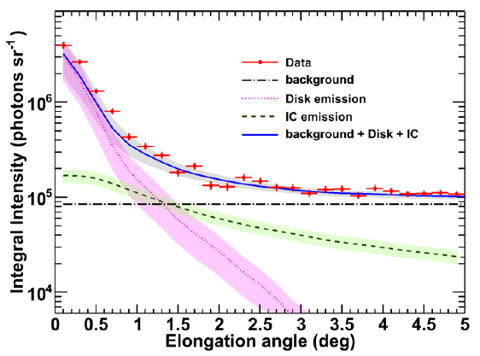
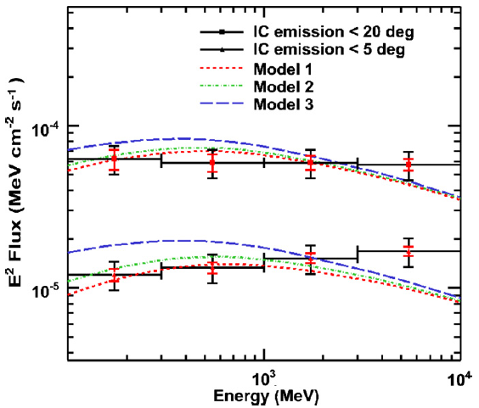
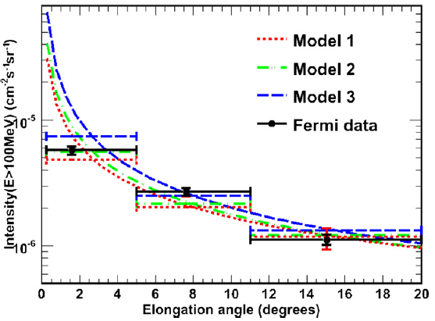
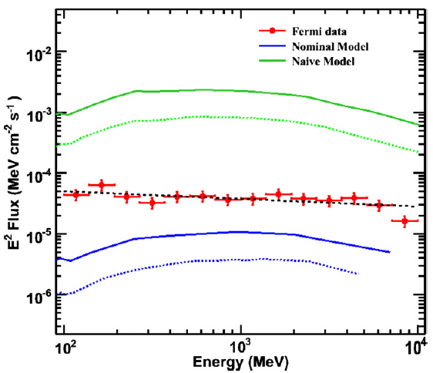
Fermi-LAT observations of the Sun (Abdo+’2011)
Profiles
IC spectrum
New analysis is in progress
IC emission profile
Seckel+’1991
Disk spectrum

Slide 18
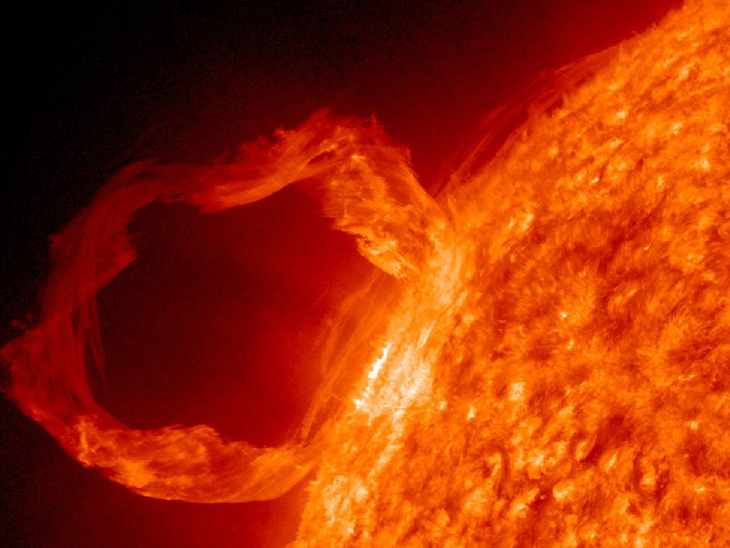
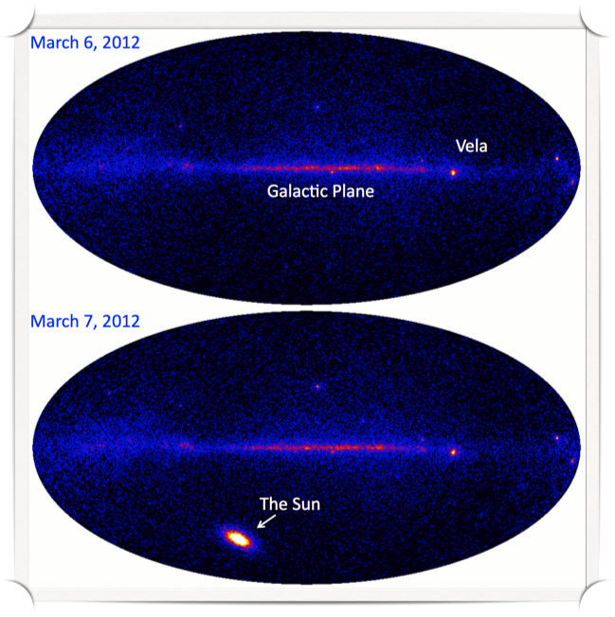
Solar Flares
The March 7, 2012, X5.4 solar flare was the second most intense in 5 years. Fermi observed gamma-ray flux at >100 MeV:
1,000 times brighter than the steady Sun’s
100 times brighter than the Vela pulsar’s
50 times brighter than the Crab “superflare” of April 2011
Highest-energy photon (4 GeV) ever detected from a solar flare!
The high-energy emission lasted about 20 hours – the longest ever seen from a solar flare.
N.Omodei

Slide 19
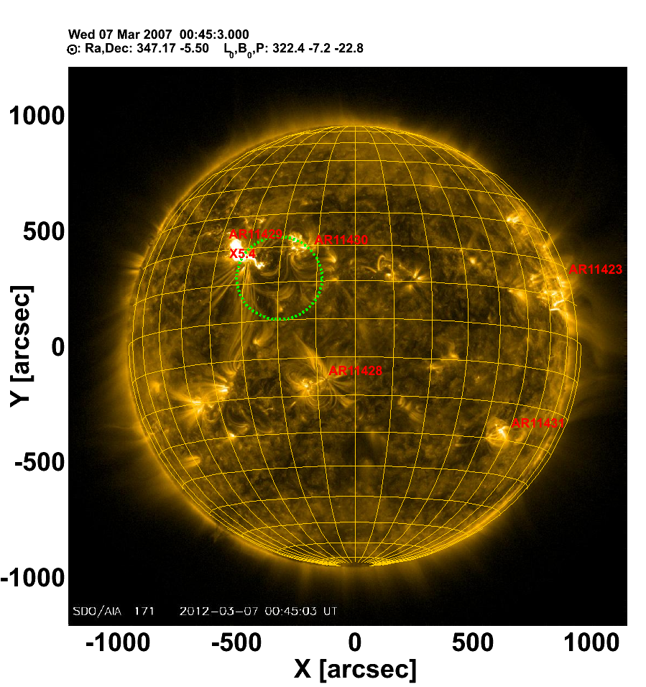
Localization of Solar Flares
For the first time >100 MeV emission was localized on the solar disk thanks to the LAT’s improved angular resolution (green circle)
Location consistent with region of flare, even at later times
This suggests some local acceleration or trapping phenomenon
N.Omodei

Slide 20
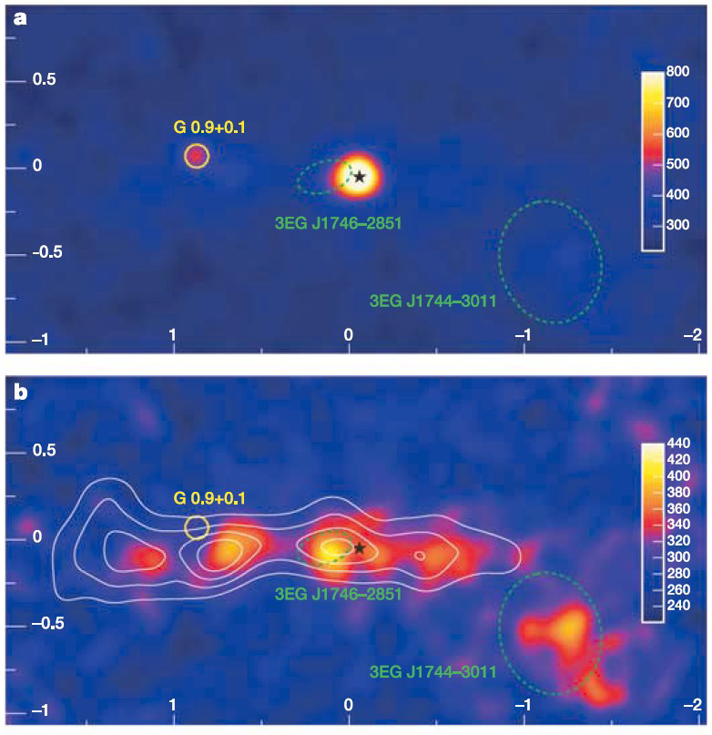
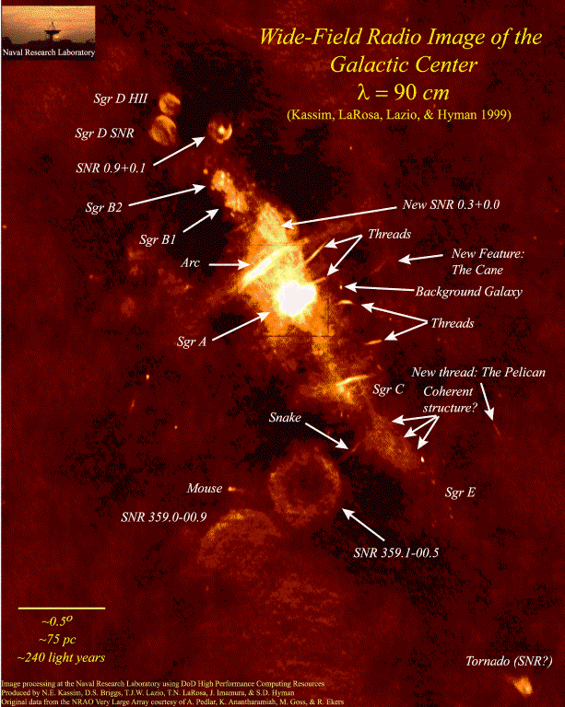
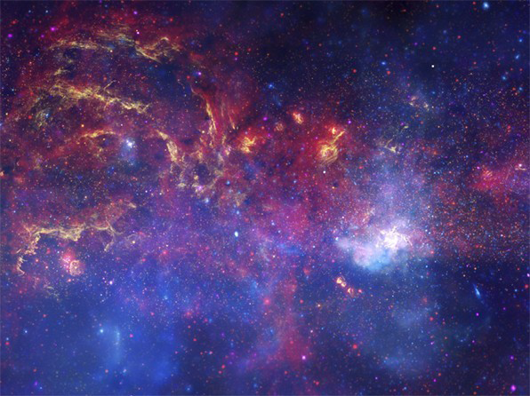
Inner Galaxy at different wavelengths
HESS TeV γ-rays
Optical/IR/X-rays
Illuminated clouds
~0.3°
l=±2°
Harbors a SMBH ~4×10⁶ M
Flaring activity of SMBH: large flare ~100 years ago, and faint flares
Huge over-density of dark matter
1000s of stars in the innermost parsec
Large concentration of binary systems and compact objects

Slide 21
S. Murgia ICRC 2015 (ApJ 819 [2016] 44A)
Fermi-LAT Study of the Inner Galaxy

Slide 22
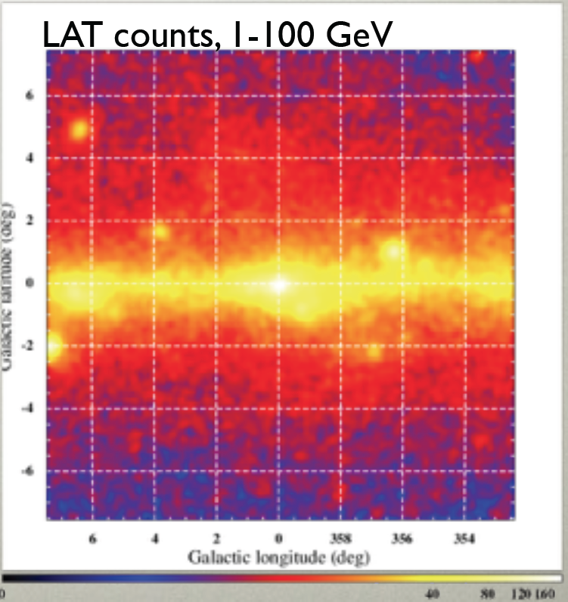
Sources in the inner Galaxy
Fixing the background model allows the sources to be detected
The sources’ position and spectra depend on the background model
The brightest sources (TS≥25) are not very much model-dependent
• − 1FIG sources TS≥25
× − 1FIG source candidates TS≤25
+ − 3FGL sources with multi-wavelengths associations
(1FIG = 1st Fermi Inner Galaxy Catalog)
Counts per 0.05² degree pixel
Fermi counts 1-100 GeV

Slide 23
Point sources
S. Murgia ICRC 2015
Point sources removed

Slide 24
S. Murgia ICRC 2015
With NFW profile

Slide 25
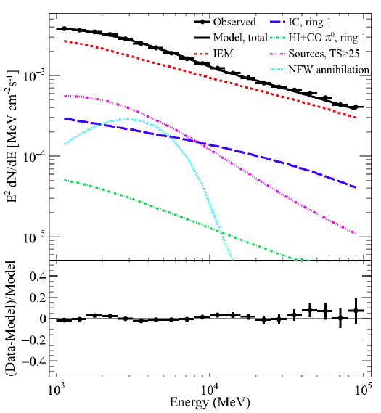
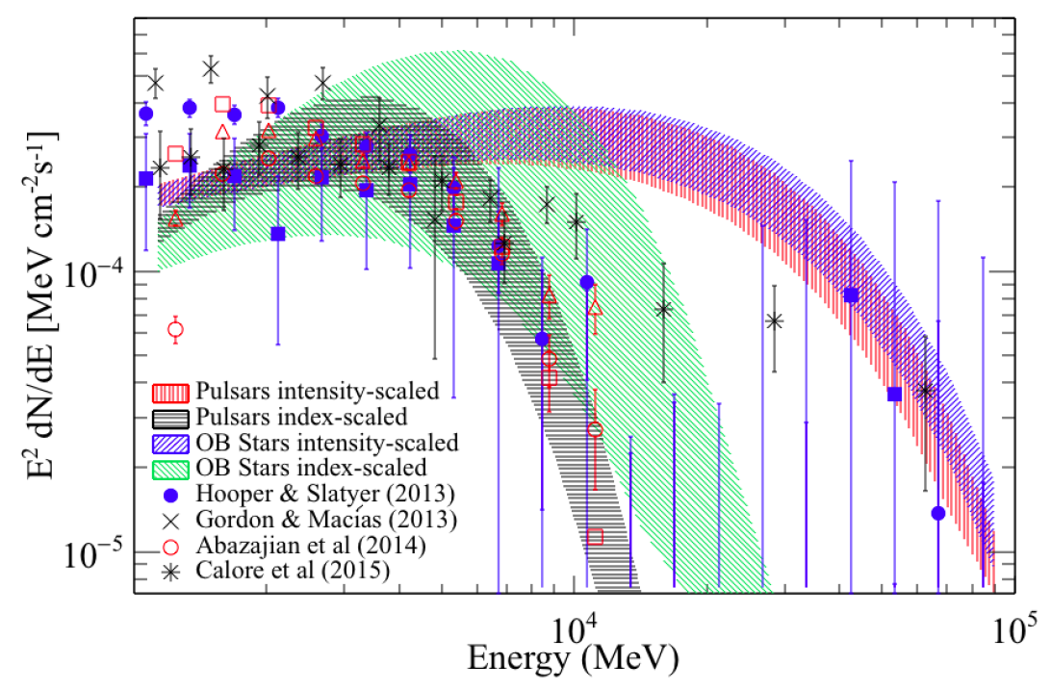
NFW component in different background models
NFW = Navarro-Frenk-White
NFW – is a peaked profile predicted in DM simulations
Components of the emission observed in the inner 15°×15° (one of the models)
Spectrum of the NFW component in different models

Slide 26
NASA press release
±55°
Models reproduce the main features of the diffuse emission quite well
Discrepancies between the physical model and high-resolution data (residuals) are the gold mines of new phenomena!
Every extended source and/or process that is not included into the model pops up and exposes itself as a residual

Slide 27
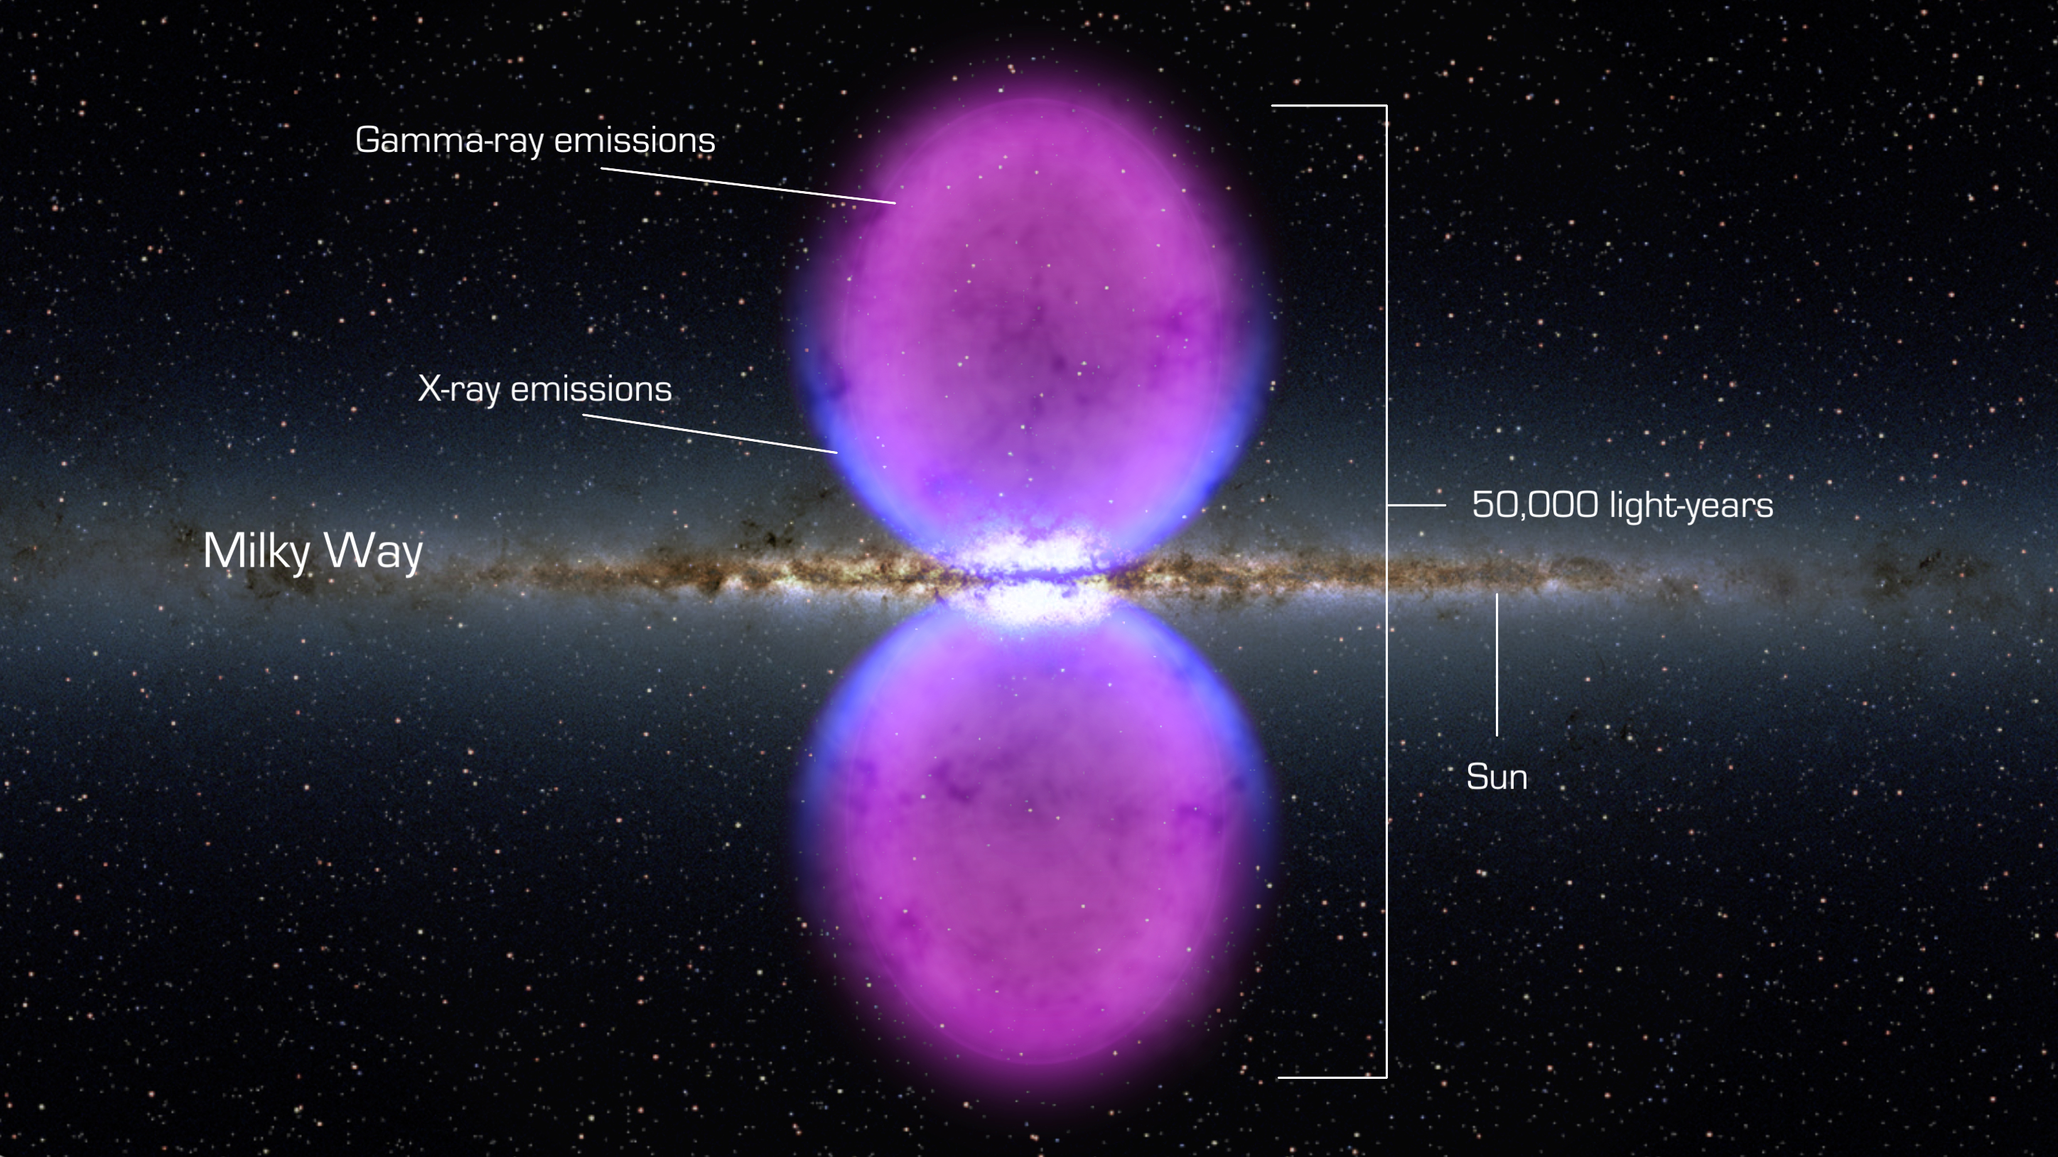
Fermi Bubbles
Artist’s concept of Fermi Bubbles
Puzzles:
The spectrum is “flat” (ongoing acceleration!)
The spectrum is uniform over these huge structures! (what is the mechanism?)

Slide 28
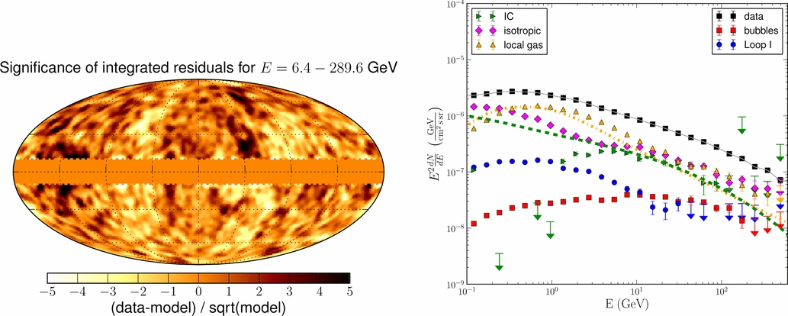
Fitting the Bubbles
Residuals are mostly flat
Bubbles

Slide 29
Spectrum of the Bubbles
The North and South lobes have very similar spectra
The spectrum is very flat which testifies that the particle acceleration is ongoing
Power-law with an exponential cutoff: index 1.9±0.2, cutoff energy 110±50 GeV
Ackermann+’2014

Slide 30
Substructures and longitude strips
“Cocoon” template and spectrum
The lobes are uniform
The spectrum of the “cocoon” is pretty much the same as the spectrum of the whole lobes
No spectral variations with the Galactic longitude
North
South
10° latitude strips

Slide 31
Edges: the width of the boundary
Edge b,l=(25.5°, 342.0°)
Δφ=1.7°±1.3°
E=10-500 GeV
Three energy ranges (68% PSF):
1–3 GeV (0.5°)
3–10 GeV (0.25°)
10–500 GeV (0.12°)
The edges of the Bubbles are well defined
The width is <6°, about 3.4°_{−2.6}^{+3.7} in average
Edge b,l=(25.0°, 13.4°)
Δφ=3.0°±1.2°
E=10-500 GeV

Slide 32
Fermi-LAT spectra of IC443 & W44: π⁰ decay γ-rays
proton spectra
Low-energy cut off at half the π⁰ mass
Clear evidence for SNR as hadronic acceleration sites

Slide 33
Crab: Recent flares of the synchrotron component
Average flux ~6×10⁻⁷ phot/cm²/sec above 100 MeV
Two flares with flux increase by a factor of ~5 (years: 2009, 2010)
A flare with flux increase by a factor of ~30 (year: 2011)
Compact emission region <0.0004 pc ~ 80 AU – diameter of the Pluto’s orbit!
No change in the pulsed emission

Slide 34
Milky Way as an electron calorimeter
Calculations for Z_{halo}= 4 kpc
Leptons lose ~60% of their energy
γ-rays: 50-50 by nucleons and by leptons
Cosmic rays
7.90×10⁴⁰ erg/s
Primary nucleons
98.6%
Synchrotron
0.35%
Ionization
losses
1%
0.29% (20.8%)
0.06% (13.4%)
Primary
electrons
1.41%
Secondary
leptons
e⁺: 0.33%
e⁻: 0.10%
Bremsstrahlung
0.15%
0.09% (6.6%)
0.06% (13.5%)
0.1% (21.1%)
0.5% (34.8%)
Inverse Compton
0.58%
0.59% (41.4%)
0.16% (34.6%)
Neutral pions
0.85%
Total gamma rays
1.6%
Strong+’2011
* The percentages in brackets show the values relative to the luminosity of their respective lepton populations

Slide 35
Starforming Galaxies
energy-loss dominated
escape dominated

Slide 36
Cosmic Rays as a Universal Phenomenon
γ-ray luminosity vs. IR luminosity for normal galaxies detected with Fermi-LAT
The γ-ray luminosity scales linearly (index ~1.1) with the total emission of hot stars reprocessed by dust − a tracer of star formation
The ratio approaches the calorimetric limit in star-burst galaxies
An evidence of the SNR-CR connection in normal star-forming galaxies
calorimetric limit
Thin target
Thick target

Slide 37
1st Fermi catalog of gamma-ray bursts (2008-11)
Pass 6
35 GRBs (E>20 MeV) out of 733 GRBs detected by the GBM
Fermi-LAT GRBs in the brighter site
short
long
The highest energy photons come at random time during the burst and afterglow
ApJS 209 (2013) 11A

Slide 38
What’s next?
Topchiev+’16

Slide 39
Lines in gamma-rays?
Better energy resolution of GAMMA-400 (smaller bins)
More sensitive to potential gamma-ray lines
Fermi-LAT
GAMMA-400
Topchiev+’16

Slide 40
Thank you!

