Slide 1
Effect of graphene monolayer on the transition radiation yield of the radiators based on polyethylene foils
ICPPA-2016, Moscow, October 10-14
A.S. Romaniouk¹, A.A. Tishchenko¹, A. Boldyrev², T. Brooks³, E. Celebi⁴, S.A. Cetin⁵, M. Cherry⁶, D. Derendarz⁷, K. Desh⁸, K. Fillipov¹, P. Fusco^{9,10}, S. Gurbuz⁴, M. Joos³,
J. Kaminski⁸, S. Konovalov¹¹, F. Loparko^{9,10}, A.Maevsky², N.Maziotta^{9,10}, C. Rembser³, E. Selebi⁴, D.Yu. Sergeeva¹, S. Setin⁵, S. Smirnov¹, P. Spinelli^{9,10}, M.N. Strikhanov¹,
P. Teterin¹, V. Tikhomirov^{1,11}, K. Vorobev¹, K. Zhukov¹¹
¹MEPhI ²MSU ³CERN ⁴Bogazici University ⁵Istanbul Bilgi University | ⁶Louisiana State University ⁷ Polish Academy of Sciences ⁸Bonn University ⁹Bari University ¹⁰INFN, Sezione di Bari ¹¹Lebedev Phys. Institute

Slide 2
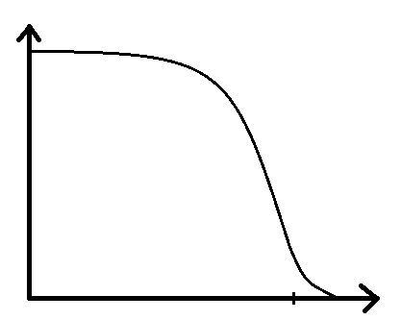
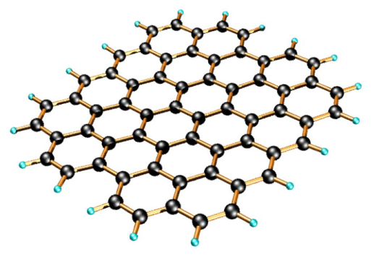
Alexey Tishchenko ICPPA-2016, Moscow, October 10-14
Motivation
TR spectrum
Cut off frequency
Plasma frequency:
Graphene:
Boundaries conditions for film – two boundaries.
Monolayer – only one boundary. Intensity of TR?
Intensity_TR_film Intensity_TR_monolayer
Are there any gain?

Slide 3
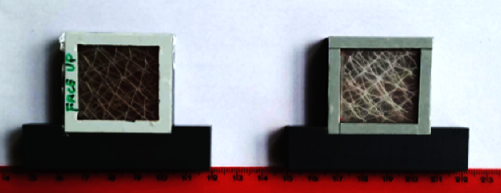
Alexey Tishchenko ICPPA-2016, Moscow, October 10-14
Experimental data
41 polyethylene films of 12.5 μm thick
~240 μm gap between films
39 films have a monolayer of graphene on one side
The first and the last films without graphene
Polyethylene foils (10 mm)

Slide 4
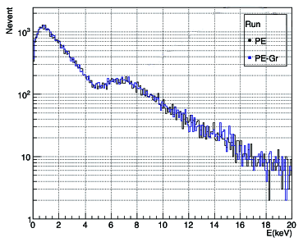
Alexey Tishchenko ICPPA-2016, Moscow, October 10-14
Experimental data
Comparison of differential dE/dX+TR spectrums of PE and PEGr radiators

Slide 5
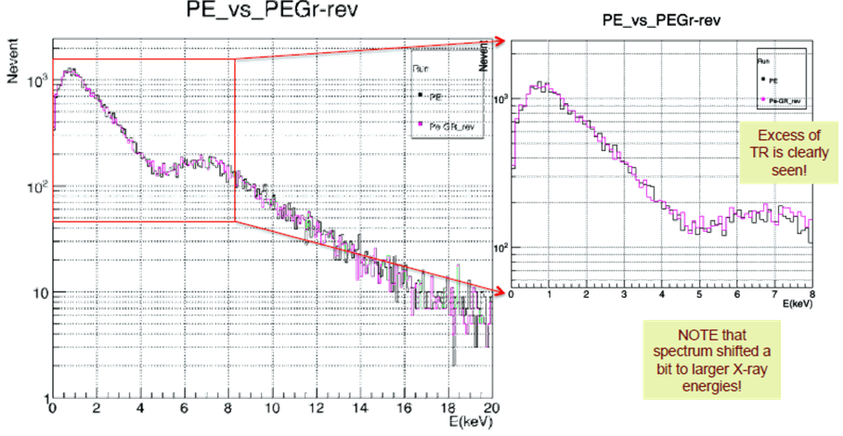
Alexey Tishchenko ICPPA-2016, Moscow, October 10-14
Comparison of differential dE/dX+TR spectrums of PE and PEGr_rev radiators

Slide 6
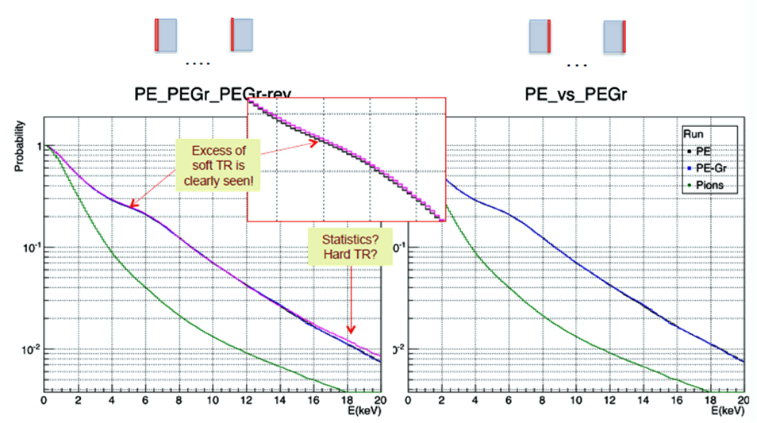
Alexey Tishchenko ICPPA-2016, Moscow, October 10-14
Probability to exceed threshold for electrons (P_{e}) VS probability to exceed threshold for pions (P) for PE and PEGr_rev radiators (left) for PE and PEGr (right)

Slide 7
Alexey Tishchenko ICPPA-2016, Moscow, October 10-14
Is this an effect of graphene monolayer?
If yes, is it connected to Graphene properties?
Statements and questions:
In the soft part of the spectrum (6-8 keV) the effect is statistically significant
At TR range > 15 keV excess may have statistics origin
If the effect we see comes from graphene monolayer why only one orientation

Slide 8
Alexey Tishchenko ICPPA-2016, Moscow, October 10-14
Maxwell’s equations
Exact solution
?

Slide 9
Alexey Tishchenko ICPPA-2016, Moscow, October 10-14
A.A. Tishchenko et al., PRE (2004); NIMB (2005)
M.I. Ryazanov, A.A. Tishchenko, JETP 103, 539 (2006)
M.I. Ryazanov, A.A. Tishchenko, NIM B 266, 3811 (2008)

Slide 10
Alexey Tishchenko ICPPA-2016, Moscow, October 10-14
Radiation from a monolayer

Slide 11
Alexey Tishchenko ICPPA-2016, Moscow, October 10-14
Radiation from a film
A.P. Potylitsyn, M.I. Ryazanov, M.N. Strikhanov, A.A. Tishchenko, Diffraction Radiation from Relativistic Particles, Springer, 2011

Slide 12
Alexey Tishchenko ICPPA-2016, Moscow, October 10-14
Vacuum-Matter
Matter-Vacuum

Slide 13
Alexey Tishchenko ICPPA-2016, Moscow, October 10-14
Conclusion
Experiment
Gr_PE(PEGr_rev) > PE_Gr
PE_Gr = PE
Spectrum extension – NO
The effect of graphene 1-2%
Theory
Gr_PE(PEGr_rev) > PE_Gr
PE_Gr = PE+Gr
Spectrum extension – NO
The effect of graphene

Slide 14
Thank you for your attention!
Alexey Tishchenko ICPPA-2016, Moscow, October 10-14

Slide 16
Local field effects
One simple example
material equation
where
Polarization is an average dipole moment
Gas. No interactions,
no structure,
no correlations.
If
then
Local field
But what is this effectve field ?
Average field, effectively acting upon single particles the substance consists of.

Slide 17
Maxwell’s equations
Exact solution
?

Slide 18
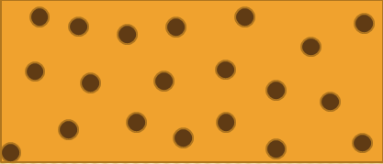
averaging
over positions of all N the particles
over positions of the rest particles relative to the given one
Uniform distribution

Slide 19
(1)
(2)
dielectric function with local field effects
OR from (2):
solution of the scattering/radiation problems
M.I. Ryazanov, A.A. Tishchenko, Clausius-Mossotti-type relation for planar monolayers, JETP 103, 539 (2006); Local field effect in diffraction radiation from a periodical system of dielectric spheres, NIM B 266, 3811 (2008).

Slide 20
Local field effects with no spatial dispersion
Clausius-Mossotti relation
Lorenz-Lorentz relation
C. Kittel, Introduction to Solid State Physics, Wiley, 1953.
«Polarization catastrophe» or «4π/3 catastrophe» (Kittel, Feinman)
Metamaterials – magnetic properties
Local field effects in magnetic materials
A.K. Sarychev, V.M. Shalaev, Electrodynamics of Metamaterials, World Scientific, 2007.
M.V. Gorkunov et al, Eur. Phys. J. B 28, 263 (2002).
J. Kästel, M. Fleischhauer, Phys.Rev. A 76, 062509 (2007).
O.V. Porvatkina, A.A. Tishchenko, M.N. Strikhanov, J. Phys.: Conf.Ser. 541, 012024 (2014).
Giant surface phenomena:
giant Raman scattering, giant second harmonic generation, giant luminescence, absorption etc.
Enhancement factor
Spherical particle

Slide 21
Local field effects with spatial dispersion
3D system

Slide 22
Local field effects with spatial dispersion
2D system
Differ!

Slide 23
Local field effects with spatial dispersion
We have obtained
On the other hand
(for simplicity alpha is scalar)
Concequently
Main components of dielectric permittivity tensor are linked? not independent?!
(reminds Kramers-Kronig relations, but physically differ)

