Slide 1
Research of fundamental interactions with use of ultracold neutrons in PNPI NRC KI
A.P. Serebrov,
PNPI Scientific Research Center KI,
Gatchina, Russia
The 2nd international conference on particle physics and astrophysics Moscow, Russia, 10-14 of October 2016

Slide 2
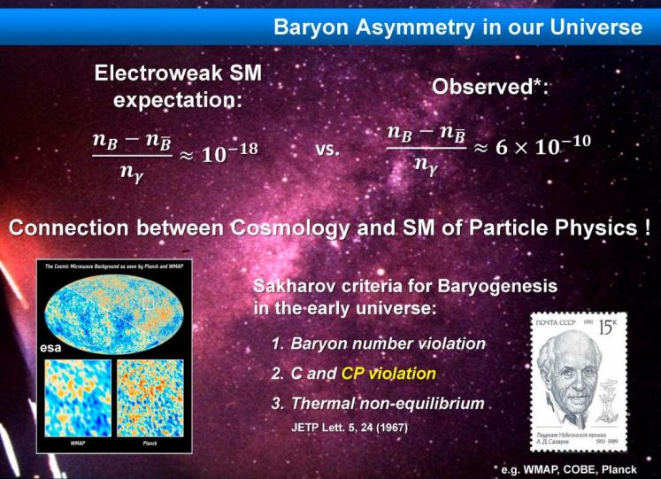

Slide 4
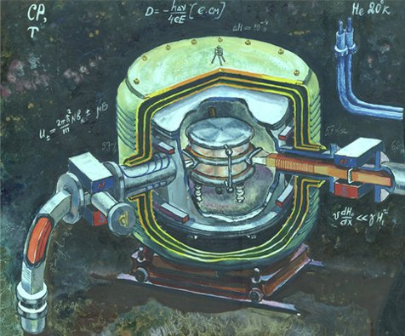
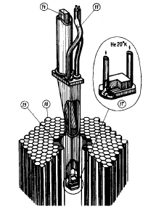
Gatchina EDM spectrometer 1975
The first result for nEDM with UCN method
⏐d_{n}⏐< 1.6⋅10⁻²⁴ е⋅см
(90% C.L.)
Altarev I.S. et al.,
Nuclear Physics A341 (1980) 269-283

Slide 5
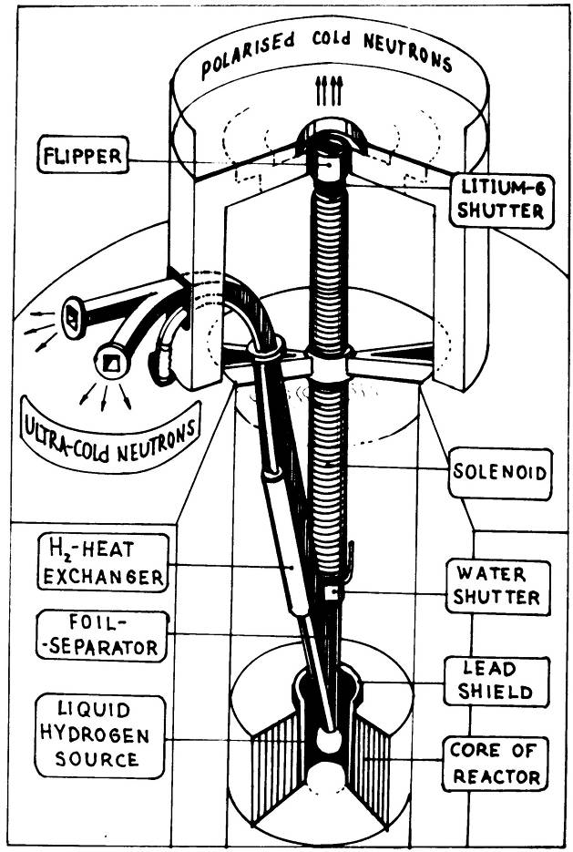
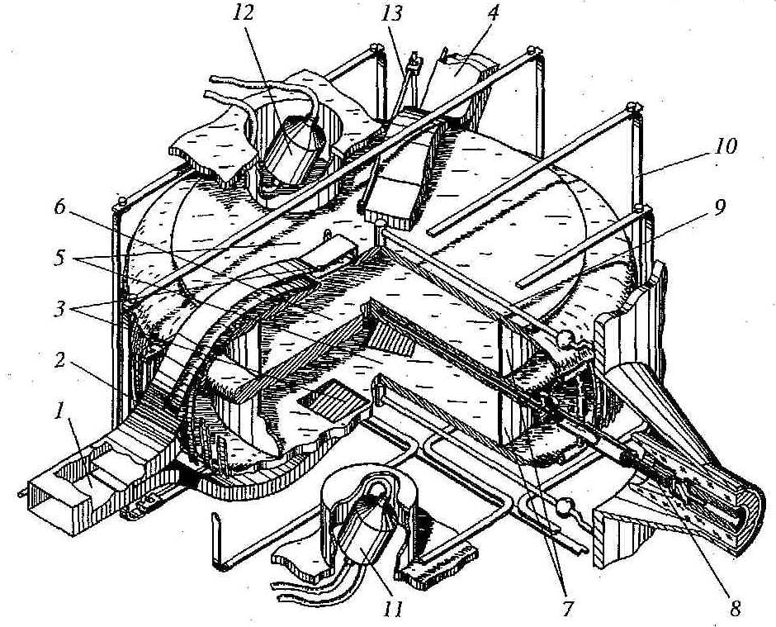
Gatchina source of UCN and polarized cold neutrons 1985 -1996
⏐d_{n}⏐< 9.7⋅10⁻²⁶ е⋅см
(90% C.L.)

Slide 6
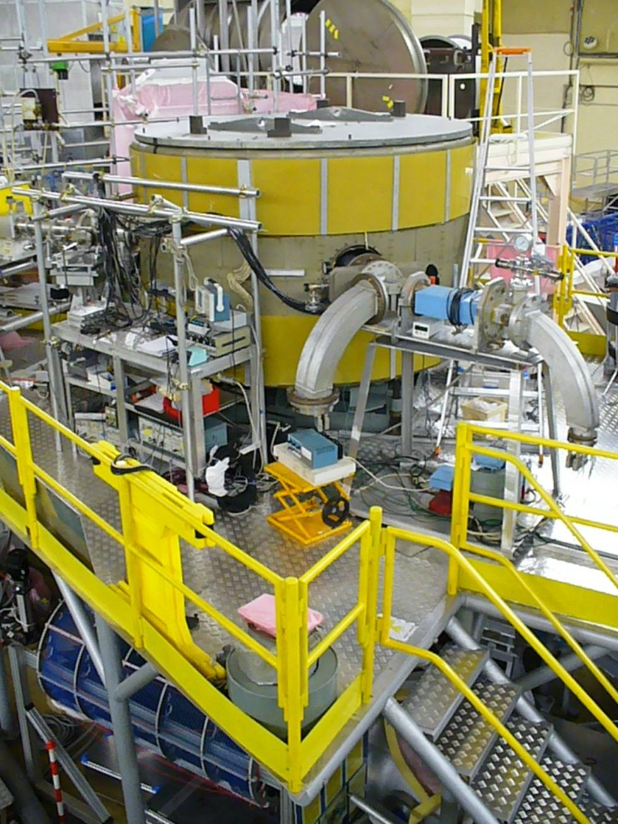
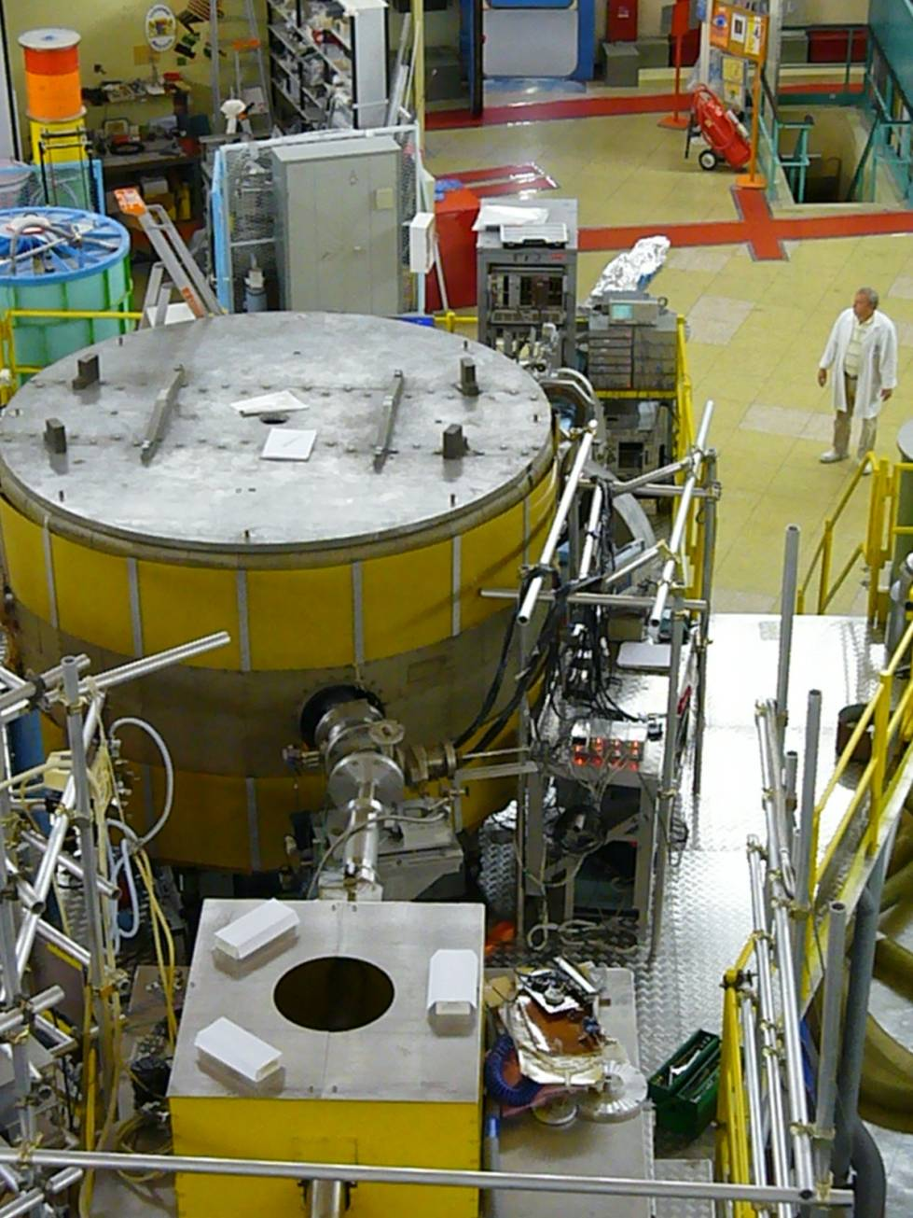
September 2008 - Assembly and testing of detectors, magnetometers and electronics.
October 2008 - Start of the first measurements with the neutrons

Slide 7
Scheme of EDM spectrometer
magnetic field coils
top UCN trap
4 top magnetometers
2 side UCN detectors
2 direct UCN detectors
valves
magnetic
screens
analyzers
UCN
flipper
polarizer
resonance frequency coils
bottom UCN trap
± high voltage electrode
4 bottom magnetometers

Slide 8
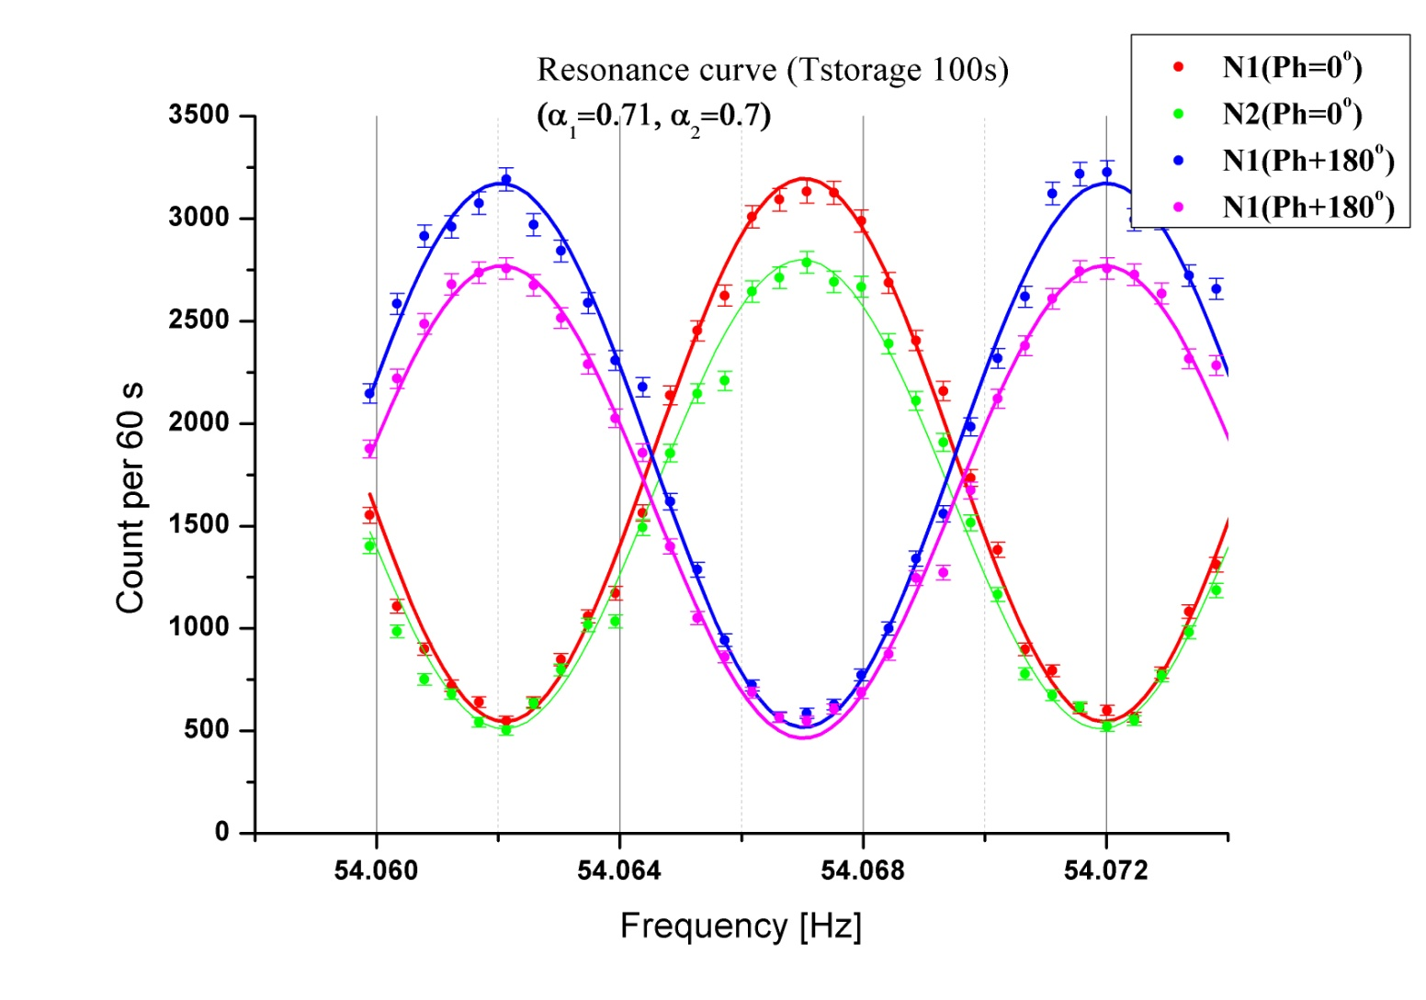
Resonance curves for holding time 100s

Slide 9
Principal scheme of measurements with false effect control
d₁ - top trap
d₂ - bottom trap
d₃ - top trap
d₄ - bottom trap
direct detectors
side detectors
EDM is EDM effect
ν is effect of influence of electric polarity changing on the resonance conditions (magnetic field or frequency)
N is effect of influence of electric polarity changing on the detector counting rate
z is compensation of all effects, including EDM effects
^{(*)} Difference of measurements for 90º and 180º

Slide 10
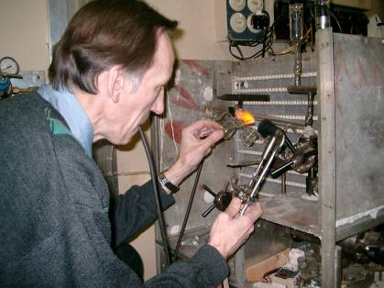
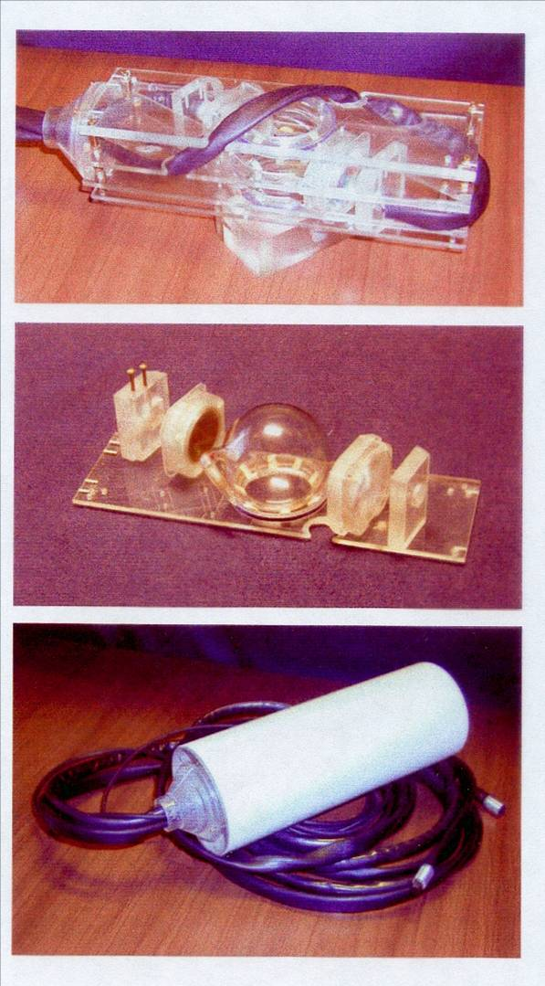
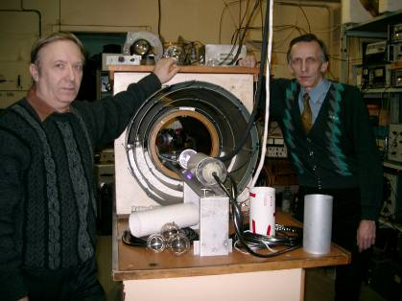
Preparation of Cs-magnetometers at PTI

Slide 11
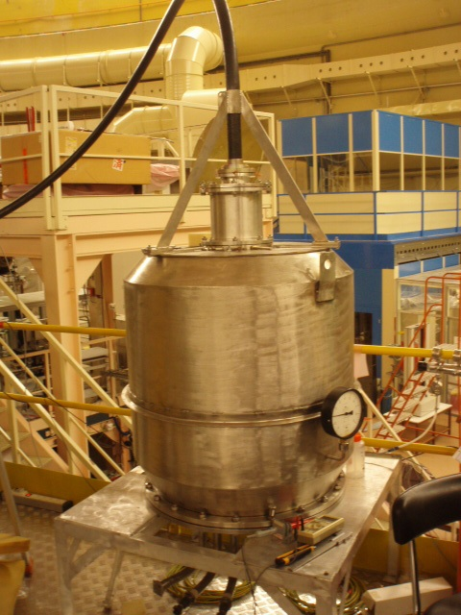
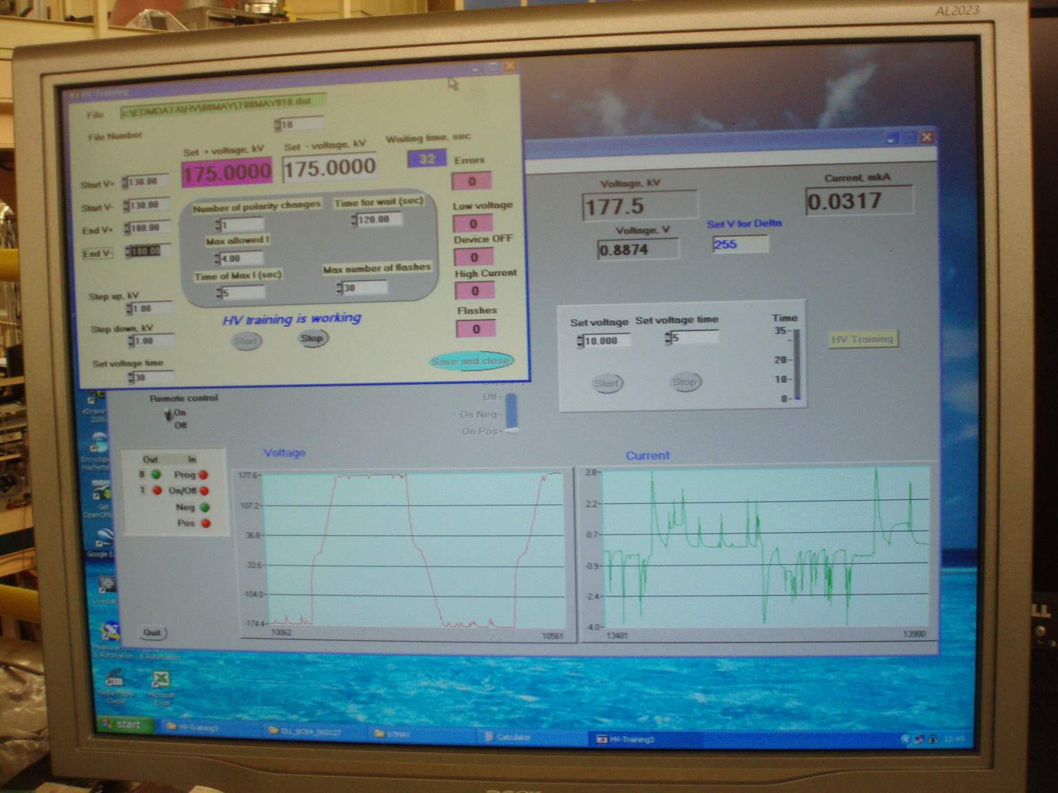
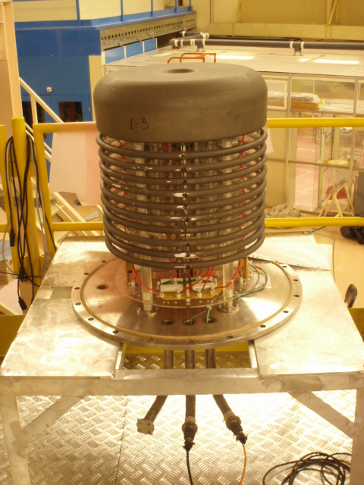
The best result with HV
(+_)175kV/ 8.7cm = 20kV/cm

Slide 12
Results of measurements in units
10⁻²⁶ e∙cm
 | Old | New | All
EDM | 0.7±4.0 | 0.363±4.68 | 0.56±3.04
ν | -22.8±9.2 | -10.04±5.98 | -13.8±5.01
N | -14.5±4.4 | 18.62±5.15 | -0.53±3.35
z | -0.8±4.0 | 3.68±4.72 | 1.05±3.05
/nEDM/ ≤ 5.5∙10⁻²⁶ e∙cm
EDM
ν
90% CL
N
z

Slide 13
OUR current result
90% CL
Present limit of RAL/Sussex
90% CL

Slide 14
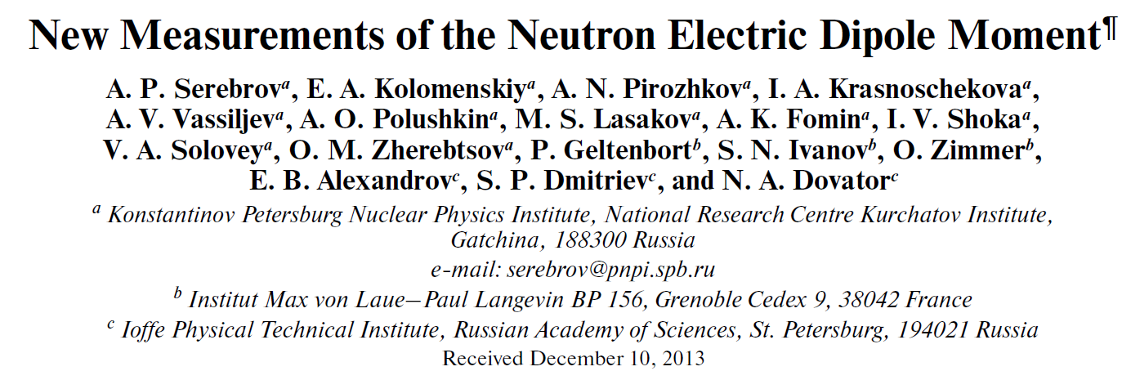
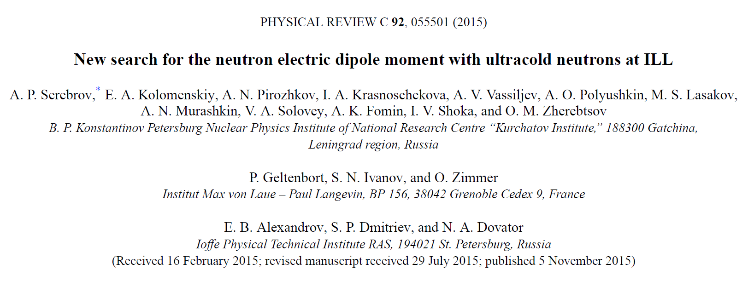
The measurement of nEDM at ILL

Slide 15
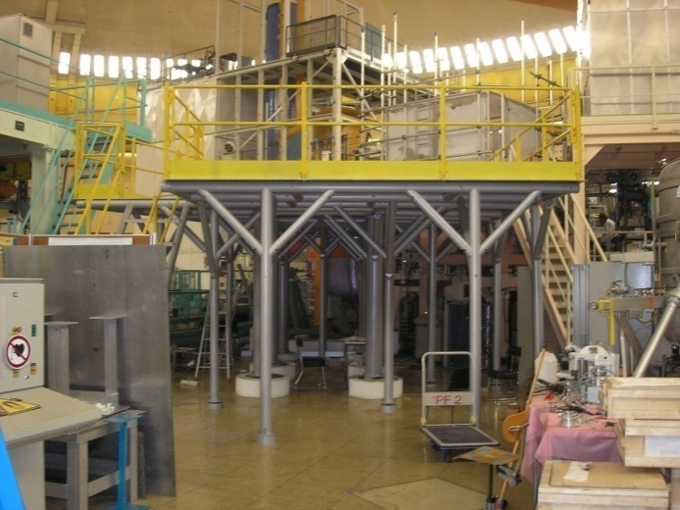
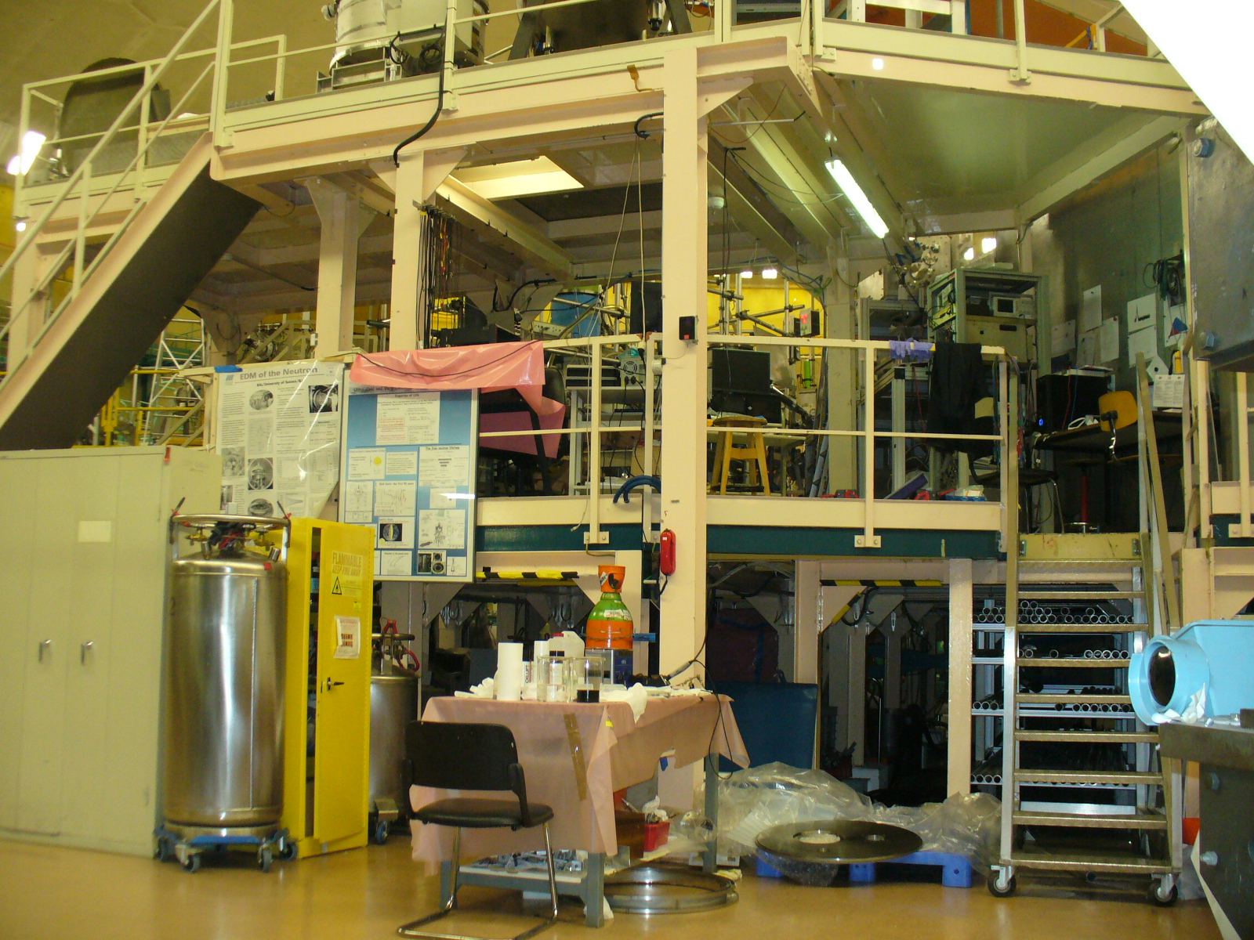
EDM spectrometer
at the PF2 EDM position
turbine
EDM spectrometer
installation
“Big gravitrap”

Slide 17
Neutron lifetime
and
ultracold neutron

Slide 18
Neutron decay and Standard Model
CKM mixing matrix:
W.Marciano
A.Sirlin
PRL 96, 032002 (2006)
Required experimental accuracy for τ_{n} and A
has to be about 10⁻³ and better.

Slide 19
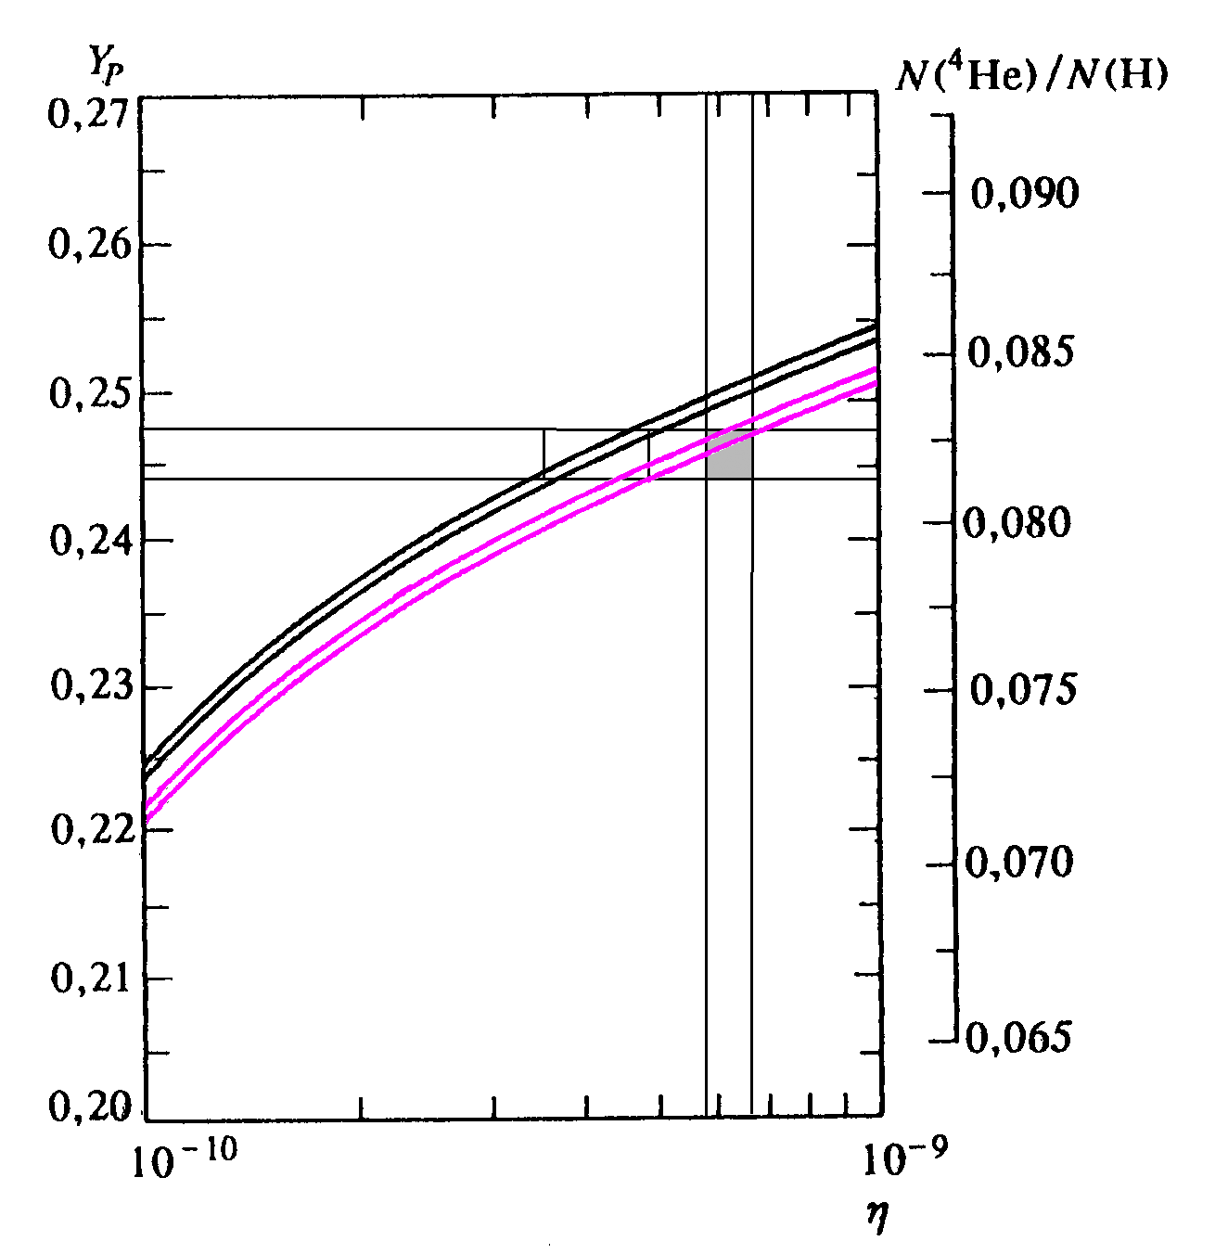
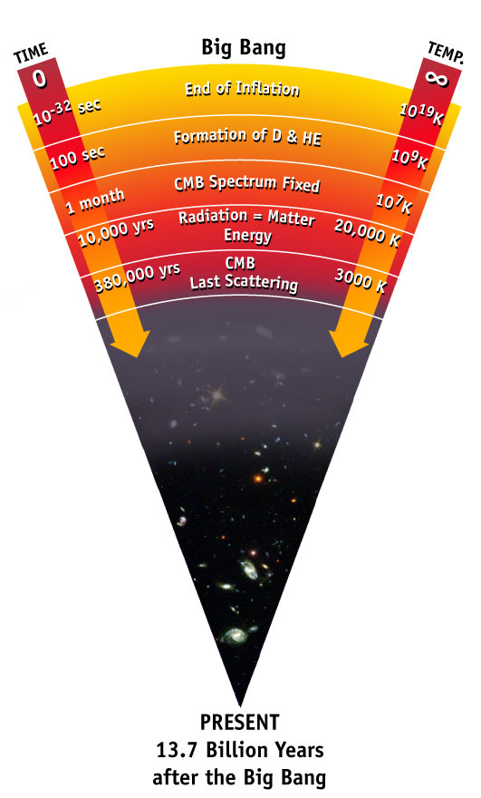






Neutron decay and cosmology (2005)
G. J. Mathews, T. Kajino, T. Shima, Phys. Rev. D 71, 021302(R) (2005)
τ_{n}, old world average
τ_{n}, “Gravitrap” result
New τ_{n}=(878.5±0.8) s confirms n_{b}/n_{γ} from CMB.

Slide 20
Neutron lifetime measurements
(history of experimental results)
Lifetime τ[s] | Ref./Year
880.2 ± 1.2 | S. Arzumanov et al. 2015
887.7 ± 2.3 | A.T. Yue et al. 2013
881.6 ± 2.1 | S. Arzumanov et al. 2012
882.5 ± 2.1 | A. Steyerl et al. 2012
880.7 ± 1.8 | A. Pichlmaier et al. 2010
878.2 ± 1.9 | V. Ezhov et al. 2007
878.5 ± 0.8 | A. Serebrov et al. 2004
886.3 ± 3.42 | M.S. Dewey et al. 2003
885.4 ± 0.95 | S. Arzumanov et al. 2000
889.2 ± 4.8 | J. Byrne et al. 1995
882.6 ± 2.7 | W. Mampe et al. 1993
888.4 ± 3.1 ± 1.1 | V. Nesvizhevski et al. 1992
893.6 ± 3.8 ± 3.7 | J. Byrne et al. 1990
887.6 ± 3.0 | W. Mampe et al. 1989
872 ± 8 | A. Kharitonov et al. 1989
878 ± 27 ± 14 | R. Kossakowski et al. 1989
877 ± 10 | W. Paul et al. 1989
891 ± 9 | P. Spivac et al. 1988
876 ± 10 ± 19 | J. Last et al. 1988
870 ± 17 | M. Arnold et al. 1987
903 ± 13 | Y.Y. Kosvintsev et al. 1986
937 ± 18 | J. Byrne et al. 1980
881 ± 8 | L. Bondarenko et al. 1978
918 ± 14 | C.J. Christensen et al. 1972
Δτ_{n}=6.5σ

Slide 21
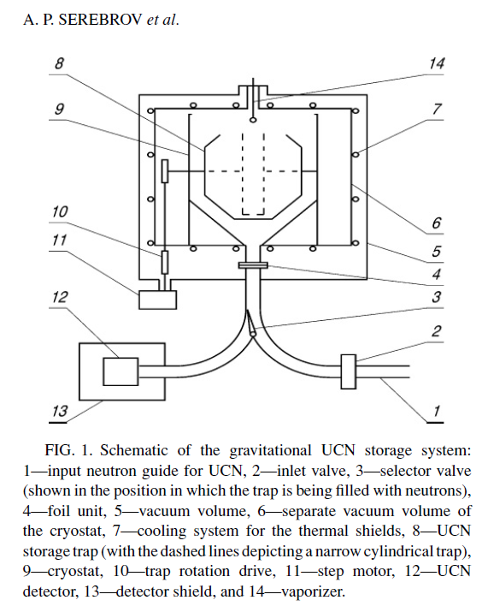
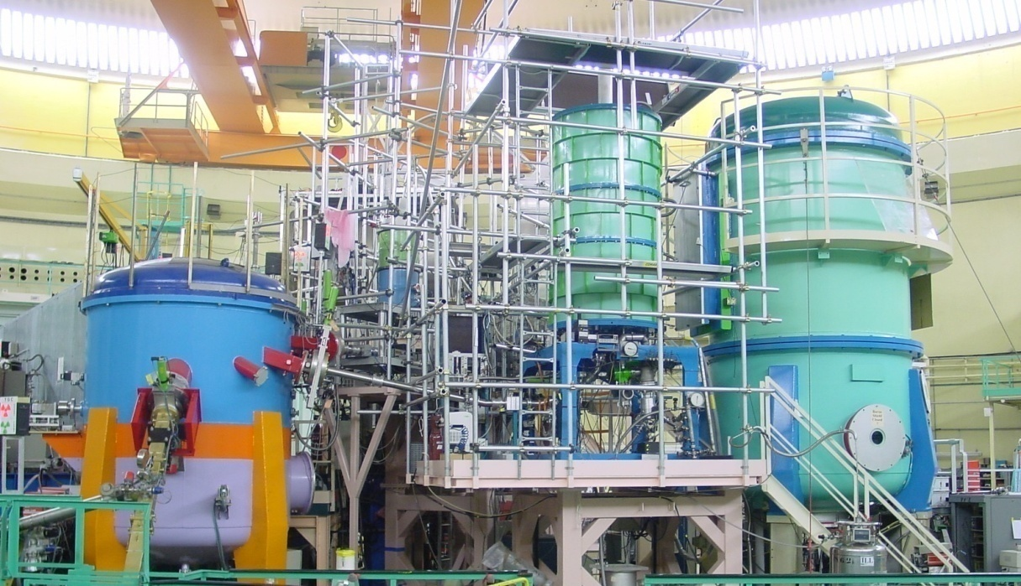
Neutron lifetime measurement with gravitational trap
of ultacold neutrons
A.Serebrov et al. , Phys Lett B 605, (2005) 72-78 :
878.5 ± 0.8 s
2002-2004 (PNPI-JINR-ILL), ILL reactor, Grenoble
Gravitrap
Discrepancy with PDG 7.2 s
PNPI
878.5 ± 0.8 s
PDG 2006
885.7 ± 0.8 s

Slide 22
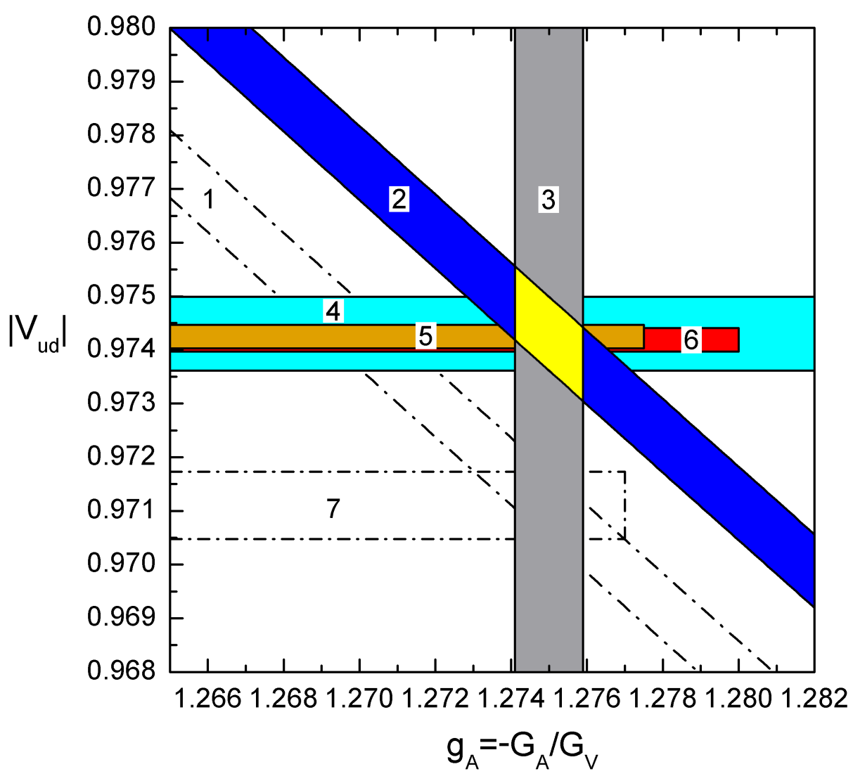
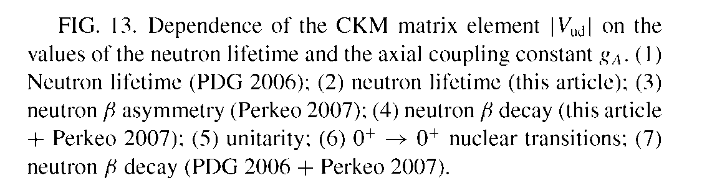
Our measurements of neutron lifetime
878.5 ± 0.8 s
liquidated the problem of discrepancy in determination of
from neutron decay

Slide 23
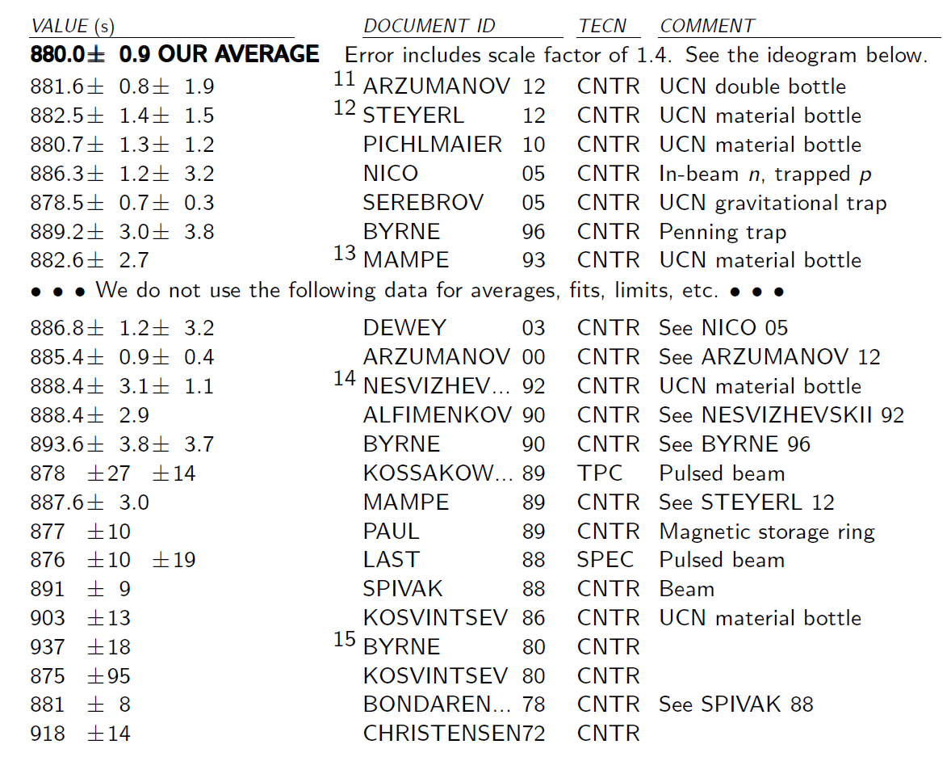
Neutron lifetime data after author corrections of experimental results
PDG 2013

Slide 24
Neutron lifetime from
UCN storage experiments and beam experiments
A.P. Serebrov and A.K. Fomin / Physics Procedia 17 (2011) 199–205
∆τ_{n}=9.8(2.96) s (3.3σ)
∆τ_{n}=8.4(2.2) s (3.8σ)
PRL 111, 222501 (2013)

Slide 25
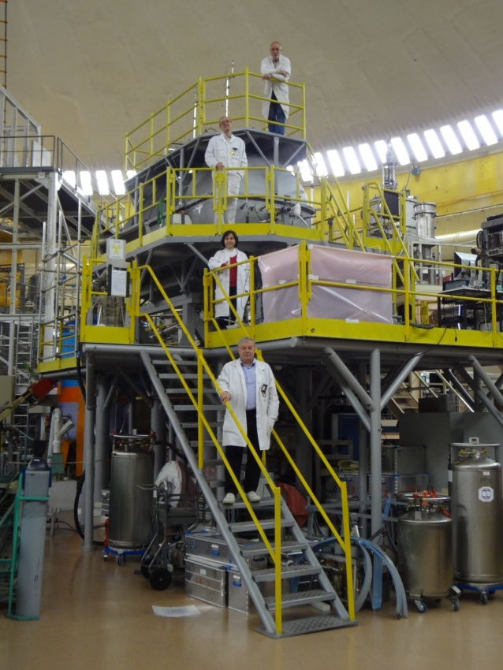
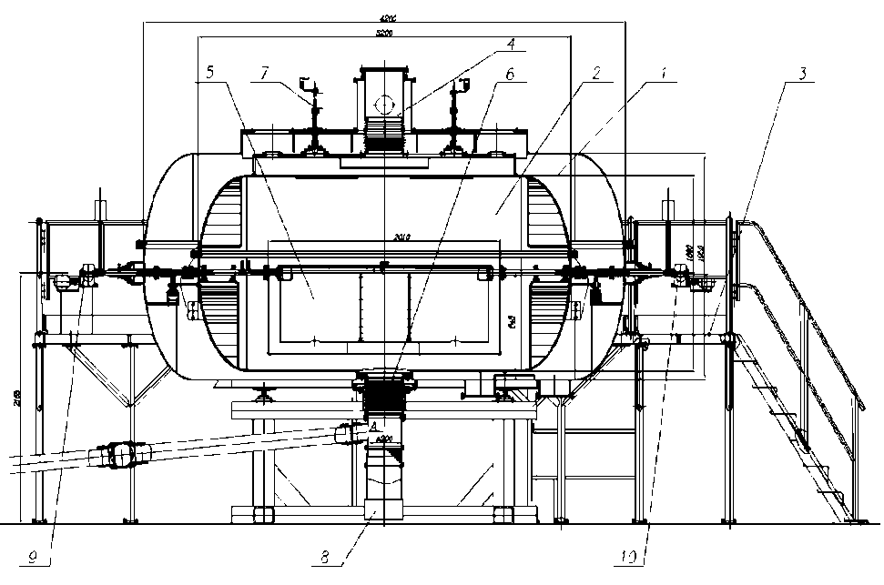
New installation of PNPI – Big Gravitational Trap
Result of current measurement
880.4±1.0stat ±0.6sys confirm
the previous PNPI result
and new world average
neutron lifetime
(Experimental report ILL 11/09/2016)

Slide 26
Other experiments with UCN
Restriction for oscillations
neutron – mirror neutron: 414s
2. The Axion limit for T-violating forces

Slide 27
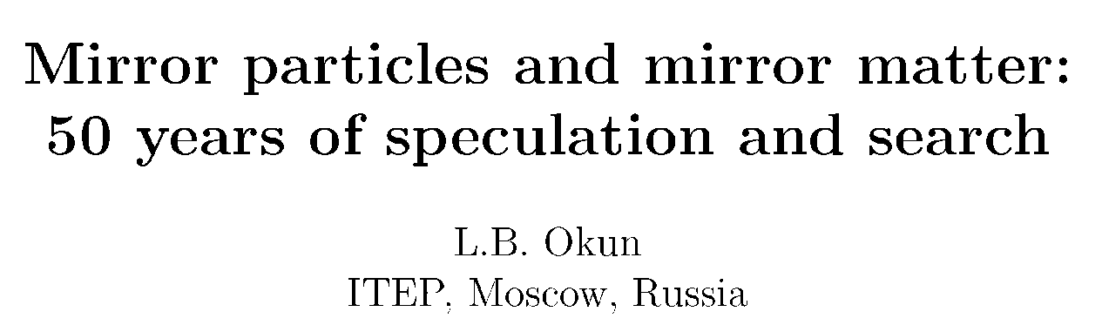
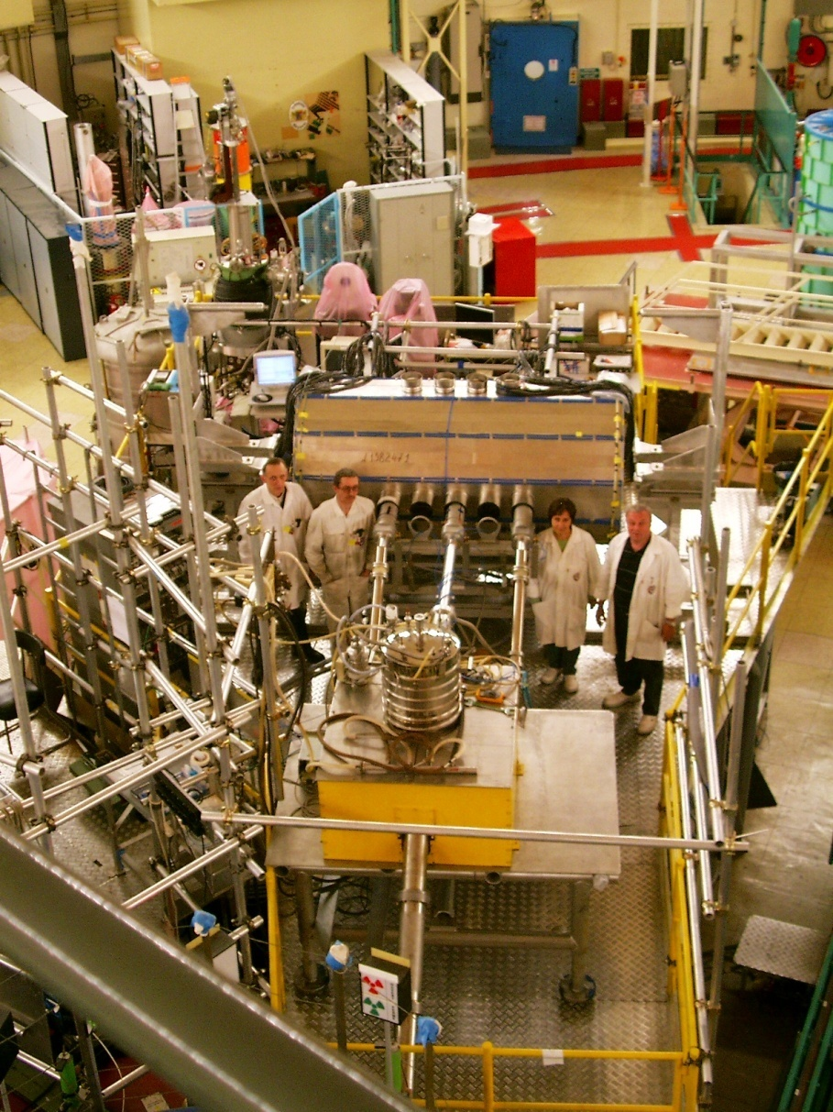
PNPI installation search for neutron – mirror neutron oscillations
The best restriction for oscillations neutron –mirror neutron:
414s
H=0 (H<10⁻⁴ Gauss)
H≠0 (H≈0.2 Gauss)
n′

Slide 28
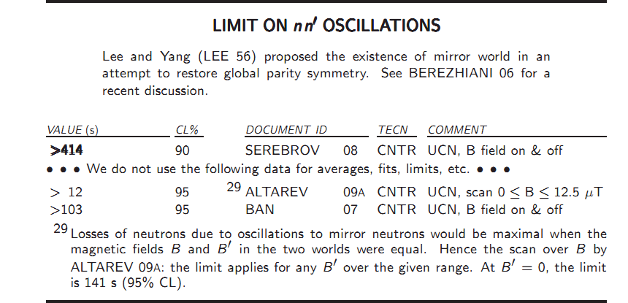

Slide 29
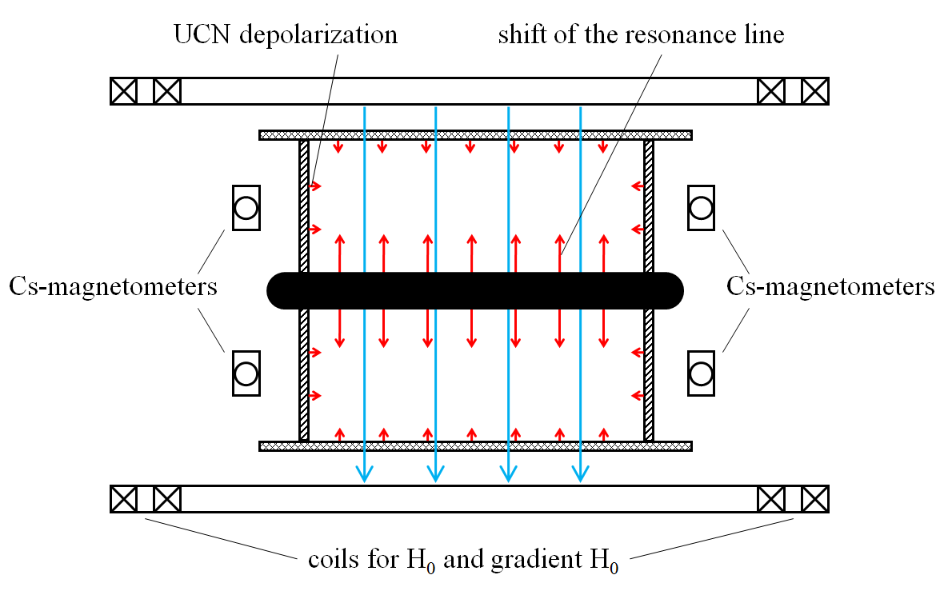
The Axion limit for T-violating forces
magnetic field down

Slide 30
Result of measurements
(JETP Letters, 2010, Vol. 91, no. 1, pp. 6-10)
.
1 – UCN depolarization (this work); 2 – shift of resonance (this work); 3 – gravitational levels [5]; 4 – [12]; 5 – astrophysical restriction of axion mass [13]; 6 – cosmological restriction of axion mass in model of cold dark matter [13]. On the upper horizontal axis the mass range of intermediate boson (axion) is shown in correspondence with formula

Slide 31
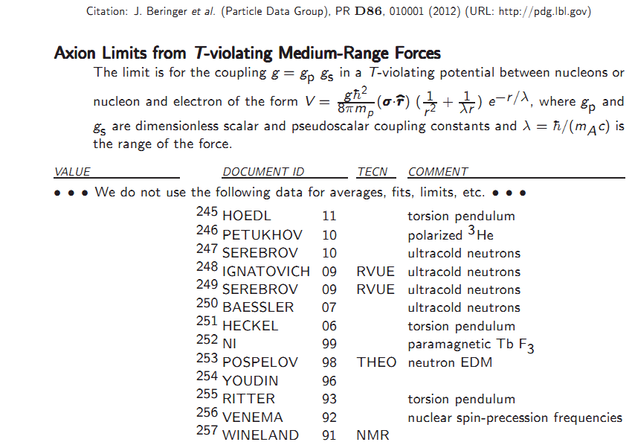

Slide 32
Future prospects with UCN source
in Gatchina

Slide 33
Sources of ultracold neutrons
History of development and prospect

Slide 34
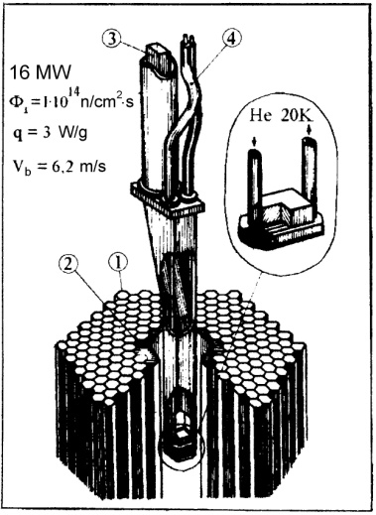
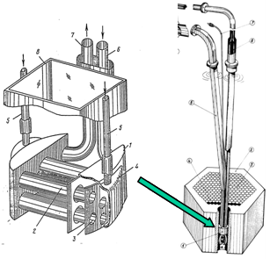
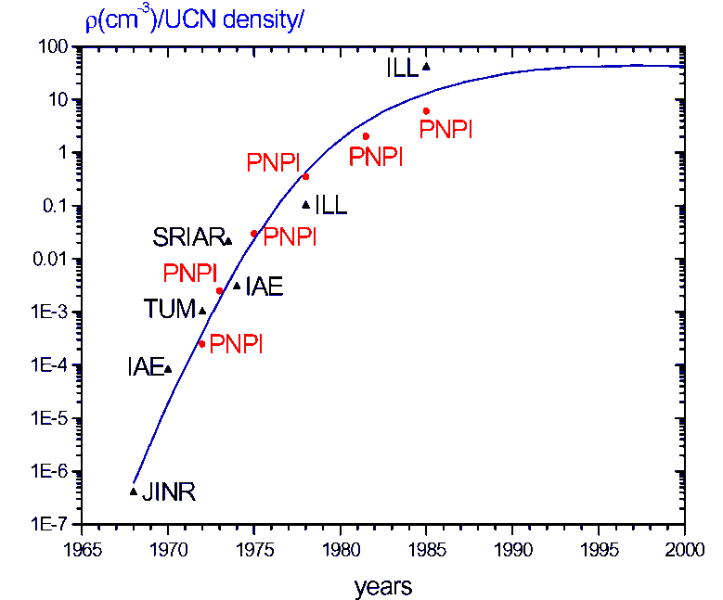
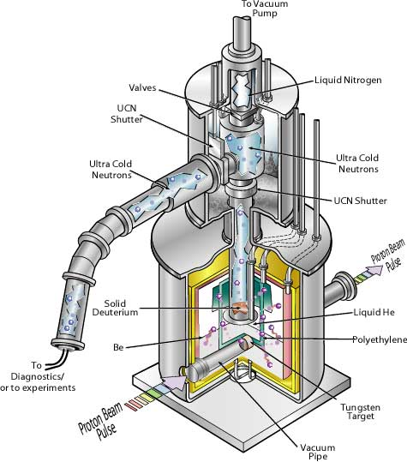
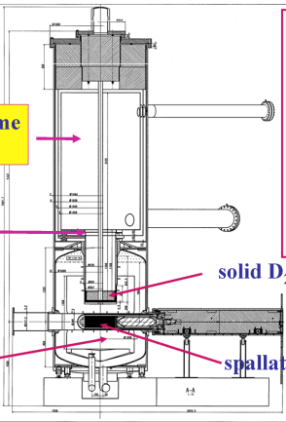
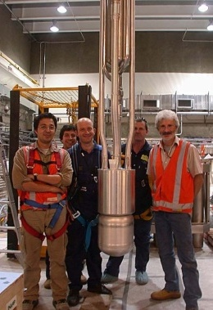
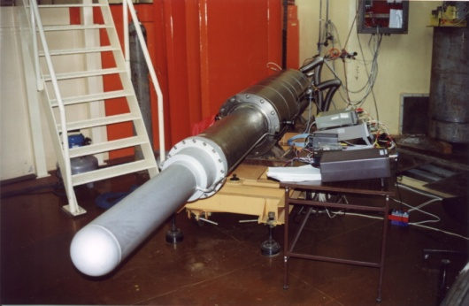
Intensive sources of UCN in PNPI
1974
1980
1986
1996
1999
2001
2002
2004
2006

Slide 35
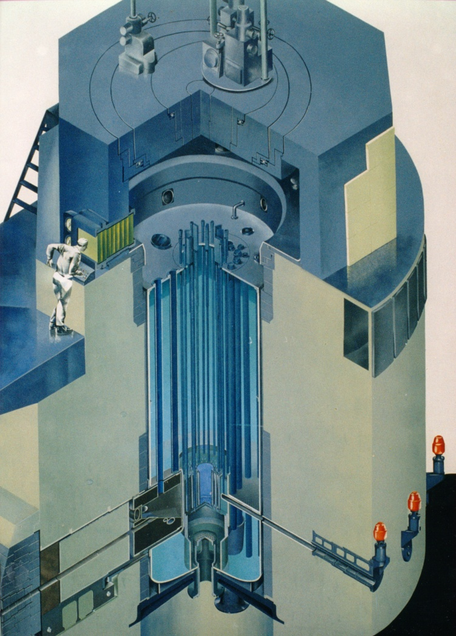
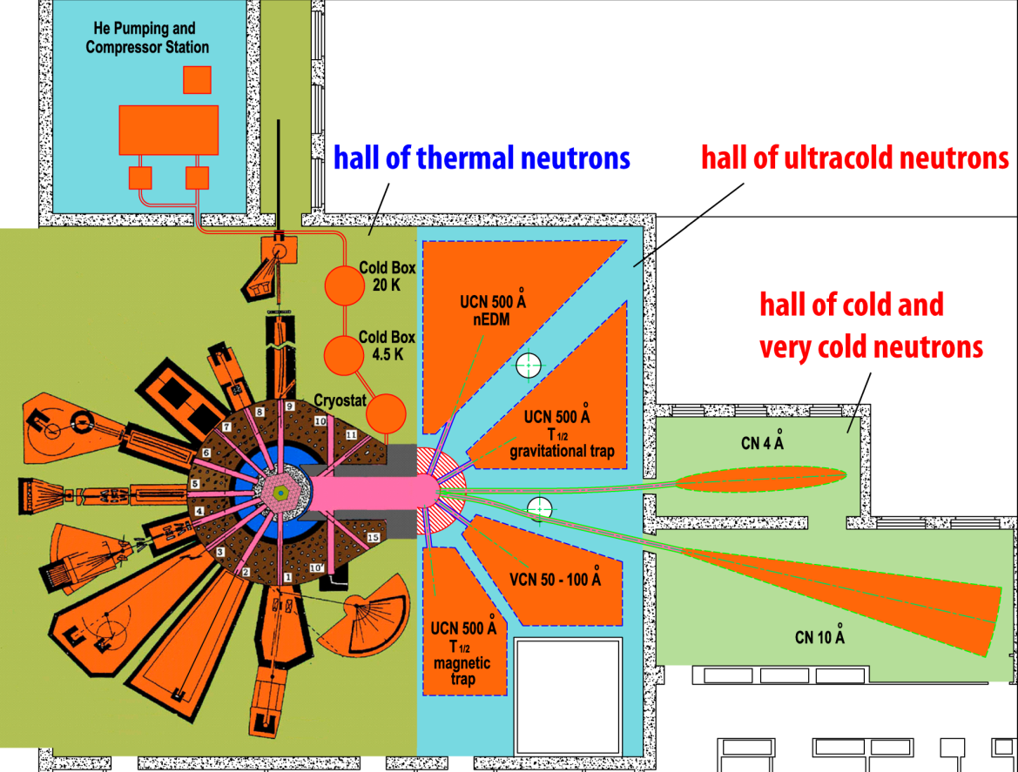
Prospects for UCN source
at WWR-M reactor
The resource of basic elements of the reactor provides its further operation within 25 years.
The scheme of experimental installations on the BBP-M reactor after installation in a thermal column of the reactor of UCN source with superfluid helium at a temperature of 1.2K.

Slide 36
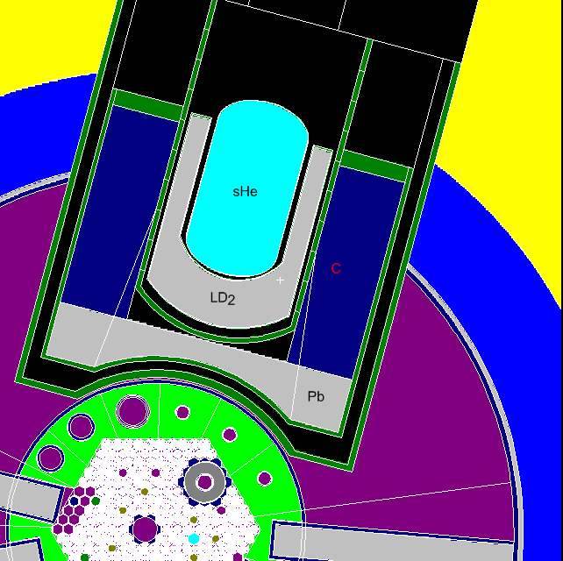
MCNP neutron flux calculation results and heat generation in thermal column of WWR-M reactor at 15 MW
ρ_{ucn}=10⁴ сm⁻³ (τ=10 s)
Ф=4.5∙10¹² n/(сm²s)
Ф(λ=9 А)=3∙10¹⁰ n/(сm²sA)
Q_{He}=6 W
He Т=1.2 К
LD₂ Т=20 К
19 W
Al, Q_{Al}=13 W
C Т=300 К
Pb Т=300 К
LD₂, Q_{LD2+Al}=100 W
C, Q_{C}=700 W
Pb, Q_{Pb}=15 кW
Ф=10¹⁴ n/(cm²s)
Q=15 MW

Slide 37
Principle of a source
UCNs are generated in helium from cold neutrons of 9Ǻ wavelength (12 K energy). It is correspond with phonon energy: cold neutron produces phonon, practically stops and becomes an ultracold one. UCN can “lives” in superfluid helium for tens or hundreds of seconds until a phonon be captured.
Cold neutrons (9Ǻ) penetrate through the wall of a trap, but ultracold neutrons (500Ǻ) are reflected, that is why UCN can be accumulated up to the density defined by the time of storage in the trap filled with superfluid helium.
UCN λ=500 Å, T=10⁻³ K
phonon
CN λ=9 Å, T=12 K

Slide 38
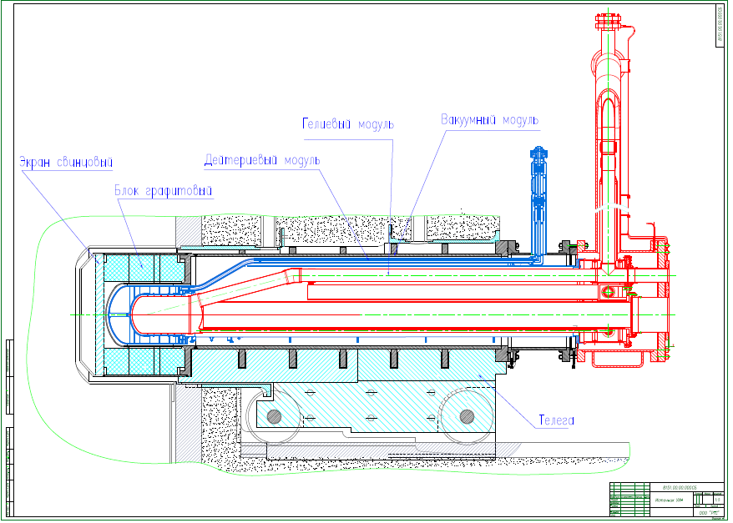
UCN source inside the thermal column of the WWR-M reactor
PNPI workshop is ready to begin production

Slide 40
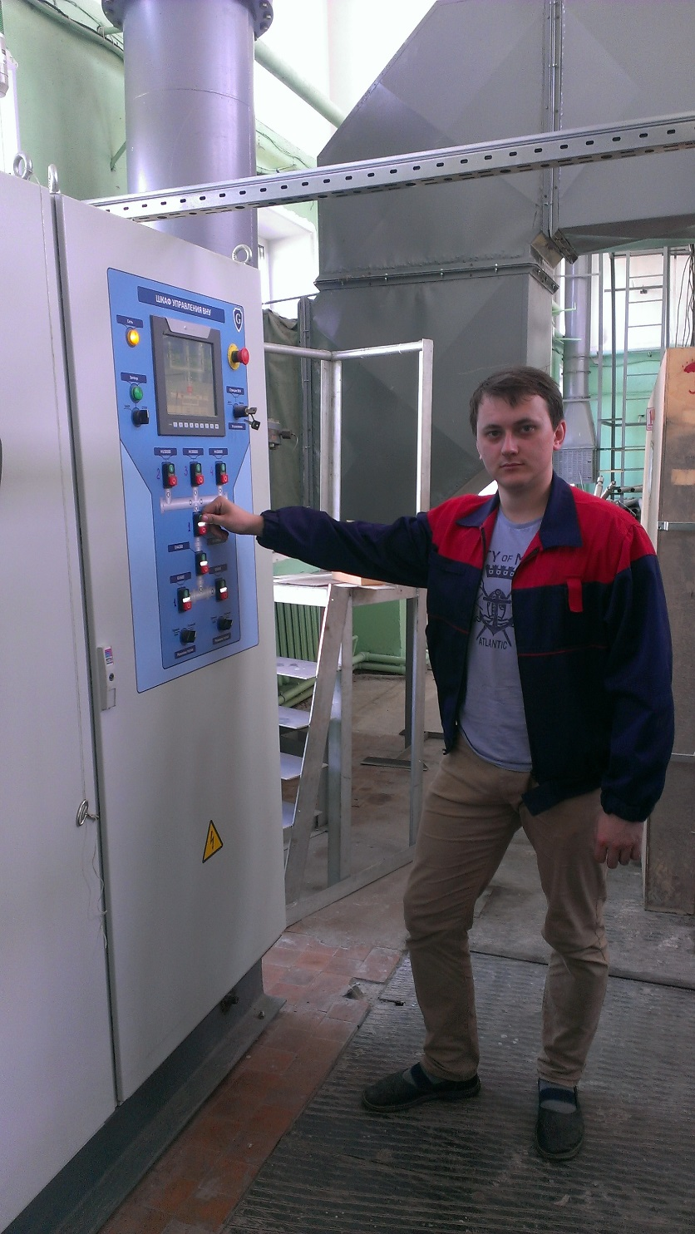
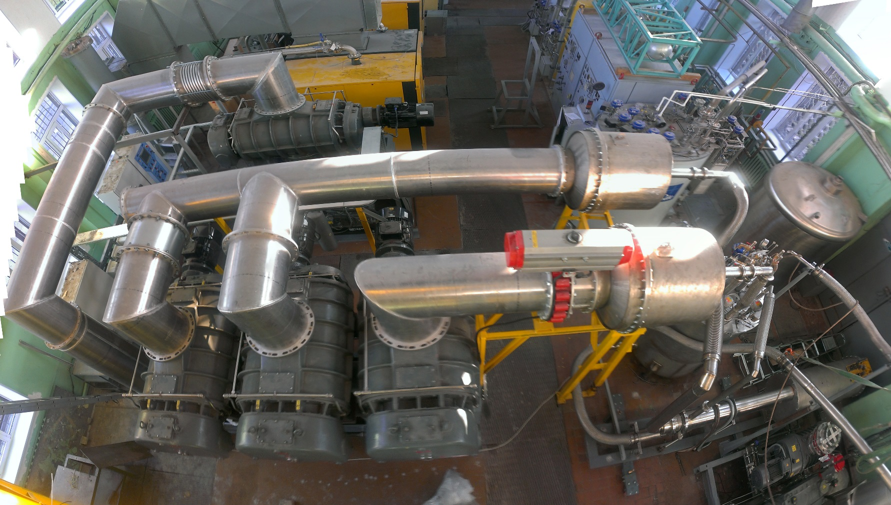
Vacuum pumps system with a total capacity of 120000 cub.m/hour
The pumps are equipped with 2 heaters that warm helium up to the room temperature
Vacuum pumps are controlled by frequency converter, allowing to adjust the pump performance (according to helium temperature)

Slide 41
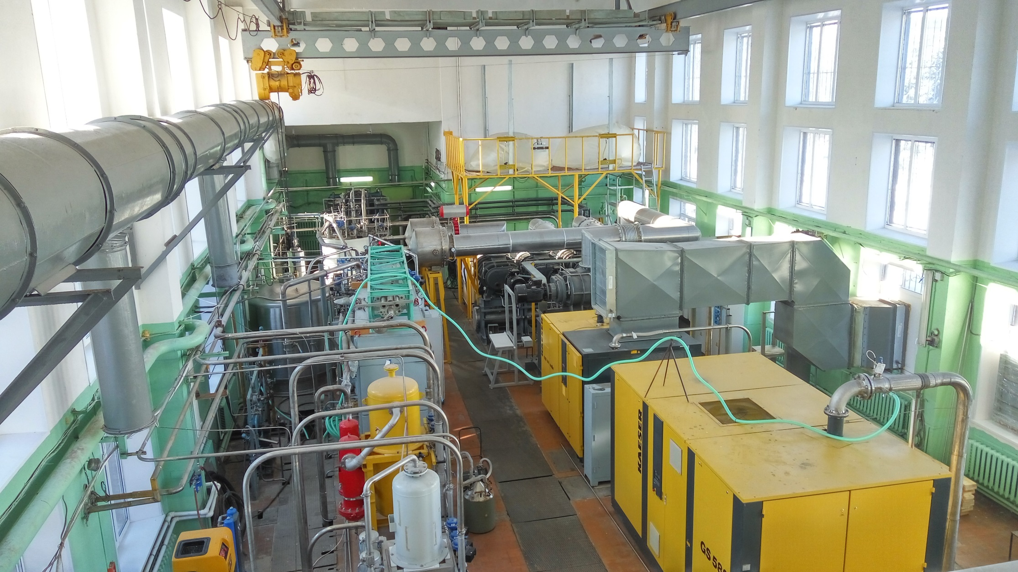
Cryogenic building at WWR-M reactor
Full-scale UCNS model complex with superfluid helium

Slide 42
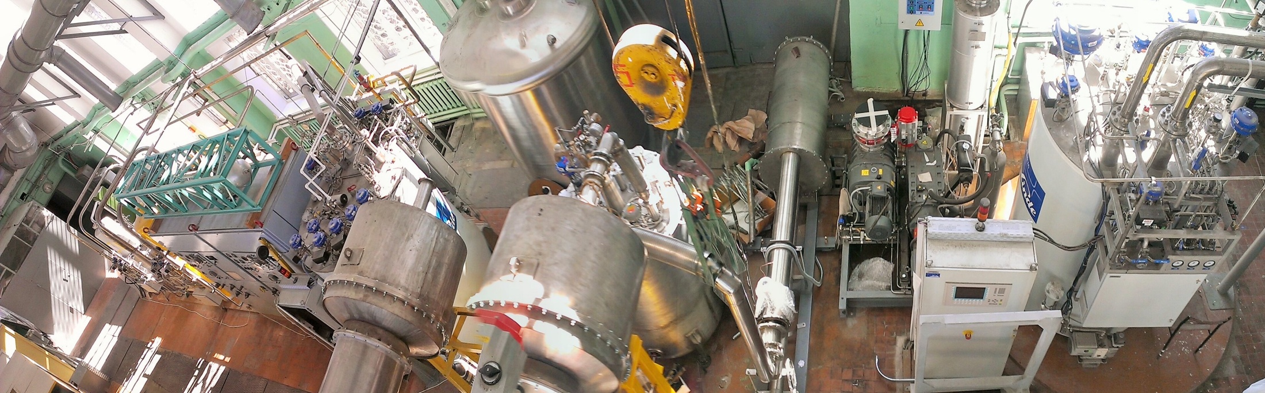
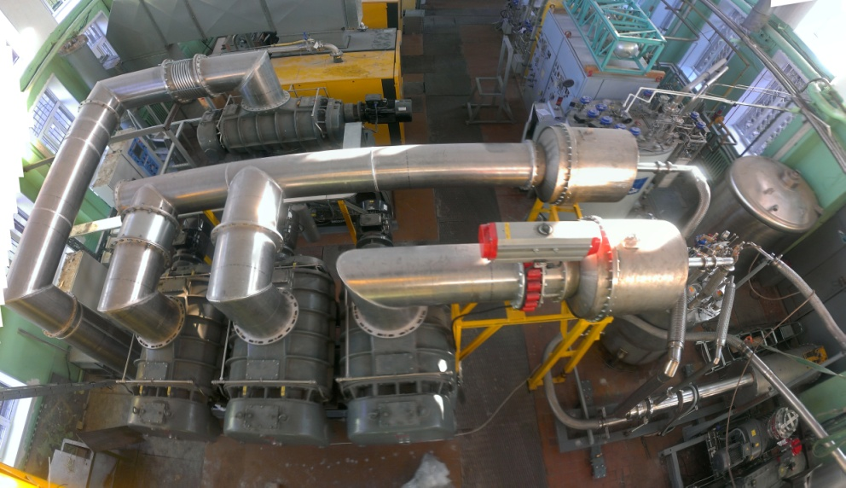
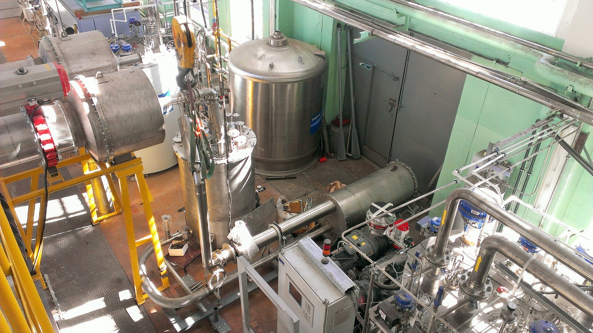
Full-scale UCNS model complex with superfluid helium has been constructed and launched

Slide 43
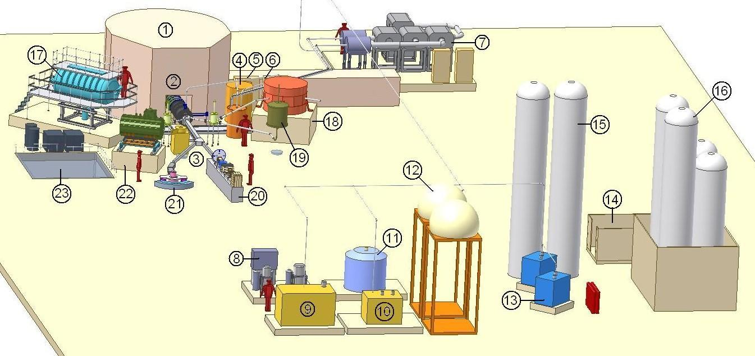
Complex of the available equipment for UCN source on the WWR-M reactor and a complex of the available experimental installations.
1. WWR-M reactor 2. Intr-channel part of UCN source in the thermal column of the reactor. 3. Neutron guide system. 4. The cryostat for superfluid helium. 5. He refrigerator on 15K. 6. He liquefier. 7. System of vacuum pumping. 8. Cleaning block He. 9. Compressor for refrigerator. 10. Compressor for He liquefier. 11. He dewar. 12. He gas-holder. 13. Downloading compressors He in cylinders. 14. Balloon cell. 15. He receivers. 16. D2 receivers. 17. Gravitational trap for measurement of neutron lifetime. 18. EDM spectrometer. 19. A magnetic trap for measurement of neutron lifetime. 20. Reflectometer. 21. Spin-echo a spectrometer with VCN. 22. Installation for search of mirror dark matter. 23. WWR-M reactor ramp.

Slide 44
UCN source at WWR-M reactor
The WWR-M reactor at PNPI is going to be equipped with a high density ultacold neutron source. Our source aims at obtaining a density of UCN up to 10⁴ n/сm³ in the experimental trap, 100 times greater then in existing sources presently available in the world.
In more details see
Poster –V. Laymkin 14 oct

Slide 45
Experimental installations
on WWR-M reactor UCN source
τ_{n} , Gravitrap
nEDM
τ_{n} , magnetic trap
n→ñ
n→n′

Slide 46


Neutron – anti-neutron oscillations
at WWR-M reactor
In more details see
Poster –A Fomin 12 oct

Slide 49


Slide 50
Thank you for attention

