Slide 1

Complex function block of processing and transferring asynchronous data for the IC of reading out the signals of multichannel detectors
P. Ivanov, E. Atkin, A. Voronin, D. Normanov, V. Shumkin
National Research Nuclear University MEPhI
The 2nd International Conference on Particle Physics and Astrophysics Moscow, Oct. 2016

Slide 2
Outline
Floor plan
CFP features
CFP structure
Data flow rate estimation
Timestamp
Peak detector
GBT interface
Present status

Slide 3
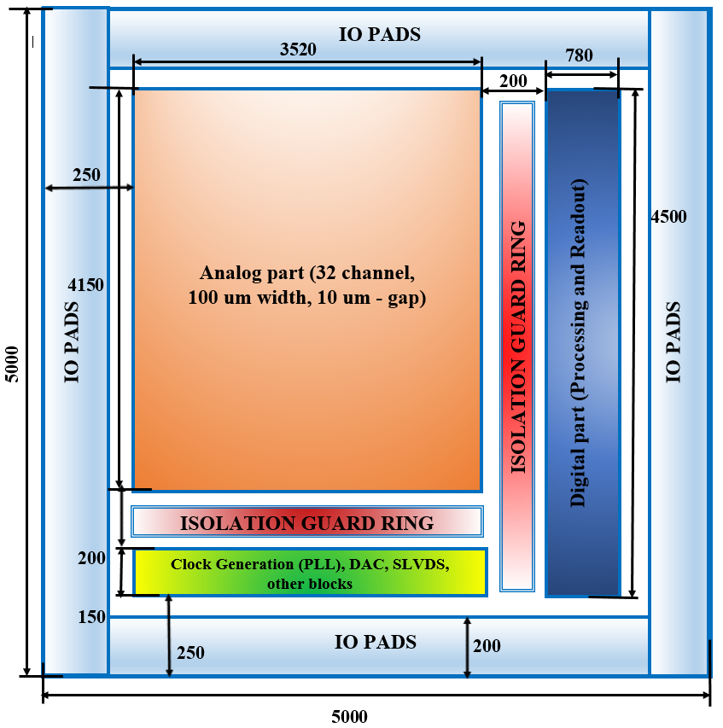
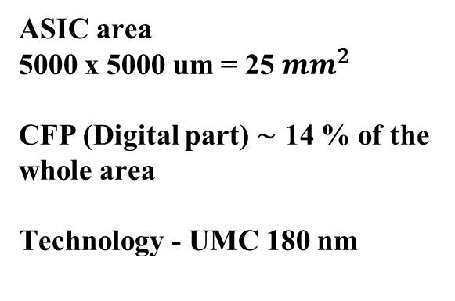
Floor plan
ASIC area
5000 х 5000 um = 25 ${mm}^{2}$
CFP (Digital part) $\sim$ 14 % of the whole area
Technology - UMC 180 nm

Slide 4
CFP features
1. Timestamp generation
2. Peak detection
3. Data readout
4. Data exchange with host via I2C/GBT interfaces
4.1 Global time synchronization
4.2 Slow control
4.2.1 Selective block resetting
4.2.2 Standby mode control
4.2.3 DACs codes setting
4.2.4 PD control
4.2.5 TS control
4.2.6 Readout fifos status monitoring
4.3 Payload data transfer to host
5. ADC control

Slide 5
CFP structure
PD – peak detector block
TS – timestamp block
ReadOut – data readout block
I2C – I2C interface block
GBT – GBTX interface block

Slide 6
Structure of the data processing and readout channel

Slide 7
Interface part structure (GBT + I2C)

Slide 8
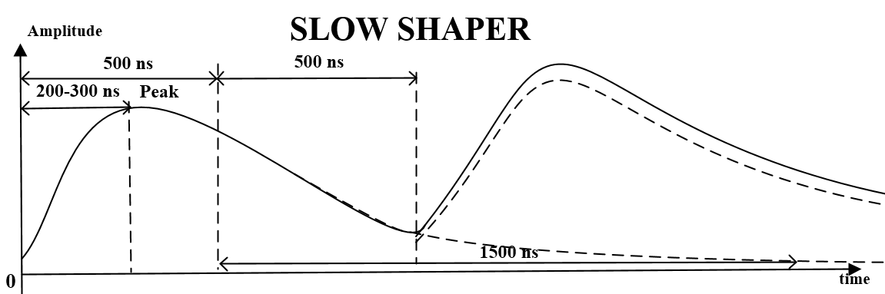
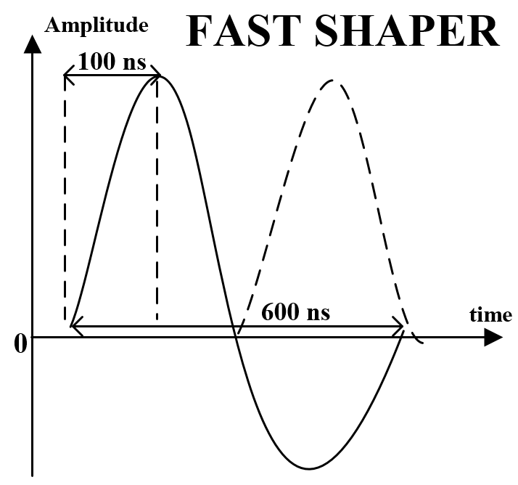
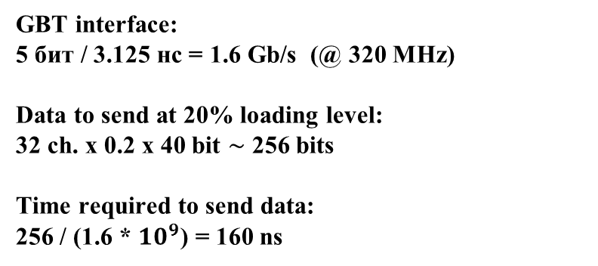
Data flow rate estimation
GBT interface:
5 бит / 3.125 нс = 1.6 Gb/s (@ 320 MHz)
Data to send at 20% loading level:
32 ch. х 0.2 х 40 bit $\sim$ 256 bits
Time required to send data:
256 / (1.6 * ${10}^{9}$) = 160 ns

Slide 9
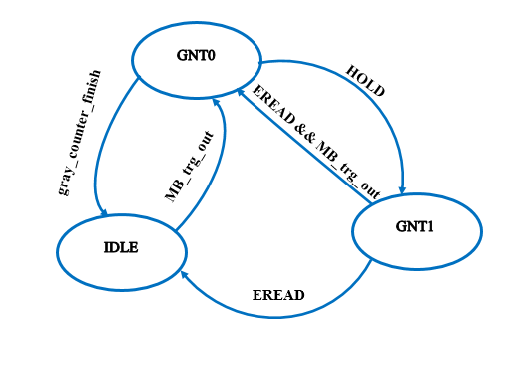
Timestamp
State diagram
States:
IDLE – idle
GNT0 –time saved, waiting for HOLD approval signal during THold time
GNT1 – time saved and approved, waiting for read enable signal
Main characteristics:
- timestamp resolution – 3.125 ns
- gray code
- 14 bit

Slide 10
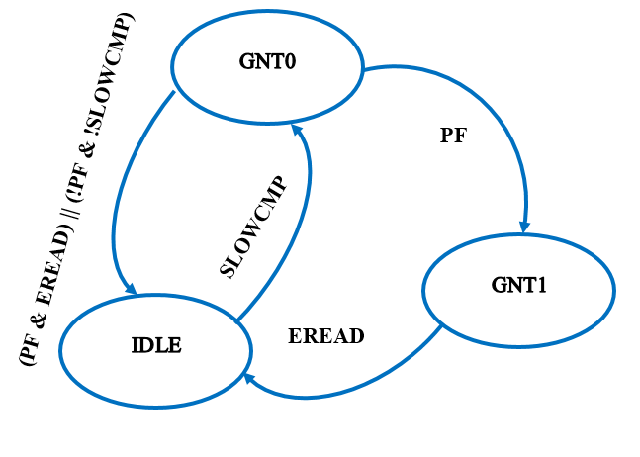
Peak detector
State diagram
States:
IDLE
GNT0 – data processing
GNT1 – peak time found and saved, new incoming data is ignored, waiting for read enable signal
Main characteristics:
2 modes: simple and smart
prevention of the false peak detection due to the noise
adjustable sensitivity level for noise detection
adjustable peak detection condition
overlay detection

Slide 11
GBT synchronization
Regular link synchronization procedure
 |  |  |  |  | Sending START of Synch |  |  |  |  |  | Waiting for SOS from all asics |  | CLK delay adjustment determining optimal setting |  |  |  |  | Data delay adjustment |  |  | End of Synch |  |  |  |  |  | Waiting for EOS from all CBM_MUCH |  | Sending FRAME |  |  |  | K28.5 is detected
Downlink | SOS |  | SOS |  | SOS |  | SOS |  | SOS |  | SOS |  | K28.1 |  | K28.1 |  | K28.1 |  | K28.1 |  | EOS |  | EOS |  | EOS |  | EOS |  | FRAME |  | FRAME |  | FRAME |  | FRAME
Uplink | K28.5 | K28.5 | K28.5 | K28.5 | K28.5 | K28.5 | K28.5 | K28.5 | sos | sos | sos | sos | sos | sos | sos | sos | k28.1 | k28.1 | k28.1 | k28.1 | k28.1 | k28.1 | k28.1 | k28.1 | EOS | EOS | EOS | EOS | EOS | EOS | EOS | EOS | K28.5 | FRAME | FRAME | FRAME
After RESET or when synchronization is required |  |  |  |  |  | Handling |  | Forming a package | Send STATRT of Synch |  |  |  |  |  |  |  |  |  |  |  |  |  |  |  |  |  |  |  |  |  |  |  | req. before sending frames | Sending FRAMES
Quick link synchronization procedure
 |  |  | Set pre-determined delays in GBTx |  |  |  |  |  |  |  |  |  |  |  |  | Wait EOS from all CBM_MUCH |  |  |  |  |  | K28.5 is detected
Downlink | K28.1 |  | K28.1 |  |  | K28.1 |  | K28.1 |  | EOS |  | EOS |  | EOS |  | EOS |  | FRAME |  | FRAME |  | FRAME |  | FRAME
Uplink | K28.5 | K28.5 | K28.5 |  | K28.5 | K28.5 | K28.5 | K28.5 | K28.5 | K28.5 | K28.5 | K28.5 | K28.5 | EOS | EOS | EOS | EOS | EOS | EOS | EOS | EOS | K28.5 | FRAME | FRAME | FRAME
 | After RESET or when synchronization is required |  |  |  |  |  |  |  |  |  |  |  |  |  |  |  |  |  |  |  |  | req. before sending frames | Sending FRAMES

Slide 12
GBT outgoing frames
 | BYTE0 |  |  |  |  |  |  |  |  |  |  | BYTE1 |  |  |  |  |  |  |  |  | BYTE2 |  |  |  |  |  |  |  |  |  | BYTE3
TYPE | 39 | 38 | 37 | 36 | 35 | 34 | 33 | 32 | 31 | 30 | 29 | 28 | 27 | 26 | 25 | 24 | 23 | 22 | 21 | 20 | 19 | 18 | 17 | 16 | 15 | 14 | 13 | 12 | 11 | 10 | 9 | 8 | 7 | 6 | 5 | 4 | 3 | 2 | 1 | 0
SOS | 0 | 0 | 0 | 0 | 0 | 1 | 1 | 1 | 1 | 1 | 1 | 1 | 1 | 1 | 1 | 0 | 0 | 0 | 0 | 0 | 0 | 0 | 0 | 0 | 0 | 1 | 1 | 1 | 1 | 1 | 1 | 1 | 1 | 1 | 1 | 0 | 0 | 0 | 0 | 0
EOS | 1 | 1 | 0 | 0 | 1 | 1 | 1 | 1 | 1 | 1 | 0 | 0 | 0 | 0 | 0 | 0 | 1 | 1 | 0 | 0 | 1 | 1 | 0 | 0 | 1 | 1 | 1 | 1 | 1 | 1 | 0 | 0 | 0 | 0 | 0 | 0 | 1 | 1 | 0 | 0
Not coded by the 8b10b coder
 | BYTE0 |  |  |  |  |  |  |  | BYTE1 |  |  |  |  |  |  |  | BYTE2 |  |  |  |  |  |  |  | BYTE3
TYPE | 31 | 30 | 29 | 28 | 27 | 26 | 25 | 24 | 23 | 22 | 21 | 20 | 19 | 18 | 17 | 16 | 15 | 14 | 13 | 12 | 11 | 10 | 9 | 8 | 7 | 6 | 5 | 4 | 3 | 2 | 1 | 0
K28.5 | 1 | 0 | 1 | 1 | 1 | 1 | 0 | 0 | 1 | 0 | 1 | 1 | 1 | 1 | 0 | 0 | 1 | 0 | 1 | 1 | 1 | 1 | 0 | 0 | 1 | 0 | 1 | 1 | 1 | 1 | 0 | 0
K28.1 | 0 | 0 | 1 | 1 | 1 | 1 | 0 | 0 | 0 | 0 | 1 | 1 | 1 | 1 | 0 | 0 | 0 | 0 | 1 | 1 | 1 | 1 | 0 | 0 | 0 | 0 | 1 | 1 | 1 | 1 | 0 | 0
Dummy HIT | 0 | 0 | 0 | 0 | 0 | 0 | 0 | 0 | 0 | 0 | 0 | 0 | 0 | 0 | 0 | 0 | 0 | 0 | 0 | 0 | 0 | 0 | 0 | 0 | 0 | 0 | 0 | 0 | 0 | 0 | 0 | 0
HIT | 0 | 1 | 5 bit Number channel |  |  |  |  | S |  | 8 bit ADC |  |  |  |  |  |  |  | 14 bit time stamp |  |  |  |  |  |  |  |  |  |  |  |  |  | Res
ACK | 1 | 0 | 2 bit ACK |  | 4 bit Sequence number |  |  |  | CP | 4 bit status value |  |  |  | 15 bit register content |  |  |  |  |  |  |  |  |  |  |  |  |  |  | 4 bit CRC
Coded by the 8b10b coder
Name | Comment
S | Overlay Pick Detector
CP | Config parity
Res | Reserve
SOS – start of synchronization
EOS – end of synchronization
K28.5 – waiting for synchronization
K28.1 – calculated latch (control word)
Ack[1:0] | Comment
0x0 | No operation
0x1 | Acknowledgment
0x2 | Error
0x3 | Warning(See STATUS[3:0])
STATUS[3:0] | Comment
0x0 | No warning
0x1 | FIFO full
0x2 | Sync alert
0x3 | Sequence error
0x4 | Check register error

Slide 13
GBT incoming frames
BYTE0 |  |  |  |  |  |  |  | BYTE1 |  |  |  |  |  |  |  | BYTE2 |  |  |  |  |  |  |  | BYTE3 |  |  |  |  |  |  |  | BYTE4 |  |  |  |  |  |  |  | BYTE5
47 | 46 | 45 | 44 | 43 | 42 | 41 | 40 | 39 | 38 | 37 | 36 | 35 | 34 | 33 | 32 | 31 | 30 | 29 | 28 | 27 | 26 | 25 | 24 | 23 | 22 | 21 | 20 | 19 | 18 | 17 | 16 | 15 | 14 | 13 | 12 | 11 | 10 | 9 | 8 | 7 | 6 | 5 | 4 | 3 | 2 | 1 | 0
Comma characted |  |  |  |  |  |  |  | Frame ID & Chip Address |  |  |  |  |  |  |  | Request type/Reserve |  |  |  |  |  |  |  | Payload |  |  |  |  |  |  |  | CRC |  |  |  |  |  |  |  | CRC
K28.5 |  |  |  |  |  |  |  | <7:4>chip address<3:0>, <3:0>sequence number<3:0> |  |  |  |  |  |  |  | <7:6> Request type <1:0>, <5:0> Reserve <5:0> |  |  |  |  |  |  |  | <7:0> Payload <7:0> |  |  |  |  |  |  |  | <7:0> CRC <15:8> |  |  |  |  |  |  |  | <7:0> CRC <7:0>
Chip Address | Comment
0x0 ... 0x7 | Individual chip addressing (max 8)
0x8 … 0xE | Reserve
0xF | Broadcast
Request Type | Code | Ack request | Payload | Comment
No_op | 0x0 | No | X | No operation
Wraddr | 0x1 | Yes | [7:0] address | Write address. Address remains for consecutive Wrdata request. But Rddata overwrites it withregister address used in Rddata frame.
Wrdata | 0x2 | Yes | [7:0] data | Write data to register block (address set previously by Wraddr). Wrdata must have the sequence number higher by one from the last Wraddr command, otherwise it is not accepted.
RDdata | 0x3 | Yes | [7:0] address | Read data from register

Slide 14
Register file
Addr[7:0] | Width (Max = 8) | Default | Description
0 | 4 | [1111] | ADC_CAL0[3:0] – calibration of comparator offsets in ADC.
1 | 4 | [1111] | ADC_CAL1[3:0] - calibration of comparator offsets in ADC.
2 | 4 | [1111] | ADC_CAL2[3:0] - calibration of comparator offsets in ADC.
3 | 4 | [1111] | ADC_CAL3[3:0] - calibration of comparator offsets in ADC.
... | 4 | [1111] | {ADC_CAL4[3:0] ... ADC_CAL28[3:0]} : ADC_CAL4[3:0] ... ADC_CAL28[3:0] - calibration of comparator offsets in ADC.
29 | 4 | [1111] | ADC_CAL29[3:0] - calibration of comparator offsets in ADC.
30 | 4 | [1111] | ADC_CAL30[3:0] - calibration of comparator offsets in ADC.
31 | 4 | [1111] | ADC_CAL31[3:0] - calibration of comparator offsets in ADC.
32 | 4 | [1111] | ADC_CAL_T1[3:0] - calibration of comparator offsets in ADC, test channel №1
33 | 4 | [1111] | ADC_CAL_T2[3:0] - calibration of comparator offsets in ADC, test channel № №2
34 | 5 | [10111] | {PD_KF[3:0], PD_CS} : KF[2:0]-threshold level; KF[3]- threshold mode (0-simple mode PD IN>OUT, 1 - smart mode; Overflow condition: CS, 1-overflow counter = 4, 0 –overflow counter = 1.
35 | 5 | [11111] | FDAC[4:0] – Threshold DAC codes in fast channel. Code [00000] – relates to 0V threshold; Code [11111] – relates to 64 mV threshold, LSB - 2 mV
36 | 5 | [11111] | SDAC[4:0] - Threshold DAC codes in slow channel Code [00000] – relates to 0V threshold; Code [11111] – relates to 64 mV threshold, LSB - 2 mV
37 | 5 | [11111] | FDAC_T1[4:0] – setting threshold DAC codes in test channel
38 | 5 | [11111] | SDAC_T1[4:0] – setting threshold DAC codes in test channel
39 | 5 | [11111] | FDAC_T2[4:0] – setting threshold DAC codes in test channel
40 | 5 | [11111] | SDAC_T2[4:0] – setting threshold DAC codes in test channel
41 | 8 | [11111111] | {RESETN_all_from_regFile, rst_n_GBT_from_regFile, rst_n_Reg_from_regFile, rst_n_I2C_from_regFile, rst_n_160_from_regFile, RESETN_FCLK_from_regFile, RESETN_SLOW2_from_regFile, RESETN_SLOW1_from_regFile}. Reset for 3 clock domains
42 | 8 | [00000000] | CH_SEL[7:0] Fast or slow channel select. 0 – ADC process signals from slow shaper 1- ADC process signals from fast shaper.
43 | 8 | [00000000] | CH_SEL[15:8] Fast or slow channel select. 0 - ADC process signals from slow shaper 1- ADC process signals from fast shaper.
44 | 8 | [00000000] | CH_SEL[23:16] Fast or slow channel select. 0 - ADC process signals from slow shaper 1- ADC process signals from fast shaper.
45 | 8 | [00000000] | CH_SEL[31:24] Fast or slow channel select. 0 - ADC process signals from slow shaper 1- ADC process signals from fast shaper.
46 | 2 | [00] | {CH_SEL_T1, CH_SEL_T2} Fast or slow channel select in teset channels
47 | 7 | [0000000] | {RO_Ctrl_ActChNum[1:0], Control_Reg[2:0], Alert, Bad_Synch} : RO_Ctrl_ActChNum[1:0] – active channels number(5, 1, 2, 5), Control_Reg[2:0] – interface control, Alert - error notification, Bad_Synch – synchronization error.
48 | 8 | [00000000] | Reserved_0 =Ilyas [7:0]
49 | 5 | [00000] | {FIFO_FULL[4:0]}
50 | 5 | [00000] | {FIFO_EMPTY[4:0]}
51 | 8 | [00111100] | waiting_for_HOLD_time_bin[7:0] – timestamp confirmation signal time
52 | 8 | [00000000] | Reserved_4 [7:0]
53 | 8 | [00000000] | Reserved_5 [7:0]
54 | 3 | [000] | { FS, TS_Grey_Cnt_En, TS_Grey_Cnt_Wr_En}

Slide 15
Present status
The following items are developed:
Basic structure of the CFP
Behavioral models of the main subblocks
Functional tests
Items to do:
Assembly of all subblocks
More complex verification tests
Layout design and verification
Noise and IR-drop analyzes
Chip submission to be done in December 2016

Slide 16
Thank you for Your attention!

