Slide 1

The 2nd international conference on a particle physics and astrophysics
Scientific & Educational Centre NEVOD
Simulation of muon bundle multiplicity detection by drift chamber setup
V.S. Vorobjevª, A.G. Bogdanovª, A.N. Drimtrievaª, R.M. Fakhrutdinov^{a,b}, R.P. Kokoulinª, A.A. Kovylyaevaª, A.S. Kozhin^{a,b}, A.S. Ovechkinª, A.A. Petrukhinª, V.V. Shutenkoª, E.A. Zadebaª
ª National Research Nuclear University MEPhI (Moscow Engineering Physics Institute)
^{b} RF SSC Institute of High Energy Physics
Notes:
1

Slide 2
Coordinate-tracking unit based on drift chambers (CTUDC)
Number of drift chambers - 16
Effective area – 29.6 m²
Number of channels – 64
Constant gas mixture flow

Slide 3
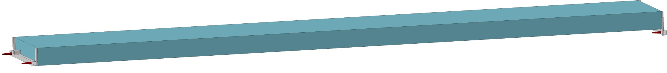
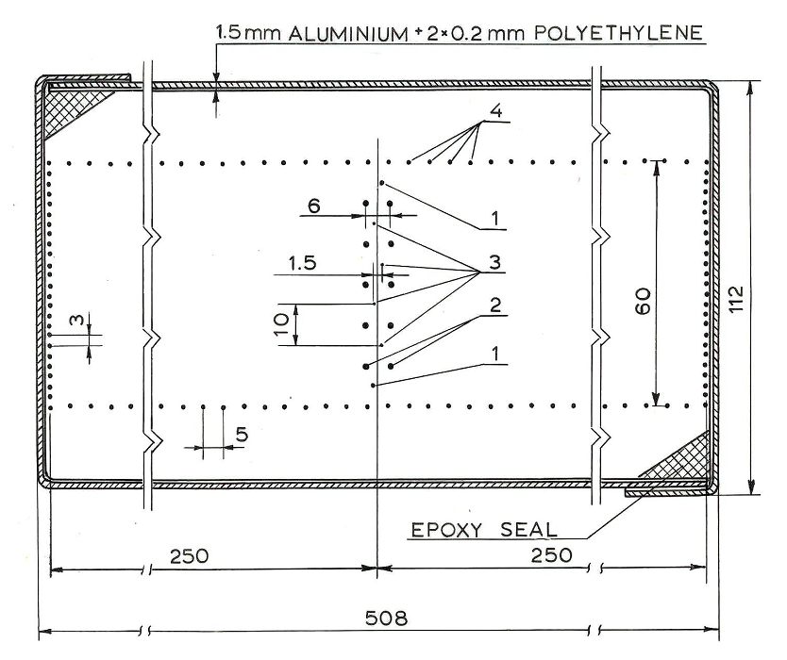
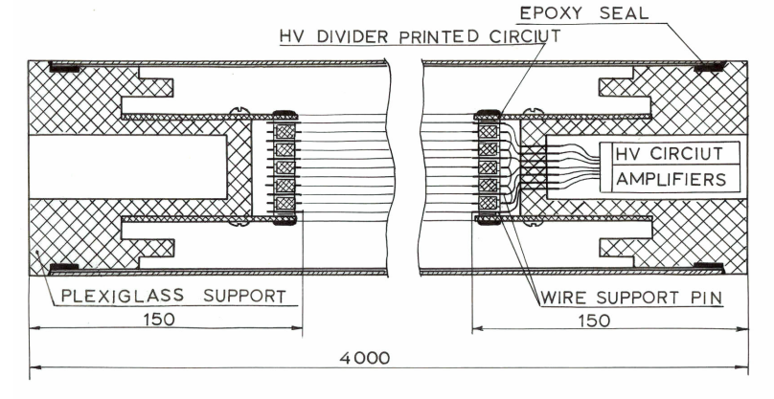
Drift chamber of the IHEP
Coordinate resolution ~ 1 mm
Angle resolution ~ 30 mrad
Resolution between close tracks ~ 5 mm
Gas mixture: 94% Ar + 6% CO₂
Drift time < 6 µs
Drift velocity ~ 40 µm/ns

Slide 4
Principe of registration

Slide 5
Tracks overlapping
Red – registered tracks
Blue – not registered tracks.

Slide 6
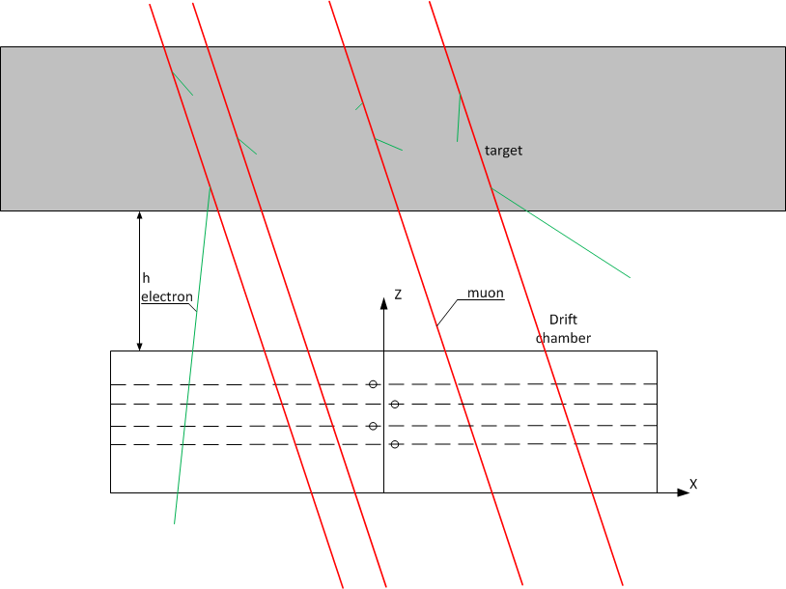
Secondary electrons

Slide 7
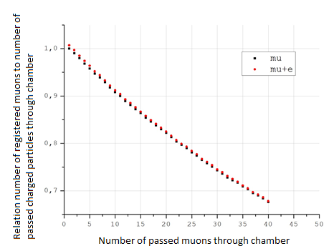
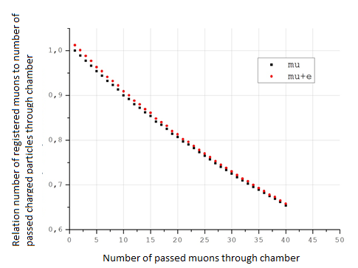
Percentage of registered muons
Perpendicular tracks
Sandwich panel, 1000 GeV
Concrete, 1000 GeV
Percentage of electron tracks < 0.5 %
Percentage of electron tracks < 1.1%

Slide 8
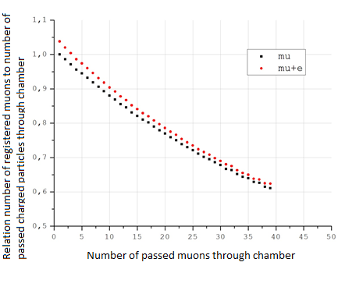
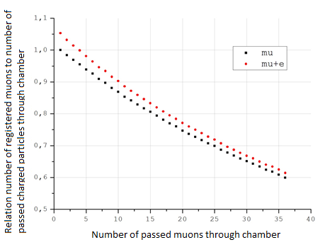
Percentage of registered muons track angle - 60°
Sandwich panel,10 GeV
Concrete, 10 GeV
Percentage of electron tracks < 2.8%
Percentage of electron tracks < 3.8%

Slide 9
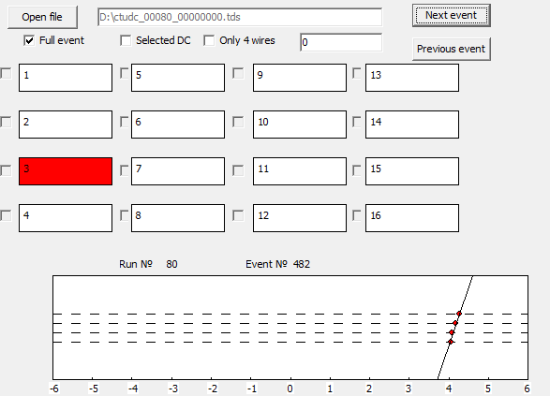
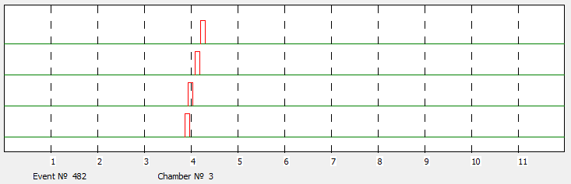
Reconstruction and visualization software for CTUDC

Slide 10
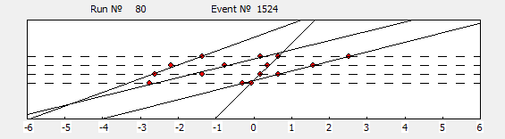
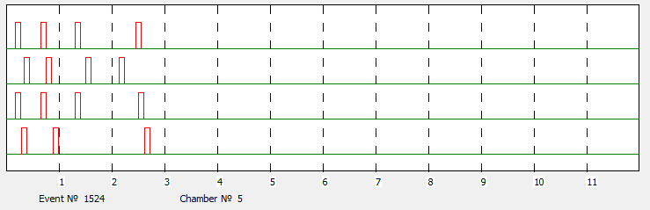
Enumeration method

Slide 11
Search of a straight section method
W – half of allowable region's width
Reconstruction occurs if all channels have W > ΔX

Slide 12
Simulation of parallel tracks

Slide 13
Histogram method
W – half of allowable region's width
α – variable angle

Slide 14
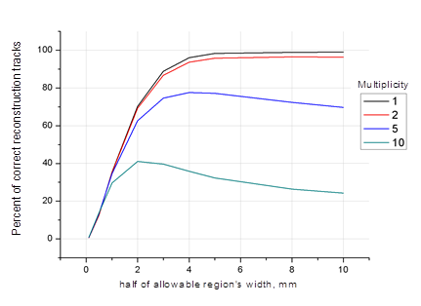
Percent of correct reconstruction of simulation events
Histogram method
Search of a straight
section method
Multiplicity | Enumeration method | Search of a straight section method | Histogram method
1 | 95.0±0.3 | 94.9±0.3 | 98.9±0.3
2 | 88.6±0.3 | 91.7±0.3 | 96.7±0.3
4 | 54.9±0.2 | 76.3±0.2 | 95.0±0.3
5 | 40.31±0.12 | 67.1±0.2 | 92.4±0.3
10 | 17.5±0.2 | 41.1±0.4 | 91.6±0.3

Slide 15
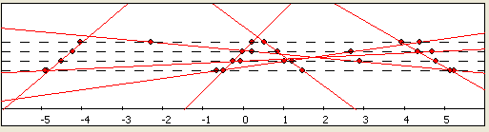
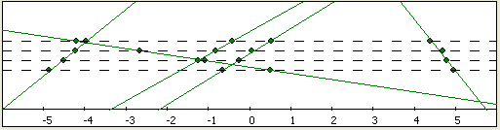
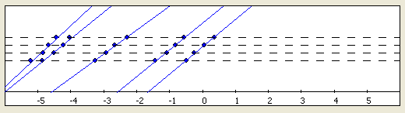
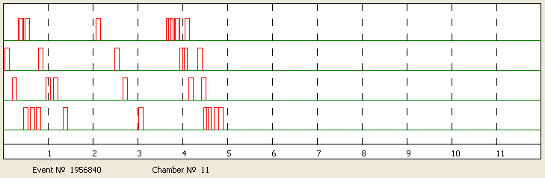
Experimental data
Enumeration method
Search of a straight
section method
Histogram method

Slide 16
Correlation between number of signals on the channel with minimum number of pulses and number of reconstructed tracks by histogram method

Slide 17
Conclusion
Correction coefficient for accounting tracks overlapping and secondary particles in events with high-energy muons obtained for two wall materials
Three methods of mutiparticle event reconstruction developed. This methods were tested with simulated and experimental data.
The analysis of CTUDC events was carried out.

Slide 18
Thank you for attention!

