Slide 1
Status and prospects of "Troitsk νu-mass" experiment
Alexander Nozik

Slide 2
Overview

Slide 3
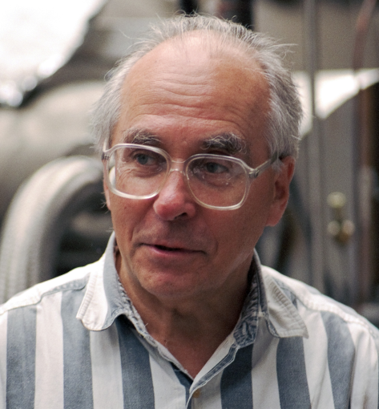
Troitsk ν-mass: 30 years
The idea of experiment was proposed in 1985
First neutrino mass measurements were made from 1994 to 2004.
After calibration measurements with krypton in 2003-2004 the experiment was stopped for modernization of spectrometer and cryogenics.
The final result for electron neutrino mass was published in 2011.
In 2013-2014 first data were taken for sterile neutrino program.
Vladimir Lobashev (1934-2011)
The founder and the actual leader of the experiment

Slide 4
The idea
Non-zero electron neutrino mass or additional neutrino mass eigenstates changes the shape of (tritium) electron beta-spectrum:
$$T_{2}→HeT^{+}+e^{−}+\overline{ν }$$
The dependency of electron spectrum shape on neutrino mass is the following:
$$S\sim \sqrt{1−\frac{m_{ν}^{2}}{{\left(E_{0}−E\right)}^{2}}}$$
Where $E_{0}$ is beta-spectrum endpoint (without neutrino mass).

Slide 5
The setup
Circulation system
Pumped tritium is injected back into the system
Spectrometer
Electrons energy analyzed
Ultra-high vacuum
“Tritium tube”
Tritium decays here
Detector
Electrons are registered and counted
Transport system
Electrons transported but tritium pumped out

Slide 6
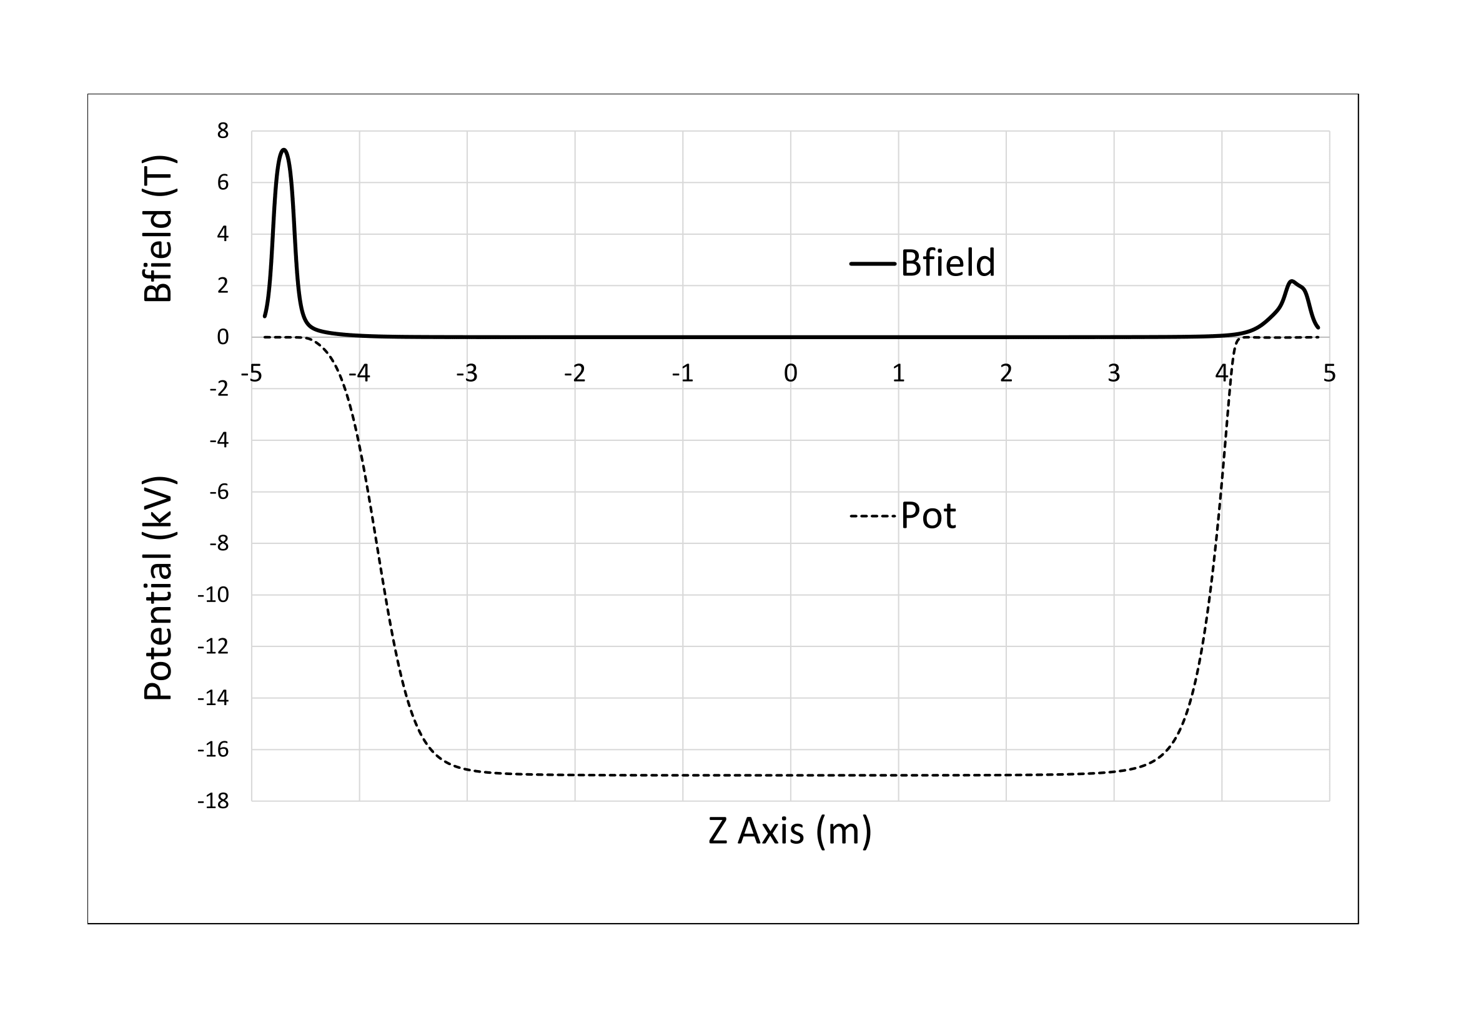
$$\frac{V_{⊥}^{2}}{B_{∥}}=const$$
$$B_{∥}⋅S=const$$

Slide 7
Status and Results

Slide 8
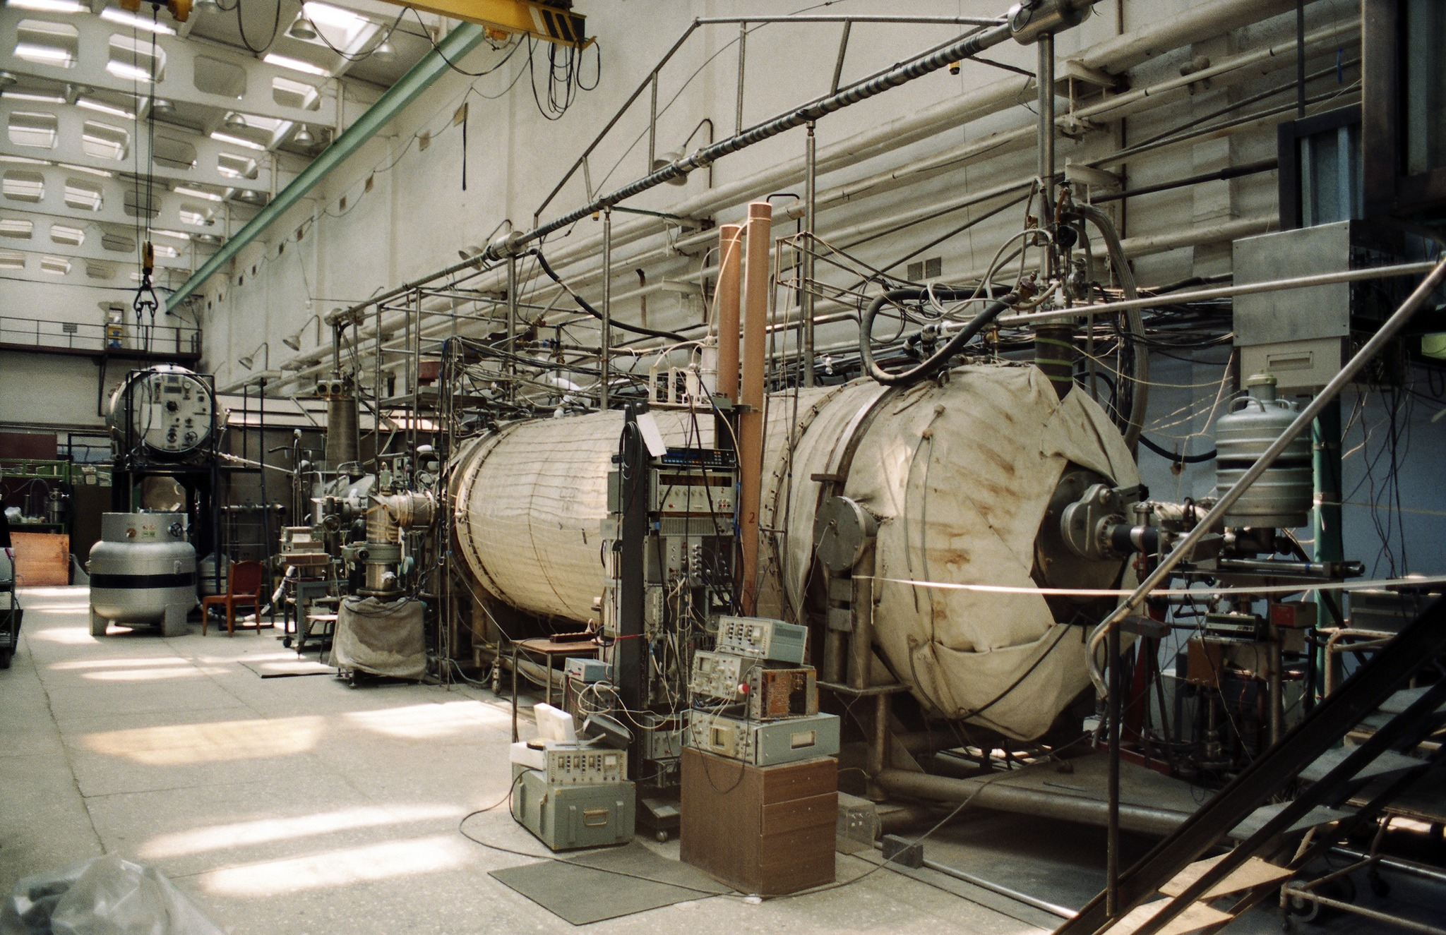
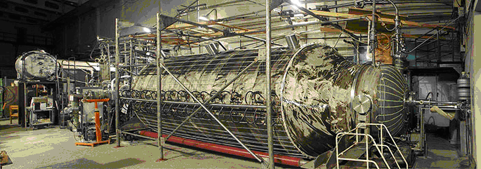
Timeline
Old spectrometer
1985 – start of the experiment
1994 – start of data acquisition
2002 – data acquisition complete
2003-2005 – Krypton measurements
2005-2010 – spectrometer upgrade
2011 – publication of final results for electron neutrino
2012 – start of sterile neutrino program
2015 – first measurements on sterile neutrino program
New spectrometer

Slide 9
Troitsk ν-mass: results for electron neutrino mass
The best direct limit on electron neutrino mass
Particle listing provided by Particle Data Group http://pdg.lbl.gov/
Systematic error could be improved about 30%
Statistical error could not be significantly improved on current setup
The best result, quoted by PDG:
$$m_{ν}^{2}=−0.67±{1.89}_{stat}±{1.68}_{syst} eV^{2}$$
V.N. Aseev et al., Phys. Rev. D84 (2011) 112003, arXiv:1108.5034
Notes:
Fit -> stat
Needs much more statistic

Slide 10
Data from 1994-2005. Sterile neutrino search in 300 eV below the spectrum endpoint
Some results on sterile neutrino could be obtained from data acquired in search for electron neutrino mass!
C.L. 95%
A.I. Belesev et al., J.Phys. G41 (2014) 015001, arXiv:1307.56387

Slide 11
Sterile neutrino program

Slide 12
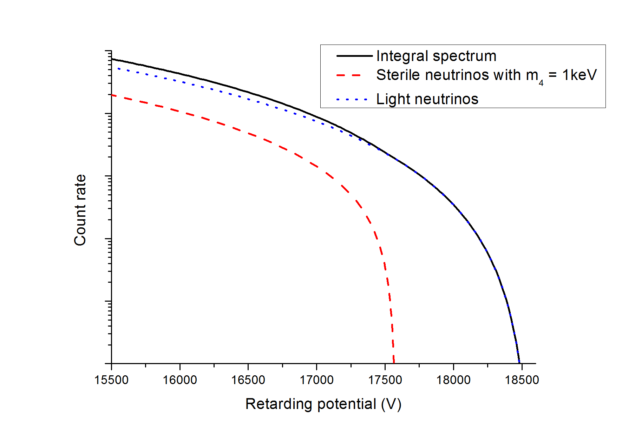
A search for sterile neutrino
$$|ν_{α}> = \sum{U_{αi} |ν_{i}>}$$
$$S\left(E\right)=U_{ex}^{2}S\left(E,m_{x}\right)+\left(1−U_{ex}^{2}\right)S(E,0)$$
One can add additional neutrino components in mixture.
Tritium beta decay could provide information about mass region up to 10 keV
(warm dark matter?).
Spectrum changes like:
Active component
Sterile component
Notes:
Vector form of mixing
No retarging potention-> intergral energy spectrum

Slide 13
Expectations with current equipment
Statistics for about 30 days of measurement including trapping error
Energy loss in the source (current precision)
Detector dead time and pile-up uncertainty (minor upgrade needed)
HV instability (current precision)

Slide 14
Current results and prospects
Current results (~2 days)
Phase I
Need to upgrade:
Transmission function calibration
Further upgrade of data acquisition system
HV stability (new HV equipment and software)
Source thickness monitoring (remodeling of tritium loop and vacuum system)
Recalculate trapping effect for electrons in WGTS and detector response for different energies (a lots of simulations).
A new software for data acquisition and storage
Phase II

Slide 15
The future

Slide 16
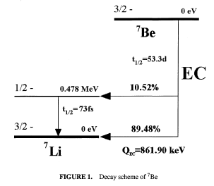
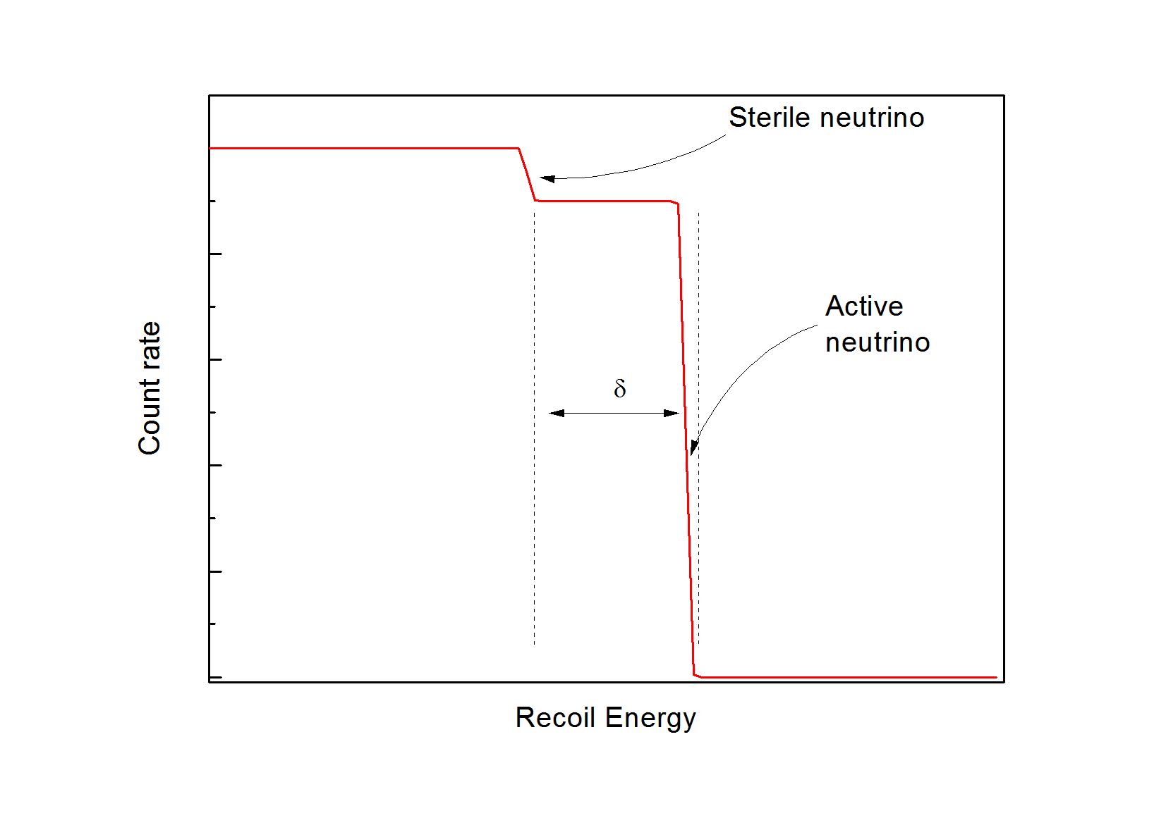
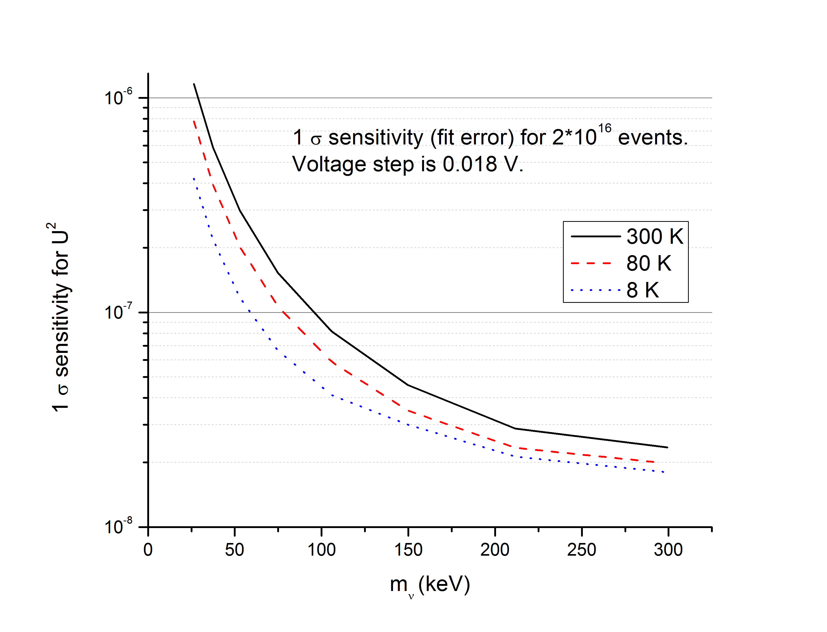
Electron capture instead of beta-decay
$$Be→Li+ν$$

Slide 17
Graphene infused source
Why make graphene infused radioactive source?
Very high chemical bounding energy (no desorption).
Very uniform surface.
Conductor (no substrate charging).
Mechanical durability (easy to cool down and heat up).
Industrial availability (200$ per sample)

Slide 18
Compact source
Sterile neutrino measurements do not require “large” source.
Old Troitsk nu-mass source is outdated and is very hard to maintain.
Solution: compact multi-purpose volume for different radioactive sources as well as e-gun measurements.
Problem: manpower.

Slide 19
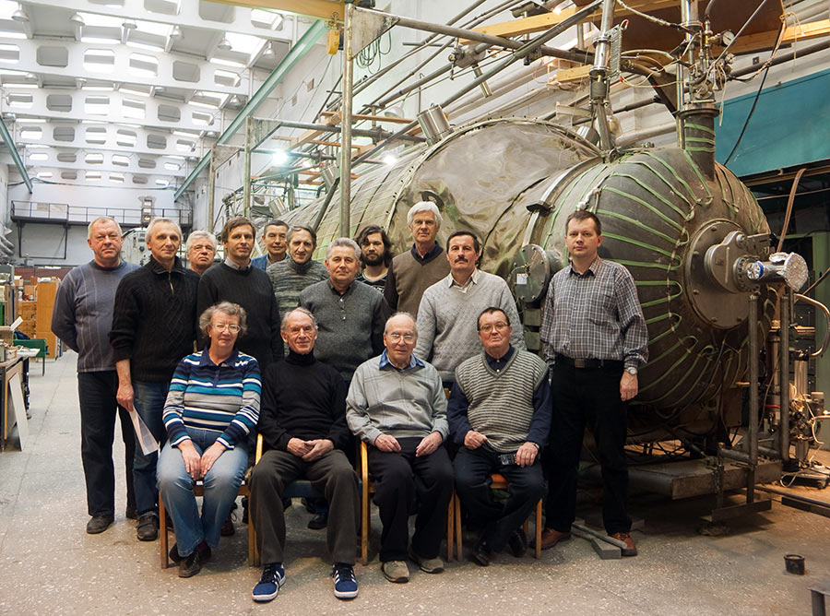
Thank you for your attention
We invite anyone interested into collaboration!

