Slide 1

Current Tendences in the Development of Neutron and X-ray Detectors for Common Use
V.I. Mikerov, A.S. Sviridov , D.I. Yurkov
All-Russia Research Institute of Automatic by N. L. Duchov
National Research Nuclear University MEPhI (Moscow Engineering Physics Institute)

Slide 2
The report is a brief review of activities of National Research Nuclear University “MEPhI” and Federal State Unitary Enterprise “VNIIA” in the development of radiation detectors
The development of state-of-the-art radiation detectors decidedly broadens potentials of nuclear techniques in a wide range of applications

Slide 3
Line of VNIIA activities in the field of radiation detection
Imaging detectors for neutron and X-ray radiography and tomography
Imaging detectors for localization and identification of radiation sources
Multi-energy X-rays (gamma) sensors
Radiation detectors for well-logging devices
Electrometric neutron sensors

Slide 4
Imaging detectors for neutron and X-ray radiography and tomography
An innovative imaging system conformed to neutron source in combination with a sophisticated software could provide appropriate productivity and achievable results in terms of testing quality

Slide 5
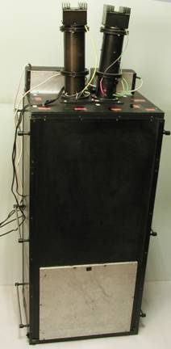

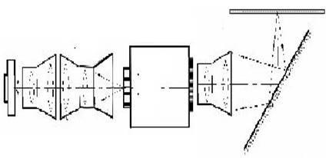
Optical arrangements of luminescent CCD-detectors for X-ray, thermal & fast neutrons
1
2
3
4
7
1
2
3
4
6
1 – CCD-matrix
2 – scaling lens
3 – image intensifier
4 – lens or taper
5 – optical filter
6 – mirror
7 – converter
400 mm

Slide 6
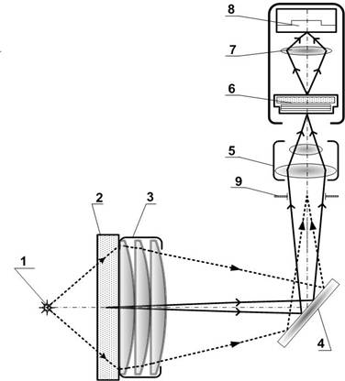
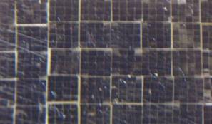
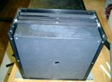
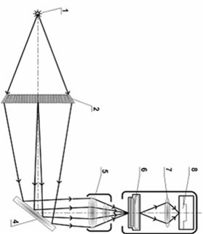
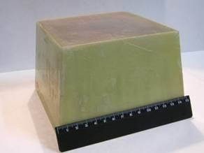
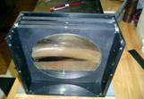
Optical arrangements of luminescent CCD-detectors for a conical beam of fast neutrons
Optics transfers only scintillation photons propagating along radiation rays emitted by a “point” like source
1 mm
9
8
7
6
5
1
2 3
sample
1
sample
4
2
1 – fast neutron source
2 – converter
3 – condenser
4 – mirror
5 – aperture
6 – lens
7 – image intensifier
8 – scaling lens
9 – CCD-matrix
6 7 8 9
3
4

Slide 7
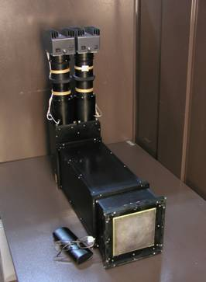
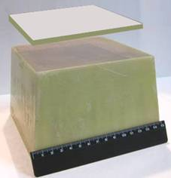
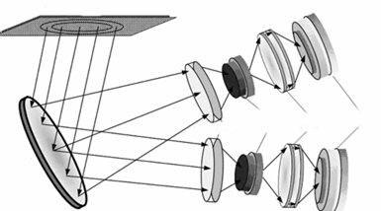
Detector for imaging X-ray and fast neutrons simultaneously
Images produced at the display surface of the screen come into view in different regions of visible spectrum. Optical filters allow to separate them and register independently
1
1 – CCD-matrix
2 – scaling lens
3 – image intensifier
4 – lens
5 – optical filter
6 – mirror
7 – composite converter
2
3
X-ray converter
λ₂ – X-ray
λ₁ - neutrons
7
fast neutron
converter
5
4
3
2
1
6

Slide 8
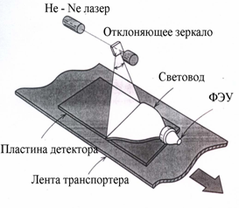
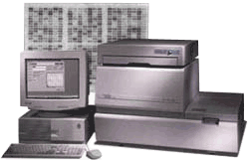
Detectors on the basis of Imaging Plates (IP)
2 types
IP-plates
reader
e⁺
n⁰
n⁰
p
γ
1. Cu - converter
2. PE - converter
(Е_{thr} >11MeV)
X - ray
n⁰
2
1
3
1 – imaging plates
2 – lead screen
3 – PE converter

Slide 9
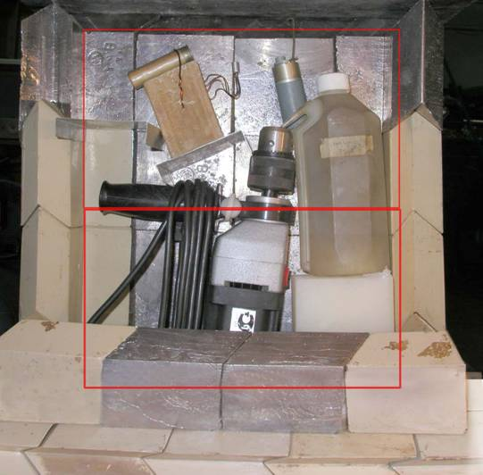
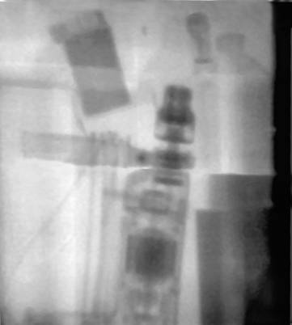
Imaging with a portable fast neutrons generator
n°

Slide 10
Imaging detectors for detection and identification of radiation sources
To prevent smuggling and illegal traffic

Slide 11
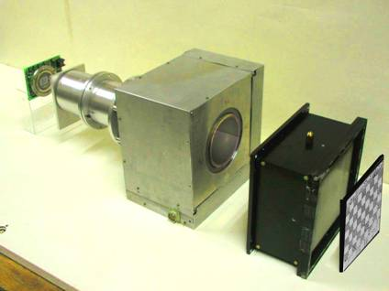
Imaging detectors for detection and identification of fast neutron sources
1600
The detector operation is based on imaging both fast neutrons of the source and thermal neutrons produced in the fiber optical screen
due to fast neutrons moderation
1500
1400
1300
1200
“LINE” – detector
(Localization and Identification of Neutron Emitters)
S
1100
2
1000
90
900
ϕ
60
ϕ
800
30
CCD-matrix
image intensifier
700
0
600
-7.5
-6.5
-5.5
-4.5
-3.5
-2.5
-1.5
-0.5
0.5
1.5
2.5
3.5
4.5
5.5
6.5
7.5
100
fission
fast
10
3 MeV
/ S
thermal
fiber optical
fast neutron converter
S
1
14 MeV
ϕ
imaging matrix for thermal
neutrons
0,1
-7,5
-6,5
-5,5
-4,5
-3,5
-2,5
-1,5
-0,5
0,5
1,5
2,5
3,5
4,5
5,5
6,5
7,5
X, cm

Slide 12
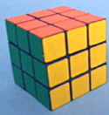
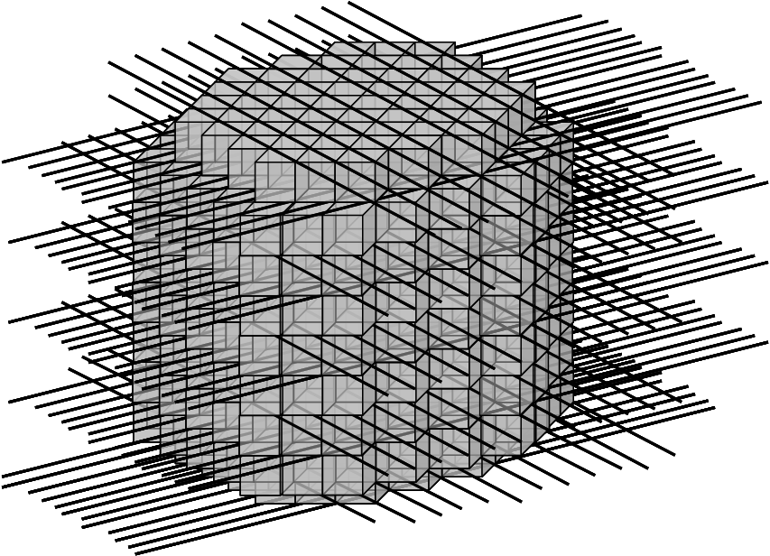
Imaging detectors for localization and identification of neutron and gamma sources
Z
WLS read-out
Y
X
radiation
Isotropy of the response function (automatic operation)
Capability to register both neutrons&gamma
and to discriminate them
Simultaneous acquisition of:
- spatial (3-D) distributions
- time distributions
amplitude distributions
More capabilities to discriminate background radiations
The number of read-out channels
is much less than the number of
scintillators

Slide 13
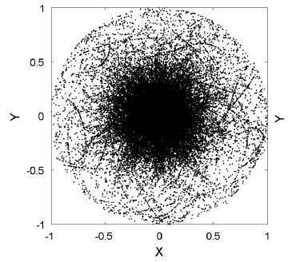
Source localization and identification by “electronic” collimation
Neutron source is identified by
primary neutron energy
Source position is localized by density of intersection
points of conical surfaces
θ_{n}
S
Image of a monodirectional source of fission neutrons
X, Y - normalized projections of the vector pointing
at the source location from the assembly center
E_{n}=E_{p1} + E_{n'} = E_{p1} + m(S/Δt)²/2

Slide 14
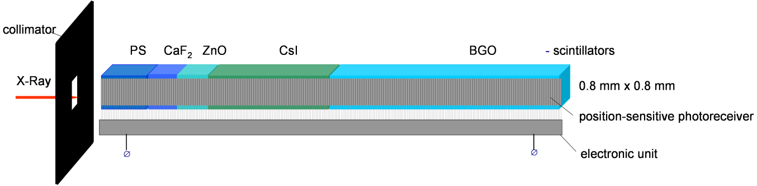
Concept of Multi-Energy X-ray (Gamma) Sensors for energy range ∼10 кэВ – 1 Мэв
Based on the relationship between the spatial distribution of scintillation signal
generated in a scintillation plate and the radiation spectrum
collimator
PS CaF₂ ZnO CsI BGO
X-ray
linear position-sensitive
photoreceiver
electronics
Response function (simulation)

Slide 15
Detectors for well-logging devices
  Neutron well-logging tools have been used to measure physical characteristics of geological formations for many years
  Spatially resolved data provide considerable additional information as compared to the data obtained at fixed distances (at two, as a rule)

Slide 16
Detectors concept for well-logging devices
Position-sensitive detector for thermal neutrons
4
Axial position of neutron interaction is determined by
relation of signals produced at the opposite ends of the scintillator
5
А-А
3
2
1
2
2
1
6
3
1 – scintillator
2 – reflector
3 – optical waveguide
4 – photomultiplier
5 – ADC
6 – controller
А
А
∼1 mm
Li glass
5
Optical waveguide decreases the reflection number more than
by order of magnitude
4

Slide 17
Detectors concept for well-logging devices
Position-sensitive detector for thermal, epithermal and fast neutrons
3
2
Axial position of neutron interaction is determined by
relation of signals produced at the opposite ends of
a luminescent fiber practically at the same time
Angular position is determined by the responded elements of
position sensitive photomultiplyers
4
А-А
1
А
А
1 fibre-optical scintillator for thermal neutrons
2 – fibre-optical taper
3 – position sensitive photomultiplier
4 – optical connector
5 thermal neutron absorber
6 fibre-optical scintillator for thermal neutrons
7 hydric fibre-optical scintillator for fast neutrons
5
7
6
4
2
3

Slide 18
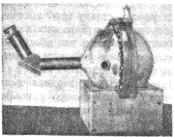
Electrometric neutron sensors concept
Design principle
Neutrons hitting the emitter (1) cause nuclear reactions which result in emitting charged particles
Some of them are accumulated in the absorber (2)
Electric field and electrostatic attraction force between the emitter and the absorber appear and increase when the sensor is exposed to neutrons
3
1
n⁰
A prototype - spherical electroscope
F
1 - emitter of charged particles
2 - absorber of charged particles
3, 4. - springing elements
F - Coulomb force
2
3
Millikan R.A., Cameron G.H.
1928

Slide 19
Efficiency of electrons generation in Gd by thermal neutrons (simulation)
e⁻/n⁰
layer thickness, μm

Slide 20
Efficiency of electric charge generation by fast neutrons (simulation)
Maximum charge output at: d ≅ 100 μm for В-11 and d ≅ 1500 μm for Са-40
Neutron energy, MeV | Material
 | B-11 | Ca-40
1 | 3.2E-5 | 8.3E-7
1,5 | 6.6E-5 | 1.3E-6
2,5 | 8.7E-5 | 1.2E-5
4 | 6.4E-5 | 2.4E-5
6 | 8.5E-5 | 1.6E-4
10 | 8.5E-5 | 3.8E-4
14,5 | 1.7E-4 | 4.1E-4

Slide 21
Measured quantities
Emitter and absorber bridging frequency
Emitter or/and absorber displacement
Elastic element deformation
Charge and electrostatic force values
Electric field intensity in the gap

Slide 22
Distinctive features
Simple design
No radioactive materials
No limitations on fluence and flux density
Low-sensitive to electromagnetic noise
No external power supply for some designs
Non-electrical detection threshold

Slide 23
Conclusion
At the moment the progress in the radiation detection is conditional upon technological achievements in the development of materials possessing in particular high luminosity, sensitivity, spatial and/or spectral resolution, capable of detecting radiation at severe environment especially while well-logging

Slide 24

Winter comes soon
THANK YOU FOR YOUR ATTENTION !

