Slide 1


Solar modulation of galactic cosmic rays during 2006-2016 based on PAMELA and ARINA data
(preliminary results)
Mayorov Andrey
on behalf of PAMELA collaboration
NRNU MEPhI
The 2nd International Conference on Particle Physics and Astrophysics, Moscow, Oct. 2016

Slide 2
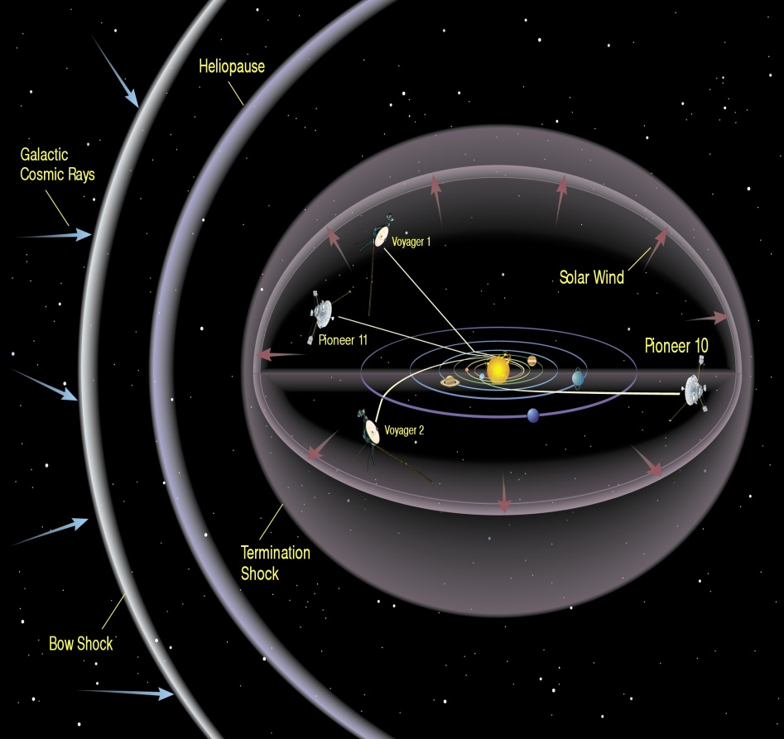
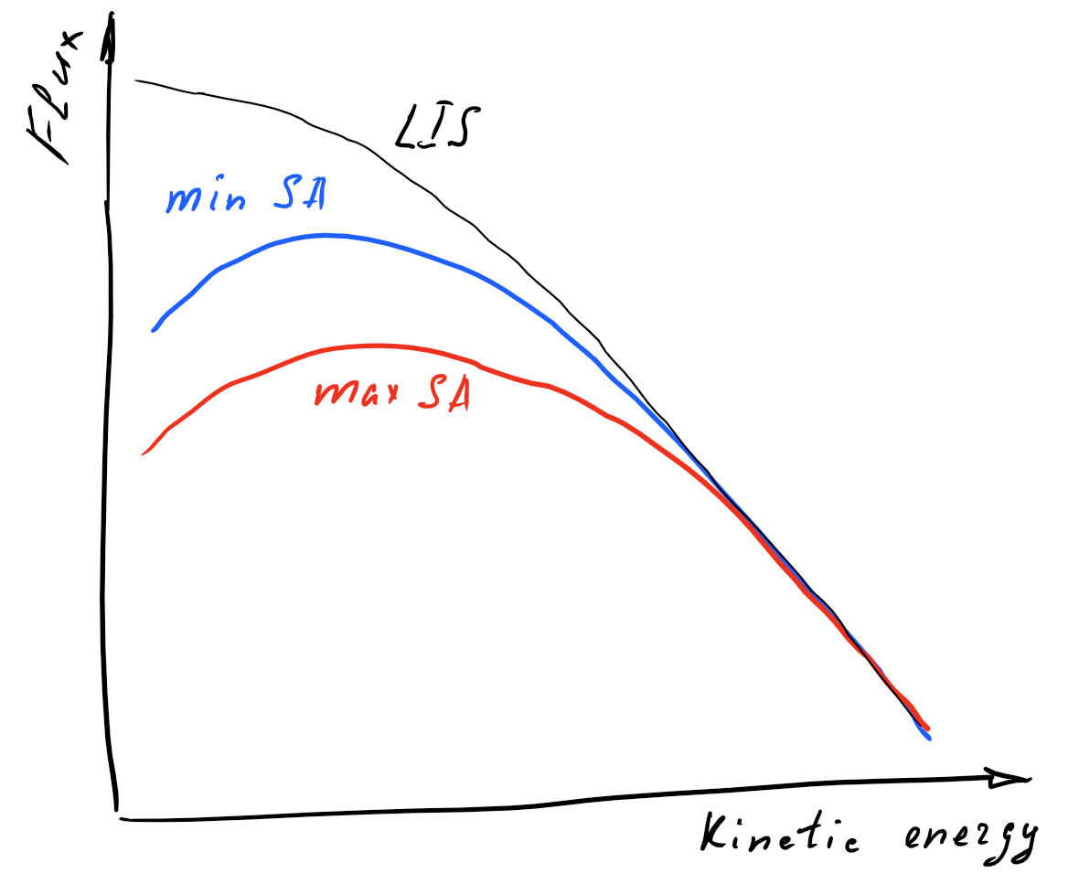


What is Solar modulation?
Flux of CR particles
Diffusion
Drift
Convection
Adiabatic losses
Solar as a source of:
Interplanetary magnetic field
  - regular component
  - current sheet
Solar wind
$$\vec{B}$$
α
$$\vec{v}$$
Transport equation

Slide 3
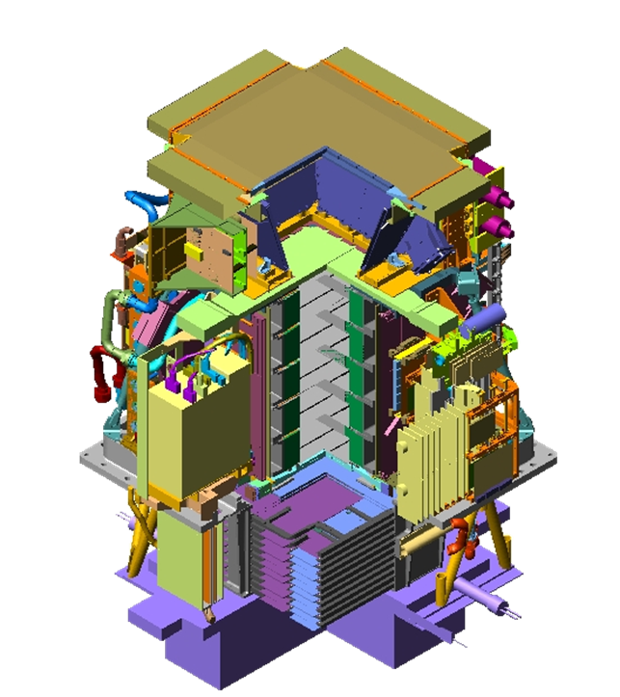
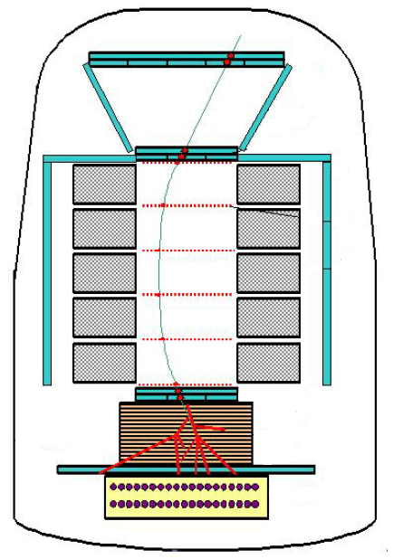
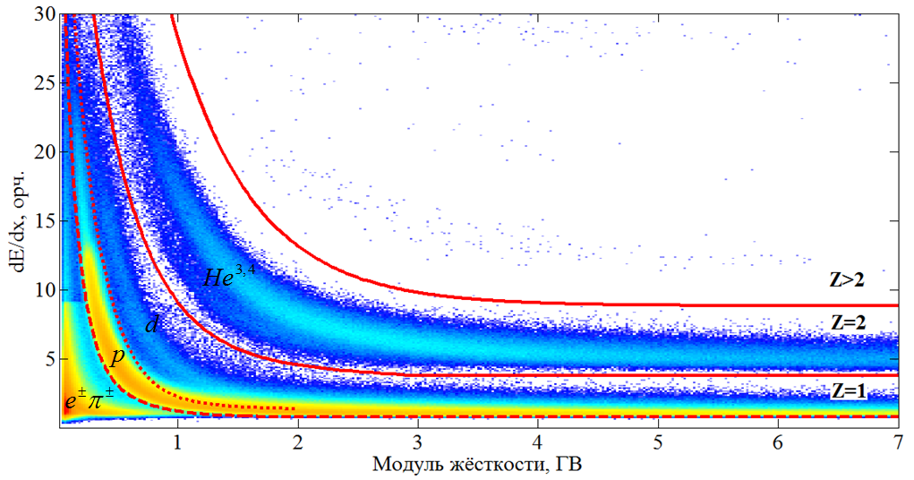
Научная аппаратура «ПАМЕЛА»
Запущена 15 ^{июня} 2006 г. на ИСЗ Ресурс-ДК1
PAMELA magnetic spectrometer
Time-of-Flight (ToF) system
Anticoincidence (AC) system
Magnetic spectrometer
The sampling imaging electromagnetic calorimeter
Bottom Scintillator S4 and Neutron Detector
7
«Инновационная деятельность в науке и технике» 1.11.2012, НИИЭМ, Истра, Россия

Slide 4
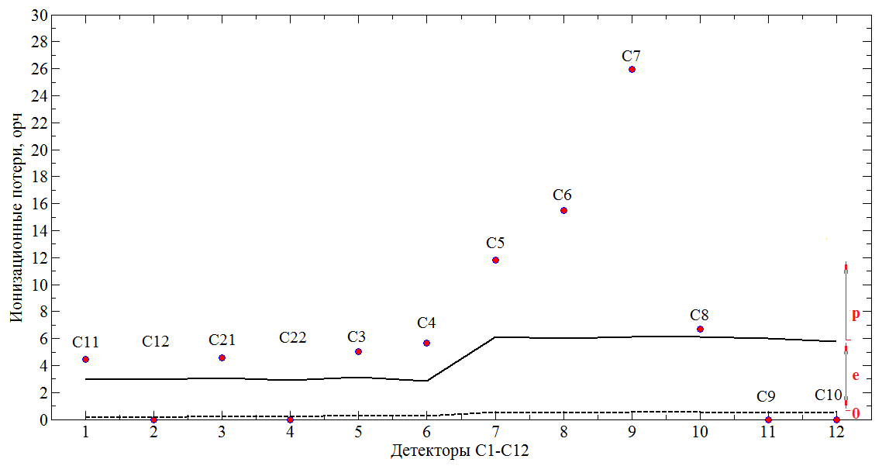
ARINA scintillator spectrometer
С1-С10 - пластические сцинтилляторы

Slide 5
Measurements of PAMELA & ARINA spectrometers
Available CR components
Electrons
Positrons
Antiprotons
Protons
Helium
Light nuclei isotopes
Nuclei
Significance of data
Time variation
- during 10 years
- ~27 days (or less)
- hourly (Forbush)
Energy dependence of SM
Charge and charge sing dependence of SM
Effective region of SM
Diffusion coefficients, drift etc.
Etc.
Time dependence of the proton flux measured by PAMELA during the 2006 July-2009 December solar minimum // Astrophysical Journal, 2013 Vol. 765, No. 2
Solar Modulation of Galactic Cosmic Rays during 2006-2015 Based on PAMELA and ARINA Data // Physics Procedia, 2015 Vol. 74
Time Dependence of the Electron and Positron Components of the Cosmic Radiation Measured by the PAMELA Experiment between July 2006 and December 2015 // Phys. Rev. Lett. , 2016 Vol. 116, No. 24
Talk of Prof. Vladimir V. Mikhailov “Sharp increasing of positron to electron fluxes ratio below 2 GV measured by PAMELA” on ICPPA-2016

Slide 6
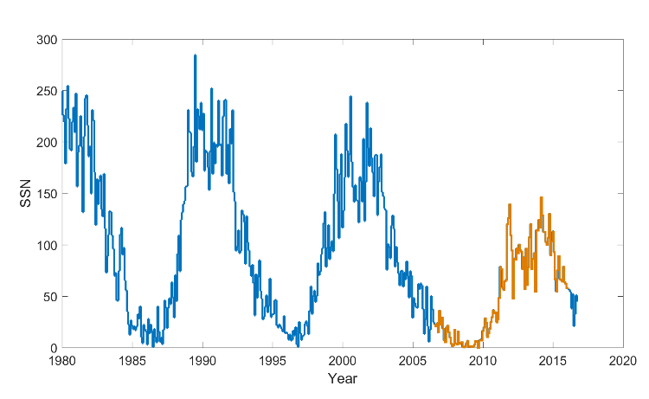
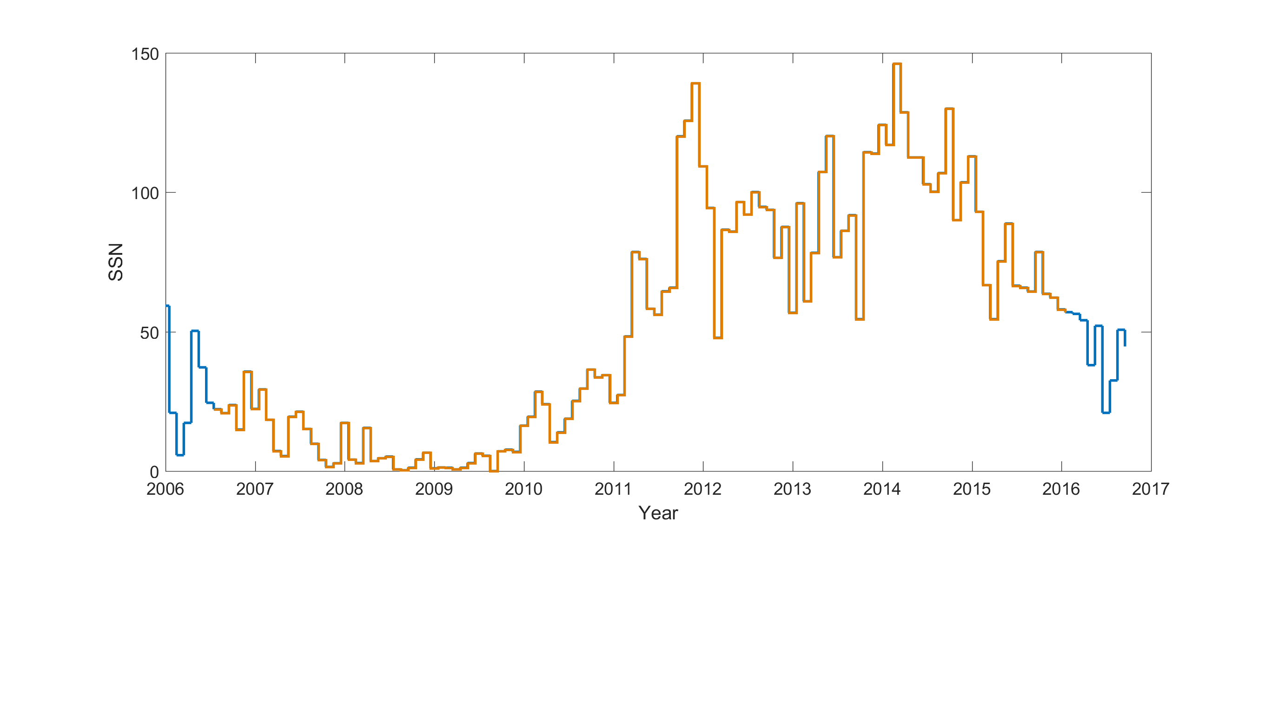
“Age” of PAMELA & ARINA
21
22
23
24

Slide 7
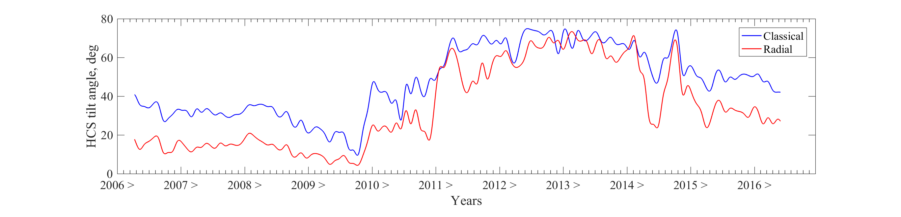
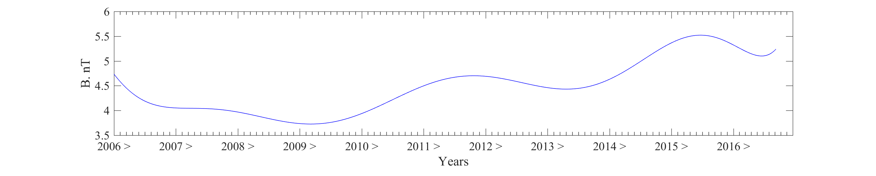
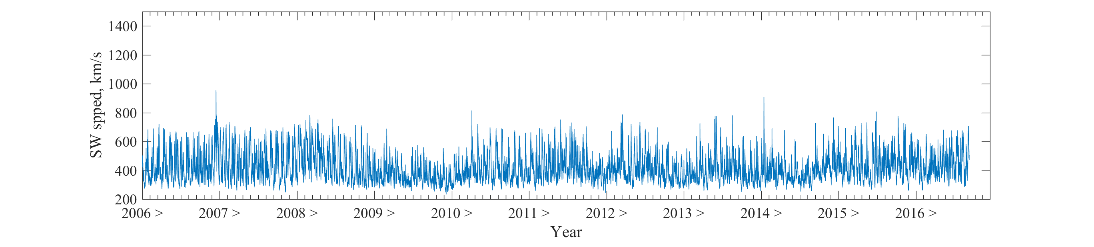
Heliospheric characteristics during PAMELA & ARINA “age”

Slide 8
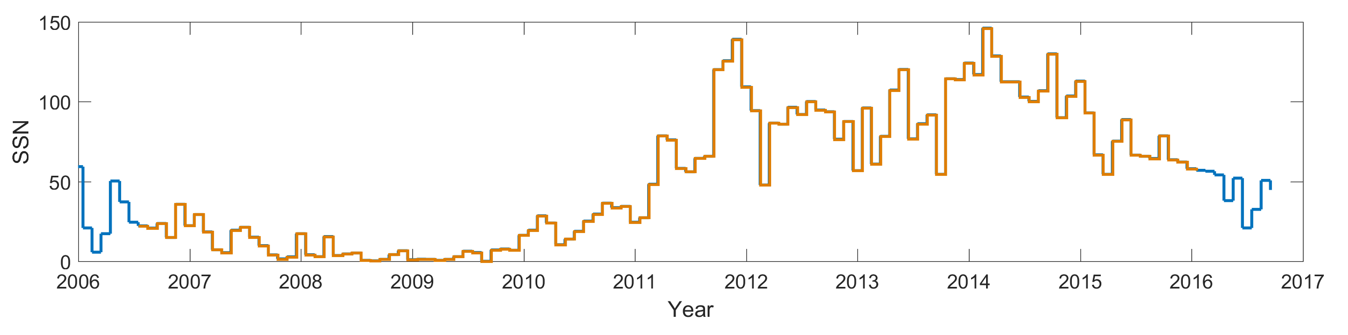
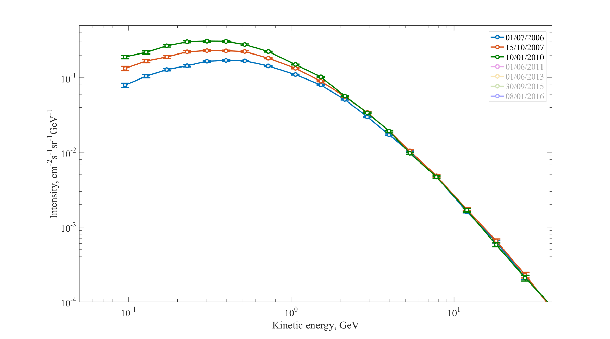
Proton and helium spectra before 2010 (decrease of SA)

Slide 9
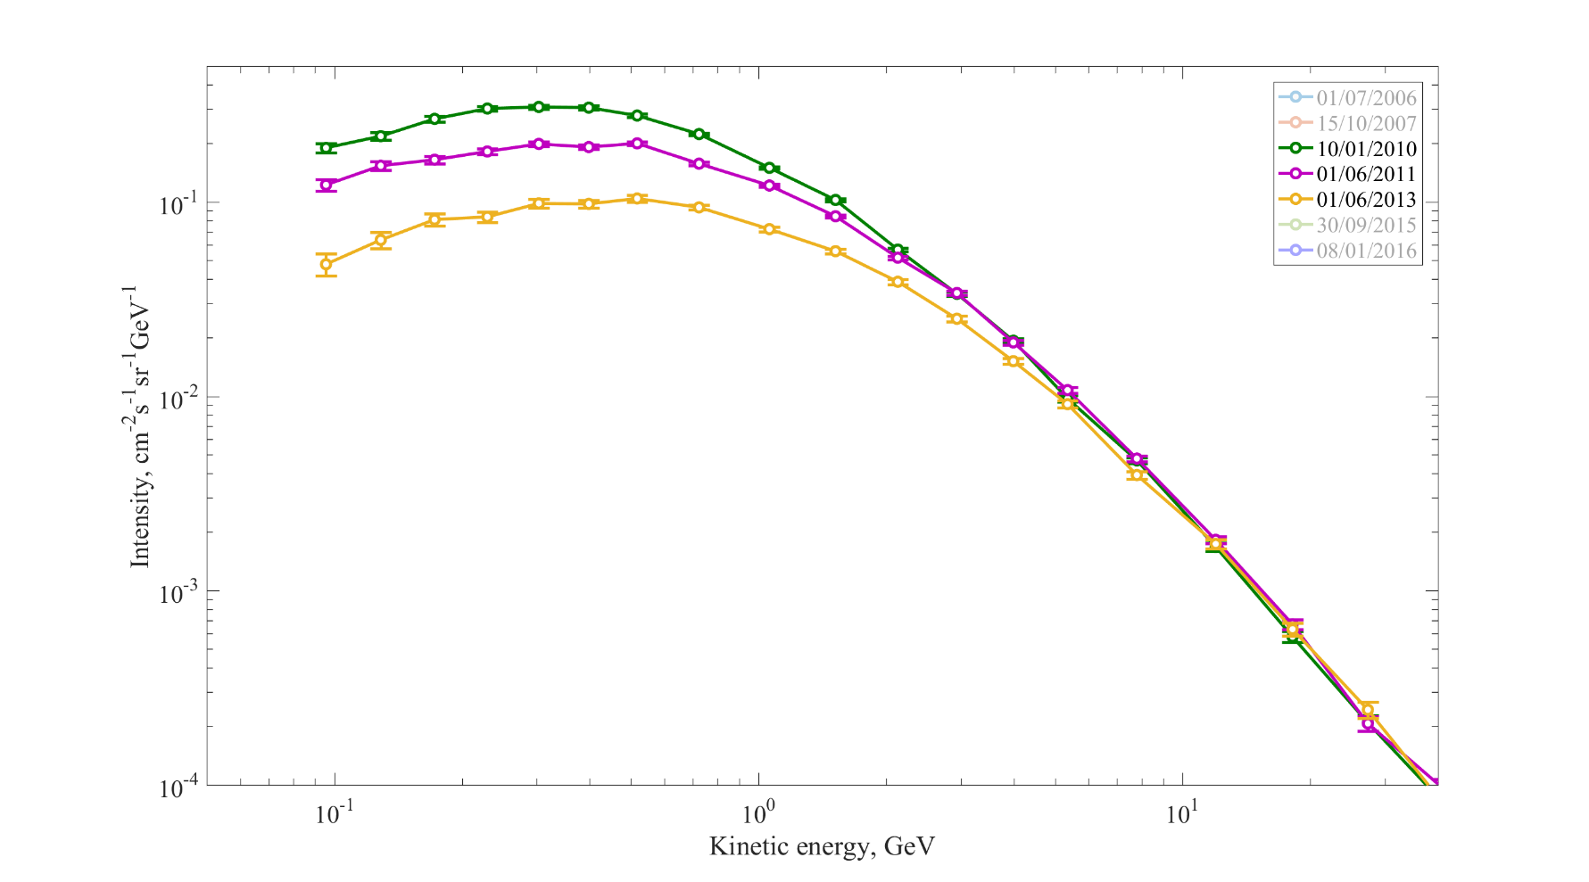
Proton and helium spectra in 2010-2013 (increase of SA)

Slide 10
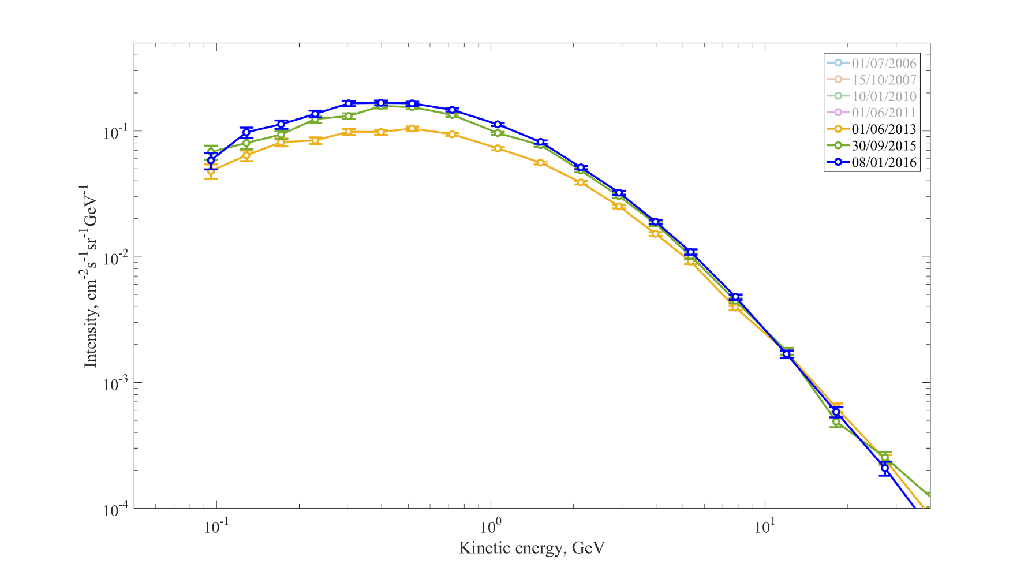
Proton and helium spectra after 2013 (decrease of SA)

Slide 11
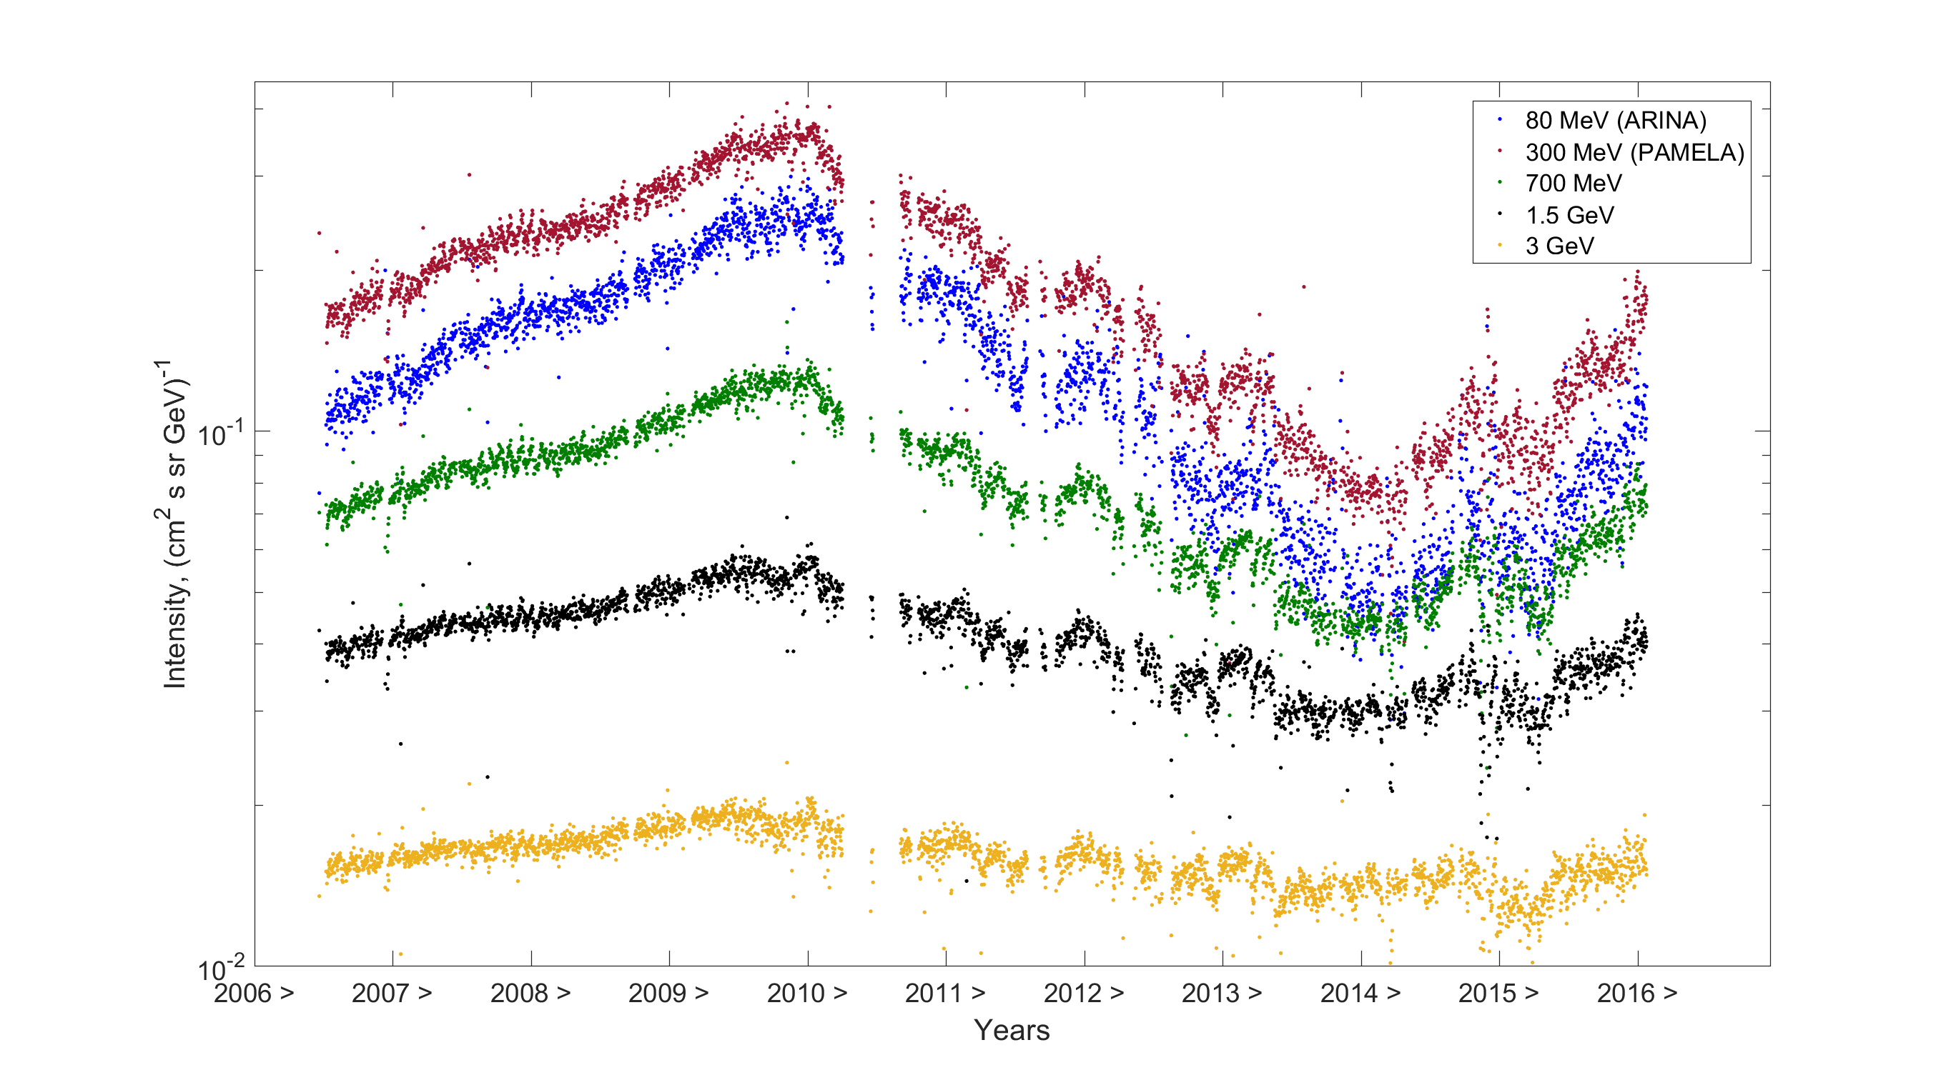
Time profiles of GCR protons
preliminary
x0.5
x0.5
x0.5

Slide 12
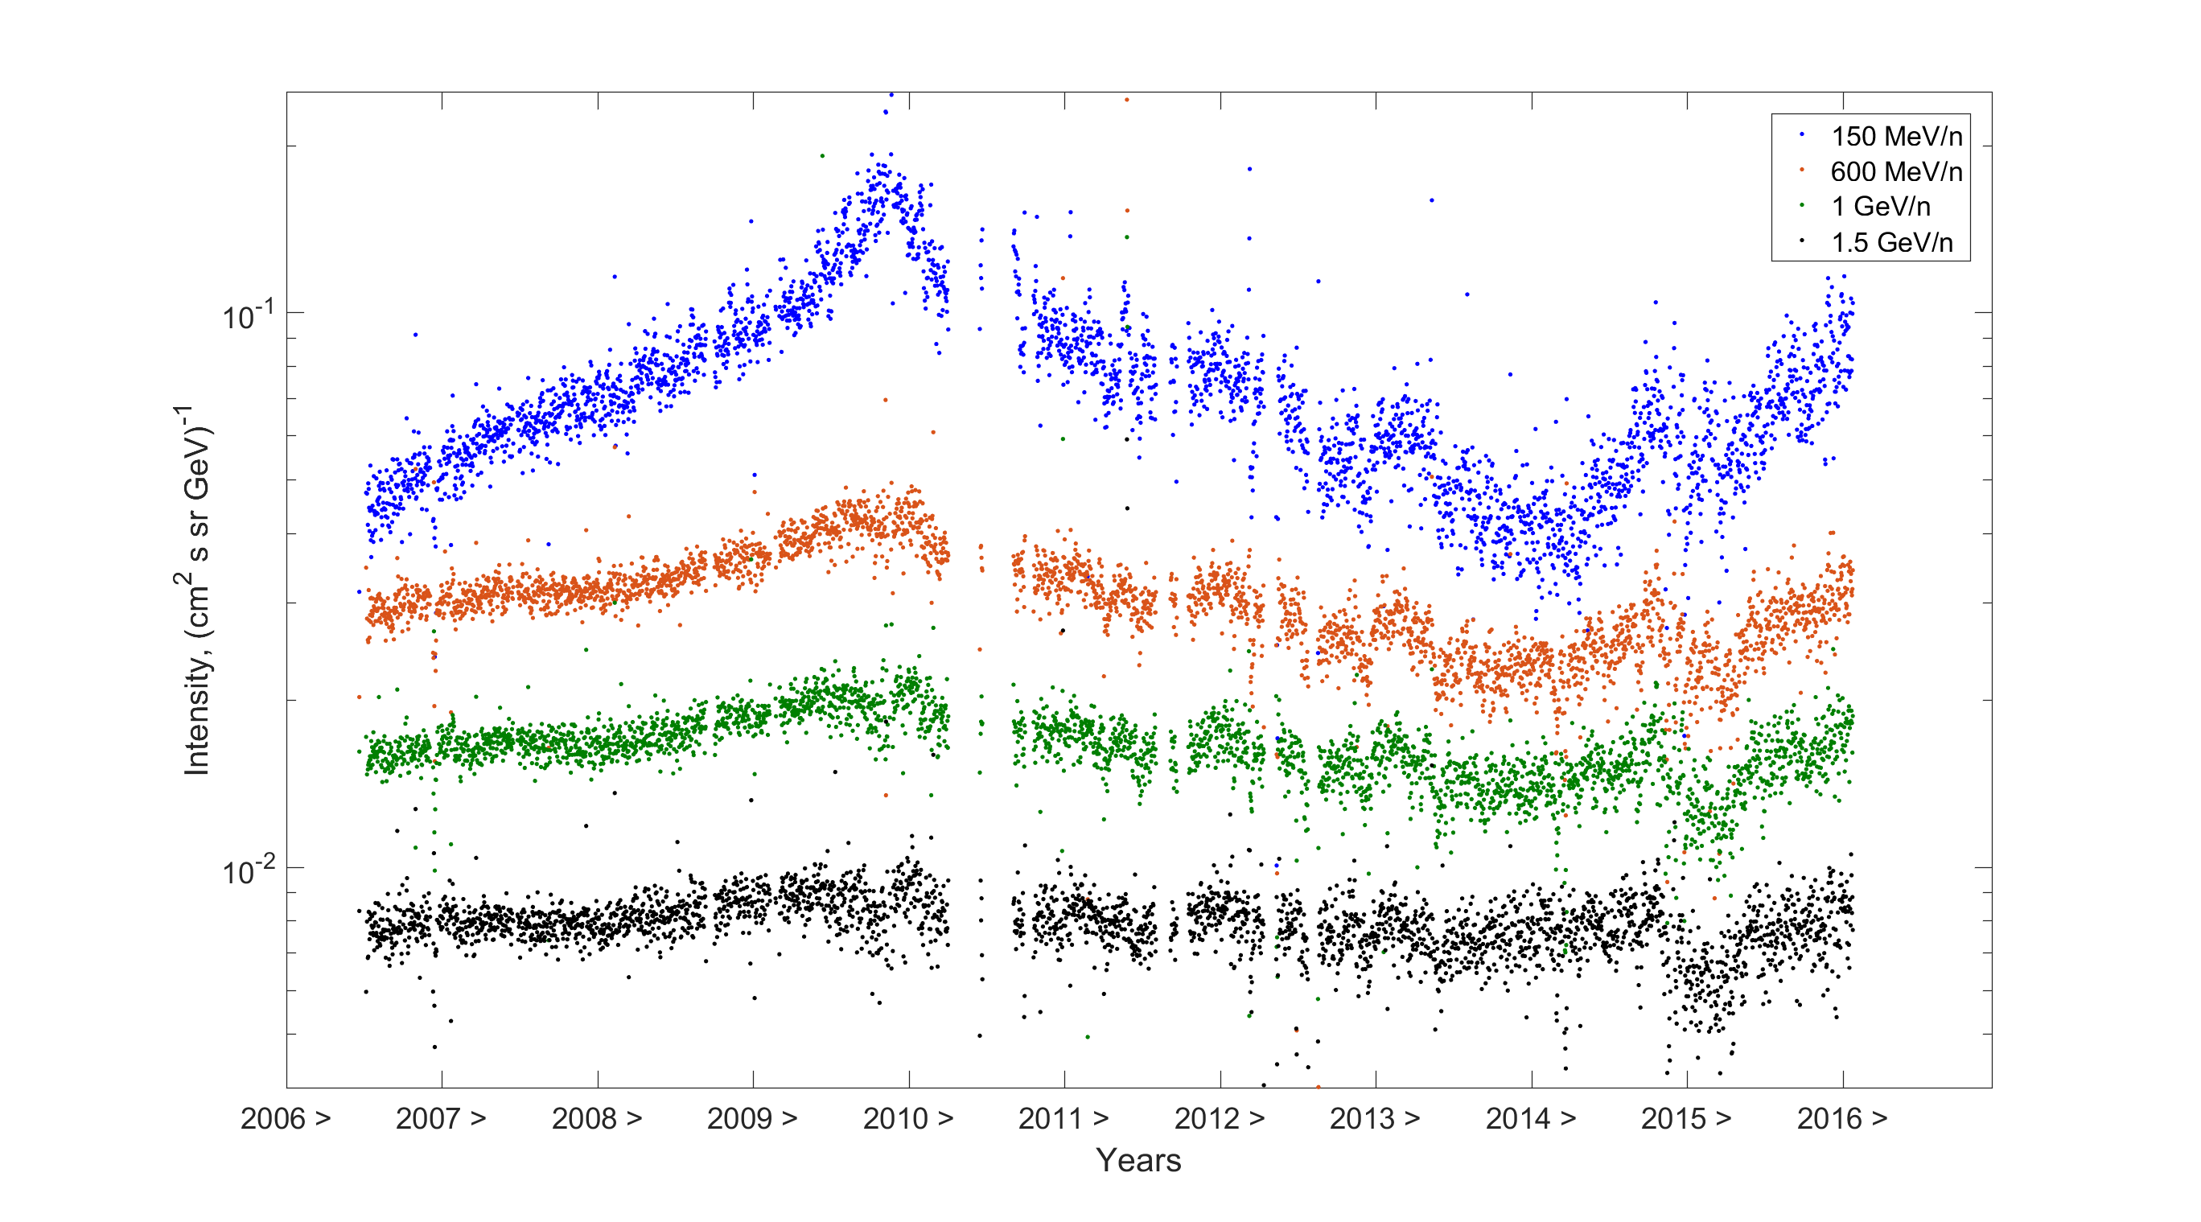
Time profiles of GCR helium
preliminary
x2

Slide 13
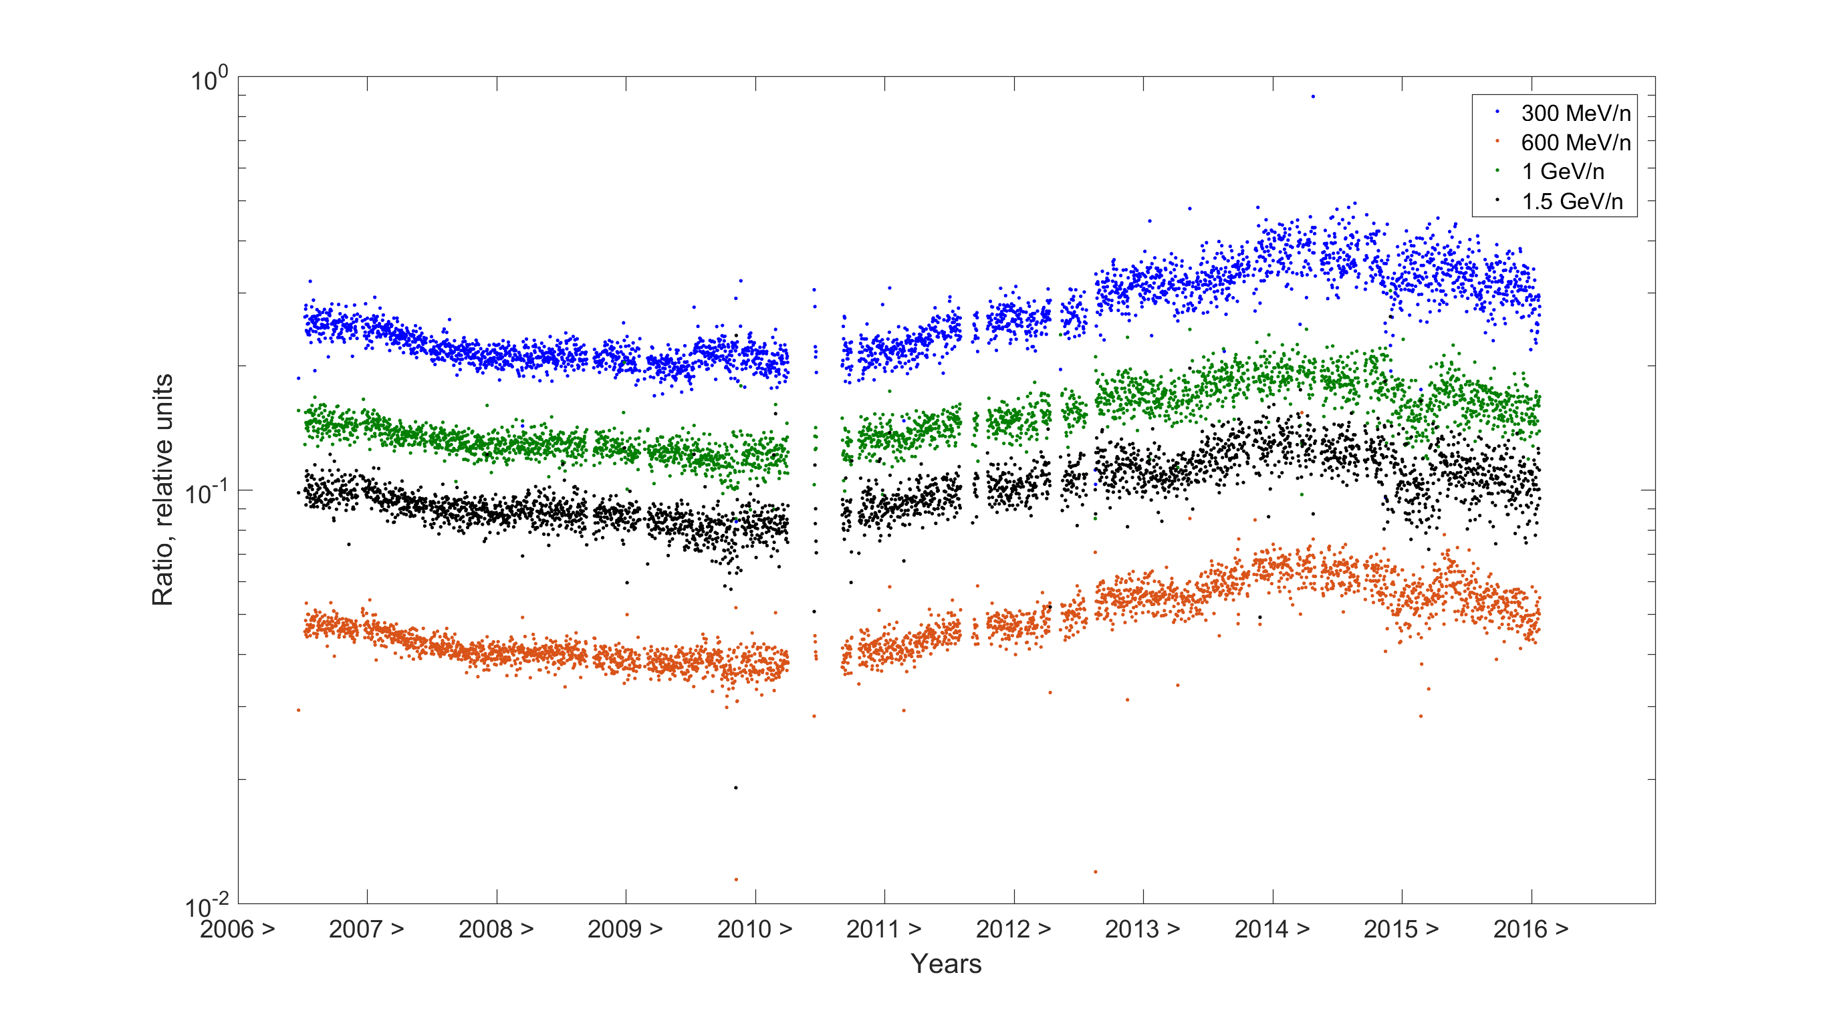
Ratio of helium to protons. Fixed kinetic energy.
preliminary

Slide 14
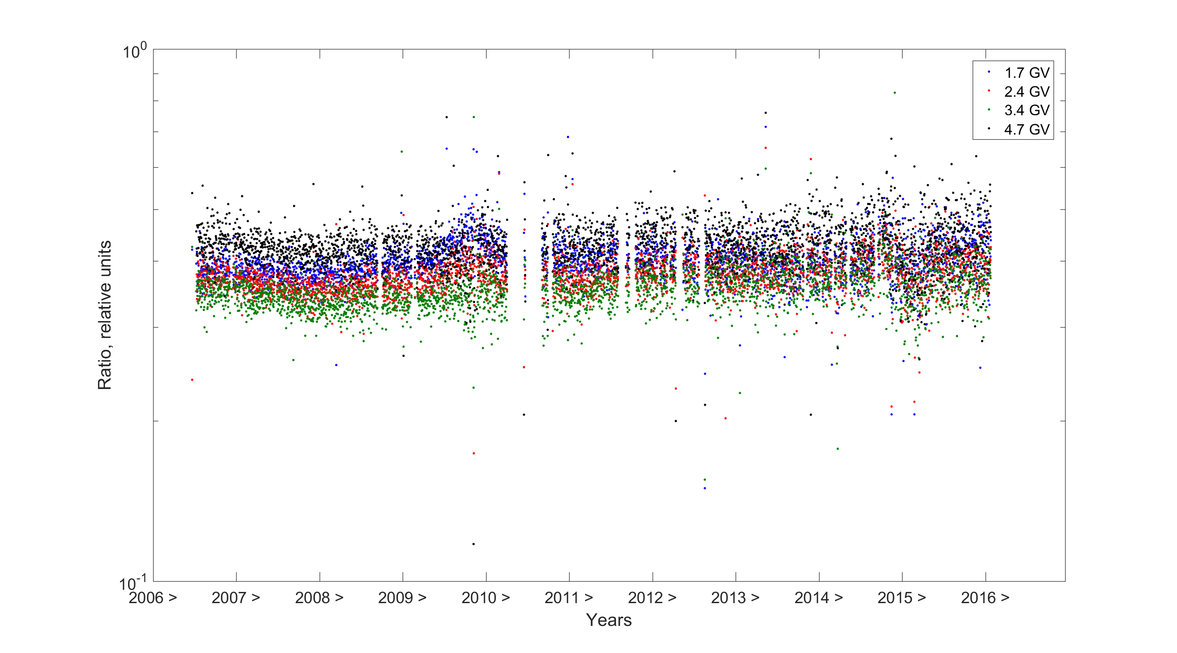
Ratio of helium to protons. Fixed rigidity.
preliminary
Rigidity dependence of solar modulation (as expected?).

Slide 15
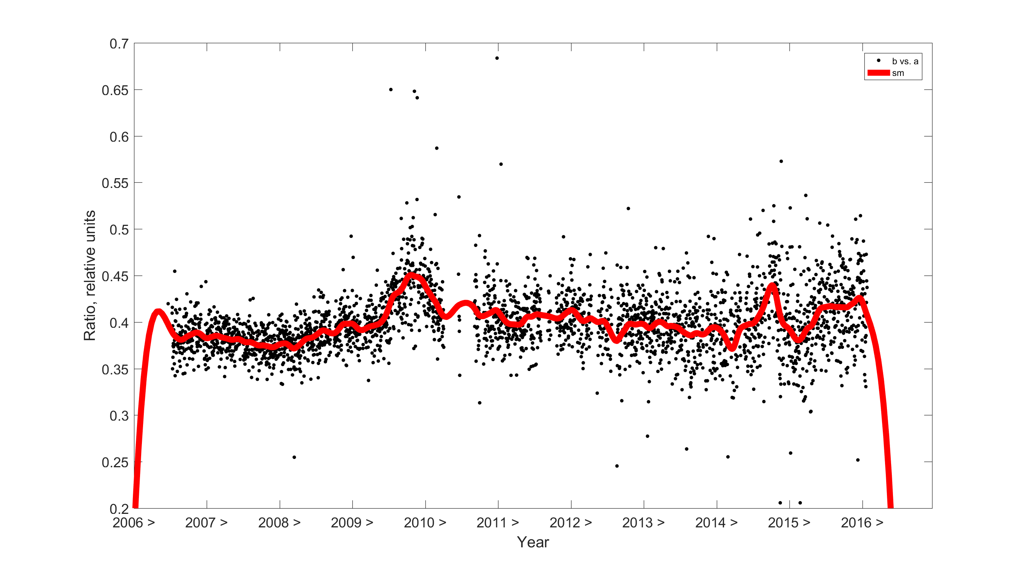
Ratio of helium to protons. Fixed rigidity.
preliminary
But in zoom we observe some features …

Slide 16
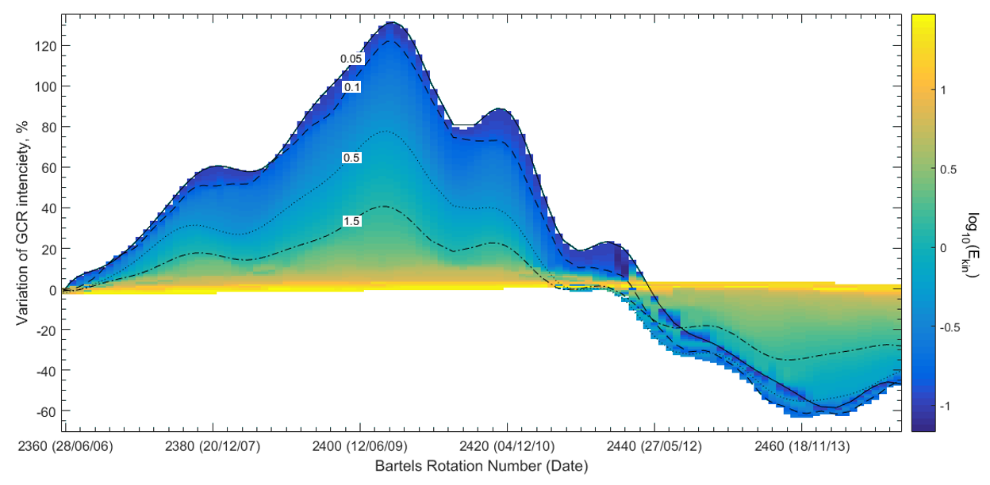
Time profiles of GCR protons

Slide 17

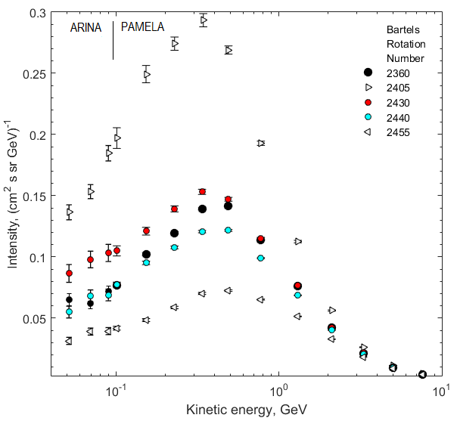
Proton spectra during some BRN

Slide 18
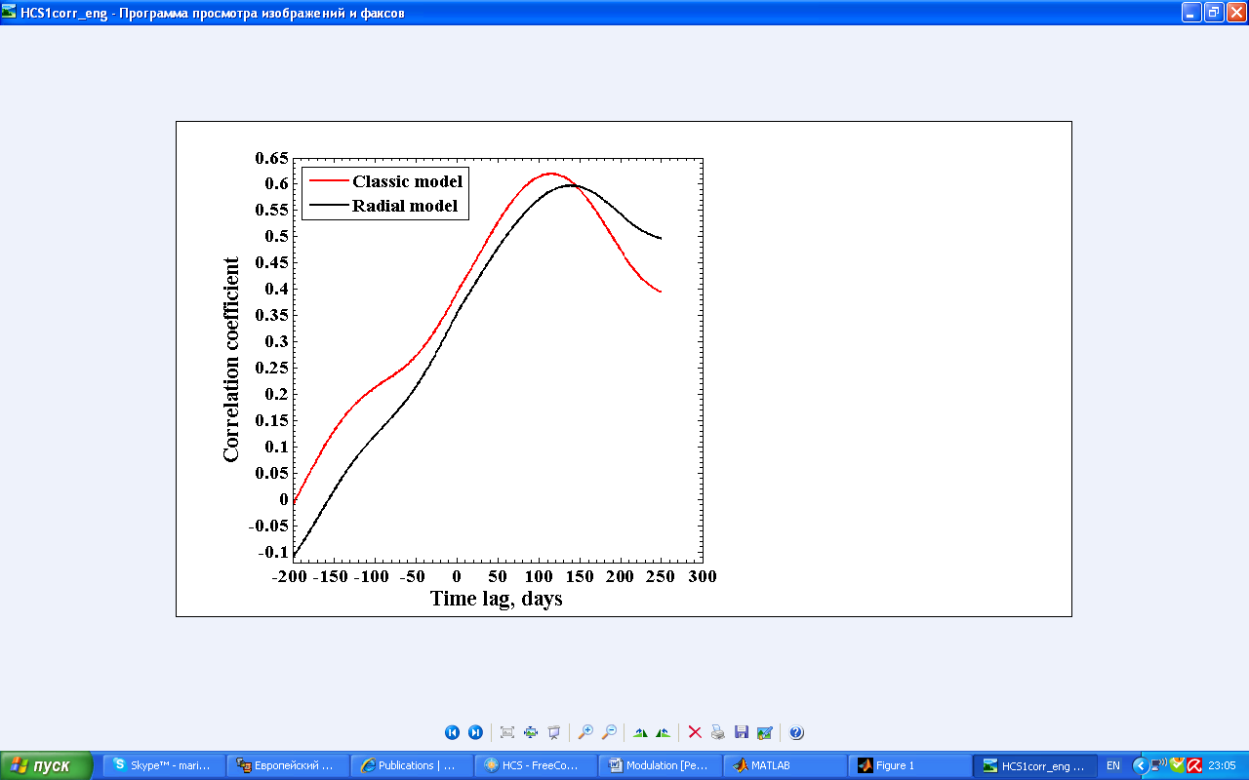
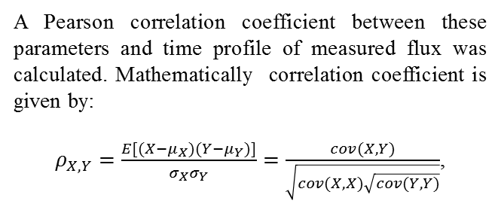
Correlation with HCS tilt angle variations
A Pearson correlation coefficient between these parameters and time profile of measured flux was calculated. Mathematically correlation coefficient is given by:
$ρ_{X,Y}=\frac{E[(X−μ_{X})(Y−μ_{Y})]}{σ_{X}σ_{Y}}=\frac{cov(X,Y)}{\sqrt{cov(X,X)\sqrt{cov(Y,Y)}}}$,

Slide 19
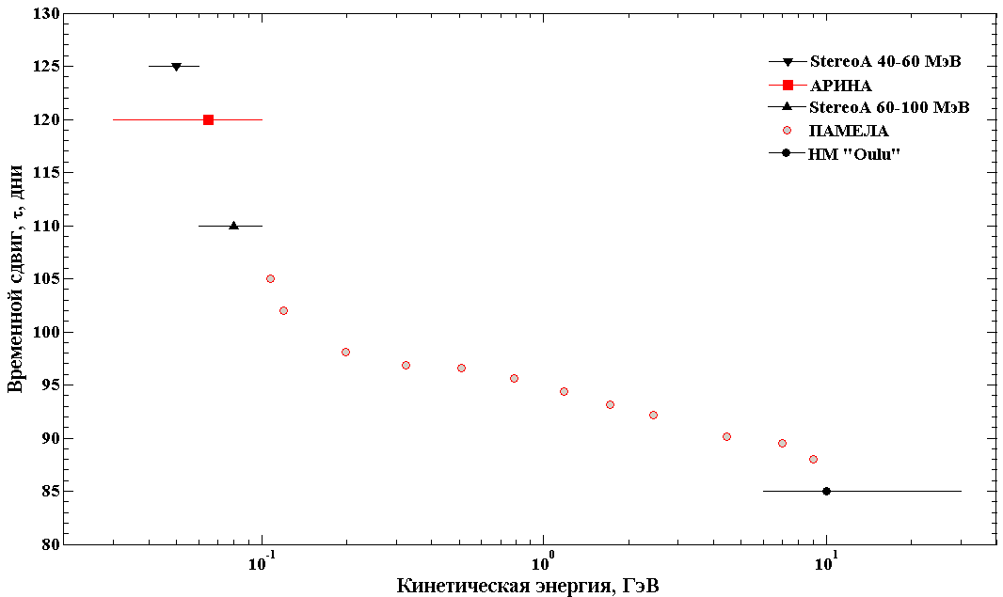
Time shift between proton flux variation and changes of Tilt angle of HCS
The result of correlation analysis
preliminary
Time shift, days
Kinetic energy, GeV
What does it mean?

Slide 20
Conclusion
The main results:
Proton & helium modulation
  Similar modulation of protons and helium nuclei with similar rigidities.
  Some features still exist, especially in 2009-2010 during anomalous solar minimum.
There is time shift between variations of GCR & tilt angle of HCS, which is depends on energy of particle.
Thank you for your attention!

Slide 21
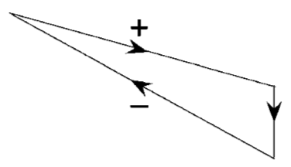
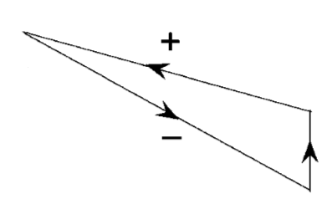
Modulation loops
It’s a Multi Variable problem from mathematical point of view
We should take into account significantly changes with SA different parameters!
Odd cycles (…, 23)
Even cycles (…, 24)
Flux
Flux
HCS tilt angle
HCS tilt angle
Observed for high energy CR by network of Neutron monitors.
May be during balloon flights, but I not found publications of such kind.
So, firstly with PAMELA & ARINA we can look on modulation loops for smaller energies!

