Slide 1
National Research Nuclear University
"Moscow Engineering Physics Institute"
Engineering Physics Institute of biomedicine
Department № 46
«Computer medical systems"
Pattern recognition in the diagnosis of cancer: morphological intelligent systems – problems and solutions
Speaker: Nikitaev Valentin Grigorievich- The head of the department "Computer medical systems" of National Research Nuclear University MEPhI, the Doctor of Science, professor, the Winner of the government Award of the Russian Federation in the field of education 2013 .

Slide 2
Problem actuality
The problem of cancer remains a priority in modern society
Cancer incidence is increasing worldwide. It ranks the second place among the causes of death in the developed countries
3 The number of deaths from cancer in 2030 could reach 11 million according to forecasts of the world health organization.*
Histological studies - the main method of diagnostic tests in the formulation Cancer Diagnosis**
*Dardyk M.V., Kondratieva T.T., Veligeva N.P. et al. A project to improve diagnosis of lung cancer in the Russian Federation // Oncology. 2013 supplement №2 p.41-48)
** Oncology. National leadership / edited Chissov V.I., Davydov M.I., 2008.

Slide 3
A generalized block diagram of image processing in the tumors recognition system.
Input:
The original image of the tumor specimen
Preprocessing
Description
Classification
Output:
Tumor
benign tumor ?
malignant tumor ?

Slide 4
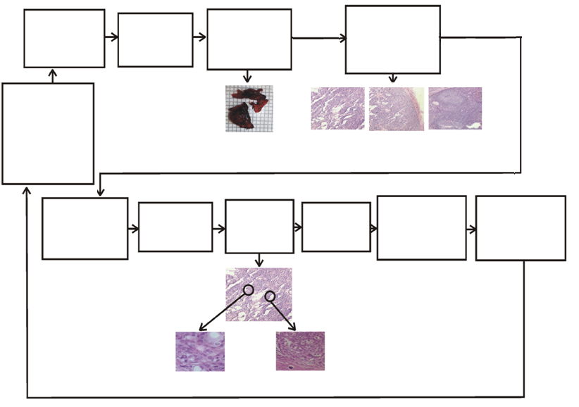
Technique of carrying out diagnostics of urgent biopsies during surgery operation
Carrying out of a surgery
the analysis of a macro preparation
the computer microscopic analysis of a specimen
Capture biopsy
Diagnostic data analysis,
scoping and tactics of surgical operation
Image of a macro specimen
of a thyroid gland
Images of a micro specimen of a thyroid gland
the analysis of the medical expert
Request of the expert for specification of data
the
experts’ conclusion
the protocol of telemedical consultation. Establishment of the diagnosis
Transfer of the diagnosis to the operating surgeon
Formation of request for consultation
Images of a micro specimen of a thyroid gland
Nikitaev V. G. Experimental High-Technology Information-Measuring Complexes of Cancer Diagnosis: Problems and Key Points of the Construction Methodology (Measurement Techniques, Web of Science, Scopus).

Slide 5
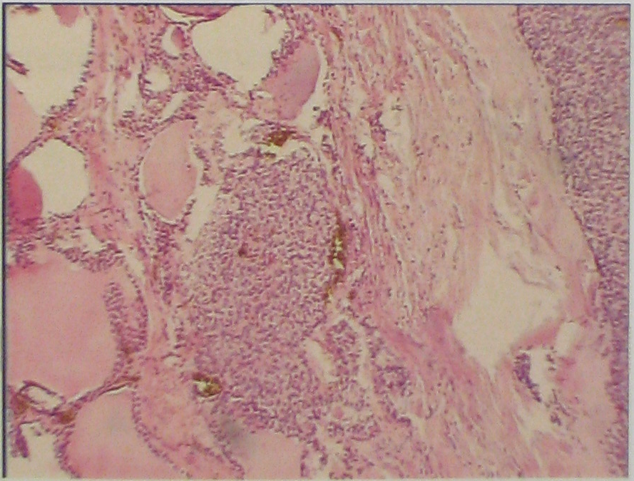
Problem characteristics
The deficit of qualified diagnosticians
(There are units of qualified diagnosticians for complicated cases in the country )
The complexity of the spatial brightness structure of the image histological specimen (in excess of 16mln. Color shades)
The large variability of objects
The difficulties of permanent access to knowledge for remote clinics
A fragment of thyroid tissue X10.
Diagnosis: follicular cancer.
Coloring: hematoxylin-eosin
A great time for training of highly skilled doctors-pathologists (10-15 years)
The unresolved tasks of creating of the clinical systems of automated histological oncodiagnostics
The work purpose – development of methods and tools of pattern recognition for histological diagnostics of oncological diseases

Slide 6
Key tasks
Formation of the feature space
Selection of the diagnostic decision-making methods
Standard histological images base creating
The cardinal decision – creation of hi-tech educational and diagnostic expert systems of support of decision-making through knowledge bases, pattern recognition and telemedicine technologies

Slide 7
Research and development
High-tech computer system for decision support in cancer diagnosis
designed for decision support in cancer diagnosis (including during surgical operations), and distance education
It embodies a wide range of high technology: digital video, pattern recognition and artificial intelligence, databases, knowledge bases, expert systems, Internet, computer design, multimedia, network and information security, programming, electronic engineering.
The priority of developments are confirmed by 12 patents.

Slide 8
Analysis of the conceptual alternatives of building of clinical systems for recognition of histological microimages
Signs model
Recognition mode
Quality
signs
Quantitative
signs
Interactive
with
the participation
of the doctor
Automatic
Classification
model
Diagnoses rating system
The only
diagnosis
Selected

Slide 9
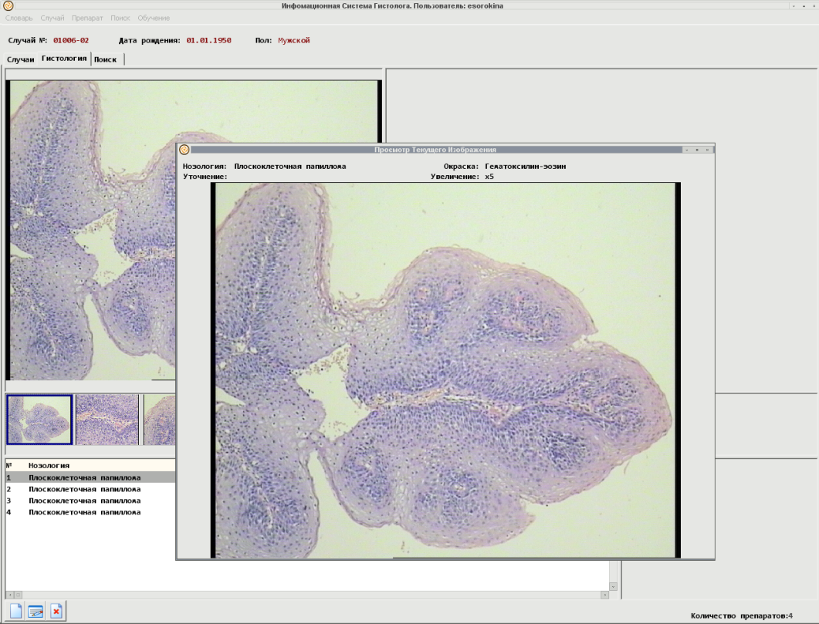
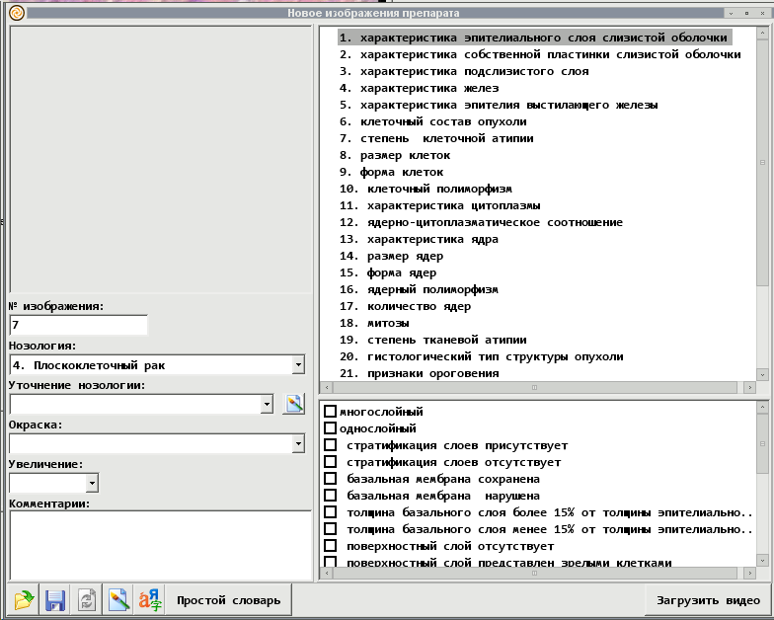
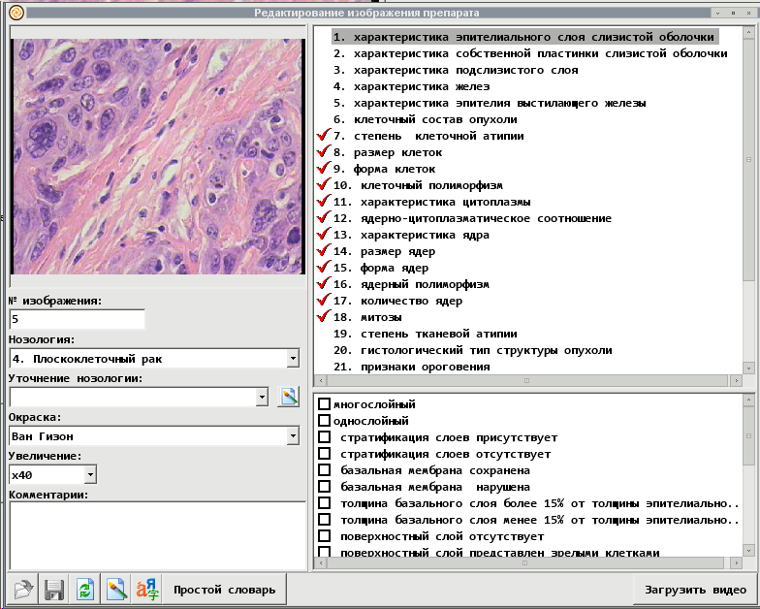
Model of characteristics of microscopic images in clinical recognition systems
The principle of assessment of structures and elements - scaling
Signs of tissue structures
Signs of cellular structures
The shape of cells
The shape of nuclei
Nuclear membrane
Contents of nuclei
The location of nuclei
The size of cytoplasm
Contents of cytoplasm
The nuclear-cytoplasmic ratio

Slide 10
"The block diagram of the expert measurement procedures in high-tech information-measuring complexes of histological and cytological cancer diagnosis using image recognition apparatus."
The measurement
system of informative
characteristics of
objects
Registration of the object of measurement
Input:
the Object to be measured
Measurement of characteristics of microimages
Database of patients
The formation of a request for classification
Expert system
Knowledge base (database of standard samples)
The definition of the most similar cases
Updating the knowledge base with new standard samples
A comparative statistical analysis
Output: Recommended set of possible diagnoses
Diagnostic conclusion of pathologist
Nikitaev V. G. Expert Systems in Information Measuring Complexes
of Oncological Diagnoses (Measurement Techniques,
Web of Science, Scopus).
Transfer of diagnostic conclusion to the Clinician
10

Slide 11
The structure of the standard (reference) base of histological micropreparations of tumor in pattern recognition system for diagnostics of oncological diseases.
On the basis of the archive of NN Blokhin Russian Cancer Research Center.
Reference database of tumors images
Pathology
Norm
Tumors
Diseases
Malignant
Benign

Slide 12
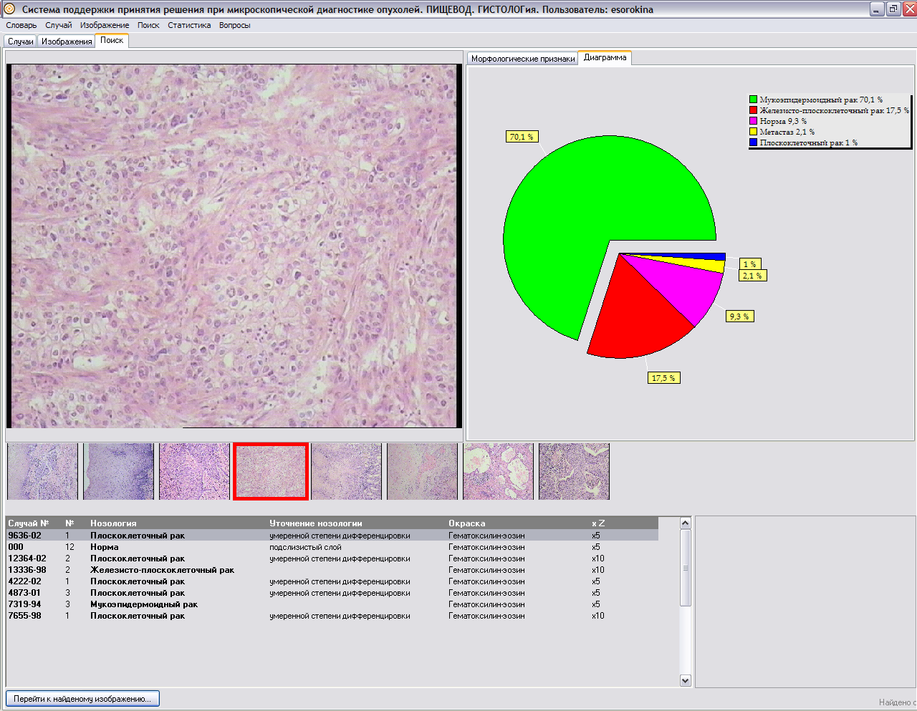
Statistical analysis of informative features of tumors with the use of intelligent technologies – tumor detection, expert system, knowledge base, rating system of evaluation of histology oncological diseases
Nikitaev V. G. Modern Measurement Principles in Intellectual Systems for a Histological Diagnosis of Oncological Illnesses(Measurement Techniques, Web of Science, Scopus).

Slide 13
The composition of the unique reference database
(on the basis of archives of the N.N.Blokhin`s Russian Cancer Scientific Center over 60 years)
Histology
 | internal organ | occurrence | the number of images
1 | Pancreatic gland | 305 | 823
2 | Thyroid gland | 324 | 813
3 | Esophagus | 323 | 1573
4 | Stomach | 290 | 1328
5 | Colon | 303 | 1057
6 | Lymph nodes | 351 | 848
7 | Mammary gland | 496 | 1028
8 | Kidney | 223 | 518
 | Total | 2615 | 7988
Nikitaev V. G. Expert Systems in Information Measuring Complexes of Oncological Diagnoses (Measurement Techniques, Web of Science, Scopus).
13

Slide 14
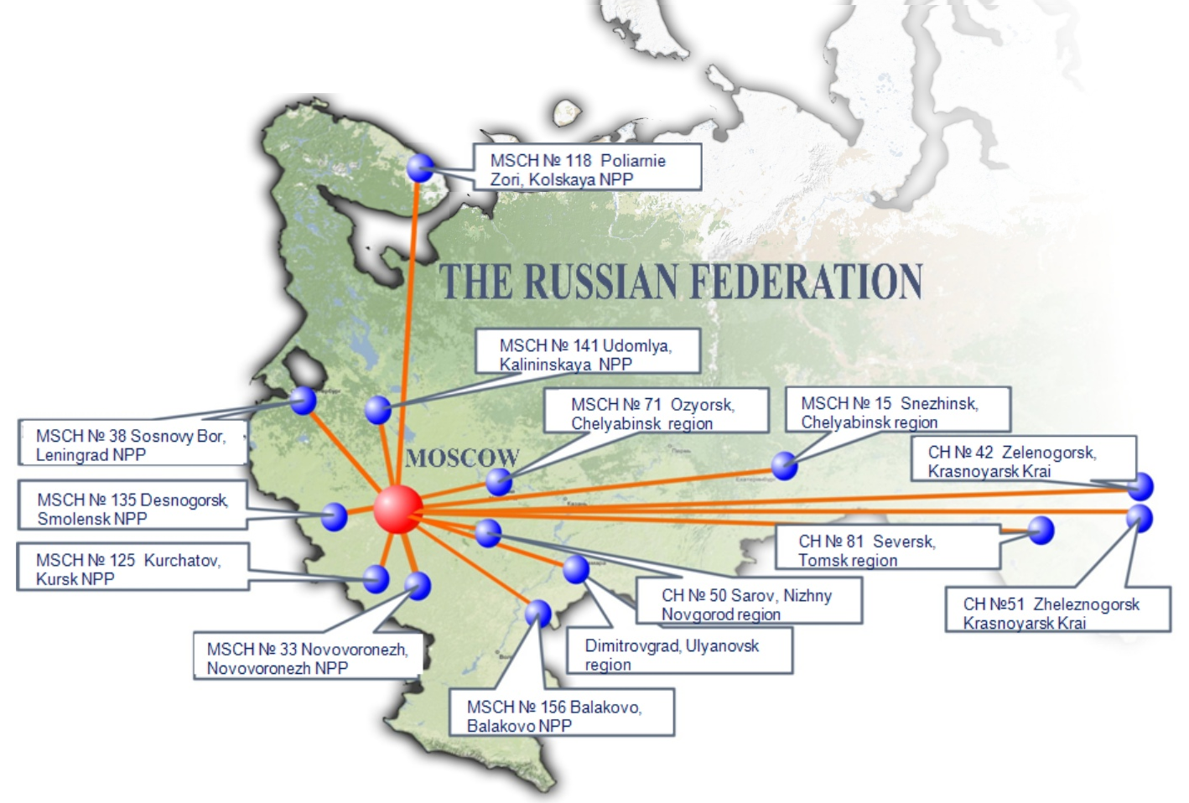
ROSATOM-FMBA-MEPhI uniform consulting and diagnostic network
Control center at the department of NRNU MEPhI «Computer medical systems»

Slide 15
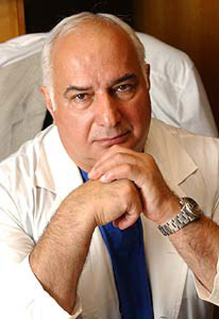
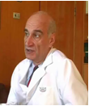
Evaluation of the results
Chief oncologist of Russia, academician of the Russian Academy of Sciences, doctor of medical sciences, professor, director of N.N. Blochin Russian oncological scientific center, Davydov Mikhail Ivanovich:
"The technologies of diagnosis of oncological diseases developed in NRNU MEPhI are perspective for Russia and demand the further development”.
Petrovichev, Nikolay Nikolayevich, Doctor of medical Sciences, Professor, head of Department of pathological anatomy of human tumors of N.N. Blochin Russian oncological scientific center:
“The system ATLANT enabled young doctors(work experience up to 5 years) to reduce the error in the setting of cancer diagnosis 6 times (the diagnostic accuracy increased from70% to 95%)”.

Slide 16
Conclusion
Systems for recognition of oncological diseases with the use of a primary diagnostic method histological research are considered.
The developed method is interactive (with the participation of the doctor - pathologist) recognition of tumors. The method is corresponded to the classical scheme of training of the doctor - the perception of the studied images at the tissue and cellular level, with ratings of likely diagnoses.
Information database of etalons (reference) images of histological micropreparations tumors is developed. It is basis for comparison the original data (the patient) with the data reference base. It contains over 7988 images of malignant and benign tumors of the thyroid, breast, lung, kidneys, etc. – formed from the archive of the N. N. Blokhin Russian Cancer Scientific Center.
A method for recognition of oncological diseases with the use of histological analysis allows young physicians of the N. N. Blokhin Russian Cancer Scientific Center to increase the accuracy of diagnosis from 70% to 95%.

Slide 17
Thank you

