Slide 1

Trends in integrated circuit design for particle physics experiments
Eduard ATKIN
dep. of Electronics & ASIC Lab
e-mail: evatkin@mephi.ru
tel. +7(499) 324-25-97
2nd International Conference on Particle Physics and Astrophysics (ICPPA-2016)
10-14 Oct 2016 , Moscow

Slide 2
Outline
Application Specific Integrated Circuits (ASICs) are one of the key complex technologies available to designers of multichannel detectors
A whole number of factors makes ASICs essential to Particle Physics and Astrophysics experiments. Among them the most important ones are: integration scale, low power dissipation, radiation tolerance
In order to make possible future experiments in the intensity, cosmic, and energy frontiers today ASICs should provide new level of functionality at a new set of constraints and trade-offs, like low-noise high-dynamic range amplification and pulse shaping, high-speed waveform sampling, low power digitization, fast digital data processing, serialization and data transmission

Slide 3
Outline (2)
All integrated circuits, necessary for physical instrumentation, should be radiation tolerant at new, earlier not reached, level (hundreds of Mrad) of total ionizing dose and allow minute almost 3D assemblies
The presention is based on literary source analysis and presents overview of the state of the art and trends in nowadays chip design, basing partially own ASIC lab experience. That shows a next stage of micro- and nanoelectronics usage at physical instrumentation

Slide 4
Aim
to present:
Trends in integrated circuit design:
history, state-of-the-art & what`s next
Tools and typical design routes, finishing in chip prototyping
Example projects of ASICs
Conclusions

Slide 5
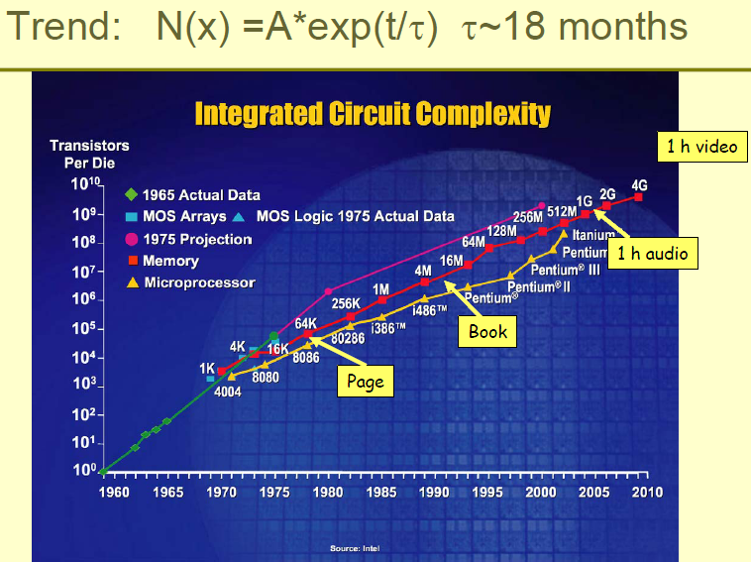
Moore Era

Slide 6
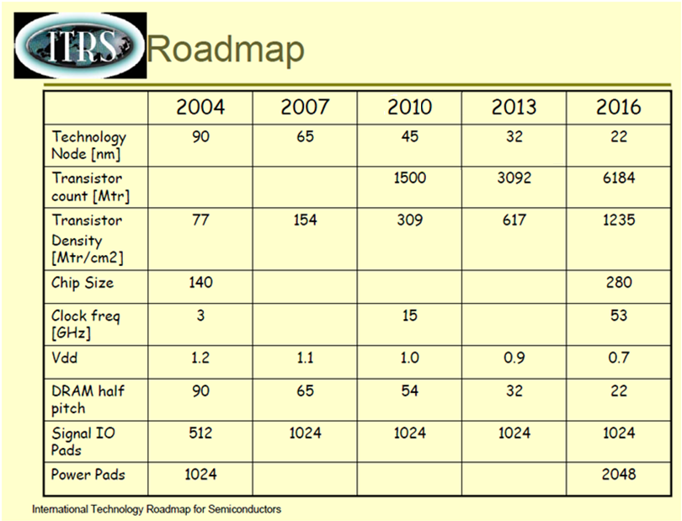
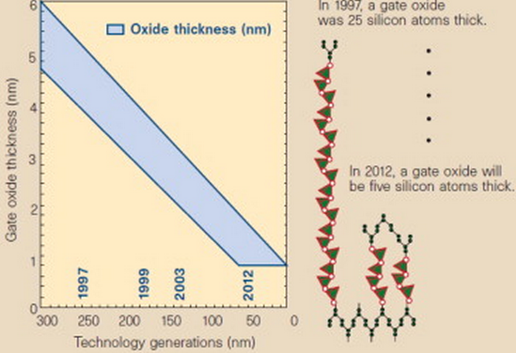
Up-to-date world-wide technologies

Slide 7
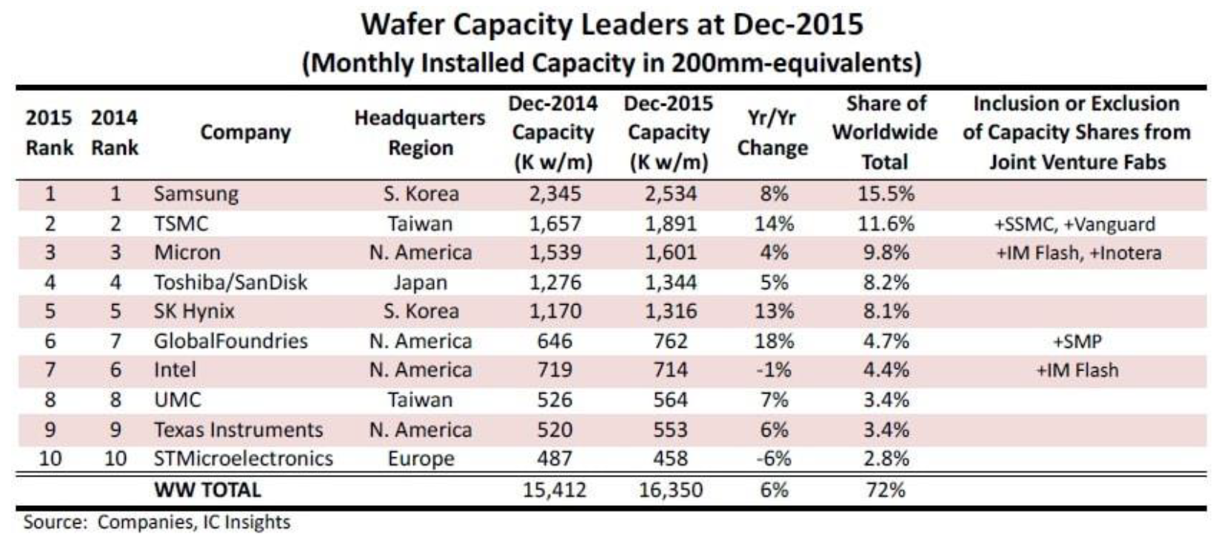
Wafer leaders

Slide 8
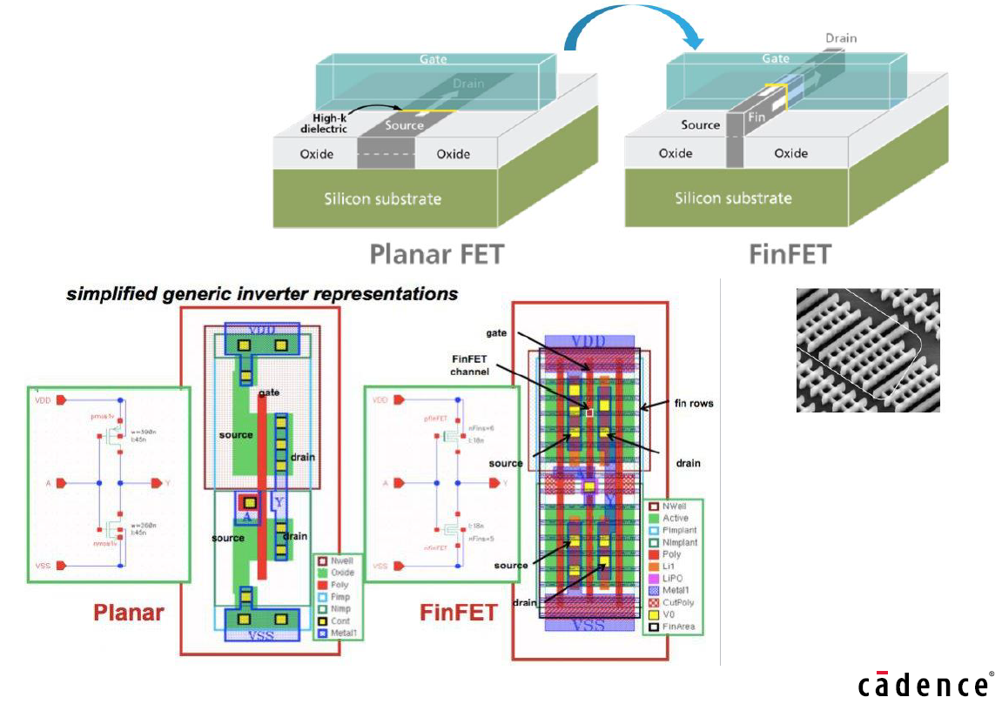
Moore law continuation

Slide 9
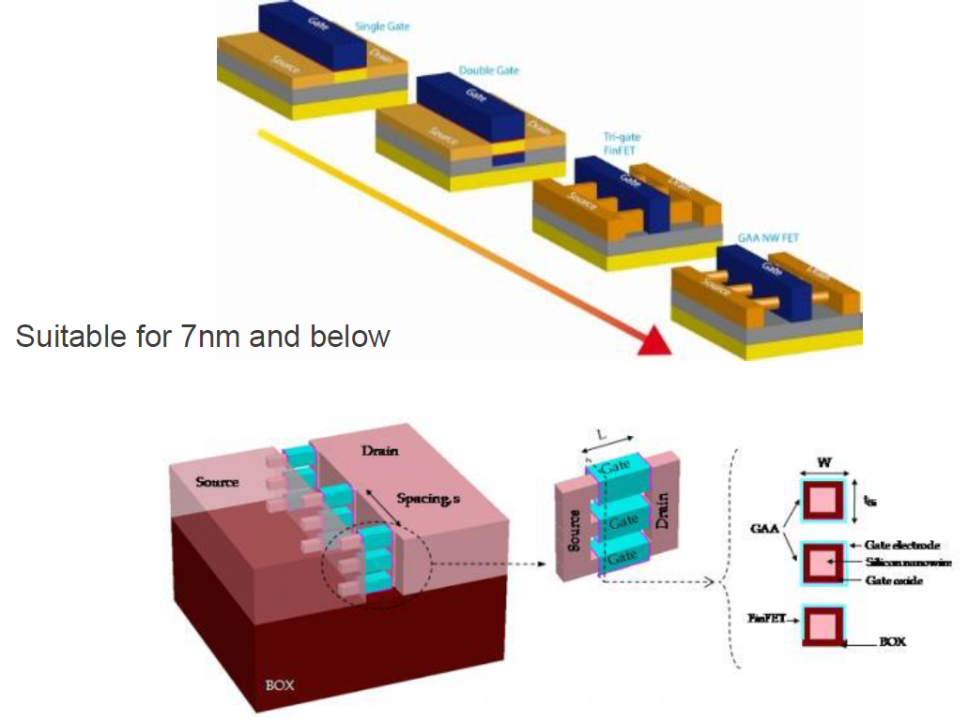

Still Science-Fiction –
Gate-All-Around Transistor

Slide 10
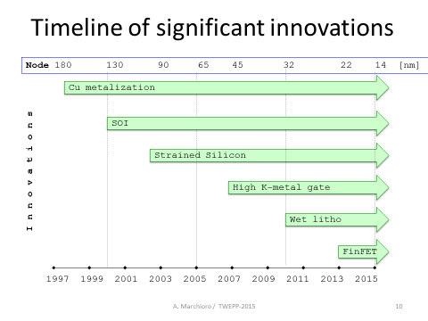

Slide 11
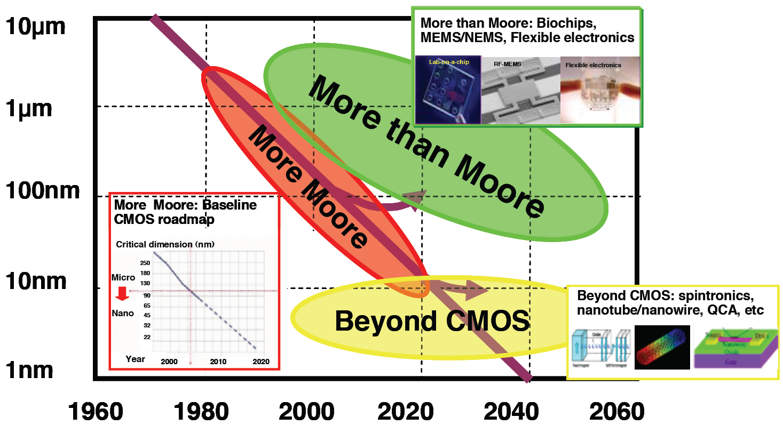
Technology variety
K.Roy, B.Jung, A.Raghunathan, Integrated systems in the more-than-Moore Era: Designing low-cost energy efficient systems using heterogeneous components/ 23rd International Conference on VLSI Design, 2010

Slide 12
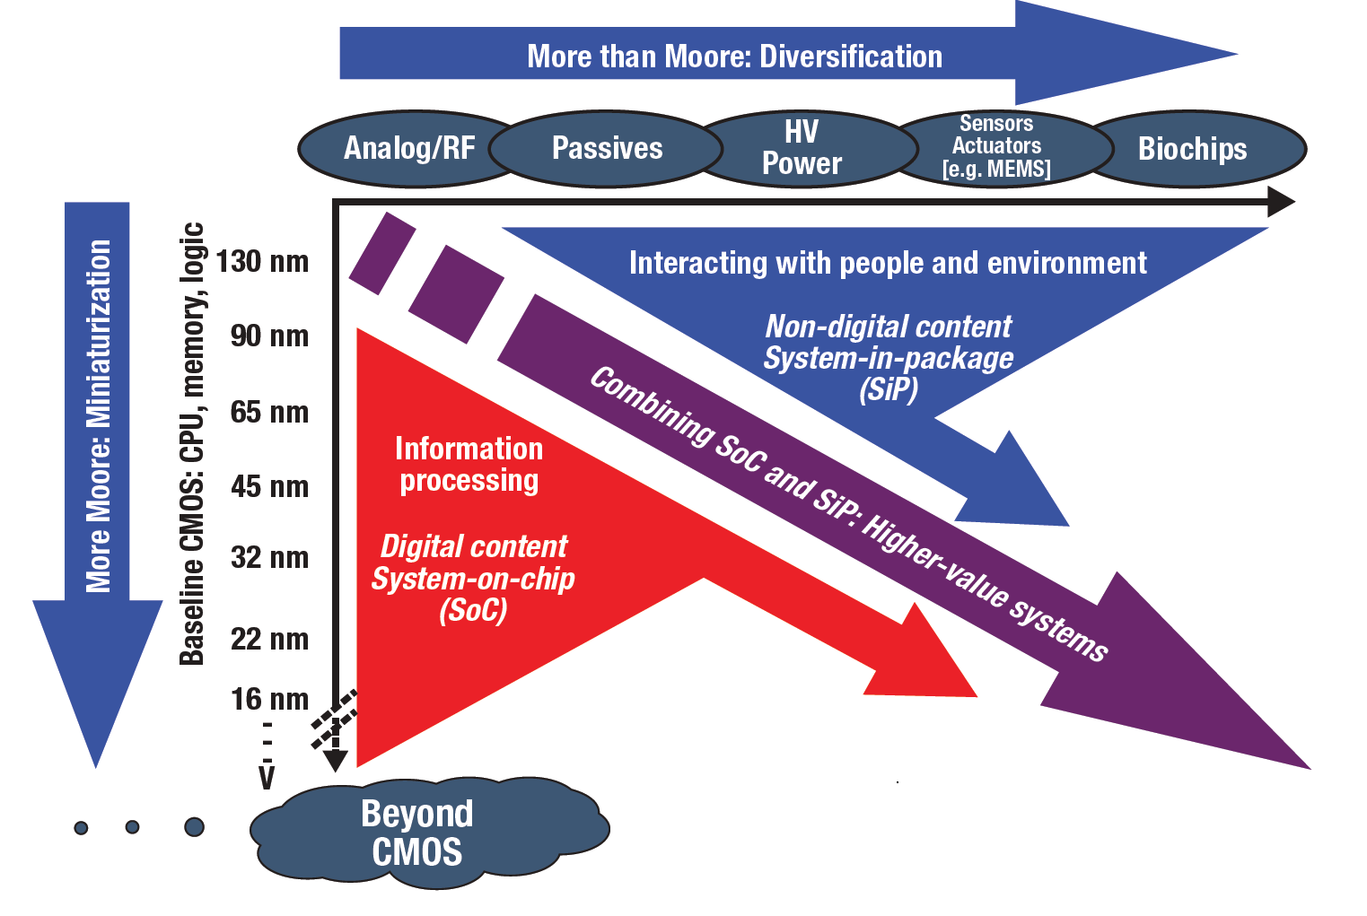
More than Moore
International technology roadmap for semiconductors , 2012 Update Overview

Slide 13

CMS
~1 000 000 custom chips ( of 20 types)
Compact Muon Solenoid
Notes:
How many people?

Slide 14
How could future systems in detector instrumentation look like?
Ideally based on hybrid technologies (at element, chip, package, board and finally system levels)
Highly integrated very sensitive analog front-end
Digitization at earliest stage
Signal processing mostly in digital domain (DSP)
High data rates via output interfaces with speed in multi-Gb/s range
Big data processing (for ex. CMS detector raw data >1000 Pbyte/day (1 Mbyte x 40 MHz))
They will not be cheaper than today

Slide 15
ASIC development trends
The increasing quantity of elements at a simultaneous increase in their complexity and density. Moore law is still valid → Increase in integration scale
Digital signal processing part more and more replaces analog one. (250nm → 10 Kgates/mm² … 28 nm → 3900 Kgates/mm²)
Design cost increase comparing to the one of manufacture
Design timeline and number of prototype cycles (respins) are reduced
For the majority of projects the minimum set of ASICs is to be developed in a one well verified technology (LHC → IBM 130 nm, SLHC → TSMC 130&65 nm, FAIR → UMC 0.18 µm) → Standardization

Slide 16
ASIC development trends (2)
ASIC adaptation for other projects as criterion of economic efficiency → Universalization
Functionality increase at a limited power consumption budget
Increase in demand for a high technology (expensive) product. The accent at design is done at system (architectural) questions → SOCs (systems on a chip) dictate a mixed-signal character of design route
The demanded number of ASIC wafers is small and can't interest a manufacturer (10⁶ channels at ~100 chs/chip and ~1000 chips/wafer→ ~10 wafers only)

Slide 17
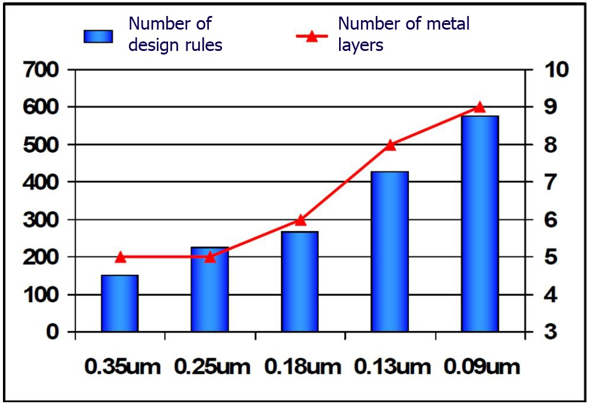
ASIC development trends (3)
Design is based on the usage of constantly modernized:
Computer Aided Design (CAD) systems (Cadence, Mentor Graphics, Synopsys, Agilent),
technological libraries or
Design Kits (elements,
standard digital and IP blocks),
including
design rules of manufacturer,
the quantity of which quickly
grows for advanced
technologies (> 2000 for 22 nm)
Necessity of a fast and actually continuous retraining of experts
Close integration of the design centers for both chip and system (hardware) level

Slide 18
Technology choice for FAIR
Use technologies more and more advanced (with life time behind 2020), but well characterized for design tools and having a reasonable cost → UMC ММRF CMOS 0.18 µm – main technology for FAIR (choice of 2004)
Extremely compressed timeline for each cycle of custom design (4-6 months) and the presence of the necessary updated CAD tools at all levels of design
Skilled staff of young engineers (till 2020-2023 at least)
Start-to-finish (system level) design is necessary: Structural and behavioral modeling → Design of IP blocks at transistor level and that of systems at high-level language → Layout → Verification (ERC, DRC, LVS, PE, PS) → GDSII

Slide 19
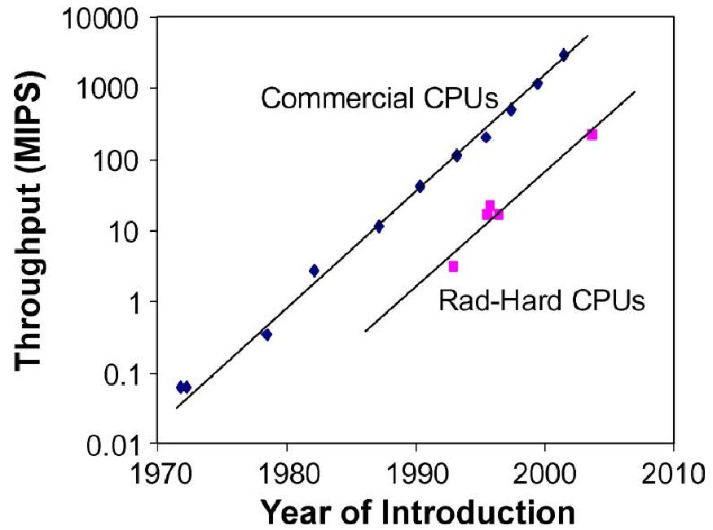
Trends for radiation-hardened ICs
Improvement of radiation hardness against total dose effects for new commercial CMOS processes. At the same time there is a wide spread of parameters among various manufacturers and no guarantee of long-term stability
Radiation-hardness processes
lag behind commercial ones
for 5-7 years (more than three
generations according to Moore)
Radiation hardening of
modern ASICs is provided
by a wider usage of commercial CMOS processes
and a refinement of different
methods and means, used at
early design stages (rad-hard by
design)
R. Lacoe, Improving Integrated Circuit Performance Through the
Application of Hardness-by-Design Methodology IEEE Transaction
on Nuclear science, v. 55, N4, 2008, p.1903-1925

Slide 20
Trends for rad-hardened ICs (2)
Rad-hard technologies are not economically efficient. For them there exists only a small volume of orders
Designer experience allows to carry out only a correct choice of the manufacturer, who can provide specific target requirements
Active investigation of radiation effects for new bulk CMOS technologies and their compiling into the standard of design rules and CAD tools (Calibre, Assura, PVS, etc.) both at element and behavioral levels

Slide 21
Short summary on rad-hard ASICs
A number of rad-hard applications will demand the design of rad-hard components and their manufacture in a radiation hardened technology to meet rigid requirements. The part of such ASICs will be decreased each year
Continuous improvement of very complex rad-hard systems will critically depend on the introduction of commercialized microelectronic innovations in these systems
Raising the limiting complexity of these systems to the level, reached in commercial technologies, will demand a shift of many projects in the direction of creating radiation-tolerant components, using traditional commercial technologies, applying the methods of maintaining an acceptable radiation hardness

Slide 22
Actual task – analytical comparison of technologies by the radiation hardness:
1) Industrial (commercial) CMOS technology with use of methods “rad-hard-by-design”
2) Rad-hardened technology, according to the Moore law, lags more than 3 generations behind the commercial CMOS one
Thus, the practical dilemma is:
What is better
either a rad-hard 350 nm process
(for example, silicon-on-isolator)
or
a bulk CMOS 130 (90) nm process?

Slide 23
Traditional methods for radiation hardening
Circuital (reservation, redundancy, coding, adaptive biasing and & so on)
Layout (guard rings, ring transistors, and so on)
Technological (low volume CMOS, SOI, trench isolation, & so on). The required rad-hardness level is provided by a semiconductor structure choice and use of the special technological processes

Slide 24
Rad-hard by design concept
Refinement of traditional non- rad hard libraries for CAD
Elaboration of additional design rules, improving rad-hardness at the following 3 levels of design:
1) Transistor level
2) Level of cells, gates and IP blocks
3) System level
Creation of calibrated test structures and expansion of the scaled element libraries
Monitoring and statistical analysis of the ASIC rad-hard stability, provided at manufacture
Rad-hard tests of chips at both passive and active work modes

Slide 25



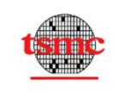







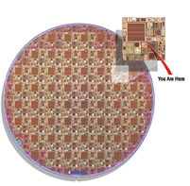

Where to manufacture chips?
Europractice
offers at a reasonable price:
licensed CADs of world leaders
access to design rules and technological libraries (design kits) for a number of nanometer and submicron (22 nm … 0.8 µm) processes, including SiGe, SOI, А₃В₅
access to microsystem and MEMS technologies
provides an inexpensive (from 270 Euro/sq.mm) prototyping of ASICs via advanced processes (down to 22 nm CMOS) using the
so called multiproject approach, when the wafer cost
is shared among projects of many customers
since 2013 Europractice provides discounted pricing
for Russia as well as EU
www.europractice-ic.com

Slide 26
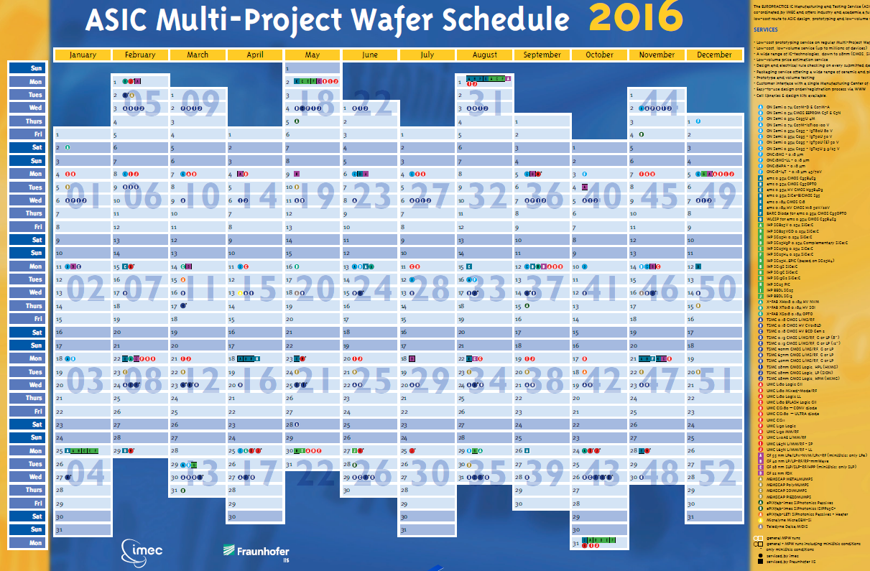

http://www.europractice-ic.com/documents_wall_calendar.php

Slide 27
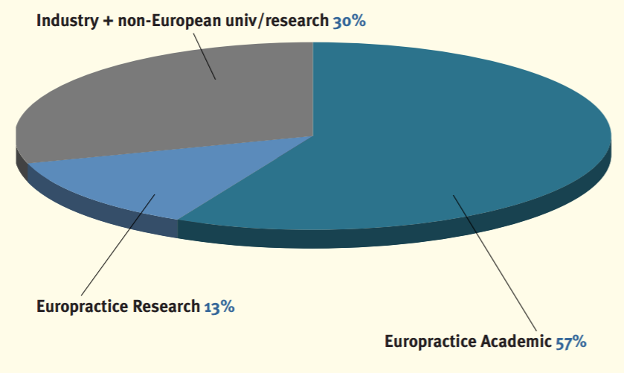
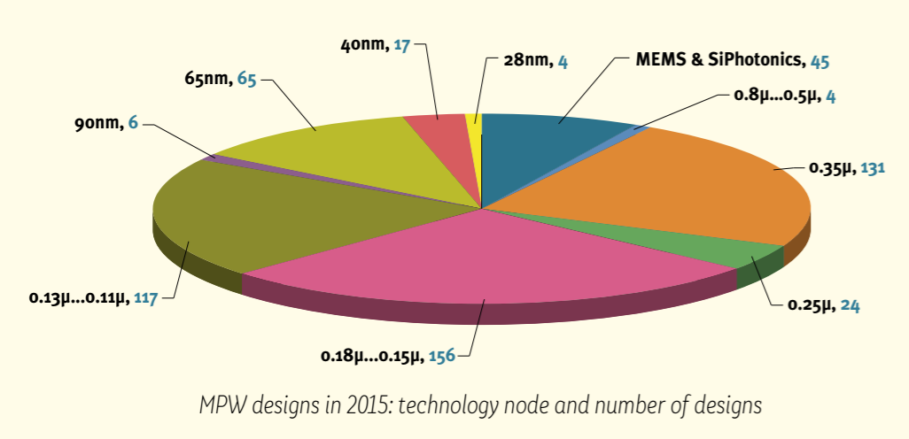
Number of ASIC projects, manufactured via Europractice in 2015 *
Total: 569 ASICs
* Europractice annual report 2015, http://www.europractice-ic.com/documents_annual_reports.php
http://www.europractice-ic.com/documents_annual_reports.php

Slide 28
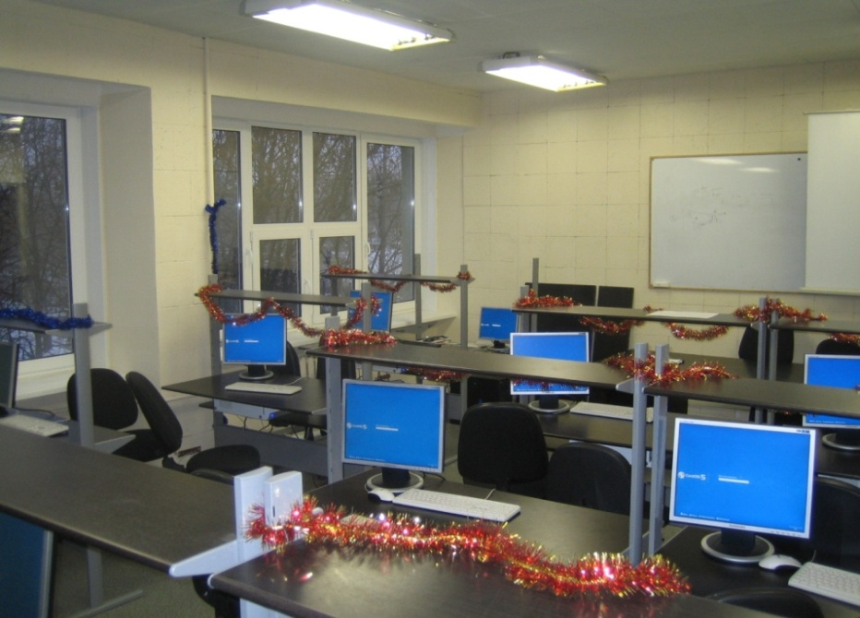
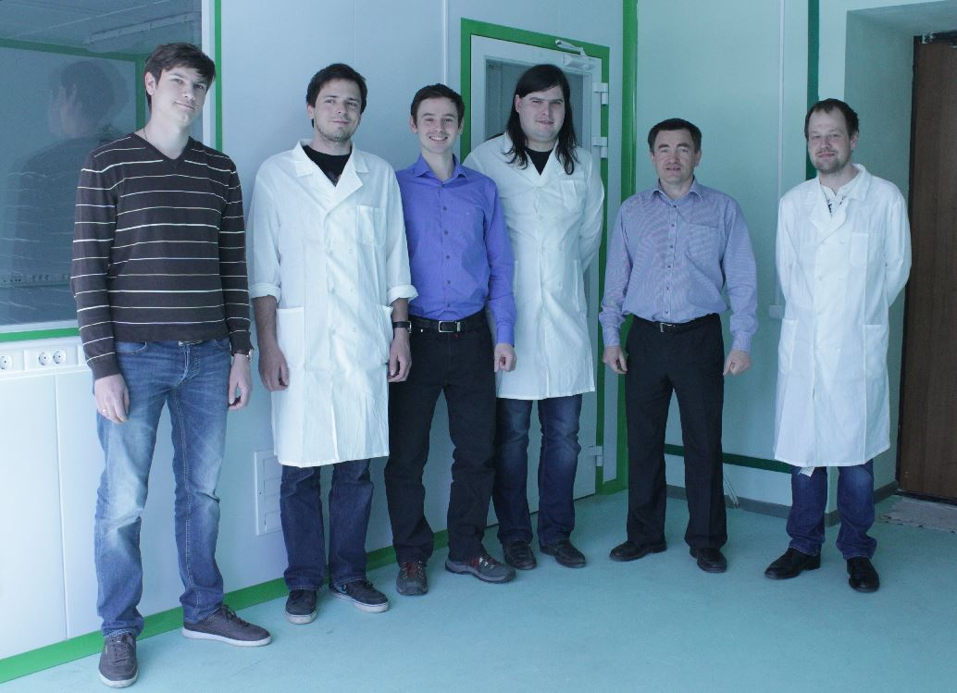
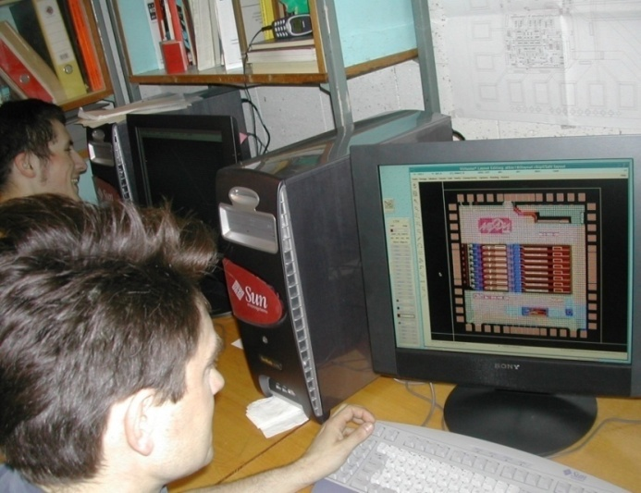
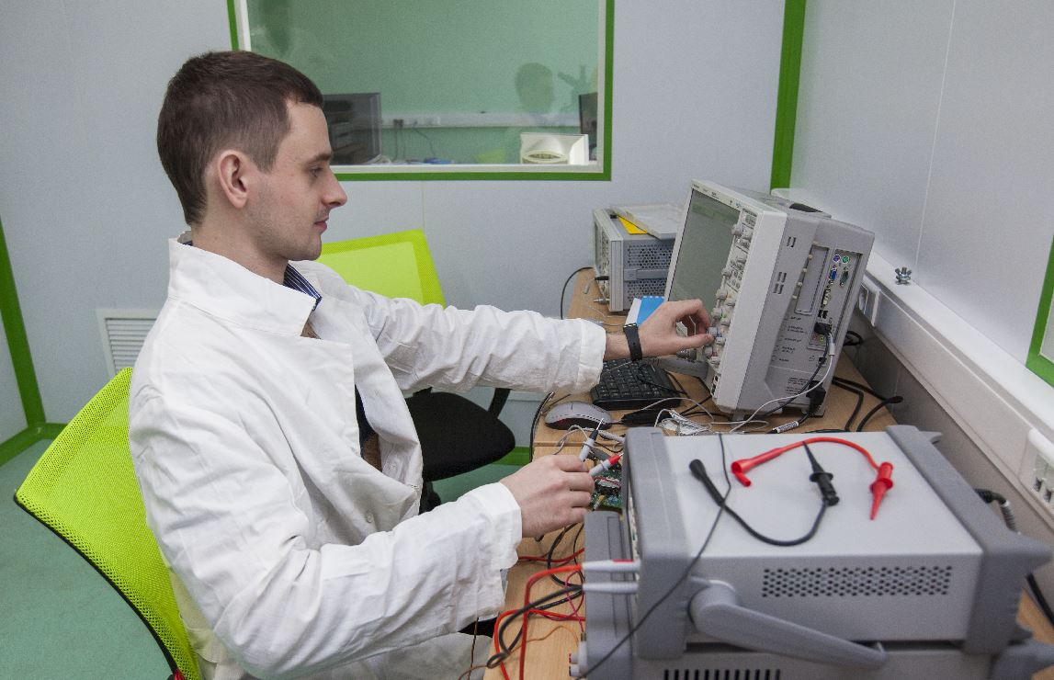
Infrastructure of the ASIC lab at MEPhI
distributed interdepartmental 1 Gb/s local Intranet
clusters of network Linux workstations in a number of departments
licensed microelectronics tools for
computer aided design – Cadence,
Mentor Graphics, Synopsys, Agilent
computer classes for core students
technological libraries starting
from 22 nm

Slide 29
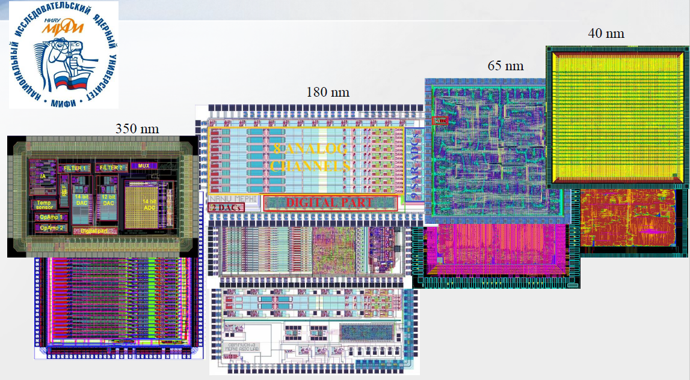
Progress in chip prototyping

Slide 30
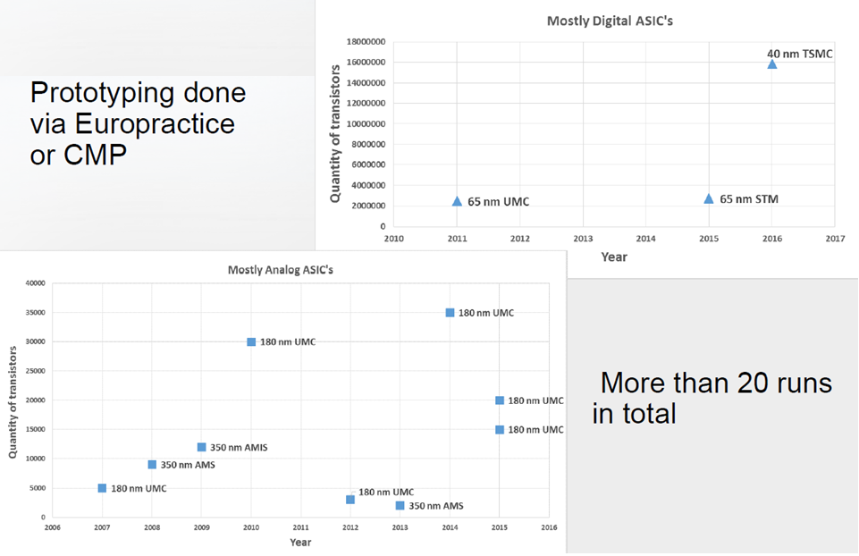
Statistics of projects

Slide 31
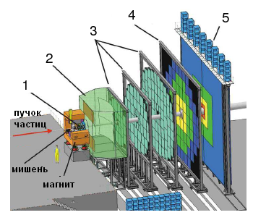
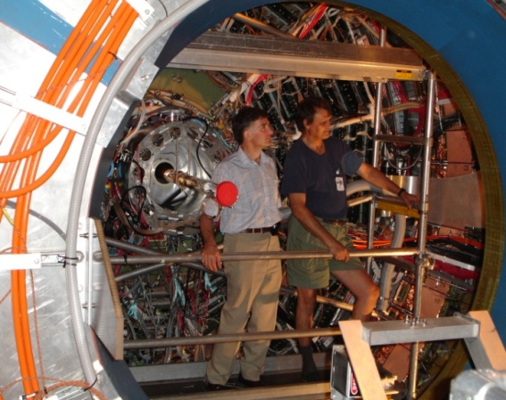
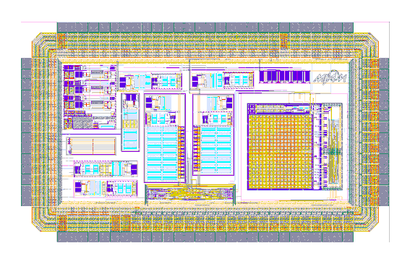
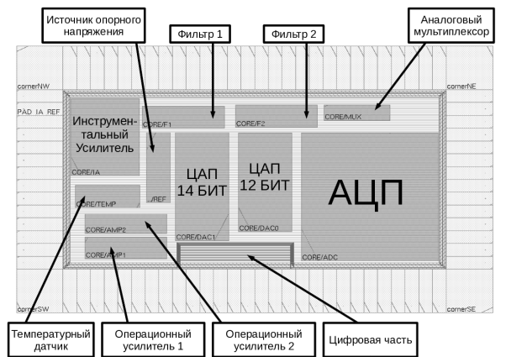
ASIC projects (examples)
128-channel prototype ASIC for data-driven read-out of CBM STS
0.18 um CMOS UMC (Taiwan), consumption 2 mW/ch., shaping time 100 ns, structure 128→16/ Chip contains preamplifier, shaper (filter), comparators, cross-point switch, peak detectors, 9-bit ADC and so on
Smart sensor readout ASIC (Rosatom)
0.35 µm SiGe BiCMOS AMS (Austria), temperature range -55…+80 °С, consumption 3 mW. Chip contains instrumentation amplifier, 14-bit ADC, two 14-bit DAC, references, electronic termometer and so on
32-channel ASIC for “Nucleon” project (Roscosmos)
0.35 µm CMOS AMIS/OnSemi (Belgium), dynamic range 100 pCb, consumption 2 mW/ch., multiplexed (serial) output
IP blocks for system on chip, controlling a new aircraft engine (Ministry of Education and Science)
0.18 um CMOS UMC (Taiwan), consumption 10 mW/ch., 9-bit ADC

Slide 32
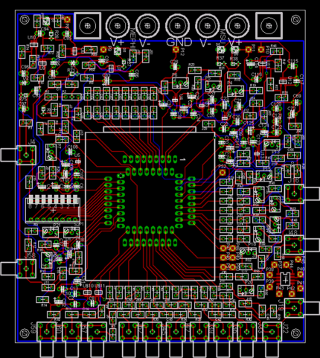
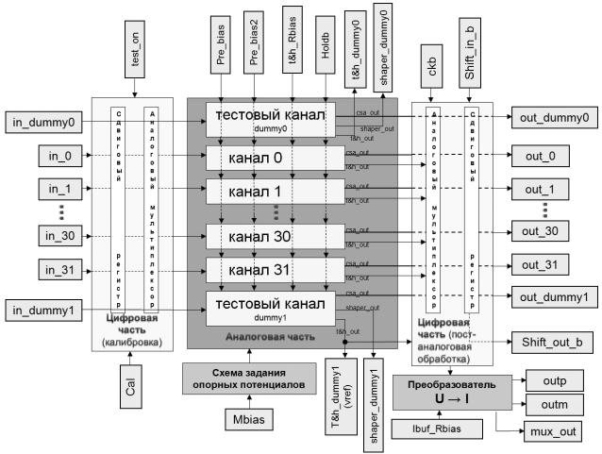
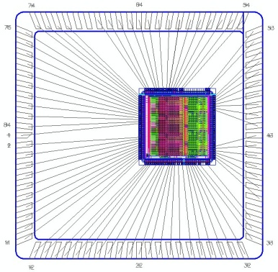
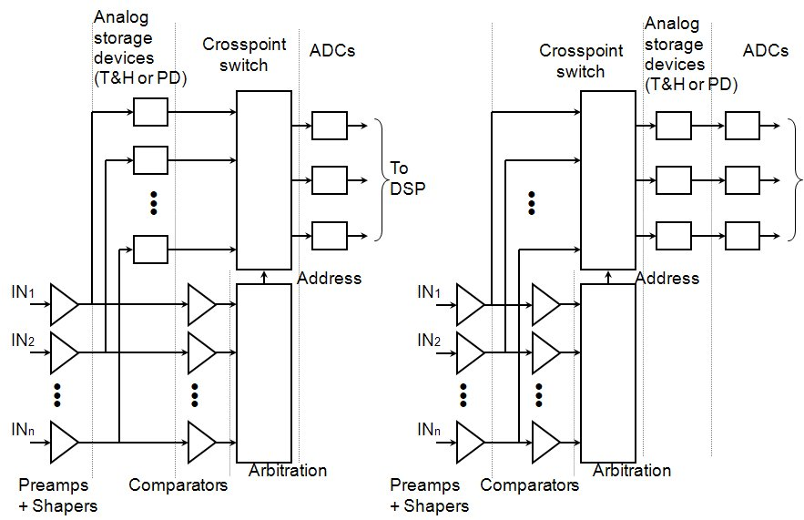
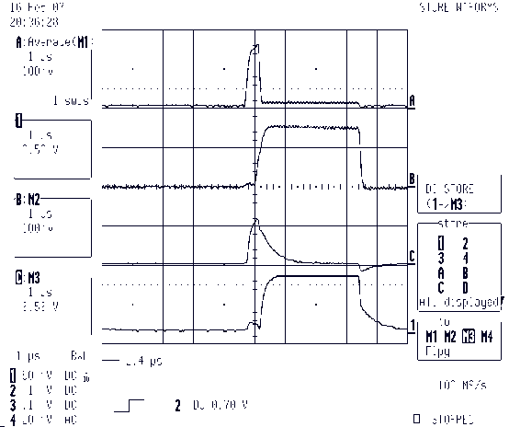
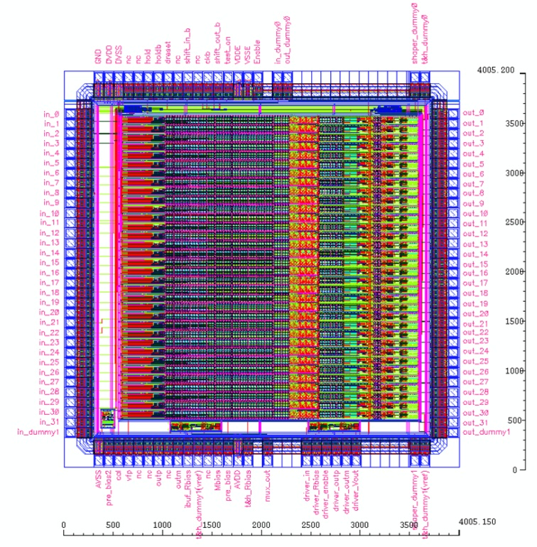
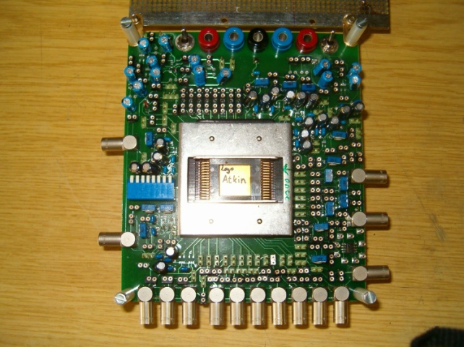
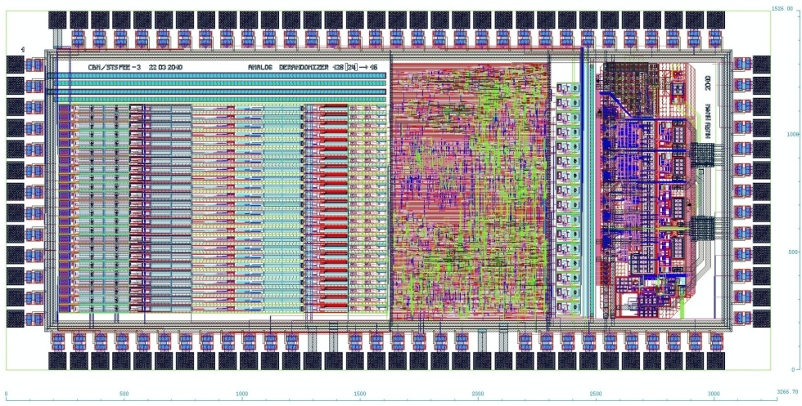
Some details of ASIC projects
32-channel ASIC for Nucleon project of ROSCOSMOS
128-channel prototype ASIC for СВМ STS

Slide 33
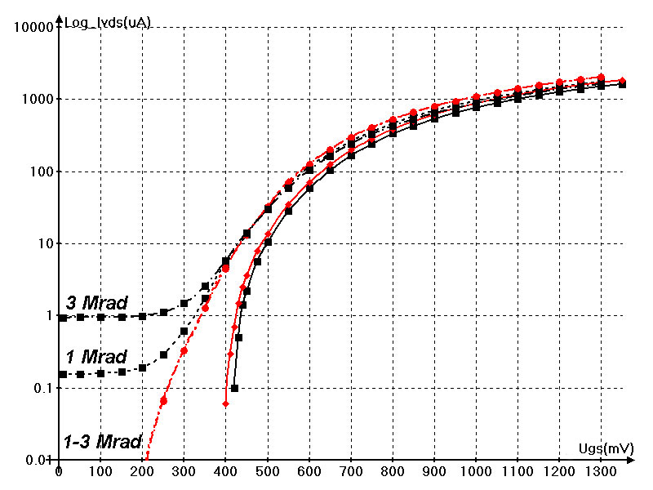
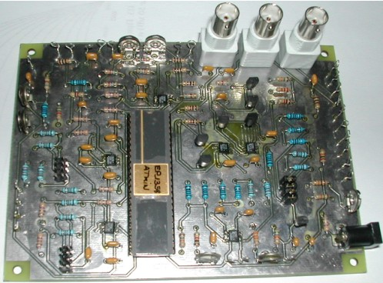
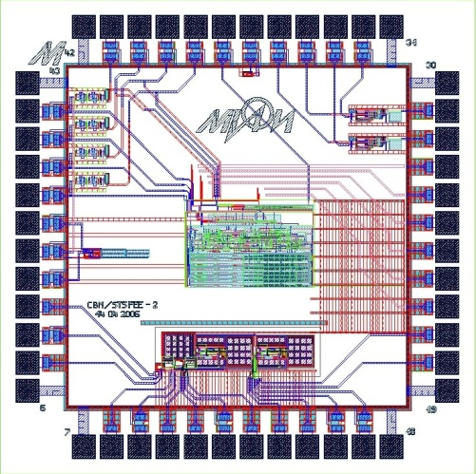
1) Threshold voltage shift (~100 mV);
2) Leakage currents --- standard (strip-like) nMOS;
--- ring transistors
Tests for total dose effects
(E=8 MeV; F=10¹¹ e/cm² s; D=0.1; 1; 3 Mrad)
0.18 µm CMOS of UMC

Slide 34
5 design phases for ASIC development
Phase I: Design of analog and mixed-signal ASICs
Phase II: Prototyping and test technique development
Phase III: First tests and prototype characterization
Phase IV: Qualification of ASICs
Phase V: Preparation for a batch production and testing automation

Slide 35
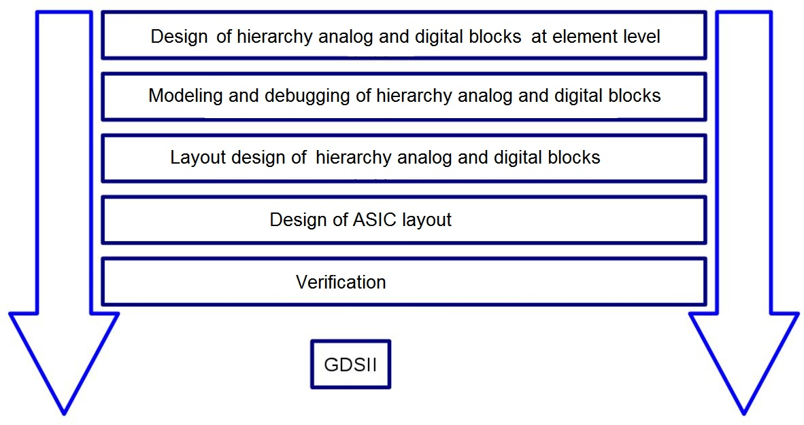
1. Route «bottom-to-top» (traditional )
Feature: the possibility to perform a mixed-signal simulation for analysis of blocks interaction appears only after the all separate blocks being ready

Slide 36
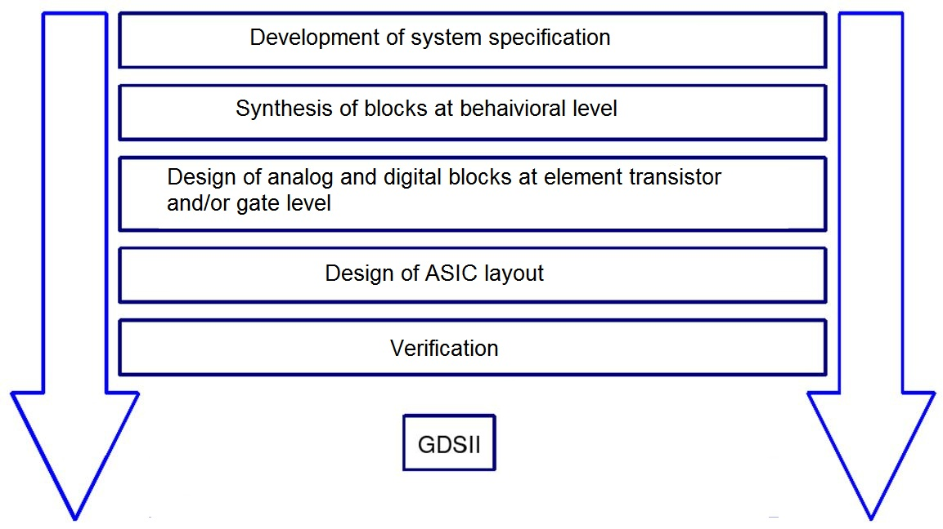
2. Route «top-to-bottom»
Feature: the usage of mixed-signal simulations at early stage. Due to system synthesis at structure level, it becomes possible to develop fastly the block descriptions at behavioral level – RTL-Verilog, Verilog-A и Verilog-AMS. The same level of abstraction is available with VHDL

Slide 37
General principles of mixed-signal design
Modern ASICs, as a rule, are mixed-signal chips. They surely include both analog and digital parts
Analog part is designed as a custom block, whereas the digital one is described by VHDL or Verilog and then synthesized as a semicustom block, based on standard digital libraries
Now a system simulation at element (transistor) level requires unacceptably a lot of time
Usage of high description languages and software tools for hierarchy design allows to perform simulation with different abstraction level of blocks

Slide 38
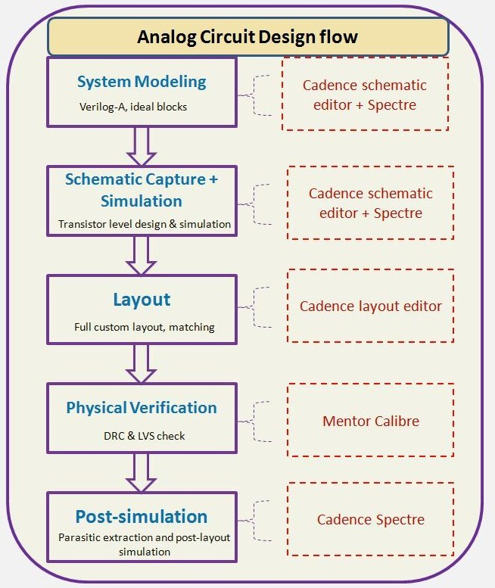
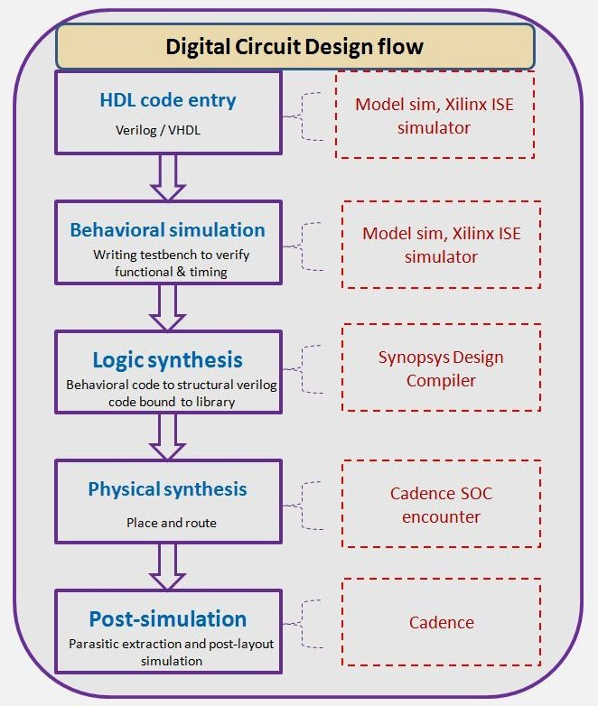
Traditional design routes

Slide 39
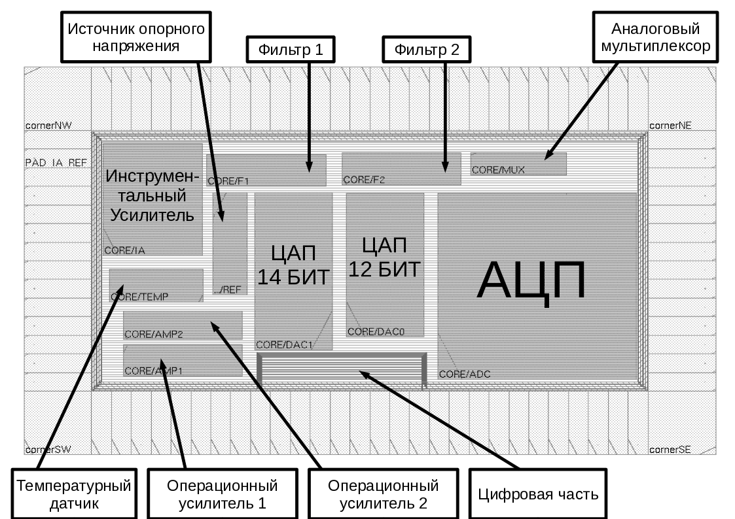
Smart pressure sensor readout ASIC
Customer – Rosatom
Design duration –
8 months of 2010
Chip planning in SoC Encounter (Cadence)

Slide 40
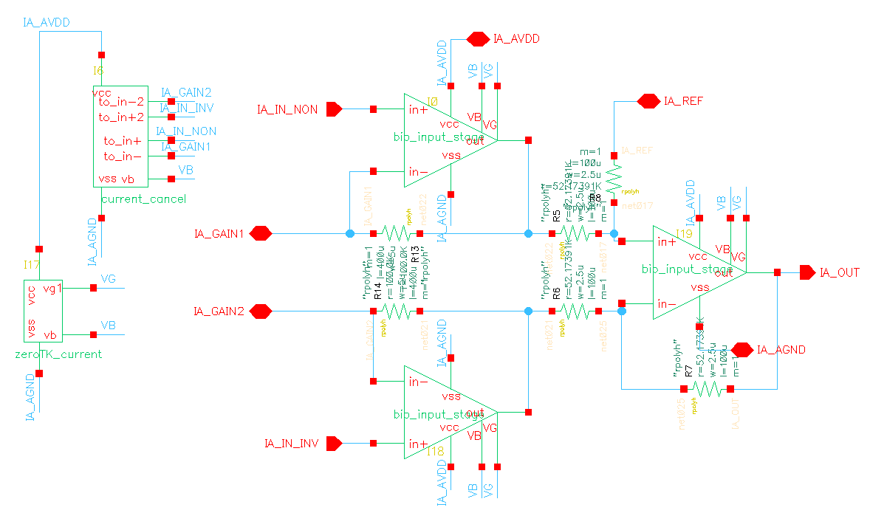
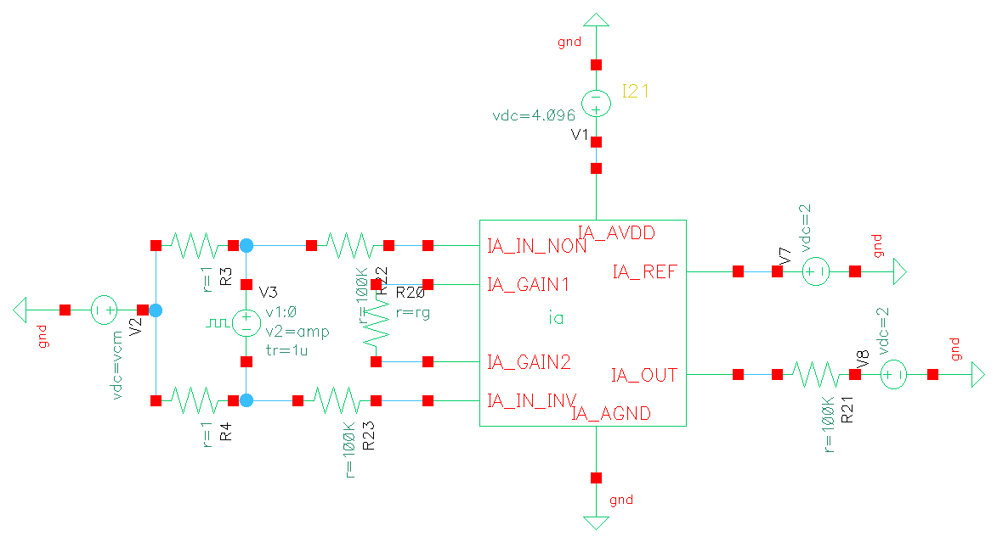
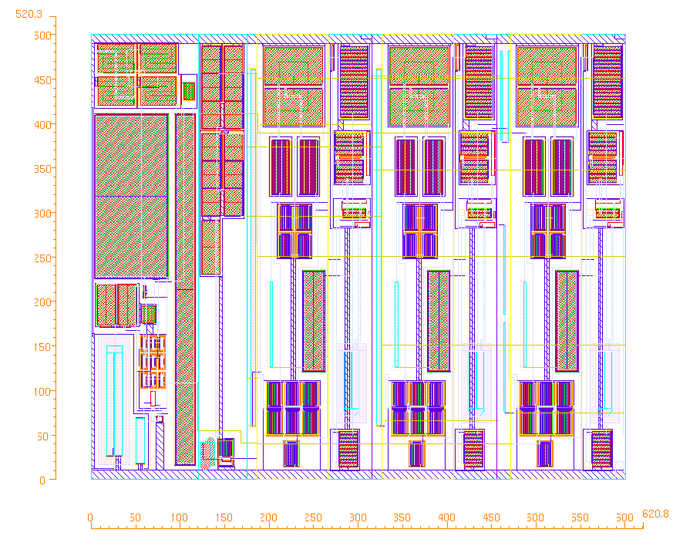
Instrumentation amplifier
Name | IA specs
Opamp gain | 96 dB
Unity gain frequency | 2 MHz
Phase margin | 70 degree
Consumption current | 100 µA
RMS noise | 20 nV/Hz^{1/2}
Temperature range | -55…+80 ºС
Input current | 5 nA
Offset voltage | 100 µV

Slide 41
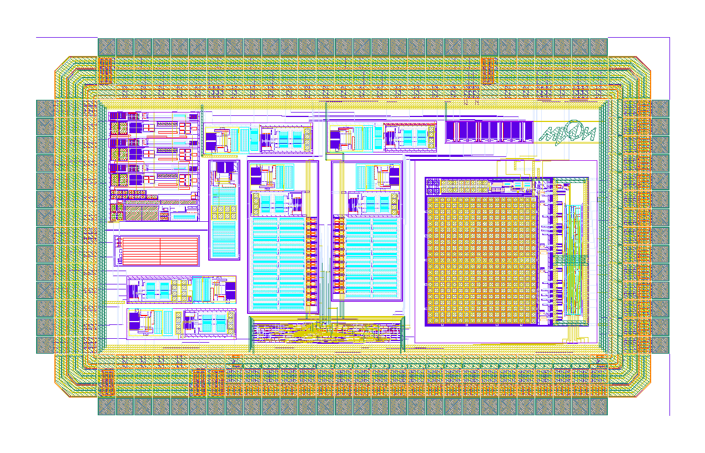
Smart sensor ASIC layout
Prototyped via Europractice in 2010:
SiGe 0.35 µm BiCMOS of AMS

Slide 42
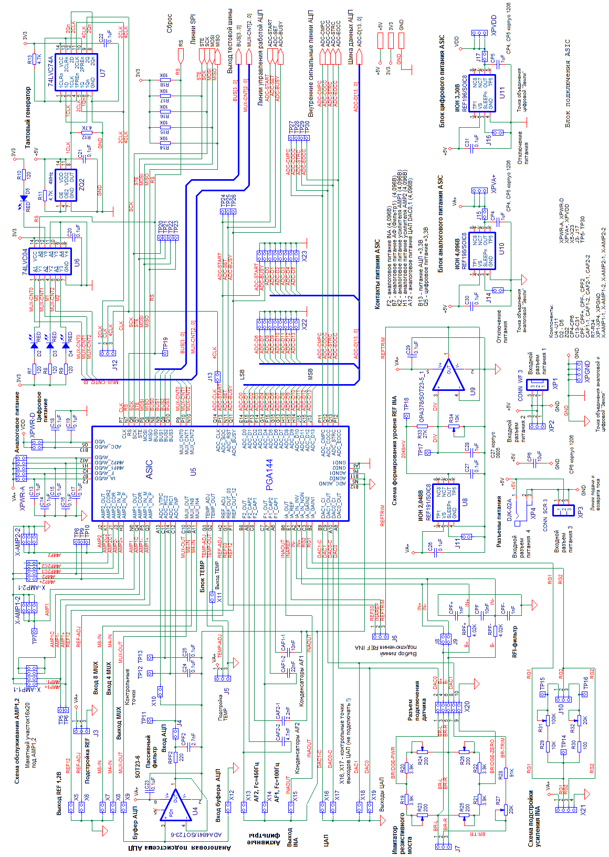
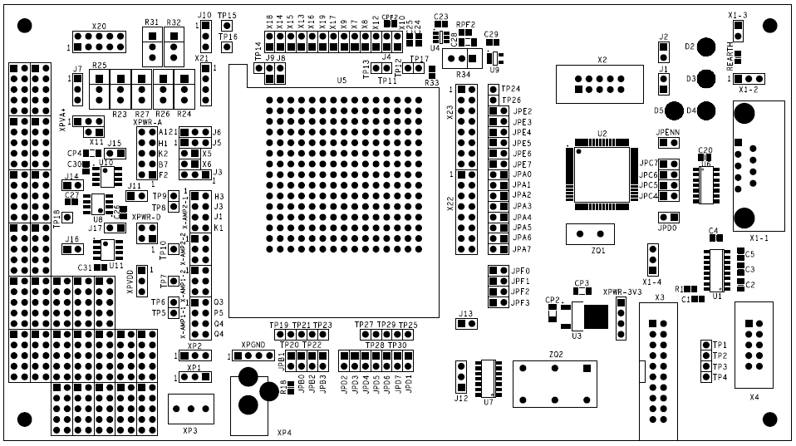
Test bench: circuit and board

Slide 43
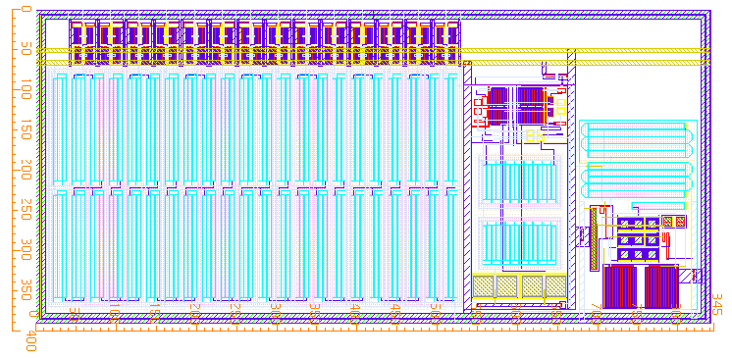
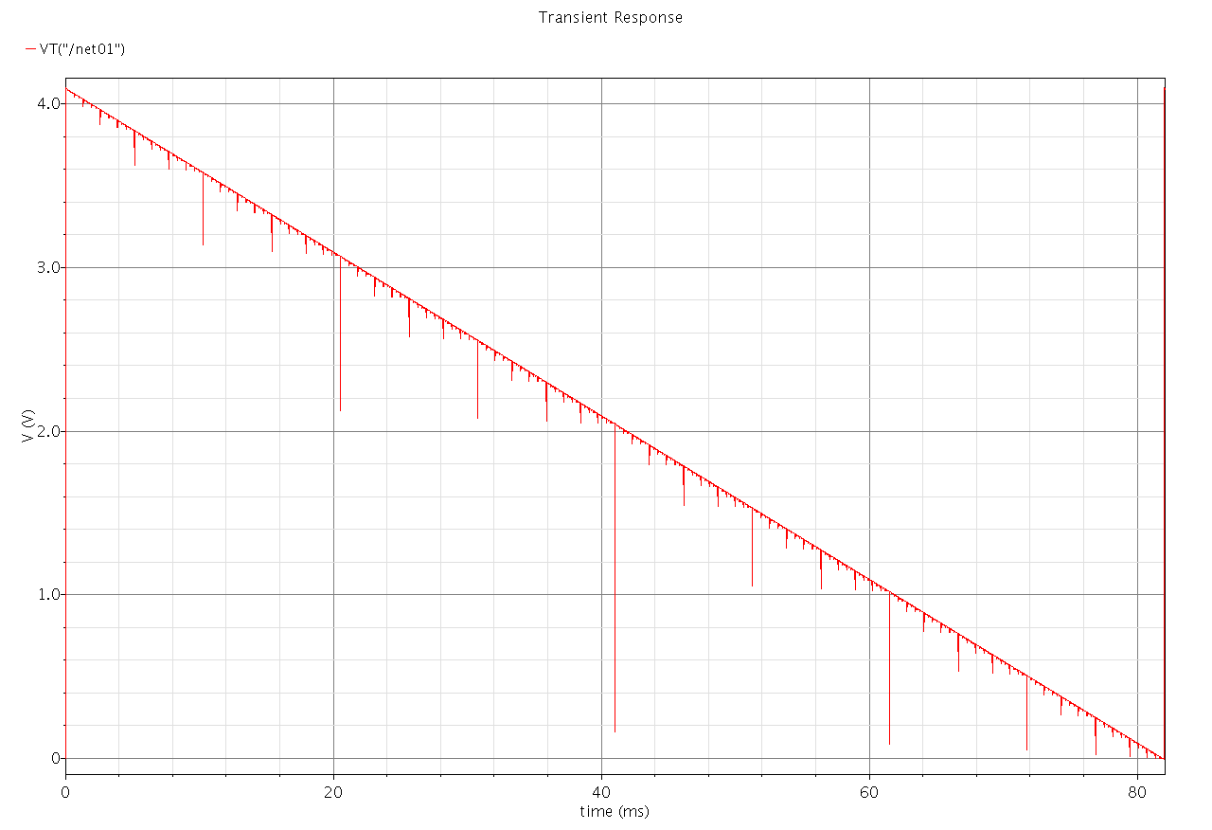

14-bit DAC
Name | DAC1
Number of bits | 14 bits
Output range | 3,9 V
Differential nonlinearity | 1 LSB
Integral nonlinearity | 2 LSB
Consumption current | 80 µA

Slide 44
Library of reusable IP blocks
Parameters:
Consumption
Speed
Dynamic range
ADC
Derandomizer
Comparators
How to build an hierarchy?
Slow
Control
Driver
CSA
Opamp
Tasks:
Track finding
Calorimetry
Charge detection
Time of flight
IP blocks
S/H
Shaper
MUX
PD
T/H
Arbitration
Logic
HDR
readout
Control
Logic
Cross-point
switch
Data-driven
readout
Analog readout
chain

Slide 45
References
1. International technology roadmap for semiconductors , 2009 Executive summary http://www.itrs.net/Links/2009ITRS/2009Chapters_2009Tables/2009_ExecSum.pdf
2. H. Spieler, Electronics and Signal Processing //XI ICFA School on Instrumentation in Particle Physics, Bariloche, Argentina , 2010 www-physics.lbl.gov/~spieler
3. A.Marchioro, Past and Future of Microelectronics in HEP // TWEPP-2015
4. Europractice annual report 2015. www.europractice-ic.com/docs/Annual_report_2015.pdf
R. Lacoe, Improving Integrated Circuit Performance Through the Application of Hardness-by-Design Methodology IEEE Transaction on Nuclear science, v. 55, N4, 2008, p.1903-1925
7. K.Roy, B.Jung, A.Raghunathan, Integrated systems in the more-than-Moore Era: Designing lowcost energy efficient systems using heterogeneous components/ 23rd International Conference on VLSI Design, 2010
8. M. Weber Highlights and Trends of Detector Instrumentation and Technology Development in Germany // TWEPP-2016
9. A. Klotz, Cadence EMEA, Science-Fiction becoming Reality 2016, MIET
10. http://www.semiwiki.com

Slide 46
Conclusions
The future of instrumentation is tightly bound with a wide usage of ASICs due to the new challenge in integration scale
Commercial technologies available today are well ahead of most requirements foreseen for particle physics` ASICs
The solution of system (architectural, structural) problems will demand substantially higher efforts to create not separate components, but whole systems on chip (SoC)
Almost all new chips have a mixed-signal character
Nowadays the design is based on microelectronic CADs and the adapted Design Kits of the chosen manufacturer
Reduction of timelines for design, extension of reusable IP block libraries, new level of system tests for readout electronics – all of that requires the usage of advanced CAD in distributed fast networks of powerful computing clusters

Slide 47
Conclusions (2)
The “Rad-hard by design” approach for commercial CMOS technology is considered to be the best way of providing an acceptable rad-hardness by circuital and layout techniques.
For rad-hardness and temperature stability of the chips it is important to refine the existing libraries and design routes
Long term planning becomes an extremely important factor, especially taking into account the “life time” of both the chosen technology and the design staff
The necessity of much stronger collaboration and coordination between all participants, sharing: the process of preparing human resources; the cost of expensive CAD and chip prototyping as well as updating existing design competences

Slide 48


Спасибо за внимание

Slide 49
Backups

Slide 50
Technological level in Russia
THE FEDERAL TARGET PROGRAM "DEVELOPMENT OF ELECTRONIC COMPONENT BASIS AND RADIOELECTRONICS"
Approved by the Government on November, 26th, 2007, decree N 809
2 main target indicators:
– The technological level of modern electronic component basis is estimated, basing on the one of microelectronic products, mastered in manufacture
    2008 → 0.18 µm
            2011 → 0.09 µm
                2015 → 0.045 µm
– There should be created 64 chip design centers in Russia
Important current tasks for Russia:
A new Federal program on developing a chip design center network, comprising up to 150 centers, has been approved
Creation of an advanced national photomask center

Slide 51

Number of ASIC projects,
manufactured via Europractice by Russian teams*
* Europractice annual report 2015, С.38
www.europractice-ic.com/docs/Annual_report_2015.pdf

Slide 52
ASIC for Nucleon project*
Большой динамический диапазон (100pC), потребление 2mW/ch, 32 канала
Период проектирования 2005-2009
AMIS 0.35 um CMOS
6 итераций:
Analog, 16 CSAs (включен в отчет Europractice 2005г. ) фев 2005
Mixed-signal, 4+2(тест.) CSA+SH+T&H+MUX+Driver сент. 2006
Mixed-signal, 4+2(тест.)CSA+SH+T&H+MUX+Driver фев. 2007
Mixed-signal, 32+2 (тест.) CSA+SH+T&H+MUX+Driver апр. 2007
Mixed-signal, 32+2 (тест.) (включен в отчет Europractice 2009г.)
CSA+SH+T&H+MUX+Driver сент. 2009
Мелкосерийное производство. Mixed-signal, 32+2 (тест.) CSA+SH+T&H+MUX+Driver апр. 2012
Late 2014 ASIC has been launched from Baikonur to the Space
* ROSCOSMOS project

Slide 53



ASIC Structure

Slide 54

От 4 (+2) к 32 (+2) каналам
References
Digital part
34 chs
6 chs
Differential Current drivers

Slide 55





Scope diagrams
CSA structure
CSA/shaper response
CSA tail adjustment
Typical waveforms
Output current driver

