Slide 1
Ultra-violet light-emitting diod calibration system for timing large area scintillation detectors.
Dr. Mikhail Runtso, Mr. Pavel Naumov,
Dr. Peter Naumov, Mr. Evgeny MAKLYAEV
Dr. Vladimir KAPLIN, Mr. Vladislav FOMIN,
Mr. Igor RAZZHIVIN, Mr. Yury Melikyan
National Research Nuclear University MEPhI
(Moscow Engineering Physics Institute) (NRNU MEPhI)

Slide 2
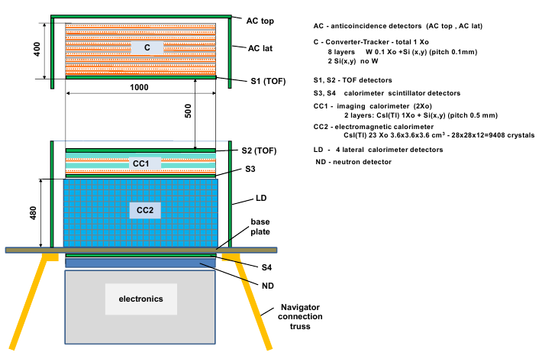
The layout of the GAMMA-400 gamma-ray telescope

Slide 3
Fast timing scintillator detectors
AC – anticoincidence detector registers charged particles with high efficiency to exclude these events
S1-S2 – time-of-flight system
S3 – calorimeter scintillation detector shows the events with high probability of back-splash particles generation
S4 – leakage detector.
Scintillator – BICRON BC-408 (Polyvinyltoluene),
Modules 1000x100x10 mm³
Light Output -64% Anthracene,
Rise time – 0,9 ns,
Decay time – 2,1 ns,
Wavelength of max. emission – 425 nm,
Light “e” times attenuation length – 210 cm,
May be used in vacuum.

Slide 4
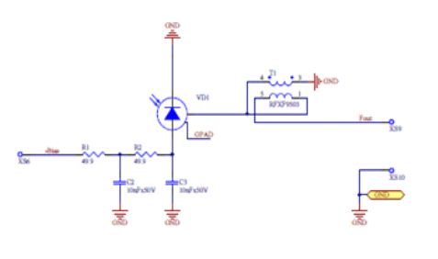


SiPM light sensors
MicroFB 60000 Series SMT Package
Fast output with SMT Transformer RFXF9503

Slide 5
Plastic scintillator detector LED calibration amplitudes during the spaceflight of PAMELA magnetic spectrometer (2006 -2015)

Slide 6
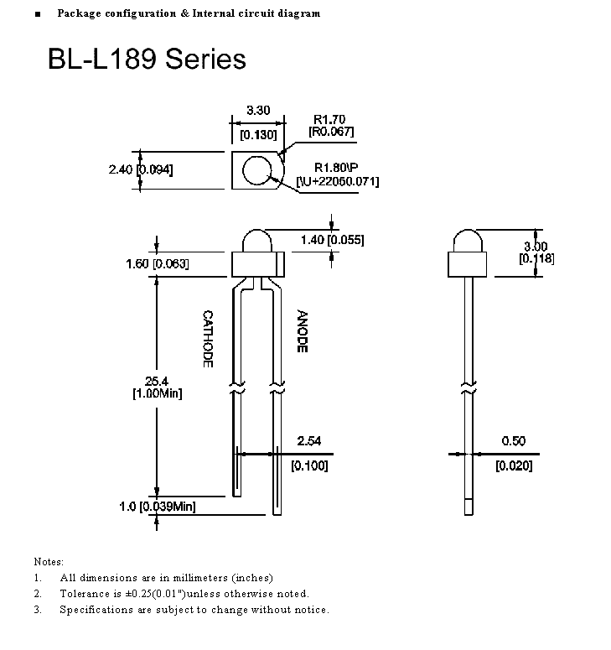
Calibration LED diode located in the center of 1000x10 mm² side
BL-L189VC
- 1.8 bb Round Tower
Type LED;
Material – InGaN;
Light wave length – 405 nm
Forward Voltage
- Typ 3.80 V
- Max 4.5 V

Slide 7
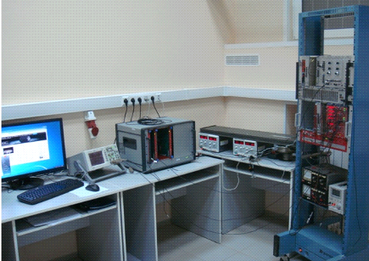
The setup for the plastic scintillator with SiPM as photosensors characteristics measurement

Slide 8
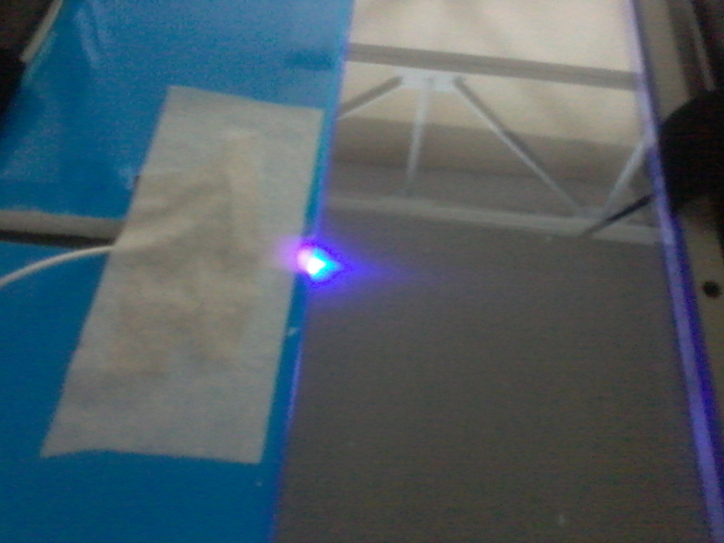
Layout of transformed light distribution of UV LED

Slide 9
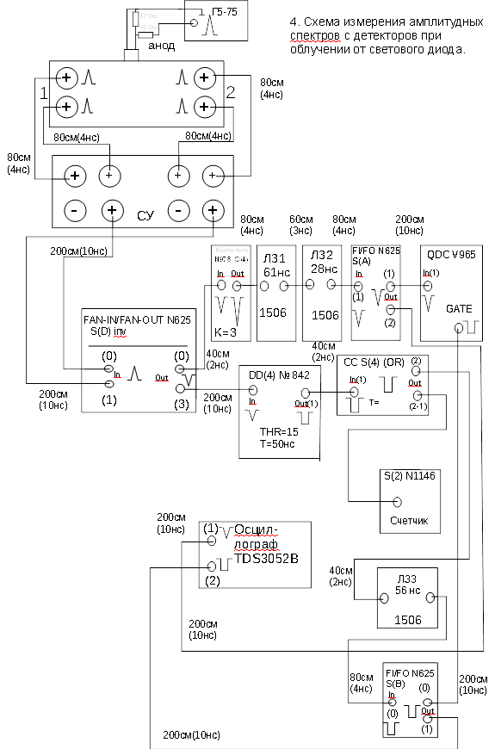
The layout of the amplitude spectra of detector measurements with LED irradiation

Slide 10
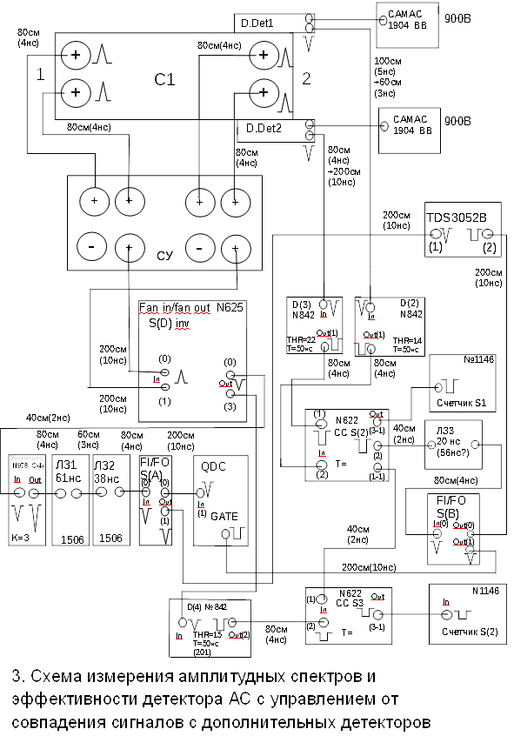
The layout of the amplitude spectra of detector measurements triggered by the coincidence of additional detectors signals.

Slide 11
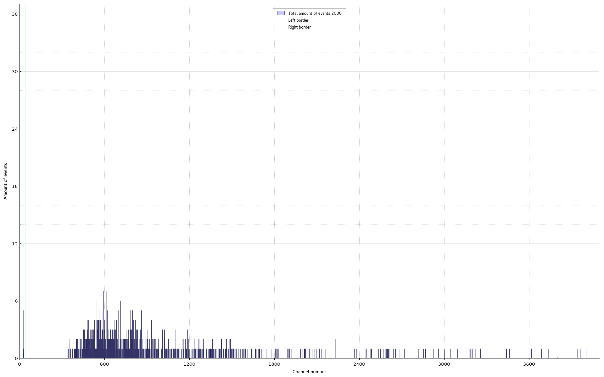
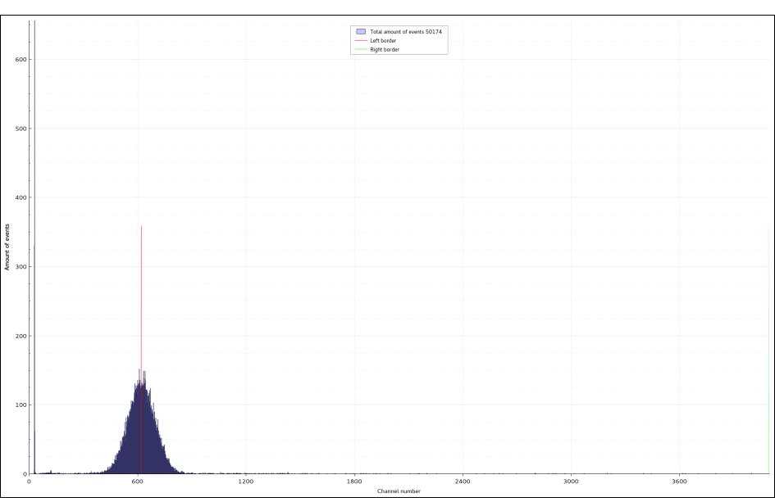
The see-level cosmic ray muons amplitude spectrum of detector sum signal from the opposite ends triggered by the coincidence of additional detectors signals (upper figure) and UV LED spectrum (down figure).

Slide 12
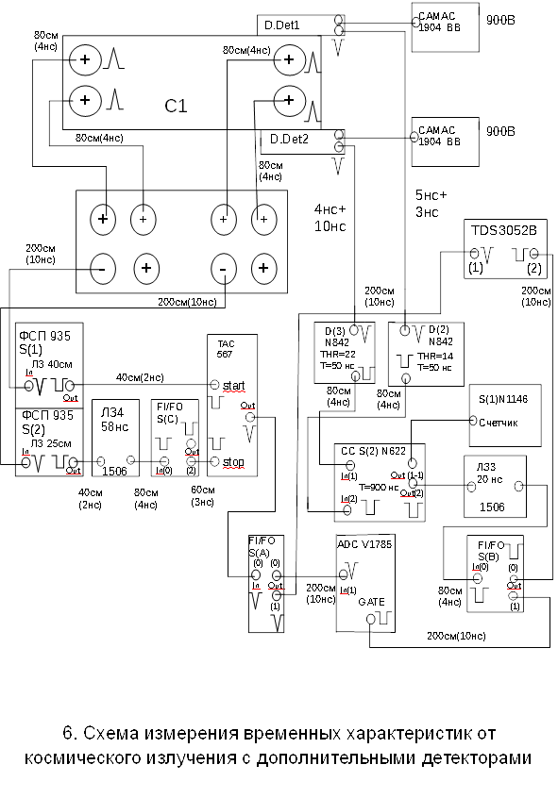
The layout of the timing spectra of detector measurements triggered by the coincidence of additional detectors signals.

Slide 13
The time intervals distributions between the moments of CR detection at the detector opposite ends. The coordinate selection was made with the help of additional detectors. The time calibration was carried out by the delay line with the step of 10 ns. Time resolution (sigma) =1.23 ns.

Slide 14
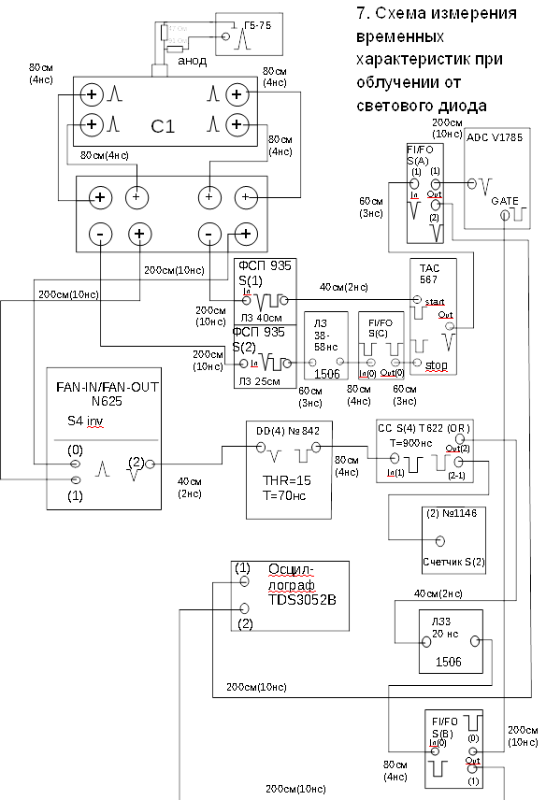
The layout of the timing spectra of detector measurements with LED irradiation

Slide 15
The time intervals distributions between the moments of LED pulses detection at the detector opposite ends. The time calibration was carried out by the delay line with the step of 10 ns. Time resolution (sigma) =0.62 ns.

Slide 16
Conclusion
Использование светоизлучающего ультрафиолетового диода для калибровки и мониторирования в условиях длительного космического эксперимента характеристик быстрых сцинтилляционных детекторов позволяет получить амплитудное и временное разрешение лучшее, чем при мониторировании от заряженных частиц. Эти два метода, использующиеся параллельно, позволят дополнительно устанавливать источник нестабильности
The application of light emitting ultraviolet diode for the calibration and in-flight monitoring of the fast plastic scintillation detector characteristics in the conditions of long-lasting space experiment allows to get amplitude and time resolution better than using calibration from charged particles. The parallel implementation of these two methods allows to determine the source of instability.

Slide 17
Thank You for your attention

Slide 18
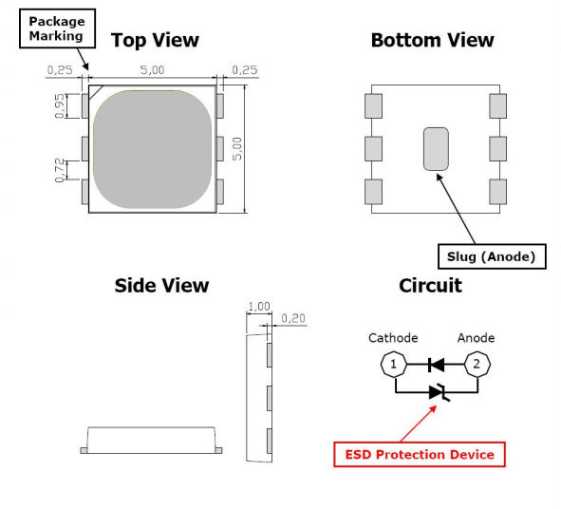
SMD 5050 395NM UV LED
Electro-Optical characteristics at 150mA
Part number | Dimensions | Wavelength | Optical power | Forward voltage | Forward current | Viewing angle | Application
TH-UV395TA- 5050 | 5.0*5.0*1.0 | 395-405nm | 45-80mW | 2.9-3.3V | 50mA | 120deg. | Nail curing

