Slide 1



Sharp increasing of positron to electron fluxes ratio below 2 GV measured by PAMELA
V. V. Mikhailov
(NRNU MEPHI)
on behalf PAMELA Collaboration

Slide 2







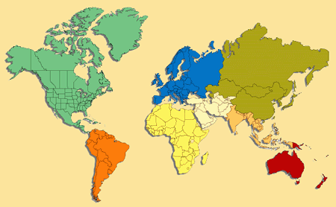





PAMELA Collaboration
Italy:
Bari
Florence
Frascati
Naples
Rome
Trieste
CNR, Florence
Russia:
Moscow
St. Petersburg
Germany:
Sweden:
Siegen
KTH, Stockholm

Slide 3
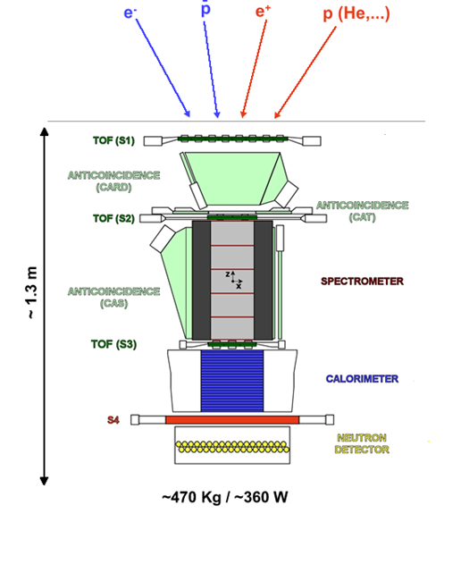
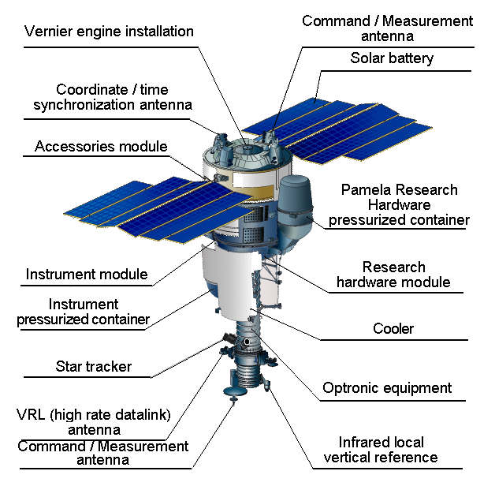
PAMELA experiment
PAMELA is here
Satellite was launched 15.06.2006 on
elliptical polar orbit with inclination 70⁰,
altitude 350-610 km.
Operating till 21 Jan 2016.
Total amount of data:
50TB , 9×10⁹ events

Slide 4
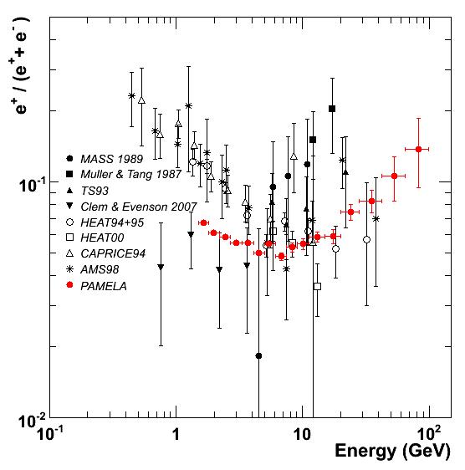
Positron fraction e⁺/(e⁺+e⁻) in Galactic Cosmic Ray
Solar modulation?
Nature, 2009

Slide 5
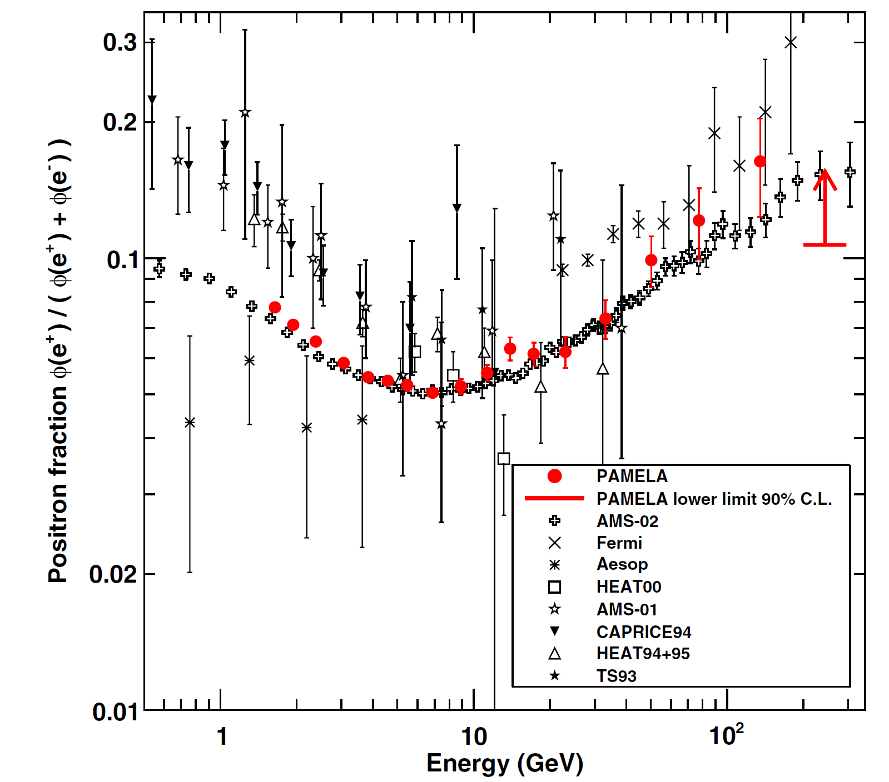
Comparison with AMS02
Figure from
O. Adriani, et al. Physics Reports, 2014,
http://dx.doi.org/10.1016/j.physrep.2014.06.003
At low energy data of PAMELA and AMS-02 are below of measurements of 90th
AMS-02 M. Aguilar, et al., Phys. Rev. Lett. 110 (2013) 141102

Slide 6
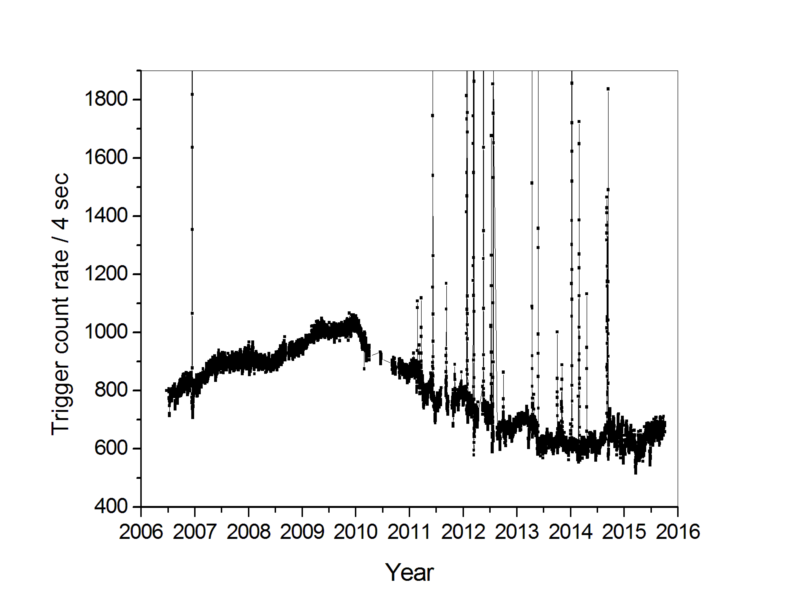
Variation of proton fluxes in 2006-2015
Proton energy spectra
PAMELA counter rate J(E>50 MeV)
MAX
MIN
AMS-02
Year

Slide 7
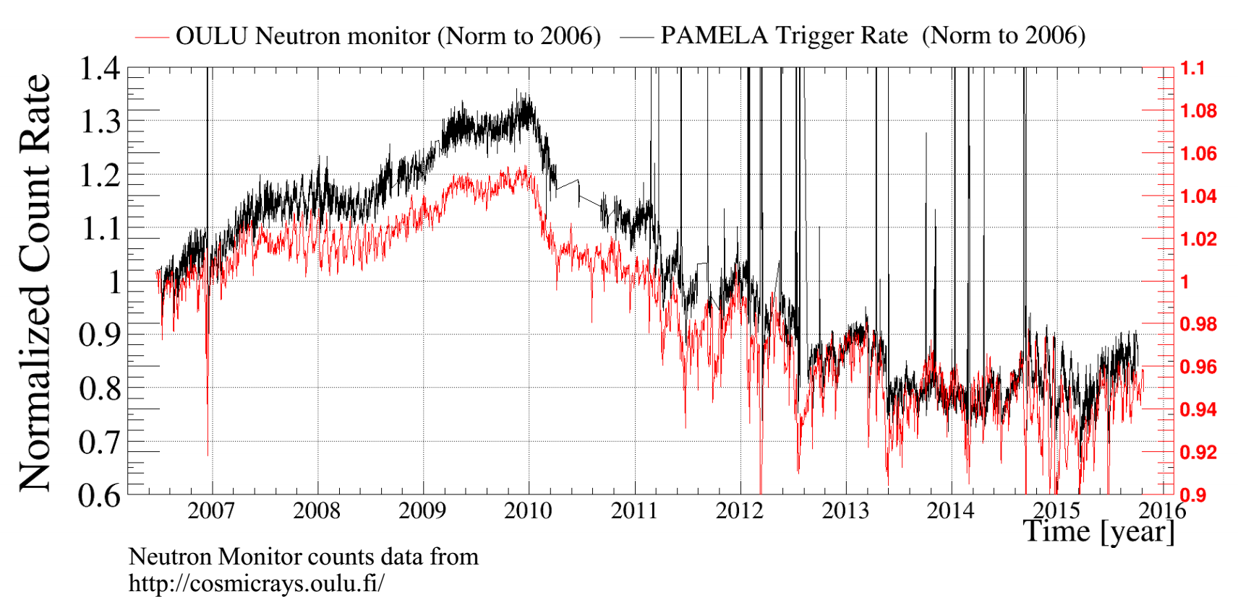
PAMELA & NM

Slide 8
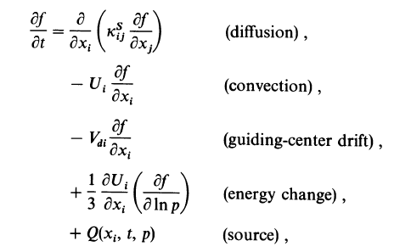
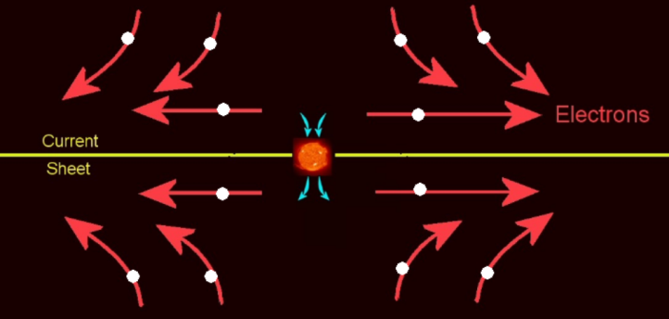
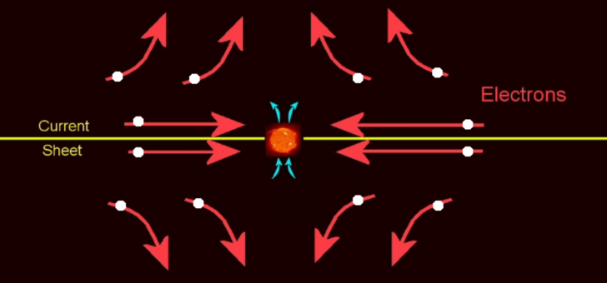

Modulation of CR positrons and electrons in Heliosphere
A>0
A<0
min
max
Parker equation, 1965
During SA MIN drift contribution correlate with tilt angle of Heliospheric sheet
Drift of electrons at different polarity epochs A
M. Potgieter , PAMELA Workshop 2009
Drift of e-
grad (B)
Drift of e+
Sun magnetic field А<0
А>0

Slide 9
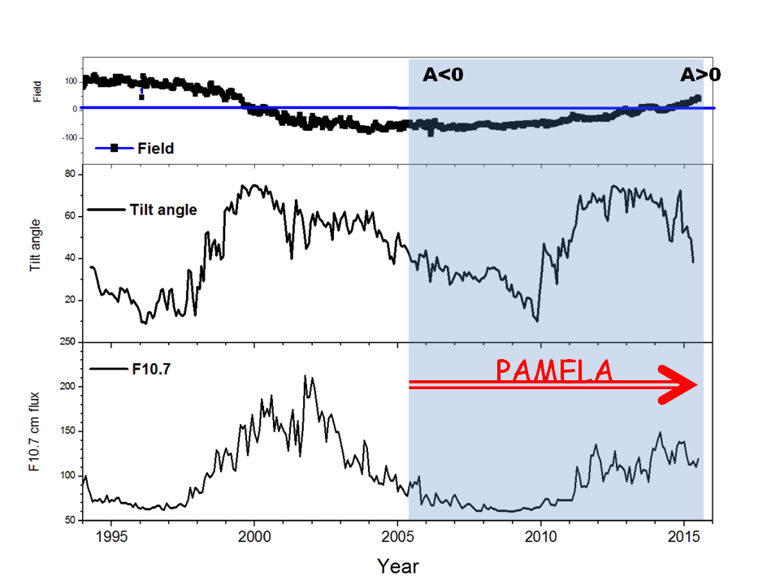
Heliospheric conditions during PAMELA observations
23rd 24th cycle
Polar Sun Field
Tilt angle
Change of polarity
in 2014
from A<0 to A>0
Solar activity
F10.7 cm flux
MIN
MAX
PAMELA observations covers ~ one solar cycle
Data of the Wilcox Solar Observatory: http://wso.stanford.edu, http://www.spaceweather.gc.ca/solarflux

Slide 10
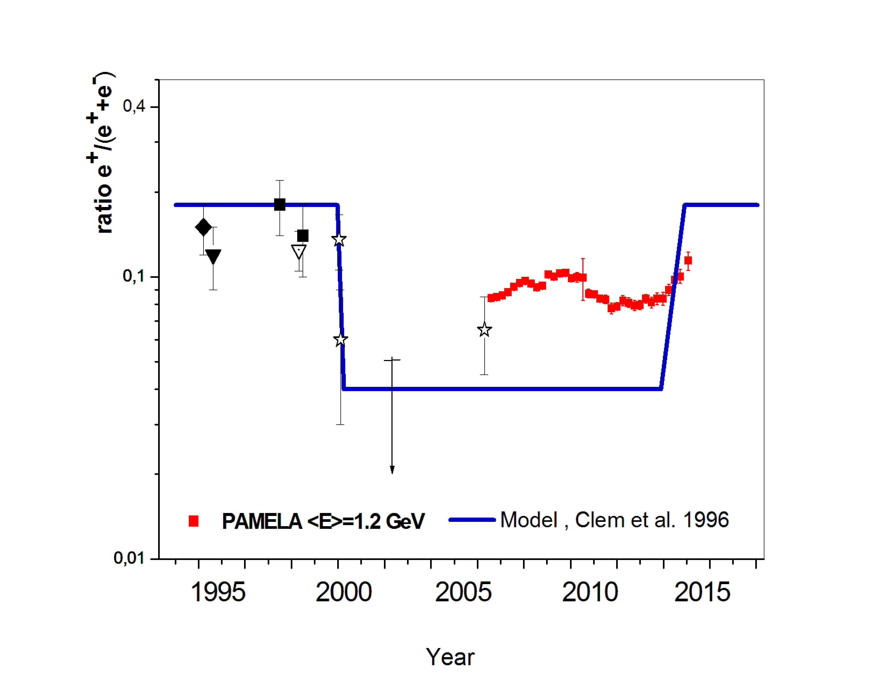
Empirical model
PAMWLA
PAMELA
Caprice, HEAT, AMS-01, AESOP data from Clem and Evenson, 2007
Model is extrapolated to 2016

Slide 11
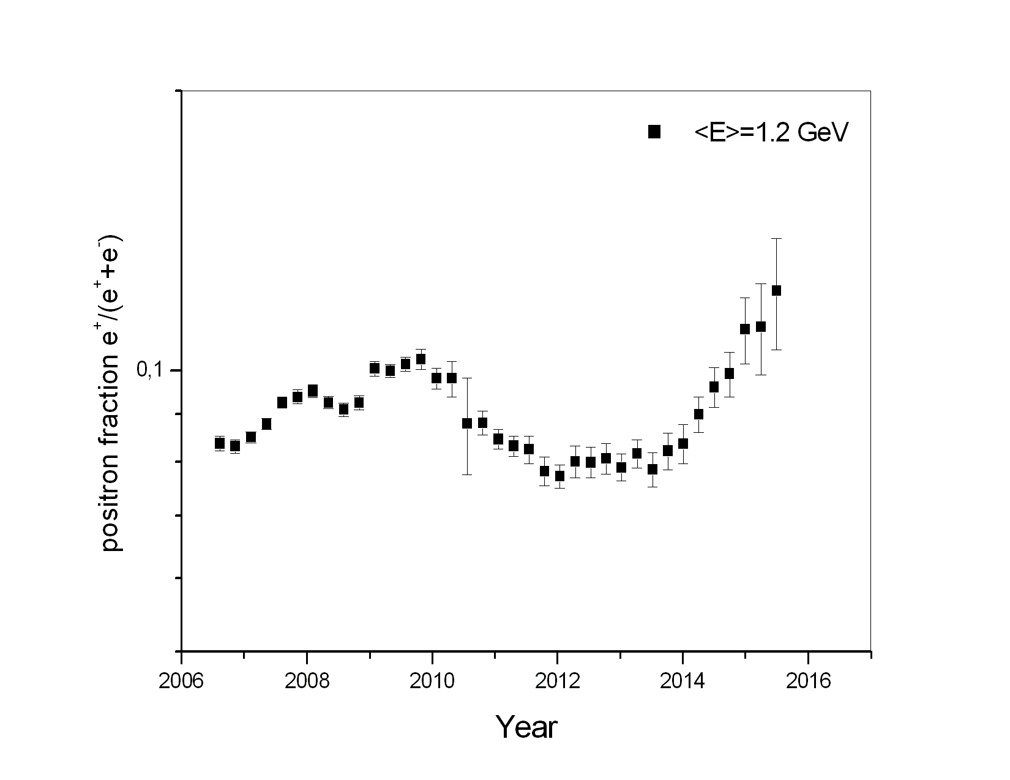
Positron fraction in Galactic Cosmic Ray e⁺/(e⁺+e⁻) since 07.2006 till 11.2015

Slide 12
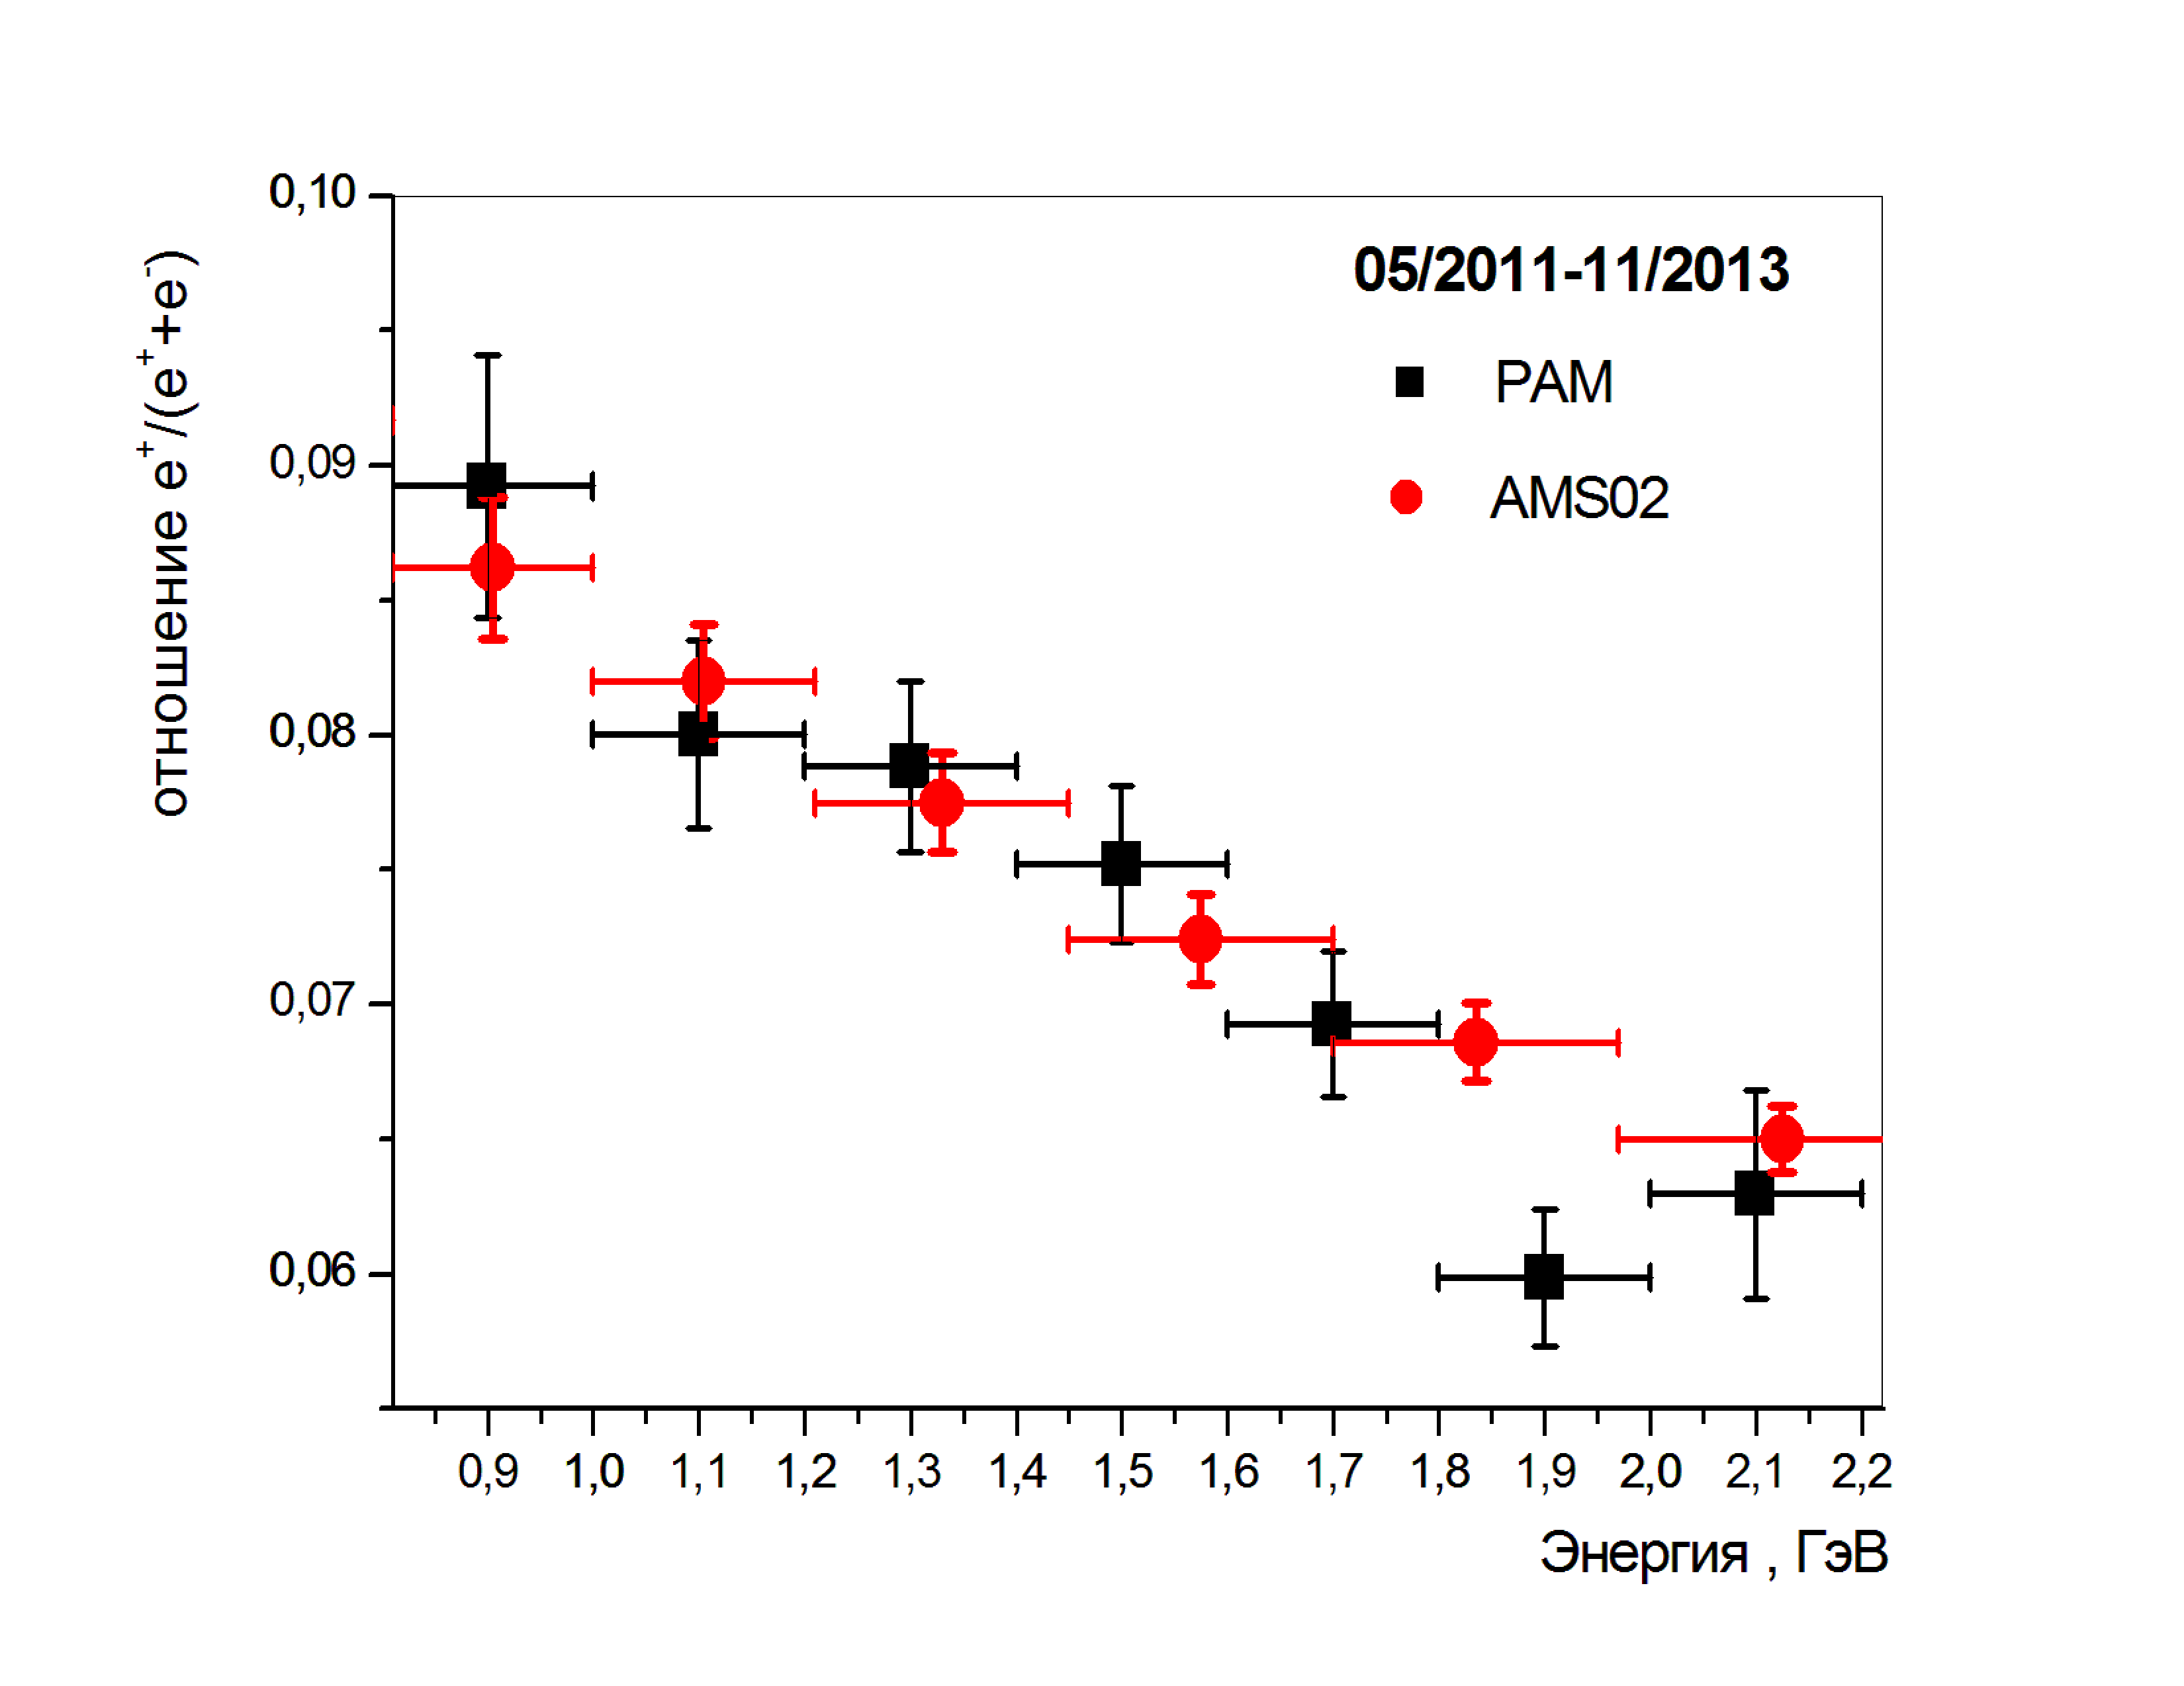
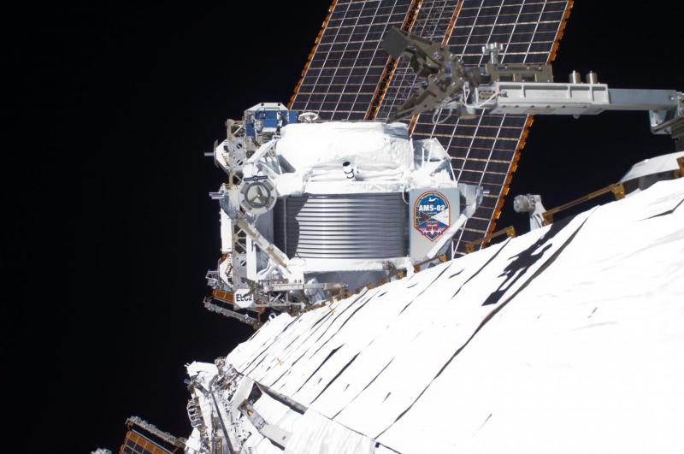
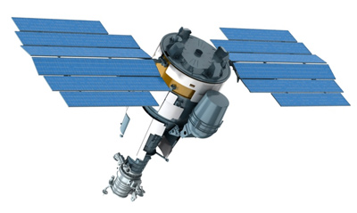
Comparison PAMELA and AMS-02
Ratio
Data of AMS-02 from(PRL 113, 121101,2014)
E, GeV
AMS-02 installed on International Space Station
in 2011. Inclination of ISS orbit 51^{0.}
The Resurs DK satellite has inclination of orbit 70⁰

Slide 13
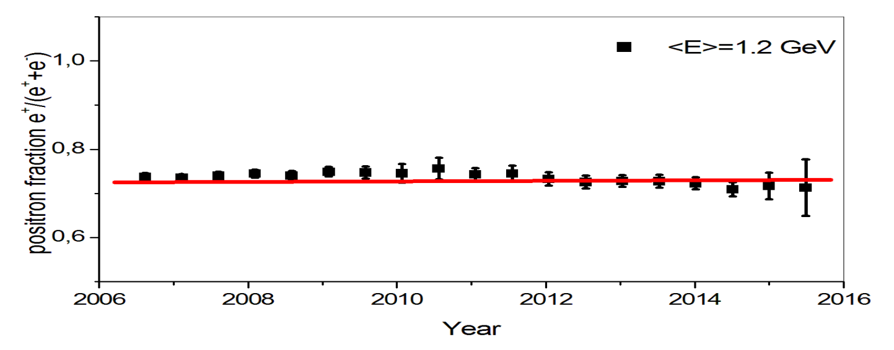
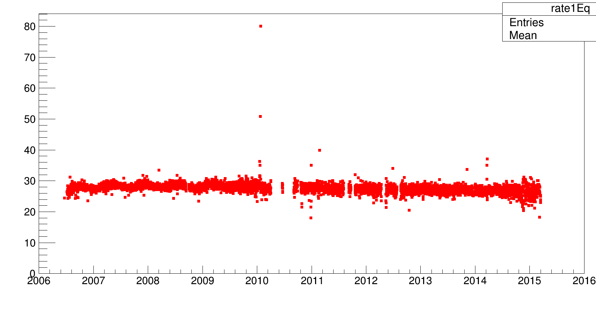
Albedo positron fractions vs time
Albedo e+, e- fluxes
produced in the interactions
of high energy CR with residual atmosphere.
Count rate, Hz
Counter ToF4 J(E>80MeV)
Total count rate.
Equatorial region

Slide 14
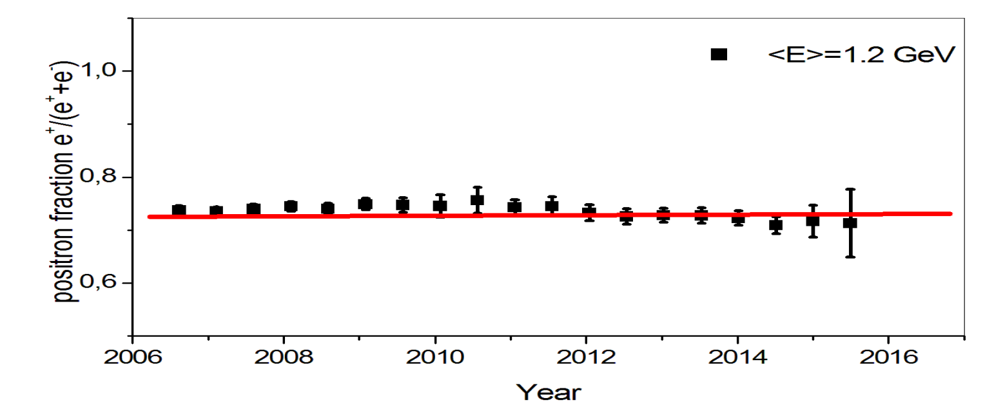
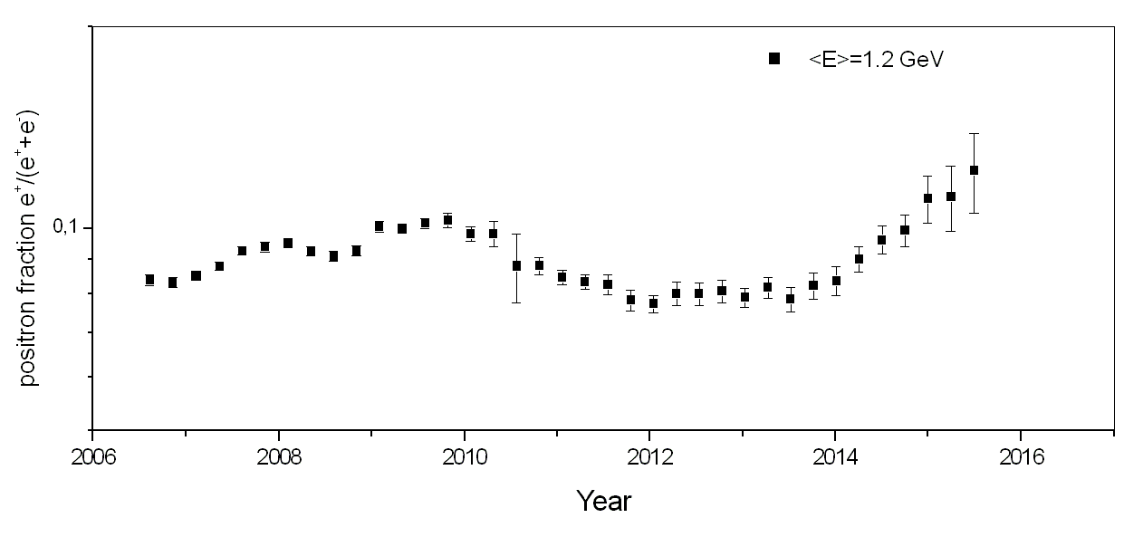
Albedo & CR positron fractions vs time
Albedo e+, e- fluxes
produced in the interactions
of high energy CR with residual atmosphere.
Not modulated!! (max-min)/min<8%
Cosmic ray ratio
at the same energy
CR positron fraction
(max-min)/min>50%

Slide 15
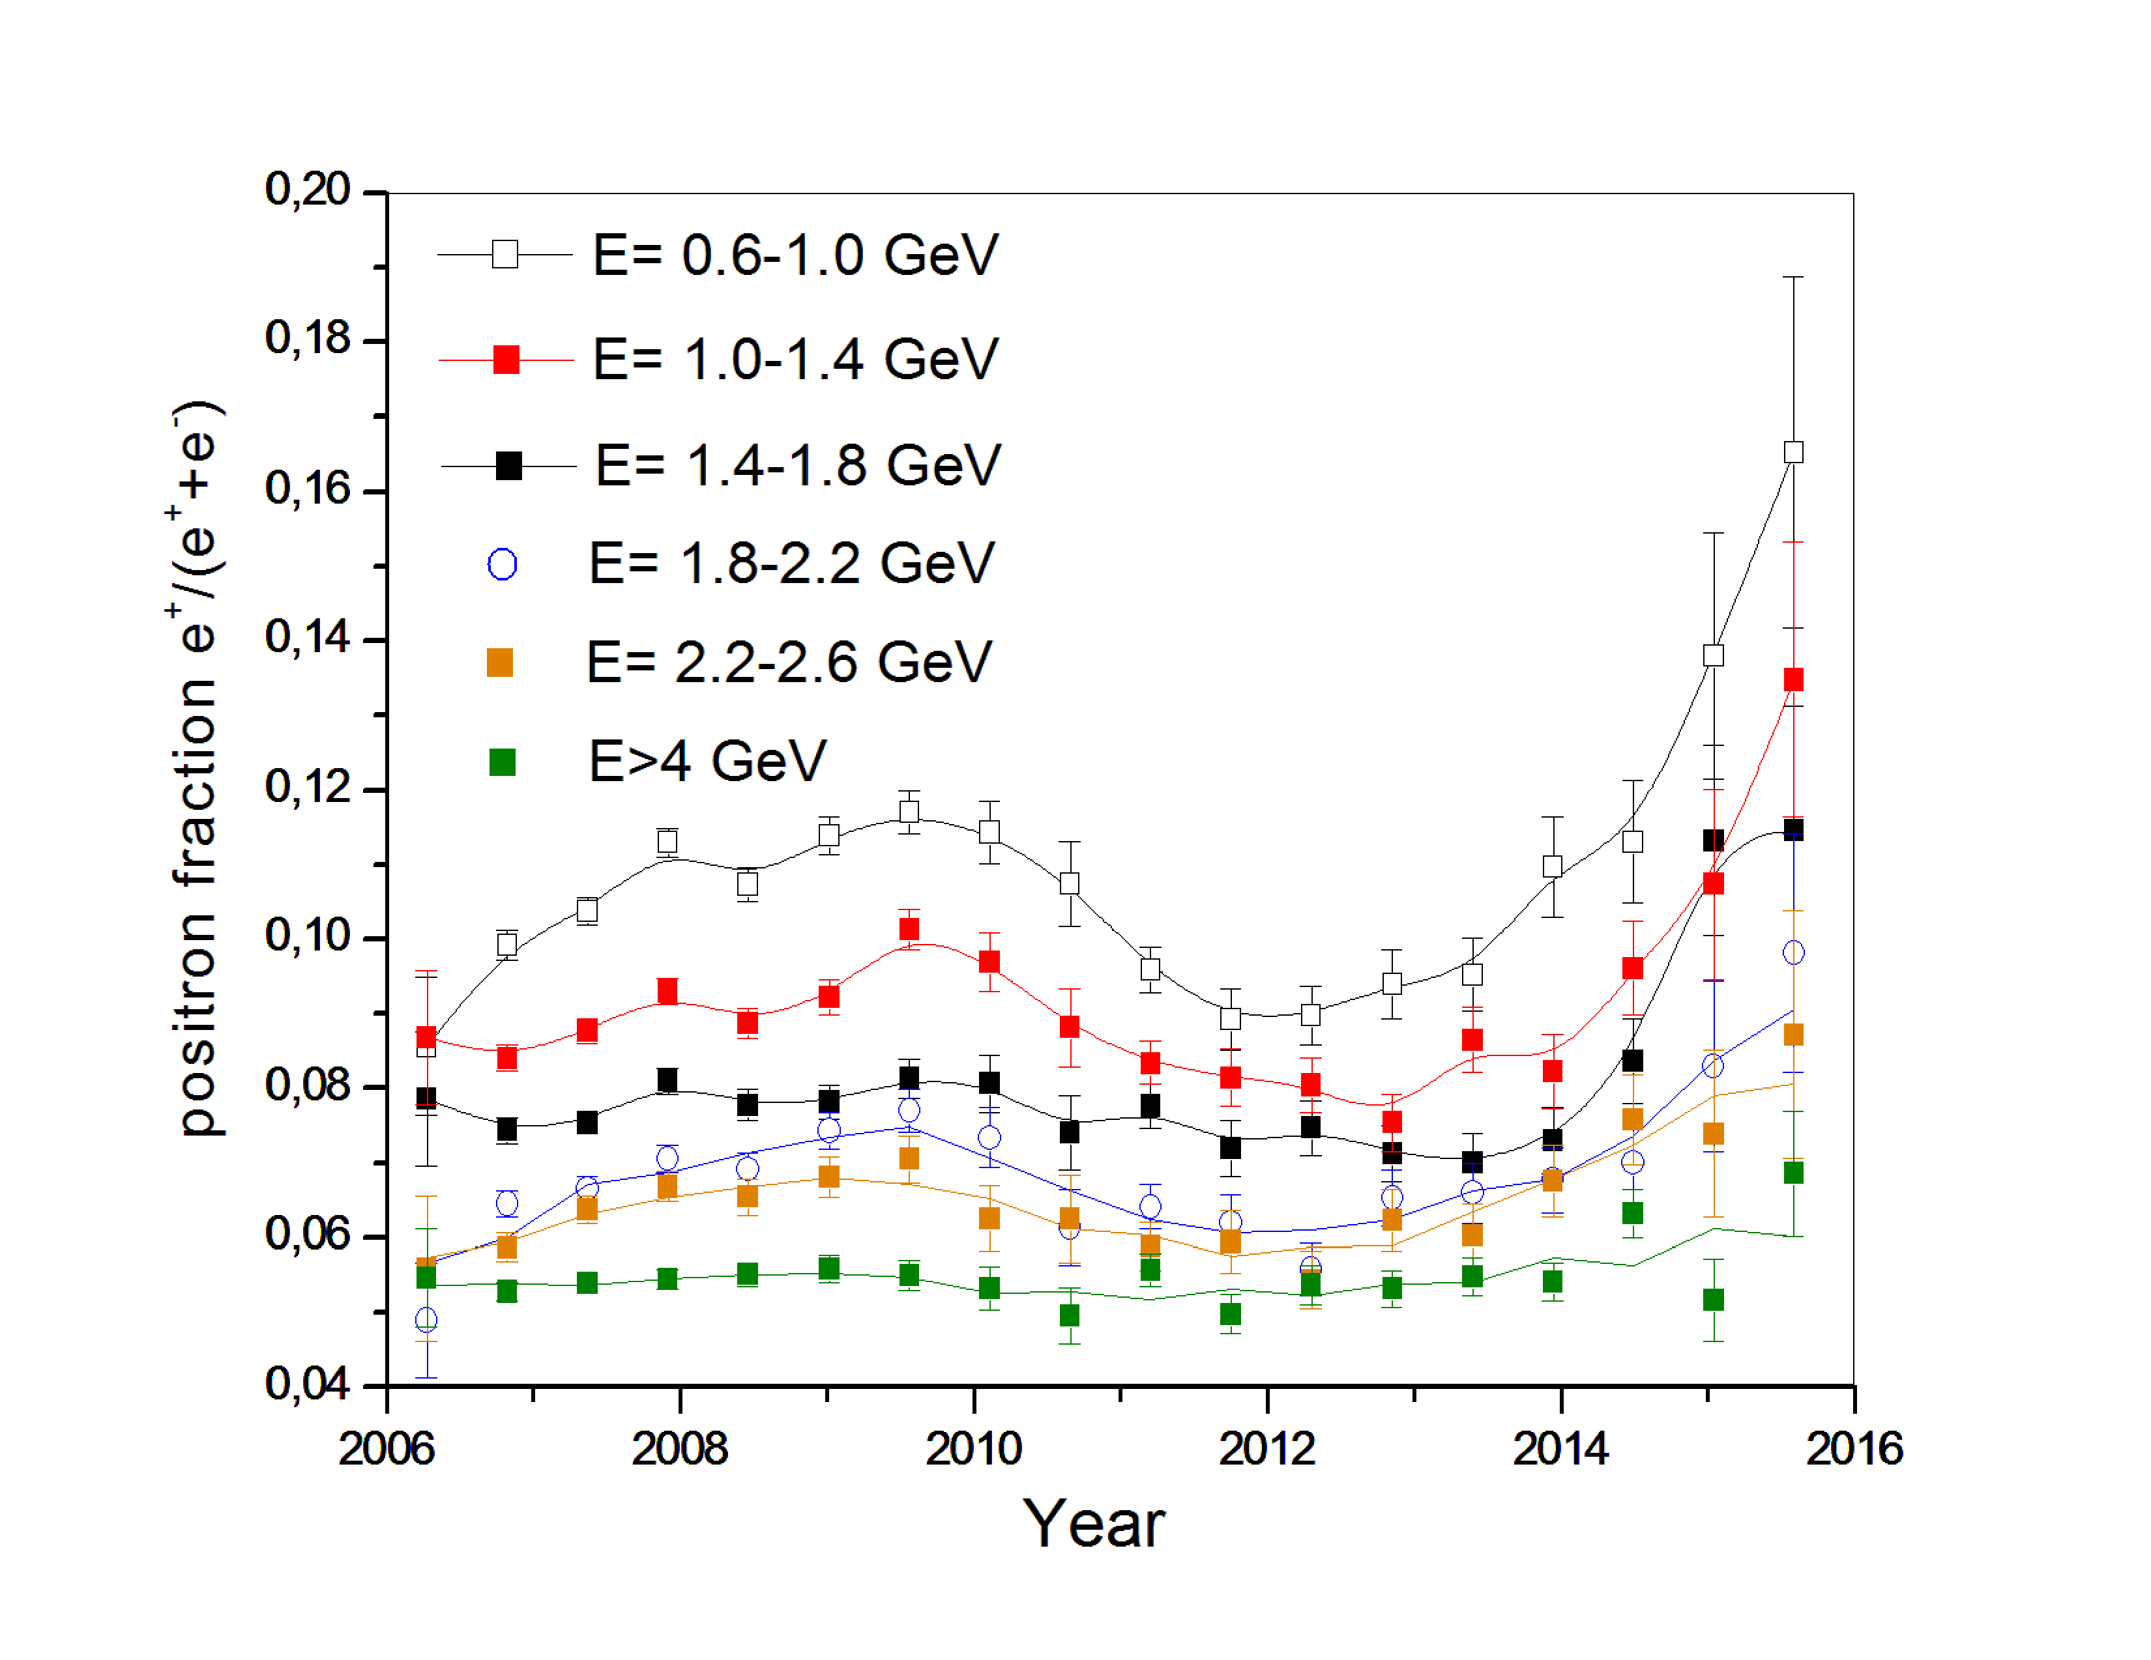
Positron fraction modulation at different energies
A<0
A>0

Slide 16
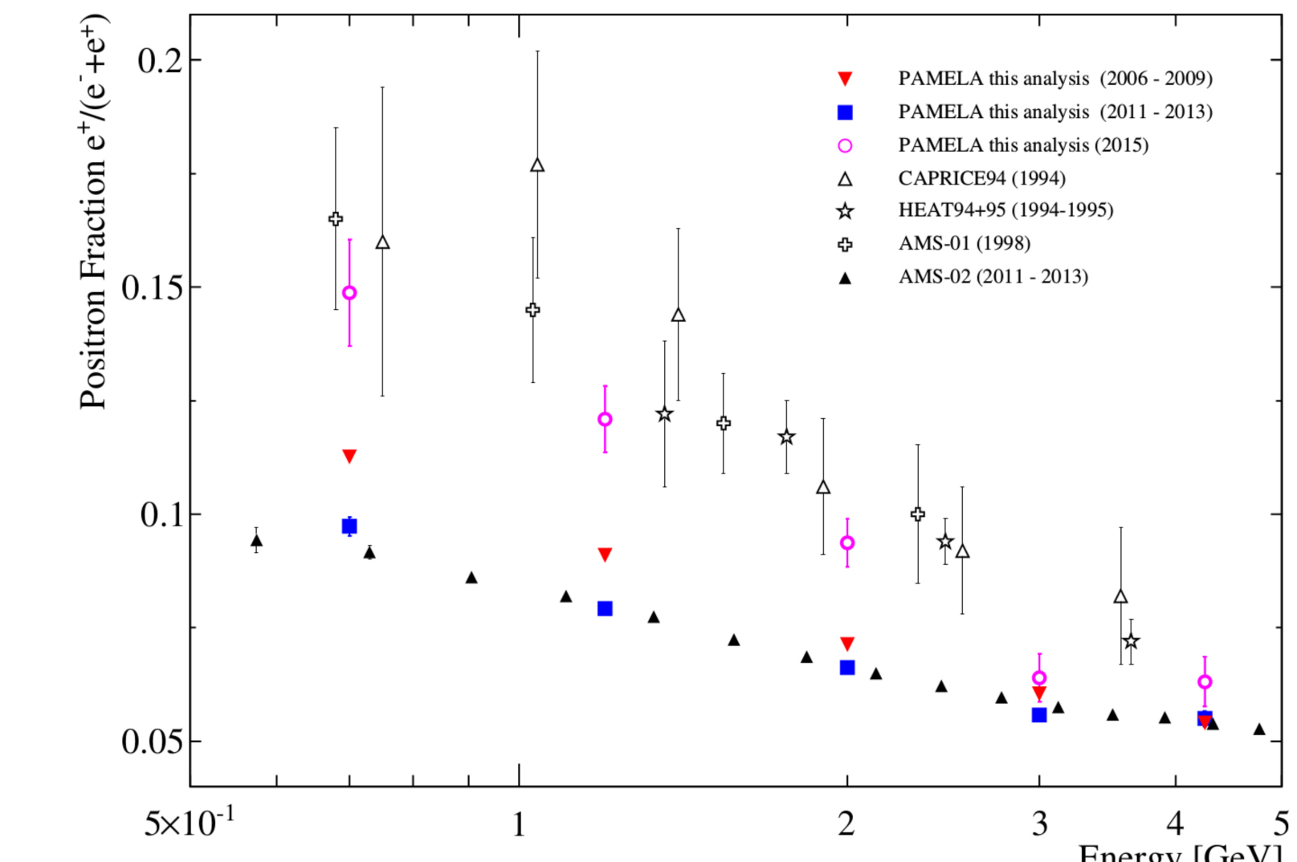
Positron fraction in 1994- 2015
(2006-2009)
(2011-2013)
(2015)

Slide 17
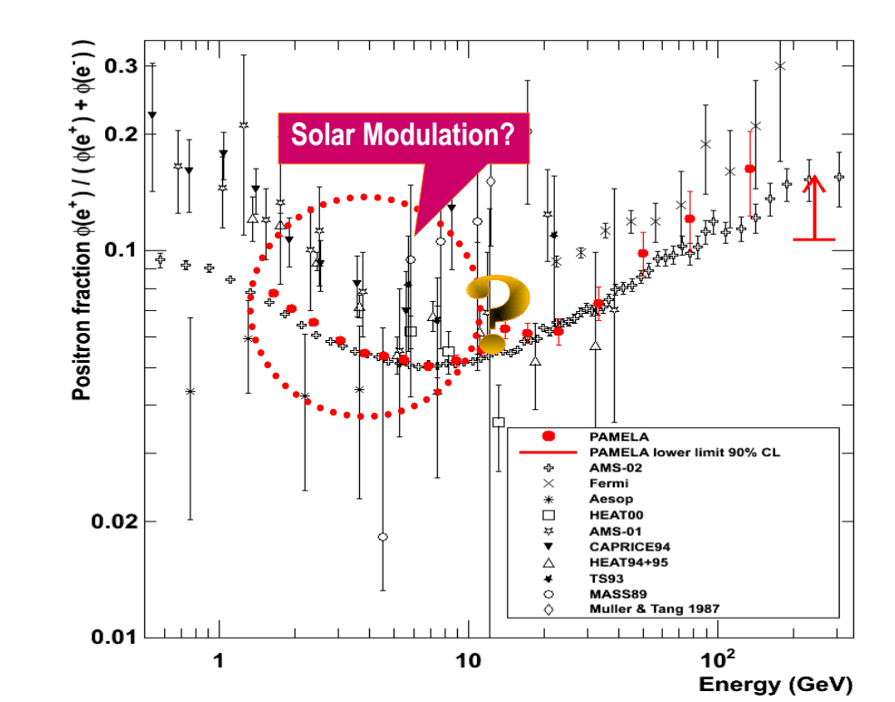

Slide 18
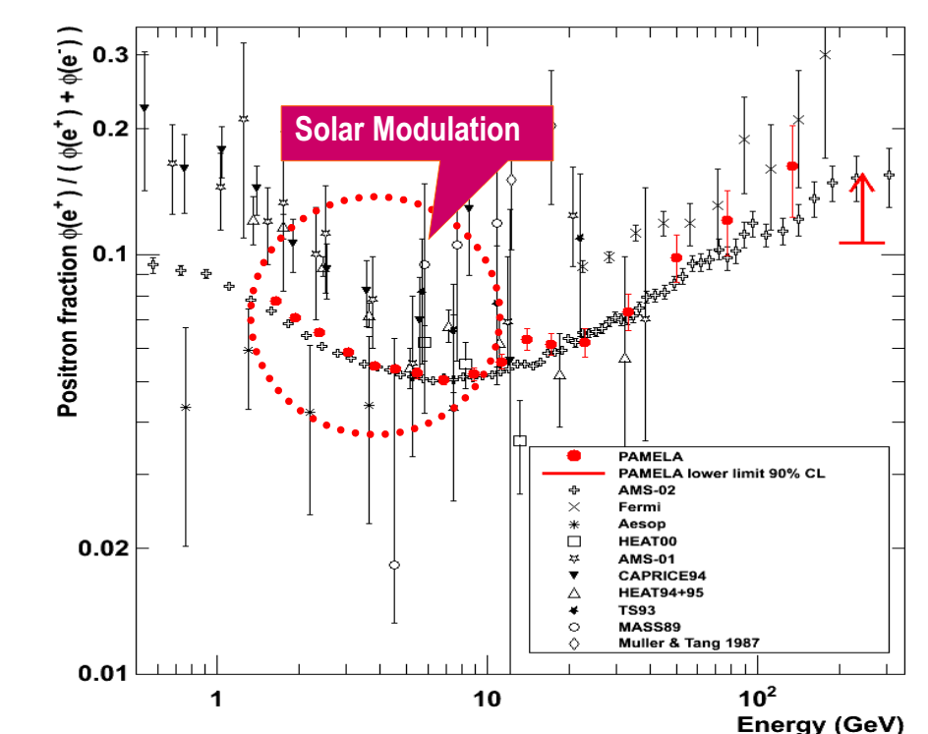

Slide 19
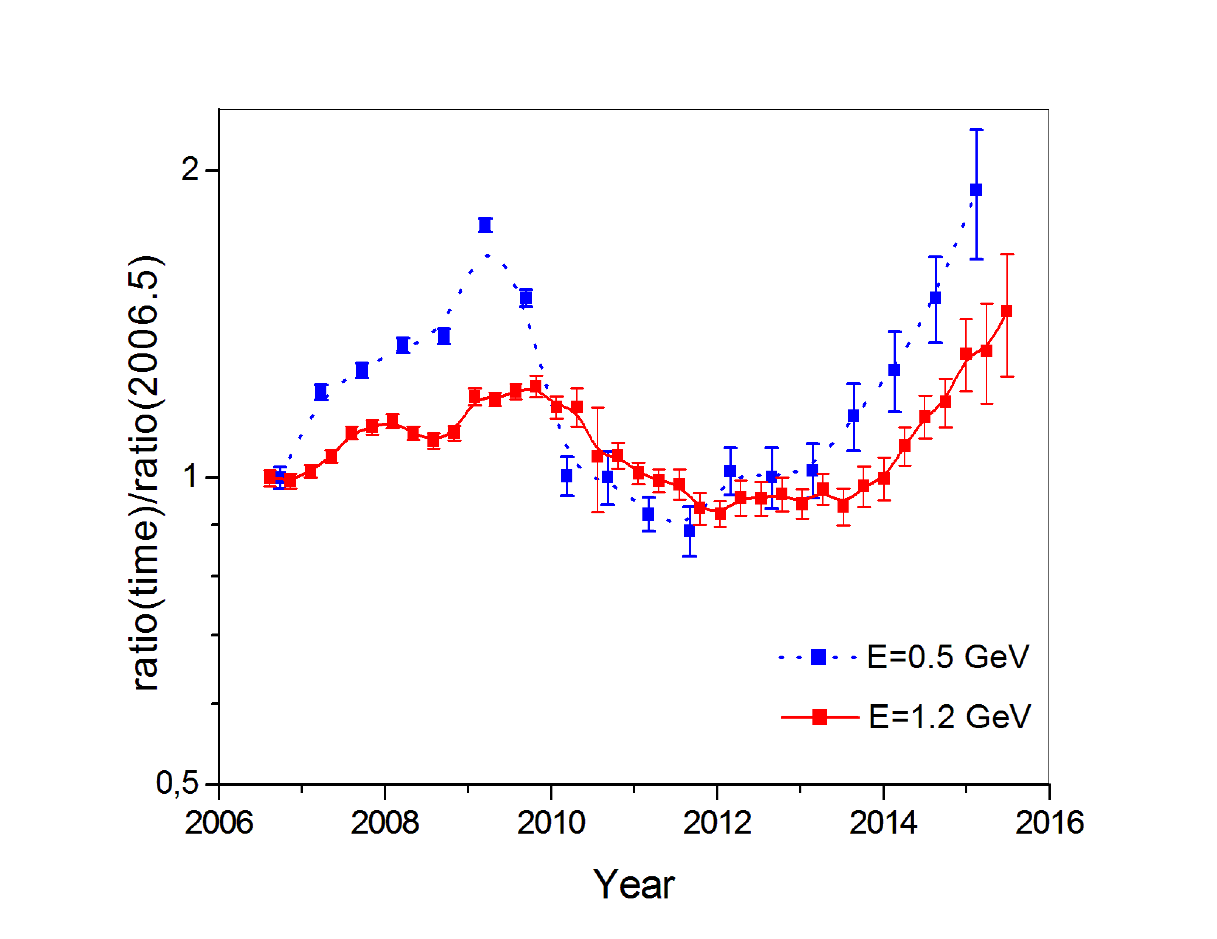
Relative fluctuations of positron fraction at E=0.5 GeV E=1.2 GeV
Positron fraction as function of time

Slide 20
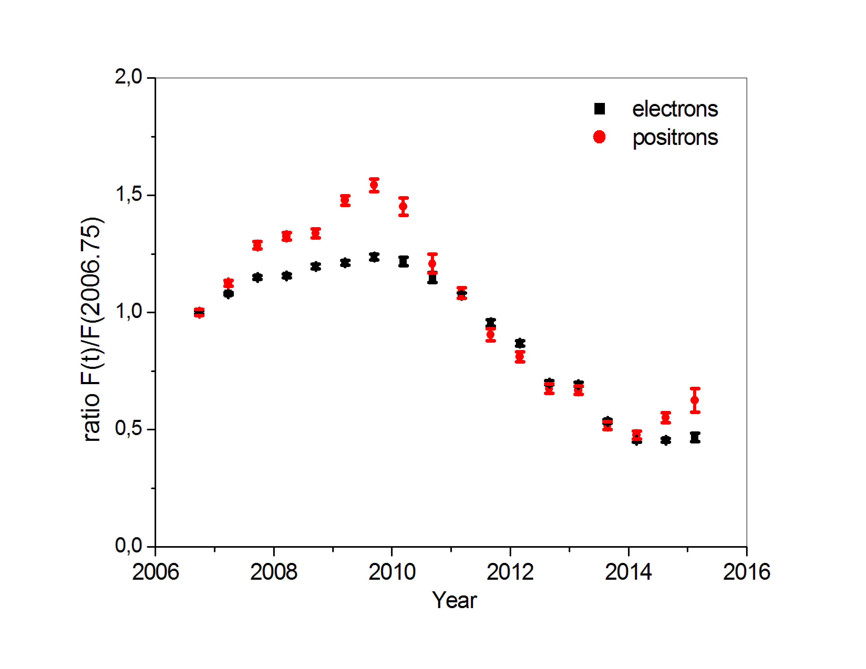
Electrons and positrons count rates

Slide 21
Conclusion
For first time long duration measurements of positron to electron intensities were performed in PAMELA experiment
Observations cover period from the end of last long 23rd solar minimum in 2006 till the maximum of next 24th cycle
This interval includes the heliospheric magnetic field polarity change from A<0 to A>0 in 2013-2014 .
Positron fraction e⁺/(e⁺+e⁻) reached minimum during 2011-2013 at E~1GeV
The ratio of the positron and electron fluxes below 2 GV shows sharp increasing since 2014 due to changing of the polarity of the solar magnetic field.

Slide 22
Spare slides

Slide 23
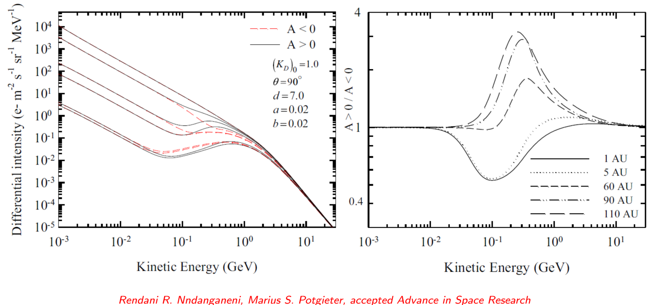
Drift contribution to electron fluxes
Направление дрейфа электронов

Slide 24
Comparison with empirical model
Caprice, HEAT, AMS-01, AESOP data from Clem and Evenson, 2007
Model is extrapolated to 2016

Slide 25
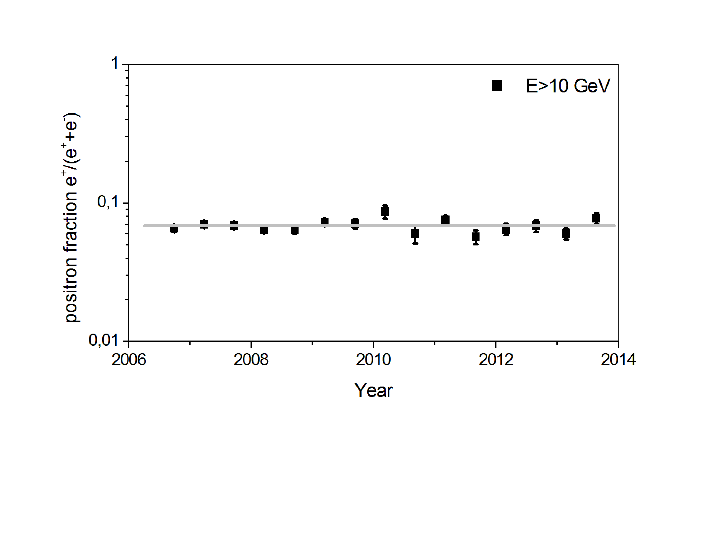
Time variations for high energy
No statistically significant variations for high energies

Slide 26
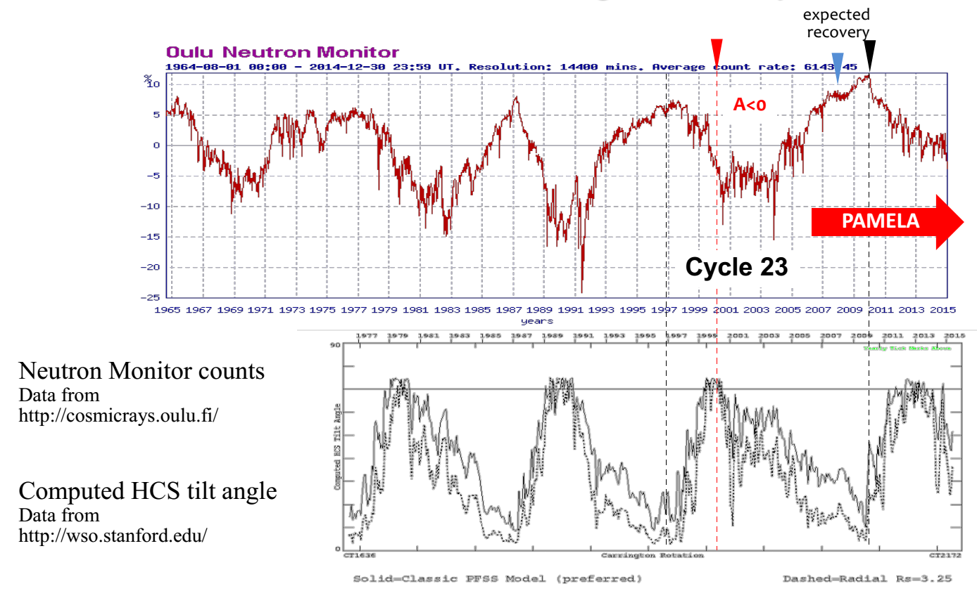
Time interval of PAMELA mission
Cycle 24

Slide 27
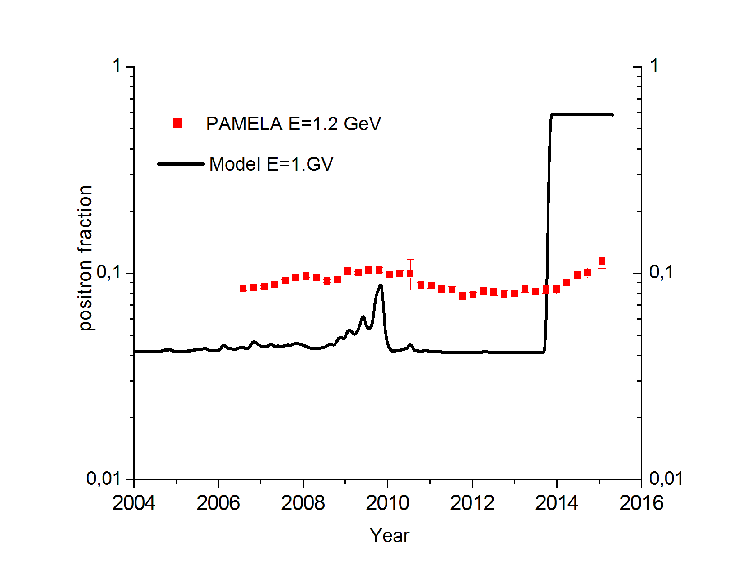
Comparison with models of 90th
Semi-empirical model,
Clem et al. 1996
Model with tilt angle
Moraal et. al, 1991
Caprice, HEAT, AMS-01, AESOP data from Clem and Evenson, 2007
Model is extrapolated to 2016

Slide 28
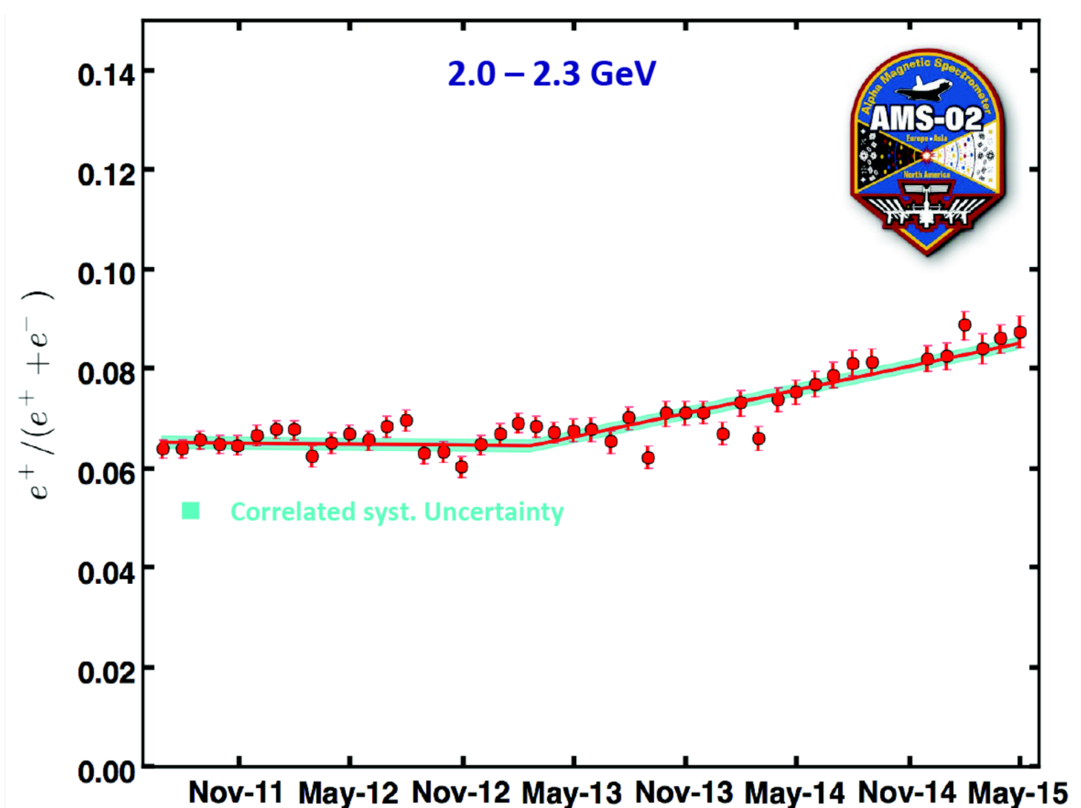
Preliminary results of AMS-02 (november 2015)

