Slide 1
Analysis of some modes of multibody decays of low excited actinide nuclei.
Yu.V. Pyatkov^{1,2}, D.V. Kamanin², J.E. Lavrova¹, N. Mkaza³, V. Malaza³, A.O. Strekalovsky²
¹National Nuclear Research University MEPhI (Moscow Engineering Physics Institute), Moscow, Russia
²Joint Institute for Nuclear Research, Dubna, Russia
³University of Stellenbosch, Faculty of Military Science, Military Academy, Saldanha 7395, South Africa

Slide 2

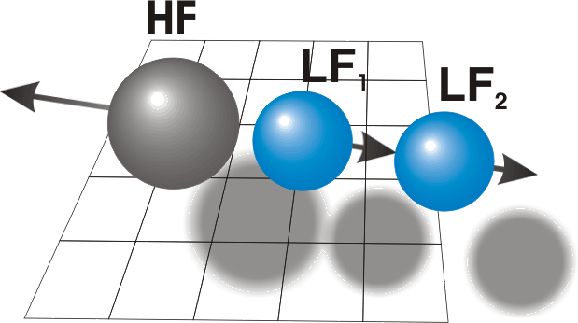
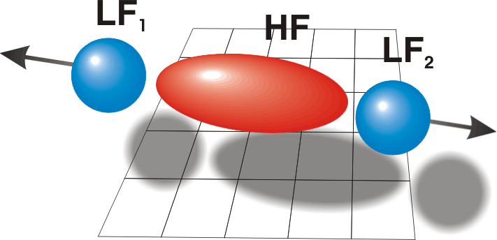
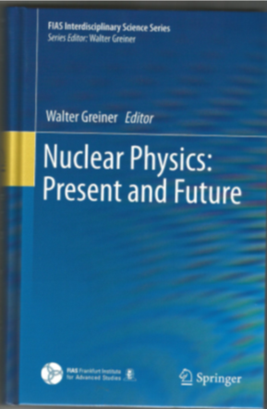
Collinear cluster tri-partition (CCT) – status quo
Prescission ternary
configurations
supposed to be in game
http://fobos.jinr.ru/

Slide 3
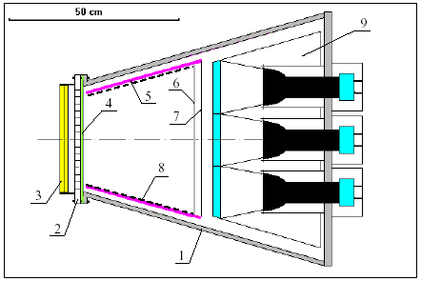
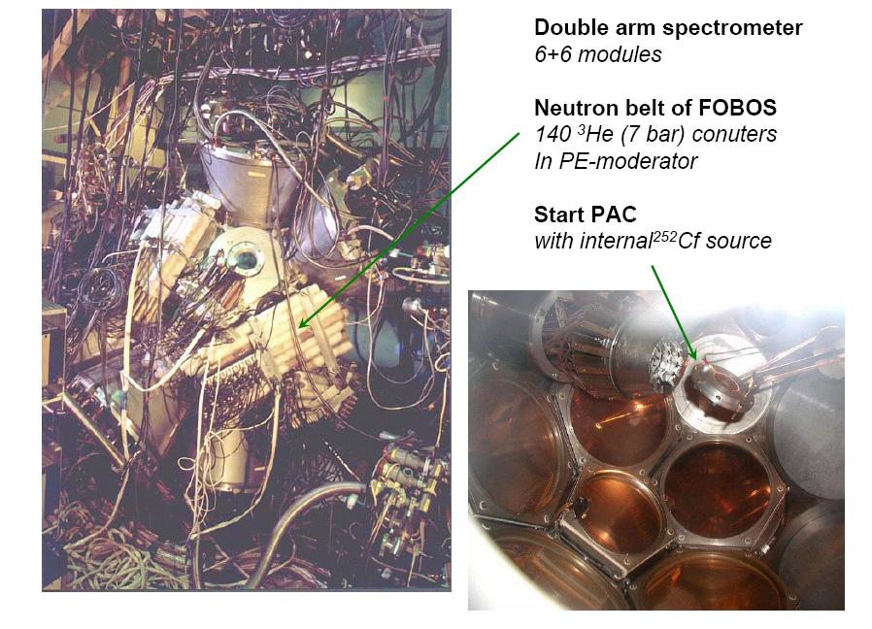
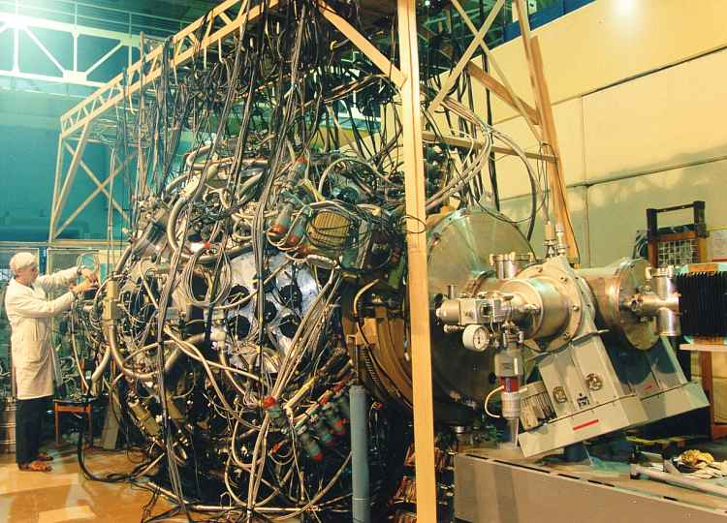
Spectrometers used
FOBOS
4π-detector of charged particles
Modified FOBOS
setup
Ex1
∼ 16% of the hemisphere;
registration efficiency for neutrons:
~4% in binary fission
~12% isotrope comp.

Slide 4
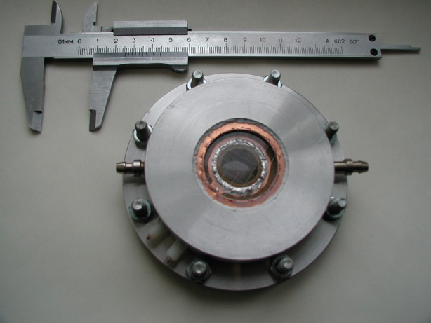
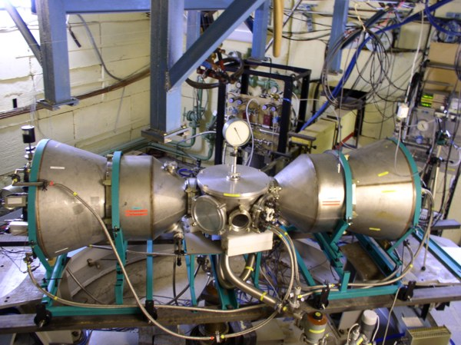
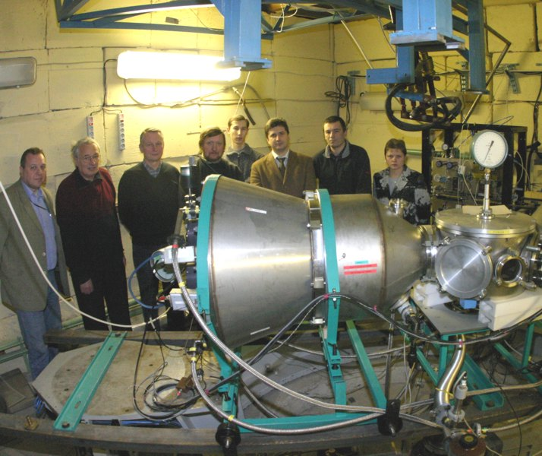
MiniFOBOS in the cave 6b of IBR-2
Z measurement !
Ex2
Start AC with ²³⁵U inside
JINR Frank Lab

Slide 5
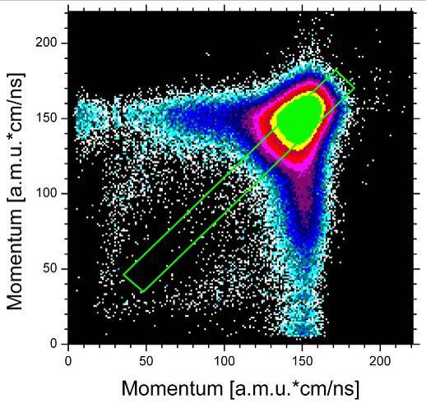
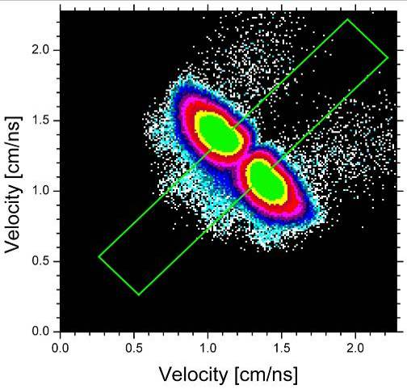
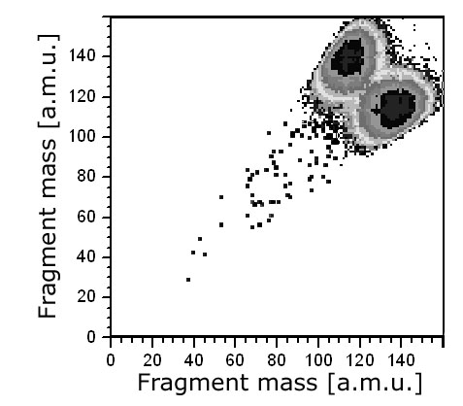
Experimental findings to be discussed
Ex1
²⁵²Cf(sf)
Y~10⁻⁵
selection windows
P1~P2 & V1~V2

Slide 6
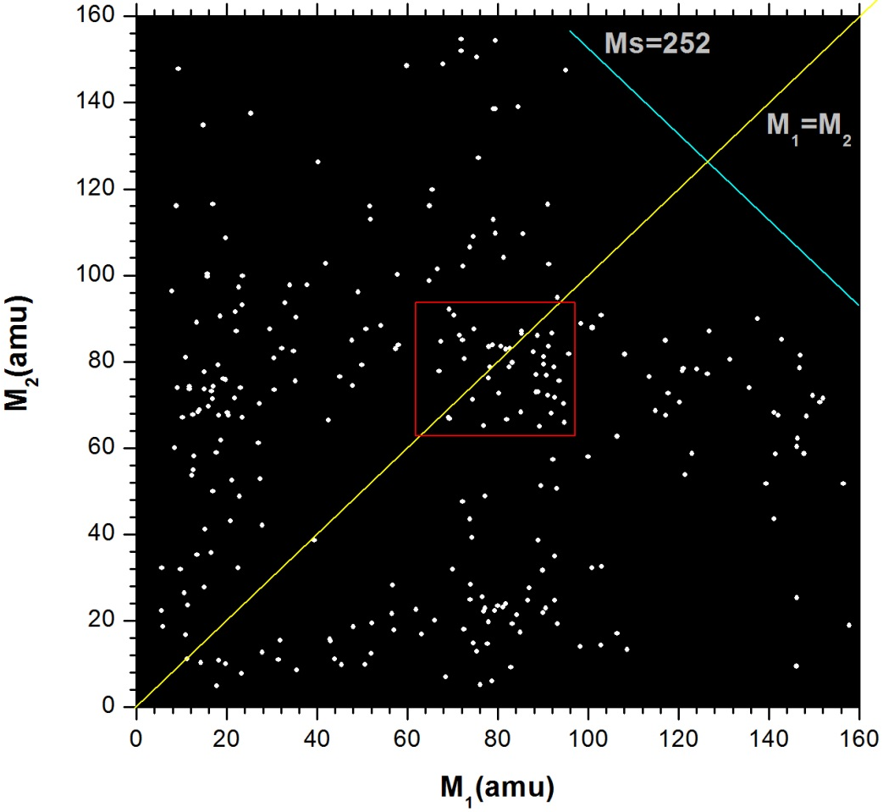
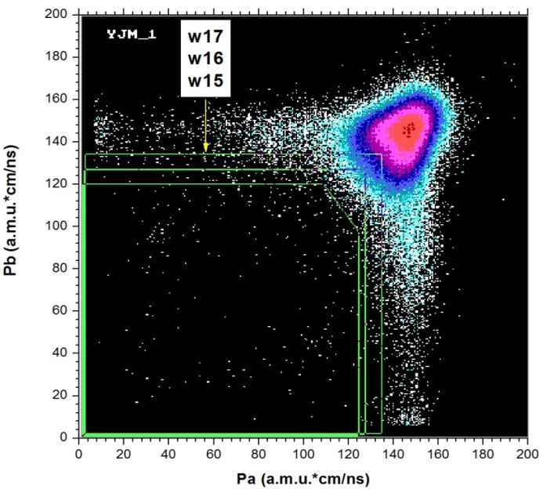
Experimental findings to be discussed
Ex1
²⁵²Cf(sf)
w15 & n=1
more than 1
neutrons were detected

Slide 7
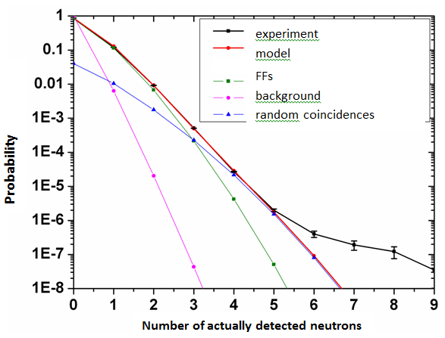
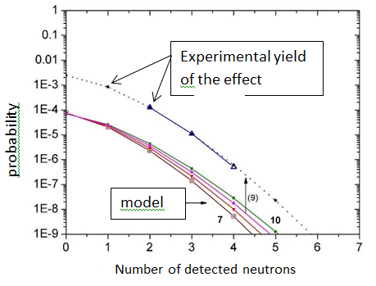
Estimation of the real neutron multiplicity
Ex1
Adequate math. model of the mosaic neutron detector used (“neutron belt”)
Yn=1~1.3*10-4/bin fission
Yn=2 ~1.3*10-5/bin fission
Due to the slope it could be:
- isotrop. n~2
- acc.FFs n~7

Slide 8
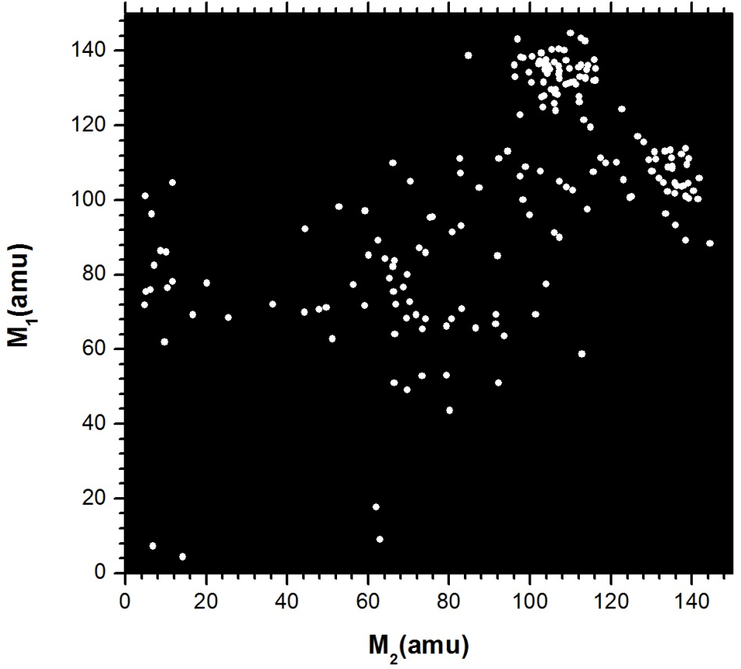
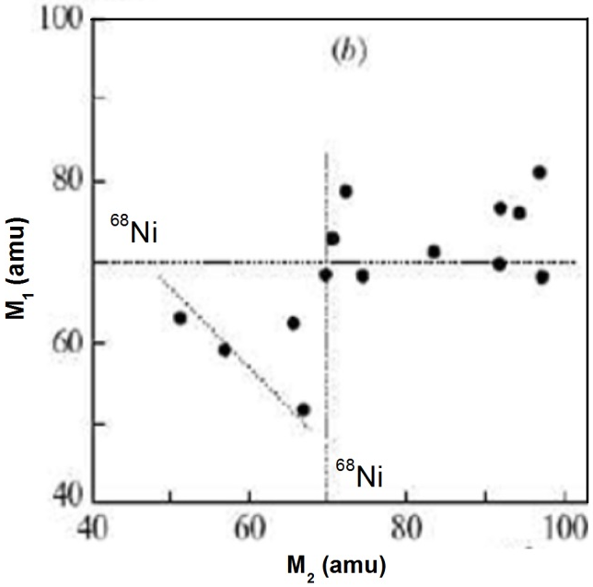
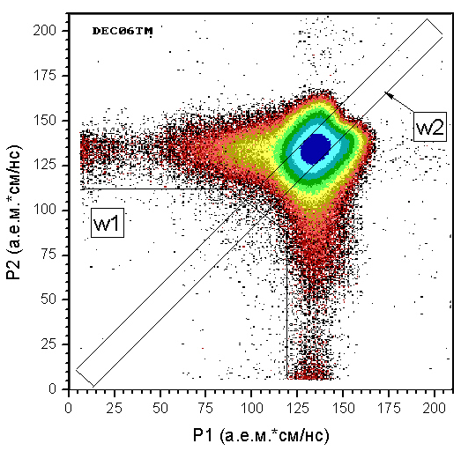
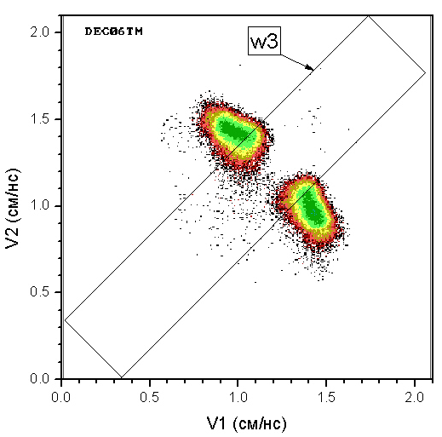
Experimental findings to be discussed
Ex2
²³⁵U(n_{th}, f)
P1~ P2
V1~ V2
Z1~Z2
Z~28
selection windows
P1~P2 & V1~V2

Slide 9
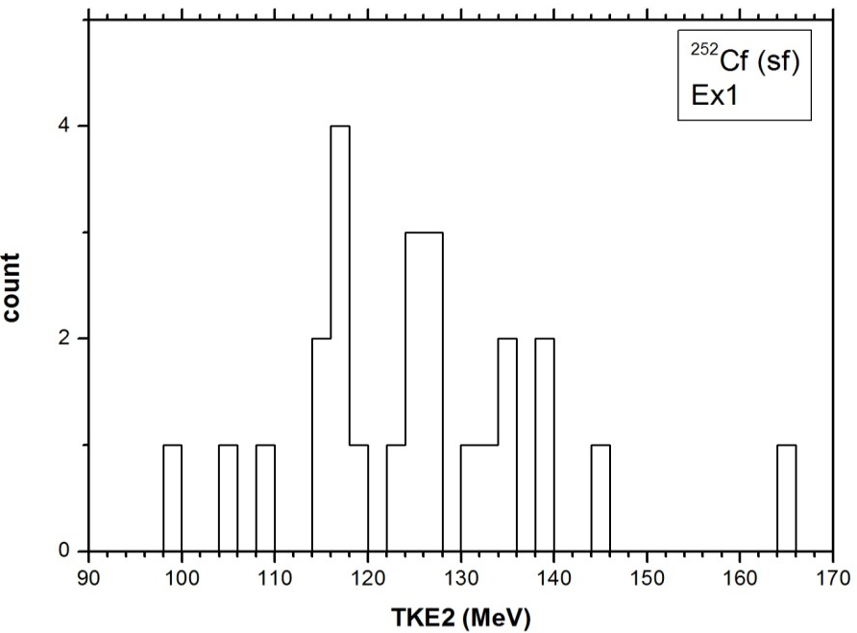
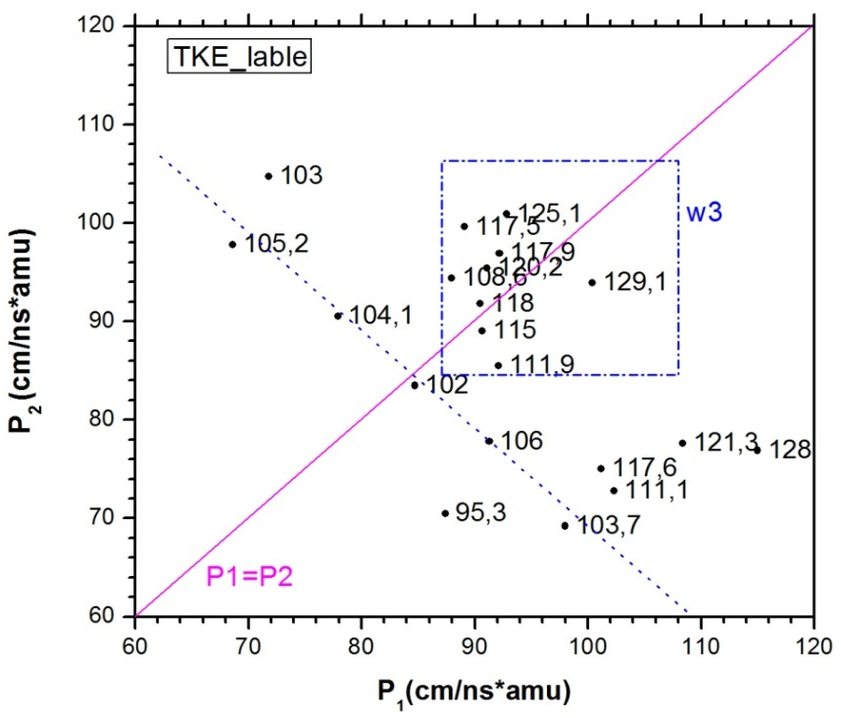
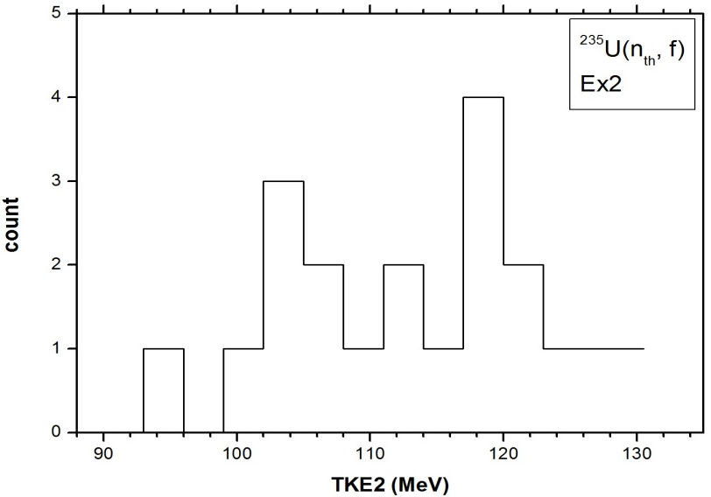
Experimental findings to be discussed
Collinear equal momenta
Extremely low TKE !

Slide 10
Discussion :
exp. background

Slide 11
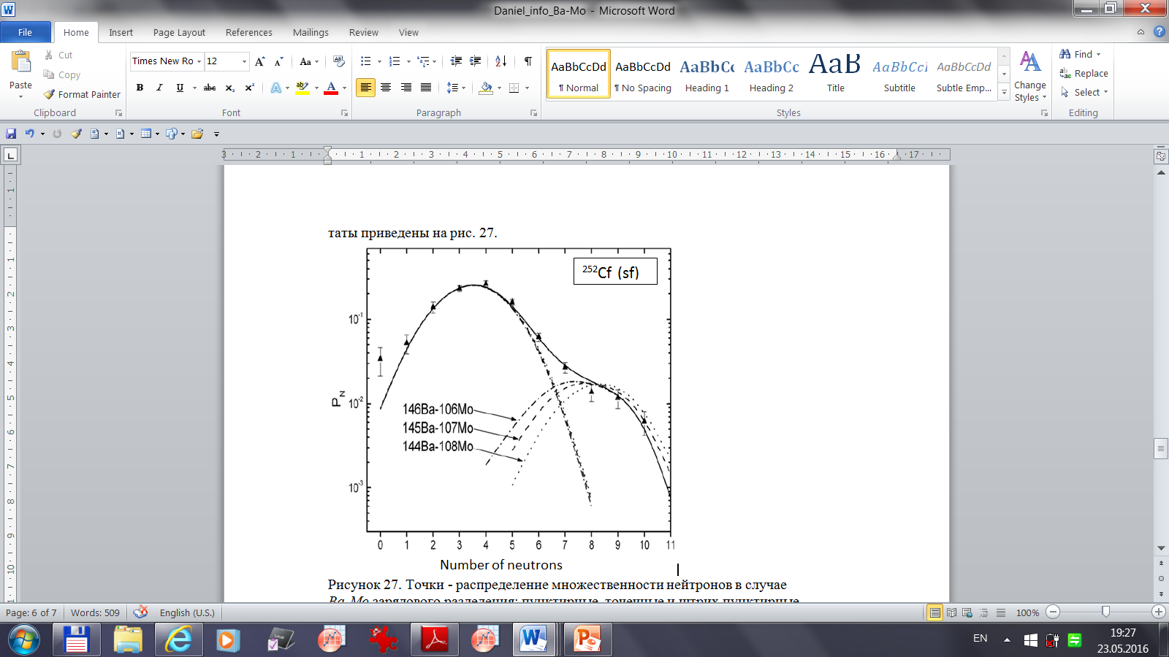
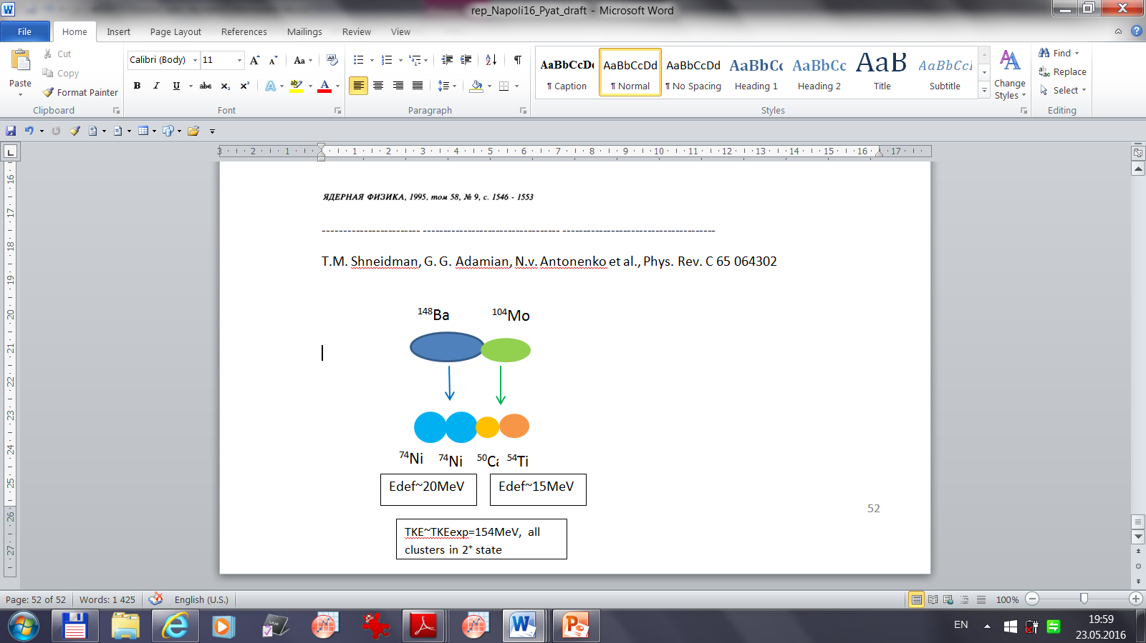
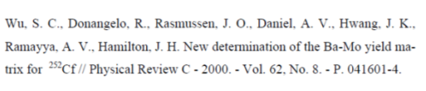
Two modes in Ba/Mo partitions
Mode_2 : TKE~154MeV,
7-10 neutrons
T.M. Shneidman, G. G. Adamian, N.V. Antonenko et al., Phys. Rev. C 65 064302
4-body clustering but binary fission

Slide 12
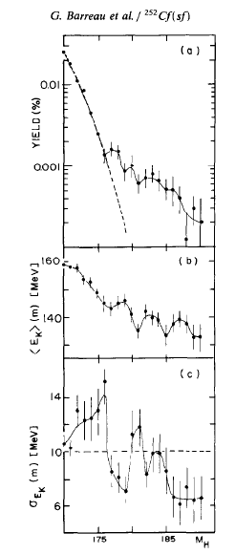
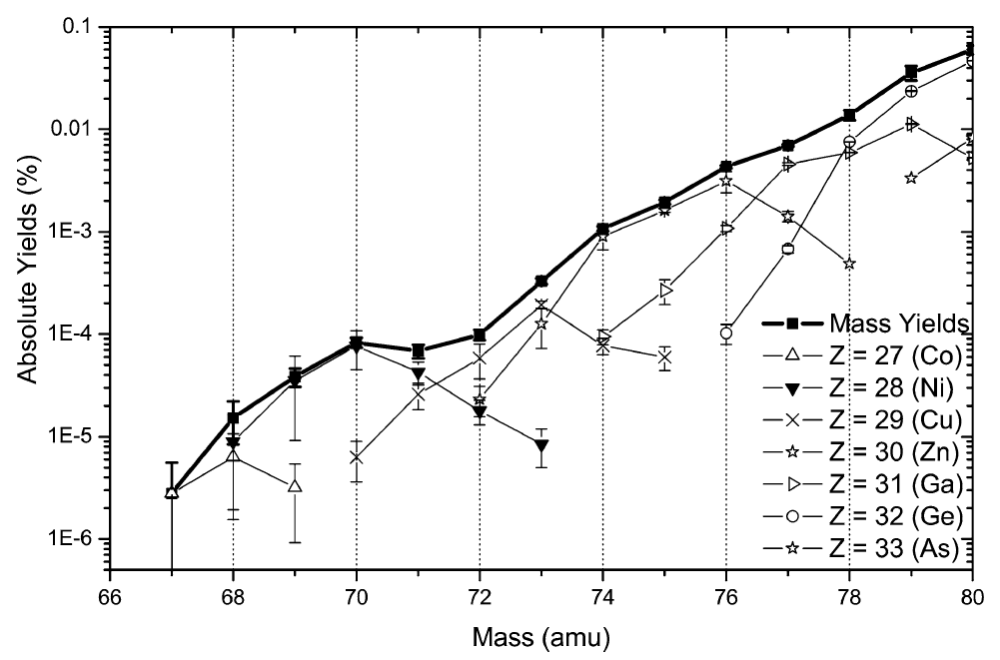
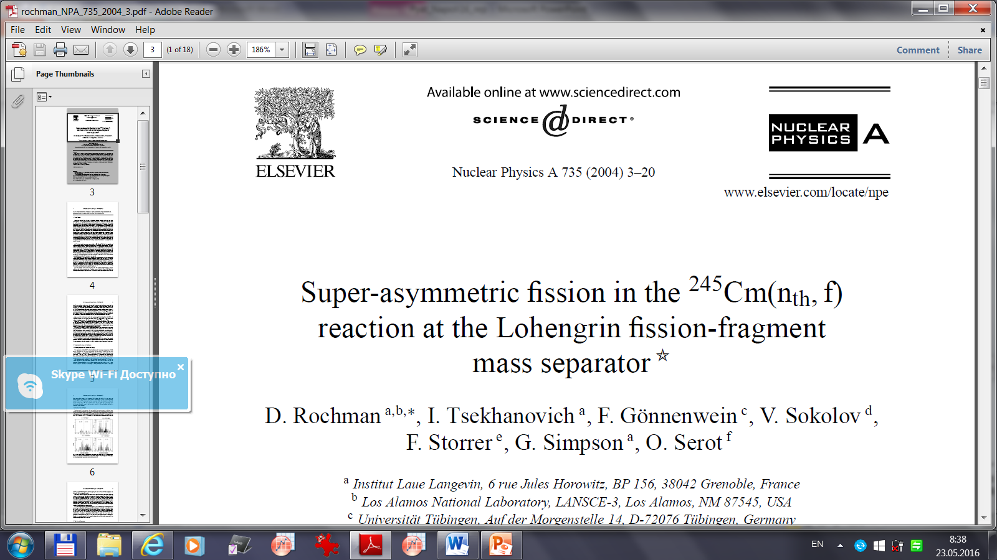
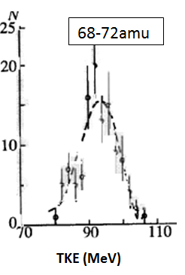
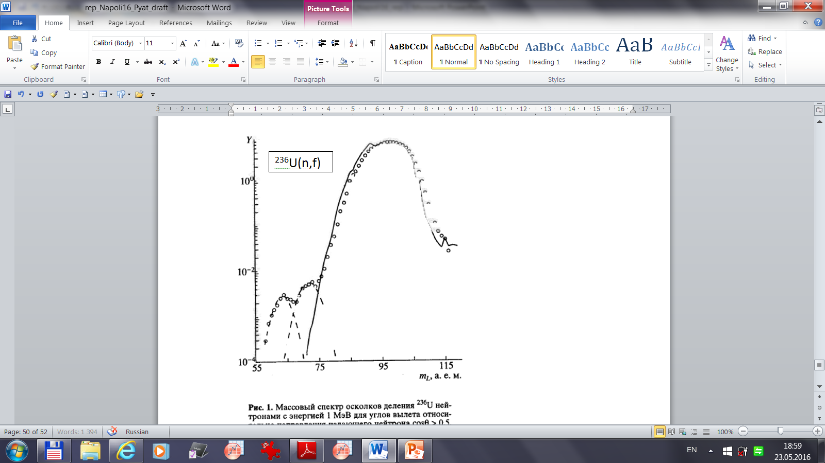
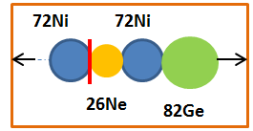

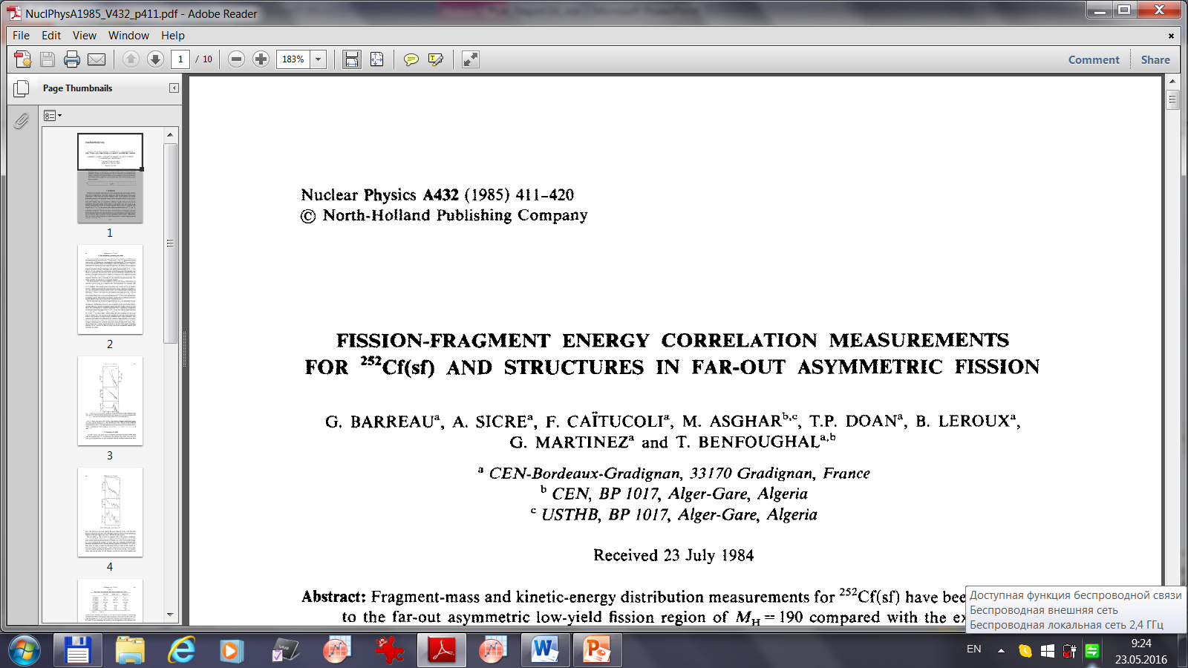
Ni in far asymmetric fission
²⁴⁵Cm(n_{th}, f)
⁶⁸⁻⁷²Ni
Ni from binary fission
- very low TKE
⁶⁸⁻⁷²Ni
Z=28
N=40
Eint~139MeV
A.A. Goverdovski et al.

Slide 13
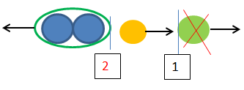
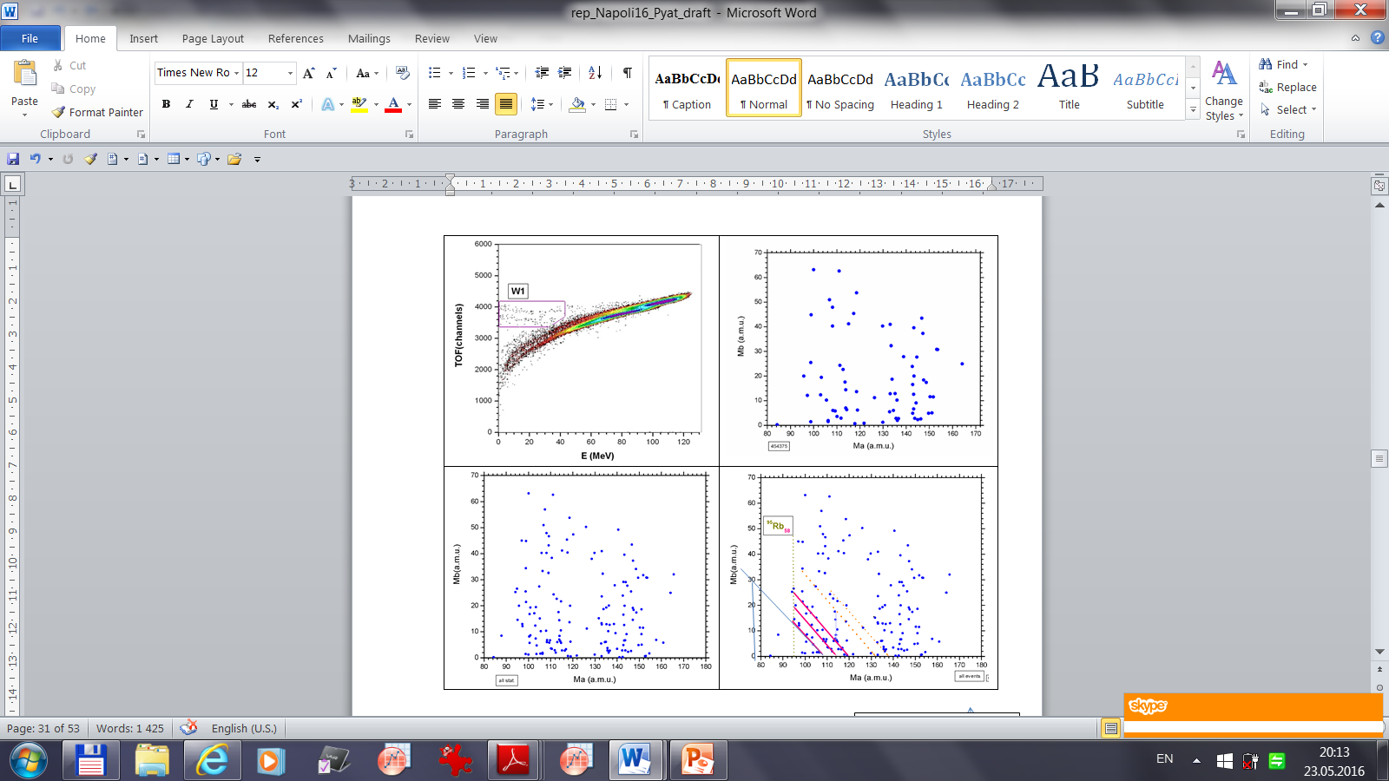
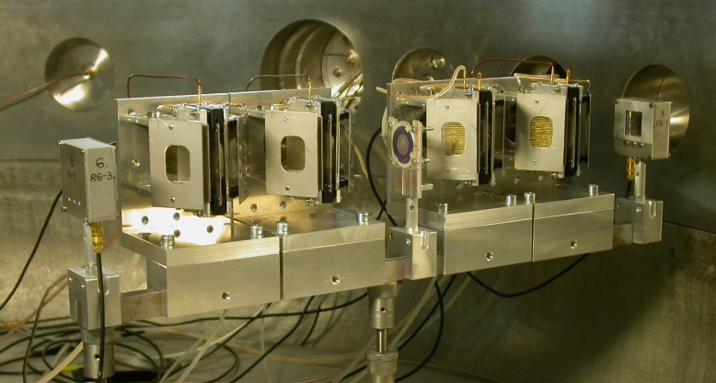
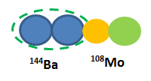
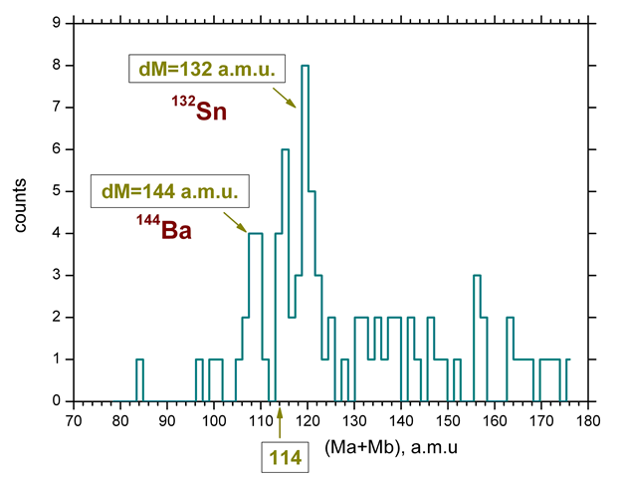
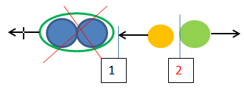
Ex3: JYFL, Finland
missing
CCT
ternary decay
missing ¹⁴⁴Ba

Slide 14
Discussion :
treating of our data

Slide 15
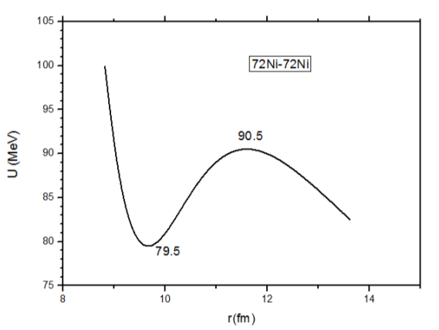
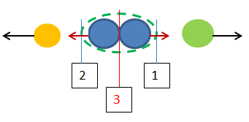
w15 & n=1
Ni/Ni partition:
TKEexp ~ Eb →
fission of 144Ba
to be at rest?!
w3

Slide 16
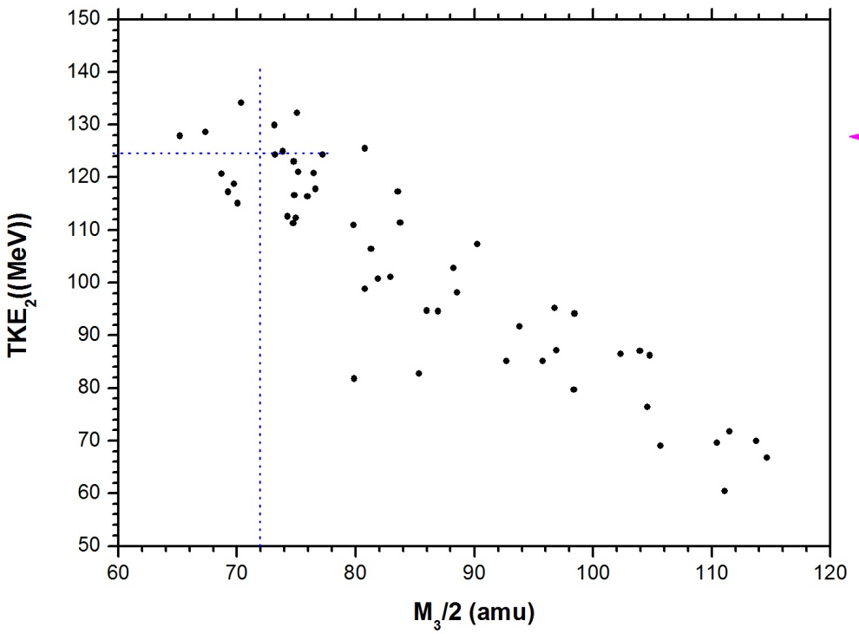
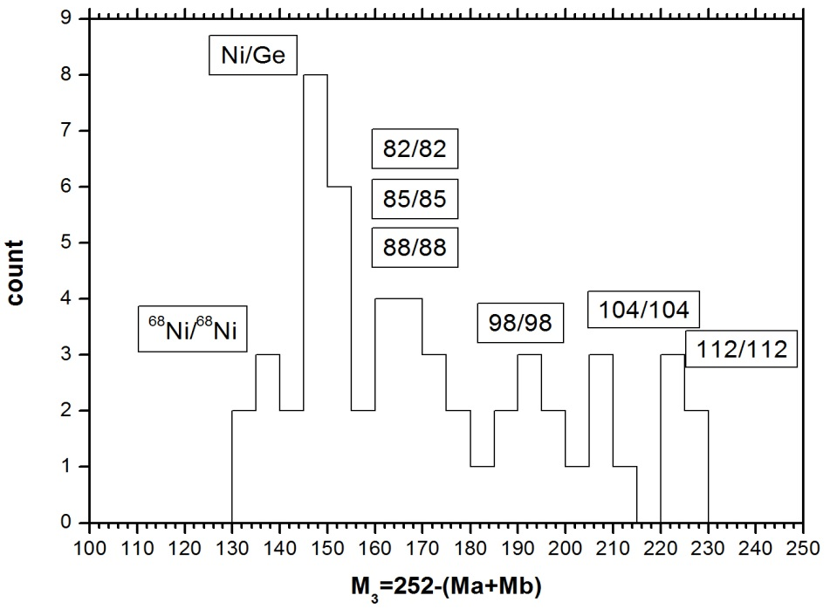
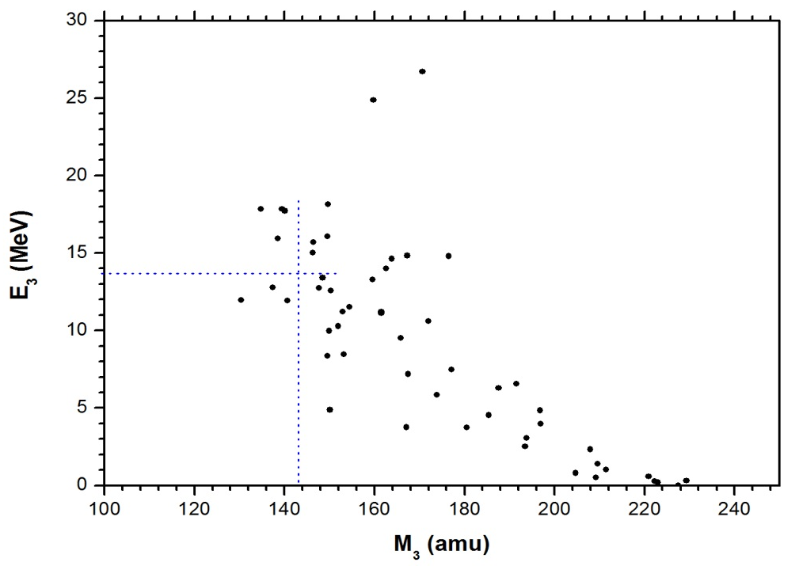
Events from w3- box
partitions from the rectangle
TKE2_exp
Central fragment
stays almost at rest
TKEtot=140+90 =230MeV

Slide 17
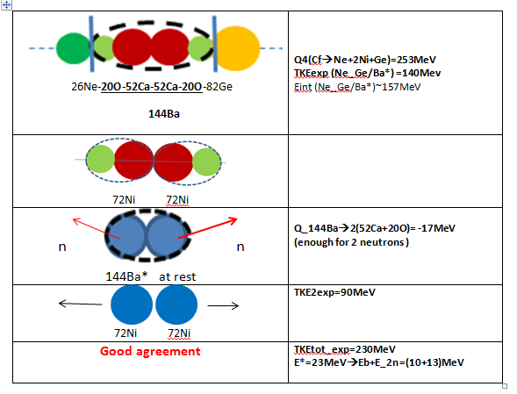
Scission scenarios
72Ni 72Ni
70Ni 72Ni
2-3neutrons
Quaternary cluster decay !

Slide 18
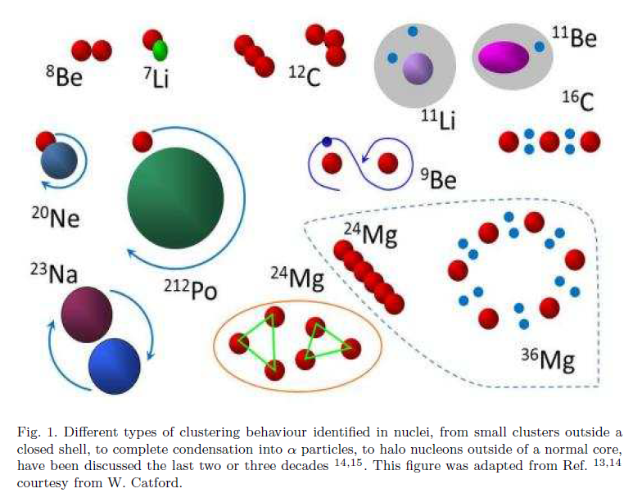
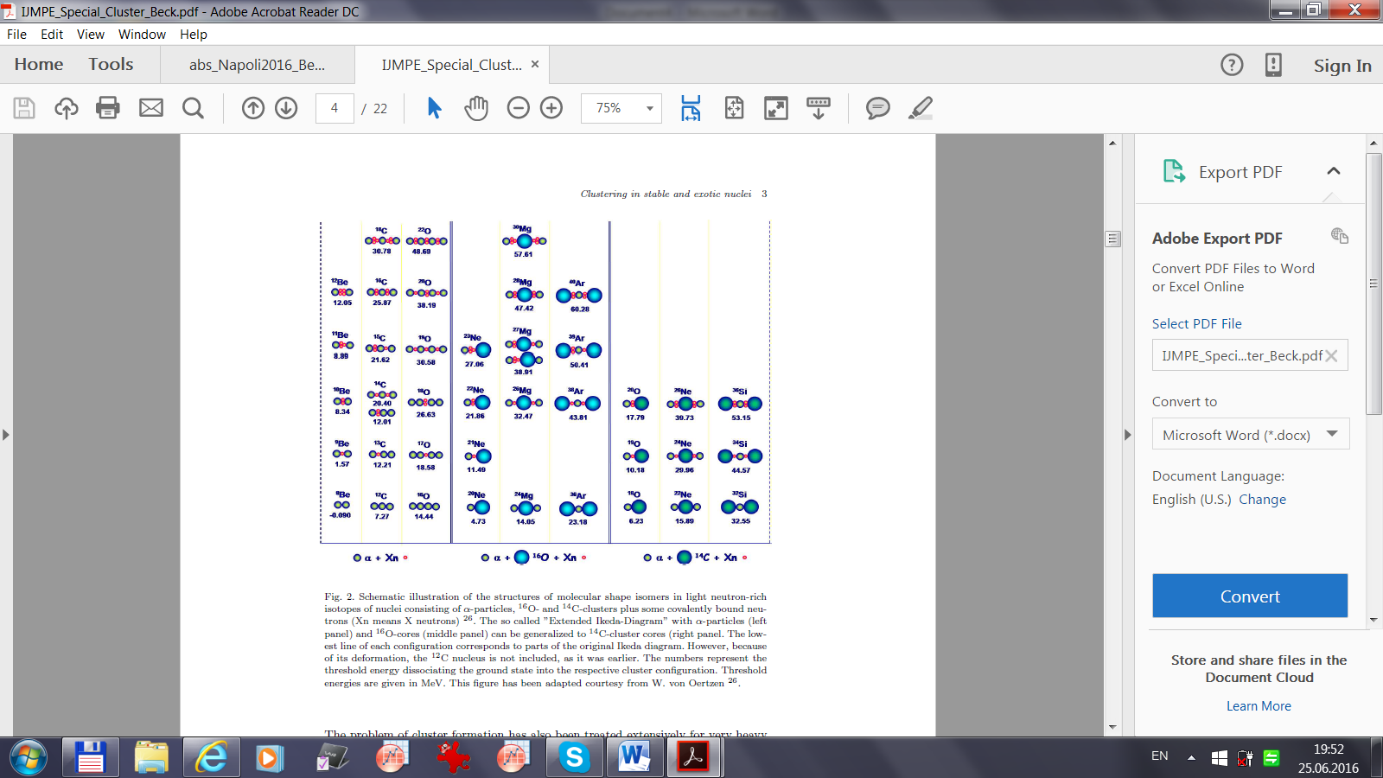
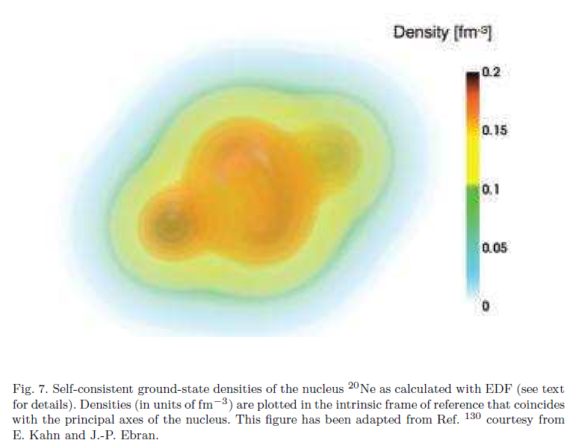
Clustering in Stable and Exotic Light Nuclei
(IJMPE Special Cluster, C. Beck, Clustering in Stable and Exotic Light Nuclei, 2016)

Slide 19
Conclusions
1. Both true ternary and quaternary decays of ²⁵²Cf are observed via clustered chain-like prescission configurations.
Magic nuclei play a role of clusters.
2. Scenarios of the decays indicate that the Ikeda diagram can be extended to heavy nuclei

Slide 21
FF with Z<20, fission in invers kinematics
PhD thesis of Engelman (supervisor F. Goennenwein), ²³⁸U (E*~20MeV), invers kinematics, Darmshtadt

Slide 22
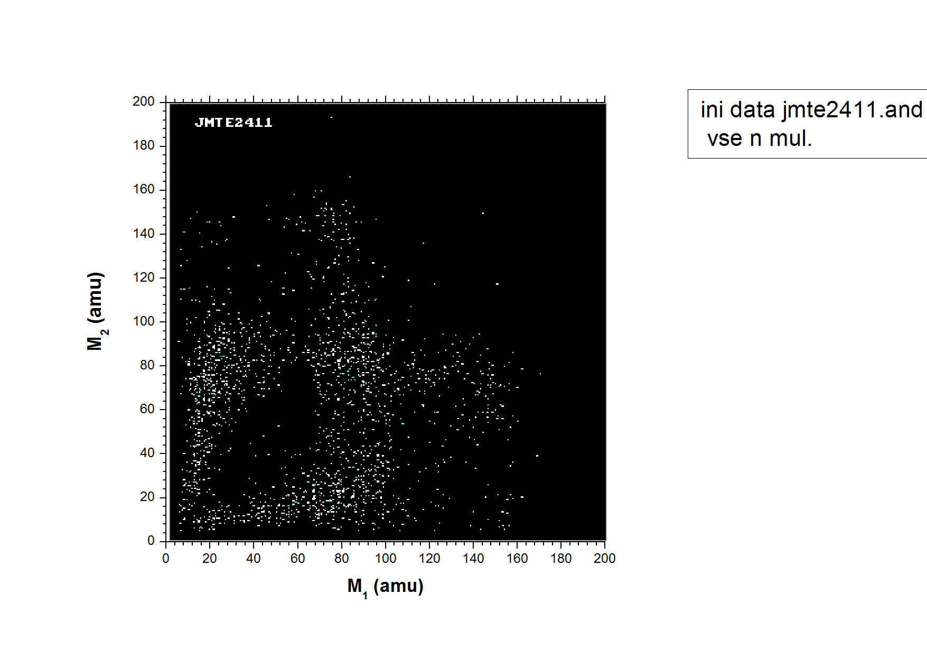
All neutron mult.

Slide 23
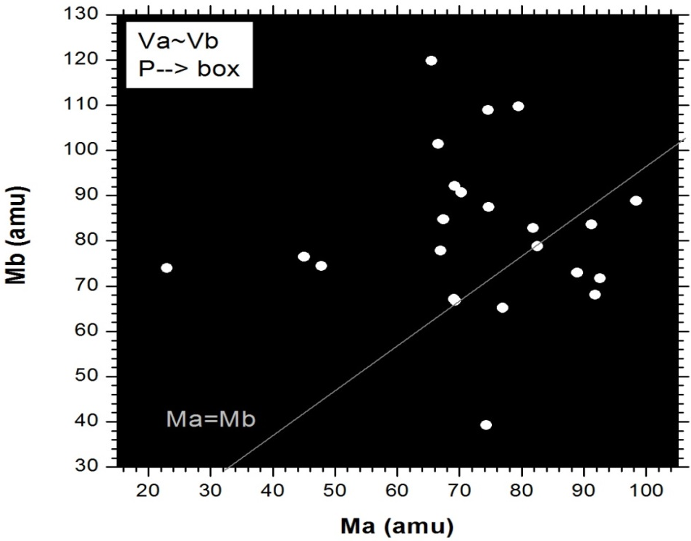

Experimental findings to be discussed
Ex1
²⁵²Cf (sf)

