Slide 1
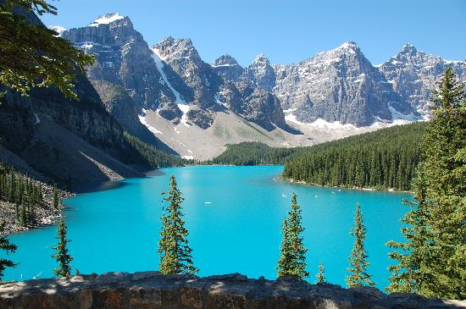
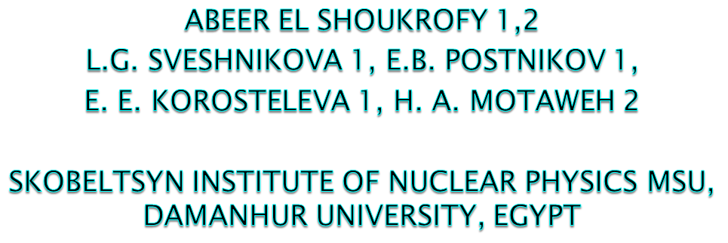
Background rejection methods for tens of TeV gamma-ray astronomy applicable to wide angle timing arrays

Slide 2
Outline
Wide angle timing array for gamma-ray astronomy TAIGA-HiSCORE
Background rejection methods
New LDF (Lateral Distribution Functions) approximation
Parametric analysis of LDF, rejections for true LDF
Estimation of the rejection factors for real array HiSCORE.
Notes:
2

Slide 3
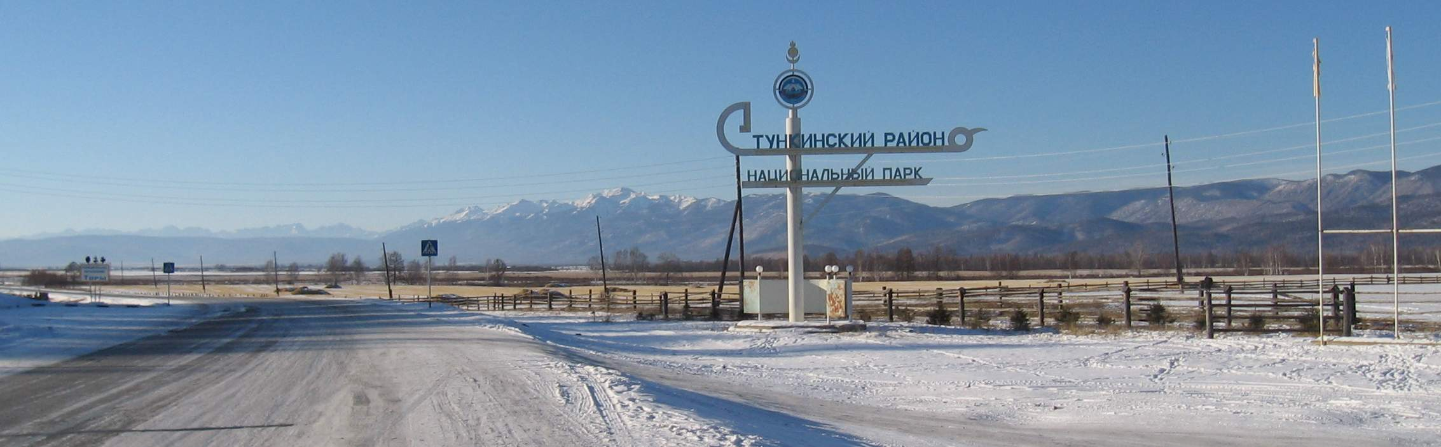
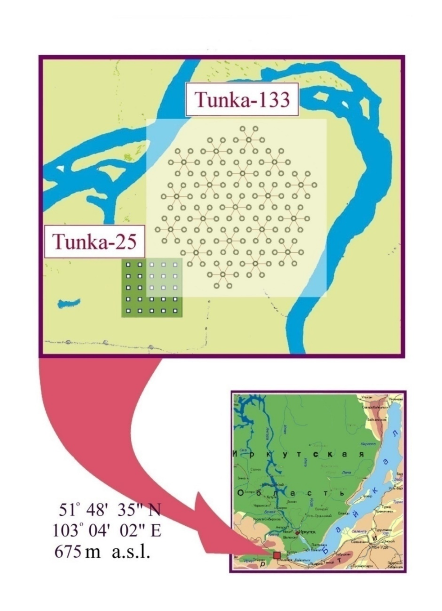
TAIGA (Tunka Advanced Instrument for cosmic ray physics and Gamma-ray Astronomy)
This work is performed in the framework of TAIGA experiment
Tunka valley
- 50 km to west
from Lake Baikal
Main topics of TAIGA:
High energy gamma-ray
astronomy
Charged cosmic ray physics
Notes:
accelerate protons and nuclei to 10^15 eV and beyond, i.e. act as cosmic PeVatrons., CMB radiation is cosmic microwave background radiation is that it comes from everywhere, and goes in every direction. This figure is tunka valley where the stations found in it. And the map with coordinate.

Slide 4
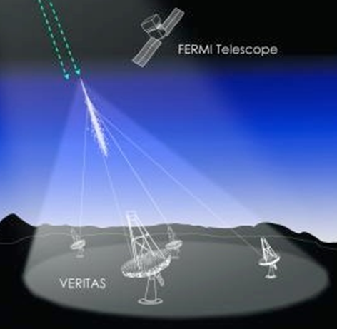
High energy gamma-astronomy
In recent years gamma-ray astronomy became
the most developing field of astroparticle physics. However, until now only about 10 sources with energy more than 10 TeV were observed and no one photon with energy around 100 TeV. Beyond 10 TeV, the rapidly decreasing fluxes (power law) require a large effective detector area.
Most of gamma telescopes (HESS, VERITAS, MAGIC) are based on the measuring of Cherenkov light emitted by EAS in atmosphere with the imaging telescopes: Energetic photon produces an electro–magnetic cascade of gammas, electrons and positrons in the atmosphere. The cascade originates high in the atmosphere (6 – 50 km), develops in number of particles by subsequent cascading and dies out before reaching the ground. Energetic electrons and positrons run faster than light in the atmosphere and produce Cherenkov light.
Notes:
4

Slide 5
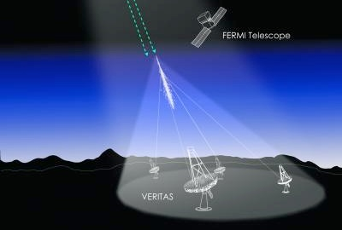
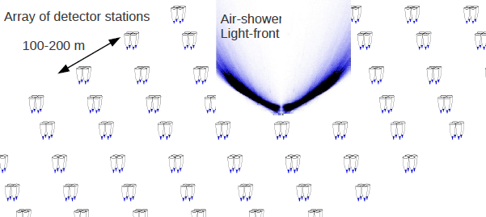
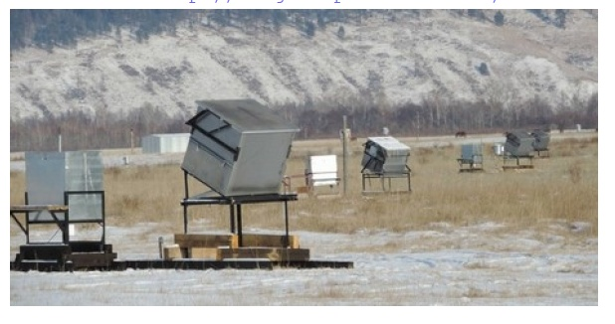
TAIGA–HiSCORE (Hundred Square-km Cosmic Origin Explorer), part of TAIGA
TAIGA-HISCORE –
is a non-imaging array. Now in the Tunka valley in Siberia 28 stations are arranged with a spacing of 106 m. They cover the area of 0.25 км² (to be extended up to 0.6 km² in the next year and up to 5 km² in future).
The technique of timing and wide angle detection of Cherenkov light: every station measures the timing impulse of Cherenkov light on some distance from the shower core. Therefore, measured for every event is the density and the arrival time of Cherenkov light Q(R,t) (the Lateral Distribution Function , LDF) as well as the timing front of the shower.
Ti, Qi,Ami
Notes:
5
These histograms using data in the ideal case or the data for the green curve only.

Slide 6
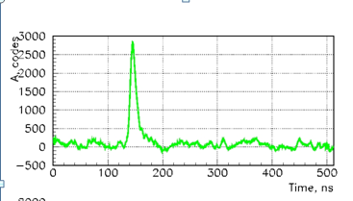
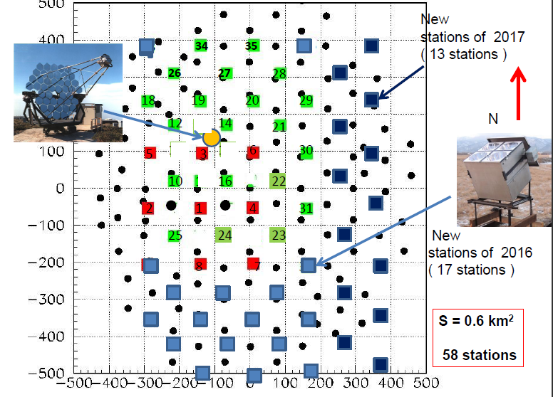
TAIGA -HiSCORE
Cherenkov light pulse
Deployment of stations
2015-2016: 28 stations
Time, nsec
Q(R,t) allows us to reconstruct:
1)The arrival direction θ:
by the relative time delays in
different stations.
2)The core position and energy:
by the lateral distribution
of Cherenkov photons
3) Type of particle
(Not so effective as in IACT)
Notes:
6
These histograms using data in the ideal case or the data for the green curve only.

Slide 7
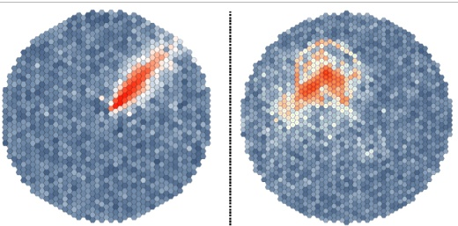
Background rejection methods
This is a most important problem in gamma astronomy, because the flux from protons, and other primary nuclei incident on the atmosphere exceeds gamma ray flux by 3 orders of magnitude.
In IACT technique reconstruction is based on the analysis of the Hillas parameters of images detected in CCD cameras telescopes.
Gamma Protons
Steps of background rejection supposed to be realized in HiSCORE
The background flux is proportional to the intensity of cosmic rays with given energy
and to the solid angle dΩ ~ π sin(dθ)² where dθ - an accuracy of arrival direction reconstruction
So at the first step background flux is suppressed due to a very good resolution dθ =0.1-0.4 ° .
At the 2-d step it is planned to perform event by event selection basing on
the parametric analysis of LDF function of events (the item of this presentation).
After the commissioning of the new IACT as part of the array HiSCORE
the Hillas’s image parameters will be used for the event by event separation.
Notes:
7
IACTs do not detect directly the gamma-rays emitted by an observed astrophysical object, they detect Cherenkov light
emitted by air showers electron-positron pairs after the gamma-rays interactions with the Earth atmosphere
Image Parametrisation -IMAGE PARAMETERS (or Hillas parameters),
main Image Parameters:
ALPHA: angle between major axis and the center of gravity-camera center direction
SIZE: total number of collected photons

Slide 8
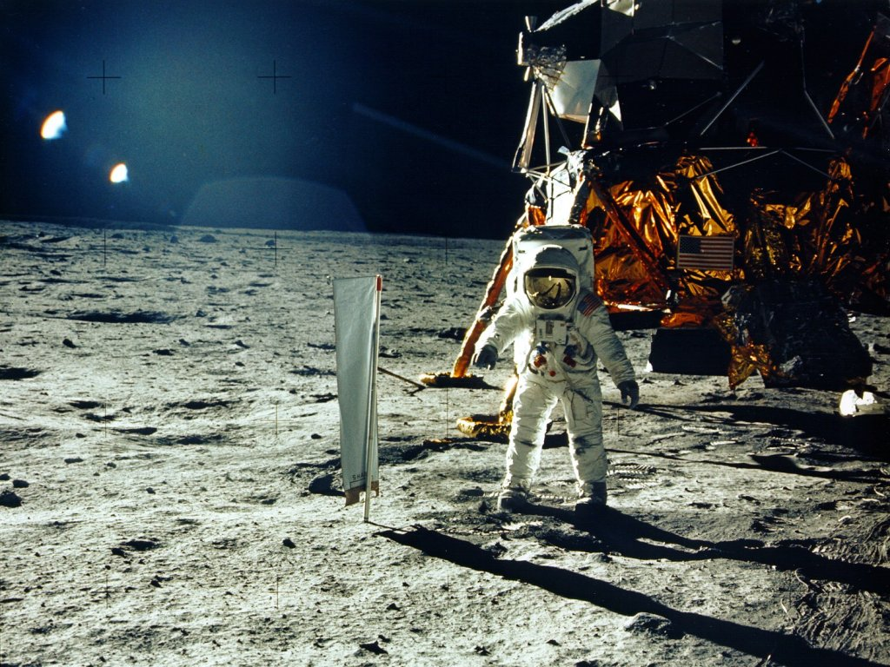
New Lateral Distribution Function approximation
Notes:
8

Slide 9
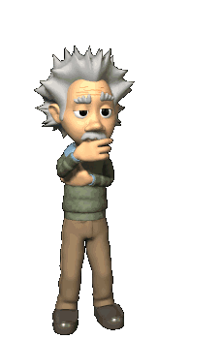
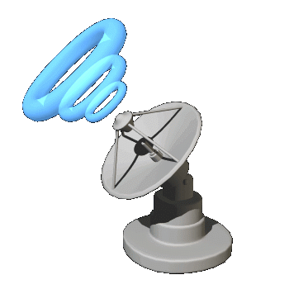
New LDF (Lateral Distribution Function) approximation.
LDF- Lateral Distribution Function of
Cherenkov light emitted by showers in
atmosphere, is a density of photons
on a distance from shower core (Q(R)).
We perform our investigation on CORSIKA-simulated data of the number of Cherenkov photons, Qph.cm⁻², emitted by showers in the atmosphere and detected with a space step of r=5 m in the shower frame perpendicular to the shower direction. Simulation was performed for the zenith angle range 0-50° for primary gamma rays, protons, and nuclei (He, C, Fe) with the energy E=30, 100, 300, 1000, 3000 TeV.
Notes:
9
IACTs do not detect directly the gamma-rays emitted by an observed astrophysical object, they detect Cherenkov light
emitted by air showers electron-positron pairs after the gamma-rays interactions with the Earth atmosphere
Image Parametrisation -IMAGE PARAMETERS (or Hillas parameters),
main Image Parameters:
ALPHA: angle between major axis and the center of gravity-camera center direction
SIZE: total number of collected photons

Slide 10
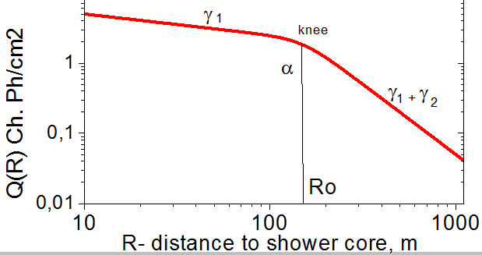
Parameters of our knee-like
approximation function
For parameterization of simulated Cherenkov light LDF Q(R) for every event, we propose the simple function designated as a ‘knee-like approximation’, which was used earlier by J. Horandel for description of the knee in the cosmic ray spectrum as a function of energy. In our approach we describe the radial density of Cherenkov photons Q(R) for individual events. It depends on five parameters C, γ₁ , γ₂ , R₀, and α.
Notes:
10
The Tunka experiment It mainly consists of a 1 km² sized array of 133 photomultipliers, which detect the Cherenkov light of air showers during dark and clear nights. From these measurements it is possible to reconstruct the arrival direction, energy and type of the cosmic rays. Aim of the measurements is to solve the question of the origin of the cosmic rays in the energy range up to about 1 EeV. Hiscore standa for Hundred I square kilometer cosmic ray origin explorer. The goal of hiscore detector is to observe cosmic ray accelerators of 1 pev (10^15) ev and higher energies. And detecting gamma rays in the ultra high energy range of E gamma >=10^13 ev.

Slide 11
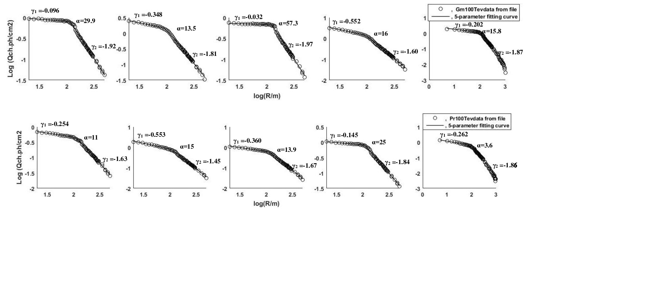
Individual LDF for gamma rays and protons
with E=100 TeV
Lateral distribution of Cherenkov light for some individual events for Gm and Pr 100 TeV which were simulated with data file (circle) and which were calculated using our new knee-like approximation function (solid line). It is clearly seen that for all the events the LDF has a specific knee-like structure. The R₀ value depends strongly on the distance to the shower maximum, and it ranges from 75 to 200 m. The parameter α is responsible for the sharpness of the knee.
Notes:
11
20m-500m was the fitting only , and the bad fitting below 20m or after 500 meter. Sometimes we see the very sharp bump at the knee (events with very large angles and events from gamma rays, sometime very smooth knee (small angles, high energy ptotons), all individual events are described with good Hi2. individual events can. Analysis shows that the new approximation function fits the individual LDFs as well as average LDFs with a very good accuracy: the mean squared error of the fit ~ 0.0005-0.002 in logarithmic scale for all energies and for each type of particle. It allows us to obtain energy dependencies, to study correlation between parameters, and to develop parametric methods of primary particle identification.

Slide 12
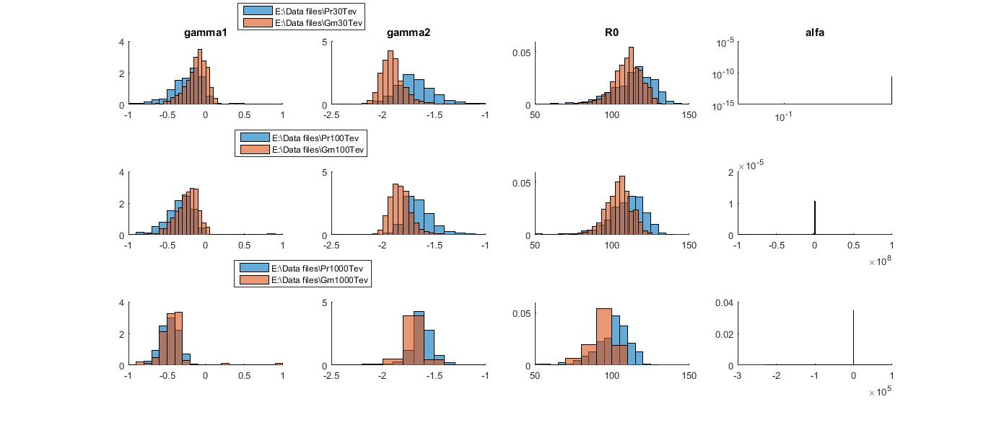
Parametric analysis of LDF for protons and gamma 30 TeV, 100 TeV, 1000 TeV
Comparison of distributions of parameters γ₁, γ₂, R₀ for gamma and proton at different energy 30, 100, 1000 TeV, for true LDF with angles (0-25⁰)
Notes:
12
The next stage we will try to find conclusion.
Title above the slide: Separation of Gm and Pr using gamma1,gamma2,R0. we found that by gamma1 Pr is at left side while by gamma2 and R0 pr at right side
By making a cut in the middle we can separate Pr from Gm by a good value may be as good as 200 times. Because we will separate pr but will contain small numbers of Gm.in the future we will develop other parameter to obtain more excellent separation.

Slide 13
Parametric analysis of LDF for protons and gamma
at large zenith angles
Comparison of distributions of parameters γ₁, γ₂, lgα for gamma and proton at energy 30,100 TeV, angles 0-50⁰
Notes:
13
You can say here that for LARGE zenith angles parameter alpha separates proton from gamma better than parameter R0, that’s why we plot distribution of lg alpha instead of R0

Slide 14
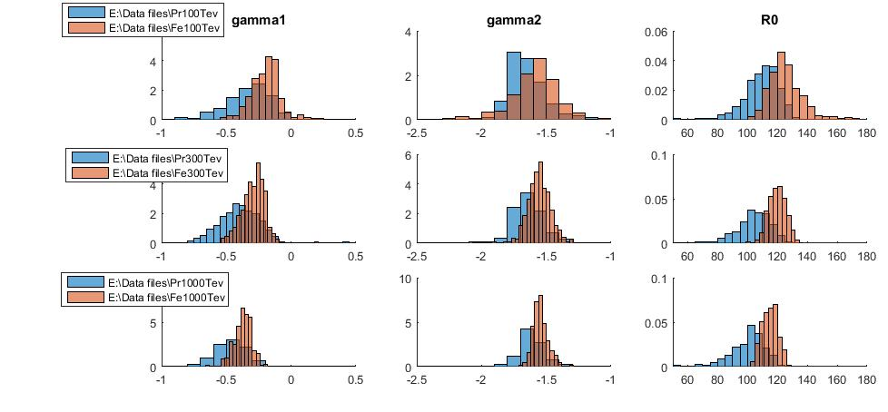
Parametric analysis of LDF for protons and Fe nuclei with energy 30 TeV, 100 TeV, 300 TeV
Comparison of distributions of parameters γ₁, γ₂, R₀ for proton and iron at different energy 100, 300, 1000 TeV, angles 0-25⁰ .
These figures show that for all of these parameters both gamma and proton distributions are separated from each other, and this fact can be used to discriminate between sorts of particles.
Notes:
14
On histograms the distributions of 3 parameters (γ₁, γ₂, R₀) are presented for the true LDF functions, which were simulated with the spacing of 5 m. we show ability to distinguish (gamma , proton) and (proton, iron) , we found that the Separation of Gm and Pr at different energy using γ₁ , γ₂ and R₀ can be made . Pr appears on the left side of the γ₁ histogram and on the right side of γ₂ and R₀ histograms. By making a cut in the middle we can separate Pr from Gm by a good value . Also the separation of pr and Fe can be made. Pr appears on the left side of the γ₁ histogram and of γ₂ and R₀ histograms.

Slide 15
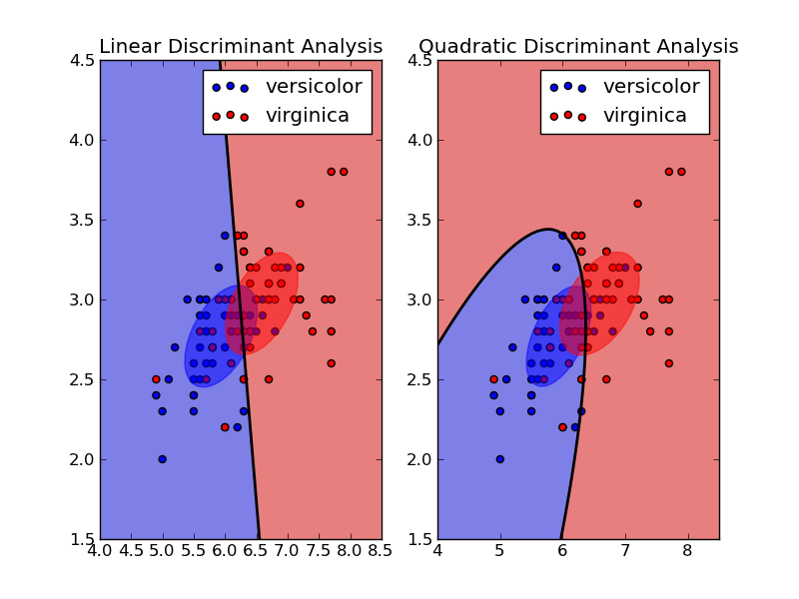
Multivariable method for separation of gamma from background
To select gamma events, we used Quadratic Discriminant Analysis (QDA). It’s a way to separate two types of events using 3 parameters: Distributions of vector of parameters are assumed to be normal in 3-dimensional space, and a quadric separating surfaces are computed depending on covariance matrices of these distributions.
For true LDF (with a spacing of 5 m) this technique applied for 3 –dimensional vectors rejects background events by 2 orders of magnitude (by 100 times )
CUT line

Slide 16
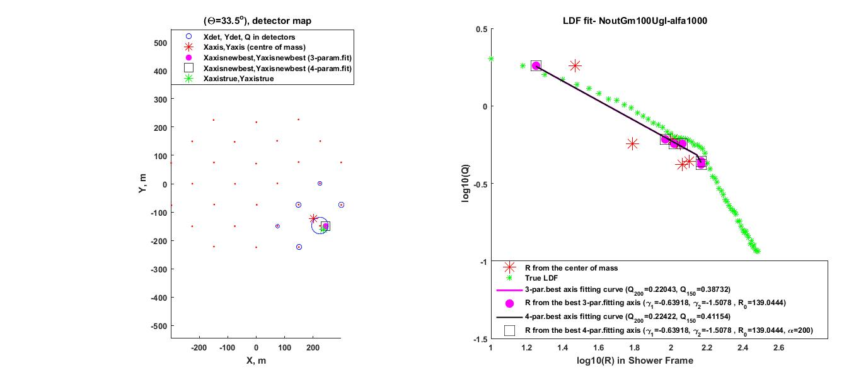
Rejection methods for real condition (28 stations with spacing 100 m)
Knee-like approximation of LDF of an array of our real 28 detectors strongly depends on the number of hit detectors, since only few detectors have a signal above noise level.
Therefore, we investigate the quality of gamma/background rejection depending on the number of hit detectors Ndet.

Slide 17
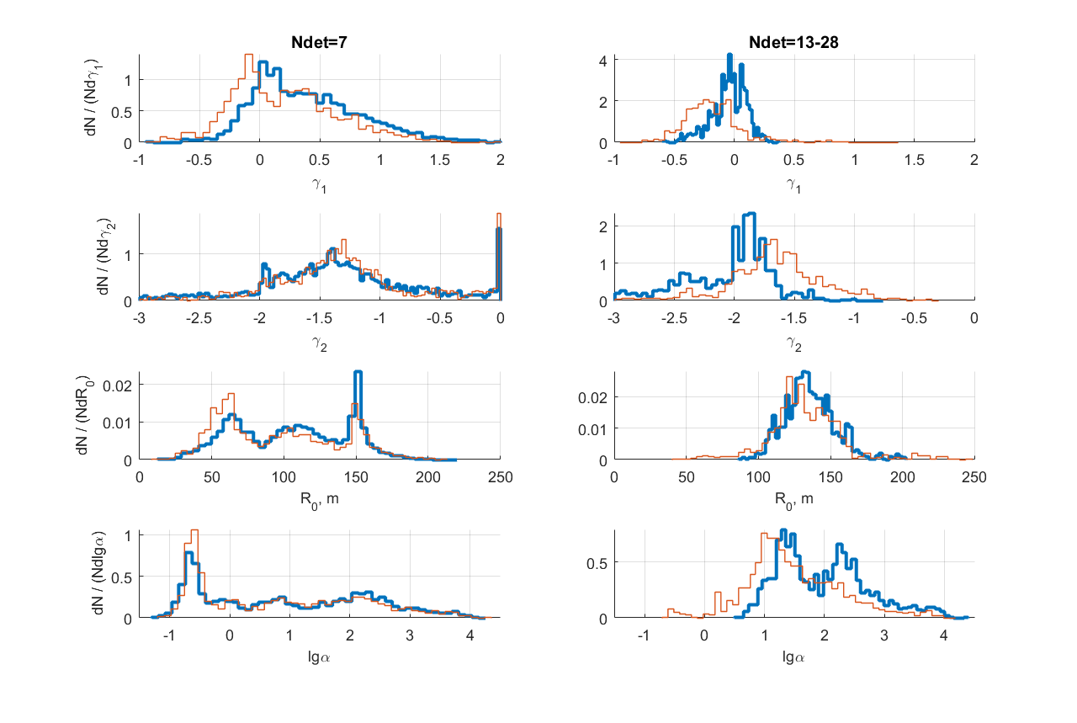
Comparison of distributions of parameters γ₁, γ₂, R₀, lgα for gamma rays (blue line) and background (proton and helium mixture, red line) for a different number of hit detectors.Energy 30-3000 TeV, zenith angles: 28-42⁰
Notes:
17

Slide 18
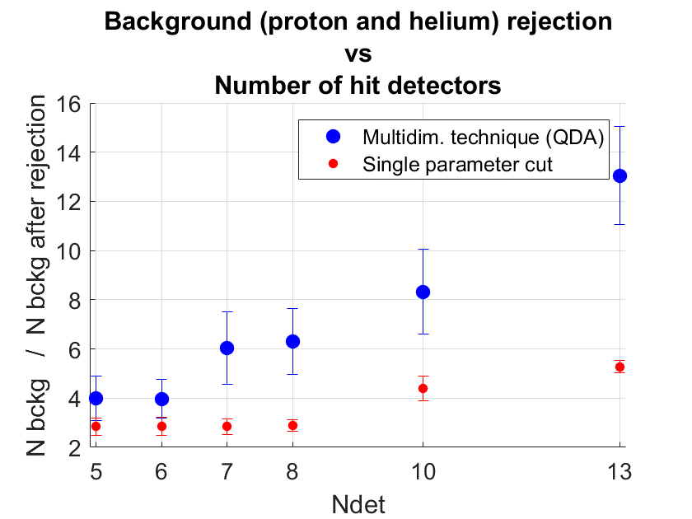
It is clearly seen from these figures that a good rejection between gamma rays and background (proton and helium mixture) can be made depending on the number of hit detectors. For a small number of hit detectors (~5-7) there is a slight difference in distribution (weak rejection) , while for a large number of detectors (~18-23) a noticeable difference in distribution appears, so we can obtain a separation between gamma events and background ones with a good accuracy.
Notes:
18

Slide 19
CONCLUSION
We proposed a simple 'knee-like' approximation of Cherenkov light radial distribution emitted by EAS and tested the quality of these approximations.
The new approximation gives the possibility to fit the whole diversity of individual LDFs for different nuclei and gamma rays on the shower core distance 20-500 m at the energy interval 30-3000 ТeV with a very good accuracy.
Parameters of approximation γ₁, γ₂, R₀, and lgα depend on the energy and the type of primary particle and allow us to separate proton and gamma induced showers for true LDF .
A good rejection between gamma and proton/helium background for the real array can also be made, depending on the number of hit detectors.
Notes:
19
Center of mass often coinsides with the real core position. But if it doesn’t , then our approach coinside with the real core.

Slide 20
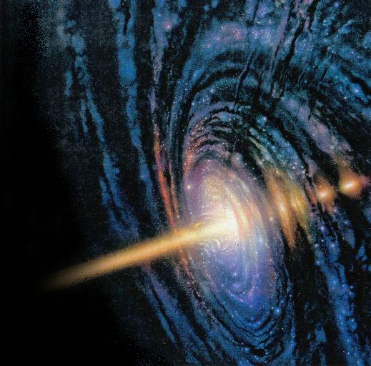

Notes:
20

