Slide 1


New detector for studies of cumulative processes in hadron collisions in NA61(SHINE) at SPS.
T.Lazareva for NA61(SHINE)
Saint-Petersburg State University
The 2nd International Conference on Particle Physics and Astrophysics
October 10-14, 2016

Slide 2
Outline
Physics motivation
  Area of interest
  Particle yield estimations
Detector requirements
Cumulative measurements in NA61(SHINE)
GEANT4 simulation
Conclusion

Slide 3
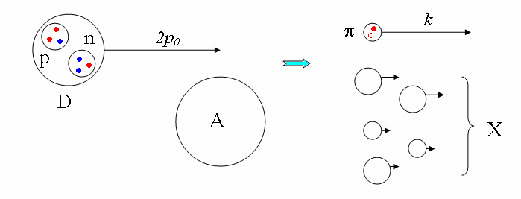
Introduction
Cumulative effect - production of particles from nuclei in a region, kinematically forbidden for reactions with free nucleons.
Classical explanation – flucton.
Ref.
1. D.I. Blochintzev. In: ZhETF 33 (1957), p. 1295.
2. M.A.Baldin, Kratkie soobshchenia po fizike, 1971, №1, p35.

Slide 4
Main features.
Scaling law;
Exponential dependence of inclusive cross section on the cumulative particle momentum;
Inclusive cross section decrease with emission angle growth
Cumulative number – number of participants.
Bigger flucton Less cross section.
Ref.
1. V.S. Stavinsky, Physics of Elementary Particles and Atomic Nuclei, 1979, v.10

Slide 5
Theory of cumulative particles.
Classical explanation.
Large distance(nuclear): bump at 0.3÷0.7 GeV/c in cumulative proton cross section due to the pion rescattering;
Nucleon coalescence model(light fragments);
Quark-parton model:
  Fast quark fragmentation
  Quark coalescence
Ref.
V.V. Vechernin M.A. Braun. In: Sov. J. Nucl. Phys. 43 (1986), p. 1016. and etc.
N.A. Nikiforov, Phys. Rev. C 22 (1980), p. 700.; I.M. Belyaev et al. In: Yad. Fiz 56 (1993), p. 135.; V.V. Ammosov et al. In: Phys. Atom. Nucl 76 (2013), p. 1213.;

Slide 6
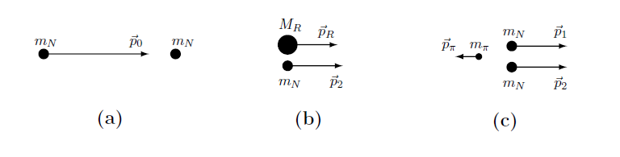
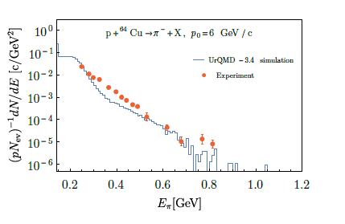
Theory of cumulative particles.
Fireball models.
Pion production in NN→NNπ reaction.
– initial stage,
– intermediate stage,
– final stage.
Comparison of calculated cross section with experimental data
Ref.
G.M. Zinovjev M.I. Gorenstein. In: Phys. Lett. B 67 (1977), p. 100.. V.P.Shelest M.I. Gorenstein
G.M.Zinovjev. In: Yad. Fiz. 26 (1977), p. 788., A. Motornenko, M. I. Gorenstein arXiv:1604.04308 [hep-ph]

Slide 7
Area of interest.
Well investigated: up to the 1.8 GeV/c
Momentum range: above 1.5 GeV/c.
Correlations between cumulative particle and particles in non cumulative region.
Ref.
V.S. Stavinsky. In: Phys. of Elem. Part. and Atom. Nucl 10 (1979), A.M. Baldin A.A. Baldin. In: Phys.Part.Nucl. 29 (1998), Yu.D. Bayukov et al. In: Sov. J. Nucl. Phys. 39 (1984), p. 938, etc.

Slide 8
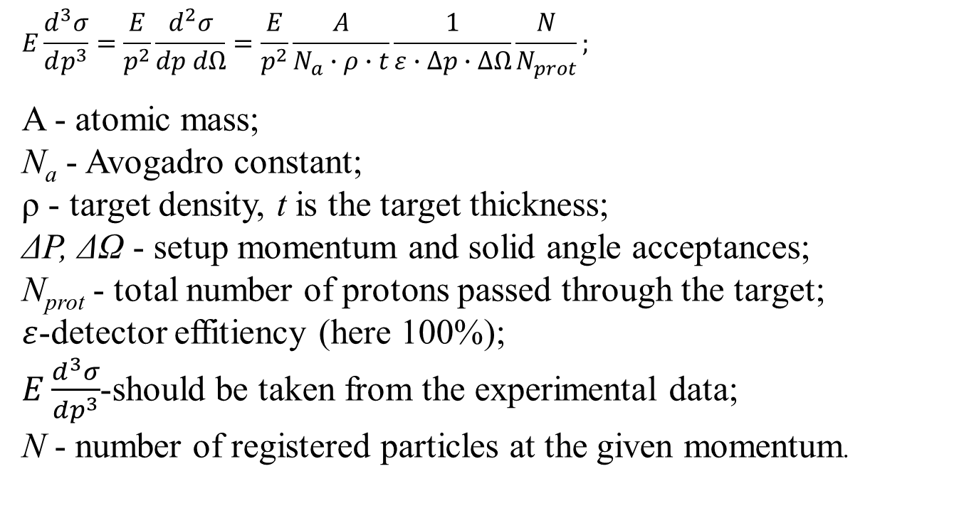
Estimation of the particle yield.
$$E\frac{d^{3}σ}{dp^{3}}=\frac{E}{p^{2}}\frac{d^{2}σ}{dp dΩ}=\frac{E}{p^{2}}\frac{A}{N_{a}∙ρ∙t}\frac{1}{ε∙∆p∙∆Ω}\frac{N}{N_{prot}};$$
A - atomic mass;
N_{a} - Avogadro constant;
ρ - target density, t is the target thickness;
ΔP, ΔΩ - setup momentum and solid angle acceptances;
N_{prot} - total number of protons passed through the target;
$ε$-detector effitiency (here 100%);
$E\frac{d^{3}σ}{dp^{3}}$-should be taken from the experimental data;
N - number of registered particles at the given momentum.
Ref.
V.V.Ammosov et al. Yadernaya Fizika I Inzhiniring 4 (2013)773–778

Slide 9
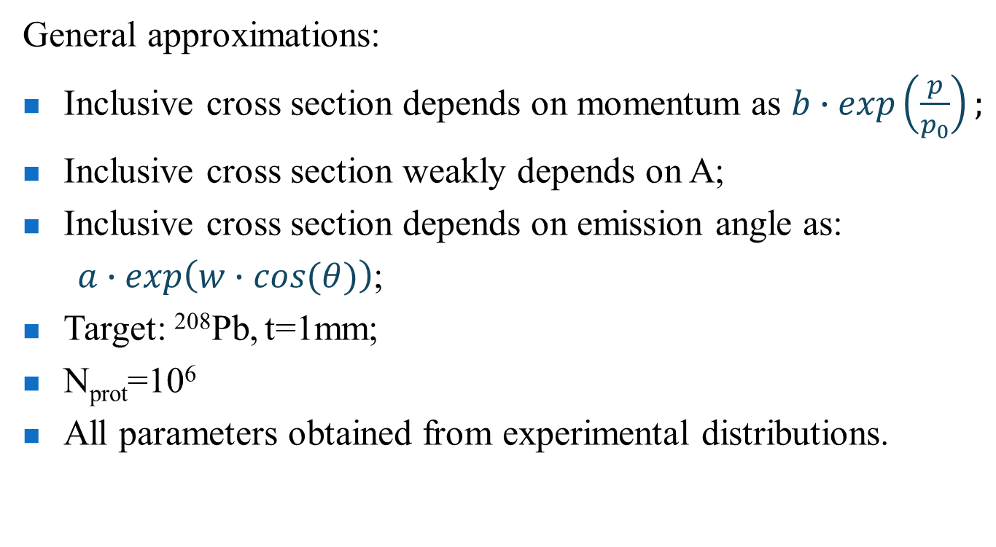
Estimation of the particle yield.
General approximations:
Inclusive cross section depends on momentum as $b∙\exp\left(\frac{p}{p_{0}}\right);$
Inclusive cross section weakly depends on A;
Inclusive cross section depends on emission angle as:
$a∙\exp\left(w∙cos⁡(θ)\right)$;
Target: ²⁰⁸Pb, t=1mm;
N_{prot}=10⁶
All parameters obtained from experimental distributions.
Ref.
V.S. Stavinsky, Physics of Elementary Particles and Atomic Nuclei, 1979, v.10;
Y.D Bayukov, Phys.Rev.C, 1979, v.20, iss.2

Slide 10
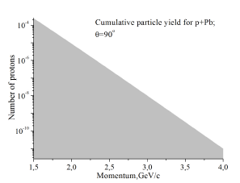
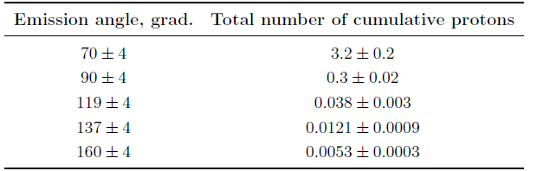
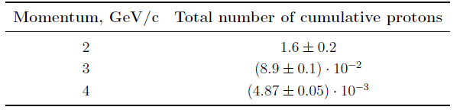
Estimation of the particle yield.
We could expect cumulative particles with high momentum!
Ref.
1. Yu.D. Bayukov et al. In: Sov. J. Nucl. Phys. 39 (1984), p. 938.

Slide 11
Detector requirements.
Cumulative particles – kinematically forbidden region: experiments with fixed target, backward hemisphere;
Low cross section – minimal noise, high luminosity;
Particle identification, which includes track and momentum reconstruction;
Vertex reconstruction;
Compact sizes.
NA61(SHINE) – optimal setup for the investigations!
Cumulative effect – due to the forming QGP droplet => close to the main purpose.

Slide 12
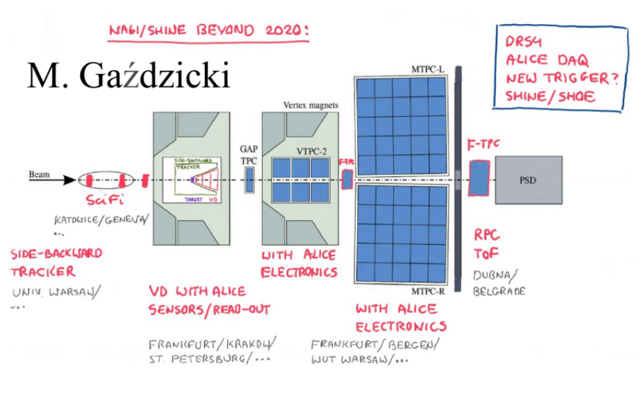
Cumulative measurements in NA61
Cumulative detector
+Target
+VD

Slide 13
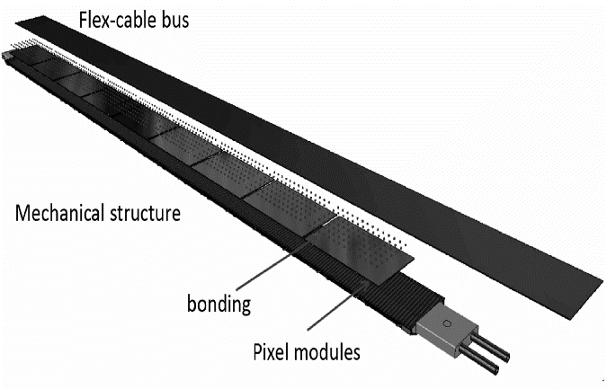
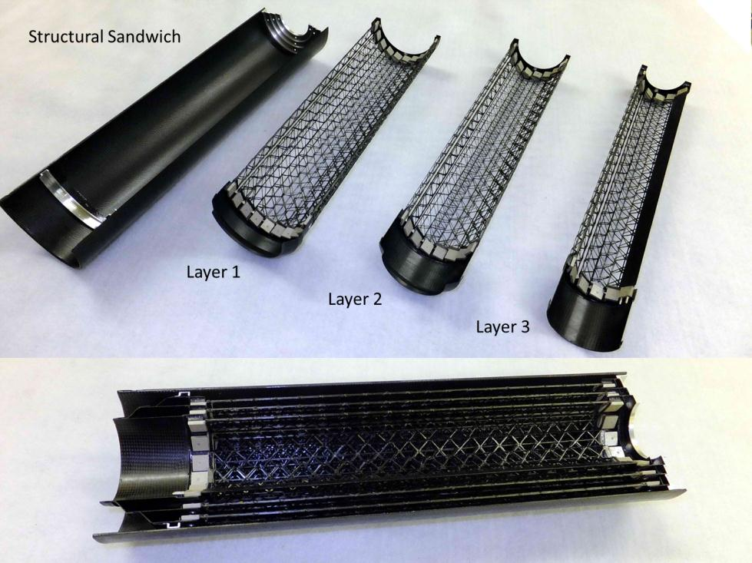
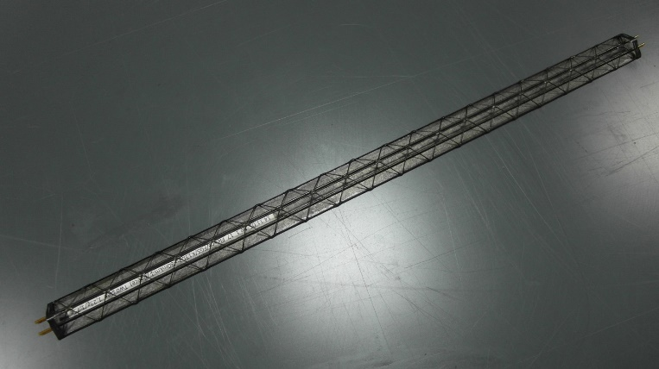
Tracking system
Could be based on ALICE Inner Tracking System.
Upgrade of the ALICE inner tracking system is based on using silicon pixel detectors of a new generation.
Support structure for the Inner barrel of the ALICE ITS could be used for cumulative tracker, in case of vertical installation.
Ref.
1. ALICE Collaboration. In: J. Phys. G: Nucl. Part. Phys. 41, 087002 (2014).

Slide 14
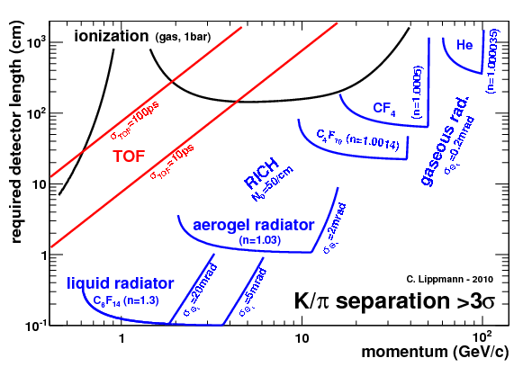
Particle identification.
Low energies:
Silicon double-sided strip detectors for particle identification up to the 0.5 – 0.8 GeV/c + additional tracking(ALICE strip detectors).
High energies:
Ref.
1. C. Lippmann. In: Nucl. Instrum. Meth. A666 (2012), pp. 148{172.

Slide 15
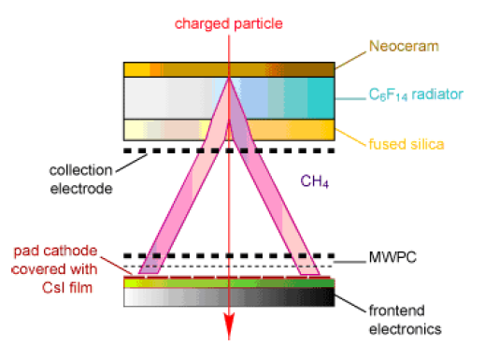
Particle identification. Ring Imaging Cherenkov detector.
Gas radiator: high energy, big size;
Aerogel radiator: low photons yield;
Liquid radiator: optimal photons yield; momentum range up to 4 – 6 GeV/c; ALICE experience.
ALICE HMPID with C6F14 radiator.

Slide 16
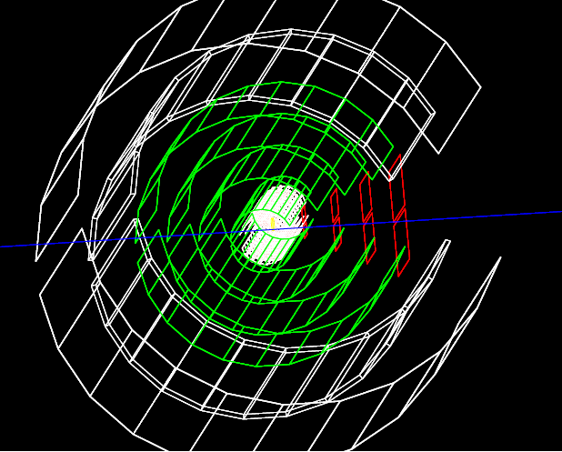
Standalone GEANT4 model.
Inner barrel of ALICE ITS (pixel detectors). Mean radii of layers: R = 2.3, 3.1, 3.9 cm.
Strip silicon detectors. Radii of layers(the same as at Vertex Detector):R = 5, 10, 15, 20cm.
Ring Imaging Cherenkov detector: liquid radiator, R=25 cm; photodetector, R=33cm.

Slide 17
Conclusion
Cumulative experiments at NA61(SHINE) opens opportunity to investigate new unexplored area. Detector geometry and construction that has been proposed above could provide registration of all particles in the area of interest.
Further work will include :
Estimation of the noise level;
Event generator for the cumulative particle (the simplest option);
Simulation in more realistic conditions, geometry and event simulations at SHINE, track reconstruction.
The author of this report from the SPbU acknowledges the support by the Russian Science Foundation research grant 16-12-10176.

Slide 18
Thank you for your attention!

Slide 19
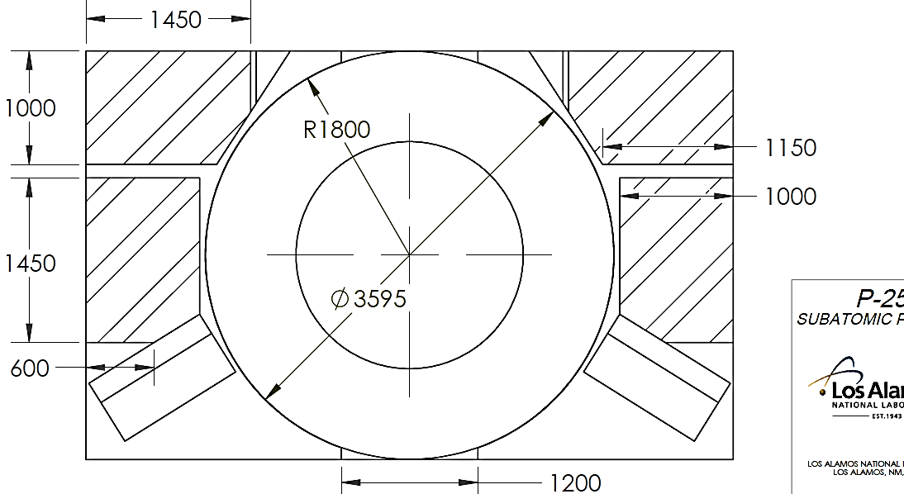
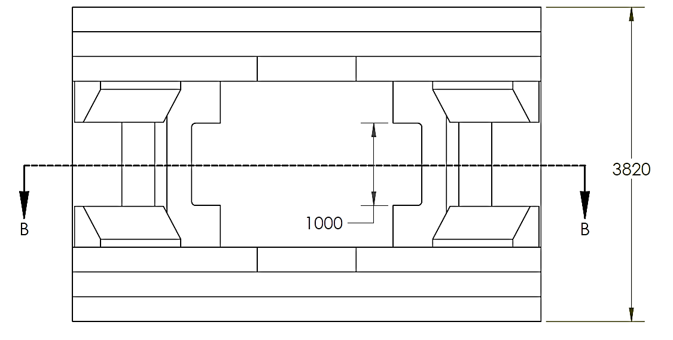
Inner size of vertex magnet
All dimensions in
millimeters.
Ref.
1. New Magnetic Field Calculations for NA61. Geoffrey Mills, Los Alamos NL, 9 October, 2012

Slide 20
Already existing ALICE support structure
 | Inner barrel |  | Outer barrel
Inner barrel: 3 layers
Outer barrel: 4 layers
 | Mean radius, mm | Staves | Mean radius, mm | Staves (2xHalf-stave)
Layer 1 | 23 | 12 | 196 | 24
Layer 2 | 31 | 16 | 245 | 30
Layer 3 | 39 | 20 | 344 | 42
Layer 4 | - | - | 393 | 48
Ref.
1. Technical Design Report for the Upgrade of the ALICE Inner Tracking System

Slide 21
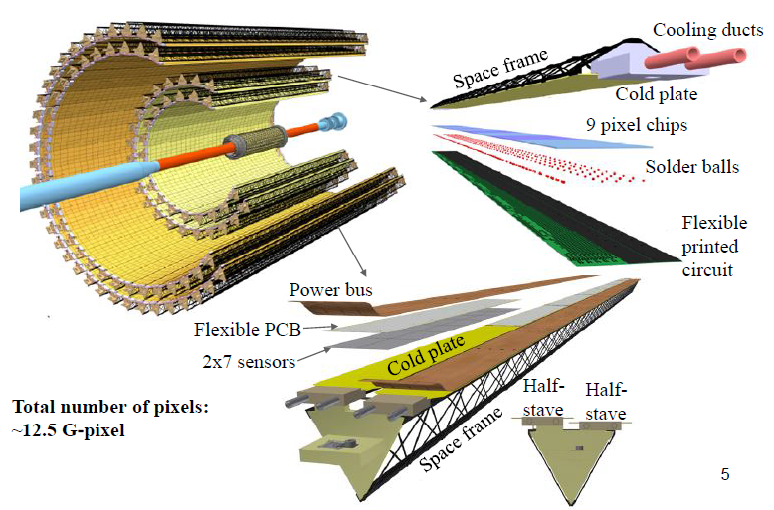
ALICE ITS upgrade.

Slide 22
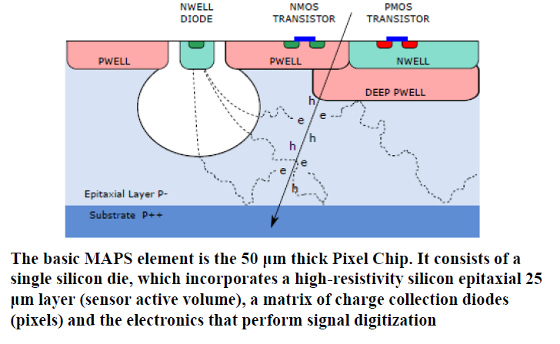
MAPS technology.

Slide 23
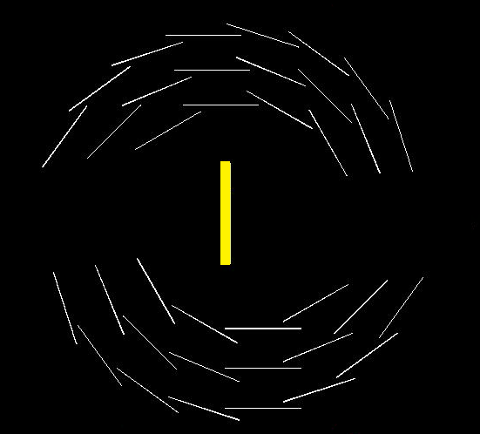
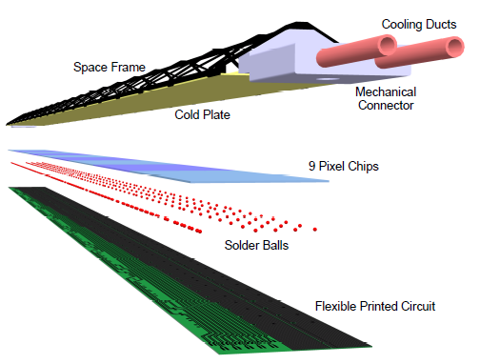
Geant4 simulation for inner layers
beam
Target
y
x
z
Each stave consists of 9 pixel chips. Removal of two staves from each side (back and front) will ensure passage of the beam.
Notes:
23

Slide 24
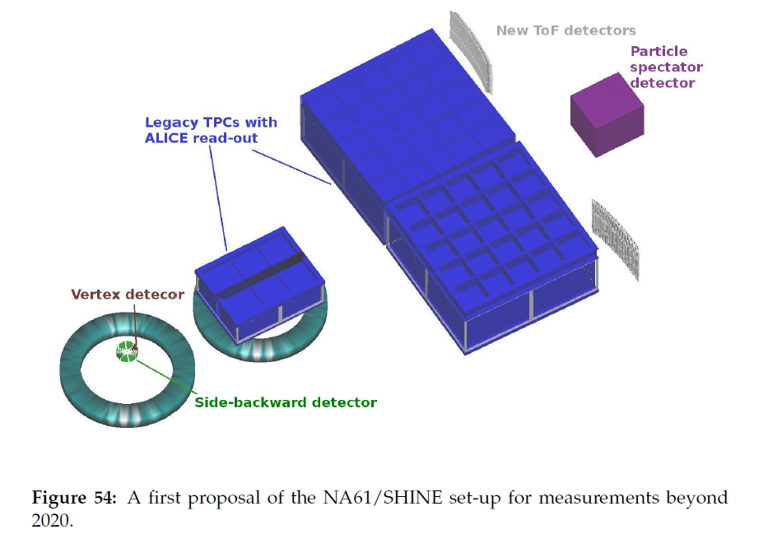
View inside the setup
Simulation by:
S. Puławski

